Slide 1

The Backtracking Covering Proof Technique
Danny Hendler
Ben-Gurion University

Slide 2
Key target audience
DC researchers
Computer scientists
Algorithms
Lower bounds!
Shared memory
Notes:
This is a relatively elite set of researches that often also enjoy building algorithms, but enjoy even more showing that it is impossible to construct then, or, if unfortunately algorithms may be constructed, enjoy at least showing that they incur high complexity. So, if you belong in this small set, this talk is primarily targeted to you. But even if you’re not - the ideas underlying the technique are fairly simple and so I hope you’ll also find interest in it.

Slide 3
Backtracking covering: what is it?
A proof technique for proving time lower bounds
  Shared memory model
  Counters, stacks, queues, consensus, …
  Obstruction-free, nonblocking, wait-free…
  Deterministic
  Linearizable
  Steps, memory stalls
Notes:
Hello,
I will describe today a lower bound proof technique called backtracking covering. It was used in the last 10 years or so a few times to prove shared memory lower bounds on various time-complexity measures such as worst case step complexity and memory stalls complexity for various objects. The goal of my talk today is to get you acquainted with this technique so that hopefully, you may be able to identify situation when it may be useful and be able to apply it.

Slide 4
Backtracking covering: what is it?
A proof technique for proving time lower bounds
  Shared memory model
  Counters, stacks, queues, consensus, …
  Obstruction-free, nonblocking, wait-free…
  Deterministic
  Linearizable
  Steps, memory stalls
A covering argument with a twist
Notes:
As the name implies, the technique uses a covering argument but with a certain twist, as we’ll see, that is required for obtaining a time complexity lower bound rather than a space complexity lower bound.

Slide 5

Origins and Usage
Linear lower bound on memory stalls
Ellen, Hendler & Shavit, FOCS 2005, SIAM J. Comput. 2012
Notes:
The technique dates back to 2005, to joint work with Faith and Nir, where we proved linear lower bounds on the time complexity of objects such as counters, stacks and queues, using arbitrary read-modify-write objects, when the delays caused by contention in accessing the same variable are taken into consideration.

Slide 6
Origins and Usage
Linear lower bound on memory stalls
Time lower bounds on step-contention free executions
Ellen, Hendler & Shavit, FOCS 2005, SIAM J. Comput. 2012
Attiya, Guerraoui, Hendler & Kouznetsov, PODC 2006, JACM 2009
Notes:
It was then used again the following year in joint work with Hagit, Rachid and Petr, to prove both step-complexity and memory stall-complexity lower bounds on perturabable objects.

Slide 7
Origins and Usage
Linear lower bound on memory stalls
Time lower bounds on step-contention free executions
Time lower bounds for restricted use objects
Ellen, Hendler & Shavit, FOCS 2005, SIAM J. Comput. 2012
Attiya, Guerraoui, Hendler & Kouznetsov, PODC 2006, JACM 2009
Aspnes, Attiya, Censor-Hillel & Hendler, SPAA 2012, SIAM J. Comput. 2016
Notes:
In joint work with Jim, Hagit and Keren, we proved in 2012 a collection of time lower bounds on restricted-use objects, that is, objects such there is a bound on either the value they may assume or the number of operations that may be applied to them.

Slide 8
Origins and Usage
Linear lower bound on memory stalls
Time lower bounds on step-contention free executions
Time lower bounds for restricted use objects
Step complexity lower bound on binary consensus
Ellen, Hendler & Shavit, FOCS 2005, SIAM J. Comput. 2012
Attiya, Guerraoui, Hendler & Kouznetsov, PODC 2006, JACM 2009
Aspnes, Attiya, Censor-Hillel & Hendler, SPAA 2012, SIAM J. Comput. 2016
Attiya, Ben-Baruch & Hendler, DISC 2016
Notes:
Finally, the last application of the technique yields a step lower bound on the solo step complexity of anonymous consensus. Ohad will speak about this result tomorrow.
A common thread to these problems is that it is easier to obtain a space lower bound than to obtain a time lower bound, and the techniques helps us obtain the latter.

Slide 9
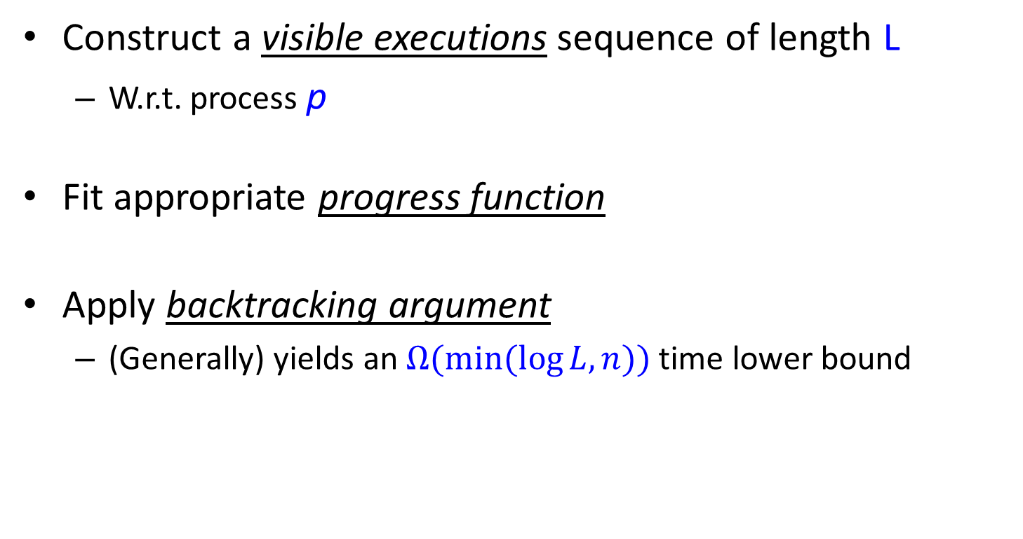
General usage structure
Construct a visible executions sequence of length L
  W.r.t. process p
Fit appropriate progress function
Apply backtracking argument
  (Generally) yields an $Ω(min⁡(\log{L, n)})$ time lower bound
Notes:
OK.
How is the backtracking technique used?
The general structure is the following.
We designate a special process p about whose time complexity we will argue.
The technique may be applied, if we may construct a sequence of executions of some length L that we call visible executions. Roughly, each such execution starts after the previous execution and ends when about to apply a new step that must be visible to p, to an object that is not yet covered.
Once we have a sequence of visible executions, we associate with the sequence of executions an appropriate progress function that is required by the proof technique.
Finally, we apply the backtracking covering argument. In general, this yields an $Ω(min⁡(\log{L, n)})$ time lower bound.

Slide 10
Talk Outline
Preliminaries
An extended example
  Constructing visible executions
  Progress function
Variations
Summary
Notes:
So in order the make the previous high-level description less obscure and more concrete, let’s go over an extended usage example of the technique in order to better understand how and when it can be applied.

Slide 11
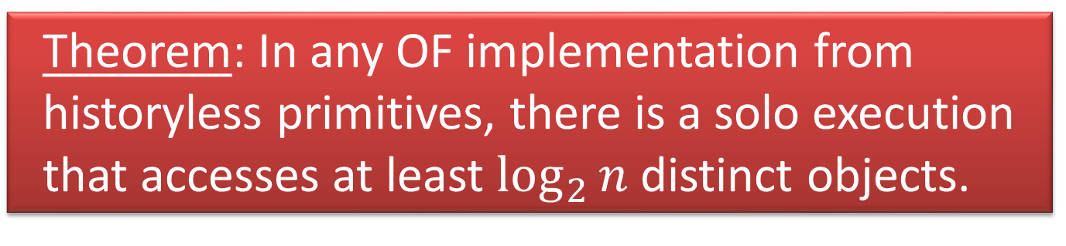
Step lower bound for counters
Counter supporting Read and Inc operations
Using Historyless primitives
  overwrite each other (e.g., write & swap)
Ellen, Herlihy & Shavit, JACM 1998
Theorem: In any OF implementation from historyless primitives, there is a solo execution that accesses at least $\log_{2}{n}$ distinct objects.
Notes:
So the example we’ll see is a proof of a step lower bounds for counters. A counter is a shared object that supports separate Read and Increment operations and we consider linearizable implementations.
Assume we have an implementation of a counter from historyless operations, such as write & swap, that overwrite each other. We will assume that the counter is long-lived, that is, any process can invoke as many operations on the counter as it likes.
We will prove, using the BC technique, that any obstruction free implementation of a counter from such primitives has an execution in which some process p can be made to run solo and access log n different base objects, while performing a single Read operation. So, let’s start.

Slide 12
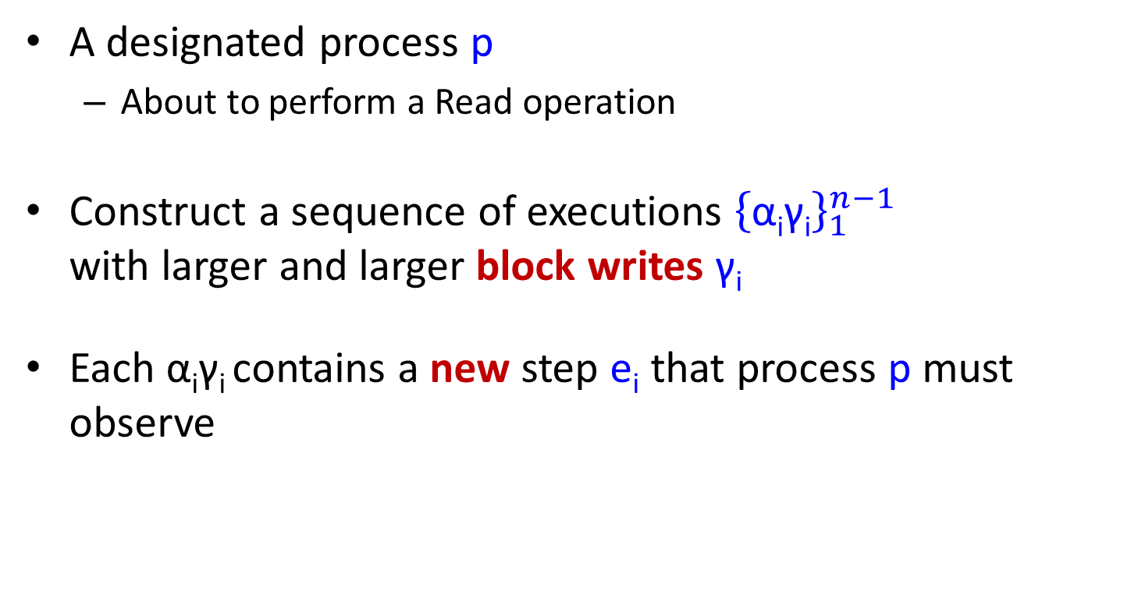
Constructing visible executions
A designated process p
  About to perform a Read operation
Construct a sequence of executions ${\left\{\text{α}\text{i}\text{γ}\text{i}\right\}}_{1}^{n−1}$
with larger and larger block writes $\text{γ}\text{i}$
Each $\text{α}\text{i}\text{γ}\text{i}$contains a new step e_{i} that process p must observe
Notes:
We designate a single process p, which will be the process that will incur the logarithmic step complexity. This process is about to perform a Read operation.
I will now show how to construct a sequence of what we call visible executions, of length n-1.
Process p does not take any step it any of these executions, but they are constructed based on what p would do if we were to let it run.
Each execution is of the form $\text{α}\text{i}\text{γ}\text{i}$ , such that $\text{γ}\text{i}$ is a block write by i distinct processes, each about to apply a write to a different base object. When I say write, I mean apply a non-trivial operation such as write or swap and not just a write operation.
Each new execution we construct ends with a step that p must be able to observe. That is, p's solo executions immediately before and after these steps must differ.
Let’s see how this is done.

Slide 13


Constructing visible executions
Base case
A solo execution of Read() will return 0
$$p$$
Notes:
This is how we construct the first visible execution.
Assuming the counter is initialized to 0, if we let process p perform its Read operation solo from the initial configuration, it will return 0.

Slide 14
Constructing visible executions
Base case
p runs solo, returns 0
C₀
A solo execution of Read() will return 0
$$p$$
1
2
3
4
5
6
Notes:
We mark the objects p would access in the order of their first access by p. Thus, p first accesses the object marked by 1, and the next object it would access is object 2, etc.

Slide 15


Constructing visible executions
Base case
p runs solo, returns 0
C₀
About to perform an Inc( ) operation
A solo execution of Read() will return 0
$$q1$$
$$p$$
1
2
3
4
5
6
Notes:
Now, consider process q1 that is about to perform an Increment operation.

Slide 16
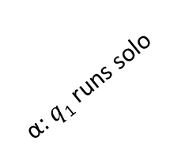
Constructing visible executions
Base case
p runs solo, returns 1
α: $q$₁ runs solo
p runs solo, returns 0
C₀
About to perform an Inc( ) operation
A solo execution of Read() will return 0
$$q1$$
$$p$$
1
2
3
4
5
6
Notes:
If we let q1 run solo starting from the initial configuration until it ends its Inc operation and only then let p run solo, then p can no longer return value 0, it must return value 1.

Slide 17


Constructing visible executions
Base case
Visible step: A step e is a visible step for p, if p's solo run performs different sequences of steps immediately before and after e.
p runs solo, returns 1
α: $q$₁ runs solo
p runs solo, returns 0
C₀
About to perform an Inc( ) operation
A solo execution of Read() will return 0
$$q1$$
$$e1$$
$$p$$
($v1)$
1
2
3
4
5
6
Notes:
This means that p must perform a modifying step for p. A modifying step is a step such that p’s solo execution immediately before and after this step return different values. However, we may want to stop p even earlier, when it is about to perform a visible step. A step is visible step for p, if p’s solo executions before and after the step differ. Thus, a modifying step for p is also a visible step for p, but the converse is not necessarily true.
But the fact that q1 must perform a modifying step for p means that it also must perform a visible step for p (the first visible step for p may precede the first modifying step for p or not). So, we stop q1 just before it is about to perform such a step.

Slide 18
Constructing visible executions
Base case
p runs solo, returns 1
α= α' e₁ α''
α: $q$₁ runs solo
p runs solo, returns 0
C₀
About to perform an Inc( ) operation
A solo execution of Read() will return 0
$$q1$$
$$e1$$
$$p$$
($v1)$
1
2
3
4
5
6
Notes:
So let e1 be the first visible step for p by q1 and let α‘ be the prefix of q1’s execution preceding it.

Slide 19
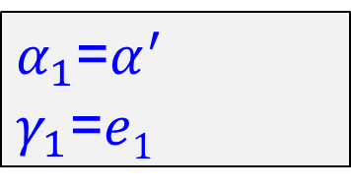
Constructing visible executions
Base case
p runs solo, returns 1
α= α' e₁ α''
α: $q$₁ runs solo
p runs solo, returns 0
C₀
$α_{1}$=$α^{′}$
$γ_{1}$=$e1$
A solo execution of Read() will return 0
$$q1$$
$$e1$$
$$p$$
($v1)$
1
2
3
4
5
6
Notes:
So we let $α_{1}$=$α^{′}$ and $γ_{1}$=$e1$and this completes the construction of the first visible execution in the sequence.
Also, let v1 be the value that event e1 is about to write. Note that this write is not necessarily to the first object accessed by p.

Slide 20
Constructing visible executions
Base case
What if p runs after $α_{1}γ_{1}$?
$α_{1}$=$α^{′}$
$γ_{1}$=$e1$
A solo execution of Read() will return 0
$$q1$$
$$e1$$
$$p$$
($v1)$
1
2
3
4
5
6
Notes:
Now, let’s consider what would happen if we let p run after execution $α_{1}γ_{1}$.

Slide 21
Constructing visible executions
Base case
What if p runs after $α_{1}γ_{1}$?
$α_{1}$=$α^{′}$
$γ_{1}$=$e1$
A solo execution of Read() will return 0
$$q1$$
$$e1$$
$$p$$
($v1)$
1
2
3
4
5
6
4
5
Notes:
First, p reads v1 from the 3’rd object it accesses and so, in general, may change the position and the number of the rest of the objects it accesses in its solo run. So in this example, it no longer accesses this object (the previous 4th) but instead access this one earlier (the new 4th).

Slide 22
Constructing visible executions
Base case
What if p runs after $α_{1}γ_{1}$?
A solo execution of Read() will return 0 or 1
$α_{1}$=$α^{′}$
$γ_{1}$=$e1$
A solo execution of Read() will return 0
$$q1$$
$$e1$$
$$p$$
($v1)$
1
2
3
4
5
6
4
5
Notes:
Also, p’s solo execution after $α_{1}γ_{1}$ does not necessarily return 0, it might return 1.

Slide 23





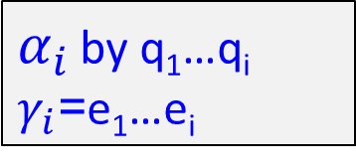

Constructing visible executions
Inductive construction
$α_{i }$by q₁…q_{i}
$γ_{i}$=e₁…e_{i}
$$q3$$
$$q2$$
$$q1$$
$$e1$$
$$e3$$
$$e2$$
$$p$$
($v3)$
($v1)$
($v2)$
1
2
3
4
5
Notes:
OK.
So now, assume we have constructed the first i executions in the sequence and we would like to construct the i+1'th execution.
In this example i=3, so we see the situation after the 3'rd execution. The induction hypothesis is that we have q1…qi, each about to perform a write to a different object, and moreover, for each i, event e_{i} is a visible event for p after $α_{i }γ_{i−1}.$

Slide 24
Constructing visible executions
Inductive construction
$α_{i }$by q₁…q_{i}
$γ_{i}$=e₁…e_{i}
p runs solo, returns v
C₀
$$q3$$
$$q2$$
$$q1$$
$$e1$$
$$e3$$
$$e2$$
$$p$$
($v3)$
($v1)$
($v2)$
1
2
3
4
5
Notes:
So now, let v denote the value that p's Read operation would return if we let it run after $α_{i }γ_{i}$.

Slide 25
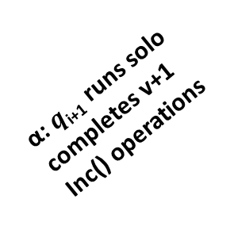
Constructing visible executions
Inductive construction
$α_{i }$by q₁…q_{i}
$γ_{i}$=e₁…e_{i}
α: $q$_{i+1} runs solo
completes v+1 Inc() operations
p runs solo, returns v
C₀
$$q3$$
$$q2$$
$$q1$$
$$e1$$
$$e3$$
$$e2$$
$$p$$
($v3)$
($v1)$
($v2)$
1
2
3
4
5
Notes:
Assuming i<n-1, we can deploy the next process – q_{i+1}. Since we assume the counter is long-lived, we can let this process perform to completion v+1 Increment operations one after the other.

Slide 26
Constructing visible executions
Inductive construction
p runs solo, returns u>v
$α_{i }$by q₁…q_{i}
$γ_{i}$=e₁…e_{i}
α: $q$_{i+1} runs solo
completes v+1 Inc() operations
p runs solo, returns v
C₀
$$q3$$
$$q2$$
$$q1$$
$$e1$$
$$e3$$
$$e2$$
$$p$$
($v3)$
($v1)$
($v2)$
1
1
2
2
3
3
4
4
5
5
Notes:
Now, if we let p run after that, p must return a value larger than v.

Slide 27
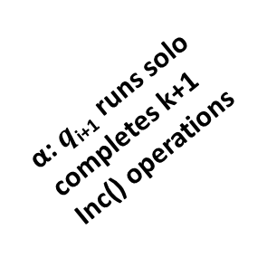
Constructing visible executions
Inductive construction
p runs solo, returns u>v
$α_{i }$by q₁…q_{i}
$γ_{i}$=e₁…e_{i}
α: $q$_{i+1} runs solo
completes k+1 Inc() operations
p runs solo, returns v
C₀
q_{i+1} must perform a visible step e_{i+1}
for p on an uncovered variable
$$q3$$
$$q2$$
$$q1$$
$$e1$$
$$e3$$
$$e2$$
$$p$$
($v3)$
($v1)$
($v2)$
1
2
3
4
5
Notes:
This means that in the course of its execution, α, $q$_{i+1} must perform a modifying event w.r.t p. Recall that we’ve shown before that if a process performs a modifying event in an execution it must also perform (possibly even earlier) a visible event. Thus, we halt process q just before it is about to perform the first visible event w.r.t. p. Clearly, this must be an event to an uncovered object.

Slide 28
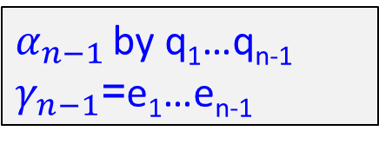
Constructing visible executions
Inductive construction
$α_{n−1 }$by q₁…q_{n-1}
$γ_{n−1}$=e₁…e_{n-1}
We get a linear space lower bound,
but not a time lower bound…
$$q3$$
$$q2$$
$$q1$$
$$e1$$
$$e3$$
$$e2$$
$$p$$
($v3)$
($v1)$
($v2)$
1
2
3
4
5
Notes:
Continuing in this manner until we exhaust all processes, we construct a sequence of n-1 visible executions for p.
Clearly, this is a linear SPACE lower bound for p but, unfortunately, not yet a time lower bound, because we don’t yet know how many different objects p must access in any one of its solo paths.

Slide 29
Talk Outline
Preliminaries
An extended example
  Constructing visible executions
  Progress function
Variations
Summary
Notes:
In order to derive a time lower bound from the sequence of visible executions, the technique defines what we call a progress function that assigns an integer value with each configuration reached after these executions in a manner that I will soon describe. This will allow us to prove the time lower bound, so let’s see how this is done.

Slide 30







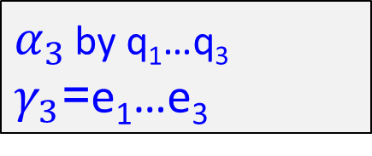


Why no time lower bound, yet:
The “good” scenario
$α_{3 }$by q₁…q₃
$γ_{3}$=e₁…e₃
$$q1$$
$$q2$$
$$q3$$
$$e1$$
$$e2$$
$$e3$$
$$p$$
($v1)$
($v2)$
($v3)$
1
2
3
4
5
6
Notes:
But first, let’s understand better what prevents us from obtaining a time lower bound from the above series of executions.
Assume we already constructed 3 executions are we are lucky so far since, if we consider p’th path after the 3’rd execution, it will access all of the 3 covered object.
(In this case it will also access a few uncovered objects).

Slide 31

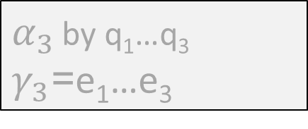



Why no time lower bound, yet:
The “good” scenario
$α_{3 }$by q₁…q₃
$γ_{3}$=e₁…e₃
$α_{4 }$by q₁…q₄
$γ_{4}$=e₁…e₄
More covered objects along p's path
$$q1$$
$$q2$$
$$q3$$
$$q4$$
$$e1$$
$$e2$$
$$e3$$
$$e4$$
$$p$$
($v1)$
($v2)$
($v3)$
($v4)$
1
2
3
4
5
6
Notes:
In this case, when we deploy q4 we are lucky once again, because the new visible event e4 is to an object further along p’s path so now p’s path includes 4 covered objects.

Slide 32
Why no time lower bound, yet:
The “bad” scenario
$α_{3 }$by q₁…q₃
$γ_{3}$=e₁…e₃
$$q1$$
$$q2$$
$$q3$$
$$e1$$
$$e2$$
$$e3$$
$$p$$
($v1)$
($v2)$
($v3)$
Notes:
However, we are not necessarily always lucky.
Returning to the configuration after the 3rd construction step,

Slide 33


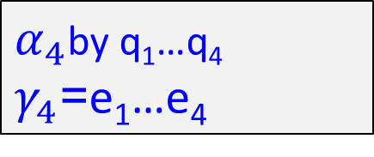
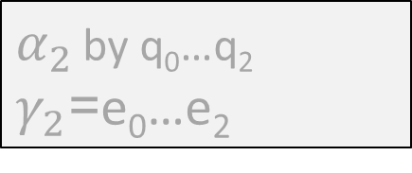

Why no time lower bound, yet:
The “bad” scenario
$α_{2 }$by q₀…q₂
$γ_{2}$=e₀…e₂
$α_{4}$by q₁…q₄
$γ_{4}$=e₁…e₄
$$q4$$
p's path may get shortcut
$$e4$$
$$q1$$
$$q2$$
$$q3$$
$$e1$$
$$e2$$
$$e3$$
$$p$$
($v1)$
($v4)$
($v2)$
($v3)$
1
2
3
3
4
5
6
Notes:
It may be that the next visible event is to an object relatively early on p’th path and moreover, this may cause p’s path to get shortcut and to no longer visit some of the objects it visits before the visible event is taken.
So in this example, p’th path will only visit 3 objects instead of the 6 objects it visited before the i'th construction step.
So the difficulty we need to address is the following: how can we prove that p’s path, at least after some of the construction steps, is long?

Slide 34
Time lower bound intuition
If the sequence of visible executions is “long”, then one of p‘s paths must be “long’’ as well
Notes:
So, we need to show that indeed if the sequence of visible executions is long, then one of p’th paths must be long as well.
We use the modus tollens rule of inference: instead of proving A ➔B, we prove not B ➔ not A.
That is, we show that if p’s solo run always accesses a small number of objects, then we cannot construct a long sequence of visible executions. So, if we have a long sequence, this means that in at least some of these paths, many objects are accessed.

Slide 35
Time lower bound intuition
If the sequence of visible executions is “long”, then one of p‘s paths must be “long’’ as well
If p accesses at most 3 variables in each solo run, how many visible executions can be accommodated?
Notes:
So let’s see the intuition of why this is so.
Assume that p never accesses more than 3 objects in a solo run, and let’s ask the following question: What is the maximum length of a visible executions sequence that may be constructed?

Slide 36

Time lower bound intuition
If the sequence of visible executions is “long”, then one of p‘s paths must be “long’’ as well
If p accesses at most 3 variables, how many visible executions can be accommodated?
$$p$$
R₁
R₂
R₃
1
2
3
Notes:
It is not difficult to see that the longest sequence is obtained as follows.

Slide 37


Time lower bound intuition
If the sequence of visible executions is “long”, then one of p‘s paths must be “long’’ as well
If p accesses at most 3 variables, how many visible executions can be accommodated?
$$e1$$
$$p$$
R₁
R₂
R₃
1
2
3
Notes:
The first visible event will be to the last object accessed by p – R3.

Slide 38

Time lower bound intuition
If the sequence of visible executions is “long”, then one of p‘s paths must be “long’’ as well
If p accesses at most 3 variables, how many visible executions can be accommodated?
$$e2$$
$$e1$$
$$p$$
R₁
R₂
R₃
1
2
3
Notes:
The next visible event will be to the previous object, R2.

Slide 39
Time lower bound intuition
If the sequence of visible executions is “long”, then one of p‘s paths must be “long’’ as well
If p accesses at most 3 variables, how many visible executions can be accommodated?
$$e2$$
$$e1$$
$$p$$
R₁
R₂
R₃
1
2
3
R₄
3
Notes:
And after that, p’s path will change: it will no longer access object R3, but will now access last another object – R4

Slide 40

Time lower bound intuition
If the sequence of visible executions is “long”, then one of p‘s paths must be “long’’ as well
If p accesses at most 3 variables, how many visible executions can be accommodated?
$$e2$$
$$e1$$
$$p$$
R₁
R₂
R₃
1
2
3
$$e3$$
R₄
3
Notes:
The next visible event would be to R4

Slide 41

Time lower bound intuition
If the sequence of visible executions is “long”, then one of p‘s paths must be “long’’ as well
If p accesses at most 3 variables, how many visible executions can be accommodated?
$$e4$$
$$e2$$
$$e1$$
$$p$$
R₁
R₂
R₃
1
2
3
$$e3$$
R₄
3
Notes:
The 4’th visible event must be to R1, since this is now the ONLY base object that is not covered along p’th solo path.

Slide 42
Time lower bound intuition
If the sequence of visible executions is “long”, then one of p‘s paths must be “long’’ as well
If p accesses at most 3 variables, how many visible executions can be accommodated?
$$e4$$
$$e2$$
$$e1$$
$$p$$
R₁
R₂
R₃
1
2
3
$$e3$$
R₄
3
R₅
R₆
2
3
Notes:
After e4, the rest of p’th path changes again, and it will now access to new objects, which allow us 3 more visible events

Slide 43

Time lower bound intuition
If the sequence of visible executions is “long”, then one of p‘s paths must be “long’’ as well
If p accesses at most 3 variables, how many visible executions can be accommodated?
$$e4$$
$$e2$$
$$e1$$
$$p$$
R₁
R₂
R₃
1
2
3
$$e3$$
R₄
3
$$e5$$
R₅
R₆
2
3
Notes:
First to R6

Slide 44


Time lower bound intuition
If the sequence of visible executions is “long”, then one of p‘s paths must be “long’’ as well
If p accesses at most 3 variables, how many visible executions can be accommodated?
$$e4$$
$$e2$$
$$e1$$
$$p$$
R₁
R₂
R₃
1
2
3
$$e3$$
R₄
$$e6$$
3
$$e5$$
R₅
R₆
2
3
Notes:
Then to R5,

Slide 45
Time lower bound intuition
If the sequence of visible executions is “long”, then one of p‘s paths must be “long’’ as well
If p accesses at most 3 variables, how many visible executions can be accommodated?
$$e4$$
$$e2$$
$$e1$$
$$p$$
R₁
R₂
R₃
1
2
3
$$e3$$
R₄
$$e6$$
3
$$e5$$
R₅
R₆
2
3
R₇
3
Notes:
Which causes p to now access R7 as its last object

Slide 46

Time lower bound intuition
If the sequence of visible executions is “long”, then one of p‘s paths must be “long’’ as well
If p accesses at most 3 variables, how many visible executions can be accommodated?
$$e4$$
$$e2$$
$$e1$$
$$p$$
R₁
R₂
R₃
1
2
3
$$e3$$
R₄
$$e6$$
3
$$e5$$
R₅
R₆
2
3
$$e7$$
R₇
3
Notes:
And finally to R7. Now all the objects accessed by p are covered and so no new visible events w.r.t. p can be added.

Slide 47
Time lower bound intuition
If the sequence of visible executions is “long”, then one of p‘s paths must be “long’’ as well
If p accesses at most 3 variables, how many visible executions can be accommodated?
2³-1
$$e4$$
$$e2$$
$$e1$$
$$p$$
R₁
R₂
R₃
1
2
3
$$e3$$
R₄
$$e6$$
3
$$e5$$
R₅
R₆
2
3
$$e7$$
R₇
3
Notes:
Altogether, we saw that if the maximum number of objects accessed is 3, then we can only construct a sequence of length roughly 2³.

Slide 48
Progress function argument
We want to show that at least one path is of length log n
Notes:
So now we would like to prove this formally. Continuing our proof for a counter where we have a sequence of length n, we would like to show that in one of the paths, p must access at least log n

Slide 49
Progress function argument
We want to show that at least one path is of length log n
Assume no path is longer…
Notes:
So, assume that no path is longer than log n

Slide 50
Progress function argument
We want to show that at least one path is of length log n
Assume no path is longer…
Associate an L-digit binary number with each path
000
$$p$$
R₁
R₂
R₃
1
2
3
Notes:
What we do, is we use what we call a progress function argument: we associate with each of the configurations reached after executions $α_{i }γ_{i}$a binary number that consists of log n digits, which is constructed as follows.
The first object access by p will give us the most significant digit. If this object is covered, the digit would be 1, otherwise it would be 0.
If there is a second object accessed by p exists and it is covered, then the second digit would be 1, otherwise it would be 0.
And so on.
So, the number associated with the initial configuration is 0 since none of the objects along p’th path are covered.

Slide 51
Progress function argument
We want to show that at least one path is of length log n
Assume no path is longer…
Associate an L-digit binary number with each path
001
$$e1$$
$$p$$
R₁
R₂
R₃
1
2
3
Notes:
If, after the first construction step, this is the situation, then the number associated with this configuration is 001, since only the 3’rd object accessed by p is covered.

Slide 52
Progress function argument
We want to show that at least one path is of length log n
Assume no path is longer…
Associate an L-digit binary number with each path
010
$$e2$$
$$e1$$
$$p$$
R₁
R₂
R₃
1
2
3
R₄
3
Notes:
And so on.

Slide 53
Progress function argument
We want to show that at least one path is of length log n
Assume no path is longer…
Associate an L-digit binary number with each path
011
$$e2$$
$$e1$$
$$p$$
R₁
R₂
R₃
1
2
3
$$e3$$
R₄
3

Slide 54
Progress function argument
We want to show that at least one path is of length log n
Assume no path is longer…
Associate an L-digit binary number with each path
100
$$e4$$
$$e2$$
$$e1$$
$$p$$
R₁
R₂
R₃
1
2
3
$$e3$$
R₄
3
R₅
R₆
2
3

Slide 55
Progress function argument
We want to show that at least one path is of length log n
Assume no path is longer…
Associate an L-digit binary number with each path
101
$$e4$$
$$e2$$
$$e1$$
$$p$$
R₁
R₂
R₃
1
2
3
$$e3$$
R₄
3
$$e5$$
R₅
R₆
2
3

Slide 56
Progress function argument
We want to show that at least one path is of length log n
Assume no path is longer…
Associate an L-digit binary number with each path
111
$$e4$$
$$e2$$
$$e1$$
$$p$$
R₁
R₂
R₃
1
2
3
$$e3$$
R₄
$$e6$$
3
$$e5$$
R₅
R₆
2
3

Slide 57
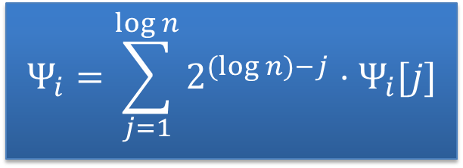
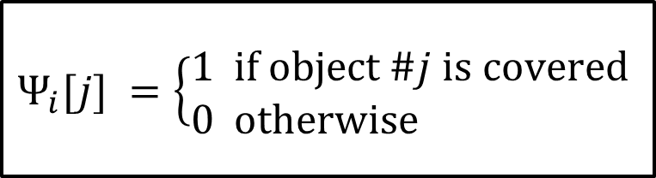
Formal progress function expression
$$Ψ_{i}=\sum_{j=1}^{\log{n}}{2^{(log{n)}−j}⋅Ψ_{i}[j]}$$
$$Ψ_{i}[j] =\left\{\begin{aligned}&1 \text{if} \text{object} \#j \text{is} \text{covered} \\ &0 \text{otherwise}\end{aligned}\right.$$
Notes:
Formally, we define the progress function associated with these configuration as follows.

Slide 58

Formal progress function expression
$$Ψ_{i}=\sum_{j=1}^{\log{n}}{2^{(log{n)}−j}⋅Ψ_{i}[j]}$$
$$Ψ_{i}[j] =\left\{\begin{aligned}&1 \text{if} \text{object} \#j \text{is} \text{covered} \\ &0 \text{otherwise}\end{aligned}\right.$$
$Ψ$is monotonically increasing, because:
Notes:
The key observation w.r.t. this function is that it is monotonically increasing, let’s see why.

Slide 59
Formal progress function expression
Function grows in “good” scenario
$$Ψ_{i}=\sum_{j=1}^{\log{n}}{2^{(log{n)}−j}⋅Ψ_{i}[j]}$$
$$Ψ_{i}[j] =\left\{\begin{aligned}&1 \text{if} \text{object} \#j \text{is} \text{covered} \\ &0 \text{otherwise}\end{aligned}\right.$$
101100
$$q1$$
$$q2$$
$$q3$$
$$e1$$
$$e2$$
$$e3$$
$$p$$
($v1)$
($v2)$
($v3)$
1
2
3
4
5
6
Notes:
Let’s recall the “good scenario” that we saw before. Assume that log n = 6, so the binary numbers that we associate with configurations have 6 digits, so the number associated with this configuration is 101100.

Slide 60
Formal progress function expression
Function grows in “good” scenario
$$Ψ_{i}=\sum_{j=1}^{\log{n}}{2^{(log{n)}−j}⋅Ψ_{i}[j]}$$
$$Ψ_{i}[j] =\left\{\begin{aligned}&1 \text{if} \text{object} \#j \text{is} \text{covered} \\ &0 \text{otherwise}\end{aligned}\right.$$
101110
101100
$$q1$$
$$q2$$
$$q3$$
$$q4$$
$$e1$$
$$e2$$
$$e3$$
$$e4$$
$$p$$
($v1)$
($v2)$
($v3)$
($v4)$
1
2
3
4
5
6
Notes:
In the good scenario, the next visible event is to an object farther along p’th path, so the configuration value increases to 101110.

Slide 61
Formal progress function expression
Function grows in “bad” scenario
$$Ψ_{i}=\sum_{j=1}^{\log{n}}{2^{(log{n)}−j}⋅Ψ_{i}[j]}$$
$$Ψ_{i}[j] =\left\{\begin{aligned}&1 \text{if} \text{object} \#j \text{is} \text{covered} \\ &0 \text{otherwise}\end{aligned}\right.$$
101100
$$q1$$
$$q2$$
$$q3$$
$$e1$$
$$e2$$
$$e3$$
$$p$$
($v1)$
($v2)$
($v3)$
1
2
3
4
5
6
Notes:
So now, let’s revert to the same configuration and consider the bad scenario.

Slide 62
Formal progress function expression
Function grows in “bad” scenario
$$Ψ_{i}=\sum_{j=1}^{\log{n}}{2^{(log{n)}−j}⋅Ψ_{i}[j]}$$
$$Ψ_{i}[j] =\left\{\begin{aligned}&1 \text{if} \text{object} \#j \text{is} \text{covered} \\ &0 \text{otherwise}\end{aligned}\right.$$
$$q4$$
$$e4$$
101100
$$q1$$
$$q2$$
$$q3$$
$$e1$$
$$e2$$
$$e3$$
$$p$$
($v1)$
($v4)$
($v2)$
($v3)$
1
2
3
3
4
5
6
Notes:
In the “bad” scenario, the event by q3 shortcuts p’s path because after reading the 2’nd object it will now only access one additional object.

Slide 63
Formal progress function expression
Function grows in “good” scenario
$$Ψ_{i}=\sum_{j=1}^{\log{n}}{2^{(log{n)}−j}⋅Ψ_{i}[j]}$$
$$Ψ_{i}[j] =\left\{\begin{aligned}&1 \text{if} \text{object} \#j \text{is} \text{covered} \\ &0 \text{otherwise}\end{aligned}\right.$$
$$q4$$
$$e4$$
110000
101100
$$q1$$
$$q2$$
$$q3$$
$$e1$$
$$e2$$
$$e3$$
$$p$$
($v1)$
($v4)$
($v2)$
($v3)$
1
2
3
3
4
5
6
Notes:
However, the value of the progress function increases also here. Although some digits are flipped from 1 to 0, a more significant digit is flipped from 0 to 1, reflecting the fact that objects farther along p’s path are no longer accessed only if p reads a new value on an earlier object.

Slide 64

Formal progress function expression
$$Ψ_{i}=\sum_{j=1}^{\log{n}}{2^{(log{n)}−j}⋅Ψ_{i}[j]}$$
$$Ψ_{i}[j] =\left\{\begin{aligned}&1 \text{if} \text{object} \#j \text{is} \text{covered} \\ &0 \text{otherwise}\end{aligned}\right.$$
$Ψ_{1}≥1$ and $Ψ$monotonically increasing
Notes:
So, we have that the progress function is monotonically increasing. Also, it is easy to see that after the first construction step its value is positive.

Slide 65
Formal progress function expression
$$Ψ_{i}=\sum_{j=1}^{\log{n}}{2^{(log{n)}−j}⋅Ψ_{i}[j]}$$
$$Ψ_{i}[j] =\left\{\begin{aligned}&1 \text{if} \text{object} \#j \text{is} \text{covered} \\ &0 \text{otherwise}\end{aligned}\right.$$
$Ψ_{1}≥1$ and $Ψ$monotonically increasing
$$Ψ_{n−1}≥n−1$$
Notes:
It follows that after a sequence of length n-1, it either reaches exactly n-1, which means that p’s path consists of exactly log n covered objects, or otherwise we get a contradiction to our assumption that none of the paths is of length more than log n.

Slide 66
Formal progress function expression
$$Ψ_{i}=\sum_{j=1}^{\log{n}}{2^{(log{n)}−j}⋅Ψ_{i}[j]}$$
$$Ψ_{i}[j] =\left\{\begin{aligned}&1 \text{if} \text{object} \#j \text{is} \text{covered} \\ &0 \text{otherwise}\end{aligned}\right.$$
$Ψ_{1}≥1$ and $Ψ$monotonically increasing
$$Ψ_{n−1}≥n−1$$
At least one path of length at least log n

Slide 67
Talk Outline
Preliminaries
An extended example
  Constructing visible executions
  Progress function
Variations
Summary

Slide 68
Sometimes “coverers” may be re-used
In our example, since counter is long-lived,
processes no longer on current path may be re-used
A linear lower bound
Notes:
Let me quickly discuss two variations on this scheme.
First, in some cases, depending on how we construct the sequence of visible executions, processes may be re-deployed if they are no longer on p’th path.
We are actually able to do so in our example, so the proof can be easily extended to show a linear step lower bound for this problem.

Slide 69





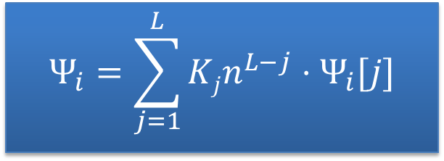
Other progress functions are possible
Example: modelling memory contention
$$Ψ_{i}=\sum_{j=1}^{L}{Kjn^{L−j}⋅Ψ_{i}[j]}$$
$$Ψ_{i}[j] =\left\{\begin{aligned}&1 \text{if} \text{object} \#j \text{is} \text{covered} \\ &0 \text{otherwise}\end{aligned}\right.$$
p
|G
|
= K
|G
|
= K
2
2
m
m
1
2
k
Notes:
Secondly, we may choose different progress function s in different settings.
So, for example, for the memory stalls lower bound Faith, Nir and I had – since we consider arbitrary read-modify-write operations and take memory stalls into consideration, multiple events may be outstanding on every object, so the function no longer associated binary numbers with configurations – it accessses n-ary numbers.

Slide 70

Take home message
IF you can construct a ``long’’ sequence of visible executions, you may use BC for time lower bound
  This may be challenging
Notes:
So if some of you will encounter in the future circumstances in which this technique can help you obtain a lower bound and this talk will help you do that, then not all my work in preparing this presentation was in vain. Haleluya!

Slide 71

Notes:
So if some of you will encounter in the future circumstances in which this technique can help you obtain a lower bound and this talk will help you do that, then not all my work in preparing this presentation was in vain. Haleluya!

