Slide 1


Explicit Binary Tree Codes
with Poly-Log Size Alphabet
Gil Cohen
Tel Aviv University
Joint with Bernhard Haeupler (CMU)
and Leonard J. Schulman (Caltech)

Slide 2
Binary Tree Codes

Slide 3
Binary Tree Codes

Slide 4



Binary Tree Codes
Binary Tree Codes (Schulman’93)
Mmm II…
A binary tree code with distance $0≤δ≤1$ is an edge-coloring of the infinite rooted binary tree such that for every pair of nodes with equal depth, $δ$-fraction of the corresponding edges from their least common ancestor have different colors.
The argument can be extended to rule out 3 colors.
A priori, a Ramsey-type argument may rule out the existence of tree codes.
Mmm…
Theorem (Schulman’93)
Does a binary tree code with distance $δ>0$ and a constant number of colors exist?
For every constant $0<δ<1$ there exists a binary tree code with distance $δ$ and $σ=σ\left(δ\right)$ colors.
Impossible with 2 colors.

Slide 5
Show Me a Tree Code!

Slide 6

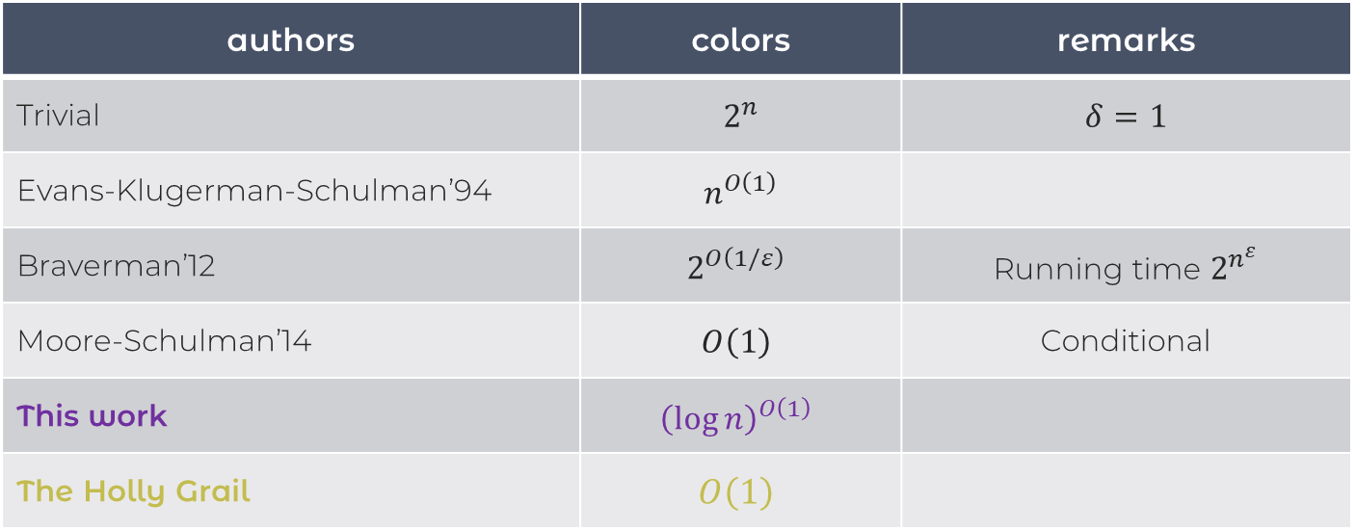
Explicit Constructions
authors | colors | remarks
Trivial | $$2^{n}$$ | $$δ=1$$
Evans-Klugerman-Schulman’94 | $$n^{O\left(1\right)}$$
Braverman’12 | $$2^{O\left(1/ε\right)}$$ | Running time $2^{n^{ε}}$
Moore-Schulman’14 | $$O\left(1\right)$$ | Conditional
This work | $${\left(\log{n}\right)}^{O\left(1\right)}$$
The Holly Grail | $$O\left(1\right)$$
$n$ is the depth.

Slide 7
An Alternative Definition

Slide 8







An Alternative Definition
A functional point of view
A function $T:{\left\{0,1\right\}}^{n}→Σ^{n}$ is a binary tree code with distance $δ$ if
$$x∈{\left\{0,1\right\}}^{n}$$
$$c$$
$$ℓ$$
* $T$ is online;
$$T\left(x\right)∈Σ^{n}$$
* For all $x≠y∈{\left\{0,1\right\}}^{n}$ with $c$ minimal for which $x_{c}≠y_{c}$, for every $ℓ≥0$, $\left|T{\left(x\right)}_{\left[c,c+ℓ\right]}−T{\left(y\right)}_{\left[c,c+ℓ\right]}\right|≥δ\left(ℓ+1\right)$.
$$T\left(y\right)∈Σ^{n}$$
For “standard” block codes

Slide 9
Why Known Block Code Constructions Fail?

Slide 10


What Fails?
The Reed-Solomon code
Given a message $m_{0},…,m_{n−1}∈F$, define a polynomial $f_{m}\left(x\right)∈F\left[x\right]$ by $f_{m}\left(x\right)=m_{0}+m_{1}x+⋯+m_{n−1}x^{n−1}$.
The codeword is defined by evaluating $f_{m}$ at points of $F$.
Why RS isn’t a tree code?
* We don’t get to see $f_{m}$ until the very end.
* Even given $f_{m}$, evaluations are not guaranteed to “generate” distance in any prefix.

Slide 11
The Construction

Slide 12





The Construction
The Newton Basis
The Construction
The set of polynomials $\left(\begin{matrix}x \\ 0\end{matrix}\right),\left(\begin{matrix}x \\ 1\end{matrix}\right),…,\left(\begin{matrix}x \\ n\end{matrix}\right)$ is called the Newton basis for real polynomials of degree at most $n$.
At time $t$ output $\left(m_{t},γ_{t}\right)$.
Theorem
This is a tree code with distance $½$.
Online-ness
Combinatorial Perspective
If $f\left(x\right)=\sum_{t=0}^{n}{γ_{t}\left(\begin{matrix}x \\ t\end{matrix}\right)}$ then $γ_{t}$ is determined by $f\left(0\right),…,f\left(t\right)$.
$γ_{t}{=f}_{t}\left(t\right)−f_{t−1}\left(t\right)$ and so can be thought of as a consistency checking procedure.

Slide 13
Distance Analysis

Slide 14











Distance Analysis
$$ℓ+1$$
$$0$$
$$m_{c}$$
$$m_{c+ℓ}$$
$m$ symbols
$$0$$
$$γ_{c}$$
$$γ_{c+ℓ}$$
$γ$ symbols
Observation
Recall $f_{c+ℓ}\left(x\right)=\sum_{t=0}^{c+ℓ}{γ_{t}\left(\begin{matrix}x \\ t\end{matrix}\right)}$.
So we need to bound the number of zeros among $c,c+1,…,c+ℓ$ for a sparse $f_{c+ℓ}$.

Slide 15
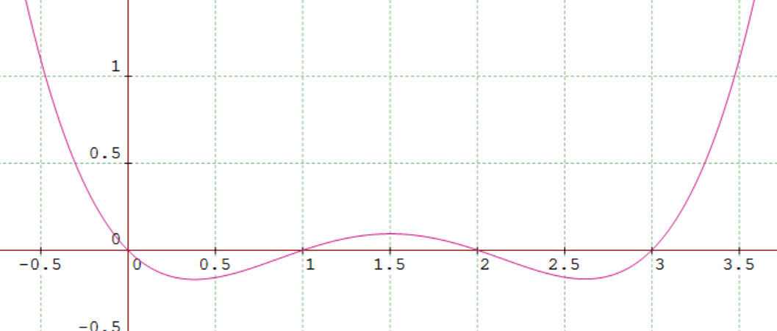




Distance Analysis
Sparsity $s=1$
$\left(\begin{matrix}x \\ c\end{matrix}\right)$ has $c$ zeros but, luckily, all to the left of $c$.
Sparsity $s=2$
$ε\left(\begin{matrix}x \\ 1\end{matrix}\right)+\left(\begin{matrix}x \\ d\end{matrix}\right)$ has $d−1$ zeros to the right of $1$ that are as close as we want to $1,2,3,…,d.$

Slide 16
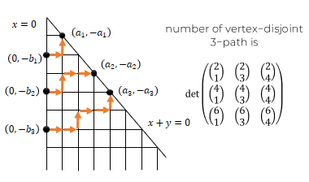
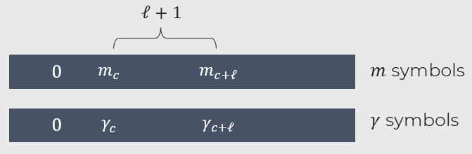

A Sparsity Lemma
Lemma
Let $f$ be a real univariate polynomial with sparsity $s≥1$ in the Newton basis. Let $c≥0$ be the least integer such that $f\left(c\right)≠0$. Then, $f$ has at most $s−1$ distinct roots in $\left(c,∞\right)∩Z$.
Our proof makes use of the beautiful Lindstrom-Gessel-Viennot Lemma (on board).

