Slide 1
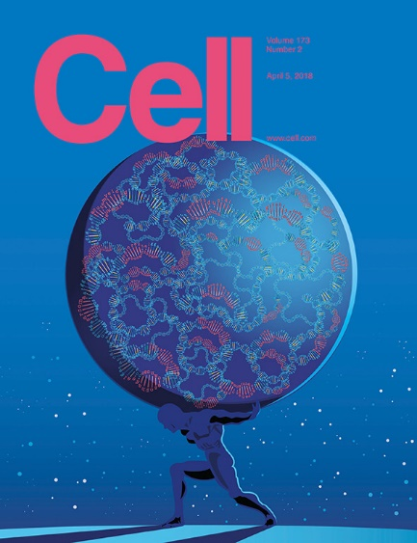

The Cancer
Genome Atlas
Pan-Cancer Analysis
Katie Hoadley
Assistant Professor
Department of Genetics
Lineberger Comprehensive Cancer Center
The University of North Carolina at Chapel Hill

Slide 2
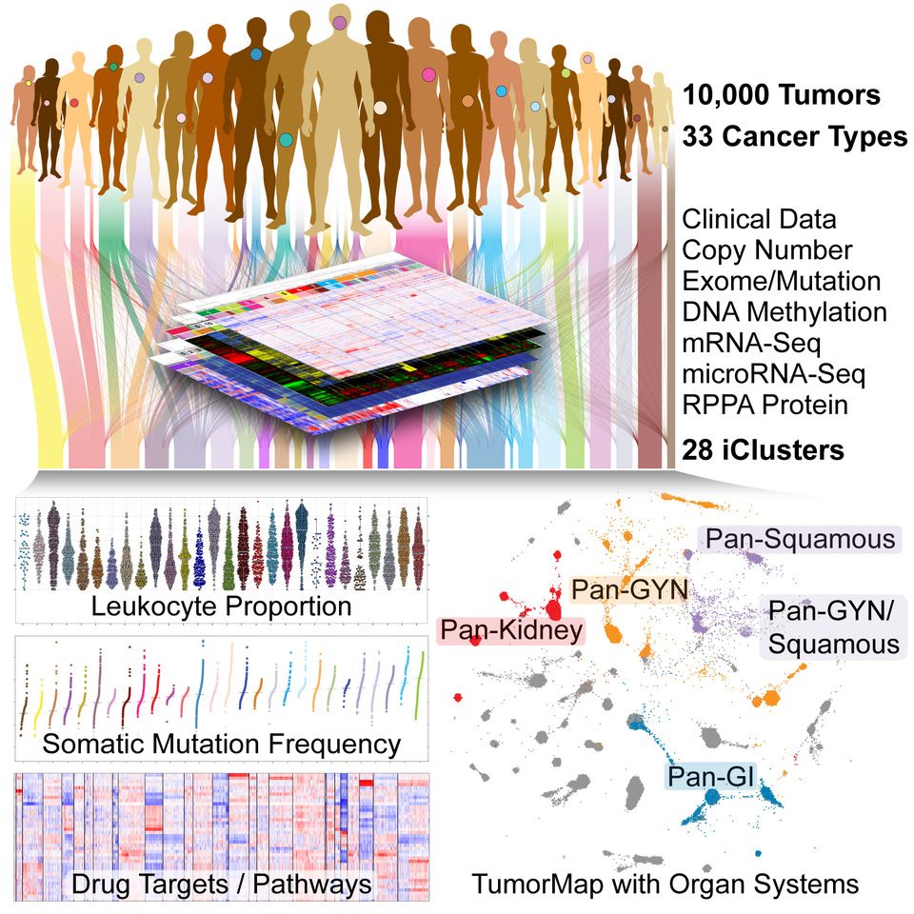

Slide 3
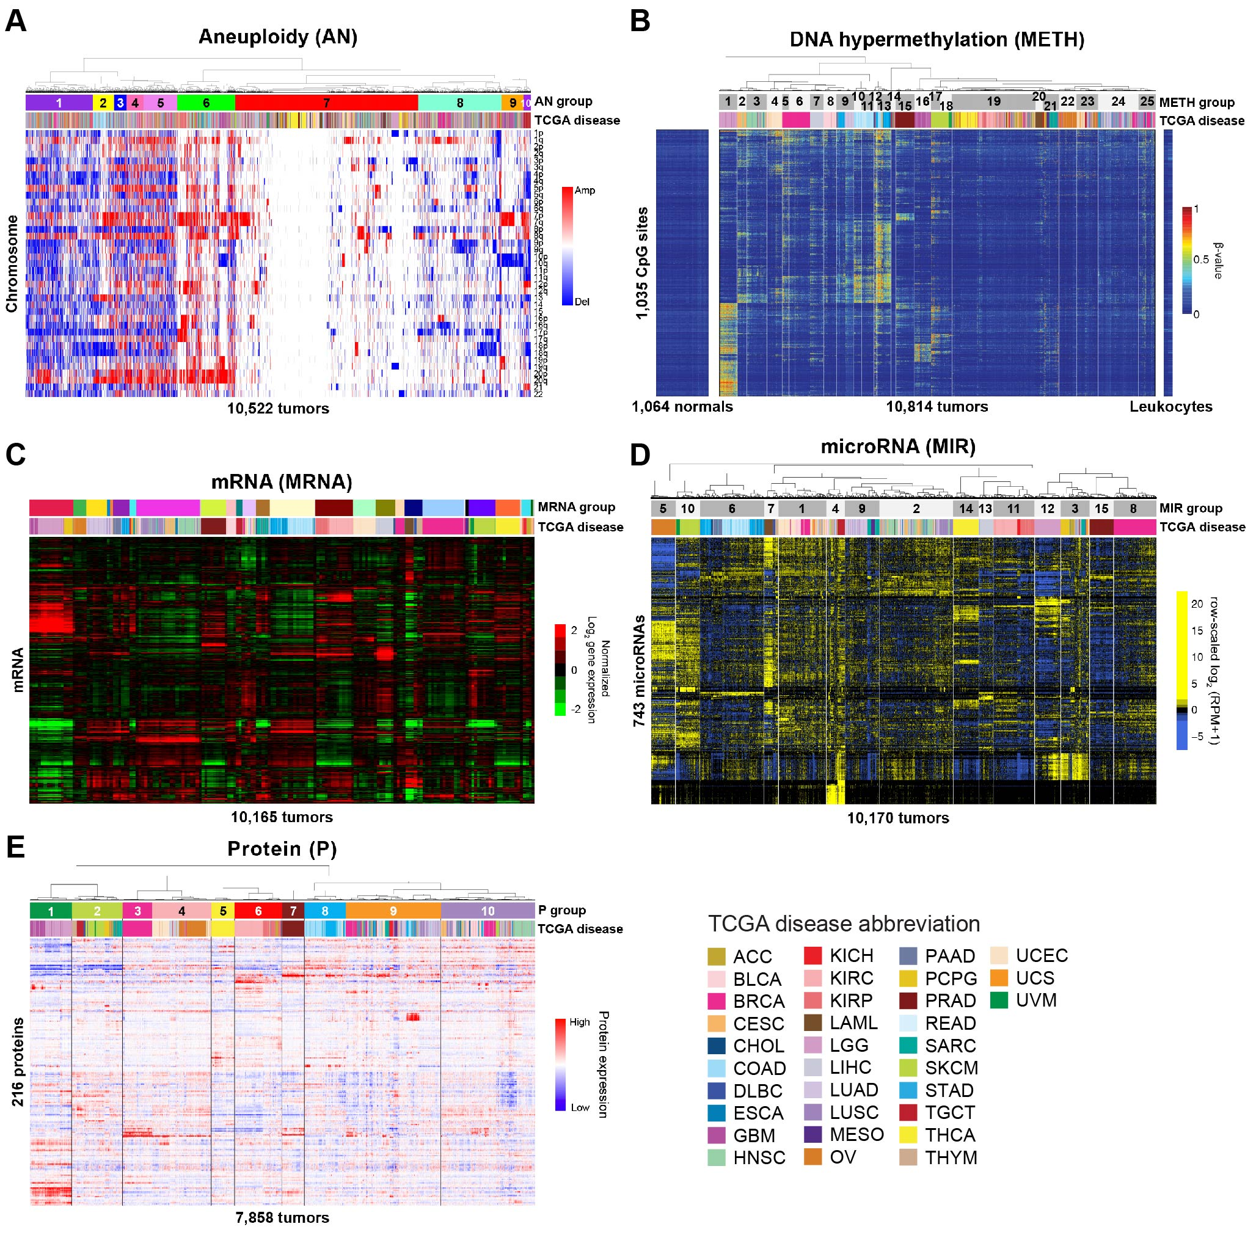
Individual Platform Classification
Alison Taylor, Andy Cherniack, Toshi Hinoue, Rehan Akbani, Chris Fan, Katie Hoadley, Gordon Robertson

Slide 4
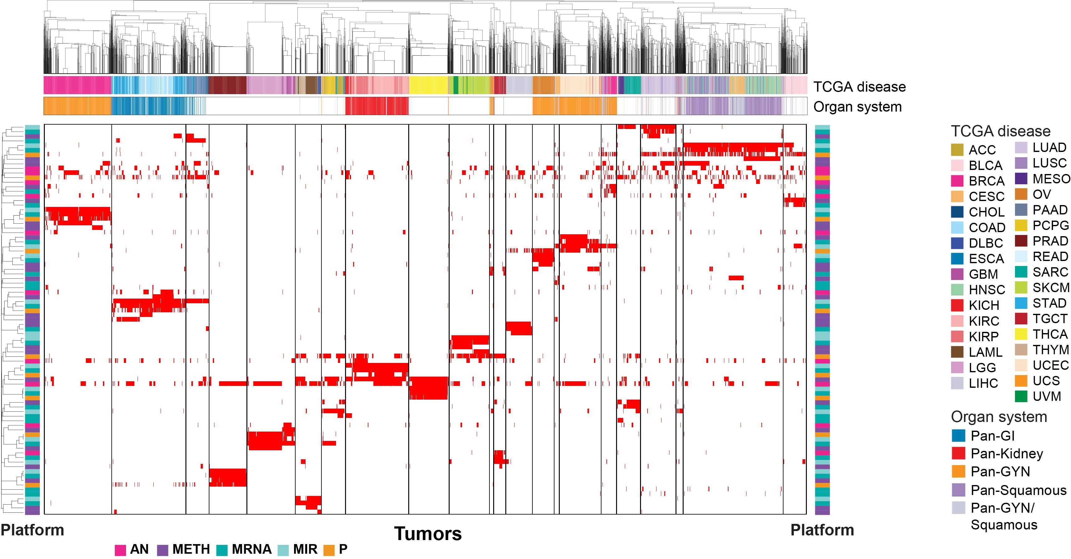
Clustering of Cluster Assignments (COCA)
Christina Yau

Slide 6
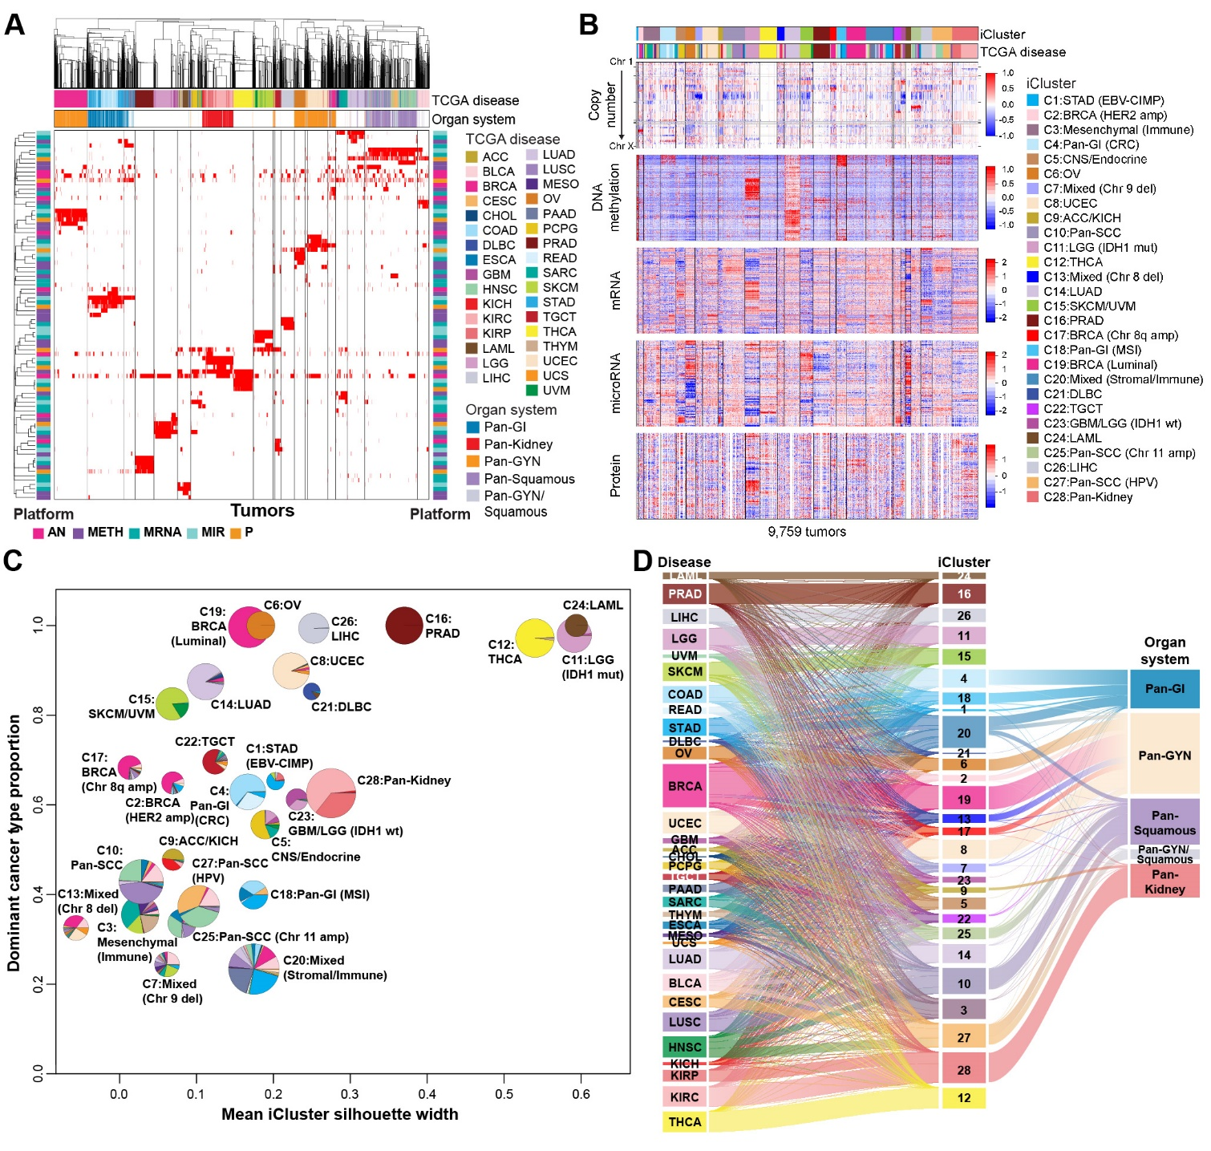
iCluster
Input features
3,105 segmented CN regions
3,139 hypermethylated features
3,217 mRNA features
382 miRNA features
*RPPA was not used but shown
Esther Drill, Ronglai Shen
Notes:
The iCluster clustering algorithm formulates the problem of subgroup discovery as a joint multivariate regression of multiple data types with reference to a set of common latent variables, which represent the underlying 28 tumor subtypes (Mo et al., 2013; Shen et al., 2009, 2012). Four molecular platforms - SCNA, DNA methylation, mRNA expression, and miRNA expression were used as input. Data were pre-processed using the following procedures: For mRNA, and mature-strand miRNA sequence data, poorly expressed genes were excluded based on median-normalized counts, and variance filtering led to a list of reduced features for clustering. mRNA and miRNA expression features were log2 transformed, normalized and scaled before using them as an input to iCluster. Pre-processing led to 3,217 mRNA and 382 miRNA features. Pre-processed DNA methylation data were obtained from the methylation merged HM27 and HM450 platform datasets and included 3,139 hypermethylation features. Circular Binary Segmented (CBS) SCNA data were further reduced to a set of 3,105 non-redundant regions as described
(Mo et al., 2013).

Slide 7
iCluster - Tumor Type Relationships
Single Tumor Type-Dominant
(>70% one tumor type)
C6: OV
C8: UCEC
C11: LGG (IDH1 mut)
C12: THCA
C14: LUAD
C16: PRAD
C19: BRCA (Luminal)
C21: DLBC
C22: TGCT
C24: LAML
C26: LIHC
Related Tumor Types
C5: CNS/Endocrine
C15: SKCM/UVM
C23: GBM/LGG (IDH1 wt)
C28: Pan-Kidney
Pan-Gastrointestinal
C1: STAD (EBV CIMP)
C4: Pan-GI (CRC)
C18: Pan-GI (MSI)
Pan-Squamous
C10: Pan-SCC
C25: Pan-SCC (Chr11 amp)
C27: Pan-SCC (HPV)
Copy Number Driven
C2: BRCA (HER2 amp)
C9: ACC/KICH
C7: Mixed (Chr9 del)
C13: Mixed (Chr8 del)
C17: BRCA (Chr8q amp)
Mixed Groups
C3: Mesenchymal (Immune)
C20: Mixed (Stromal/Immune)
Notes:
ACC and KICH hypodiploid karyotypes

Slide 8
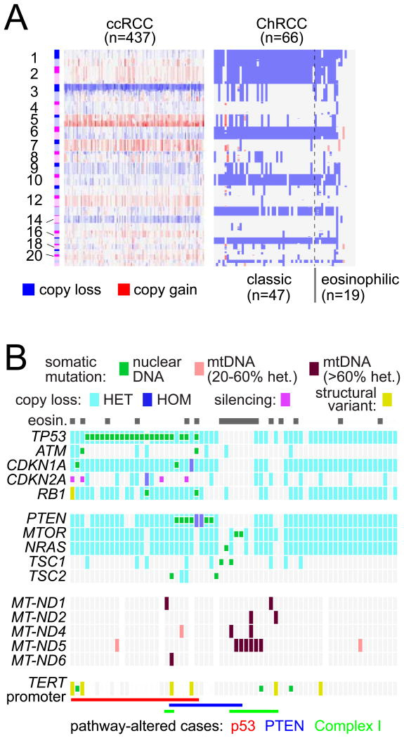
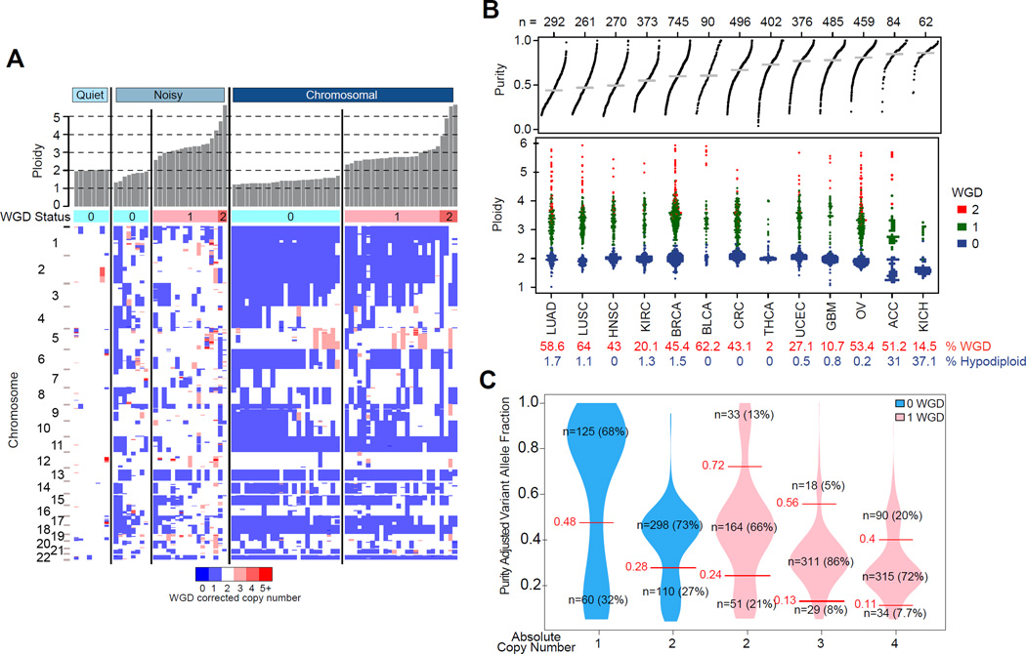
C9: ACC/KICH
KICH
ACC
Davis et al, Cancer Cell 2014
ACC, Zehng et al, Cancer Cell 2016

Slide 9
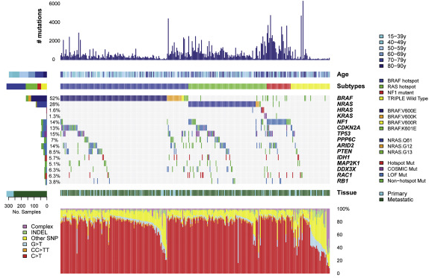
C15: SKCM/UVM
UVM
SKCM
Robertson et al, Cancer Cell 2018
TCGA, Cell 2015

Slide 10
Clustering of Cluster Assignments (COCA)
Christina Yau

Slide 11
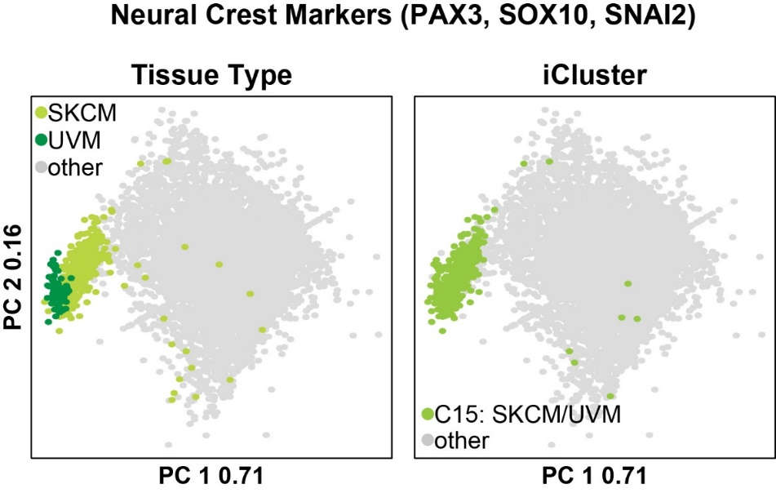
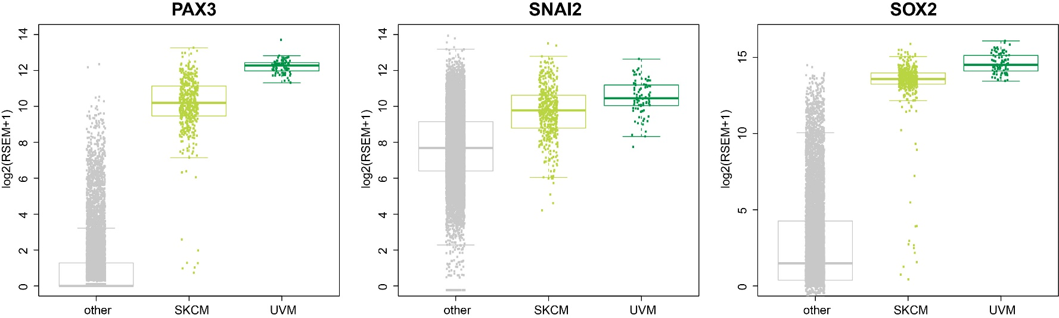
Neural Crest Cell-of-Origin
Kalirai et al, Biochemistry and Molecular Biology, 2011

Slide 12
Tumor Type – iCluster Relationships
Diffuse Tumor Classifications (<70%)
SKCM, COAD, SARC, MESO, GBM, DLBC, LUSC, BRCA, STAD, HNSC, UCS, ESCA, CHOL, and BLCA
Moderate Tumor Classifications (70 - 89%)
READ, LUAD, LGG, UCEC, UVM, CESC, PAAD, ACC, KICH, THYM
Strong Tumor Classifications (90 - 100%)
PCPG, PRAD, THCA, LAML, TGCT, KIRC, KIRP, OV, LIHC
Notes:
BLCA in 15 different icluster groups

Slide 13
Tumor Type – iCluster Relationships
Diffuse Tumor Classifications (<70%)
SKCM, COAD, SARC, MESO, GBM, DLBC, LUSC, BRCA, STAD, HNSC, UCS, ESCA, CHOL, and BLCA
GBM
64% C23: GBM/LGG (IDH1 wt)
16% C5: CNS/Endocrine
12% C3: Mesenchymal (Immune)
6% C11: LGG (IDH1 mut)
STAD
44% C20: Mixed (Stromal/Immune)
28% C18: Pan-GI (MSI)
8% C1: STAD (EBV CIMP)
6% C4: Pan-GI (CRC)
4% C2: BRCA (HER2 amp)
BRCA
53% C19: BRCA (Luminal)
12% C17: BRCA (Chr8q amp)
10% C2: BRCA (HER2 amp)
8% C20: Mixed (Stromal/Immune)
7% C13: Mixed (Chr8 del)
4% C25: Pan-SCC (Chr11 amp)
Bladder (BLCA) was the most diverse with samples members of 15 different iClusters with a maximum enrichment of only 24% of samples in an iCluster (Squamous).
Notes:
BLCA in 15 different icluster groups

Slide 14
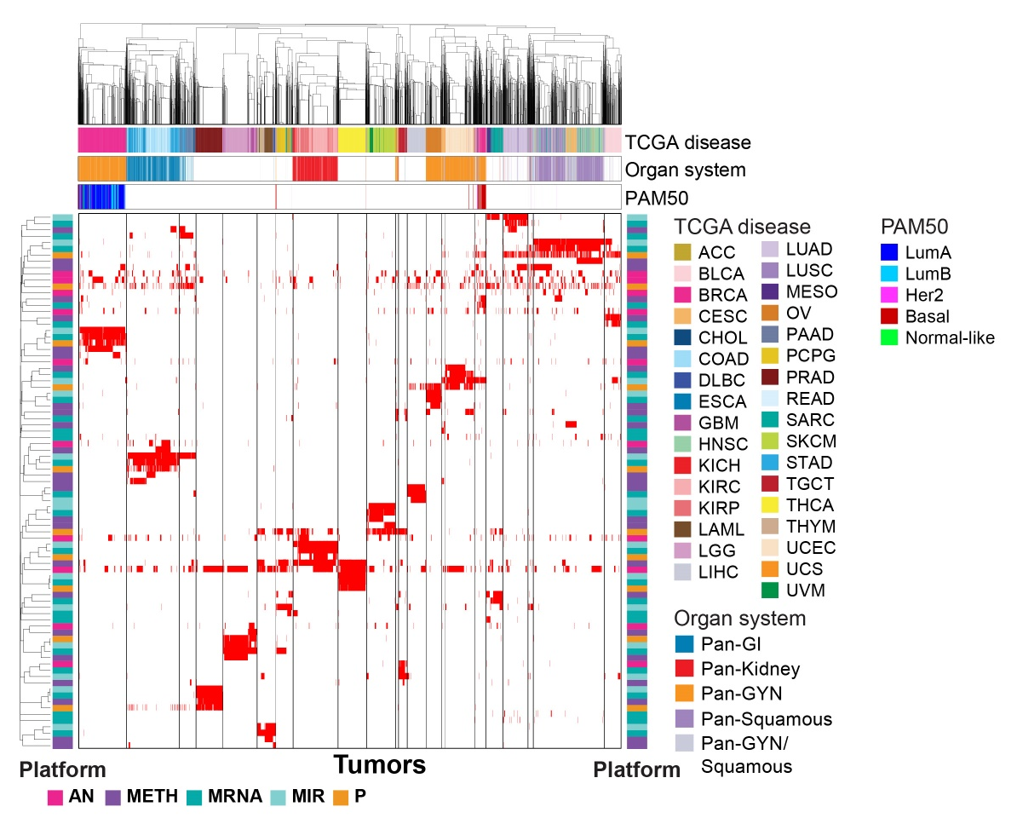
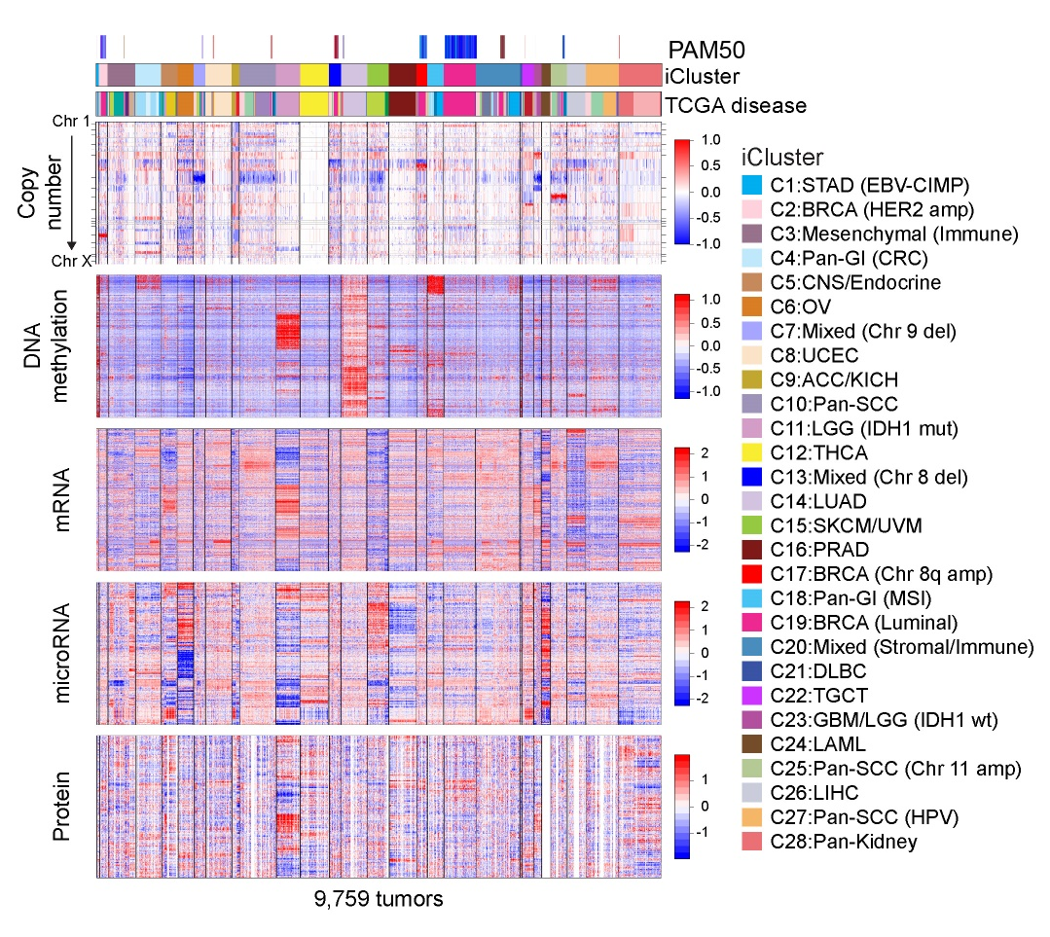
Basal-like Classification
Notes:
Icluster – most went into C13: Mixed (chr8 del) or C20: Mixed Stroma/immune. But also others went into C8:UCEC, C10:Pan-SCC, C17:BRCA (Chr 8q amp), C19: BRCA Luminal, and C27:PAnSCC-HPV

Slide 15
How many Etiological subtypes of breast cancer: two, three, or more? William F. Anderson, Philip S. Rosenberg, Aleix Prat, Charles M. Perou,
and Mark E. Sherman. JNCI, (2014). PMID:25118203
Clemmesen’s Hook
n=2000
Notes:
A bimodal age distribution at diagnosis with peak frequencies near ages 50 and 70 years is a funda- mental characteristic of breast cancer for important tumor features, clinical characteristics, risk factor profiles, and molecular subtypes. The bimodal peak frequencies at diagnosis divide breast cancer overall into a “mixture” of two main components in varying proportions in different cancer populations. The first breast cancer tends to arise early in life with modal age-at- diagnosis near 50 years and generally behaves aggressively.The second breast cancer occurs later in life with modal age near 70 years and usually portends a more indolent clinical course. These epidemiological and molecular data are consistent with a two-component mixture model and compatible with a hierarchal view of breast cancers arising from two main cell types of origin.

Slide 16
iCluster Stability and Relationships
Christina Yau

Slide 17
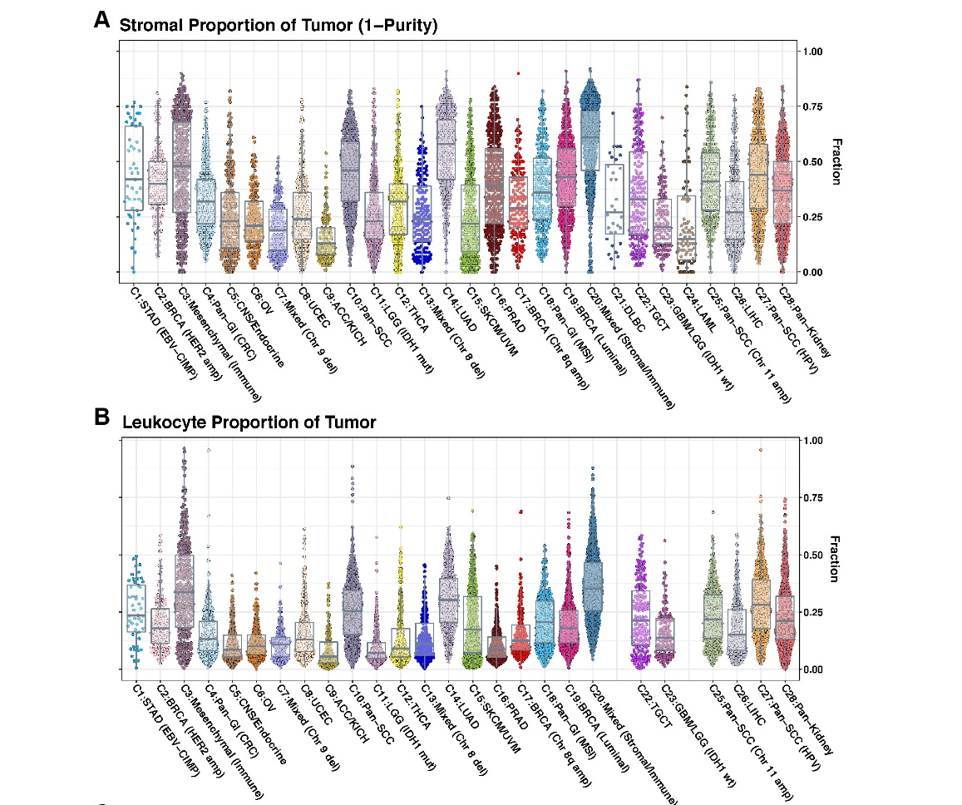
Stroma and Leukocytes
Stroma fraction was defined as 1 – the purity estimates from ABSOLUTE. (Carter et al, 2012)
Leukocyte proportion was defined with DNA Methylation data by identifying DNA methylation probes that differed between pure leukocyte cells and normal tissues and estimating the leukocyte content using a mixture model.
Vesteinn Thorsson, Toshi Hinoue

Slide 18
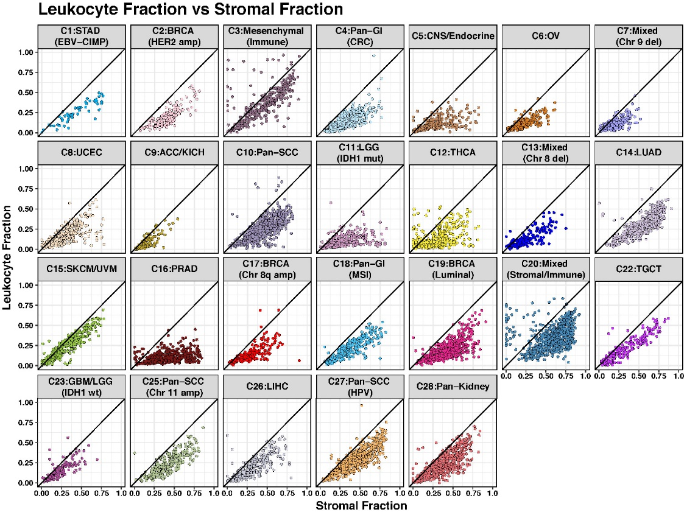
Vesteinn Thorsson
Notes:
C3- SARC, SKCM, MESO, THYM, DLBC,
C20 – BRCA, BLCA, HNSC, ESCA, STAD, COAD, READ, PAAD, LUSC, LUAD,

Slide 19
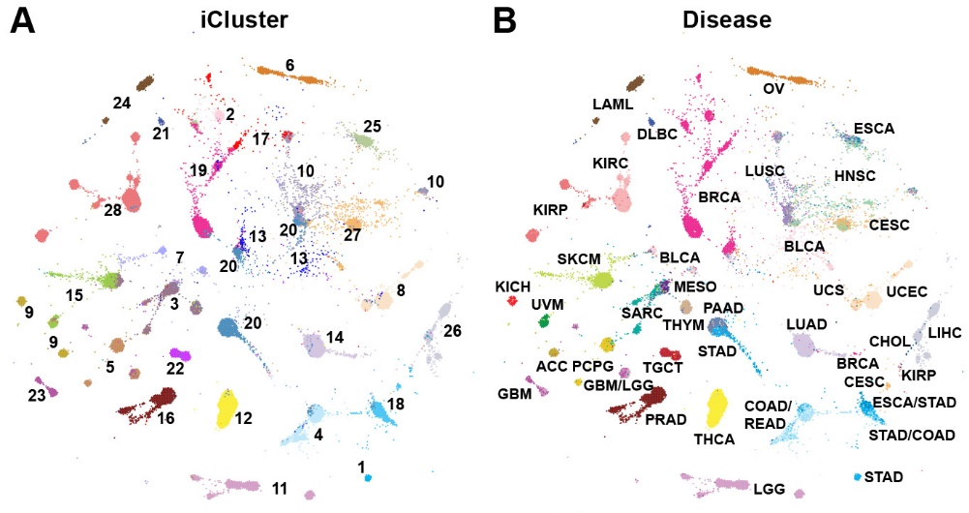
Tumor Map
Chris Wong, Josh Stuart
Notes:
We visualized the samples by calculating Euclidean distances between the iCluster latent variables for all sample pairs and projecting the distances onto a 2D layout with TumorMap

Slide 20
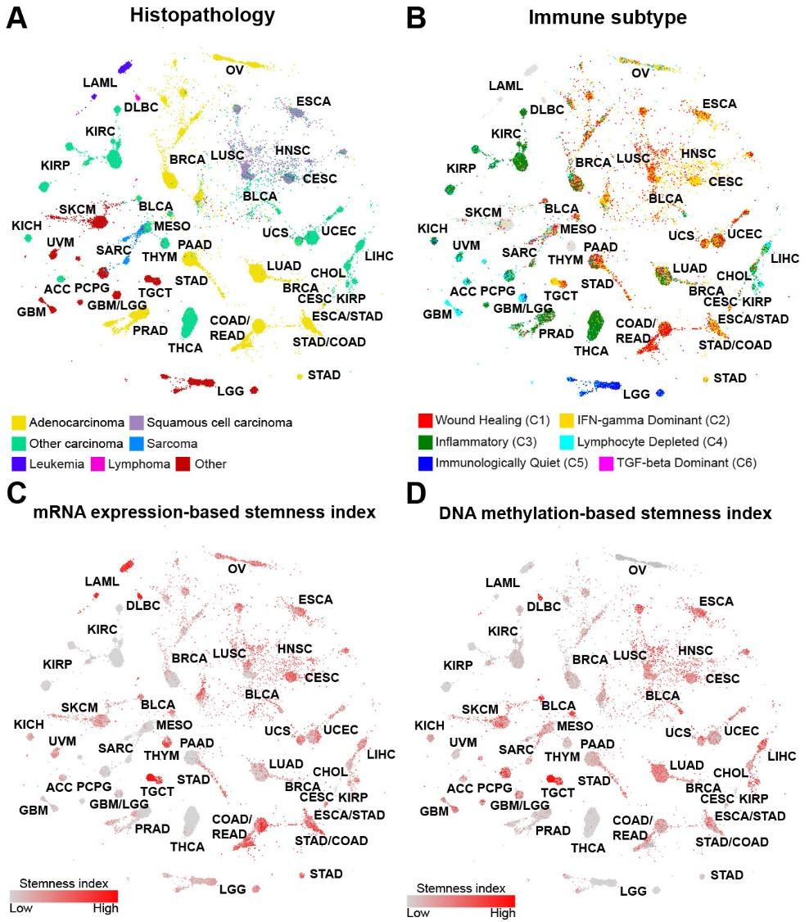
Histology and Immune Relationships
Chris Wong, Alex Lazar
Thorsson et al, Immunity 2018

Slide 21
Stemness Scores
Chris Wong, Tathi Malta, Houtan Noushmehr, Maciej Wizerowicz
Malta et al, Cell 2018

Slide 22
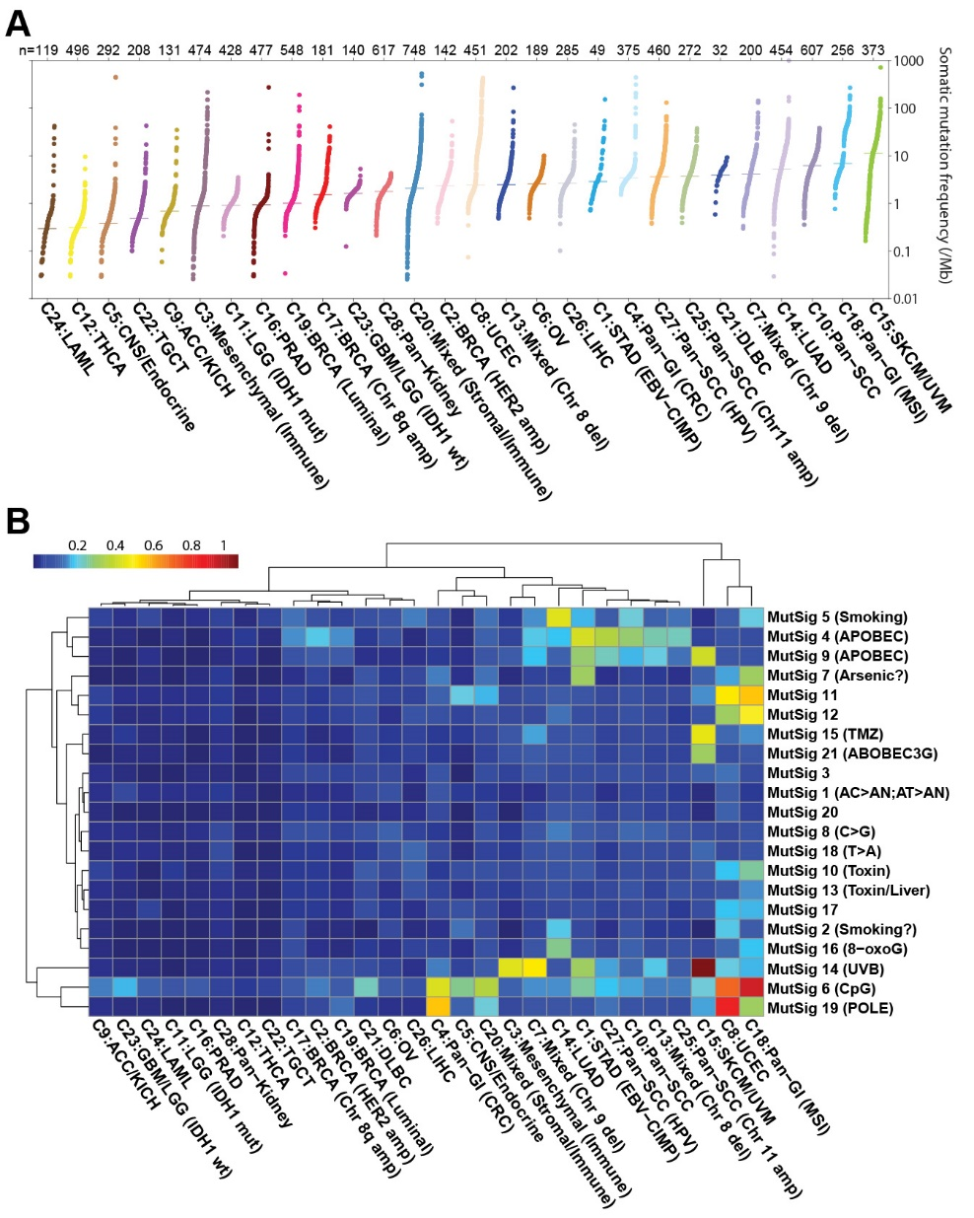
Somatic Mutation Frequency
Mike Lawrence

Slide 23
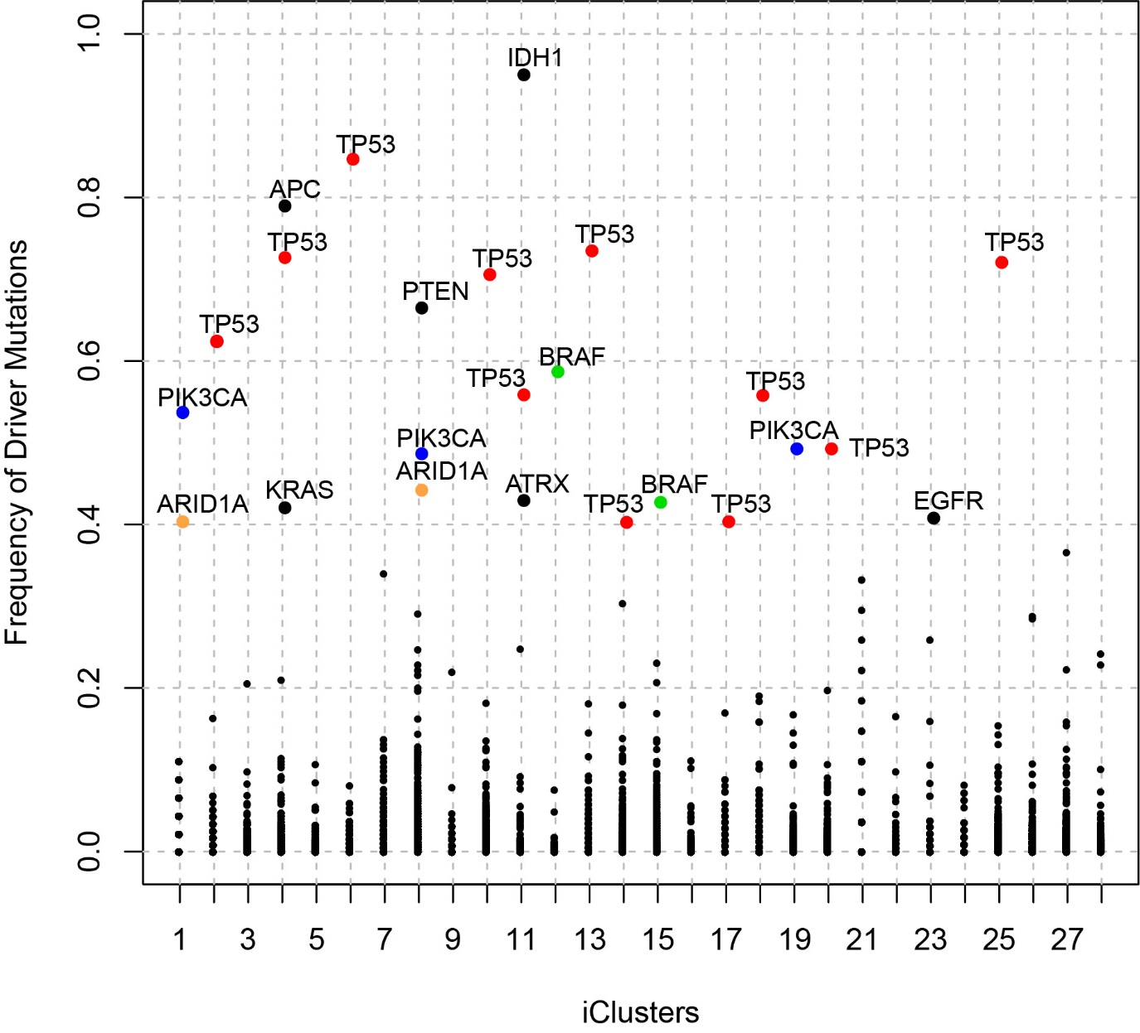
Driver Mutation Enrichment
C1:STAD (EBV-CIMP) PIK3CA, ARID1A
C2:BRCA (HER2 amp) TP53
C4:Pan-GI (CRC) APC, TP53, KRAS
C6:OV TP53
C8:UCEC PTEN, PIK3CA, ARID1A
C10:Pan-SCC TP53
C11:LGG (IDH1 mut) IDH1, TP53, ATRX
C12:THCA BRAF
C13:Mixed (Chr 8 del) TP53
C14:LUAD TP53
C15:SKCM/UVM BRAF
C17:BRCA (Chr 8q amp) TP53
C18:Pan-GI (MSI) TP53
C19:BRCA (Luminal) PIK3CA
C20:Mixed (Stromal/Immune) TP53
C23:GBM/LGG (IDH1 wt) EGFR
C25:Pan-SCC (Chr 11 amp) TP53
Bailey et al, Cell, 2108

Slide 24
Mutational Signatures
Denise Wolf, Linghua Wang

Slide 25
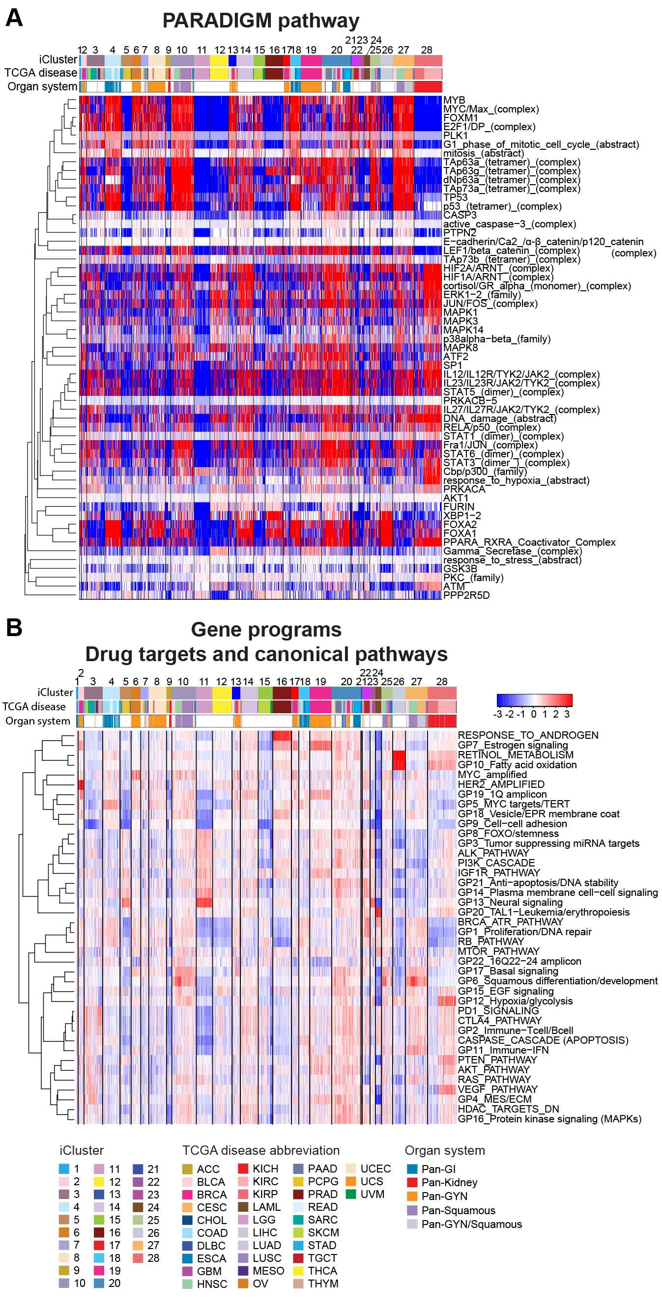
Christina Yau, Denise Wolf

Slide 26
Summary
Integrative Clustering methods to classify human tumors
Tissue type influences but does not fully determine tumor classification
Classification might help identify cancers of unknown primary origin or help identify new biomarkers.
Identifying similar molecular characteristics across tumors of different tissues might help us use information from one tumor/cell type to gain information about other tumor/cell types.

Slide 27
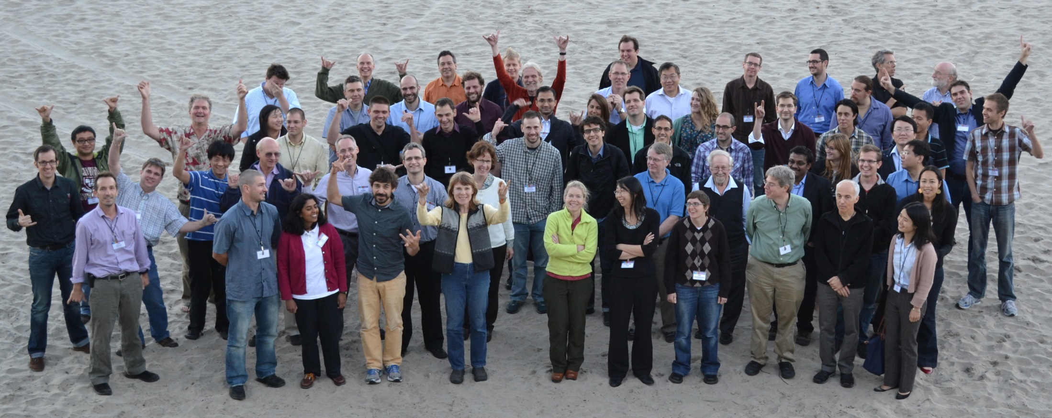
TCGA Pan Cancer Atlas Working Group
+725 individuals from around the world

