Slide 1

Design and analysis of a single cell
RNA-seq benchmarking data set to compare protocols and analysis methods
Dr Matt Ritchie
@mritchieau
(joint work with Luyi Tian, Xueyi Dong, Shian Su and others…)
Notes:
Abstract: Single cell RNA sequencing (scRNA-seq) technology has undergone rapid development in recent years and has brought with it new challenges in data processing and analysis. This has led to an explosion of tailored analysis methods for scRNA-seq to address various biological questions, from cell type identification, to marker gene discovery and trajectory analysis. The current lack of gold-standard benchmarking datasets makes it difficult for researchers to evaluate the performance of the many different methods available in a systematic manner.
To address this problem, we designed and generated a cross-platform benchmark dataset that has in-built truth in various forms as well as varying levels of biological noise. We use this dataset to compare different protocols, examine popular assumptions made in scRNA-seq analyses and compare methods for tasks ranging from normalization to trajectory analysis. We found significant differences in the results from the methods compared and have identified a few that performed well across protocols in high and low variability scenarios. Our dataset and analysis provide a valuable resource for understanding the nature of scRNA-seq data and can be used to guide algorithm selection in different biological settings.

Slide 2
Talk overview
Data processing
scPipe: An R package for single cell RNA-seq data processing and quality control
Method evaluations
Design and analysis of a series of single cell RNA-seq control data sets to compare different protocols and analysis methods

Slide 3
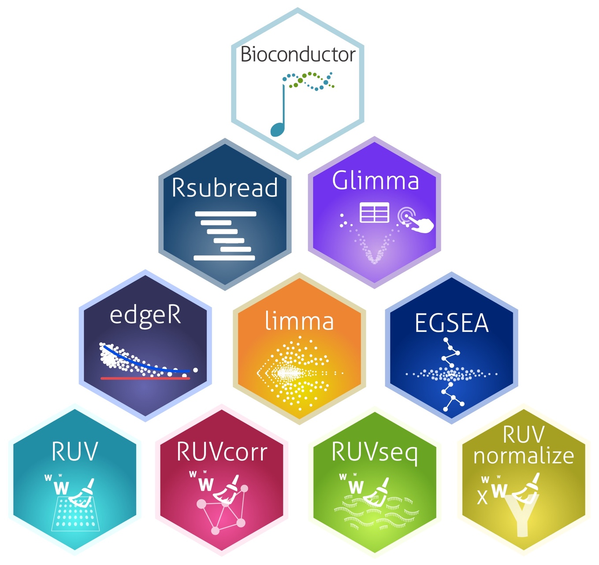

AUSTRALIA
Melbourne
www.bioconductor.org

Slide 4
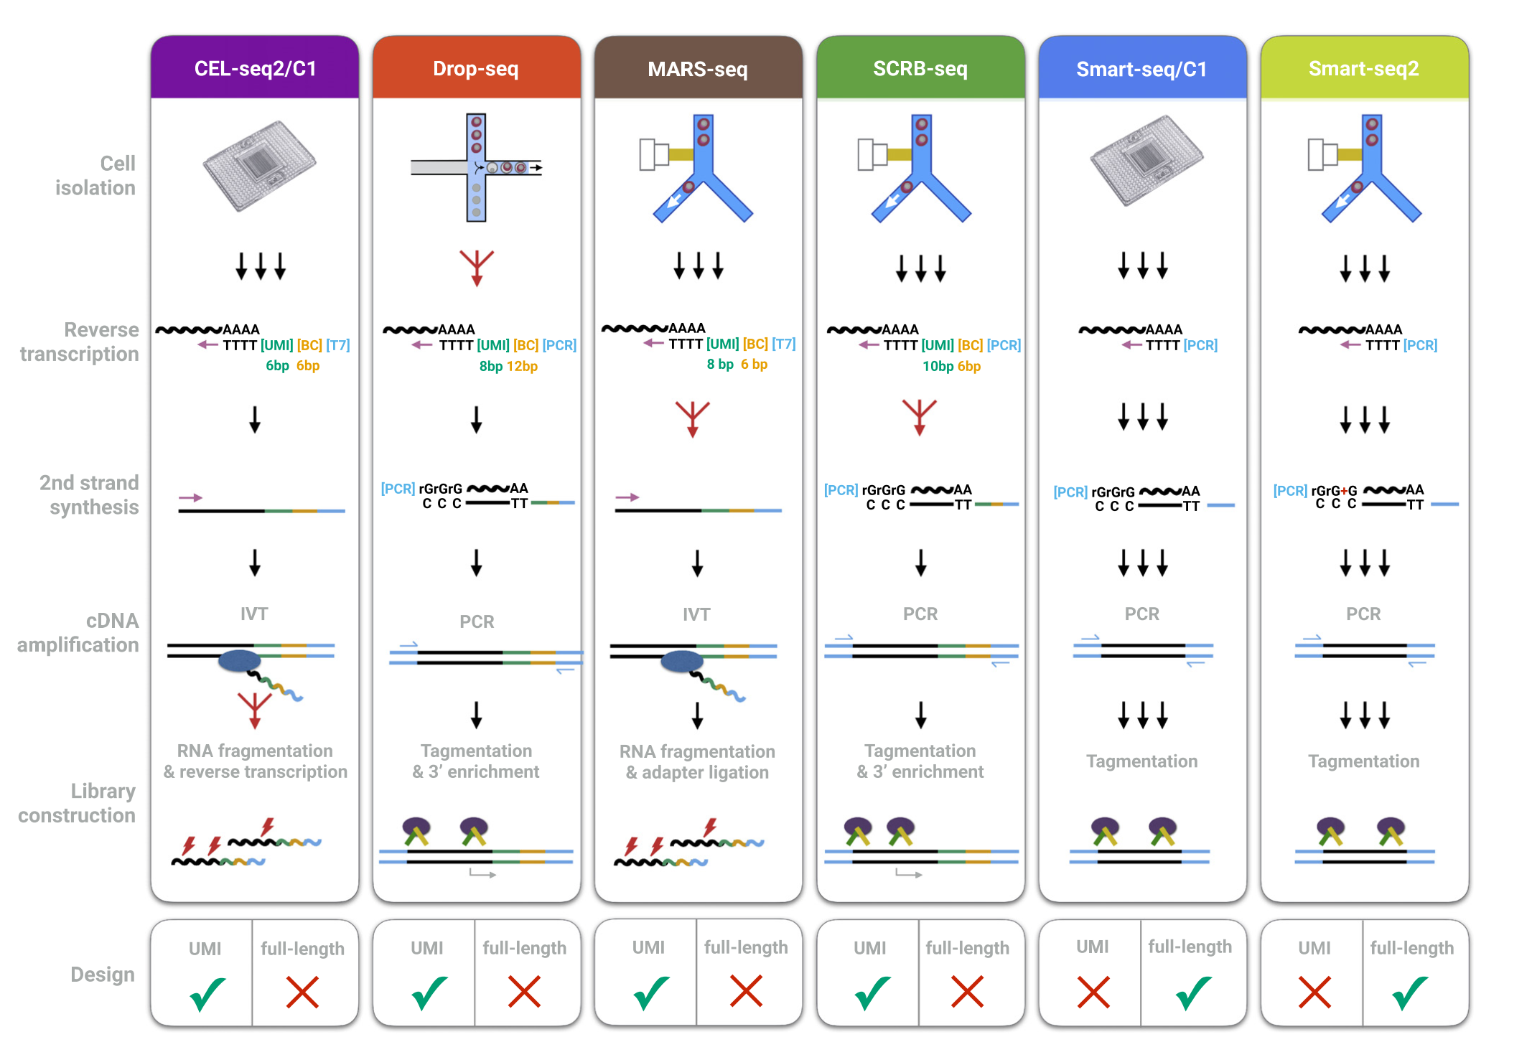
There are many scRNA-seq protocols available…

Slide 5


Data preprocessing challenge: barcodes everywhere…
Goal: develop software to process data generated by different
protocols we routinely encountered

Slide 6


Data pre-processing with scPipe
Quality control metrics collected at each step
scPipe workflow
Fastq reformat (sc_trim_barcode)
Number of Removed reads
Reads alignment
(Rsubread::align)
Alignment rate
scPipe can process data from 10X, Drop-seq,
CEL-seq2 and SORT-seq protcols.
Exon mapping
(sc_exon_mapping)
Number of reads mapped to intron/exon
Barcode demultiplex
(sc_demultiplex)
Reads per cell; unmatched barcodes
Gene count
(sc_gene_counting)
Number of corrected UMI & filtered genes
Gene counting matrix
Quality control information matrix
Tian, Su, Dong et al. (2018) PLoS Comp Biol
A SingleCellExperiment object for quality control and further downstream analysis
Notes:
Perform barcode demultiplexing, UMI dedup and quality control.
Can process data from 10X, Drop-seq, CEL-seq2 and SORT-seq.
Easy to use together with other Bioconductor packages such as scater and scran, share the same object.
Collect quality control metrics at different steps.

Slide 7
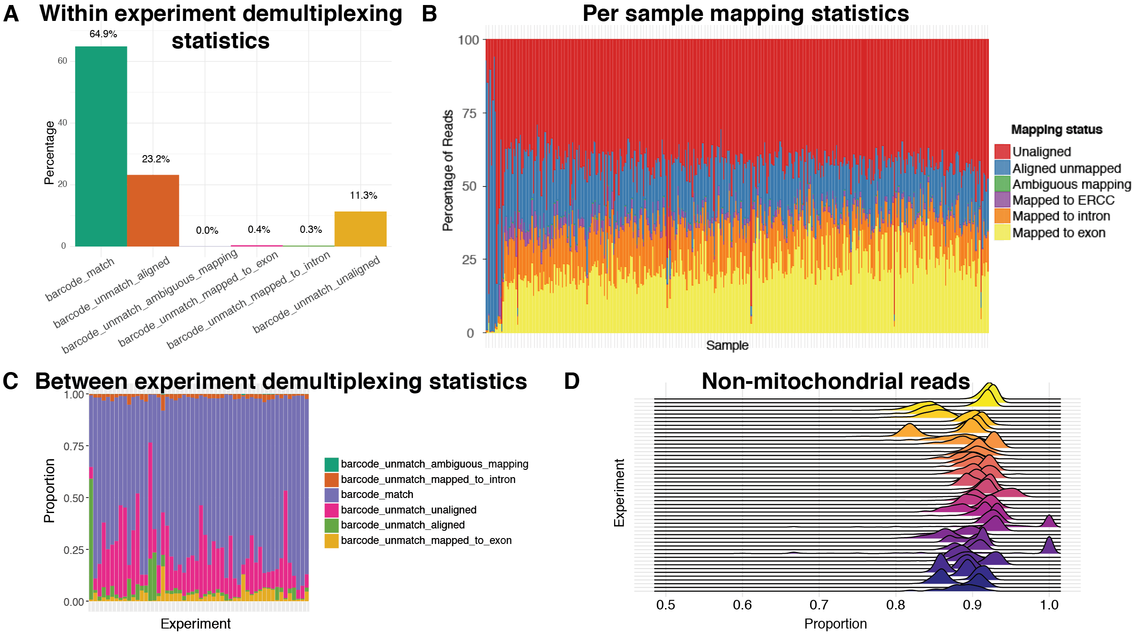
Quality control metrics for data cleaning

Slide 8
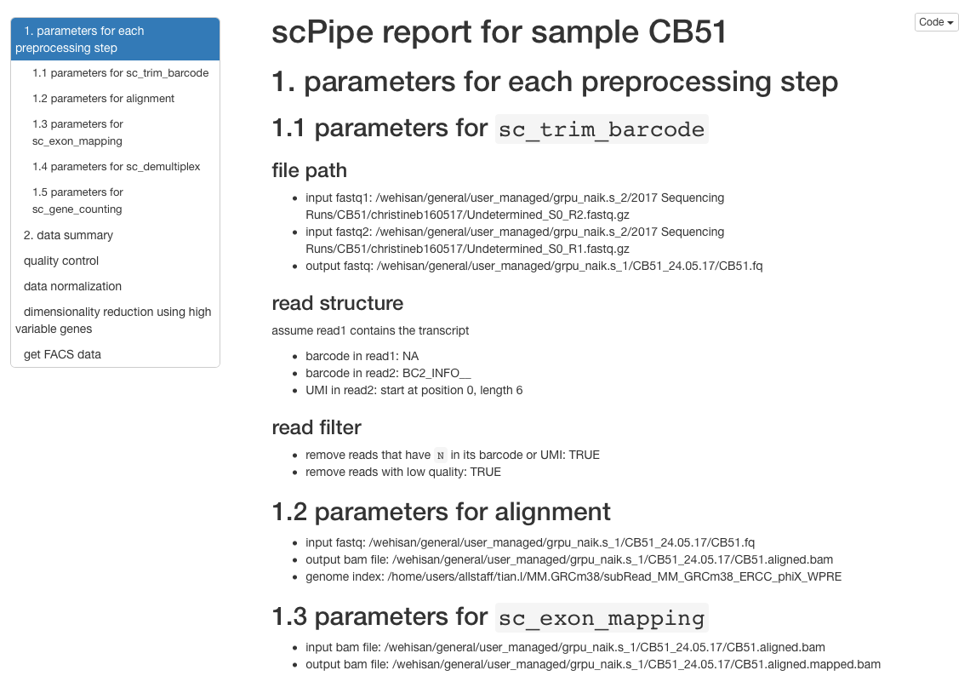
Summary reports are easy to compile

Slide 9

One package to rule them all

Slide 10
Comparison of preprocessing software
Software | Multiple Technologies | Alignment | UMI handling | QC Metrics | Downstream analysis
scPipe | ✔️ | ✔️ | ✔️ | ✔️ | ✖️
dropSeqPipe | ✖️ | ✔️ | ✔️ | ✔️ | ✖️
CellRanger | ✖️ | ✔️ | ✔️ | ✔️ | ✔️
UMI-tools | ✔️ | ✖️ | ✔️ | ✖️ | ✖️
umis | ✔️ | ✖️ | ✔️ | ✖️ | ✖️
sircel | ✔️ | ✖️ | ✔️ | ✖️ | ✖️
PoissonUMIs | ✔️ | ✖️ | ✔️ | ✖️ | ✖️
TRUmiCount | ✔️ | ✖️ | ✔️ | ✖️ | ✖️
DrSeq2 | ✔️ | ✔️ | ✔️ | ✔️ | ✔️
Sharq | ✖️ | ✔️ | ✔️ | ✔️ | ✖️
zUMIs | ✔️ | ✔️ | ✔️ | ✔️ | ✖️

Slide 11
Talk overview
Data processing
scPipe: An R package for single cell RNA-seq data processing and quality control
Method evaluations
Design and analysis of a series of single cell RNA-seq control data sets to compare different protocols and analysis methods

Slide 12
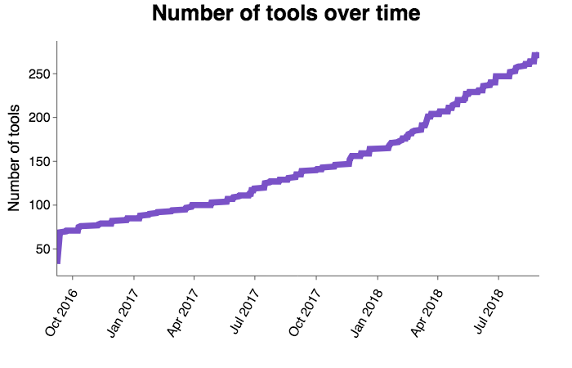
Explosion of scRNA-seq analysis methods…
https://www.scrna-tools.org/
Zappia, Phipson & Oshlack, PLoS Comp Biol 2018

Slide 13
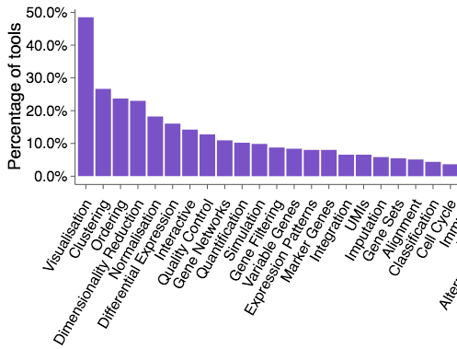
Many different types of analysis are possible…

Slide 14
There have been comparisons but no gold-standard benchmarking data sets exist*
Protocols: Svensson et al. Nature Methods 2017
Normalization: Cole et al. bioRxiv 2017
Imputation: Zhang et al. bioRxiv 2017
Feature selection: Yip et al. Briefings in Bioinformatics 2018
Differential expression: Soneson et al. Nature Methods 2018
Clustering: Duo et al. F1000Research 2018
Trajectory: Saelens et al. bioRxiv 2018
* that we are aware of!
Notes:
add more reason for why we do benchmark. add more background
list different approaches, protocols
picture. flowchart, explain each step

Slide 15



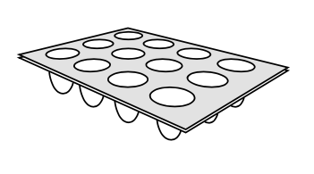

Experimental Design
Profiled over 4000 cells (pseudo cells)
Single cell
9 cell mixtures
RNA mixtures
Dolomite Drop-seq
CEL-seq2
SORT-seq
CEL-seq2
~400
CEL-seq2
384
10X chromium
4 x 384
384
384
~1000
Data preprocessing using scPipe

Slide 16
Data pre-processing with scPipe
Quality control metrics collected at each step
scPipe workflow
Fastq reformat (sc_trim_barcode)
Number of Removed reads
Reads alignment
(Rsubread::align)
Alignment rate
scPipe can process data from 10X, Drop-seq,
CEL-seq2 and SORT-seq protcols.
Exon mapping
(sc_exon_mapping)
Number of reads mapped to intron/exon
Barcode demultiplex
(sc_demultiplex)
Reads per cell; unmatched barcodes
Gene count
(sc_gene_counting)
Number of corrected UMI & filtered genes
Gene counting matrix
Quality control information matrix
Tian, Su, Dong et al. (2018) PLoS Comp Biol
A SingleCellExperiment object for quality control and further downstream analysis
Notes:
Perform barcode demultiplexing, UMI dedup and quality control.
Can process data from 10X, Drop-seq, CEL-seq2 and SORT-seq.
Easy to use together with other Bioconductor packages such as scater and scran, share the same object.
Collect quality control metrics at different steps.

Slide 17
Various quality control metrics collected

Slide 18
Experimental design
Pseudo cells
SORTseq
Notes:
explain why we do 9 cells. why it is important

Slide 19
Single cell data
CEL-seq2
10X chromium
Dolomite Drop-seq

Slide 20
9 cell mixture design
Single cell:
H2228
7 H2228 cells
1 HCC827 cells
1 H1975 cells
H2228
HCC827
H1975
ERCC spike-in RNA:
Take 1/9 to mimic
single cell amount
H1975
HCC827
20 replicates of 9 cell mixtures
in major trajectory
5 replicates of 9 cell mixtures
in minor trajectory
Population control
3 replicates of 90 cell mixtures
in major trajectory

Slide 21
Mixing cells in different combinations controls cluster number and creates pseudo-trajectories
9 H2228
0 HCC827
0 H1975
7 H2228
1 HCC827
1 H1975
0 H2228
0 HCC827
9 H1975
3 H2228
3 HCC827
3 H1975
1 H2228
1 HCC827
7 H1975

Slide 22
9 cell mixture data
CEL-seq2

Slide 23
RNA mixture design
RNA extracted from bulk cell lines:
H2228
68% H2228
16% HCC827
16% H1975
HCC827
H1975
RNA amount
30pg
ERCC spike-in RNA:
15pg
7.5pg
3.75pg

Slide 24
Mixing RNA in different proportions controls cluster number and creates pseudo-trajectories
100% H2228
0% HCC827
0% H1975
68% H2228
16% HCC827
16% H1975
0% H2228
0% HCC827
100% H1975
33% H2228
33% HCC827
33% H1975
16% H2228
16% HCC827
68% H1975

Slide 25
RNA mixture data
SORT-seq
CEL-seq2

Slide 26
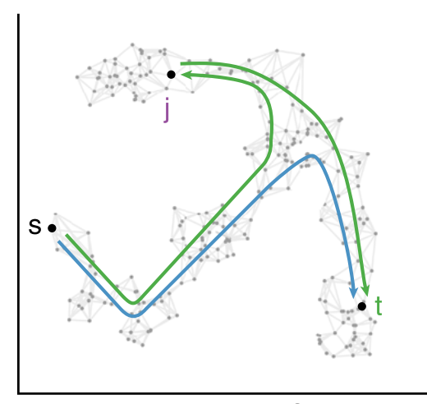
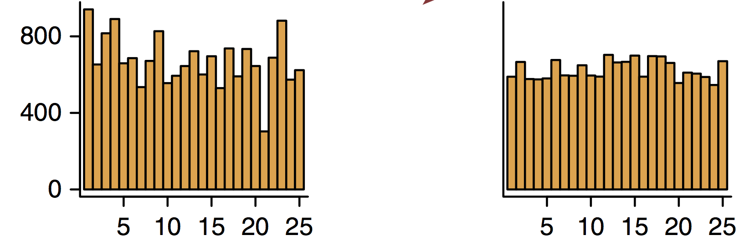
scRNA-seq data analysis involves multiple steps
Feature selection
Data preprocessing
Normalization
Downstream analysis
Reduce gene #
10000 -> 1000
Fastq file
ACGATCGTACGTAG
CACTACAGCTACGA
Trajectory
0 | 5 | 2
2 | 4 | 1
3 | 7 | 4
Gene counting matrix
Reduce heterogeneity
that is technical in nature
Quality control
Remove dead cells, cells with few reads
Clustering
Imputation
0 | 5 | 2
2 | 0? | 1
3 | 7 | 4
Differential expression
Infer missing values using known data

Slide 27
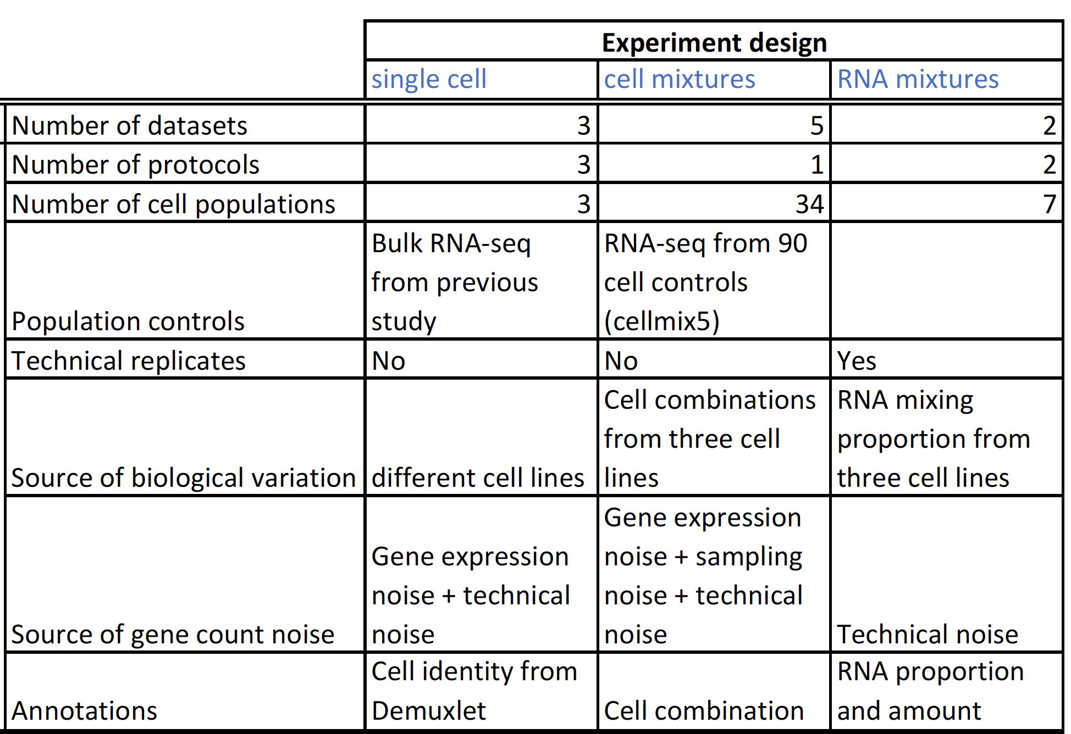
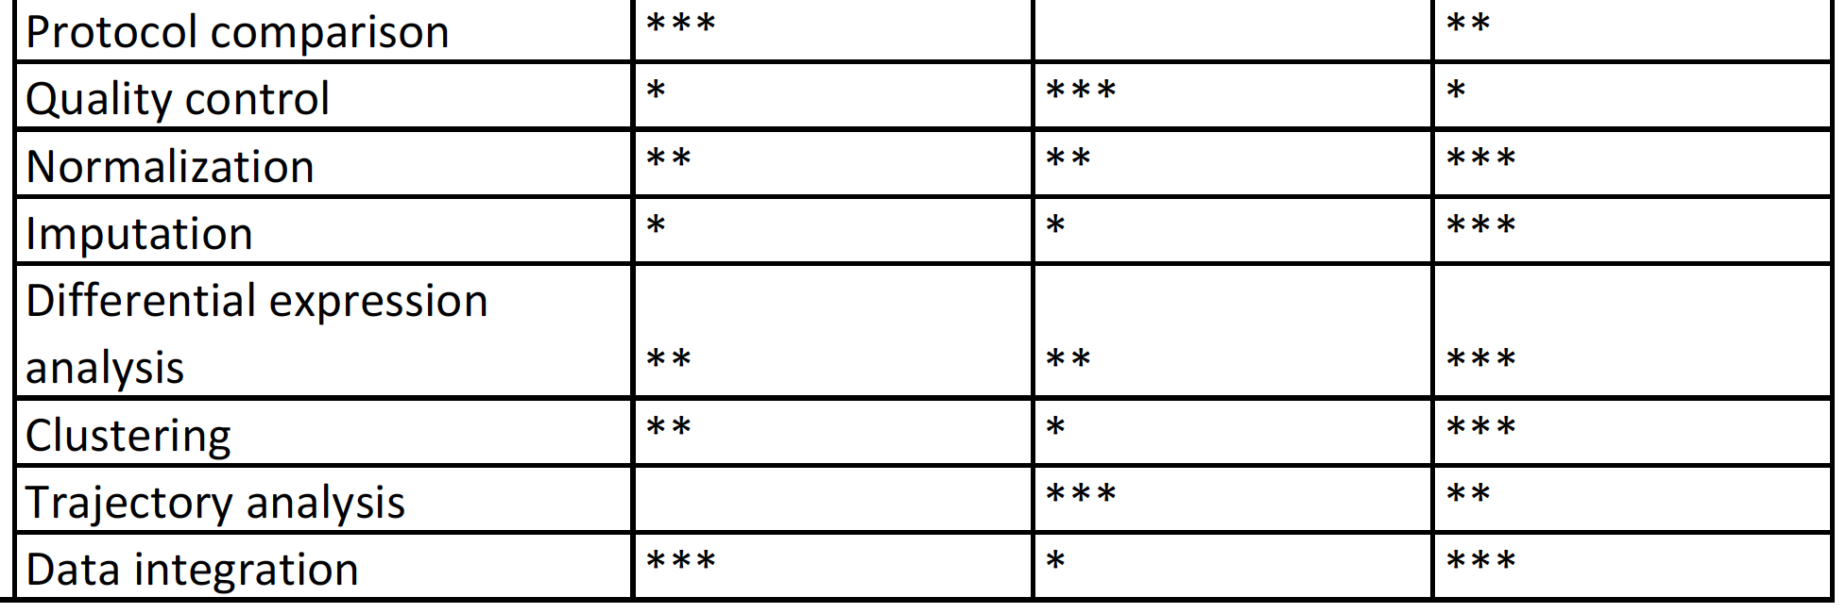
What are these data good for?

Slide 28
Summary of scRNA-seq benchmark design

Slide 29
Benchmarking dataset guide protocol selection and model assumptions
Which protocol outperform others?
There are many model assumptions in computational methods for scRNAseq data. Are they reasonable assumptions?

Slide 30
Quality control metrics on single cells show 10X as a superior protocol

Slide 31
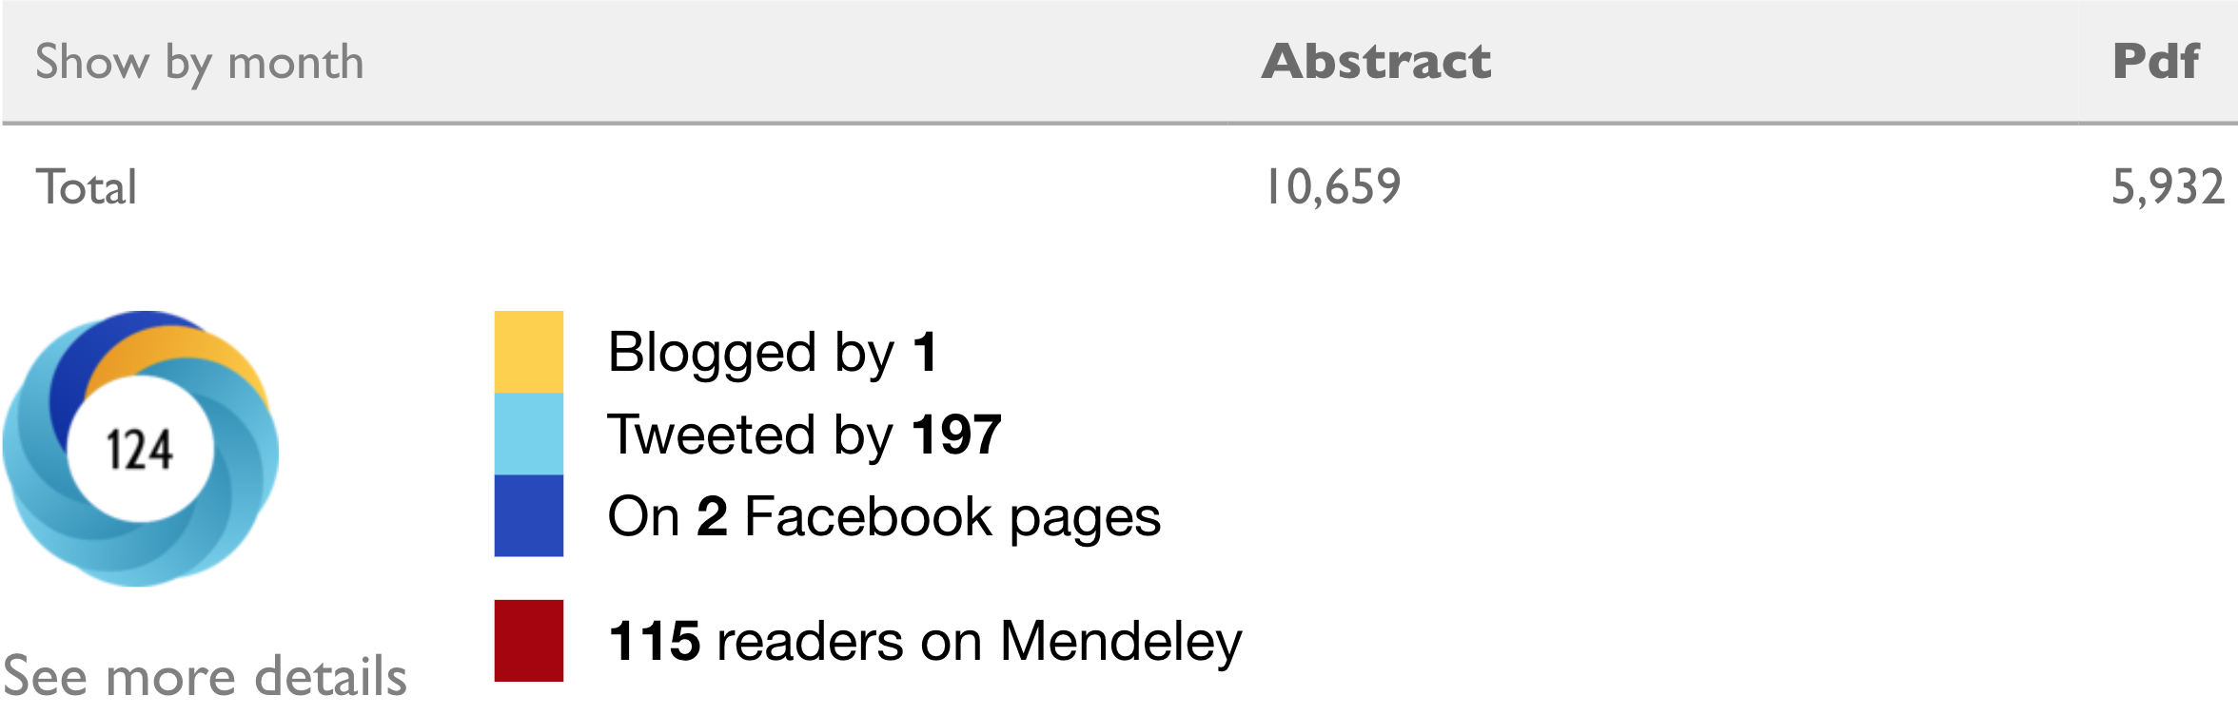
Intron mapping ratios vary among protocols
Recently popular method such as RNA velocity
which considers intron reads as unspliced-mRNA.
RNA velocity
bioRxiv statistics
>10000 view
However, we found the proportion of intron
reads varies between different protocols,
which indicate protocol bias.

Slide 32
ERCC spike-in has been widely used to deconvolve technical variability
Technical variability
biological variability
ERCC spike-in RNA
Cellular RNA

Slide 33
Exon mapping rate per protocol / data set

Slide 34
Intron mapping rate per protocol / data set

Slide 35
scRNA-seq data analysis involves multiple steps
Data preprocessing
Normalization, imputation
Clustering
Trajectory analysis

Slide 36
Good range of library sizes in each data set

Slide 37
Normalization & Imputation: compare 11 representative methods
CPM
TMM
DESeq:
ZINB-WaVE: normalization by factor decomposition (Risso et al. Nat Comms, 2018)
scone: Ensemble method (Cole et al. bioRxiv, 2017)
KNN-smooth: imputation by smoothing (Wager et al. bioRxiv, 2017)
BASiCS: normalization using ERCCs (Vallejos et al. PLoS Comp Biol, 2015)
Linnorm: (Yip et al. Nucleic Acids Res, 2017)
scran: normalization by size factors (Lun et al. Genome Biology, 2016)
scran + SAVER (Huang et al. Nat Methods, 2018)
scran + Drimpute (Gong et al, BMC Bioinformatics, 2018)
normalization
+ imputation

Slide 38
PCA after normalization by different methods
H2228
3.75pg
30pg
HCC827
H1975
scran
scran+Drimpute
BASiCS

Slide 39
PCA after normalization by different methods
H2228
3.75pg
30pg
HCC827
H1975
ZINB-WaVE
KNN-smooth
BASiCS

Slide 40
PCA after normalization by different methods
H2228
3.75pg
30pg
HCC827
H1975
CPM
TMM
ZINB-WaVE

Slide 41
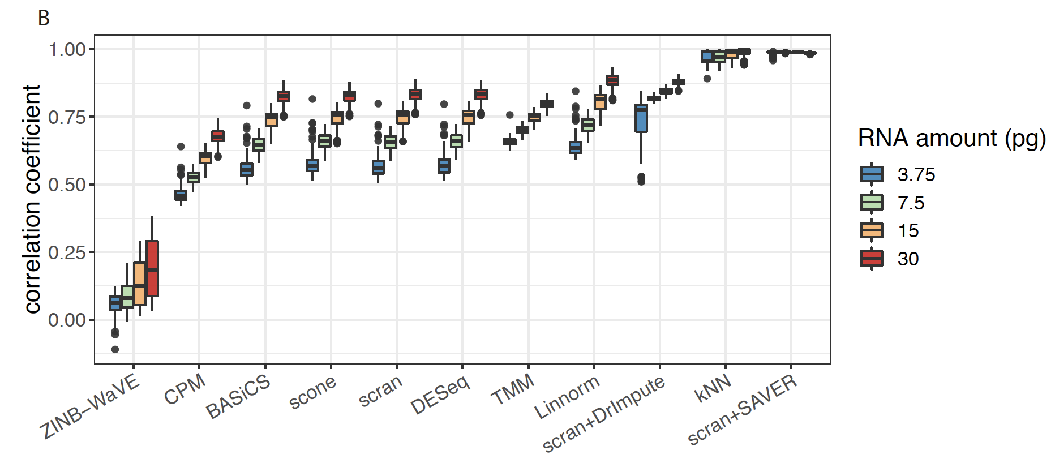
Performance assessment I: measure correlation between technical replicates for RNA mixture

Slide 42
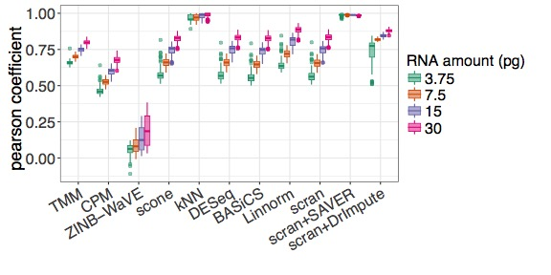
Correlation amongst technical replicates

Slide 43
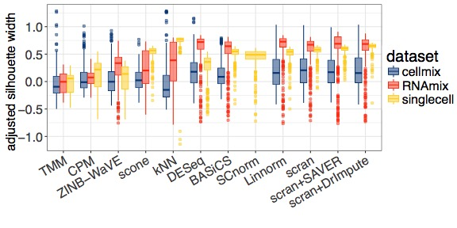
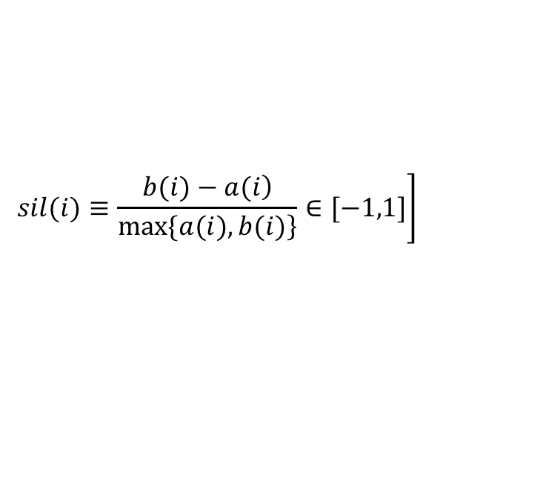
Silhouette width per dataset / method combination
$$\left.sil(i)≡\frac{\left.b(i)−a(i\right)}{\left.max⁡\{a(i), b(i)\right\}}∈[−1,1]\right]$$

Slide 44
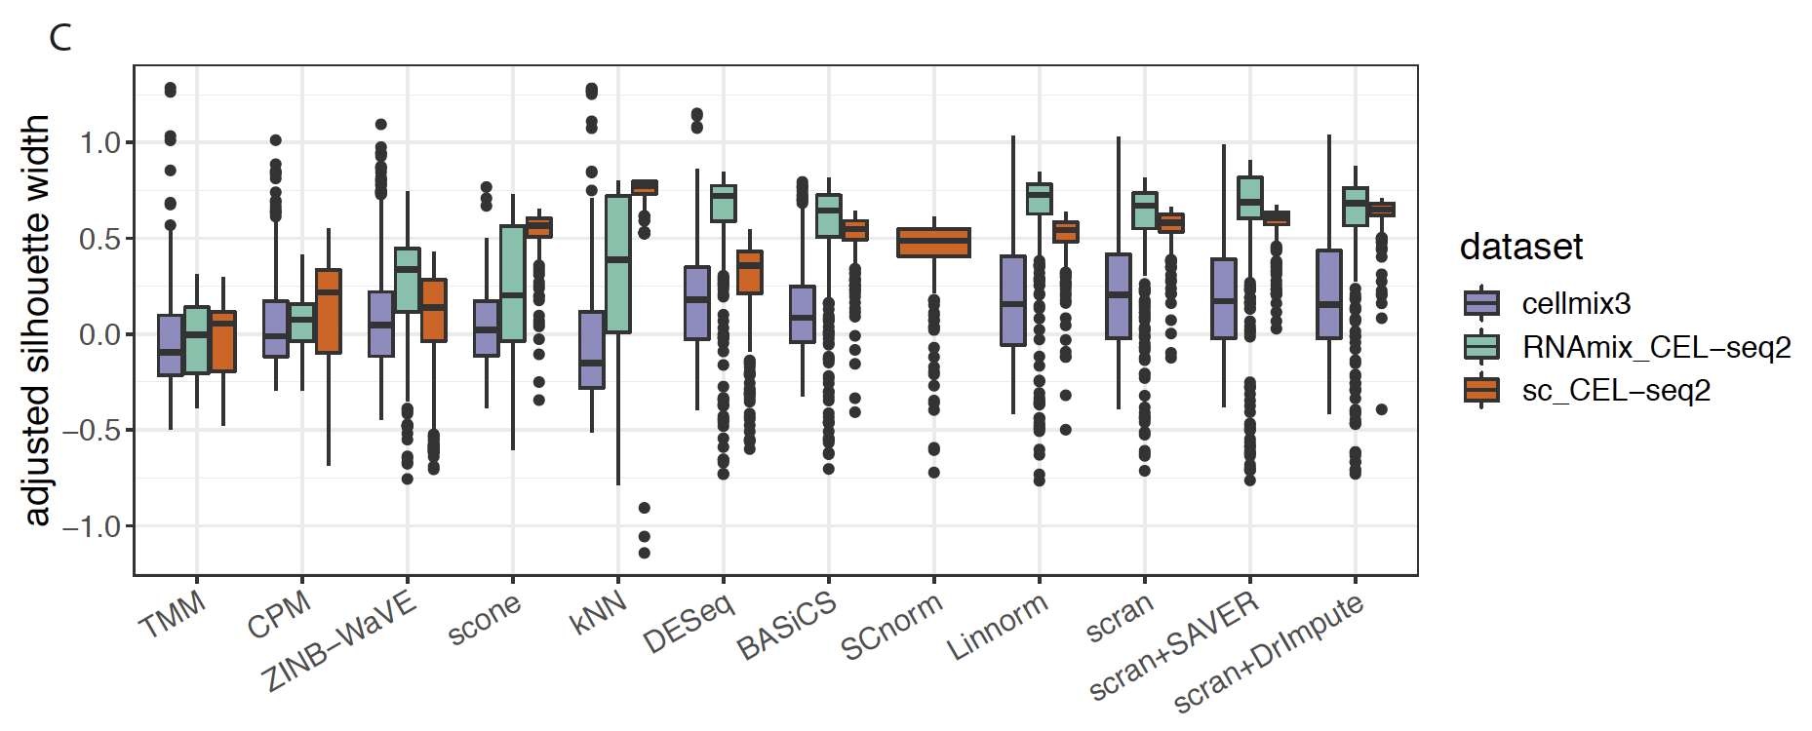
Performance assessment II: calculate silhouette width per data set / method combination

Slide 45
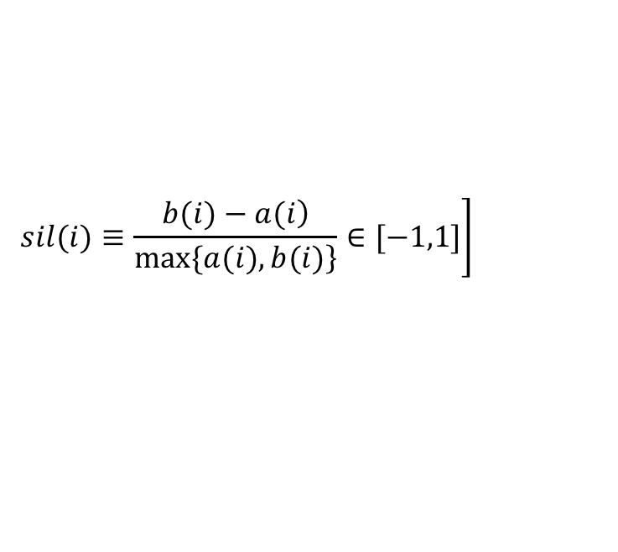
Performance assessment II: calculate silhouette width per data set / method combination
$$\left.sil(i)≡\frac{\left.b(i)−a(i\right)}{\left.max⁡\{a(i), b(i)\right\}}∈[−1,1]\right]$$

Slide 46
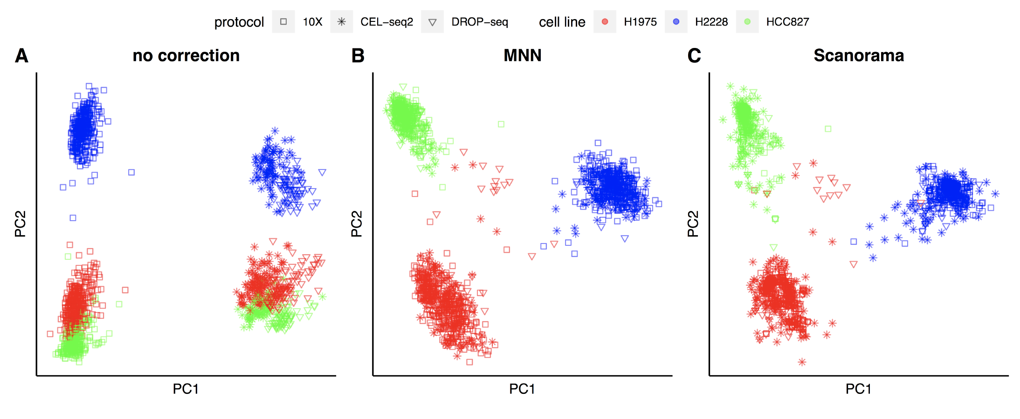
Data integration: comparing 6 representative methods
MNN Haghverdi et al. Nat Biotech, 2018
ZINB-WaVE Risso et al. Nat Comms, 2018
Seurat Butler et al. Nat Biotech, 2018
scMerge Lin et al. bioRxiv, 2018
scanorama Lie et al. bioRxiv, 2018
MINT Rohart et al. BMC Bioinformatics, 2017

Slide 47
PCA before and after batch correction using different methods: single cell data

Slide 48
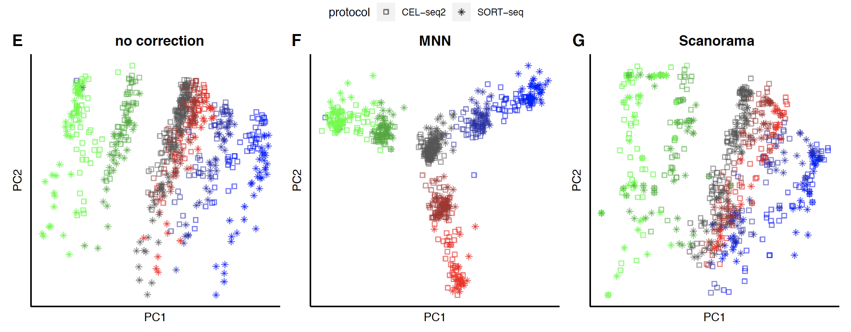
PCA before and after batch correction using different methods: RNA mixtures

Slide 49
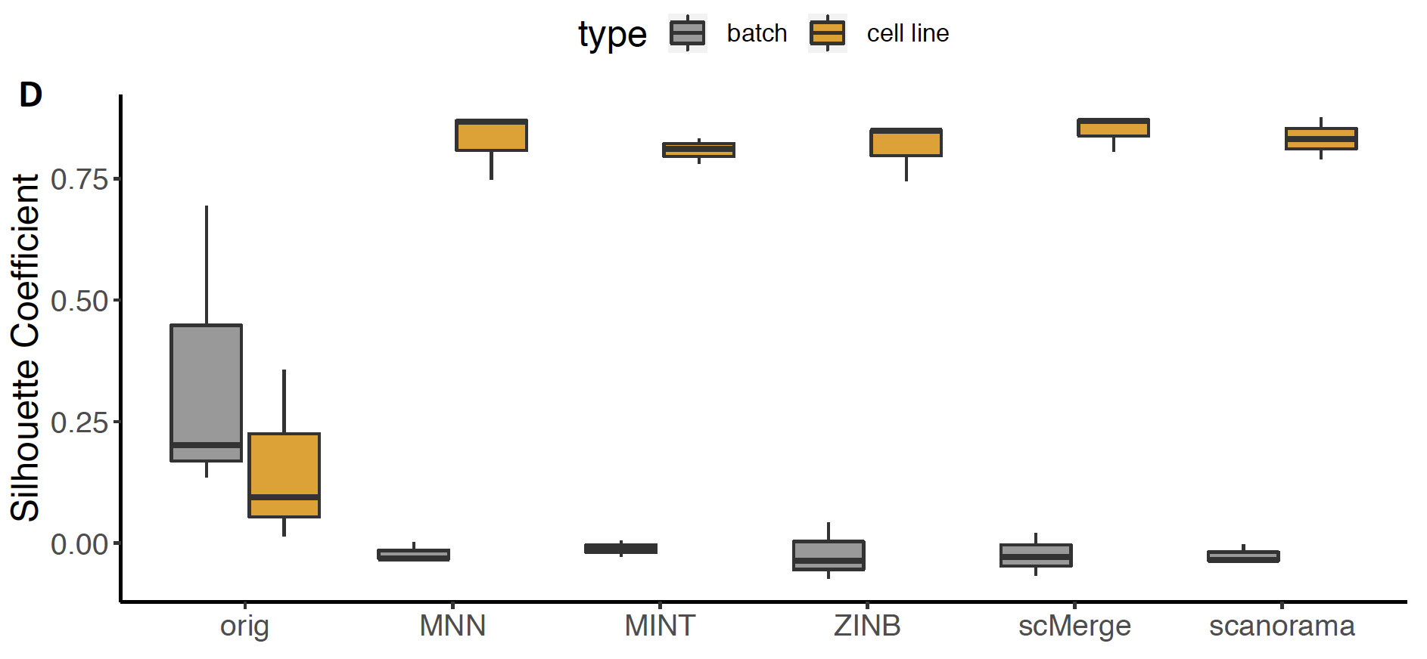
Silhouette width per method: single cell data

Slide 50
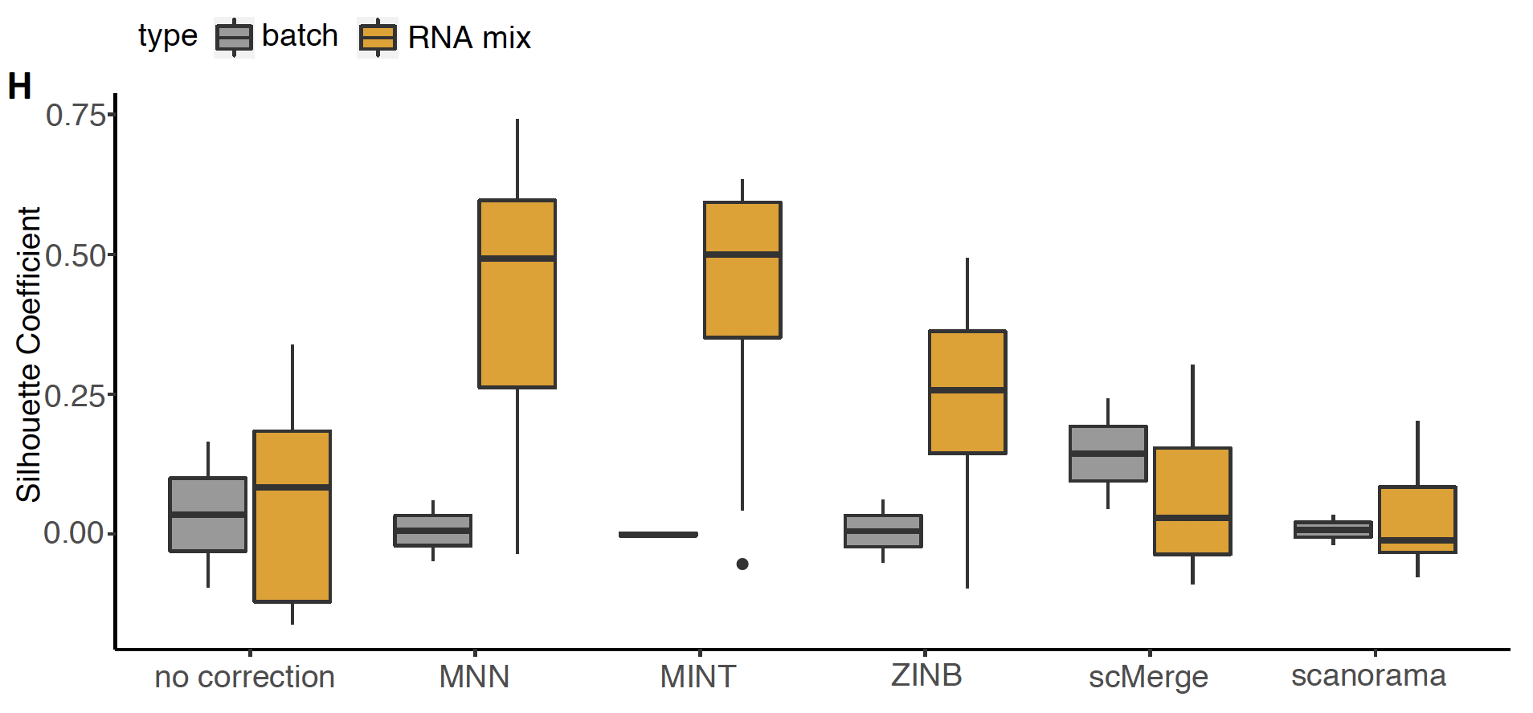
Silhouette width per method: RNA mixture

Slide 51

https://www.biorxiv.org/content/early/2018/10/08/433102
https://github.com/LuyiTian/CellBench_data

Slide 52
Summary and challenges
We’ve created a unique data resource to help researchers evaluate different platforms and analysis methods in this fast moving field
  Developing a benchmarking software platform CellBench to make this easier
Analysis of these data sets across a range of tasks reveals no global optimum
Default settings used is all analyses. We haven’t assessed interactions between analysis steps i.e. the effect of different normalizations on clustering results
We are hopeful that more of these types of data sets and analyses will improve the quality and performance of scRNA-seq methods available to researchers
Easy to install software (i.e. Bioconductor) makes these efforts easier!

Slide 53
Current work and future plans
Develop a benchmarking software platform, CellBench (think affycomp / rnaseqcomp but for scRNA-seq) that makes it easy to generate performance metrics so that new methods can be added to the comparison as they become available.
Extend scPipe to handle preprocessing of other single cell data types (long-read scRNA-seq)

Slide 54
Pilot long-read scRNA-seq data
t-SNE
MinION
PacBio

Slide 55
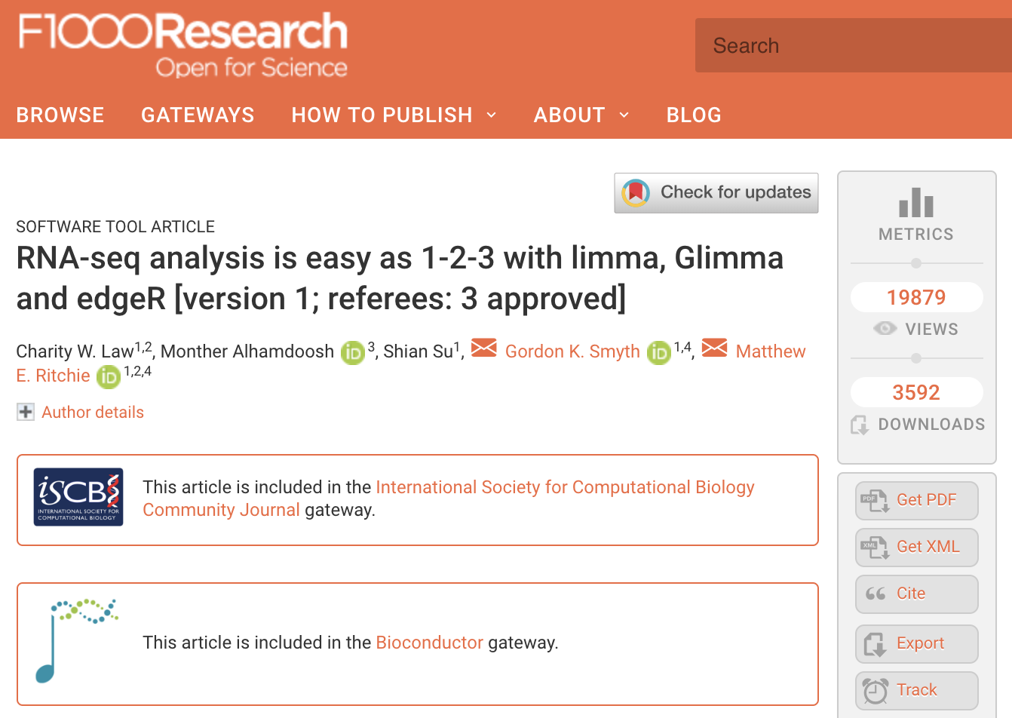
https://f1000research.com/articles/5-1408/v2

Slide 56


Acknowledgements
Luyi Tian
Xueyi Dong
Shian Su
Shalin Naik
Daniela Zalcenstein
Jaring Schreuder
Dawn Lin
Tom Weber
Kim-Anh Lê Cao
Christine Biben
Doug Hilton
Saskia Freytag
Terry Speed
Funding:

Slide 57



Notes:
First one was held in Canberra in 2003

Slide 58
https://agtaconference.org/

Slide 59


