Slide 1



Genomic profiling of normal and heterogeneous tissues in cancer patients
Paul Scheet, Ph.D.
Professor & Chair, Dept. of Epidemiology
Joint: Translational Molecular Pathology, Genomic Medicine
Program Lead, Risk, Detection & Outcomes | CCSG
University of Texas MD Anderson Cancer Center, Houston
BIRS
Statistical and Computational Challenges in High Throughput Genomics with Application to Precision Medicine
6 November, 2018

Slide 2
Personalized Cancer Prevention
Advantages of thinking of prevention
  Risk stratification
  Screening
  Early detection
Transition to malignant phenotypes
  Tissue sampling
    Premalignant lesions
    Field cancerization
  Low mutant cell fraction settings
Translation
  Risk-stratified screening
  Interception
  Molecular targets for personalized prevention

Slide 3
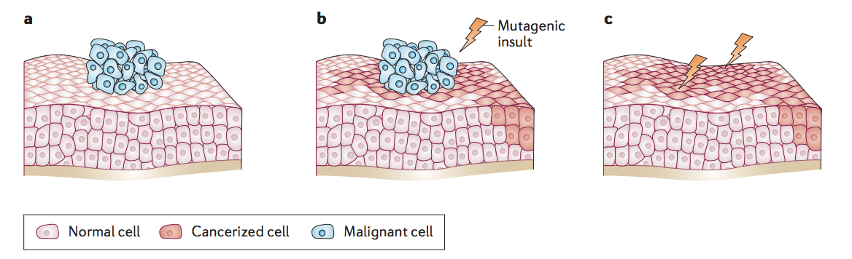
Field cancerization
Curtius K, Wright NA, Graham TA. An evolutionary perspective on field cancerization. Nat Rev Cancer. 2018;18: 19–32

Slide 4
Experimental set-up
498 multi-region samples from 48 early-stage NSCLC patients
  42 smokers / 6 non-smokers
  37 LUAD / 11 LUSC
  Stage IA-IIIA (I : 22 / II : 19 / III : 7)
Tumor: Tumor sections, core-needle biopsy
Field: Adjacent small airways, large airway, nasal epithelium, uninvolved normal lung tissue
Germline control: Blood / normal lung
Deep targeted DNA sequencing of a panel of 409 cancer associated genes to identify somatic mutations in the airway field.
Courtesy : Sasha Jakubek
Joint work with H. Kadara, Am. Univ. of Beirut

Slide 5
NGS of normal airway epithelia
Life Tech Ion Torrent NGS @ 500-1000x
409 genes, 5-15 samples per patient
No standard variant detector for these settings
Apply a suite of callers using the sample of interest and the paired normal:
  VarScan,
  MuTect,
  Ion Reporter,
  “Poor man’s” subtraction method using TVC
Ensemble of results, e.g.
  Require a variant to be identified by ≥ 2 strategies in ≥ 1 sample
  If a variant is obs. in ≥ 1 sample from pt, require only 1 caller in new sample
Deshpande et al (2018; BMC Bioinformatics)

Slide 6
Lower mutation burden in airway field
Tumor
Small
Airway
Large
Airway
Nasal
Epithelium
Normal

Slide 7
Lower variant allele frequency in airway field

Slide 8
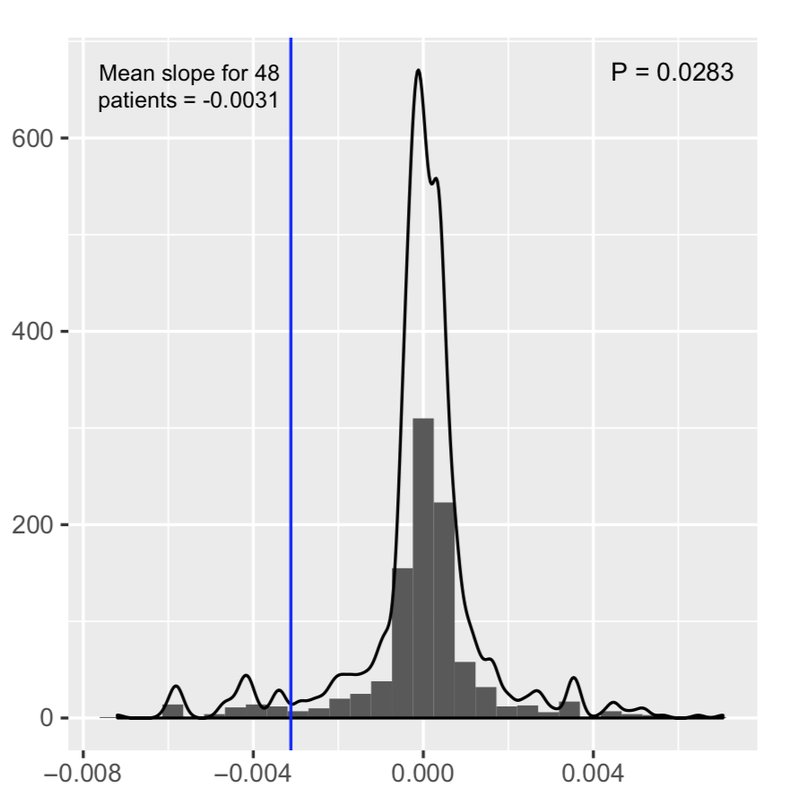
Lower variant allele frequency in airway field
Is there a net negative slope across all patients?
Is it significant?

Slide 9
Somatic mutation landscape in airway field

Slide 10
Somatic mutation landscape in airway field
Tissue | Cancer Genes*⁺
Small Airway | AMER1, ARID2, ATM, ATRX, CDC73, CDKN2A, CTNNB1, CYLD, DNMT3A, HRAS, IDH1, JAK1, JAK2, JAK3, KEAP1, KIT, KMT2C, KMT2D, KRAS, NOTCH1, STK11, TP53
Large Airway | CDKN2A, PIK3CA, SETD2, TP53, TSHR
Normal Lung | RB1, RET, TSHR
Nasal Epithelium | AKT1
*TCGA LUAD, LUSC, putative cancer drivers ⁺Shared mutations with corresponding tumor

Slide 11
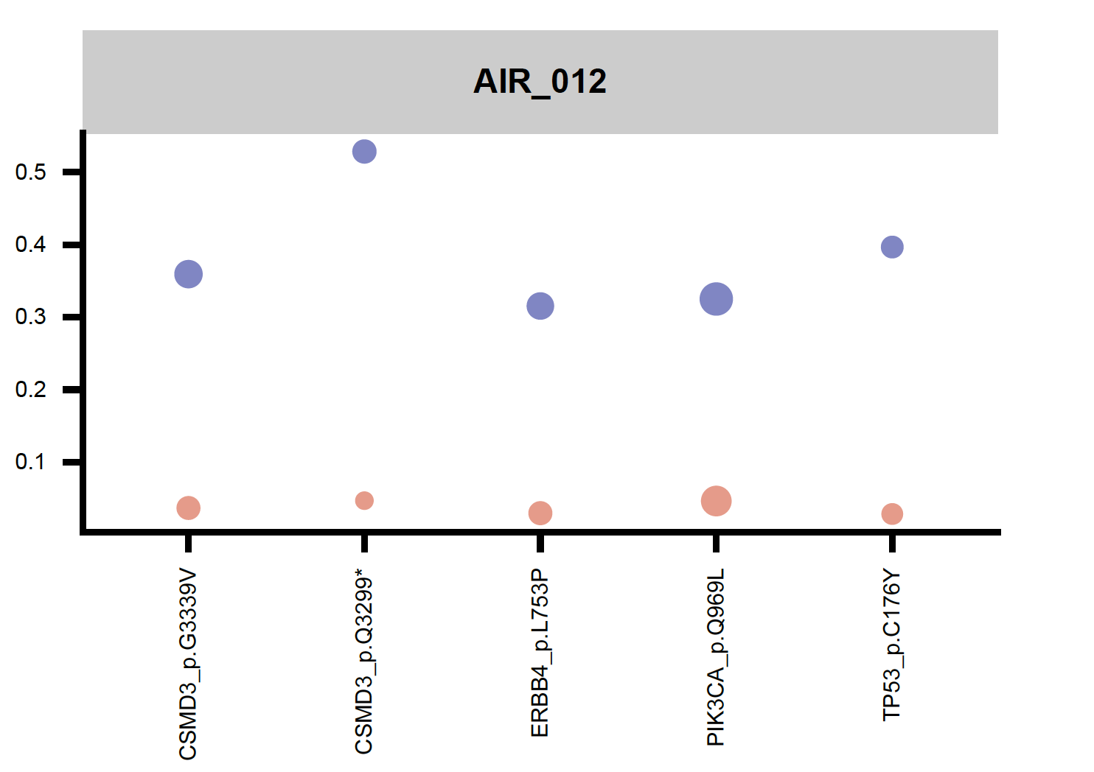
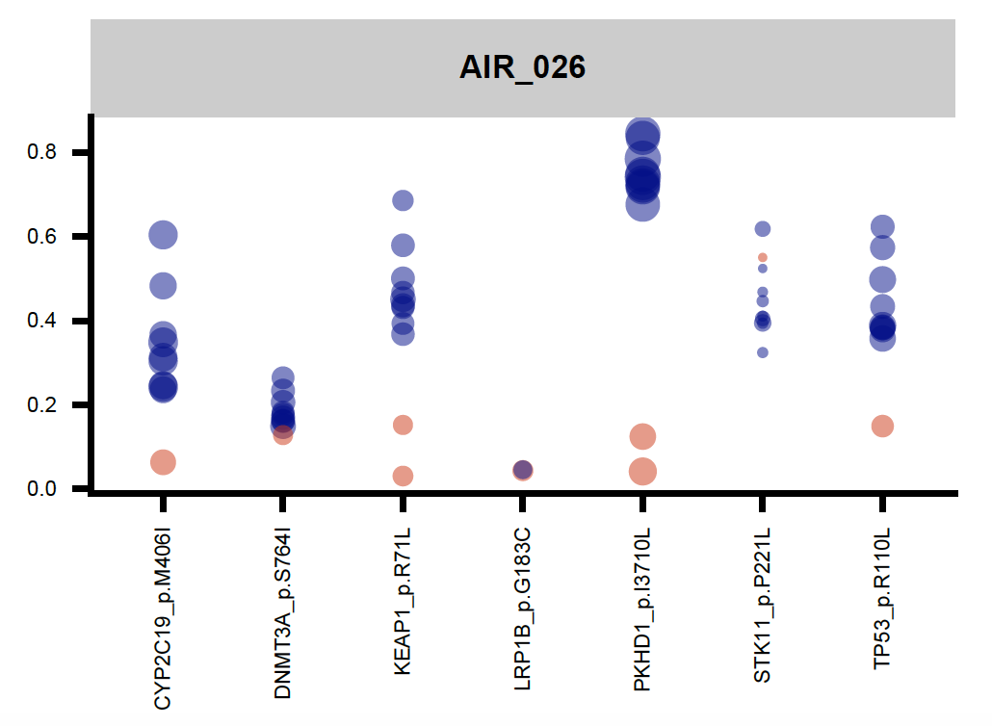
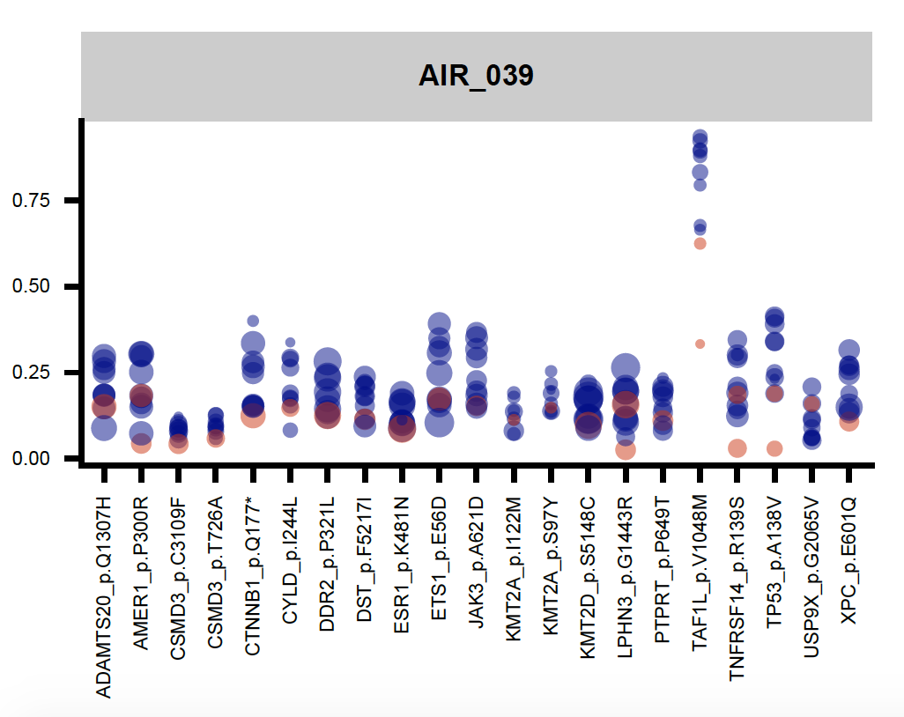
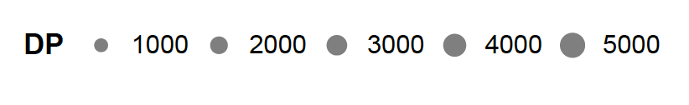

Shared mutations in airway field and NSCLC
VAF
VAF
VAF

Slide 12
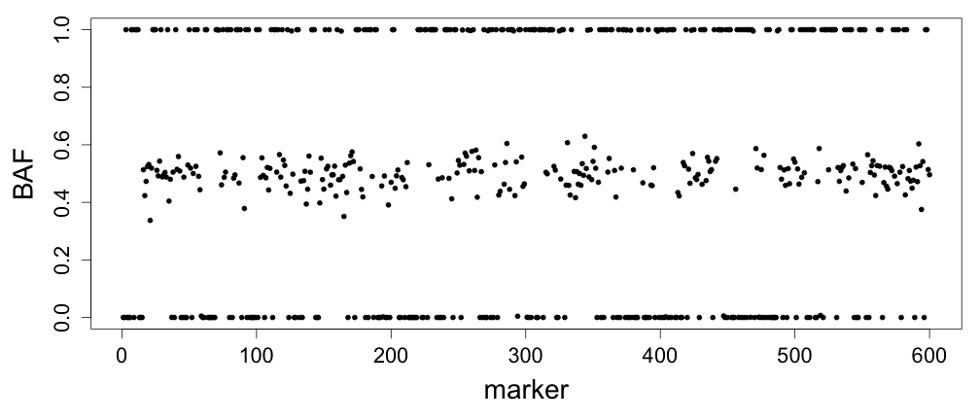
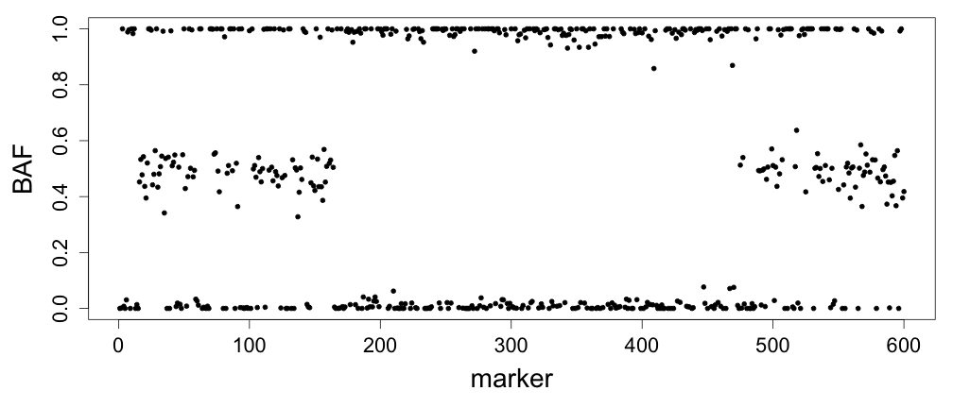
B allele frequencies (BAFs) inform allelic imbalance
Corresponds to proportion of chromosomes with allele ‘B’
Stochastic deviation (noise) from canonical values
B
A
A
B
B
B
A
B
A
B
A
B
B
A
BB
AB/BA
normal
AA
BB
B
A
B
A
B
B
A
B
A
B
A
B
B
A
100%
tumor
AA
S. Vattathil

Slide 13
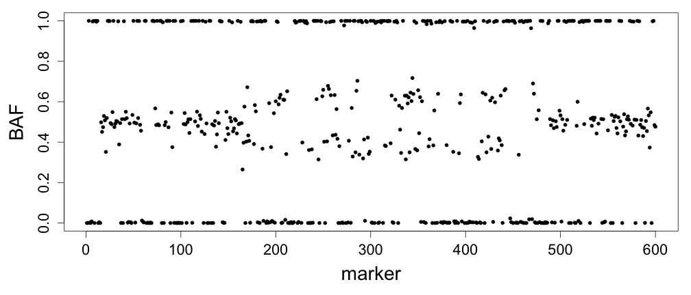
B allele frequencies (BAFs) inform allelic imbalance
Corresponds to proportion of chromosomes with allele ‘B’
Stochastic deviation (noise) from canonical values
B
A
A
B
B
B
A
B
A
B
A
B
B
A
BB
AB/BA
normal
AA
BB
B
A
A
B
B
B
A
B
A
B
A
B
B
A
B
A
B
A
B
B
A
B
A
B
A
B
B
A
B
A
A
B
B
B
A
B
A
B
A
B
B
A
100%
tumor
25%
tumor
AA
B
A
A
B
B
B
A
B
A
B
A
B
B
A
S. Vattathil

Slide 14
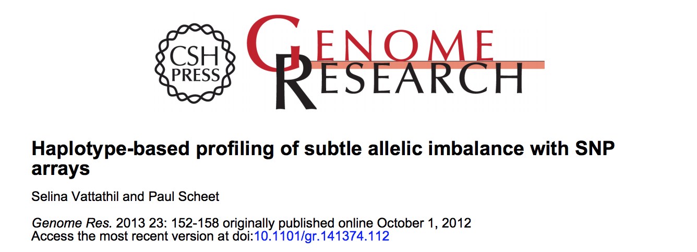
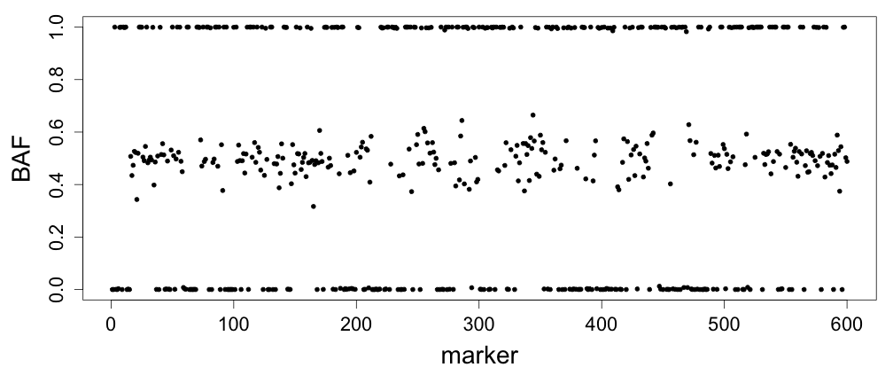
Strategies for detecting subtle imbalance
Allelic imbalance increases dispersion
Standard Approach – look for two distributions
  e.g. high and low bands, or flip about horizontal axis
Difficulty -- magnitude of shifts is small at low proportions
AB+BB
25%
tumor
?
10%
tumor
AB+AA

Slide 15
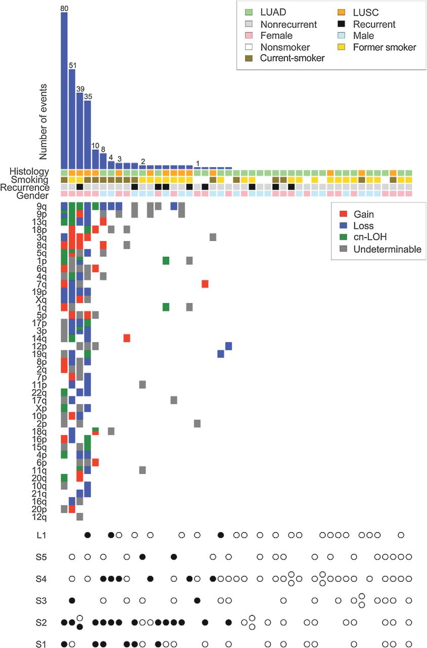
Integrative genomic analysis
+
Jakubek Y, Lang W, Vattathil S, Garcia M, Xu L, Huang L, et al. Genomic Landscape Established by Allelic Imbalance in the Cancerization Field of a Normal Appearing Airway. Cancer Res. 2016;76: 3676–3683.
Jakubek et al (2016, Ca Res)

Slide 16
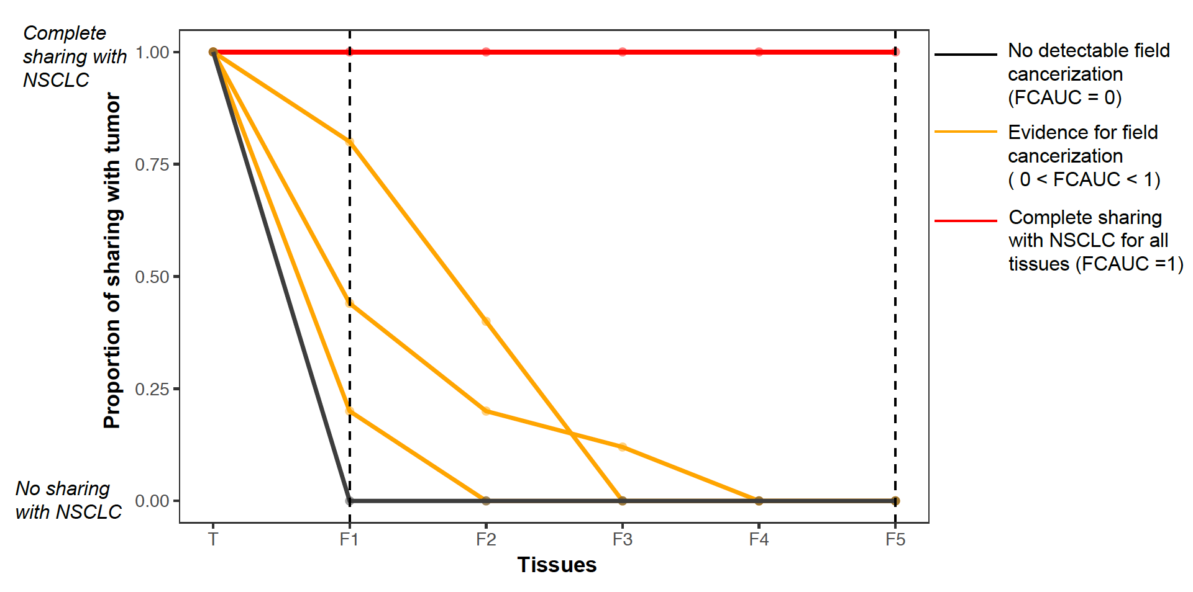
Field cancerization quantification

Slide 17
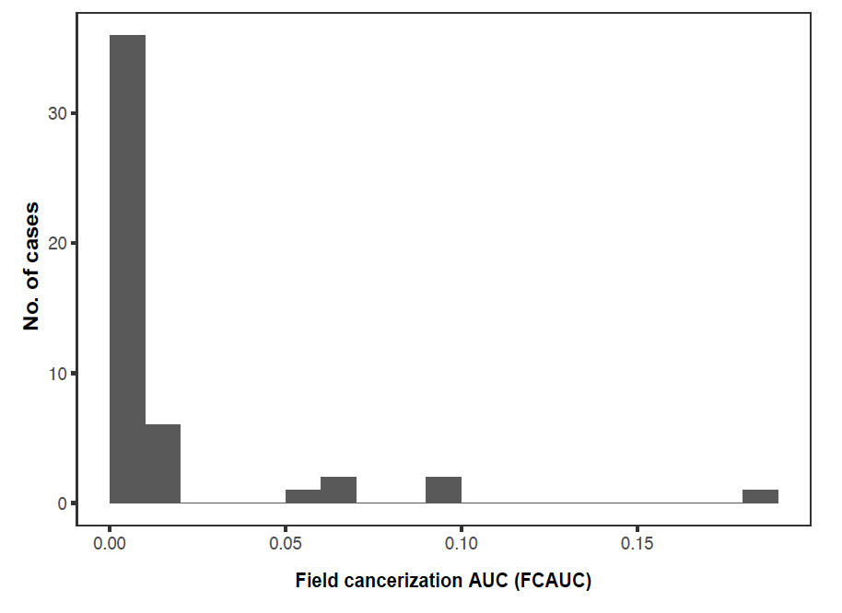
Field cancerization quantification
25 cases exhibited non-zero FCAUC, indicating shared events (AI or mutations) with matched NSCLC
Cases with highest FCAUC

Slide 18
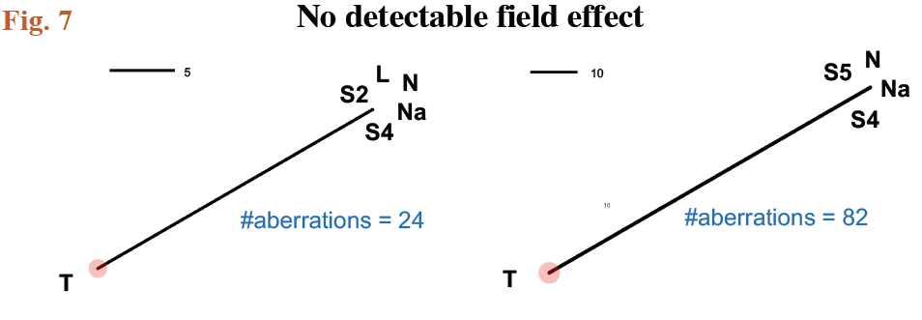
Phylogenetic analysis reveals field cancerization

Slide 19
Phylogenetic analysis reveals field cancerization

Slide 20
Somatic multi-hit progression

Slide 21
Somatic multi-hit progression
Tissue | Two-hit cancer associated genes*⁺ in the airway field
Small Airway | KEAP1, KRAS, STK11, TP53
Large Airway | CDKN2A, SETD2, TSHR
*TCGA LUAD, LUSC
⁺Genes overlapping with corresponding tumor

Slide 22
Somatic multi-hit progression
Tissue | Shared first hit | NSCLC-specific second hit
Small Airway | 9q cnLOH | NOTCH1
 | 2p gain | MSH2
 | 9q cnLOH | ABL1
 | 9q cnLOH | PTCH1
 | 16q loss | CDH1
 | IDH1 | 2q gain
 | KRAS | 12p gain (focal)
 | CDKN2A | 9p cnLOH
Large Airway | PIK3CA | 3q gain
 | TP53 | 17p cnLOH

Slide 23
Detection chromosomal alterations in blood & NAT in TCGA
hapLOH for allelic imbalance (AI) detection SNP arrays
Excluded samples
  missing rate > 0.05
  noted as contaminated in Broad CGA Firehose
Removed putative germline gains
  Size < 5 Mb
  50% reciprocal overlap with DGV gold standard gains
Excluded TCGA cohorts
  Hematological malignancies
  Prostate cancer due to tumor contamination in NAT
gain
loss
cn-LOH
Vattathil S, Scheet P. Haplotype-based profiling of subtle allelic imbalance with SNP arrays. Genome Research. 2013;23(1):152-158.
Notes:
Somatic mutations can be difficult to detect as many are expected to be at low frequencies in normal tissues.
Our approach was to focus on the detection of mega-base scale events. To do this we used the hapLOH algorithm to detect allelic imbalance events; represented in this figure as a deviation from a 1 to 1 ratio of pink to teal haplotypes
Such deviations indicate the presence of chromosomal alterations and allow us to detect copy neutral loss of heterozygosity events.
In our approach we use phased haplotype information, which allows us to detect events at low cellular fractions.

Slide 24
Detection chromosomal alterations in blood & NAT in TCGA
hapLOH for allelic imbalance (AI) detection SNP arrays
  phase genotypes improve detection subtle events
Excluded samples
  missing rate > 0.05
  noted as contaminated in Broad CGA Firehose
Removed putative germline gains
  Size < 5 Mb
  50% reciprocal overlap with DGV gold standard gains
Excluded TCGA cohorts
  Hematological malignancies
  Prostate cancer due to tumor contamination in NAT
gain
loss
cn-LOH
Vattathil S, Scheet P. Haplotype-based profiling of subtle allelic imbalance with SNP arrays. Genome Research. 2013;23(1):152-158.
Notes:
We removed samples with potential contamination
As well as putative germline gains
In addition, we excluded TCGA cohorts of hematological malignancies, because the tumor could be detected in the blood

Slide 25
Detection chromosomal alterations in blood & NAT in TCGA
Blood
samples | 7149
somatic events | 178
samples w/somatic event | 130 (1.8%)
NAT
samples | 1708
events | 338
samples w/somatic event | 78 (4.6%)
No significant difference in size between NAT and blood events (median 32 Mb)
Notes:
Approximately 7000 blood samples and 1700 NAT samples passed QC
We detected 178 somatic chromosomal alterations in 130 of the blood samples
And 338 somatic chromosomal alterations in 78 of the NAT samples
We did not see a difference in the distribution of the size of events between mosaic NAT and blood

Slide 26
Somatic alterations and clinical features
Blood
NAT
Association with age (p = 3e-15) in blood
No association with age in NAT
No association with stage, sex
not mosaic
mosaic
not mosaic
mosaic
Notes:
As previously reported we did observe a strong association with mosaicism in the blood and age
However, we did not see an association of mosaicism and age in the NAT
Stage and sex were not associated with mosaicism in neither blood nor NAT

Slide 27
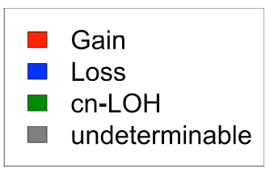
Distribution of somatic alterations
Chr
Notes:
We then looked at the distribution of events across the genome.
Here is a histogram showing 1 Mb windows across the genome and the number of events observed at each window, with NAT shown in the top and Blood in the bottom

Slide 28
Distribution of somatic alterations
8q
Chr
Notes:
The blood and NAT distributions have some similarities. One being 8q gains, a common copy number found across many different cancers

Slide 29
Distribution of somatic alterations
9q
Chr
Notes:
We do se a few striking differences between the blood and the normal tissues adjacent to the tumor
Specifically 9q appear to be enriched in the NAT

Slide 30
Distribution of somatic alterations
13
Chr
Notes:
We see previously reported small focal deletions of chromosome 13q in the blood
Which we do not observe in NAT; instead in NAT we see gains, which were not detected in the blood

Slide 31
Distribution of somatic alterations
20
Chr
Notes:
Both blood and NAT have several events targeting chromosome 20; however, these are predominantly losses in the blood and gains in the NAT

Slide 32
Normal tissues adjacent to tumor (NAT)
come from 27 different cancer sites with different anatomical locations.
Notes:
So far I have been lumping NAT samples in one group. However, the NAT samples come from 27 different cancer sites with different anatomical locations and they represent many different tissues

Slide 33
Fraction samples mosaic NAT samples across TCGA sites
25% head & neck
(no association w/smoking)
Fraction mosaic samples
18% bladder
~10% breast, sarcoma, stomach, ovarian
Notes:
When we group the data by TCGA site, we see significantly different rates of mosaicism
Notably head and neck had the highest rate with 25% mosaic NAT samples
The second highest was bladder with 18% mosaic samples
Followed by approximately 10% in breast, sarcoma, stomach and ovarian

Slide 34
Burden of somatic alterations in mosaic samples
TCGA site* | Avg. # events in samples with > 1 somatic alteration
ovarian | 9.9
bladder | 4.0
breast | 3.8
stomach | 3.0
head & neck | 2.5
lung (adeno) | 2.25
liver | 2.0
lung (squamous) | 1.25
blood | 1.4
kidney (KIRC) | 1.0
Higher burden in NAT vs blood (4.3 vs 1.4 average # events) p = 2e-5
Notes:
Next we looked at the average number of somatic events in mosaic samples
1 is the lower limit as we only include samples with at least one event
The burden of events had a wide range in different tissues; with the highest detected in ovarian
Overall it appears that NAT mosaic samples have a higher burden of chromosomal alterations relative to blood, potentially explained by a field cancerization effect in a subset of tissues

Slide 35
Somatic alterations NAT
stomach
head & neck
breast
ovarian
bladder
Chromosome arm
Notes:
This figure shows a summary of the events by chromosome arm for each patient
With one patient per column

Slide 36
Somatic alterations NAT
stomach
9q head & neck**
1q breast**
20 stomach*
9p bladder*
head & neck
breast
ovarian
bladder
Chromosome arm
*p < 0.01
** p < 1e-5
Notes:
We used an omnibus test to determine if these events were distributed randomly across TCGA sites
We observe an enrichment for 9q events in head and neck ; 1q in breast and 9p in bladder
As well as enrichment of Chromosome 20 gains in stomach, a common somatic mutation in stomach cancers

Slide 37
Pan-cancer patterns reflected in NAT
Cluster of epithelial tumors with 1q gain
(breast, lung adenocarcinoma, liver hepatocellular carcinoma)
breast
lung adeno
liver h.c.
esophageal
Co-occurring gains of 8q, 13q, chr 20 in gastrointestinal tumors
(esophageal, stomach, rectum adenocarcinoma)
rectum
stomach
Notes:
We observed similarities between our data and 2 patterns reported in this pan cancer survey
The first pattern is that of 1q gains in epithelial tumors shown on the top
The second one are co-ocurring gains of 8q, 13q and 20 in gastrointestinal tumors; where several NAT samples from those organs show 1, 2, or sometimes all three gains

Slide 38
Comparing normal – tumor
no overlap
Normal
(blood, NAT)
overlap but different event type
tumor
Notes:
Using this data set we can compare the profile of chromosomal alterations between the normal and the matched tumor samples from the same patient in an attempt to infer the clonal origin of events.
The middle figure shows the set of events in the normal sample on the top and the events from the tumor on the bottom, both ordered by genomic location
We can compare events by looking at the boundaries, as well as comparing the event types for overlapping events as shown on the right

Slide 39
Comparing normal – tumor
no overlap
Normal
(blood, NAT)
overlap but different event type
tumor
same origin?
Notes:
When events overlap and the are both of the same type or one of the events is subtle we tried to distinguish between the two, as they may or may not have originated from the same clonal lineage
To do so we looked at the allelic imbalance shifts

Slide 40
Comparing normal – tumor
Normal
(blood, NAT)
same origin?
gain
tumor
Jakubek YA, San Lucas FA, Scheet P. Directional allelic imbalance profiling and visualization from multi­sample data with RECUR . Bioinformatics (in press)
Available at: scheet.org
Notes:
Here you see two gains of the same genomic region present in both the tumor and adjacent normal sample
We developed a tool called RECUR, that compares the direction of the allelic shift between overlapping events in two or more samples from the same individual
In this example we identified gains in the NAT and the matched tumors that were molecularly independent from each other. In other words the NAT had an extra copy of the opposite paternal haplotype.

Slide 41
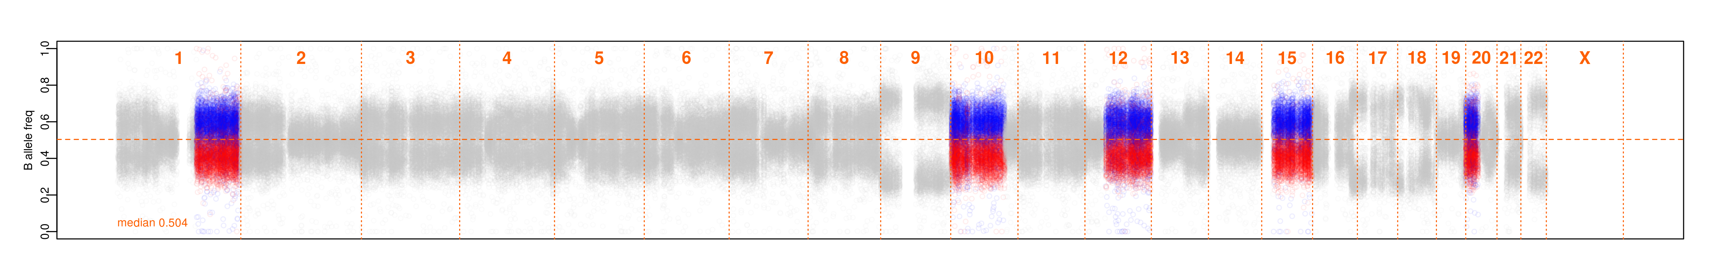
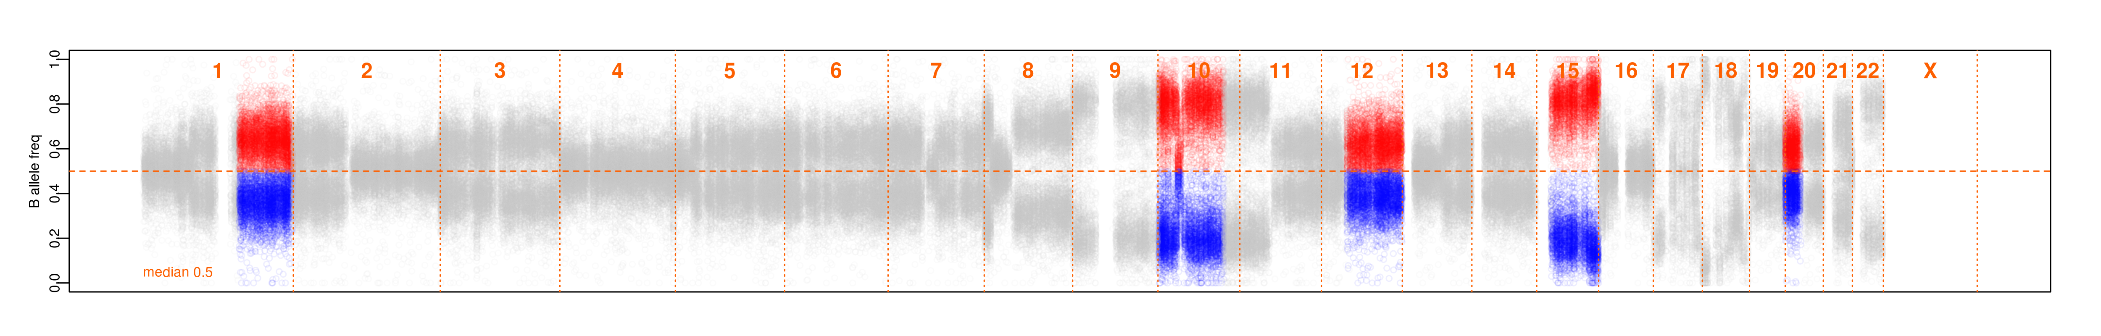
Repeat Chromosomal changes Uncovered by Reflection (RECUR)
15 of 78 NAT with “mirrored” events
NAT
Tumor
NAT
Tumor
“mirrored”
RECUR Available at: scheet.org
Notes:
When we perform this analyses we observe these “mirrored” shifts in 15 of 78 mosaic NAT samples.
The two images on the bottom of the slide show the B-allele frequencies of het markers for the tumor and the nat.
The RECUR algorithm processes B-allele frequency values and produces images depicting these opposite shifts where you see the blue BAF values shift upwards in the Nat and the opposite pattern in the tumor below.
Recur detected 5 such mirrored events in this esophageal tumor-NAT pair

Slide 42
Comparison of normal – tumor mosaic events
 |  | Blood | NAT
overlap (>= 50%) |  | 39% | 73%
reciprocal overlap |  | 24% | 50%
excluding mirrored and conflicting event types |  | 16% | 41%
“shared”
Notes:
Here I am trying to define the similarities between the somatic alterations in the normal tissues and those found in the matched tumor.
We define an event as shared if it there is 50% reciprocal overlap, no disagreement in event type and no mirroring
Using this definition, NAT have 41% “shared” events compared to 16% in the blood
These data suggest that NAT have more similar mutational profiles because they are of the same tissue type as the tumor and/or in some instances the events arose in the same clonal lineage

Slide 43
NAT – head & neck tumor
8/18 “mirrored” events
42% shared events
Notes:
This figure shows all mosaic events in head and neck with those in the matched tumor
We see 42% shared events, similar to NAT overall
However we detected “mirrored” events in 8 of the 18 mosaic NAT samples
This was unexpected and our estimate of these “mirrored” molecularly independent events is most likely a lower estimate, as we would expect to pick these up approximately 50% of the time

Slide 44
NAT – stomach tumor
21% shared events
Notes:
When we looked at stomach we see less similarities between the tumor and adjacent tissues with only 21% shared events

Slide 45
NAT – stomach tumor: chr 20 gains
Whereas in Breast and Ovarian
large proportion of shared events between normal and tumor
but no mirrored events (no obvious recurrent alterations)
Notes:
We see examples of chromosome 20 gains that are present in the adjacent tissues but not the tumor,
This was unexpected to me given that gain of chromosome 20 is considered a putative driver event in stomach cancer

Slide 46
Mirrored gains and losses target driver genes
Gene | Event | TCGA study
H3F3A | gain | LUAD
CARD11 | gain | HNSC
EGFR | gain | HNSC
JAK2 | gain | HNSC
FLT3 | gain | STAD
APC | loss | LUSC
&
&
Notes:
When we looked at “mirrored” (recurrent) gains and losses of established cancer genes we observed several independent oncogenic gains in paired tumor-adjacent normal samples
We also observed one mirrored loss of the APC gene in tissues from a lung cancer patient
These data support a model where there are strong selective pressures within a tissue that lead to recurrent chromosomal alterations that provide clones with a growth advantage

Slide 47
Subtle allelic imbalance, clonal mosaicism
Point and chromosomal mutations in normal lung epithelia
Acquired somatic chromosomal copy number alterations exist in normal tissue, blood - TCGA
Initiated by environmental insult
Serve as models for early disease pathology
These may reside at lower mutant cell fractions than previously evidenced
Able to attempt an assessment of instability
Seem to offer prognostic value, as a marker of risk (e.g. in blood, 11-fold risk of hem. cancers)
Risk of secondary cancers or recurrence
Molecular targets for personalized prevention

Slide 48
My Lab
Jerry Fowler
Smruthy Sivakumar
Sasha Jakubek
Christina McDowell
Kyle Chang
Zuhal Ozcan
Alumni
Selina Vattathil
Anthony San Lucas
Yue-Ming Chen
Aditya Deshpande
Yulun Liu
Xiangjun Xiao
Lili Huang
Rui Xia
Yihua Liu
MD Anderson
Chad Huff
Eduardo Vilar
Sonia Cunningham
Wenhua Lang
Li Xu
Ximing Tang
Wei Lu
George Eapen
Ignacio Wistuba
Andrew Futreal
Hector Alvarez
Anirban Maitra
Michael Overman
Carrie Daniel
Avera Inst. for Human Genetics
Erik Ehli
Gareth Davies
Zachary Weber
Moffitt Cancer Center
Ken Tsai
Jenny Permuth
Am. Univ. of Beirut
Humam Kadara
U Penn
Yong Chen
Jing Huang
TCH
Philip Lupo
Michael Scheurer
Vrijie Universiteit
Dorret Boomsma
Funding for work presented:
R01, NHGRI, Statistical Methods for Population Genomics and "Next-gen" Sequencing Data
IIRA, CPRIT, Elucidating the evolution of the premalignant airway genome in space and time
MIRA, CPRIT, Evolution of primary lung tumors to lymph node metastasis
Seed grant, DFI, Using UV-induced epidermal mosaicism to predict skin cancer risk

Slide 49
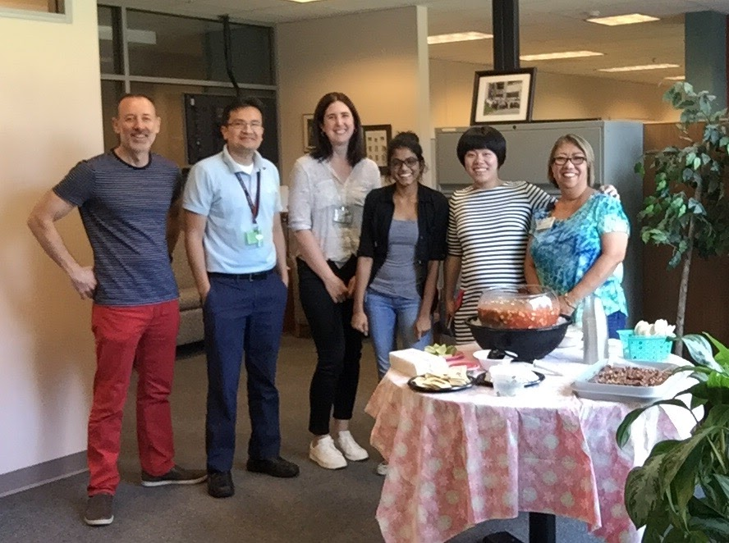
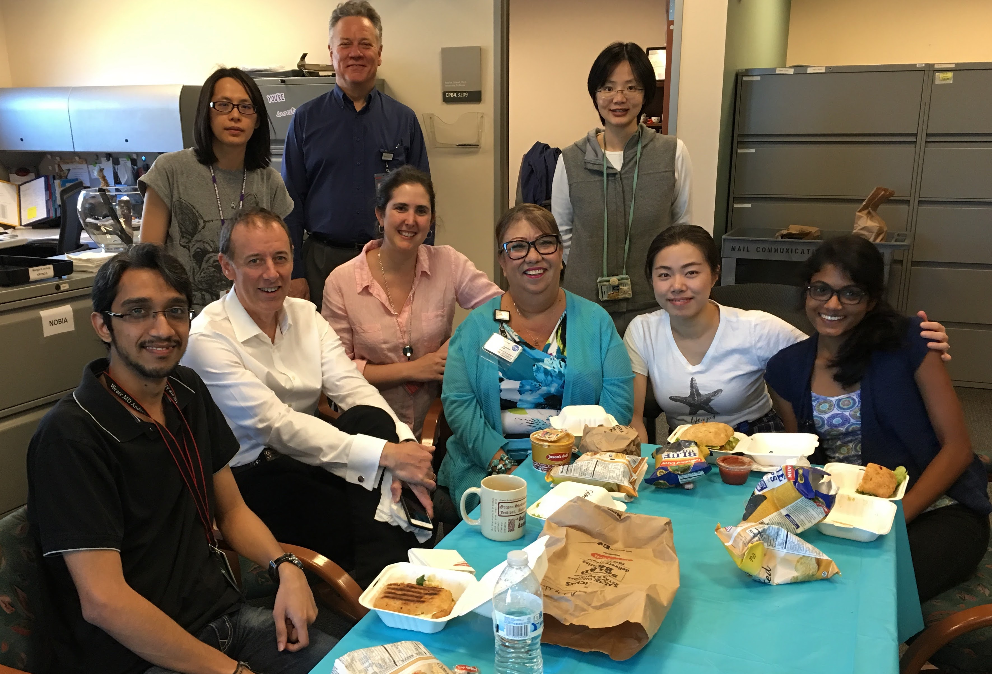
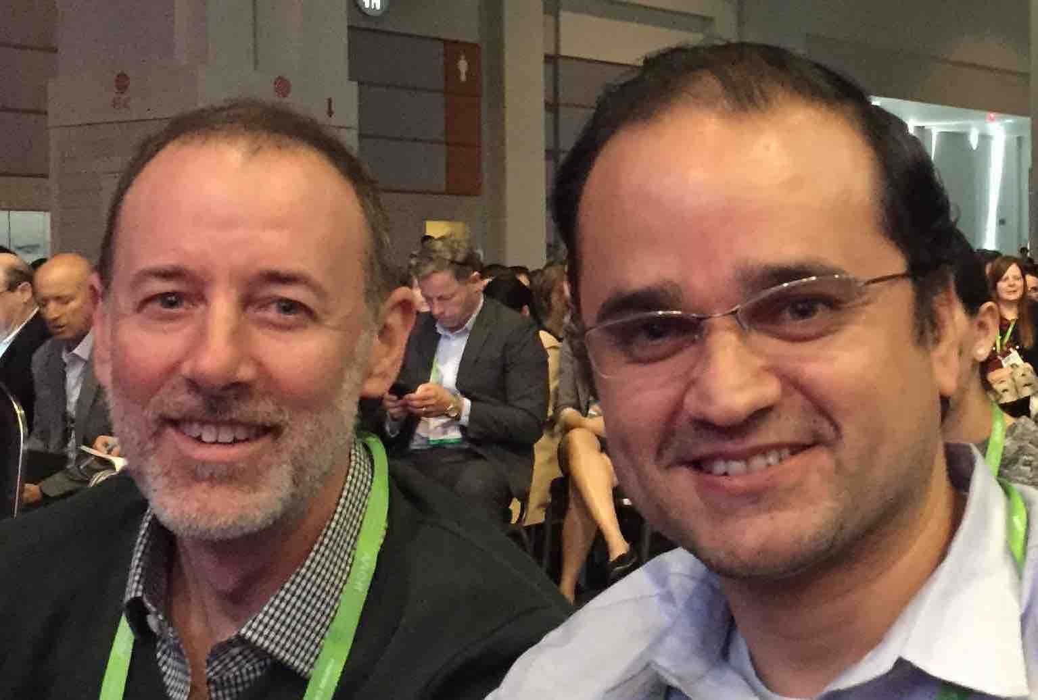
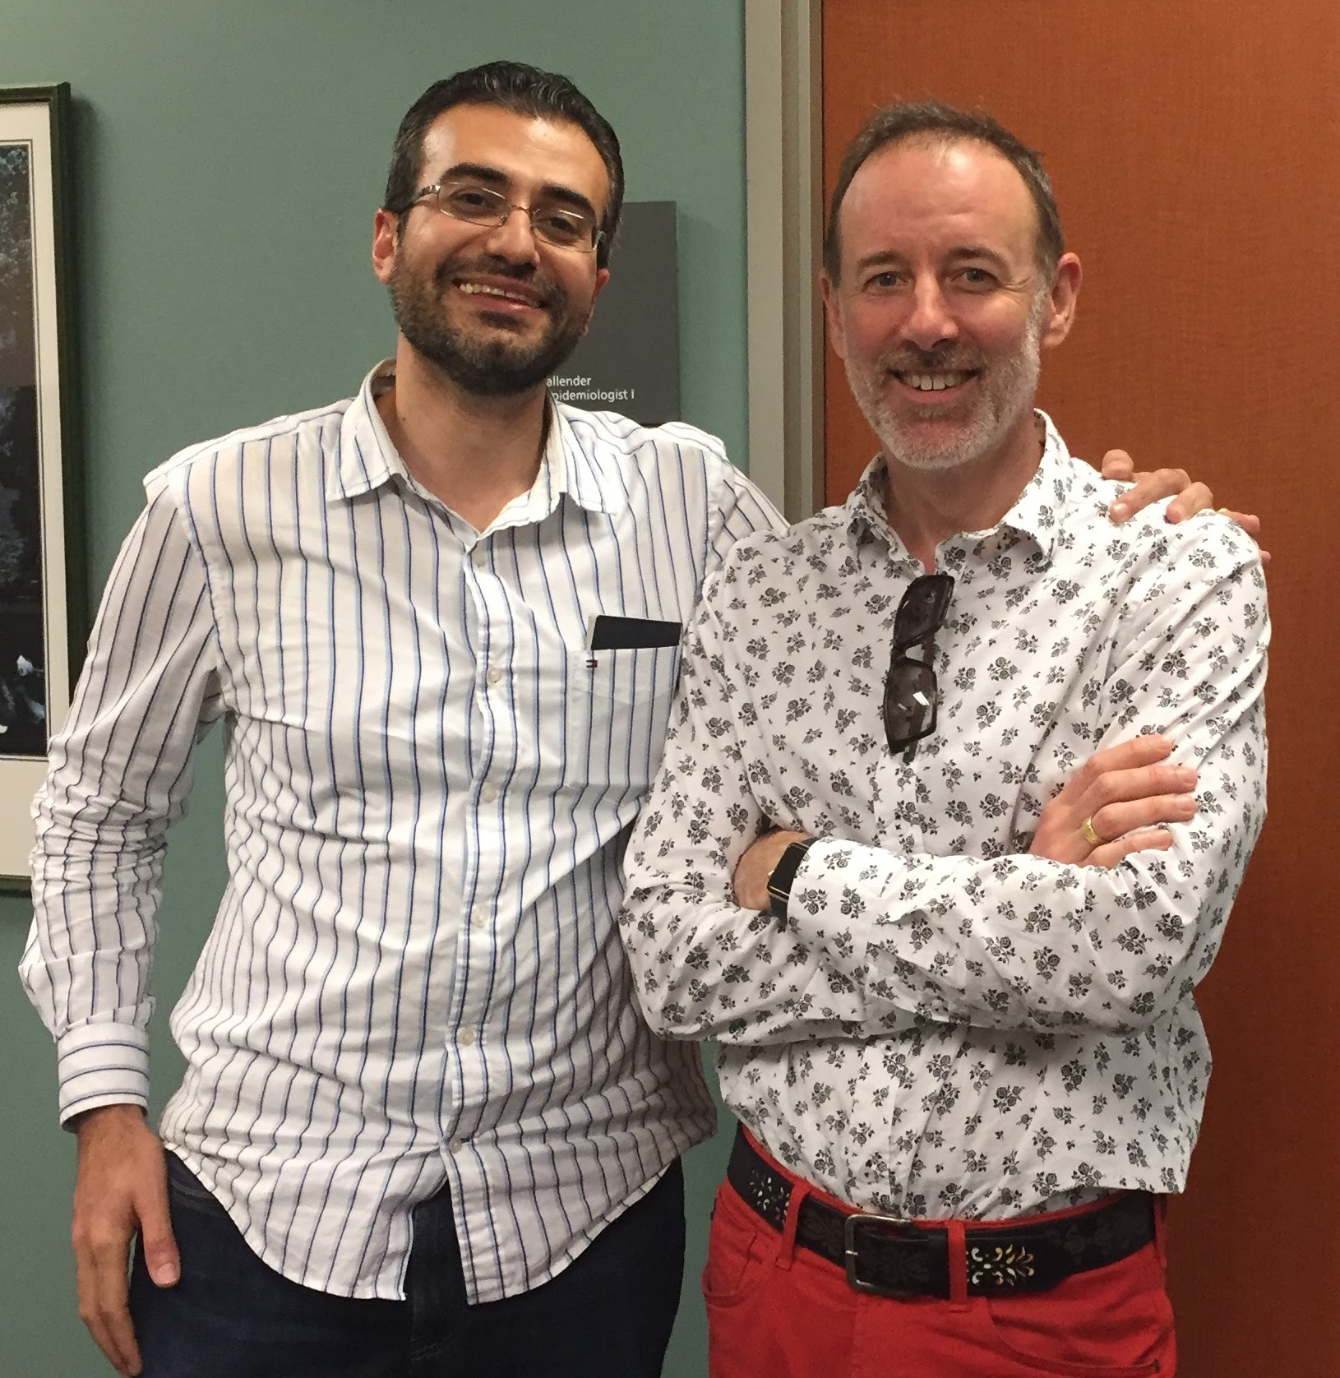
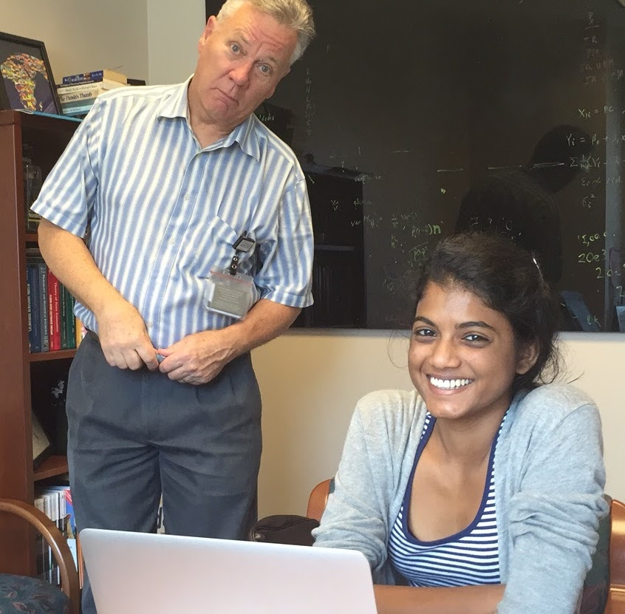
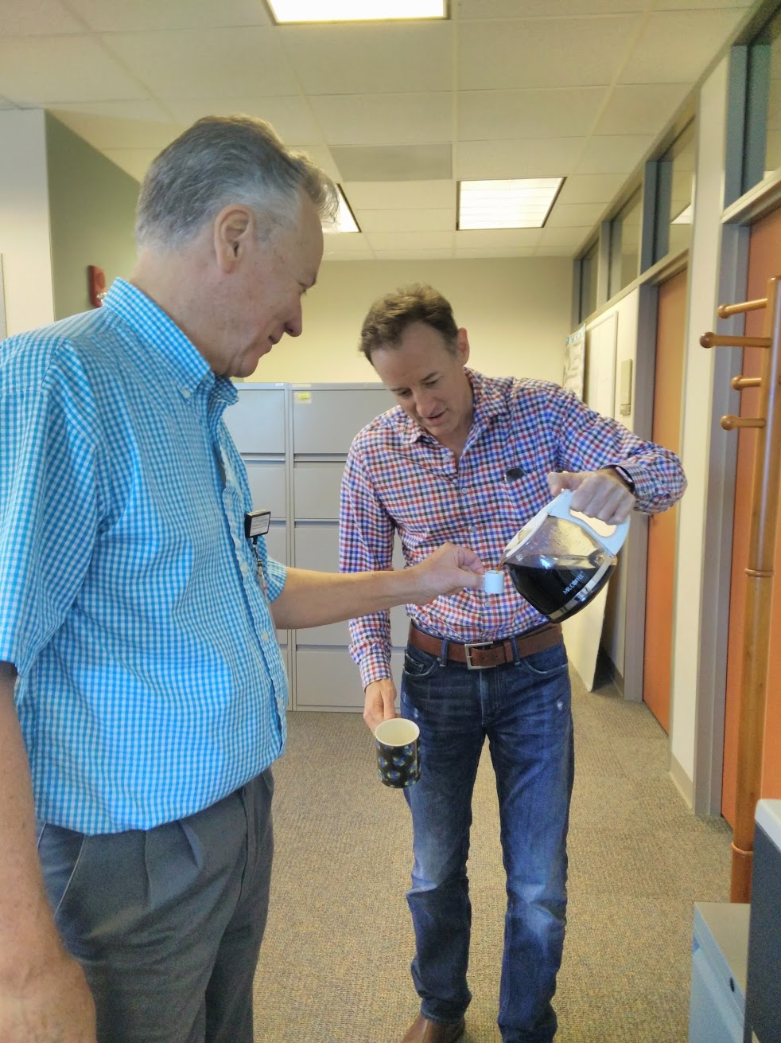
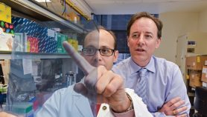

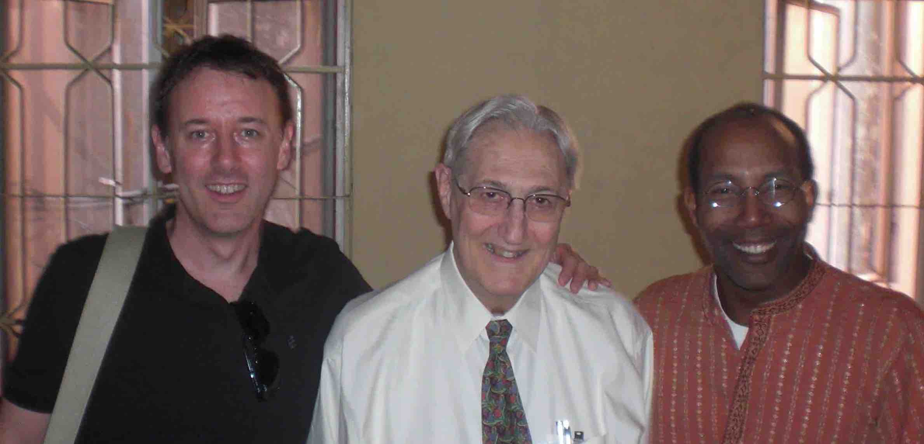
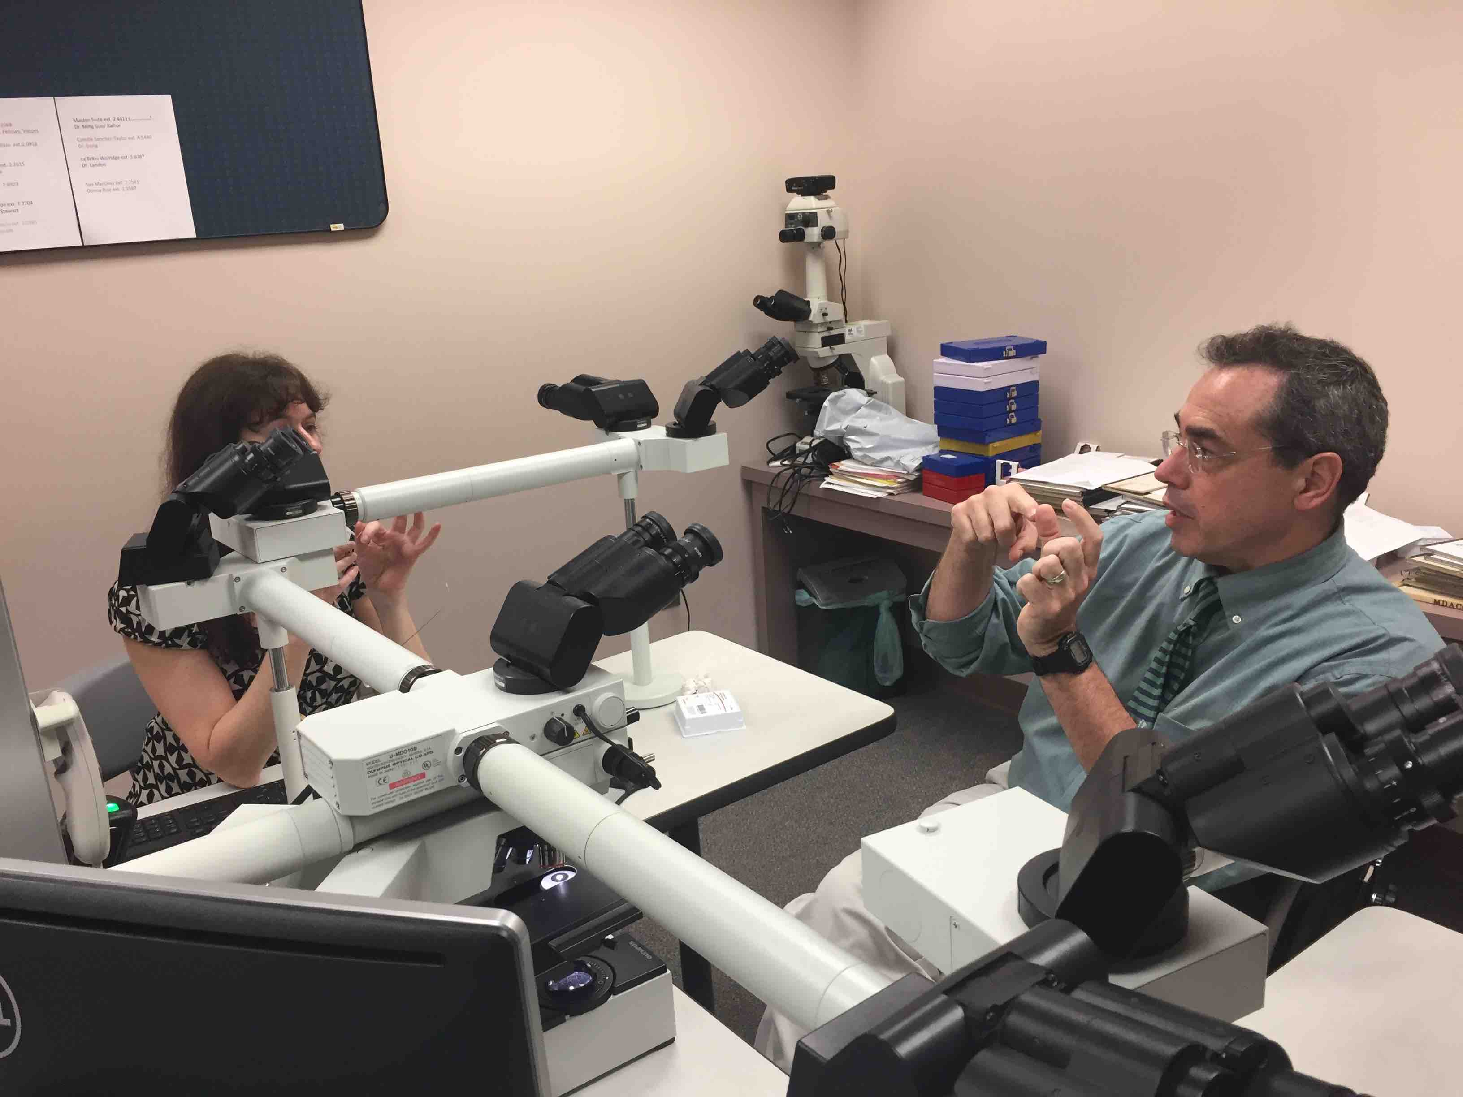
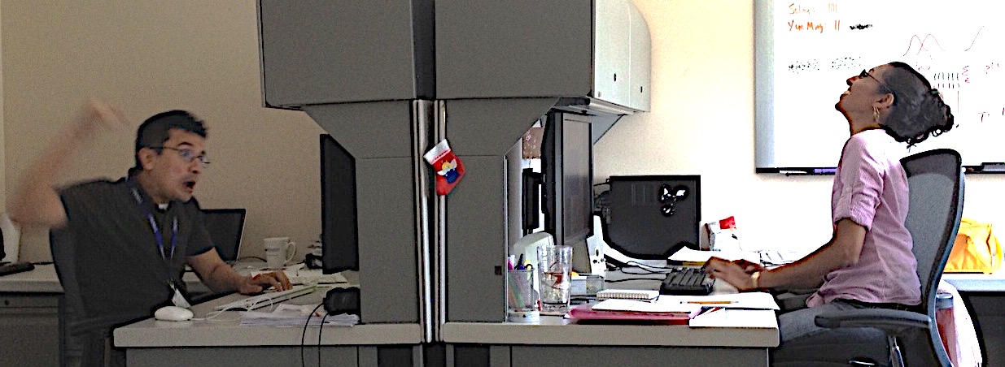
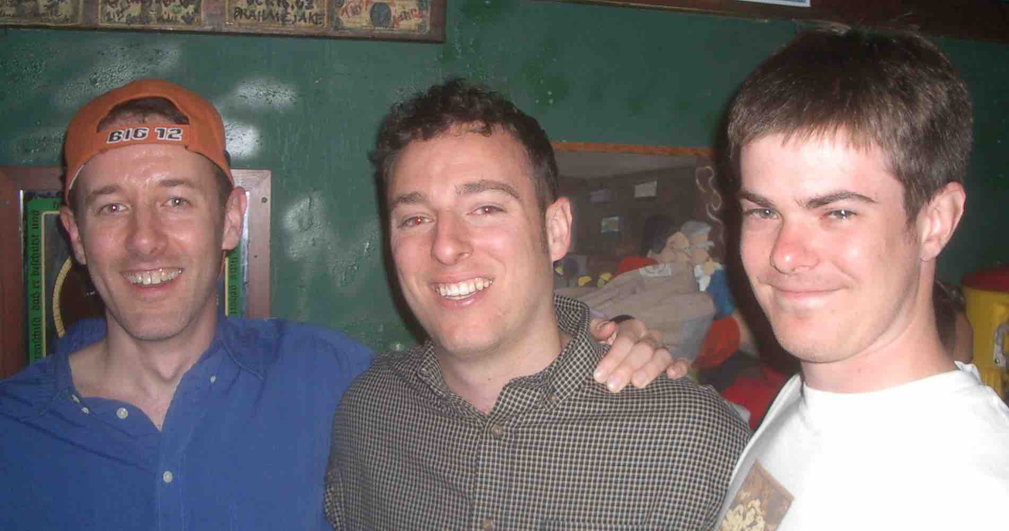
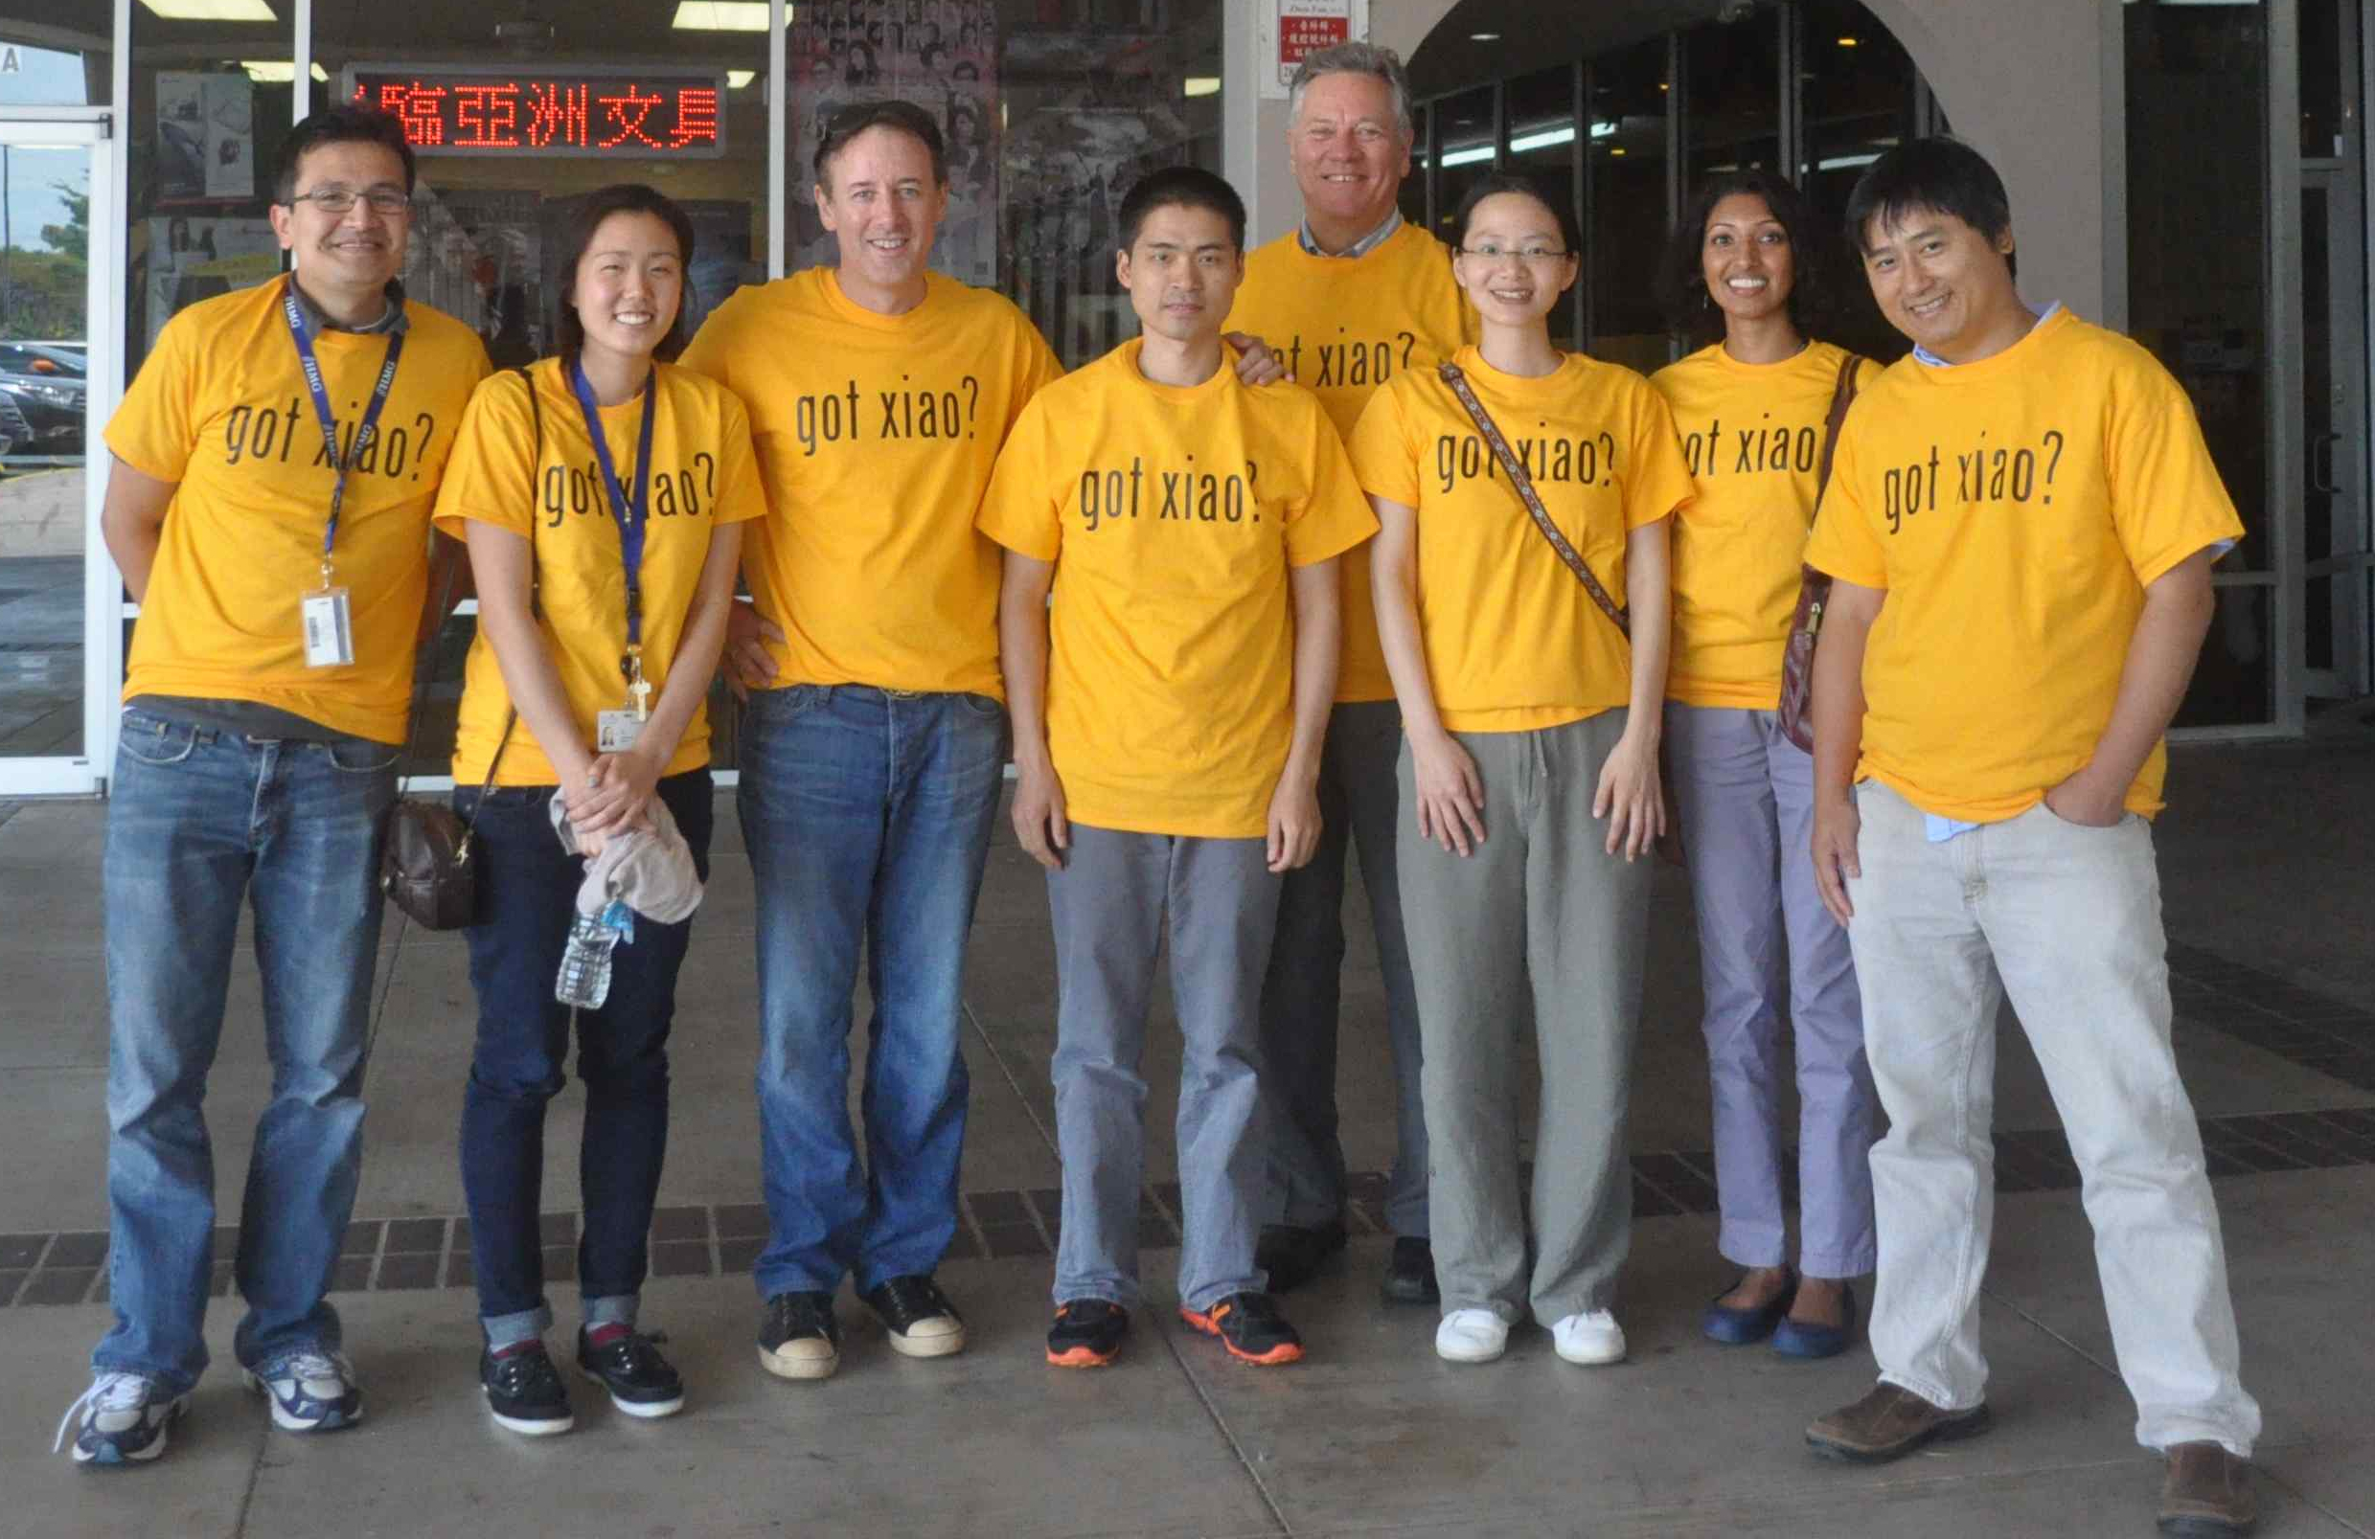
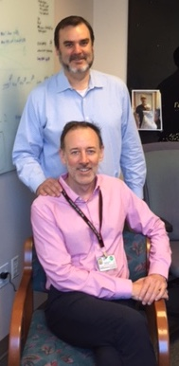
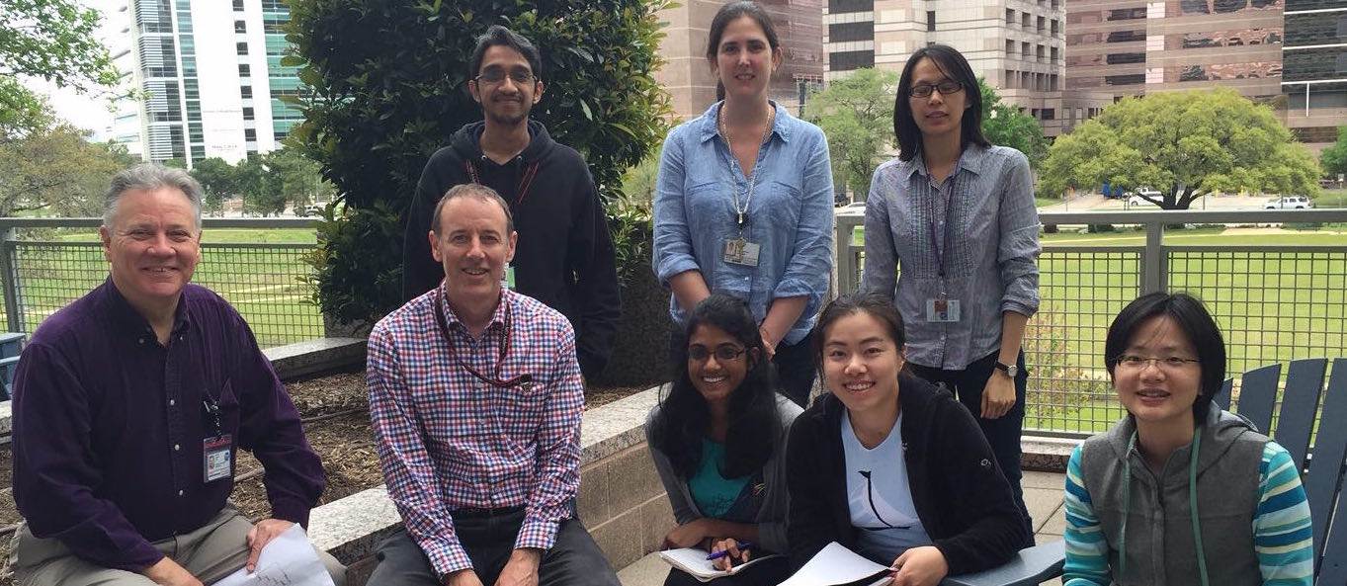
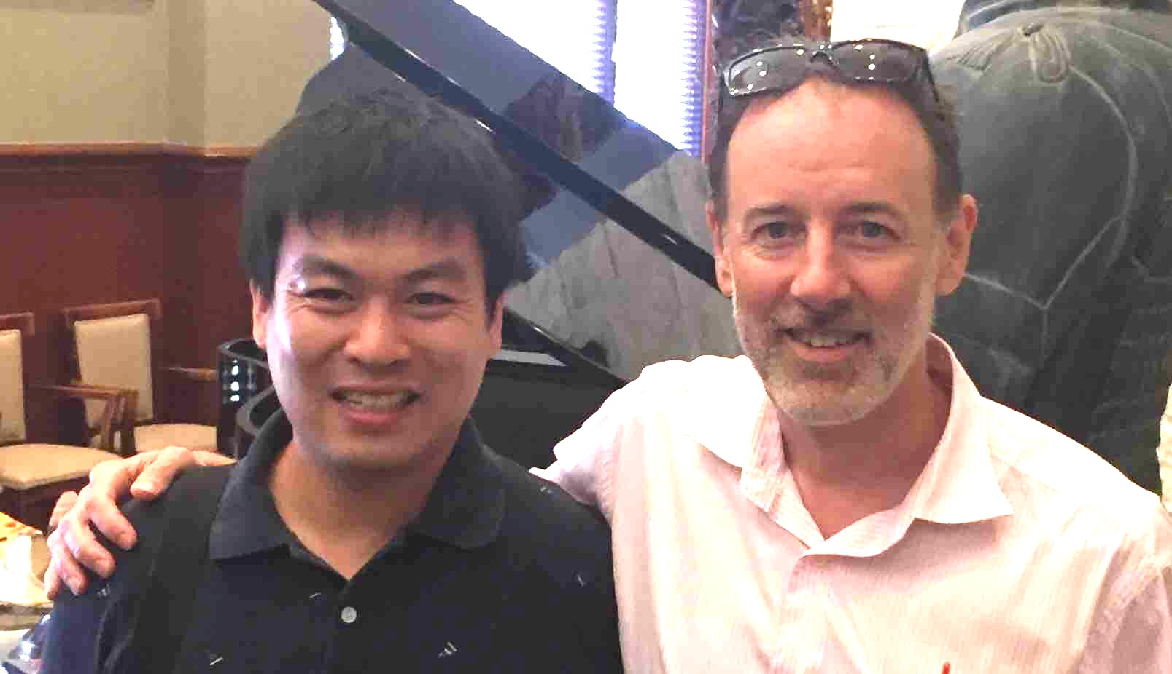

Slide 50
Somatic alterations: Blood
Size not independent of event type (p = 2.8e-8)
5 15 25 5 15 5
Number AI events
size Mb
0
40
80
120
Notes:
We then shift our attention the the size of the events in the mosaic blood samples
These are four histograms of event size. One for each event type.
Throughout this talk red represent gains, blue losses, green copy-neutral loss of heterozygosity
Subtle events are represented by the color gray; we are confident in these events as they have a strong allelic imbalance signal but due to low-clonal fraction or other factors, they have small log-R and BAF deviations for classification
As previously reported, we see an association of event type with event size in mosaic blood samples

