Slide 1
Multi-omics integration for identifying prognostic biomarkers in complex disease.
Presented by
Professor Jean Yang
School of Mathematics and Statistics
Charles Perkin Center

Slide 2

Where I belong …
Theme leader in Integrative System and Modelling
@ Charles Perkins Center
@ School of Mathematics and Statistics

Slide 3


Sydney bioinformatics and biometric research
We consists of senior and junior statisticians and bioinformaticians who share the interests in developing statistical and computational methodologies to study biology and complex diseases at the systems level. The group has joint strengths and expertise ranging from genomics, epigenomics, proteomics and beyond uniquely positions the individuals and the group as a whole to tackle the foremost significant challenges posed by modern biology and medicine.
Meet our senior and junior research leaders:
We also have: Senior research associate: 2; PhD candidates: 15; Honours and TSP student: 8
Contact us:
http://www.maths.usyd.edu.au/bioinformatics/
Samuel Müller
Pengyi Yang
Rachel Wang
Emi Tanka
Jean Yang
John Ormerod
Ellis Patrick
Garth Tarr
Want to get interactive? Visit shiny.maths.usyd.edu.au and get exploring!

Slide 4
Precision medicine: finding best cause of action for patients
~30,000 genes
~100 samples
up to 100 ~ 600 genes
1000 samples and up
Discovery phase
Translational phase
Implementation phase

Slide 5
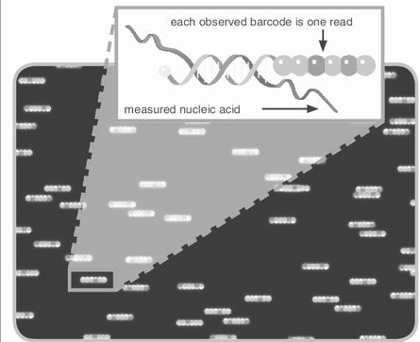
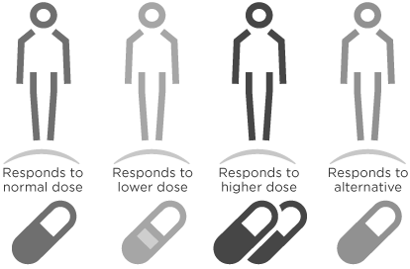
Precision medicine: finding best cause of action for patients
~30,000 genes
~100 samples
up to 100 ~ 600 genes
1000 samples and up
Discovery phase
Translational phase
Implementation phase

Slide 6
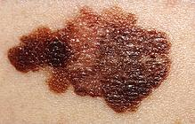



Melanomas
Melanomas are common in a large demographic of the population, especially in Caucasians living in sunny climates.
Samples were obtained from Professor Graham Mann's group from the Westmead Institute for Cancer Research and Melanoma Institute, Australia (MIA).
We focus our attention on data from Stage III individuals.
Of those that metastasise (Stage III), about 40% go on to live cancer free, but another 40% succumb to the disease in less than 1 year.
Notes:
Slide 3
Today I will speak about one aspect of my integration work motivated by a collaboration I established with Prof Graham Mann at University of Sydney. Prof Graham Mann and his collaborator from Prof John Thompson and Prof. Richard Scolary from Melanoma Institute of Australia collected sets of fresh frozen tissues from tumor patients. These are special set of patient whose melanoma had come back after a few years. What is of interest from this group of patient is that the survival outcome is very different.
< 1 year and
4 years

Slide 7
Characteristics of our data
Detailed clinical and pathological data, with mutation status for majority of the patients.
“Small” clinical data
  Small relative to other cancer types.
  Large study of fresh tissue samples focusing on Stage III patients.
  Missing values in certain platforms potentially could lead to unstable models.
Vertical (omics) data
  More genetic / molecular information on the same patients.
  Contrast to horizontal (more patients with the same genetic information)

Slide 8
Survival outcome -
Stage III metastatic melanoma
Two survival groups
Bad prognosis: Survival < 1 year and died due to melanoma
Good prognosis:
Survival ≥ 4 years with no sign of relapse

Slide 9
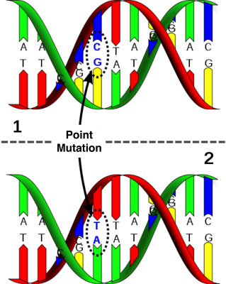
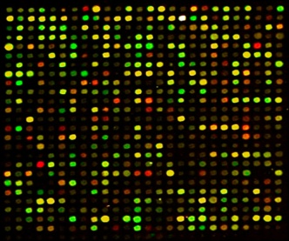
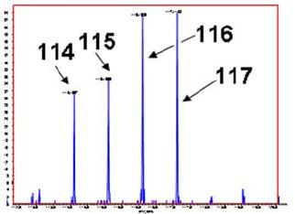
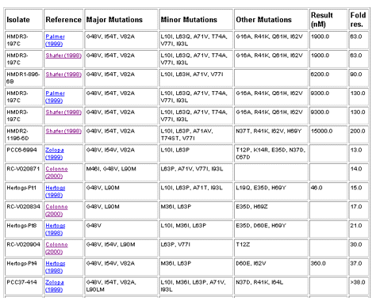
Multi-omics data
DNA
SNP array
Exome-seq
DNA-seq
genome
RNA
transcriptome
mRNA array
microRNA
RNA-seq
Protein
proteome
iTRAQ
MRM
Metabolic
metabolome
MS/MS
Phenotype
phenome
Clinical and pathological data

Slide 10
Multi-omics data
DNA
SNP array
Exome-seq
DNA-seq
genome
RNA
transcriptome
mRNA array
microRNA
RNA-seq
Aim: To identify prognostic biomarker for
Stage III melanoma patients.
Protein
proteome
iTRAQ
MRM
Metabolic
metabolome
MS/MS
Phenotype
phenome
Clinical and pathological data

Slide 11
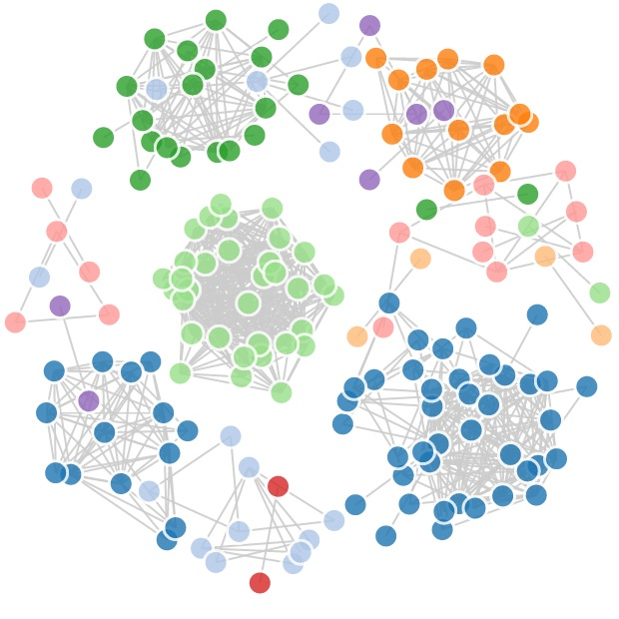
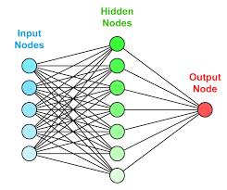
Data integration
Statistical learning
Machine learning
SNP array
Exome-seq
DNA-seq
mRNA array
microRNA
RNA-seq
iTRAQ
MRM
MS/MS
Clinical and pathological data

Slide 12
Data integration
Statistical learning
Machine learning
SNP array
Exome-seq
DNA-seq
mRNA array
microRNA
RNA-seq
iTRAQ
MRM
MS/MS
Clinical and pathological data

Slide 13
To avoid …

Slide 14
Examine each individual platform
Can we trust the biomarker ?
  Cross-validation between multiple datasets.
Can we trust some new platform ?
  Technical (Wet lab) validation of iTRAQ technology.
To identify candidate biomarkers: Is there different ways to think about biomarkers
  Identify biomarkers with differential distributions.
  Identify network biomarkers – which may help us understand underlying mechanism.
Notes:
What did we learn from the individual platform

Slide 15
Examine each individual platform
Can we trust the biomarker ?
  Cross-validation between multiple datasets.
Can we trust some new platform ?
  Technical (Wet lab) validation of iTRAQ technology.
Notes:
What did we learn from the individual platform

Slide 16
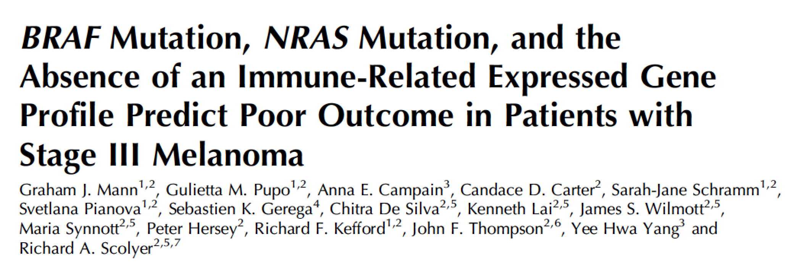
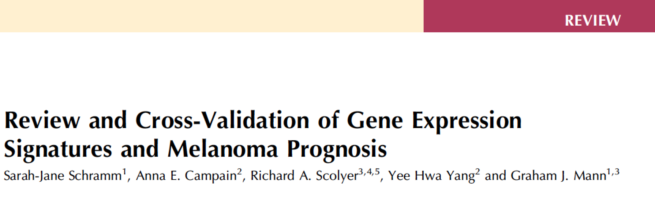
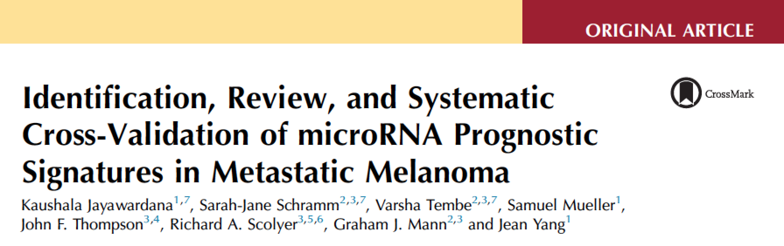
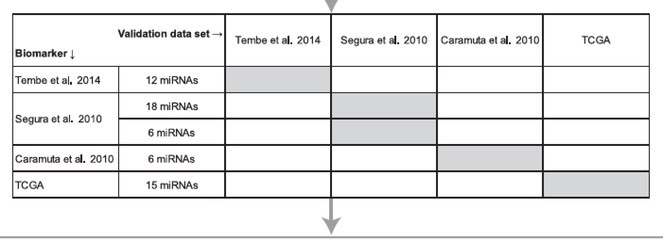
Examine each individual platform
Gene
Expression
microRNA
Expression
Notes:
What did we learn from the individual platform

Slide 17
Examine each individual platform
Can we trust the biomarker ?
  Cross-validation between multiple datasets.
Can we trust some new platform ?
  Technical (Wet lab) validation of iTRAQ technology.
To identify candidate biomarkers: Is there different ways to think about biomarkers
  Identify biomarkers with differential distributions.
  Identify network biomarkers – which may help us understand underlying mechanism.
Notes:
What did we learn from the individual platform

Slide 18
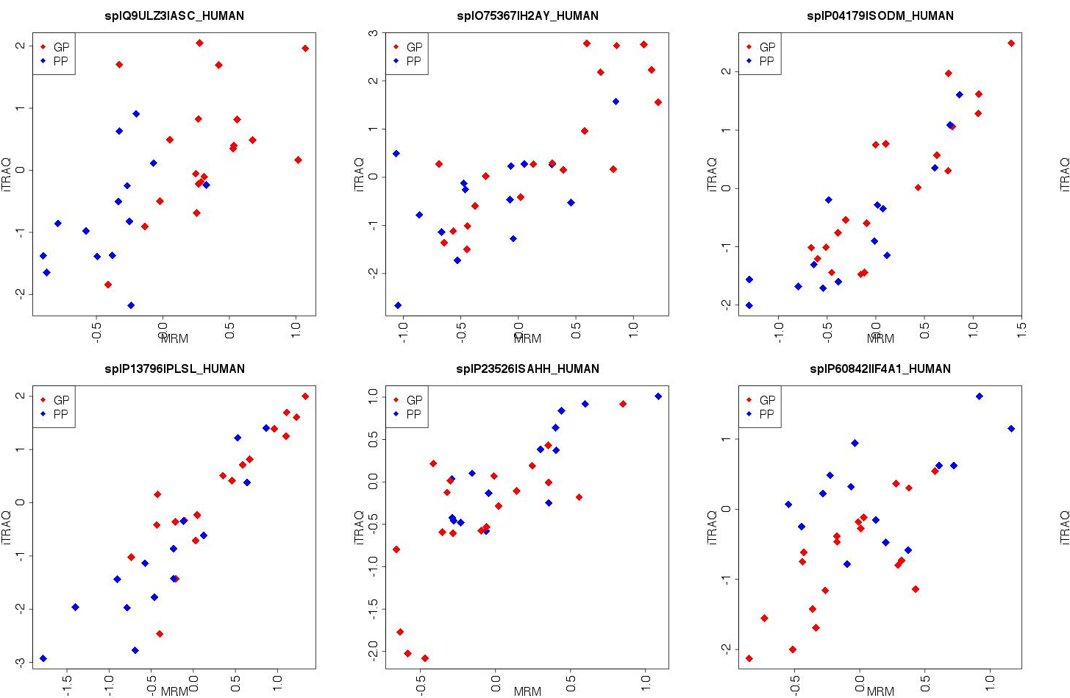
Scatter plots between two types of proteomics data
y-axis: expression values
from original iTRAQ
x-axis: expression values from SRM (MRM)

Slide 19
Scatter plots between two types of proteomics data
y-axis: expression values
from original iTRAQ
x-axis: expression values from SRM (MRM)

Slide 20
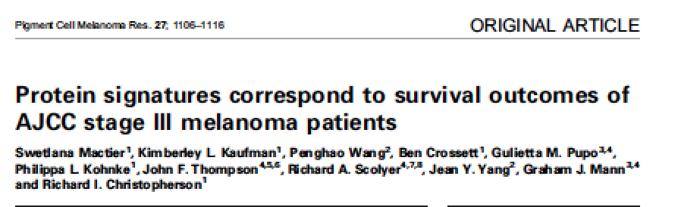
Scatter plots between two types of proteomics data
y-axis: expression values
from original iTRAQ
x-axis: expression values from SRM (MRM)

Slide 21
Examine each individual platform
Can we trust the biomarker ?
  Cross-validation between multiple datasets.
Can we trust some new platform ?
  Technical (Wet lab) validation of iTRAQ technology.
To identify candidate biomarkers: Is there different ways to think about biomarkers
  Identify biomarkers with differential distributions.
  Identify network biomarkers – which may help us understand underlying mechanism.
Notes:
What did we learn from the individual platform

Slide 22
Data integration - question
To identify prognostic biomarker for Stage III melanoma patients.
Which platforms or combination of platforms is better ?

Slide 23
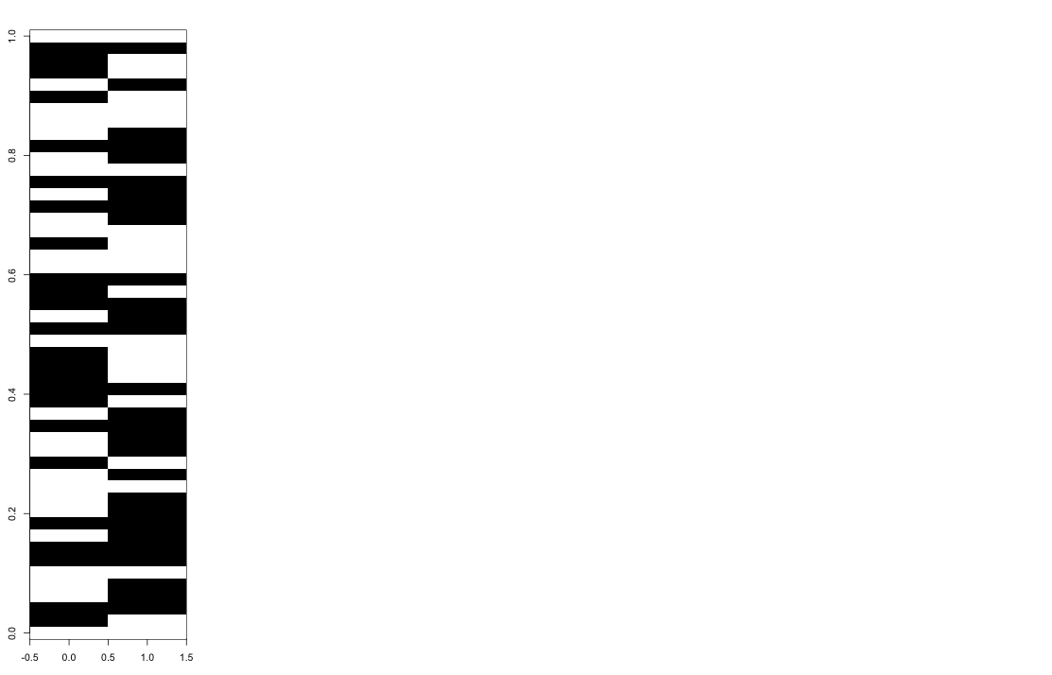
Repeated 5-fold cross validation
resample
Patients
5-fold CV
Patients
Genes
Testing set
Learning set
Notes:
Here Black = Classified wrongly
White = Classified correctly
Let’s think about understanding why certain columns are predominantly black, white and why are some mixed: Sample = column.
Conjecture: samples that are consistently misclassified (shown in white) could belong to some minority group

Slide 24
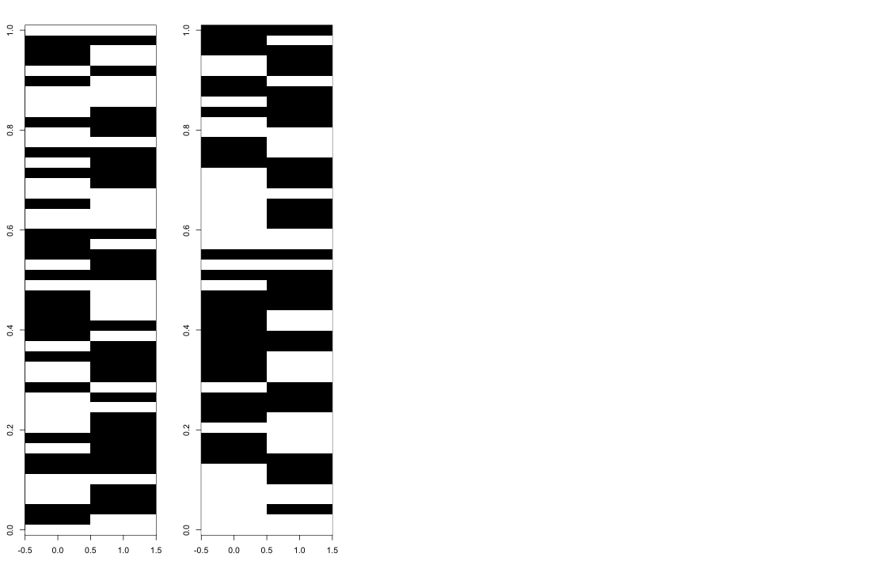
Repeated 5-fold cross validation
resample
Patients
5-fold CV
Patients
5-fold CV
Genes
5-fold CV
Testing set
Learning set
Notes:
Here Black = Classified wrongly
White = Classified correctly
Let’s think about understanding why certain columns are predominantly black, white and why are some mixed: Sample = column.
Conjecture: samples that are consistently misclassified (shown in white) could belong to some minority group

Slide 25
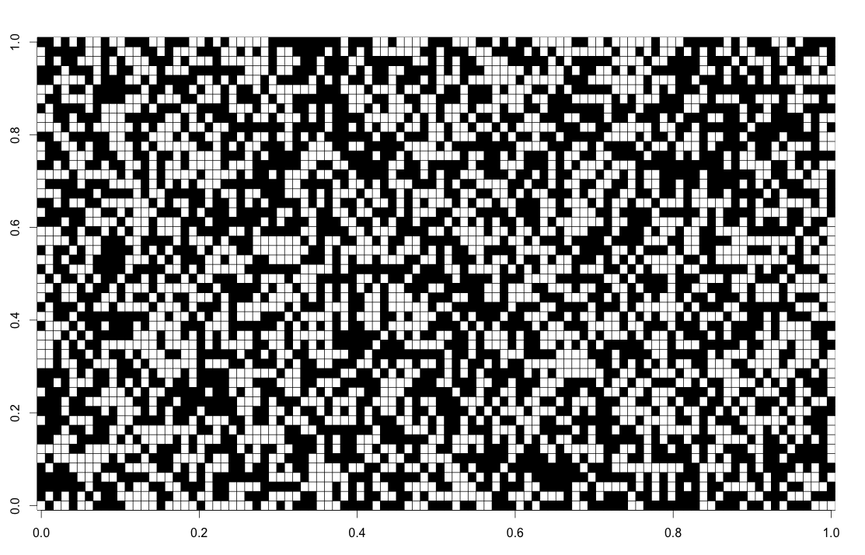
Repeated 5-fold cross validation
resample
Patients
5-fold CV
Patients
Patients
CV errors
5-fold CV
Genes
100 resamples
5-fold CV
Testing set
Learning set
Notes:
Here Black = Classified wrongly
White = Classified correctly
Let’s think about understanding why certain columns are predominantly black, white and why are some mixed: Sample = column.
Conjecture: samples that are consistently misclassified (shown in white) could belong to some minority group

Slide 26
Which platforms or combination of platforms is better ?
Individual platform
Clinical: CPM
G: mRNA
P: protein
M: microRNA
Integration through
pre-validation
CPM + G
CPM + P
CPM + M
CPM + G + P + M
5-fold CV error rate
Jayawardana K et al, IJC, 2015

Slide 27
Precision medicine: finding best cause of action for patients
~30,000 genes
~100 samples
up to 100 ~ 600 genes
1000 samples and up
Discovery phase
Translational phase
Implementation phase

Slide 28
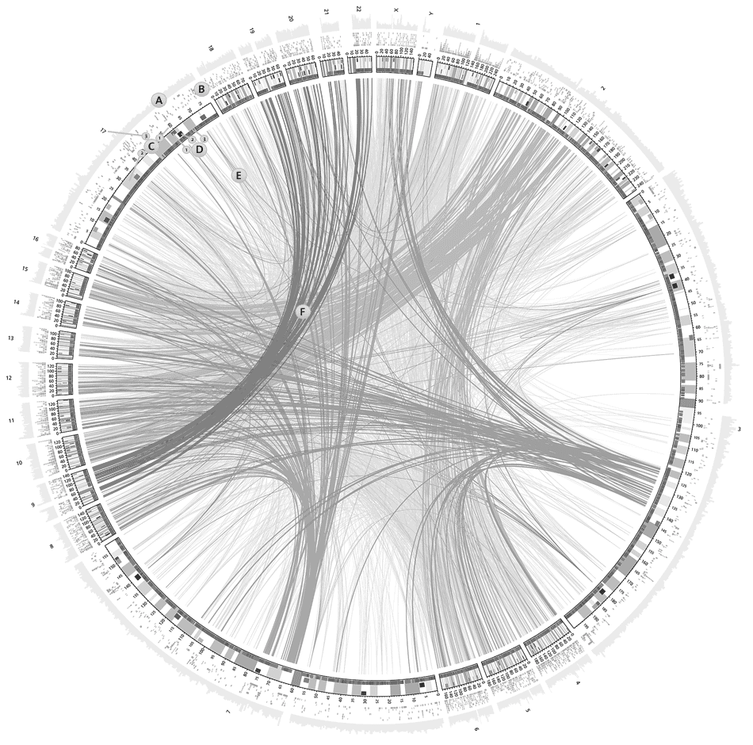
Moving towards precision medicine
Which platform to select?
Prospective normalisation of data and standardised calibration
Biomarker selection with large n, “smaller” p
~30,000 genes
~100 samples
up to 100 ~ 600 genes
1000 samples and up
Discovery phase
Translational phase
Implementation phase

Slide 29
Repeated 5-fold cross validation
resample
Patients
5-fold CV
Patients
Patients
CV errors
5-fold CV
Genes
100 resamples
5-fold CV
Testing set
Learning set
Notes:
Here Black = Classified wrongly
White = Classified correctly
Let’s think about understanding why certain columns are predominantly black, white and why are some mixed: Sample = column.
Conjecture: samples that are consistently misclassified (shown in white) could belong to some minority group

Slide 30
Repeated 5-fold cross validation
resample
Patients
5-fold CV
Patients
Patients
CV errors
5-fold CV
Genes
100 resamples
5-fold CV
Testing set
Average patient
accuracy
Learning set
Notes:
Here Black = Classified wrongly
White = Classified correctly
Let’s think about understanding why certain columns are predominantly black, white and why are some mixed: Sample = column.
Conjecture: samples that are consistently misclassified (shown in white) could belong to some minority group

Slide 31
Repeated 5-fold cross validation
resample
Patients
5-fold CV
Patients
Patients
CV errors
For every patient we can count how often we classify the patient correctly
Patient specific accuracy
Hard vs easy samples
5-fold CV
Genes
100 resamples
5-fold CV
Testing set
Average patient
accuracy
Learning set
Notes:
Here Black = Classified wrongly
White = Classified correctly
Let’s think about understanding why certain columns are predominantly black, white and why are some mixed: Sample = column.
Conjecture: samples that are consistently misclassified (shown in white) could belong to some minority group

Slide 32
Patient accuracy
45 samples (excluding protein data)
GP
PP
Clinical_AJCC
CPM
mRNA
microRNA
CPM + mRNA
CPM + microRNA
Samples
Clinical_AJCC = 4 AJCC variables: 1. Ulceration, 2. thickness of the primary tumour, 3. number of metastatic nodes and 4. nodal size.
Jayawardana K et al, IJC, 2015

Slide 33
Patient accuracy
45 samples (excluding protein data)
1. Good performance regardless of the platform.
GP
PP
Clinical_AJCC
CPM
mRNA
microRNA
CPM + mRNA
CPM + microRNA
Samples
Clinical_AJCC = 4 AJCC variables: 1. Ulceration, 2. thickness of the primary tumour, 3. number of metastatic nodes and 4. nodal size.
Jayawardana K et al, IJC, 2015

Slide 34
Patient accuracy
45 samples (excluding protein data)
1. Good performance regardless of the platform.
GP
PP
Clinical_AJCC
CPM
mRNA
microRNA
CPM + mRNA
CPM + microRNA
Samples
Clinical_AJCC = 4 AJCC variables: 1. Ulceration, 2. thickness of the primary tumour, 3. number of metastatic nodes and 4. nodal size.
Jayawardana K et al, IJC, 2015

Slide 35
Patient accuracy
45 samples (excluding protein data)
2. Only one sample that is extremely hard to classify
GP
PP
Clinical_AJCC
CPM
mRNA
microRNA
CPM + mRNA
CPM + microRNA
Samples
Clinical_AJCC = 4 AJCC variables: 1. Ulceration, 2. thickness of the primary tumour, 3. number of metastatic nodes and 4. nodal size.
Jayawardana K et al, IJC, 2015

Slide 36
Patient accuracy
45 samples (excluding protein data)
2. Only one sample that is extremely hard to classify
GP
PP
Clinical_AJCC
CPM
mRNA
microRNA
CPM + mRNA
CPM + microRNA
Samples
Clinical_AJCC = 4 AJCC variables: 1. Ulceration, 2. thickness of the primary tumour, 3. number of metastatic nodes and 4. nodal size.
Jayawardana K et al, IJC, 2015

Slide 37
Patient accuracy
45 samples (excluding protein data)
3. Many samples work differently depending on different platforms
GP
PP
Clinical_AJCC
CPM
mRNA
microRNA
CPM + mRNA
CPM + microRNA
Samples
Clinical_AJCC = 4 AJCC variables: 1. Ulceration, 2. thickness of the primary tumour, 3. number of metastatic nodes and 4. nodal size.
Jayawardana K et al, IJC, 2015

Slide 38
Patient accuracy
45 samples (excluding protein data)
4. Same story in GP
GP
PP
Clinical_AJCC
CPM
mRNA
microRNA
CPM + mRNA
CPM + microRNA
Samples
Clinical_AJCC = 4 AJCC variables: 1. Ulceration, 2. thickness of the primary tumour, 3. number of metastatic nodes and 4. nodal size.
Jayawardana K et al, IJC, 2015

Slide 39
Another study: TCGA
A subset of samples from The Cancer Genome Atlas (TCGA) with the necessary clinico-pathologic annotation; stage III
mRNA
microRNA
Notes:
There is benefit of considering multiple ‘-omics’ platforms in predicting the survival outcome of patients.
Both mRNA and microRNA data perform well for a subset of patients, while for other groups, and/or individuals mRNA is the more accurate prognostic indicator cf. miRNA, and vice versa.
there are approximately 9 samples (33%) that fall off the diagonal, indicating that for these patients one data platform out-performed the other.
Further implicates the potential utility of multiple data platforms rather than one, when predicting the survival outcome of patients.

Slide 40
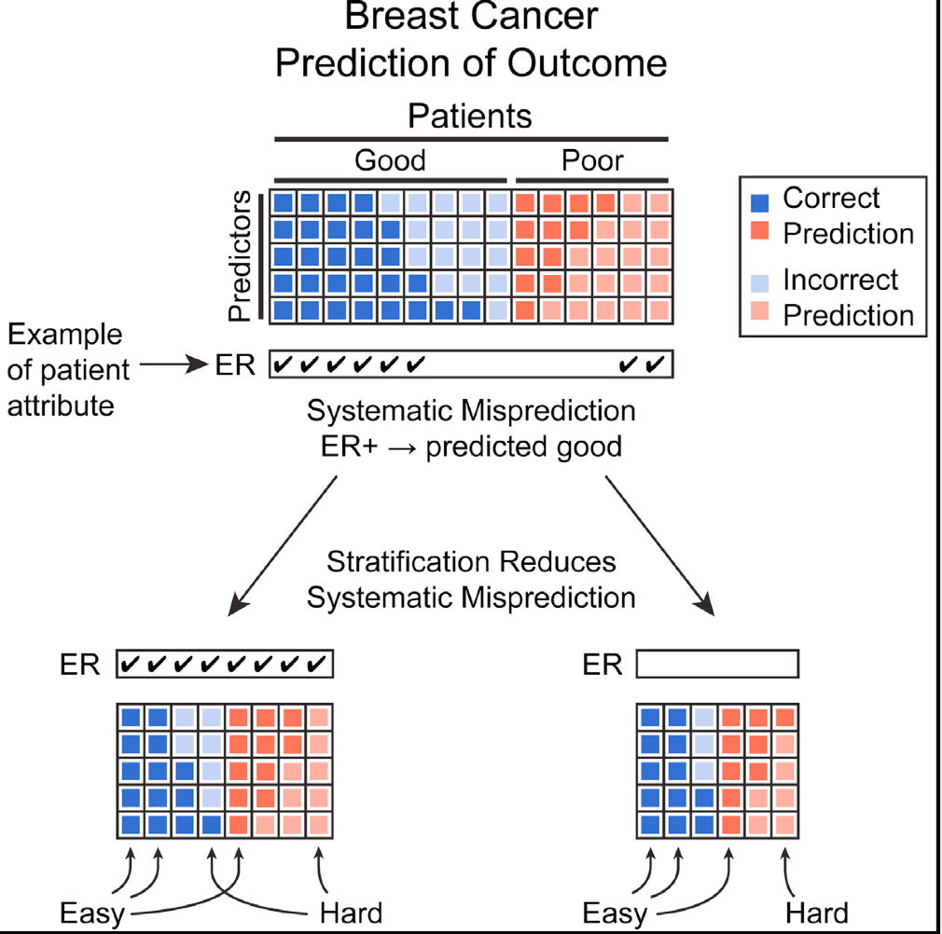
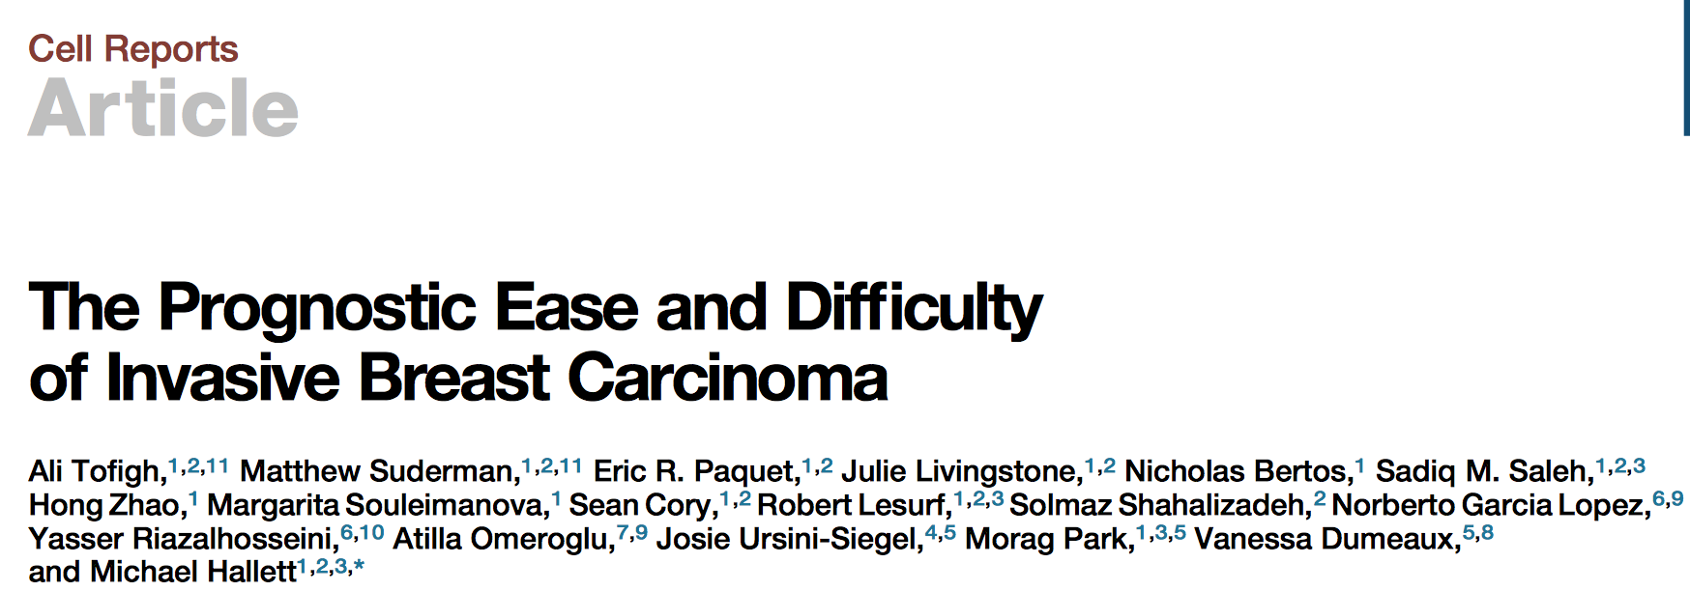
Cell Reports, October, 2014

Slide 41
Regression output
Hard and easy measures
for each patients
Y = number of correctly classified bootstrap samples under the mRNA (gene expression) platform.
Aim: To identify clinical variables that is associated with Y
Variable | Estimate | SD | t | p-value
Intercept | 0.23 | 0.76 | 2.98 | 0.005
Extranodal growth (Tum_Extranodal) | 0.37 | 0.12 | 3.22 | 0.002
Number of invasive nodes (Tum_Nodes) | -0.02 | 0.01 | -2.04 | 0.050
Notes:
Here (although we should do this differently in the future), using the average classification error as the new y (new response) we run a linear regression (which of course is not ideal and we should have worked on either transformed y’s or using nonlinear regression models) and run forward stepwise with AIC. Extranodal is dichotomous and Number of invasive nodes is integer valued 0 to 10+

Slide 42
CV error rates
Hard to
classify samples
Notes:
Suggests no sub groups and minimal mislabelling
Going back to the rowmeans, however, classification is based on only those patients (samples) who had Tum_extranodal = No in the left boxplot and yes in the right.
The boxplot is for 100 5-fold-CV repeats to classify into GP and PP.
Because of the different behaviour, we see now clearly that Tum_extranodal should be used as a interaction term when combining it with either Gene Expression or CPM.
If we had a reduction in CV error in both boxplots within Gene Expression say, then it is clear that we need to have two different classifiers for the No and Yes patients respectively, i.e. an interaction term within Gene expression

Slide 43
CV error rates
Hard to classify using
gene expression but easy with clinical data.
Notes:
Suggests no sub groups and minimal mislabelling
Going back to the rowmeans, however, classification is based on only those patients (samples) who had Tum_extranodal = No in the left boxplot and yes in the right.
The boxplot is for 100 5-fold-CV repeats to classify into GP and PP.
Because of the different behaviour, we see now clearly that Tum_extranodal should be used as a interaction term when combining it with either Gene Expression or CPM.
If we had a reduction in CV error in both boxplots within Gene Expression say, then it is clear that we need to have two different classifiers for the No and Yes patients respectively, i.e. an interaction term within Gene expression

Slide 44
Where has this lead us?
Hierarchical two stage procedure
Easy
Hard
In practice:
To identify variables that is associated with patient specific accuracy.
For example, perform classification
  Prediction based on gene expression for the easy group, and
  prediction based on other platforms (e.g. clinical) for the hard group.
variables
Patients
?
PP
GP
Use other platforms?
Surgical or treatment related data?
mRNA

Slide 45
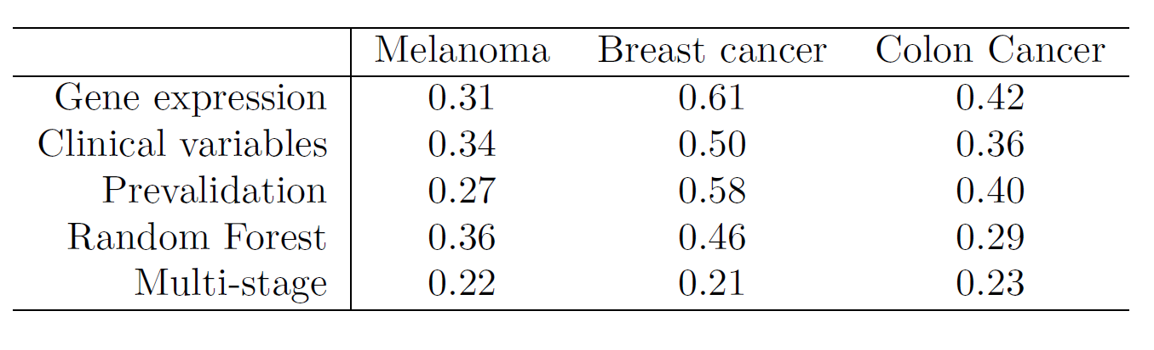
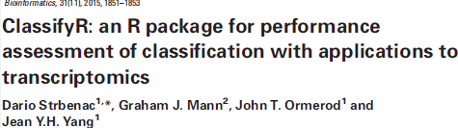
Marisa et al. (2013). Gene expression classification of colon cancer into molecular subtypes: characterization, validation, and prognostic value. Cancer Cell.
Chin et al. (2006). Genomic and transcriptional aberrations linked to breast cancer pathophysiologies. PLoS Med.
Patrick E et al, OncoTarget 2017

Slide 46
Summary so far …
What we learn …
  Good clinico-pathogical data is invaluable.
  ‘Hard’ and ‘Easy’ classification will lead to patient specific accuracy.
  Multi-stage classification framework has the potential to identify interaction effects in large data as well as cost of individual platform.
  Practically, patient (or sample) specific accuracy can provide a practical setting to engaged with multi-omics data.

Slide 47
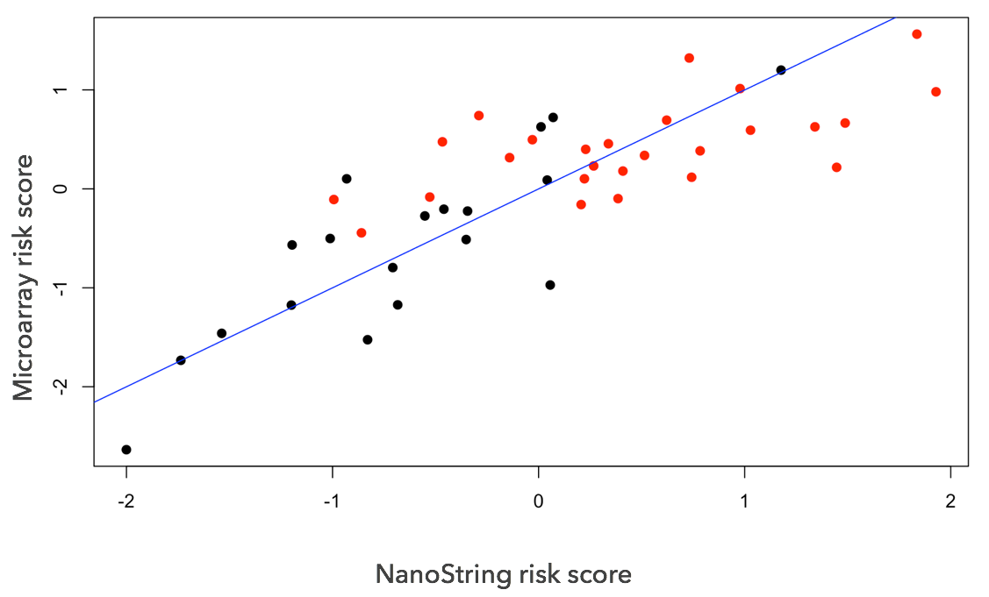
Moving towards precision medicine
Biomarkers
  Each data platform has its own challenges and one can cross-validating platform specific biomarkers.
  Looking at prognostic markers differently, this includes
    selecting features with differential variability, and
    selecting features with disturbed network.
  A Nanostring panel of ~200 markers was created
A Cox PH model was constructed from
NanoString and the same coefficients
were used to derive a risk score on the
microarray data.

Slide 48
Moving towards precision medicine
Which platform to select?
Prospective normalisation of data and standardised calibration
Biomarker selection with large n, “smaller” p
~30,000 genes
~100 samples
up to 100 ~ 600 genes
1000 samples and up
Discovery phase
Translational phase
Implementation phase

Slide 49
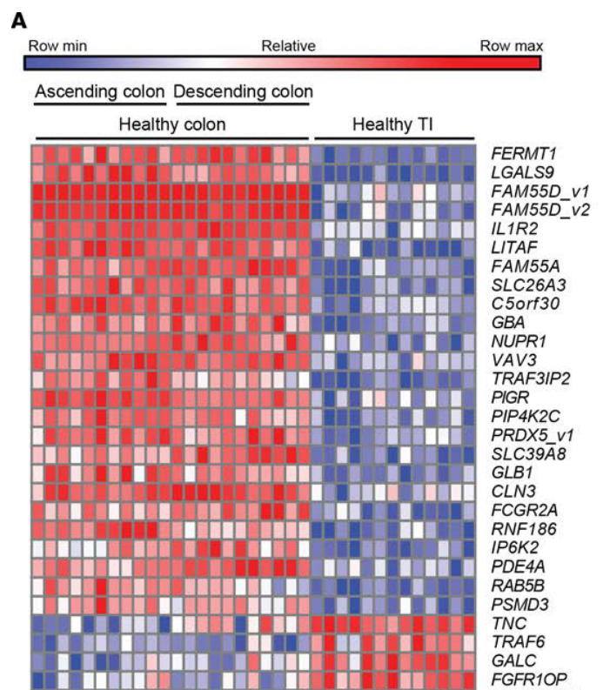
Using pubic data
712 genes and 983 samples was used to study inflammatory bowel disease (IBD)
Suppose we are interested in predicting each sample as being either inflamed or not inflamed
The gene expression was measured on a NanoString® panel, known for its accuracy and relatively low-cost
Peloquin, et. al. (2016). Characterization of candidate genes in inflammatory bowel disease–associated risk loci. JCI Insight

Slide 50


Remove unwanted variation prospectively (RUV-Pro)
raw data
Biological signal
Residuals
Normalised data
Unwanted variation
The RUVIII method (Molania et.al. 2018) performs estimation of using factor analysis on control genes and replicates
The RUV-Pro method adapts RUVIII to suit a prospective study
Unwanted variation from previous batches

Slide 51
RUV-Pro
Using the noise estimation from batch 1, we can normalise the entire 987 samples. We will focus on two evaluations metrics
  The predictive strength of a Lasso-logistic regression risk score; and
  Using SVM to calculate the classification error of the normalised data. We repeat this process for batch 2, … 20.
Batch 1
Batch 2
after a long time
Batch B
Notes:
My research is a bit unusual, in the sense that it is about time machine.
Let me explain…
Imagine that you are performing a large scale transcripotmics experiment, over several years.
However, the main challenge associated with this type of data is that
We only have small sets of data at each time point and but we are required to perform normalisation and prediction stably and reliably so that therapeutic actions can be taken for individual patients before the whole experiment can conclude.
-----------
RUV-Pro is a method for removing unwanted variation in this type of experimental design.
RUV-Pro can consistently break down the noise structure in an initial data so that any future prospective samples can be normalised stably
We can show the biological signals can be extracted from a subset of samples as if all the data were available to you (just like a time traveller!).
The predictive analysis can also be done in a stable way, so that you can be sure that a small contamination in the initial study cohort will not ripple through the space time continuum and impact on your future samples.
If you want to know more about the time machine method, please come and talk to me at poster numebr xxx.

Slide 52
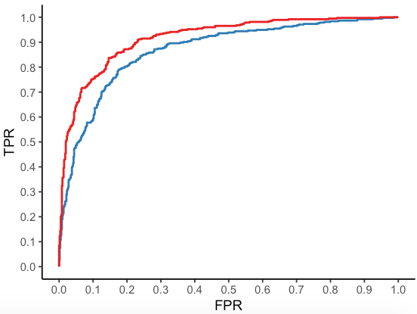
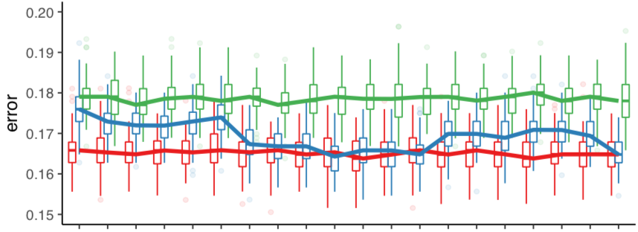
Evaluating RUV-Pro
Risk score using logistics regression
SVM classification of all 987 samples
No normalisation: 18%
RUV-Pro: 17%
RUVIII: 16.5%
987 samples, AUC = 92%
150 samples, AUC = 87%
Batch 1
Batch 20

Slide 53
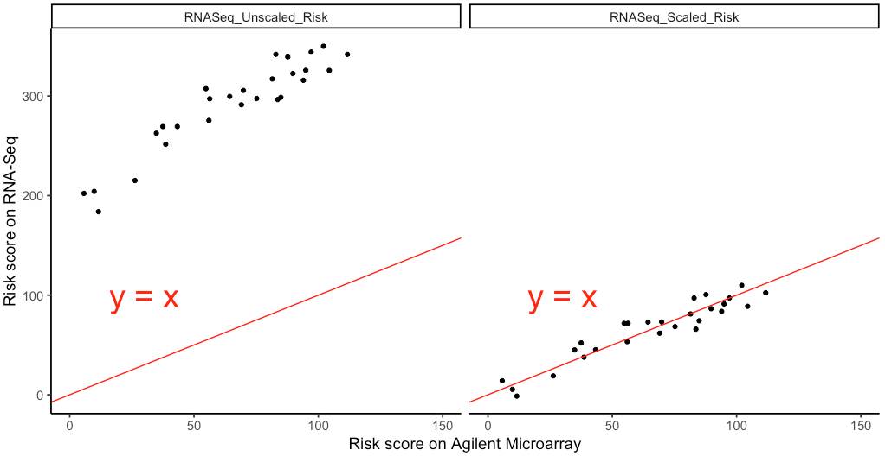
Standarization
Virtually all risk prediction models are data-dependent.
These models can vary greatly depending on normalisation methods, measurement platforms, etc.

Slide 54
Summary
What we learn …
  Good clinico-pathogical data is invaluable.
  ‘Hard’ and ‘Easy’ classification will lead to patient specific accuracy.
  Multi-stage classification framework has the potential to identify interaction effects in large data as well as cost of individual platform.
  Practically, patient (or sample) specific accuracy can provide a practical setting to engaged with multi-omics data.
Moving into translational phase
  An application of RUV-III allow prospective normalization provided replicates are available between batches.
  Building risk model on standardize values may provide a way to create platform independent risk score.

Slide 55




Acknowledgements
School of Mathematics and Statistics
Samuel Mueller
John Ormerod
Dario Strbenac
Rebecca Barter
Shila Ghanazfar
Vivek Jayaswal
Ellis Patrick
Kaushala Jayawardana
Kevin Wang
Sarah Romanes
Mark Greenaway
Melanoma program at MIA/WMI/RPA
Graham Mann
Gulietta Pupo
Varsha Tembe
Sara-Jane Schramm
John Thompson (MIA)
Lauren Haydu
Alex Menzies (MIA)
Georgina Long (MIA)
Richard Scolyer (RPA)
James Wilmott (RPA)
University of Sydney – Proteomics
Ben Crossett
Swetlana Mactier
Richard Christopherson
Notes:
This work wouldn’t be possible without a large team of interdisciplinary researchers working in a team.
prof rs and his team provide the samples and assoc. clinic-path data
Many people are involved with the generation of multiple sets of omics data
Many collegue and students were involved with the anlaysis of different individual omics platform as it comes before integration.
This highlights the power of interdisciplinary collaboration how statistics and statistical bioinformatics contributes to biomedical research.

Slide 57
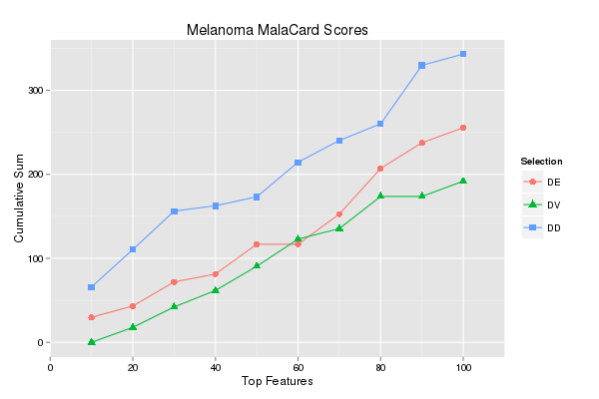
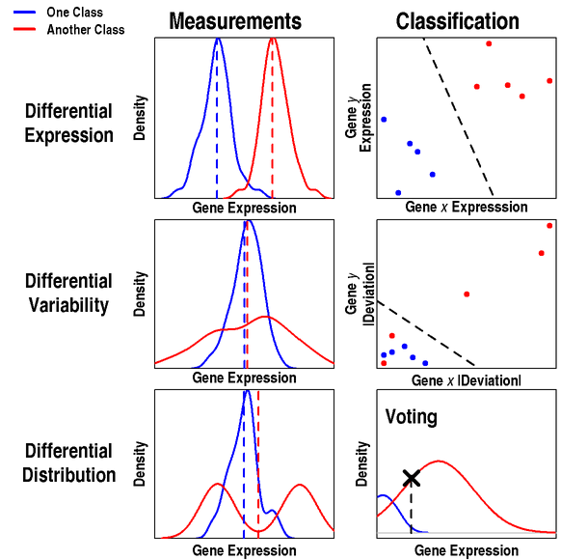
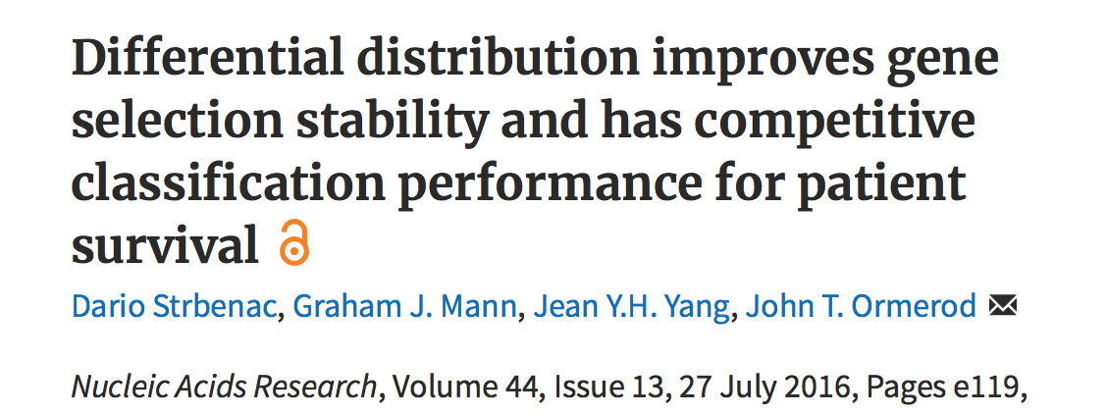
Prognosis with gene expression ONLY

Slide 58
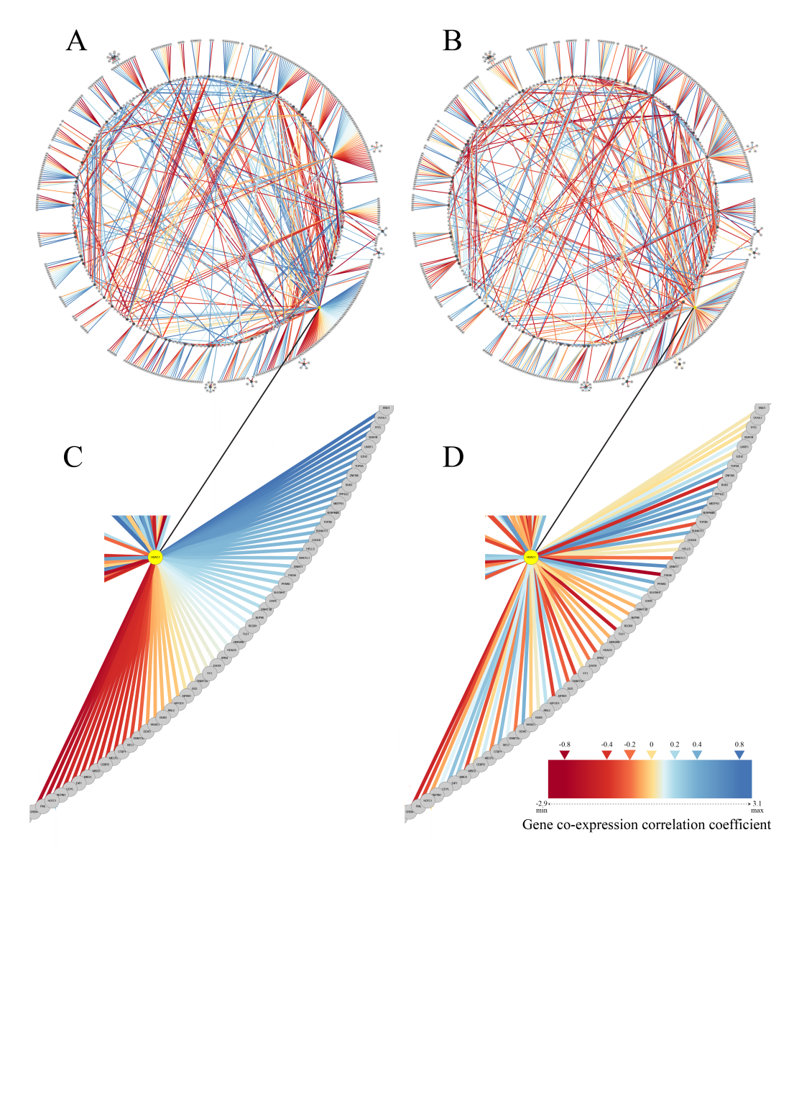
Looking differential correlation
Results – gene co-expression networks are significantly disturbed among patients with good and poor clinical outcomes
A: Patients surviving >4yr post resection of metastatic disease
B: Patients surviving <1yr post resection of metastatic disease
C & D:
Enlarged view (HDAC)
PIG. CELL & MEL. RES 2013
Notes:
And we identified protein networks that behaved differently, in terms of gene co-expression, among protein-protein interaction pairs, with respect to patient clinical outcome.
Here’s one example.
However, I had generated 20 separate networks by using 4 different gene expression & clinical information datasets with 4 different protein interaction networks. And, as I mentioned earlier, using different cohorts and different PPI networks virtually ensures that there is some variation among results.
So, how can these networks be interpreted?
Well, I reasoned that it would be interesting to know which genes keep appearing among the different datasets despite the sources of variation. Therefore, in relation to the networks describing differences between good and poor prognosis patients, we asked the question…

Slide 59
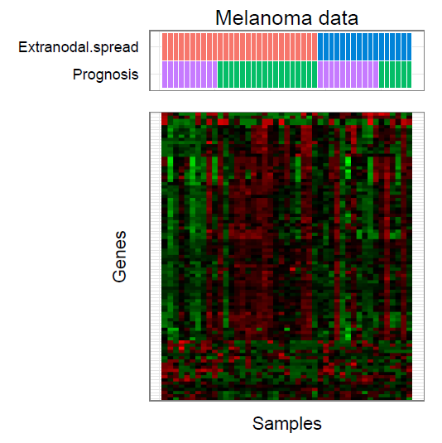
Going forward …
Bringing

Slide 60
Breast cancer data
Stage II patients
GP: less than 5 years (n = 18)
PP: greater thann 5 years (n = 31)
Public data from E-TABM-158 (Chin et al, 2006)
Affymetrix HT-U133AA of Av2 GeneChip

Slide 61
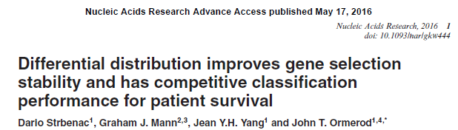


Implementation
Detailed analysis of feature selection stability, error rates, biological relevance in simulation, as well as cancer datasets.
ClassifyR software developed for fast and easy classification and its performance evaluation.

Slide 62
Regression output
Hard and easy measures
for each patients
Y = number of correctly classified bootstrap samples under the mRNA (gene expression) platform.
Aim: To identify clinical variables that is associated with Y
Variable | Estimate | SD | t | p-value
Intercept | 0.23 | 0.76 | 2.98 | 0.005
Extranodal growth (Tum_Extranodal) | 0.37 | 0.12 | 3.22 | 0.002
Number of invasive nodes (Tum_Nodes) | -0.02 | 0.01 | -2.04 | 0.050
Notes:
Here (although we should do this differently in the future), using the average classification error as the new y (new response) we run a linear regression (which of course is not ideal and we should have worked on either transformed y’s or using nonlinear regression models) and run forward stepwise with AIC. Extranodal is dichotomous and Number of invasive nodes is integer valued 0 to 10+

Slide 63
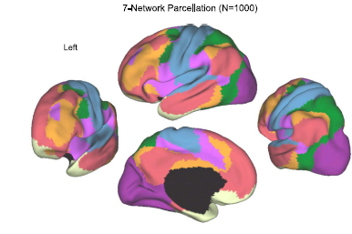
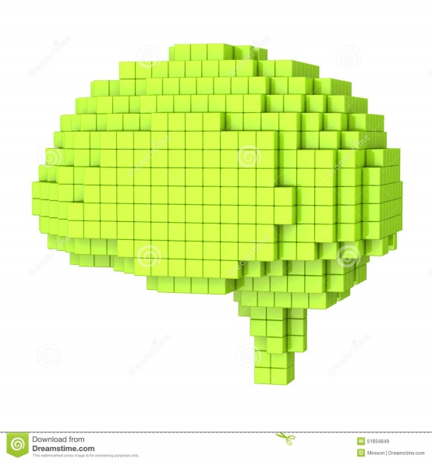
What about other data in a different disease
Lets look at imaging data

Slide 64
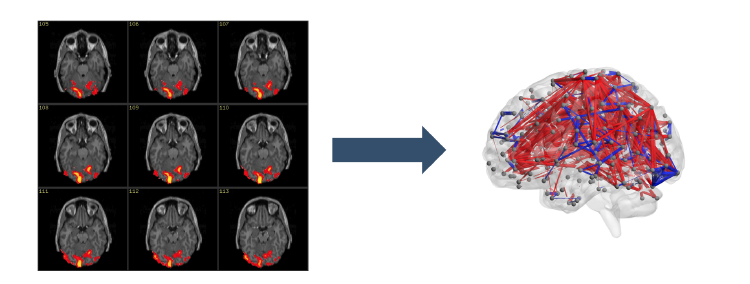
Brain network data from rest-state fMRI
Functional magnetic resonance images (fMRI):
  Blood-oxygenation levels measured over time in dierent locations of the brain.
  Associated with brain activity.
Nodes : predefined brain regions
  Voxels or regions of interest (ROIs).
  Time-series of blood oxygenation levels for each node.
Edges: a functional connectivity measure obtained from the time-series
  Commonly, correlation or partial correlation.

Slide 65
Subject-specific networks
COBRE dataset (http://fcon_1000.projects.nitrc.org/indi/retro/cobre.html)
124 subjects: 54 schizophrenic patients vs 70 controls
For each subject, a brain network constructed based on fMRI imaging is encoded in the adjacency matrix.
Networks are constructed based on z-transformed Pearson correlation, so edges have positive and negative values.
Each network has 263 nodes (Power et al. 2011 parcellation), giving a total of 34453 different edges, which are the features used for classification.

Slide 66
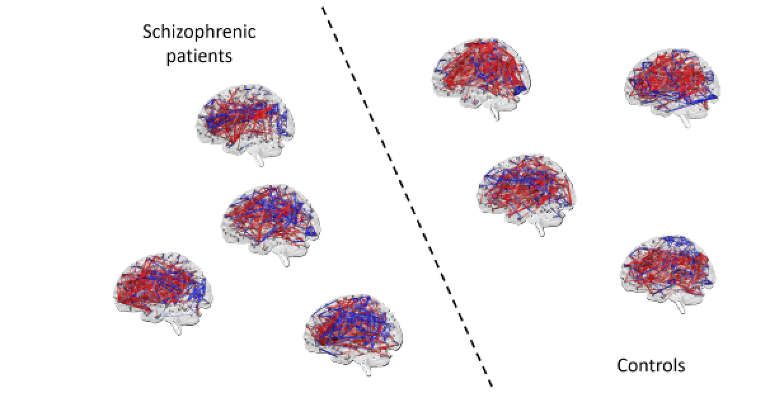
Supervised classification with network covariates
Brain networks from multiple subjects are available
  Subject adjacency matrices A⁽¹⁾, … , A^{(n)}
Additional subject-specific labels Y₁, … ,Y_{n}
Network classification:

Slide 67
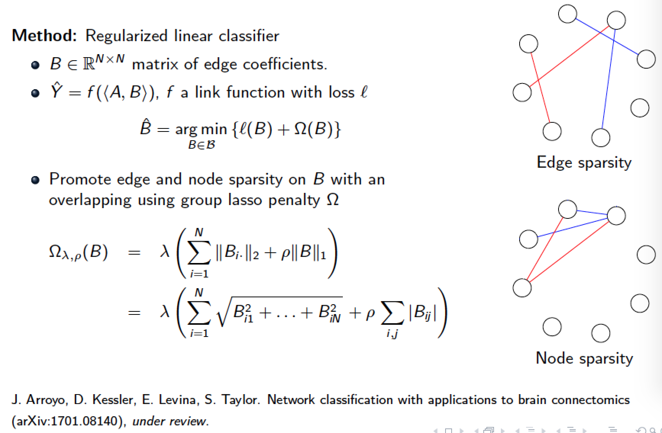
Methodology
J. Arroyo, D. Kessler, E. Levina, S. Taylor. Network classification with applications
to brain connectomics (arXiv:1701.08140), under review.
Qu? Email: Liza Levina <elevina@umich.edu>

Slide 68
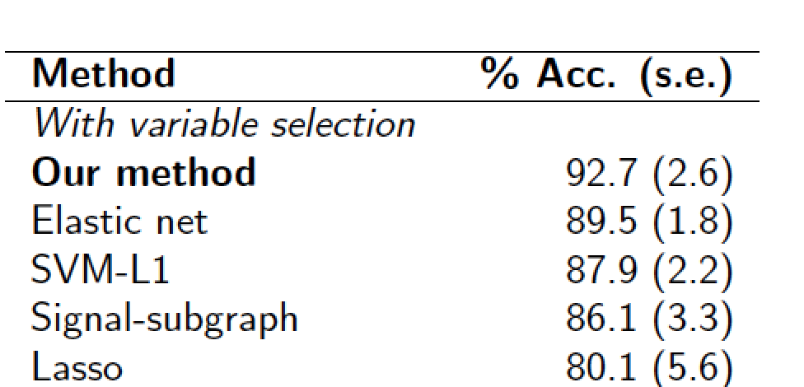
Supervised classification with network covariates
Graph-aware classifier that performs node selection.
Good accuracy with a substantially reduced set of edges.
Arroyo et al is able to obtain solutions with a smaller set of active nodes than other variable selection approaches.
Arroyo et al
J. Arroyo, D. Kessler, E. Levina, S. Taylor. Network classification with applications
to brain connectomics (arXiv:1701.08140), under review.
Qu? Email: Liza Levina <elevina@umich.edu>

Slide 69
Examine subject-specific accuracy (error) graph.

Slide 70
Regression output with rsfMRI data
Hard and easy measures for each subject
Y = number of correctly classified bootstrap samples under the rs-fMRI imaging platform.
Aim: To identify phenotype variables that is associated with Y
Variable | Estimate | SD | t | p-value
Intercept | 0.01 | 0.13 | 0.1 | 0.92
meanFD: motion | 0.70 | 0.35 | 1.97 | 0.05*
meanFDquad: motion² | -0.95 | 0.46 | -2.07 | 0.04*
Gender | 0.01 | 0.03 | 0.44 | 0.66
Age | -0.0009 | 0.001 | -0.85 | 0.40
Handedness | 0.004 | 0.05 | 0.09 | 0.93
Notes:
Participants typically move their heads (slightly) during the course of image acquisition, so a standard preprocessing step is to estimate and apply a bunch of rigid body transforms to align the framesnew messages[6:38] However, everybody knows this realignment is imperfect and the very act of motion usually introduces some blurring[6:39] so people use the estimated parameters for the rigid body transform at each frame and calculate (using a semi-standard formula) a singular scalar value that indicates how much displacement exists between frame t and frame t-1[6:39] It's calculated per-frame, and thus you have framewise displacement[6:39] however, that's also time series data, so people then calculate the mean across all frames

Slide 71
Summary …
Before actual vertical integration
  Each data platform has its own challenges.
  Cross-validating platform specific bio-markers.
  Looking at prognostic markers differently, this includes
    selecting features with differential variability, and
    selecting features with disturbed network.
Vertical integration
  Good clinico-pathogical data is invaluable.
  Interaction effects are difficult to find when p is large.
  Multi-stage classification framework has the potential to identify interaction effects in large data as well as cost of individual platform.
Concept of classifiability
  ‘Hard’ and ‘Easy’ classification will lead to patient specific accuracy.
  ‘Hard’ and ‘Easy’ classification also helps to find interaction terms.
  We may observe quality issue instead of cohort heterogeneity.

Slide 72
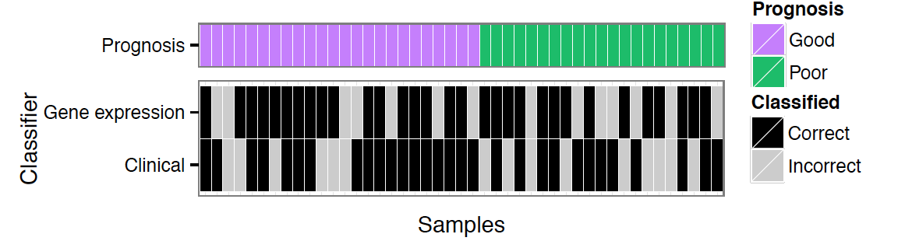

Prognosis and biomarkers …
Genes with
differential
distribution
Network as
biomarkers
Statistical machine
learning
Evaluation
Strategies including
Informative markers
Multi-stage classification
based on classifiably

Slide 73
omics data
mRNA gene expression
  Human-6 v3 expression BeadChips (Illuminia);
  Processing: VST, quantile normalization with unexpressed probes were remove (48802 → 26085)
microRNA expression
  Agilent platform;
  Processing: quantile normalization and probe expression were average over technical replicates;
  Large proportion of unexpressed probes in the data.
  Summarizing from technical replicates values → probes → miRNAs.
iTRAQ protein expression
  QSTAR MS/MS and initial processing with ProteinPilot 3.0;
  Large number of missing value mainly due to different sets of protein being identified from different runs.
  Summarizing spectrum values → peptides → protein.

Slide 74
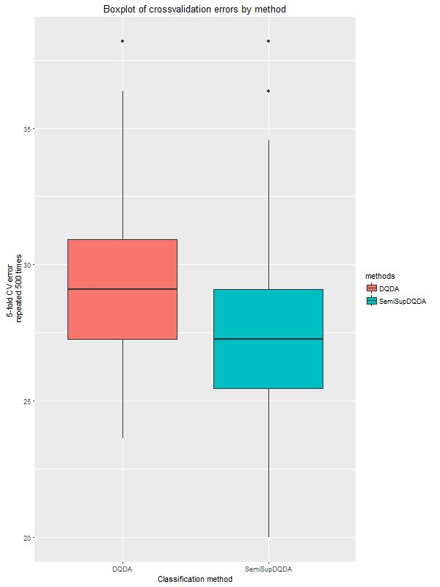
Semisupervised Bayesian diagonal quadratic discriminant Analysis with variable selection
John Ormerod and Weichang Yu
Classification via DQDA where a subset of samples are labelled and a subset of samples are unlabeled.
Variational Bayes is used to select features and handle missing class labels.
Asymptotic distribution of Bayes factors is derived under the null hypothesis (that a feature is not included) which allows control of Type I error.
Resulting method is very fast since it only depends on univariate sufficient statistics (5 fold cv with n = 50, p = 23000 in under a second).
Semisupervised method gives slightly reduced (but statistically significant) error rates.

Slide 75
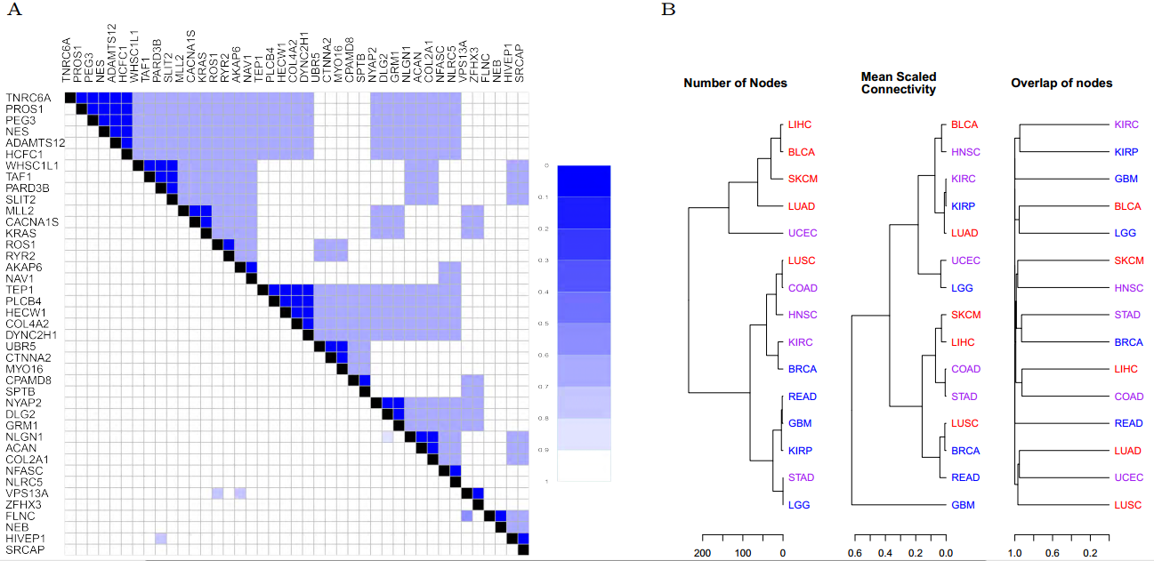
Node overlap among cancers
More mutated genes shared among cancers than DE genes
Lowly mutated ---- highly mutated
Ghazanfar, S., Yang, J. (2016).
Computational Biology and Chemistry, 63,

Slide 76
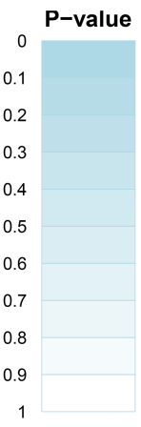
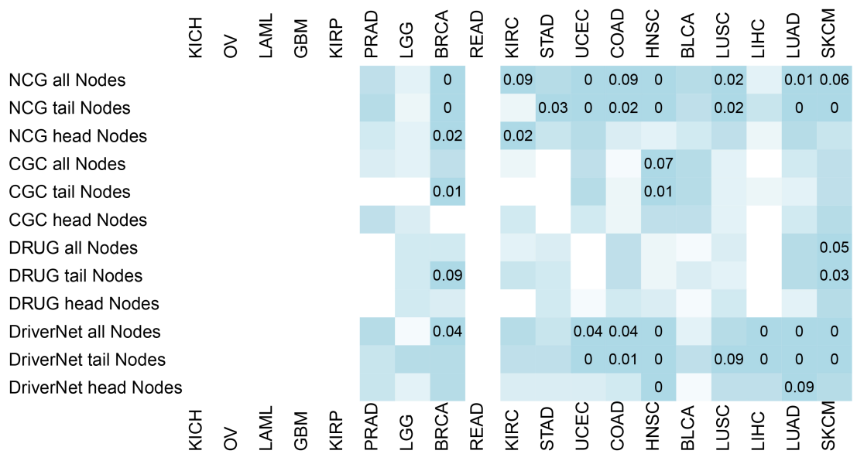
Mutation-expression networks and known cancer genes compared to randomly permuted networks
Ghazanfar, S., Yang, J. (2016).
Computational Biology and Chemistry, 63,
Notes:
Highlight one row
The heatmap displays comparisons of the
non-empty networks generated for each cancer against networks generated through randomly
permuting the sample and gene labels. The top heatmap is for the HIPPIE network and
bottom is for UPPI. Cancers are ordered in increasing overall mutation rate. Enrichment of
genes among the NCG 4.0 [38], CGC [39] and DrugBank [40] databases, as well as the driver
nodes identied through DriverNet algorithm are displayed, using all nodes in the directed
network, the tail nodes and head nodes respectively. Cell colors correspond to empirical p-
values, blue closer to 1 and white closer to 0, with empirical p-values less than 0.1 enumerated.
28

Slide 77
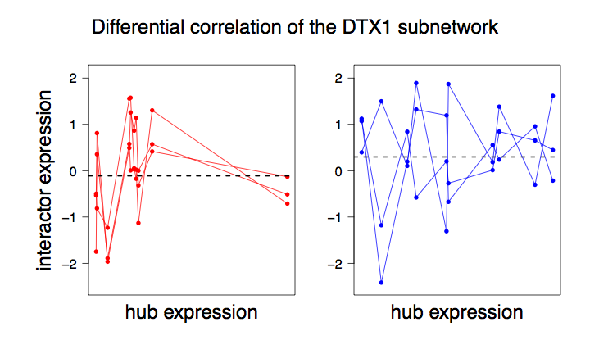
Closer look

Slide 78
Summary so far - our approach
To predict survival prognosis for Stage III melanoma patients.
Which platforms or combination of platforms is better ?
To identify candidate biomarkers: Is there different ways to think about biomarkers
  Identify biomarkers with differential distributions.
  Identify network biomarkers – which may help us understand underlying mechanism.
Can we trust the biomarker ?
  Cross-validation between multiple datasets.
Can we trust the platform ?
  Technical (Wet lab) validation of iTRAQ technology.

Slide 79
Do we pick up different genes ?
Scatter plot between DE and Differential correlation
Focus on the hub gene

