Slide 1
Momentum Polarization: an Entanglement Measure of Topological Spin and Chiral Central Charge
Xiao-Liang Qi
Stanford University
Banff, 02/06/2013

Slide 2
Reference: Hong-Hao Tu, Yi Zhang, Xiao-Liang Qi, arXiv:1212.6951 (2012)
Hong-Hao Tu (MPI)
Yi Zhang (Stanford)

Slide 3
Outline
Topologically ordered states and topological spin of quasi-particles
Momentum polarization as a measure of topological spin and chiral central charge
Momentum polarization from reduced density matrix
Analysis based on conformal field theory in entanglement spectra
Numerical results in Kitaev model and Fractional Chern insulators
Summary and discussion

Slide 4
Topologically ordered states
Topological states of matter are gapped states that cannot be adiabatically deformed into a trivial reference with the same symmetry properties.
Topologically ordered states are topological states which has ground state degeneracy and quasi-particle excitations with fractional charge and statistics. (Wen)
Example: fractional quantum Hall states.
$$B⊗$$
Topo. Ordered states
Topological states

Slide 5
Topologically ordered states
Only in topologically ordered states with ground state degeneracy, particles with fractionalized quantum numbers and statistics is possible.
A general framework to describe topologically ordered states have been developed (for a review, see Nayak et al RMP 2008)
A manifold with certain number and types of topological quasiparticles define a Hilbert space.
$$\overline{c}$$
$$b$$
$$a$$
$$c$$

Slide 6
Fractional statistics of quasi-particles
Particle fusion: From far away we cannot distinguish two nearby particles from one single particle ➔Fusion rules $a×b=\sum_{c}{N_{ab}^{c}c}.$ Multiple fusion channels for Non-Abelian statistics
Braiding: Winding two particles around each other leads to a unitary operation in the Hilbert space. From far away, $a$ and $b$ looks like a single particle $c$, so that the result of braiding is not observable from far away. ➔Braiding cannot change the fusion channel $c$ and has to be a phase factor $R_{ab}^{c}=e^{iθ_{ab}^{c}}$
$$c$$
$$b$$
$$a$$

Slide 7
Topological spin of quasi-particles
Quasi-particles obtain a Berry’s phase $e^{i2πh}$ when it’s spinned by $2π$.
Spin is required since the braiding of particles $a, b$ looks like spinning the fused particle $c$ by $π$.
In general the spins $h_{a,b,c}$ are related to the braiding $θ_{ab}^{c}$ (the “pair of pants” diagram):
Examples:
1. $q/m$ charge particle in $1/m$ Laughlin state: $h=πq^{2}/m$
2. Three particles $(1,σ,ψ)$ in the Ising anyon theory $$h=(0,\frac{1}{16},\frac{1}{2})$$
$$c$$
$$c$$
$$a$$
$$b$$
$$a$$
$$b$$
$${2θ}_{ab}^{c} = 2π(h_{a}+h_{b}−h_{c})$$

Slide 8
Topological spin of quasi-particles
Topological spin of particles determines the fractional statistics.
Moreover, topological spin also determines one of the Modular transformation of the theory on the torus
Spin phase factor $e^{2πih_{a}}$ is the eigenvalue of the Dehn twist operation:
$$a$$
$$a$$
$$a$$
$$a$$

Slide 9
Chiral central charge of edge states
Another important topological invariant for chiral topological states.
Energy current carried by the chiral edge state is universal if the edge state is described by a CFT. $I_{E}=\frac{π}{6}cT^{2}$ (Affleck 1986)
The central charge also appears (mod 24) in the modular transformations.

Slide 10
Measuring $h_{a}$ and $c$
The values of topological spin and $c$ mod $24$ can be computed algebraically for an ideal topological state (TQFT).
Analytic results on FQH trial wavefunctions (N. Read PRB ‘09, X. G. Wen&Z. H. Wang PRB ’08, B. A. Bernevig&V. Gurarie&S. Simon, JPA ’09 etc)
Numerics on Kitaev model by calculating braiding (V. Lahtinen & J. K. Pachos NJP ’09, A. T. Bolukbasi and J. Vala, NJP ’12)
Numerical results on variational WF using modular S-matrix (e.g. Zhang&Vishwanath ’12)
Central charge is even more difficult to calculate.
We propose a new and easier way to numerically compute the topological spin and chiral central charge for lattice models.

Slide 11
Momentum polarization
Consider a lattice model on the cylinder, with lattice translation symmetry $T_{y}$ ($T_{y}^{L_{y}}=1$)
For a state with quasiparticle $a$ in the cylinder, rotating the cylinder is equivalence to spinning two quasi-particles to opposite directions.
A Berry’s phase $e^{i2πh_{a}/L_{y}}$ is obtained at the left edge, which is cancelled by an opposite phase at the right.
Total momentum of the left (right) edge $±2πh_{a}/L_{y}$➔Momentum polarization $P_{M}=2πh_{a}/L_{y}$
$$e^{i2πh_{a}/N_{y}}$$
$$a$$
$$a$$
$$T_{y}$$
$$e^{−i2πh_{a}/N_{y}}$$

Slide 12
Momentum polarization
Viewing the cylinder as a 1D system, the translation symmetry is an internal symmetry of 1D system, of which the edge states carry a projective representation.
(A generalization of the 1D results Fidkowski&Kitaev, Turner et al 10’, Chen et al 10’)
Ideally we want to measure
Difficult to implement. Instead, define discrete translation $T_{y}^{L}$. Translation of the left half cylinder by one lattice constant

Slide 13
Momentum polarization
Naive expectation: $T_{y}^{L}|G_{a}〉∼e^{i\frac{2π}{L_{y}}h_{a}}|G_{a}〉$ contributed by the left edge. However the mismatch in the middle leads to excitations and makes the result nonuniversal.
Our key result: $〈G_{a}\left|T_{y}^{L}\right|G_{a}〉=\exp{[i\frac{2π}{L_{y}}\left(h_{a}−\frac{c}{24}\right)−αL_{y}]}$
$α$ is independent from topological sector $a$
Requiring knowledge about topological sectors. Even if we don’t know which sector is trivial $|G_{1}〉$, $h_{a}$ can be determined up to an overall constant by diagonalizing $〈G_{n}\left|T_{y}\right|G_{m}〉$ .

Slide 14
Momentum polarization and entanglement
$T_{y}^{L}$ only acts on half of the cylinder
The overlap $λ_{a}=〈G_{a}\left|T_{y}^{L}\right|G_{a}〉=tr(T_{y}^{L}ρ_{La})$
$ρ_{La}$ is the reduced density matrix of the left half.
Some properties of $ρ_{La}$ are known for generic chiral topological states.
Entanglement Hamiltonian $ρ_{La}=e^{−H_{Ea}}$. (Li&Haldane ‘08) In long wavelength limit, for chiral topological states $H_{Ea}∝H_{CFT}{\left.​\right|}_{a}+const.$
Numerical observations (Li&Haldane ’08, R. Thomale et al ‘10, .etc.)
Analytic results on free fermion systems (Turner et al ‘10, Fidkowski ‘10), Kitaev model (Yao&Qi PRL ‘10), generic FQH ideal wavefunctions (Chandran et al ‘11)
A general proof (Qi, Katsura&Ludwig 2011)
Notes:
Check papers here

Slide 15
General results on entanglement Hamiltonian
A general proof of this relation between edge spectrum and entanglement spectrum for chiral topological states (Qi, Katsura&Ludwig 2011)
Key point of the proof: Consider the cylinder as obtained from gluing two cylinders
Ground state is given by perturbed CFT $H_{L}+H_{R}+rH_{int}$
B
“glue”
B
$$r=1$$
B
$$rH_{int}$$
A
A
A

Slide 16
Momentum polarization: analytic results
Following the results on quantum quench of CFT (Calabrese&Cardy 2006), a general gapped state in the “CFT+relevant perturbation” system has the asymptotic form in long wavelength limit
${|G}_{a}⟩=e^{−τ_{0}\left(H_{L}+H_{R}\right)}$ $⋅\sum_{n=0,1,…}{\sum_{d_{a}(n)}{{\left|n,d_{a}\left(n\right)\right\rangle }_{L}{\overline{\left|n,d_{a}\left(n\right)\right\rangle }}_{R}}}$
This state has an left-right entanglement density matrix $ρ_{La}=Z^{−1}e^{−4τ_{0}H_{L}}{\left.​\right|}_{a}$.
Including both edges, $ρ_{La}=Z^{−1}e^{−{(β}_{l}H_{l}+β_{r}H_{r})}{\left.​\right|}_{a}$ $β_{l}=∞, β_{r}=4τ_{0}<∞$
$$t$$
$\left|G_{a}\right\rangle$
$$τ_{0}$$
Maximal entangled state $\left|G_{0a}\right\rangle$
$$β_{r}$$
$$β_{l}$$

Slide 17
Momentum polarization: analytic results
$ρ_{L}$ describes a CFT with left movers at zero temperature and right movers at finite temperature. In this approximation, $λ_{a}=tr\left(T_{y}^{L}ρ_{La}\right)=tr\left(e^{i\left(H_{l}−H_{r}\right)}ρ_{La}\right)$ $=\frac{χ_{a}\left(e^{2π\frac{i−β_{l}}{L_{y}}}\right){\overline{χ}}_{a}\left(e^{2π\frac{−i−β_{r}}{L_{y}}}\right)}{χ_{a}\left(e^{−2π\frac{β_{l}}{L_{y}}}\right){\overline{χ}}_{a}\left(e^{−2π\frac{β_{r}}{L_{y}}}\right)}$
$χ_{a}\left(q\right)=tr(q^{L_{0}})$ is the torus partition function in sector $a$. In the limit $β_{r}≪L_{y}$, left edge is in low T limit and right edge is in high T limit.
Doing a modular transformation gives the result $λ_{a}=\exp{[i\frac{2π}{L_{y}}\left(h_{a}−\frac{c}{24}\right)−αL_{y}]}$ $α=−\frac{c}{24}\frac{2πi}{β_{r}\left(β_{r}−i\right)}$nonuniversal contribution independent from $a$.

Slide 18
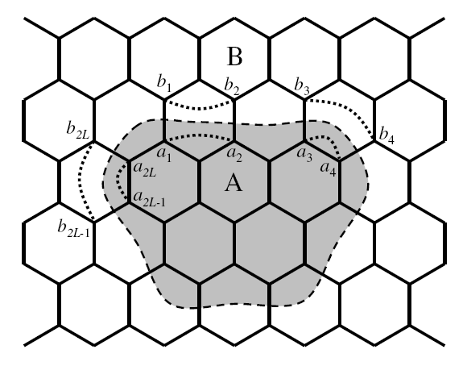
Momentum polarization: Numerical results on Kitaev model
Numerical verification of this formula
Honeycomb lattice Kitaev model as an example (Kitaev 2006)
An exact solvable model with non-Abelian anyon
Solution by Majorana representation with the constraint
$H=−\sum_{x−link}{J_{x}σ_{i}^{x}σ_{j}^{x}}−\sum_{y−link}{J_{y}σ_{i}^{y}σ_{j}^{y}}$- $\sum_{z−link}{J_{z}σ_{i}^{z}σ_{j}^{z}}$
Physical Hilbert space
Enlarged Hilbert space

Slide 19
Momentum polarization: Numerical results on Kitaev model
In the enlarged Hilbert space, the Hamiltonian is free Majorana fermion
$u_{ij}^{a}$ become classical $Z_{2}$ gauge field variables.
Ground state obtained by gauge average
Reduced density matrix can be exactly obtained (Yao&Qi ‘10)
$T_{y}^{L}$ becomes gauge covariant translation of the Majorana fermions
$$T_{y}^{LF}$$
$${\tilde{T}}_{y}$$
Gauge transformation

Slide 20
Momentum polarization: Numerical results on Kitaev model
$$1$$
Non-Abelian phase of Kitaev model (Kitaev 2006)
Chern number 1 band structure of Majorana fermion
$π$ flux in a plaquette induces a Majorana zero mode and is a non-Abelian anyon.
On cylinder, 0 flux leads to zero mode
$$γ_{k}^{+}$$
$$γ_{−k}^{+}$$
$$ψ$$
$$σ$$
$$E$$
$$E$$
$$φ=π$$
$$φ=0$$
$$k$$
$$k$$

Slide 21
Momentum polarization: Numerical results on Kitaev model
Fermion density matrix $ρ_{LF}=Z^{−1}e^{−η_{i}h_{E}^{ij}η_{j}}$ is determined by the equal-time correlation function $〈η_{i}η_{j}〉$ (Peschel ‘03)
$T_{y}=exp[i\sum_{k,n}{kγ_{kn}^{+}γ_{kn}}]$ in entanglement Hamiltonian eigenstates. ($H_{E}=\sum_{n}{γ_{kn}^{+}γ_{kn}}λ_{n}$)
We obtain $λ_{σ,1}=\det\left[\frac{e^{\frac{ip}{2}}\cosh{\frac{h_{E}−ip}{2}}}{\cosh{\frac{h_{E}}{2}}}\right]{\left.​\right|}_{flux 0,π}$

Slide 22
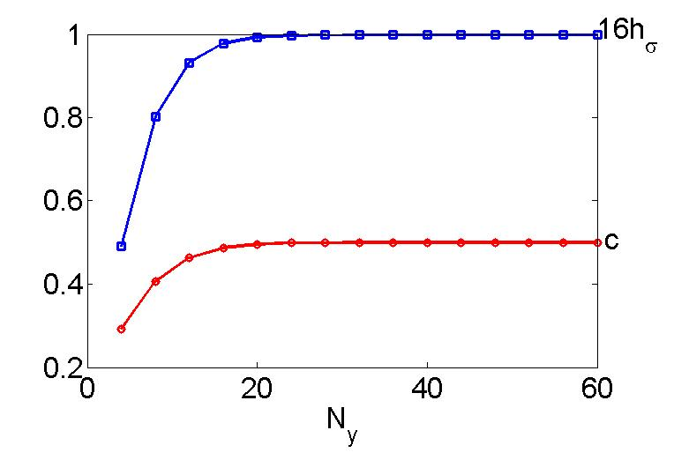
Momentum polarization: Numerical results on Kitaev model
Numerically, $h_{σ}=\frac{N_{y}}{2πi}\log{\frac{λ_{σ}}{λ_{1}}}$
$h_{ψ}=\frac{1}{2}$ is known analytically)
Central charge $c$ can also be extracted from the comparison with CFT result $λ_{a}=e^{i\frac{2π}{L_{y}}\left(h_{a}−\frac{c}{24}\right)}e^{\frac{c}{24}\frac{2πL_{y}i}{β_{r}\left(β_{r}−i\right)}}$
$imag(\log{λ_{1})=−\frac{c}{24}\left[\frac{2π}{L_{y}}+\frac{2πL_{y}}{1+β_{r}^{2}}\right]}$

Slide 23
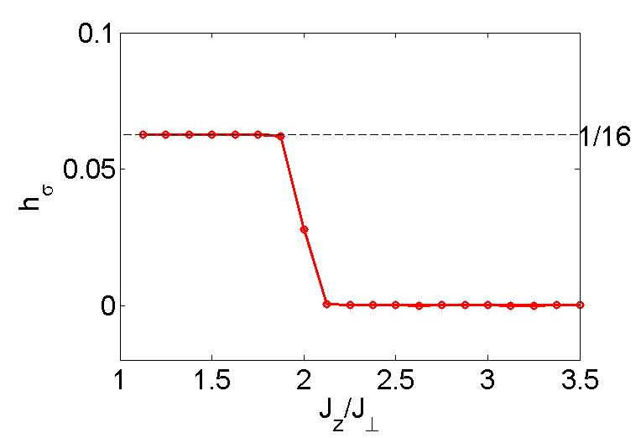
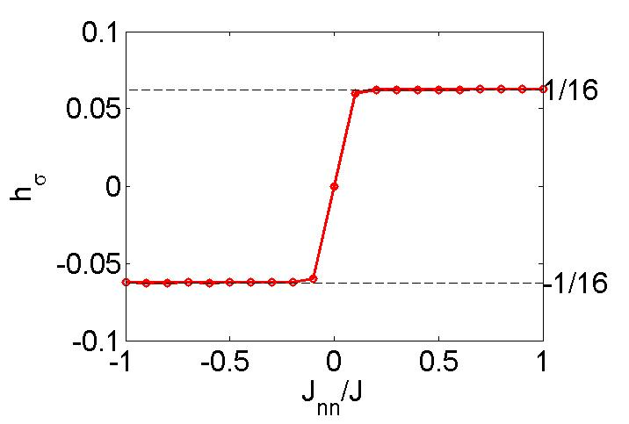
Momentum polarization: Numerical results on Kitaev model
The result converges quickly for $N_{y}>$correlation length $ξ$
Across a topological phase transition tuned by $\frac{J_{z}}{J_{x}}$ to an Abelian phase, we see the disappearance of $h_{σ}$
Sign of $h_{σ}$ determined by second neighbor coupling $J_{nn}$

Slide 24
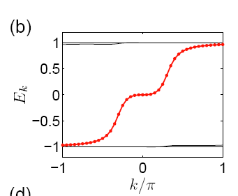
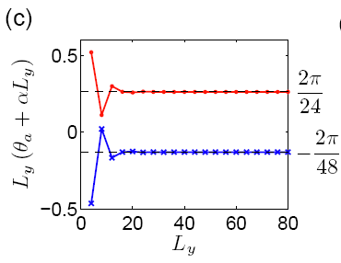
Momentum polarization: Numerical results on Kitaev model
Interestingly, this method goes beyond the edge CFT picture.
Measurement of $h_{σ}$ and $c$ are independent from edge state energy/entanglement dispersion. In a modified model, the entanglement dispersion is $E∝k^{3}$, the result still holds.
$J_{nn}$ turned off

Slide 25
Momentum polarization: Numerical results on Fractional Chern Insulators
Fractional Chern Insulators: Lattice Laughlin states
Projective wavefunctions as variational ground states
E.g., for $ν=\frac{1}{2}$: $|G〉=P|G_{1}〉⊗|G_{2}〉$
$|G_{1,2}〉$: Parton IQH ground states $P$: Projection to parton number $n_{1}=n_{2}$ on each site
Two partons are bounded by the projection
Such wavefunctions can be studied by variational Monte Carlo.

Slide 26
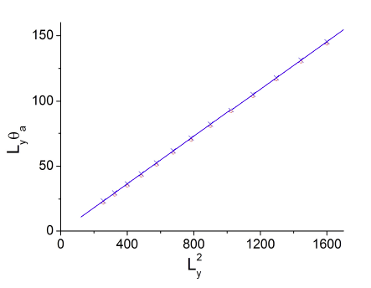
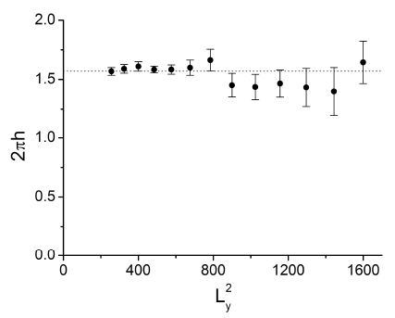
Momentum polarization: Numerical results on Fractional Chern Insulators
Different topological sectors are given by (Zhang &Vishwanath ‘12) $|Φ_{1}〉=P\left(c_{L1}^{+}c_{L2}^{+}+c_{R1}^{+}c_{R2}^{+}\right)|G_{1}〉⊗|G_{2}〉$ $|Φ_{2}〉= P\left(c_{L1}^{+}c_{R2}^{+}+c_{R1}^{+}c_{L2}^{+}\right)|G_{1}〉⊗|G_{2}〉$
$〈T_{y}^{L}〉$ can be calculated by Monte Carlo. $c=1.078±0.091, h_{s}=0.252±0.006$
Non-Abelian states can also be described
Notes:
Discuss more background on FCI wavefunctions

Slide 27
Conclusion and discussion
A discrete twist of cylinder measures the topological spin and the edge state central charge $Im\log{{〈T_{y}^{L}〉}_{a}=\left(h_{a}−\frac{c}{24}\right)\frac{2π}{L_{y}}−α_{2}L_{y}}$
A general approach to compute topological spin and chiral central charge for chiral topological states
Numerically verified for Kitaev model and fractional Chern insulators. The result goes beyond edge CFT.
This approach applies to many other states, such as the MPS states (see M. Zaletel et al ’12, Estienne et al ‘12).
Open question: More generic explanation of this result

Slide 28
Thanks!

Slide 29
Momentum polarization: Numerical results on Kitaev model
Macroscopic ground state degeneracy in the enlarged Hilbert space
The degeneracy is removed in the physical Hilbert space
1
-1
1
-1
1
gauge transformation
-1
Summation over all possible gauge transformations

Slide 30
Momentum polarization: Numerical results on Kitaev model
Due to the classical nature of the $Z_{2}$ gauge field, the entanglement in the system is almost separable into that of the fermion and gauge field sectors.
Renyi entropy $S_{n}=S_{Fn}+S_{Gn}$ ($S_{Gn}=\left(L−1\right)log 2$) Density matrix $ρ_{A}=\sum_{g_{A},g_{A}^{′},w}{Y_{gA}ρ_{F}(u)Y_{gA′}^{+}⊗|g_{A}u,w〉〈g_{A}^{′}u,w|}$
$ρ_{F}(u)$: Fermion reduced density matrix in a certain gauge $u$. $g_{A}, g_{A}^{′}$: gauge transformations. $w$: boundary $Z_{2}$ variables. $Y_{gA}:$ unitary gauge transformation to fermions
(Yao&Qi ‘10)

Slide 31
Momentum polarization: Numerical results on Kitaev model
Translation operator average value
$λ_{a}=tr\left(T_{y}^{L}ρ_{A}\right)=\sum_{g_{A},g_{A}^{′},w}{tr_{F}\left(T_{y}^{LF}Y_{gA}ρ_{F}Y_{gA^{′}}^{+}\right)}$ $⋅〈g_{A}^{′}u,w|T_{y}^{LG}|g_{A}u,w〉$
The translation on $Z_{2}$ gauge fields gives a $δ$ function: $g_{A}^{′}$ is determined by $g_{A},$denoted by $g_{A}^{T}$.
$λ_{a}=\sum_{g_{A},w}{tr_{F}\left({Y_{g_{A}^{T}}^{+}T}_{y}^{LF}Y_{g_{A}}ρ_{F}\right)}$
${Y_{g_{A}^{T}}^{+}T}_{y}^{LF}Y_{g_{A}}=\tilde{T_{y}}$ the translation combined with gauge transformation.
$$T_{y}^{LF}$$
$${\tilde{T}}_{y}$$
Gauge transformation

