Slide 1
From Natural Images to MRIs: Using TDA to Analyze Image Data
Maria Gommel, University of Iowa
Topological Methods in Brain Network Analysis
May 10, 2017

Slide 2
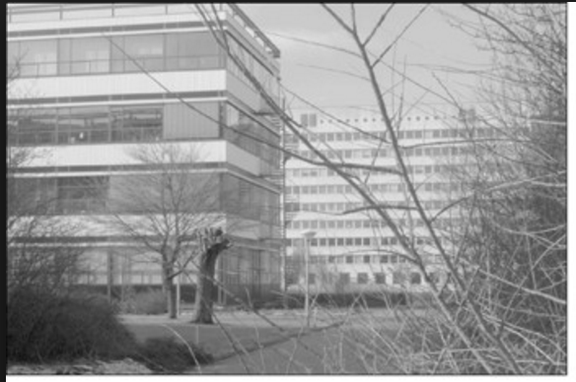
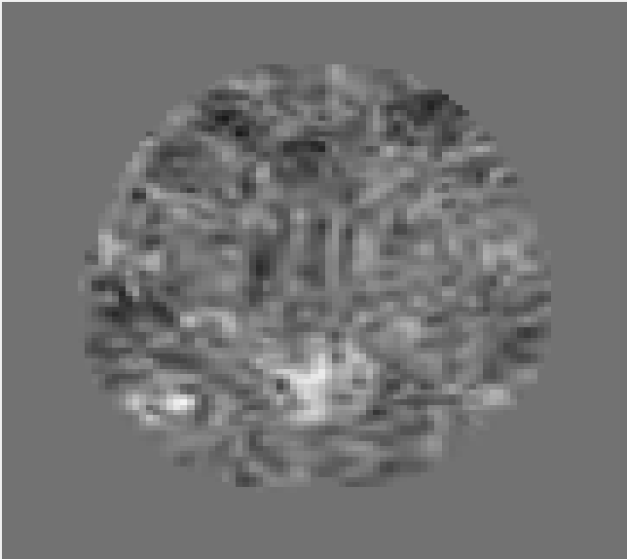
Motivation
vs.
Natural Image from van Hateren and van der Schaaf dataset
Slice of fMRI image from Nopoulos Lab (University of Iowa)

Slide 3
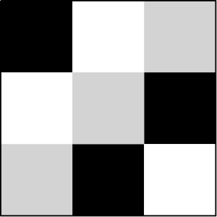
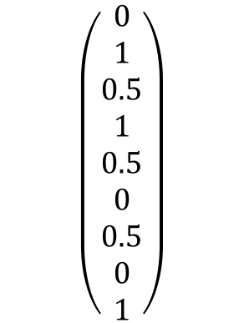
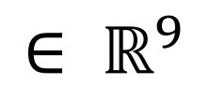
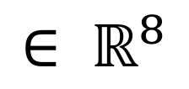
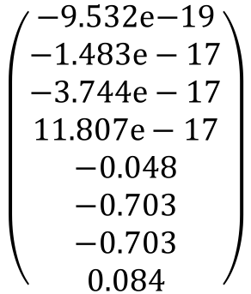
Results on Natural Images
$$\left(\begin{aligned}0 \\ 1 \\ 0.5 \\ 1 \\ 0.5 \\ 0 \\ 0.5 \\ 0 \\ 1\end{aligned}\right)$$
$$\left(\begin{aligned}\text{−9.532}\text{e}\text{−19} \\ −1.483e−17 \\ −3.744e−17 \\ 11.807e−17 \\ −0.048 \\ −0.703 \\ −0.703 \\ 0.084\end{aligned}\right)$$
$$∈ ℝ^{9}$$
$$∈ ℝ^{8}$$
Extract 3x3 pixel patches from
the images (natural image)
Create a vector corresponding
to the greyscale value of each pixel
Normalize intensity, extract high contrast
patches, and normalize contrast
Gunnar Carlsson, Tigran Ishkhanov, Vin de Silva, and Afra Zomorodian. On the local behavior of spaces of natural images. International Journal of Computer Vision, 76(1):1–12, 2008.

Slide 4

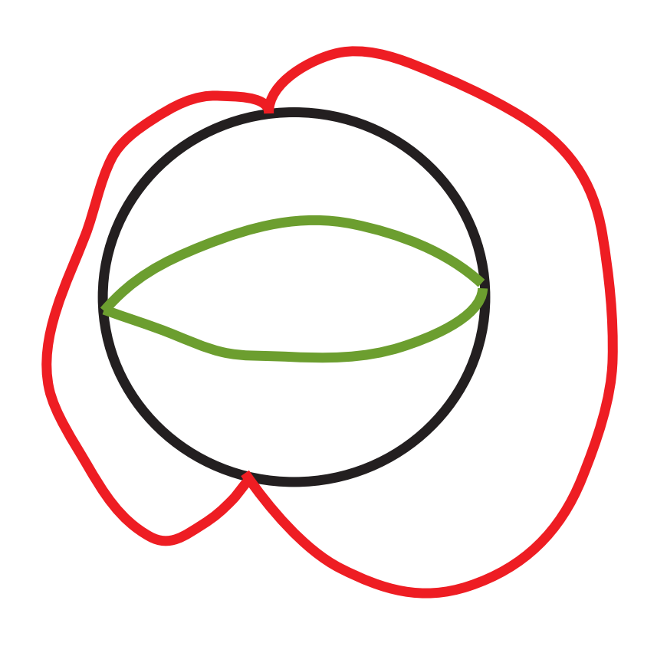
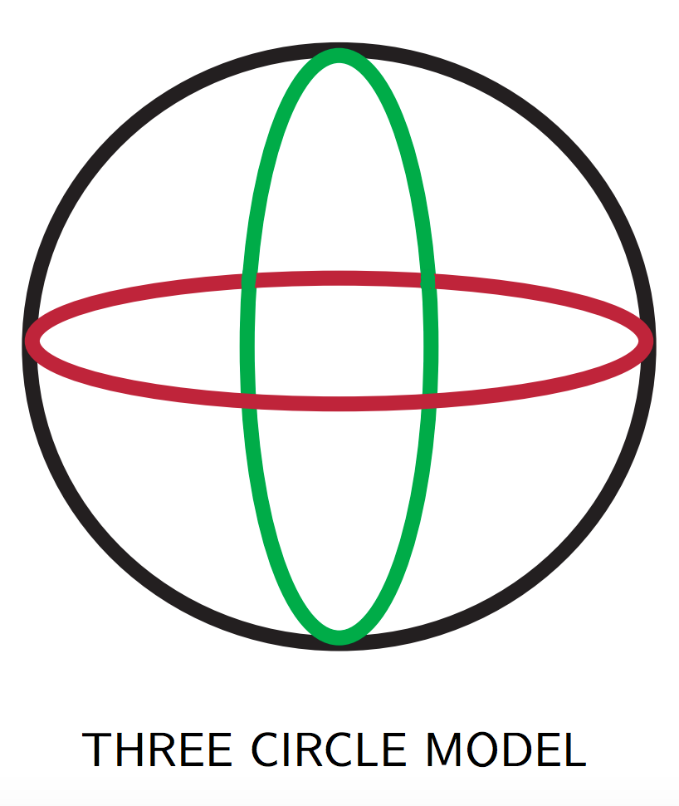
Results on Natural Images
Barcode (dimension 1) for the top 30% densest patches, where density is measured using KNN, k = 15
Images from Carlsson’s talk “Topological Methods for Large and Complex Data Sets”, 2012. https://www.ima.umn.edu/materials/2011-2012/W3.26-30.12/11925/imamachinefinal.pdf

Slide 5
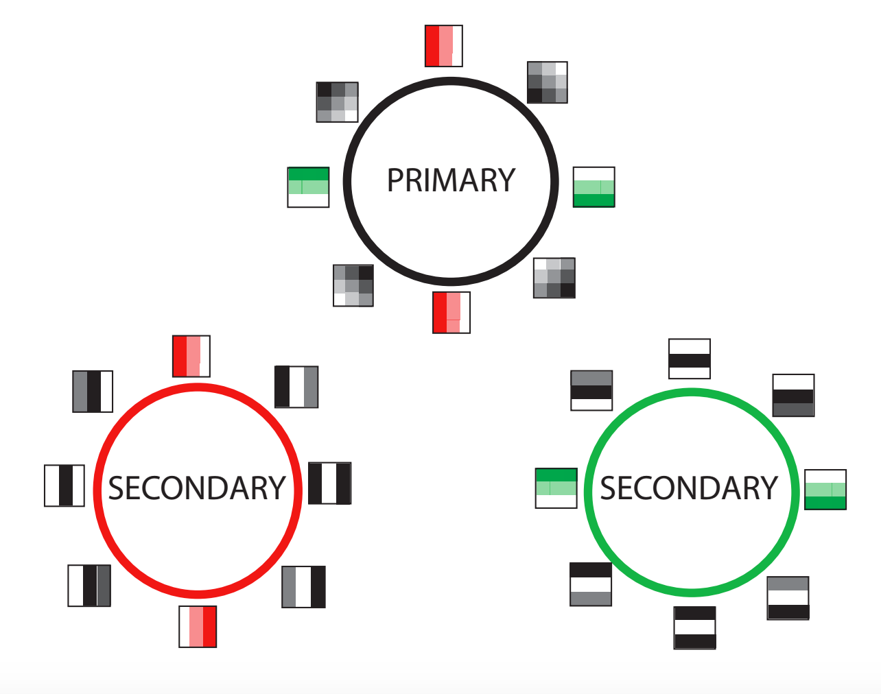
Results on Natural Images
Images from Carlsson’s talk “Topological Methods for Large and Complex Data Sets”, 2012. https://www.ima.umn.edu/materials/2011-2012/W3.26-30.12/11925/imamachinefinal.pdf

Slide 6
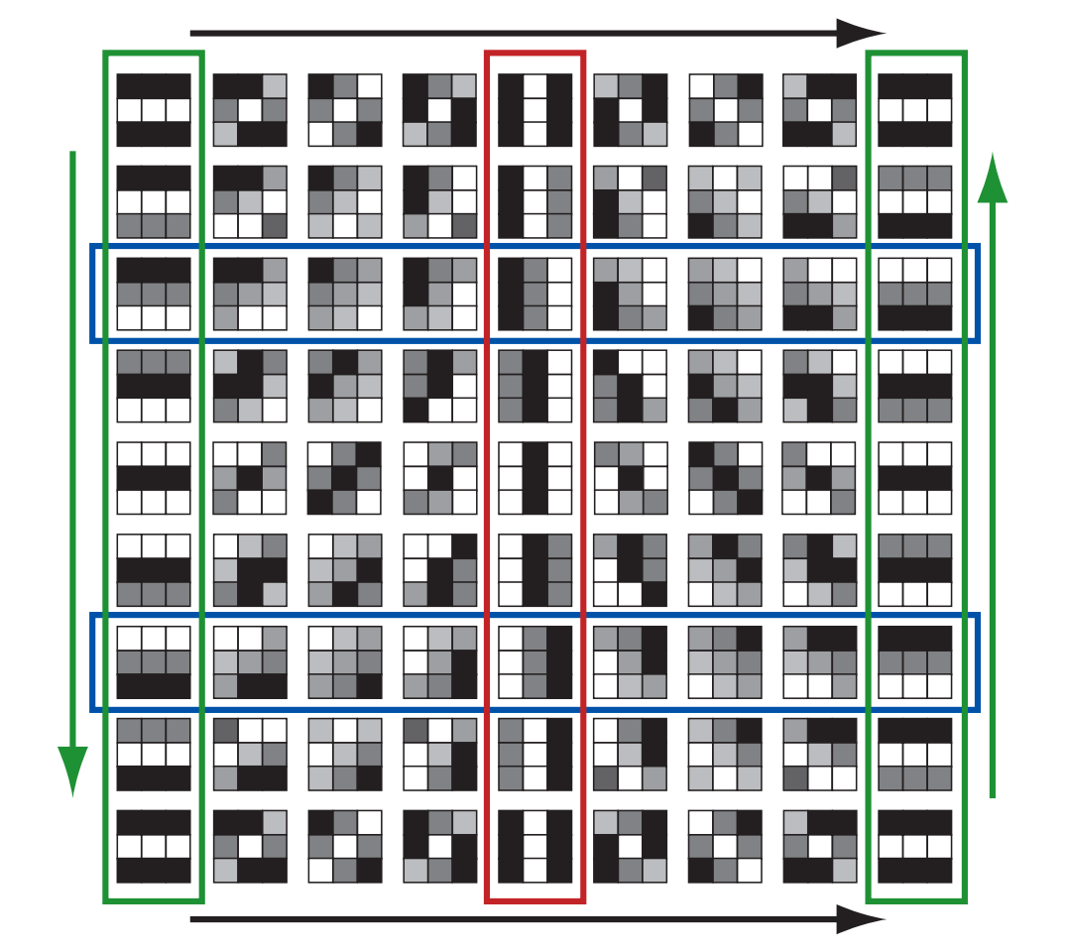
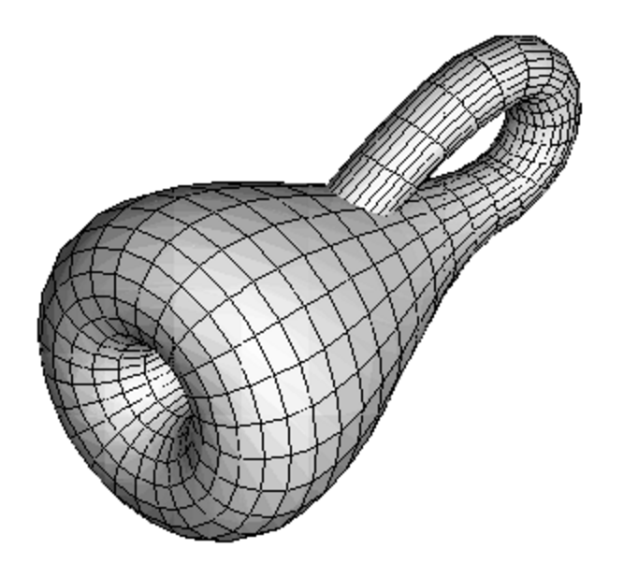
Results on Natural Images
Image from http://www.math.union.edu/~dpvc/papers/rp2/Glossary/KleinBottle.html
Image from Robert Ghrist, “Barcodes: The Persistent Topology of Data”

Slide 7
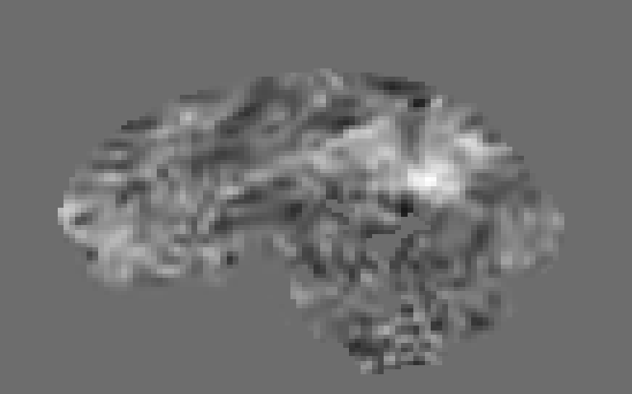
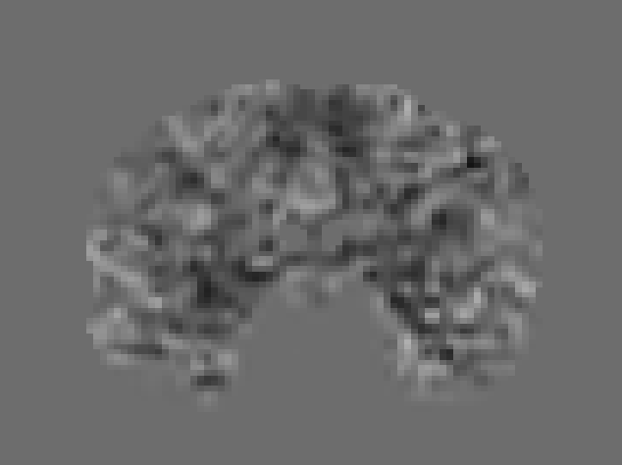
Toy Problem: Apply same ideas to fMRI image
We fix one slice, and extract patches from this slice from each patient
Our data is three-dimensional

Slide 8
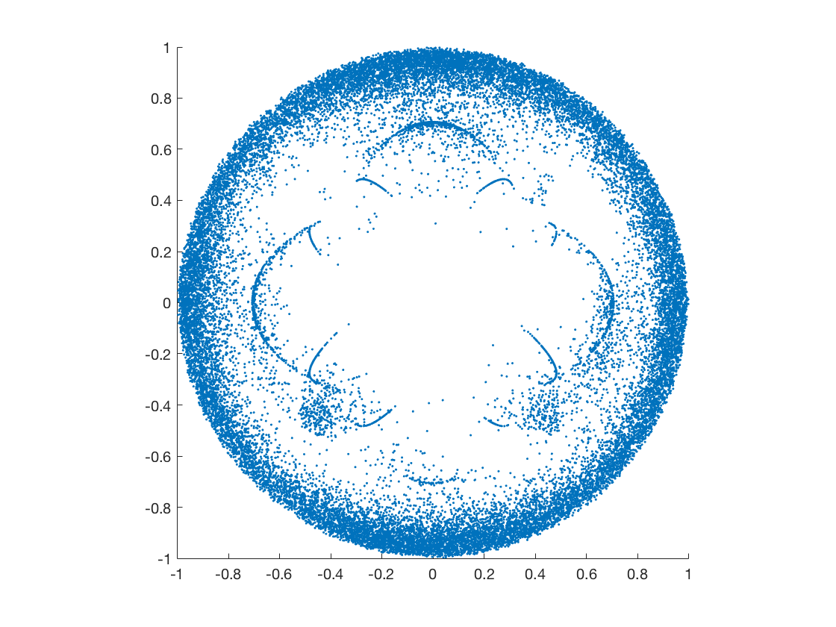
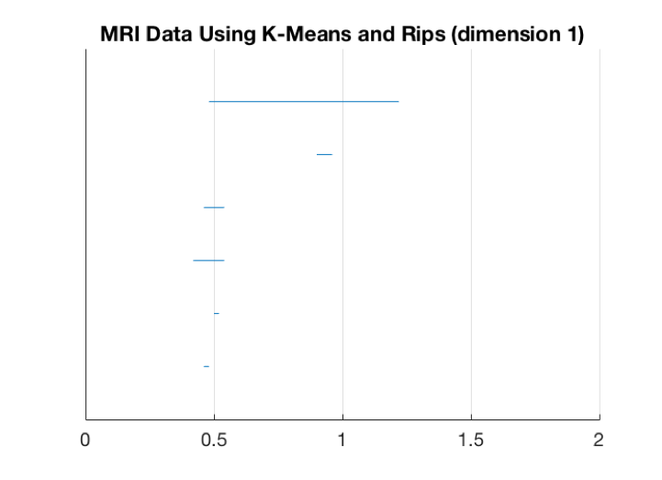
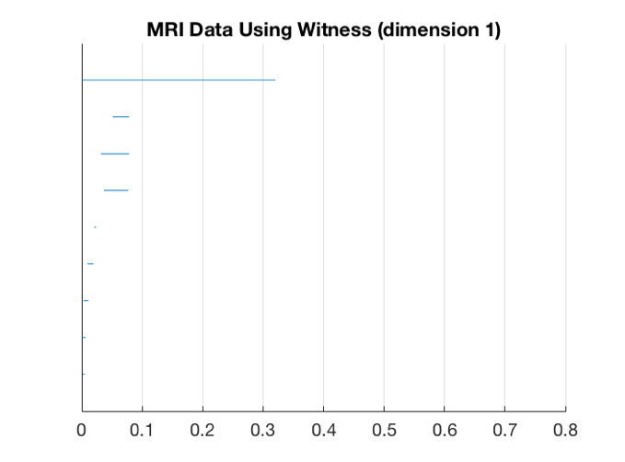
Initial Results – fMRI Data
Projection of the data onto the first two coordinates
Barcode (dimension 1) using K-means to find centroids, then using the Rips complex
Barcode (dimension 1) using the witness complex
Results from the 30% densest points, where density is measured using kNN with k = 15

Slide 9
There is much more we could do…
Find which patches form the circle.
  Then, look for the placement of these patches in the original image.
What are the other structures that appear in the projection?
Use 3x3x3 pixel cubes instead of 3x3 squares.

Slide 10
…but we have many questions.
Are we using the “correct” data for this analysis?
  The data we’ve been using are “seed-derived network maps”.
  What would our results mean in this context? Would the results be useful?
  Unseeded, 4-dimensional data is also available, but adds another layer of complexity.
Are these methods appropriate for fMRI data?
  Natural images and MRIs are very different in many ways.
  Should we use patches and other image processing techniques on fMRI data?

Slide 11
Questions?
If you have ideas or comments about this project, please share them with me! I’d very much appreciate it. ☺

Slide 12
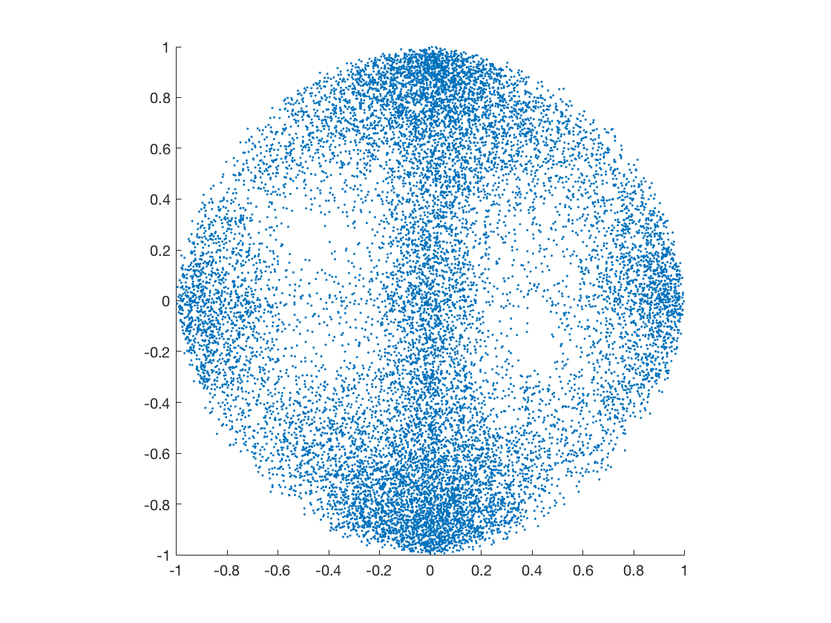
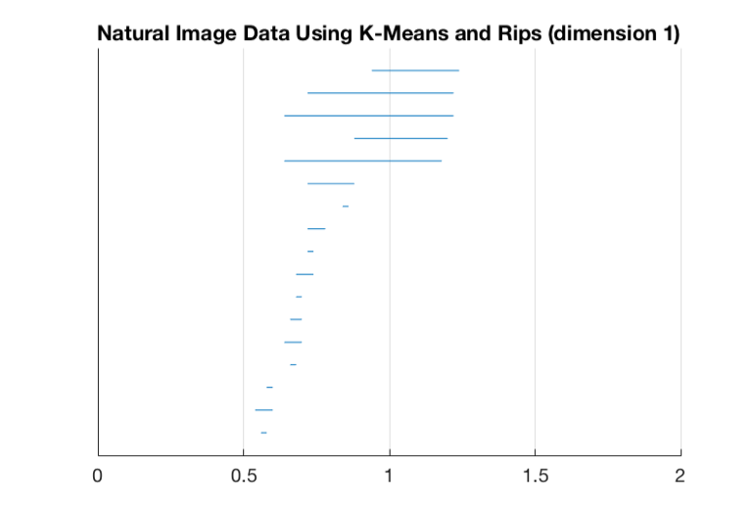
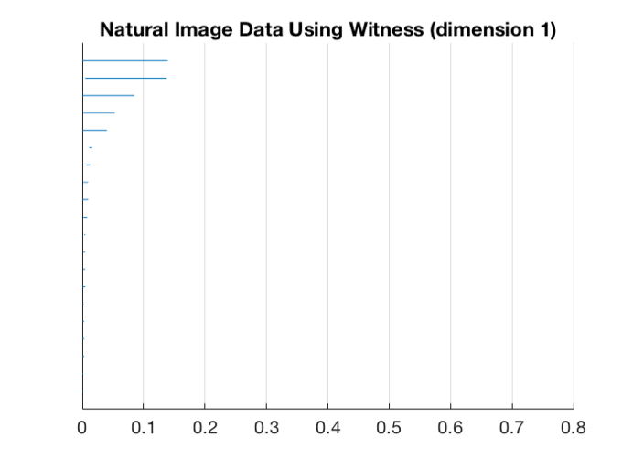
Initial Results – replication of natural images
Projection of the data onto the first two coordinates
Barcode (dimension 1) using K-means to find centroids, then using the Rips complex
Barcode (dimension 1) using the witness complex
Results from the 30% densest points, where density is measured using kNN with k = 15

