Slide 1
Feedforward, Feedback and Response Variability
André Longtin
Physics
Centre for Neural Dynamics
University of Ottawa
BIRS Topological Methods in Brain Network Analysis, May 2017

Slide 2
QUESTIONS
ORIGIN OF NEURAL RESPONSE VARIABILITY
Are networks constantly reconfiguring themselves based on past history?
HOW DOES THE NOISE INDUCE EFFECTIVE CONNECTIVITY (and topology)?
Quasi-Cycles:
noise induces oscillatory activity

Slide 3
The trouble with noise…

Slide 4
The trouble with noise…
You have to use Fokker-Planck formalism to understand dynamics, and therefore, functional connectivity

Slide 5
Networks talk to each other slowly
Delays between brain regions can be quite long (tens of milliseconds)
But the trouble with noisy delayed networks is:

Slide 6
You can’t use Fokker-Planck
Dynamics are non-markovian…But:
We developed approximate formalism to understand random activity

Slide 7
Linear Response Theory (LRT)
Can be very accurate even for:
noisy spiking neurons
delays
multiple populations
arbitrary connectivity
Spatially and temporally correlated input

Slide 8
Linear Response theory for spiking neural nets with noise and delay (2004,2005)
y_{i}(t) : spike train from i^{th} neuron in a network
Assuming weak inputs, the Fourier transform of the spike train is:
Y_{i}(ω)=Y_{bg}(ω) + A(ω) X_{i}(ω)
A(ω): intrinsic frequency response of the noisy neuron
X_{i}(w): Fourier transform of input (external + feedback) to neuron i.

Slide 9
Linear Response theory for spiking neural nets with noise and delay (2004,2005)
y_{i}(t) : spike train from i^{th} neuron in a network
Assuming weak inputs, the Fourier transform of the spike train is:
Y_{i}(ω)=Y_{bg}(ω) + A(ω) X_{i}(ω)
Spontaneous activity
A(ω): intrinsic frequency response of the noisy neuron
X_{i}(w): Fourier transform of input (external + feedback) to neuron i.

Slide 10
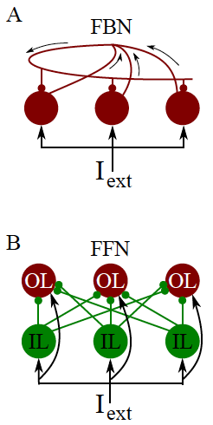
FBN: Feedback FNN: feedforward
IL: input layer OL: output layer

Slide 11
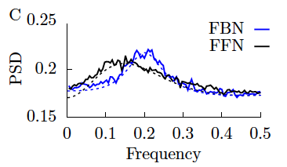
Both display a peak !

Slide 12
Why am I telling you about this?
I have recently begun trying to understand EEG and fMRI data
Controls + psychiatric patients
For example, certain (depressed) patients have different perceptions of the flow of time
Other (schizophrenic) patients have a different sense of peri-personal space
Collaboration with Georg Northoff, Inst. Mental Health Research, Royal Ottawa Hospital
I also started talking with Maia Fraser
(Math Department, across the street)

Slide 13
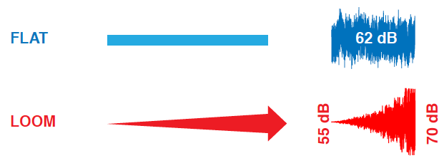
With Georg and trainees, method to extract more predictability from evoked responses
We look at human EEG data

Slide 14
New Adventure
Can we use linear response theory to understand
- response variability?
dependence on correlation time of resting state
how noise determines topological structure
Provide tests/null hypotheses about network activity
that yield similar topological features across time scales
→ varying topological features across repeated stimuli.

