Slide 1



Medial temporal lobe measurements and cognitive decline
Rosanna Olsen
Topological Methods in Brain Network Analysis
May 11, 2017

Slide 2
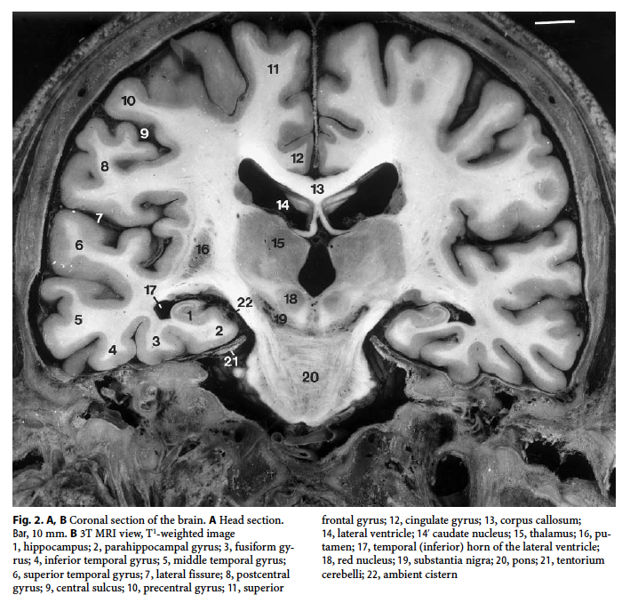
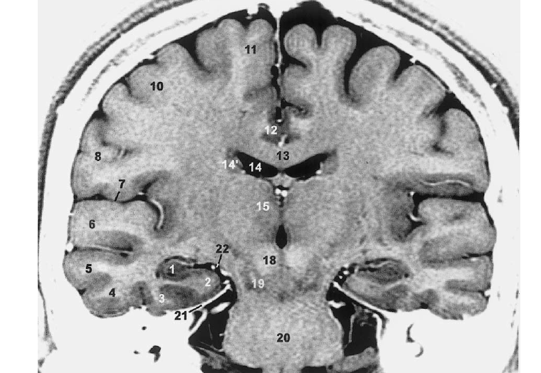
Hippocampal and medial temporal lobe (MTL) subregions
Duvernoy, 2005

Slide 3
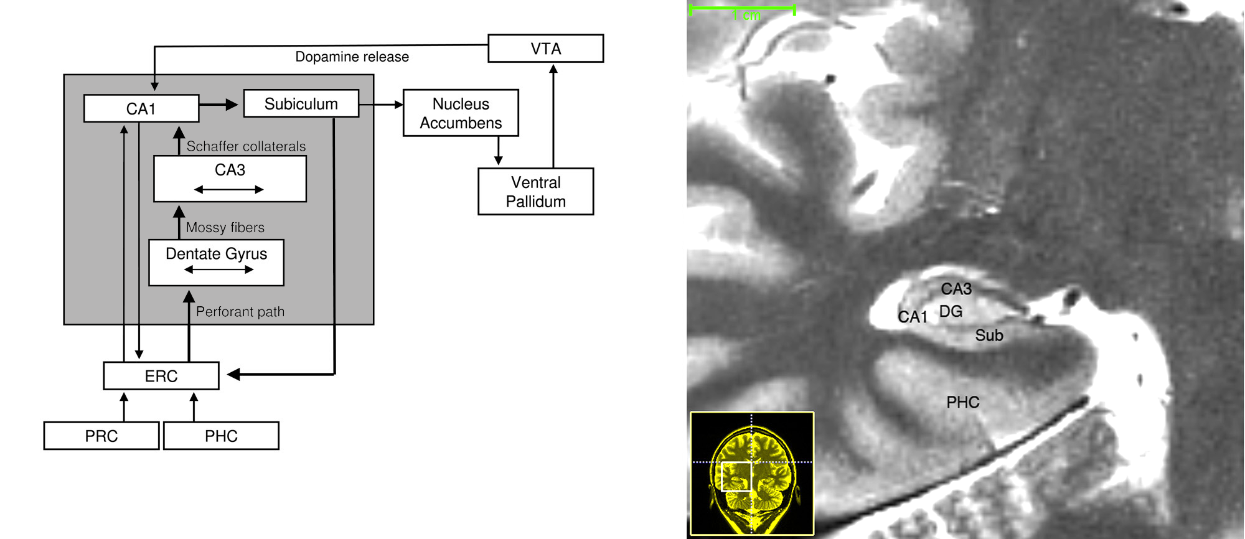
Organization of the medial temporal lobe
Olsen et. al., Frontiers in Human Neuroscience, 2012

Slide 4
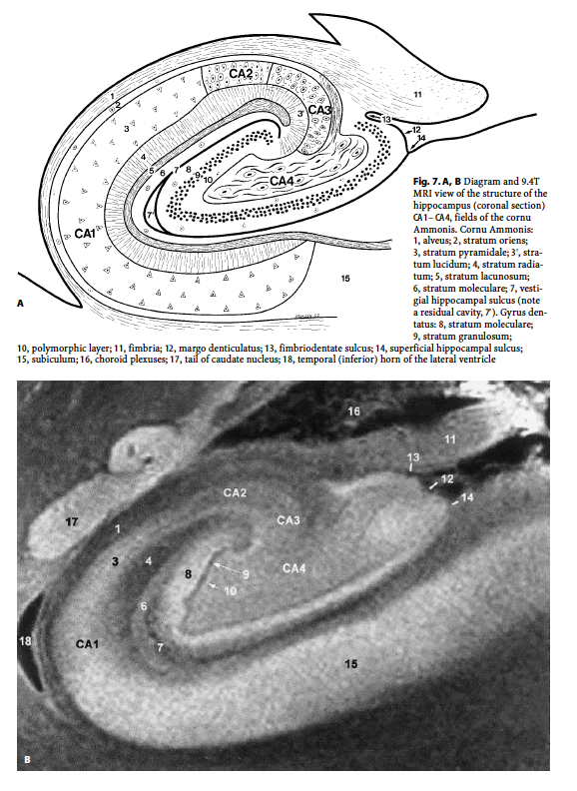
Organization of the medial temporal lobe
Duvernoy, 2005

Slide 5
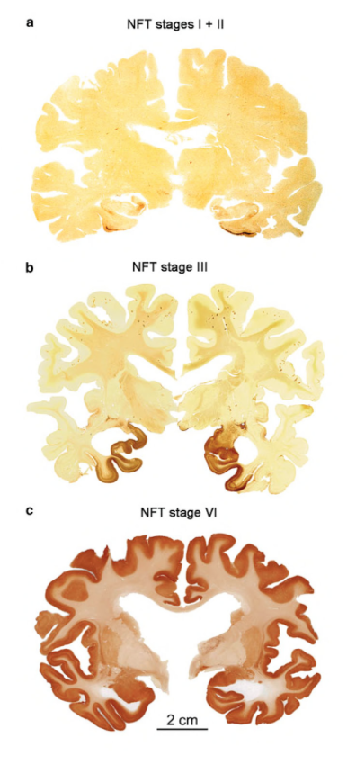
Where does Alzheimer’s disease originate?
Post-mortem studies indicate regions of lateral entorhinal cortex are first affected (Braak & Braak, Acta Neuropathol, 1991)
These changes may precede clinical symptoms by many years
Braak & Tredici, 2014

Slide 6
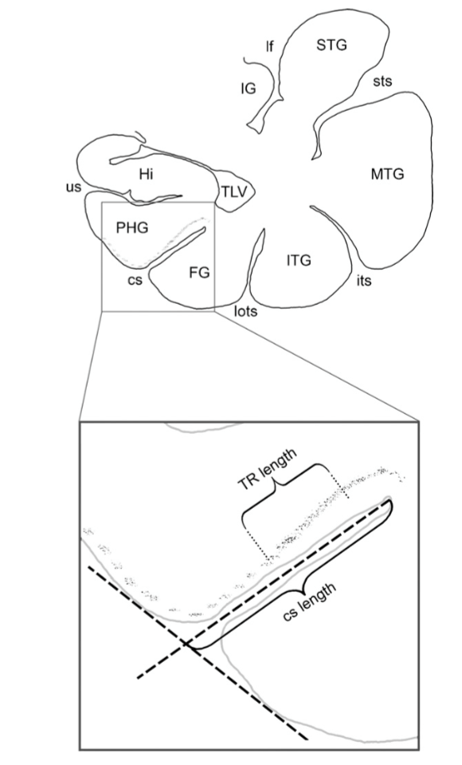
Where is ‘transentorhinal’ cortex?
TEC is defined by its unusual cytoarchitectonic feature: layers III and IV of area 35 “invade” layer II or ERC or (area 28), resulting in an oblique layer of neurons
TEC falls in the medial bank of the CS (if only one CS) or straddled the more medial, shallow CS (if two CS)
Taylor and Probst (Neurobiology of Aging, 2008)

Slide 7
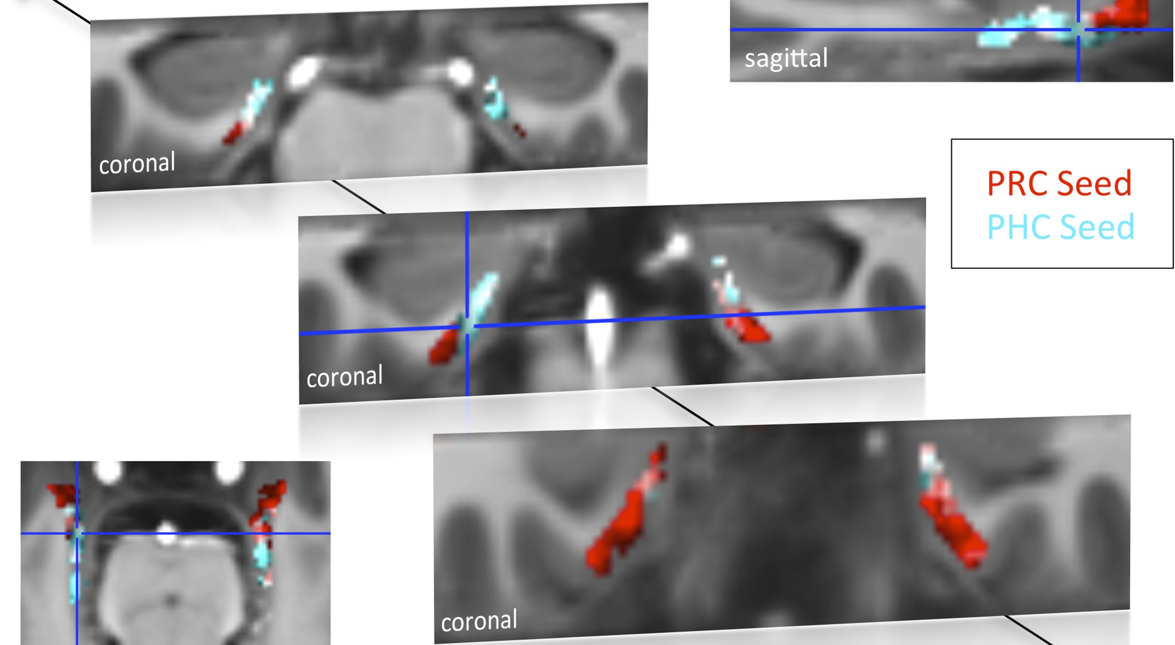
ERC cortex subregions defined by functional connectivity
Maass, Berron, et al., Elife, 2015

Slide 8
Study details
Scanned 40 nominally healthy community dwelling older adults (30 female; mean age=71.4; range=59-81; mean education=16.3; range=12-23)
Montreal Cognitive Assessment (MoCA) determined group status (at risk, healthy)
Whole brain T1-weighted and FLAIR scans & high-resolution T2-weighted scan for delineation of the MTL regions
Neuropsychological battery evaluated cognitive status
Olsen, Yeung, et al., Neurobio Aging, in press
Notes:
All participants were fluent English speakers with normal or corrected-to-normal vision, and were screened for non-MRI compatible metal implants, color blindness, diabetes, neurological disorders, stroke, or brain trauma.

Slide 9
MoCA and cognitive decline
MoCA evaluates executive function, orientation, visuospatial skills, naming, attention, language, and delayed memory (Nasreddine et al., 2005)
More sensitive than the Mini-Mental State Examination (MMSE) in detecting cognitive decline (Markwick et al., 2012)
Participants were categorized as “at risk” if they tested below the recommended cut-off score of 26 points (out of 30)
Olsen, Yeung, et al., Neurobio Aging, in press

Slide 10
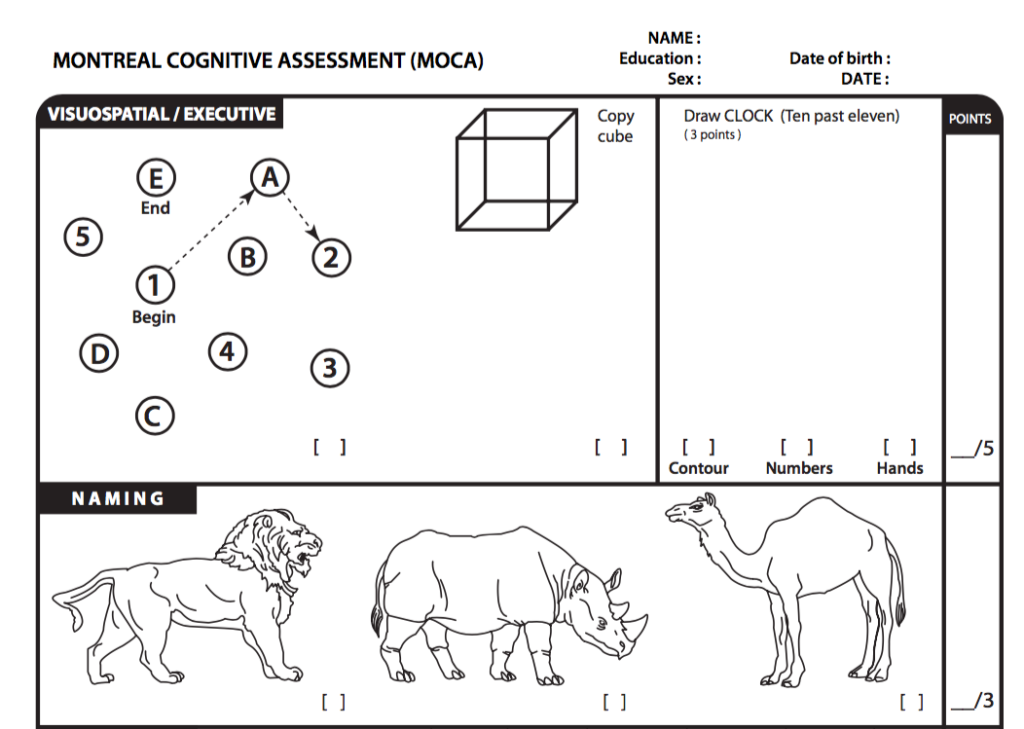
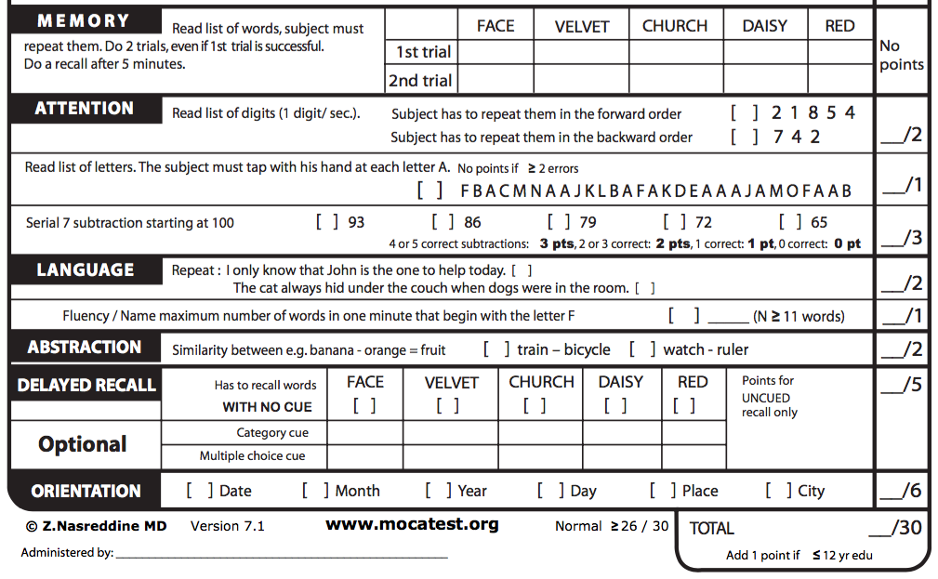

Slide 11
Neuropsychological battery
Wechsler Memory Scale, Logical memory subtest
Rey-Osterrieth Complex Figure
Digit span
Wechsler Abbreviated Scale of Intelligence

Slide 12

Memory in daily life
Subjective memory complaints was evaluated with a Memory Functioning Questionnaire (Gilewski et al., 1990)

Slide 13
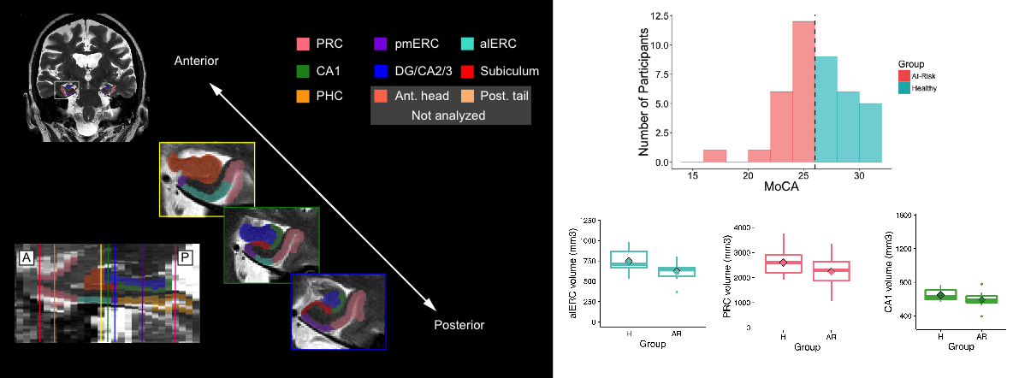
Medial temporal lobe and memory

Slide 14
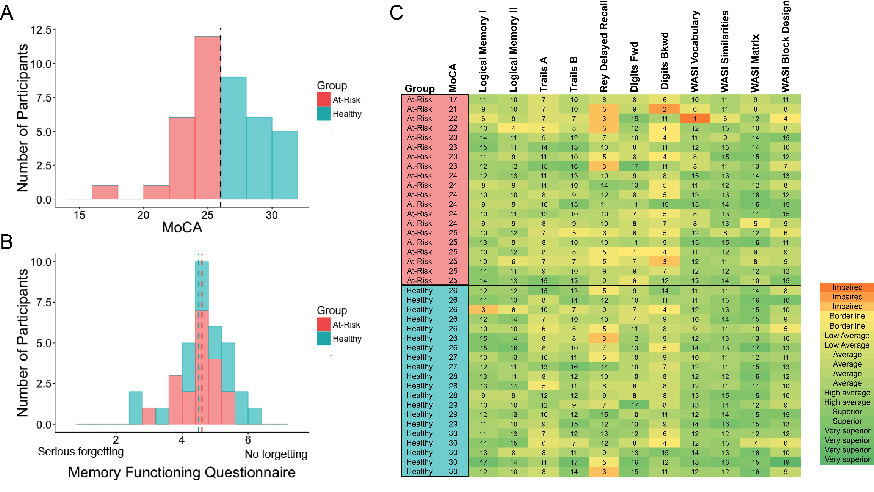
Neuropsychological performance

Slide 15
Results: Group differences
p = 0.01
Olsen, Yeung, et al., Neurobio Aging, in press
Notes:
***Significant group by subregion interaction

Slide 16
Results: correlation with MoCA
Results: Group differences
p = 0.001
p = 0.02
Olsen, Yeung, et al., Neurobio Aging, in press

Slide 17
Multivariate analysis (PLS)
MoCA subscores
Visuospatial/Executive
Naming
Attention
Language
Abstraction
Delayed recall
Orientation
MTL subregions
CA1
DG/CA2/3
Subiculum
alERC
pmERC
PRC
PHC

Slide 18
Multivariate analysis (PLS)
MoCA subscores
Visuospatial/Executive
Naming
Attention
Language
Abstraction
Delayed recall
Orientation
MTL subregions
CA1
DG/CA2/3
Subiculum
alERC
pmERC
PRC
PHC

Slide 19
Global neuroimaging measurements
 | Estimated Intracranial volume (mL) | Cortical grey matter volume (mL) | Cortical white matter volume (mL) | Cerebrospinal fluid volume (mL) | White Matter Hyperintensities (mL)
At-risk | 1,477.24 [193.40] | 407.63 [26.47] | 401.58 [39.87] | 1.34 [0.22] | 7.07 [13.96]
Healthy | 1,428.60 [167.56] | 416.31 [26.61] | 419.56 [37.50] | 1.28 [0.28] | 2.32 [3.15]
t-value | -.85 | 1.04 | 1.47 | -.76 | -1.48
Effect size (Cohen’s d) | .25 (small) | .33 (small) | .47 (small) | .22 (small) | .34 (small)
Olsen, Yeung, et al., Neurobio Aging, in press

Slide 20
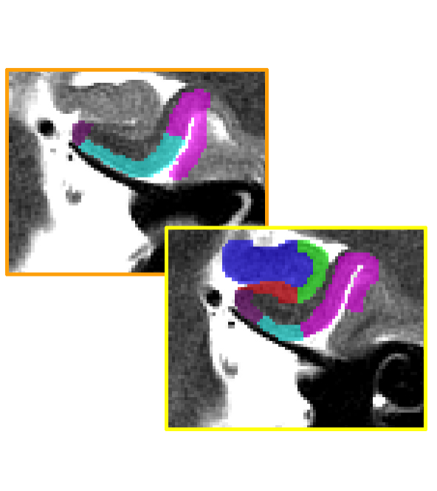
Conclusions
MTL volumes were related to cognitive decline
Largest difference was in the alERC; smaller effects observed in PRC, CA1, DG/CA2/3
alERC volume is a potentially sensitive imaging biomarker, useful for evaluating treatment efficacy

Slide 21
Topological approaches to structural neuroimaging data?
Can topological methods be used to classify individuals at risk for dementia?

Slide 22
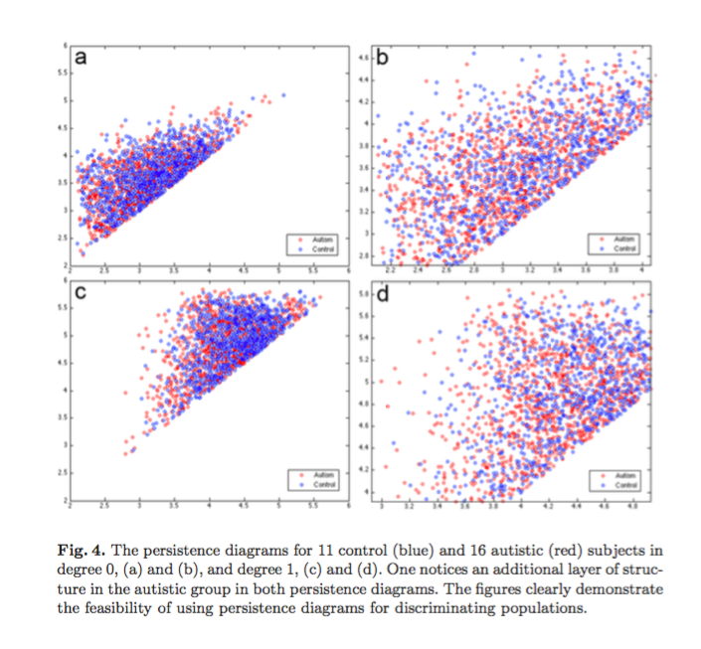
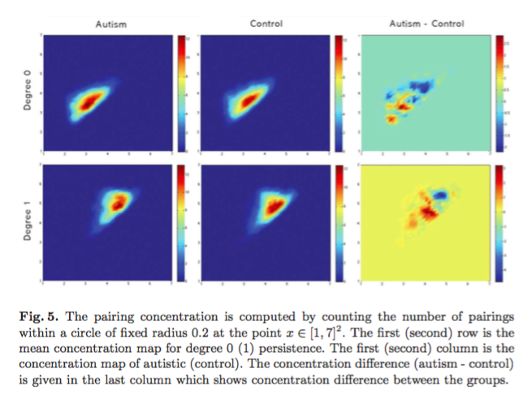
Topological methods and cortical thickness
Chung et al., 2009 discovered differences in cortical thickness comparing individuals with autism to controls using topology

Slide 23
Medial temporal lobe and memory
Study of patients with damage or compromise to the MTL can yield insights into neural function
These include:
  Individuals with developmental amnesia
  Individuals with acquired amnesia

Slide 24
Developmental amnesia cases
H.C. was born premature (32 weeks gestation) and was previously presumed to have suffered an undetected hypoxic episode. She has difficulties forming episodic memories but can learn through repetition
N.C. suffered from a stroke at 9 days of age due to malnourishment. He also presents with difficulties with memory, although he has no overt damage to his medial temporal lobes

Slide 25
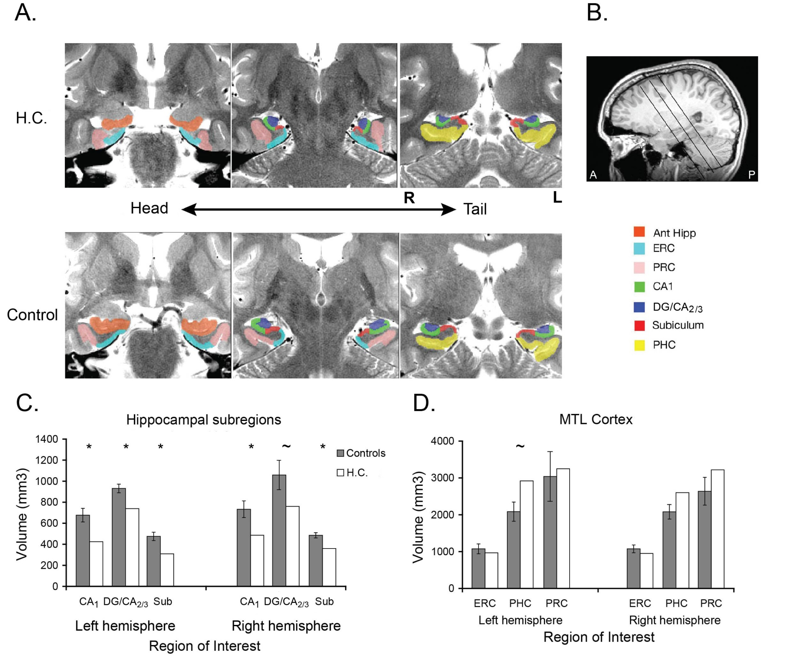
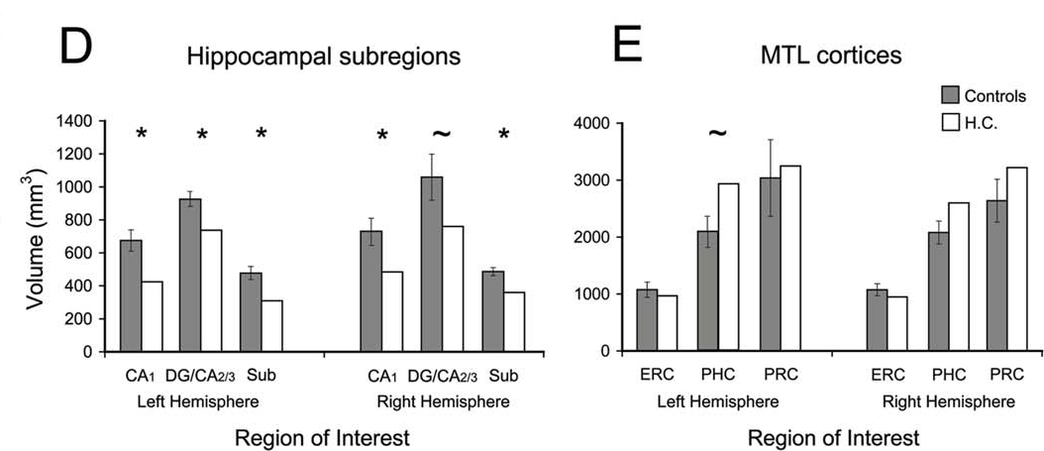
Bilateral reductions of hippocampal volume
Olsen, et al, Hippocampus, 2013
Notes:
Through a collaboration with Shayna Rosenbaum, we studied HC who was born premature and hypoxic and later presented with a significant amnesia. She was 22 years old at the time of testing.
Rosanna conducted structural tracing on HC and discovered that HC showed significant volume reductions within hippocampal subfields, but perirhinal and entorhinal are not different from control volumes, and HC’s parahippocampus is actually larger than controls.
Largely anterior hc, but some posterior on the right

Slide 26
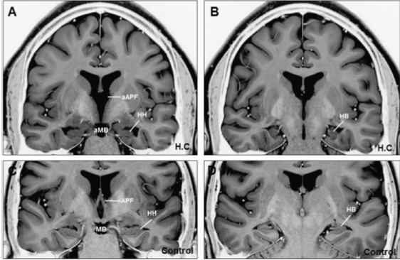
Developmental amnesia case: H.C.
Rosenbaum, Gao et al., Neuropsychologia, 2014

Slide 27
Developmental amnesia case N.C.
Rosenbaum, et. al., in preparation

Slide 28
MTL-thalamic connectivity
(or Papez circuit)

Slide 29
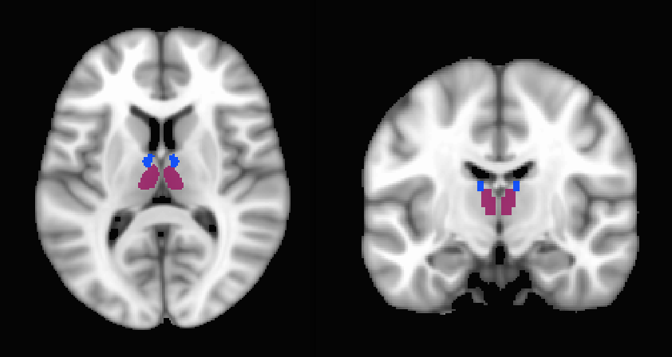
PFC and MTL coupling modulated by thalamic subregions?
Goal: Use existing structural-MEG datasets (e.g. HCP, Rockland) to examine either functional coupling or structural-functional interactions

Slide 30
Topological approaches to structural neuroimaging data?
Can topological methods be used to classify individuals at risk for dementia?
What can topological methods tell us about reorganization of brain networks due to brain injury?
  Widespread cortical dysfunction can occur with local damage to hub structures (e.g. thalamus)

