Slide 1
Can we apply topological methods to cortical thickness data?

Slide 2
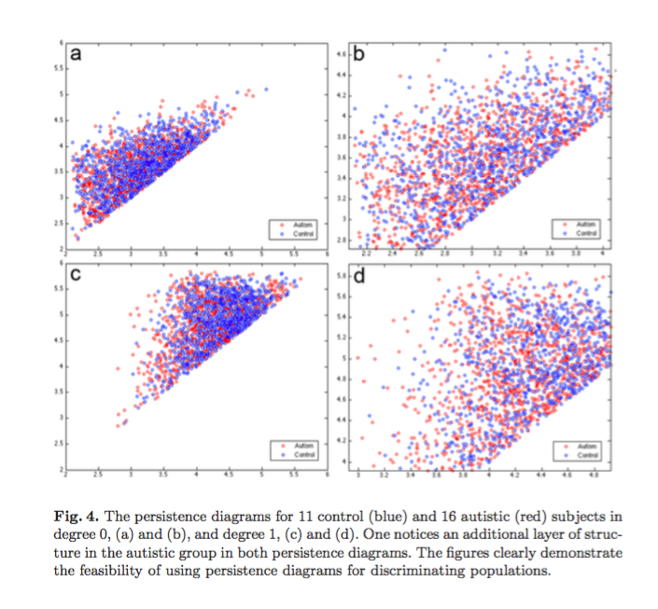
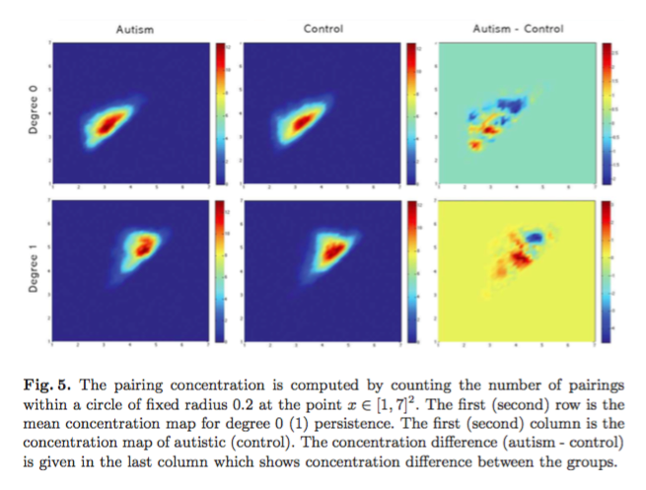
Topological methods and cortical thickness
Chung et al., 2009 discovered differences in cortical thickness comparing individuals with autism to controls using topology

Slide 4
Work flow
HCP:
subject+'.R.corrThickness.32k_fs_LR.shape.gii
subject+'.R.pial.32k_fs_LR.surf.gii
Use Python code to get .mat file:
Matlab or Octave:
Save_weighted_triangle_surface.m
Command line:
Dipha <input> <output>
Calculate simplicial complex
2) 1xM array for vertex values ( thickness)
1) 3xN array for triangles (mesh)
Sublevel-filtration
Matlab or Octave: plot_persistence_diagram.m
Persistance diagram

Slide 5
Visualization of persistence plot

Slide 6
Next steps
Compute persistence plots for younger and older participants
Use Ghudi tools to compare group?

