Slide 1

The challenge of diurnal sea surface temperatures
Sam Pimentel, Simon Tse TWU, Canada
Andrea Storto, Eric Jansen, Isabelle Mirouze CMCC, Italy
Gerasimos Korres, Demitra Denaxa HCMR, Greece
Nonlinear and Stochastic Problems in Atmospheric and Oceanic Prediction
Banff International Research Station, 21 Nov 2017

Slide 2
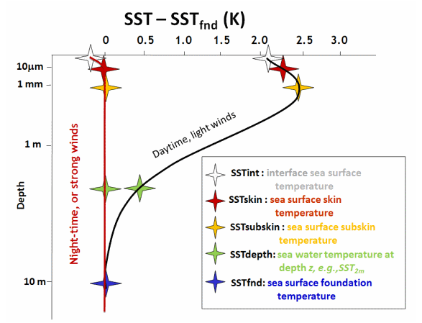
Diurnal Sea Surface Temperatures (SST)
Nonlinear problem
Driven by total heat flux at the sea surface
  Predominately insolation
  Sensitive to cloud cover
Highly sensitive to wind speed
  Shear driven turbulence – vertical mixing
  Gustiness can quickly erode the diurnal thermocline
Cool skin effect
Image from ghrsst.org

Slide 3
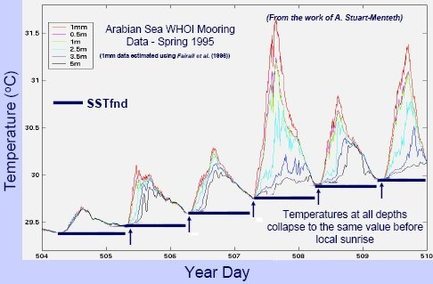
Diurnal Sea Surface Temperatures (SST)
Motivation
SST is a key variable in computing surface heat fluxes
It modulates heat storage in the upper ocean
Important in many biological and chemical processes
The SST diurnal cycle is important for many of these processes

Slide 4
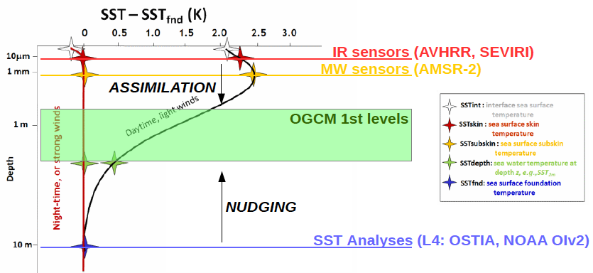
The Science Problem

Slide 5
The Science Problem
Generally only night time satellite SST observations are used in data assimilation at the moment
To also assimilate daytime SST, it is necessary to account for the diurnal warming
Models that describe diurnal warming exist, but are too computational intensive to be used inside a data assimilation system
The goal of this work is to provide a statistical observation operator that is based on a dynamical model of diurnal SST, but much more efficient

Slide 6
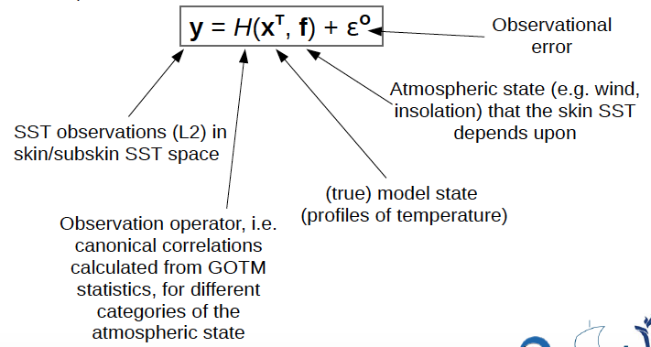
The Science Problem
The statistical observation operator, H, projects the model state x onto the space of the satellite-derived SST observations y (i.e. skin/subskin SST):

Slide 7
Modelling Diurnal Variability in SST
The General Ocean Turbulence Model (GOTM)
One-dimensional water column model
Tailored for modelling the SST diurnal cycle (Pimentel et al., 2008a)
30 second timestep, hourly output
122 levels to depth of 75m, higher resolution near surface (e.g. top level is 0.015m, 21 levels in top 1m, 52 levels in top 5m, and 68 levels in top 10m)
Vertical mixing using a k-ε turbulent kinetic energy parameterization and internal wave parameterization
Air-Sea fluxes computed using Fairall et al., 1996b, 2003
Cool skin SST parameterization (Fairall et al., 1996a)
Solar absorption using MODIS chlorophyll data (Ohlmann & Siegel, 2000)

Slide 8
Mediterranean Sea Simulations
GOTM is run on a 1/16 degree grid for 2013-2014
Forcing:
3-hourly atmospheric data from ERA-Interim: u10m, v10m, t2m, q2m, airp, swrd, lwrd
Compute air-sea fluxes using linearly interpolated ERA data and modelled skin SST (Fairall et al., 1996a, 1996b, 2003)
Initialization:
Daily Temperature and Salinity profiles from MED MFC reanalysis are used to initialize GOTM at sunrise each day
Rationale – GOTM does not model horizontal transport

Slide 9
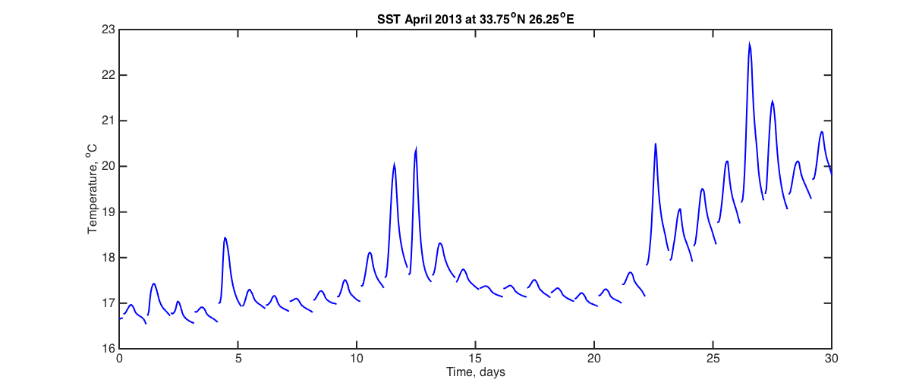
Sample Output

Slide 10
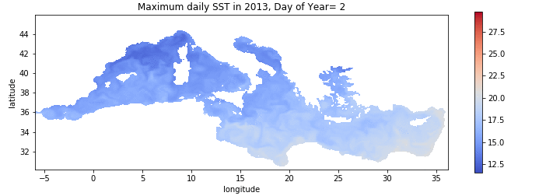
Mediterranean Sea Results
Daily maximum SST

Slide 11
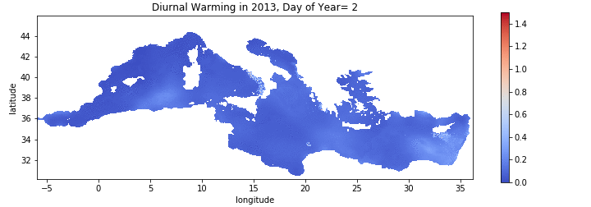
Mediterranean Sea Results
Daily diurnal variability (max SST – min SST)

Slide 12
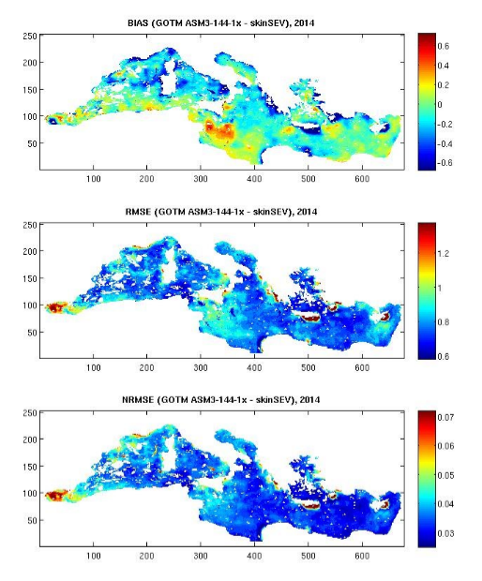
GOTM Validation against SEVIRI SST
Skin SST
2014
1/16 degree grid
3 hourly SEVIRI
Bias
RMSE
2014 | Skin SST
BIAS | -0.063
RMSE | 0.847
NRMSE | 0.039
NRMSE

Slide 13
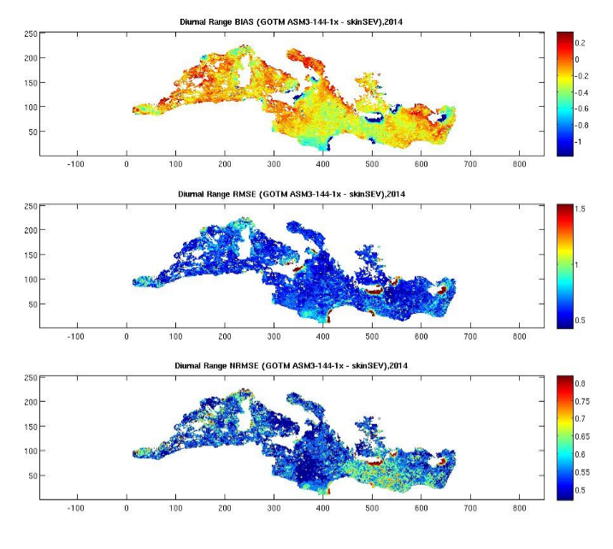
GOTM Validation against SEVIRI SST
Diurnal Range
2014
1/16 degree grid
3 hourly SEVIRI
Bias
RMSE
2014 | Diurnal Range
BIAS | -0.191
RMSE | 0.665
NRMSE | 0.587
NRMSE

Slide 14
Diurnal warming, K
Hour, LMT

Slide 15
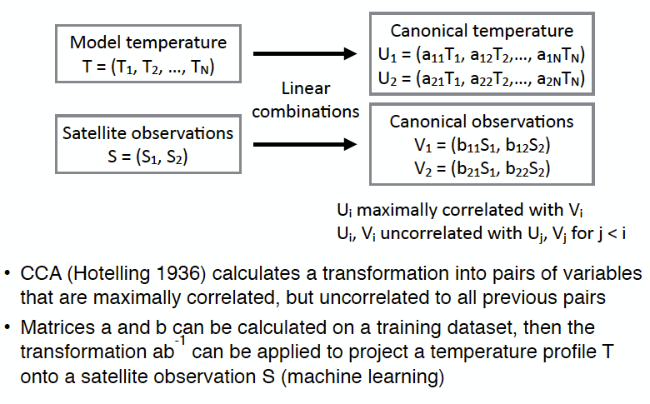
Canonical Correlation Analysis

Slide 16
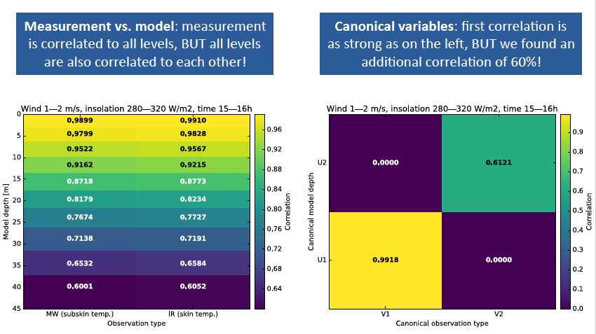
Correlation Plots

Slide 17
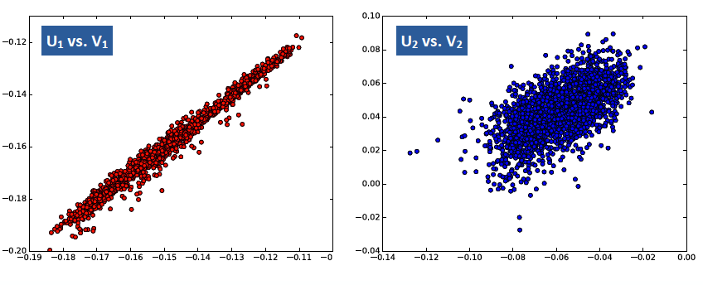
Canonical Model vs Canonical Observation

Slide 18
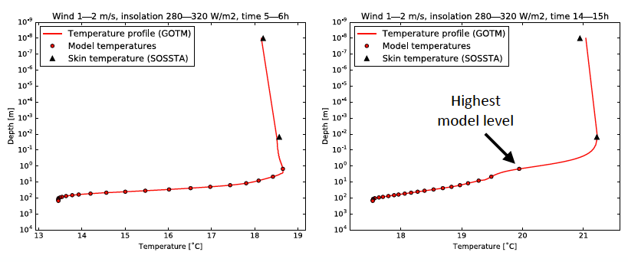
Examples
Temperature profile (GOTM)
Model temperatures
Skin and subskin SST
Temperature profile (GOTM)
Model temperatures
Skin and subskin SST
Projected values using observation operator
During low wind and high insolation, the daytime skin and subskin SST can be significantly higher than the highest model level
The statistical operator can describe these temperatures quite well

Slide 19
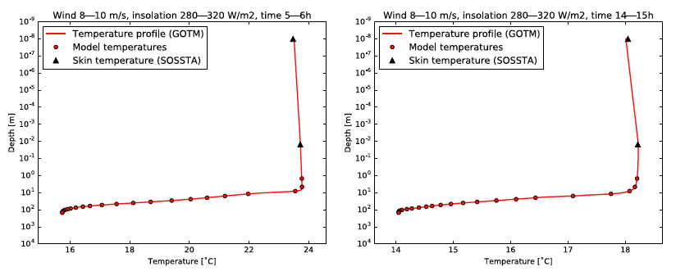
Temperature profile (GOTM)
Model temperatures
Skin and subskin SST
Temperature profile (GOTM)
Model temperatures
Skin and subskin SST
Higher wind speeds cause more mixing in the water column and the diurnal heating effect almost disappears

Slide 20
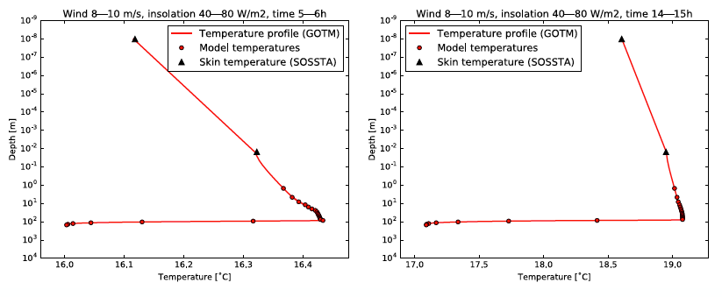
Temperature profile (GOTM)
Model temperatures
Skin and subskin SST
Temperature profile (GOTM)
Model temperatures
Skin and subskin SST
During days of high wind and low insolation, the skin temperature can drop significantly below that of the highest model level

Slide 21
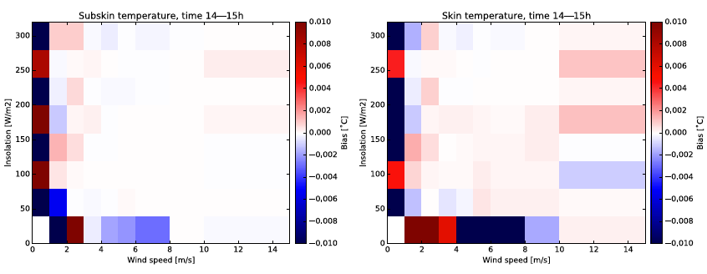
Validation: Bias
Error statistics are calculated for each bin w.r.t. GOTM profile
  Remove one profile from the correlation calculation, then verify the resulting projection using that profile
  Repeat the procedure for every profile in the bin

Slide 22
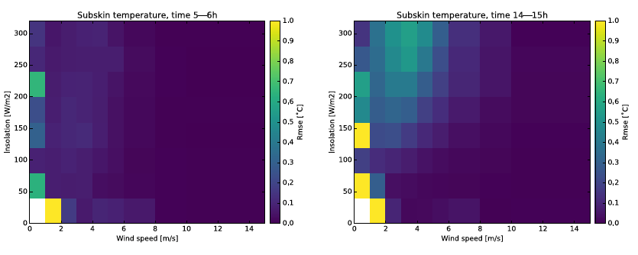
Validation: RMSE
RMSE shows an increase for low wind speeds and high insolation during the day
This is where the diurnal warming is largest

Slide 23
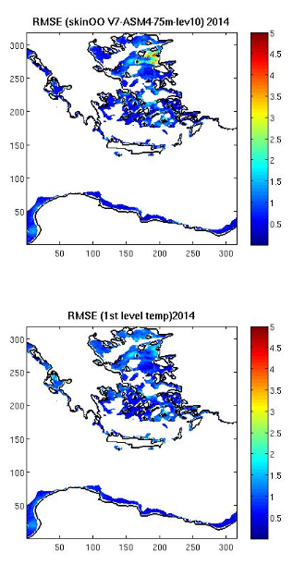
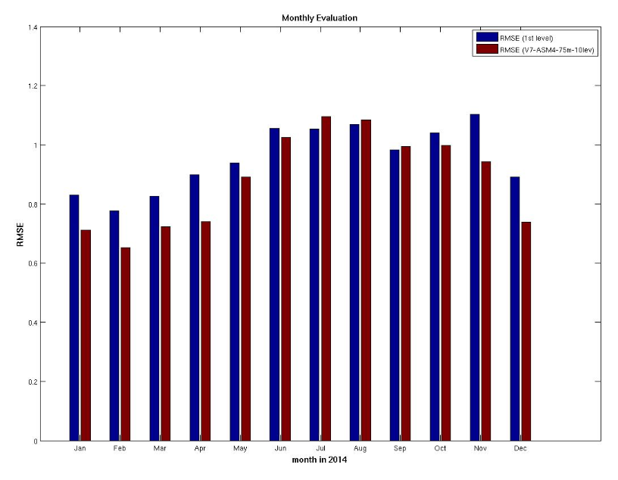
Preliminary results
RMSE with OO
Tested in the Greek POSEIDON system (a SEEK regional analysis scheme, Korres et al., 2010)
Performs better at midday than midnight
Performs better in winter than summer
Monthly Evaluation
without OO
with OO
RMSE
RMSE without OO
Jan Feb Mar Apr May June July Aug Sept Oct Nov Dec
 | with operator | without operator
2014 | 0.8573 | 0.9423
00UTC | 0.8037 | 0.6620
12UTC | 0.7495 | 0.9021

Slide 24
Preliminary results
RMSE(without OO) – RMSE(with OO)
Tested in the Med-MFC system
(a 3D-Var system)
Performs better in Eastern Mediterranean than Western
Also found to be better in winter than summer and during daytime rather than nighttime
Better without OO
Better with OO

Slide 25
Conclusions
A low computational cost observation operator for satellite SST has been developed
Initial results of the statistical operator show promise
Canonical correlations are able to provide good estimates of the skin and subskin SST
Implementation and testing of the operator in data assimilation systems has started
Further improvements and validation of GOTM results are ongoing
Further optimization (of categories and number of levels) of the observation operator is continuing

