Slide 1
Direct Sum, Direct Product and Information Theory
Rahul Jain
National University of Singapore

Slide 2
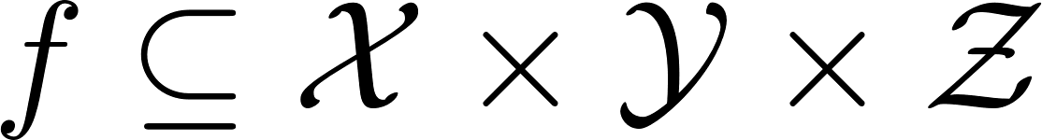
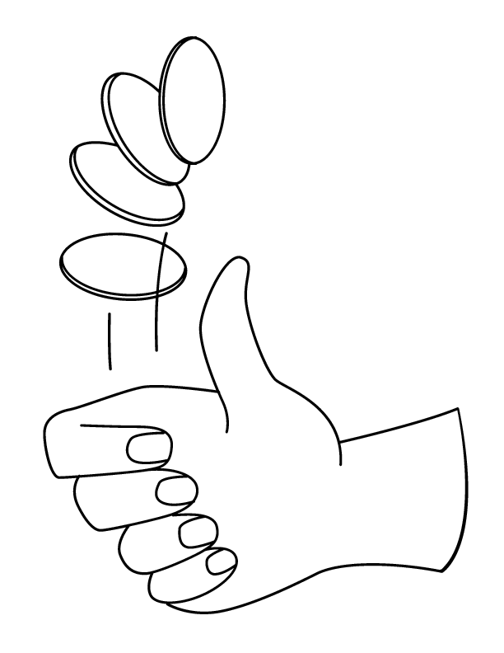




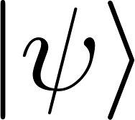

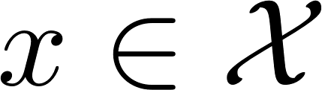
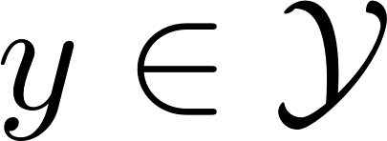
Communication protocols

Slide 3
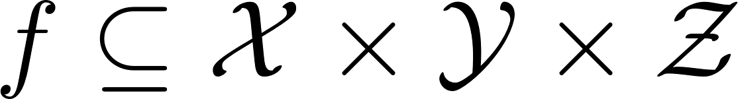
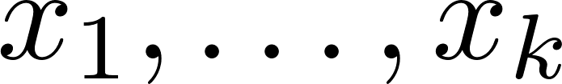

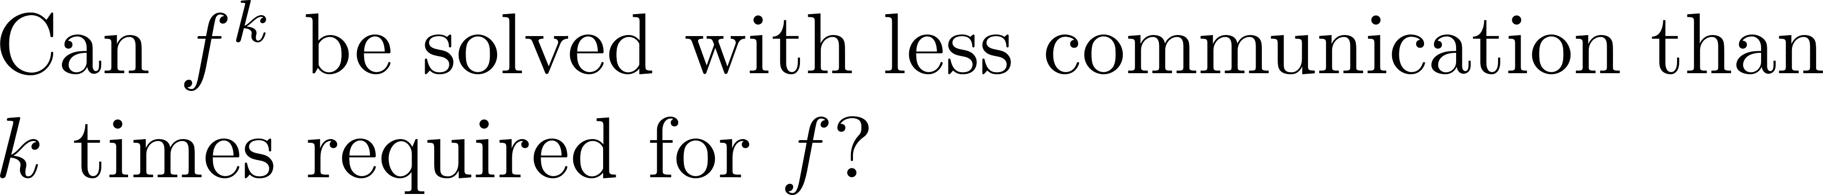
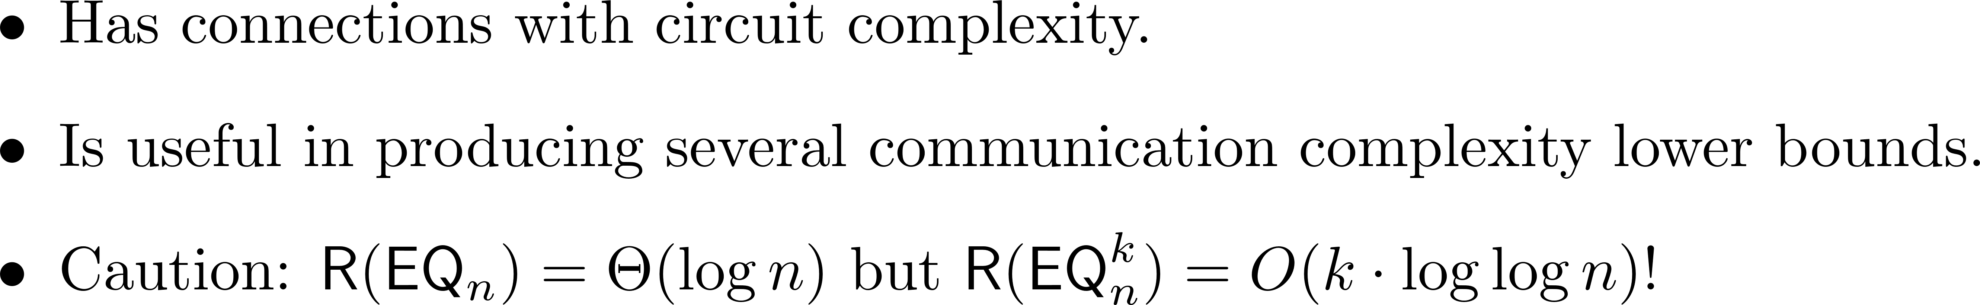
Direct sum
Can we solve k copies faster ?

Slide 4

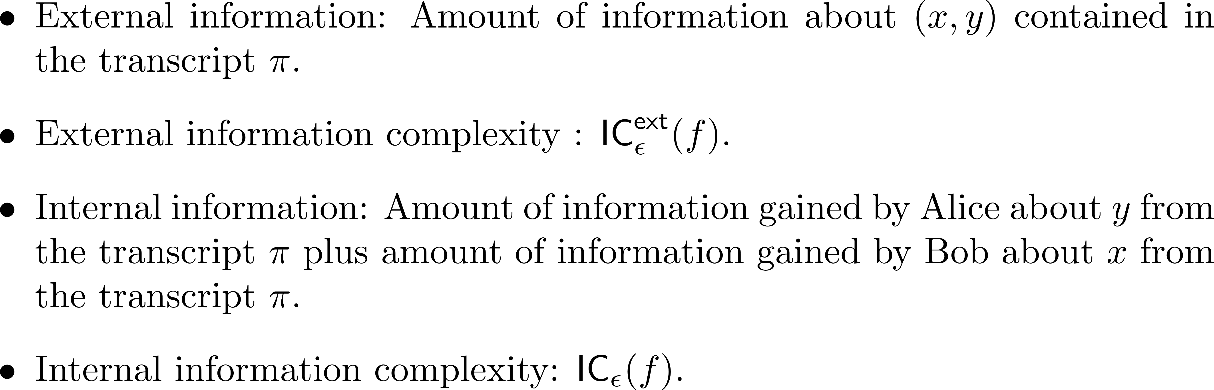
Information Complexity

Slide 5
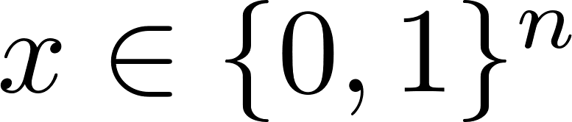
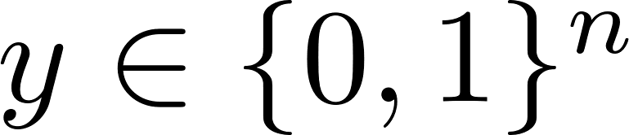
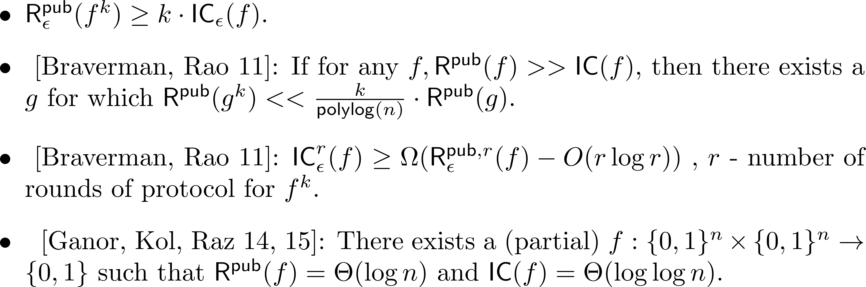
The IC v/s CC Question

Slide 6
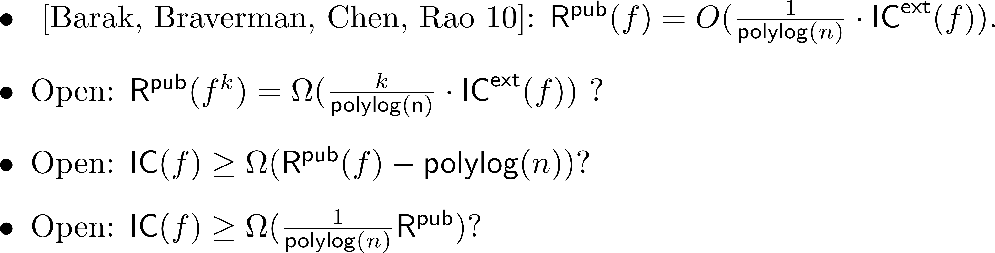
The IC v/s CC Question

Slide 7




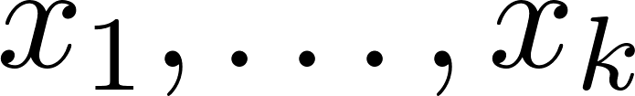


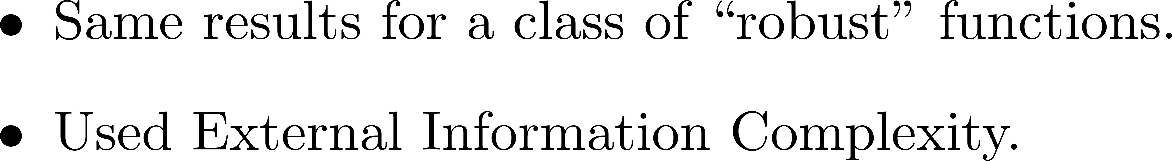
Direct sum: First Results
Can we solve k copies faster ?
Can we solve k copies faster ?
No, My Dear!
No, My Dear!
[Chakrabarti, Shi, Wirth and Yao 01]

Slide 8




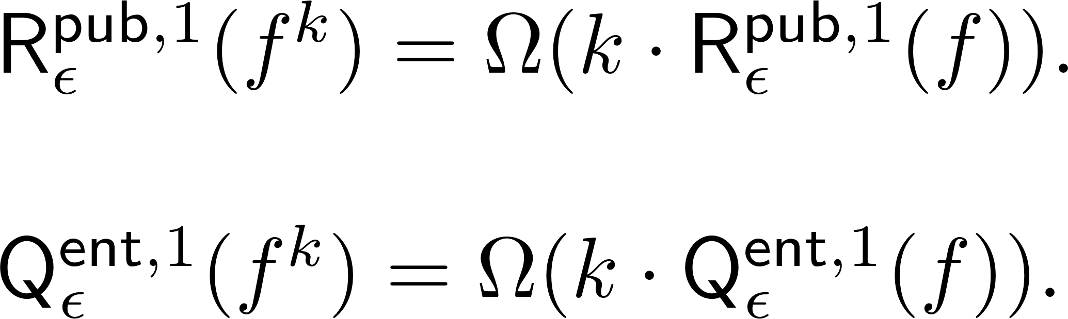
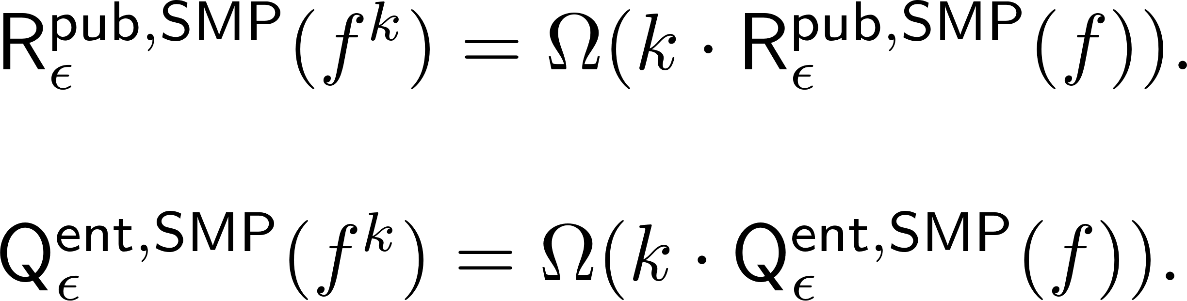
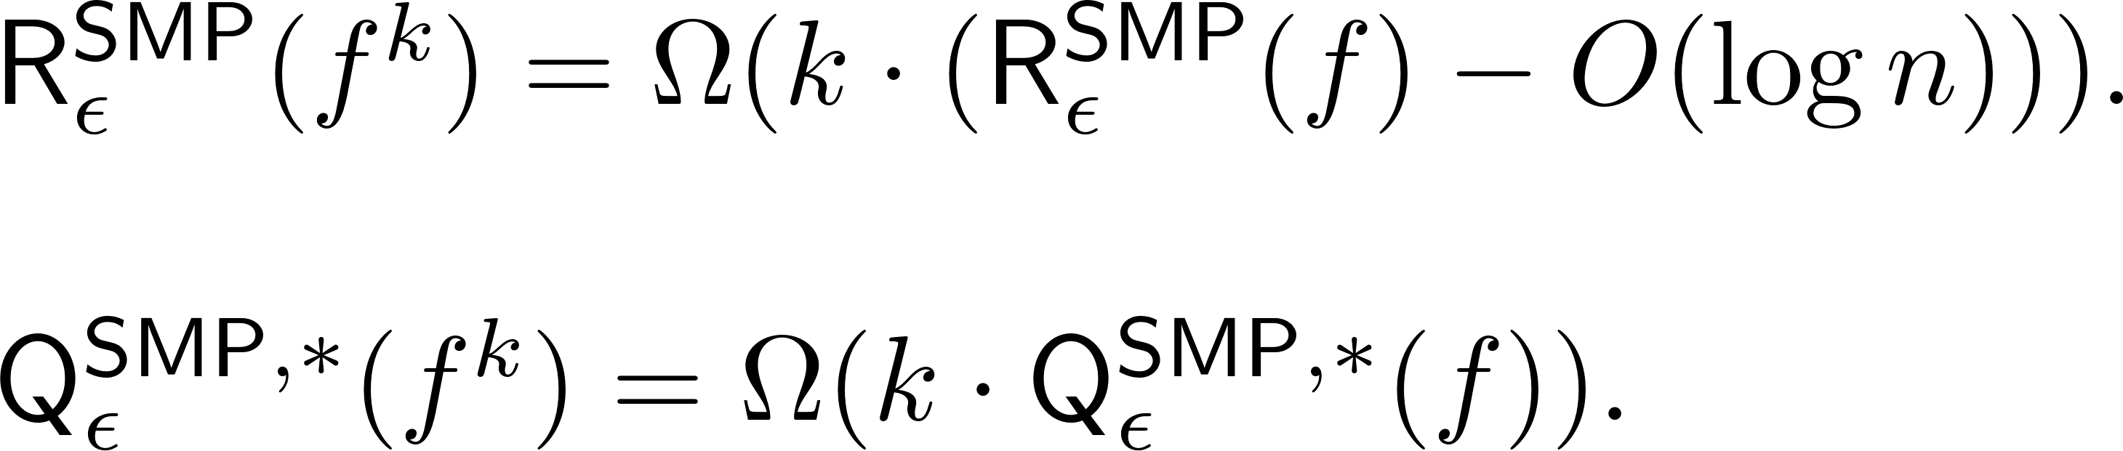
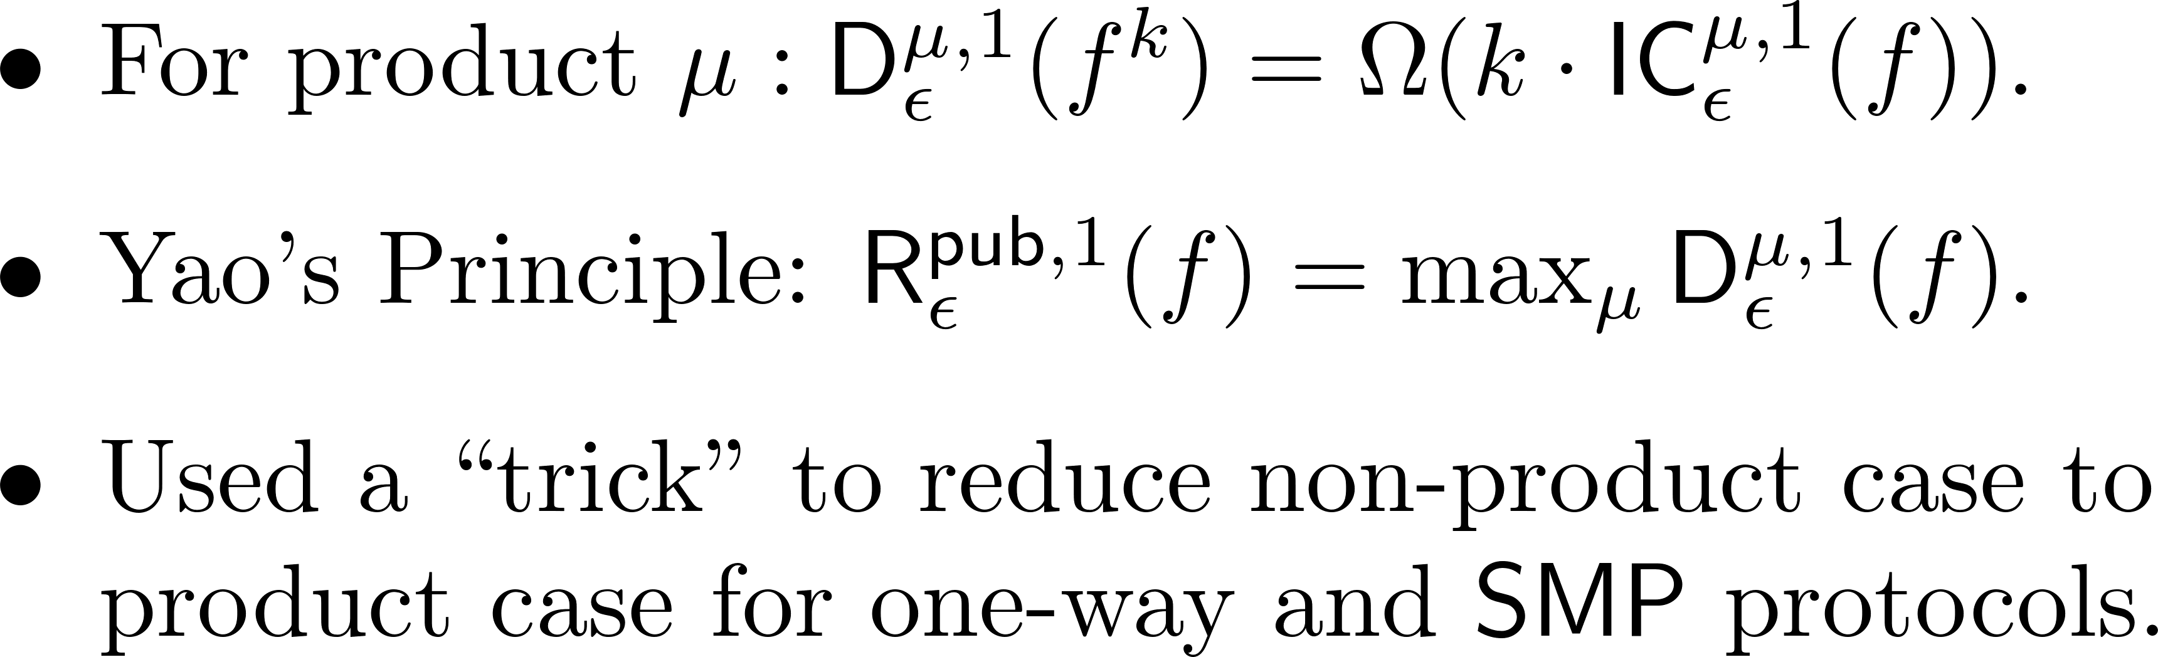
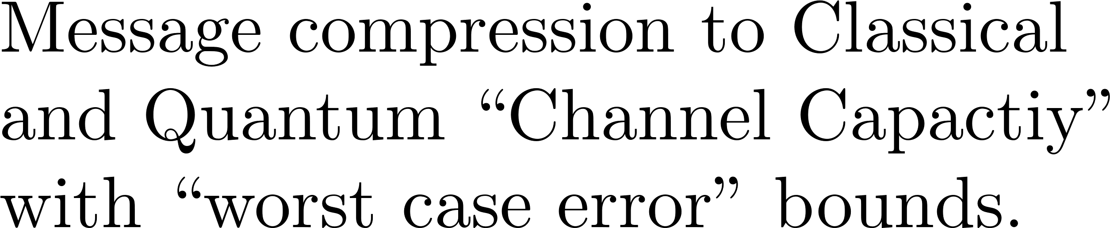
Direct sum: One-way and SMP
Can we solve k copies faster ?
Can we solve k copies faster ?
No, My Dear!
No, My Dear!
[J, Radhakrishnan, Sen 03, 05]
[J, Klauck 09]

Slide 9
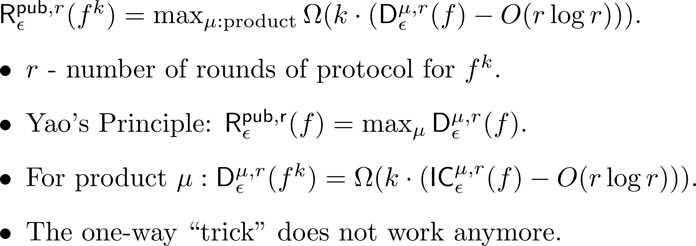


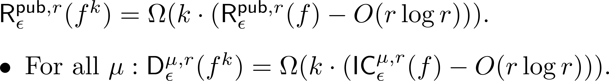
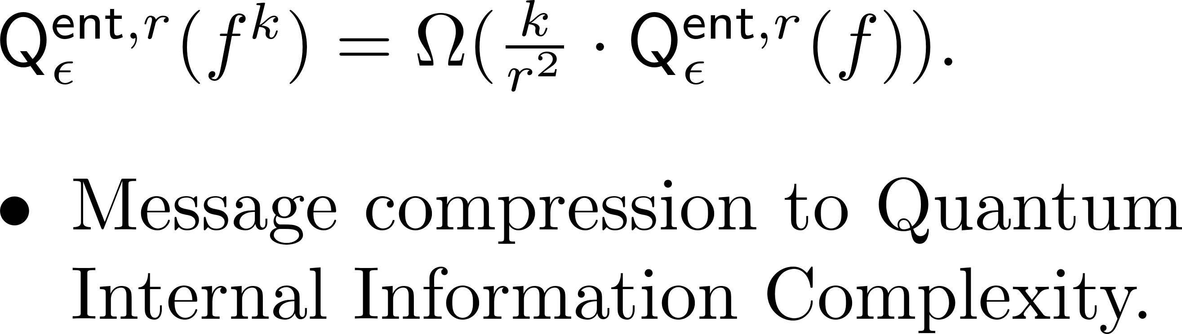
Direct sum : Two-way
[J, Radhakrishnan, Sen 03; Harsha, J, McAllester, Radhakrishnan 07]
Can we solve k copies faster ?
No, My Dear!
[Braverman, Rao 12]
[Touchette 15]

Slide 10
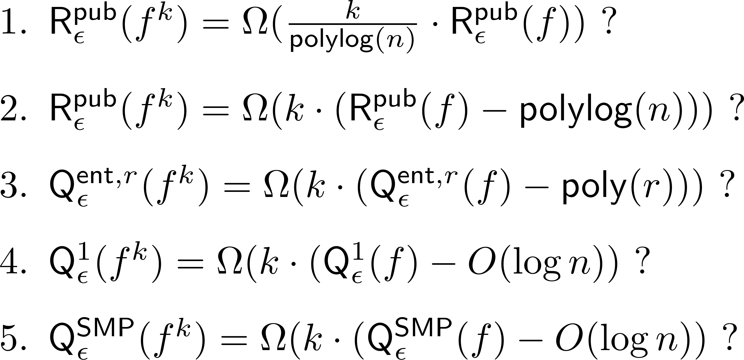
Direct sum : Open questions

Slide 11

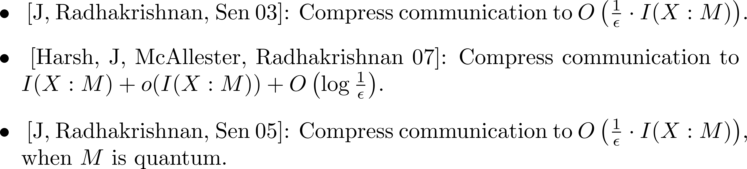
Message compression

Slide 12

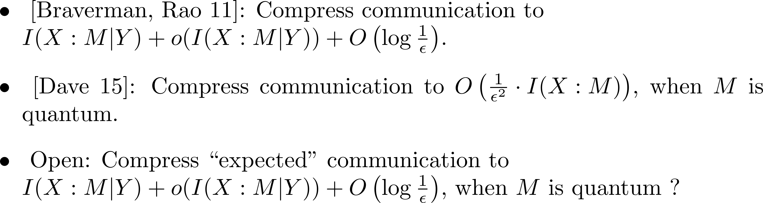
Message compression with side information

Slide 13
Direct Product
Can we solve k copies faster ?
Let there be ERROORR!

Slide 14

Direct Product
Can we solve k copies faster ?
[J 11]
Let there be ERROORR!
[J, Pereszlényi, Yao 12]
[Braverman, Rao, Weinstein, Yehudayoff 13]

Slide 15

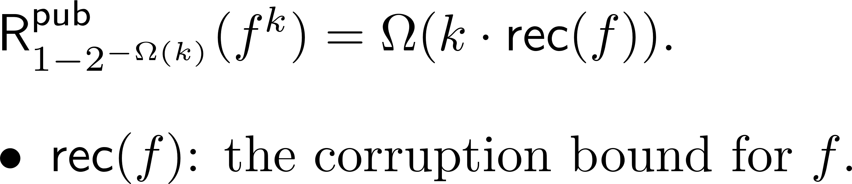
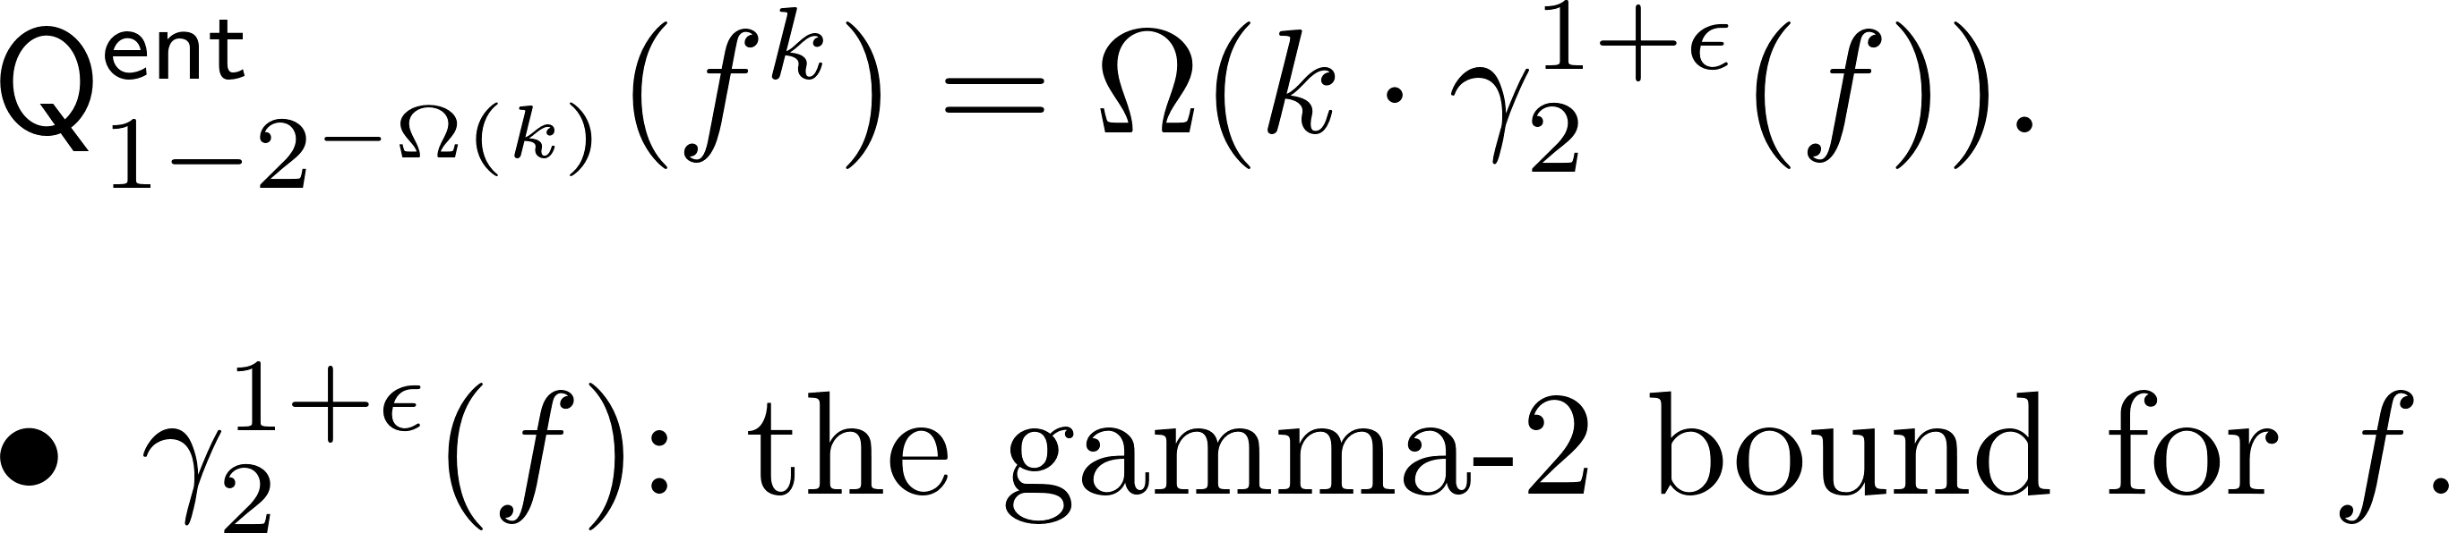
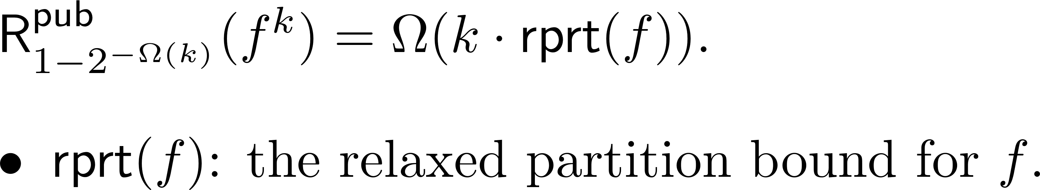
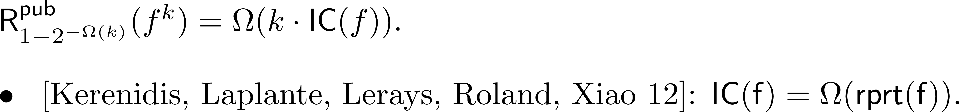
Direct Product in terms of lower bounds
Can we solve k copies faster ?
[Beame, Pitassi, Segerlind, Wigderson 07] [J, Nayak, Klauck 08]
Let there be ERROORR!
[Sherstov 10]
[J, Yao 12]
[Braverman, Weinstein 15]

Slide 16
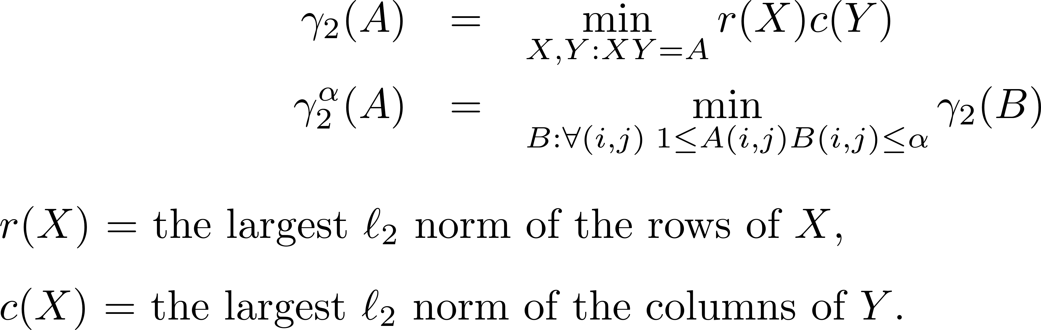
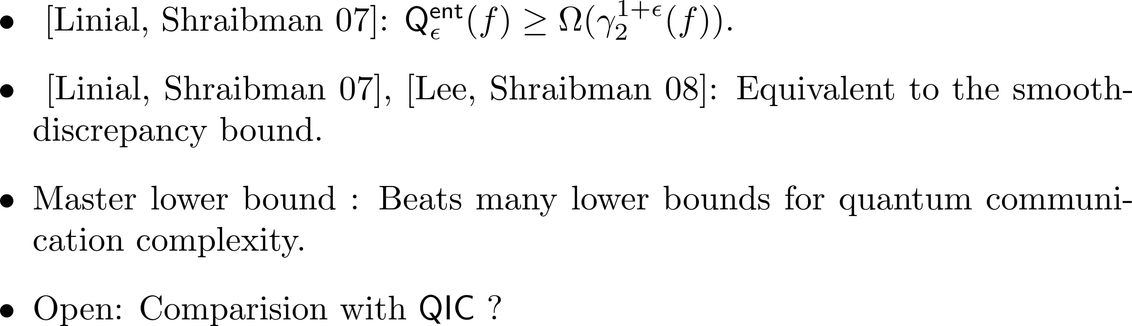

The γ₂ Bound

Slide 17
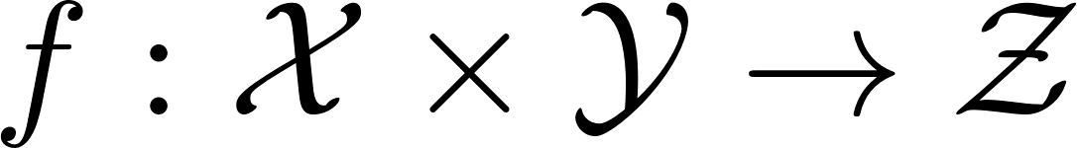

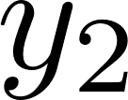
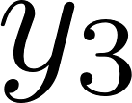

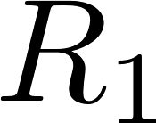

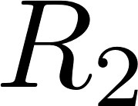
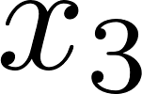
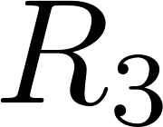
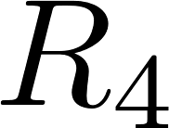
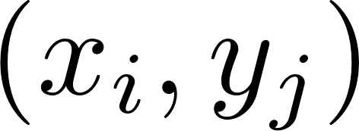
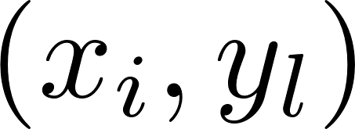
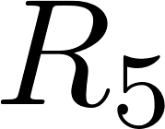
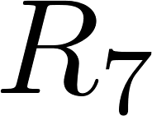

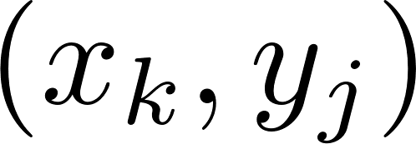
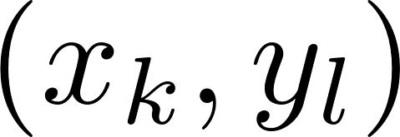
The Partition Bound [J, Klauck 10]
A deterministic protocol represents a partition of the inputs into rectangles.

Slide 18



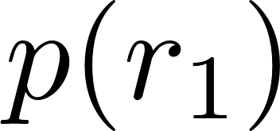

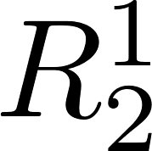
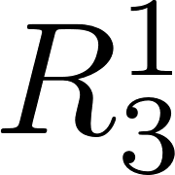


















The Partition Bound
Public-coin protocol with communication c.

Slide 19









Relation with other bounds
Maximizes rectangle bound over all functions g close to f
Captures the partition structure
Smooth Rectangle Bound
Partition Bound
Requires all large rectangles to be balanced (up to a small multiplicative bias)
Requires all rectangles to be balanced
(up to a small additive bias)
γ^{α}₂ is smooth-discrepancy
Rectangle Bound
Discrepancy Bound

Slide 20

Summary of relations

Slide 21



Message compression, contd.

Slide 22

Message compression, contd.

Slide 23

Direct product : Open questions
Thanks !

