Slide 1
On the Communication Complexity of Property Testing in Graphs
Joint work with Orr Fischer and Shay Gershtein

Slide 2
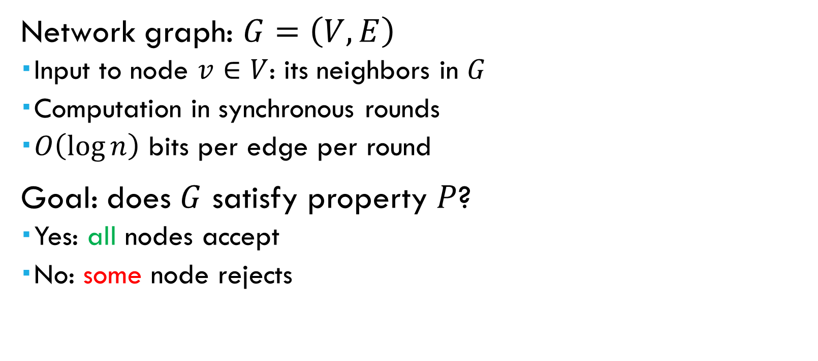
The “Congest” Network Model
Network graph: $G=\left(V,E\right)$
  Input to node $v∈V$: its neighbors in $G$
  Computation in synchronous rounds
  $O\left(\log{n}\right)$ bits per edge per round
Goal: does $G$ satisfy property $P$?
  Yes: all nodes accept
  No: some node rejects

Slide 3
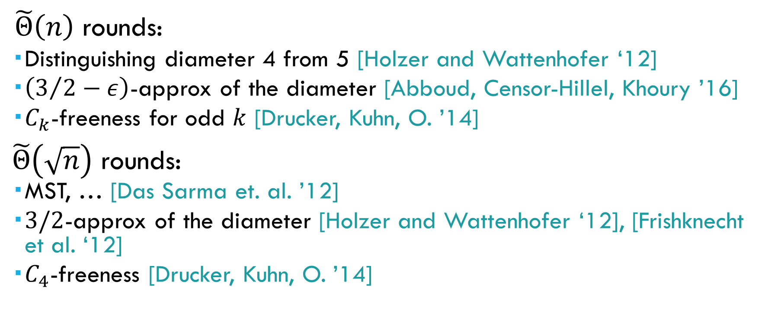
Examples of Hard Problems
  $\tilde{Θ}\left(n\right)$ rounds:
  Distinguishing diameter 4 from 5 [Holzer and Wattenhofer ‘12]
  $\left(3/2−ε\right)$-approx of the diameter [Abboud, Censor-Hillel, Khoury ’16]
  $C_{k}$-freeness for odd $k$ [Drucker, Kuhn, O. ’14]
$\tilde{Θ}\left(\sqrt{n}\right)$ rounds:
  MST, … [Das Sarma et. al. ’12]
  $3/2$-approx of the diameter [Holzer and Wattenhofer ‘12], [Frishknecht et al. ‘12]
  $C_{4}$-freeness [Drucker, Kuhn, O. ’14]

Slide 4

Open Problem
Is there a “natural” graph property that requires $ω\left(n\right)$ rounds?

Slide 5
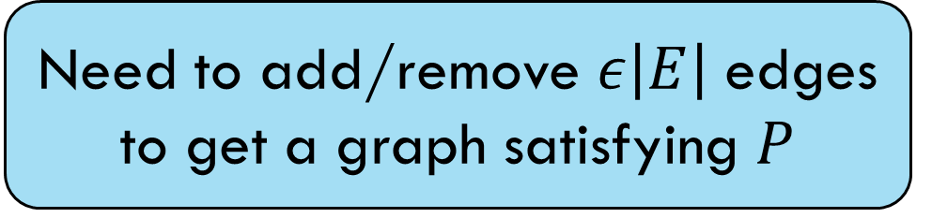

What about Property-Testing?
Does $G$ satisfy $P$, or is $G$ $ε$-far from satisfying $P$?
Need to add/remove $ε\left|E\right|$ edges to get a graph satisfying $P$

Slide 6

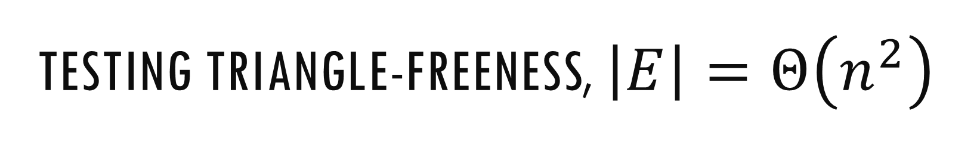
Testing Triangle-Freeness, $\left|E\right|=Θ\left(n^{2}\right)$
Observation:
If $G$ is $ε$-far from triangle-free, then
$G$ contains $Θ\left(εn^{2}\right)$ edge-disjoint triangles
Algorithm:
  Sample each edge w.p. $\tilde{O}\left(1/\left(εn^{2}\right)\right)$
  Announce sampled edges to neighbors
  Locally check for triangles

Slide 7
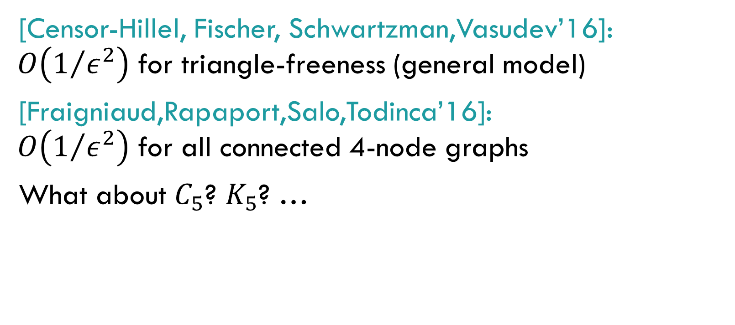
Testing subgraph-freeness
[Censor-Hillel, Fischer, Schwartzman,Vasudev’16]: $O\left(1/{ε^{2}}\right)$ for triangle-freeness (general model)
[Fraigniaud,Rapaport,Salo,Todinca’16]: $O\left(1/{ε^{2}}\right)$ for all connected 4-node graphs
What about $C_{5}$? $K_{5}$? …

Slide 8
Lower bounds From Communication Complexity
Alice
Bob

Slide 9
Communication Complexity of Graph Property Testing

Slide 10
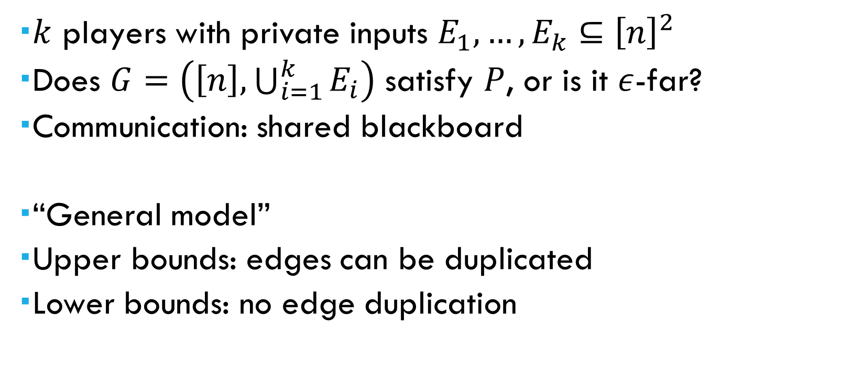
The Model
  $k$ players with private inputs $E_{1},…,E_{k}⊆{\left[n\right]}^{2}$
  Does $G=\left(\left[n\right],\bigcup_{i=1}^{k}{E_{i}}\right)$ satisfy $P$, or is it $ε$-far?
  Communication: shared blackboard
  “General model”
  Upper bounds: edges can be duplicated
  Lower bounds: no edge duplication

Slide 11
“Building Blocks”
Can efficiently implement:
  Sampling a random subgraph
  Estimating the average degree
  Random walk
  …

Slide 12

Testing Triangle-Freeness
Upper bound: $O\left(k{\left(nd\right)}^{1/4}+k^{2}\right)$ (adapting [Alon et. al. ‘06])
  Also: simultaneous protocol with CC of $O\left(k\sqrt{n}\right)$ when $d=O\left(\sqrt{n}\right)$ and $O\left(k{\left(nd\right)}^{1/3}\right)$ when $d=Ω\left(\sqrt{n}\right)$

Slide 13
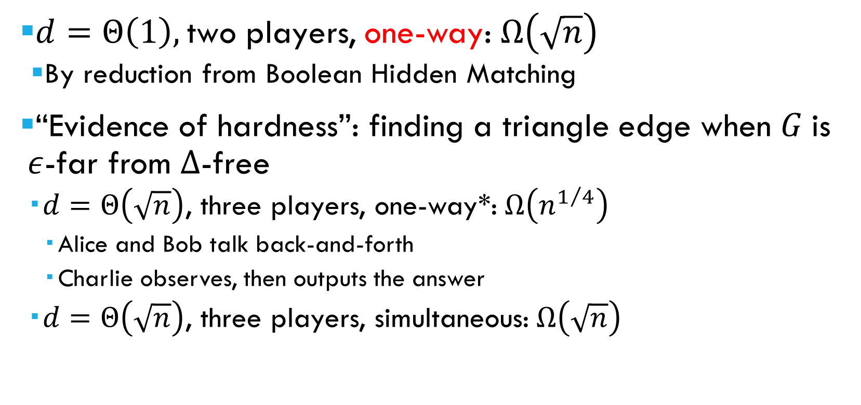
Testing Triangle-Freeness: Lower Bounds
$d=Θ\left(1\right),$two players, one-way: $Ω\left(\sqrt{n}\right)$
  By reduction from Boolean Hidden Matching
“Evidence of hardness”: finding a triangle edge when $G$ is $ε$-far from ∆-free
  $d=Θ\left(\sqrt{n}\right)$, three players, one-way*:$Ω\left(n^{1/4}\right)$
    Alice and Bob talk back-and-forth
    Charlie observes, then outputs the answer
  $d=Θ\left(\sqrt{n}\right)$, three players, simultaneous:$Ω\left(\sqrt{n}\right)$

Slide 14




The Hard Distribution [Inspired by Alon et. Al. ‘06]
Charlie
Tripartite graph $G=\left(U∪V_{1}∪V_{2},E\right)$
The edges are iid $B_{γ/{\sqrt{n}}}$
$E\left[\#triangles\right]=Θ\left(n^{3/2}\right)$
W.h.p., $G$ is $Θ\left(1\right)$-far from triangle-free
Let $p$ be the probability that $e∈Δ$
Alice
$$V_{1}$$
$$U$$
Bob
$$V_{2}$$

Slide 15




The Hard Distribution [Inspired by Alon et. Al. ‘06]
Tripartite graph $G=\left(U∪V_{1}∪V_{2},E\right)$
The edges are iid $B_{γ/{\sqrt{n}}}$
Upper bound:
  Fix $u∈U$
  Alice and Bob send $Θ\left(n^{1/4}\right)$ edges from $u$
$$V_{1}$$
$$Θ\left(n^{1/4}\right)$$
$$U$$
$$u$$
$$Θ\left(n^{1/4}\right)$$
$$V_{2}$$

Slide 16

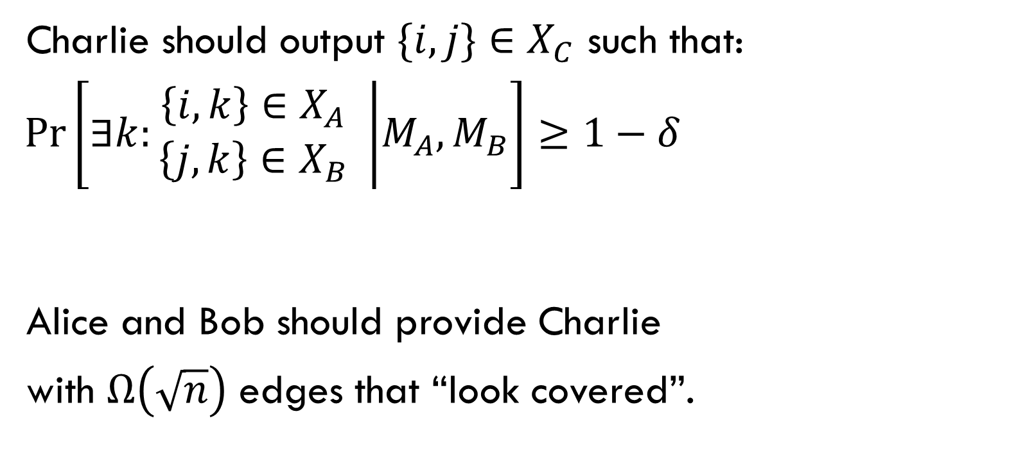
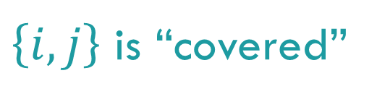


The Protocol’s Goal
Charlie should output $\{i,j\}∈X_{C}$ such that:
$\operatorname{Pr}\left[∃k:\begin{matrix}\left\{i,k\right\}∈X_{A} \\ \left\{j,k\right\}∈X_{B}\end{matrix} | M_{A},M_{B}\right]≥1−δ$
Alice and Bob should provide Charlie
with $Ω\left(\sqrt{n}\right)$ edges that “look covered”.
$$i$$
$\left\{i,j\right\}$ is “covered”
$$k$$
$$j$$

Slide 17

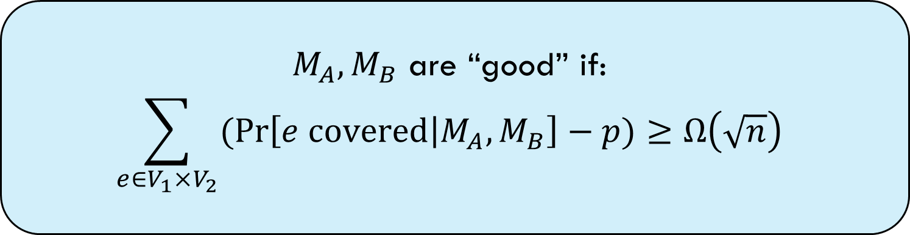
The Protocol’s Goal
Charlie should output $\{i,j\}∈X_{C}$ such that:
$\operatorname{Pr}\left[∃k:\begin{matrix}\left\{i,k\right\}∈X_{A} \\ \left\{j,k\right\}∈X_{B}\end{matrix} | M_{A},M_{B}\right]≥1−δ$
$$i$$
$M_{A},M_{B}$ are “good” if:
$$\sum_{e∈V_{1}×V_{2}}{(\operatorname{Pr}\left[e covered | M_{A},M_{B}\right]−p)}≥Ω\left(\sqrt{n}\right)$$
$$k$$
$$j$$
Prior probability of being
In a triangle

Slide 18
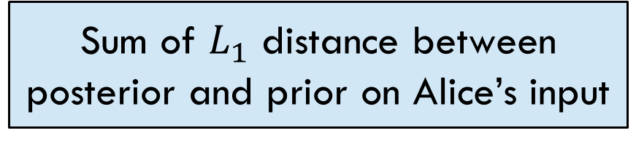
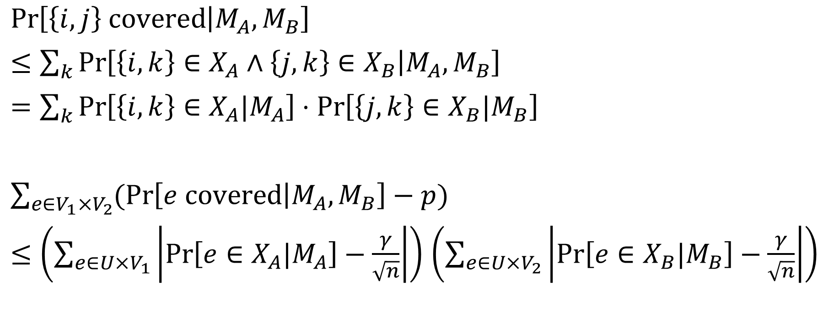
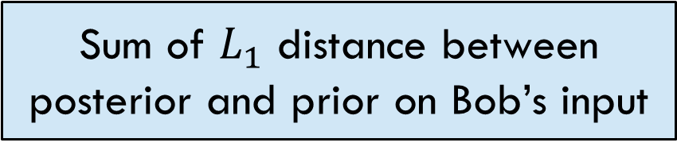
Bounding the Sum of cover-probabilities
$\operatorname{Pr}\left[\left\{i,j\right\} covered | M_{A},M_{B}\right]$
$≤\sum_{k}{\operatorname{Pr}\left[\left\{i,k\right\}∈X_{A}∧\left\{j,k\right\}∈X_{B} | M_{A},M_{B}\right]}$
$=\sum_{k}{\operatorname{Pr}\left[\left\{i,k\right\}∈X_{A}|M_{A}\right]⋅\operatorname{Pr}\left[\left\{j,k\right\}∈X_{B}|M_{B}\right]}$
$\sum_{e∈V_{1}×V_{2}}{(\operatorname{Pr}\left[e covered | M_{A},M_{B}\right]−p)}$
$≤\left(\sum_{e∈U×V_{1}}{\left|\operatorname{Pr}\left[e∈X_{A}|M_{A}\right]−\frac{γ}{\sqrt{n}}\right|}\right)$ $\left(\sum_{e∈U×V_{2}}{\left|\operatorname{Pr}\left[e∈X_{B}|M_{B}\right]−\frac{γ}{\sqrt{n}}\right|}\right)$
Sum of $L_{1}$ distance between posterior and prior on Alice’s input
Sum of $L_{1}$ distance between posterior and prior on Bob’s input

Slide 19
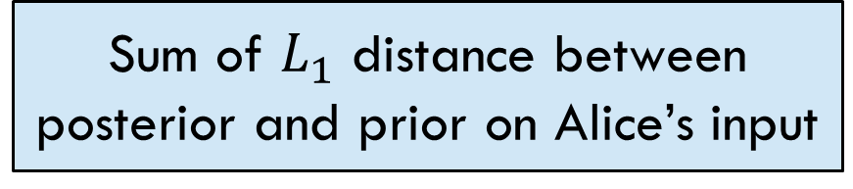
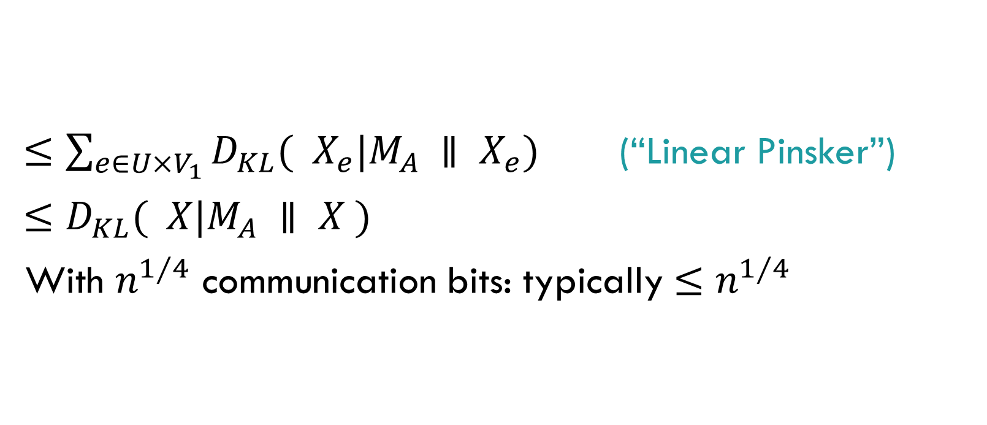
Bounding the Sum of cover-probabilities
$≤\sum_{e∈U×V_{1}}{D_{KL}({ X}_{e}|M_{A} ∥ X_{e}})$ (“Linear Pinsker”)
$≤D_{KL}( X|M_{A} ∥ X )$
With $n^{1⁄4}$ communication bits: typically $≤n^{1⁄4}$
Sum of $L_{1}$ distance between posterior and prior on Alice’s input

Slide 20
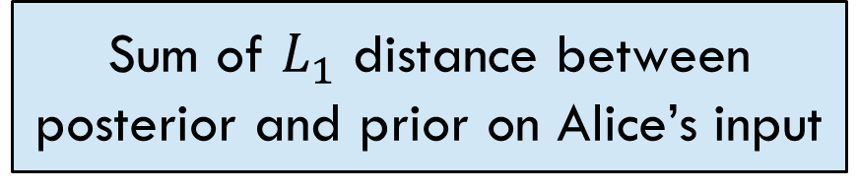

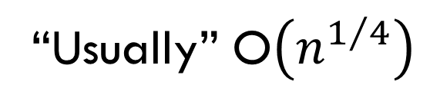
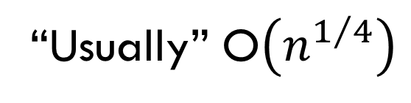
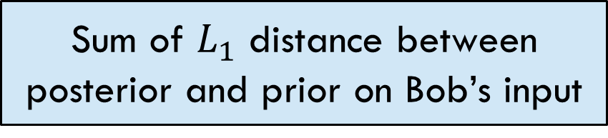
Bounding the Sum of cover-probabilities
$\sum_{e∈V_{1}×V_{2}}{(\operatorname{Pr}\left[e covered | M_{A},M_{B}\right]−p)}$
$≤\left(\sum_{e∈U×V_{1}}{\left|\operatorname{Pr}\left[e∈X_{A}|M_{A}\right]−\frac{γ}{\sqrt{n}}\right|}\right)$ $\left(\sum_{e∈U×V_{2}}{\left|\operatorname{Pr}\left[e∈X_{B}|M_{B}\right]−\frac{γ}{\sqrt{n}}\right|}\right)$
$≤$ $O\left(\sqrt{n}\right)$
Sum of $L_{1}$ distance between posterior and prior on Alice’s input
Sum of $L_{1}$ distance between posterior and prior on Bob’s input
“Usually” O$\left(n^{1/4}\right)$
“Usually” O$\left(n^{1/4}\right)$

Slide 21
Simultaneous Protocols?
Tripartite graph $G=\left(U∪V_{1}∪V_{2},E\right)$
The edges are iid $B_{γ/{\sqrt{n}}}$
Upper bound:
  Fix $u∈U$
  Alice and Bob send $Θ\left(n^{1/4}\right)$ edges from $u$
$$V_{1}$$
$$Θ\left(n^{1/4}\right)$$
$$U$$
$$u$$
$$Θ\left(n^{1/4}\right)$$
$$V_{2}$$

Slide 22
Open Problems: subgraph-freeness
“Real” lower bounds for testing triangle-freeness
  Multi-round
  Testing triangle-freeness, not “finding a triangle”
Going to larger subgraphs
Embedding back in the CONGEST model

