Slide 1
Assessing model adequacy in molecular phylogenetics (or more to the point – not doing it and saying why it’s tricky) Barbara Holland University of Tasmania

Slide 2
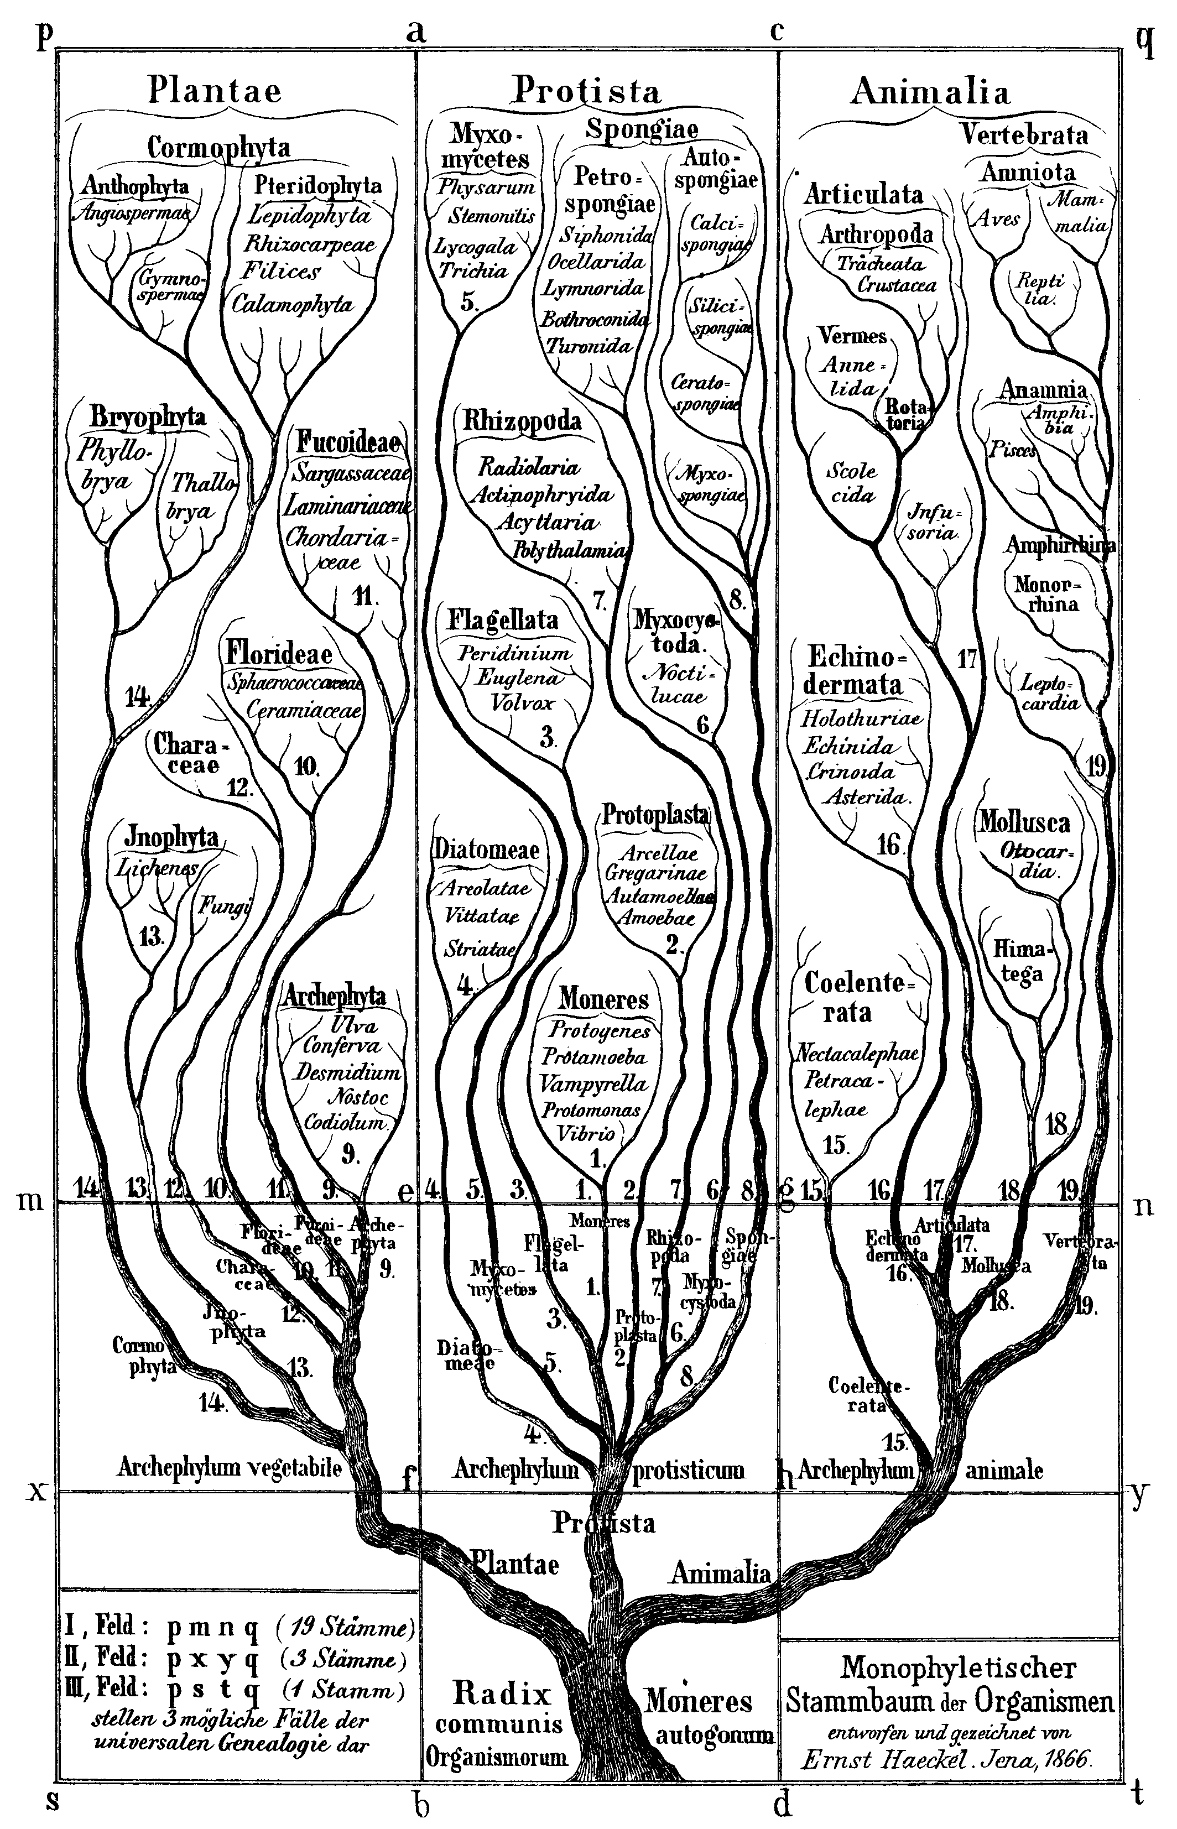
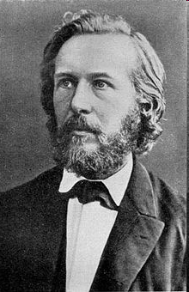
Ernst Haeckel’s Tree of Life (1866)
Since the publication of Origin of the Species in 1859 people have been trying to infer the evolutionary Tree of Life.

Slide 3
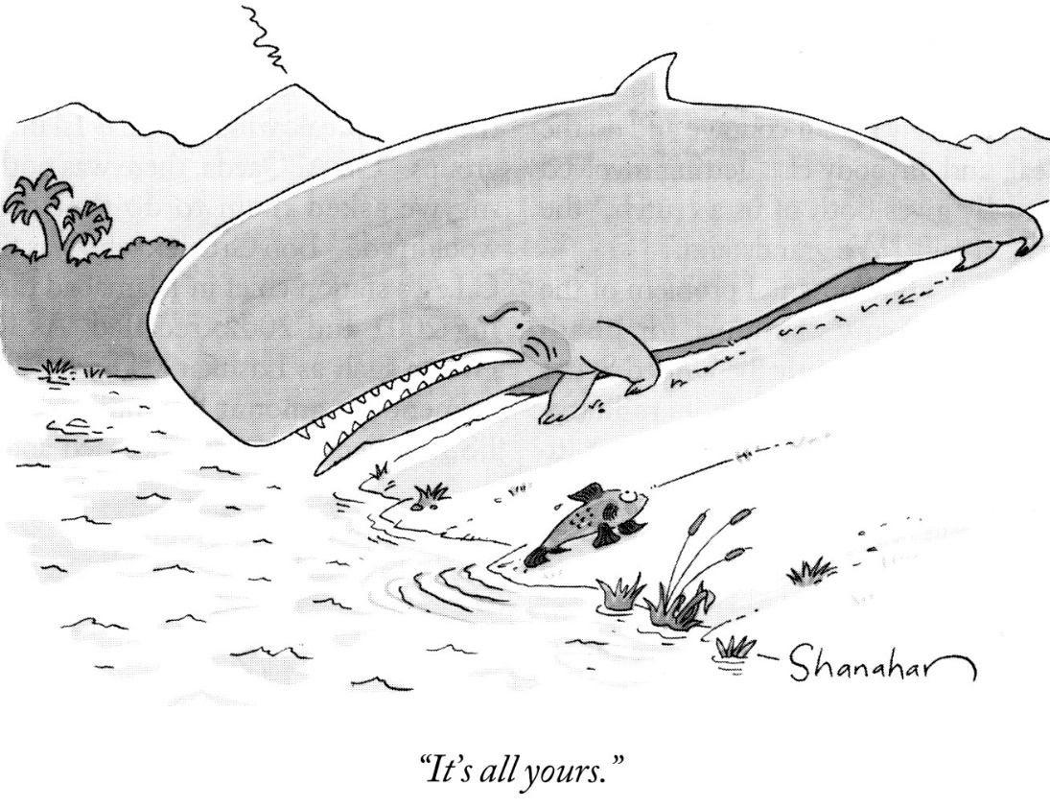
Why molecular phylogenetics?
It is difficult to compare the ankle bones of whales to those of other artiodactyls.
Most DNA evolves independently of adaptations affecting morphology.
It is fairly easy to find genes that are present in all species of interest, e.g., a 12S RNA molecule in mitochondria is functional over all mammals.
Useful mathematical models of sequence evolution have been developed that underpin attempts to infer evolutionary trees.

Slide 4
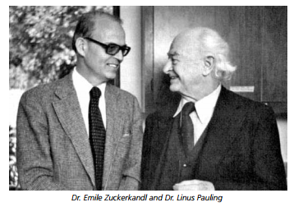
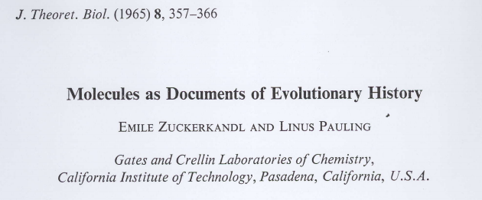
The molecular clock
Most mutations are neutral
DNA accumulates mutations (roughly) linearly with time
The amount of sequence divergence between species can be used to date how long ago they shared a common ancestor

Slide 5
The molecular phylogeny problem
?
ACCGCTTA
ACCCCTTA
ACTGCTTA
Time
ACCCCTTA
ACCCCATA
ACTGCTTA
ACTGCTAA
…ACCCCTTA…
…ACCCCATA…
…ACTGCTTA…
…ACTGCTAA…
We see the aligned
modern day sequences
And want to recover the
underlying evolutionary tree.

Slide 6
Sometimes the data agrees
ACCGCTTA
Time
ACCCCTTA
ACTGCTTA
ACCCCTTA
ACCCCATA
ACTGCTTA
ACTGCTAA
Species 1 ACCCCTTA
Species 2 ACCCCATA
Species 3 ACTGCTTA
Species 4 ACTGCTAA

Slide 7
Sometimes the data disagrees
ACCGCTTA
ACCCCTTA
ACTGCTTA
Time
ACCCCTTC
ACCCCATA
ACTGCTTC
ACTGCTAA
Species 1 ACCCCTTC
Species 2 ACCCCATA
Species 3 ACTGCTTC
Species 4 ACTGCTAA

Slide 8
Maximum parsimony
Maximum parsimony chooses the tree that requires the fewest mutations to explain the data
1
3
1
2
2
4
3
4

Slide 9
Maximum parsimony
Maximum parsimony chooses the tree that requires the fewest mutations to explain the data
A
G
A
G
A
G
A
A
A
G
G
A

Slide 10
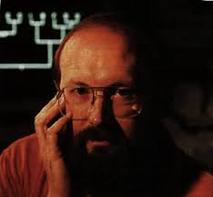
The “Felsenstein Zone”
Parsimony was once a very popular method of phylogenetic inference but it has fallen from grace in recent years due to the fact that it is statistically inconsistent for many relevant phylogenetic models.
A
C
A
C
B
D
B
D
True tree
Long branch attraction tree

Slide 11
Enter statistical phylogenetics
Over the last 30 years model-based methods of phylogenetic inference have come to the fore.
These methods assume a model of nucleotide substitution which specifies the rates that nucleotides (A,C,G,T) mutate into other nucleotides.
They aim to find the tree with the highest probability of generating the sequence data observed, i.e. the maximum likelihood tree

Slide 12
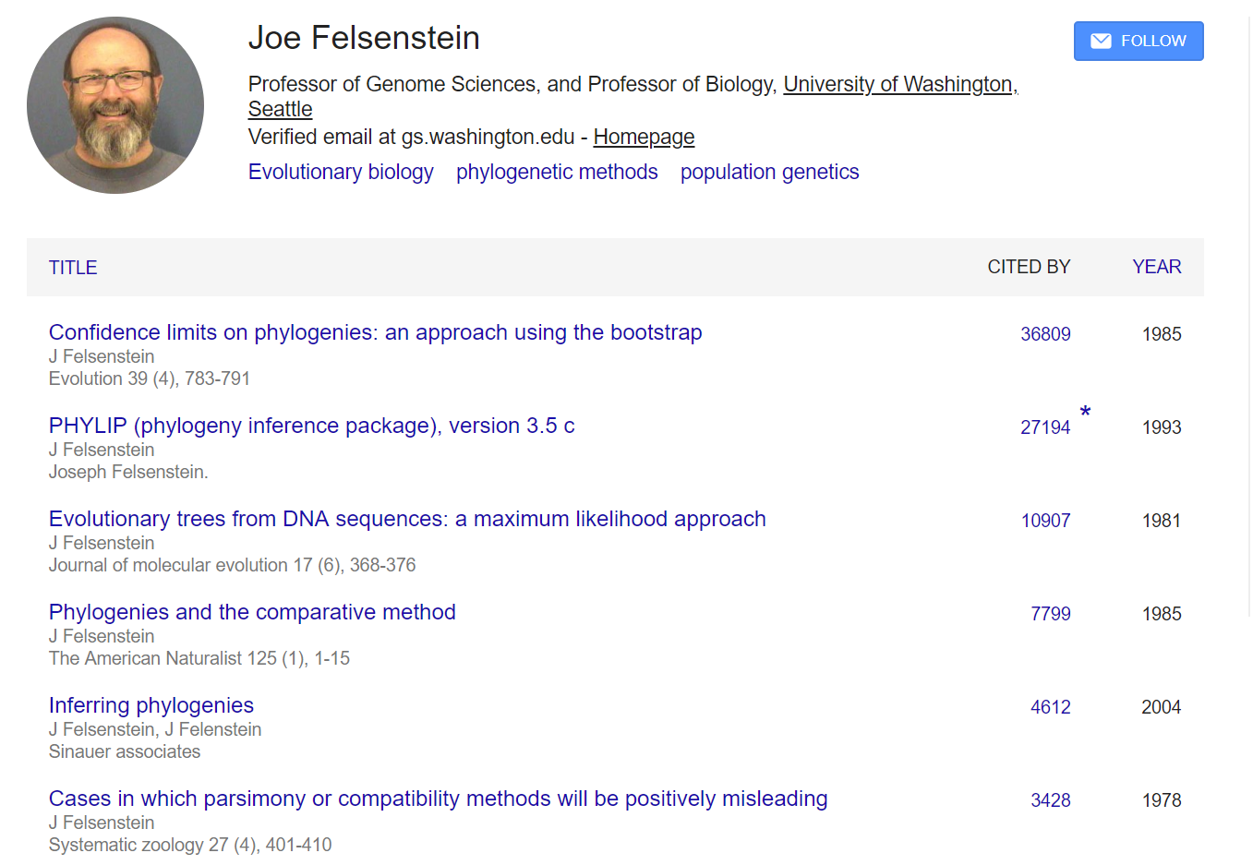
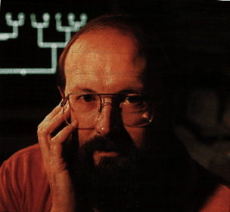
The standard phylogenetic model
Joe Felsenstein

Slide 13
Sequence evolution is (modelled as) a Markov process
A
Consider a single edge in a phylogeny, i.e. evolution of a single species, and the evolution of a single DNA base amongst the possible states {A, C, G, T}.
The probability of mutating from state i to j over a length of time t depends only on the current state i and the potential future state j, not on any of the previous history of the sequence, and can be written p_{ij}(t).
C
A
time
T
time t
G

Slide 14
Continuous time Markov chains
 | A | C | G | T
A | -q_{A*} | q_{AC} | q_{AG} | q_{AT}
C | q_{CA} | -q_{C*} | q_{CG} | q_{CT}
G | q_{GA} | q_{GC} | -q_{G*} | q_{GT}
T | q_{TA} | q_{TC} | q_{TG} | -q_{T*}
 | A | C | G | T
A | p_{AA} | p_{AC} | p_{AG} | p_{AT}
C | p_{CA} | p_{CC} | p_{CG} | p_{CT}
G | p_{GA} | p_{GC} | p_{GG} | p_{GT}
T | p_{TA} | p_{TC} | p_{TG} | p_{TT}
Q =
Where q_{i*} = Σ_{j} q_{ij,} j ≠ i
i.e. rows sum to zero.
M =
Instantaneous rate matrix
Transition matrix
M = exp(Qt)
A
G
C
T

Slide 15
Models define probability distributions on site patterns
The model consists of: the tree topology, edge weights, a rate matrix Q, and root distribution π.
y
Edge weights t₁, t₂, t₃, t₁₂
M_{e} = exp(Qt_{e})
p_{ijk} = Σ_{x,y} M₁(x,i) M₂(x,j) M₁₂(y,x) M₃(y,k) π(y)
M₁₂
M₃
x
M₁
M₂
1
2
3
Our models give us multinomial distributions on site patterns
Our sequence alignments give us empirical multinomial distributions on site patterns
* Not the way software actually does it

Slide 16
What makes phylogenetics quirky?
The model is a mix of discrete combinatorial structure (the tree) + continuous parameters (edge lengths, parameters in rate matrices,…)
It is a common maxim that just because a model fits “best” doesn’t mean it fits “well”. However, it is surprisingly difficult to do anything analogous to residual diagnostics in a phylogenetic context.
Our models basically give us a multinomial distribution on site patterns. Even for just 10 species there are 4^10 ~ 1 million possible site patterns, and in any particular sequence alignment the vast majority of these will not be observed.
We need more tools to help us visualise how well our models fit and where they break down.

Slide 17
Assessing confidence in trees
We would like some measure of confidence in the inferred tree.
Is the tree likely to change if we got more data, or if we had used slightly different data?
Are some parts of the tree more robust than others?
The bootstrap is a useful tool for answering these sorts of questions.

Slide 18
The bootstrap
In 1985 Felsenstein introduced the idea of the bootstrap to phylogenetics.
For each bootstrap sample
Create a new alignment by resampling the columns of the observed alignment
Construct a tree for the ‘bootstrap’ alignment
Can be applied to any method that starts from a sequence alignment, e.g., parsimony, likelihood, clustering methods if the distances are derived from an alignment…
The bootstrap support for each edge is the number of bootstrap trees that edge appears in.
*Pretty much everything said here about bootstrap values carries over to the Bayesian setting where you assess how many times a particular edge appears in the MCMC chain

Slide 19
1234567
a ATATAAA
b ATTATAA
c TAAAATA
d TATAAAT
1224567
a ATTTAAA
b ATTATAA
c TAAAATA
d TAAAAAT
1334567
a AAATAAA
b ATTATAA
c TAAAATA
d TTTAAAT
1234567
a ATATAAA
b ATTATAA
c TAAAATA
d TATAAAT
1244567
a ATTTAAA
b ATAATAA
c TAAAATA
d TAAAAAT
a
a
c
a
c
c
a
b
b
d
c
d
b
d
b
d
a
c
0.75
b
d

Slide 20
Example where the bootstrap is useful
Simulate data on the four taxon tree below (JC model)
Use sequence lengths of 100, 1000, and 10000
 | 100 | 1000 | 10000
((a,b),(c,d)) | 5.7% | 97% | 100%
((a,c),(b,d)) | 42.8% | <5% | 0
((a,d),(b,c)) | 49.8% | <5% | 0
0.01
0.2
a
b
c
d

Slide 21
Example where the bootstrap is not so useful
Simulate data on the two four-taxon trees below (JC model) in the proportion 55%, 45% and concatenate the sequences
Use total sequence lengths of 100, 1000, and 10000
0.05
 | 100 | 1000 | 10000
((a,b),(c,d)) | 64% | 80% | 98%
((a,c),(b,d)) | 33% | 20% | <5
((a,d),(b,c)) | 3% | 0% | <5
0.1
55%
a
b
c
d
0.05
0.1
45%
a
c
b
d

Slide 22
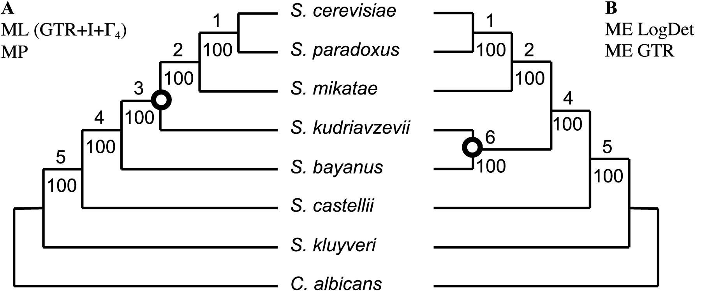
Mistaking precision for accuracy
106 nuclear genes: Different methods provide conflicting Yeast topologies, each with 100% bootstrap support
Phillips et al. (MBE, 2004)
The results show the importance of systematic error

Slide 23
Phylogenomics
With increasing quantities of sequence data it is common to get very well resolved trees, i.e. bootstrap values (or posterior probabilities) close to 100% (or 1)
HOWEVER, slight changes to the model or inference method used can mean you get 100% support for different trees?!
This suggests that it is very important to know how well our models fit our data.

Slide 24
Testing model fit
In phylogenetic studies we often ask questions of the form “Is model A better than model B?” (relative goodness-of-fit tests, based on likelihood ratio tests or information criteria such as the AIC or BIC)
We less frequently ask questions of the form “Is model C a good fit to the data?” (absolute goodness-of-fit tests)
The last question is clearly important as if our models fit poorly our results may be subject to systematic errors
So why is the last question less popular?

Slide 25
Absolute GOF tests
Absolute tests of goodness-of-fit are fiddlier to implement than relative tests. They typically require doing many parametric simulations under the best model and then summarizing each simulated dataset by a single test statistic.
With very large datasets you almost always will be able to reject your model (Dushoff – your null is always wrong).
If the best model fails an absolute GOF test, it’s not clear what you should do next…
A simple test statistic doesn’t tell you anything about how your model is wrong.

Slide 26
Case study: The Amborella Wars

Slide 27
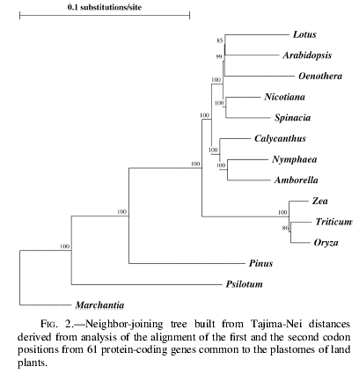
Angiosperms
A New Caladonian
shrub
Grasses

Slide 30
NJ bootstraps with ML distances
Grasses basal
JC 100%
K2P 100%
HKY 100%
K3P 100%
GTR 100%
Models without rates across sites
Amb + Nym basal
JC + G 100%
K2P + G 100%
HKY + G 100%
K3P + G 100%
GTR + G 100%
Models with rates across sites

Slide 31
NJ bootstrap with ML distances using a GTR + gamma
100
80
Amb+Nym
bootstrap support
60
Grasses
40
Amb
Nym
20
0
0.1
0.15
0.2
0.25
0.3
0.35
0.4
0.45
0.5
0.55
0.6
0.65
0.7
0.75
alpha (gamma shape parameter)

Slide 32
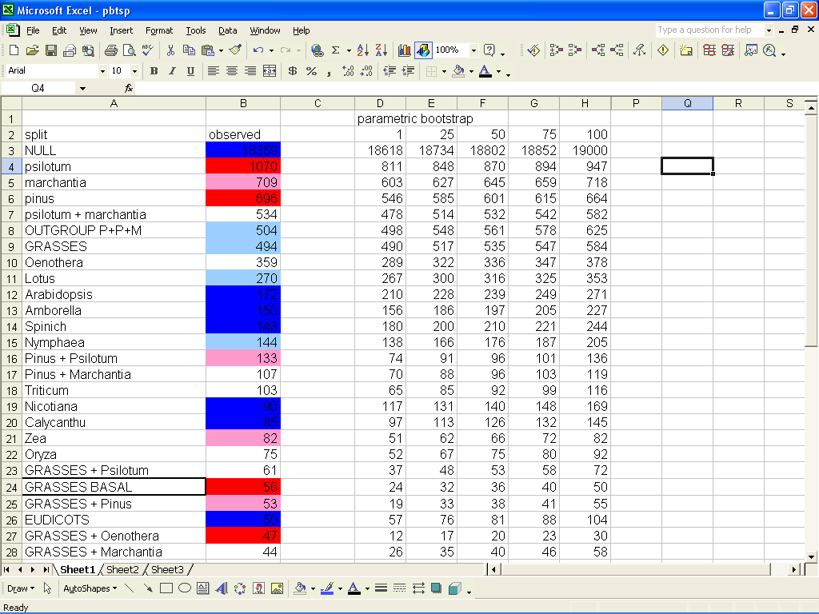

Slide 33
30
25
20
15
Frequency
(# splits)
10
5
0
0-9
10-19
20-29
30-39
40-49
50-59
60-69
70-79
80-89
90-100
Number of parametric btsp data sets where split has more supporting sites

Slide 34
Conclusions
Trees can be wrong because of sampling error OR systematic error.
Bootstrap values of 100% tell you that sampling error is not a problem, but it’s dangerous to interpret them as measures of accuracy given that our models are mis-specified.
Results for genome-scale data are very sensitive to model specification, AND we know our models are mis-specified;

Slide 35
What should we do?
Clearly sampling error is not to blame.
The problem may be model specification due to…
concatenation of genes
lineage-specific evolution
Positive selection (i.e. convergent evolution)
Not really a tree
Signals from systematic error compete with historical signal. The systematic error is actually interesting!
What we really need is better (some) ways of visualising the ways in which our models don’t fit.

