Slide 1
What’s under those old linkage peaks?
Laura Almasy

Slide 2
A meditation on what underlies linkage peaks - in which the scientist questions some of her long held, basic assumptions - as told via the parable of the Beta EEG.

Slide 3
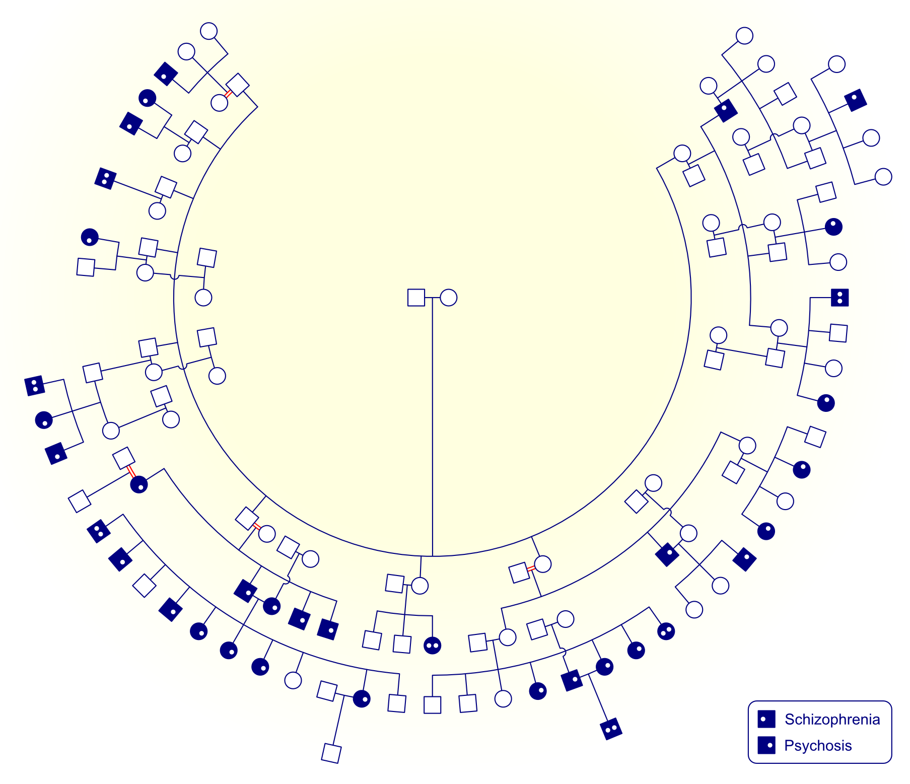
Why do we get ‘loaded’ families for complex traits?
High polygenic risk?
Background of polygenic risk with moderate/high environmental risk?
Assortative mating?
Background of polygenic risk plus a few rare alleles of larger effect?
Chance?

Slide 4
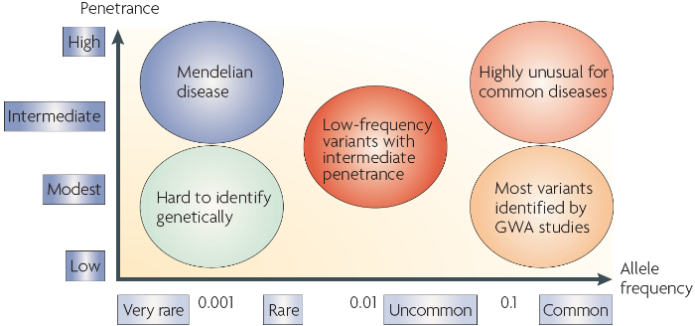
X
Do these exist? Wouldn’t we have found them by linkage?
McCarthy et al Nature Reviews Genetics 9, 356-369 (May 2008)

Slide 5
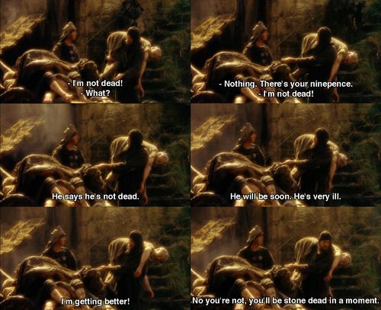
Linkage: Not dead yet

Slide 6
Simple Variance Component Model
p
=
μ
+
Σ
β
x
+
q
g
e
+
+
i
i
μ
Baseline mean
β
Regression coefficients
x
Scaled covariates
g
Additive genetic effects
q
QTL effect
e
Random environmental effects

Slide 7
Pedigree-Specific Model
Fix total variance at value from overall sample, but allow proportions to differ by family.
p
=
μ
+
Σ
β
x
+
q
g
e
+
+
i
i
Fix at values from full sample
μ
Baseline mean
β
Regression coefficients
x
Scaled covariates
g
Additive genetic effects
q
QTL effect
e
Random environmental effects

Slide 8
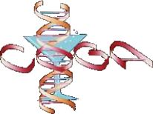
COGA:
Collaborative Study on the Genetics of Alcoholism
Started in 1989
Family study, including both families selected through individuals in treatment and representative families from the community
Now following children in these families longitudinally
Rich database of phenotypic and genetic info
One of the first psychiatric genetic studies to collect endophenotypes

Slide 9
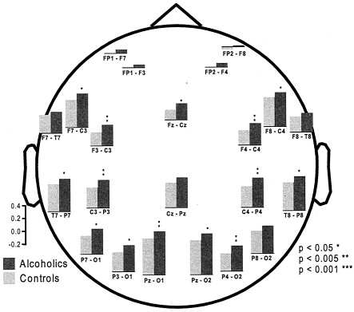
Resting Beta EEG power is higher in individuals with AUD
Rangaswamy et al. Biol Psychiatry 2002
Bernice Porjesz
SUNY Downstate

Slide 10
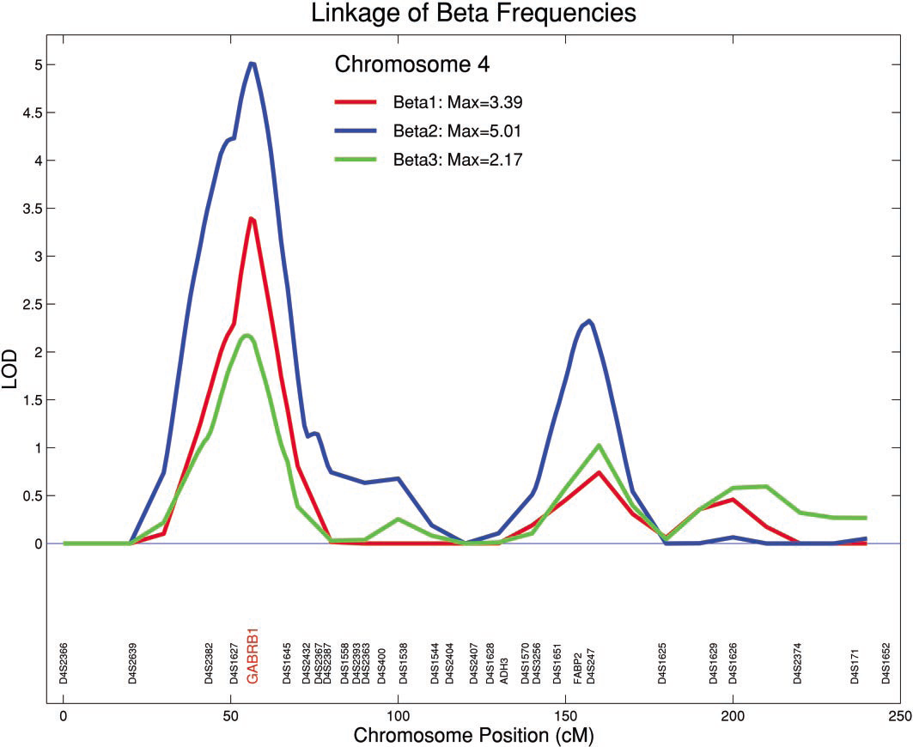
Circa 2000: We needed an obvious candidate to get anywhere with a linkage peak.
Porjesz et al., PNAS 2002

Slide 11
Pedigree-specific linkage
Family | Phenotype | Chr | LOD
20059 | Beta EEG | 6 | 4.36
30018 | Beta EEG | 8 | 3.96
50043 | Beta EEG | 5 | 3.19
50110 | ERO | 12 | 3.37
30003 | ERO | 16 | 3.07
This region of chromosome 6 was linked to AD in 1999 in several GAW11 papers. (Almasy & Borecki Gen Epi 1999)

Slide 12

Pedigree-specific linkage
Family | Phenotype | Chr | LOD
20059 | Beta EEG | 6 | 4.36
30018 | Beta EEG | 8 | 3.96
50043 | Beta EEG | 5 | 3.19
50110 | ERO | 12 | 3.37
30003 | ERO | 16 | 3.07
This region of chromosome 6 was linked to AD in 1999 in several GAW11 papers. (Almasy & Borecki Gen Epi 1999)

Slide 13
Pedigree-specific linkage
Within 10 Mb of
Family | Phenotype | Chr | LOD
20059 | Beta EEG | 6 | 4.36
30018 | Beta EEG | 8 | 3.96
50043 | Beta EEG | 5 | 3.19
50110 | ERO | 12 | 3.37
30003 | ERO | 16 | 3.07
This region of chromosome 6 was linked to AD in 1999 in several GAW11 papers. (Almasy & Borecki Gen Epi 1999)

Slide 14
Assumptions
Parsimony: one linkage peak = one QTL
Uniqueness: has to be rare or we’d see linkage in other families
Function: it has to have a reasonably big effect size so likely will have discernable functionality

Slide 15
Sequenced individuals
8 people sequenced
10 additional family members examined
12 meet DSM4 or DSM5 criteria for AUD
Tatiana Foroud, Howard Edenberg, Alison Goate

Slide 16
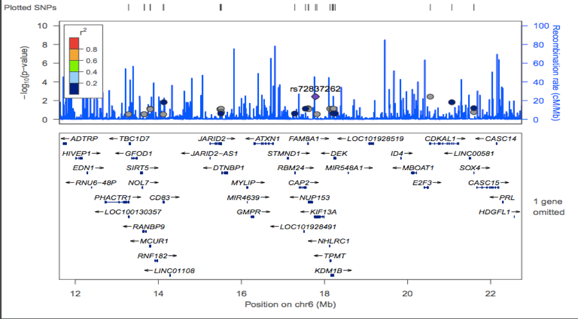
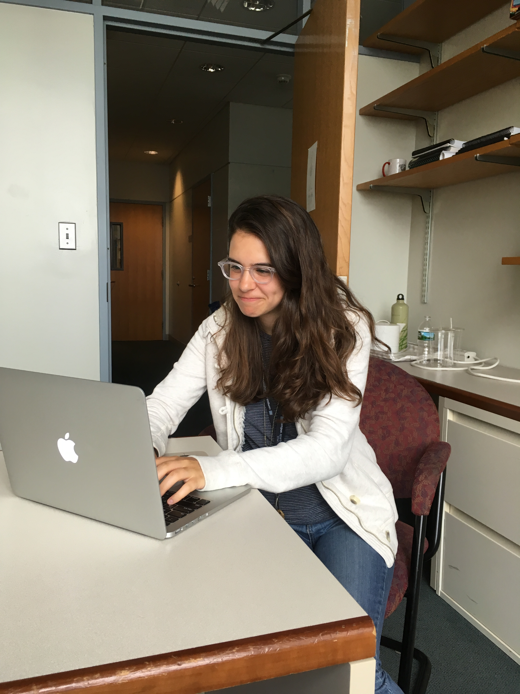
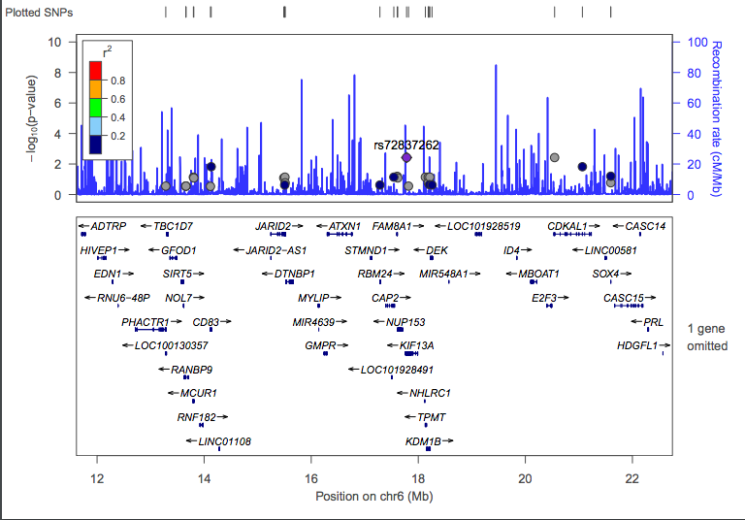
What’s in the region?
43 genes, 52 rare variants, most NC or SYN
Talya Koschitzky

Slide 17
Nonsynonymous coding variants:
 | EA MAF | Type | SIFT | Polyphen
CDKAL1 rs77152992 | 6% | Missense | del | benign
CD83 rs35118414 | 4% | Missense | tol | benign
SOX4 rs201864836 | 1% | Missense | del | ?
SOX4 21595266 G->GGGC | 0.1% | In frame insertion | ? | ?
ADTRP rs115489595 | 0.5% | Missense | del | prob
SOX4: transcription factor, regulation of embryonic development, determination of cell fate, apoptosis
ADTRP: regulates expression and anticoagulant activity of TFPI

Slide 18
Imputation on GWAS framework with GIGI
Dosage
Marry-ins have essentially no info and are getting frequency-based dosage
Can’t infer genotype on third generation, but we call tell if they got a rare allele from one of their grandparents

Slide 19
Association within linkage family
Family | Gene | SNV | pval | EA MAF | Type | Reg SNP | Brain Expr | eQTL | Beta EEG
20059 | KIF13A | rs72837262 | 0.0038 | 0.017 | Intron | 0.25 | High | No | ↓
20059 | CDKAL1 | rs9465799 | 0.0038 | 0.030 | Intron | 0.29 | Low | No | ↓
20059 | CDKAL1 | rs77152992 | 0.01 | 0.06 | Mis | N/A | Low | No | ↑
20059 | CD83 | rs35118414 | 0.01 | 0.04 | Mis | N/A | Med | No | ↑
KIF13A: kinesin family, microtubule-based motor proteins
CDKAL1: methylthiotransferase family, unknown function, associated with type 2 diabetes
CD83: membrane protein, immunoglobulin superfamily of receptors

Slide 20
Who is carrying these alleles?
+ BetaEEG
- BetaEEG

Slide 21
What’s in the region?
rs1570989
p=2.4x10-6
Alcohol + nicotine
SAGE
Zuo et al. AmJMedGenet Neuropsychitr Genet 2012
+
-
p = 4-6x10-4
Cigs per day
Tobacco and Genetics Consortium
Nat Gen 2010

Slide 22
Genes of interest
CD83: membrane protein, immunoglobulin superfamily of receptors, mRNA ↑ w/stress in mouse model, alcohol consumption suppresses generation of CD83+ cells in mice, mRNA in LCLs↑ w/EtOH exposure
KIF13A: kinesin family, microtubule-based motor proteins, deficiency in mice associated with anxiety via serotonin receptor transport, mRNA in LCLs↑ w/EtOH exposure
DTNBP1: glutamatergic regulation, associated with SCZ, opiate and nicotine dependence, associated with dopamine and serotonin metabolites in CSF

Slide 23
Different family, different chromosome, same story.
Two associated variants in separate founders, one high & one low. Both are uncommon but not rare (MAF 1 – 3.5%). Neither shows obvious function.
Neuronal cholinergic nicotinic receptor cluster CHRNB3-A6 is within this linkage peak.
SAGE maxdrinks GWAS signal at rs67666182 just qter of this linkage peak (Kapoor et al. Hum Genet 2013)

Slide 24
Where’s my big, glowing, rare, unique, neon functional variant?
Parsimonious explanation: it’s not coding, it’s regulatory
Can I bring in population-level information from GWAS in the larger COGA sample to narrow down the region or point me to a gene?
NOT

Slide 25
GWAS hits in linkage region, minus family 20059
SNP | P value | Info
6.16235239.TACTTAACTTTATTTCTGGG.T | 2e-06 | Intergenic
6.16488084.C.T | 2.346e-06 | Intron of ATXN1, Not a known eQTL
6.19944399.T.G | 3.126e-06 | Intergenic
Not in LD with each other

Slide 26
GWAS hits in linkage region, minus family 20059
STILL NOT
SNP | P value | Info
6.16235239.TACTTAACTTTATTTCTGGG.T | 2e-06 | Intergenic
6.16488084.C.T | 2.346e-06 | Intron of ATXN1, Not a known eQTL
6.19944399.T.G | 3.126e-06 | Intergenic

Slide 27
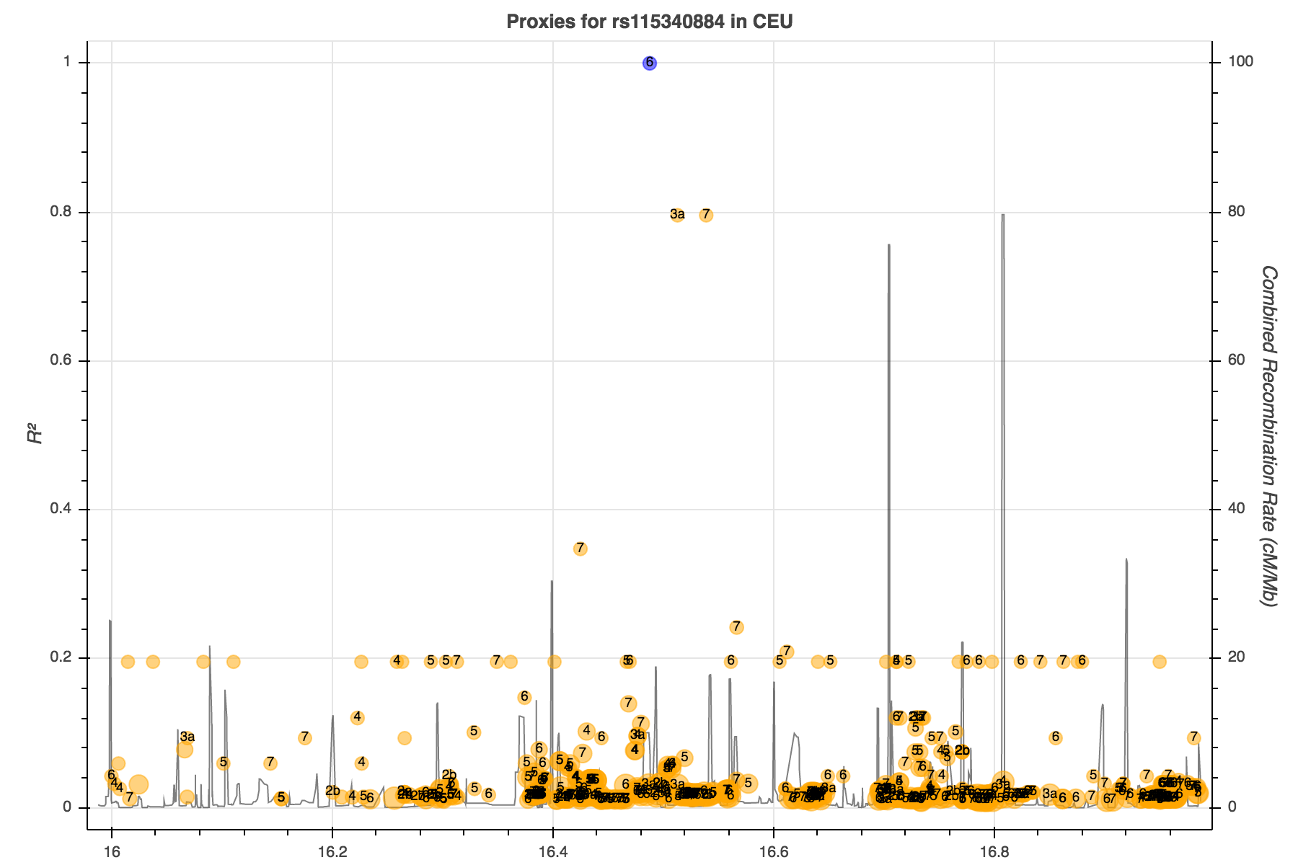
ATXN1 SNP is in LD with two others, one of which has regulatory potential.
Also, associated with Cialis use in PheWAS.

Slide 28
ATXN1 SNP is in LD with two others, one of which has regulatory potential.
Also, associated with Cialis use in PheWAS.
might be part of

Slide 29
Pedigree-specific linkage
Family | Phenotype | Chr | LOD
20059 | Beta EEG | 6 | 4.36
30018 | Beta EEG | 8 | 3.96
50043 | Beta EEG | 5 | 3.19
50110 | ERO | 12 | 3.37
30003 | ERO | 16 | 3.07
This region of chromosome 6 was linked to AD in 1999 in several GAW11 papers. (Almasy & Borecki Gen Epi 1999)

Slide 30
Assumptions – Do I still believe them?
Parsimony: one linkage peak = one QTL What about those opposite haplotypes? Maybe it’s multiple QTLs and that’s why I got the linkage peak? Allelic or even locus heterogeneity within a single family?
Uniqueness: has to be rare or we’d see linkage in other families Or maybe it’s overlaid on a vulnerable background in this family. Look at all those mouse studies with strain effects.
Function: it has to have a reasonably big effect size so likely will have discernable functionality in the right assay/tissue/etc …

Slide 31
Conclusions:
Linkage: Not Dead Yet!
Pedigree-specific linkage is useful in the setting of heterogeneity of effect size
Complex traits are complex, even within a single family
A lot of our assumptions arise from Mendelian trait architecture and may need to be adapted

Slide 32
COGA
COLLABORATIVE STUDY ON THE GENETICS OF ALCOHOLISM
Principal Investigators: B. Porjesz, SUNY Downstate Medical Center
V. Hesselbrock, University of Connecticut
H. Edenberg, Indiana University
L. Bierut, Washington University
    COGA includes eleven different centers:
        University of Connecticut V. Hesselbrock
        Indiana University H. Edenberg, J. Nurnberger Jr., T. Foroud
        University of Iowa S. Kuperman, J. Kramer
        SUNY Downstate Medical Center B. Porjesz
        Washington University L. Bierut, J. Rice, K. Buchholz, A. Agrawal
        University of California UCSD M. Schuckit
        Howard University R. Taylor
        Rutgers University J. Tischfield, A. Brooks
        CHOP/Penn L. Almasy
        Virginia Commonwealth Univ. D. Dick
        Mount Sinai School of Medicine A. Goate
        Howard University R. Taylor
        A. Parsian and M. Reilly, NIAAA Staff Collaborators
This national collaborative study is supported by the NIH through Grant U10AA008401 from the National Institute on Alcohol Abuse and Alcoholism (NIAAA) and the National Institute on Drug Abuse (NIDA).

Slide 33
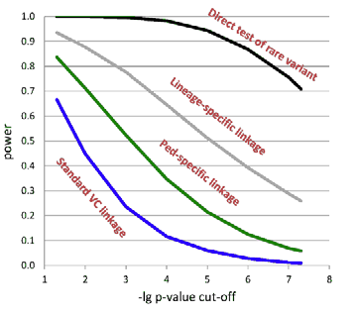
Blangero et al, unpublished

