Slide 1
Genomic inference and simulations in population-scale genealogies
Dominic Nelson, Simon Gravel

Slide 2
Goals
Integrate genealogical and genetic data to learn about
History
Evolution
Biology
Health

Slide 3
Goals
Integrate genealogical and genetic data to learn about
History
Evolution
Biology
Health
Law enforcement
Immigration

Slide 4
Genes and genealogies
Many population-scale genealogical datasets are becoming available.
Here we focus on Balsac
Based on curated Catholic church records
3.4M individuals
Primarily French-Canadian in Quebec
12-17 generations deep
But see also Ancestry.com, Decode, geni, familytree …

Slide 5
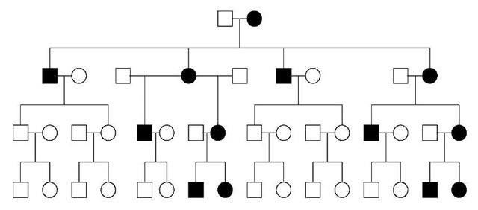

Slide 6
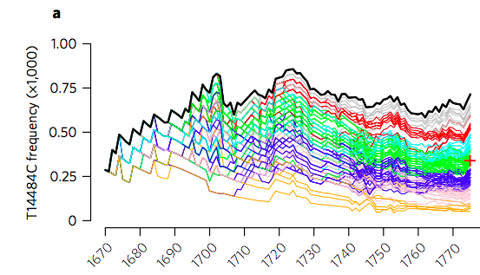
The history of rare variants
Given a mitochondrial or y chromosome mutation, we can infer a transmission history.
Milot et al, Nat. Ecol. Evo. 1, 2400 (2017)

Slide 7
Imputing autosomal variants
For autosomes, this is much harder.
Consider Chronic Atrial et Intestinal Dysrhythmia (CAID):
Causal mutation on Chromosome 3 in SGOL1
Recessive condition with high penetrance – fertility of homozygotes is much reduced
Rare allele present in Europe with f~0.0002, likely not de novo in Quebec
We know of ~11 patients tied to the genealogy

Slide 8
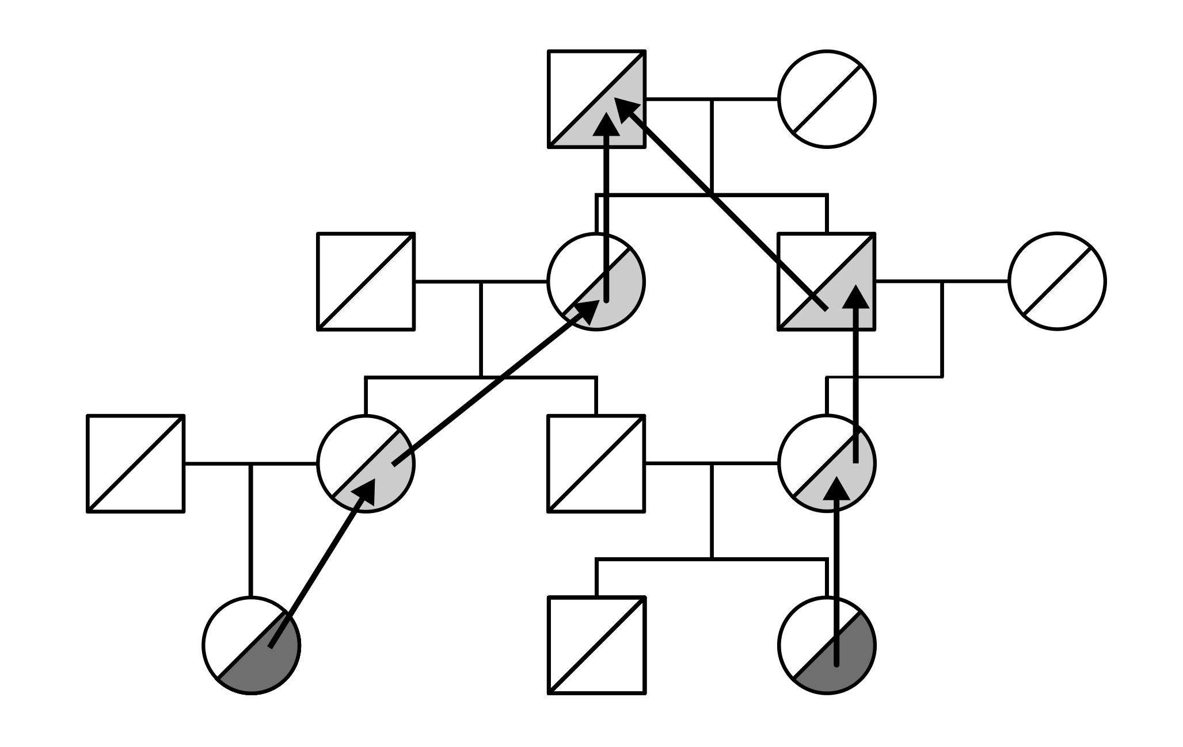
Problem setup:
Can we impute the status of untyped ancestors assuming:
Mutation entered the population through unique founder
Genealogy is correct

Slide 9
Tracing mutation history in genealogies
Monte Carlo climbing simulations
Carriers inherit a variant at random from either parent
Parents inherit from grandparents, etc.
Likelihood of an ancestor carrying an allele depends on how often it is chosen.

Slide 10
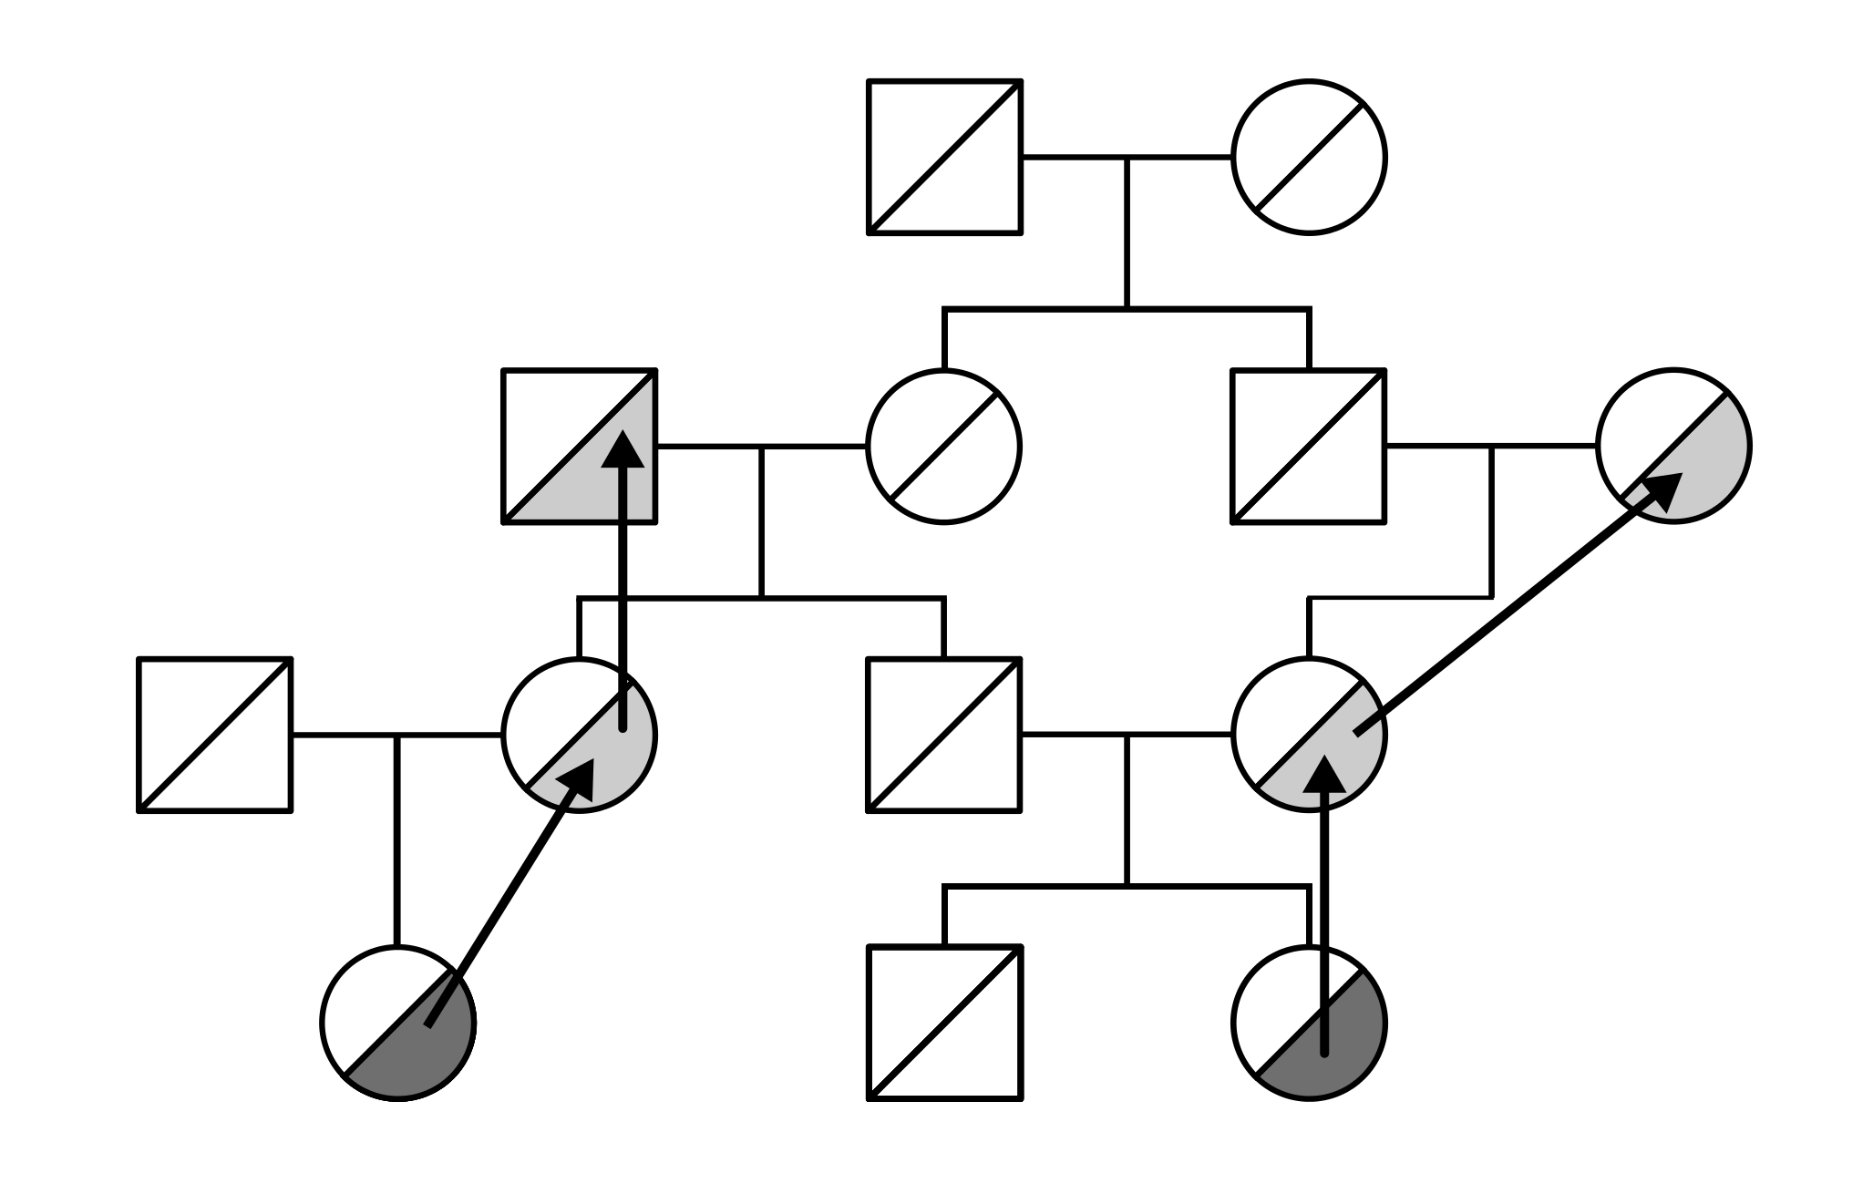
Allele climbing impractical for founder mutations
Extraordinarily unlikely that we will converge to a single ancestor.
Most simulations lead to too many founders

Slide 11
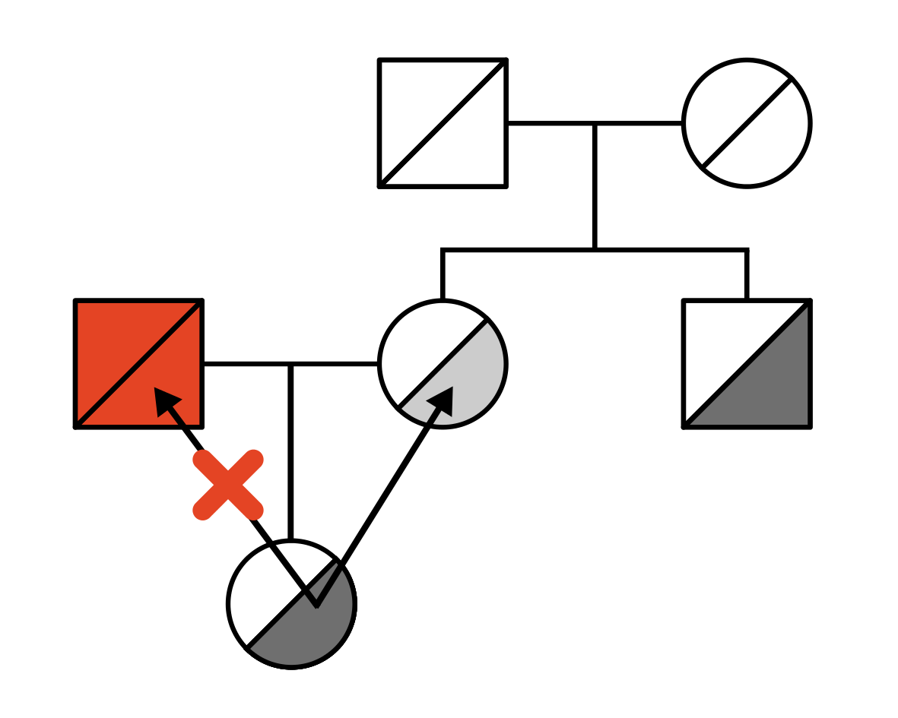
Finding a plausible path
We can favor more promising paths, then correct for the resulting bias in likelihood computation.

Slide 12
Inferring mutation history
We obtain likelihoods of each founder carrying the allele, and of each trajectory

Slide 13
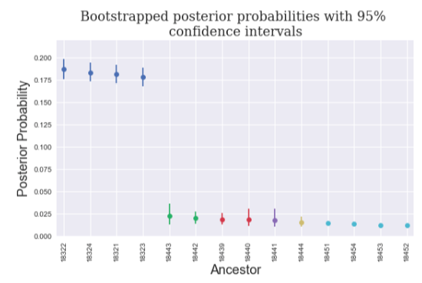
Finding the likelihood of a recent ancestor
Posterior probability
0.2
0.1
0
Founders (in decreasing order of posterior)

Slide 14
Application to CAID
Two families with 5 individuals capture 98% of the posterior probability.
I can’t tell you who they are
What do we do with this information?
Find old world relatives

Slide 15
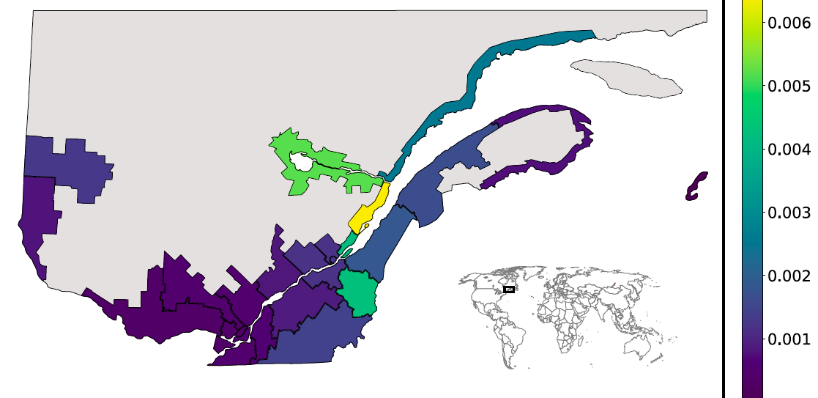
Regional frequency estimates

Slide 16
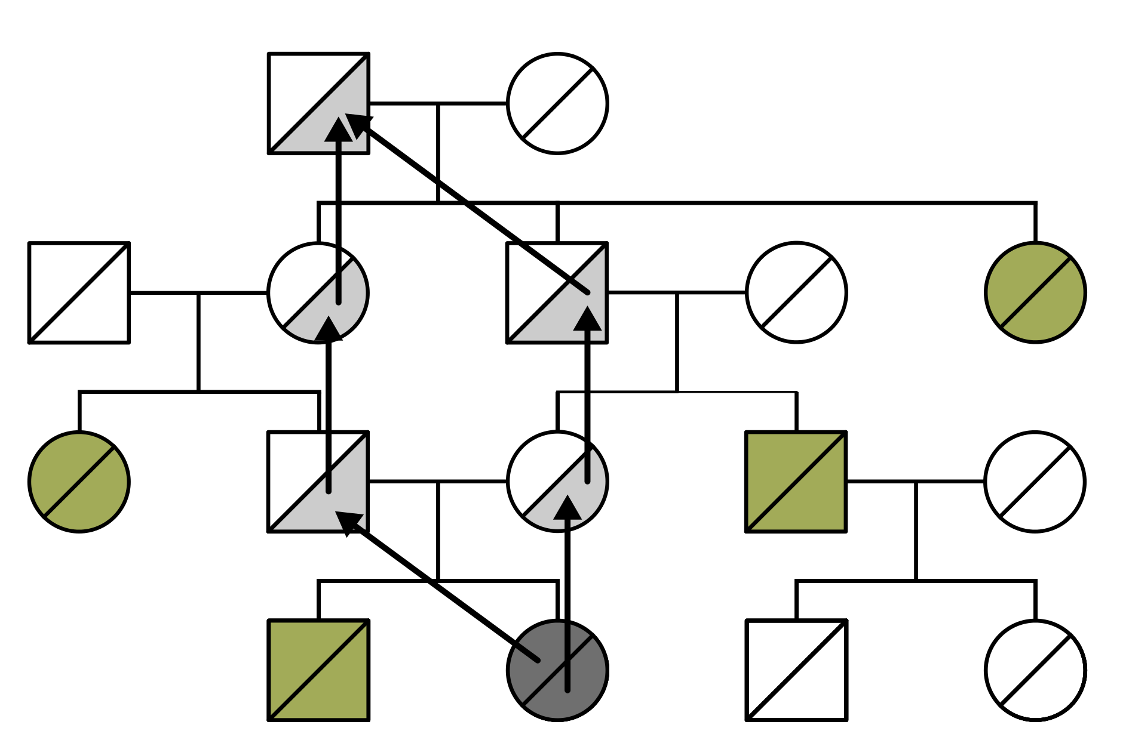
Incorporating the observed allele frequency
We estimate the contributions from assigned individuals by summing over contributions of each
To avoid overlapping contributions, we use their first-generation descendants
We combine this likelihood with the climbing likelihood

Slide 17
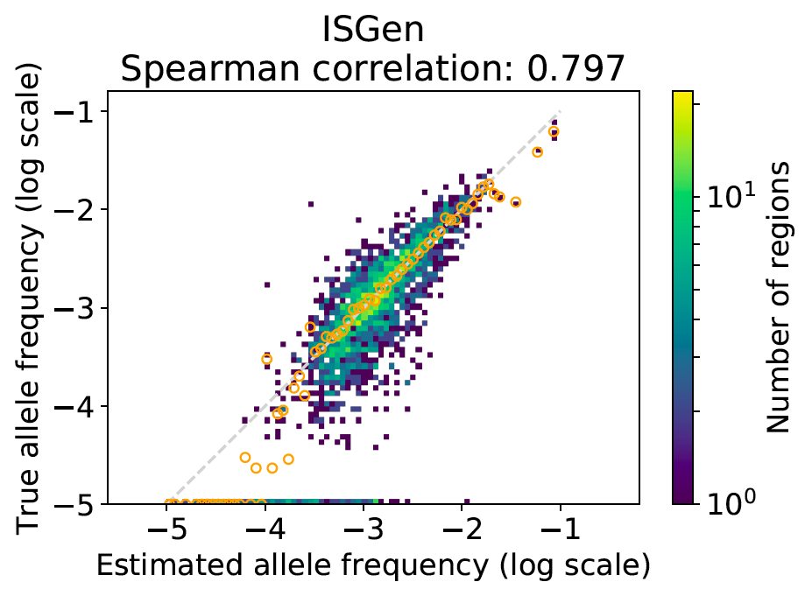
Validation

Slide 18
Regional frequency estimates for CAID

Slide 19
Summary -- inference
We can run inference in millions of samples
We can take into account inheritance mode, haplotype sharing
Need to relax some model assumptions

Slide 20
Simulating millions of whole genomes

Slide 21
Simulating millions of whole genomes
Test statistical methods
Infer evolutionary parameters
Selection, migration, demography
Mutation, recombination

Slide 22
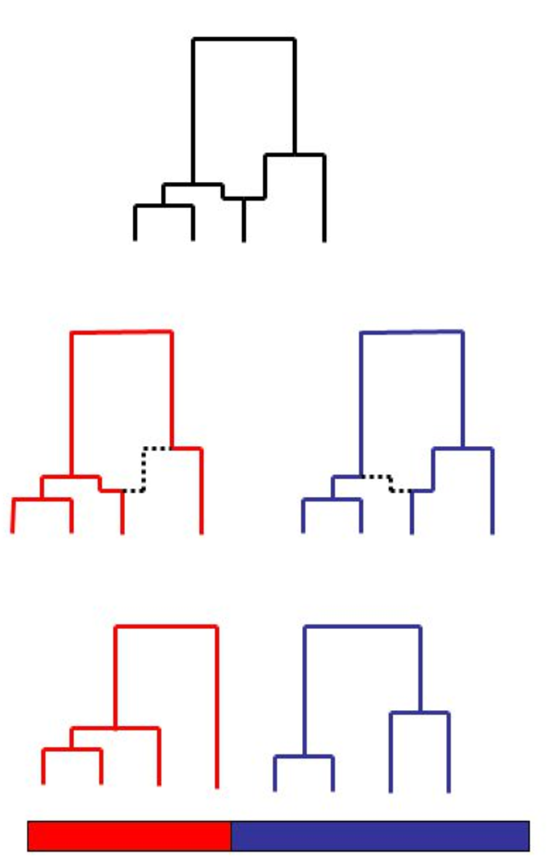
Tracking millions of genomes
Coalescent approach
Simulate gene trees along the genome
Simulate mutations along the trees
Very efficient numerically, but difficult to generalize to non-neutral cases.
Image: Simon Myers

Slide 23
Recent progress in numerical applications of coalescent theory
ms (Hudson, 2002)
“Sequentially Markovian Coalescent” (McVean, Cardin, 2005) uses an approximation to speed things up. Led to a cottage industry of inference tools (2012-2017)
msprime (Kelleher, McVean, 2016)

Slide 24
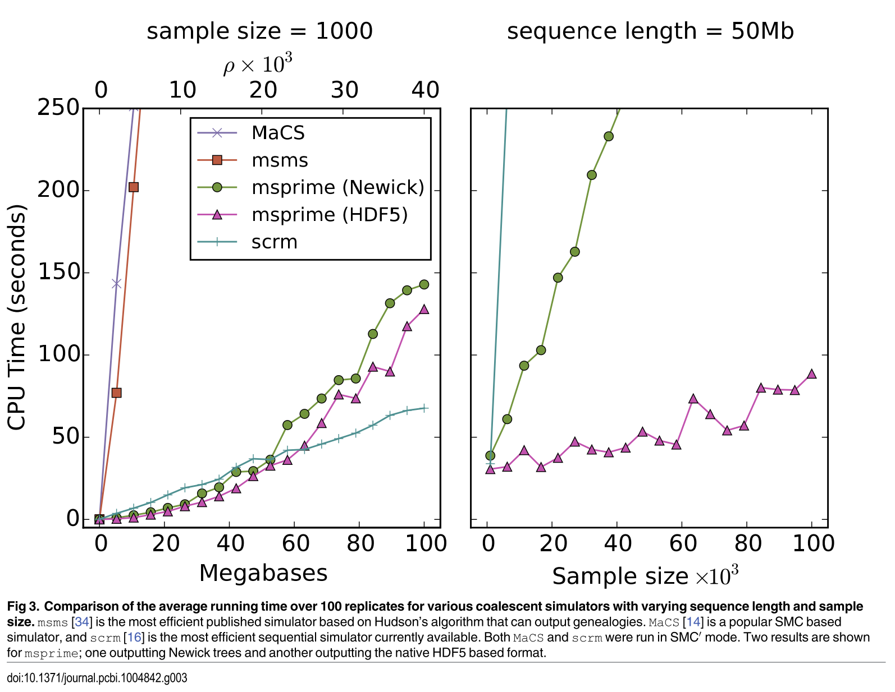
Msprime’s ridiculous edge
Compute
time(s)

Slide 25
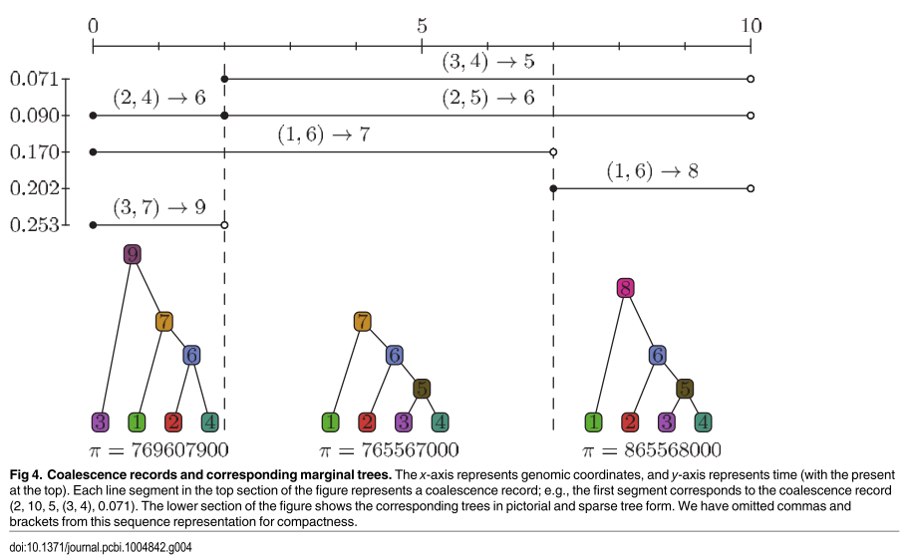
How does msprime do it?
ms stores each genealogical tree
Msprime only stores a relationship between lineages:
(L, R, parent, child 1, child 2 , t)
These records are sufficient to reconstruct the ancestral recombination graph.

Slide 26
Msprime reduces redundancies
Adjacent trees are very similar
Single storage of a shared information saves tons of time.

Slide 27
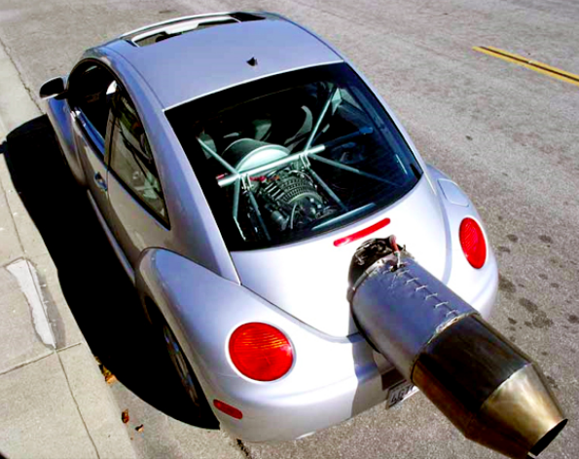
Is msprime too fast for its own good?

Slide 28
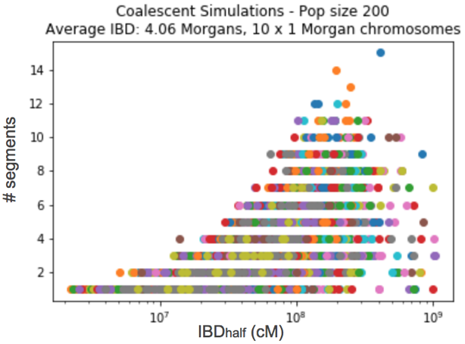
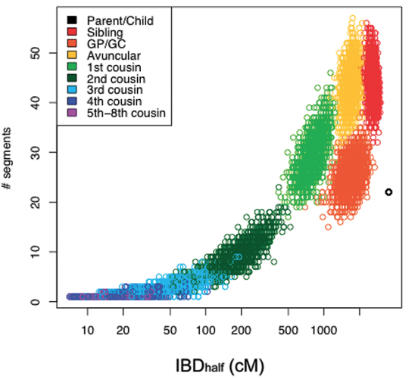
IBD: data vs simulations
Data (23andme)
Simulations
Shared segments
Median length
Median length(cm)

Slide 29
Large sample issues
Too many doubletons and too few singletons (Yun Song 2014)
(coalescent theory misses multiple mergers)

Slide 30
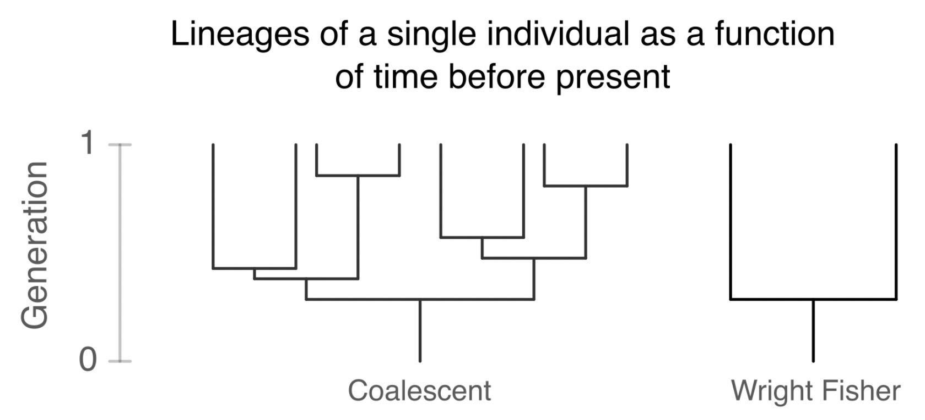
Classical coalescent models create crazy genealogies

Slide 31
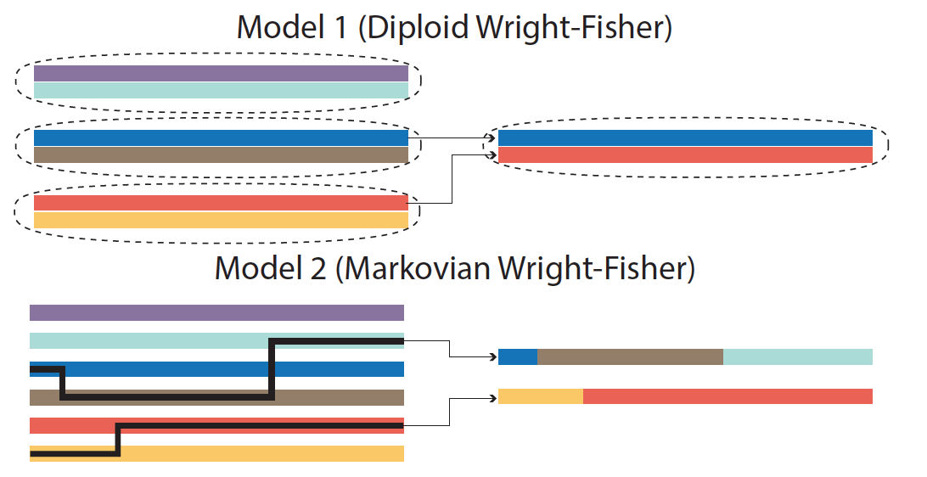
When too much simulations lead to problems

Slide 32
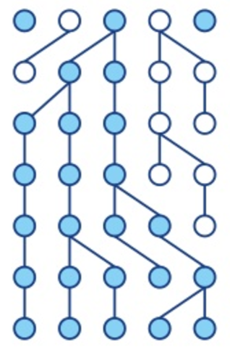
Can we get back to Wright-Fisher
No problem with large cohorts
Proper diploid individuals
Arbitrary genealogies.
Image: Paula Tataru, www.slideshare.net

Slide 33
IBD: data vs simulations
Data (23andme)
Simulations
# shared
segments
Median length (cM)
Median length (cM)

Slide 34
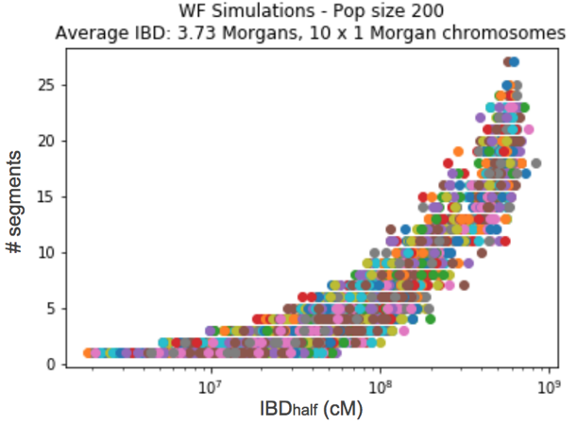
IBD: data vs simulations
Data (23andme)
Simulations
# shared
segments
Median length (cM)
Median length (cM)

Slide 35
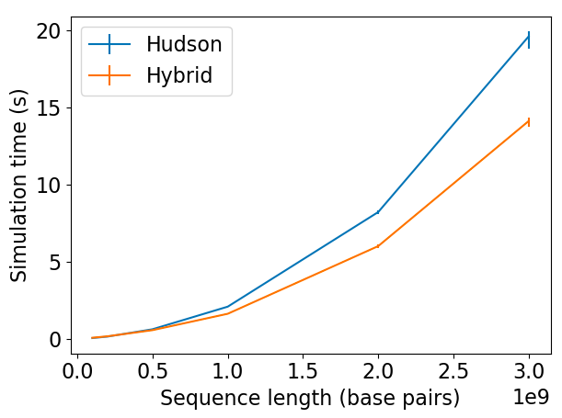
Performance
Compute
time(s)
msprime
hybride
Genome length (Gbp)

Slide 36
Classical coalescent models create crazy genealogies

Slide 37
Simulations – summary
We can simulate genome-wide gene trees under Wright-Fisher model
I think that we can do the same for arbitrary genealogies, including missing data and genealogical errors

Slide 38
Thank you!
Gravel Lab
Dominic Nelson
Luke Anderson-Trocmé
Chief Ben-Eghan
Sergio Hleap
Aaron Ragsdale
Yixiao Zeng
Marianne de Vriendt
McVean Lab
Jacob A. Garcia
Jerome Kelleher
Gil McVean
Claudia Moreau
Carl Ernst
Hélène Vézina
Damian Labuda
Marie-Hélène Roy-Gagnon
Emmanuel Milot
Michele Jomphe
Gregor Andelfinger
Chritoph Preuss
Simon Girard

Slide 39
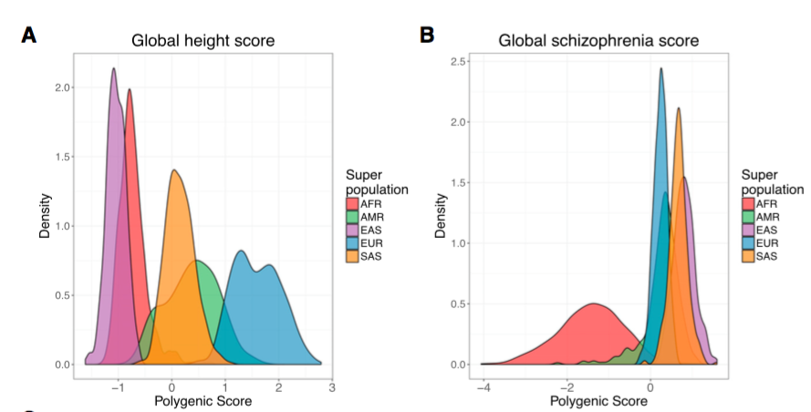
What to do with tens of thousands of genomes
Martin et al, AJHG 100, 635–649, 2017

Slide 40
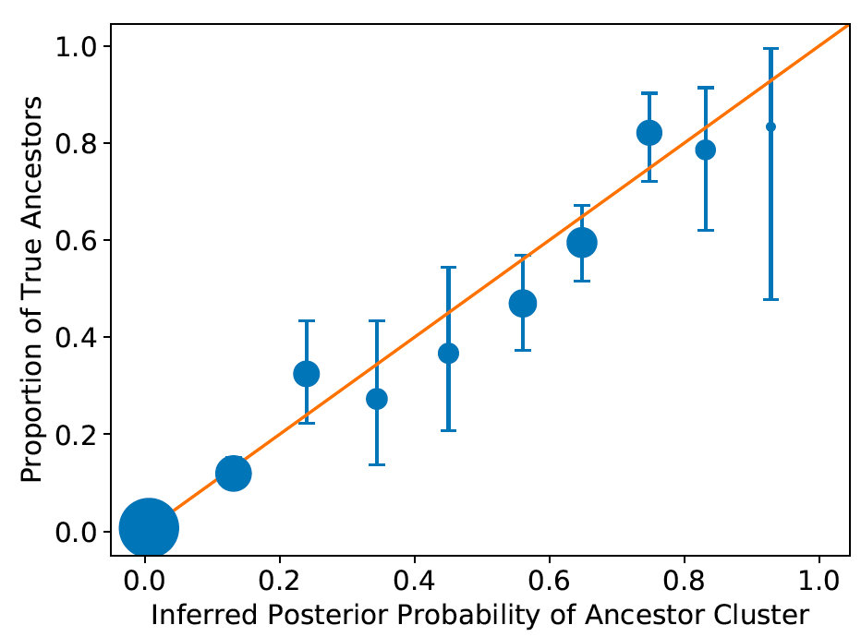
Validation (founder identification)

Slide 41
Importance sampling

Slide 42
Importance sampling

Slide 43
Importance sampling

Slide 44
Importance sampling

Slide 45
Importance sampling

Slide 46
Importance sampling

Slide 47
Importance sampling

Slide 48
Importance sampling

