Slide 1
Exceptional points of the quantum LiuovIllian dynamics
Naomichi Hatano
U. Tokyo, Japan
Molecular Phys. 117, 2121 (2019)
in Special Issue dedicated to
Nimrod Moiseyev
“QUANTUM DYNAMICS AND RESONANCES
IN CHEMISTRY AND PHYSICS”

Slide 2
What is Exceptional Point?
Hermitian matrices: Degeneracy
Two independent eigenvectors
with
and
Non-Hermitian matrices: “Coalescence”
Two eigenvectors collapse into one
with
only
Jordan block

Slide 3
Damped Harmonic Oscillator
k
m
2b
2nd-order homogeneous linear differential eq.
Find two independent special solutions.
The general solution is their superposition.

Slide 4


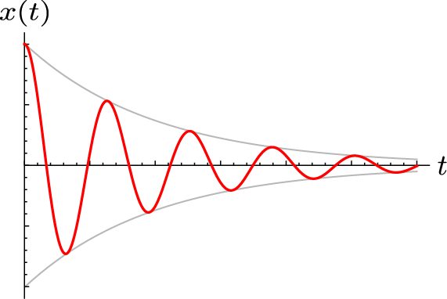
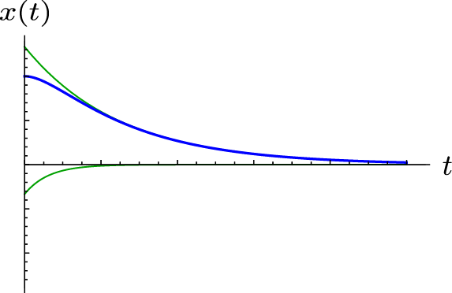
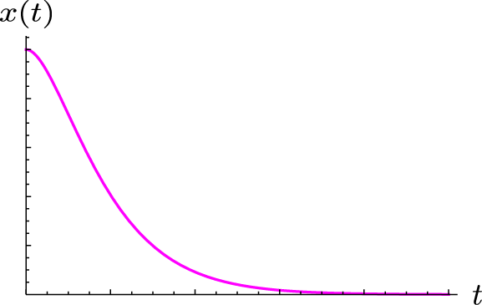
Damped Harmonic Oscillator
Assume
Critical damping
Underdamped
Overdamped

Slide 5
Damped Harmonic Oscillator
Ｄｅｆｉｎｅ
The eigenvalues “Coalesce”

Slide 6
Critical Damping
Matrix
Eigenvalue:
Eigenvector:
Pseudo-Eigenvector:
and
Jordan block

Slide 7
Open QuanTUM Systems
Total Hamiltonian
System Hamiltonian
P
Environmental
Hamiltonian
Q
Coupling Hamiltonian

Slide 8
OPEN QuanTUM SYSTEMS
Schrödinger dynamics
P
Q

Slide 9
OPEN QUAnTUM SYSTEMS
assumed.

Slide 10
OPEN QUAnTUM SYSTEMS
memory kernel

Slide 11
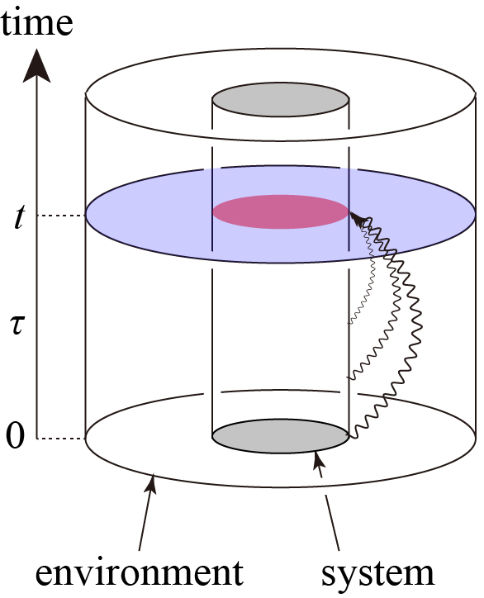
Open quantum SYSTEMs
Generally
non-Markovian
dynamics
memory kernel

Slide 12
Markov Approximation
memory kernel
Markov (No Memory) Approximation

Slide 13
Density Matrix (mixed State)
Density matrix
with
Liouville-von Neumann eq.
Markov (No Memory) Approximation
Replace H in Liouville-von Neumann eq.
with H_{eff} in Markov (no memory) approximation

Slide 14


Markov Approximation
No trace conservation
Lindblad equation: conserves trace

Slide 15
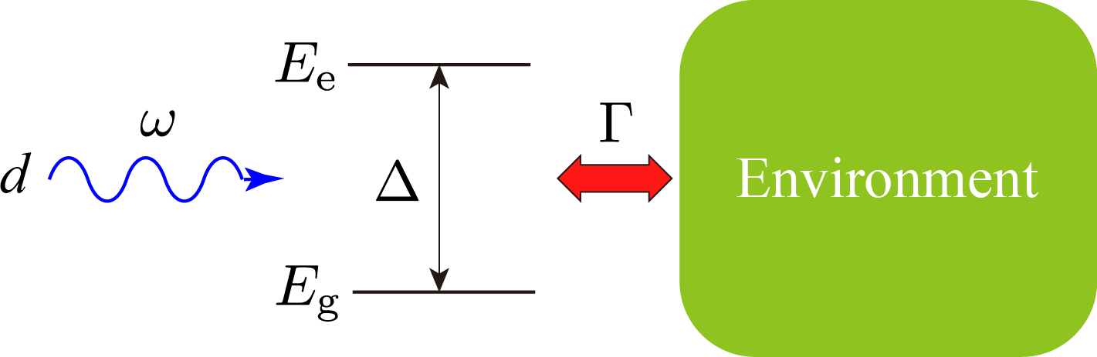
Two-level system
P
Q
Lindblad equation

Slide 16
Two-level system
P
Q
: detuning
d : field strength
: environmental coupling

Slide 17
Two-level system
P
Q
Lindblad equation

Slide 18
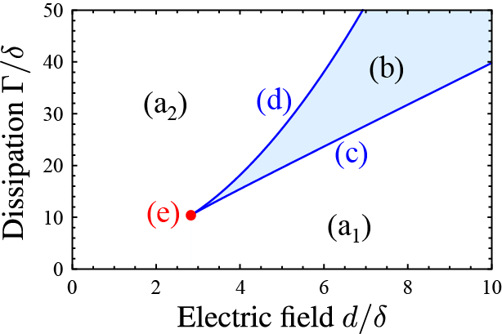
Two-level system
P
Q
: detuning
d : field strength
: environmental coupling

Slide 19
Matrix Representation
Linear equations!

Slide 20
Matrix Representation

Slide 21
Relaxation to Equilibrium
One null eigenvalue:
equilibrium
Three eigenvalues
with negative imaginary parts

Slide 22
Symmetry
isospectral
symmetric w.r.t. imaginary axis

Slide 23
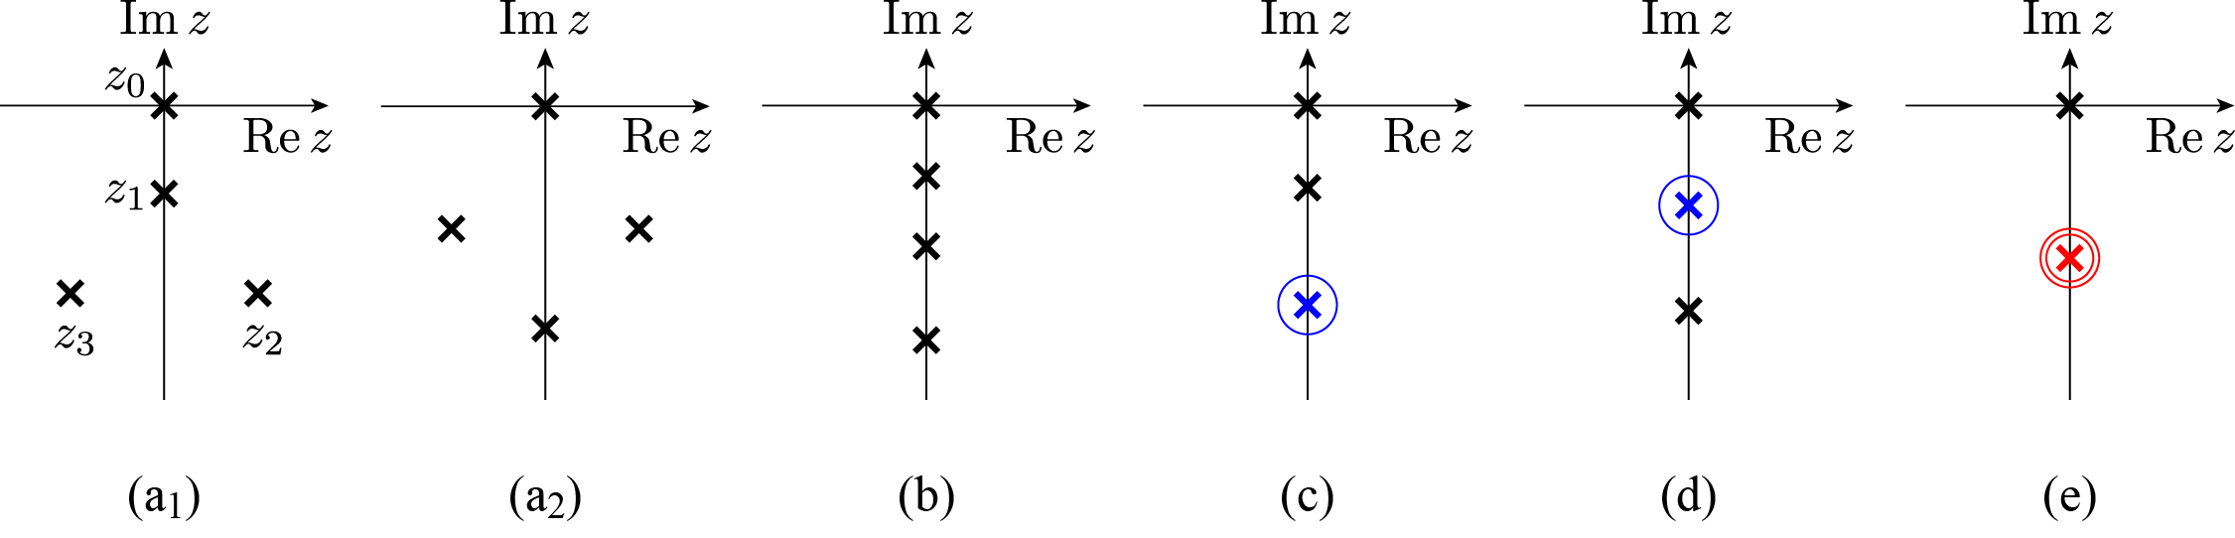
Liouvillian Spectrum
: detuning
d : field strength
: environmental coupling
two free
parameters
and
one condition

Slide 24
Liouvillian Spectrum
: detuning
d : field strength
Overdamped
: environmental coupling
Underdamped
Underdamped

Slide 25
Summary
N. Hatano, Molecular Phys. 117, 2121 (2019)
Open quantum system
+ Density matrix (mixed state)
+ Markov approx.
= Lindblad eq.
Dissipation too large 😔
2nd-order EP
on lines
3rd-order EP
at points

