Slide 1



Essentials of 54 years of functional development in physical sciences
Kieron Burke and friends
UC Irvine
Physics and Chemistry
http://dft.uci.edu

Slide 2
Outline
General background about semilocal functionals
Principle of locality
Relation to optimal transport

Slide 3
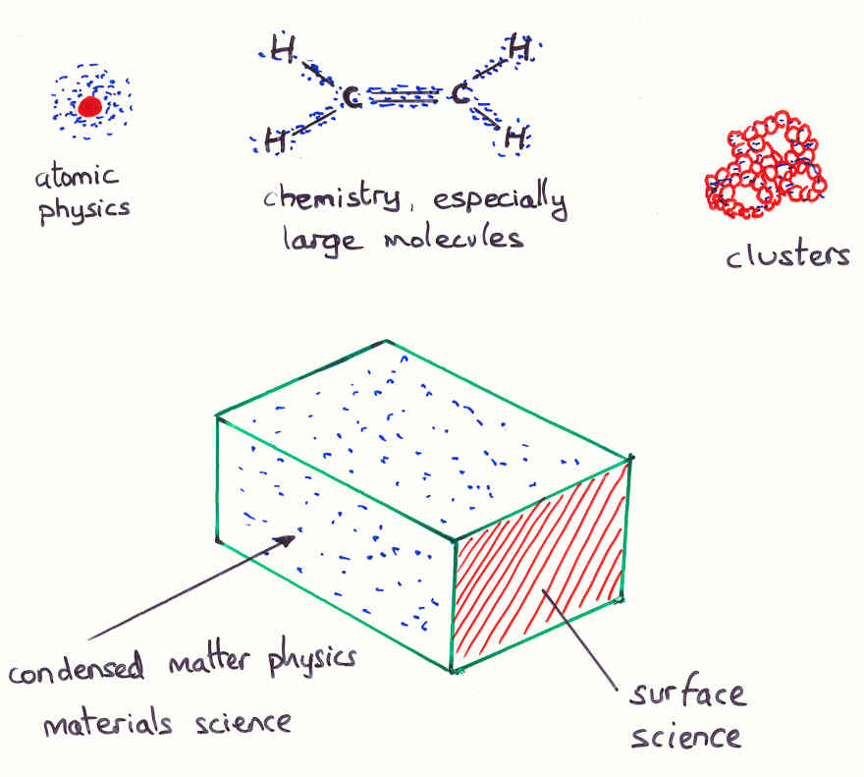
Electronic Structure Problem: Diversity
For all everyday matter

Slide 4
Properties from Electronic Ground State
Make Born-Oppenheimer approximation
Solids:
  Lattice structures and constants, cohesive energies, phonon spectra, magnetic properties, …
Liquids:
  Can do AIMD, ab initio (DFT) molecular dynamics
Molecules:
  Bond lengths, bond angles, rotational and vibrational spectra, bond energies, thermochemistry, transition states, reaction rates, (hyper)-polarizabilities, NMR, …

Slide 5
Hamiltonian
Use atomic units
Born-Oppenheimer approximation
All non-relativistic (but added back in)
Wavefunctions antisymmetric and normalized
Only discuss ground-state electronic problem here, but many variations.

Slide 6

The greatest free lunch ever: DFT
1964: Hohenberg and Kohn proved a theorem showing lowest energy can be found by search over electronic densities (much simpler than wavefunction)
1965: Created Kohn-Sham (KS) equations of fake non-interacting electrons (not many-body anymore) which, when solved, yield lowest E and density alone.
[136] DFT in a nutshell, Kieron Burke, Lucas O. Wagner, Int. J. Quant. Chem. 113, 96-101 (2013).

Slide 7
HK theorem (1964)
Makes TF an approximation to an exact theory
Can find both ground-state density and energy via Euler equation

Slide 8
KS equations (1965)
F =

Slide 9
The kicker
Need a formula for a small fraction of electronic energy, called XC energy, in terms of density, containing all quantum many-body effects.
First modern formula (1965) good for solids, but not accurate enough for chemistry or materials science.
GGA’s (~1990) give useful accuracy for chemistry and materials.
These days, hundreds of formulas have been suggested, bringing field into disrepute.

Slide 10


The standard functionals
Local density approximation (LDA)
  Uses only n(r) at a point.
Generalized gradient approx (GGA)
  Uses both n(r) and |∇n(r)|
  Should be more accurate, corrects overbinding of LDA
  Examples are PBE and BLYP
Hybrid:
  Mixes some fraction of HF
  Examples are B3LYP and PBE0

Slide 11
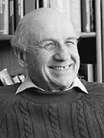
Modern research to find XC energy

Slide 12
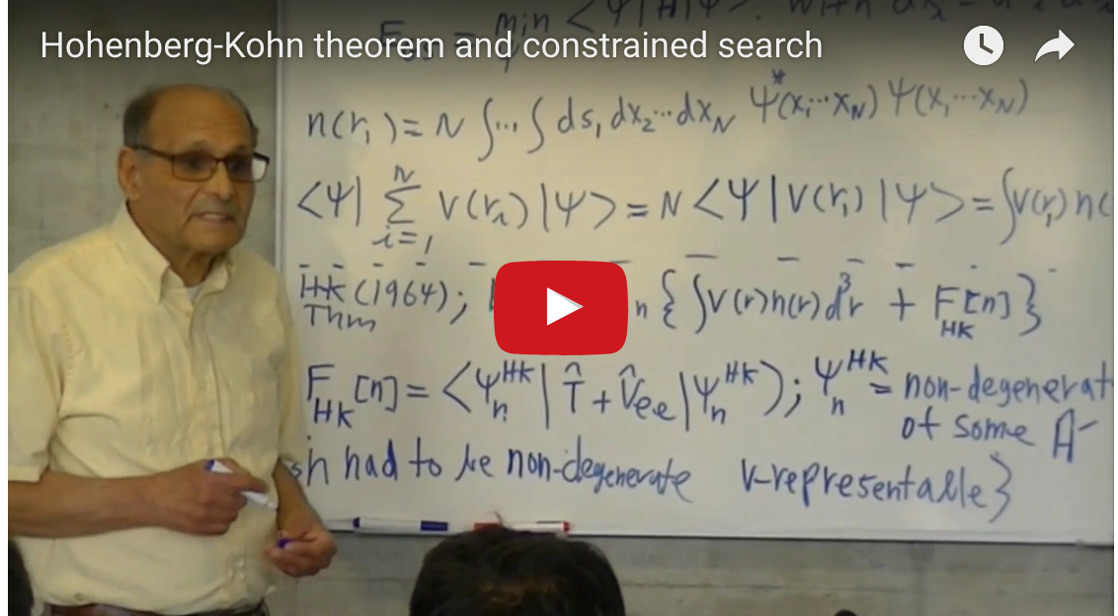
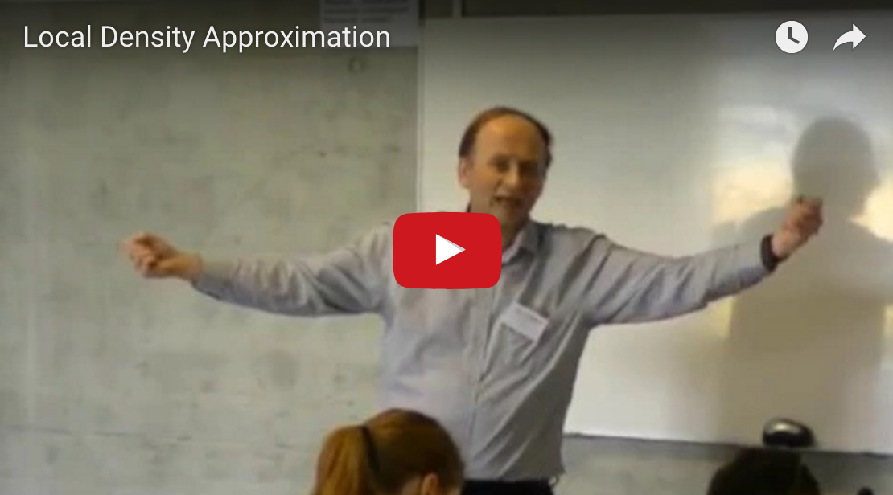
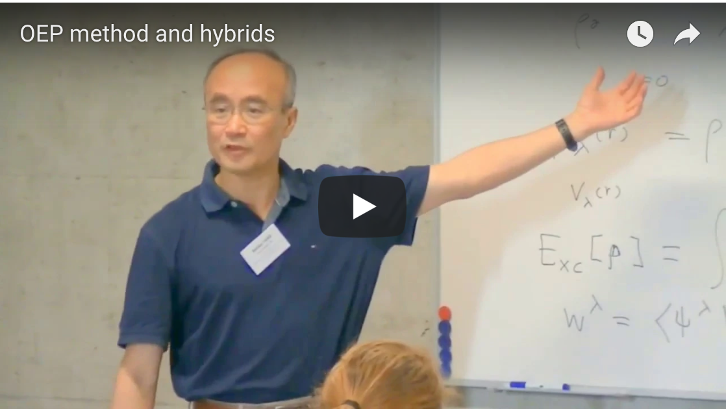
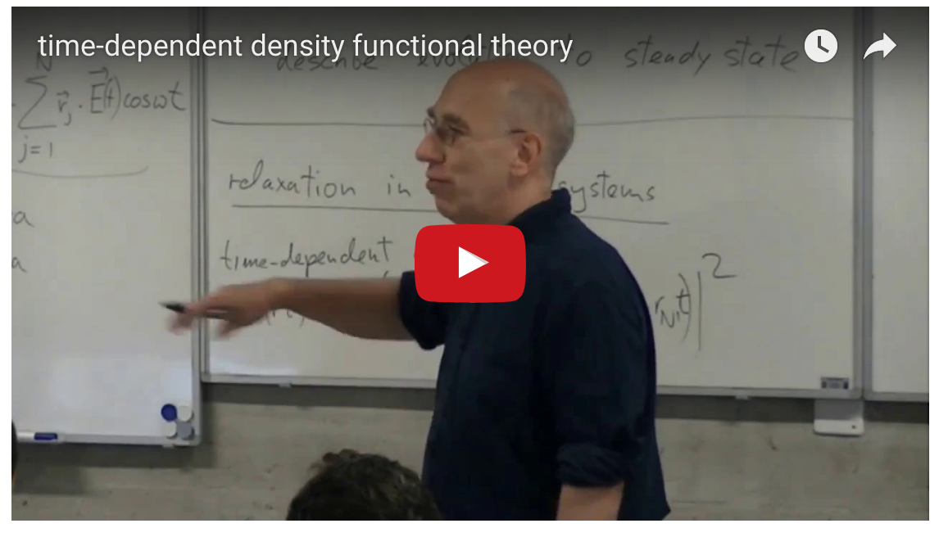
Teaching the theory in DFT: http://dft.uci.edu/learnDFT.php

Slide 13
Perdew’s vision
Idea: Successively refine approximations
Avoid fitting of parameters to data sets
Enforce relevant exact conditions
Each rung is more sophisticated, but costs more

Slide 14
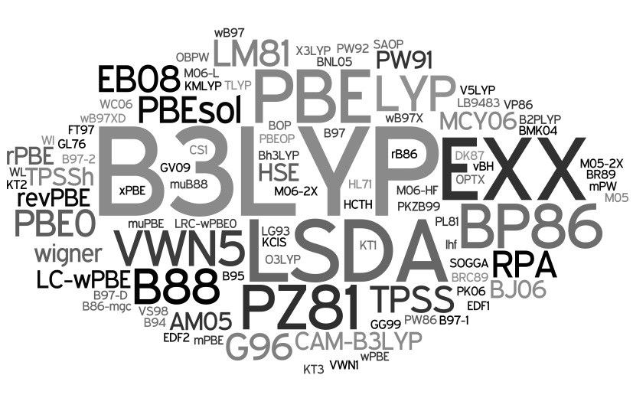

In reality…

Slide 15
DFT papers
DFT: A Theory Full of Holes, Aurora Pribram-Jones, David A. Gross, Kieron Burke, Annual Review of Physical Chemistry (2014).

Slide 16
A few recent applications
E.g., a new better catalyst for Haber-Bosch process (‘fixing’ ammonia from air) was predicted after about 25,000 failed experiments (Jens Norskov’s group)
Now scanning chemical and materials spaces using big data methods for materials design (materials genome project).
World’s hottest superconductor (203K) is hydrogen sulfide, predicted by DFT calculations, then made.
No lead needed to make airbook.

Slide 17
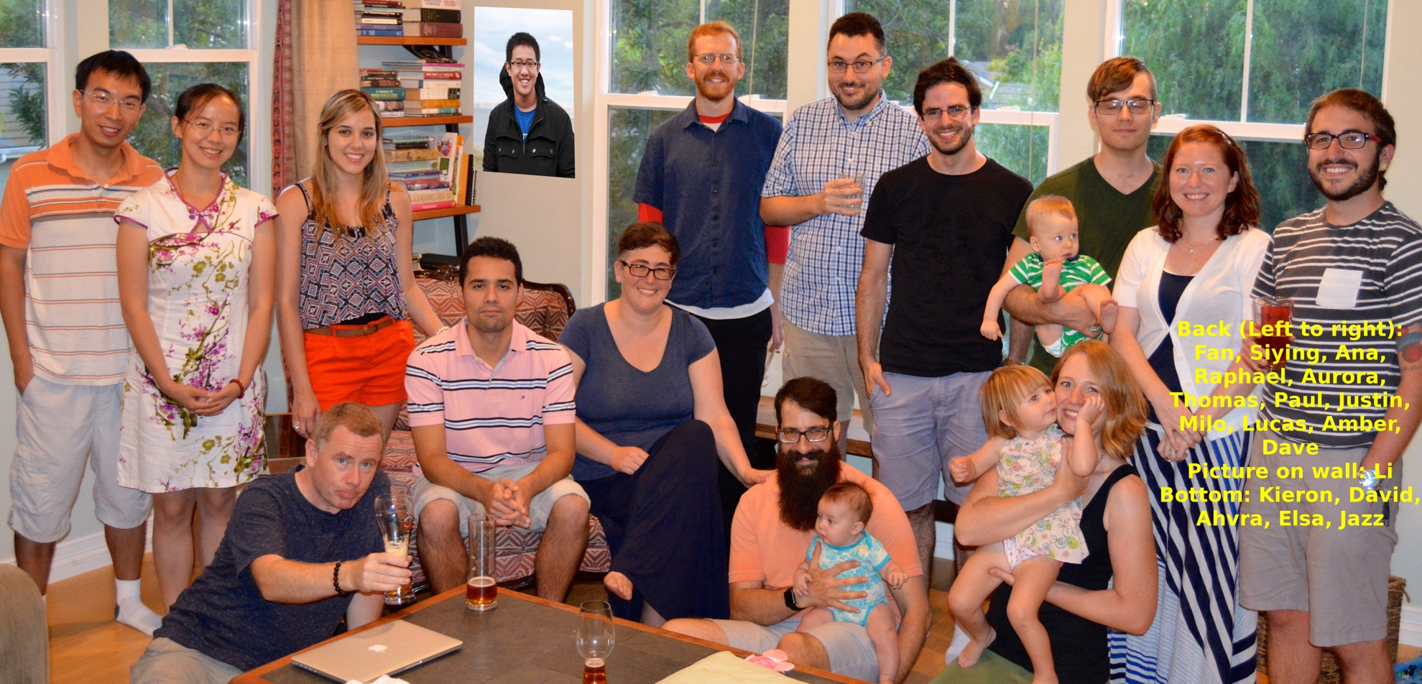
Group, summer, 2015

Slide 18
Current areas group works in
Semiclassical origins of approximations
  all DFT calculations in all fields
Thermal DFT
  warm dense matter (50kK to 1MK)
Strong correlation in DFT
  many DOE energy applications
Density-corrected DFT
  Anions, barrier heights, dissociation, ions/radicals in solution
Electronic excitations in DFT
  All areas/applications where ground-state not enough
Finding functionals with machine-learning
  May cut down cost of all DFT calculations, and make new XC

Slide 19
Two distinct problems
Find ‘better’ XC approximations
  Improve accuracy where current approximations already work
  Extend domain to regimes where current approximations fail qualitatively
Find approximations to T_{S}[n]
  In fact, absolute accuracy high, but requirements higher
  Need good functional derivative to get good densities (Euler equation)

Slide 20
Gradient expansion
Expand energy of infinitely slowly varying gas, take limit of slow variations
T_{S} -> T_{S}^{LDA} + ΔT_{S}^{GEA(2)} + …
ΔT_{S}^{GEA(2)} =T^{W}/8 in 3D, -T^{W}/3 in 1D
E_{X} -> E_{X}^{LDA} + ΔE_{X}^{GEA(2)} + …
E_{C} known only in high-density limit
  Ma-Bruckner, 1968
  Geldart and Rasolt, 70’s

Slide 21
Generalized gradient approximation
Found simple gradient expansion can worsen LDA results for finite systems.
Instead of additional correction in terms of gradient, make it a function of dimensionless gradient
Perdew: Use simple forms and fix parameters with exact conditions
Becke/Lee-Yang-Parr: Fit to atoms

Slide 22
History of GGA for XC
See Ma & Bruckner, 1968;

Slide 23
Energetics of standard functionals

Slide 24
Summary of A
Modern DFT is huge (1/6 of world’s supercomputers)
Two distinct problems: Ts and Exc
LDA invented by KS65
Gradient expansion gives energies of slowly varying gas
Generalized gradient approximations work well enough for materials
Hybrids for more accurate energetics (but much more expensive than GGA for solids)

Slide 25
B. PRINCIPLE OF LOCALITY

Slide 26
Systematic approach to DFT approximations
How can dumb little formulas be so successful in solving the many-body problem?
Success of local density approximation is via coarse-graining of space. Uses principle of locality.
In fact, each component (T_{s},E_{x},E_{c}) appears to becomes relatively exact in certain, large N, semiclassical limit.
GGA’s are our best attempt to get leading corrections for Coulombic systems.
Corrections to Thomas-Fermi Densities at Turning Points and Beyond Raphael F. Ribeiro, Donghyung Lee, Attila Cangi, Peter Elliott, Kieron Burke,Phys. Rev. Lett. 114, 050401 (2015) Almost exact exchange at almost no computational cost in electronic structure calculations Peter Elliot, Attila Cangi, Stefano Pittalis, E.K.U. Gross, Kieron Burke, Phys. Rev. A (accepted) (2015) Potential functionals versus density functionals Attila Cangi, E. K. U. Gross, Kieron Burke, Phys. Rev. A 88, 062505 (2013). Electronic Structure via Potential Functional Approximations Attila Cangi, Donghyung Lee, Peter Elliott, Kieron Burke, E. K. U. Gross, Phys. Rev. Lett.106, 236404 (2011) Leading corrections to local approximations Attila Cangi, Donghyung Lee, Peter Elliott, Kieron Burke, Phys. Rev. B 81, 235128 (2010)…

Slide 27
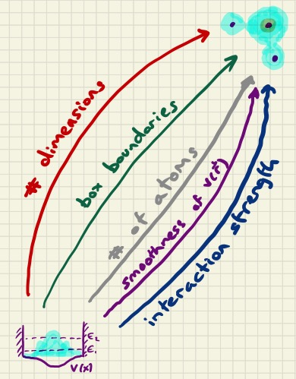
cartoon

Slide 28
Large-Z limit
See Fournais, Lewin, Solovej work
Corresponding Density scaling: n_{ζ}(r) = ζ² n(ζ^{1/3} r)

Slide 29
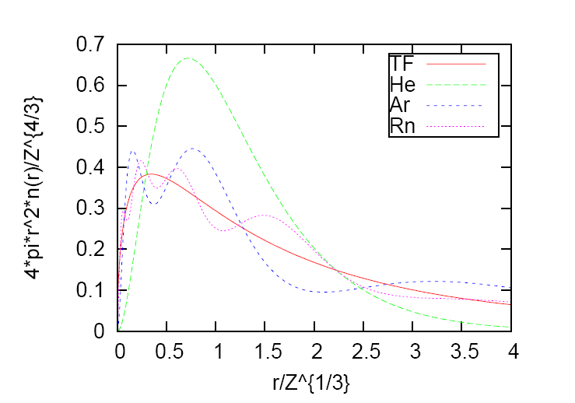
Classical limit for neutral atoms
For interacting systems in 3d, increasing Z in an atom, keeping it neutral, approaches the classical continuum, i.e. same as ħ→0
Can study E_{x} as Z→∞, find universal limit

Slide 30
KS analog of Lieb-Simon statement

Slide 31
Formal theory
Expand functional in powers of ξ
Leading terms are LDA
Define leading corrections to LDA:
  ΔE_{xc}[n] = E_{xc}[n]-E_{xc}^{LDA}[n]
  B_{xc}[n] = lim ΔE_{xc}[n_{ξ}]/ξ as ξ->∞
Becomes relatively exact in large-Z limit:
  % error in ΔE_{xc}-> 0 in large-Z limit
Approximately captured by GGA and meta-GGA’s
Static correlation probably accounted for by hybrids.

Slide 32
Relevance of locality principle
LDA is universal limit of all atoms, molecules, solids.
Leading corrections are different in slowly-varying periodic densities from those in real materials.
Both T_{S} and E_{X} are dominated by LDA contributions, but E_{C} is not (except in extreme limit).
Explains why many chemistry functionals do not reduce to LDA for correlation.

Slide 33
A major ultimate aim: E_{XC}[n]
Explains why gradient expansion needed to be generalized (Relevance of the slowly-varying electron gas to atoms, molecules, and solids J. P. Perdew, L. A. Constantin, E. Sagvolden, and K. Burke, Phys. Rev. Lett. 97, 223002 (2006).)
Derivation of β parameter in B88 (Non-empirical 'derivation' of B88 exchange functional P. Elliott and K. Burke, Can. J. Chem. 87, 1485 (2009).).
PBEsol Restoring the density-gradient expansion for exchange in solids and surfaces J.P. Perdew, A. Ruzsinszky, G.I. Csonka, O.A. Vydrov, G.E. Scuseria, L.A. Constantin, X. Zhou, and K. Burke, Phys. Rev. Lett. 100, 136406 (2008))
  explains failure of PBE for lattice constants and fixes it at cost of good thermochemistry

Slide 34
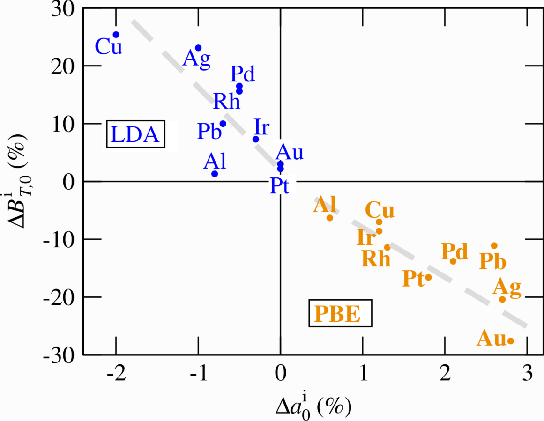
Improvements of PBEsol
Structural and Elastic Properties
Errors in LDA/GGA(PBE)-DFT computed lattice constants and
bulk modulus with respect to experiment
→ Fully converged results
(basis set, k-sampling,
supercell size)
→ Error solely due to
xc-functional
→ GGA does not outperform
LDA
→ characteristic errors of
<3% in lat. const.
< 30% in elastic const.
→ LDA and GGA provide
bounds to exp. data
→ provide “ab initio
error bars”
Blazej Grabowski, Dusseldorf
Inspection of several xc-functionals is critical to estimate
predictive power and error bars!

Slide 35
Improving PBEc
PBE has two derivations
  Real-space cutoff of XC hole yields numerical GGA
  Results deducible from simple form and several exact conditions
Both derivations determine the leading contribution for large gradient (logarithmic)
They yield two different results for the constant.
Neither is quite right for large-Z limit (10% off).
acGGA correlation is a different form that has the constant right!
Now available in libXC

Slide 36
Errors in atomic Ec
Fitting a round peg into a round hole: asymptotically correcting the generalized gradient approximation for correlation Antonio Cancio, Guo P. Chen, Brandon T. Krull and Kieron Burke, The Journal of Chemical Physics 149, 084116 (2018)
Locality of correlation in density functional theory Kieron Burke, Antonio Cancio, Tim Gould, Stefano Pittalis, The Journal of Chemical Physics and ArXiv: 145, 054112 (2016)

Slide 37
Shell structure in X and C

Slide 38
Semiclassical conditions for XC in use
Lucian Constantin has used asymptotic exactness to construct several exchange functionals.
Provides the atomic norms in SCAN, Jianwei Sun et al’s latest meta-GGA.

Slide 39
B. Kinetic energy functional

Slide 40
Little math exercise
Given a sequence: a_{i}
  a_{i}=1, ¼, ¼, ¼, ¼, 1/9, 1/9, 1/9, 1/9, 1/9, 1/9, 1/9, 1/9, 1/9, 1/16,…
Find partial sums of N terms S_{N}:
  S_{N} = Σ a_{i}
  S_{N} = 1,1.25,1.5,1.75,2,2.11111,2.2222,2.33333,…

Slide 41
Exact partial sums up to 300

Slide 42
Expand for large N
S_{N} = B₀(N) + B₁(N) + B₂(N)+…
B₀(N) = (3N)^{1/3}, B₁(N) = -1/2,…

Slide 43
Why is this relevant? Bohr atom
For doubly occupied non-interacting electrons in a hydrogenic atom: E_{N} = - Z² S_{N/2}
Virial theorem: T_{s} = Z² S_{N/2}
Lieb-Simon principle: TF theory yields exact dominant term, E^{TF} = -Z² (3N)^{(1/3)}
Only those approximations that have a TF term that dominates can get this right.
No DFT approximation gets next correction right, except by `fixing’ it…

Slide 44
Next correction
For N=1:
  S₁=1
  B₀=1.442249570
  B₀+B₁=0.9422495703
  B₀+B₁+B₂=1.000029677

Slide 45
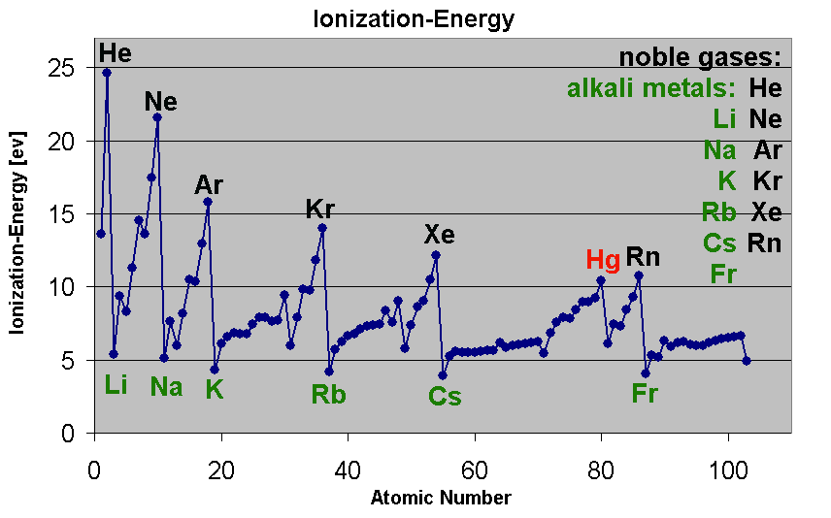
What about energy differences?
wikipedia

Slide 46
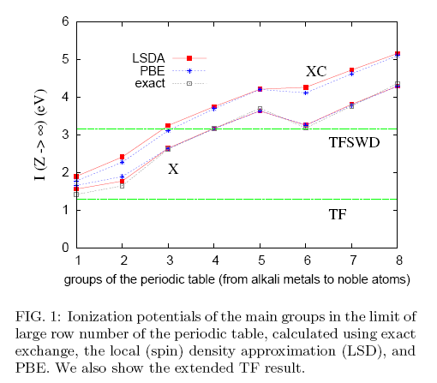
Z→∞ limit of ionization potential
Shows even energy differences can be found
Looks like LDA exact for E_{X} as Z-> ∞.
Looks like finite E_{C} corrections
Looks like extended TF (treated as a potential functional) gives some sort of average.
Lucian Constantin, John Snyder, JP Perdew, and KB, JCP (2010).

Slide 47
Original KS idea: Simple metals
WKB for one level=>sum over many=>TF theory
Corrections to WKB => sum over many => gradient expansion
As Ћ -> 0, TF becomes relatively exact (asymptotic expansion)
n(x)
μ
v(x)
Notes:
Put in TF density, explain gradient expansion, explain classical motion, WKB

Slide 48
Chemistry and most materials
n(x)
μ
v(x)
TF theory STILL relatively exact in limit Ћ -> 0.
Leading corrections come from turning points, yielding quantum oscillations.
Notes:
Now TP, now quantum oscillations, isolated systems connected by evanescent regions, still TF exact

Slide 49
Leading corrections to TF
Corrections to Thomas­-Fermi Densities at Turning Points and Beyond Raphael F. Ribeiro, Donghyung Lee, Attila Cangi, Peter Elliott, Kieron Burke, Phys. Rev. Lett. 114, 050401 (2015).
Leading corrections to local approximations II : The case with turning points R. Ribeiro, K. Burke, Phys. Rev. B 95, 115115 (2017).
Deriving uniform semiclassical approximations for one­-dimensional fermionic systems Ribeiro, Raphael F. and Burke, Kieron, The Journal of Chemical Physics 148, 194103 (2018).

Slide 50
Tunneling in 1d

Slide 51
But…
Found that integrated T_{S} is often less accurate than TF theory!
Leading corrections from evanescent regions exactly cancel leading corrections (oscillations) from traveling regions!
So energy functionals not improved!

Slide 52
However…work in progress
Consider constructing potential functionals from WKB energy formulas.
Get accurate energies without accurate densities
Depends on smoothness of potential
Can extract leading corrections to WKB (next order)
Can show these produce gradient expansion for solid
But get very different result for evanescent region, because of turning points.

Slide 53
Better approach
Look at everything at (slightly) finite temperature in the grand ensemble as functional of μ-v(r)
Get expressions for energies and densities as expansions in gradients of μ-v(r)
Invert to create expansions in terms of densities and gradients
Find qualitative differences when turning points are present
Find further differences with finite number of states
Find further differences with non-smooth potentials (gradient expansion must be generalized)

Slide 54
After a decade of work
[99] Relevance of the Slowly Varying Electron Gas to Atoms, Molecules, and Solids John P. Perdew, Lucian A. Constantin, Espen Sagvolden, Kieron Burke, Phys. Rev. Lett. 97, 223002 (2006)
[108] Restoring the Density­ Gradient Expansion for Exchange in Solids and Surfaces John P. Perdew, Adrienn Ruzsinszky, Gábor I. Csonka, Oleg A. Vydrov, Gustavo E. Scuseria, Lucian A. Constantin, Xiaolan Zhou, Kieron Burke, Phys. Rev. Lett. 100, 136406 (2008).
[111] Semiclassical Origins of Density Functionals Peter Elliott, Donghyung Lee, Attila Cangi, Kieron Burke, Phys. Rev. Lett. 100, 256406 (2008).
[113] Condition on the Kohn­Sham kinetic energy and modern parametrization of the Thomas­Fermi density Donghyung Lee, Lucian A. Constantin, John P. Perdew, Kieron Burke, J. Chem. Phys. 130, 034107 (2009).
[118] Non­empirical derivation of the parameter in the B88 exchange functional Peter Elliott, Kieron Burke, Canadian Journal of Chemistry 87, 1485­1491 (2009).
[125] Leading corrections to local approximations Attila Cangi, Donghyung Lee, Peter Elliott, Kieron Burke, Phys. Rev. B 81, 235128 (2010).
[128] Communication: Ionization potentials in the limit of large atomic number Lucian A. Constantin, John C. Snyder, John P. Perdew, Kieron Burke, The Journal of Chemical Physics 133, 241103 (2010).
[130] Electronic Structure via Potential Functional Approximations Attila Cangi, Donghyung Lee, Peter Elliott, Kieron Burke, E. K. U. Gross, Phys. Rev. Lett. 106, 236404 (2011).
[146] Potential functionals versus density functionals Attila Cangi, E. K. U. Gross, Kieron Burke, Phys. Rev. A 88, 062505 (2013).
[157] Almost exact exchange at almost no computational cost in electronic structure Peter Elliott, Attila Cangi, Stefano Pittalis, E. K. U. Gross, Kieron Burke, Phys. Rev. A 92, 022513 (2015)
[158] Atomic correlation energies and the generalized gradient approximation Kieron Burke, Antonio Cancio, Tim Gould, Stefano Pittalis, submitted and ArXiv:1409.4834 (2014).
[159] Corrections to Thomas­-Fermi Densities at Turning Points and Beyond Raphael F. Ribeiro, Donghyung Lee, Attila Cangi, Peter Elliott, Kieron Burke, Phys. Rev. Lett. 114, 050401 (2015).
[170] Uniform semiclassical approximations for one­-dimensional fermionic systems Raphael F. Ribeiro, Kieron Burke, submitted and ArXiv:1510.05676 (2015).
Notes:
Fill in publications here.

Slide 55
C. Relation to Optimal transport

Slide 56
stretched H₂
Consider v_{s}(r) as function of bond length R
For exact KS potential, new turning points occur at about R=3.3 Å
Coulson-Fischer point (where spontaneous symmetry is broken) is 3.3 Å in LDA
Beyond that point (i.e., for strongly correlated systems), there is a different non-universal asymptotic expansion!
Failure of local-type approximations for strongly-correlated systems.

Slide 57
When correlations are bigger
Key effect: Electrons delocalized over more than one site.
One electron in stretched H₂⁺; one spin up electron in stretched H₂
Stretch a single bond (or multiple bonds at equilibrium): Strong static correlation, partially accounted for by hybrids
Consider, eg longer and longer chains, get strong correlation in thermodynamic limit
None are strictly correlated (SCE)

Slide 58
Static correlation
Eg when a diatomic is stretched, such as H2.
See effects in all bonds when stretched.
See noticeable contributions in multiple bonds at equilibrium (eg N2)
See also Cr2
Even CCSD(T) fails for stretched N2, because based on single-reference state.
Find a small HOMO-LUMO gap and large slope (MP2 energy) in adiabatic connection curve.

Slide 59
Strong correlation
Take thermodynamic limit of finite chain.
As number of units grows, number of broken symmetries grows when bonds stretched.
Infinity of degeneracies.
Eg quantum phase transition to Mott-Hubbard insulator

Slide 60
Entanglement spectrum
Make cut in middle
See which fluctuations are most relevant as a function of separation
When stretched, all charge fluctuations move higher

Slide 61
Small challenges for optimal transport
Find low-cost sufficiently accurate method to solve SCE problem for arbitrary 3D geometry
Make approximations to give accurate energies for less strong correlation.
Capture ordinary correlation of dissociated fragments.
Justify hybrids?

Slide 62
Summary
Improving approximations in DFT is very useful
Present day approximations are crude attempts to capture leading corrections to local density approximation
In simple cases where we can find explicit formulas, asymptotic corrections are far more accurate than typical DFT corrections
Difficult problem in mathematical physics: find a general procedure for such corrections
Could be another 12 years before any practical results
But only increases accuracy for weak correlation; need something quite different for bigger correlations.
Thanks to students, collaborators, and NSF.

