Slide 1


Memory in Time-Dependent DFT:
Exact Features and Approximations
Neepa T. Maitra
Hunter College and the Graduate Center of the City University of New York
Notes:
Sorry for not having any optimal transport in my talk but aparently it’s not really used for dynamics, perhaps some of the work here will be a motivation to see whether it can be adapted.

Slide 2
Outline
What do we mean by memory in TDDFT?
The adiabatic approximation and its failures
Development of memory-dependent functionals
Notes:
Will try to give sort of an introduction to the problems – i know most of you don’t do dynamics, so i wont go too detailed into the latest things we are doing, but sort of discuss more the background

Slide 3
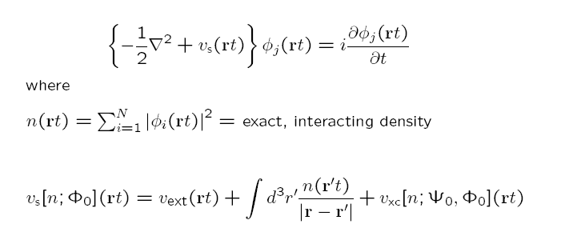
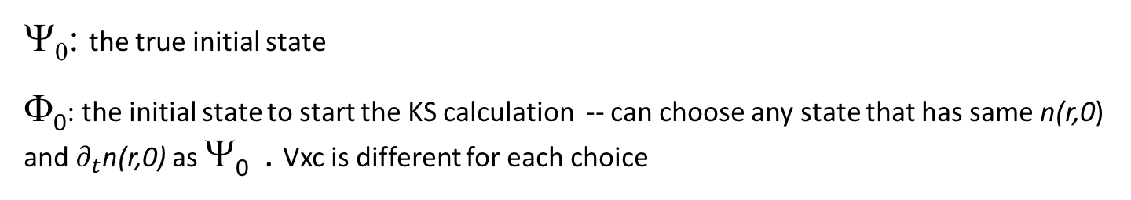
Whence Memory?
1-1
Runge-Gross Theorem:
(PRL 52, 997 1984)
Ψ₀ : n v_{ext}
true system
1-1
KS system
Φ₀ : n v_{S}
Hartree depends only on instantaneous density
Actually, v_{ext} [n,Ψ₀] (rt)
History: n(r t’<t), and, initial states Ψ₀, and Φ₀ of true and KS systems
but v_{ext} is prescribed by problem, so functional dep. not directly important.
Ψ₀: the true initial state
Φ₀: the initial state to start the KS calculation -- can choose any state that has same n(r,0) and $∂_{t}$n(r,0) as Ψ₀ . Vxc is different for each choice
usually choose Slater determinant but not necessary
Notes:
As jonas said in his nice talk yesterday, tddft is based on …

Slide 4
Memory
functional depends on history, n(r t’<t), and on initial states of true and KS systems
Also, for a general observable: A[n; Φ₀]
Special, and common, case:
Ψ₀ = Ψ_{GS}
Φ₀ = Φ_{GS}
Then, by the Hohenberg-Kohn theorem, Ψ₀ = Ψ₀[n(0)] and Φ₀ = Φ₀ [n(0)]
-- no explicit initial-state-dependence → v_{xc}[n](r,t)
e.g. linear response regime (most applications)

Slide 5
The Adiabatic Approximation
Almost all calculations today ignore memory, and use an
adiabatic approximation:
input instantaneous density into a ground-state approximation
frequency-independent
Example:

Slide 6
The Adiabatic Approximation
Almost all calculations today ignore memory, and use an
adiabatic approximation:
input instantaneous density into a ground-state approximation
Two sources of error:
Adiabatic approximation itself
Ground-state functional approximation
To disentangle, study “adiabatically-exact” approximation:
v_{xc}^{A-ex} (r,t) = v_{xc}^{exact-gs}[n(t)](r)

Slide 7
One of the worst examples: Charge-transfer dynamics out of the ground-state
LiCN molecule
S. Ragunathan, M. Nest, J. Chem. Th. Comput. 7 2492 (2011).
J. I. Fuks, P. Elliott, A Rubio, N. T. Maitra J. Phys. Chem. Lett. 4, 735 (2013)
EXX
ω = 0.5177
ω^{adia-ex} = 0.5187
J.I. Fuks and Maitra, Phys. Rev. A. 89, 062502 (2014); Phys. Chem. Chem. Phys. 16, 14504 (2014)

Slide 8
The exact correlation potential develops step and peak features …
…gradual build-up of step associated with charge-transfer…
Vc
n
…on top of much faster “dynamical step” oscillating on the optical time-scale..
Generically appears in non-perturbative dynamics, completely missed in any adiabatic approximation,
e.g. J. D. Ramsden and R. W. Godby, Phys. Rev. Lett. 109, 036402 (2012);
P. Elliott, J. I. Fuks, A Rubio, N. T. Maitra, Phys. Rev. Lett. 109, 266404 (2012);
Notes:
Write on board how to find the exact Vxc

Slide 9
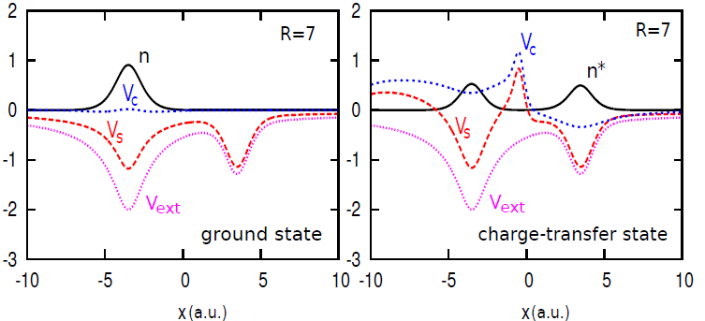
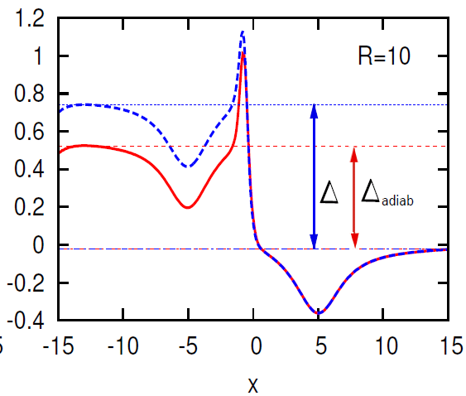
What does the “best” adiabatic approximation, v_{c}^{adia-ex} , look like?
Correlation potential in the final CT state, as R→ ∞
V_{c}
V_{c}^{adia-ex}
EXX
ω = 0.5177
ω^{adia-ex} = 0.5187
N. T. Maitra, Topical Review on Charge Transfer in TDDFT in J. Phys. Condens. Matt. 29 423001 (2017)
Notes:
charge-transfer out of the ground-state is challenging for KS, since a single KS orbital must always describe both the transferring electron and one that stays...

Slide 10
Where memory is important in TDDFT
Linear response: need frequency-dependent kernel for double-excitations, gap in optical response of solids…
Non-perturbative: studies of the exact xc potential show:
Neglect of memory-dependence responsible for some complete failures
-- Resonantly driven dynamics
-- Pump/probe spectroscopy
-- Charge-transfer dynamics out of the ground-state
Generically, dynamical steps and peaks appear that require non-adiabatic density-dependence
Approximations giving good response can give bad non-perturbative dynamics
-- probing the functional in a very different domain.
(e.g. scattering, see Lacombe, Suzuki, Watanabe, Maitra, EPJB (2018) & PRL (2017))
With a judicious choice of Φ₀ , the adiabatic approx can better approximate the exact v_{xc}
N. T. Maitra, Perspective on TDDFT, JCP 144, 220901 (2016).
Notes:
Let us remind ourselves of the equations that these calculations were based on, the TDDF equations.
Here is the TDKS potential, and it is this xc part that needs to be approx
Memory – aspect that must be considered in td theory, not in gs.
Initial state dep might appear to be a confusing complication…exact potential is different for each choice. However this also opens the door to be taken advantage of – can we find an ..

Slide 11
Outline
What do we mean by memory in TDDFT?
The adiabatic approximation and its failures
Development of memory-dependent functionals
Notes:
Will try to give sort of an introduction to the problems – i know most of you don’t do dynamics, so i wont go too detailed into the latest things we are doing, but sort of discuss more the background

Slide 12

Memory-Dependent Functionals …
Gross-Kohn (1985)
Phys. Rev. Lett. 55, 2850 (1985)
linear-response kernel of the uniform electron gas at finite frequency
Non-adiabatic -- time-non-local although spatially local; “finite-frequency LDA”
Violates exact conditions: harmonic potential theorem, zero-force theorem
Notes:
GK assumes slowly varying GS density (so can use hom kernel) as well as slowly varying density-response (q=0)

Slide 13
A couple of exact conditions in TDDFT:
Harmonic Potential Theorem (Dobson (PRL 73, 2244, (1994); Vignale PRL 74, 3233, (1995))
N electrons in a harmonic well subject to a TD uniform electric field, E(t)
→ density rigidly sloshes back and forth following classical center of mass oscillations
n(r,t) = n_{GS}(r – r_{CM}(t))
→ Vxc(r,t) = Vxc^{GS}(r – r_{CM}(t))
Instead, GK finds an n-dependent shift in the frequency of the CM motion, and a damping of the oscillations.
One way to think about why is that when you only look locally at the density at r, you can’t tell difference between sloshing motion and local compression/rarefaction
Notes:
HPT violation: Dobson found GK gives an n-dep shift in the CM motion which becomes damped. Problem is because local density can’t distinguish btn compression/rarefaction (squeezing, breathing, as in a long-wavelength plasmon) and global translation (sloshing). GK “chooses” breathing, so get dissipation where there is none.

Slide 14

A couple of exact conditions in TDDFT:
Zero Force Theorem (Vignale PRL 74, 3233, (1995); Phys. Lett. A, 209, 206 (1995) )
xc field cannot exert a net force on itself
Linear response regime:
Using GK:
f_{xc}^{unif}[n₀(r)](q=0,ω)
ω-dependent
ω-independent
The exact conditions imply time-non-locality → spatially non-local n-dependence, i.e. a local density approximation with memory does not exist.
even in limit of slowly-varying densities → “ultra-non-locality”
Notes:
HPT violation: Dobson found GK gives an n-dep shift in the CM motion which becomes damped. Problem is because local density can’t distinguish btn compression/rarefaction (squeezing, breathing, as in a long-wavelength plasmon) and global translation (sloshing). GK “chooses” breathing, so get dissipation where there is none.
Can prove ZFT by evaluating d^2r/dt^2 using Psi and then Phi and then subtracting

Slide 15
… Memory-Dependent Functionals
R’,t’
r,t
Dobson-Bünner-Gross (1997)
Phys. Rev. Lett. 79, 1905 (1997)
Apply Gross-Kohn in frame that moves along with local velocity of electron fluid: memory resides with the fluid element.
Spatially-local relative to where a fluid element at (r,t) was at earlier times t’, R’(t’|r,t)
Non-adiabatic, and satisfies harmonic potential theorem, zero-force theorem
Vignale-Kohn (VK) (1996) – spatially local approx in terms of the current-density, j(r,t) → TD-current-density-FT Phys. Rev. Lett. 77, 2037 (1996)
Ψ₀
Based on map:
j A_{ext}
1-1
VK constructed from dynamical longitudinal and transverse responses to slowly-varying perturbations of uniform electron liquid; involves Navier-Stokes-like eqn with complex viscosity coefficients.
Non-adiabatic, and satisfies harmonic potential theorem, zero-force theorems…

Slide 16
… A little more about Vignale-Kohn and TDCDFT…
Note that RG’s 1st step was j ←→ v_{ext}
Using A instead of v makes it easier to satisfy non-interacting representability: many currents of interacting systems in scalar potentials can only be reproduced by a non-interacting systems in vector potentials
Note that spatially local knowledge of current j → spatially ultra-nonlocal dependence on density n
E.g.
So even for static response (no memory), VK can help when spatial-non-locality important.
Seen some success for: correcting overestimate of LDA polarizabilities in long-chain polymers, dissipation in extended systems, spin-Coulomb drag, stopping power in metals….BUT problems for finite systems due to spurious damping
Vignale-Ullrich-Conti (1997) – extended VK to non-linear regime.
G. Vignale, C.A. Ullrich, and S. Conti, PRL 79, 4878 (1997)

Slide 17
…Memory-Dependent Functionals
Kurzweil & Baer (2004, 2005, 2006)
Tokatly (2005, 2007)
Orbital functionals v_{xc}[{φ_{i}(t)}]
– instantaneous KS orbitals incorporate “infinite KS memory”
Computationally more involved: TDOEP
Approximations based on an exact formula for Vxc
Fuks, Lacombe, Nielsen, Maitra, Phys. Chem. Chem. Phys. 20, 26145 (2018)
L. Lacombe & N. T. Maitra, J. Chem. Theory and Comput. to appear (2019); arXiv:1809.07378
Notes:
Kurzweil and Baer: Galilean- invariant “memory action functional”, J. Chem. Phys. 121, 8731 (2004).
TD-deformation-FT
Ch. 25 in “Fundamentals of TDDFT” book, I.V. Tokatly, PRB 71, 165104 and 165105 (2005); PRB 75, 125105 (2007)
Formulate density & current dynamics in a Lagrangian frame. Since moving with the flow, spatially local xc is sensible & all complications including memory are contained in Green’s deformation tensor g_{i j}

Slide 18
Expression for the exact Vxc
Equate equation of motion for $∂^{2}$n(r,t)/$∂t^{2}$ coming from interacting system,
with that of the KS system, and then subtract →
TD one-body density-matrix:
interacting, KS
TD exchange-correlation hole

Slide 19
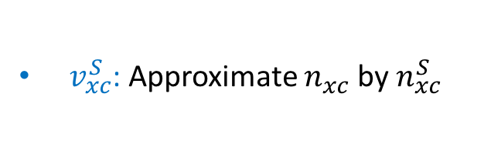
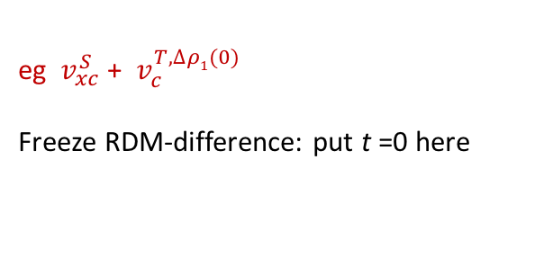
Approximations starting from the exact Vxc
kinetic component→ v_{c}^{T}
interaction component → v_{xc}^{W}
${ v}_{xc}^{S}$: Approximate $n_{xc}^{}$ by $n_{xc}^{S}$
Tried various frozen approximations
eg ${ v}_{xc}^{S}$ + ${ v}_{c}^{T,∆ρ1(0)}$
Freeze RDM-difference: put t =0 here
tested and checked satisfaction of important exact conditions, e.g. zero force theorem..
Fuks, Lacombe, Nielsen, Maitra, PCCP 20, 26145 (2018).
density-matrix coupled approximation

Slide 20
… “density-matrix coupled xc approximation”
(Lionel Lacombe)
v_{c}^{T}
v_{xc}^{W}
Notes:
This been driven by postdoc Lionel Lacombe in both the idea and the implementation.
So we want a dynamical expression for the 1RDM of the interacting system. We know that the true 1RDM satisfies the BBGKY1 eqn…which forms a heirarchy with rho2…

Slide 21
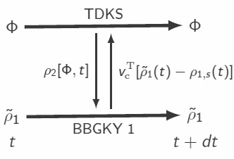

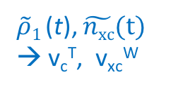
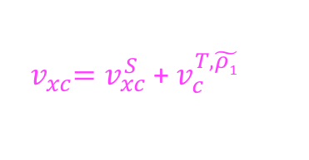


… “density-matrix coupled xc approximation”
(Lionel Lacombe)
v_{c}^{T}
$\tilde{ρ}$₁
v_{xc}^{W}
$\tilde{n}$_{xc}
Use approximation
e.g. replace with KS, ρ_{2,S}
${{ v}_{xc}^{}=v}_{xc}^{S}$ +${ v}_{c}^{T,\tilde{ρ1}}$
ρ_{1,s} (t)
$\tilde{ρ}1$ (t), $\tilde{nxc}(t)$
→ v_{c}^{T}, v_{xc}^{W}
~
Method guarantees ρ₁ (r,r,t) = n_{Φ}(r,t)
with $\tilde{ρ}$₂ [$\tilde{ρ}1$, ρ_{1,s} ](t)
L. Lacombe and N. T. Maitra, arXiv:1809.07378, JCTC to appear
Notes:
Lionel’s idea was to now find an approximation for rho2 in terms of the 1RDM and of the KS 1RDM.
Why bbgky gives same diagonal as tdks – ndoubledot eqn
Note rho-tilde fictitious system, not supposed to be 1RDM of any physical system, only the near-diag elts are hoped to have physical meaning.
Need the rho1s dependence since otherwise just RDMFT and no point in doing KS.

Slide 22
Summary
Memory-dependence is important – adiabatic approximations can sometimes fail to even qualitatively capture the dynamics
Development of memory-dependent approximations is needed, guided by exact conditions
Density-matrix coupled approximations may be a fruitful route

Slide 23


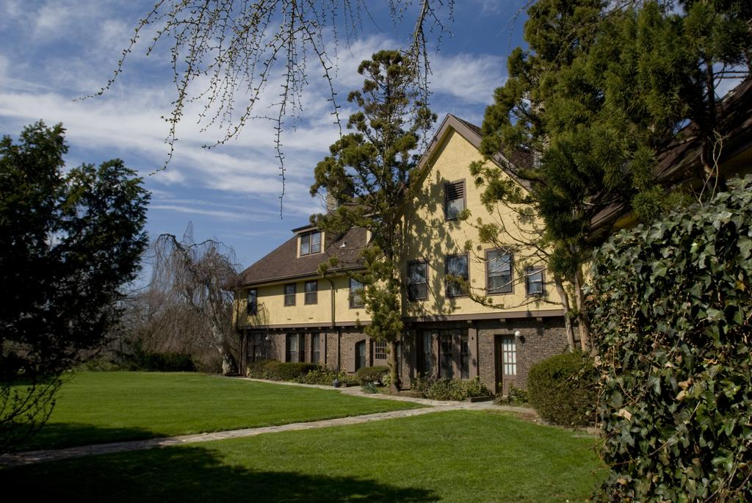
Thanks to Paola, Mathieu, Brendan
Exact factorization
Dr. Graeme Gossel
Enxi Yu
Norah Hoffmann
Dr. Lionel Lacombe
Steven Crisostomo
and to you all for listening!
2nd US School & Workshop on TDDFT: Aug 4 – 9 & Aug 11 – 14, 2019, Rutgers University, New Jersey, USA
https://sites.rutgers.edu/tddft/

Slide 25
Finding the exact xc potential for a given known density-evolution
Generally, not so easy.
One can show:
into TDKS
orbital-density and orbital-phase of any one of the occupied orbitals
where
j_{i}
In 1D, can express in terms of orbital-density and orbital-”velocity”, u_{i} = j_{i} /n_{i}
So, problem becomes finding the exact KS orbitals -- generally difficult, but possible, Nielsen, Ruggenthaler, van Leeuwen, Europhys. Lett. 101, 33001 (2013)
One easy case: 2 electrons spin-singlet in 1D, in a doubly-occupied KS orbital
n_{i}(x,t) → ½ n(x,t), the exact density, and u_{i}(x,t)→ j(x,t)/n(x,t), where j is the exact current-density

Slide 26
Expression directly for the exact exchange-correlation potential …
Those expressions are directly for v_{s}; to find v_{xc} we must subtract Hartree and v_{ext}
Note there is also an expression directly for v_{xc}:
Equate equation of motion for $∂^{2}$n(r,t)/$∂t^{2}$ coming from interacting system,
with that of the KS system, and then subtract →
TD one-body density-matrix: interacting, KS
Exact expression for the TD exchange-correlation potential
TD exchange-correlation hole

