Slide 1
Modelling Epithelial Morphogenesis
Clinton H. Durney, James J. Feng, Tony J.C. Harris

Slide 2

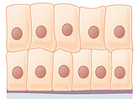

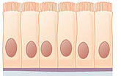

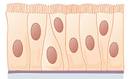
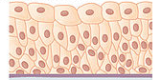
Epithelial Tissues
Notes:
Epithelial tissues line the outer surfaces of organs and blood vessels throughout the body, as well as the inner surfaces of cavities in many internal organs. An example is the epidermis, the outermost layer of the skin

Slide 3
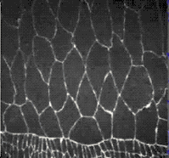
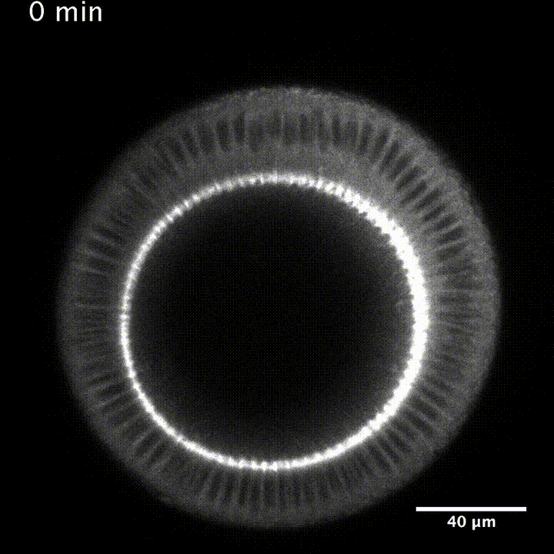
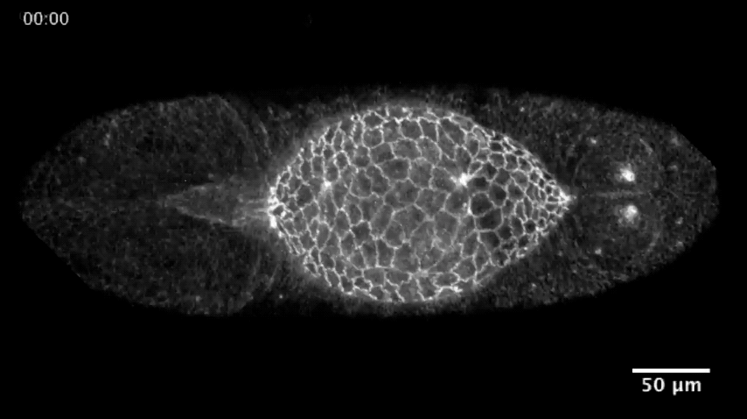
Mechanical Behavior of Epithelial Tissues

Slide 4
Key Questions
What is the cause of cellular oscillations?
What is the cause of cellular contraction?
What is the cause of out-of-plane bending?
What are the mechanical properties that cause invagination?

Slide 5
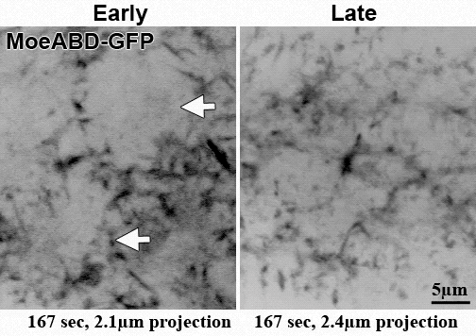
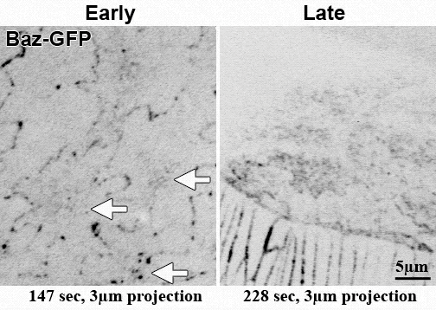
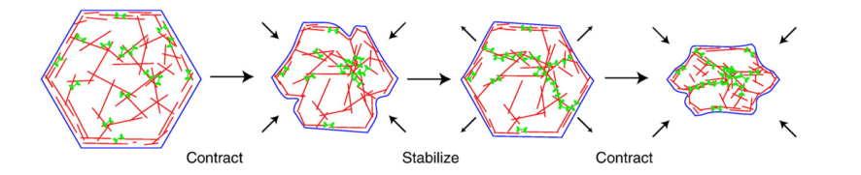
Drosophila Dorsal Closure
What causes the AS cellular oscillations?
What causes the loss of area during the Slow Phase?
David et. al, Development 137, 1645-1655, 2010
David et. al, Development 140, 4719-4729, 2013
Martin et. al., Nature, Vol 457, 2009
Notes:
Phrase in terms as physical scientists as ourselves these things come to mind.
Swap out with video

Slide 6
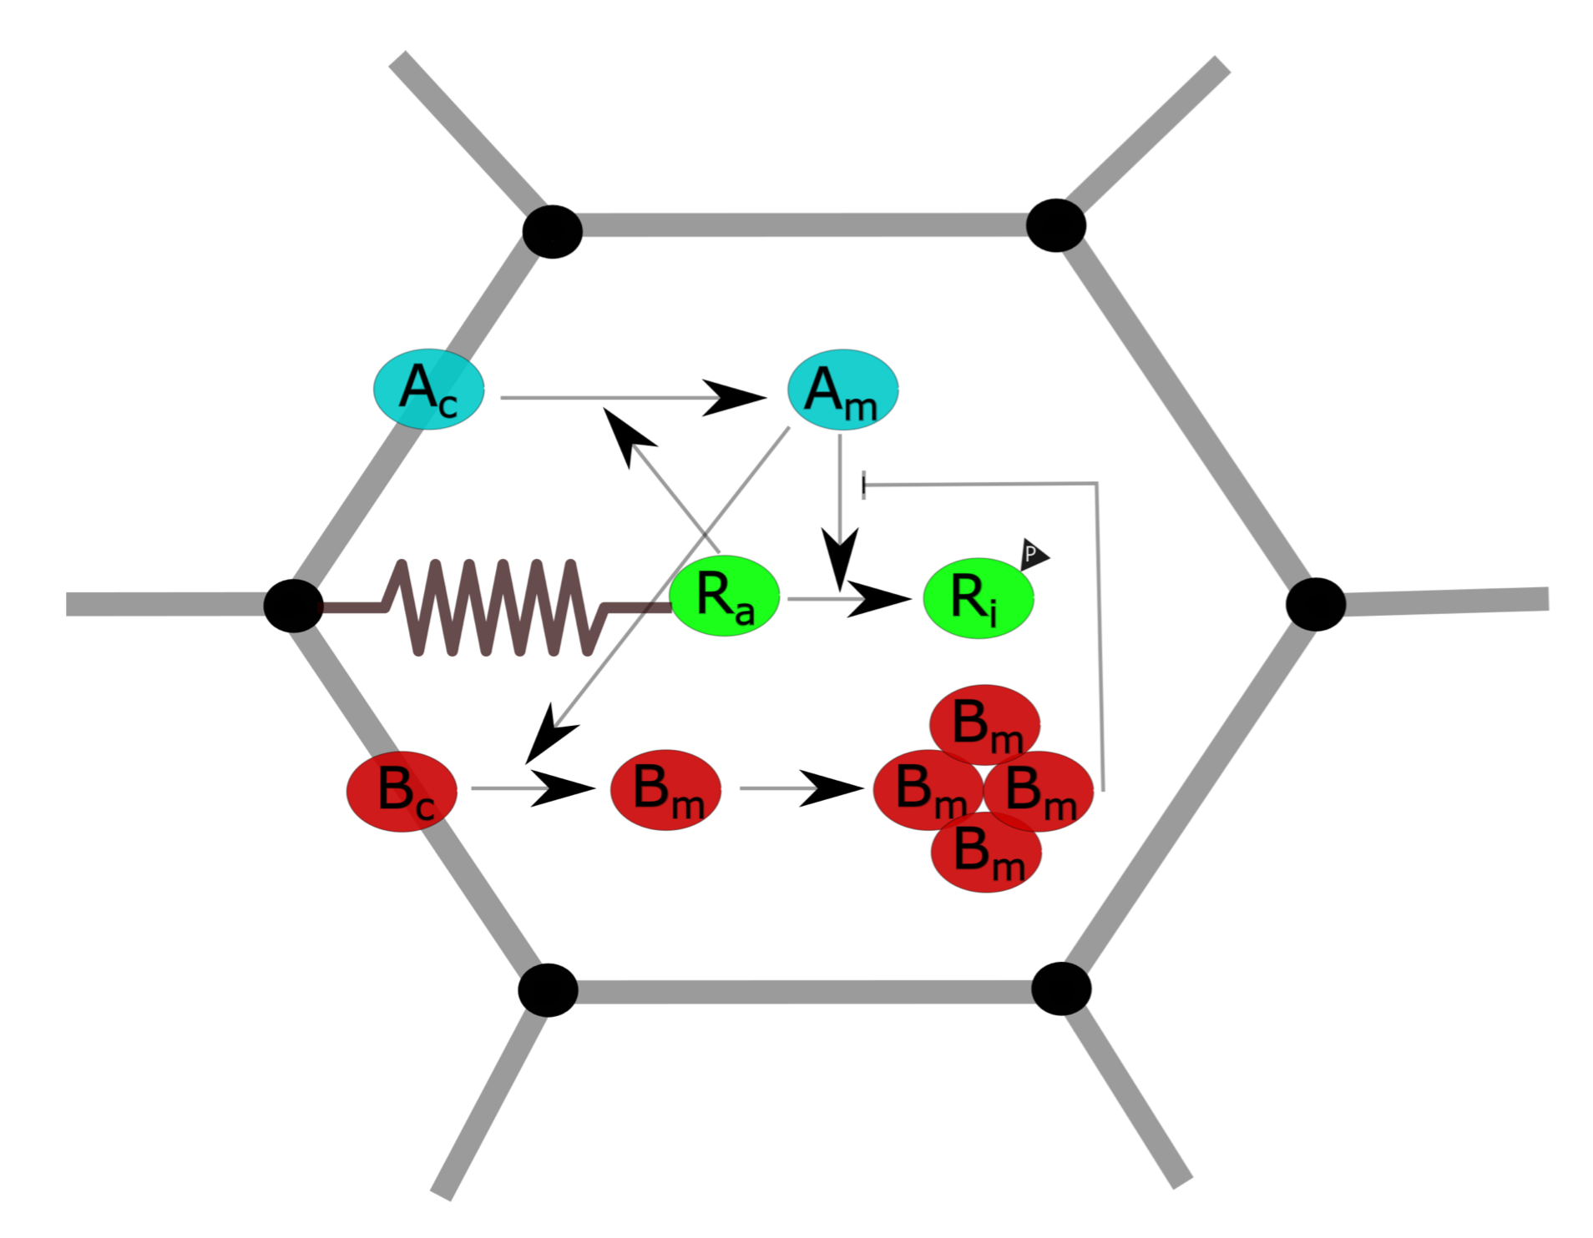
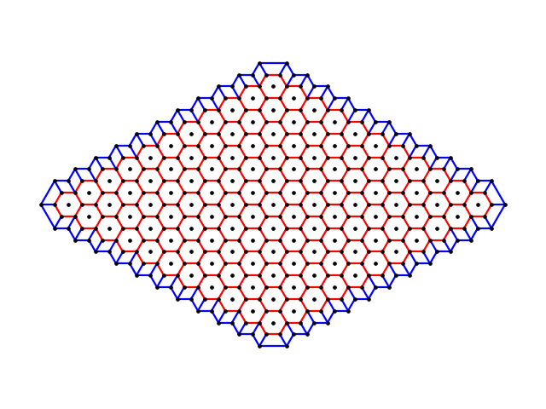
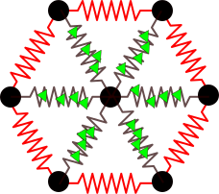

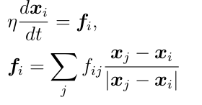
Ingredients of the model
Mechanical
Biochemical
Nodal Motion:

Slide 7
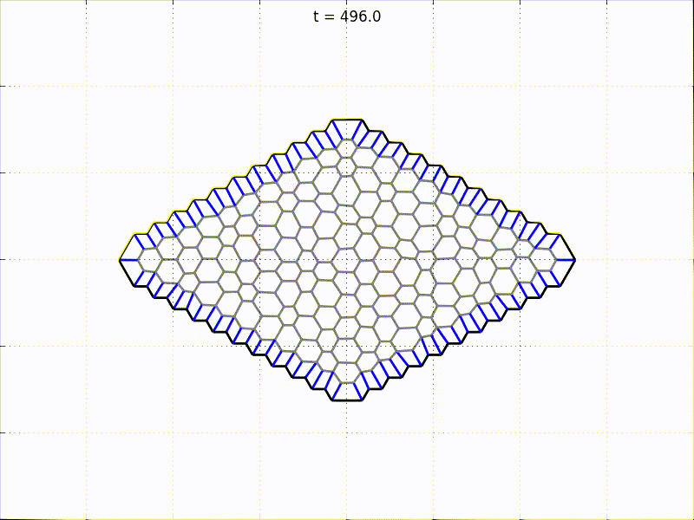
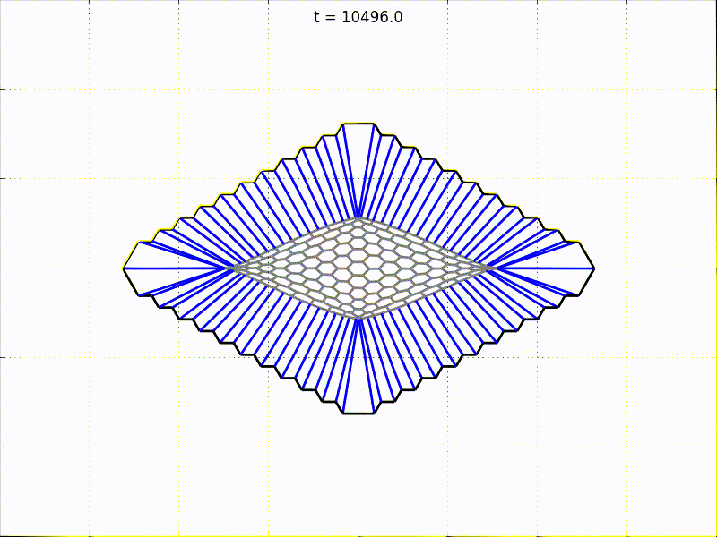
Results
Cellular Oscillations: Mutual inhibition creates negative feedback loop
Ratcheting : Exhaustion of myosin inhibitor

