Slide 1

A total energy error analysis of dynamical cores and physics-dynamics coupling in the
Community Atmosphere Model (CAM)
Peter H. Lauritzen
Climate and Global Dynamics Laboratory, National Center for Atmospheric Research
October 15, 2019
Banff International Research Station (BIRS) workshop on Physics-Dynamics coupling in Earth System Models, Banff, Canada

Slide 2
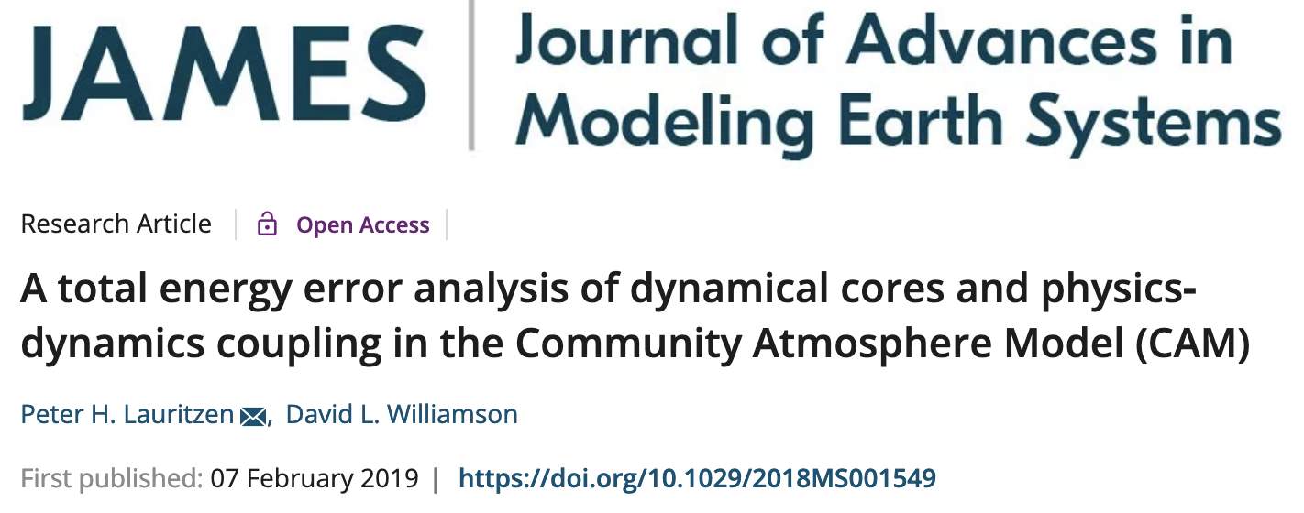
A total energy error analysis of dynamical cores and physics-dynamics coupling in the
Community Atmosphere Model (CAM)
https://agupubs.onlinelibrary.wiley.com/doi/full/10.1029/2018MS001549
Peter H. Lauritzen
Climate and Global Dynamics Laboratory, National Center for Atmospheric Research
October 15, 2019
Banff International Research Station (BIRS) workshop on Physics-Dynamics coupling in Earth System Models, Banff, Canada

Slide 3

Research question
How large are the spurious total energy sources/sinks in an atmosphere model and where are they coming from?

Slide 4
Outline
Define total energy:
- dry-mass based vertical coordinate: a simpler formulation
for tracking energy budget in a moist atmosphere
Energy errors in an atmospheric model: NCAR’s Community Atmosphere Model (CAM)

Slide 5
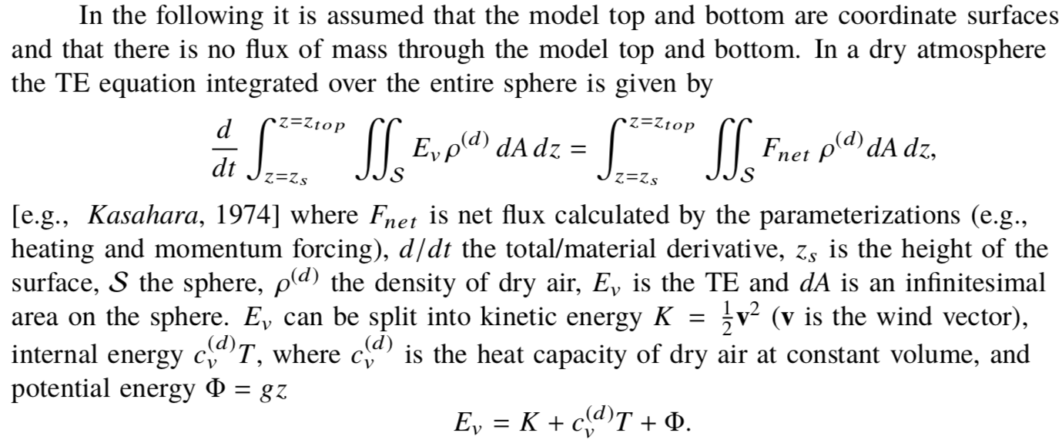
Total energy (TE) equation
- dry atmosphere (height coordinates)
Calculated by parameterizations (e.g., heating, momentum forcing)
Lauritzen and Williamson (2019)

Slide 6
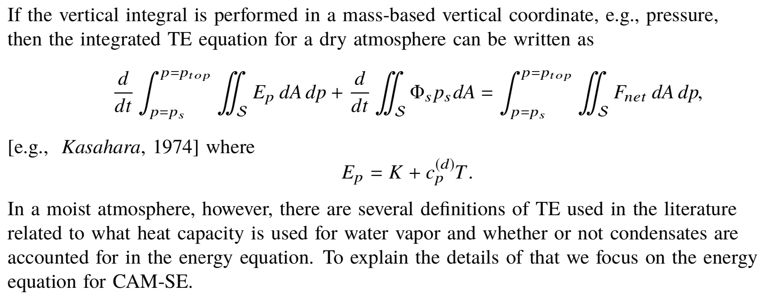
Total energy (TE) equation
- dry atmosphere (mass coordinates)
And assuming hydrostatic balance
CAM-SE = Community Atmosphere Model – Spectral Element dynamical core (Lauritzen et al., 2017)

Slide 7
Total energy (TE) equation
- dry atmosphere (mass coordinates)
CAM-SE = Community Atmosphere Model – Spectral Element dynamical core (Lauritzen et al., 2018)

Slide 8
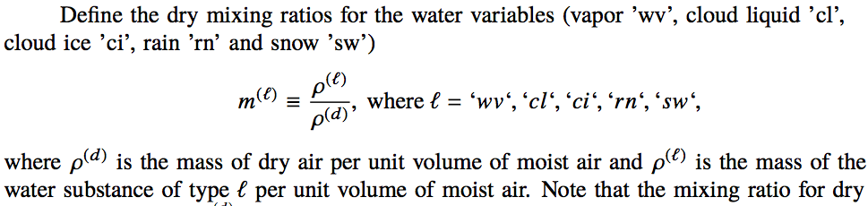


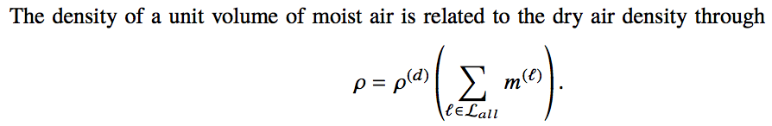
Total energy (TE) equation
- moist atmosphere (mass coordinates)
Without loss of generality assume moist air consists of dry air (‘d’), water vapor (‘wv’), cloud liquid (‘cl’), cloud ice (‘ci’), rain (‘rn’) and snow (‘sn’):
Aside: The condensates are assumed to be suspended in the air (no separate momentum or thermodynamic equations for them)
Notes:
What is the mixing ratio for dry air? What is the difference between water vapor+dry air and cloud liquid, ice, rain and snow?

Slide 9
Total energy (TE) equation
- moist atmosphere (mass coordinates)
SI unit for density: kg/m³
Notes:
What is the mixing ratio for dry air? What is the difference between water vapor+dry air and cloud liquid, ice, rain and snow?

Slide 10
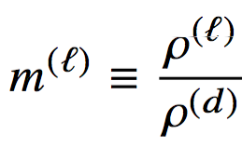
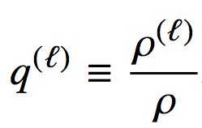
Total energy (TE) equation
- moist atmosphere (mass coordinates)
Dry versus specific (‘wet’) mixing ratios
Note: if, e.g., water vapor rains out then \rho changes and therefore all mixing ratios q^{(l)} change whereas m^{(l)} remain unaffected
=> Formulation using a dry basis makes “book keeping” straight forward
SI unit for density: kg/m³
Notes:
What is the mixing ratio for dry air? What is the difference between water vapor+dry air and cloud liquid, ice, rain and snow?

Slide 11
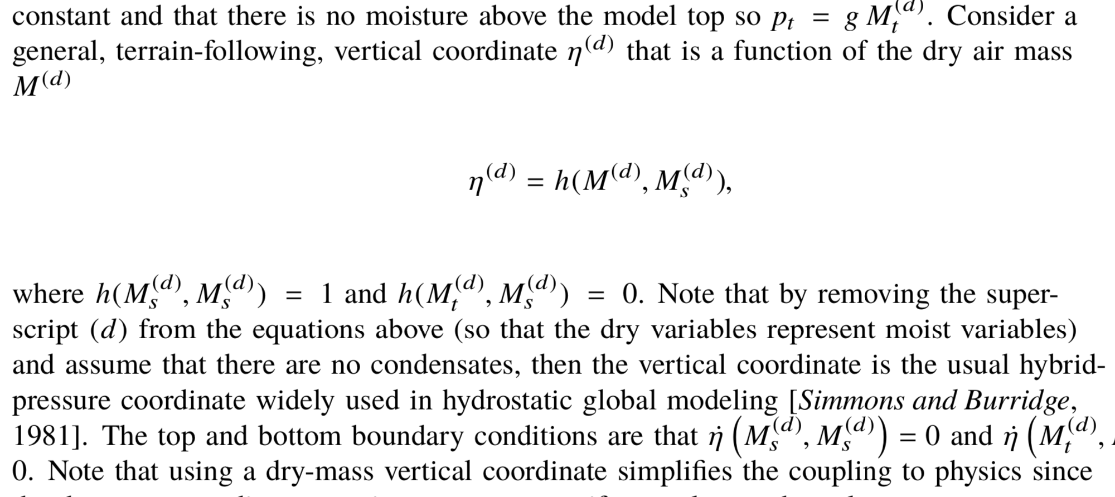
Terrain-following dry-mass coordinate

Slide 12
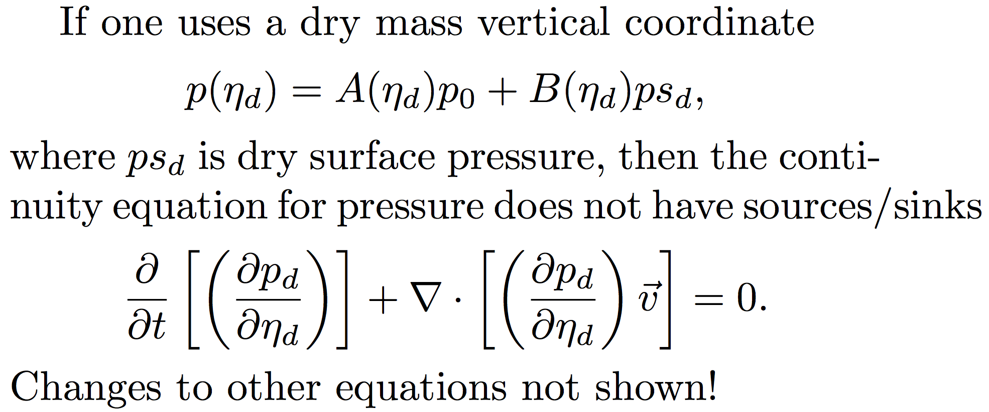
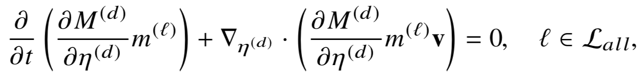
Terrain-following dry-mass coordinate
Model levels do not move during physics-dynamics coupling!

Slide 13
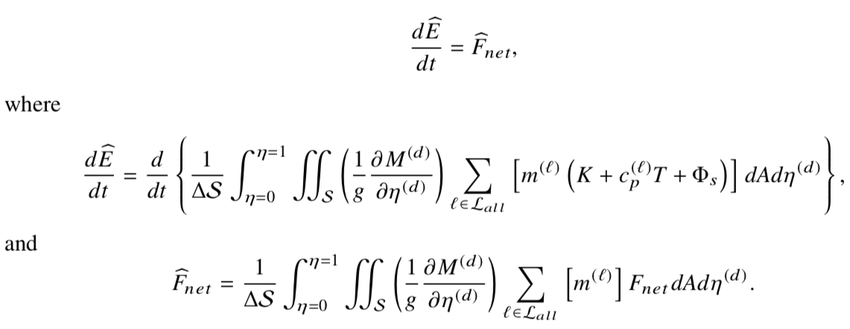
Total energy (TE) equation
- moist atmosphere
Net energy flux calculated by parameterizations
Thermal energy
Kinetic energy
Dry mixing ratio
Lauritzen et al. (2018); https://agupubs.onlinelibrary.wiley.com/doi/abs/10.1029/2017MS001257

Slide 14
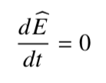
Total energy (TE) equation
- moist atmosphere
The continuous equations of motion on which the dynamical core is based conserve TE globally:

Slide 15

Total energy (TE) equation
- moist atmosphere
Conserving total energy to within ~0.01 W/m² is considered “good enough” for coupled climate modeling (Boville, 2000; Williamson et al., 2015)
Earths energy imbalance is
~1 W/m²

Slide 16

Total energy (TE) equation
- moist atmosphere
Column physics: TE change in column should be balanced by fluxes in/out of the top and bottom

Slide 17
Potential spurious sources/sinks of total energy in
an atmosphere model:
Parameterization errors: Individual parameterizations may not have a closed energy budget.
CAM parameterizations are required to have a closed energy budget under the assumption that
pressure remains constant during the computation of the subgrid-scale parameterization tendencies.
In other words, the TE change in the column is exactly balanced by the net sources/sinks given by the
fluxes through the column.
Pressure work error: That said, if parameterizations update specific humidity then the surface pressure changes
(e.g., moisture entering or leaving the column). In that case the pressure changes which, in turn, changes TE.
This is referred to as pressure work error [section 3.1.8 in Neale et al., 2012].
Continuous TE formula discrepancy: If the continuous equations of motion for the dynamical core conserve
a TE different from the one used in the parameterizations then an energy inconsistency is present in the system
as a whole. In CAM this mismatch arose from the evolutionary nature of the model development and not by deliberate
design; and should be eliminated in the future.
Dynamical core errors: Energy conservation errors in the dynamical core, not related to physics-dynamics coupling
errors, can arise in multiple parts of the algorithms used to solve the equations of motion.
Physics-dynamics coupling (PDC): Assume that physics computes a tendency. Usually the tendency (forcing) is
passed to the dynamical core which is responsible for adding the tendencies to the state.

Slide 18
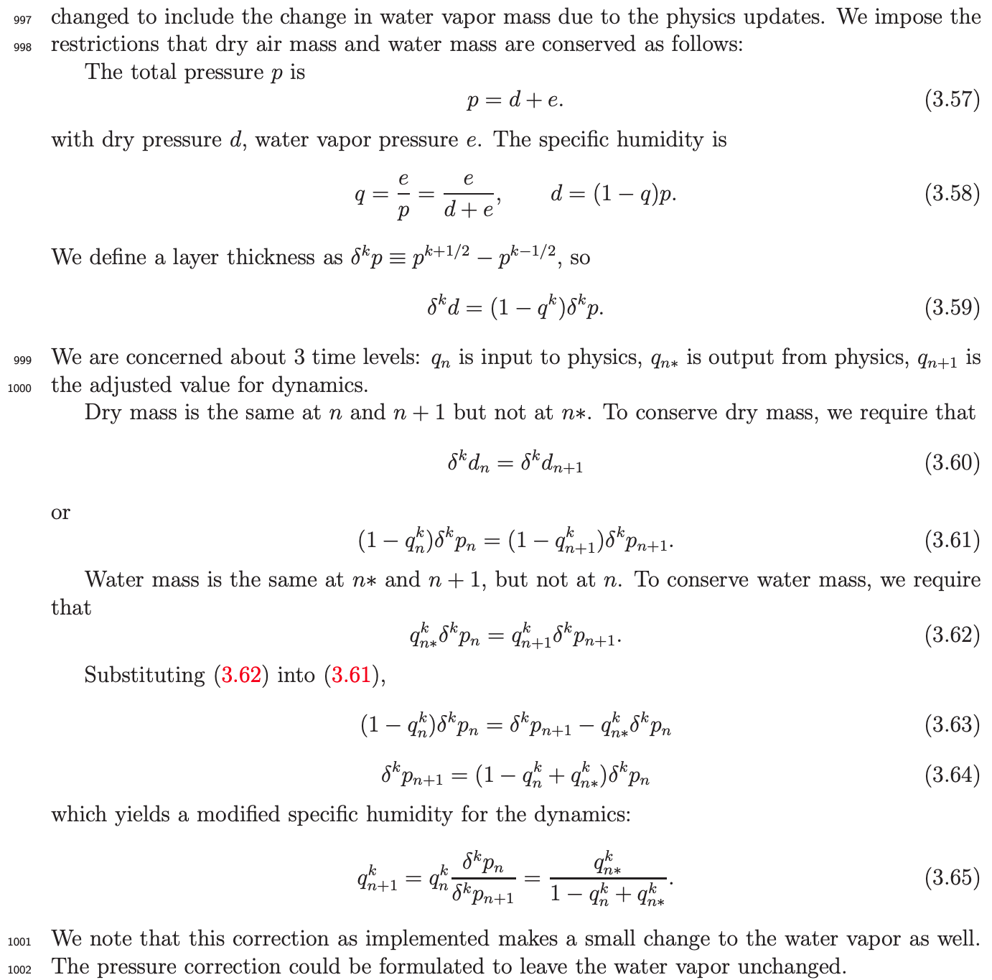

Not TE conserving
Potential spurious sources/sinks of total energy in
an atmosphere model:
Parameterization errors: Individual parameterizations may not have a closed energy budget.
CAM parameterizations are required to have a closed energy budget under the assumption that
pressure remains constant during the computation of the subgrid-scale parameterization tendencies.
In other words, the TE change in the column is exactly balanced by the net sources/sinks given by the
fluxes through the column.
Pressure work error: That said, if parameterizations update specific humidity then the surface pressure changes
(e.g., moisture entering or leaving the column). In that case the pressure changes which, in turn, changes TE.
This is referred to as pressure work error [section 3.1.8 in Neale et al., 2012].
Continuous TE formula discrepancy: If the continuous equations of motion for the dynamical core conserve
a TE different from the one used in the parameterizations then an energy inconsistency is present in the system
as a whole. In CAM this mismatch arose from the evolutionary nature of the model development and not by deliberate
design; and should be eliminated in the future.
Dynamical core errors: Energy conservation errors in the dynamical core, not related to physics-dynamics coupling
errors, can arise in multiple parts of the algorithms used to solve the equations of motion.
Physics-dynamics coupling (PDC): Assume that physics computes a tendency. Usually the tendency (forcing) is
passed to the dynamical core which is responsible for adding the tendencies to the state.
CAM5 scientific documentation
Held fixed during CAM physics updates
But water vapor may change so TE changes!
Problem to discuss during breakout session

Slide 19

CAM-SE dynamical core
CAM physics
Potential spurious sources/sinks of total energy in
an atmosphere model:
Parameterization errors: Individual parameterizations may not have a closed energy budget.
CAM parameterizations are required to have a closed energy budget under the assumption that
pressure remains constant during the computation of the subgrid-scale parameterization tendencies.
In other words, the TE change in the column is exactly balanced by the net sources/sinks given by the
fluxes through the column.
Pressure work error: That said, if parameterizations update specific humidity then the surface pressure changes
(e.g., moisture entering or leaving the column). In that case the pressure changes which, in turn, changes TE.
This is referred to as pressure work error [section 3.1.8 in Neale et al., 2012].
Continuous TE formula discrepancy: If the continuous equations of motion for the dynamical core conserve
a TE different from the one used in the parameterizations then an energy inconsistency is present in the system
as a whole. In CAM this mismatch arose from the evolutionary nature of the model development and not by deliberate
design; and should be eliminated in the future.
Dynamical core errors: Energy conservation errors in the dynamical core, not related to physics-dynamics coupling
errors, can arise in multiple parts of the algorithms used to solve the equations of motion.
Physics-dynamics coupling (PDC): Assume that physics computes a tendency. Usually the tendency (forcing) is
passed to the dynamical core which is responsible for adding the tendencies to the state.

Slide 20
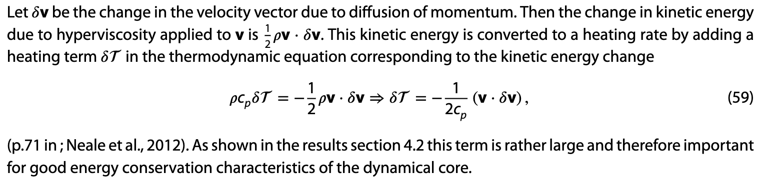
Potential spurious sources/sinks of total energy in
an atmosphere model:
TE errors in the CAM spectral-element dynamical core:
Horizontal inviscid dynamics: Energy errors resulting from solving the inviscid, adiabatic equations of motion.
Hyperviscosity: Filtering errors; Note that we use frictional heating:
Vertical remapping: The vertical remapping algorithm from Lagrangian to Eulerian reference surfaces does not conserve TE.
Near round-off negative values of water vapor which are filled to a minimal value without compensation.
Parameterization errors: Individual parameterizations may not have a closed energy budget.
CAM parameterizations are required to have a closed energy budget under the assumption that
pressure remains constant during the computation of the subgrid-scale parameterization tendencies.
In other words, the TE change in the column is exactly balanced by the net sources/sinks given by the
fluxes through the column.
Pressure work: That said, if parameterizations update specific humidity then the surface pressure changes
(e.g., moisture entering or leaving the column). In that case the pressure changes which, in turn, changes TE.
This is referred to as pressure work [section 3.1.8 in Neale et al., 2012].
Continuous TE formula discrepancy: If the continuous equations of motion for the dynamical core conserve
a TE different from the one used in the parameterizations then an energy inconsistency is present in the system
as a whole. In CAM this mismatch arose from the evolutionary nature of the model development and not by deliberate
design; and should be eliminated in the future.
Dynamical core errors: Energy conservation errors in the dynamical core, not related to physics-dynamics coupling
errors, can arise in multiple parts of the algorithms used to solve the equations of motion.
Physics-dynamics coupling (PDC): Assume that physics computes a tendency. Usually the tendency (forcing) is
passed to the dynamical core which is responsible for adding the tendencies to the state.

Slide 21
Potential spurious sources/sinks of total energy in
an atmosphere model:
Parameterization errors: Individual parameterizations may not have a closed energy budget.
CAM parameterizations are required to have a closed energy budget under the assumption that
pressure remains constant during the computation of the subgrid-scale parameterization tendencies.
In other words, the TE change in the column is exactly balanced by the net sources/sinks given by the
fluxes through the column.
Pressure work error: That said, if parameterizations update specific humidity then the surface pressure changes
(e.g., moisture entering or leaving the column). In that case the pressure changes which, in turn, changes TE.
This is referred to as pressure work error [section 3.1.8 in Neale et al., 2012].
Continuous TE formula discrepancy: If the continuous equations of motion for the dynamical core conserve
a TE different from the one used in the parameterizations then an energy inconsistency is present in the system
as a whole. In CAM this mismatch arose from the evolutionary nature of the model development and not by deliberate
design; and should be eliminated in the future.
Dynamical core errors: Energy conservation errors in the dynamical core, not related to physics-dynamics coupling
errors, can arise in multiple parts of the algorithms used to solve the equations of motion.
Physics-dynamics coupling (PDC): Assume that physics computes a tendency. Usually the tendency (forcing) is
passed to the dynamical core which is responsible for adding the tendencies to the state.

Slide 22
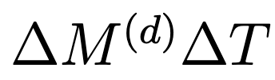
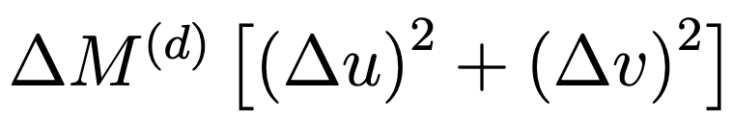
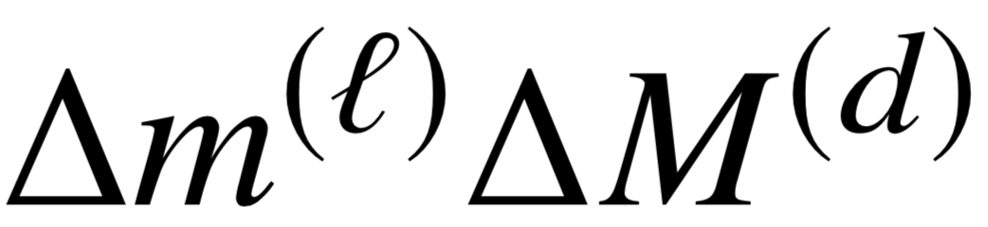
Temporal physics-dynamics coupling methods
State-update method
No physics-dynamics coupling error:
“Dry” energy change due to physics energy increments
= Energy change due to physics forcing when added in dynamics

Slide 23
1 year average |dps/dt|; AMIP run

Slide 24
Temporal physics-dynamics coupling methods
State-update method
“Dribbling”

Slide 25
1 year average |dps/dt|; AMIP run

Slide 26
Temporal physics-dynamics coupling methods
Two potential problems with “dribbling”:
Tracer mixing ratios may go negative: if mixing ratios
are set to zero if tendency drives mixing ratio negative
it results in a net SPURIOUS source of tracer mass
State-update method
“Dribbling”

Slide 27
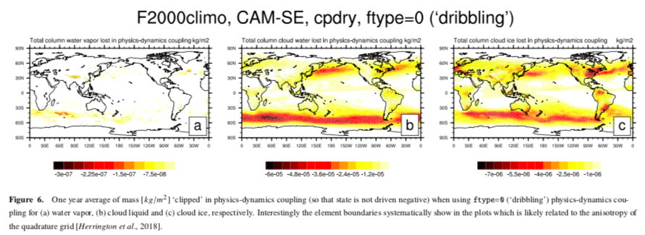

Slide 28
Temporal physics-dynamics coupling methods
Two potential problems with “dribbling”:
Tracer mixing ratios may go negative: solution: combine ftype=0 and 1
State-update method
“Dribbling”

Slide 29
ftype=2: state-updating (type=1) for tracers (i.e. no mass-clipping errors) and
“dribbling” (ftype=0) for u,v, and T.

Slide 30
Temporal physics-dynamics coupling methods
Two potential problems with “dribbling”:
Tracer mixing ratios may go negative: solution: combine ftype=0 and 1
Total energy conservation errors (next slides)
State-update method
“Dribbling”

Slide 31

Thermal energy “dribbling” error: Thermal energy increment from physics ~
does not match thermal energy change in dycore when tendency is added to dycore state since dM might have changed.
Thermal increments in “dribbling” (assume 2 “dribblings”): ~
Temporal physics-dynamics coupling methods
State-update method
“Dribbling”

Slide 32
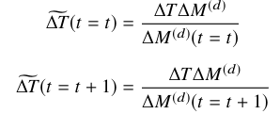

Thermal energy “dribbling” error: Thermal energy increment from physics ~
does not match thermal energy change in dycore when tendency is added to dycore state since dM might have changed.
Thermal increments in “dribbling” (assume 2 “dribblings”):
Temporal physics-dynamics coupling methods
State-update method
“Dribbling”

Slide 33

Kinetic energy “dribbling” error:
We can do momentum conserving “dribbling” pretty easily:
by using same “trick” as for thermal energy …
Kinetic energy conserving “dribbling”?
Temporal physics-dynamics coupling methods
State-update method
“Dribbling”

Slide 34
Potential spurious sources/sinks of total energy in
an atmosphere model:
Parameterization errors: Individual parameterizations may not have a closed energy budget.
CAM parameterizations are required to have a closed energy budget under the assumption that
pressure remains constant during the computation of the subgrid-scale parameterization tendencies.
In other words, the TE change in the column is exactly balanced by the net sources/sinks given by the
fluxes through the column.
Pressure work error: That said, if parameterizations update specific humidity then the surface pressure changes
(e.g., moisture entering or leaving the column). In that case the pressure changes which, in turn, changes TE.
This is referred to as pressure work error [section 3.1.8 in Neale et al., 2012].
Continuous TE formula discrepancy: If the continuous equations of motion for the dynamical core conserve
a TE different from the one used in the parameterizations then an energy inconsistency is present in the system
as a whole. In CAM this mismatch arose from the evolutionary nature of the model development and not by deliberate
design; and should be eliminated in the future.
Dynamical core errors: Energy conservation errors in the dynamical core, not related to physics-dynamics coupling
errors, can arise in multiple parts of the algorithms used to solve the equations of motion.
Physics-dynamics coupling (PDC): Assume that physics computes a tendency. Usually the tendency (forcing) is
passed to the dynamical core which is responsible for adding the tendencies to the state.

Slide 35
Fixing spurious sources/sinks of total energy in
an atmosphere model:
Compensating Energy fixers: To avoid TE conservation errors which could accumulate and ultimately lead to a
climate drift, it is customary to apply an arbitrary energy fixer to restore TE conservation. Since the spatial distribution
of many energy errors, in general, is not known, global fixers are used. In CAM a uniform increment is added to the
temperature field to compensate for TE imbalance from all processes, i.e. dynamical core, physics-dynamics coupling,
TE formula discrepancy, energy change due to pressure work, and possibly parameterization errors if present.
Energy fixer:
when energy is
not restored or
conserved locally
do uniform incr.
in temperature
Physics-dynamics coupling
Dynamical core
Pressure work
error
Continuous TE formula discrepancy
Note: sometimes that is the better solution

Slide 36
Diagnosing TE errors:
Implemented using CAM history
infrastructure by computing
column integrals of energy at
various places in CAM and
outputting the 2D energy fields.
CAM history internally handles
accumulation and averaging in
time at each horizontal grid
point.

Slide 37
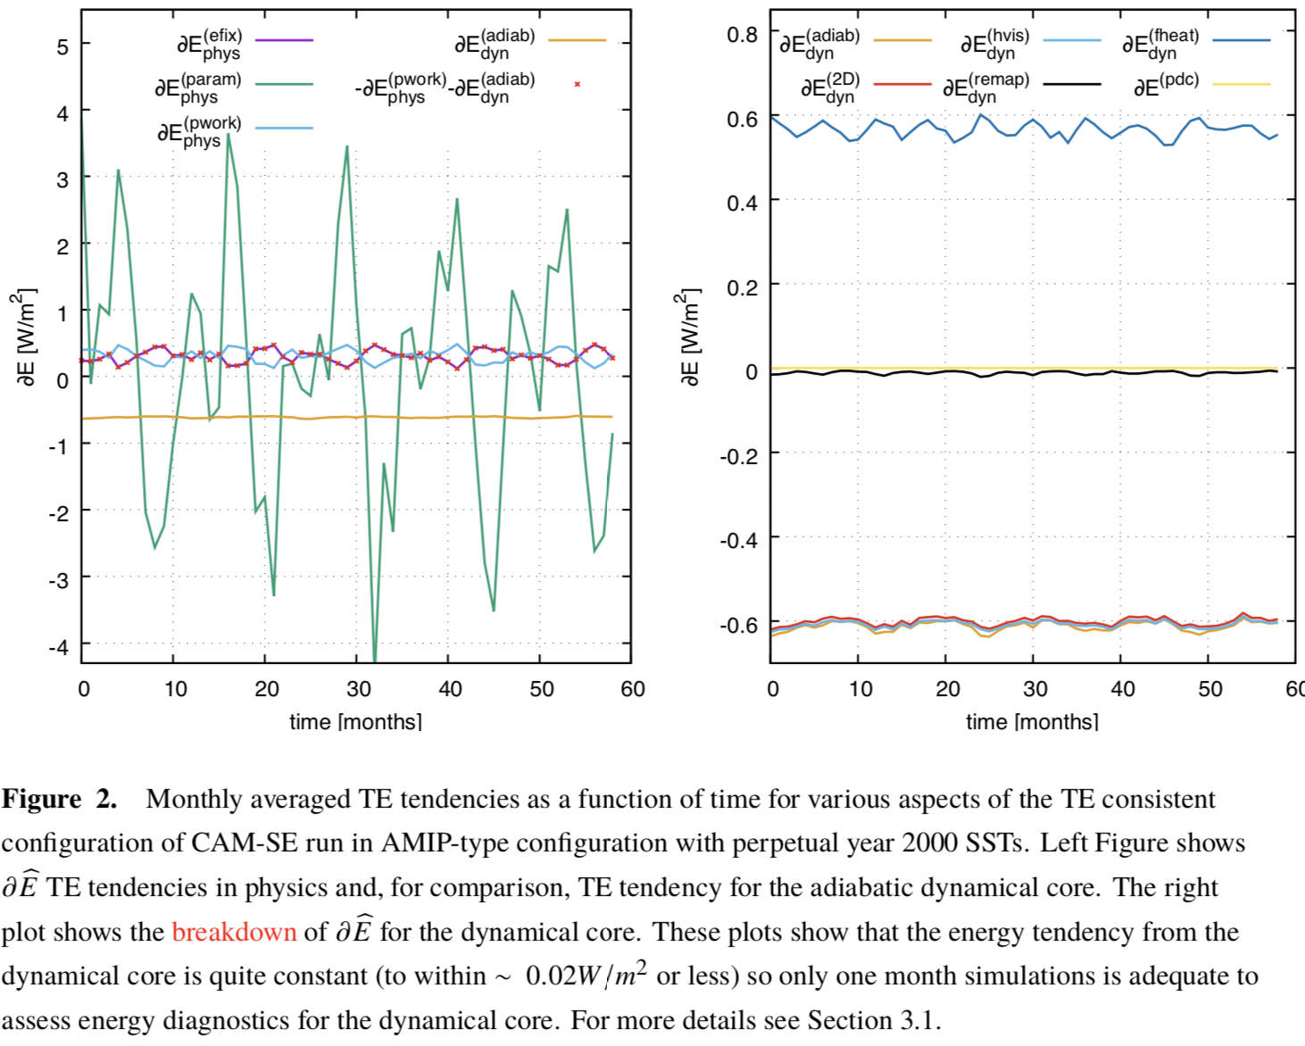
How long an average is needed for
robust estimates of TE errors?

Slide 38
Spurious sources/sinks of total energy in
atmosphere model:
Budget closed in CAM 😀
(except for small “clipping” errors) but …
Parameterization errors: Individual parameterizations may not have a closed energy budget.
CAM parameterizations are required to have a closed energy budget under the assumption that
pressure remains constant during the computation of the subgrid-scale parameterization tendencies.
In other words, the TE change in the column is exactly balanced by the net sources/sinks given by the
fluxes through the column.
Pressure work: That said, if parameterizations update specific humidity then the surface pressure changes
(e.g., moisture entering or leaving the column). In that case the pressure changes which, in turn, changes TE.
This is referred to as pressure work [section 3.1.8 in Neale et al., 2012].
Continuous TE formula discrepancy: If the continuous equations of motion for the dynamical core conserve
a TE different from the one used in the parameterizations then an energy inconsistency is present in the system
as a whole. In CAM this mismatch arose from the evolutionary nature of the model development and not by deliberate
design; and should be eliminated in the future.
Dynamical core errors: Energy conservation errors in the dynamical core, not related to physics-dynamics coupling
errors, can arise in multiple parts of the algorithms used to solve the equations of motion.
Physics-dynamics coupling (PDC): Assume that physics computes a tendency. Usually the tendency (forcing) is
passed to the dynamical core which is responsible for adding the tendencies to the state.
Pressure work: ~0.3 W/m²
TE formula discr. (CAM-SE only): ~0.6 W/m²
CAM-SE: ~-0.3 W/m²
CAM-FV and CAM-FV3: ~ -1.1 W/m²
CAM-SE: PDC errors (“dribbling”): ~0.5 W/m²
When using thermal energy and momentum conserving dribbling: ~0.05 W/m²

Slide 39
Spurious sources/sinks of total energy in
atmosphere model:
Parameterization errors: Individual parameterizations may not have a closed energy budget.
CAM parameterizations are required to have a closed energy budget under the assumption that
pressure remains constant during the computation of the subgrid-scale parameterization tendencies.
In other words, the TE change in the column is exactly balanced by the net sources/sinks given by the
fluxes through the column.
Pressure work: That said, if parameterizations update specific humidity then the surface pressure changes
(e.g., moisture entering or leaving the column). In that case the pressure changes which, in turn, changes TE.
This is referred to as pressure work [section 3.1.8 in Neale et al., 2012].
Continuous TE formula discrepancy: If the continuous equations of motion for the dynamical core conserve
a TE different from the one used in the parameterizations then an energy inconsistency is present in the system
as a whole. In CAM this mismatch arose from the evolutionary nature of the model development and not by deliberate
design; and should be eliminated in the future.
Dynamical core errors: Energy conservation errors in the dynamical core, not related to physics-dynamics coupling
errors, can arise in multiple parts of the algorithms used to solve the equations of motion.
Physics-dynamics coupling (PDC): Assume that physics computes a tendency. Usually the tendency (forcing) is
passed to the dynamical core which is responsible for adding the tendencies to the state.
TE errors in the CAM spectral-element dynamical core (break-down):
Horizontal inviscid dynamics: Energy errors resulting from solving the inviscid,adiabatic equations of motion.
Hyperviscosity: Filtering errors (frictional heating is used!).
Note that if no frictional heating is used then TE error would be > 1 W/m²
Vertical remapping: The vertical remapping algorithm from Lagrangian to Eulerian reference surfaces does not conserve TE.
Budget closed in CAM 😀
(except for small “clipping” errors) but …
New version of SE dycore (Exner PGF formulation+subtract reference states in hyperviscosity)
Pressure work: ~0.3 W/m²
~0.010 W/m²
~-0.078 W/m²
Frictional heating is ~0.41 W/m²
TE formula discr. (CAM-SE only): ~0.6 W/m²
CAM-SE: ~-0.6 W/m² (decreases to -0.3W/m² with smoother topography)
CAM-FV and CAM-FV3: ~ -1.1 W/m²
~-0.2 W/m²
Discretization choices/details do matter!
CAM-SE: PDC errors (“dribbling”): ~0.5 W/m²

Slide 40
Spurious sources/sinks of total energy in
atmosphere model:
Parameterization errors: Individual parameterizations may not have a closed energy budget.
CAM parameterizations are required to have a closed energy budget under the assumption that
pressure remains constant during the computation of the subgrid-scale parameterization tendencies.
In other words, the TE change in the column is exactly balanced by the net sources/sinks given by the
fluxes through the column.
Pressure work: That said, if parameterizations update specific humidity then the surface pressure changes
(e.g., moisture entering or leaving the column). In that case the pressure changes which, in turn, changes TE.
This is referred to as pressure work [section 3.1.8 in Neale et al., 2012].
Continuous TE formula discrepancy: If the continuous equations of motion for the dynamical core conserve
a TE different from the one used in the parameterizations then an energy inconsistency is present in the system
as a whole. In CAM this mismatch arose from the evolutionary nature of the model development and not by deliberate
design; and should be eliminated in the future.
Dynamical core errors: Energy conservation errors in the dynamical core, not related to physics-dynamics coupling
errors, can arise in multiple parts of the algorithms used to solve the equations of motion.
Physics-dynamics coupling (PDC): Assume that physics computes a tendency. Usually the tendency (forcing) is
passed to the dynamical core which is responsible for adding the tendencies to the state.
TE errors in the CAM spectral-element dynamical core (break-down):
Horizontal inviscid dynamics: Energy errors resulting from solving the inviscid,adiabatic equations of motion.
Hyperviscosity: Filtering errors (frictional heating is used!).
Note that if no frictional heating is used then TE error would be > 1 W/m²
Vertical remapping: The vertical remapping algorithm from Lagrangian to Eulerian reference surfaces does not conserve TE.
Budget closed in CAM 😀
(except for small “clipping” errors) but …
Old version of SE
Pressure work: ~0.3 W/m²
~0.010 W/m²
~-0.587 W/m²
Frictional heating is ~0.579 W/m²
TE formula discr. (CAM-SE only): ~0.6 W/m²
CAM-SE: ~-0.6 W/m² (decreases to -0.3W/m² with smoother topography)
CAM-FV and CAM-FV3: ~ -1.1 W/m²
~-0.012 W/m²
CAM-SE: PDC errors (“dribbling”): ~0.5 W/m²

Slide 41
Note that there are compensating errors in the system
-> need to do detailed TE budget analysis!
Aside: these diagnostics are really useful for debugging physics-dynamics coupling when new dynamical cores are integrated into CAM
- have been used with FV3 coupling to CAM physics and
bugs were found!
- planned to be used with MPAS integration into CAM
Spurious sources/sinks of total energy in
atmosphere model:
Budget closed in CAM 😀
(except for small “clipping” errors) but …
Parameterization errors: Individual parameterizations may not have a closed energy budget.
CAM parameterizations are required to have a closed energy budget under the assumption that
pressure remains constant during the computation of the subgrid-scale parameterization tendencies.
In other words, the TE change in the column is exactly balanced by the net sources/sinks given by the
fluxes through the column.
Pressure work: That said, if parameterizations update specific humidity then the surface pressure changes
(e.g., moisture entering or leaving the column). In that case the pressure changes which, in turn, changes TE.
This is referred to as pressure work [section 3.1.8 in Neale et al., 2012].
Continuous TE formula discrepancy: If the continuous equations of motion for the dynamical core conserve
a TE different from the one used in the parameterizations then an energy inconsistency is present in the system
as a whole. In CAM this mismatch arose from the evolutionary nature of the model development and not by deliberate
design; and should be eliminated in the future.
Dynamical core errors: Energy conservation errors in the dynamical core, not related to physics-dynamics coupling
errors, can arise in multiple parts of the algorithms used to solve the equations of motion.
Physics-dynamics coupling (PDC): Assume that physics computes a tendency. Usually the tendency (forcing) is
passed to the dynamical core which is responsible for adding the tendencies to the state.
Pressure work: ~0.3 W/m²
TE formula discr. (CAM-SE only): ~0.6 W/m²
CAM-SE: ~-0.6 W/m² (decreases to -0.3W/m² with smoother topography)
CAM-FV and CAM-FV3: ~ -1.1 W/m²
CAM-SE: PDC errors (“dribbling”): ~0.5 W/m²
When using thermal energy and momentum conserving dribbling: ~0.05 W/m²

Slide 42
Spurious sources/sinks of total energy in
atmosphere model:
TE conservation must be assessed with moist physics forcing and ‘real-world’ topography!
dE_{dycore}/dt for
CAM-SE using Held-Suarez forcing
(no moisture forcing) : ~-0.02 W/m²
CAM-SE in Aqua-planet setup
(no topography but moist physics) : ~-0.14 W/m²
CAM-SE with smoother topography
(“real-world” AMIP setup) : ~-0.3 W/m²
CAM-SE default (old version) : ~-0.6 W/m²
Parameterization errors: Individual parameterizations may not have a closed energy budget.
CAM parameterizations are required to have a closed energy budget under the assumption that
pressure remains constant during the computation of the subgrid-scale parameterization tendencies.
In other words, the TE change in the column is exactly balanced by the net sources/sinks given by the
fluxes through the column.
Pressure work: That said, if parameterizations update specific humidity then the surface pressure changes
(e.g., moisture entering or leaving the column). In that case the pressure changes which, in turn, changes TE.
This is referred to as pressure work [section 3.1.8 in Neale et al., 2012].
Continuous TE formula discrepancy: If the continuous equations of motion for the dynamical core conserve
a TE different from the one used in the parameterizations then an energy inconsistency is present in the system
as a whole. In CAM this mismatch arose from the evolutionary nature of the model development and not by deliberate
design; and should be eliminated in the future.
Dynamical core errors: Energy conservation errors in the dynamical core, not related to physics-dynamics coupling
errors, can arise in multiple parts of the algorithms used to solve the equations of motion.
Physics-dynamics coupling (PDC): Assume that physics computes a tendency. Usually the tendency (forcing) is
passed to the dynamical core which is responsible for adding the tendencies to the state.
Budget closed in CAM 😀
(except for small “clipping” errors) but …
Pressure work: ~0.3 W/m²
TE formula discr. (CAM-SE only): ~0.6 W/m²
CAM-SE: ~-0.6 W/m² (decreases to -0.3W/m² with smoother topography)
CAM-FV and CAM-FV3: ~ -1.1 W/m²
CAM-SE: PDC errors (“dribbling”): ~0.5 W/m²

Slide 43
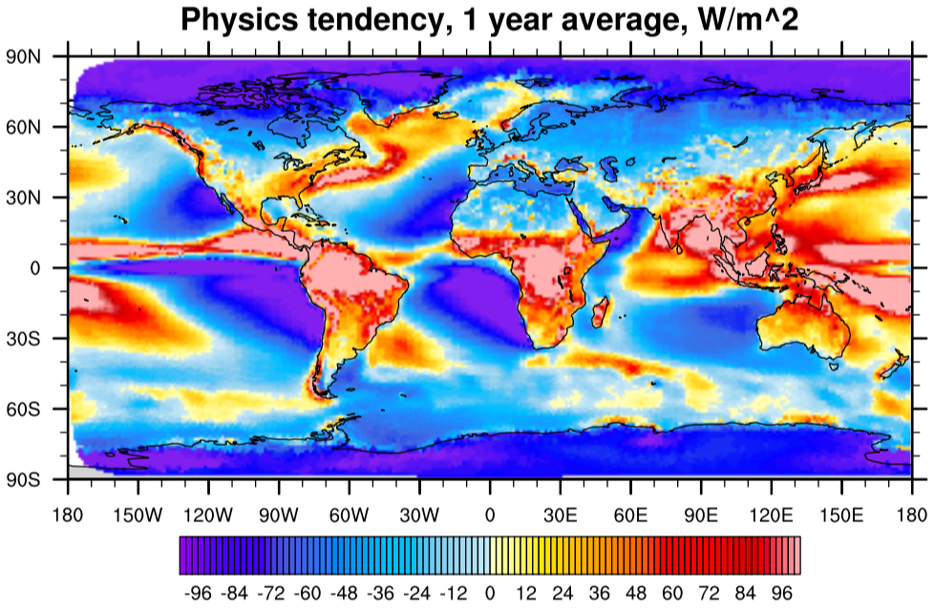
NOT SPURIOUS

Slide 44
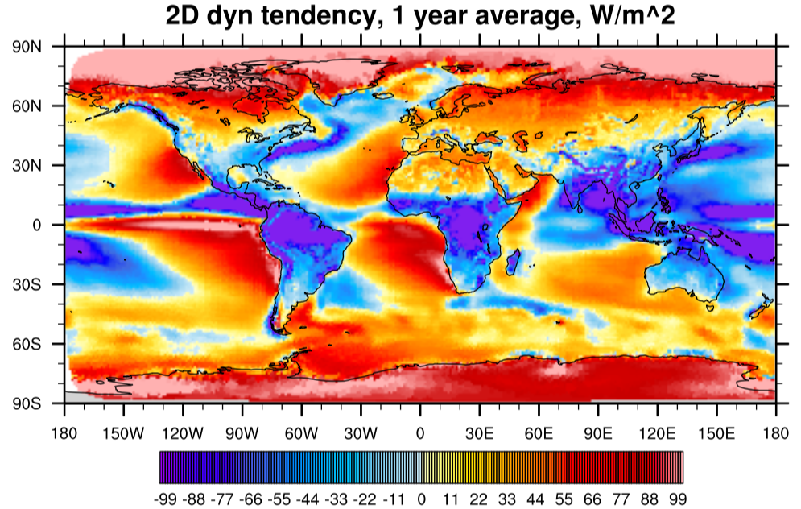
Not SPURIOUS locally
– should integrate to 0

Slide 45
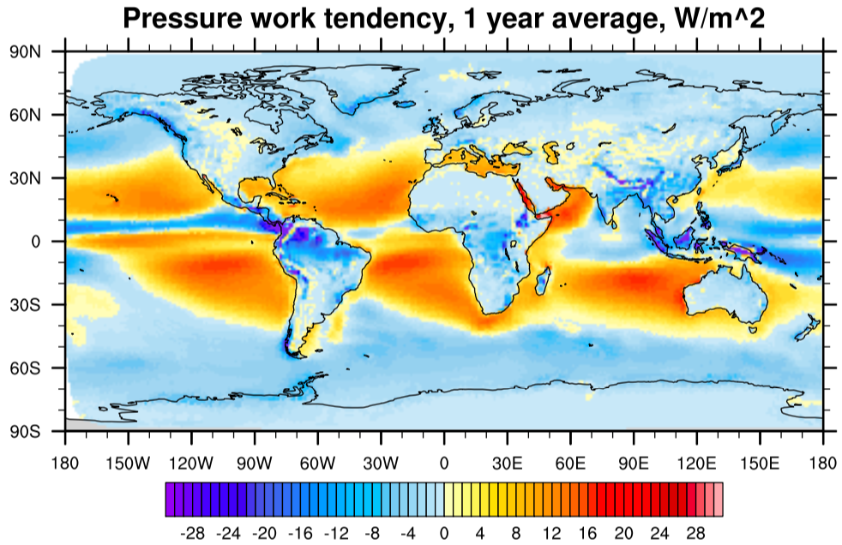
SPURIOUS in each column

Slide 46
Summary
Total energy errors in numerical discretizations (dynamical core), physics-dynamics coupling and pressure work errors are ~-0.6 – 0.3 W/m²
Local errors can be an order of magnitude larger (at least)!
Encourage modelers to implement TE diagnostics in their codes
In next-generation models we should consider formulating physics in dry pressure coordinates (so that coordinate surfaces stay fixed during physics updates)

Slide 47
Not discussed
coupling height-based dynamical cores with pressure-based physics
coupling non-hydrostatic dynamical cores with
“hydrostatic” physics packages
parameterizations developed for weather models are not
designed to conserve TE (to my knowledge); must be dealt with in weather-climate model unification efforts
(NOAA, NCAR, …)

Slide 48
Open question: Can we close the total energy budget locally in models?
Use comprehensive TE formula in physics?
Pressure work error?
Locally TE conserving dynamical core?
- TE conserving vertical remapping (may be problematic) - how to deal with temperature or pressure damping
(where to put TE associated with viscosity on T and dp)
TE conserving physics-dynamics coupling?

Slide 49

√∫

Slide 50
NOT SPURIOUS

Slide 52
Not SPURIOUS locally
– should integrate to 0

Slide 54
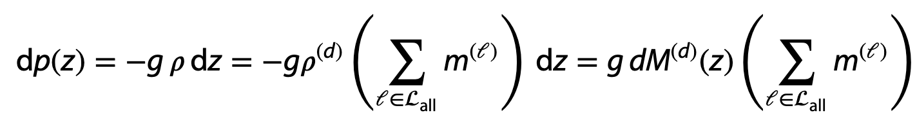
Total energy (TE) equation
- moist atmosphere (mass coordinates)
Also assume hydrostatic balance:
where M^{(d)} is the dry air mass per unit area
SI unit for density: kg/m³
Notes:
What is the mixing ratio for dry air? What is the difference between water vapor+dry air and cloud liquid, ice, rain and snow?

