Slide 1
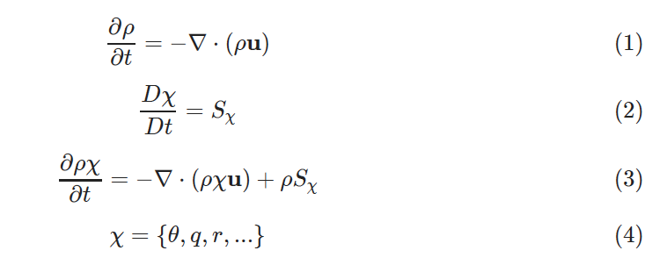
Total Energy and Water Conservation in Atmospheric Models
Phil Rasch
Pacific Northwest
National Laboratory
q → (mass tracer / moist air)
r → (mass tracer / dry air)
Notes:
Rather than having each person talk about their specific research, we are soliciting talks on specific themes (both keynote lectures and short talks to start breakout discussions). We are a little low on physics developers (Vince Larson, Dave Randall and Michael Prichard will be there) and really need an experienced modeler to talk about total energy and water conservation in physics (there will be separate talks/break-outs on dynamics and physics-dynamics coupling). The talk should address how the TE energy equation is satisfied (or not) in physics parameterizations, what the fluxes of TE, etc. Would you be willing to prepare such a talk? You have about 45 min - 1h.
Also, we really need someone to talk about coupling components (what fluxes are exchanges, what is missing, ...). Please let me know if you have any suggestions ...

Slide 2
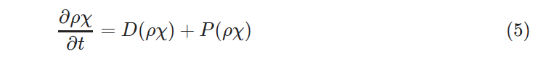






Global Models typically do operator splitting
Solutions are advanced over 10s of minutes
Sometimes lateral fluxes H are “dribbled”, and can appear as a source term

Slide 3
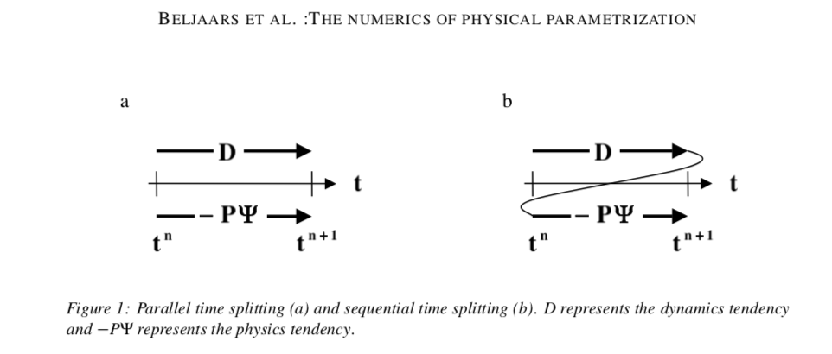
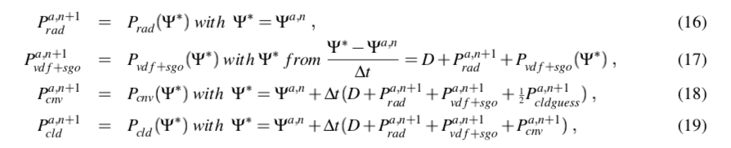

Slide 4
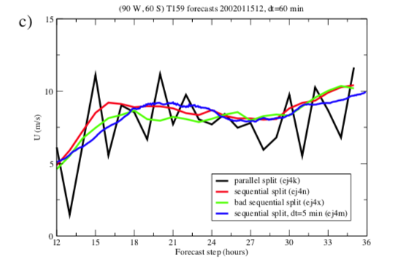

Slide 5
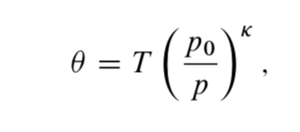

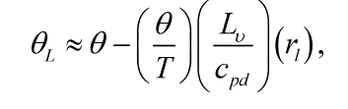
Choice of thermodynamic variable is a matter of convenience, and translation occur frequently

Slide 6
Ideas for presentation
Conservation forms
Primer of thermodynamics of moist air
  Remind audience of 1st law forms, and conserved variables
  Remind audience of approximations used
  Identify a few errors along the way???
Do a survey of recent models to identify
  when latent heats are not constant
  (discuss amplitudes of errors, implications)
  When heat capacity of condensate is carried by model
Discuss errors in treatments (following Johnson)
Possible paths forward

Slide 7
Alternate forms

Slide 8
Kirchhoff’s equation for phase change
(following Emanuel, 1994)
4219
1884
2050

Slide 9
Latent heat of Vaporization
xxx

Slide 10
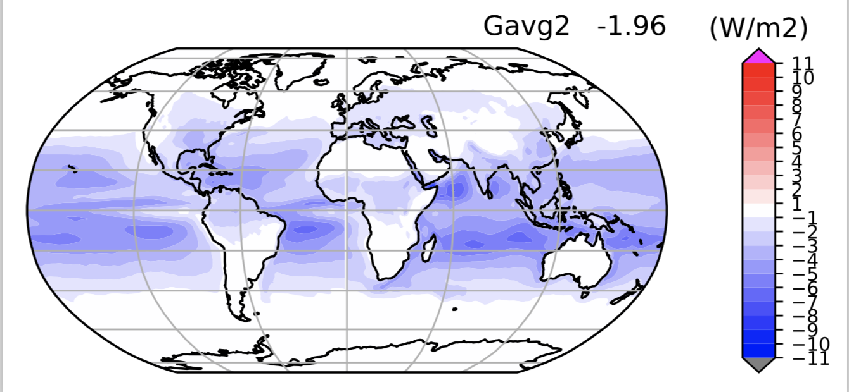
Impact of Temperature Dependent Latent Heat on Surface heat flux
June, July, August Climatology
Global Avg LHF ~ 90W/m2
Impact largest where precip small

Slide 11
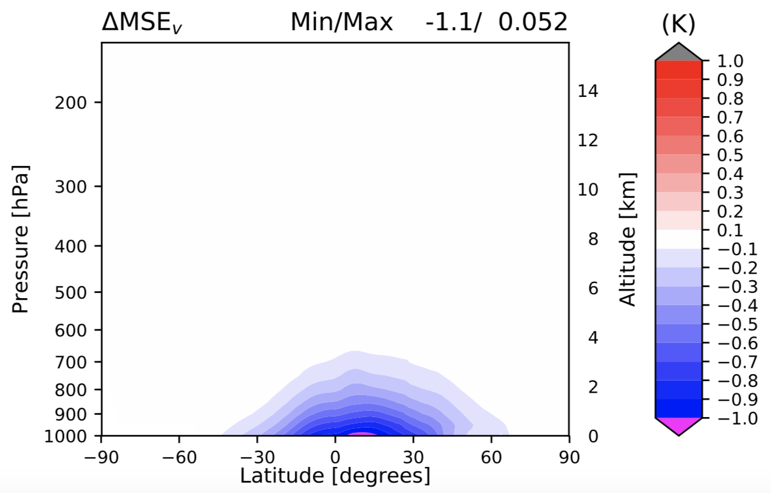
Virtual Moist Static Energy Change associated with LFLX(T)
xxx

Slide 12
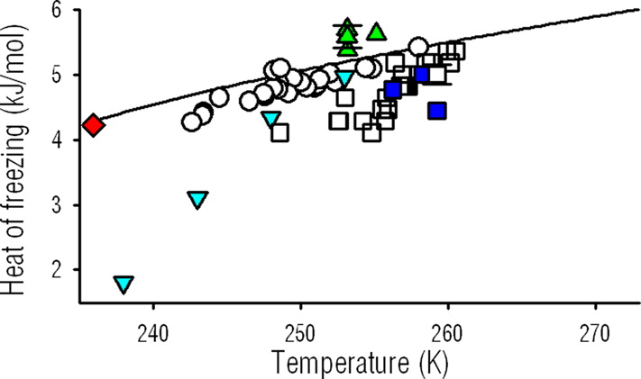
Latent heat of fusion
Much smaller than Lv
Strong temperature dependence
Important for:
  Glaciation
  Specification of vapor pressure
Sensitive to details of the freezing process
Cantrell et al, 2011

Slide 13
Latent heat of sublimation
xxx

Slide 14
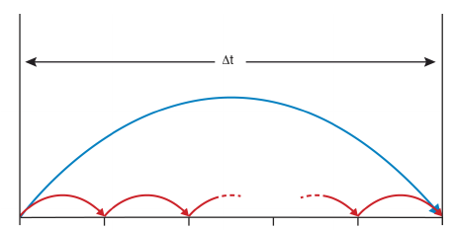
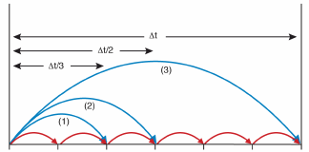
Split-explicit example in a diagram
From Diamantikas, 2013
Split-explicit Euler
Split-explicit RK3
1-cycle/per stage i: slow process integrated with Δt, each stage approximates solution at t+c_{i} Δt where, c_{i}=1/3,1/2,1 the RK3 coefficient
1-cycle: slow process integrated with Δt
n-cycles: fast process integrated with Δt/n
(Diagram courtesy of S.J. Lock, ECMWF Seminar proceedings 2013, HEVI time-stepping for NWP and climate models)

Slide 15
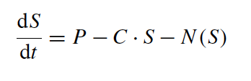
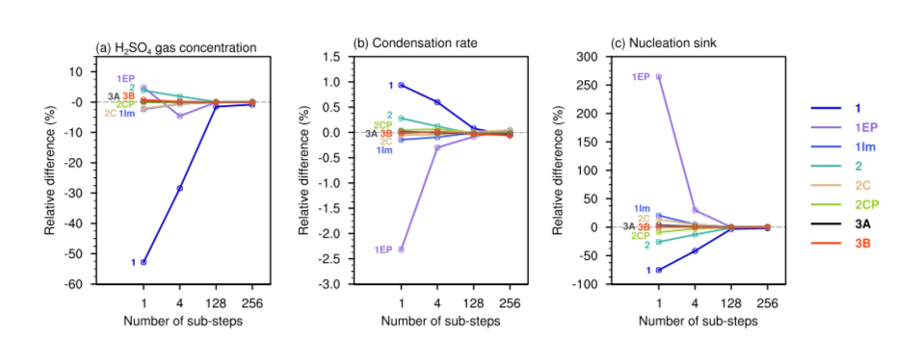
Wan et al, 2013
Condensation
The key conclusion from this work is that, in order to reduce the biases associated with process interactions, it is important to apply numerical methods that solve multiple processes simultaneously.
Production
Nucleation

Slide 16
Split-explicit forward Euler integration
From Diamantikas, 2013
Fast forcing term
Slow forcing term
Fast term updated
Slow term kept constant (stored)
1S + n_{s} F evaluations
versus fw-Euler
n_{s} S+ n_{s} F evaluations

Slide 17
Filamentary Structures in the atmosphere are well known and studied at mid-latitudes
Long range transports are connected with “Warm Conveyor Belts”
Transports often occur on isentropic surfaces that ascend in altitude from equator → pole
Isentropes form a ”polar dome” with implications for seasonality of transport from local/remote sources
Warm Conveyor Belts as a Transport Mechanism for water and tracers
Kiley and Fuelberg, 2006

Slide 18
Intense transport processes in Climate
Water vapor
Heat
Slower more sinuous jet stream associated with Arctic Warming
→ blocking and cold air outbreaks
Park et al. (2015a&b)
Francis and Vavrus (2012)
Aerosols
Quinn et al, 2008
Extreme transport of moisture to the Arctic in winter/spring connected to sea ice concentration the following summer.
(Changes associated with 50% reduction in Atlantic sector sea ice 1979-2011)

Slide 19
Unknowns related to strong, episodic transports of Water, Heat, and Aerosol
Do they occur in the same meteorological features of a storm (e.g., the Warm Conveyor Belt)? At the same time?
If they are connected, how do the transport processes occur? It is very unlikely that they are transported in the same air masses, because the cloud/precipitation events will scavenge the aerosols
  What are the spatial relationships?
  What are the meteorological relationships/controls?
  How might they change?

Slide 20
First Steps
Familiarization
  Quick look for “golden events”
  Get a sense for spatial, temporal relationships between filamentary features
Characterize Transport Episodes
  Reanalyses
    MERRA2
    ERA5,
    ERA-Interim
  Explored using versions of CAM5 and E3SM
    Attention to high latitude cloud processes
    High and low resolution (25km and 100km)
    Winds nudged to Reanalyses

Slide 21
Vertical Integrals of Water Cycle Fields
TMQ | Water Vapor
LWP | Liquid Water Path
PRECT | Precipitation

Slide 22
Vertical Integrals of Aerosol and Precipitation
DUST | Dust
BC | Black Carbon
PRECT | Precipitation

