Slide 1
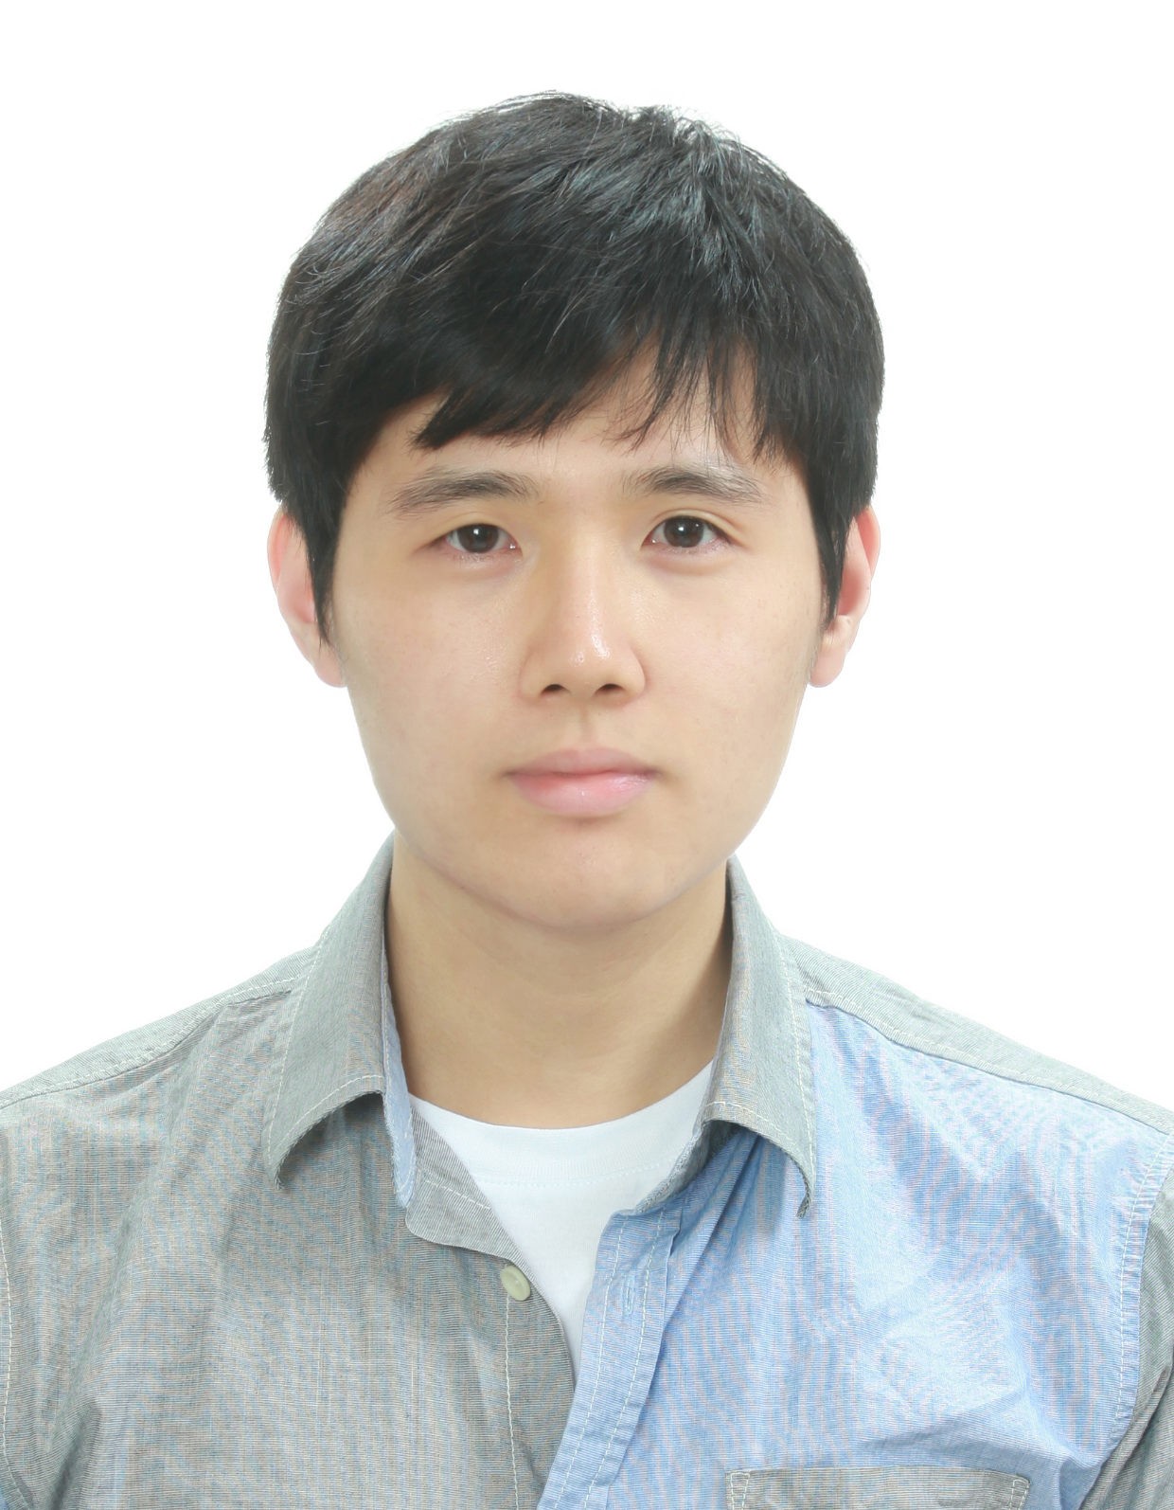
Fundamental limits to electromagnetic response by convexity, causality, and duality
Owen Miller
Yale Applied Physics
& Energy Sciences Institute
“Fundamental Limits to Near-Field Optical Response over Any Bandwidth”
“Maximal Free-Space Concentration of Light”
“Minimum Mode Volume of Dielectric Resonators”
millergroup.yale.edu/publications
Andrew Shim, Qingqing Zhao, Haejun Chung
millergroup.yale.edu/talks

Slide 2
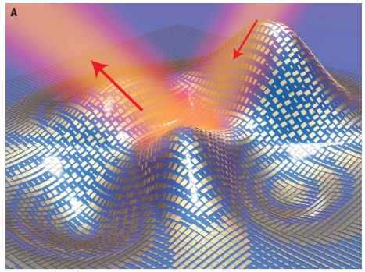
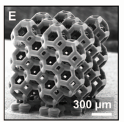
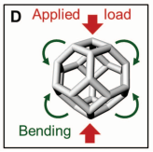
Design & Optimization with Waves
Owen Miller, Yale Applied Physics
The design challenge:
Lots of degrees of freedom in geometry,
but what structure is best for given device & materials?
And what performance & phenomena are possible?
Bottom-up
Large-scale optimization
Top-down
Optical-response bounds
Rapidly discover
superior, non-intuitive
structures
Identify fundamental limits,
subject only to
Maxwell’s equations
Theory + Computation + Expt. collaborators

Slide 3
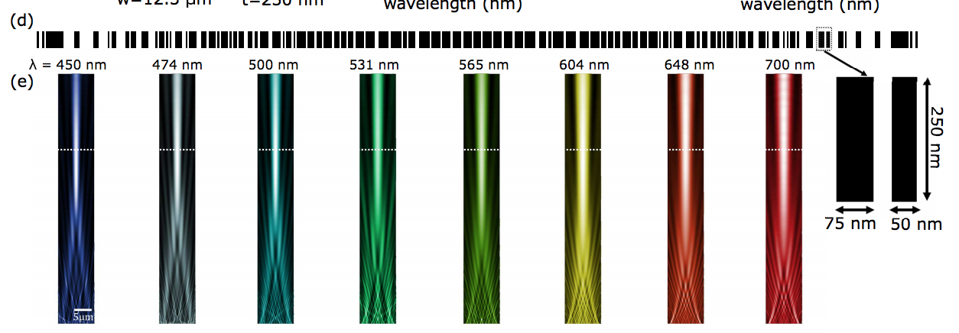
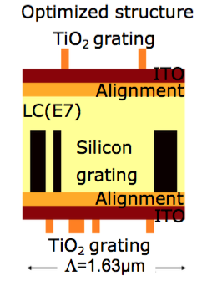
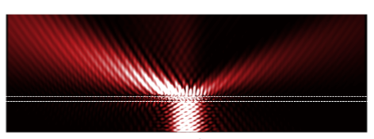
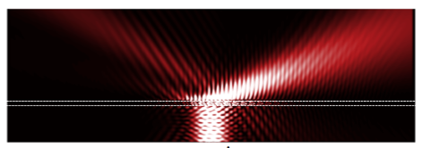
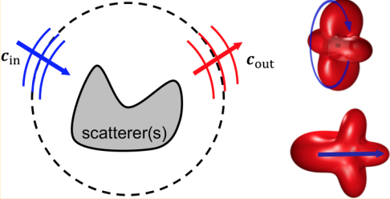
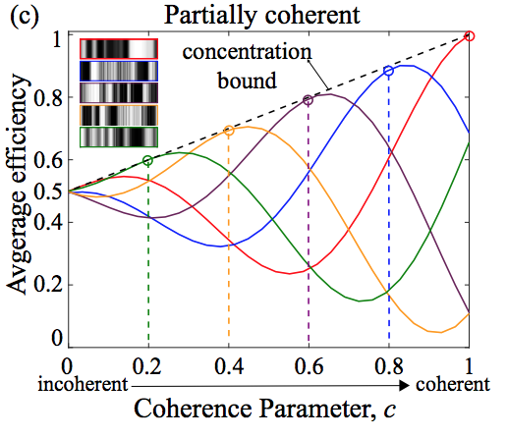
Recent Results
High-NA Achromatic
Metalenses by Inverse Design
High-steering-angle metasurfaces by inverse design
arXiv: 1905.09213 (2019)
Submitted, arXiv: TBD (2019)
Optimal nanoparticle forces, torques, and illumination fields
Brightness Theorems
for Waves
ACS Photonics 6, 395 (2019)
Optica 6, 1321 (2019)

Slide 4
Today
Power-bandwidth limits to optical response
  convexity (passivity) + analyticity (causality) for maximum response
Maximum free-space concentration of light
  Going beyond the diffraction “limit”: tradeoffs and bounds via convex relaxations of quadratic programs
Computational bounds, via duality
  Multi-frequency and/or fabrication tolerance constraints

Slide 5
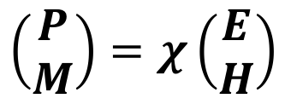
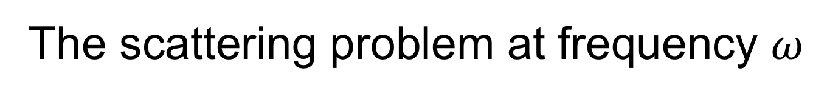
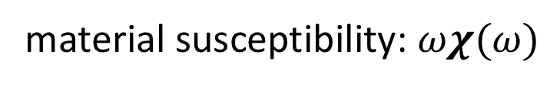

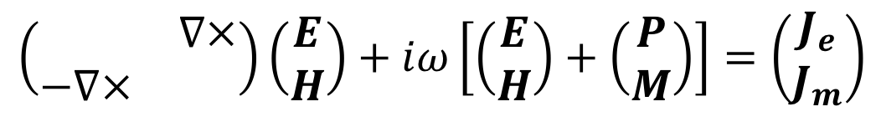
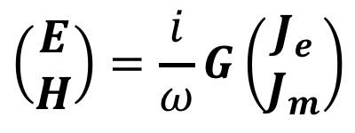

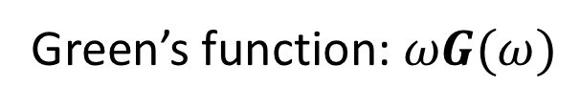
The scattering problem at frequency $ω$
scatterer(s)
$$ψ_{inc}$$
$$χ(x,ω)$$
$$\left(\begin{matrix} & ∇× \\ −∇× & \end{matrix}\right)\left(\begin{matrix}E \\ H\end{matrix}\right)+iω\left[\left(\begin{aligned}E \\ H\end{aligned}\right)+\left(\begin{aligned}P \\ M\end{aligned}\right)\right]=\left(\begin{aligned}J_{e} \\ J_{m}\end{aligned}\right)$$
Passive convolution operators (Herglotz functions):
material susceptibility: $ωχ(ω)$
$$\left(\begin{aligned}P \\ M\end{aligned}\right)=χ\left(\begin{aligned}E \\ H\end{aligned}\right)$$
Green’s function: $ωG(ω)$
$$\left(\begin{aligned}E \\ H\end{aligned}\right)=\frac{i}{ω}G\left(\begin{aligned}J_{e} \\ J_{m}\end{aligned}\right)$$
“Near-field:” point sources, close ($<λ$) to a scatterer
Notes:
Note that chi and G are generally 6x6 tensor fields

Slide 6
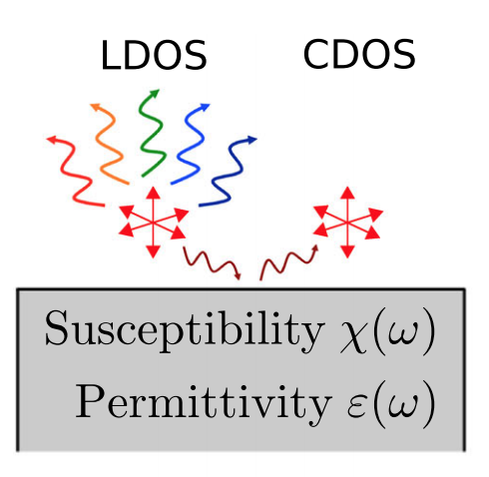
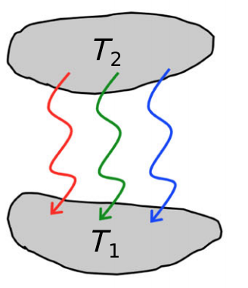
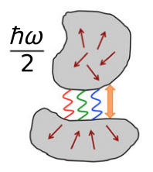
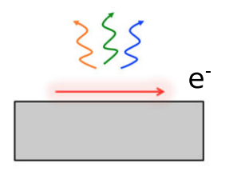
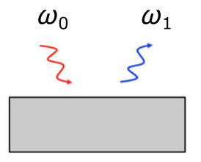
Near-field nanophotonics
Prototypical quantity: spontaneous emission
Related response functions:
CDOS
RHT
Casimir
Smith-Purcell
Raman
Fundamental question: How large can these effects be, over any bandwidth, for any material & patterning?

Slide 7
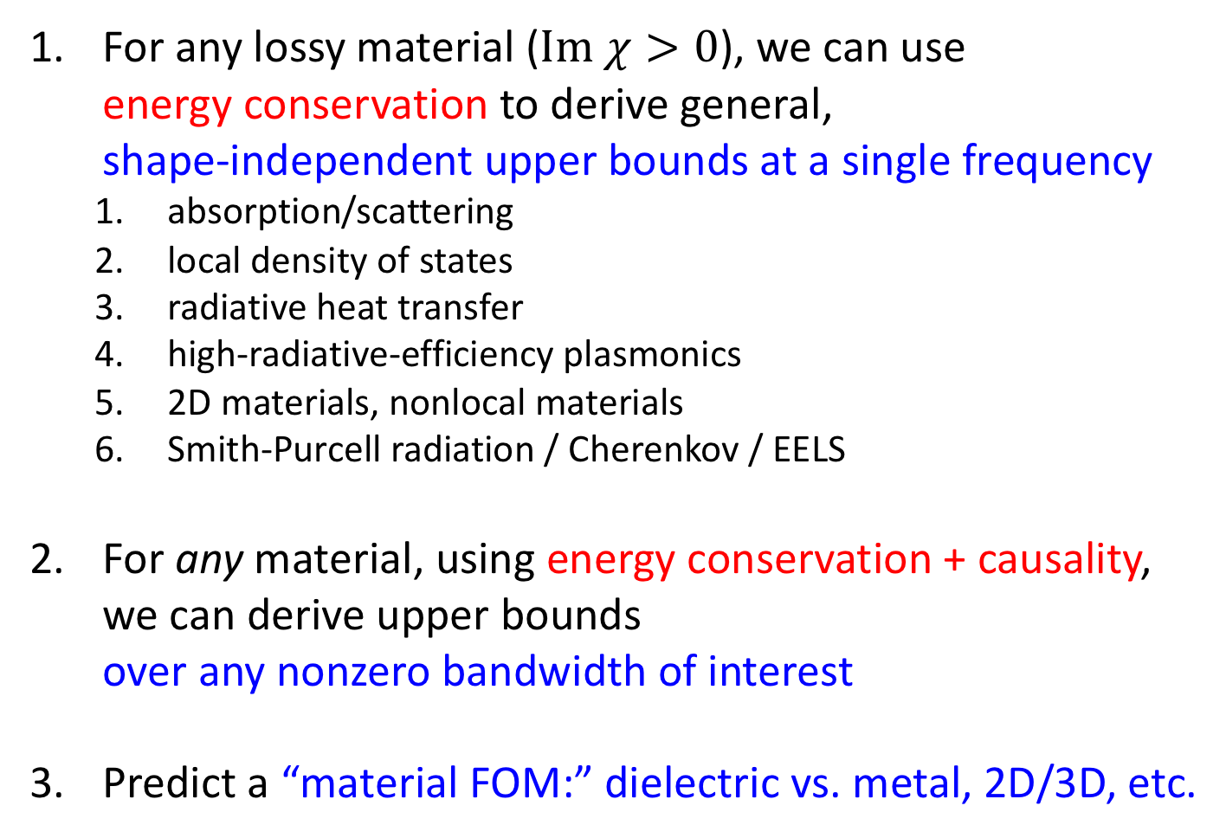
Bounds to Light–Matter Interactions
For any lossy material ($Im χ>0$), we can use
energy conservation to derive general,
shape-independent upper bounds at a single frequency
  absorption/scattering
  local density of states
  radiative heat transfer
  high-radiative-efficiency plasmonics
  2D materials, nonlocal materials
  Smith-Purcell radiation / Cherenkov / EELS
For any material, using energy conservation + causality,
we can derive upper bounds
over any nonzero bandwidth of interest
Predict a “material FOM:” dielectric vs. metal, 2D/3D, etc.
Opt. Exp. (2016)
PRL (2015)
Nano Lett. (2017a)
Nano Lett. (2017b)
Nat. Phys. (2018)
PRX (2019)

Slide 8
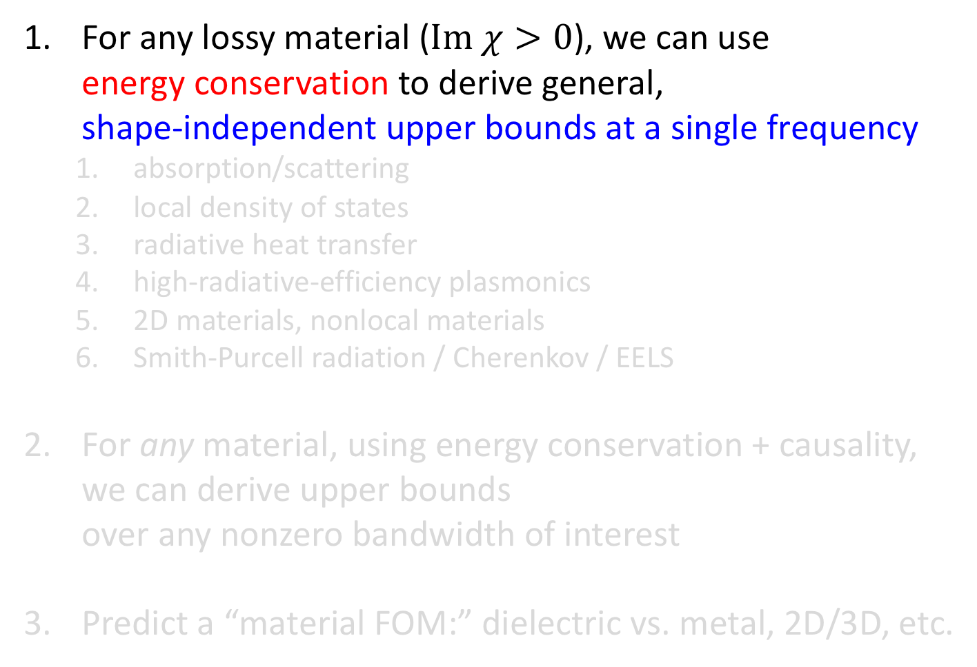
Bounds to Light–Matter Interactions
For any lossy material ($Im χ>0$), we can use
energy conservation to derive general,
shape-independent upper bounds at a single frequency
  absorption/scattering
  local density of states
  radiative heat transfer
  high-radiative-efficiency plasmonics
  2D materials, nonlocal materials
  Smith-Purcell radiation / Cherenkov / EELS
For any material, using energy conservation + causality,
we can derive upper bounds
over any nonzero bandwidth of interest
Predict a “material FOM:” dielectric vs. metal, 2D/3D, etc.
Opt. Exp. (2016)
PRL (2015)
Nano Lett. (2017a)
Nano Lett. (2017b)
Nat. Phys. (2018)
arXiv (2018)

Slide 9
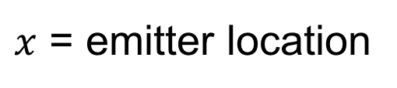
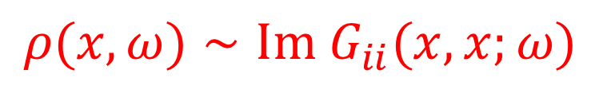
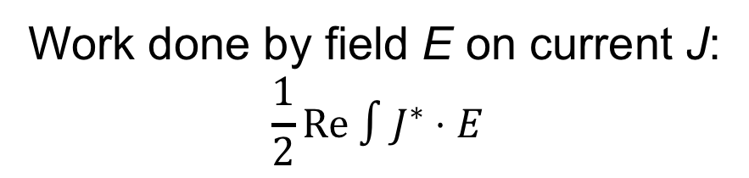
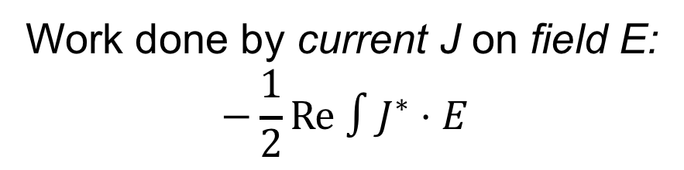
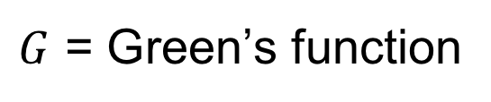
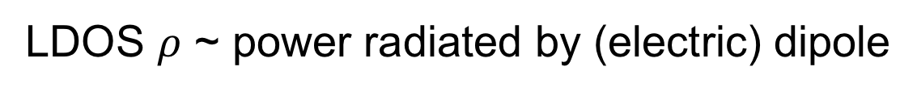
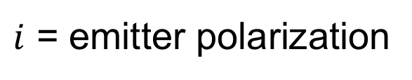
Local density of states, LDOS
LDOS $ρ$ ~ power radiated by (electric) dipole
Work done by field E on current J:
$$\frac{1}{2}Re ∫J^{∗}⋅E$$
Work done by current J on field E:
$$−\frac{1}{2}Re ∫J^{∗}⋅E$$
= total power radiated
$$ρ(x,ω)∼Im G_{ii}(x,x;ω)$$
$G$ = Green’s function
$x$ = emitter location
$i$ = emitter polarization

Slide 10

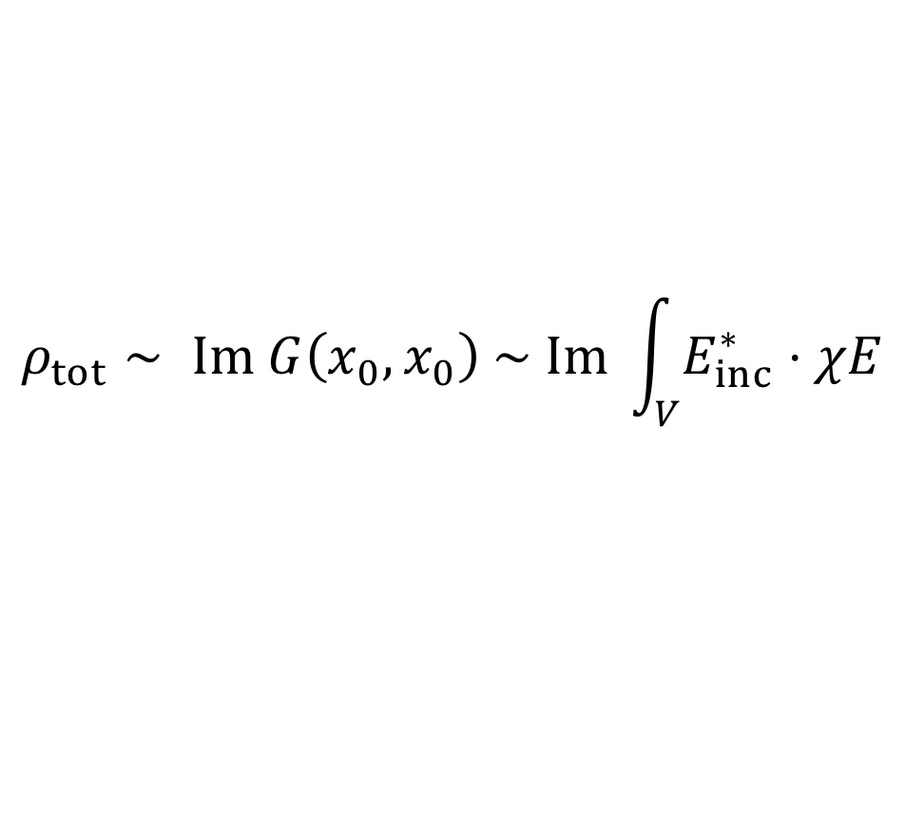


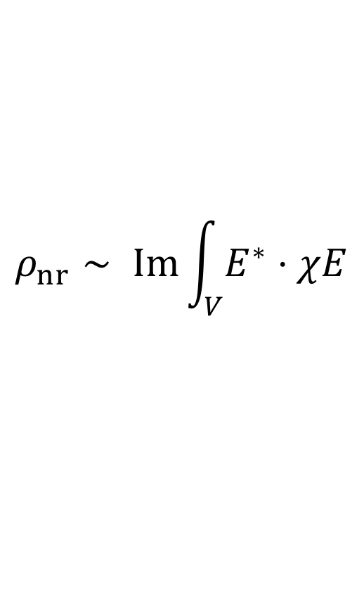
General limits to optical response
[Owen Miller et. al, Opt. Exp. 24, 3329 (2016)]
Total spontaneous emission ~ Im(scattering amplitude)
total SE ~ total LDOS ~ linear in response
$$ρ_{tot}∼ Im G\left(x_{0},x_{0}\right) \sim Im \int_{V}{E_{inc}^{∗}⋅χE}$$
nonradiative LDOS = dissipation ~ quadratic
$$ρ_{nr}∼ Im\int_{V}{E^{∗}⋅χE}$$
total SE (rad. + nonrad.)
> nonrad. SE
$$P_{ext}$$
unphysical
power
$$P_{abs}$$
induced current $P_{ind}$

Slide 11
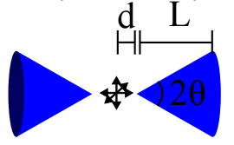
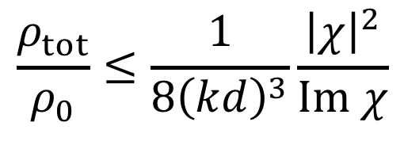

General limits to optical response
[Owen Miller et. al, Opt. Exp. 24, 3329 (2016)]
At a single (real) frequency:
$$\frac{ρ_{tot}}{ρ_{0}}≤\frac{1}{8{\left(kd\right)}^{3}}\frac{{\left|χ\right|}^{2}}{Im χ}$$
$$d$$
near-field
enhancement
material
enhancement
Notes:
depends on dimensionality, local vs nonlocal, etc.

Slide 12
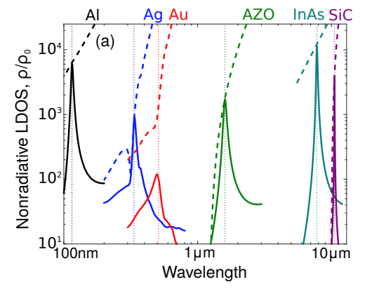
The upper bounds are tight
[Owen Miller et. al, Opt. Exp. 24, 3329 (2016)]
LDOS, computed
LDOS limit
…at least at the surface-plasmon frequency of a metal
Notes:
depends on dimensionality, local vs nonlocal, etc.

Slide 13
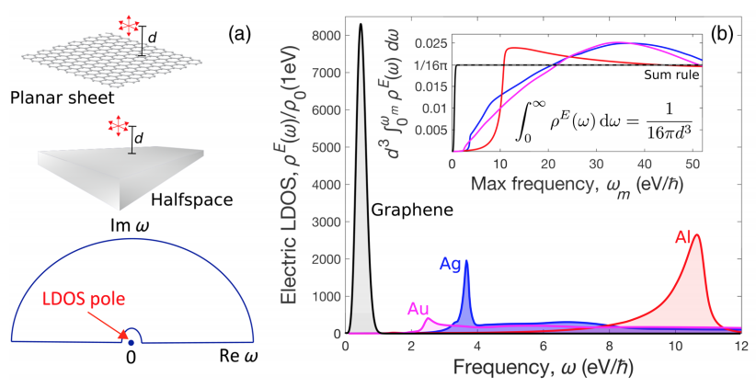
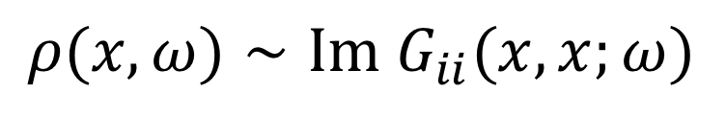
All-frequency bounds: LDOS sum rule
$$ρ(x,ω)∼Im G_{ii}(x,x;ω)$$
causal linear response function
Notes:
depends on dimensionality, local vs nonlocal, etc.

Slide 14
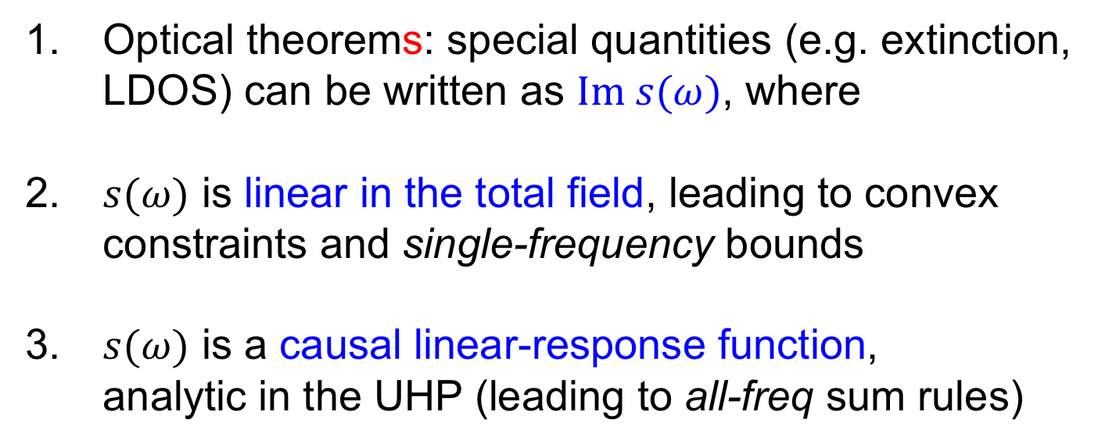
Power–bandwidth limits
Optical theorems: special quantities (e.g. extinction,
LDOS) can be written as $Im s(ω)$, where
$s(ω)$ is linear in the total field, leading to convex
constraints and single-frequency bounds
$s(ω)$ is a causal linear-response function,
analytic in the UHP (leading to all-freq sum rules)
Items #2 and #3 share the same origin!
We can use this connection for bounds over any bandwidth
Notes:
These two ideas had developed in parallel, seemingly unrelated

Slide 15
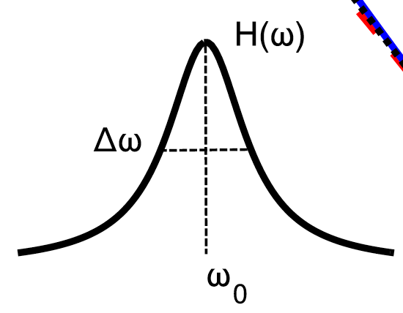
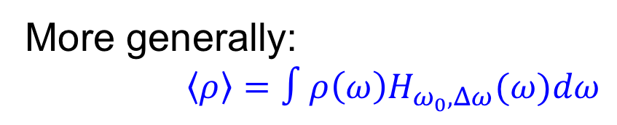
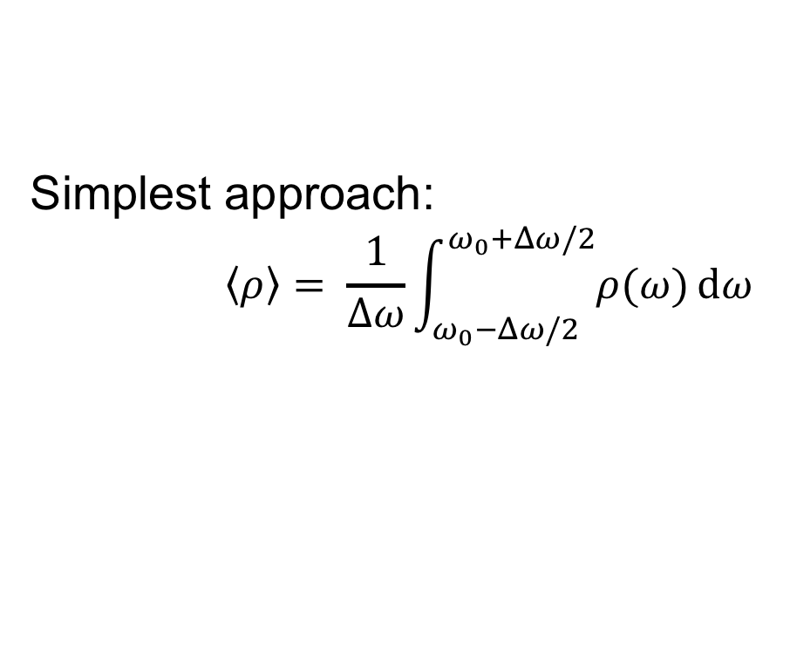
Freq-averaged LDOS
How to compute average response over bandwidth $Δω$?
Simplest approach:
$$\left\langle ρ\right\rangle = \frac{1}{Δω}\int_{ω_{0}−Δω/2}^{ω_{0}+Δω/2}{ρ(ω)}dω$$
More generally:
$\left\langle ρ\right\rangle =∫ρ\left(ω\right)H_{ω_{0},Δω}(ω)dω$
window
function

Slide 16
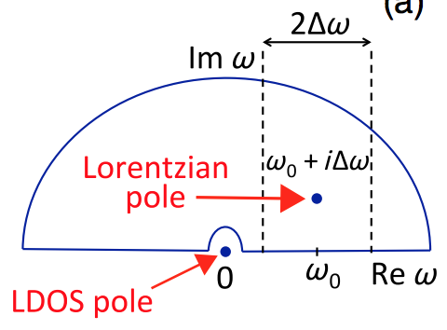
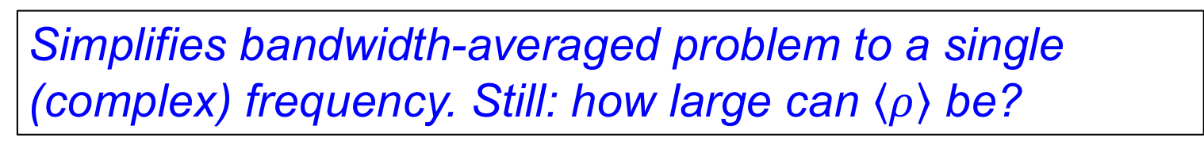
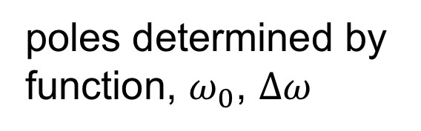
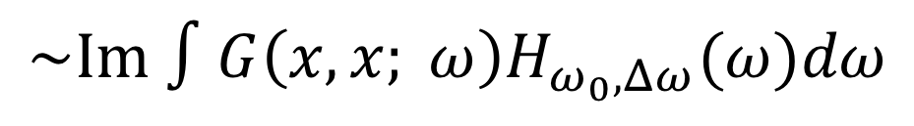
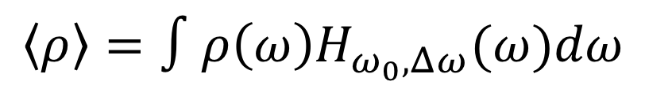
Freq-averaged LDOS = complex-freq LDOS!
$$\left\langle ρ\right\rangle =∫ρ\left(ω\right)H_{ω_{0},Δω}(ω)dω$$
$$\sim Im ∫G\left(x,x; ω\right)H_{ω_{0},Δω}(ω)dω$$
analytic in the upper-half
of the complex-⍵ plane
poles determined by
function, $ω_{0}$, $Δω$
Simplifies bandwidth-averaged problem to a single
(complex) frequency. Still: how large can $\left\langle ρ\right\rangle$ be?

Slide 17

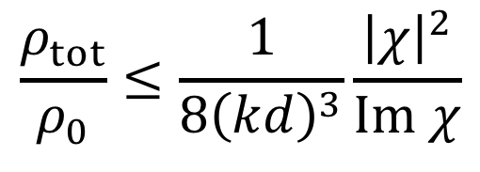
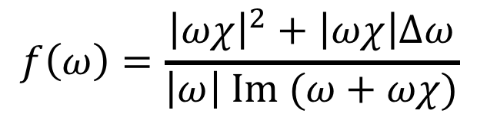
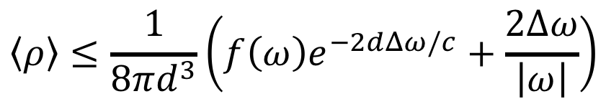
Upper bounds to bandwidth-avg LDOS
Physical Review X 9, 011043 (2019)
At a single (real) frequency:
$$\frac{ρ_{tot}}{ρ_{0}}≤\frac{1}{8{\left(kd\right)}^{3}}\frac{{\left|χ\right|}^{2}}{Im χ}$$
Averaged over bandwidth $Δω$ around center freq $ω_{0}$
$$\left\langle ρ\right\rangle ≤\frac{1}{8πd^{3}}\left(f\left(ω\right)e^{−2dΔω/c}+\frac{2Δω}{\left|ω\right|}\right)$$
where
$$ω=ω_{0}+iΔω$$
and $f(ω)$ is a “material figure of merit”
$$f\left(ω\right)=\frac{{\left|ωχ\right|}^{2}+\left|ωχ\right|Δω}{\left|ω\right| Im (ω+ωχ)}$$
Notes:
depends on dimensionality, local vs nonlocal, etc.

Slide 18
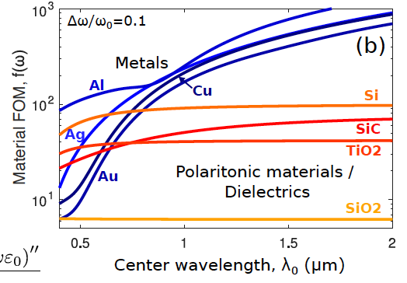


Material performance vs center wavelength
Notes:
Now we compare the material fom for metal and dielectrics, whose fom simplifies. As wavelength increases, metals have larger and larger negative real part of permittivity, and so fom increases with wavelength. For dielectrics, since permittivity remains constant with wavelength, their fom does so as well.
-the results themselves are not surprising, we know that silver is better than gold at visible and infrared frequencies.
-but it is really worth pointing out the fact that we can quantitatively predict which materials are superior to others
-here we fixed the bandwidth ratio to be 0.1, but we can also see how these materials perform with changing bandwidth…

Slide 19

Material performance vs bandwidth
Notes:
The behavior here can be understood from the fact that imaginary frequency is equivalent to adding loss to the system. Metals are already lossy, and so a small enough delw doesn’t affect its behavior, whereas dielectrics are lossless and so are very sensitive to even a small loss from imaginary frequency.

Slide 20

2D vs 3D material
Δω/ω₀ = 0.1
ρ 1/d⁴
ρ 1/d³
Notes:
We can also compare bulk materials to 2d materials. Here we show bound on average ldos that scales as 1/d^4 for 2d and 1/d^3 for 3d, arising from our framework. The dividing line depends on the material properties (here we chose drude-like materials), but we can conclude from our framework that in general 2d materials have a bigger potential than 3d for smaller separations.

Slide 21
Today
Power-bandwidth limits to optical response
  convexity (passivity) + analyticity (causality) for maximum response
Maximum free-space concentration of light
  Going beyond the diffraction “limit”: tradeoffs and bounds via convex relaxations of quadratic programs
Computational bounds, via duality
  Multi-frequency and/or fabrication tolerance constraints

Slide 22
Superresolution: spot sizes << λ
Optical resolution: a foundational imaging metric
Superresolution: resolution below diffraction limit
Approaches to superresolution:
a priori information (Betzig, Hell, Moerner, et al.)
near-field scatterers/probes (Fink, Ammari, et al.)
quantum metrology (Tsang, Lu, et al.)
far-field beam interference (“superoscillations”)
M. Berry, Aharonov, Zheludev, Eleftheriades, Rogers, et al.

Slide 23
Superoscillations: “Faster than Fourier”
Fourier analysis: oscillations of a signal not strictly
limited by maximum Fourier component
(Slepian 1961, Levi 1965, Ferreira 2006, etc.)
Chen, Wen, & Qiu, Light: Science and Applications (June 2019)

Slide 24




Superoscillations: “Faster than Fourier”
Fourier analysis: oscillations of a signal not strictly
limited by maximum Fourier component
(Slepian 1961, Levi 1965, Ferreira 2006, etc.)
Best-known computational bounds (Sales & Morris 1997) require a scalar-wave approximation of weakly scattering rotationally symmetric apertures
Recent advances in metasurface have led to significant efforts at design and experiment
Qin, Hong et al. Sci. Rep.
5, 9977 (2015)
Huang, CW Qiu et al. Laser
Photonics Rev 8, 152 (2014)
see also: Dholakia, Berry, Eleftheriades, Noda
N. Zheludev Nature Materials 7, 420 (2008)
F. Huang et al. J. Opt. A 9, S285 (2007)

Slide 25






The superresolution problem
maximize the field
intensity at the origin, given a desired spot size
for any excitation…
maximize ${\left|ψ\left(0\right)\right|}^{2}$
field $ψ\left(x\right)=\left(\begin{aligned}E(x) \\ H(x)\end{aligned}\right)$
subject to $ψ\left(\left|x\right|=ρ_{0}\right)=0$

Slide 26



Superresolution: our approach
$$ψ(x) =\int_{A}{Γ\left(x,x^{′}\right)ξ(x^{′})}$$
$$ξ=\left(\begin{aligned}K_{eff} \\ N_{eff}\end{aligned}\right)$$
(surface) equivalence principle
→ encapsulate the beam-generation structures
with surface currents in free space

Slide 27



Now the problem is
maximize ${\left|ψ\left(0\right)\right|}^{2}=ξ^{†}Γ_{0}^{†}Γ_{0}ξ$
subject to $ψ\left(\left|x\right|=ρ_{0}\right)=Γ_{c}ξ=0$
$$power flow from currents ξ=1$$
where
$Γ_{0}$: GF from equivalent currents to origin
$Γ_{c}$: GF from equivalent currents to zero-field contour
No prescription for analytical bounds

Slide 28

Now the problem is
maximize ${\left|ψ\left(0\right)\right|}^{2}=ξ^{†}Γ_{0}^{†}Γ_{0}ξ$
subject to $ψ\left(\left|x\right|=ρ_{0}\right)=Γ_{c}ξ=0$
$$power flow from currents ξ=1$$
No prescription for analytical bounds.
Transformations, towards global analytical bounds:
project onto currents that satisfy zero-field constraint
do separate maximization over polarization at origin
Fourier decomposition at origin, keep N lowest-order modes
$$ℙ=I−Γ_{c}^{†}{\left(Γ_{C}Γ_{C}^{†}\right)}^{−1}Γ_{C}$$

Slide 29

Follow the algebra and…
general upper bounds!
For any aperture, beam-generation mechanism, focal spot, etc., the maximum intensity at the origin is
$$I={\left|ψ\left(0\right)\right|}^{2}≤μ^{†}\left[Γ_{0}Γ_{0}^{†}−Γ_{0}Γ_{C}^{†}{\left(Γ_{C}Γ_{C}^{†}\right)}^{−1}Γ_{C}Γ_{0}^{†}\right]μ$$
For the typical case of a planar aperture and far-zone beam, the Strehl ratio (max intensity / Airy max) is:
$$S_{max}=1−\frac{4}{η_{0}^{2}}\frac{{\left[J_{1}\left(η_{0}\right)\right]}^{2}}{{\left[J_{0}\left(η_{0}\right)\right]}^{2}+{\left[J_{1}\left(η_{0}\right)\right]}^{2}}$$
η is a normalized spot-size radius, $η_{0}=ρ_{0}kR/z$

Slide 30


reciprocity-based intuition
how does the current state-of-the-art (SOA) compare?
Airy beam
Smax, bound
Are better designs possible?
Strehl Ratio, S
(Focal Intensity / Airy)

Slide 31










“Inverse Design” (adjoint-based optimization):
A classical control technique, newly emerging in photonics
Aerodynamics
Elasticity
Boeing
Altair PDG
Bendsoe & Sigmund,
“Topology Optimization” (2003)
A. Jameson JSC 3, 233 (1988)
O. Pironneau JFM 64, 97 (1974)
Photonics
Deep Learning
Werbos, “The Roots of Backpropagation” (1994)
Miller, Ganapati, Keraly et al. (2012-)
Rumelhart et al. Nature 323, 533 (1986)
Vuckovic et al. Nat. Phot. 9, 374 (2015)
Sigmund, Rodriguez, Engheta, SGJ, S/J Fan, etc.
Fast computation of $N$ derivatives, for any $N$!
Notes:
This method goes back to studies of designs in fluid flow, aerodynamics, and elasticity

Slide 32

Inverse design of super-resolving metasurfaces approaching fundamental limits
(b)
(c)
(d)

Slide 33

Superresolution: alternative formulations
max. ${\left|ψ\left(0\right)\right|}^{2}=ξ^{†}Γ_{0}^{†}Γ_{0}ξ$
s.t. $ψ\left(\left|x\right|=ρ_{0}\right)=0$
or ${\left|ψ\left(\left|x\right|=ρ_{0}\right)\right|}^{2}≤ \frac{1}{2}{\left|ψ\left(0\right)\right|}^{2}$
or ${\left.{{−∇}^{2}\left|ψ\right|}^{2}\right|}_{0}≤k_{loc}^{2}{\left|ψ\left(0\right)\right|}^{2}$
zero-field constraint
FWHM constraint
Local wavevector
for latter two, bounds can be found via semidefinite relaxations:
Strehl ratio, S
Strehl ratio, S
Strehl ratio, S
Zero-field spot size
FWHM spot size
Local wavevector

Slide 34
Superresolution: alternative formulations
max. ${\left|ψ\left(0\right)\right|}^{2}=ξ^{†}Γ_{0}^{†}Γ_{0}ξ$
s.t. $ψ\left(\left|x\right|=ρ_{0}\right)=0$
or ${\left|ψ\left(\left|x\right|=ρ_{0}\right)\right|}^{2}≤ \frac{1}{2}{\left|ψ\left(0\right)\right|}^{2}$
or ${\left.{{−∇}^{2}\left|ψ\right|}^{2}\right|}_{0}≤k_{loc}^{2}{\left|ψ\left(0\right)\right|}^{2}$
zero-field constraint
FWHM constraint
Local wavevector
for latter two, bounds can be found via semidefinite relaxations:
Strehl ratio, S
Strehl ratio, S
Strehl ratio, S
Zero-field spot size
FWHM spot size
Local wavevector

Slide 35
Superresolution: alternative formulations
max. ${\left|ψ\left(0\right)\right|}^{2}=ξ^{†}Γ_{0}^{†}Γ_{0}ξ$
s.t. $ψ\left(\left|x\right|=ρ_{0}\right)=0$
or ${\left|ψ\left(\left|x\right|=ρ_{0}\right)\right|}^{2}≤ \frac{1}{2}{\left|ψ\left(0\right)\right|}^{2}$
or ${\left.{{−∇}^{2}\left|ψ\right|}^{2}\right|}_{0}≤k_{loc}^{2}{\left|ψ\left(0\right)\right|}^{2}$
zero-field constraint
FWHM constraint
Local wavevector
for latter two, bounds can be found via semidefinite relaxations:
Strehl ratio, S
Strehl ratio, S
Strehl ratio, S
Zero-field spot size
FWHM spot size
Local wavevector

Slide 36



The mode-volume problem
“Mode volume” is a measure of the spatial concentration of an electromagnetic mode
For a number of applications, one wants the smallest mode volume possible
(apps: spontaneous-emission enhancements, nonlinear freq generation, nanolasers, etc…)
There has been significant design effort:
$$V=\frac{\int{ε{\left|E\right|}^{2}}}{ε\left(x_{0}\right){\left|E\left(x_{0}\right)\right|}^{2}}$$
(high-Q)

Slide 37

What is the smallest possible mode volume? Without constraints, it is zero, 0.
The fields near a sharp tip diverge, → zero mode volume
In reality, fabrication constraints prevent perfectly sharp tips.
How to find bounds subject to such constraints?
Andersen and Solodukhov, IEEE TAP AP-26, 598 (1978)

Slide 38





Computational bounds via duality
Typical: replace (nonconvex) Maxwell equation constraint with simpler (typically convex) constraint. Can we keep Maxwell?
For mode volume, the problem is:
$$\min_{ε,E}{\frac{\int_{V}{ε{\left|E\right|}^{2}}}{ε\left(x_{0}\right){\left|E\left(x_{0}\right)\right|}^{2}}}$$
$$s.t.\left(\frac{∇×∇×}{ω^{2}}−ε\right)E=0$$
$$ε=Bc$$
$B$ defines $ε$ on a grid of given fabrication resolution
Try to directly find Lagrangian dual with Maxwell constraint
Inspiration: “Computational Bounds for Photonic Design,” Angeris/Vuckovic/Boyd, ACS Photonics 6, 1232 (2019)

Slide 39

Dual formulation of mode-volume min.
We “lift” the quadratic constraint to a linear one
The dual is a convex QCQP
Dual problem can be solved by Gurobi or other standard optimization toolboxes

Slide 40

Mode-volume: guess optimal structures

Slide 41

Mode-volume bounds

Slide 42

Dual-frequency mode-volume bounds
A really nice perk of the duality approach is that we can seamlessly accommodate two-frequency (and multi-frequency) designs, as required e.g. in nonlinear optics

Slide 43
Looking forward
Near field offers tremendous opportunity:
  100–1000X enhancements in LDOS
Maximum-efficiency superresolving beams can be defined, and achieved with metasurfaces
Lagrangian duality: an approach for Maxwell-constrained bounds
Large-scale comp.
optimization
General bounds for light–matter interactions

Slide 44
Supplementary Materials

Slide 45



Radiative Heat Transfer
Far-field
Kirchoff’s Law:
absorptivity = emissivity
= 1
“blackbody” definition
(ray-optical)
Stefan-Boltzmann
$$H/A≤\int{1⋅Θ\left(ω,T\right)/λ^{2}=σT^{4}}$$
image:Wikipedia
Near field
e.g. for future
thermo-photovoltaic systems?
In the near field,
(evanescent) thermal transport
can exceed “black-body” limit
heat
hot
photons
PV cell
Difficulty: comp/expt
progress is very recent
Wang et. al.
Nat Nano 9, 126 (2014)

Slide 46


Upper limits to near-field heat transfer
Heat flux between a hot body of temp. T and a cold body is bounded above by:
Lorentzian-weighted average of
electric/magnetic LDOS
for a minimum separation d between extended objects:
Stefan-Boltzmann
near-field
enhancement
~ 1/d²
material
enhancement
factors

Slide 47







Limits on what is possible: Examples
Shockley–Queisser limit to solar-cell energy-conversion efficiency
Black-body limit on thermal radiation (ray optics, in far field for linear and/or equilibrium surface)
Wheeler–Chu bounds on antenna quality factor Q (per V)
Shannon bounds on channel information capacity
…
$$\max_{ω, shape}{f(ω)}$$
Scattering
quantity, $f$
$$\int_{0}^{∞}{f\left(ω\right)dω}$$
$$\int_{0}^{∞}{f_{res}\left(ω\right)dω}$$
$$Q=\frac{ω}{Δω}$$
Frequency, $ω$

Slide 48



Linear wave scattering
scattered light, power P_{scat}
scatterer
incident light,
wavelength λ,
intensity I₀
$$χ$$
local, linear materials:
6x6 susceptibility χ(x,$ω$)
frequency domain, passive materials:
$$ω Im χ(x,ω)>0$$
(i.e., polarization currents cannot supply energy)
(scatterer = nanoparticle / metasurface / waveguide / etc.)
How much power can the body scatter/absorb/radiate/etc.?
…for a given volume of material (or emitter–scatterer separation),
...and a given frequency or bandwidth

Slide 49









Optical theorem: Power ~ Im[amplitude]
Extinguished power (absorption + scattering) is proportional to the (imaginary part of) the overlap of the incident field and the induced polarization currents
$$P_{ind}=χE$$
$$P_{ext}∝Im\int_{V}{E_{inc}^{∗}⋅P_{ind}}$$
$$E_{inc}$$
$$P_{ind}$$
$$χ$$
linear in $P_{ind}$
meanwhile…
extinction (abs. + scat.) > absorption
$$P_{abs}∝\left(Im χ\right)\int_{V}{E^{∗}⋅E}$$
$$=\left(Im\frac{1}{χ}\right)\int_{V}{P_{ind}^{∗}⋅P_{ind}}$$
$$P_{ext}$$
unphysical
power
$$P_{abs}$$
absorption is quadratic in $P_{ind}$
induced current $P_{ind}$

Slide 50

the rest is easy:
Optimize desired objective subject to absorption ≤ extinction
(typically a convex optimization problem, can be solved analytically)

Slide 51


General limits to optical response
[Owen Miller et. al, Opt. Exp. 24, 3329 (2016)]
By energy conservation, variational calculus
and standard optimization theory (optimality conditions)…
(∂P_{abs}/∂P_{ind} = 0, etc.)
$$P_{abs},P_{scat}≤βω(incident energy inside V)\left\|{\overset{̿}{χ}}^{†}{\left(Im \overset{̿}{χ}\right)}^{−1}\overset{̿}{χ}\right\|$$
$$β=\left\{\begin{aligned}1 \\ 1/4\end{aligned}\right.$$
absorption
scattering
Ideal materials for smoke grenades

Slide 52

Bounds to Light–Matter Interactions
For any lossy material ($Im χ>0$), we can use
energy conservation to derive general,
shape-independent upper bounds at a single frequency
  absorption/scattering
  local density of states
  radiative heat transfer
  high-radiative-efficiency plasmonics
  2D materials, nonlocal materials
  Smith-Purcell radiation / Cherenkov / EELS
For any material, using energy conservation + causality,
we can derive upper bounds
over any nonzero bandwidth of interest
Predict a “material FOM:” dielectric vs. metal, 2D/3D, etc.
Opt. Exp. (2016)
PRL (2015)
Nano Lett. (2017a)
Nano Lett. (2017b)
Nat. Phys. (2018)
PRX (2019)

Slide 53
Low-loss plasmonics

Slide 54




Hybrid dielectric–metal resonators
with Yi Yang
(MIT)
Metal film: provides subwavelength (~quasistatic) resonance
Dielectric nanoparticle: lateral confinement and large ${\left|χ\right|}^{2}/Imχ$
Previous hybrid approaches:
Maksymov,
Lalanne et al.
PRL 105, 180502 (2010)
Outlon, Zhang et al.
Nat. Phot. 2, 496 (2008)

Slide 55


Near-field enhancements w/ dielectric-on-metal
Near-field spontaneous emission enhancement:
Simultaneous large enhancement (>5k)
and high radiative efficiency (90%, >75% photon)
Yang, Miller et al. Nano Letters 16, 4110 (2017)
Previous all-metal
approaches (theory):
10k & 20%
Faggiani et al., ACS Phot. 2, 1739 (2015)
4k & ≈20%
Mikkelson et al., Nat. Phot. 8, 836 (2014)
5k & <30%
Yang et al. Nano Lett. 16, 4110 (2016)

Slide 56

Free-electron radiation
Three pathways for free, charged particles to radiate,
at constant velocity:
Cherenkov radiation (within medium)
Smith–Purcell radiation (near medium)
Transition radiation (across material boundary)
Fundamental question:
How much spontaneous radiation can be extracted from free electrons?
(EELS)
Notes:
Note that Smith-Purcell formula connect radiation wavelength to the electron speed, structure period, angle, etc. But at what intensity?
Need to have applications at finger tip

Slide 57






Bound on radiation / EELS, via earlier prescription:
$$\frac{dN_{τ}(ω)}{dω}≤\frac{ε_{0}}{2ℏ}ξ_{τ}\frac{{\left|χ\right|}^{2}}{Im χ}\int{{\left|E_{inc}\right|}^{2}}$$
$$\frac{dN_{τ}(ω)}{dω}≤\frac{αLξ_{τ}}{β^{2}c}\frac{{\left|χ\right|}^{2}}{Im χ}\left[κ_{ρ}d K_{0}\left(κ_{ρ}d\right)K_{1}(κ_{ρ}d)\right]$$
Surprising prediction: slow electrons can be optimal
velocity, $β$
separation, $kd$

Slide 58

Experimental probe of theoretical bound
Yang et al., Nat. Phys. 14, 894 (2018)

Slide 59
Outline
Large-scale computational design:
subwavelength absorbers for solar cells
Bounds to general EM scattering response
  linear wave scattering in absorptive systems
  graphene, 2D materials
  hydrodynamic nonlocality
  low-loss plasmonics
Free-electron radiation
Near-field radiative heat transfer

Slide 60



Geometry-dependent cross-section bounds
$$σ≤\frac{3λ^{2}}{2π}$$
(E dipole)
scatterer
incident planewave
in vacuum
χ
$$σ≤\frac{5λ^{2}}{2π}$$
(E quadrupole)
scattered power
…
$$σ≤(N^{2}+2N)\frac{λ^{2}}{2π}$$
Spherical scatterers: Hamam et al. PRA 75, 053801 (2007)
(N multipoles)
Ruan & Fan APL 98, 43101 (2011)
Generic scatterers: Yaghjian JAP 80, 2547 (1996)
… depends non-trivially on shape
(N ~ diameter as size ⟶ ∞)
but not on the materials!
Kwon & Pozar IEEE TAP 57, 3720 (2009)
Liberal et al. IEEE TAP 62, 4726 (2014)
Scattered-field operator: Hugonin, Besbes, and Ben-Abdallah
PRB 91, 180202 (2015)

Slide 61



How tight are these bounds?
plane-wave excitation:
the limits are “tight” across many frequencies
for absorption and scattering

Slide 62

“Best” materials vs. wavelength
dashed lines: optimal ellipsoids require aspect ratios > 30:1

Slide 63
Low-loss plasmonics

Slide 64
Hybrid dielectric–metal resonators
with Yi Yang
(MIT)
Metal film: provides subwavelength (~quasistatic) resonance
Dielectric nanoparticle: lateral confinement and large ${\left|χ\right|}^{2}/Imχ$
Previous hybrid approaches:
Maksymov,
Lalanne et al.
PRL 105, 180502 (2010)
Outlon, Zhang et al.
Nat. Phot. 2, 496 (2008)

Slide 65
Near-field enhancements w/ dielectric-on-metal
Near-field spontaneous emission enhancement:
Simultaneous large enhancement (>5k)
and high radiative efficiency (90%, >75% photon)
Yang, Miller et al. Nano Letters 16, 4110 (2017)
Previous all-metal
approaches (theory):
10k & 20%
Faggiani et al., ACS Phot. 2, 1739 (2015)
4k & ≈20%
Mikkelson et al., Nat. Phot. 8, 836 (2014)
5k & <30%
Yang et al. Nano Lett. 16, 4110 (2016)

Slide 66

Bound response from 2D Materials? polarization currents $P$ → surface currents $K$ susceptibility $χ$ → conductivity $σ$

Slide 67





2D Materials: Bounds & material FOM
Bounds on cross-section:
…and for near-field quantities:
(LDOS)
(NF RHT)
O. D. Miller et. al, Limits to the Optical Response of Graphene & 2D Materials,
Nano Letters (Aug. 2017)

Slide 68


How tight are these bounds?
ellipses
“pinched” ellipses
plane-wave excitations:
the limits are “tight” (or nearly so) across
many frequencies

Slide 69

“Best” materials vs. wavelength

Slide 70






Towards quantum: hydrodynamic nonlocality
At <10nm sizes & length scales, bulk $χ,σ$ no longer valid
In 2–10nm range, for certain materials, can approximate susceptibility/conductivity with a hydrodynamic model:
$$\left[−\frac{i}{ωω_{p}^{2}}\left(β^{2}+D\left(γ−iω\right)\right)∇∇⋅+σ_{loc}^{−1}\right]K=E$$
“convection”
“diffusion”
Mortensen et al.
Nat. Comm. 5, 3809 (2014)
DR Smith et al. Science 337, 1072 (2012)

Slide 71









Convex constraint for nonlocal response
Hydrodynamic current–field relationship:
Write absorbed power in terms of currents:
quadratic in $K$ and $∇⋅K$
Similarly, extinction:
linear in $K$ and $∇⋅K$

Slide 72






Tighter bounds for nonlocal response
Consider a figure of merit $f$ = extinction / local density of states:
Far-field extinction
Near-field LDOS
Define
$$ρ_{2D}≲\frac{1}{d^{2}}$$
$r$ = scatterer size
$ℓ_{D}=\sqrt{\frac{D}{Z_{0}ω_{p}^{2}}}$ = “diffusion length”
$$\left(ρ_{3D}≲\frac{1}{d}\right)$$
Nano Letters 17,
5408–5415 (Aug. 2017)
Notes:
Interesting note: bounds only depend on D, resistive component, not beta, reactive component

Slide 73






Common FOM: High Radiative Efficiency
Often want to optimize response
such that radiative efficiency ($P_{scat}/P_{ext}$) > $η$
Example:
$$\max_{E,H}{P_{abs,scat,ext}(E,H)}$$
solar cells,
LEDs, …
$$s.t.{P_{abs}}<\left(1−η\right)P_{ext}$$
Nat. Mat. 9, 205 (2010)
$$P_{scat}≤η\left(1−η\right)ωU_{inc}\frac{{\left|χ\right|}^{2}}{Im χ}$$
$$P_{abs}≤{\left(1−η\right)}^{2}ωU_{inc}\frac{{\left|χ\right|}^{2}}{Im χ}$$

Slide 74





Maximum free-electron radiation
Field emanating from an electron at speed $v$:
$$E_{inc}\left(r,ω\right)=e^{iωx/v}\left[\hat{x}a_{0}K_{0}\left(κ_{ρ}ρ\right)−\hat{ρ}a_{1}K_{1}(κ_{ρ}ρ)\right]$$
$κ_{ρ}=ω\sqrt{\frac{1}{v^{2}}−\frac{1}{c^{2}}}$
$κ_{ρ}d$: impact parameter
Bound on radiation / EELS, via earlier prescription:
$$\frac{dN_{τ}(ω)}{dω}≤\frac{ε_{0}}{2ℏ}ξ_{τ}\frac{{\left|χ\right|}^{2}}{Im χ}\int{{\left|E_{inc}\right|}^{2}}$$
$$\frac{dN_{τ}(ω)}{dω}≤\frac{αLξ_{τ}}{β^{2}c}\frac{{\left|χ\right|}^{2}}{Im χ}\left[κ_{ρ}d K_{0}\left(κ_{ρ}d\right)K_{1}(κ_{ρ}d)\right]$$

Slide 75

Large scattering efficiencies

Slide 76
Takeaways
For a surprising variety of nanophotonics phenomena, we can derive upper bounds to what is possible
There is a simple material figure of merit that universally dictates maximal response
There appears to be tremendous opportunity for improvement in the near field, through patterning/structure
Approaches
that won’t work:
$$\frac{{\left|χ\left(ω\right)\right|}^{2}}{Im χ(ω)}$$
$$\frac{{\left|σ\left(ω\right)\right|}^{2}}{Re σ(ω)}$$
Hyperbolic metamaterials
Emergent effective-medium
Epsilon-near-zero
Hydrodynamic nonlocality
…
(3D)
(2D)
Notes:
%$Note that in TPV conductive heat is waste.

