Slide 1
Proof Complexity 2020
Paul Beame
University of Washington

Slide 2
It was 20 years ago today
Sergeant Pepper taught the band to play…
Eric Allender asked Toni Pitassi and me to write a survey article for the EATCS Bulletin on the state of the art in proof complexity in 2000. We…
  chose a grandiose title: “Propositional Proof Complexity: Past, Present, and Future”
  stressed the importance and interest of proof complexity
  stated a number of open problems/directions
20 years later
  Progress on our open problems
  Directions and importance we didn’t anticipate

Slide 3
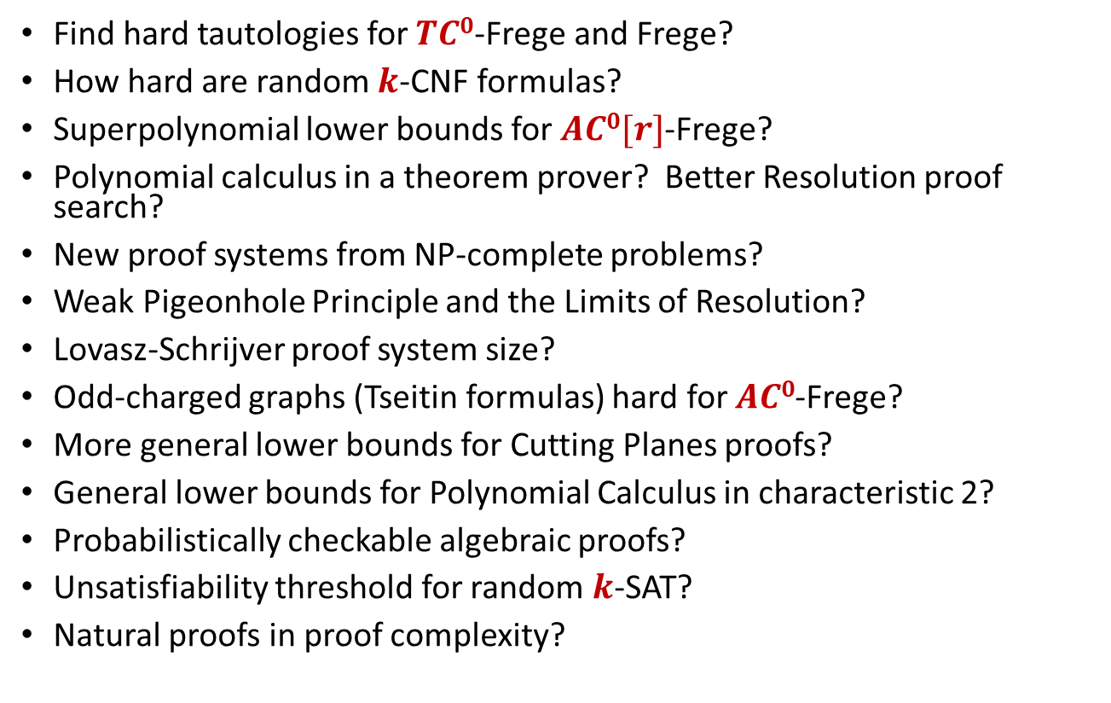
Our list
Find hard tautologies for $TC0$-Frege and Frege?
How hard are random $k$-CNF formulas?
Superpolynomial lower bounds for $AC0[r]$-Frege?
Polynomial calculus in a theorem prover? Better Resolution proof search?
New proof systems from NP-complete problems?
Weak Pigeonhole Principle and the Limits of Resolution?
Lovasz-Schrijver proof system size?
Odd-charged graphs (Tseitin formulas) hard for $AC0$-Frege?
More general lower bounds for Cutting Planes proofs?
General lower bounds for Polynomial Calculus in characteristic 2?
Probabilistically checkable algebraic proofs?
Unsatisfiability threshold for random $k$-SAT?
Natural proofs in proof complexity?

Slide 4
Major trends and developments
… which we mostly didn’t anticipate

Slide 5
Convergence of research on algorithmic hardness and proof complexity
… bringing together the best methods of both

Slide 6
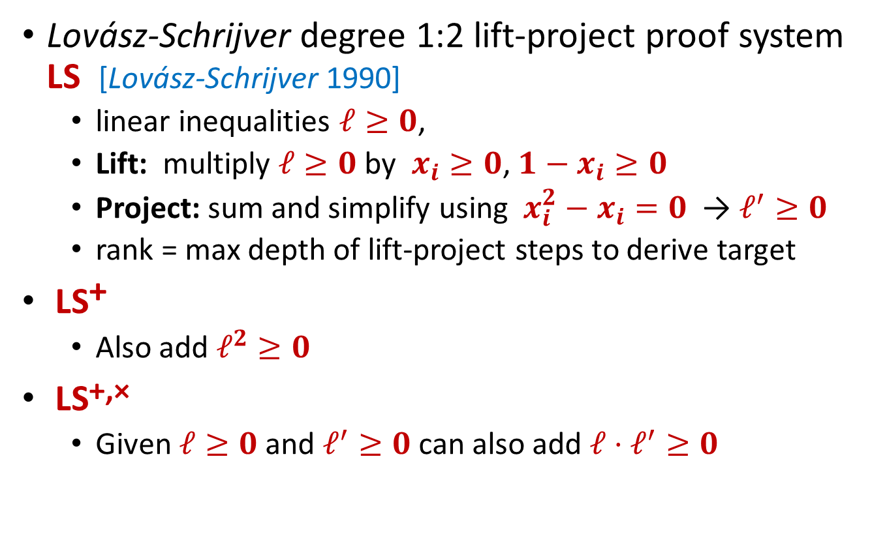
Semi-algebraic proof hierarchies
Lovász-Schrijver degree 1:2 lift-project proof system LS [Lovász-Schrijver 1990]
  linear inequalities $ℓ≥0$,
  Lift: multiply $ℓ≥0$ by $x_{i}≥0$, ${1−x}_{i}≥0$
  Project: sum and simplify using $x_{i}^{2}−x_{i}=0$ → $ℓ^{′}≥0$
  rank = max depth of lift-project steps to derive target
LS⁺
  Also add $ℓ^{2}≥0$
LS^{+,×}
  Given $ℓ≥0$ and $ℓ^{′}≥0$ can also add $ℓ⋅ℓ^{′}≥0$

Slide 7
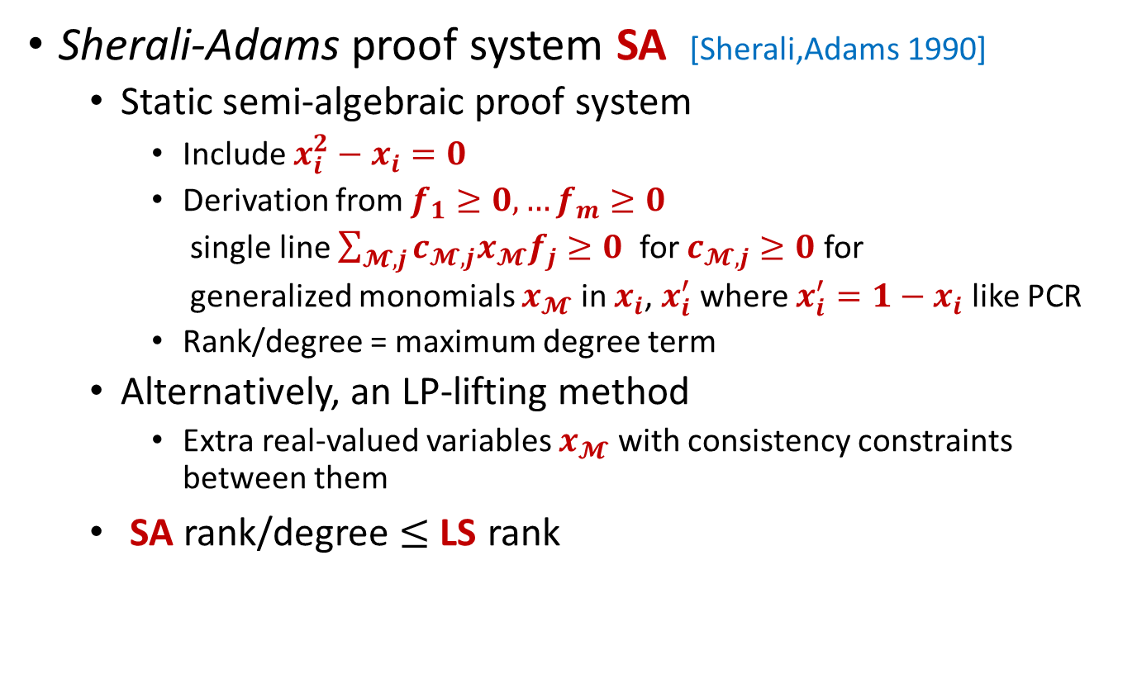
Semi-algebraic proof hierarchies
Sherali-Adams proof system SA [Sherali,Adams 1990]
  Static semi-algebraic proof system
    Include $x_{i}^{2}−x_{i}=0$
    Derivation from $f_{1}≥0,…f_{m}≥0$
    single line $\sum_{𝓜,j}{c_{𝓜,j}x_{𝓜}f_{j}}≥0$ for $c_{𝓜,j}≥0$ for
    generalized monomials $x_{𝓜}$ in $x_{i}$, $x_{i}^{′}$ where $x_{i}^{′}=1−x_{i}$ like PCR
    Rank/degree = maximum degree term
  Alternatively, an LP-lifting method
    Extra real-valued variables $x_{𝓜}$ with consistency constraints between them
  SA rank/degree $≤$ LS rank

Slide 8
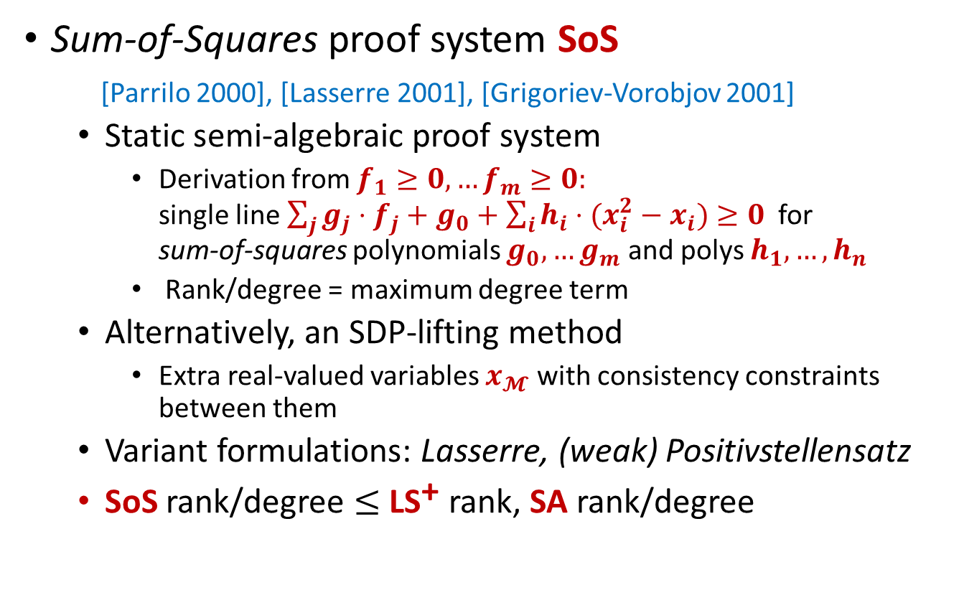
Semi-algebraic proof hierarchies
Sum-of-Squares proof system SoS
[Parrilo 2000], [Lasserre 2001], [Grigoriev-Vorobjov 2001]
  Static semi-algebraic proof system
    Derivation from $f_{1}≥0,…f_{m}≥0:$ single line $\sum_{j}{g_{j}⋅f_{j}+g_{0}+\sum_{i}{h_{i}⋅(x_{i}^{2}−x_{i})}}≥0$ for sum-of-squares polynomials $g_{0},…g_{m}$ and polys $h_{1},…,h_{n}$
    Rank/degree = maximum degree term
  Alternatively, an SDP-lifting method
    Extra real-valued variables $x_{𝓜}$ with consistency constraints between them
  Variant formulations: Lasserre, (weak) Positivstellensatz
  SoS rank/degree $≤$ LS⁺ rank, SA rank/degree

Slide 9
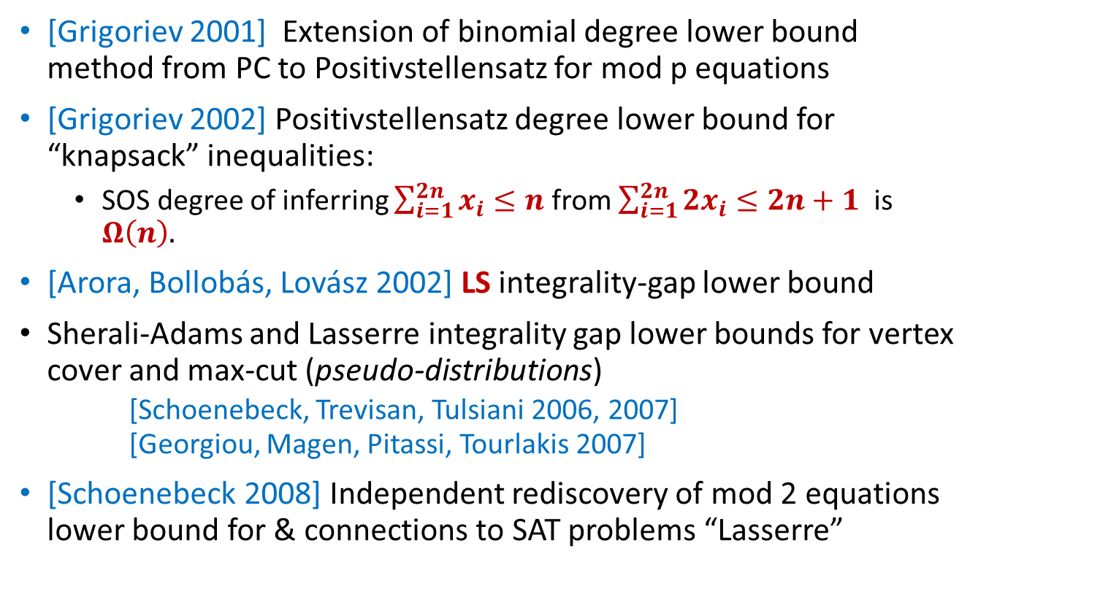
Some key milestones
[Grigoriev 2001] Extension of binomial degree lower bound method from PC to Positivstellensatz for mod p equations
[Grigoriev 2002] Positivstellensatz degree lower bound for “knapsack” inequalities:
  SOS degree of inferring $\sum_{i=1}^{2n}{x_{i}≤n}$ from $\sum_{i=1}^{2n}{{2x}_{i}≤2n+1}$ is $Ω\left(n\right).$
[Arora, Bollobás, Lovász 2002] LS integrality-gap lower bound
Sherali-Adams and Lasserre integrality gap lower bounds for vertex cover and max-cut (pseudo-distributions) [Schoenebeck, Trevisan, Tulsiani 2006, 2007] [Georgiou, Magen, Pitassi, Tourlakis 2007]
[Schoenebeck 2008] Independent rediscovery of mod 2 equations lower bound for & connections to SAT problems “Lasserre”

Slide 10
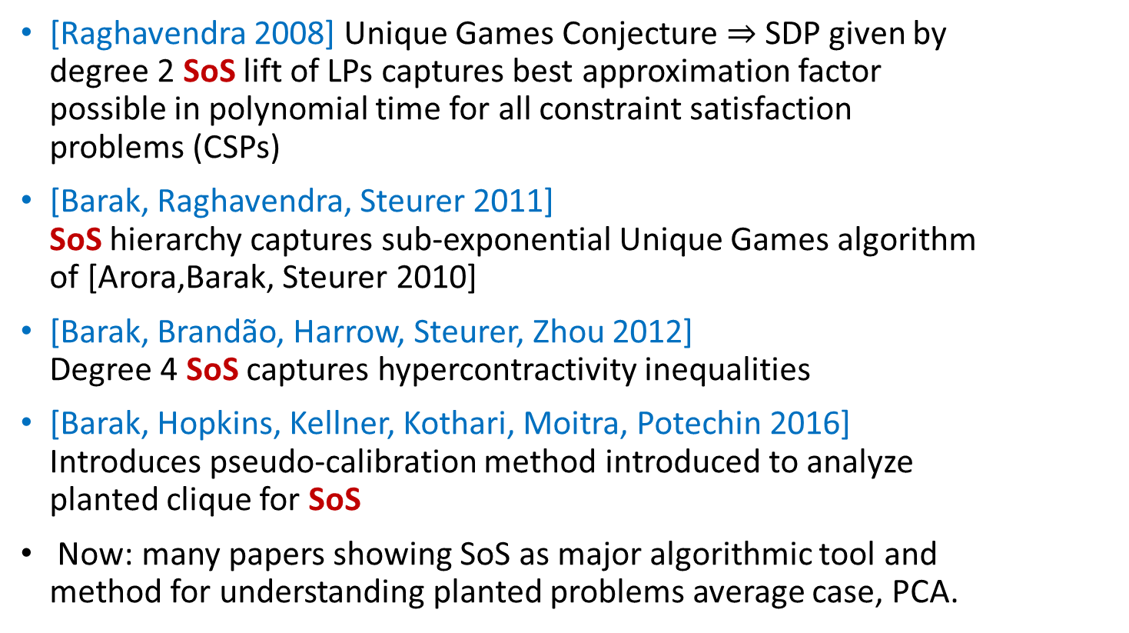
Some key milestones
[Raghavendra 2008] Unique Games Conjecture $⇒$SDP given by degree 2 SoS lift of LPs captures best approximation factor possible in polynomial time for all constraint satisfaction problems (CSPs)
[Barak, Raghavendra, Steurer 2011] SoS hierarchy captures sub-exponential Unique Games algorithm of [Arora,Barak, Steurer 2010]
[Barak, Brandão, Harrow, Steurer, Zhou 2012] Degree 4 SoS captures hypercontractivity inequalities
[Barak, Hopkins, Kellner, Kothari, Moitra, Potechin 2016] Introduces pseudo-calibration method introduced to analyze planted clique for SoS
Now: many papers showing SoS as major algorithmic tool and method for understanding planted problems average case, PCA.

Slide 11
Lifting (of another sort) comes into its own

Slide 12
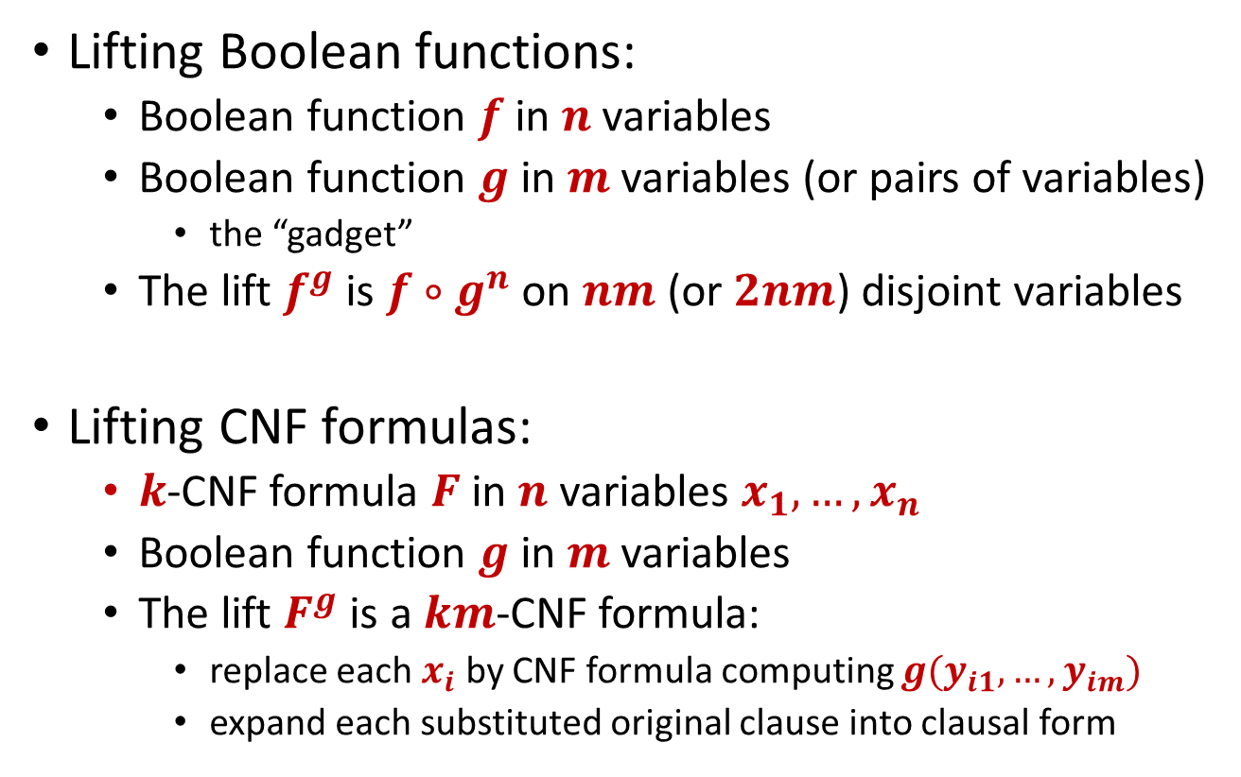
Lifting
Lifting Boolean functions:
  Boolean function $f$in $n$ variables
  Boolean function $g$ in $m$ variables (or pairs of variables)
    the “gadget”
  The lift $f^{g}$ is $f∘g^{n}$ on $nm$ (or $2nm$) disjoint variables
Lifting CNF formulas:
  $k$-CNF formula $F$ in $n$ variables $x_{1},…,x_{n}$
  Boolean function $g$ in $m$ variables
  The lift $F^{g}$ is a $km$-CNF formula:
    replace each $x_{i}$ by CNF formula computing $g(y_{i1},…,y_{im})$
    expand each substituted original clause into clausal form

Slide 13
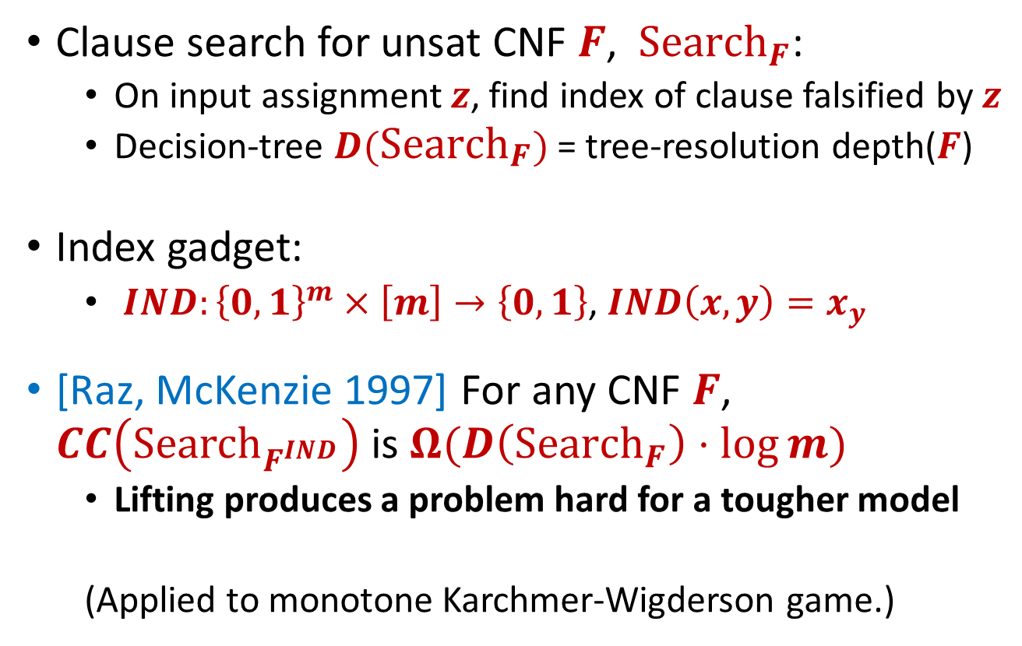
Origins and proof complexity
Clause search for unsat CNF $F$, ${Search}_{F}$:
  On input assignment $z$, find index of clause falsified by $z$
  Decision-tree $D({Search}_{F})$= tree-resolution depth($F$)
Index gadget:
  $IND:{\left\{0,1\right\}}^{m}×\left[m\right]→\left\{0,1\right\}$, $IND\left(x,y\right)=x_{y}$
[Raz, McKenzie 1997] For any CNF $F$, $CC\left({Search}_{F^{IND}}\right)$is $Ω(D\left({Search}_{F}\right)⋅\log{m)}$
  Lifting produces a problem hard for a tougher model
  (Applied to monotone Karchmer-Wigderson game.)

Slide 14
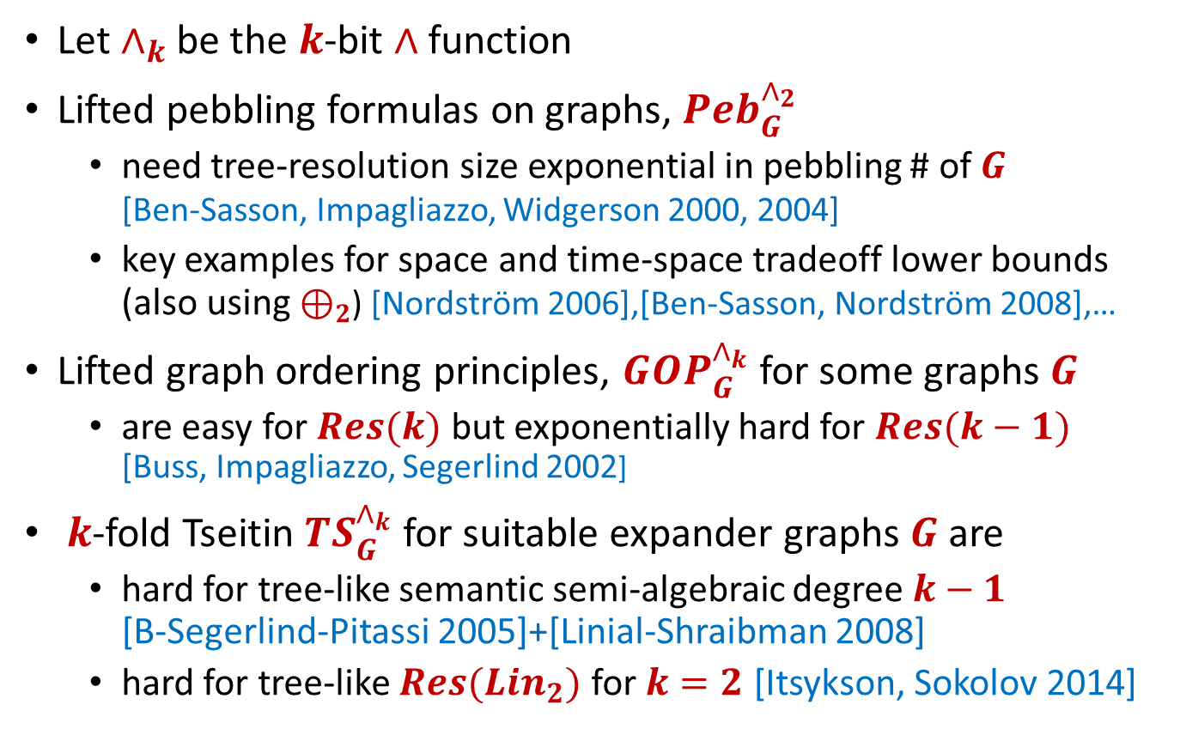
Simple lifting in proof complexity
Let $∧_{k}$ be the $k$-bit $∧$function
Lifted pebbling formulas on graphs, $Peb_{G}^{∧_{2}}$
  need tree-resolution size exponential in pebbling # of $G$ [Ben-Sasson, Impagliazzo, Widgerson 2000, 2004]
  key examples for space and time-space tradeoff lower bounds (also using $⊕_{2}$) [Nordström 2006],[Ben-Sasson, Nordström 2008],…
Lifted graph ordering principles, $GOP_{G}^{∧_{k}}$ for some graphs $G$
  are easy for $Res(k)$ but exponentially hard for $Res(k−1)$ [Buss, Impagliazzo, Segerlind 2002]
$k$-fold Tseitin $TS_{G}^{∧_{k}}$ for suitable expander graphs $G$ are
  hard for tree-like semantic semi-algebraic degree $k−1$ [B-Segerlind-Pitassi 2005]+[Linial-Shraibman 2008]
  hard for tree-like $Res(Lin_{2})$ for $k=2$ [Itsykson, Sokolov 2014]

Slide 15
Much lifting in the last decade…
and lots of follow-on work that has solved many open problems in communication complexity
[Göös,Pitassi 2014] General lifting for tree-like semi-algebraic proofs.
[Göös, Pitassi, Watson 2015] Deterministic CC
[Göös 2017] Nondeterministic CC
[Chattopadhyay, Kouckŷ, Loff, Mukhopadhyay 2017]
[Göös, Pitassi, Watson 2017] Randomized CC

Slide 16
Strong applications of lifting
Extension complexity
  First exponential lower bounds for LP extension [Kothari-Meka-Raghavendra 2016]
  LP extension for independent set, based on lifting Tseitin formulas [Göös, Jain, Watson 2016]
Communication complexity from search
  Clique-Independent Set [Göös 2015]
  Approximate Nash equilibria [Göös, Rubinstein 2018]
First exponential lower bounds for:
  Monotone span programs from Nullstellensatz degree lower bounds [Robere, Pitassi, Rossman, Cook 2016]
  Monotone comparator network size lower bounds from Nullstellensatz degree lower bounds [Pitassi, Robere 2017], [Pitassi, Robere 2018]

Slide 17
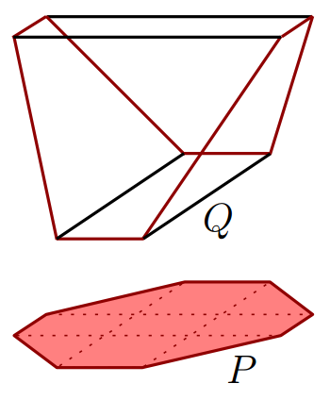
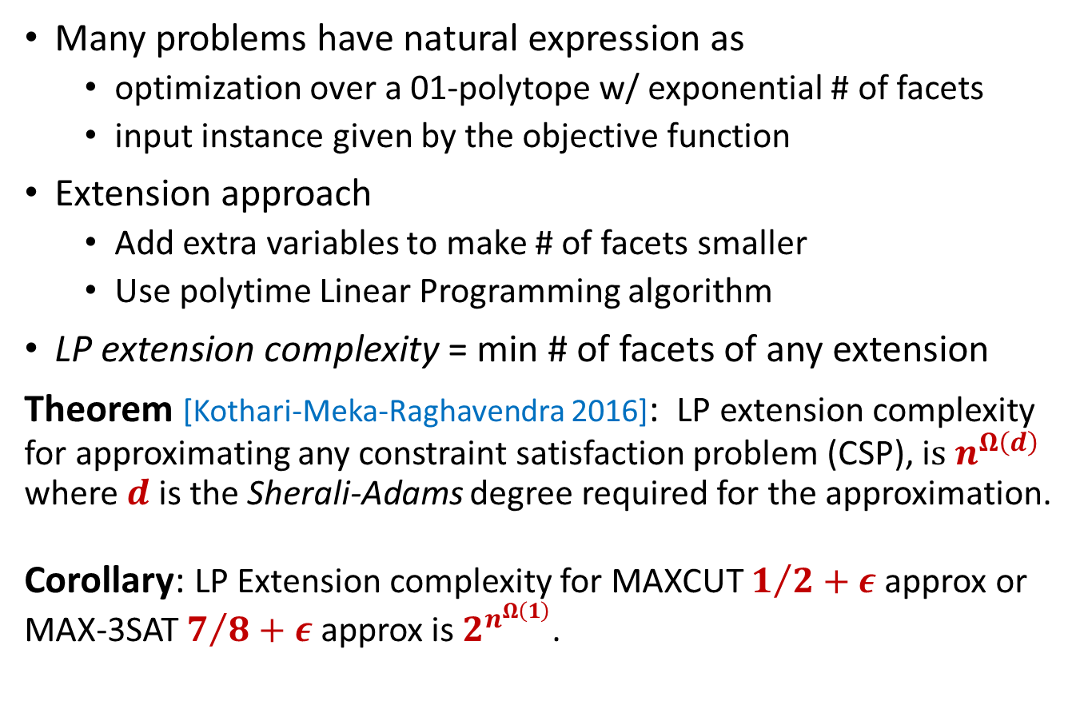
Extension Complexity [Yannakakis 1991]
Many problems have natural expression as
  optimization over a 01-polytope w/ exponential # of facets
  input instance given by the objective function
Extension approach
  Add extra variables to make # of facets smaller
  Use polytime Linear Programming algorithm
LP extension complexity = min # of facets of any extension
Theorem [Kothari-Meka-Raghavendra 2016]: LP extension complexity for approximating any constraint satisfaction problem (CSP), i$s n^{Ω\left(d\right)}$ where $d$ is the Sherali-Adams degree required for the approximation.
Corollary: LP Extension complexity for MAXCUT $1/2+ε$ approx or MAX-3SAT $7/8+ε$ approx is $2^{n^{Ω\left(1\right)}}$.

Slide 18
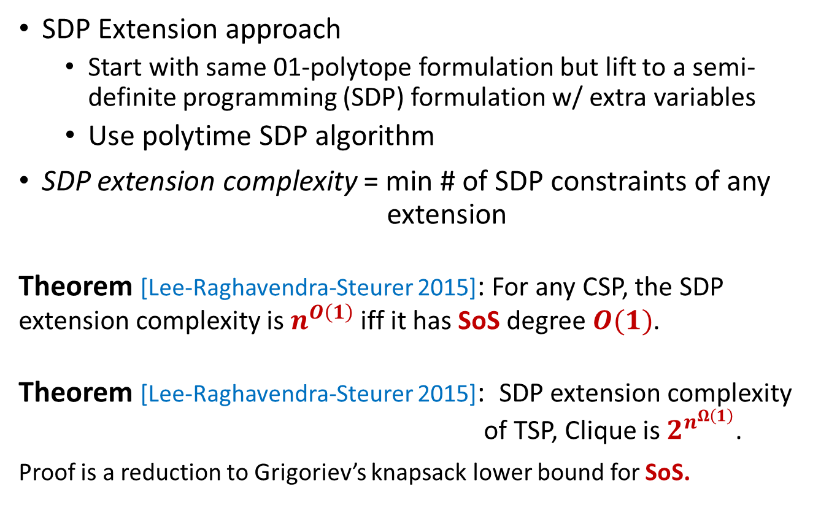
SDP Extension Complexity [Gouveia-Parrilo-Thomas 2011], [Fiorini-Massar-Pokutta-Tiwari-de Wolf 2012]
SDP Extension approach
  Start with same 01-polytope formulation but lift to a semi-definite programming (SDP) formulation w/ extra variables
  Use polytime SDP algorithm
SDP extension complexity = min # of SDP constraints of any extension
Theorem [Lee-Raghavendra-Steurer 2015]: For any CSP, the SDP extension complexity is $n^{O\left(1\right)}$ iff it has SoS degree $O(1)$.
Theorem [Lee-Raghavendra-Steurer 2015]: SDP extension complexity of TSP, Clique is $2^{n^{Ω\left(1\right)}}$.
Proof is a reduction to Grigoriev’s knapsack lower bound for SoS.

Slide 19
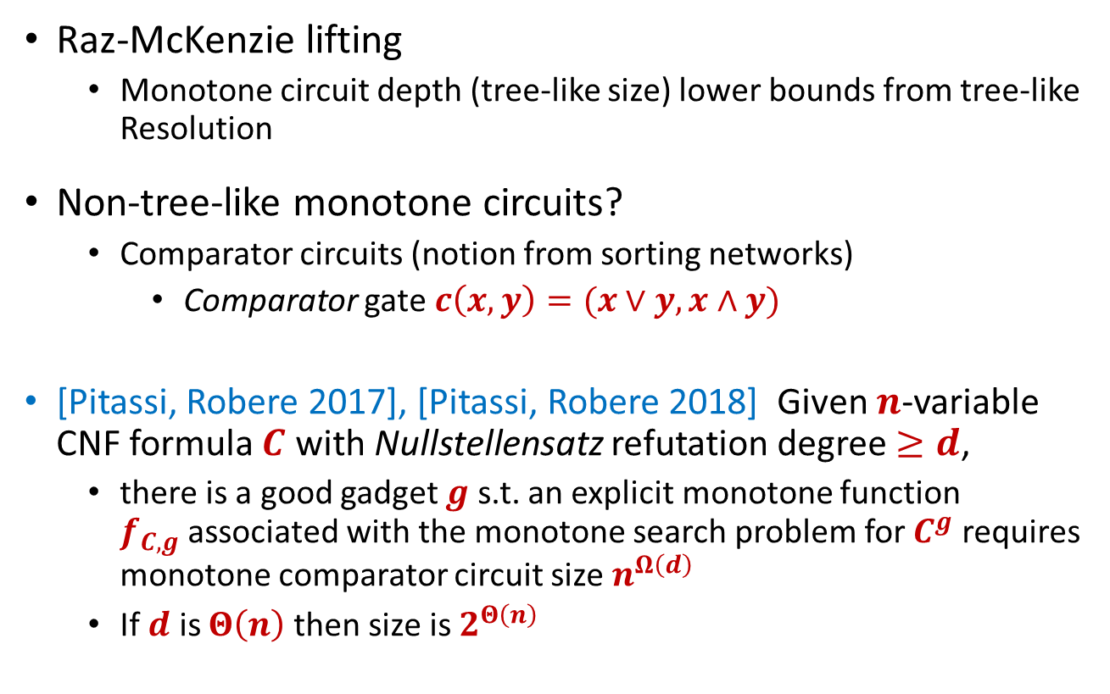
Proof complexity to circuit complexity
Raz-McKenzie lifting
  Monotone circuit depth (tree-like size) lower bounds from tree-like Resolution
Non-tree-like monotone circuits?
  Comparator circuits (notion from sorting networks)
    Comparator gate $c\left(x,y\right)=(x∨y, x∧y)$
[Pitassi, Robere 2017], [Pitassi, Robere 2018] Given $n$-variable CNF formula $C$ with Nullstellensatz refutation degree $≥d$,
  there is a good gadget $g$ s.t. an explicit monotone function $f_{C,g}$associated with the monotone search problem for $C^{g}$ requires monotone comparator circuit size $n^{Ω\left(d\right)}$
  If $d$ is $Θ\left(n\right)$then size is $2^{Θ\left(n\right)}$

Slide 20
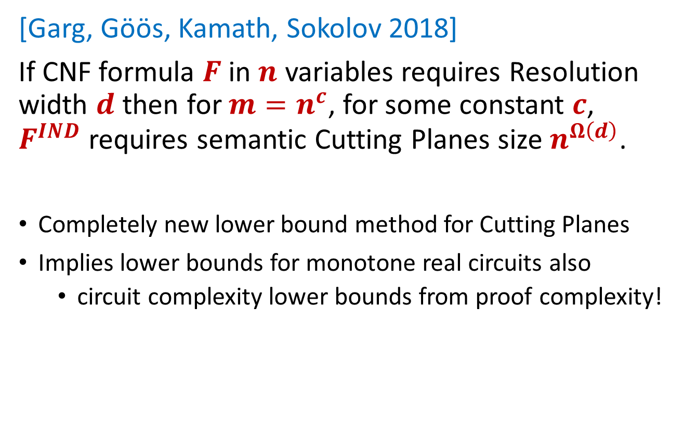
Amazing proof complexity lifting
[Garg, Göös, Kamath, Sokolov 2018]
If CNF formula $F$ in $n$ variables requires Resolution width $d$ then for $m=n^{c}$, for some constant $c$, $F^{IND}$ requires semantic Cutting Planes size $n^{Ω\left(d\right)}$.
Completely new lower bound method for Cutting Planes
Implies lower bounds for monotone real circuits also
  circuit complexity lower bounds from proof complexity!

Slide 21
Proof complexity and SAT solving come together

Slide 22
Better Resolution proof search?
We speculated that ideas would come from degree/width-based proof search...instead it came from…
Conflict-directed clause learning (CDCL) SAT solvers with watched literals, multiplicative-weight update literal selection heuristics on top of 1-UIP (asserting) clause learning, e.g.
  Chaff, zChaff [Moscewicz,Madigan,Zhao,Zhang,Malik 2001]
  MiniSAT [Een,Sörensson 2005] conflict clause minimization
  …
Landscape of proof search has completely changed
  Orders of magnitude improvement in solvable problem size means that SAT solvers and proof search are practical tools!

Slide 23
Proof complexity of CDCL SAT solvers
[B, Kautz, Sabharwal 2004] CDCL solvers w/
  nondet literal selection + nondet learning + nondet restarts ≡ Resolution
  nondet literal selection + nondet learning not closed under restriction unless ≡ Resolution (extra vars/clauses)
[Hertel, Bacchus, Pitassi, Van Gelder 2008] CDCL solvers w/
  nondet literal selection + nondet learning effectively p-simulates Resolution (generic extra vars/clauses)
  [Pipatsrisawat, Darwiche 2009], [Atserias, Maneva 2010] CDCL w/
    nondet or random variable selection + phase saving + 1UIP learning + nondet restarts ≡ Resolution
[B, Sabharwal 2014] CDCL solvers w/
  nondet variable selection + phase saving + 1UIP learning effectively p-simulates Resolution (generic extra vars/clauses)

Slide 24
Proof complexity for CDCL SAT solvers
Annual competitions between “complete” SAT solvers
  sometimes disagreements on claims of unsatisfiability
  need to make all claims checkable
    Idea: solvers record a “trace” of their actions
What format?
  Solvers can do many things outside of strict CDCL on original formula
  DRAT proof system [Heule, Hunt, Wetzler 2014]
    RAT = Resolution Asymmetric Tautology
    Stronger than Resolution even without adding variables
Produces large practically checkable proofs
  Pythagorean triples proof (Terabyte scale) [Heule, Kullman, Marek 2016]

Slide 25
Proof space
Variables, clauses, monomials, lines
  [Alekhnovich, Ben-Sasson, Razborov, Wigderson 2000]
Resolution width vs Resolution space
  [Atserias, Dalmau 2003]
Relationships with black-white pebbling
  E.g. [Håstad, Nordström 2006], [Nordström 2012]
Space-Size Tradeoffs
  Sublinear, e.g. [Ben-Sasson, Nordström 2008, 2011]
  Superlinear, e.g. [B, Beck, Impagliazzo 2012], [Huynh, Nordström 2012]
Many more topics: see survey [Nordström 2013]

Slide 26
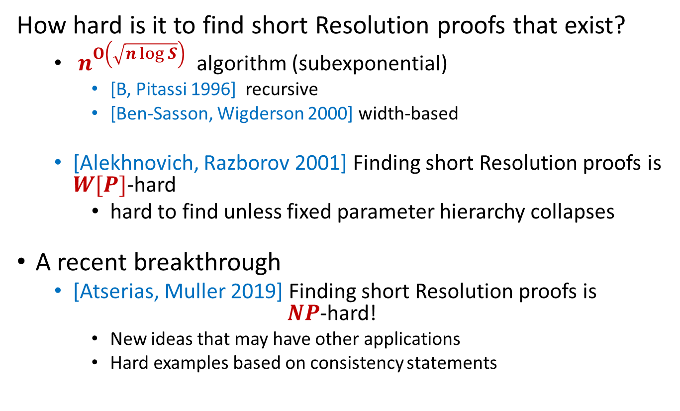
Automatizability
How hard is it to find short Resolution proofs that exist?
  $n^{O\left(\sqrt{n log S}\right)}$ algorithm (subexponential)
    [B, Pitassi 1996] recursive
    [Ben-Sasson, Wigderson 2000] width-based
  [Alekhnovich, Razborov 2001] Finding short Resolution proofs is $W[P]$-hard
    hard to find unless fixed parameter hierarchy collapses
A recent breakthrough
  [Atserias, Muller 2019] Finding short Resolution proofs is $NP$-hard!
    New ideas that may have other applications
    Hard examples based on consistency statements

Slide 27
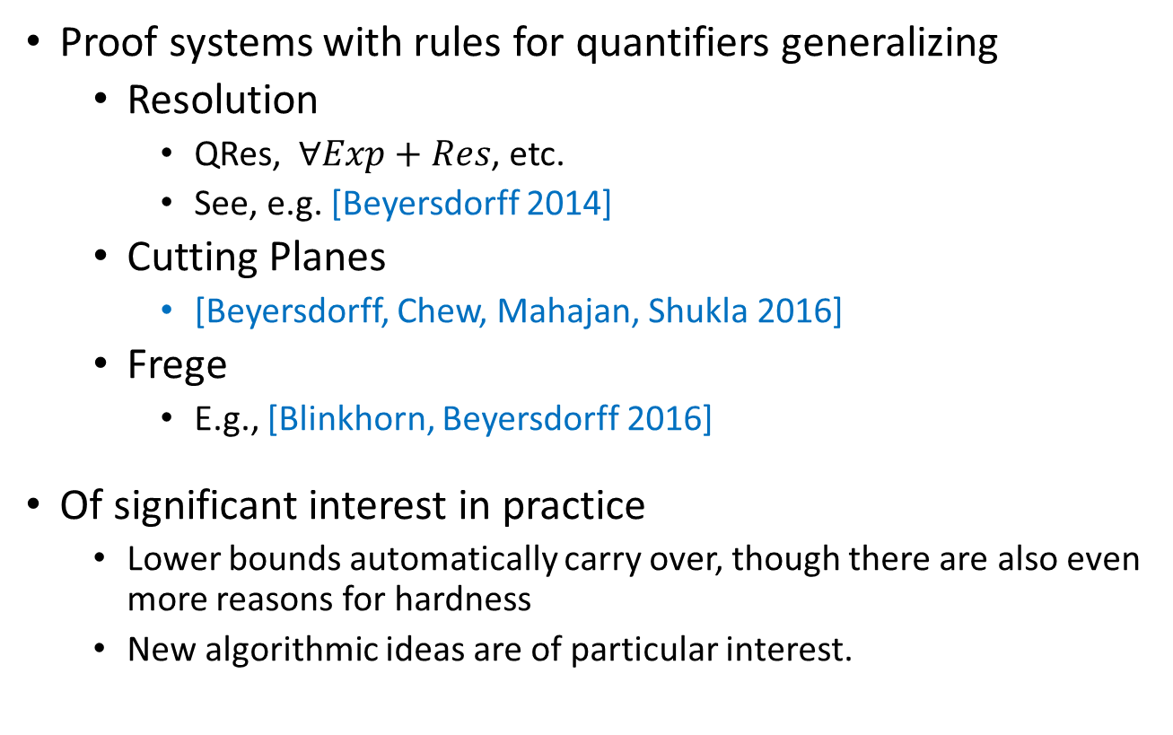
Proof complexity of QBF
Proof systems with rules for quantifiers generalizing
  Resolution
    QRes, $∀Exp+Res$, etc.
    See, e.g. [Beyersdorff 2014]
  Cutting Planes
    [Beyersdorff, Chew, Mahajan, Shukla 2016]
  Frege
    E.g., [Blinkhorn, Beyersdorff 2016]
Of significant interest in practice
  Lower bounds automatically carry over, though there are also even more reasons for hardness
  New algorithmic ideas are of particular interest.

Slide 28
Progress on our list?
Find hard tautologies for $TC0$-Frege and Frege?
How hard are random $k$-CNF formulas?
Superpolynomial lower bounds for $AC0[r]$-Frege?
Polynomial calculus in a theorem prover? Better Resolution proof search?
New proof systems from NP-complete problems?
Weak Pigeonhole Principle and the Limits of Resolution?
Lovasz-Schrijver proof system size?
Odd-charged graphs (Tseitin formulas) hard for $AC0$-Frege?
More general lower bounds for Cutting Planes proofs?
General lower bounds for Polynomial Calculus in characteristic 2?
Probabilistically checkable algebraic proofs?
Unsatisfiability threshold for random $k$-SAT?
Natural proofs in proof complexity?

Slide 29

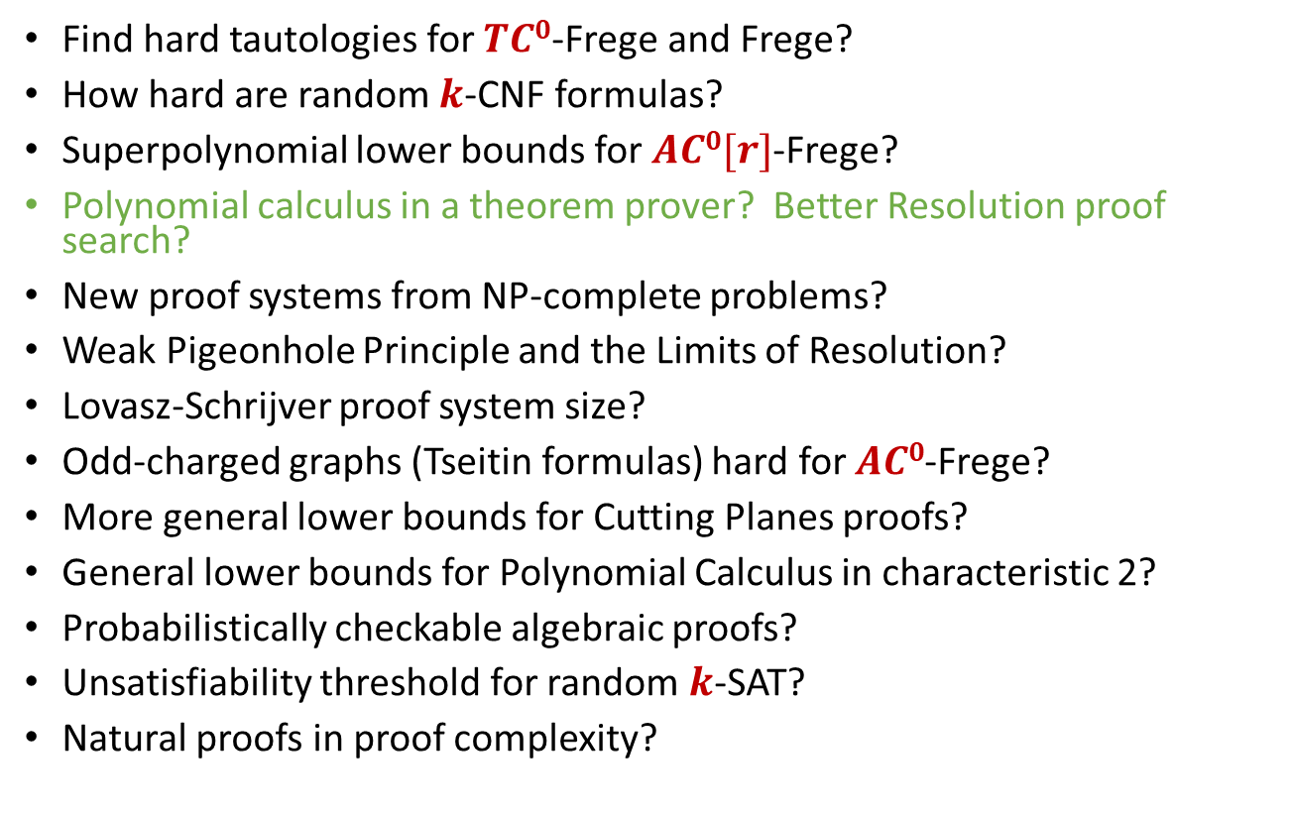
Progress on our list?
Find hard tautologies for $TC0$-Frege and Frege?
How hard are random $k$-CNF formulas?
Superpolynomial lower bounds for $AC0[r]$-Frege?
Polynomial calculus in a theorem prover? Better Resolution proof search?
New proof systems from NP-complete problems?
Weak Pigeonhole Principle and the Limits of Resolution?
Lovasz-Schrijver proof system size?
Odd-charged graphs (Tseitin formulas) hard for $AC0$-Frege?
More general lower bounds for Cutting Planes proofs?
General lower bounds for Polynomial Calculus in characteristic 2?
Probabilistically checkable algebraic proofs?
Unsatisfiability threshold for random $k$-SAT?
Natural proofs in proof complexity?

Slide 30
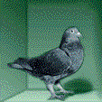
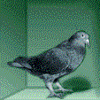
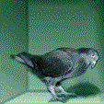

Weak Pigeonhole Principle and the limits of Resolution
Pigeonhole Principle
  CNF formula $PHP_{n}^{m}$ for any $m>n$
    No 1-1 relation
  Functional version $FPHP_{n}^{m}$
  Weak: $m≥2^{n}$
  Previous: Hard for resolution
    when $m≤n^{2}/\log{n}$
Thm [Raz 2002], [Razborov 2003],[ Razborov 2004] Weak $PHP$, $FPHP$ require $2^{Ω\left(n^{1/3}\right)}$ size resolution proofs.
Cor: [Raborov 2003] Resolution cannot prove that SAT does not have a polynomial-sized DNF formula
    i.e. Resolution can’t prove $NP⊄P/poly$”.

Slide 31
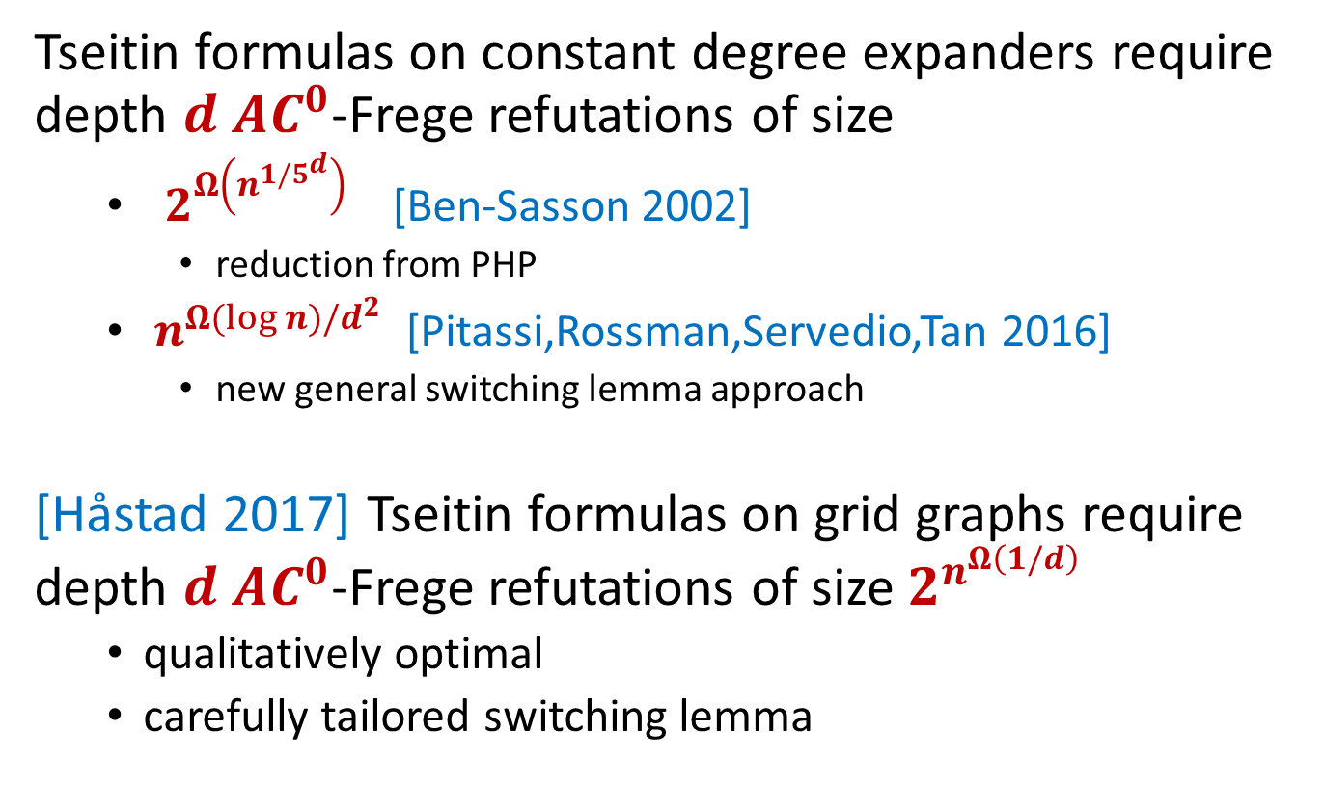
Odd-charged graphs and AC⁰-Frege
Tseitin formulas on constant degree expanders require depth $d$ $AC^{0}$-Frege refutations of size
  $2^{Ω\left(n^{{1/5}^{d}}\right)}$ [Ben-Sasson 2002]
    reduction from PHP
  $n^{Ω(\log{n)/d^{2}}}$ [Pitassi,Rossman,Servedio,Tan 2016]
    new general switching lemma approach
[Håstad 2017] Tseitin formulas on grid graphs require depth $d$ $AC^{0}$-Frege refutations of size $2^{n^{Ω\left(1/d\right)}}$
  qualitatively optimal
  carefully tailored switching lemma

Slide 32

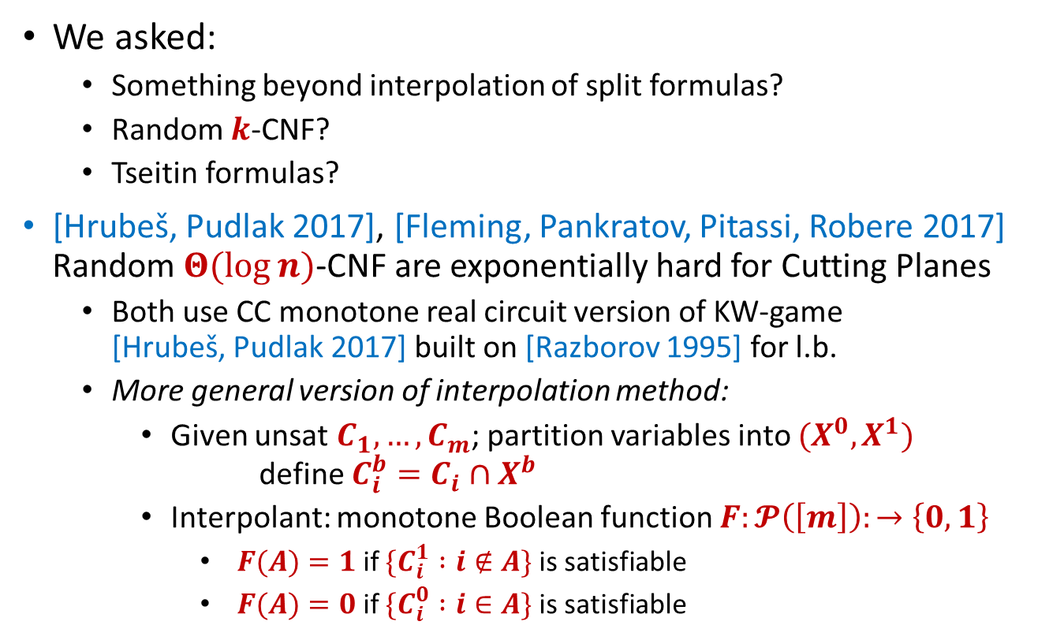
More general lower bounds for Cutting Planes proofs?
[Garg, Göös, Kamath, Sokolov 2019]
Lifting from Resolution
We asked:
  Something beyond interpolation of split formulas?
  Random $k$-CNF?
  Tseitin formulas?
[Hrubeš, Pudlak 2017], [Fleming, Pankratov, Pitassi, Robere 2017] Random $Θ(\log{n)}$-CNF are exponentially hard for Cutting Planes
  Both use CC monotone real circuit version of KW-game [Hrubeš, Pudlak 2017] built on [Razborov 1995] for l.b.
  More general version of interpolation method:
    Given unsat $C_{1},…, C_{m}$; partition variables into $(X^{0},X^{1})$ define $C_{i}^{b}=C_{i}∩X^{b}$
    Interpolant: monotone Boolean function $F:𝓟\left(\left[m\right]\right):→\left\{0,1\right\}$
      $F(A)=1$if $\{C_{i}^{1} :i∉A\}$ is satisfiable
      $F(A)=0$if $\{C_{i}^{0} :i∈A\}$ is satisfiable
[HP 17] Also for Bit Pigeonhole Principle $BPHP_{N}^{M}$

Slide 33
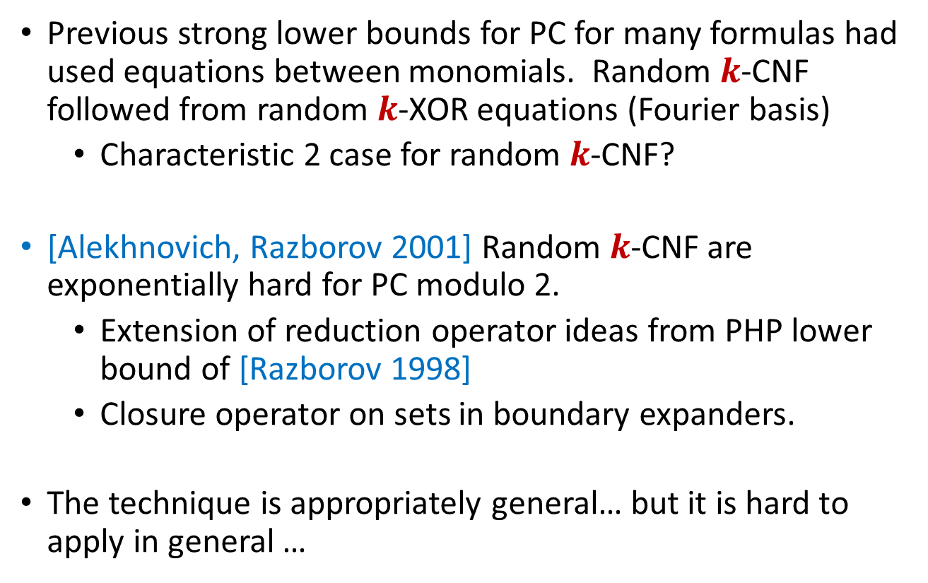
General lower bounds for Polynomial Calculus in characteristic 2?
Previous strong lower bounds for PC for many formulas had used equations between monomials. Random $k$-CNF followed from random $k$-XOR equations (Fourier basis)
  Characteristic 2 case for random $k$-CNF?
[Alekhnovich, Razborov 2001] Random $k$-CNF are exponentially hard for PC modulo 2.
  Extension of reduction operator ideas from PHP lower bound of [Razborov 1998]
  Closure operator on sets in boundary expanders.
The technique is appropriately general… but it is hard to apply in general …

Slide 34
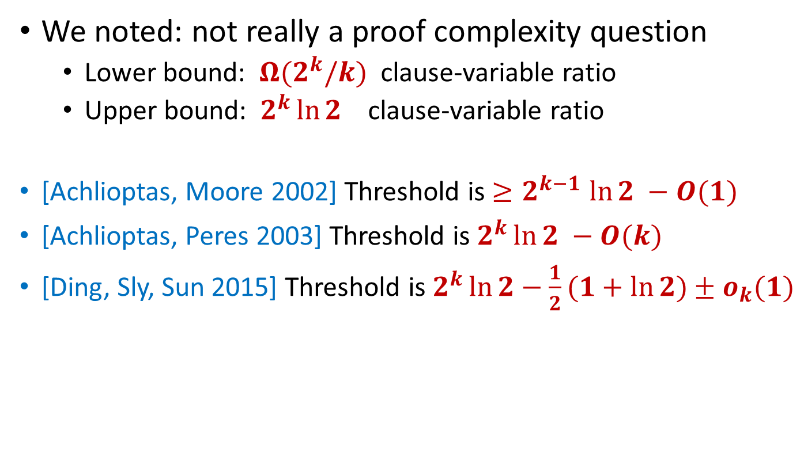

Unsatisfiability threshold for random $k$-SAT?
We noted: not really a proof complexity question
  Lower bound: $Ω(2^{k}/k)$ clause-variable ratio
  Upper bound: $2^{k}\ln{2}$ clause-variable ratio
[Achlioptas, Moore 2002] Threshold is ${≥2}^{k−1}\ln{2 −O(1)}$
[Achlioptas, Peres 2003] Threshold is $2^{k}\ln{2 −O(k)}$
[Ding, Sly, Sun 2015] Threshold is $2^{k}\ln{2−\frac{1}{2}(1+\ln{2)±o_{k}(1)}}$

Slide 35
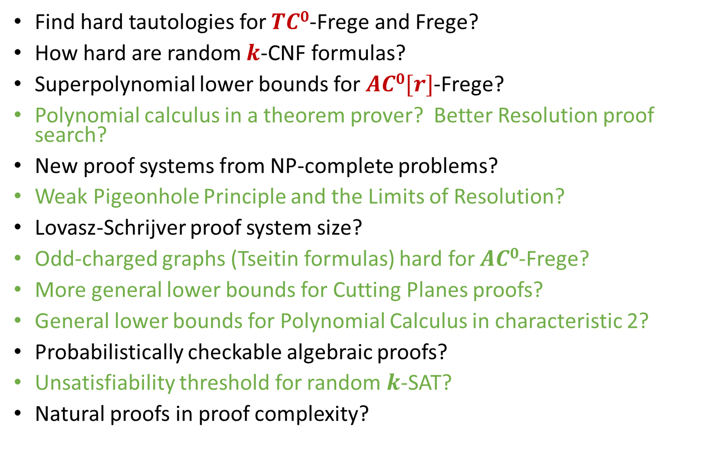
Progress on our list?
Find hard tautologies for $TC0$-Frege and Frege?
How hard are random $k$-CNF formulas?
Superpolynomial lower bounds for $AC0[r]$-Frege?
Polynomial calculus in a theorem prover? Better Resolution proof search?
New proof systems from NP-complete problems?
Weak Pigeonhole Principle and the Limits of Resolution?
Lovasz-Schrijver proof system size?
Odd-charged graphs (Tseitin formulas) hard for $AC0$-Frege?
More general lower bounds for Cutting Planes proofs?
General lower bounds for Polynomial Calculus in characteristic 2?
Probabilistically checkable algebraic proofs?
Unsatisfiability threshold for random $k$-SAT?
Natural proofs in proof complexity?

Slide 36
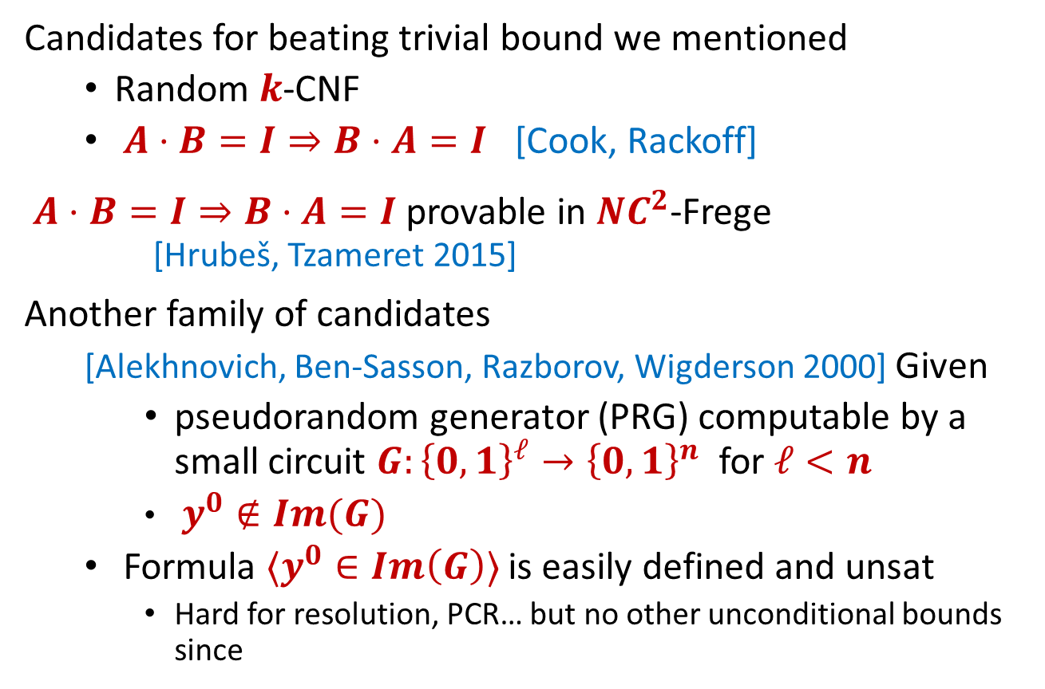

Hard tautologies for $TC0$-Frege and Frege?
Candidates for beating trivial bound we mentioned
  Random $k$-CNF
  $A⋅B=I⇒B⋅A=I$ [Cook, Rackoff]
$A⋅B=I⇒B⋅A=I$ provable in $NC^{2}$-Frege [Hrubeš, Tzameret 2015]
Another family of candidates
  [Alekhnovich, Ben-Sasson, Razborov, Wigderson 2000] Given
    pseudorandom generator (PRG) computable by a small circuit $G:{\left\{0,1\right\}}^{ℓ}→{\left\{0,1\right\}}^{n}$ for $ℓ<n$
    $y^{0}∉Im(G)$
  Formula $〈y^{0}∈Im\left(G\right)〉$ is easily defined and unsat
    Hard for resolution, PCR… but no other unconditional bounds since

Slide 37
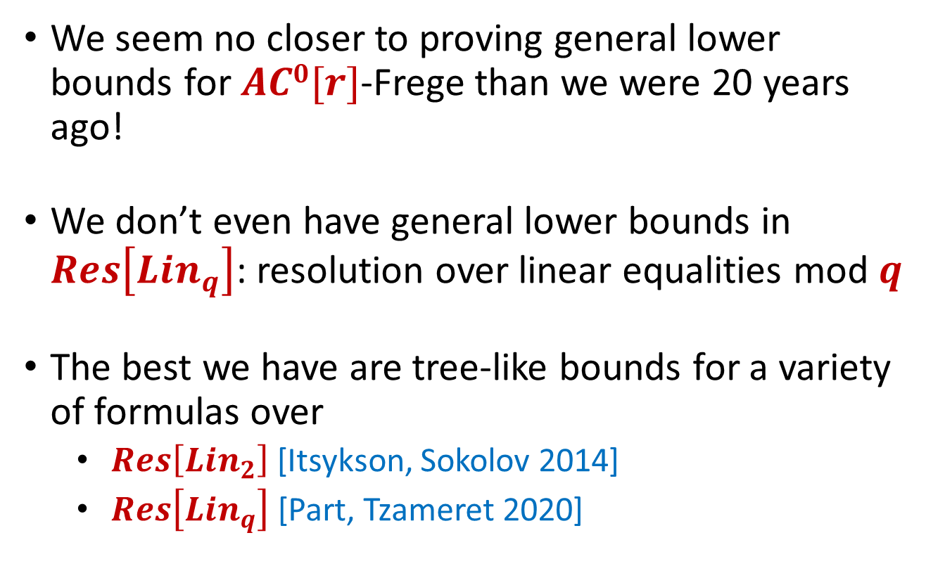

Lower bounds for $AC0[r]$-Frege?
We seem no closer to proving general lower bounds for $AC0[r]$-Frege than we were 20 years ago!
We don’t even have general lower bounds in $Res\left[Lin_{q}\right]$: resolution over linear equalities mod $q$
The best we have are tree-like bounds for a variety of formulas over
  $Res\left[Lin_{2}\right]$[Itsykson, Sokolov 2014]
  $Res\left[Lin_{q}\right]$ [Part, Tzameret 2020]

Slide 38
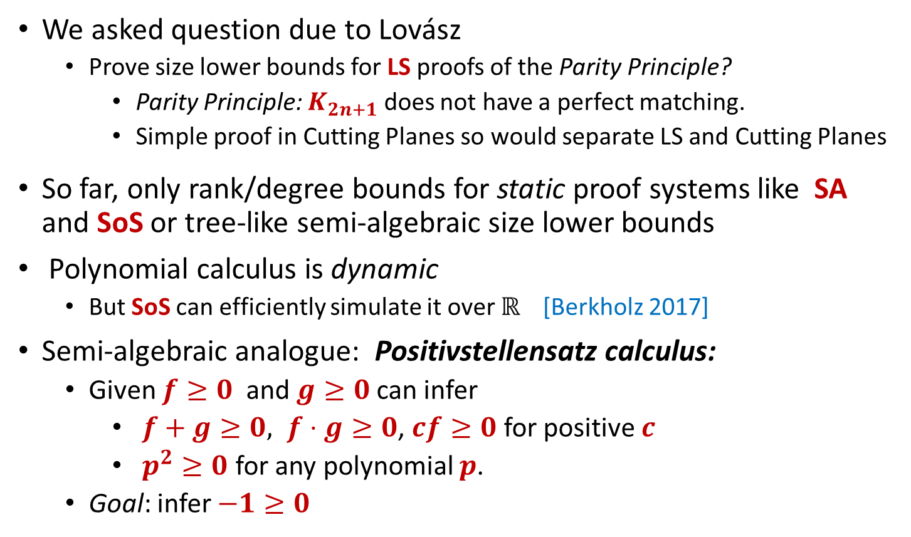
Lovász-Schrijver size?
We asked question due to Lovász
  Prove size lower bounds for LS proofs of the Parity Principle?
    Parity Principle: $K_{2n+1}$ does not have a perfect matching.
    Simple proof in Cutting Planes so would separate LS and Cutting Planes
So far, only rank/degree bounds for static proof systems like SA and SoS or tree-like semi-algebraic size lower bounds
Polynomial calculus is dynamic
  But SoS can efficiently simulate it over ℝ [Berkholz 2017]
Semi-algebraic analogue: Positivstellensatz calculus:
  Given $f≥0$ and $g≥0$ can infer
    $f+g≥0, f⋅g≥0$, $cf≥0$ for positive $c$
    $p^{2}≥0$ for any polynomial $p$.
  Goal: infer $−1≥0$

Slide 39
Proof system relationships
ZFC
Extended Frege
Simulation
Frege
Simulation + Exponential Separation
TC⁰-Frege
Positivstellensatz Calculus
AC⁰ [r]-Frege
Cutting Planes
SOS/Lasserre
AC⁰-Frege
Polynomial Calculus_{ℝ}
Sherali-Adams
Resolution
Nullstellensatz_{ℝ}
Incomparable
DPLL
1-way separation
Truth Tables

Slide 40

Complexity of $PHP_{n}^{n+1}$
ZFC
Extended Frege
Frege
Easy
TC⁰-Frege
Positivstellensatz Calculus
AC⁰ [r]-Frege
Cutting Planes
SOS/Lasserre
AC⁰-Frege
Polynomial Calculus_{ℝ}
Sherali-Adams
Resolution
Nullstellensatz_{ℝ}
Exponentially hard
DPLL
Truth Tables

Slide 41


Complexity of random $k$-CNF
ZFC
Not known to be easy for any proof system!
Extended Frege
Frege
Random 3XOR
$O(log⁡n)$-CNF
TC⁰-Frege
Positivstellensatz Calculus
AC⁰ [r]-Frege
Cutting Planes
SOS/Lasserre
AC⁰-Frege
Polynomial Calculus_{ℝ}
Sherali-Adams
Resolution
Nullstellensatz_{ℝ}
DPLL
Exponentially hard
Truth Tables

Slide 42
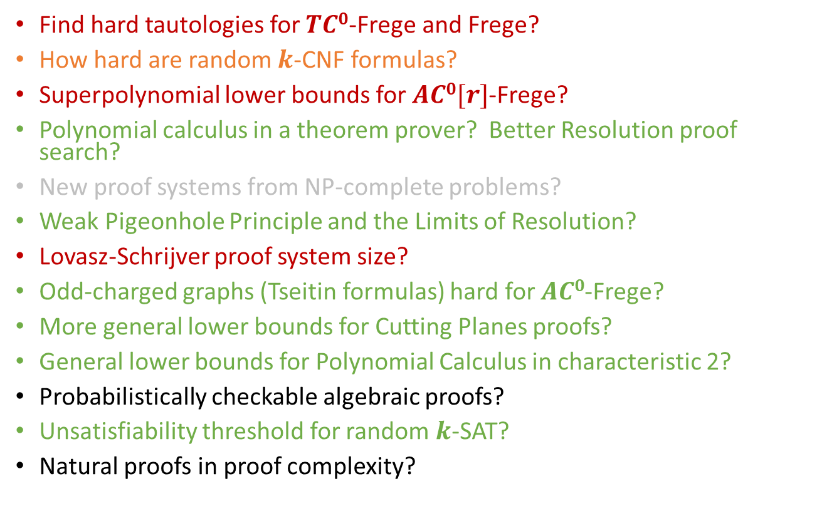
Progress on our list?
Find hard tautologies for $TC0$-Frege and Frege?
How hard are random $k$-CNF formulas?
Superpolynomial lower bounds for $AC0[r]$-Frege?
Polynomial calculus in a theorem prover? Better Resolution proof search?
New proof systems from NP-complete problems?
Weak Pigeonhole Principle and the Limits of Resolution?
Lovasz-Schrijver proof system size?
Odd-charged graphs (Tseitin formulas) hard for $AC0$-Frege?
More general lower bounds for Cutting Planes proofs?
General lower bounds for Polynomial Calculus in characteristic 2?
Probabilistically checkable algebraic proofs?
Unsatisfiability threshold for random $k$-SAT?
Natural proofs in proof complexity?

Slide 43
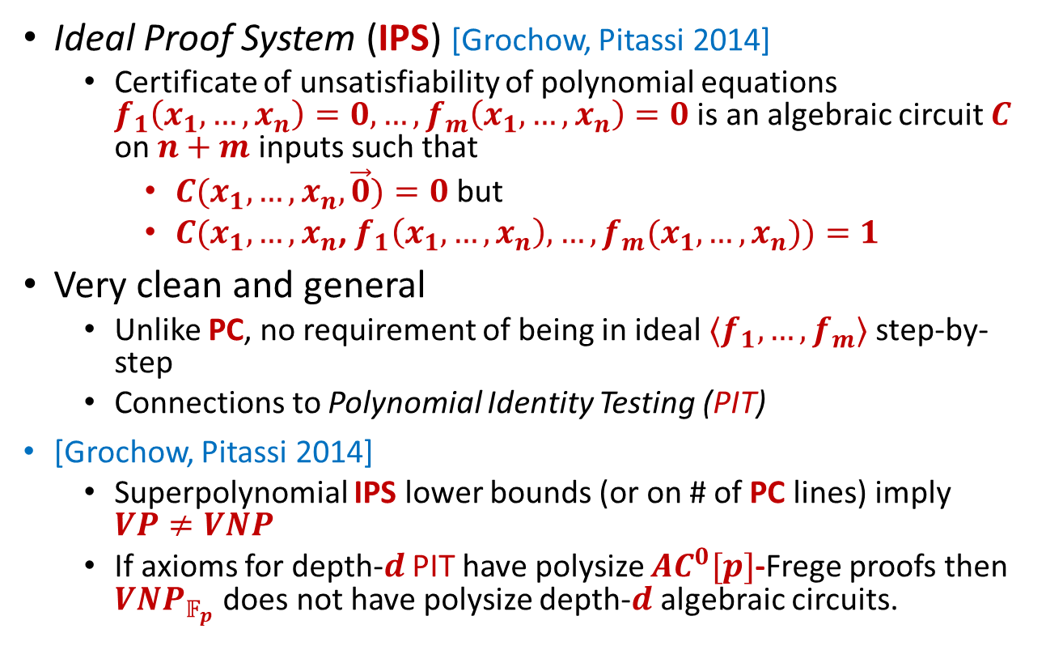
Probabilistically checkable algebraic proofs?
Ideal Proof System (IPS) [Grochow, Pitassi 2014]
  Certificate of unsatisfiability of polynomial equations $f_{1}\left(x_{1},…, x_{n}\right)=0,…,f_{m}\left(x_{1},…, x_{n}\right)=0$ is an algebraic circuit $C$ on $n+m$inputs such that
    $C(x_{1},…,x_{n},\vec{0})=0$ but
    $C(x_{1},…,x_{n}$, $f_{1}\left(x_{1},…, x_{n}\right),…,f_{m}(x_{1},…,x_{n}))=1$
Very clean and general
  Unlike PC, no requirement of being in ideal $⟨f_{1},…,f_{m}⟩$ step-by-step
  Connections to Polynomial Identity Testing (PIT)
[Grochow, Pitassi 2014]
  Superpolynomial IPS lower bounds (or on # of PC lines) imply $VP≠VNP$
  If axioms for depth-$d$ PIT have polysize $AC^{0}[p]$-Frege proofs then $VNP_{𝔽_{p}}$ does not have polysize depth-$d$ algebraic circuits.

Slide 44
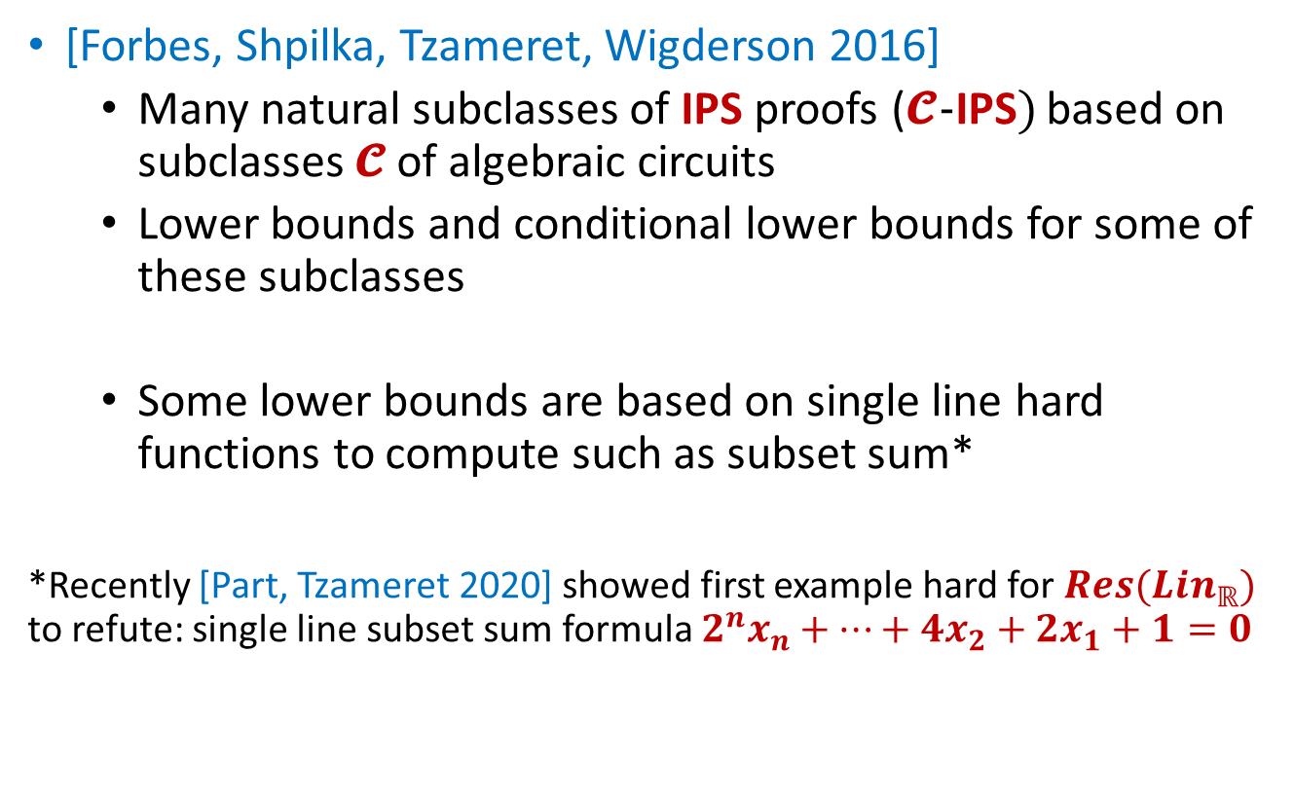
Probabilistically checkable algebraic proofs?
[Forbes, Shpilka, Tzameret, Wigderson 2016]
  Many natural subclasses of IPS proofs (𝓒-IPS) based on subclasses 𝓒 of algebraic circuits
  Lower bounds and conditional lower bounds for some of these subclasses
  Some lower bounds are based on single line hard functions to compute such as subset sum*
*Recently [Part, Tzameret 2020] showed first example hard for $Res(Lin_{ℝ})$ to refute: single line subset sum formula $2^{n}x_{n}+⋯+4x_{2}+2x_{1}+1=0$

Slide 45
Some more directions…

Slide 46
Cutting Planes solvers
Get the full extra value of CP over Resolution in practice? A CP analogue of CDCL?
Implementations of Cutting Planes-style proofs are called pseudoBoolean (pB) solvers
  e.g. Sat4j, RoundingSAT, pbsolver, minisatp, etc.
Key use case:
  concise linear representation of input constraints (e.g. PHP)
  All current pB solvers (slowly) simulate ordinary CDCL when only given naïve translations of clauses. [Elffers, Giraldez-Cru, Gocht Nordström 2018]
Almost all pB solvers do not implement full CP rules
  and are provably weaker as a result [Gocht, Nordström, Yehudayoff 2019]

Slide 47
3-party DAG-protocol lifting?
[Garg, Göös, Kamath, Sokolov 2019] used 2-party DAG-protocol lifting for CP size lower bounds
The 3-party case would be a breakthrough
  Degree 2 semi-algebraic size lower bounds.

Slide 48
LBs for Cutting Planes extensions?
R(CP) - resolution over CP linear inequalities [Krajicek]
Stabbing Planes [B, Fleming, Impagliazzo, Kolokolova, Pankratov, Pitassi, Robere 2018]

Slide 49
Proof complexity of SAT solvers
How powerful is CDCL without restarts?
  With nondeterministic literal selection, nondeterministic learning can clearly simulate Regular Resolution
    What about the rest of Resolution?
  Model: RegWRTL [Bonet, Buss, Johannsen 2014]
  All known candidates separating general Resolution from Regular Resolution have short RegWRTL proofs
  [Bonet, Buss, Johannsen 2014], [Buss, Kolodziejczyk 2014]
How powerful are DRAT proofs without new variables?

Slide 50
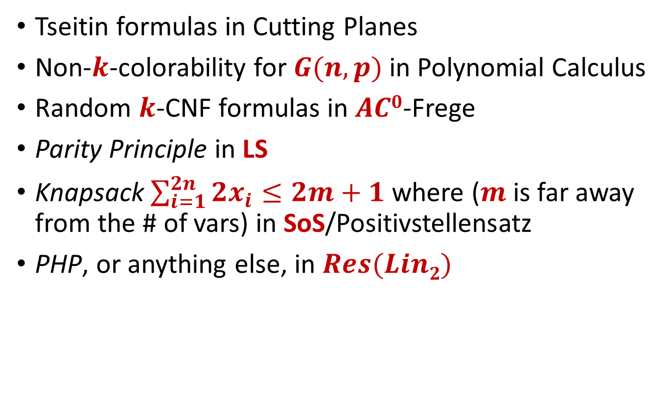
Candidates for lower bounds
Tseitin formulas in Cutting Planes
Non-$k$-colorability for $G(n,p)$in Polynomial Calculus
Random $k$-CNF formulas in $AC0$-Frege
Parity Principle in LS
Knapsack $\sum_{i=1}^{2n}{{2x}_{i}≤2m+1}$where ($m$ is far away from the # of vars) in SoS/Positivstellensatz
PHP, or anything else, in $Res(Lin2)$

Slide 51
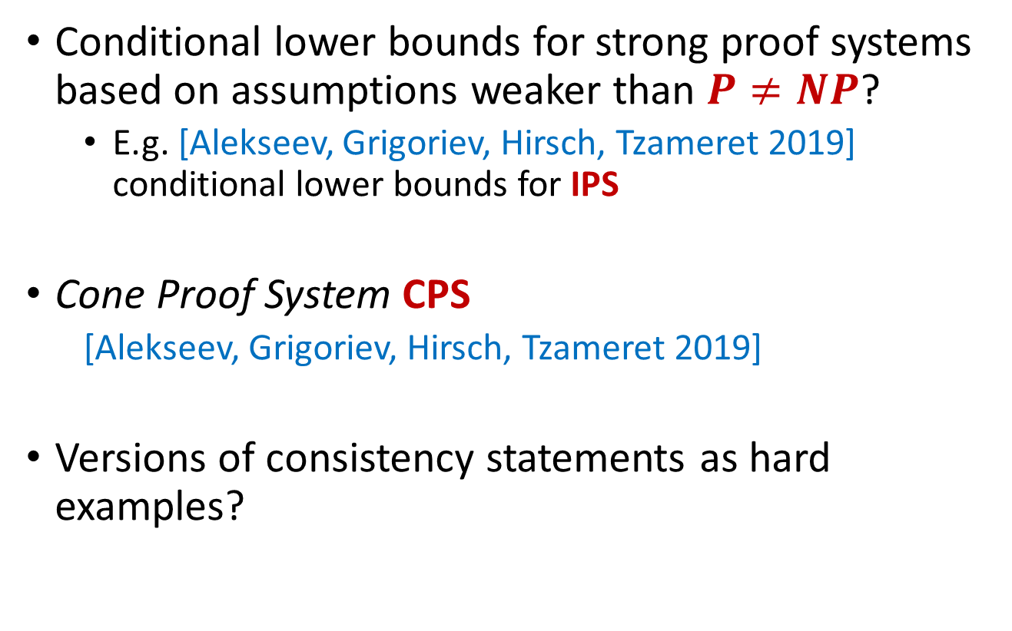
Many other directions…
Conditional lower bounds for strong proof systems based on assumptions weaker than $P≠NP$?
  E.g. [Alekseev, Grigoriev, Hirsch, Tzameret 2019] conditional lower bounds for IPS
Cone Proof System CPS
  [Alekseev, Grigoriev, Hirsch, Tzameret 2019]
Versions of consistency statements as hard examples?

Slide 52
So much more to do!

