Slide 1
Validating LIGER Integration Using scNMT-seq and SNARE-seq
Joshua Welch

Slide 2
Taxonomy of Single-Cell Data Integration
scRNA across protocols,
individuals, species, etc.
Single-Cell Data
Different Cells
Same Modality
Different Modality
Same
Cells
Shared Features
No Shared Features
scRNA, snATAC, snmC,
scHi-C, CyTOF
Seurat v3, LIGER
scRNA + snATAC, etc.
scNMT, SNARE-seq
scRNA + scHi-C, etc.
MOFA, SNF, MINT
MATCHER, MMD-MA

Slide 3
Why Integrate Different Cells from Different Modalities?
scRNA across protocols,
individuals, species, etc.
Single-Cell Data
Different Cells
Same Modality
Different Modality
Same
Cells
Shared Features
No Shared Features
scRNA, snATAC, snmC,
scHi-C, CyTOF
Seurat v3, LIGER
scRNA + snATAC, etc.
scNMT, SNARE-seq
scRNA + scHi-C, etc.
MOFA, SNF, MINT
MATCHER, MMD-MA
Use multiple modalities to jointly cluster cells
Link cells of different modalities to infer “pseudo-multi-omic” profiles
Investigate similarities and differences among modalities

Slide 4
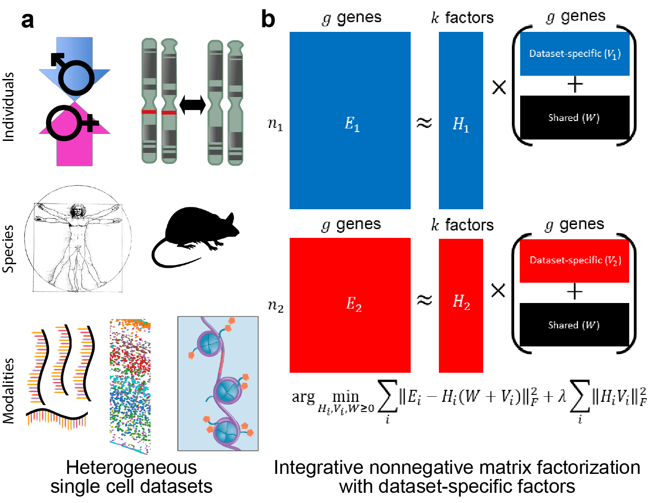
LIGER: Linked Inference of Genomic Experimental Relationships
Welch et al. Cell 2019
https://doi.org/10.1016/j.cell.2019.05.006

Slide 5
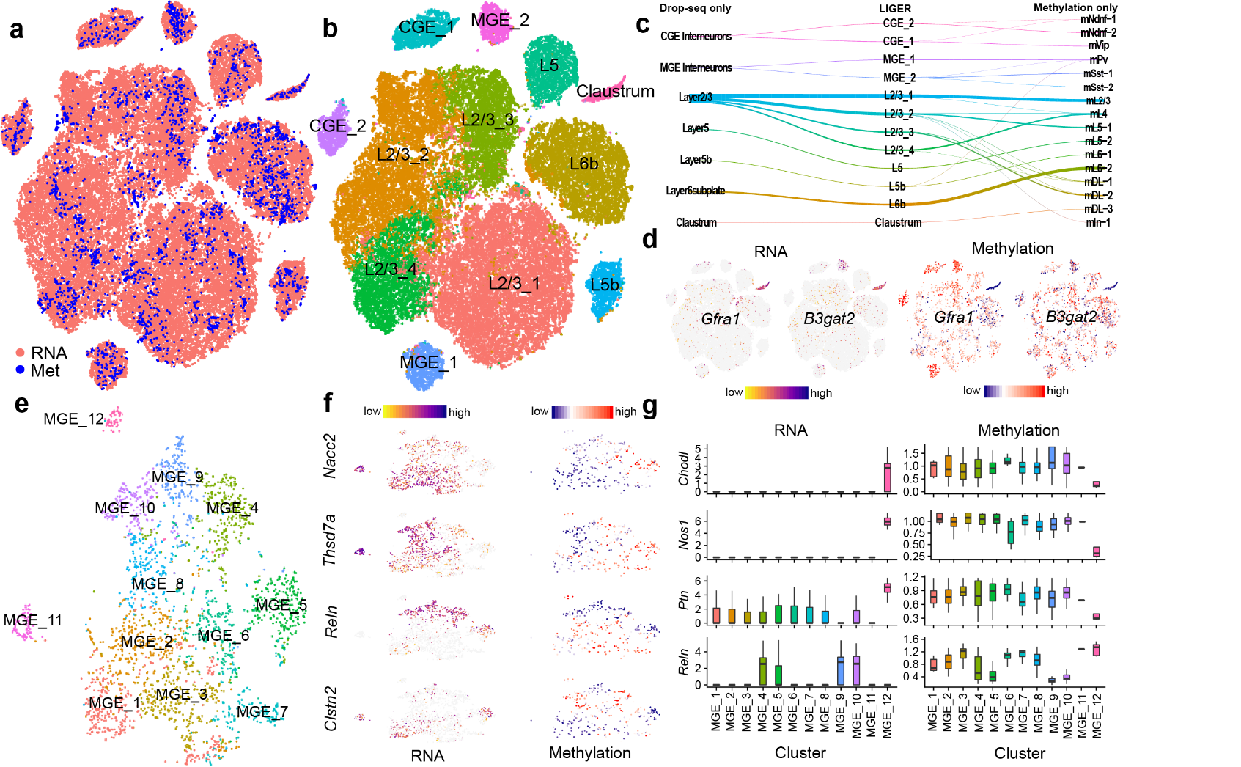
LIGER Integrates scRNA-seq and snmC-seq
Welch et al. Cell 2019
https://doi.org/10.1016/j.cell.2019.05.006
Strong alignment between RNA and methylation from mouse cortex
Published cluster annotations from each data type correspond
Integration with RNA allows annotation of ambiguous cell types

Slide 6
LIGER Resolves Fine Methylation Subtypes
Integration resolved 12 MGE interneuron clusters vs. 3 from methylation only
Clearly distinguishing markers that correspond between RNA and methylation
Resolved Sst+Chodl+ cells, which represent only 0.1% of all cortical cells
Welch et al. Cell 2019
https://doi.org/10.1016/j.cell.2019.05.006

Slide 7
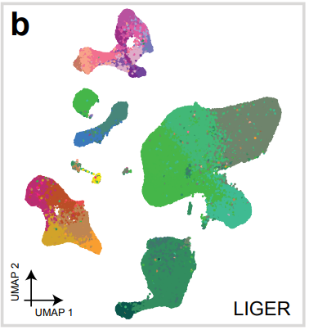
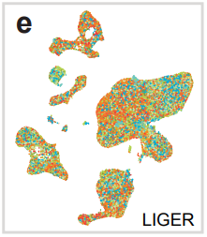
LIGER Integrates scRNA, snmC, and snATAC
By Cluster
By Dataset
Mouse primary motor cortex (MOp)
Brain Initiative Cell Census Network
8 datasets, 5 protocols, 4 labs
scRNA-seq, snRNA-seq, snATAC-seq, snmC-seq
408,885 cells/nuclei
Yao et al. 2020 doi.org/10.1101/2020.02.29.970558

Slide 8
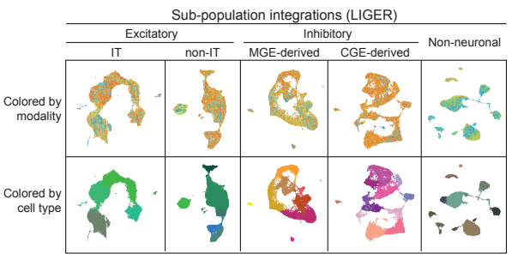
LIGER Integrates scRNA, snmC, and snATAC
Mouse primary motor cortex (MOp)
Brain Initiative Cell Census Network
8 datasets, 5 protocols, 4 labs
scRNA-seq, snRNA-seq, snATAC-seq, snmC-seq
408,885 cells/nuclei
56 joint clusters
Yao et al. 2020 doi.org/10.1101/2020.02.29.970558

Slide 9
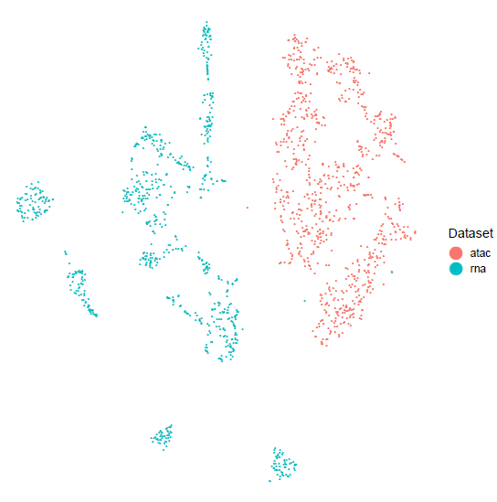
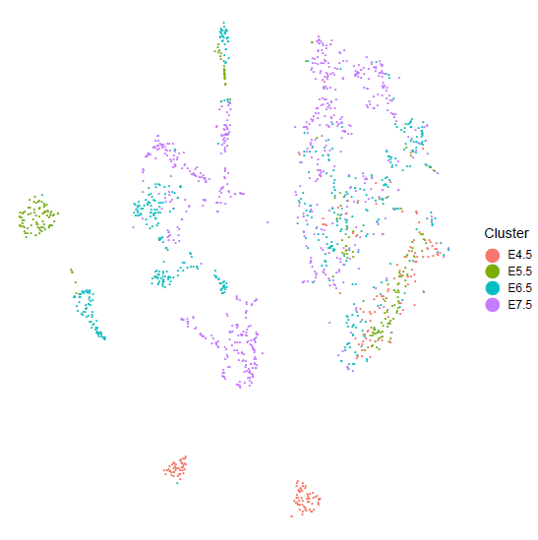
Separately Integrating scNMT-seq Modalities
Stages separate well using both gene expression and gene/promoter epigenomic state
Lineages do not separate well using accessibility or methylation

Slide 10
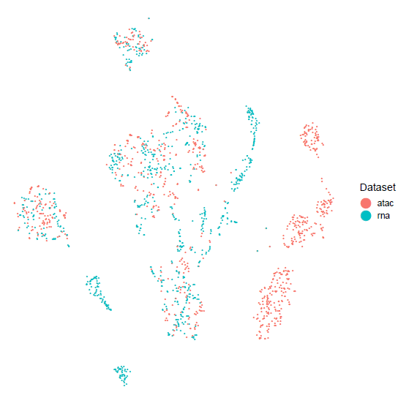
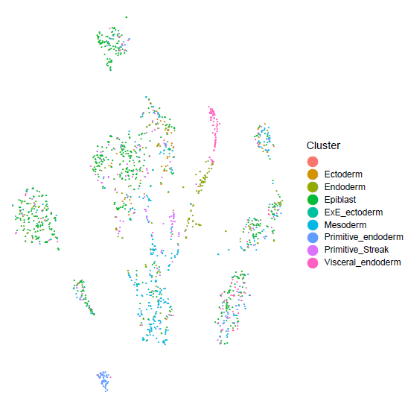
Separately Integrating scNMT-seq Modalities
Gene body/promoter epigenomic state does not align well with expression state
Different preprocessing strategies do not change result
Alignment Metric: 0.44

Slide 11
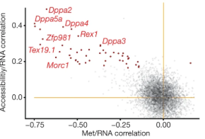
Epigenomic Decoupling?
Poor alignment may be due to epigenomic decoupling in early embryo
Only a few genes show significant correlation between promoter epigenomic state and expression
MOFA analysis suggests that enhancers may be more predictive of gene expression
Argelauget et al. Nature 2019

Slide 12
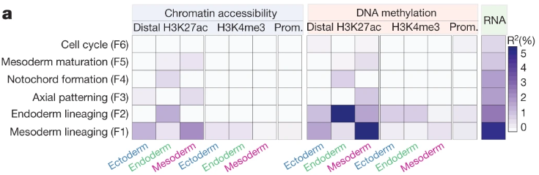
Epigenomic Decoupling?
Poor alignment may be due to epigenomic decoupling in early embryo
Only a few genes show significant correlation between promoter epigenomic state and expression
MOFA analysis suggests that enhancers may be more predictive of gene expression
Argelauget et al. Nature 2019

Slide 13
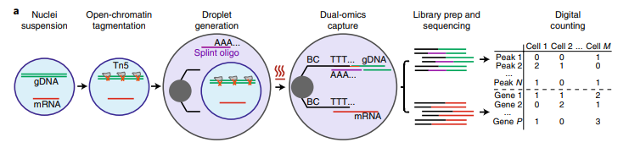
SNARE-seq Protocol
Treat nuclei with Tn5 before droplet generation
Attach poly(A) to transposed fragment allowing capture by Drop-Seq beads
More ATAC reads per cell than sci-CAR

Slide 14
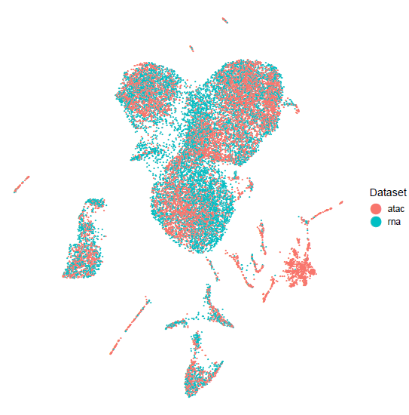
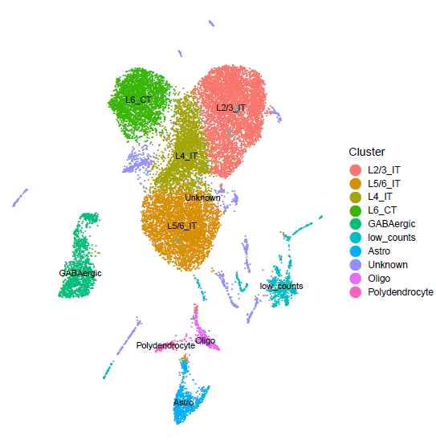
Separately Integrating SNARE-seq Modalities
Mouse cortex
Brain Initiative Cell Census Network
8 datasets, 5 protocols, 4 labs
scRNA-seq, snRNA-seq, snATAC-seq, snmC-seq
408,885 cells/nuclei
56 joint clusters
Alignment Metric: 0.85

Slide 15
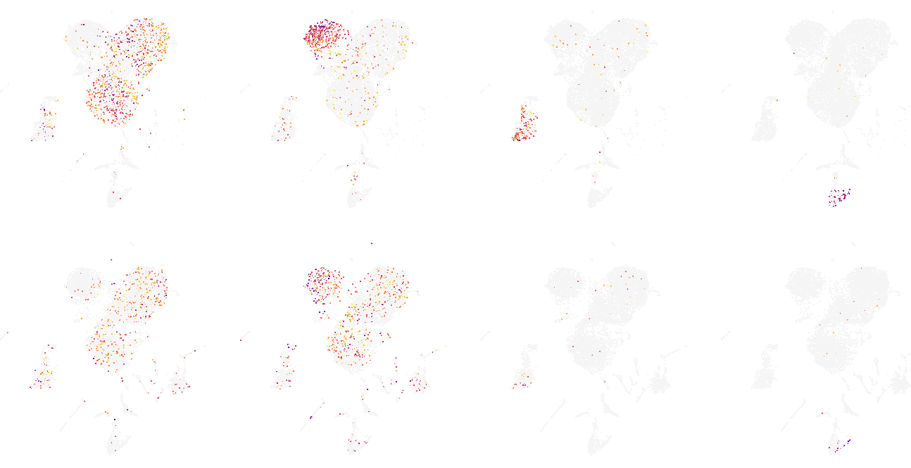
Separately Integrating SNARE-seq Modalities
SNARE-seq RNA
SNARE-seq ATAC
Slc30a3 (IT neurons)
Foxp2 (non-IT neurons)
Gad2 (GABAergic neurons)
Aqp4 (astrocytes)

Slide 16
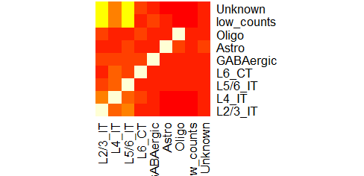
Separately Integrating SNARE-seq Modalities
Most cell pairs map to the same cluster
Mistakes are mostly between closely related clusters
Mismapping rates are higher for “unknown” and “low counts” clusters

Slide 17
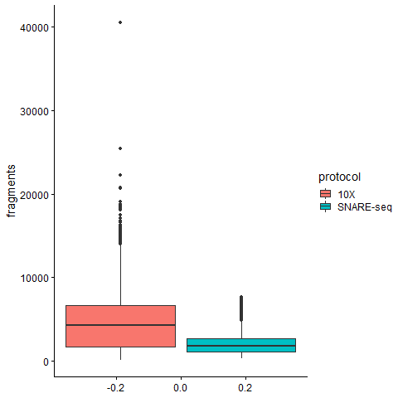
Comparing Single-Cell Chromatin Protocols
10X ATAC protocol gives significantly more reads per gene than SNARE-seq
Median gene body and promoter fragments: 4271 vs. 1787

Slide 18





Acknowledgments
Welch Lab
Chao Gao
Jialin Liu
April Kriebel
Josh Sodicoff

