Slide 1

Biological Network Integration Using Convolutions
Duncan Forster, University of Toronto
Bader, Boone Labs
June 16, 2020

Slide 2
Some quick background
A major goal in systems biology is to functionally characterize genes and identify the systems in which they operate (i.e. modules)
Biological networks (i.e. PPI, COEX, GI) encode useful functional information, but each contain their own individual biases (e.g. only measure a certain part of the functional spectrum) and noise (include spurious relationships or miss true relationships)
By integrating networks we can overcome these issues in order to more effectively characterize genes
We’ve developed a network integration algorithm, BIONIC (Biological Network Integration using Convolutions), to do this

Slide 3
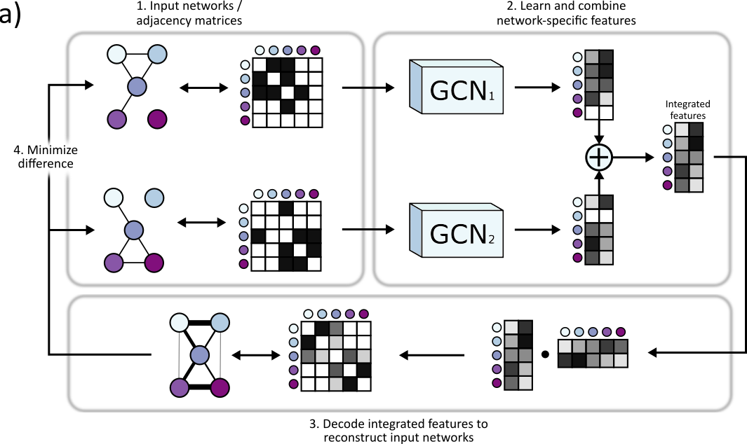
BIONIC overview

Slide 4
Some problems we encountered

Slide 5
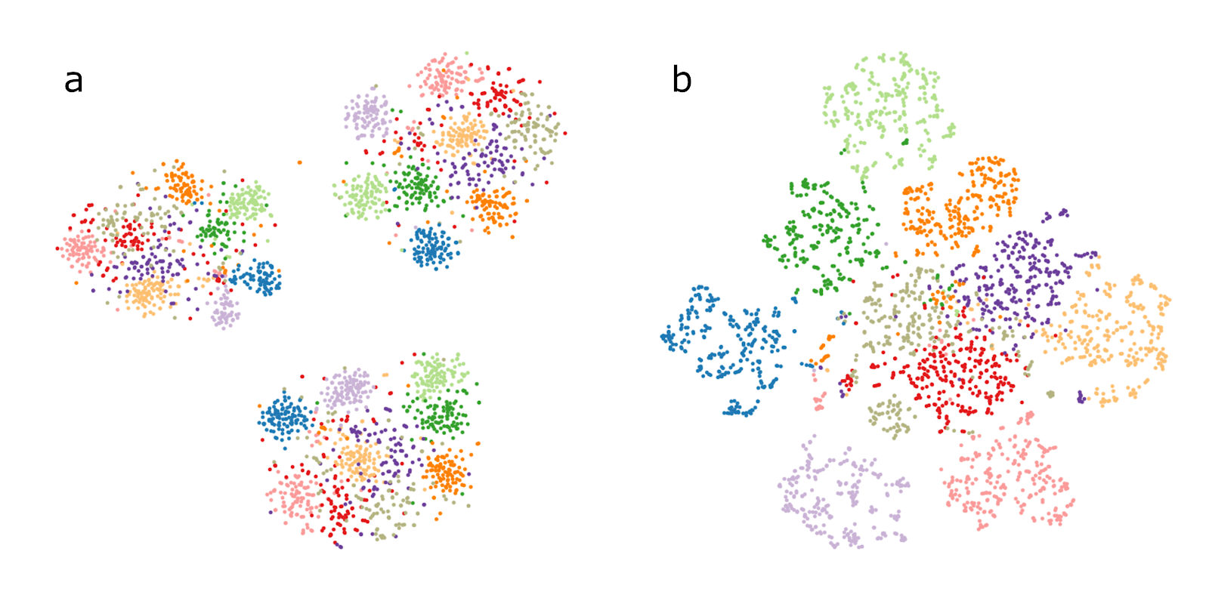
Partially overlapping datasets
Network 1
Genes
Network 2
Genes

Slide 6
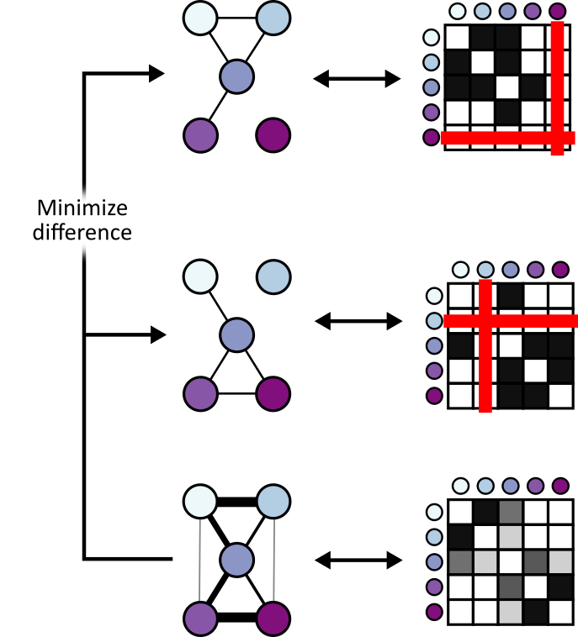
Partially overlapping datasets

Slide 7
Evaluation techniques
How do we construct benchmarks?
Comparing method output to individual input networks is difficult when the input network has a subset of output genes
How do we ensure method performance isn’t driven by bias in certain functional categories?
We opted for three evaluation approaches:
  Gene-gene interaction assessment
  Functional module detection (cluster quality)
  Supervised gene function prediction

Slide 8



Acknowledgements
Supervisors
Gary Bader
Charlie Boone
Collaborators
- Bo Wang

Slide 9
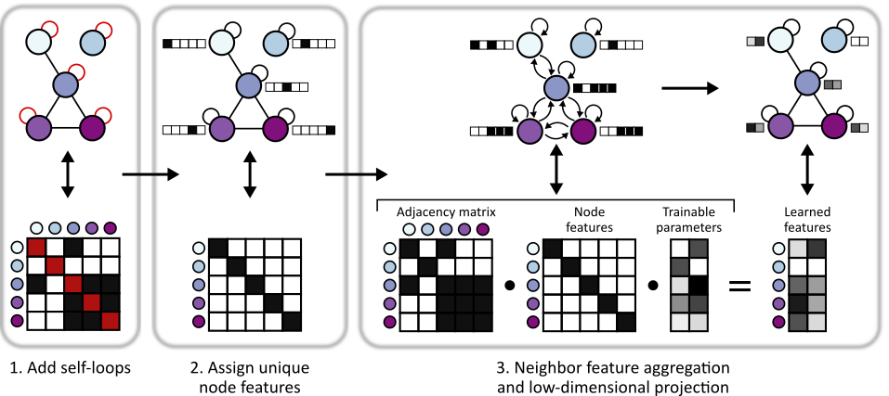
Graph convolutional network (GCN) overview

Slide 10
Evaluating BIONIC features
Integrated 68 yeast networks, consisting of GI, COEX and PPI experiments
Also integrated 37 human PPI networks
Evaluated the performance of BIONIC integrated gene features on three downstream tasks
  Gene-gene interaction prediction
  Functional module detection
  Gene function prediction
Compared BIONIC to three other integration approaches
  A naïve union of networks (combine all nodes and edges across networks)
  iCell, a matrix factorization approach
  Mashup, a diffusion state approximation method

Slide 11
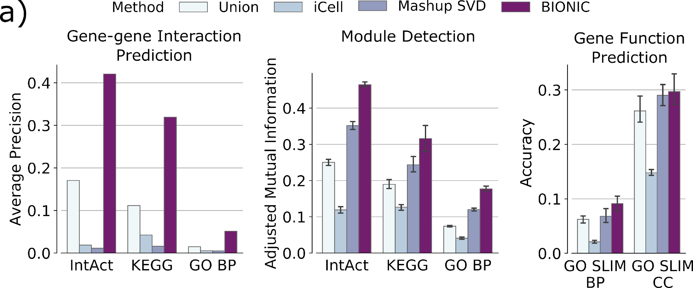
Global evaluations

Slide 12
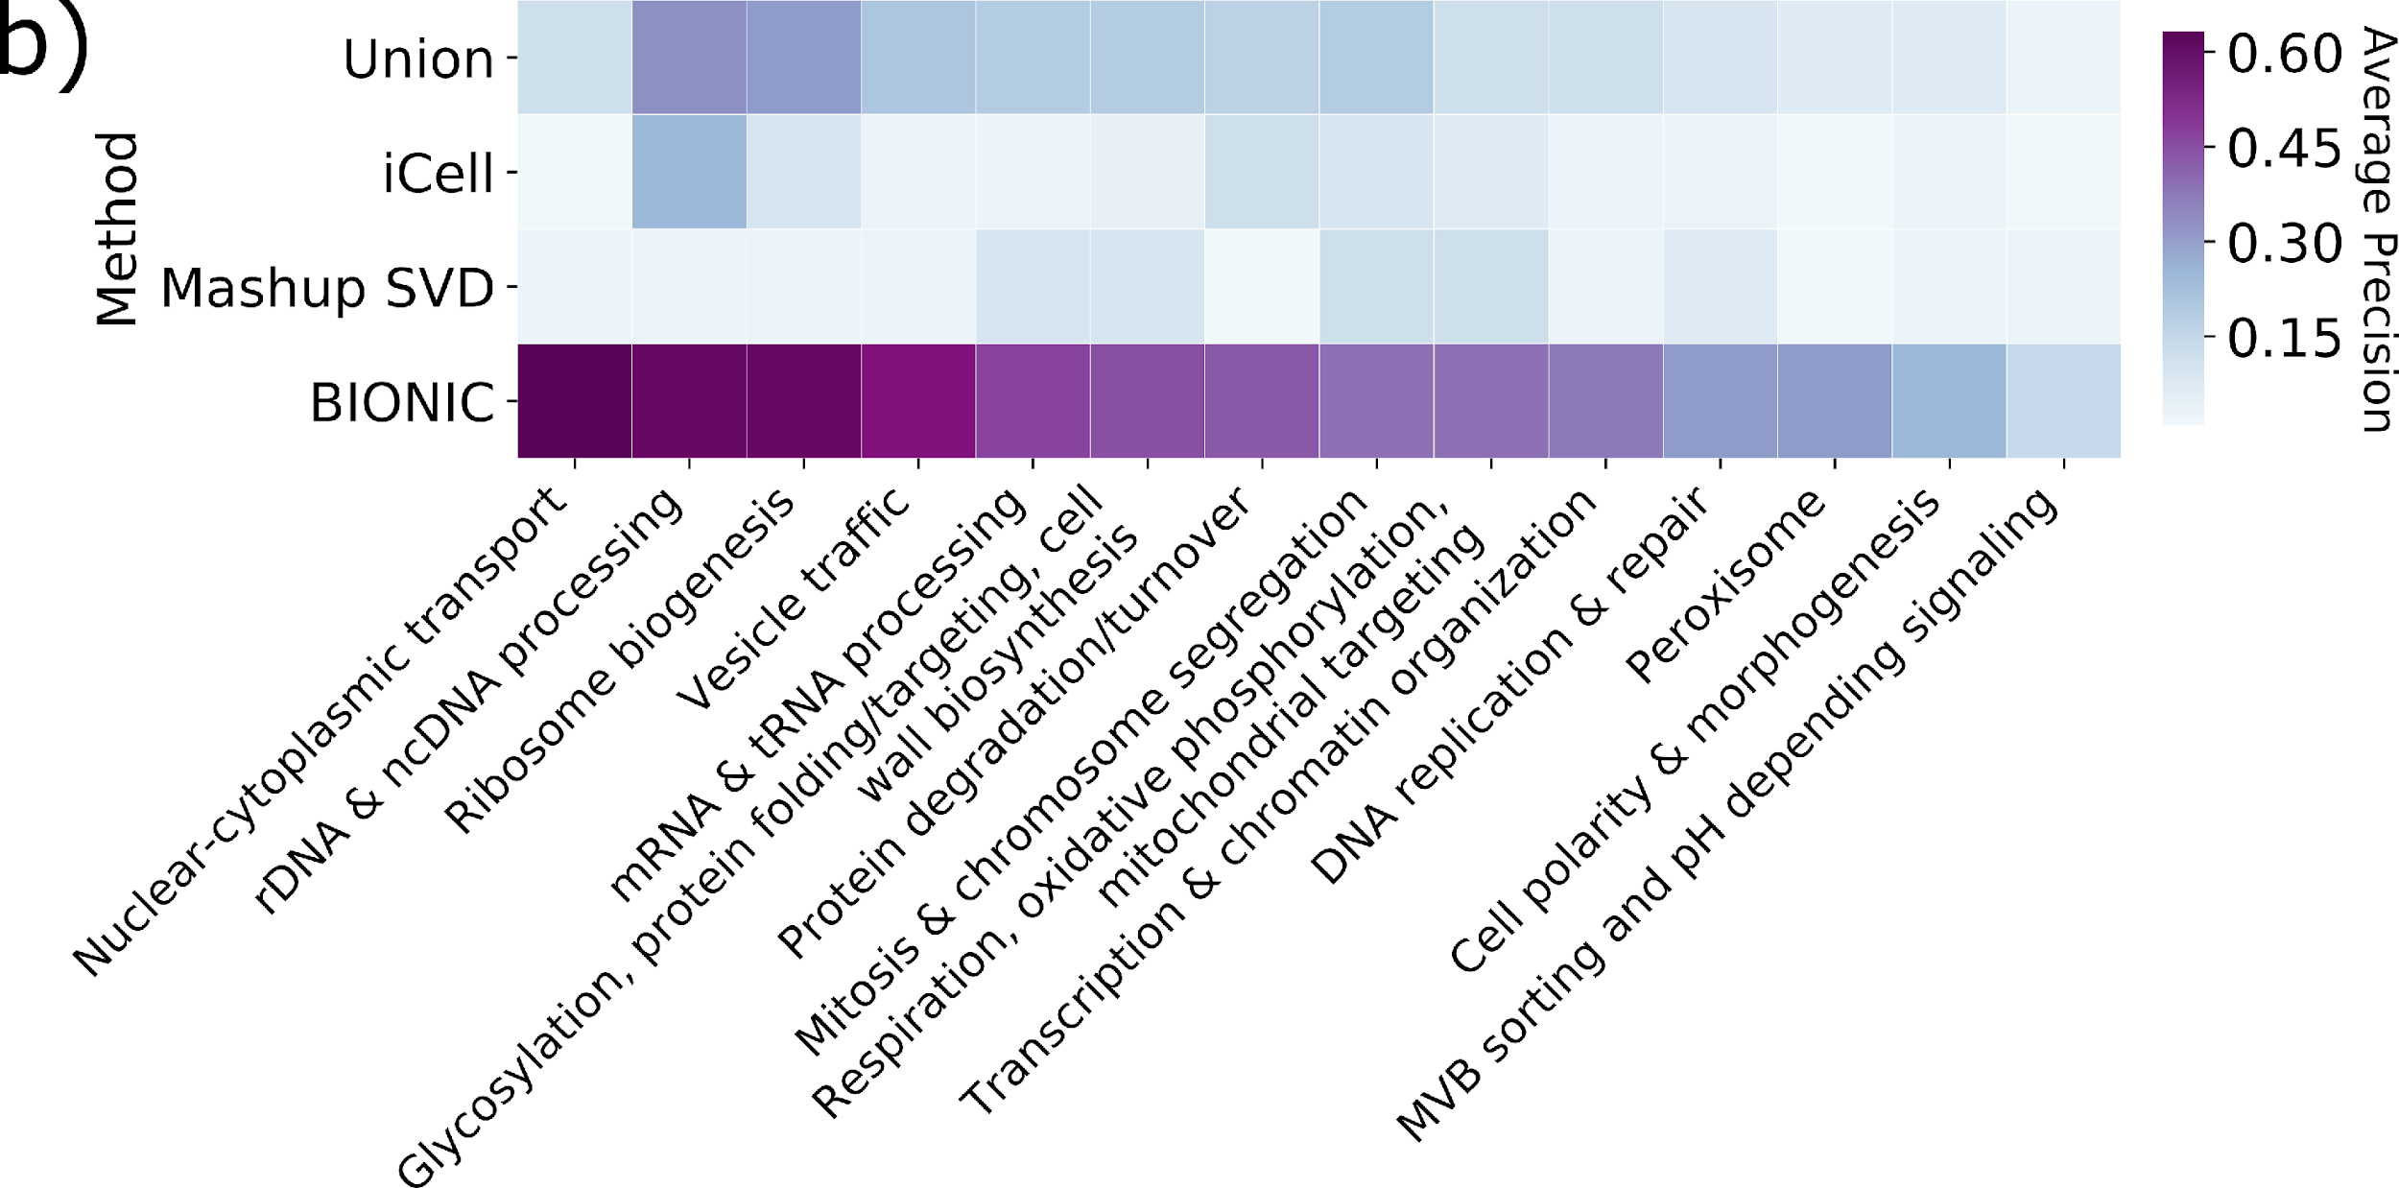
Function-wise evaluation

Slide 13
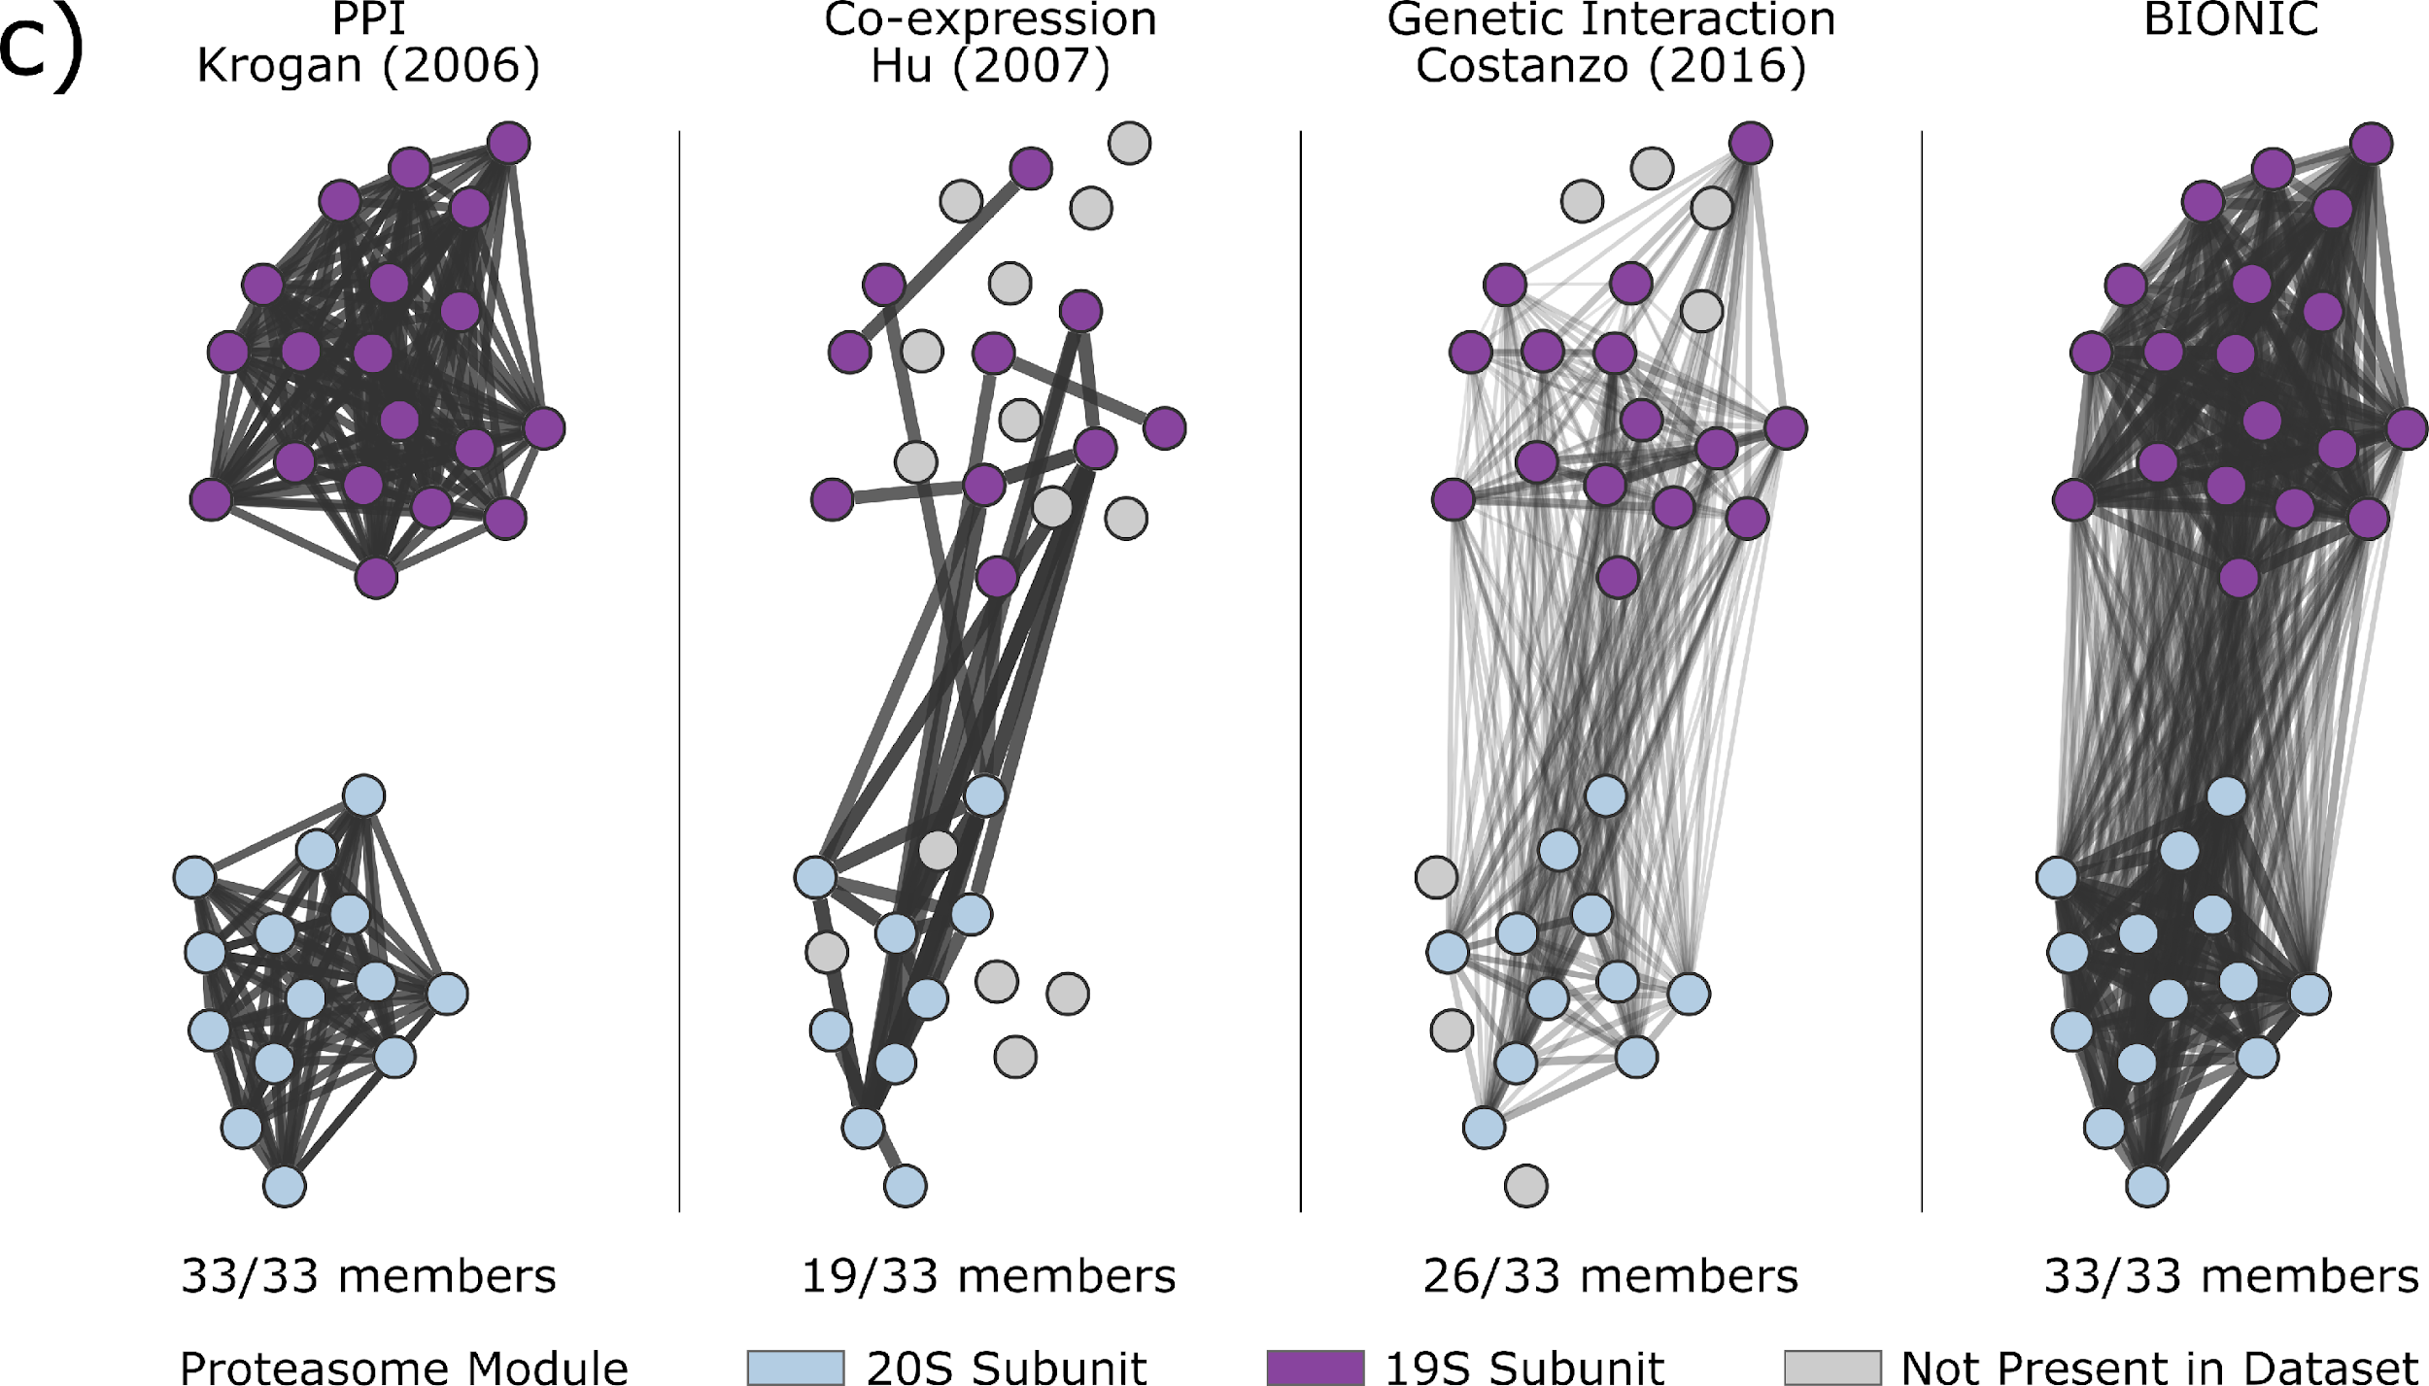
Example integrated module

Slide 14

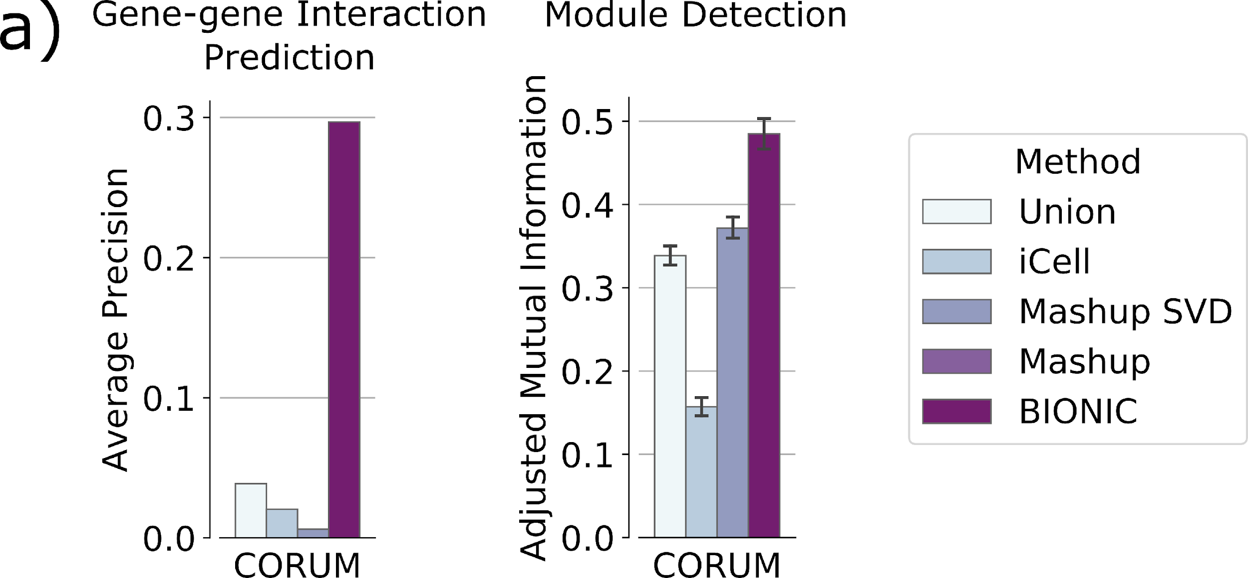
Global evaluations on human networks

Slide 15
Evaluating BIONIC scalability
Many integration approaches either cannot scale to many networks or networks with many genes
  These methods either don’t run, or run with reduced performance (e.g. Mashup SVD)
To assess whether BIONIC scales in number of networks, we integrate increasing numbers of yeast coexpression networks
To determine if BIONIC scales in network size, we subsample genes from four human PPI networks and integrate them with increasing sample sizes

Slide 16
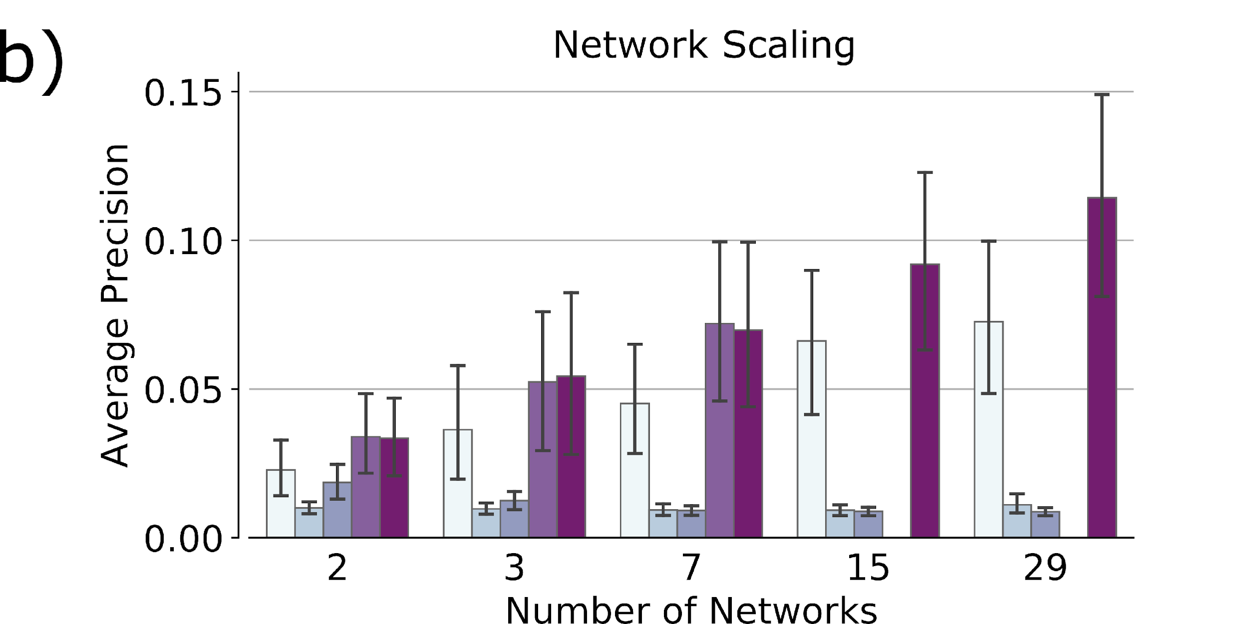
Scalability in number of networks

Slide 17
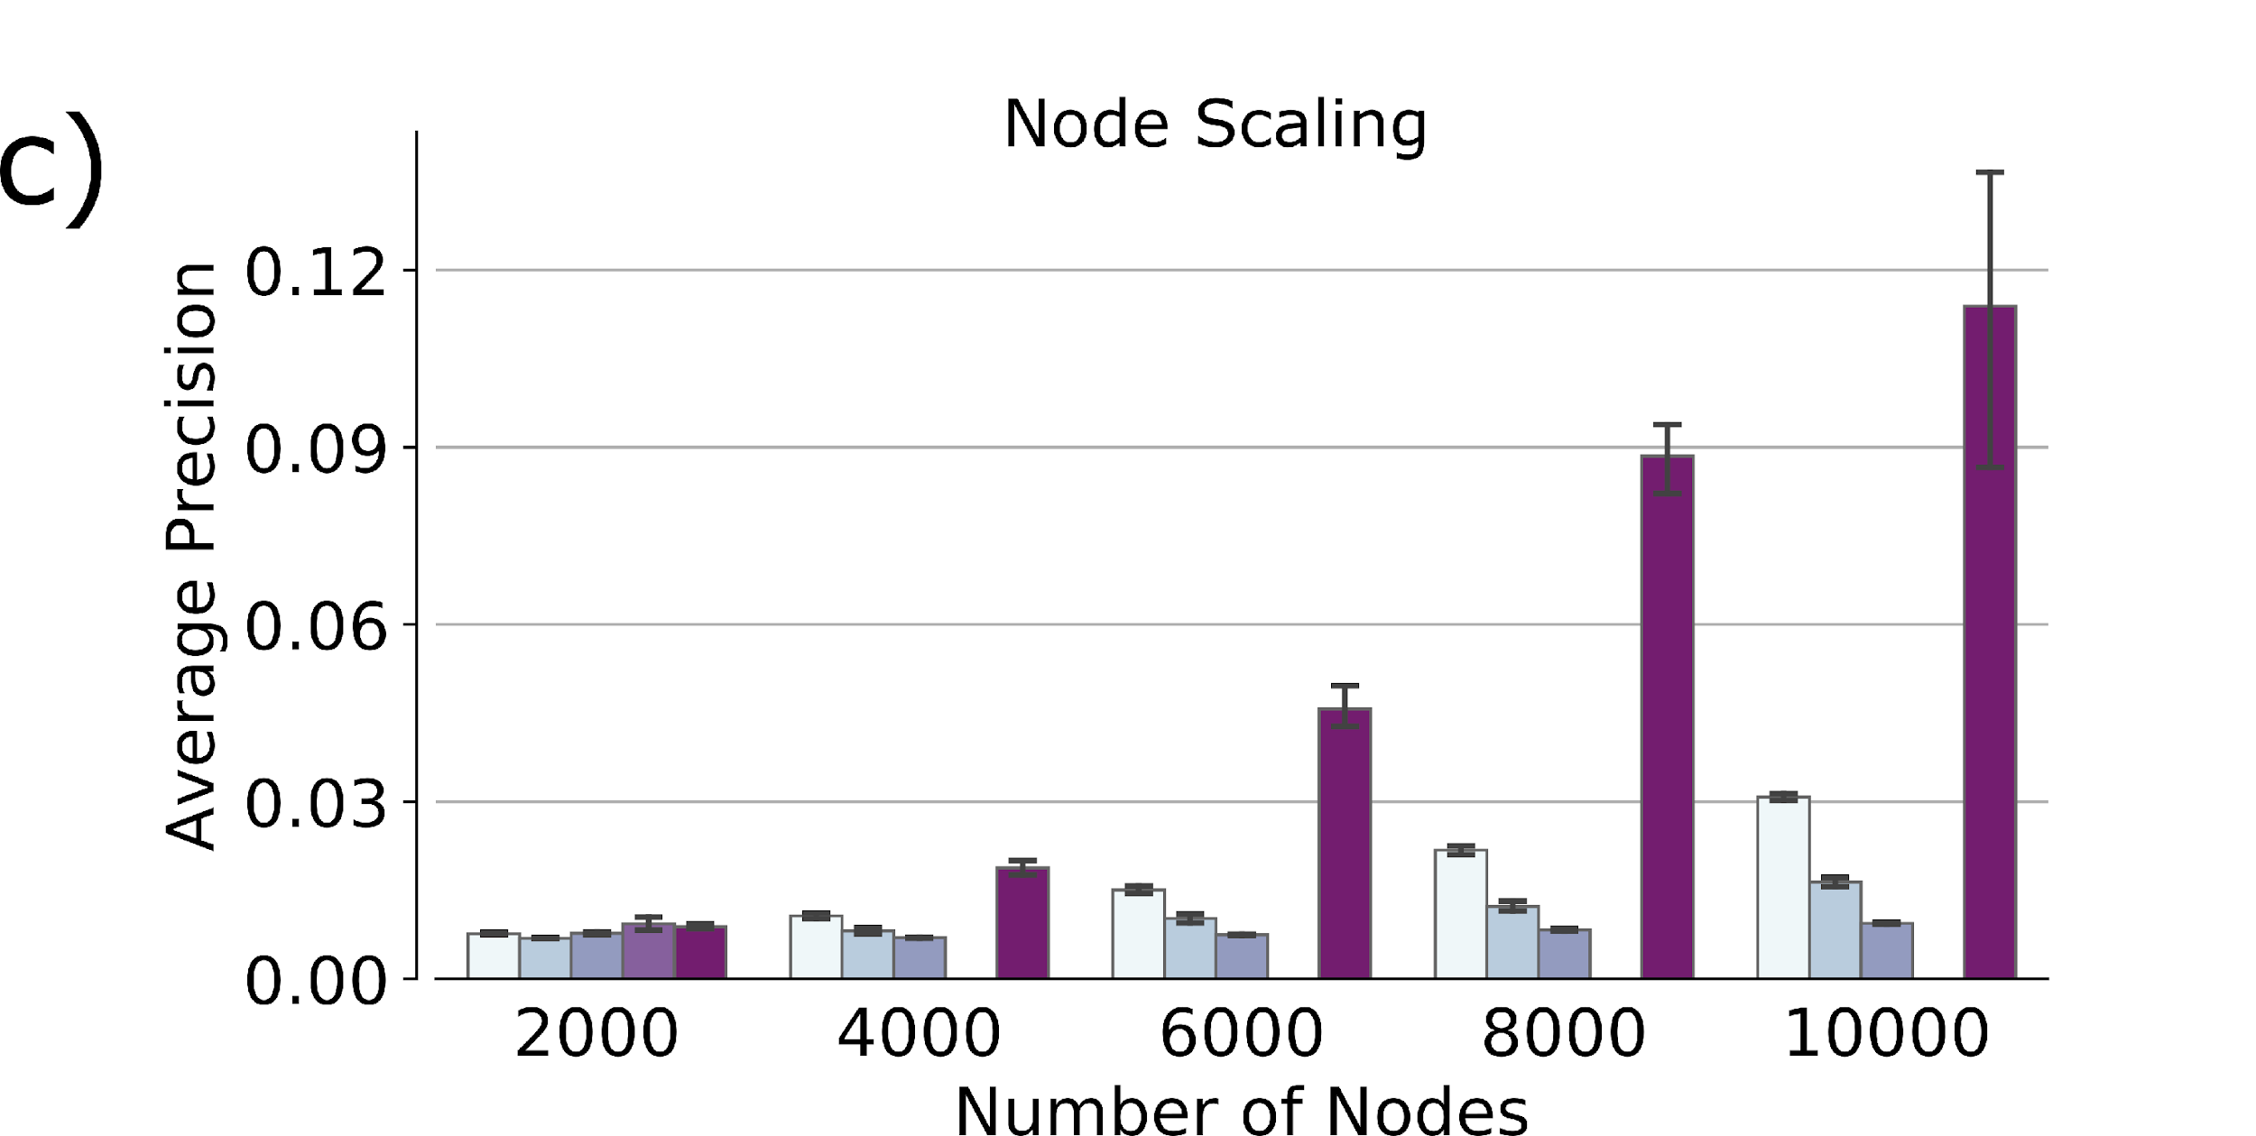
Scalability in number of nodes

