Slide 1
CORTEX seq-FISH: gene selection
Hang Xu
Stanford University

Slide 2
seqFish & scRNA integration
Question:
What is the minimal number of genes needed for data integration?

Slide 3
seqFish & scRNA integration
Question:
What is the minimal number of genes needed for data integration?
What is the minimal number of genes needed to distinguish cell types in both datasets ?

Slide 4
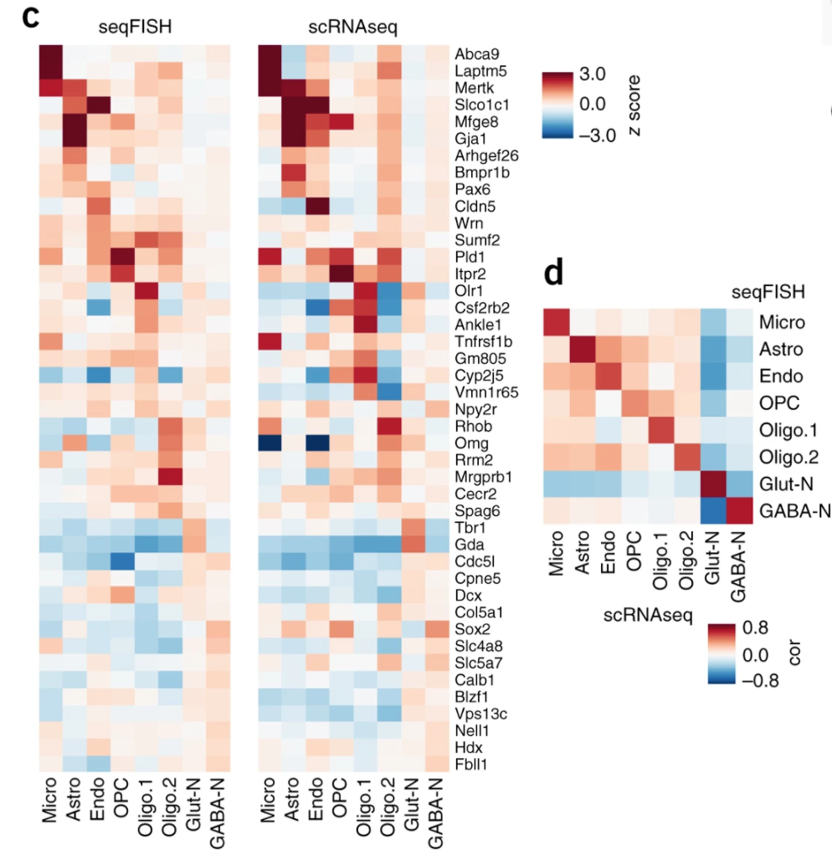
seqFish & scRNA integration
Qian et al. 2018, Figure 1 c,d
Question:
What is the minimal number of genes needed for data integration?
What is the minimal number of genes needed to distinguish cell types in both datasets ?
43 genes !
8 major cell types
Notes:
jor

Slide 5
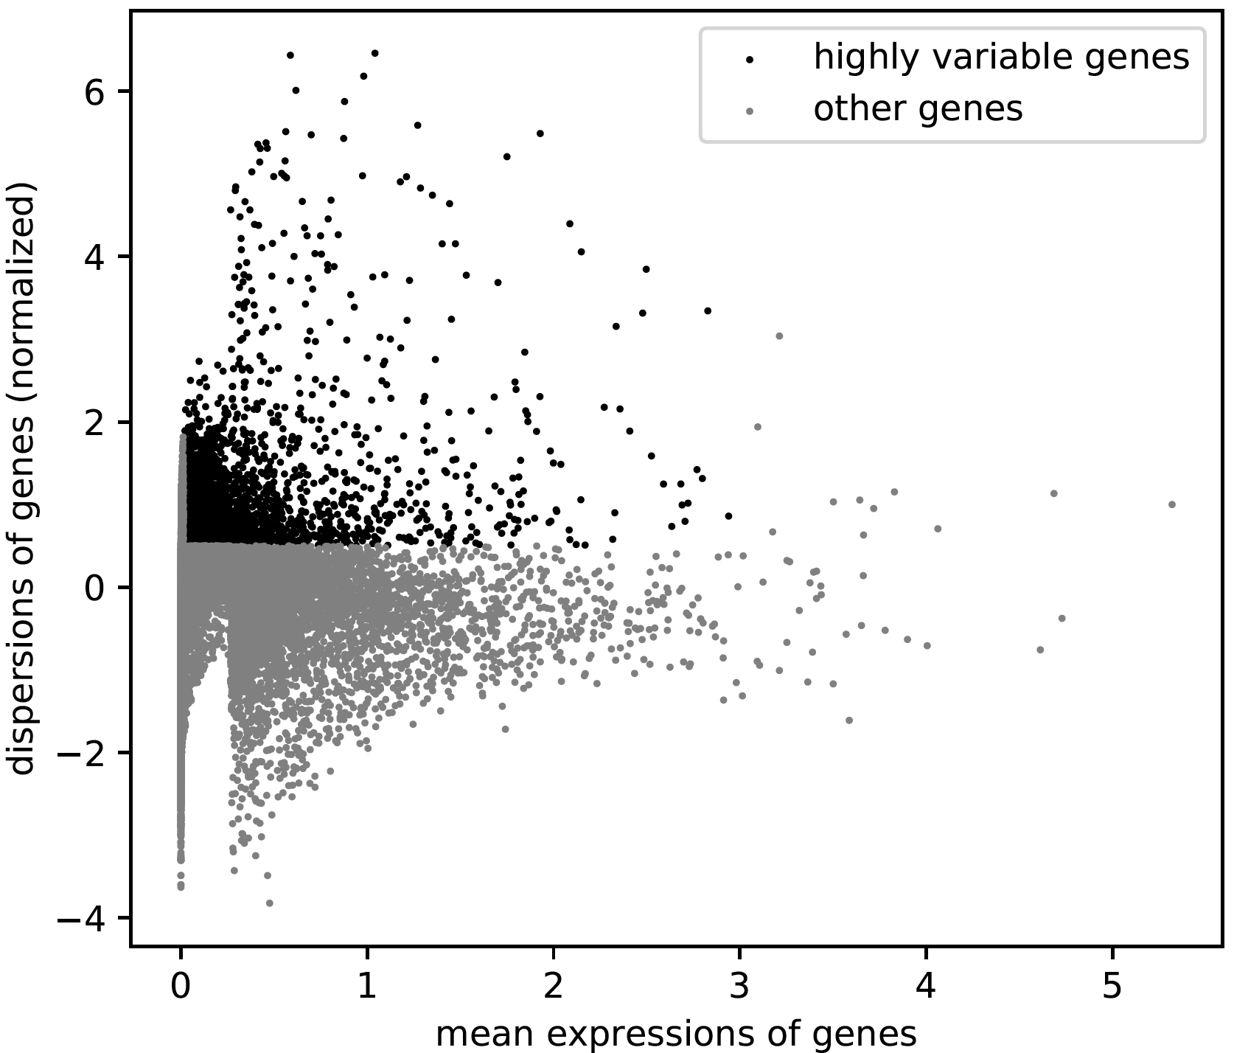
Identify highly variable genes
scRNA read counts
Package: Scanpy
Filter cells:
Num genes >= 200 & < 10000
mitochondrial gene percent < 15%
Filter genes:
min_cells =3
Normalization
Annotate highly variable genes
Min_mean = 0.0125
Max_mean = 3
Min_dispersion = 0.5
Notes:
Question: What is the minimal number of genes needed for data integration?
Each cell’s expression is determined by both intrinsic and extrinsic factors. The intrinsic are cell type. Extrinsic is the microenvironment. To integrate scRNA and seqFish data, genes that responsive to both the intrinsic and extrinsic factors matter here.
So the question divided into two: 1) what is the minimum number of genes needed for cell type recognition. 2) what is the minimum number of genes for spatial domain recognition.

Slide 6
Identify highly variable genes
scRNA read counts
Package: Scanpy
Filter cells:
Num genes >= 200 & < 10000
mitochondrial gene percent < 15%
Filter genes:
min_cells =3
Normalization
Annotate highly variable genes
Min_mean = 0.0125
Max_mean = 3
Min_dispersion = 0.5
Among the 113 genes overlapped between scRNAseq and seqFish
46 genes are annotated as high variable genes
Notes:
Question: What is the minimal number of genes needed for data integration?
Each cell’s expression is determined by both intrinsic and extrinsic factors. The intrinsic are cell type. Extrinsic is the microenvironment. To integrate scRNA and seqFish data, genes that responsive to both the intrinsic and extrinsic factors matter here.
So the question divided into two: 1) what is the minimum number of genes needed for cell type recognition. 2) what is the minimum number of genes for spatial domain recognition.

Slide 7
Colinear relationship between 46 highly variable genes in scRNAseq data
Notes:
Utilize Pearson correlation score that takes into account pairs of features at a time. The pairs of features are then ranked by score and visualized using the lower left triangle of a feature co-occurrence matrix.

Slide 8
Strategy
scRNAseq data
SVM classification model
Notes:
Training data and testing data
Workflow
Recursive Feature elimination (RFE) is a feature selection method that fits a model and removes the weakest feature (or features) until the specified number of features is reached. Features are ranked by the model’s coef_ or feature_importances_ attributes, and by recursively eliminating a small number of features per loop, RFE attempts to eliminate dependencies and collinearity that may exists in the model.
REF requires a specific number of features to keep, however, it is often not known in advance how many features are valid. To find the optimal number of features cross-validation is used with RFE to score different feature subsets and select the best scoring collection of features.

Slide 9
Strategy
Parameter
C: [1e-6, 1e-3, 1]
scRNAseq data
SVM classification model
Fit model
Gain the importance
of every feature
Recursive
Feature
Elimination
(RFE)
no
Remove the least
important feature
Specific number of
features reached
yes
Cross validation for scoring
Notes:
Training data and testing data
Workflow
Recursive Feature elimination (RFE) is a feature selection method that fits a model and removes the weakest feature (or features) until the specified number of features is reached. Features are ranked by the model’s coef_ or feature_importances_ attributes, and by recursively eliminating a small number of features per loop, RFE attempts to eliminate dependencies and collinearity that may exists in the model.
REF requires a specific number of features to keep, however, it is often not known in advance how many features are valid. To find the optimal number of features cross-validation is used with RFE to score different feature subsets and select the best scoring collection of features.

Slide 10
Feature selection
C = 1e-6
f1 weighted

Slide 11
Feature selection
C = 1e-6
C = 1e-3
f1 weighted
C = 1e-6
C = 1e-3

Slide 12
Feature selection
C = 1e-6
C = 1e-3
C = 1
f1 weighted
C = 1e-6
C = 1e-3
C = 1

Slide 13
Feature selection
12 features
C = 1e-6
7 features
C = 1e-3
C = 1
f1 weighted
C = 1e-6
C = 1e-3
C = 1

Slide 14
Prediction results
C: 1e-3
Num_features: 12
scRNA
seqFish
Average
z-score

Slide 15
Prediction results
scRNA
seqFish
C: 1e-6
Num_features: 7
Average
z-score

Slide 16
Thank you!
Questions?

Slide 17
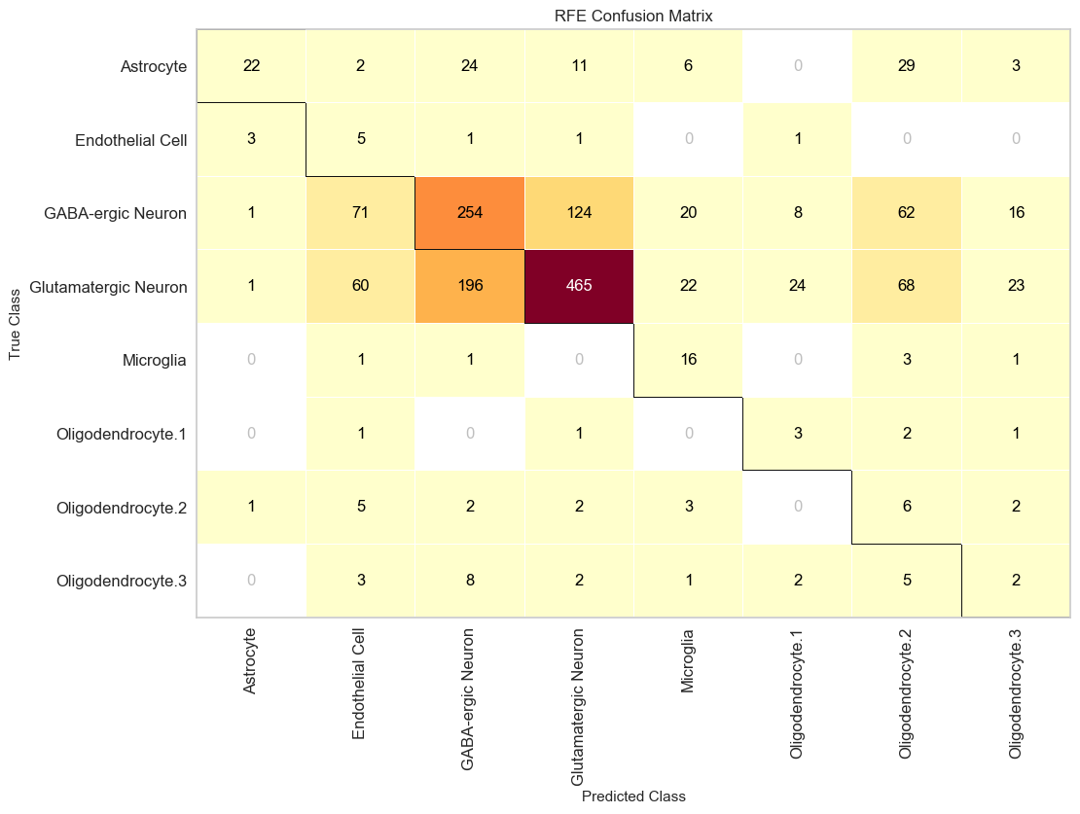
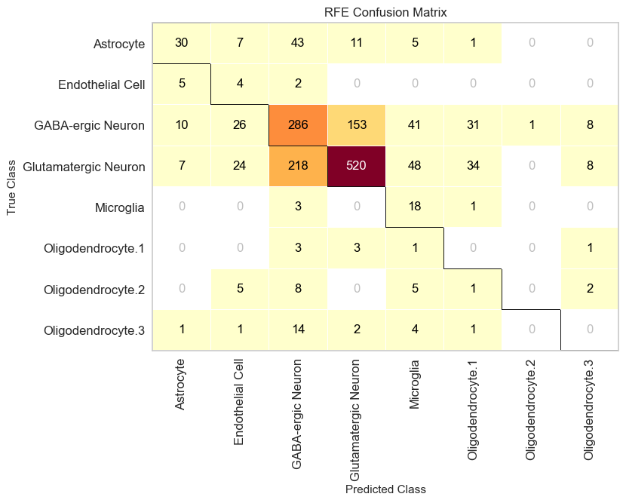
Compare with Original prediction
C: 1e-3
Num_features: 12
C: 1e-6
Num_features: 7

