Slide 1
”Reviving” Depth sensitivity in MITgcm: Sensitivity of ice-shelf melt to bathymetric uncertainty
Daniel N Goldberg¹, Tim Smith², Krishna Narayanan³, Patrick Heimbach^{1,2,4}
¹University of Edinburgh, School of GeoSciences
²Institute for Computational Engineering and Science, UT-Austin
³Math and Computational Science, Argonne National Lab
⁴Jackson School of Geosciences, UT-Austin
Mathematical Modelling in Glaciology, Banff Int’l Research Station, 14 Jan 2020

Slide 2
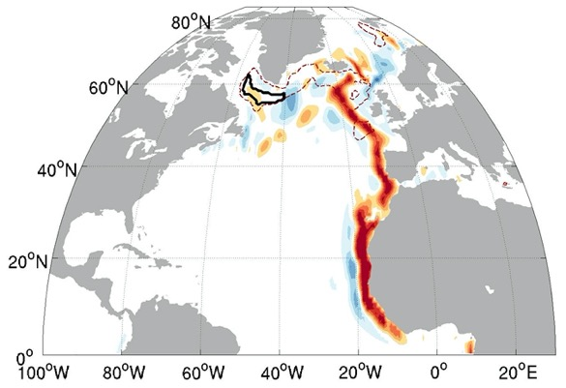
Adjoint Ocean Models
Adjoint models of ocean circulation represent powerful tools for analysing oceanic drivers (cf Patrick’s Talk)
They can be used to assess high-dimensional (infinite-dimensional) gradients of model outcomes with respect to parameter/input fields
e.g., Surface Wind Forcing (Jones et al, 2018)
or Bottom Topography (Losch and Heimbach, 2007)
… which can then be used to characterise the impact of uncertainty in these fields

Slide 3
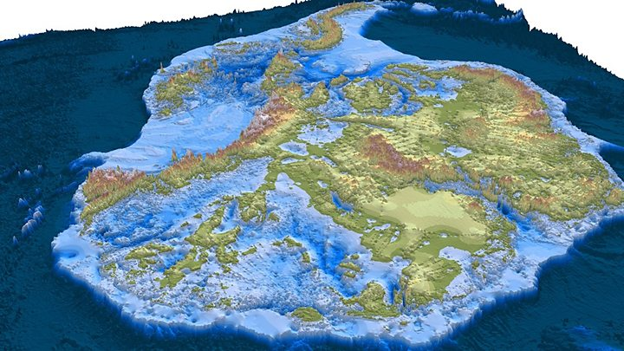
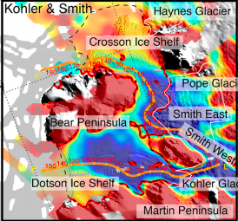
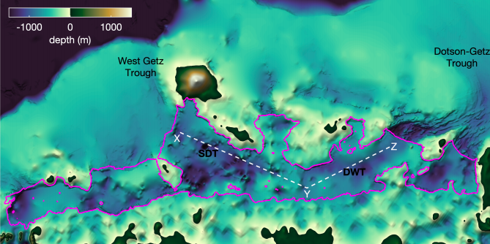
Impact of Bathymetry on ice-shelf cavities
Morlighem et al, 2019
Impact of bathymetric uncertainty on under-ice circulation is quite important to constrain:
Bathymetry has strong impact on cavity circulation;
And our understanding of ice-shelf bathymetry is being constantly rewritten!
Millan et al, 2017
Dutrieux et al, 2014
Wei et al, 2019

Slide 4
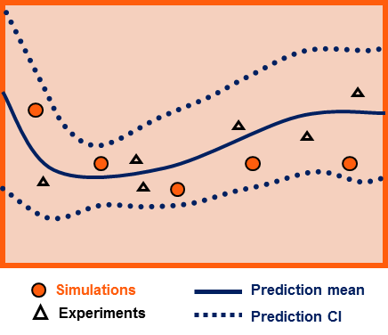
Sensitivities versus Uncertainty
CAVEAT – This work is NOT uncertainty quantification
This would involve a multivariate posterior probability distribution of a VERY high dimensional set of parameters
HOWEVER – adjoint sensitivities have been a prerequisite to UQ in a number of ice- and ocean studies (e.g. Isaac et al, 2015; Kalmikov and Heimbach, 2014)
Adjoint sensitivities of ice-shelf melt to bathymetry has not been previously studied – and such is the focus of this work

Slide 5
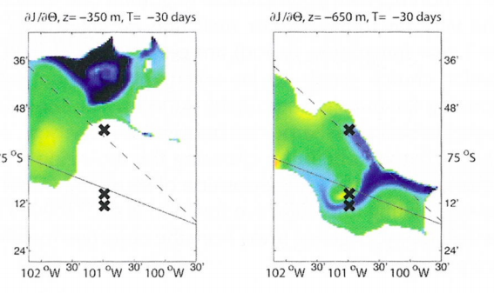
Previous work and Difficulties
MITgcm adjoint has been used to study melt rates before (e.g. Heimbach and Losch, 2012), though sensitivity to bathymetry not considered
Heimbach and Losch, 2012
In part due to code structure (to facilitate Algorithmic Differentiation, code must be designed with AD in mind)
Implementation of bathymetry in MITgcm is nondifferentiable, with “kinks” and discontinuities…
fluid
from mitgcm.org
h_{w}Δz
h_{c}Δz
Δz
bed

Slide 6
Previous work
Previous work and Difficulties
MITgcm adjoint has been used to study melt rates before (e.g. Heimbach and Losch, 2012), though sensitivity to bathymetry not considered
Heimbach and Losch, 2012
In part due to code structure (to facilitate Algorithmic Differentiation, code must be designed with AD in mind)
Implementation of bathymetry in MITgcm is nondifferentiable, with “kinks” and discontinuities…
fluid
from mitgcm.org
δz_{b}
h_{w}Δz
h_{c}Δz
Δz
bed

Slide 7
Previous work
Previous work and Difficulties
MITgcm adjoint has been used to study melt rates before (e.g. Heimbach and Losch, 2012), though sensitivity to bathymetry not considered
Heimbach and Losch, 2012
In part due to code structure (to facilitate Algorithmic Differentiation, code must be designed with AD in mind)
Implementation of bathymetry in MITgcm is nondifferentiable, with “kinks” and discontinuities…
fluid
from mitgcm.org
fluid
δz_{b}
h_{w}Δz
h_{c}Δz
Δz
bed
bed

Slide 8
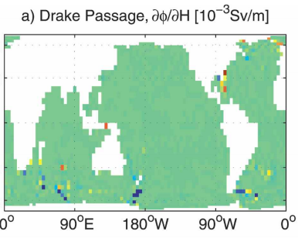
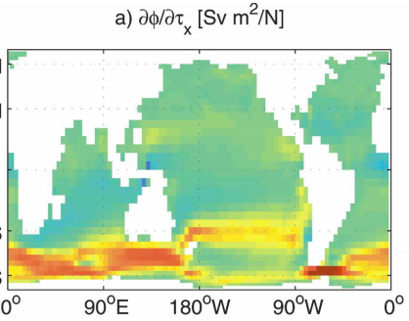
Previous work
Previous work and Difficulties
MITgcm adjoint has been used to study melt rates before (e.g. Heimbach and Losch, 2012), though sensitivity to bathymetry not considered
Heimbach and Losch, 2012
”Smoothing” of kinks (Losch and Heimbach, 2007) can partly address these issues but still gradients tend to be noisier than other fields
Sensitivity of MOC to bathy
Sensitivity of MOC to winds

Slide 9
New development
Timestepping the barotropic mode in MITgcm involves solution of an elliptic PDE
But A depends on ocean depth, so adjoint equations become (Giles, 2002)
Finally – we are working with open-source tool OpenAD (as opposed to TAF)!
Additional changes to “restart” adjoint (OpenAD-DIVA) …
Ax = b
(1) A^{T} (δ*b) = δ*x
(2) δ*A = - δ*b x^{T}
(1) already implemented in MITgcm code, (2) is new

Slide 10
2 Experiments
Idealised experiment (ISOMIP with ridge) in order to make sense of bathymetric influence
Application to realistic domain (Dotson + Crosson ice shelves) to place (1) in context

Slide 11
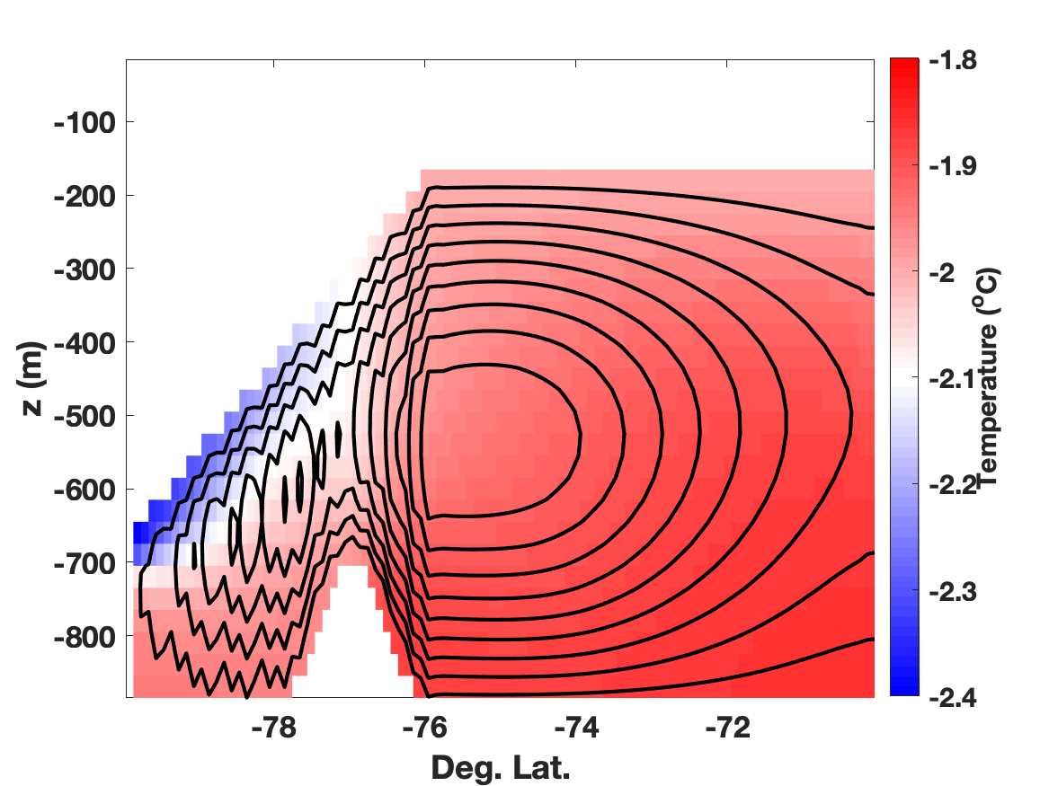
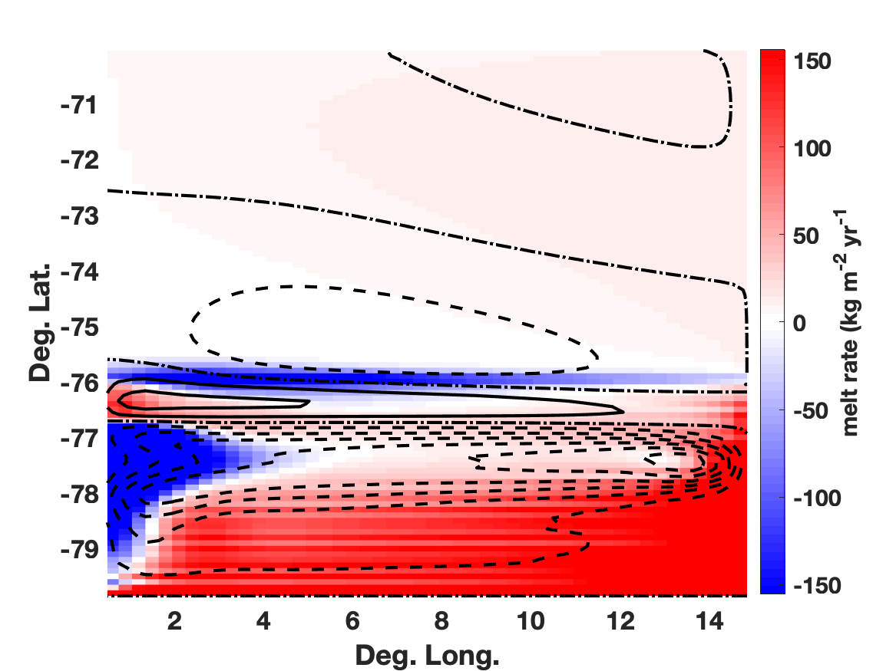
ISOMIP-Ridge
ISOMIP configuration (Holland, 2003)
Idealised cavity filled with cold water, circulation driven by “ice-shelf pump”
Modified with undersea ridge, spun up for 1 decade
North
Overturning streamfunction (contours) and temperature (shading)
Barotropic streamfunction (contours) and melt rate (shading)

Slide 12
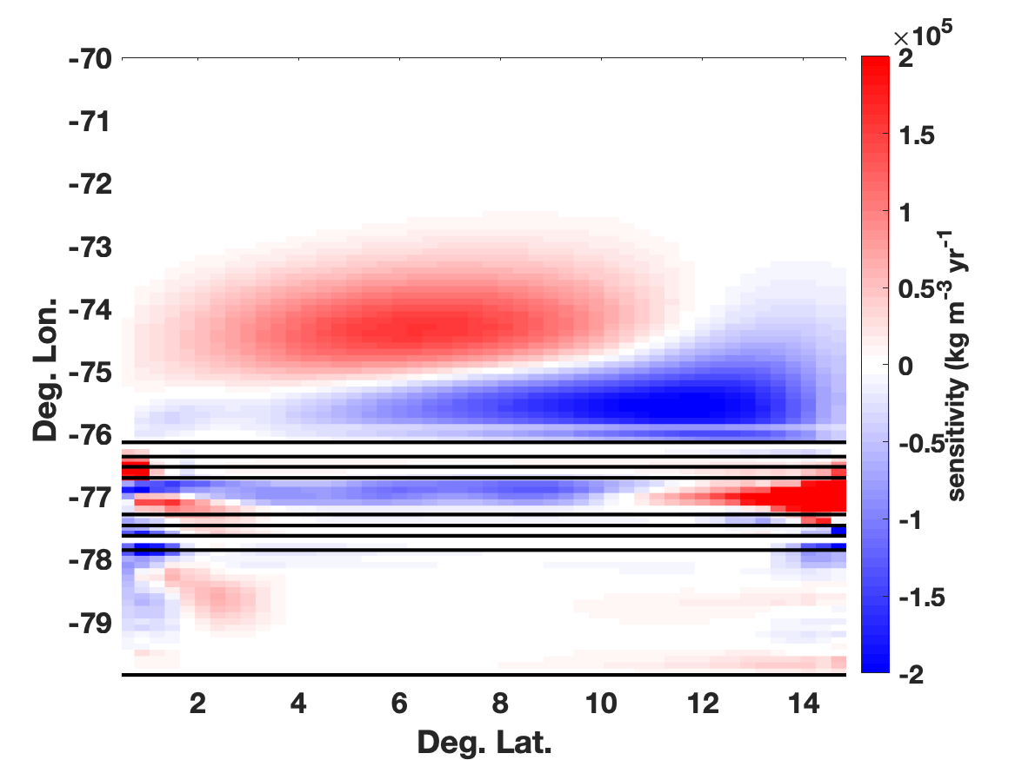
ISOMIP-Ridge Sensitivity Experiment
Adjoint experiment:
Run spun-up model for 2 years, define cost function
J $=\int{m dx}$ (integrated melt rate)
Use adjoint to find
$\frac{∂J}{∂zbi}$ (gradient wrt depth in cell i)
Open ocean
1
2
3
4
ridge
Grounding line
Red: Raised bed → More melt
Blue: Raised bed → Less melt

Slide 13
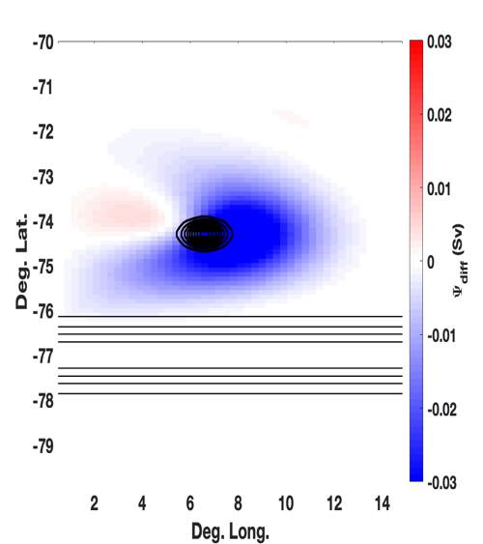
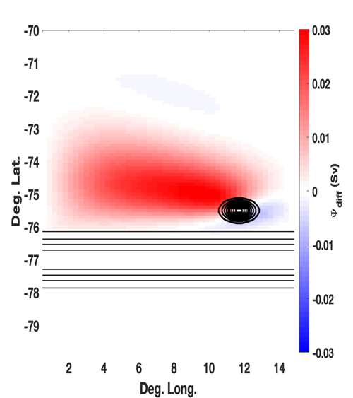
ISOMIP-Ridge Perturbation Experiments
1
2
Seaward of ridge: perturbations induce broad circulation
Similar to interaction with seamount (e.g. Holland, 2001; Huppert and Bryan, 1976)
Likely affects melt by acting with or against mean circulation
Thick contours: Bathymetric perturbation (positive)
Shading: Perturbed Barotropic Streamfunction
(red = counterclockwise)

Slide 14
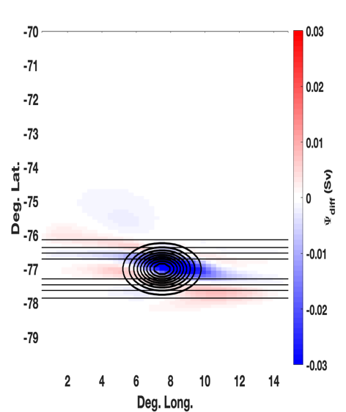
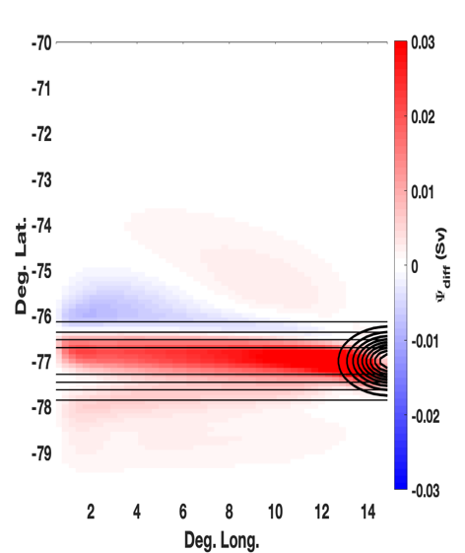
ISOMIP-Ridge Perturbation Experiments
3
4
On Ridge: more complicated but broadly the same effect
Likely affects position of warm-water “jet” along ridge
Thick contours: Bathymetric perturbation (positive)
Shading: Perturbed Barotropic Streamfunction
(red = counterclockwise)

Slide 15
ISOMIP-Ridge Perturbation Experiments
Main takeaways:
In presence of ridge, lowering in the center can increase melt – but so can raising in the margin
Seaward of ridge, bathymetry can control transport of warm water into cavity
Weakly sensitive to bathymetry within ice cavity

Slide 16
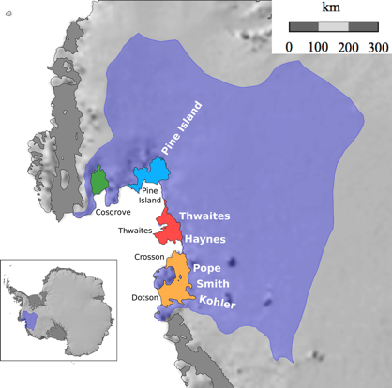
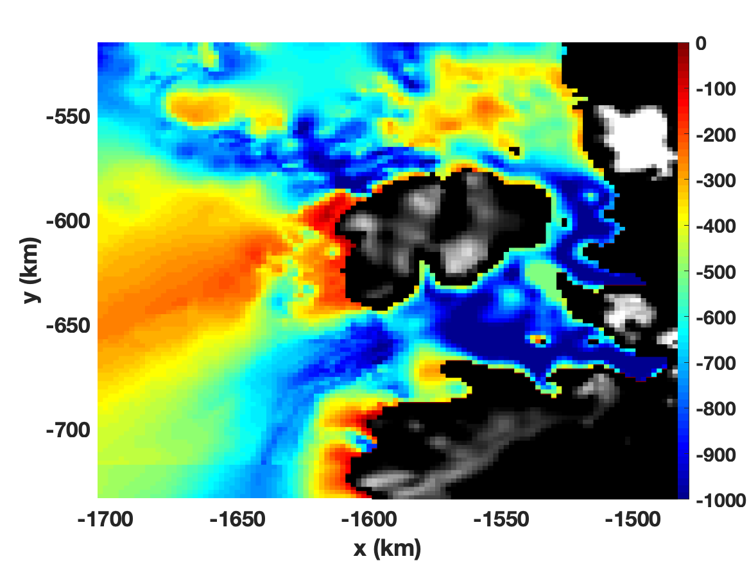
Dotson-Crosson Experiment
Domain based on Goldberg et al (2019)
Bathymetry based on Millan et al (2017)
Far-field ocean conditions from Kimura et al (2017)
Ocean model run at 2 km resolution (coarser than previously), steady forcing and high eddy viscosity
Model Bathymetry

Slide 17
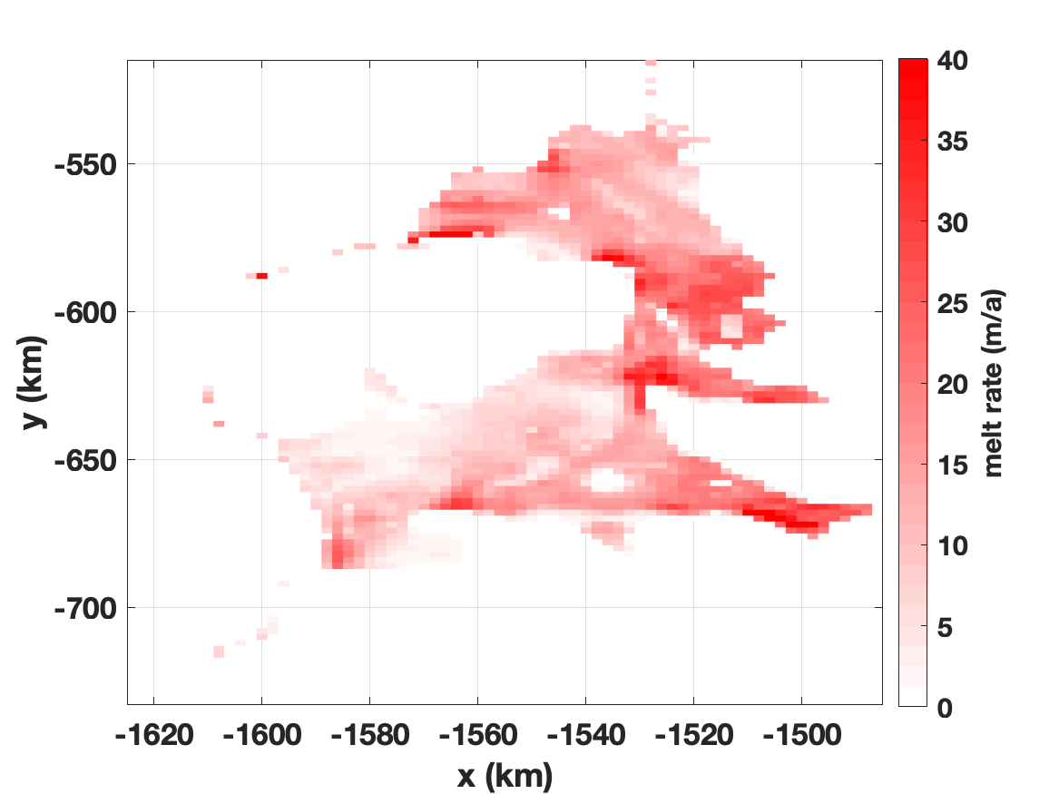
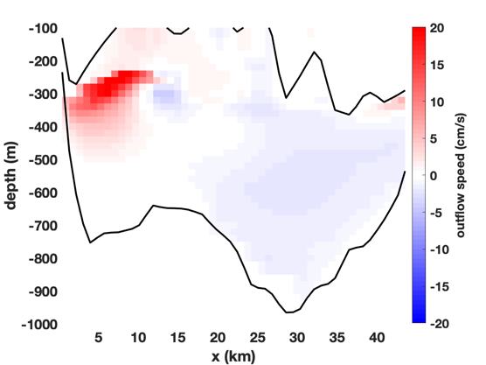
Dotson-Crosson Experiment
Modelled melt rate
Modelled Dotson outflow
Observed Dotson outflow (Randall-Goodwin et al, 2015)
Model is initialised by running to a steady state
Proceed with adjoint experiment:
Run for a single year
Cost function = Total Melt
Find sensitivity to bathymetry

Slide 18
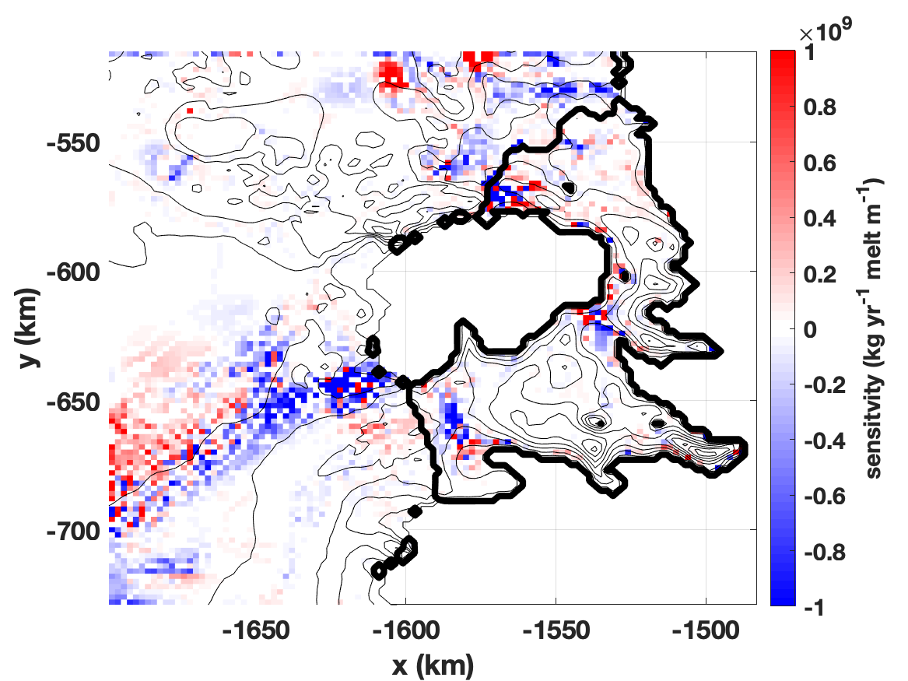
Dotson-Crosson Experiment
Result is noisy but shows similar elements to ISOMIP-Ridge
Similar bimodal pattern on ridge
Trough geometry controlling inflow
Melt more sensitive overall to Crosson bathymetry than Dotson
Thin contours: bathymetry
Thick contours: bathy. sensitivity

Slide 19
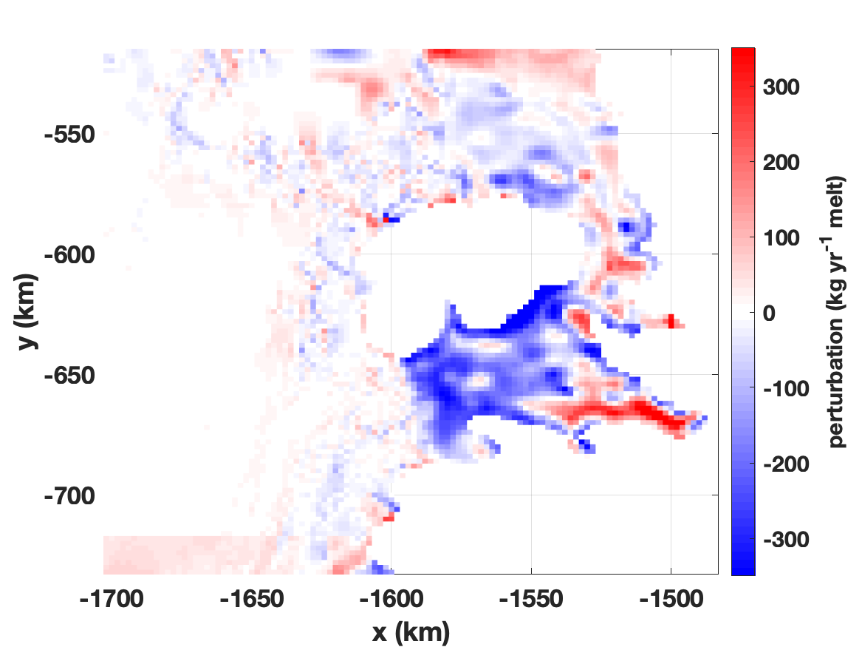
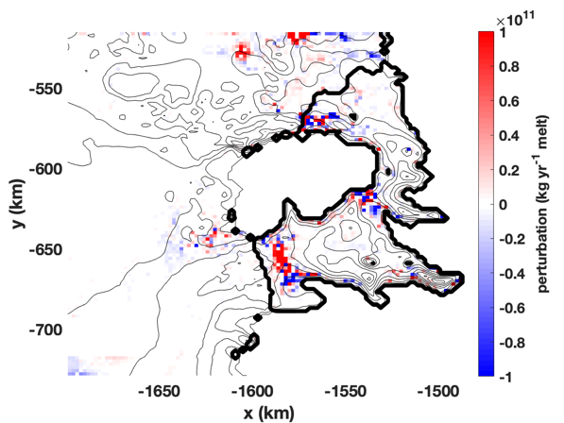
1. Impact of BedMachine
An adjoint field can be applied to a perturbation to approximate the response:
$$ΔMelt= \sum_{i}{\left(\frac{∂Melt}{∂zbi}\right)×∆zbi}$$
BedMachine-Millan difference (m)
or
$$ΔMelt= \sum_{i}{\left(\frac{∂Melt}{∂zbi}\right)×(z_{bi,BM}−z_{bi,Mil})}$$
i.e. difference with BedMachine
Total melt response: 7 Gt/yr (about 10%)
Impact of difference on melt (kg/y)

Slide 20
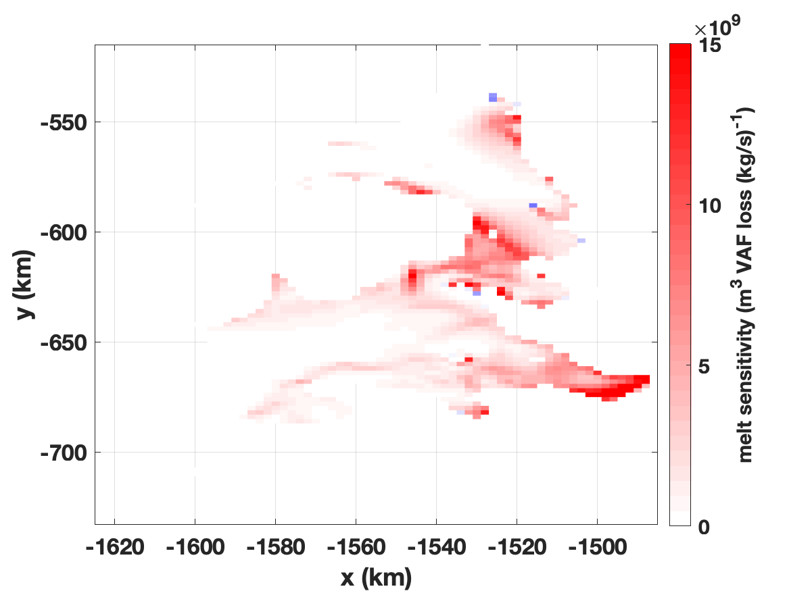
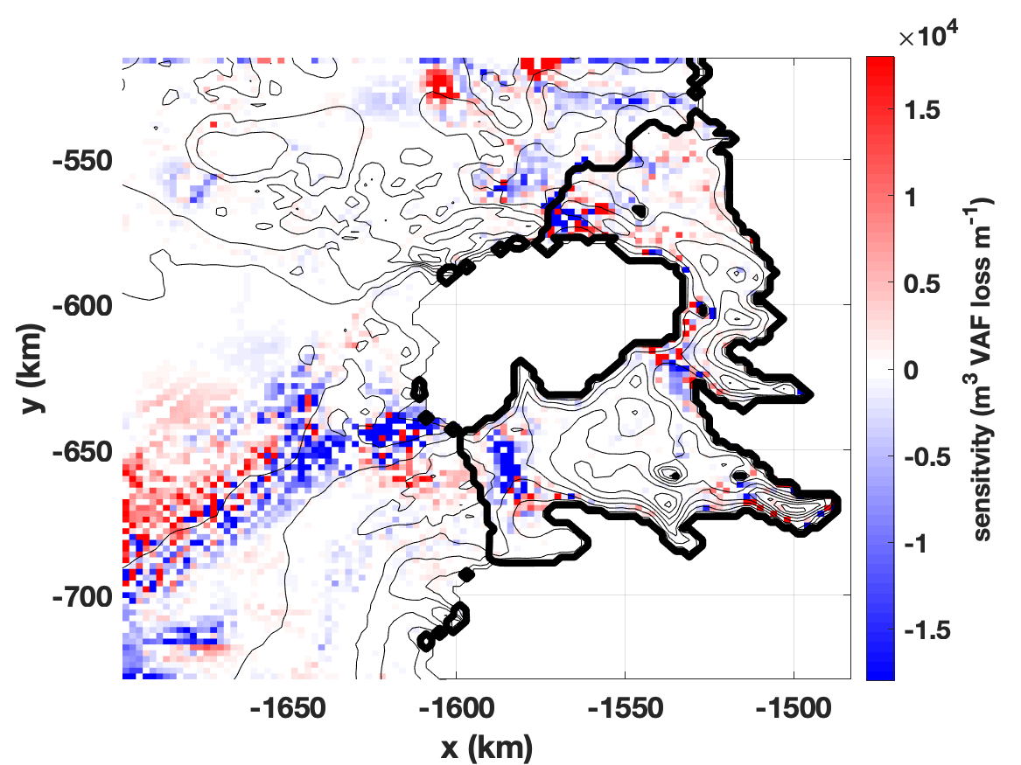
2. Sensitivity of ice loss
Goldberg et al (2019) found adjoint sensitivity of Grounded Ice Loss to melt:
$$\frac{∂VAF}{∂mi}$$
This can be propagated through to bathymetry by defining a new cost function:
Adjoint gives an approximation of
VAF loss sensitivity to melt rate
J_{VAF} = $\sum_{i}{\left(\frac{∂VAF}{∂mi}\right)×mi}$
$$\frac{∂VAF}{∂zbi}$$
VAF loss sensitivity to depth

Slide 21
Conclusions
Bathymetry can affect melt rates strongly, but only in certain locations (undersea ridges, thin ocean columns) and sometimes counterintuitively
Adjoint depth sensitivity provides a means to identify those locations where bathymetric uncertainty is most impactful on melt rate (and needs refinement)
However, melt rate alone is not likely to be able to constrain bathymetry

Slide 22
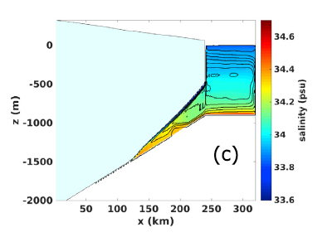
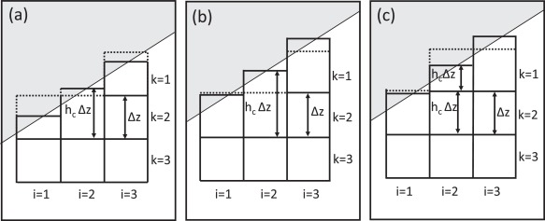
Conclusions
Use of open-source AD tool is promising – and could potentially be applied to an “online” coupled ice-ocean model…
but performance improvements needed if work to be taken
further: Adjoint run time 40-50 times forward model (cf 6-8x for TAF)
Goldberg et al 2018

Slide 23
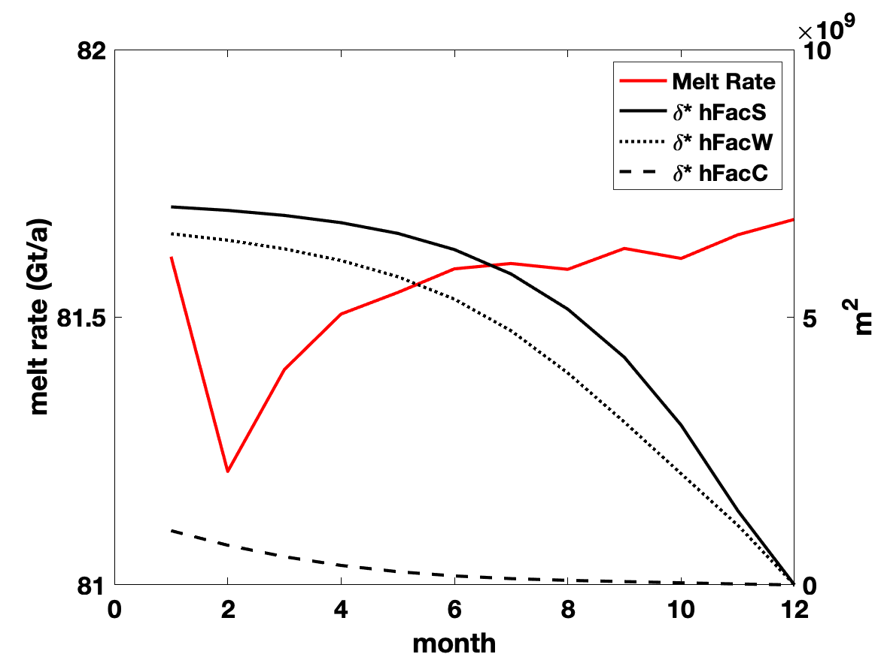
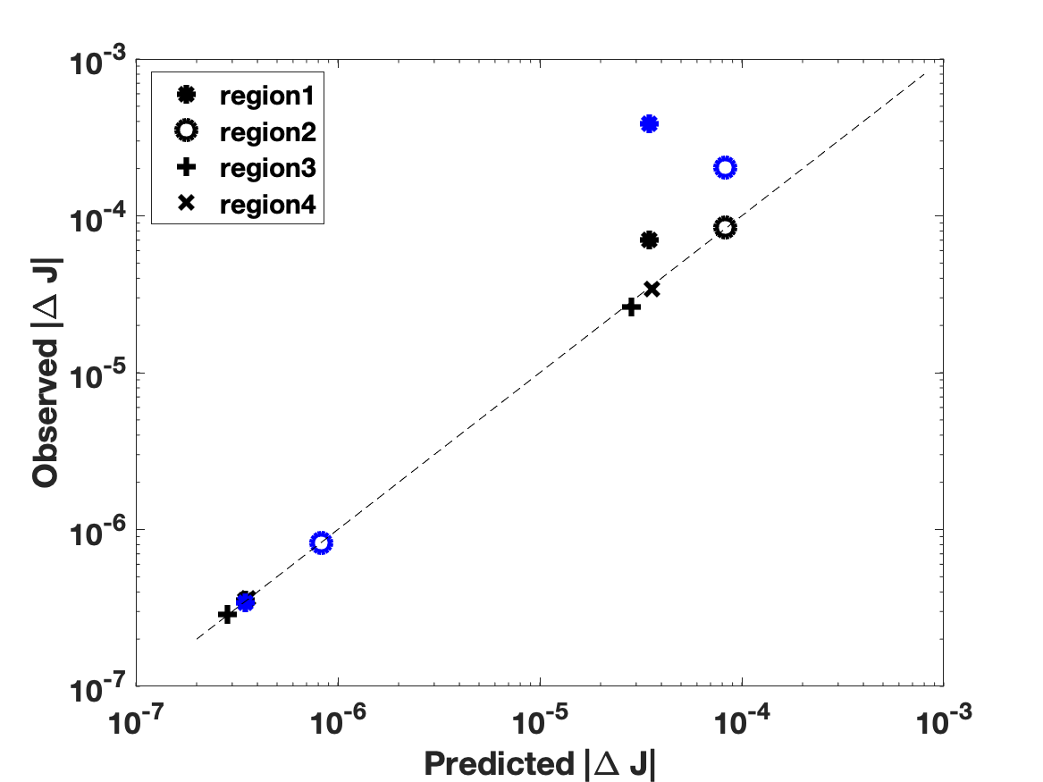

Slide 24
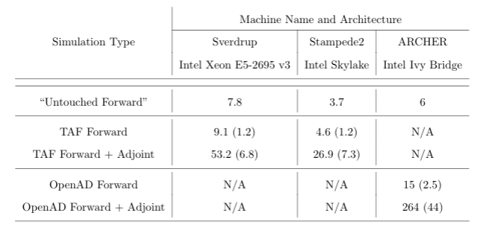
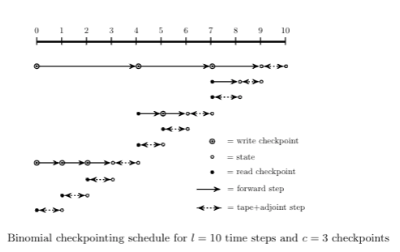

Slide 25
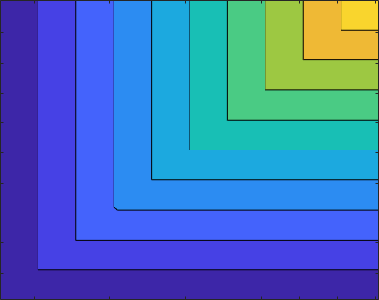
MIN(X,Y)
Y
X

