Slide 1




Machine Learning Approaches for Classifying ER Patients Progressing to Sepsis
Arjun Baghela
University of British Columbia
BIRS Workshop, Oaxaca, Mexico

Slide 2
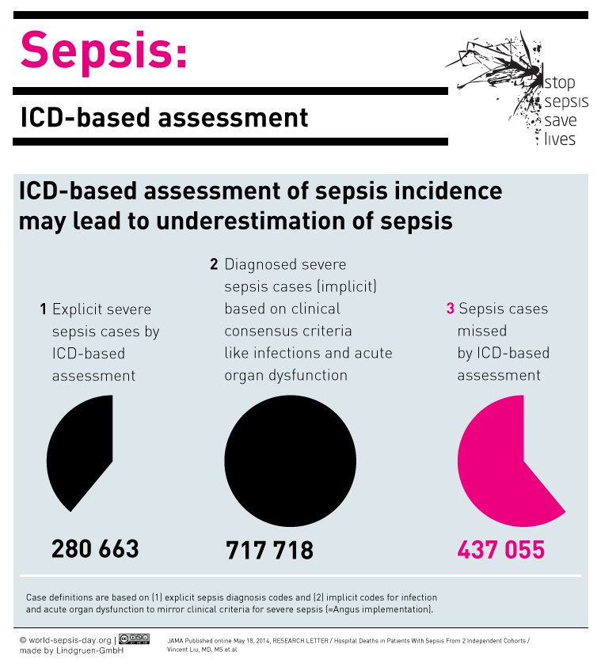

Sepsis is the dysregulated host response to infection
Involves both sustained excessive inflammation and immune suppression, and a failure to return to normal homeostasis (van der Poll 2017, Pena 2015)
  Renders cells unable to respond to infection
Extent varies between individuals, environment, pathogen
Makes sepsis highly heterogeneous
30 million cases, 6 million deaths annually (WHO, 2017)
Notes:
Before I get into the machine learning part - I’d like to talk a bit more about sepsis, because it really is quite an interesting condition
Sepsis is the dysregulated host response to an infection
Previously, the long standing paradigm for understanding sepsis was that it was an inflammatory condition, and excessive inflammation caused septic shock
Now many groups, including ours, are suspecting that sepsis involves both sustained excessive inflammation and excessive immune suppression - and then this failure to return to normal homeostasis, which is the reason why peoples chances of mortality from any infection increases after sepsis, even if they live after the initial infection
The extent varies between individuals, the environment, and the pathogen one is infected with AND THIS makes sepsis an extremely heterogeneous condition
There are approximately 30 million cases a year, and 6 million deaths annually - and this number is only going to grow with the rise of antibiotic resistance.
And actually - it is believed that more than half of sepsis cases are not even reported. So this is a statistic from America, which shows that almost 400 K cases don’t get reported as sepsis - likely due to the heterogeneous nature of the condition

Slide 3
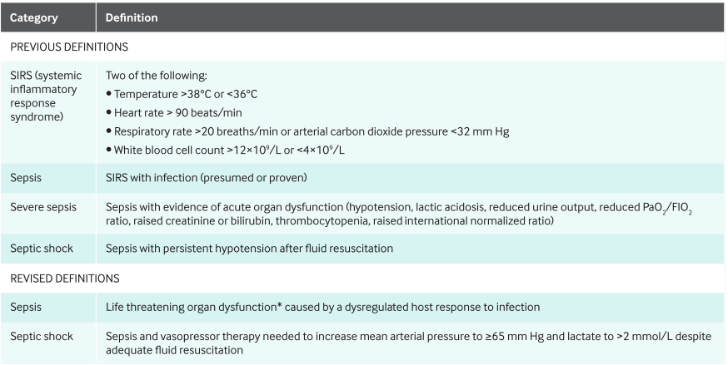
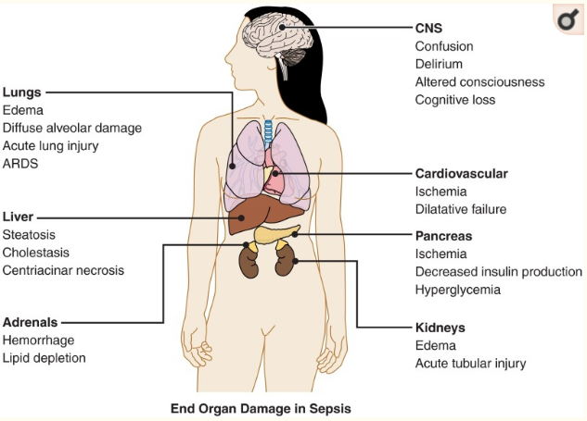
Sepsis heterogeneity prevents accurate diagnoses
Clinical data indicates symptoms and outcomes are diverse
Definition of sepsis has changed many times
True diagnosis often missed
  Patient sent home, improper use of antibiotics and ICU
Diagnosis may require genetic and clinical basis
Iskander et al, 2013, Physiol Rev
Gott et al, 2016, BMJ
Notes:
So like I just mentioned, the condition is very heterogeneous - and this often prevents an accurate diagnosis
Clinical data indicates symptoms and outcomes are very diverse - with cases looking very different. Likely because sepsis can affect so many different body parts, like shown here
The definition of sepsis has also changed many times in the past - which also results in diagnoses being missed
This figure shows some commonly used definitions
There is SIRS- which stands for Systemic Inflammatory Response Syndrome- but people are moving away from this because it assumes the condition is inflammatory in nature only
Now the SOFA score is used often - which stands for Sequential Organ Failure Assessment - which assesses the performance of several organ systems.
So for all the reasons I just discussed, a true diagnosis is often missed
So this means that patients could be sent home without being treated Or that antibiotics or the ICU is improperly used
We feel that a diagnosis likely requires a genetic and/or clinical basis - because clinical data may not be enough

Slide 4
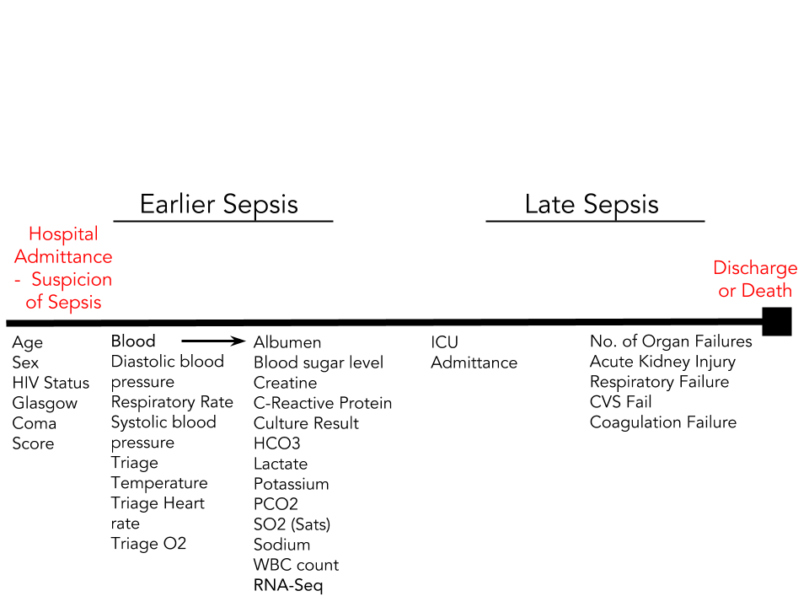
Use gene expression and clinical data to predict progression to sepsis and identify relevant features
Goals
Determine if sepsis is inability to respond to infection (cellular reprogramming)
Develop classifier that predicts sepsis early (in ER)
Identify relevant features (genes + clinical variables) which help shed light on etiology
82 patients suspected of sepsis, retroactively classified
Sepsis = positive blood culture OR SOFA score >= 2 (53 sepsis; 29 non-sepsis)
Use variables collected early (up to 24 hours after ER admission) for prediction
Notes:
So this forms the basis of my project - using gene expression and clinical metadata to predict the progression to sepsis and identify relevant features, which I will mainly be talking about today
We recruited 82 patients suspected of sepsis into our cohort in Australia, these patients were then retroactively classified as sepsis or no sepsis
And here, sepsis is a positive blood culture OR a SOFA score of 2 or more. Which resulted in 53 patients with sepsis and 29 without.
So here is a little timeline - we collected patients at this point, right at hospital admission. We collect alot of information- including clinical tests and triage measures. Like blood pressure, etc. We collected information about the patient throughout the stay - but for the purposes of this study, we only looked at the first 24 hours - since we want to be able to predict sepsis AS early as possible. Once patients start getting to this point - with organ failures - its pretty much pointless predicting sepsis cause we know they have sepsis! And of course, we collected blood for RNA-seq. And we are actually embarking on the largest sepsis study which uses RNA seq for gene expression measurement. And then using all these variables we performed machine learning

Slide 5
Data preprocessing primarily involves reducing dimensionality of RNA-seq data
Blood collection and RNA sequencing
Clinical data collection
Alignment (STAR)
Read counting (htseq)
RNA sequencing data preprocessing
  Filter low count genes
Variance stabilizing transformation
Determine most variable genes
  Genes with variance > 1 (1427 genes)
Cross Validation and Model Training
Repeated 5 fold cross validation for model hyperparameter tuning using R Caret package (Kuhn 2008)
LASSO, Ridge, Elastic net, KNN, SVM, Random Forest
Feature Importance
Determined by training models using full dataset
Count transformation and filtering
Counts
Meta/ clinical data
Combined
Repeated CV
Train models
Feature Coefficients/Importance
Notes:
Now I am just going to go over what my workflow was:
Like I said, we performed RNA -sequencing and collected clinical data.
The RNA seq data
Aligned and reads were counted
I filtered low count genes - because they really aren’t that important in a clinical setting and would be hard to measure
I performed a variance stabilizing transformation because RNA-seq data is not homoskedastic - so the variance of each gene grows with the mean. So high count genes usually bias an analysis
I then determined the most variable genes and used genes with a variance of greater than 1 - which resulted in 1427 genes.
Then I created 3 different matrices - a counts one, a clinical metadata one, and a combined one
I performed a repeated 5 fold cross validation for model hyperparameter tuning using the R package Caret
And the models I used were: LASSO, ridge, elastic net, KNN, SVM, and Random Forest
So I selected various models to try out because they all have their strengths – whether that be predictive power, interpretability, feature selection, and handling of mixed data types
LASSO/ridge/elastic net are linear models with regularization (target value is expected to be a linear combination of the input variables)
KNN is used to identify training samples that are closest in distance to a new point, and predict a label from these
SVM is used to identify a decision function or boundary that separates classes
Random forest which uses hundreds of decision trees to classify
And finally, for feature importance, I again trained the model using all data and the best hyperparameters - today this is my main focus since I do not have a completely untouched validation cohort quite yet.

Slide 6
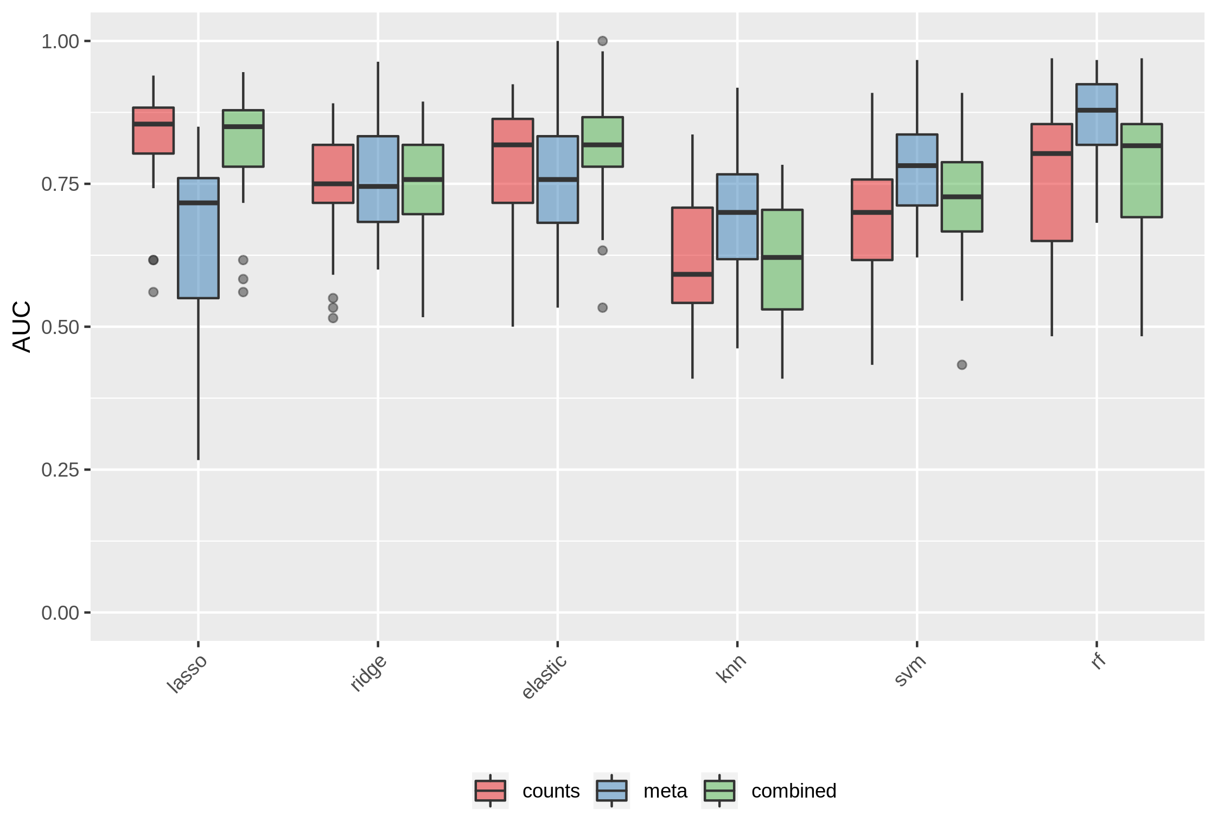
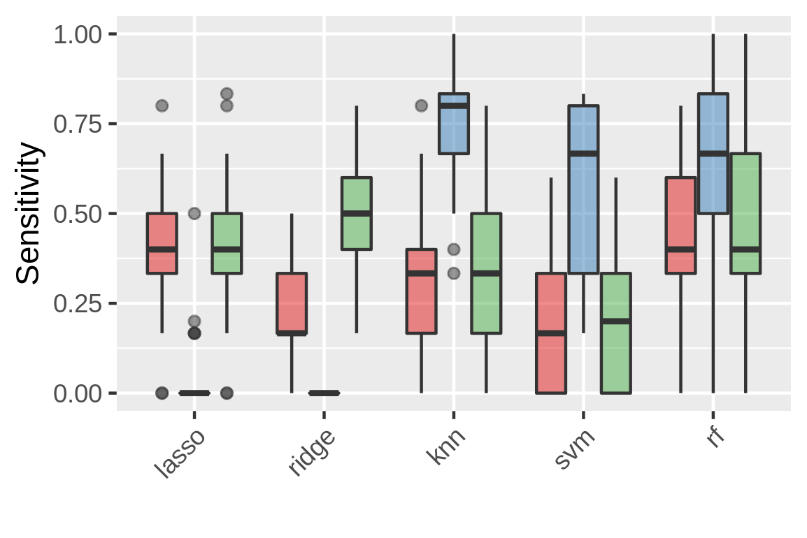
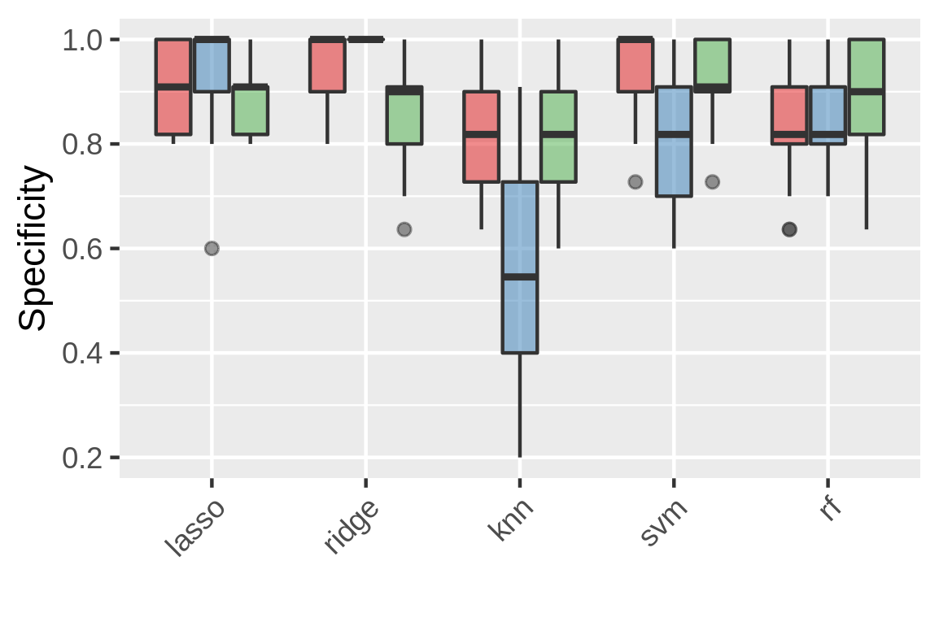
Method comparison to predict sepsis/non-sepsis patients
Clinical data performs worse than RNA seq data in linear models
Highest median AUC is approximately 0.85
Elastic Net, LASSO, and Random Forest models were further explored for feature importance
Notes:
Like I said, I compared the methods using a repeated 5 fold cross validation
I compared their performance using the Area under the Receiver operator curve measure which represents the probability a classifier will rank a randomly chosen positive example higher than a negative one.
The linear models and the random forest seem to perform the best - with median AUCs of about 0.85, which is higher than many reported studies out, especially the microarray studies
Most notably, the clinical data models perform worse in the linear models and the count data performs better. Indicating they might need to be analyzed differently
The combined models does not appear to result in higher AUCs, simply performing as well as either the counts or clinical data. So possibly trying an ensemble method where we treat the data types separately, and obtain a prediction based on the two models may work better.
So, the models which resulted in the highest AUCs were Elastic net, LASSO, and Random Forest - so I will just go over the relevant features coming out of those models.

Slide 7
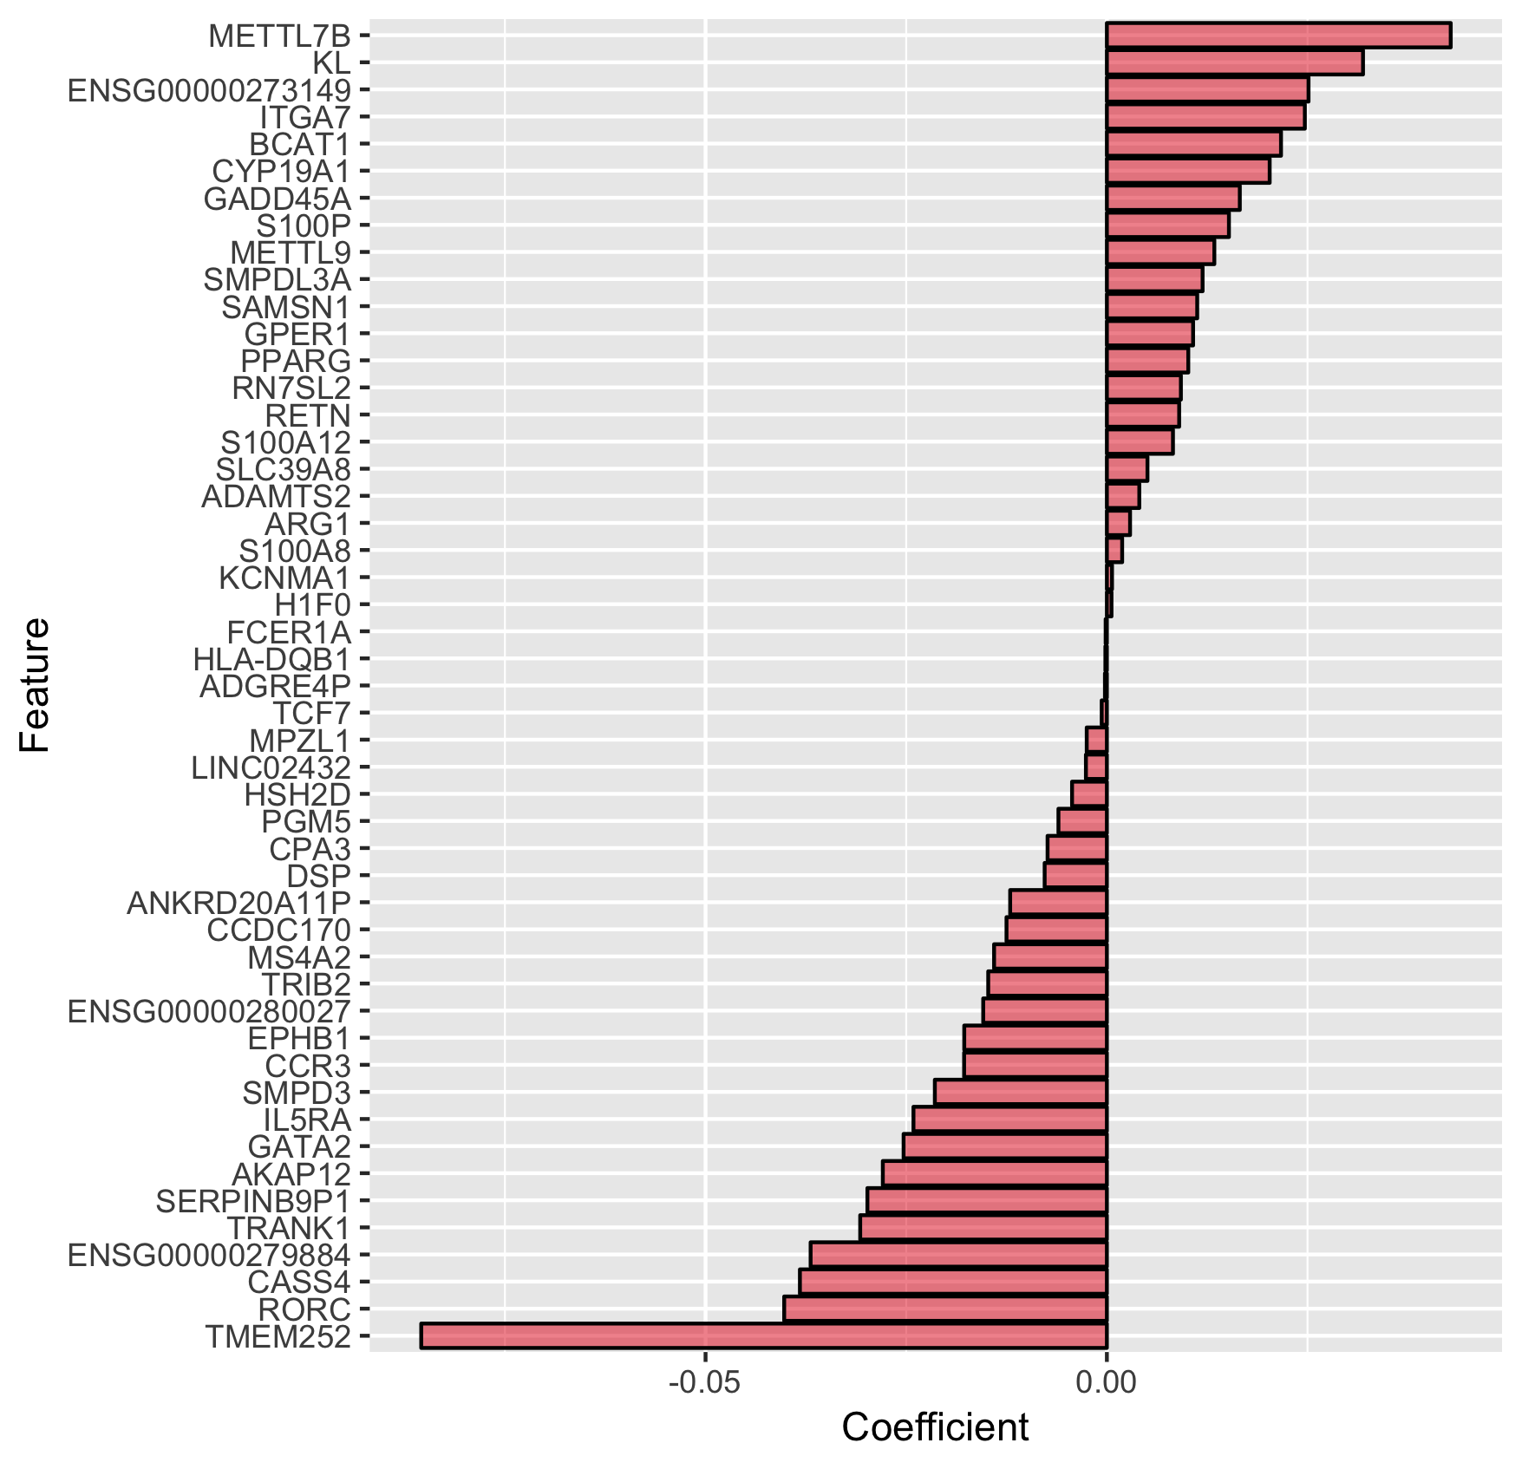
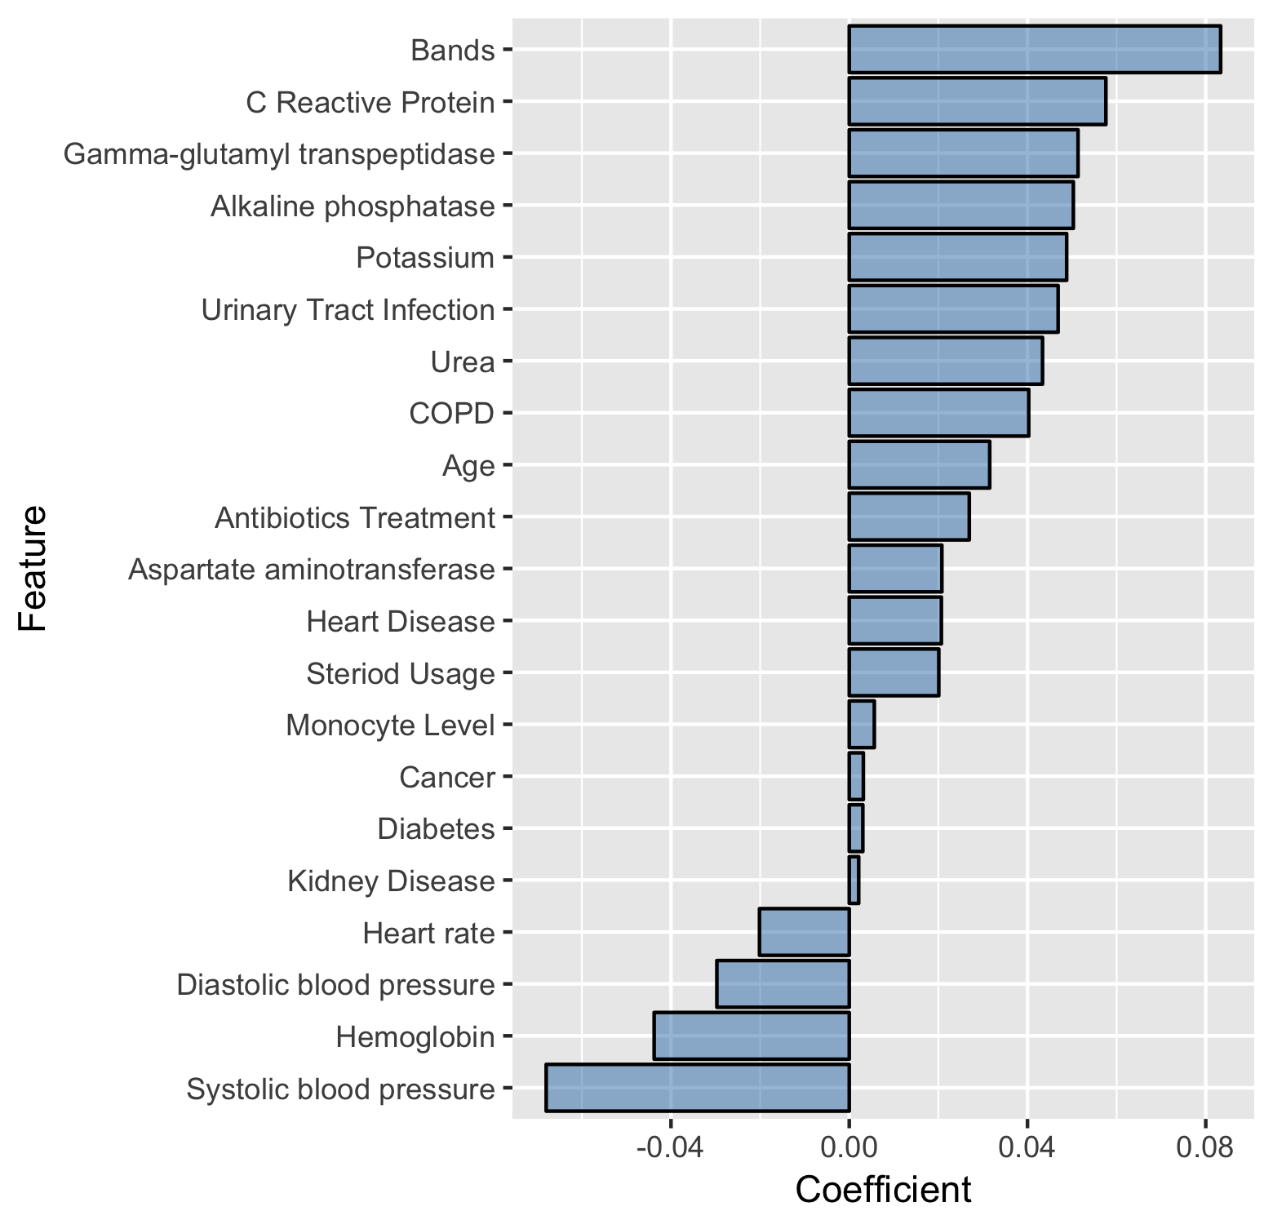
Assessing feature importance from Elastic net
Coefficients indicates how change in variable impacts response
Combined model resulted in similar features and coefficients
Notes:
So looking at elastic net now.
I am assessing the importance of features using the coefficient of the feature - which is a simple measure which indicates how the change in a variable impacts a response
So here are the gene features and here are the clinical data features that are coming up and below the respective coefficient value.
So I know they are quite low, but considering the complexity and heterogeneity of the disease - I don’t expect any signal to be too high.
So we have about 40 genes coming up and 20 clinical variables coming up as important for the prediction of sepsis
Actually many of the genes we see coming up are implicated in sepsis - especially the S100 proteins (calcium binding proteins), SERPINA, and others
And the combined model resulted in similar features thus I didn’t include them

Slide 8
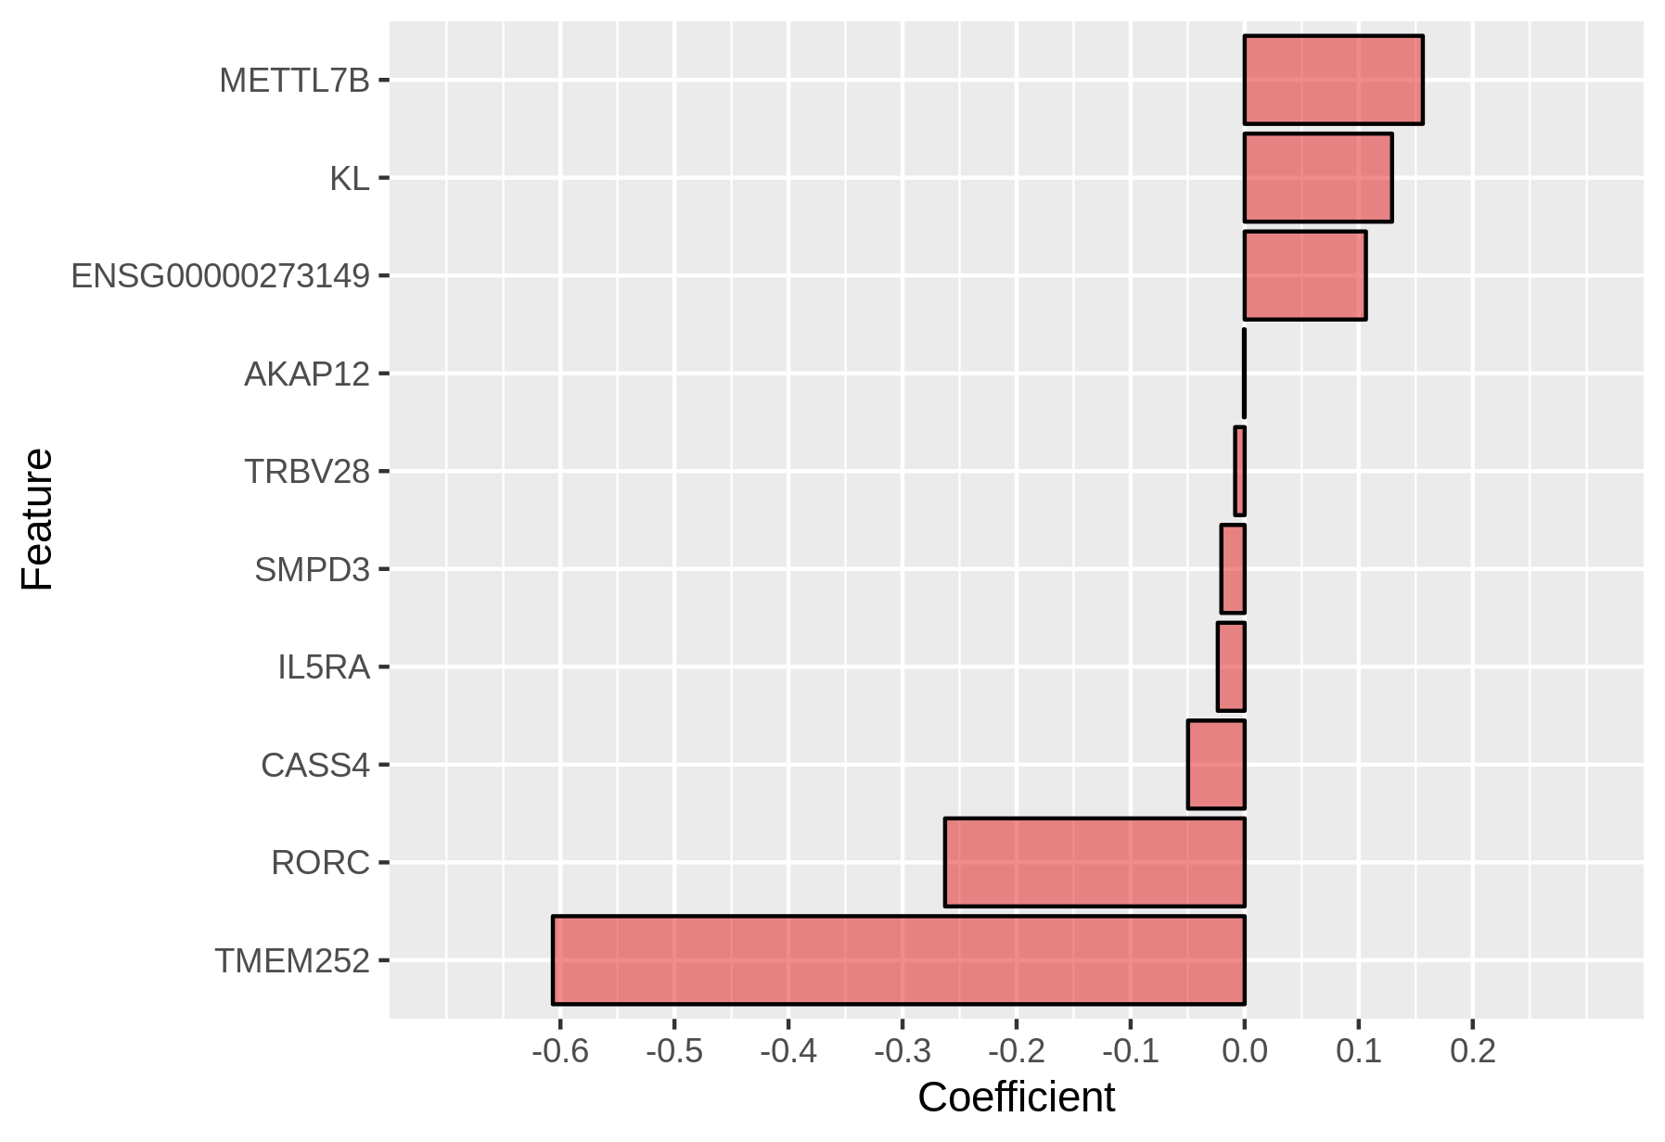
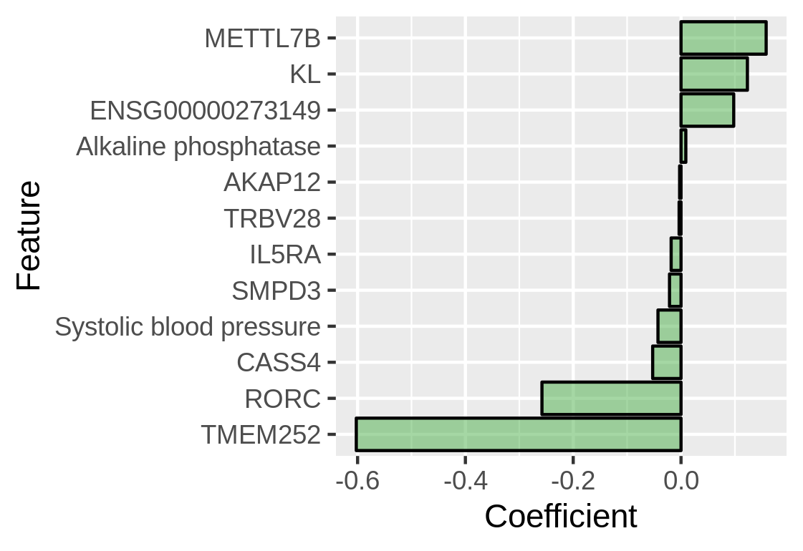
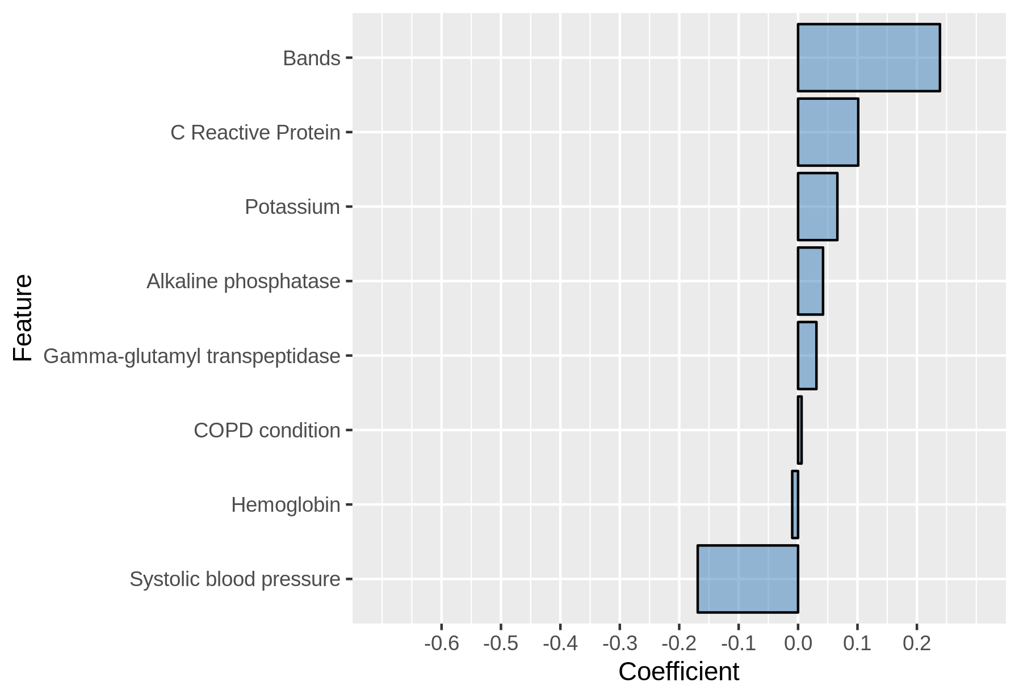
LASSO features are a subset of Elastic Net
Combined model resulted in similar features and coefficients
Notes:
LASSO features were a subset of Elastic net features, likely because it has a more stricter regularization
So right now, we are trying to delve a bit further into these features and assess their implications in sepsis
RNA seq features
METTL7B- methyltransferase – often upregulated in infectious conditions
IL5RA- interleukin 5 – seen to be actually protective during sepsis through the recruitment of neutrophils
KL- Klotho gene – allievates renal dysfunction in sepsis induced AKI
Clinical data features
Systolic blood pressure is important; which has been shown to actually predict sepsis mortality over 28 days
Bands which is a measure of neutrophil level, which increase during infectious states
CRP which right now is often used in hospitals as a sepsis checker because it measures if there is a bacterial infection
Again, the combined model resulted in similar features

Slide 9
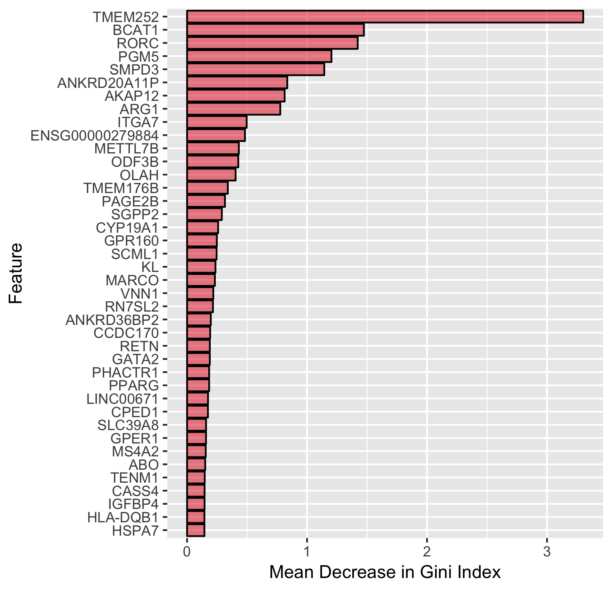
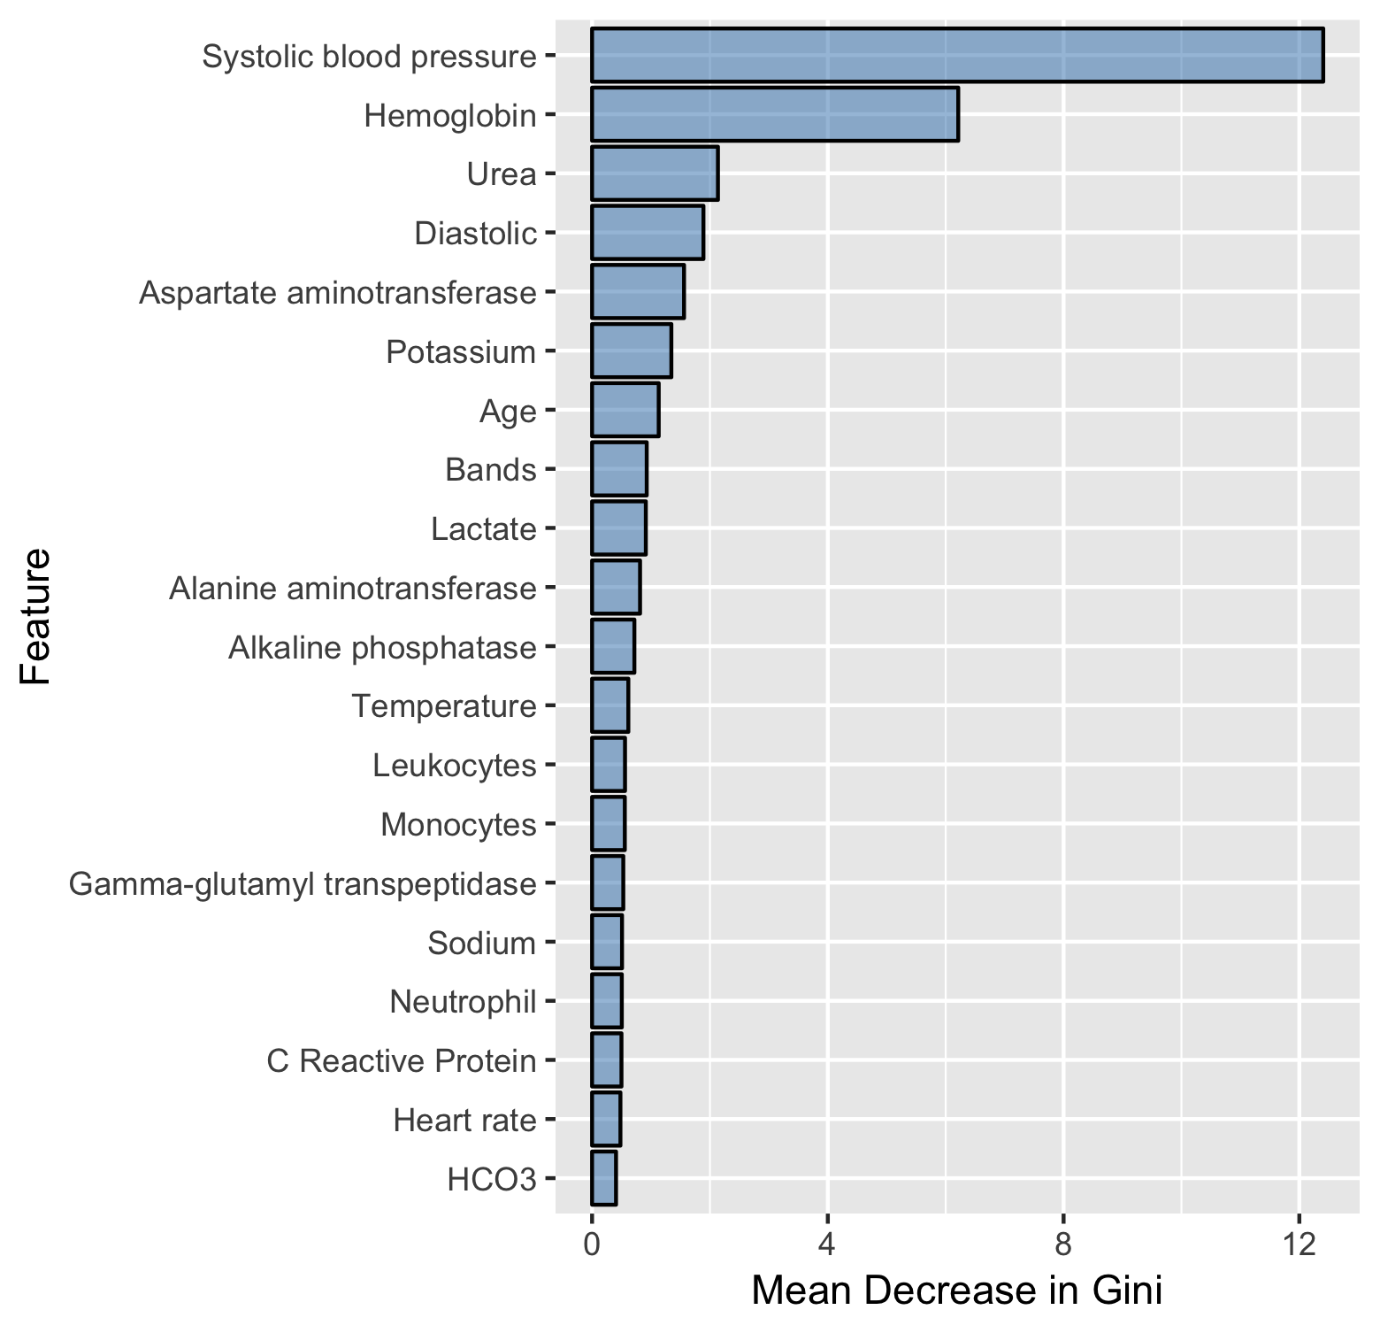
Feature importance from Random Forest generates similar results to Elastic Net
Mean decrease in Gini index represents features total decrease in node impurity averaged over trees in the forest
Again, combined model resulted in similar features and coefficients
Most genes not inflammatory in nature
Notes:
Finally, I looked at Random Forest - and the importance of each feature was assessed by the mean decrease in Gini Index, which represents a features decrease in node impurity averaged over all trees in the forest
And node impurity are used in decision trees to assess how well a feature splits the classes
Very similar features are popping up, similar to the ones showing up in Elastic Net
Again, the combined model resulted in similar features
Most notably, without getting too into the biology - we noticed that these important genes are not inflammatory in nature despite being enriched in the initial 1400 genes.
This strengthens the cases that sepsis has concurrent inflammation and immune suppression, and possibly to differentiate sepsis we require NON INFLAMMATORY biomarkers
We are getting more sequencing data pretty soon, so I am hoping to validate these genes
Furthermore, I plan to validate these genes using publicly available microarray data, since that is all that is really available currently. So it will be interesting to see if the two technologies are compatible in that regard.

Slide 10





Conclusions and Future Directions
Non-inflammatory genes are appear to be more important in differentiating sepsis cases (endotoxin tolerance/cellular reprogramming)
  Mine literature for biological relevance or novelty
Combining clinical metadata and RNAseq data did not result in a marked increase in predictivity
  Explore other methods for integrating clinical and gene expression data for patient classification
  Preliminary analysis shows integration is superior when using cellular reprogramming genes
Limited by sample size; part of an ongoing study to collect 1000 patients in global cohorts
Acknowledgments
Dr. REW Hancock
Dr. GV Cohen Freue
Dr. OM Pena
Dr. AHY Lee
Dr. B Tang

Slide 11
Supplementary Slides

Slide 12
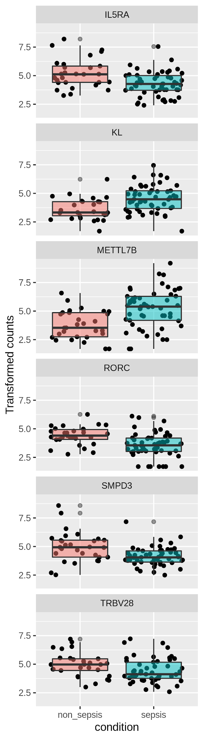
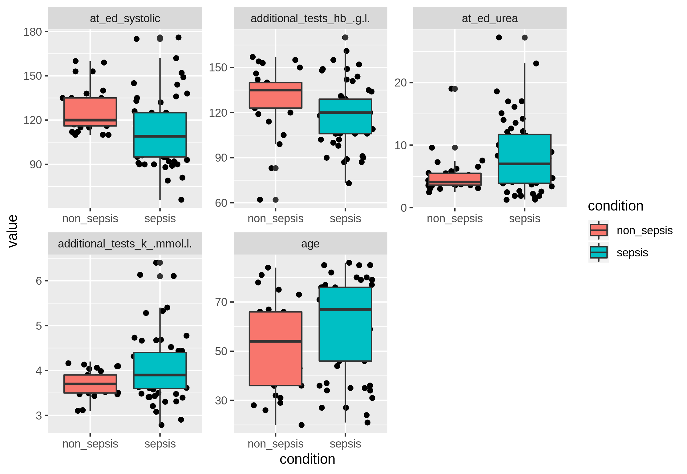
Significant features from models are implicated in sepsis

Slide 13
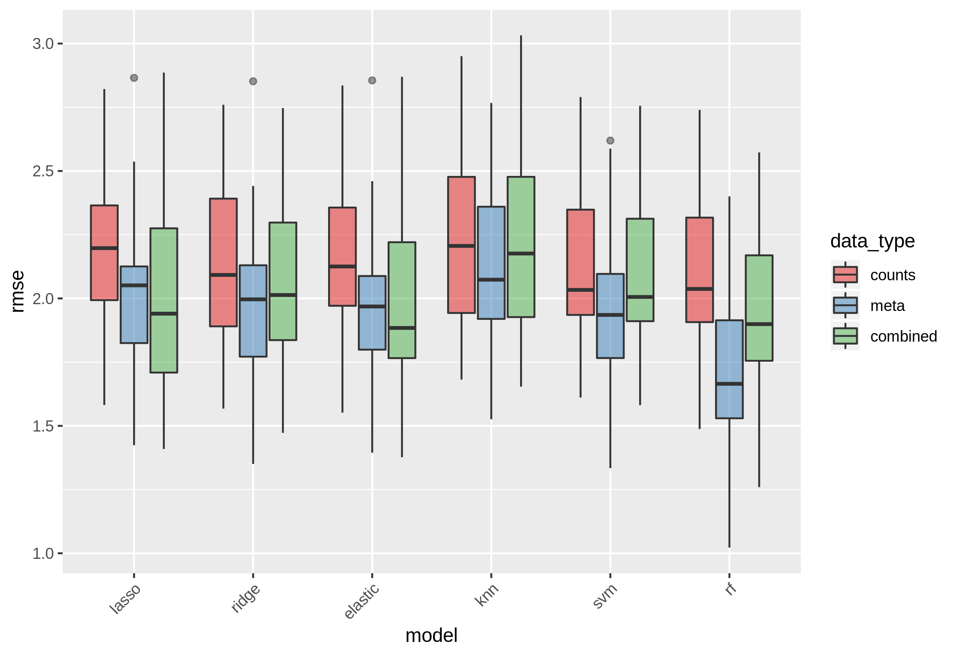
Method comparison to predict SOFA scores
SOFA scores can be from 0 to 16
Cohort has patients with scores from 0 to 9
Linear models show better performance using combined dataset

Slide 14
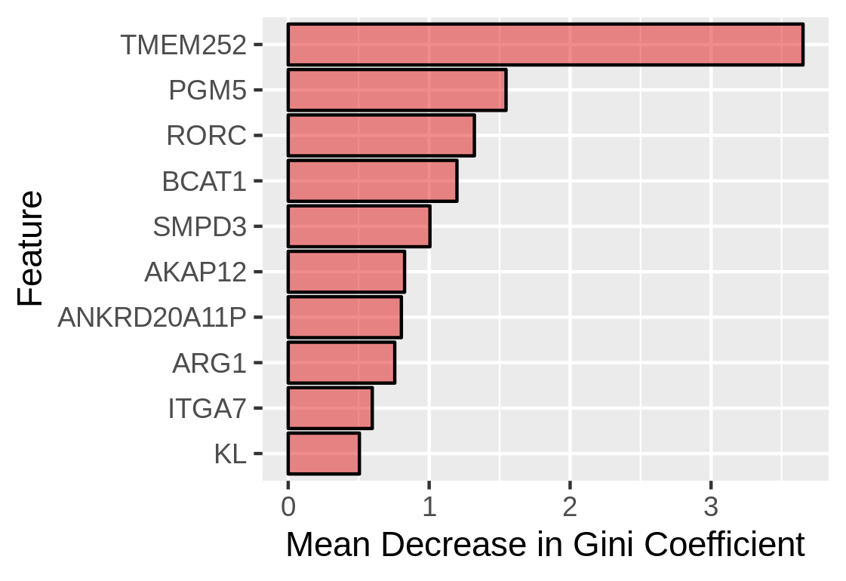
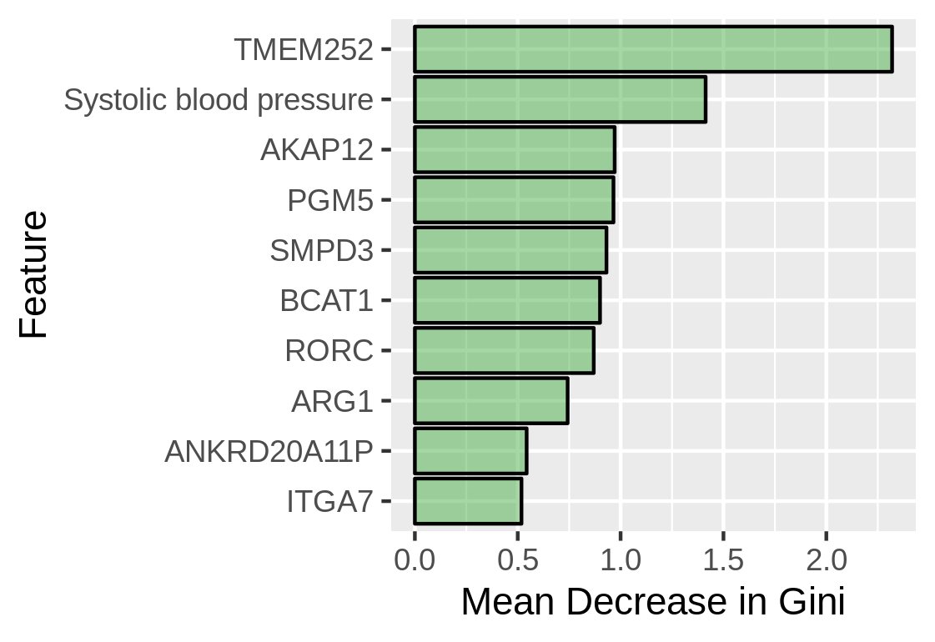
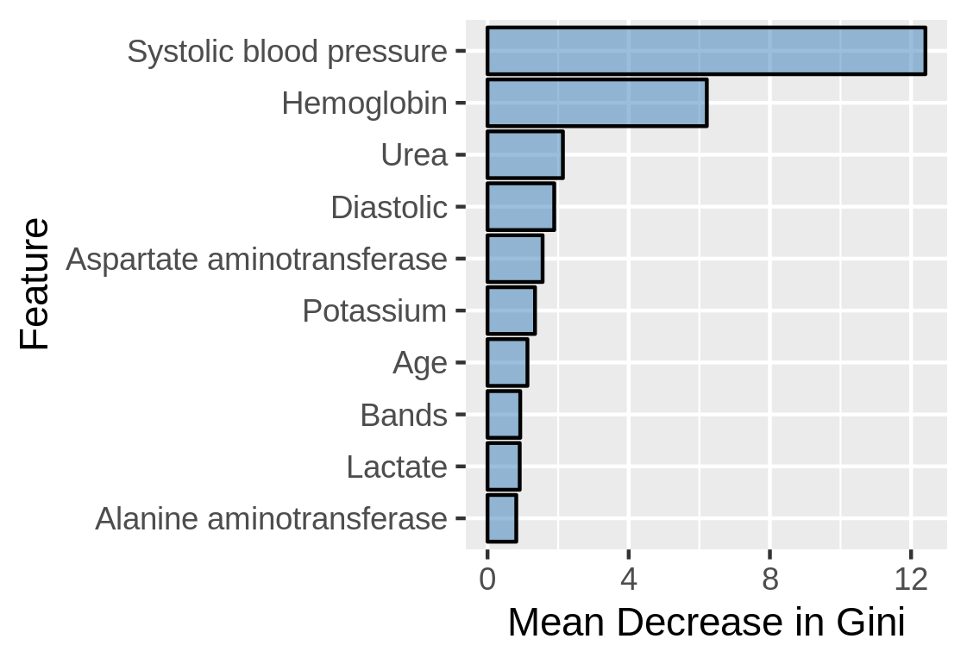
Feature importance from Random Forest generates similar results to LASSO
Mean decrease in Gini index represents features total decrease in node impurity averaged over trees in the forest
Again, combined model resulted in similar features and coefficients
Most genes not inflammatory in nature
Notes:
PGM5
Generates similar results to LASSO

