Slide 1
TBA: The Brazilian Approach
Benilton S Carvalho
Department of Statistics
UNICAMP

Slide 2
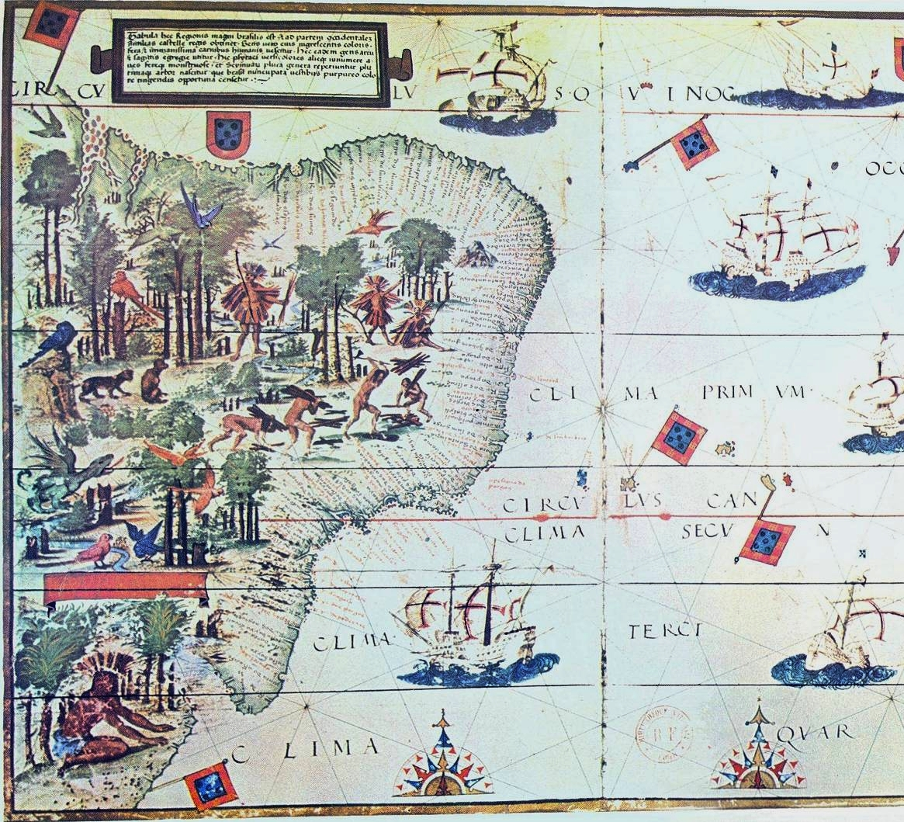
Brazilian Genomic Landscape
Not trivial;
Multiple influences;
Essential for the development of Precision Medicine!
Pedro Reinel, Jorge Reinel, Lopo Homem, and António de Holanda – Brazil, 1519

Slide 3

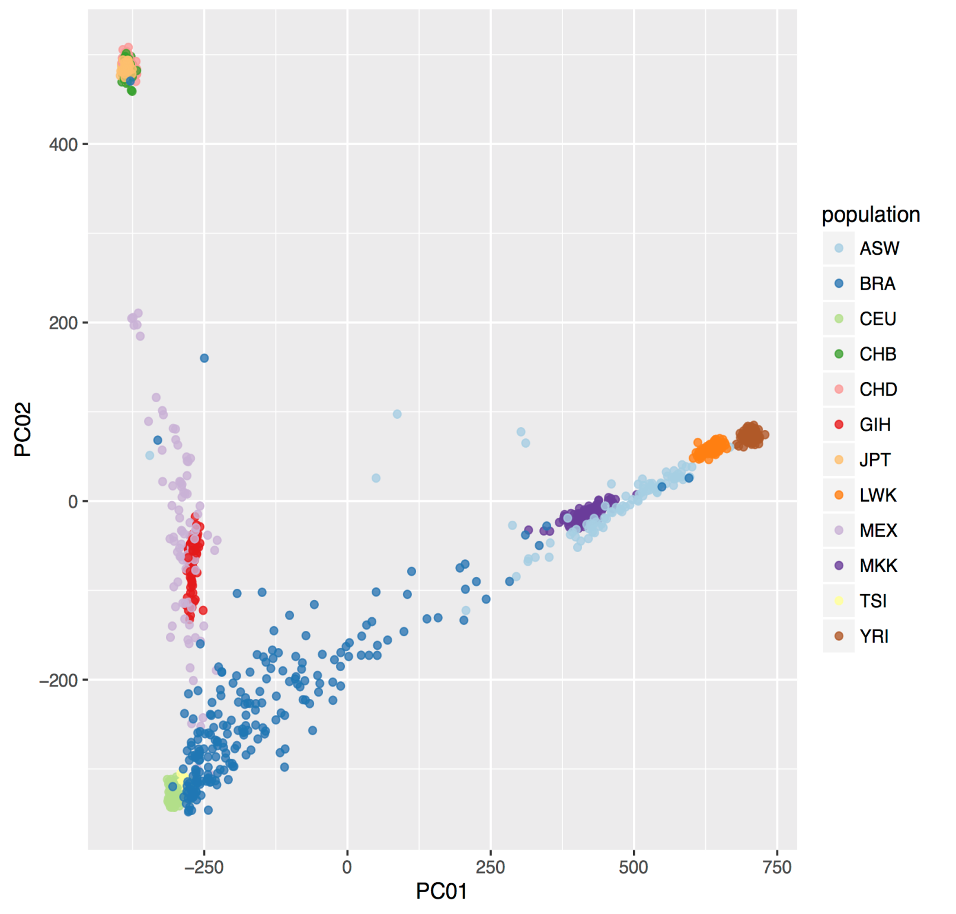
Asia
JPT+CHB+CHD
HapMap Samples
Different allele frequencies
Different predisposition levels
PM will recommend different medical actions for different groups;
We need to draw and understand the Brazilian Genomic Landscape in order to succeed!
MEX
LWK
Mixed
MKK
GIH
YRI
Africa
ASW
BRA
TSI
Europe
CEU

Slide 4

Efforts on Characterizing the Reference Population in
São Paulo
Rodrigo Secolin

Slide 5
Background
Brazil: admixture population, three main ancestry populations
  European;
  Sub-Saharan African;
  Native American;
BIPMed Sample
  SNP array dataset: 340 individuals
  WES dataset: 257 individuals
Moura et al., 2015; Kehdy et al., 2015

Slide 6
Study design
Merge datasets
BIPMed Raw data
Remove variants with MAF < 0.01
SNParray
340 individuals
905,176 variants
SNParray
296 individuals
905,176 variants
SNParray
296 individuals
884,445 variants
Remove individuals with
Heterozygosity rate + 3 SD ,
IBS > 0.85,
IBD and relatedness > 0.125
WES
257 individuals
819,360 variants
WES
239 individuals
819,360 variants
WES
239 individuals
819,360 variants
Remove non-autosomes,
Hardy-Weinberg p < 0.01
missing data > 0.05,
ambiguous variants,
Overlap variants
SNParray/WES
323 individuals
1,679,014 variants
SNParray/WES
212 individuals
1,250,414 variants
SNParray/WES/1000 Genome
817,240 variants
(50.2% among BIPMed variants)
(1% among 1000 Genome variants)
1000 Genome
2,504 individuals
~ 84,400,000 variants

Slide 7
Distribution of common and rare variants between 1000 Genome populations and BIPMed.
MAF distribution | Common in BIPMed | Rare BIPMed | Total
Common in EUR | 595,874 (72.9%) | 7,493 (1.0%) | 817,240 (100%)
Rare in EUR | 75,584 (9.2%) | 138,289 (16.9%)
Common in AFR | 604,349 (74.0%) | 65,565 (8.0%) | 817,240 (100%)
Rare in AFR | 67,109 (8.2%) | 80,217 (9.2%)
Common in AMR | 637,098 (78.0%) | 12,132 (1.5%) | 817,240 (100%)
Rare in AMR | 34,360 (4.2%) | 13,3650 (16.3%)
EUR=European; AFR=African; AMR=admixed American. We defined common variants those with MAF higher or equal 0.01, and rare variants otherwise.

Slide 8
Main conclusions
The difference of frequency of variants between ancestry populations (EUR, AFR, AMR) and BIPMed dataset shows that the set of disease-associated variants found in other populations could be totally different in Brazilian population.
Admixed American populations available in 1000 Genomes Project or another public reference database cannot be used as surrogates for studies in Brazilian individuals.
We need a Brazilian-specific dataset in order to improve precision medicine for Brazilian individuals.

Slide 9

MicroRNAs and Epilepsy
Maíra Rodrigues

Slide 10
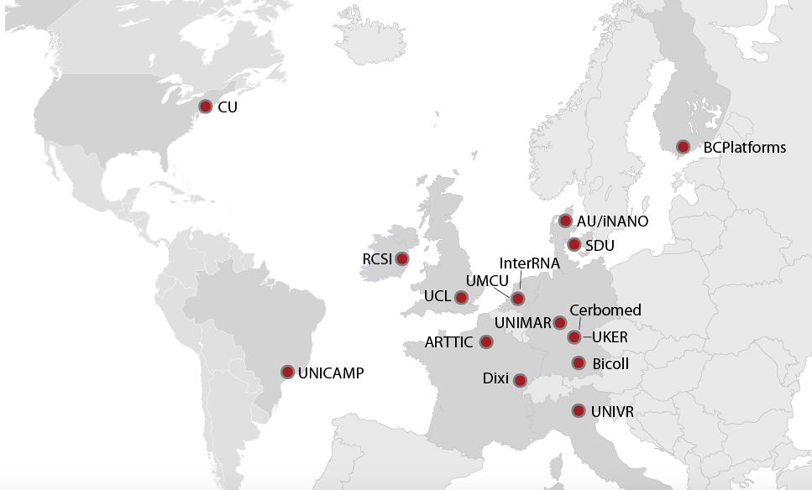


Slide 11
Participants
Institute of Genomic Medicine (IGM) at Columbia (formerly Duke);
Royal College of Surgeons;
University of Marburg;
University of Campinas (UNICAMP);
University Hospital Bonn;
University Hospital Tübingen;
University of Melbourne;
Université libre de Bruxelles.

Slide 12
Study Design
Customized panel:
  Human miRNAs;
  miRNA biogenesis genes;
  Predicted miRNA targets;
Genomic DNA from blood;
Standard SeqCap EZ protocol;
HiSeq 2500
  2 x 100bp
  12 individuals / lane
  Average coverage > 100X

Slide 13

Gene-based association tests for rare variants in case-control datasets
ACACGCCTTCGG
ACACGCCTTCGG
ACATGCCTTCGA
ACACGCCTTCGG
ACATGCCTTCGG
ACATGCCTTCGA
ACACGCCTTCGA
ACACGCCTTCGG
SNP1
SNP2
Gene A

Slide 14
Gene-based association tests for rare variants in case-control datasets
Ultra-rare variants
Rare variants
Difficult for single-SNP association tests to capture the effect of rare variants on phenotype
Alternative: Burden tests – assess the cumulative effects of multiple variants in a genomic region (e.g., a gene).

Slide 15
Gene-based association tests for rare variants in case-control datasets
Method SKAT (Sequence Kernel Association Test) (Wu et al., 2011)
  Allows different variants to have different directions and magnitude of effects.
  Uses a kernel function to measure the genetic similarity between subjects i and i’ in the region via p markers.
  Applies weights for each variant based on their minor-allele frequencies (MAF)
  The kernel function can be linear, implying that the phenotype depends on the variants in a linear fashion; or quadratic, implying the presence of variant by variant interactions.
  For each gene, SKAT calculates a p-value for association.

Slide 16
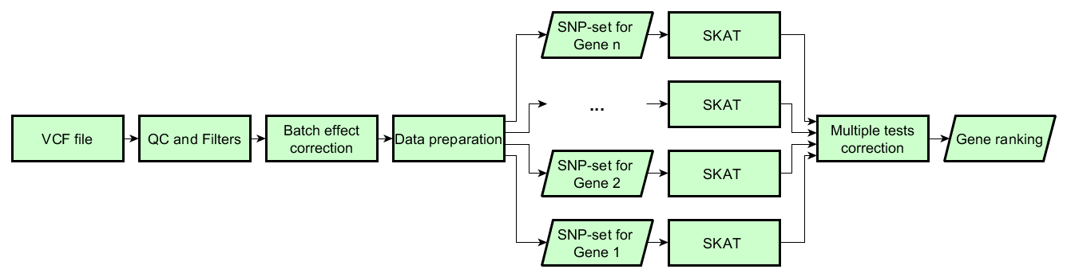
Gene-based association tests for rare variants in case-control datasets

Slide 17
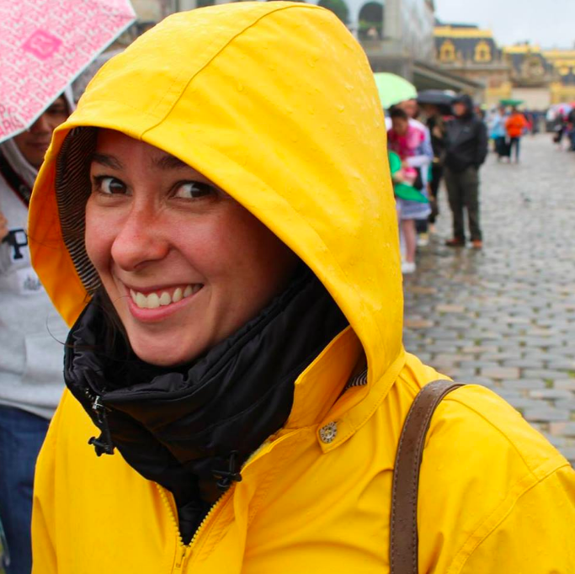
CNV vs. Stroke
Barbara Henning

Slide 18
CNV in patients that had a stroke
Data preprocessing
Raw data normalisation (rawcopy¹ R Package)
CNV identification with 3 methods: PSCBS², copynumber³, and GADA⁴
Keep only the regions with
  At least 25 probes (deletions) or 50 probes (gains)
  > 100kb
  LRR <= -0.3 (deletions) or LRR >= 0.3 (gains)
  and were identified as a alteration by the 3 methods
  At this point each subject has a set of alterations consistent for the 3 methods

Slide 19
CNV in patients that had a stroke
Data preprocessing
  At this point each subject has a set of alterations consistent for the 3 methods
Identification of alterations belonging only to CONTROL subjects, therefore probably not related to the disease
Remove all the alterations identified in step 4
Final data:
all the alterations that were not observed in CONTROL subjects
¹rawcopy: Scientific reports 6 (2016): 36158, ²PSCBS: Bioinformatics 27.15 (2011): 2038-2046, ³copynumber: BMC genomics 13.1 (2012): 591, ⁴GADA: BMC genomics 13.1 (2012): 591.

Slide 20
CNV in patients that had a stroke
Sample:
  BRA: 45 subjects
  ITA: 13 subjects
  USA: 450 subjects

Slide 21
CNV in patients that had a stroke
 | PSCBS | copynumber | GADA | FINAL*
gains | 1451 | 1483 | 1477 | 1473
deletions | 2658 | 2626 | 2632 | 2636
 | Average
gains | 59787
deletions | 37652
Number of gains and deletions:
  *called as a deletion if at least two methods called it as a deletion; the same for gains.
Alteration size:

Slide 22
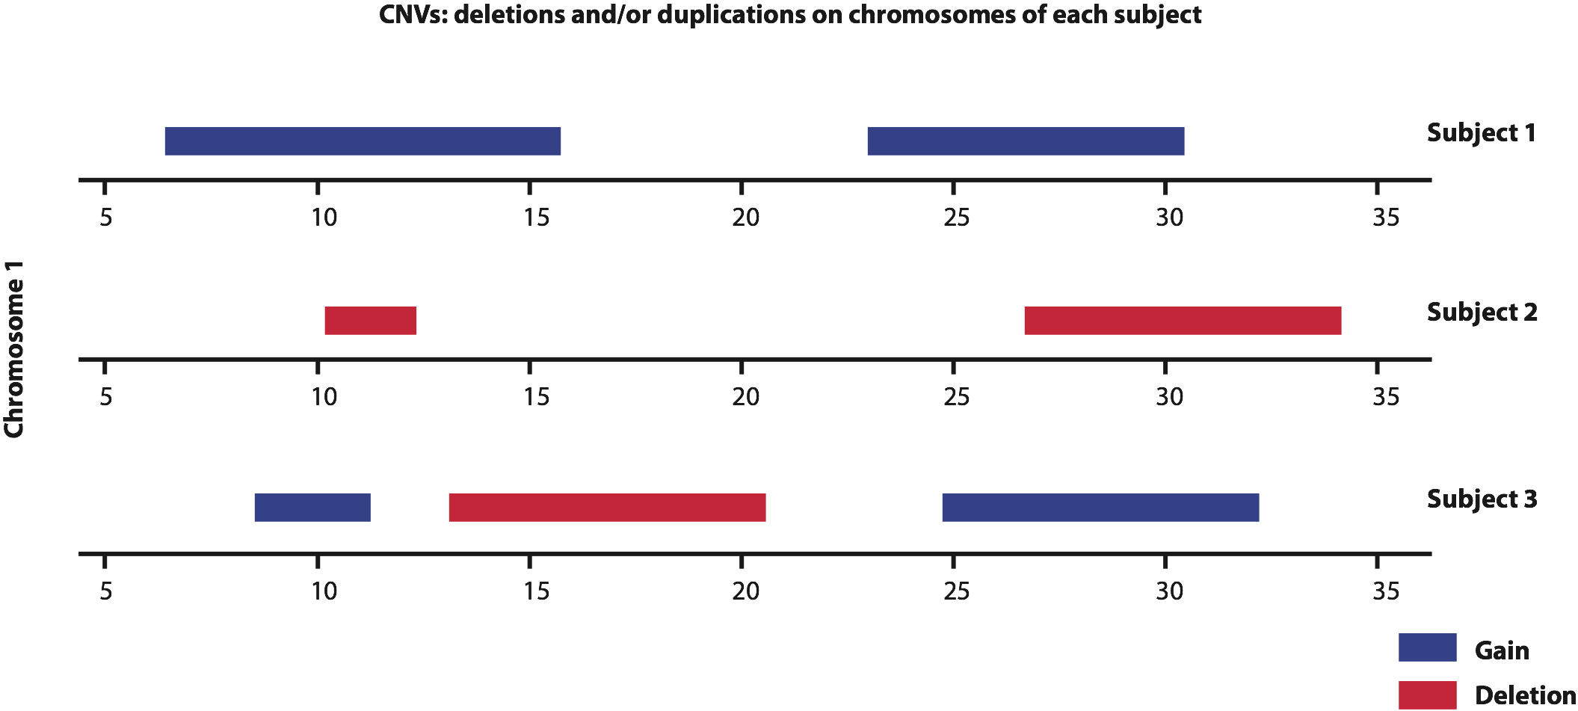
CNV frequency
CNVs mapping of each subject on a given chromosome
Notes:
Example of CNVs mapping of each subject on chromosome 1.
Then, we create the disjoint map of all possible CNVs by finding all start or end points of CNVs we observed in our subjects. This procedure is done across all the chromosomes. With this mapping we create the set of all CNV events per chromosome, as illustrated at the bottom of figure 2.

Slide 23
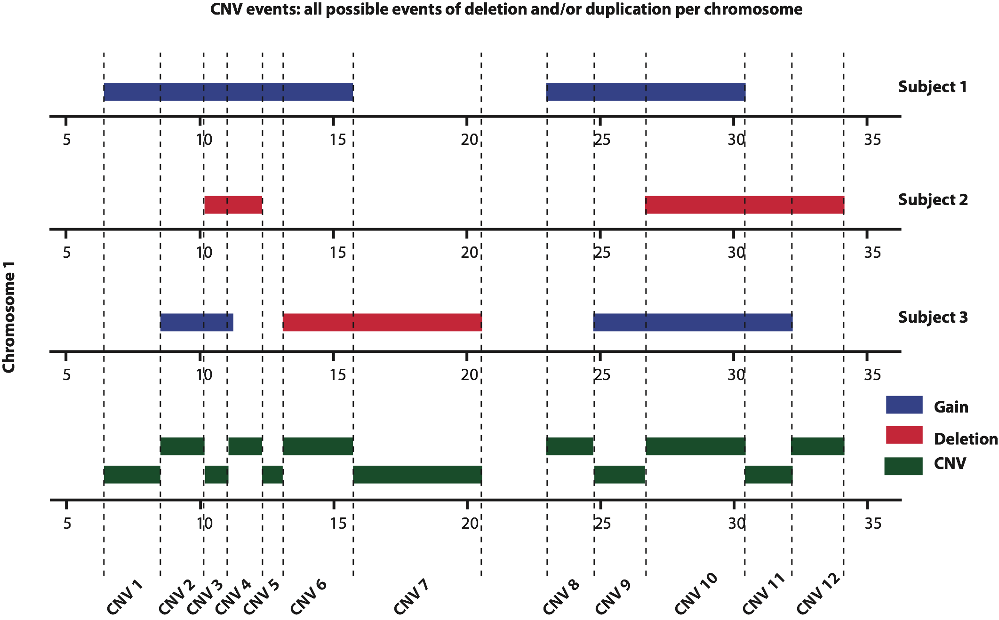
CNV frequency
…3655 CNV events
Disjoint map
Notes:
Fig2. Disjoint map example. Bottom: example of mapping of all CNV events in chromosome 1. The events are defined by finding all start or end points of CNVs observed in all subjects.
In our sample, we have 3655 CNV events.

Slide 24
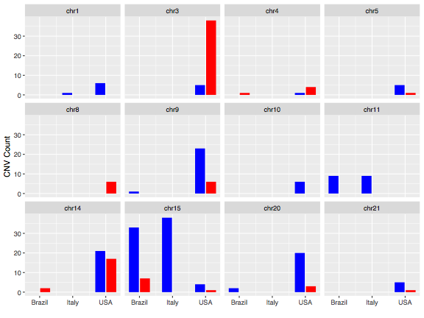
CNV frequency
Common CNV events (frequency >1%)
Notes:
And we have 276 common CNVs in our dataset.
Common CNVs are grouped by chromosome and origin in the following chart, where gains are colored in blue and deletions are colored in red:

Slide 25
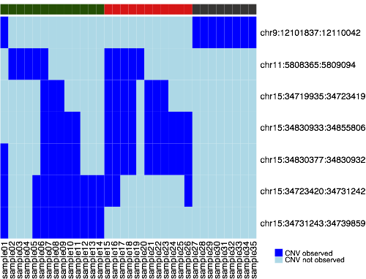
CNV frequency
Overlap of the most frequent CNVs

Slide 26
Integrating Multimodal Data to Improve Diagnostics and Treatment Assignment
Barbara Henning

Slide 27
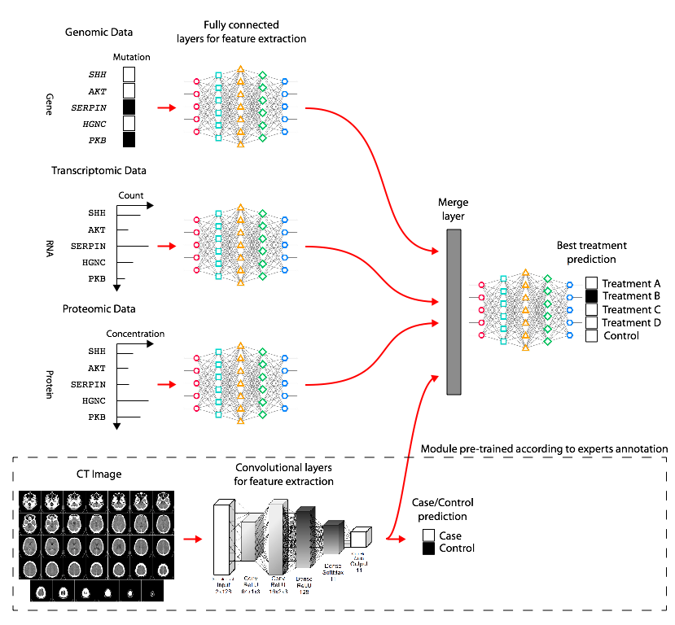
Integrating multimodal data for best treatment prediction
Notes:
Third step: learn how to integrate molecular data (measured or predicted) and imaging data to predict the best treatment

Slide 28
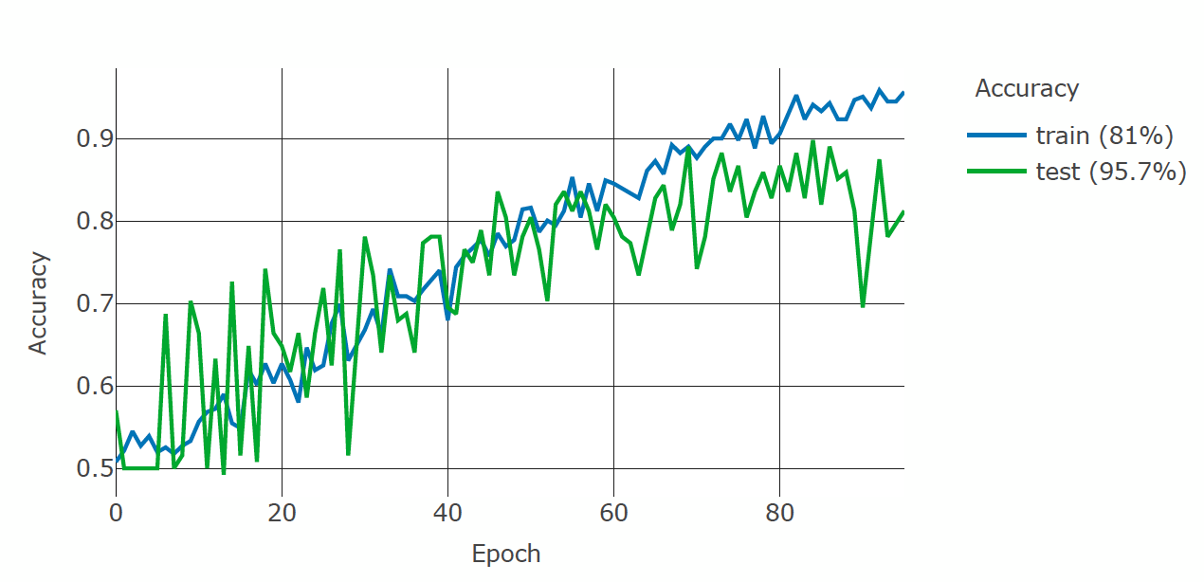
Results based on images only
Notes:
Accuracy evolution as we train a 3D convolutional neuronal network to classify MRI images into two classes, control and patient.

Slide 29
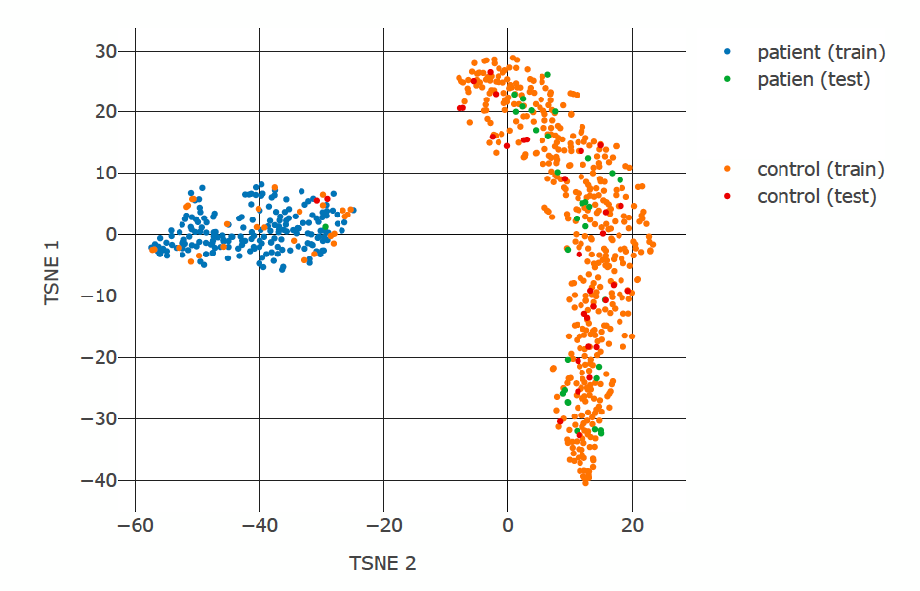
Results based on images only
Notes:
2D projection of features extracted from our dataset of MRI images using our trained model

Slide 30

Sharing our Findings
Welliton Souza

Slide 31
Past developments
2015
LOVD
Beacon – Beacon Network
2016
GA4GH Genomics API
GA4GHclient - Bioconductor package
GA4GHshiny – web application
Bottleneck server for Beacon
Beacon client – R package
New website
2017
Cloud environment
Improved web application

Slide 32
GA4GH​ ​Connect:​ ​A​ ​5-Year​ ​Strategic​ ​Plan (2017)
Technical Work Streams
Data Use & Researcher Identifiers (DURI) – ELIXIR Beacon
Large Scale Genomics – htsget, refget
Cloud – Workflow Execution Service API
Discovery – Beacon API
Genomics Knowledge Standards – Genomics API (deprecated)

Slide 33
Beacons – Beacon Management System
Implementation of the GA4GH Beacon API version 1.0
Allow multiple Organizations, Beacons and Datasets
Expose beacons as GA4GH Beacon API endpoints
User-authenticated web application for data management
Web client

Slide 34
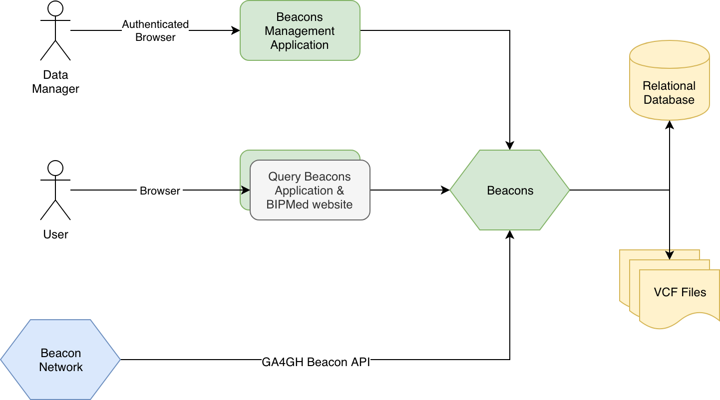
Beacons

Slide 35
BraVE – BIPMed Variant Explorer
Custom API – version 1.0.0
Server implementation
Web application
Supports multiple queries
  Gene symbols – SCN1A, BRCA1
  Genomic locations – 1:65000-70000
  Genomic positions – 1:7737651
  dbSNP IDs – rs35735053
Support multiple datasets
Support multiple reference genomes
After data import, VCF files are not required
Analytics data collection for data science and reports

Slide 36
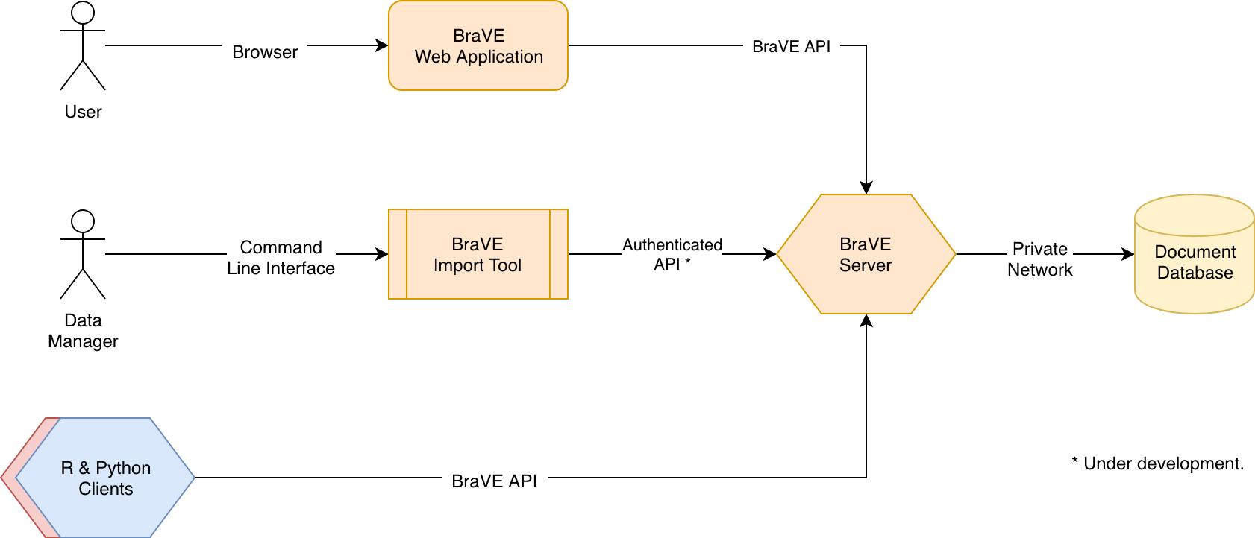
BraVE

Slide 37
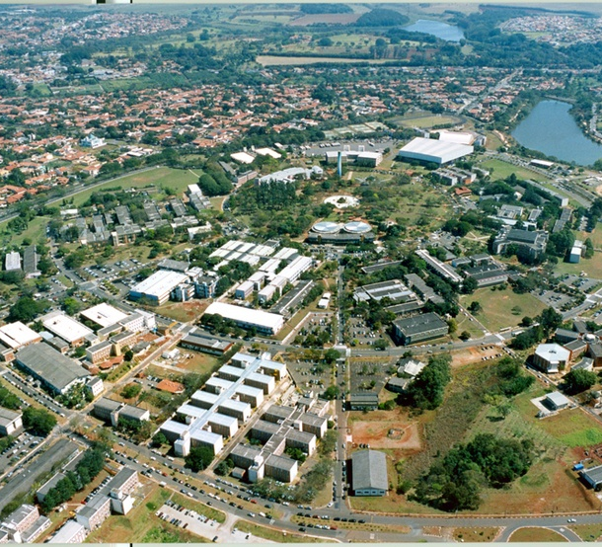
Thank You!
Benilton Carvalho
  benilton@unicamp.br
BIPMed
  www.bipmed.org
  contact@bipmed.org

