Slide 1
Comparing real-world and clinical trial somatic mutation data
Svetlana Lyalina
PHC Data Science Analytics
Product Development
Genentech Inc.
BIRS workshop on “Statistical and Computational Challenges in High-Throughput Genomics with Application to Precision Medicine"
November 7th,2018

Slide 2
Expected evolution of biopharma value chain
Advances in science and technology will change how therapies are discovered, developed, approved, reimbursed, and commercialized
Drug Discovery
Clinical Development
Regulatory Filing
Treatment Selection/ Monitoring
Reimbursement
FUTURE
Molecular profile-driven with tools using comprehensive Diagnostics and RWD | Adaptive trials and smaller RCT in biomarker subpopulation guided by molecular profiling, RWD to supplement evidence generation | Approvals conditional on demonstrating post-marketing outcomes. More frequently updated and molecular profile-based labels | Outcomes-focused personalized reimbursement payment models for an integrated product offering* | Decisions influenced by HCP, payers, CDS tools, and beyond incl. patients, pathologists, etc.
CURRENT
Biomarker-driven, targeted | Large RCTs with some biomarker subgroups | Pivotal trials required / broader indication-based labels with rare updates | Cost/value-based payment for therapeutics, some with innovative pricing | Decisions influenced by HCPs and increasingly payers
* Integrated product offering includes therapy, diagnostics, data and value added services
Notes:
First I’d like to give some insight on what Personalized Healthcare means for Roche. Originally Jane had a whole talk about the company wide initiatives on this topic, but since she could not attend very suddenly, I will just give a two slide recap of that in terms of what I have been exposed to. You can see that personalized healthcare should induce changes in how we do multiple aspects of business, from the more familiar drug development to clinical decisions and regulatory interactions. The two sections relevant to my day to day work are the first two

Slide 3
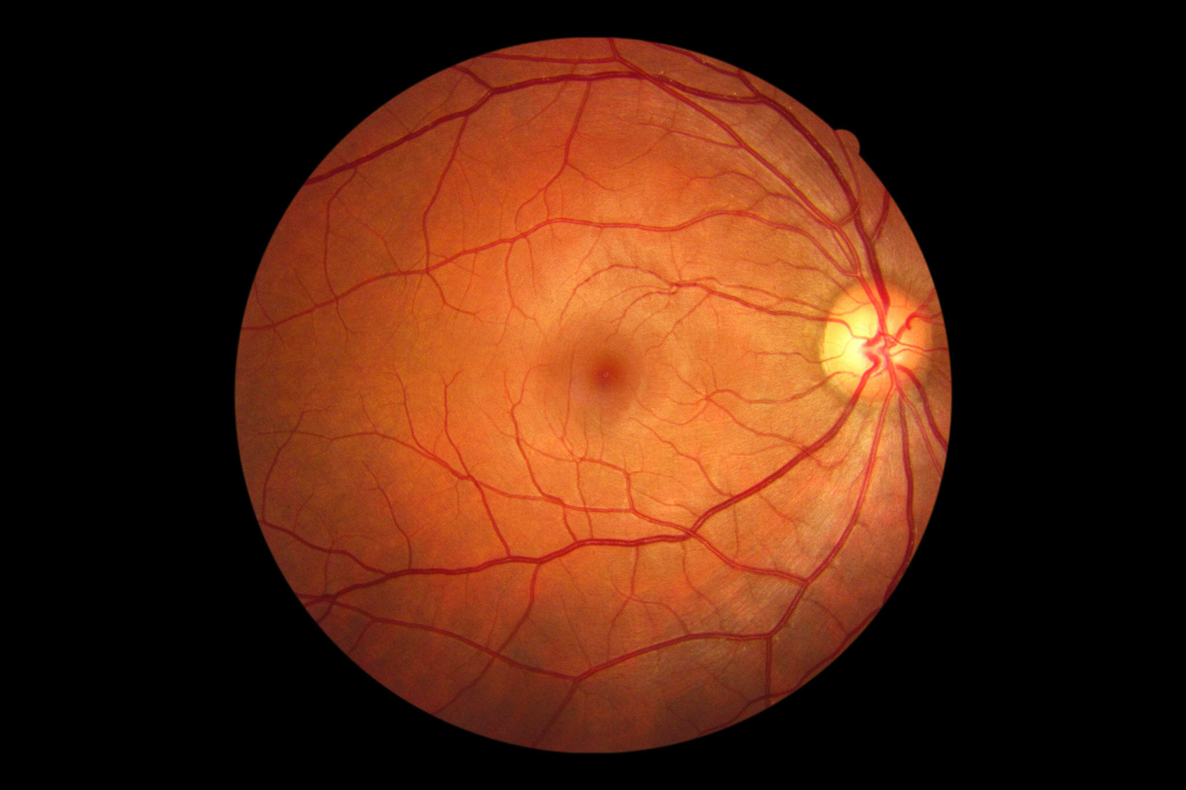
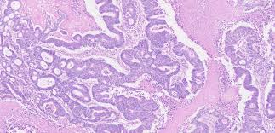
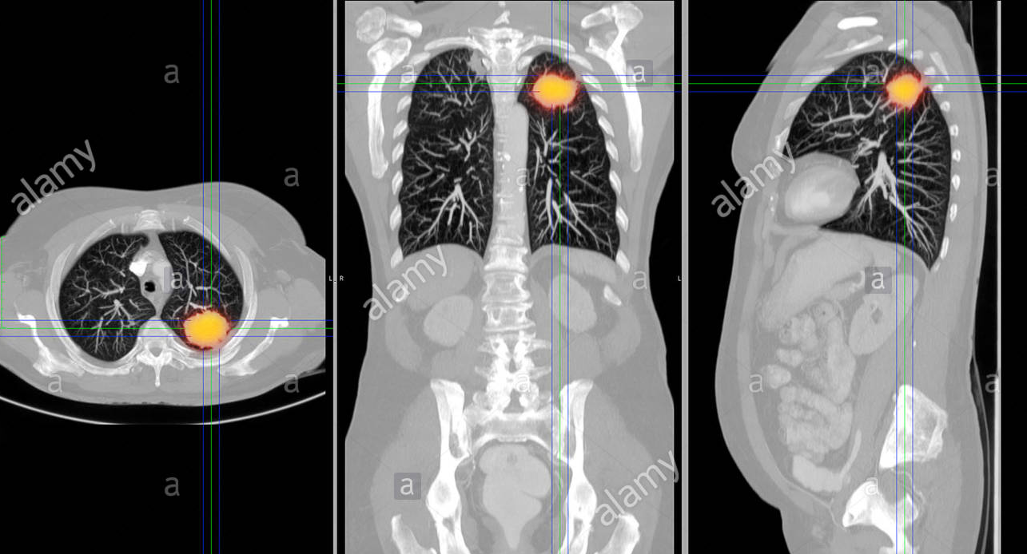
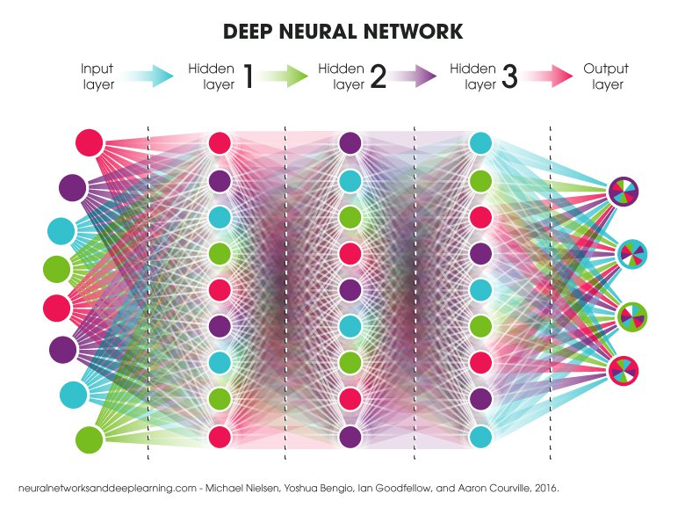
Ramp up capability development with showcases Focus on core disease areas: CIT, Ophthalmology, and MS
EDIS (Enhanced Data Insights and Sharing)
Assemble existing Roche trial data for analysis at scale:
5000+ genomic and imaging datasets in CIT lung cancer trials
1M+ retinal images from ophthalmology trials
10K+ MRI from MS trials
Data and Analytics Platforms
Omics
Imaging
Digital
Machine
Learning
New models for MDAS (Meaningful Data at Scale)
Floodlight OPEN
Slide provided by J. Fridlyand
Notes:
To further elaborate what these changes mean for people like me in the Data Science realm, I’ve plucked another one of Jane’s slides highlighting the data sources being compiled and the internal capabilities being cultivated. The three disease areas of highest interest are cancer immunotherapy, ophthalmology, and multiple sclerosis. The data themselves generally come from the harmonization of previous trials and the partnering and acquisition of external large scale data. The external data sources I’m more familiar with are Flatiron Health and Foundation Medicine, which are two I’ll be mentioning in my project talk.

Slide 4
Onto the actual project: Motivating clinical need and broader scientific question
Triple negative breast cancer constitutes a high unmet need.
Single arm trials can benefit from comparisons against a synthetic control arm. However, the comparability of this control arm needs to be evaluated.
More broadly, we would like to know how the populations we have sampled in different settings compare to each other
Notes:
-Triple negative breast cancer has no recommended treatment aside from chemotherapy, has poor prognosis, and constitutes a high unmet need.
-Single arm trials (for TNBC drugs, as well as other indications) can benefit from comparisons against a synthetic control arm. However, the comparability of this control arm needs to be evaluated, not only from the clinical covariates side, but on the genomic level as well.
- More broadly, we would like to know how the populations we have sampled in different settings compare to each other, and whether they are informative of the mutational landscape at large.

Slide 5
Data sources
Patient populations:
Patients with locally advanced or metastatic TN breast cancer in LOTUS trial
Patients in Flatiron/FMI TNBC CGDB (further filtering required)
Both sets of biopsy specimens are assayed with Foundation Medicine’s FoundationOne platform, which profiles a set of ~400 genes.
Kim et al. The Lancet Oncology 18.10 (2017): 1360-1372.

Slide 6
Frampton et al. Nature biotechnology 31.11 (2013): 1023.
Notes:
To give some background on the particular mutational profiling method, here’s some information on what Foundation Medicine does. FMI, now a Roche company, provides information specific to patients mutational profiles for purposes of treatment guidance. Patient-level genomic data includes specimen features (e.g., tumor mutation burden, pathologic purity), alteration-level details (e.g., genomic position, reference and alternate alleles, mutant allele count, minor allele frequency), and therapeutic recommendations that were reported to the clinician at the time of testing

Slide 7
Initial data delivery:
● Data cut-off is July 31, 2017
● N=524 patients (includes patients with both early and metastatic disease
● ~80% of the cohort has metastatic disease
● ~75% of the cohort had metastatic disease when FMI test was reported. Of
these patients, ~83% had tissue collected after their metastatic diagnosis
Applying a stricter definition of TNBC already drops the N to 287
Notes:
The clinico-genomics database, or CGDB as it will be referred to for the rest of the talk, constitutes the intersection of the information provided by Flatiron Health and Foundation Medicine. Flatiron is an oncology EMR provider with more than 280 practices in the network. They aim to give information on a patient’s full cancer journey, combining labs, biomarker testing, visits, demography, and outcomes.
While the full CGDB is quite large, when you start subsetting to very specific patient populations you quickly get to the hundreds range. With the TNBC data, the initial delivery used an intentionally broad definition, which is not optimal for some of the use cases within the PHC group. Hence a stricter internal definition was developed by Chris Craggs and Nathaniel Phillips. This definition aims to ensure that the 3 biomarkers (ER/PR/HER2) have been consistently negative through all tests up to a patient’s metastatic diagnosis.

Slide 8
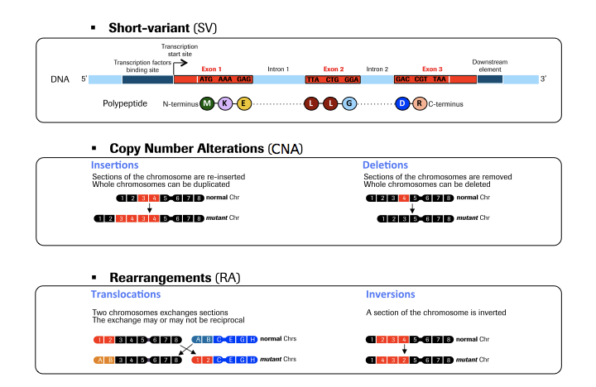
Data constraints and caveats
FMI data is not as rich as WGS or WES - it’s tumor only, and it’s bait-based. Furthermore, the way this data is delivered focuses on alterations that fall into 3 categories - short variants (SV), copy number alterations (CNA), and rearrangements (RA).
Numerically, this results in feature vectors of mixed numeric types - two are binary (WT vs affected for SV and RA), and one is real valued non-negative (CNA).
On the clinical front, things are even more complicated, because Flatiron doesn’t have full capture of a patient’s early treatment history and we have to be extra careful to compare apples to apples.

Slide 9
Filtering rules applied to Flatiron data to mimic LOTUS eligibility criteria
N = 287
N = 179
N = 157
N = 118
N = 103
N = 102
Patients’ biomarker (ER/PR/HER2) testing results are consistent and disease status must be classified as mTNBC
Patients must have specimen collected before start of metastatic firstline therapy
Patients must have no chemotherapy 6 months prior to their first line treatment
First line treatment must start within 90 days of metastatic diagnosis
Patients must have no CNS mets
Patients must be diagnosed after January 1st, 2011, must be female, over 18, and had no prior treatment with Akt, PI3K, and/or mTOR inhibitors
Unenforced filter: patients must be metastatic or locally advanced inoperable - we cannot capture that second category, so end up with a stricter set of metastatic only

Slide 10
Summary of clinical covariates
variable | levels | CGDB | LOTUS
N |  | 102 | 103
Age (mean (sd)) |  | 57.67 (10.99) | 53.40 (12.11)
Race (%)
 | Unknown | 12 (11.8) | 0 ( 0.0)
 | Asian | 3 ( 2.9) | 46 (44.7)
 | Black or African American | 6 ( 5.9) | 7 ( 6.8)
 | Other Race | 8 ( 7.8) | 4 ( 3.9)
 | White | 73 (71.6) | 46 (44.7)
Body weight (mean (sd)) |  | 73.22 (14.76) | 65.59 (17.23)
Body mass index (mean (sd)) |  | 27.55 (5.55) | 25.62 (6.05)
ECOG (%) | 0 | 39 (38.2) | 61 (59.2)
 | 1 | 33 (32.4) | 38 (36.9)
 | 2 | 7 ( 6.9) | 0 ( 0.0)
 | Unavailable | 23 (22.5) | 4 ( 3.9)
DFI (%) | No prior chemotherapy | 0 ( 0.0) | 35 (34.0)
 | <=12 | 16 (15.7) | 21 (20.4)
 | >12 | 14 (13.7) | 47 (45.6)
 | NA | 72 (70.6) | 0 ( 0.0)
Number of metastatic sites (%) | One | 18 (17.6) | 37 (35.9)
 | Multiple | 84 (82.4) | 65 (63.1)
 | None | 0 ( 0.0) | 1 ( 1.0)
Liver metastases present (%) | FALSE | 56 (54.9) | 74 (71.8)
 | TRUE | 46 (45.1) | 28 (27.2)
 | NA | 0 ( 0.0) | 1 ( 1.0)
Notes:
Multiple things jump out as different between the two populations. LOTUS recruited heavily in East Asia - South Korea, Taiwan, Singapore, and hence has an enrichment for Asian patients. Patients in the Flatiron network, which is currently US-only, skew more white.
Potentially due to these global-scale demographic differences, we consequently see differences in the body weight and BMI variables.
One of the prognostic variables that LOTUS collected - disease free interval - is hard to replicate with the Flatiron data, since early chemotherpy exposure is not fully captured, and hence we code an absence of these instances as NA instead of “No prior chemotherapy”. The remaining variables suggest an overall conclusion that the CGDB patients are less healthy as they are older at diagnosis, have more metastatic sites and particularly are more likely to have liver metastases, which are indicative of poor prognosis

Slide 11
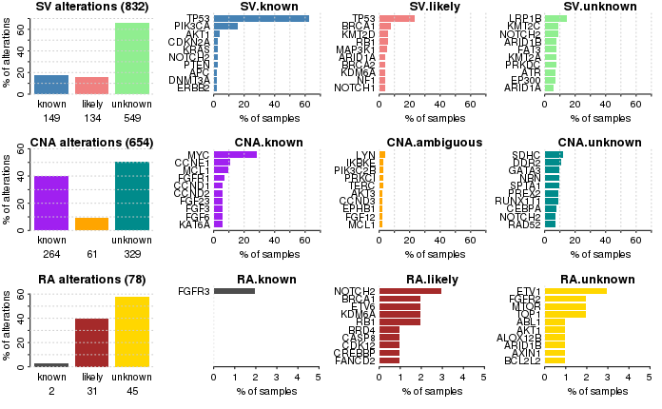
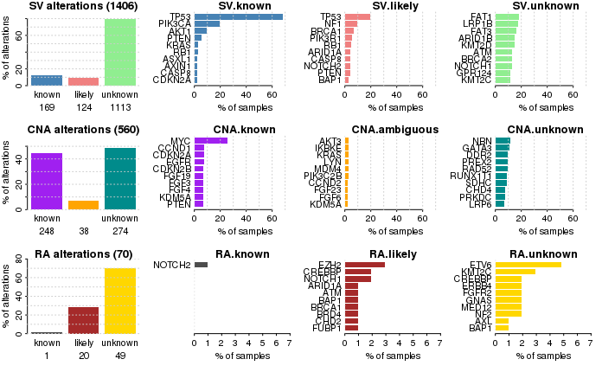
Summary of mutation data
HER2
CGDB
LOTUS
Notes:
While there is some overlap in the very top genes listed (TP53, PIK3CA, AKT1, PTEN short variants, amplification of MYC, BRCA involvement), there’s quite a number of differences in this summary snapshot of the two groups when looking at the less prevalent genes. For example, the presence of ERBB2 (HER2) short variants in the CGDB data is interesting, since some studies report that even if a patient does not overexpress this gene by standard assays, they could still have an activating mutation which is treated well with HER2 therapy.

Slide 12
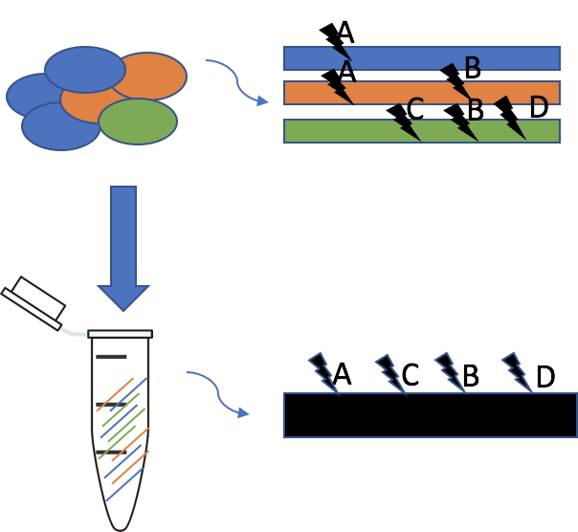
Proposed approach for comparing the two populations using ideas from ecology
At its most basic, we have a question that frequently comes up in ecology - are the two regional samples similar to each other and are they representative of the unobserved whole population.
Setting up the analogy:
Individual tumor cells with distinct genotypes are “species”
The tumor itself as a collection of cells is a “site” or “community”
The whole set of tumors in a dataset is a “region”
The unobserved overall set of patients with TNBC is a “landscape”
What scDNA-seq would give
The readout we get
Maley et al. , Nature Reviews Cancer 17.10 (2017): 605-619.
Notes:
A lot of tumor profiling can be seen as a metagenomics problem, with the difference that the observed collection of “strains” are a lot closer to each other and the host than different microbes would be.
The cartoon on the right illustrates the limitation of this analogy - that while we truly have three distinct genotypes present, the “blackboxing” that occurs through bulk tumor DNA sequencing results in a depletion of information, causing us to treat all mutations as independent.

Slide 13
Some basic quantities of interest
Alpha, beta, and gamma diversity assess differences in ecological entities at different levels
Alpha answers what the diversity within a sample is
Beta answers what the diversity between samples is
Gamma attempts to gauge the diversity in the broad population which we cannot fully observe
Theoretically, gamma = alpha x beta, but there is debate about this
Jost. Ecology 88.10 (2007): 2427-2439.
Whittaker. Taxon (1972): 213-251.

Slide 14
Necessary simplification
While ideally each subclone’s genotype would constitute a species in this oncology-ecology framework, the data we have force a convolution of all the individual genotypes in a tumor.
Methods exist for deconvolving the individual lineages, but they require WGS data or multiple samples per specimen.
For the analyses I have performed I’ve been working with the simplification of single mutation equaling a species.

Slide 15
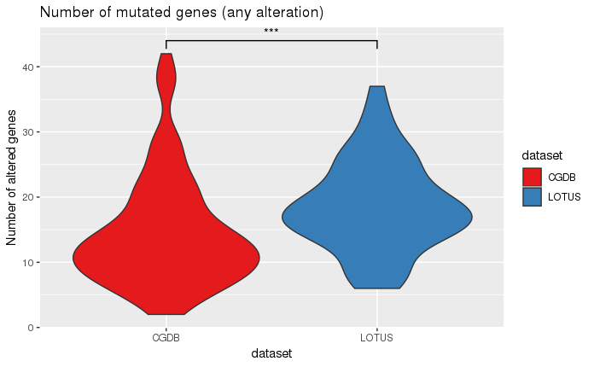
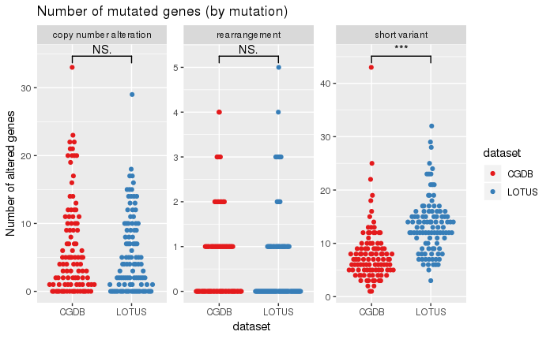
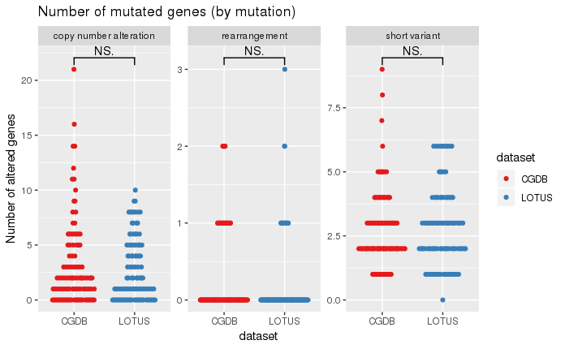
Alpha-diversity: mutational richness within samples
All evidence tiers
Known and likely only
This effect goes away if we restrict the mutations to variants of known and likely significance
Garofalo et al. Genome medicine 8.1 (2016): 79.
Notes:
Garofalo et al investigated the effects of a different sized gene panels and patient ancestry backgrounds on mutation calling, finding a significant increase in false positives in non-white populations
Looking at the by-race breakdown of unknown significance mutations (not shown), we see that within LOTUS, Asian and Black patients do have higher numbers of these variants, but overall when comparing in both datasets, there is a main effect of LOTUS having more unknown SVs.

Slide 16
Beta-diversity: Differences between samples
Key analysis choices when performing this:
Distance metrics
Ordination type

Slide 17
Distance metrics
Like previously mentioned, the FMI data has an unusual make-up - some features are binary and some are non-negative real-valued
Only one distance metric (from what I could find) can deal with this without altering the data - Gower’s distance
If we collapse the data (make the features be “is gene X mutated in any way?”) then we can try all distance metrics suited to binary data: Jaccard, Manhattan, Binomial, Raup-Crick, Mahalanobis
Jaccard = size of intersection divided by size of union
Manhattan = L1 norm, “city block distance”
Binomial = Binomial deviance under null hypothesis that the two compared communities are equal
Raup-Crick = 1-(probability of observing at least j species is shared in compared communities), where the probability is derived from hypergeometric distribution
Mahalanobis = Euclidean distances of a matrix where columns are centred, have unit variance, and are uncorrelated

Slide 18
Ordination methods
Applicability of classical PCA to binary data is debatable
If we get distance matrices instead, we have a wider selection of options:
Principal Coordinates Analysis (PCoA)
Nonmetric Multidimensional Scaling (NMDS)
t-SNE
Notes:
While PCA has a variety of attractive properties like capturing the maximum amount variance in orthogonal axes, it’s unclear whether it’s still applicable for datasets in non-Euclidean space.
PCoA aims to preserve the distances between datapoints, while compressing them down from their original 400+ dimensions, to just 2

Slide 19
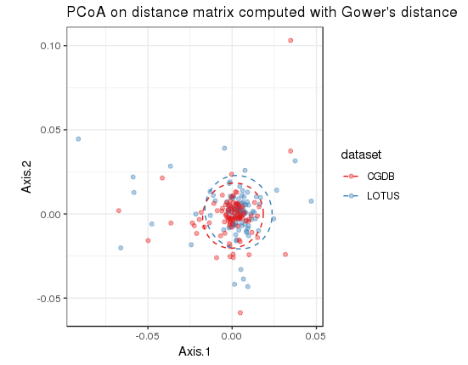
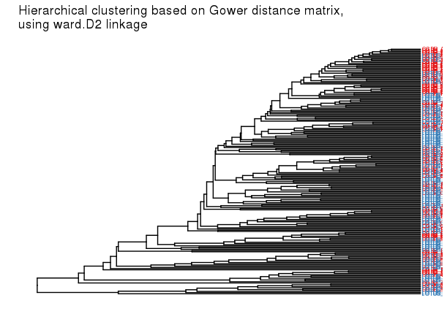
PCoA and hierarchical clustering results
Centroids are largely overlapping in PCoA, however hierarchical clustering does suggest a concentration of CGDB samples that form a more similar subset
Notes:
Overlapping centroids in PCA vs some subgrouping in tree

Slide 20
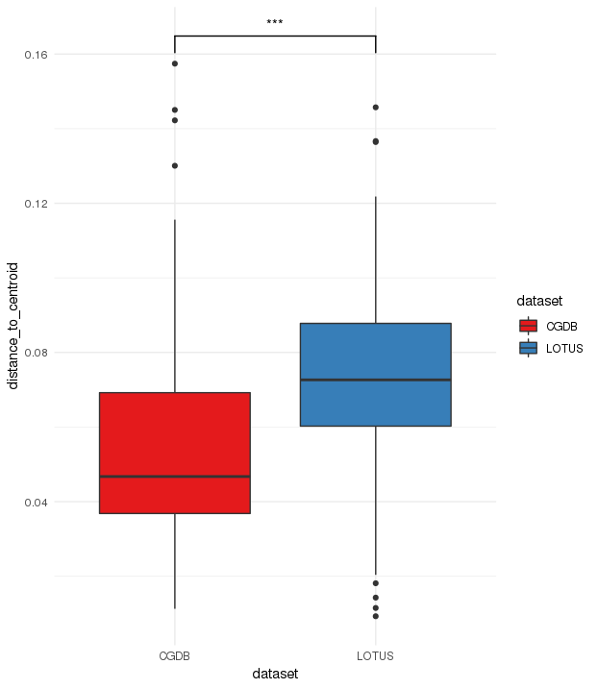
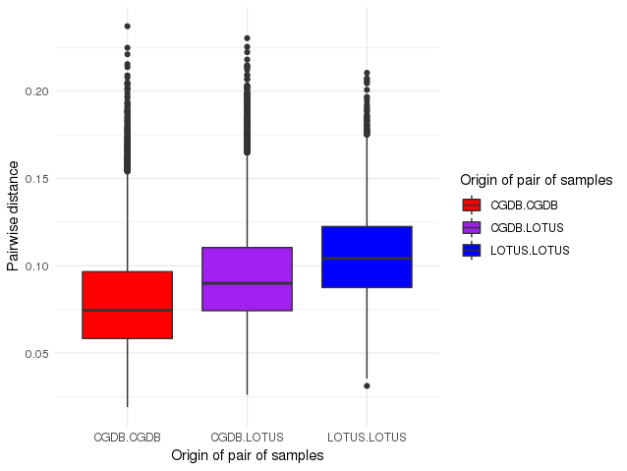
Tests of homogeneity of dispersion and distance partitioning
This analysis essentially tests if the centroids of the two groups are similar
This analysis tests if one group is more variable than the other
PERMDISP2 p-value = 2.721e-05
ADONIS2 p-value = 0.175
Anderson, Biometrics 62.1 (2006): 245-253.
Zapala et al., PNAS 103.51 (2006): 19430-19435.

Slide 21
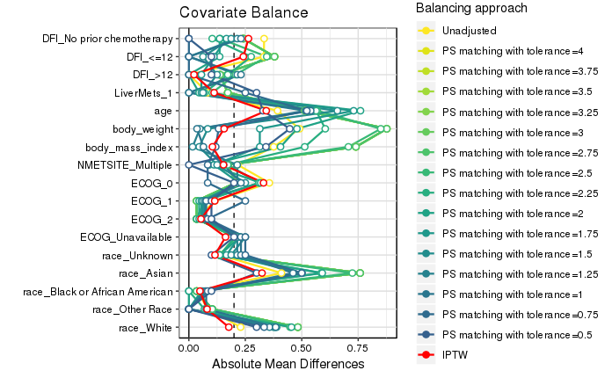
We know that some clinical variables are unbalanced between the datasets
We attempt to create more balanced datasets via propensity score (PS) matching at different levels of strictness.
The PS estimates likelihood of patient being in LOTUS treatment arm
The PS itself is calculated via a gradient boosting machine with the predictors age, weight, BMI, DFI, presence of liver metastases,and number of metastatic sites
Matching is on the PS only, not the variables that go into classifier
Using propensity score matching we can try to make the datasets more comparable, at least on the clinical covariates front
Poor match even at strictest level
Points further left are better matched in that covariate

Slide 22
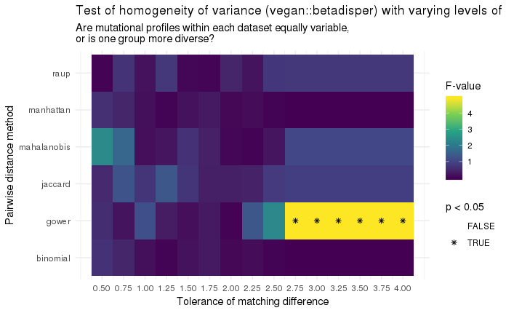
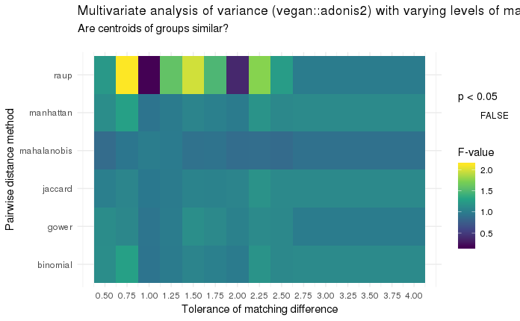
If we start restricting what patients we analyze based on clinical data, do we see changes in the mutational comparisons?
Stricter match, smaller subsample
Stricter match, smaller subsample
The difference in dispersions eventually goes away as we tighten the matching of clinical covariates
Notes:
These are results of applying differing levels of match strictness on the outcomes of the two tests I showed earlier - test of dispersion and centroid overlap. As mentioned previously 5 different distance metrics are evaluated on the collapsed binary mutation data, and gower distance applied to the full mutation feature matrix is also shown. As one goes from right to left in each plot, the subsampled groups have more similar propensity scores. We see that even at the laxest matching level, we already have a non-significant p-value for all distance metrics except Gower on both tests. In the case of dispersion, the F-value still remains high until a tolerance of 2.5 in Gower and eventually falls off. In the case of the PERMANOVA test on the right, there’s generally no change in F-values with subsampling, aside from the odd case of the Raup-Crick distance which is likely influenced by high levels of absent mutations induced by the severe sample size shrinkage.

Slide 23
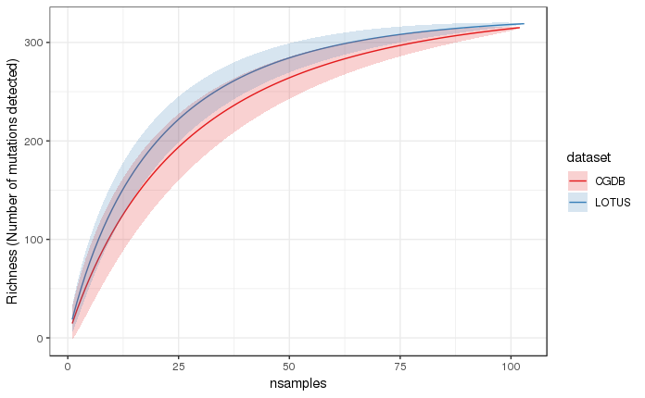
Gamma diversity: total amount of variation in the broader population
This cannot be computed directly, since it deals with unobserved species as well. Most approaches center around bootstrap estimates at different sample sizes
Estimates from LOTUS start plateauing earlier, likely due to these samples overall more diverse nature
Have to remember that this data has a practical maximum for observable number of genes – 404
Chao et al., Quantitative Biology 3.3 (2015): 135-144.

Slide 24
Conclusions
Compared 103 trial patients and 102 real world patients that fulfilled all filtering criteria to be maximally similar to trial participants.
Found significant differences in dispersion, but not in group centroids between the datasets.
Restricting the datasets by clinical covariate matching showed a reduction in the dispersion difference.
Estimation via collector’s curve of the broader population’s number of mutations showed a plateau of approximately 320 mutations

Slide 25
General takeaways
It’s hard to get cohort selection right when aligning real world patients to a trial population, particularly when both the trial and real world datasets are small
The relationship between clinical covariates and mutational profiles is not straightforward, however constricting the population via propensity score matching on the clinical variables does seem to reduce the amount of dispersion seen in the genomic data.
Another factor that influences the results is what level of FMI information we do the analysis at - whether we take only mutations marked as known and likely, or all mutations. There is potential for an underexplored confounding of race and number of short variants.

Slide 27
Extra Slides

Slide 28
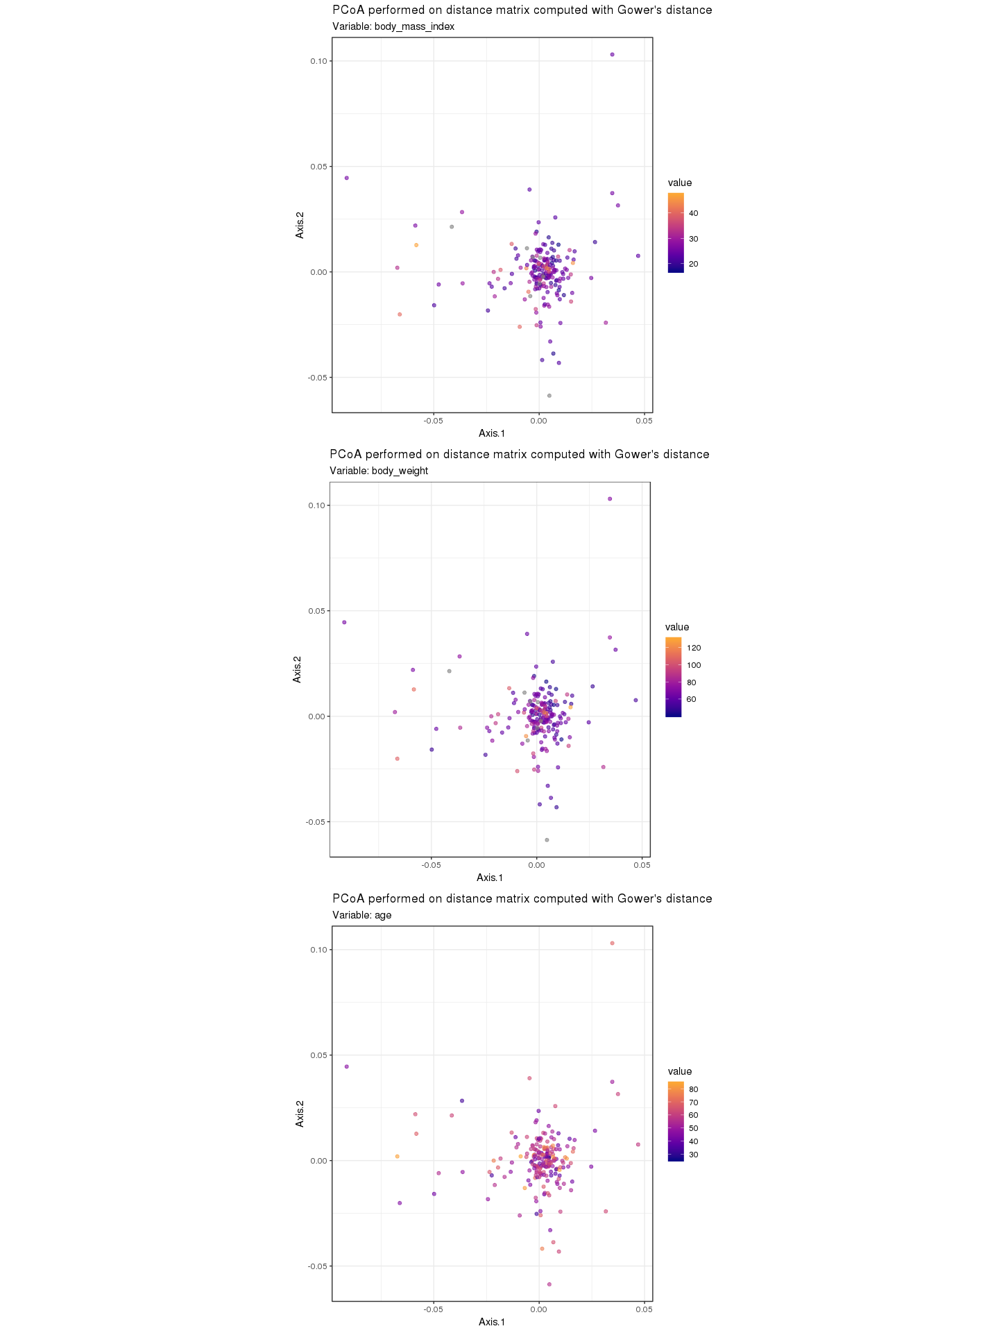
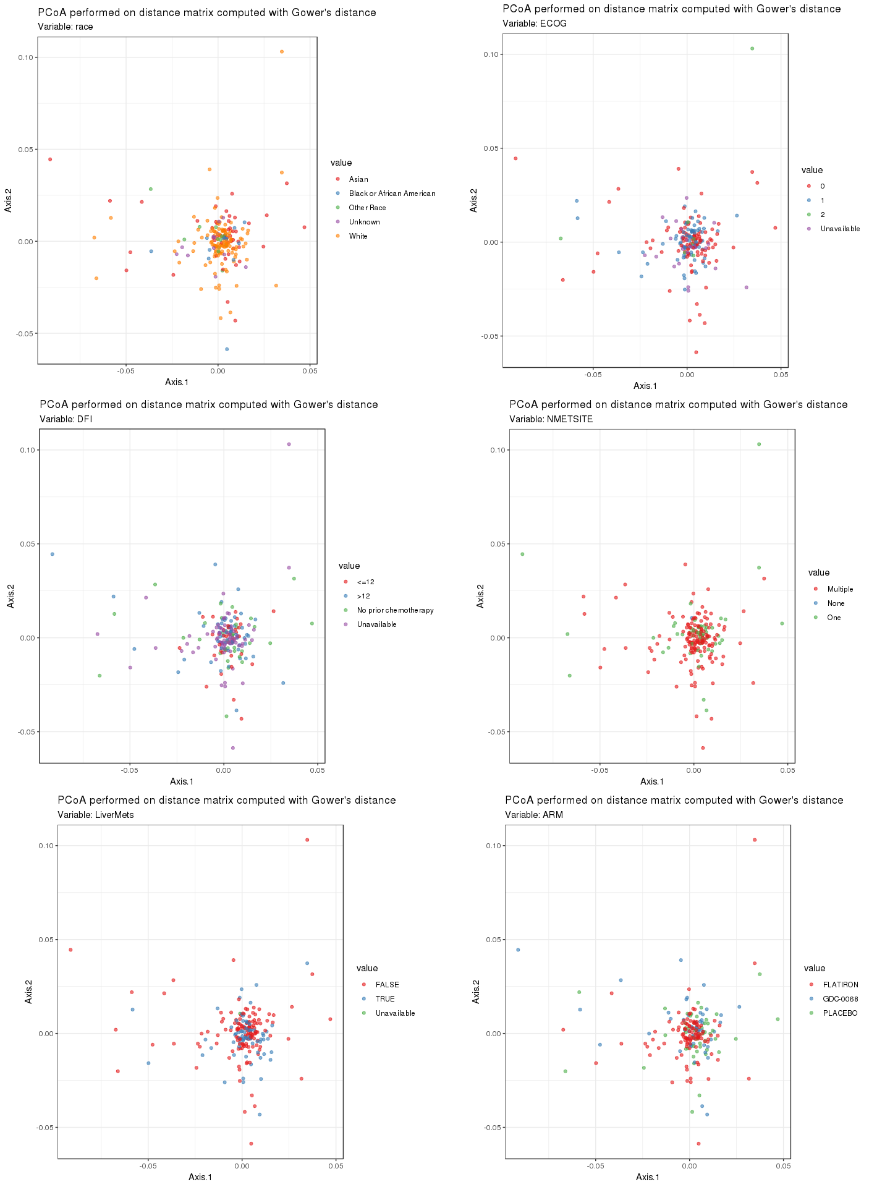
Clinical covariates mapped onto PCoA results.
Notes:
Extra information for slide 17

Slide 29
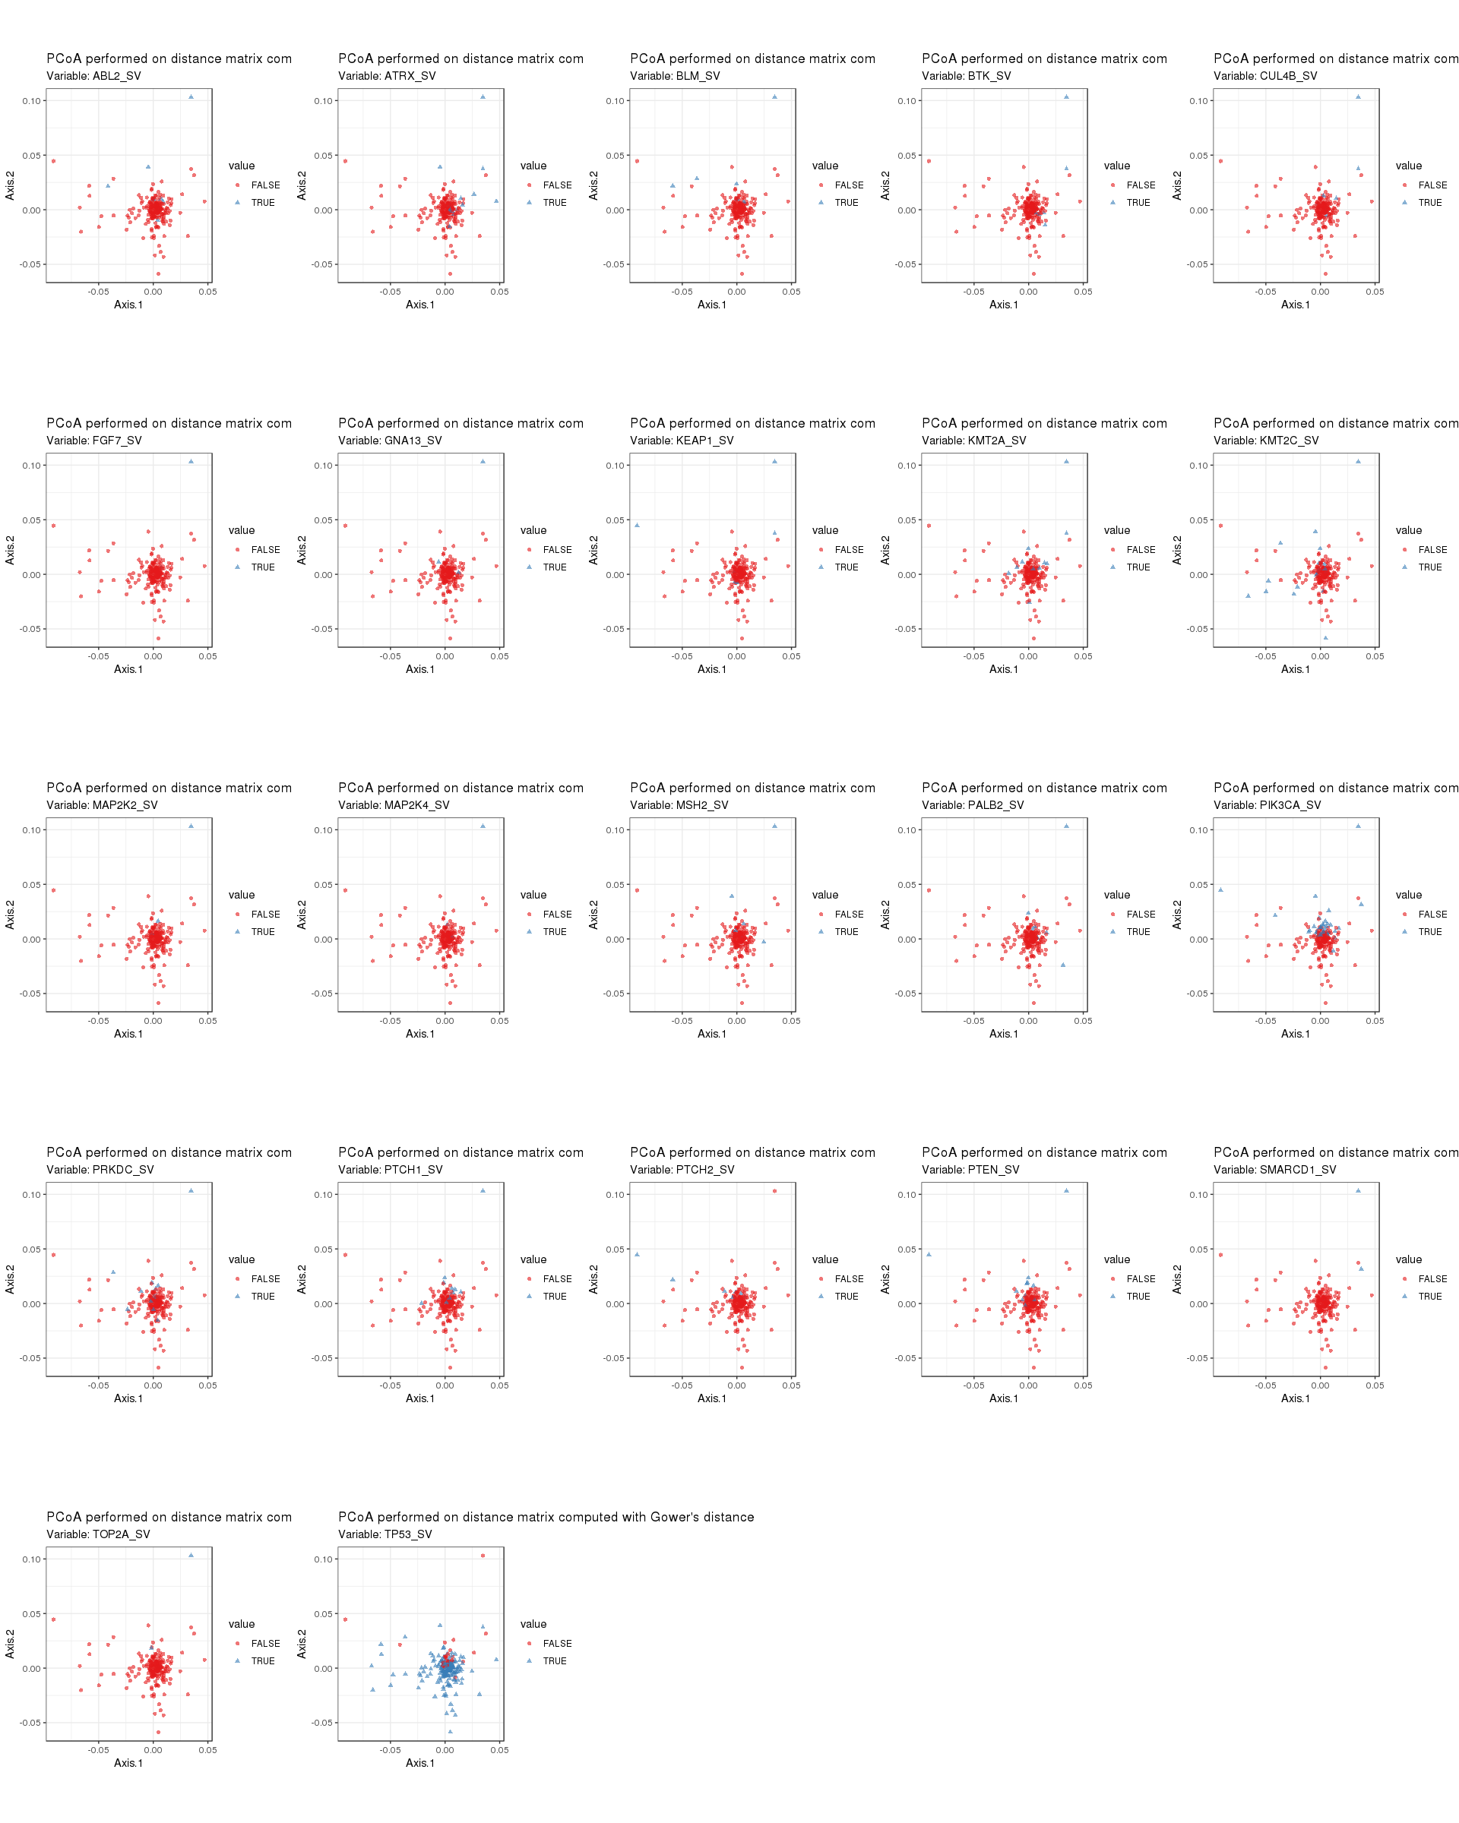
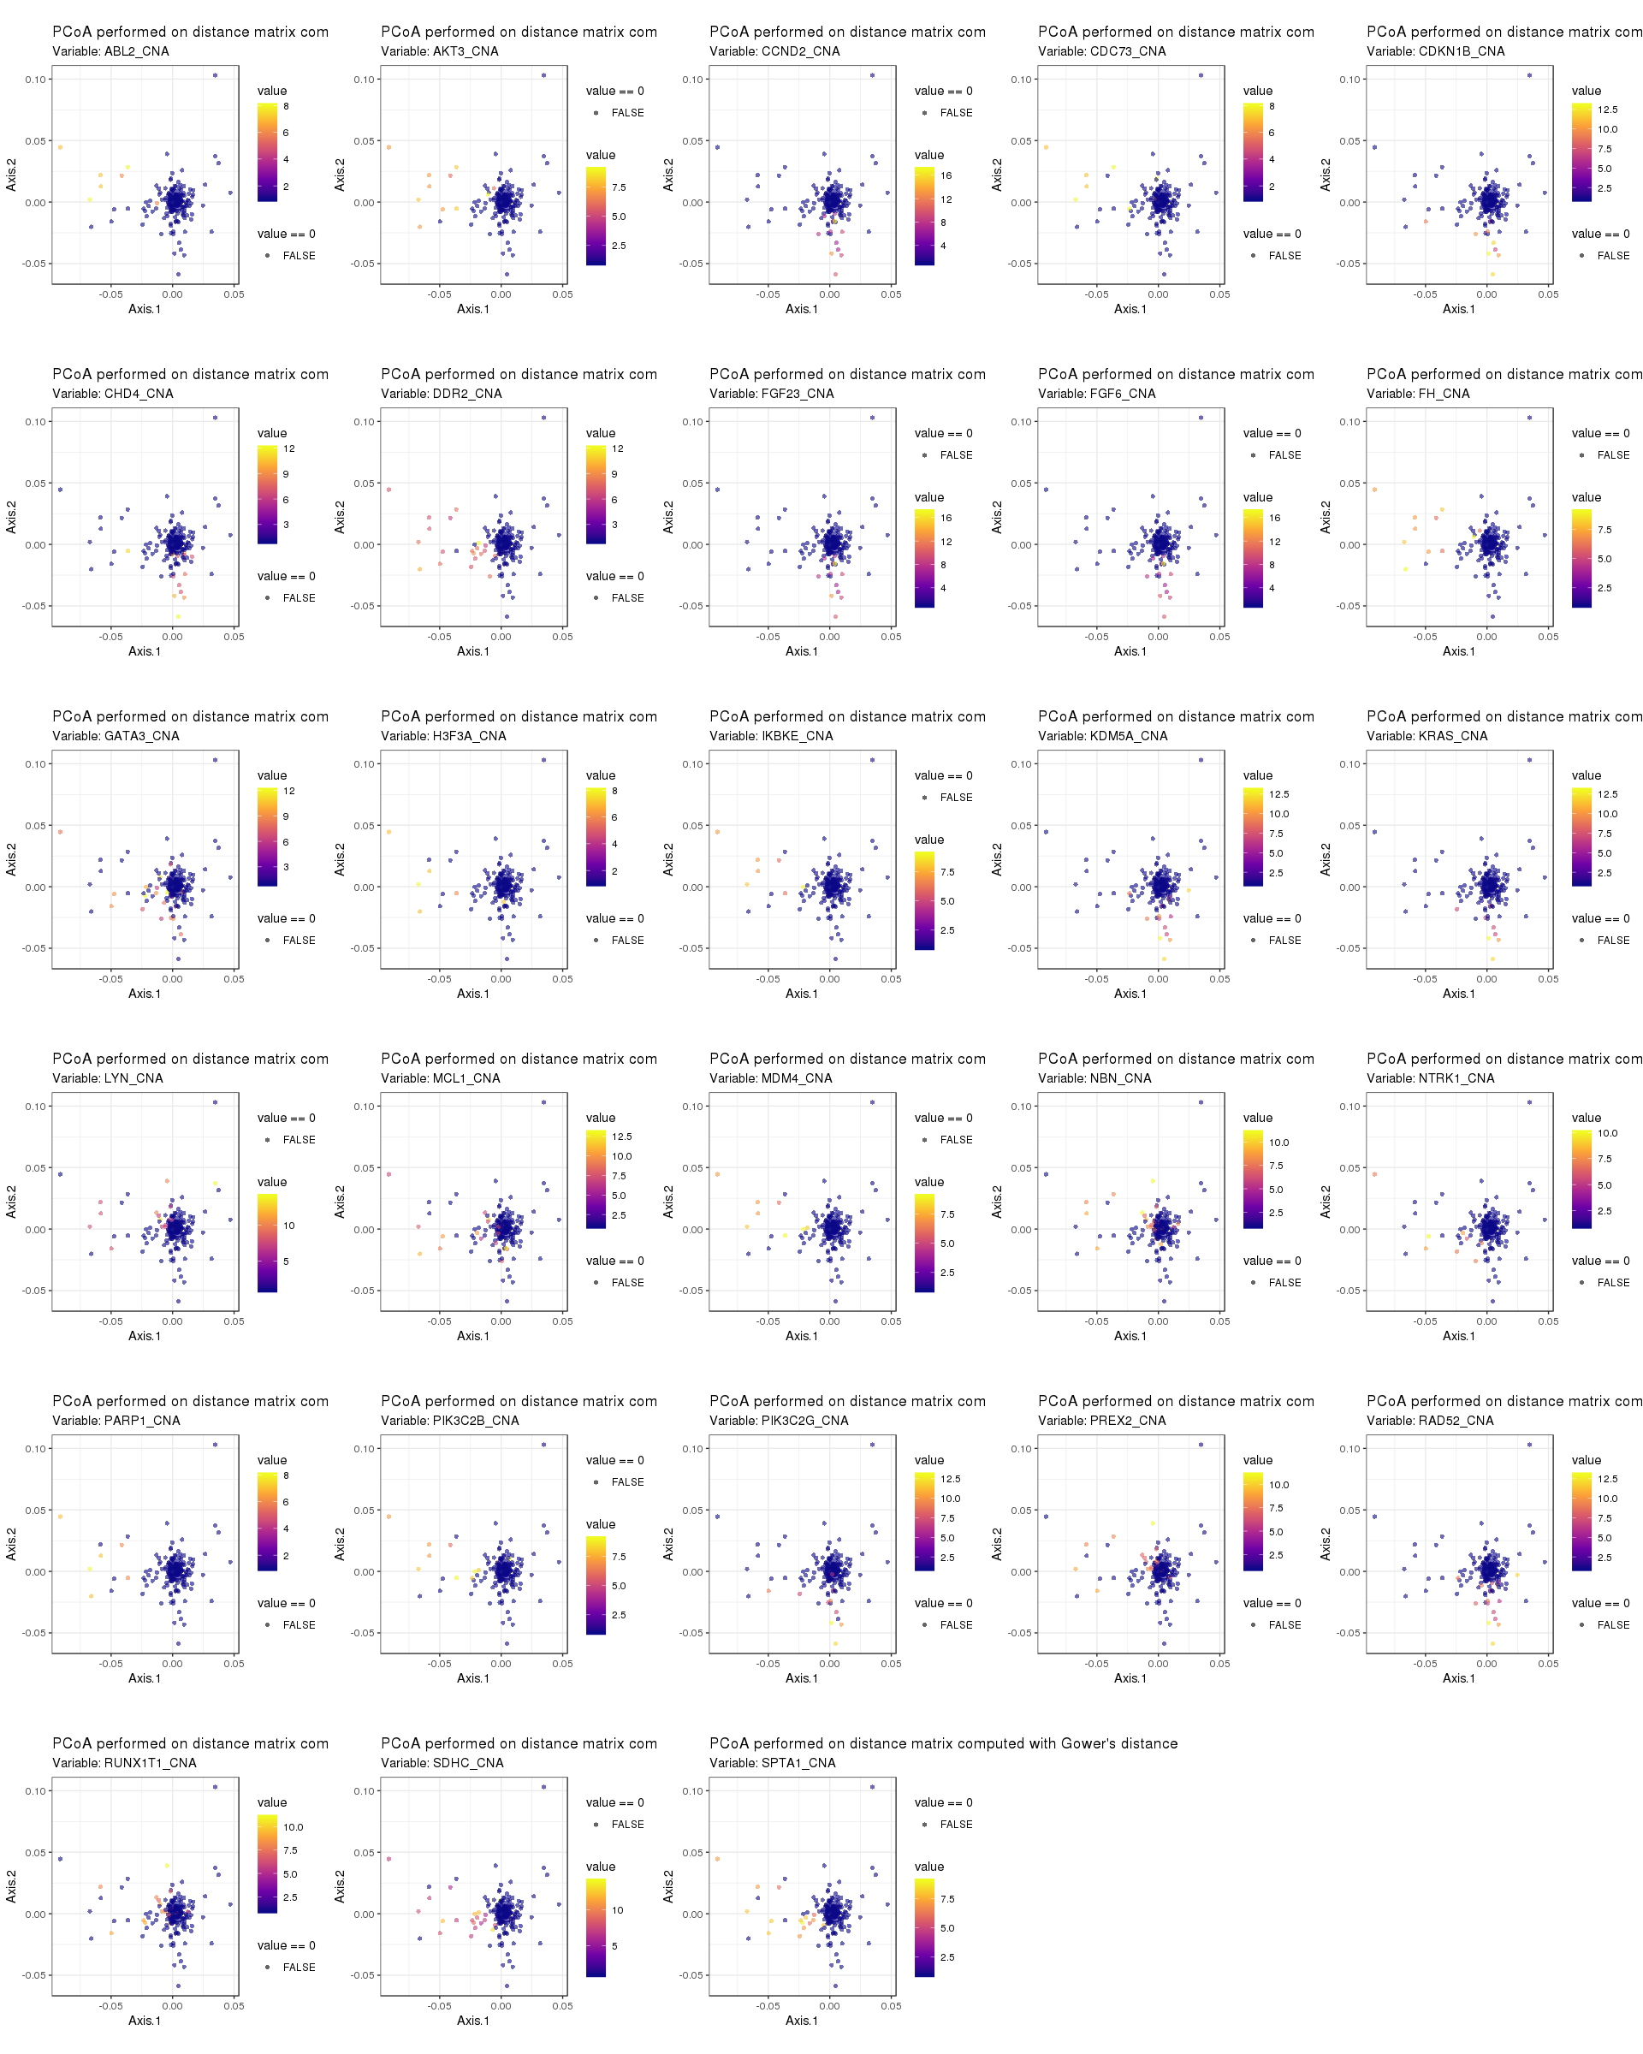
Binary mutations significantly associated with PCoA axis scores
(filter at p<0.005)
Continuous mutations significantly associated with PCoA axis scores
(filter at p<0.005)
Notes:
Extra information for slide 17

