Slide 1
Development of an enhanced deconvolution algorithm for methylation studies
Annette M. Molinaro, PhD
Notes:
Thank you
Brain tumor center
Glioma – WHO 2007, poor prognosis
Until 2005 mOS was 12 months – seminal paper – now 14 months
Brain SPORE

Slide 2
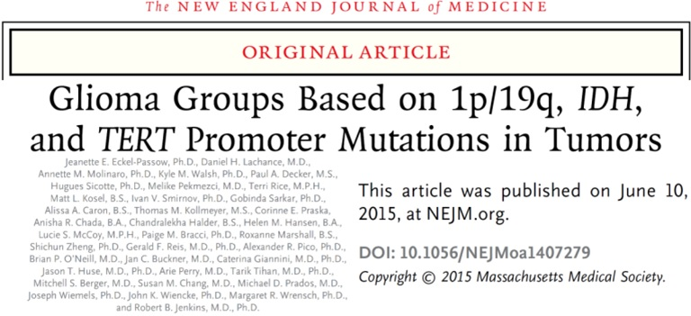
UCSF Brain Tumor SPORE (2013-2018)
Project 1: PIs Wrensch & Wiencke
Eckel-Passow et al., NEJM 2015

Slide 3
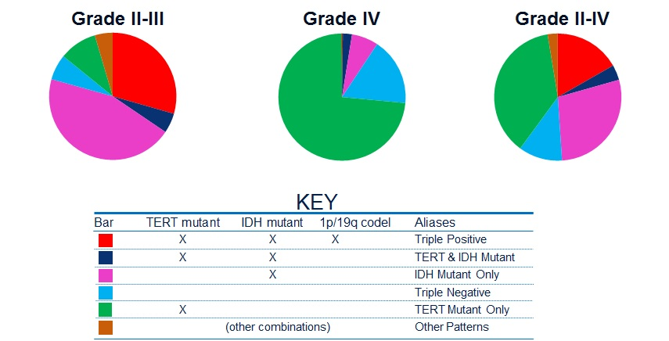
UCSF Brain Tumor SPORE (2013-2018)
Project 1: PIs Wrensch & Wiencke
Eckel-Passow et al., NEJM 2015

Slide 4
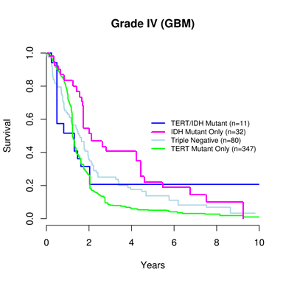
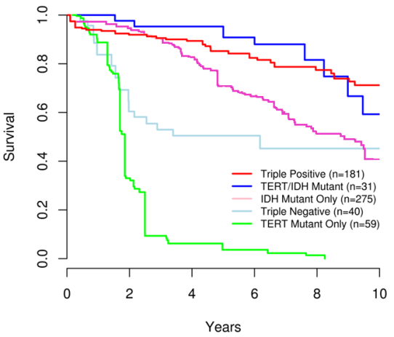
UCSF Brain Tumor SPORE (2013-2018)
Project 1: PIs Wrensch & Wiencke
Eckel-Passow et al., NEJM 2015

Slide 5
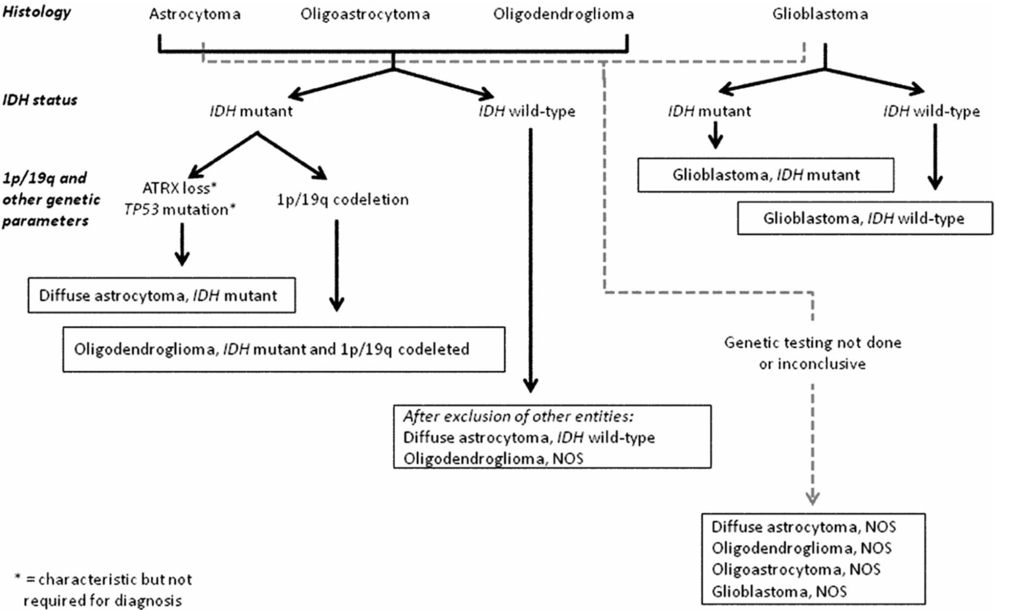
WHO 2016 integrated classification
Louis et al. Acta Neuropathology 2016

Slide 6
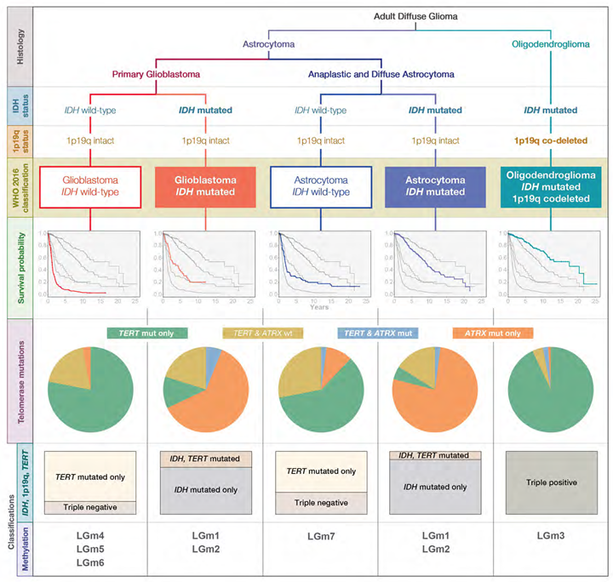
Molinaro et al. Nature Neurology Reviews, 2019
Notes:
Conducted 450K methylation pilot study in blood from 72 glioma patients
Focused on pink (IDH MT) and green (TERTp MT) groups only
Frequency matched on age
Hard to find IDH MT only in older patients (already saw they are younger patients)
75% of gliomas are IDH MT or TERT MT only

Slide 7
What about the immune system?
We know that:
Overall balance of leukocyte subclasses in blood or tissue influences pathogenesis.
  Cytotoxic T-cells and natural killer (NK) cells recognize and eliminate incipient cancer cells.
  Inflammatory cells, including B-cells, neutrophils, regulatory T-cells, etc., promote tumorigenesis via angiogenesis, tumor cell proliferation, tissue invasion and metastasis
Thus, need methods that quantify cell compositions to describe the underlying immuno-biology of disease states, the immune response to many chronic medical conditions, and predict therapeutic outcomes.
Houseman et al. BMC Bioinformatics, 2012
Notes:
Facs is expensive and need whole blood

Slide 8
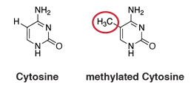
Immunomethylomics
Immunomethylomics measures DNA methylation which serves as a marker to help classify the types and quantities of immune cells in a biologic specimen.
Glioma patients’ distribution of types of immune cells changes during cancer development, treatment, and progression, thus..
Using a non-invasive blood test, immunomethylomics:
  improves understanding of the interaction between the immune system and gliomas
  helps assess response to glioma therapies
Notes:
FACs is expensive and need fresh whole blood
Use DNA methylation as a surrogate marker of cell mixture

Slide 9

Cell mixture deconvolution
The goal of cell mixture deconvolution is to estimate the mixture weights ω_{i} that minimize:
$argmin⍵i$ ||Y_{i} - ⍵_{i}μ_{i}||²
Where,
Y_{i} are the methylation beta values across J* CpG loci for sample i.
K underlying cell types with proportions ω_{i}
μ_{i} is unknown so use Μ_{i} estimated from reference population.
ω_{i} subject to certain constraints (e.g., cell type estimates are bounded (0,1) and sum to 1)
Houseman et al. BMC Bioinformatics, 2012
Notes:
Relative estimates
Houseman’s algorithm performs inference using a quadratic programming technique known as linear constrained projection (CP), where non-negativity and normalization constraints on cellular proportions are imposed during inference. Interestingly, in the gene expression context, a recent comparative study concluded that CP is outperformed by a non-constrained reference-based approach which relies on the technique of Support Vector Regressions (SVR) [10].

Slide 10
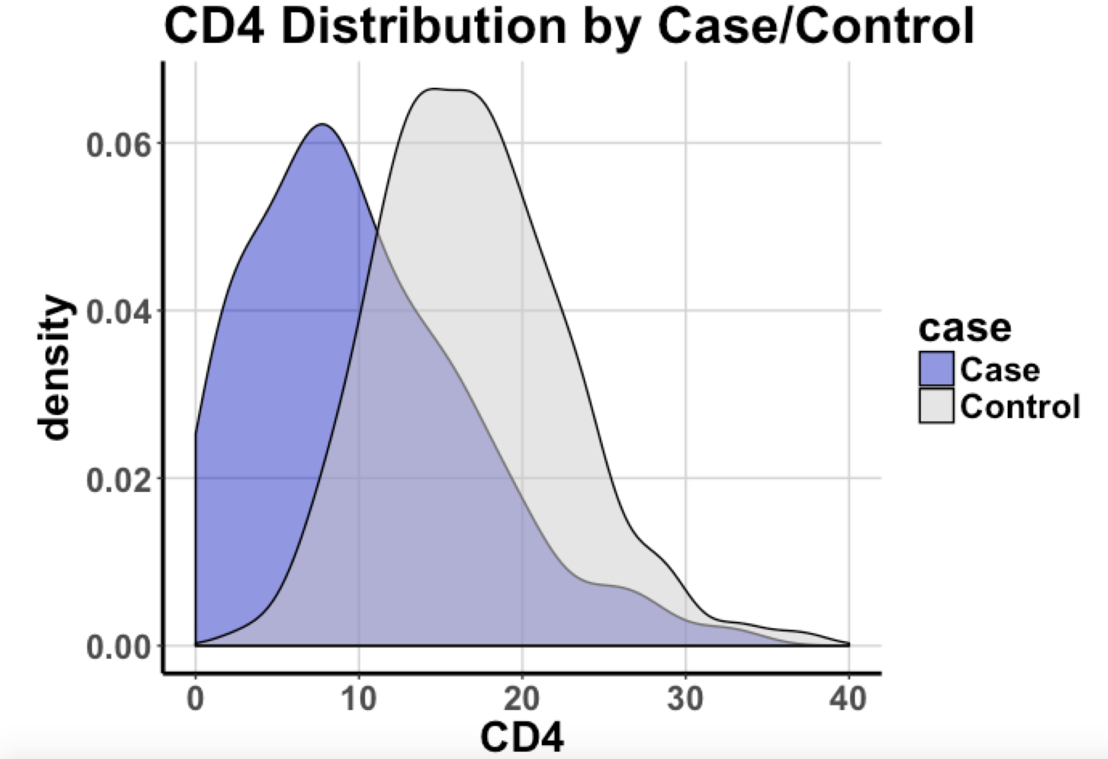
Leukocyte cell composition estimates
Lymphoid
  CD4T
  CD8T
  B cell
  NK cell
Myeloid
  Monocytes
  Neutrophils
Notes:
Relative estimates

Slide 11
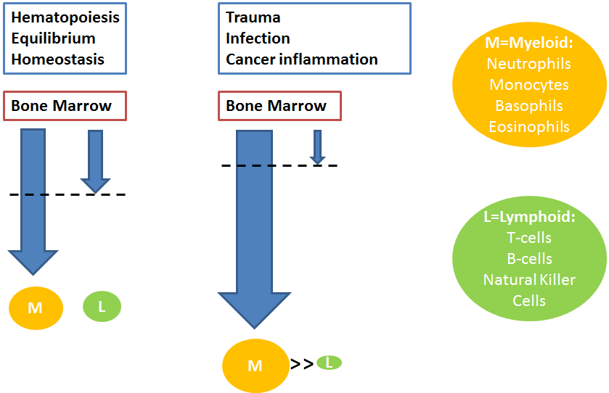
Neutrophil Lymphocyte Ratio: NLR
The ratio of myeloid derived neutrophils to lymphocytes increases in many inflammatory conditions including cancer

Slide 12
Neutrophil Lymphocyte Ratio: NLR
The ratio of myeloid derived neutrophils to lymphocytes is a biomarker associated with decreased patient survival in many solid tumors.
Templeton et al., JNCI, 2014

Slide 13
Wiencke et al Clinical Epigenetics, 2017
Notes:
Conducted 450K methylation pilot study in blood from 72 glioma patients
Focused on pink (IDH MT) and green (TERTp MT) groups only
Frequency matched on age
Hard to find IDH MT only in older patients (already saw they are younger patients)
75% of gliomas are IDH MT or TERT MT only

Slide 14
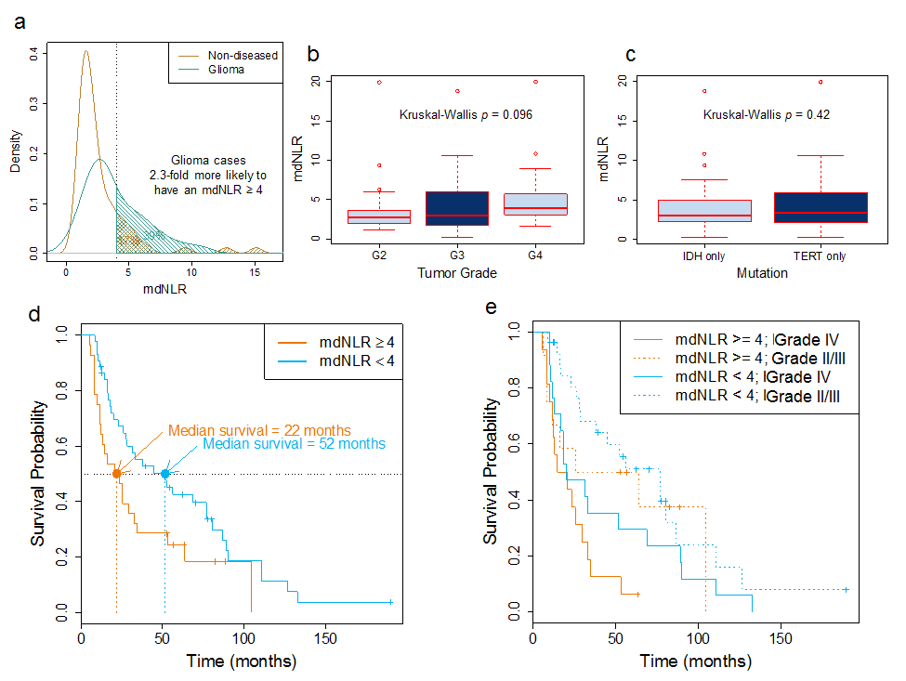
Wiencke et al Clinical Epigenetics, 2017
Notes:
Also held up in MV models

Slide 15
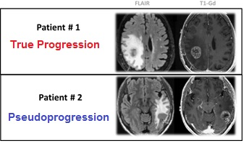
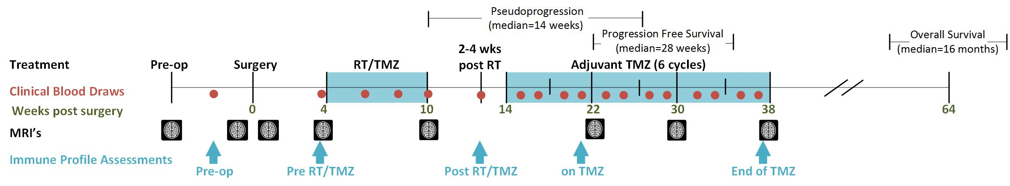
UCSF Brain Tumor SPORE (2018 – 2023)
Project 1: PIs Wiencke, Molinaro, Clarke
Questions of interest:
What are the most important elements of the immune profile for patient management?
Do Peripheral Immune Profiles predict recurrence and survival in lower grade and GBM patients?
Notes:
Also have loglio grant to LGGs

Slide 16
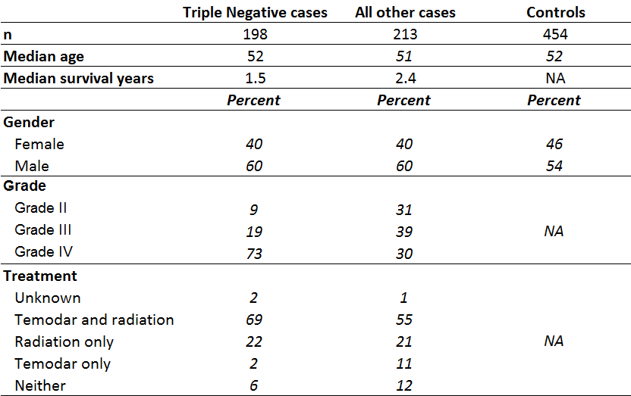
UCSF Brain Tumor SPORE (2018 – 2023)
Project 1: Pilot Study
Pilot study info

Slide 17
UCSF Brain Tumor SPORE (2013-2018)
Project 1: PIs Wrensch & Wiencke
Eckel-Passow et al., NEJM 2015

Slide 18
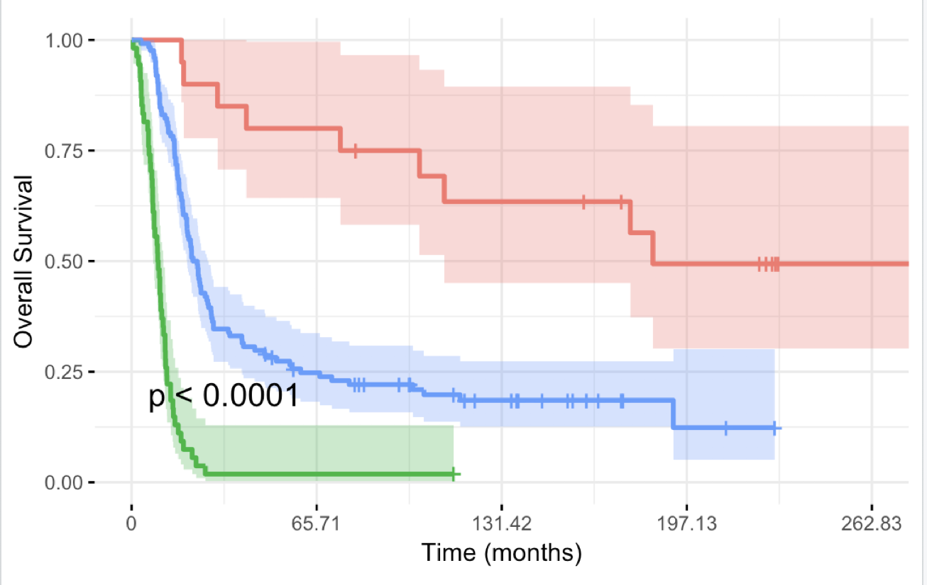
Diagnosis Age
>58
<=58
Treatment
CD4
RT only, Chemo only, or neither
Chemo and RT
>14%
≦ 14%
GBM
Total Lymphocytes
Neutrophils
Non GBM
GBM
>10%
≦10%
>76.5%
≦76.5%
CD8
>4.1%
≦4.1%

Slide 19
Noted limitations/difficulties with current deconvolution algorithms
Why are cell composition values not bound by [0,1]?
What is importance/accuracy of values < 0.05?
How to predict beyond the 6 immune values?
Not all combinations of CpGs are investigated for optimized library
Estimate relative proportions – not absolute counts
Immunomethylomics Working Group is a collaboration between investigators at UCSF, Brown University, University of Kansas and Dartmouth University.

Slide 20
Remove CpG q from the J* CpGs and apply mixture deconvolution using the remaining (J* - 1) CpGs
Identify the U CpGs that uniquely characterize each of the P cell types
0
4
Compute absolute/relative prediction performance when CpG q is withheld from the set of J* CpGs
Among the U candidate CpGs, J* < U are randomly selected for mixture deconvolution with probability , j = 1,…,U
1
Assess contribution of CpG q to prediction performance
by comparing prediction performance when CpG q is withheld, to the prediction performance when all J* CpGs are used for mixture prediction
5
Using the J* randomly selected CpGs, cell mixture distribution is predicted using mixture deconvolution
(Houseman et al., 2012)
2
Koestler et al. BMC Bioinformatics 2016
Update probability of selection for each of the J* CpGs based on how beneficial it was for prediction performance
6
Predicted cell distribution is compared to the observed cell distribution (FACS or CBC) and the absolute/relative prediction performance is computed
3
7
Repeat steps 1-6 until convergence
20
Notes:
Houseman’s algorithm performs inference using a quadratic programming technique known as linear constrained projection (CP), where non-negativity and normalization constraints on cellular proportions are imposed during inference. Interestingly, in the gene expression context, a recent comparative study concluded that CP is outperformed by a non-constrained reference-based approach which relies on the technique of Support Vector Regressions (SVR) [10].

Slide 21
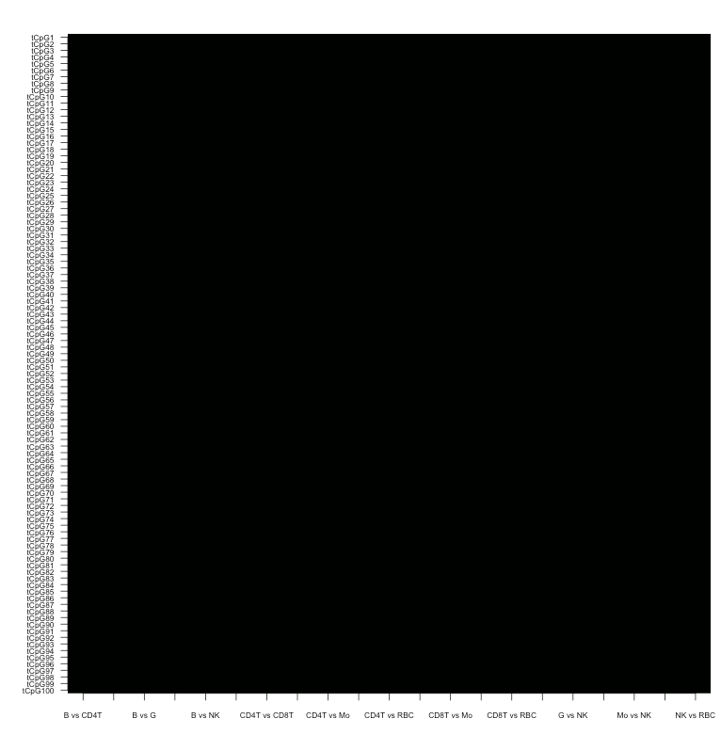
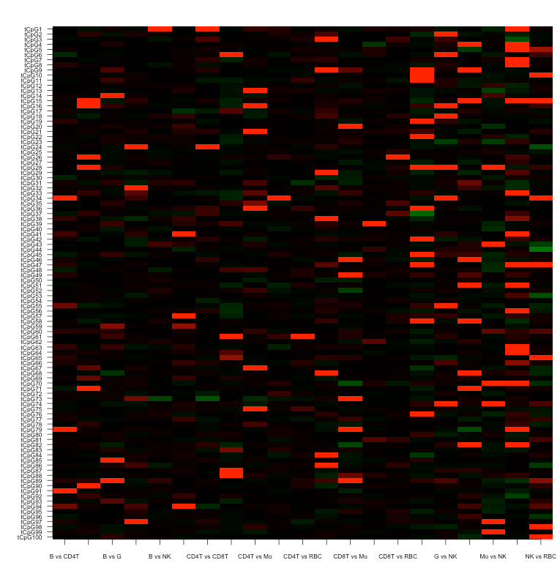
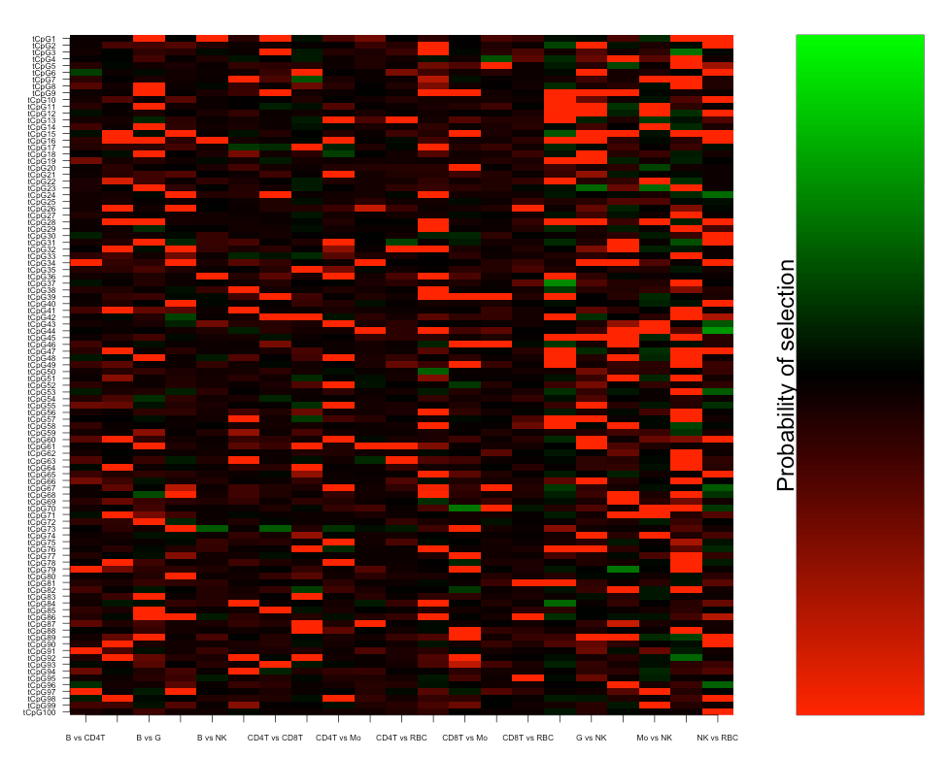
Conceptual illustration of IDOL
Iteration: 0
Iteration: 100
Iteration: 500
Not Beneficial for prediction performance
⬇ probability of selection
All CpGs have equal chance of being selected
Probability of selection is modified based on how beneficial a given CpG was in improving prediction performance
Beneficial for prediction performance ⬆probability of selection
Probability of selection
Decreasing
Unchanged
Increasing
Koestler et al. BMC Bioinformatics 2016

Slide 22
Remove CpG q from the J* CpGs and apply mixture deconvolution using the remaining (J* - 1) CpGs
Identify the U CpGs that uniquely characterize each of the P cell types
0
4
Compute absolute/relative prediction performance when CpG q is withheld from the set of J* CpGs
Among the U candidate CpGs, J* < U are randomly selected for mixture deconvolution with probability , j = 1,…,U
1
Assess contribution of CpG q to prediction performance
by comparing prediction performance when CpG q is withheld, to the prediction performance when all J* CpGs are used for mixture prediction
5
Using the J* randomly selected CpGs, cell mixture distribution is predicted using mixture deconvolution
(Houseman et al., 2012)
2
Koestler et al. BMC Bioinformatics 2016
Update probability of selection for each of the J* CpGs based on how beneficial it was for prediction performance
6
Predicted cell distribution is compared to the observed cell distribution (FACS or CBC) and the absolute/relative prediction performance is computed
3
7
Repeat steps 1-6 until convergence
22

Slide 23
Current exploration of addition to IDOL
Probability of selection
Low
Medium
High
Iteration: 0
Iteration: 0
All CpGs have equal chance of being selected
Alternative approach
Selection probabilities are not equal across CpGs, but rather based on some criteria
Devin Koestler

Slide 24
Remove CpG q from the J* CpGs and apply mixture deconvolution using the remaining (J* - 1) CpGs
Identify the U CpGs that uniquely characterize each of the P cell types
0
4
Compute absolute/relative prediction performance when CpG q is withheld from the set of J* CpGs
Among the U candidate CpGs, J* < U are randomly selected for mixture deconvolution with probability , j = 1,…,U
1
Assess contribution of CpG q to prediction performance
by comparing prediction performance when CpG q is withheld, to the prediction performance when all J* CpGs are used for mixture prediction
5
Using the J* randomly selected CpGs, cell mixture distribution is predicted using mixture deconvolution
(Houseman et al., 2012)
2
Koestler et al. BMC Bioinformatics 2016
Update probability of selection for each of the J* CpGs based on how beneficial it was for prediction performance
6
Predicted cell distribution is compared to the observed cell distribution (FACS or CBC) and the absolute/relative prediction performance is computed
3
7
Repeat steps 1-6 until convergence
24

Slide 25
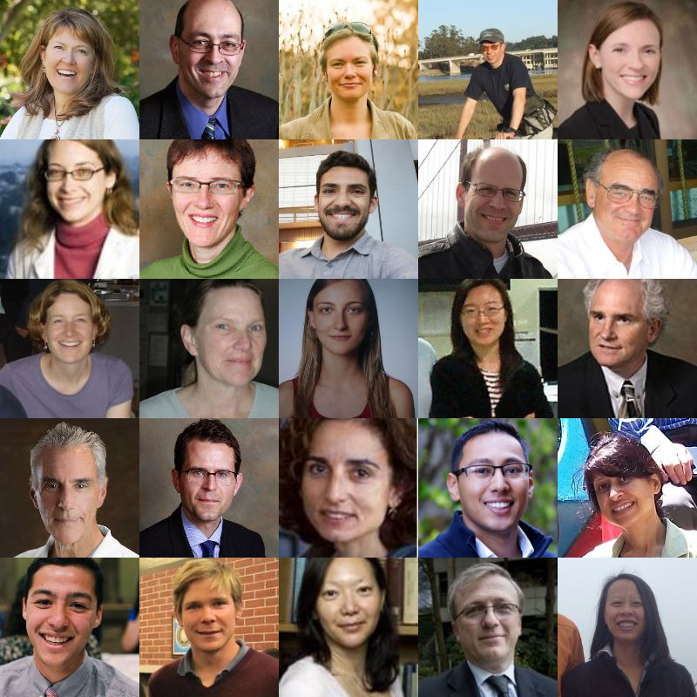
Acknowledgments
UCSF Adult Glioma Study and Neuro-oncology Clinic
R1: Annette Molinaro, PhD, Arie Perry, MD, Helen Hansen, Ivan Smirnov, PhD, Jennie Taylor, MD
R2: Jennifer Clarke, MD, Joanna Phillips, MD, Joaquin Anguiano, Joe Wiemels, PhD, John Wiencke, PhD
R3: Lucie McCoy, MPH, Margaret Wrensch, PhD, Melike Pekmezci, MD, Mi Zhou, MD, Michael Prados, MD
R4: Mitchel Berger, MD, Nicholas Butowski, MD, Paige Bracci, PhD, Pavan Shrestha, Ritu Roy, PhD
R5: Sean Lee, Steve Francis, PhD, Susan Chang, MD, Tarik Tihan, MD, Terri Rice, MPH
Supported by NIH grants: U01CA182371,R01CA139020, R01CA126831,R01CA052689, R01CA119215, P50CA097257, R01CA207360 and the
loglio collective

Slide 26
Acknowledgments
School of Medicine,
Brown University
Karl Kelsey, M.D.
Rondi Butler, Ph.D.
Pranathi Chunduru, M.S.
Biostatistics Department,
University of Kansas Medical Center
Devin Koestler, Ph.D.
Dept of Epi and Community Medicine,
Dartmouth University
Brock Christensen, Ph.D.
Lucas A. Salas Diaz, Ph.D.
Gayathri Warrier, M.S.

Slide 27
Current exploration of addition to IDOL
Training Data
Input
Name: candidateDMRFinder
Purpose: Builds a candidate library of CpGs with marked methylation differences across the cell types.
Name: IDOLOptimize
Purpose: Finds “optimal” DMR libraries, of a prespecified size, for obtaining accurate deconvolution estimates of a mixed biospecimen (e.g, WB)
Input
Devin Koestler

Slide 28
Deconvolution algorithms
U
Reference
Need known – via FACS
Build library – use something publicly available Reinius or experimental – Method A and Method B
IDOL for library building
Estimated cell counts (Houseman et al.) using CP/QP to get proportions
Notes:
Purified granulocytes, monocytes, CD4T, CD8T, natural killer cells, and B cells
from normal human subjects were purchased from AllCells LLC (Emeryville, CA).
Following quantification, DNA extracted from purified leukocyte subtypes
were mixed in predetermined proportions to reconstruct two distinct sets, consisting
of n = 6 samples each. The first set of reconstructed samples used mixtures
of purified leukocyte subtype DNA in relatively equivalent proportions across the
leukocyte subtypes, hereafter referred to as the MethodA samples. For the second
set of six samples, the proportion of DNA for each leukocyte subtype were selected
to resemble their relative fractions in the peripheral blood of normal human adult
subjects (MethodB samples). All DNA samples were bisulfite modified using the
Zymo EZ DNA Methylation kit (Irvine, CA) and epigenome-wide DNA methylation
assessment was performed using the Illumina HumanMethylation450 array
platform.

Slide 29
Current exploration of addition to IDOL
Training Data
Input
Name: candidateDMRFinder
Purpose: Builds a candidate library of CpGs with marked methylation differences across the cell types.
Name: IDOLOptimize
Purpose: Finds “optimal” DMR libraries, of a prespecified size, for obtaining accurate deconvolution estimates of a mixed biospecimen (e.g, WB)
Name: InitialProbs
Purpose: Modifies initial selection probabilities for CpGs in the candidate library based on some criteria
Input
Input
Devin Koestler

Slide 30
Cell mixture deconvolution via CP/QP
Y_{i} = M_{i}W_{i} + E_{i}
Y_{i}: Q x 1 vector of DNA methylation beta values for subject i, profiled over a mixed cell population (i.e., WB).
M_{i}: Q x K matrix of cell-specific methylation signatures for subject i (e.g., “reference methylation matrix”)
W_{i}: K x 1 vector of the cell-type fractions within subject i

Slide 31
Cell mixture deconvolution via CP/QP
Y_{i} = M_{i}w_{i} + E_{i}
Y_{i}: Q x 1 vector of DNA methylation beta values for subject i, profiled over a mixed cell population (i.e., WB).
M_{i}: Q x K matrix of cell-specific methylation signatures for subject i (e.g., “reference methylation matrix”)
w_{i}: K x 1 vector of the cell-type fractions within subject i
Goal: Estimate w_{i}, subject to certain constraints (e.g., cell type estimates are bounded (0,1) and sum to 1)

