Slide 1












Statistical and Computational Challenges in High-Throughput Genomics with Application to Precision Medicine
November 6th, 2018
Biologist-intelligible alternative splicing
analysis of RNA-seq data
Nuno Barbosa Morais
nmorais@medicina.ulisboa.pt

Slide 2
Statistical and Computational Challenges in High-Throughput Genomics with Application to Precision Medicine
November 6th, 2018
Biologist-intelligible alternative splicing
and perturbagen analysis of RNA-seq data
Nuno Barbosa Morais
nmorais@medicina.ulisboa.pt

Slide 3


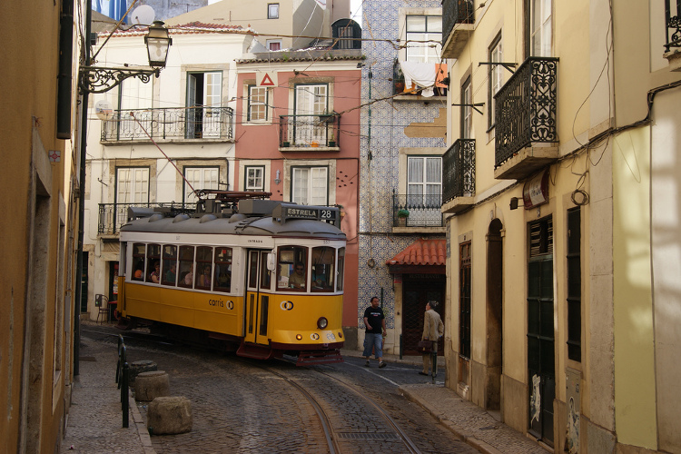

Slide 4
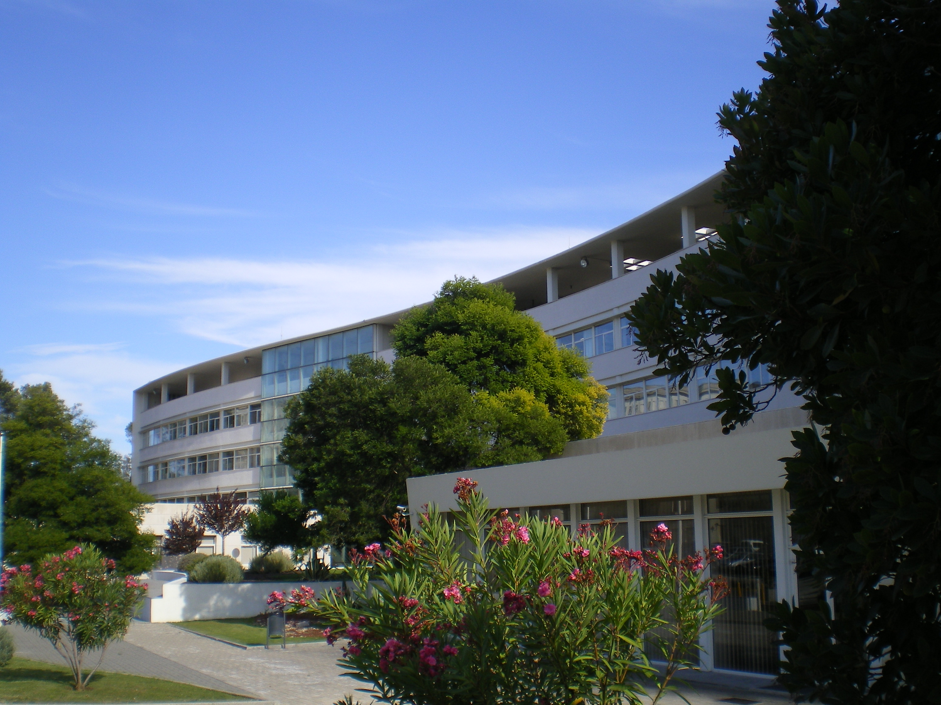


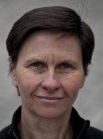








Who am I?
. Degree in Technologic Physics Engineering, IST Lisbon, 2000
. PhD in Biomedical Sciences, Lisbon Medical School, 2007
. EMBL, early 2002
. Cambridge U., 2003-2006
. Postdoc, Cambridge U., 2006-2010
. Senior Postdoc, University of Toronto, 2010-2013
Sam
Aparício
Carmo
Fonseca
Juan Valcárcel
Simon
Tavaré
Ben
Blencowe

Slide 6
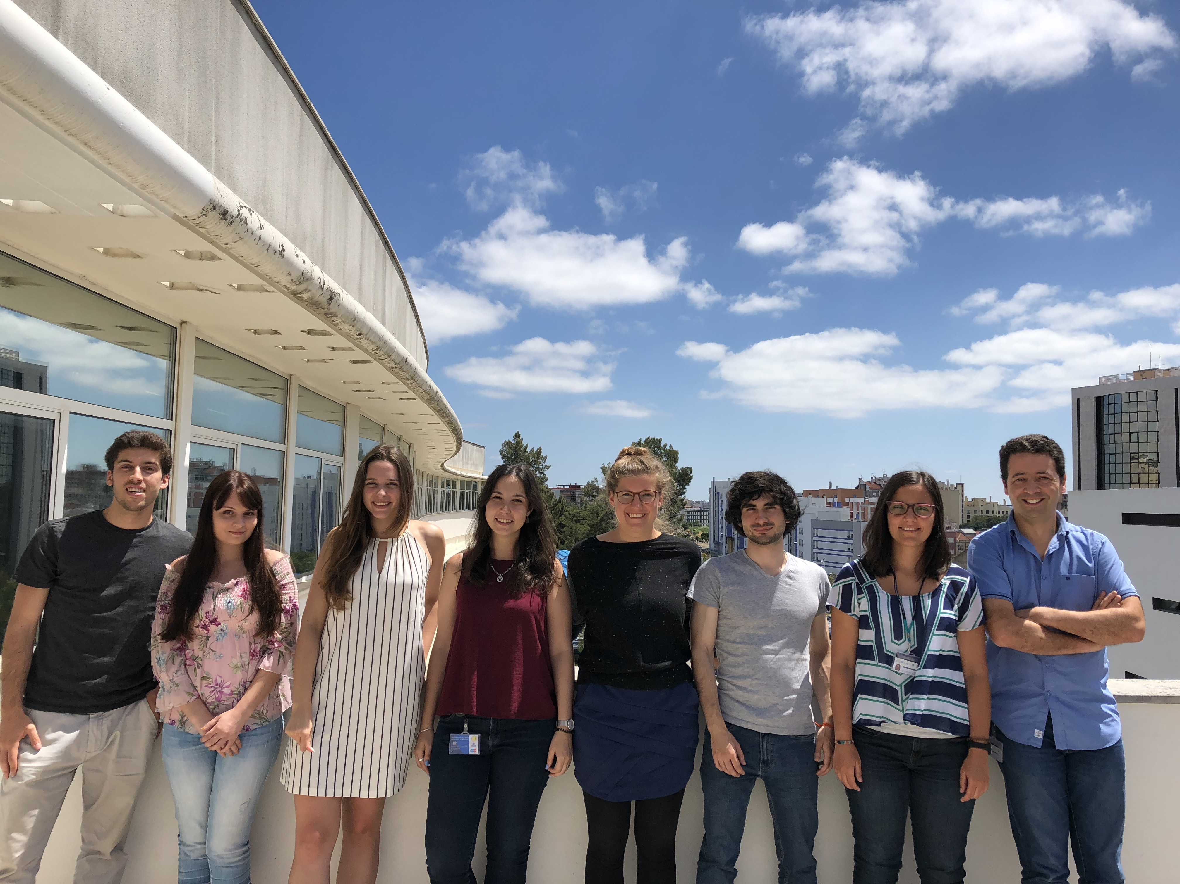


http://imm.medicina.ulisboa.pt/group/distrans/
https://twitter.com/NMoraisLab

Slide 7

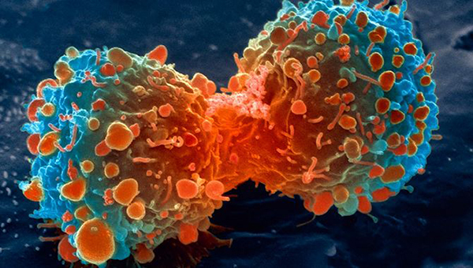

What we do: disease transcriptomics
Goal
Understand how ageing-associated molecular changes in human tissues increase proneness to disease
Disease models
Neurodegeneration
Cancer

Slide 8
Why the transcriptome?
Early and accurately profileable measure of cells’ response to stimuli
Our expertise: computational biology
+ transcriptional regulation
Timely: recent availability of data

Slide 9
What we do: disease transcriptomics
Data?

Slide 10



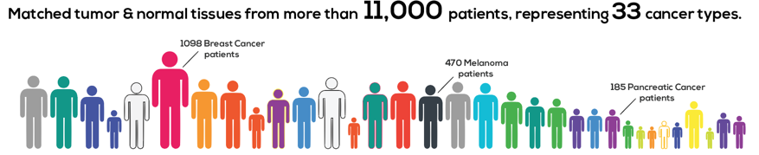
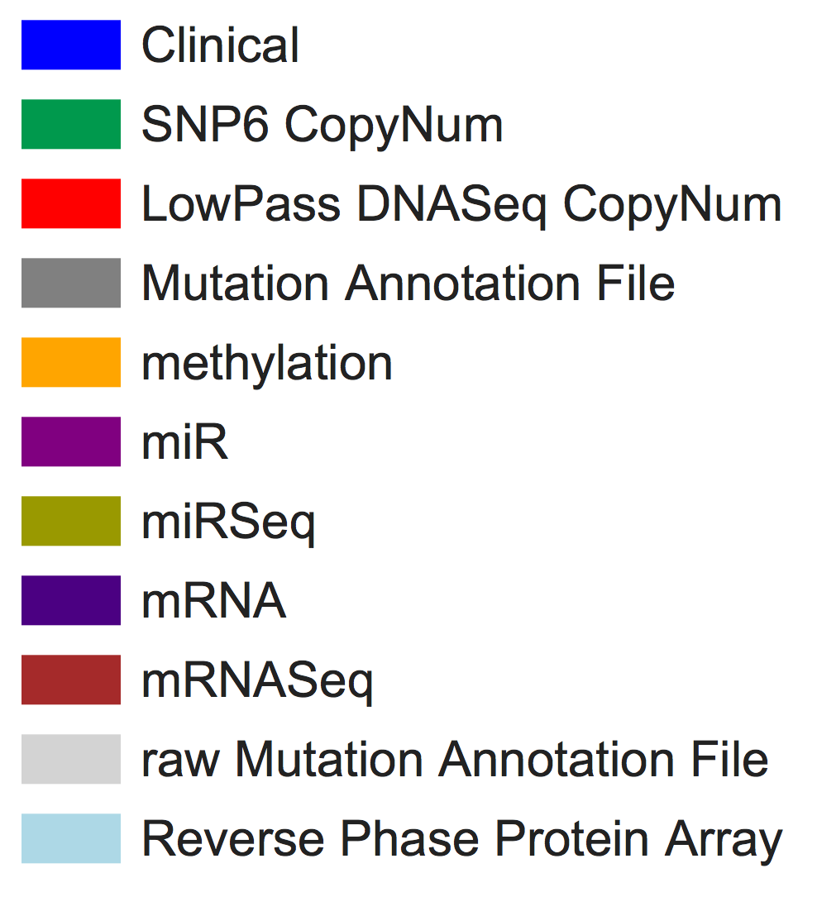
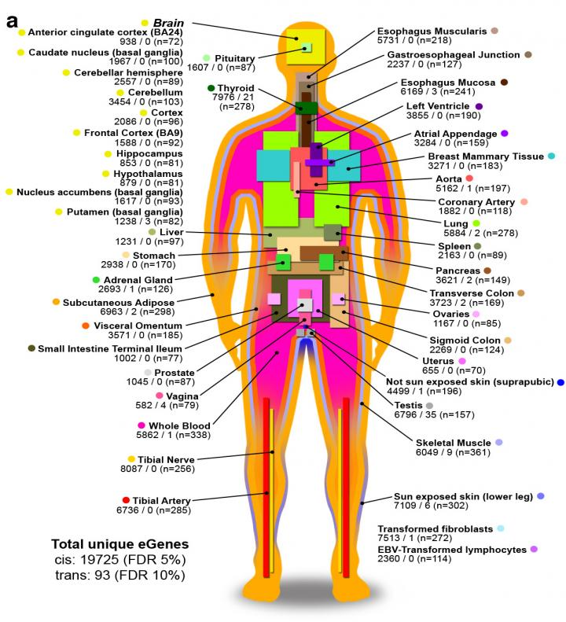

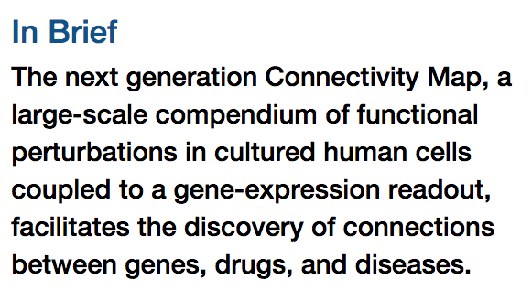
Genotype-Tissue Expression
RNA-seq and genotype from 53 human tissues
>10.000 samples (100s per tissue)
clinically annotated (age, gender, ethnicity, cause of death, diseases)
Subramanian et al (2017) Cell 171:1437

Slide 11
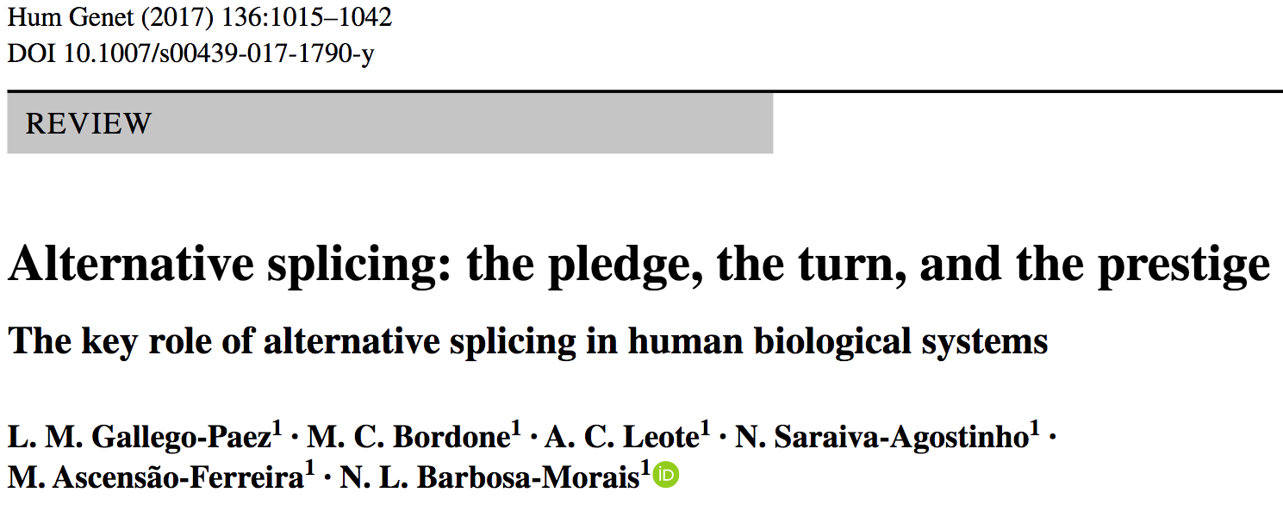
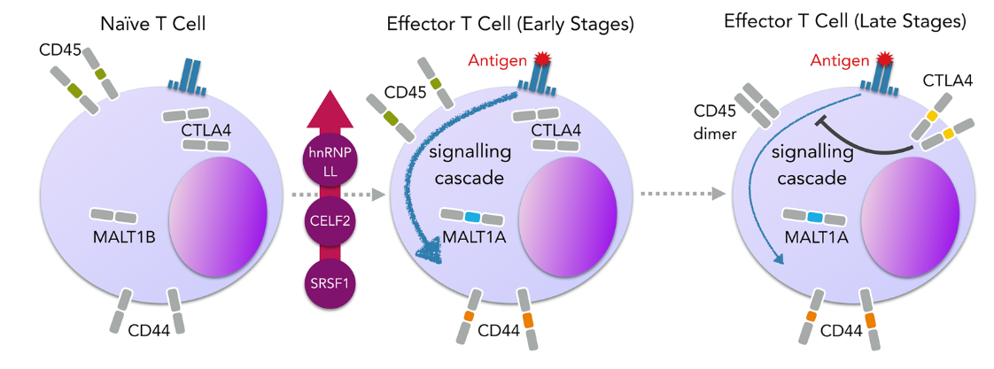
Alternative splicing (AS)

Slide 12

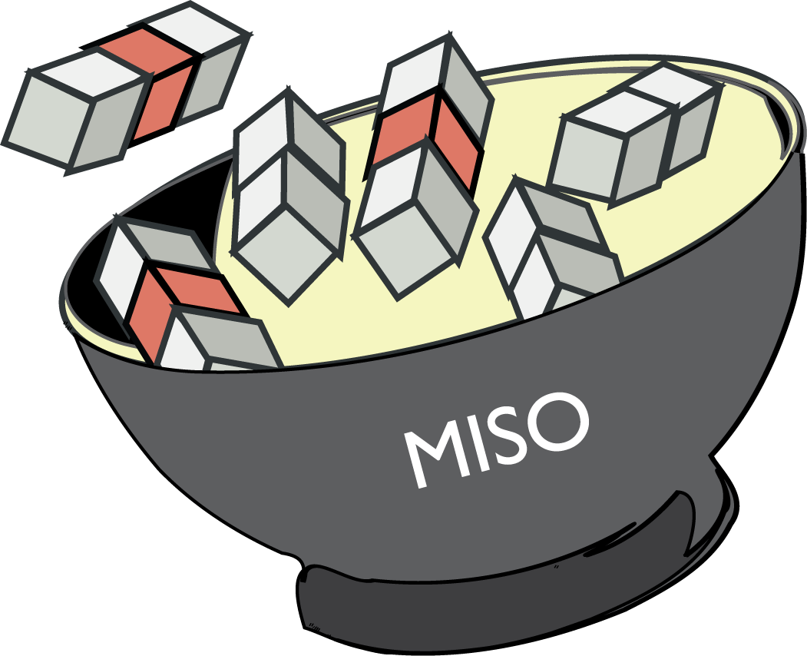





Many tools for AS analysis of RNA-seq data
Non-computational biologists not using them:
user-unfrendly
hard-to-interpret event annotation and results
resource-demanding for basic analysis of large datasets (e.g. TCGA)

Slide 13

Each ≥ one shortcoming:
No support for imputing pre-processed data (e.g. splice junction read counts, available for TCGA, GTEx and SRA): redundant, time/resource-consuming alignments
Nuno
Limited statistics for differential splicing analysis, mostly median-based non-parametric tests and restricted to pairwise comparisons
No incorporation of molecular/clinical/design information (e.g. survival data for potential prognostic value assessment)
No transcriptome-wide filtering and sub-setting, based on common features or statistics, for interactive exploration of events of interest
No user-friendly interactive graphical interface, no support for customisable statistical plots

Slide 14
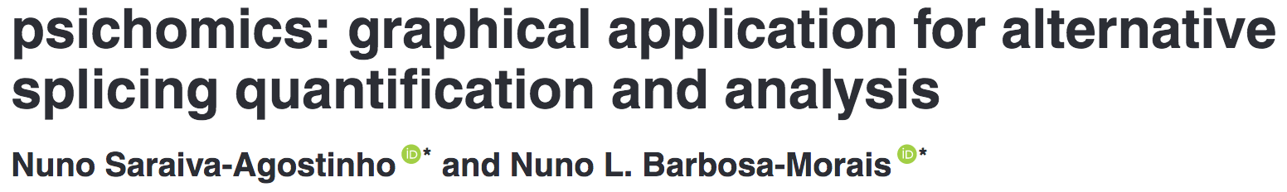
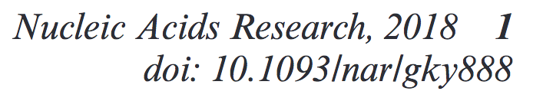




Nuno
https://bioconductor.org/packages/psichomics
SRA
. processed RNA-seq
. clinical info

Slide 15

psichomics
Nuno
Notes:
V recount2

Slide 16
psichomics
Nuno

Slide 17
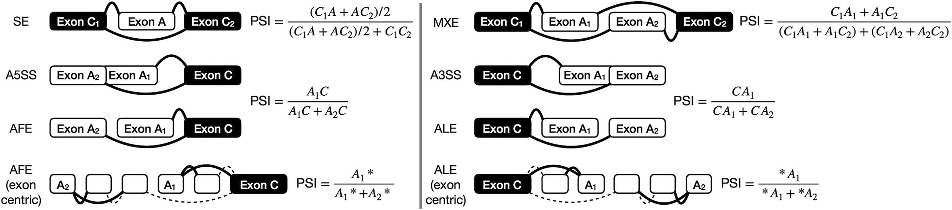
psichomics
Nuno

Slide 18

psichomics
Nuno
Notes:
Shiny:
Web app framework using R, HTML, CSS and JavaScript
Reactive programming model (Excel-like reactivity)

Slide 19
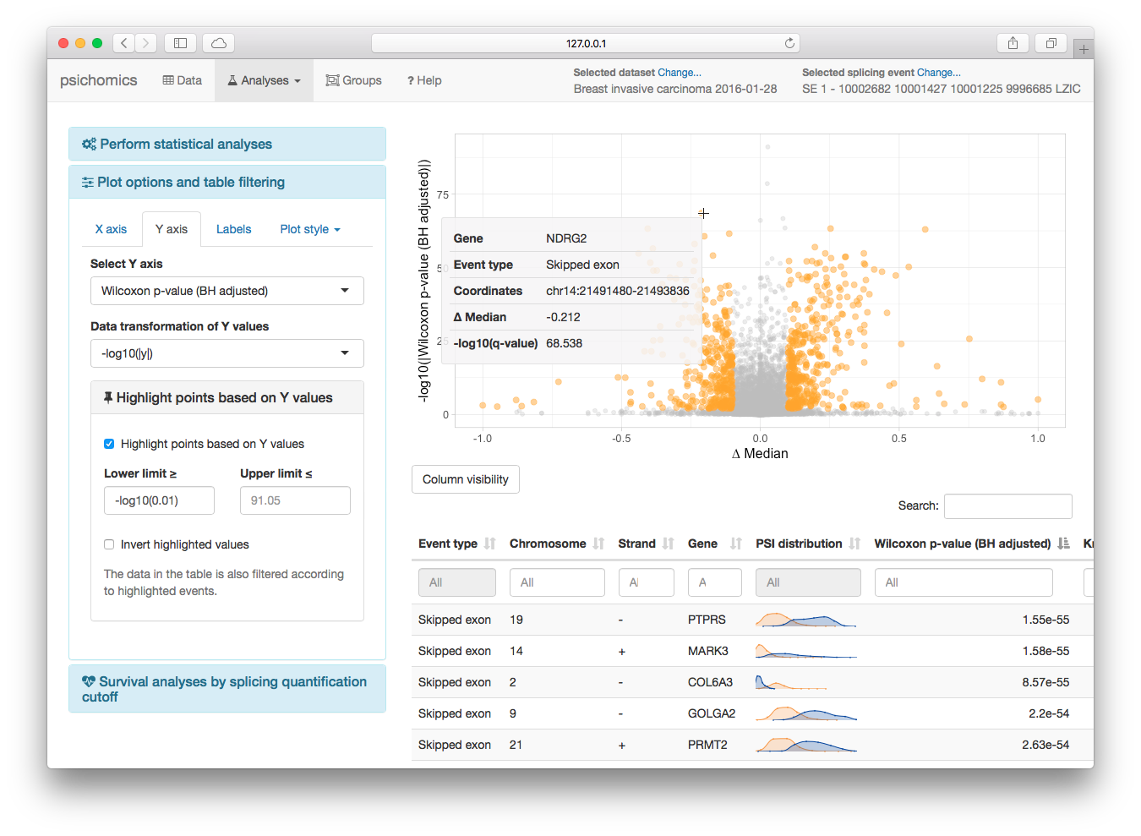
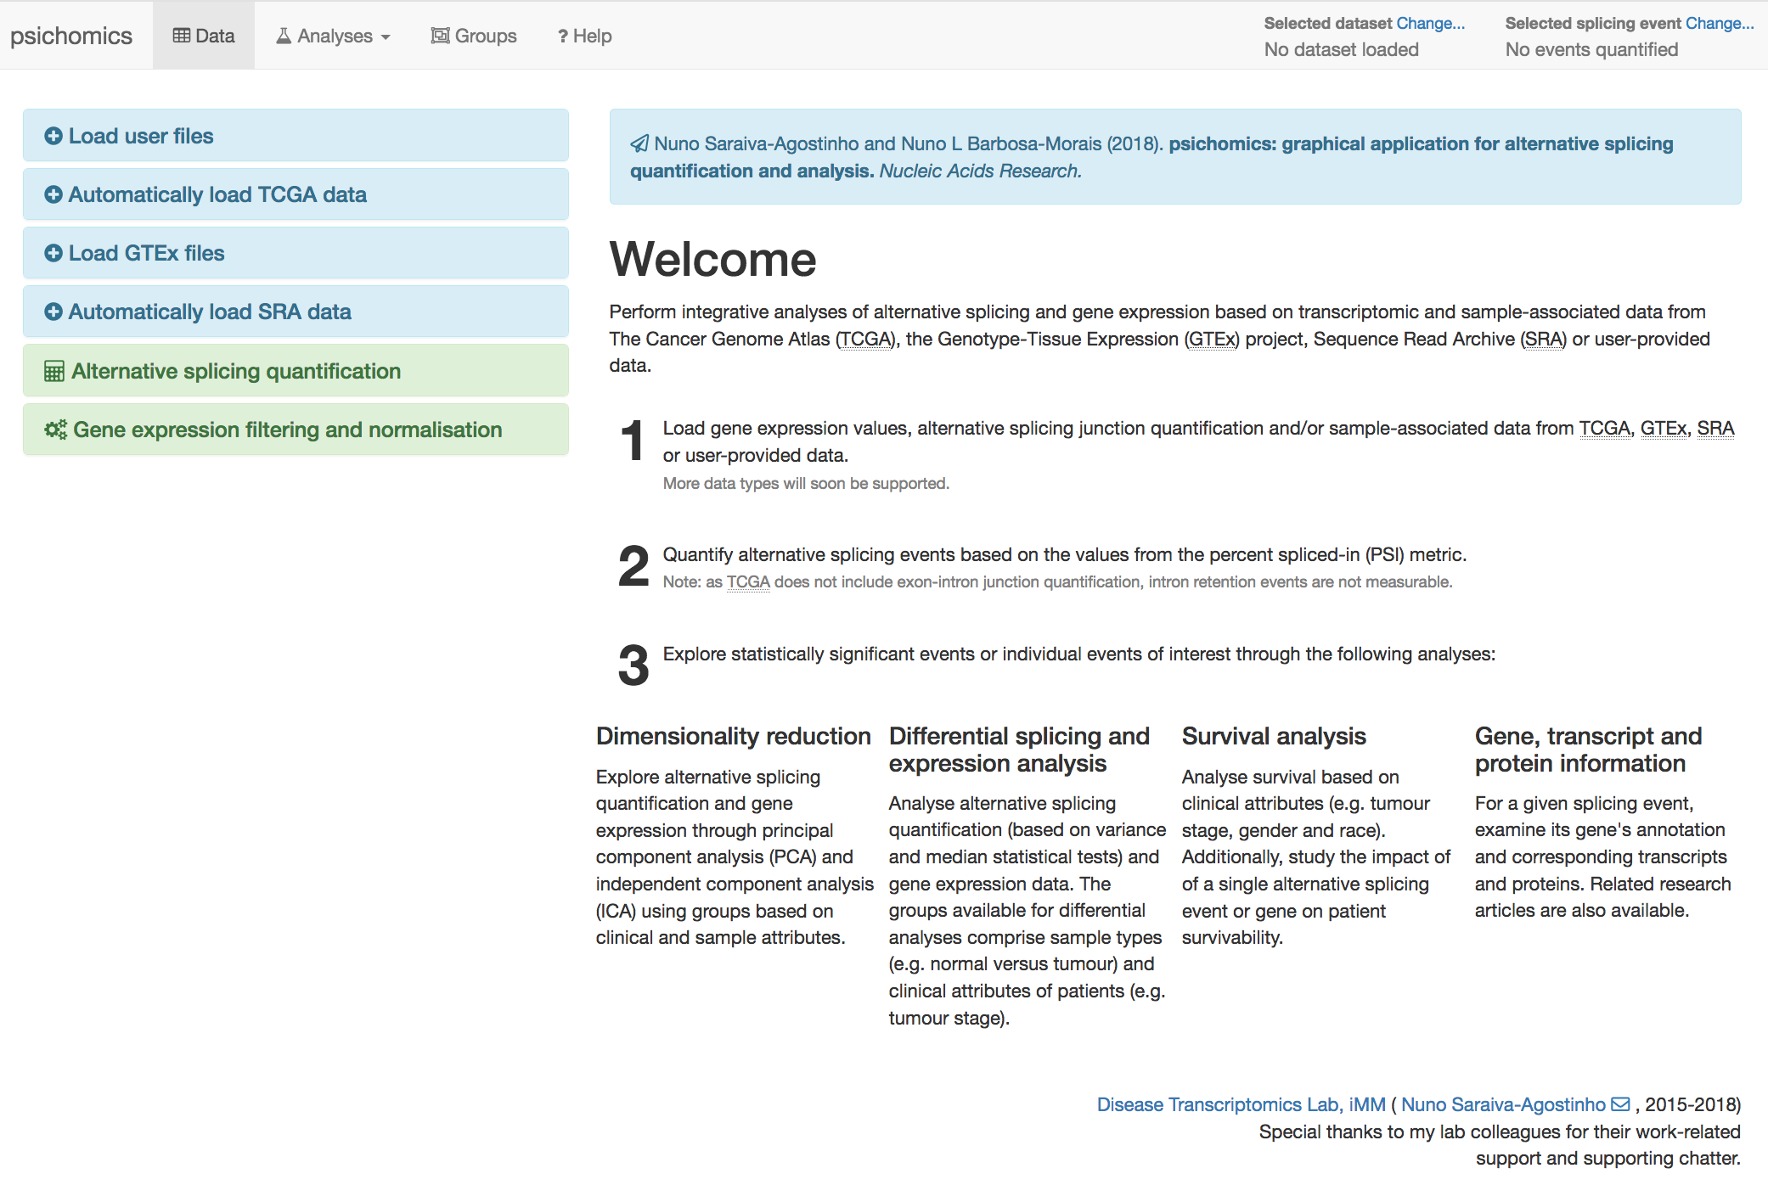
psichomics
Nuno
Notes:
Shiny:
Web app framework using R, HTML, CSS and JavaScript
Reactive programming model (Excel-like reactivity)

Slide 20
psichomics
Nuno
Notes:
Shiny:
Web app framework using R, HTML, CSS and JavaScript
Reactive programming model (Excel-like reactivity)

Slide 21
Case study
Breast cancer: looking for biomarkers of early tumour progression
Nuno

Slide 22
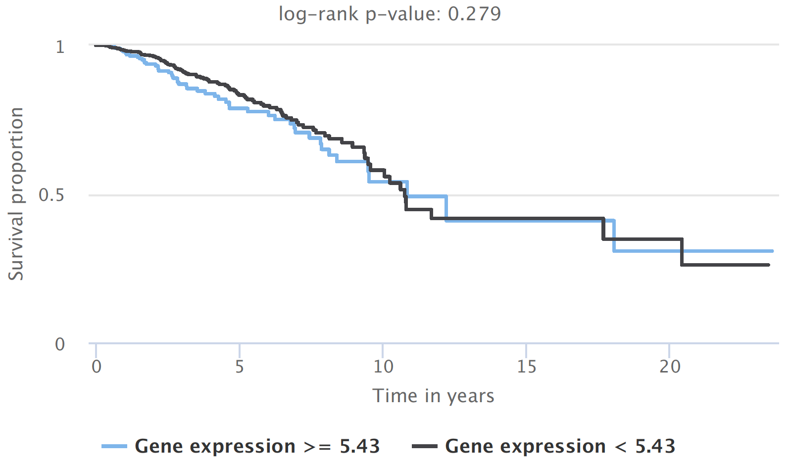
Case study
Nuno
Notes:
Ubiquitin Like With PHD And Ring Finger Domains 2

Slide 23
Case study
NUMB exon 12
Nuno
Notes:
NUMB - Endocytic Adaptor Protein, QKI - Quaking Homolog, KH Domain RNA Binding
QKI has been shown to repress NUMB exon 12 inclusion in lung cancer cells by competing with core splicing factor SF1 for binding to the branchpoint sequence, thereby repressing the Notch signalling pathway, which results in decreased cancer cell proliferation

Slide 24

Benchmarking: performance
Nuno
OS X 10.13.1
4 cores
8GB RAM

Slide 25
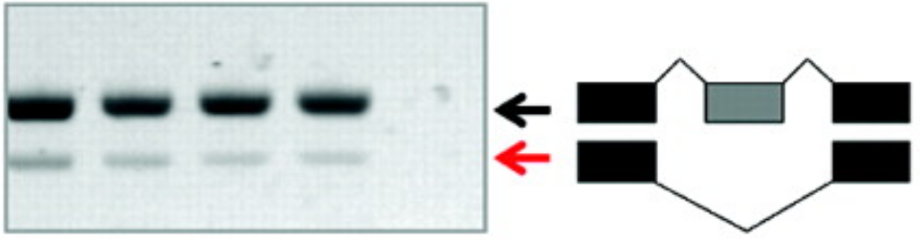
Benchmarking: accuracy
Nuno

Slide 26
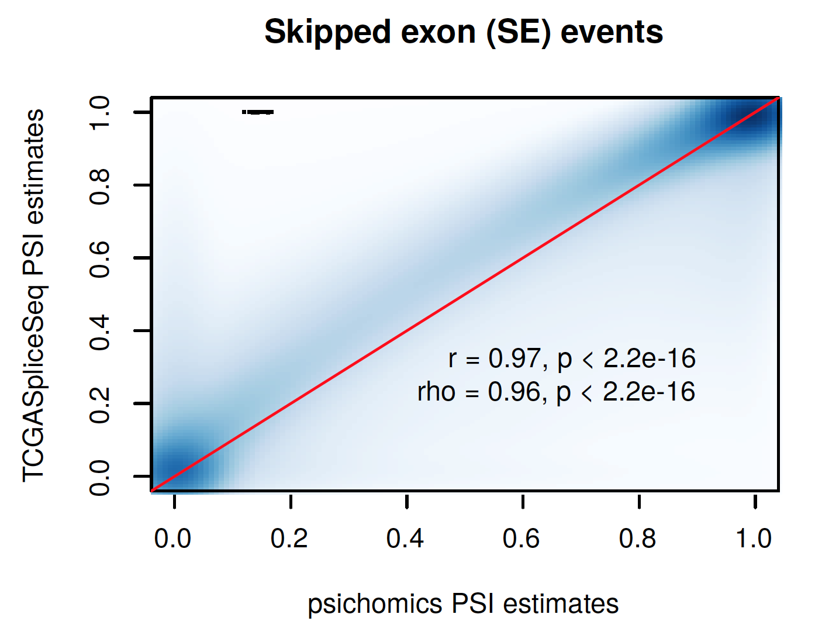
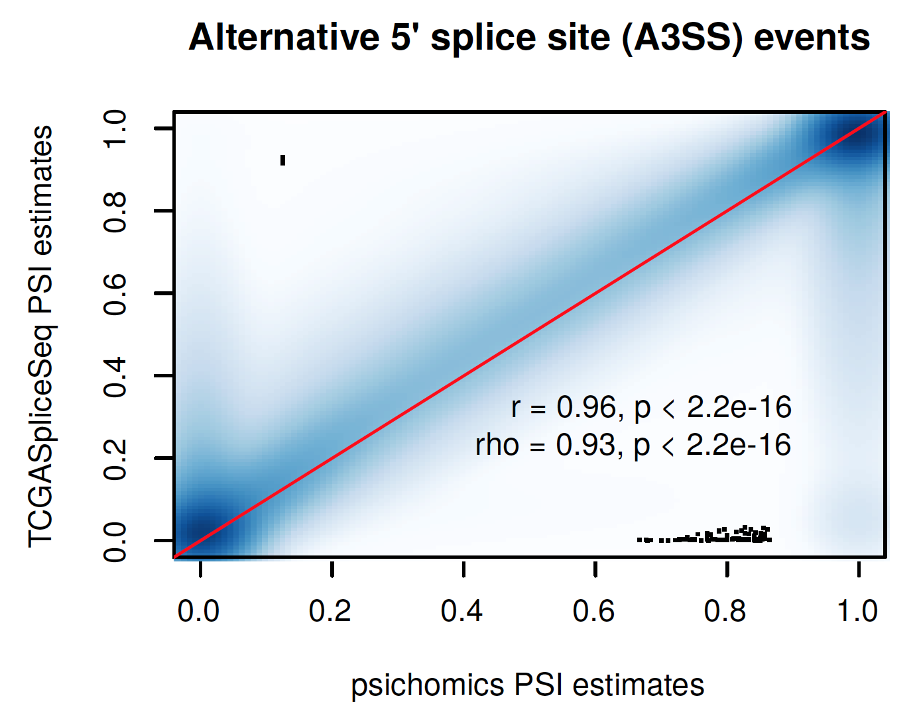
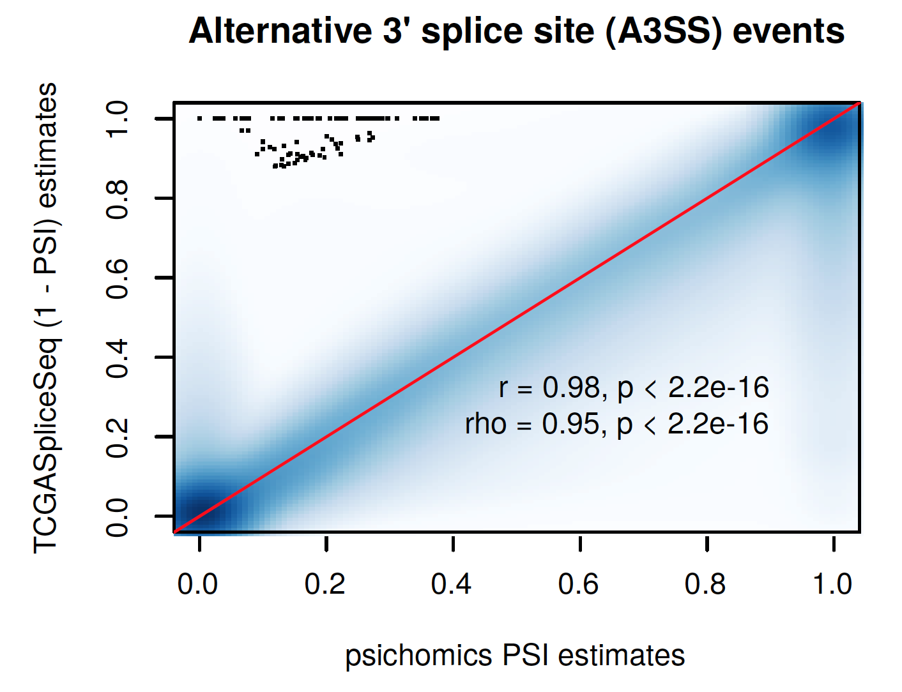
Benchmarking: accuracy
Nuno
Notes:
321 183/757 749 (42%) skipped exon, 70 837/126 725 (56%) alternative 5′ splice site and 90 940/155 799 (58%)
9913 samples

Slide 27
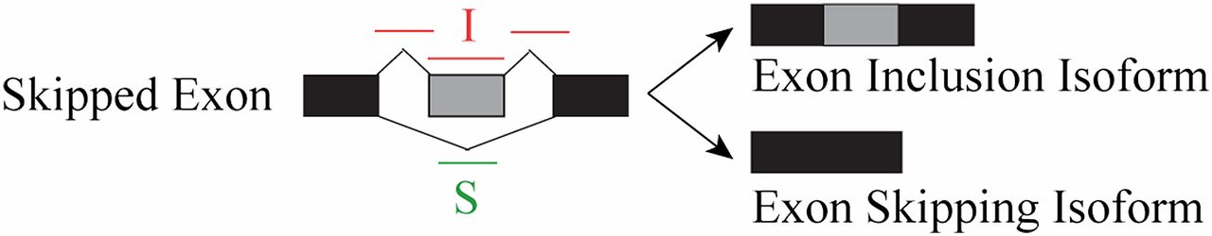
Differential splicing analysis with small sample size
Compromise between modeling the estimation uncertainty in individual samples and accounting for variability among replicates (which most tools overlook)
rMATS
Shen et al. (2014), PNAS 11:E5593
exon i, sample group j=1,2, replicate k
I_{ijk} - inclusion read counts
S_{ijk} - skipping read counts
ψ_{ijk} - exon inclusion levels
f_{i}(ψ_{ijk}) - length normalization
ψ_{ij} - mean inclusion level of group j
σ_{ij} - variance of group j
c – user-defined threshold
Maths not intelligible to non-experts
Each replicate’s contribution to the final stats hidden in the “black box”

Slide 28
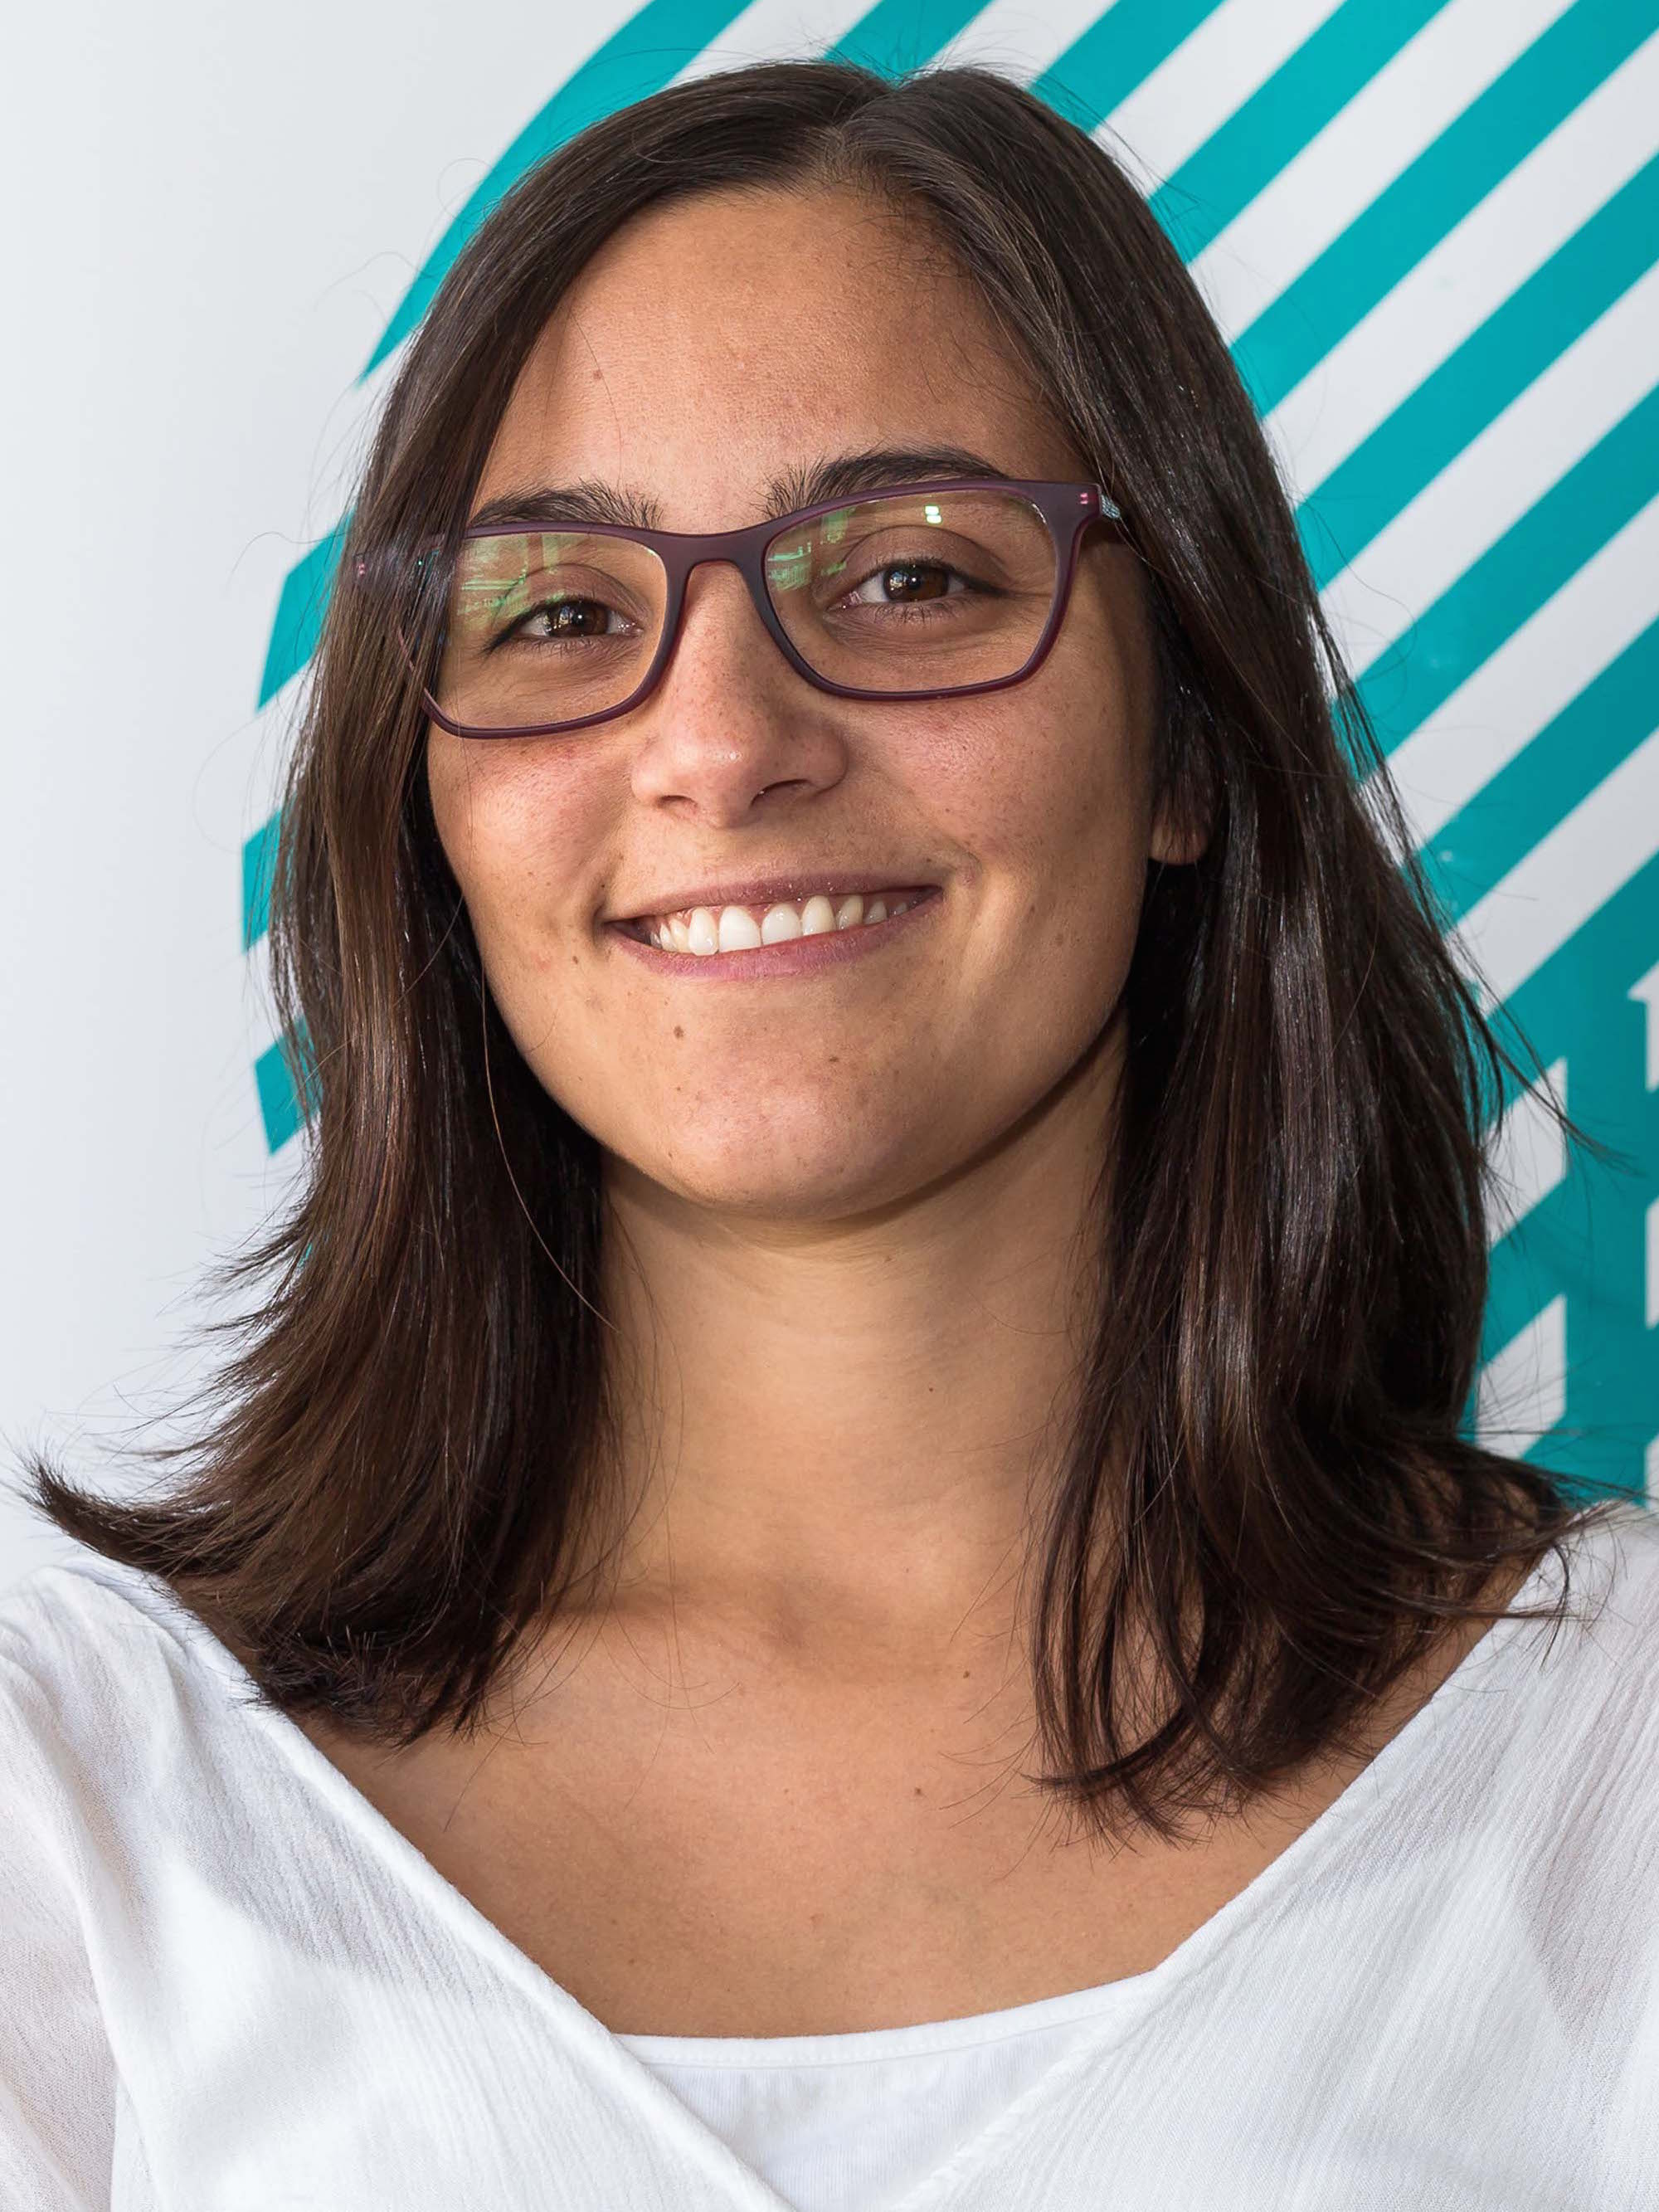
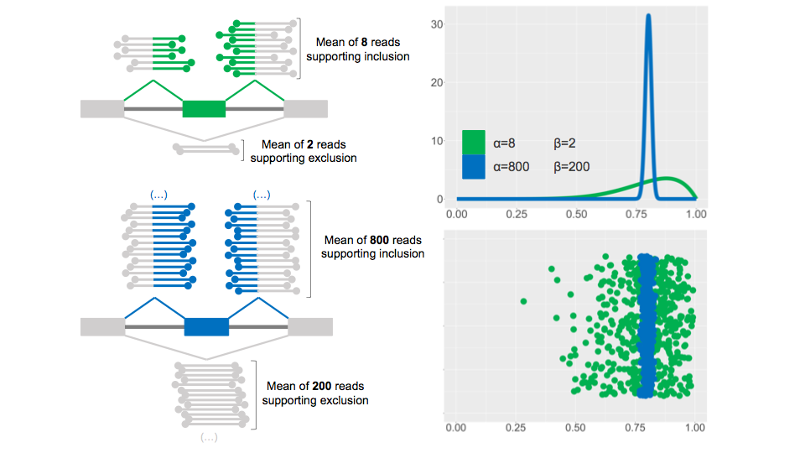

Splicing quantification and precision
Mariana
PSI = 0.8
PSI = 0.8
same PSI with contrasting evidence for inclusion
CI_{95%} = 0.49-0.94
CI_{95%} = 0.77-0.82

Slide 29
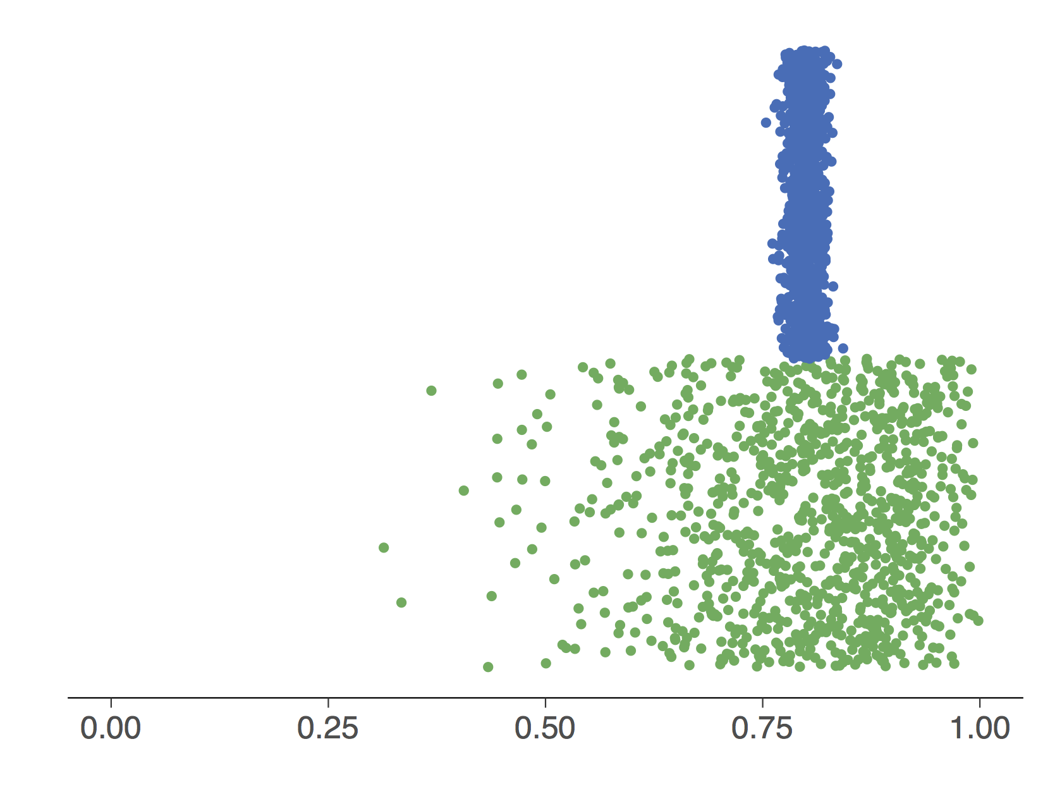
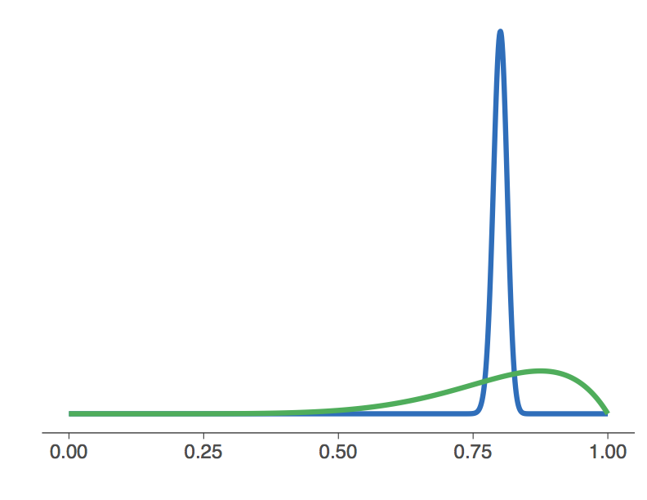

Splicing quantification using beta distributions
Mariana
Beta distribution is:
restricted to the interval ]0,1[
appropriate for modelling proportions
parameters α and β control the distribution shape
ratio α/(α + β) defines the distribution mean
the distribution gets narrower as α and β increase
α = 800
β = 200
α = 8
β = 2
with α ≃ # inclusion reads and
β ≃ # exclusion reads:
PSI ≃ mean of Beta dist. with parameters α and β
Notes:
In Bayesian inference, the beta distribution is the conjugate prior probability distribution for the Bernoulli, binomial, negative binomial and geometric distributions. For example, the beta distribution can be used in Bayesian analysis to describe initial knowledge concerning probability of success such as the probability that a space vehicle will successfully complete a specified mission. The beta distribution is a suitable model for the random behavior of percentages and proportions.

Slide 30
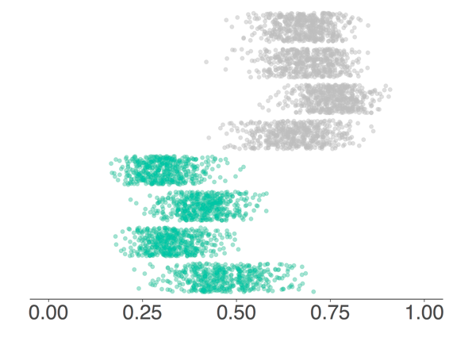
Beta distribution-based differential AS
Mariana
condition A
for each considered alternative splicing event:
condition B
Emit individual beta distributions per sample, using inclusion and exclusion reads as shape parameters
Tapial et al. (2017), Genome Res 27:1759

Slide 31
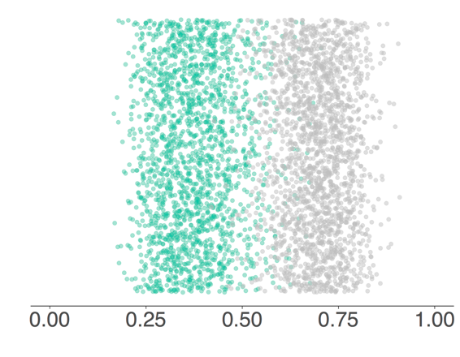
Beta distribution-based differential AS
Mariana
condition A
for each considered alternative splicing event:
condition B
Emit individual beta distributions per sample, using inclusion and exclusion reads as shape parameters
Considering the experiment design, gather all emitted individual beta distributions per condition
Tapial et al. (2017), Genome Res 27:1759

Slide 32
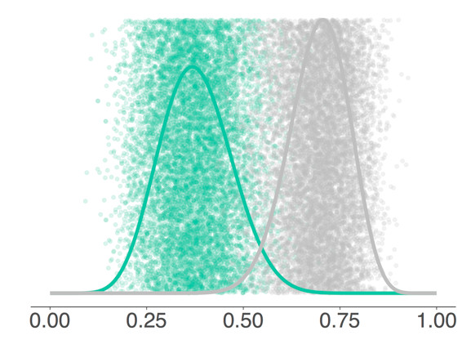
Beta distribution-based differential AS
Mariana
condition A
for each considered alternative splicing event:
condition B
Emit individual beta distributions per sample, using inclusion and exclusion reads as shape parameters
Considering the experiment design, gather all emitted individual beta distributions per condition
Fit a condition-specific global beta distribution (if unimodal)
Tapial et al. (2017), Genome Res 27:1759

Slide 33
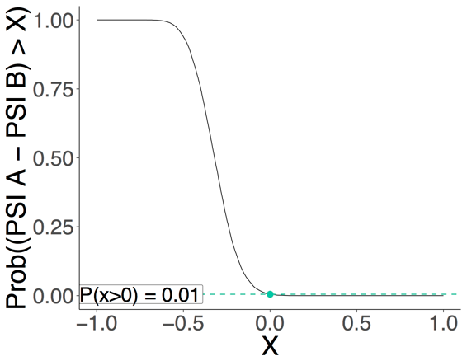
Beta distribution-based differential AS
how often are the emitted points A greater than the emitted points B?
Mariana
for each given ΔPSI threshold (x), between -1 and 1:
      calculate the probability that point A - point B > x
Tapial et al. (2017), Genome Res 27:1759

Slide 34
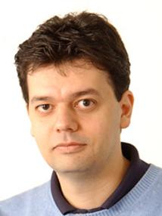
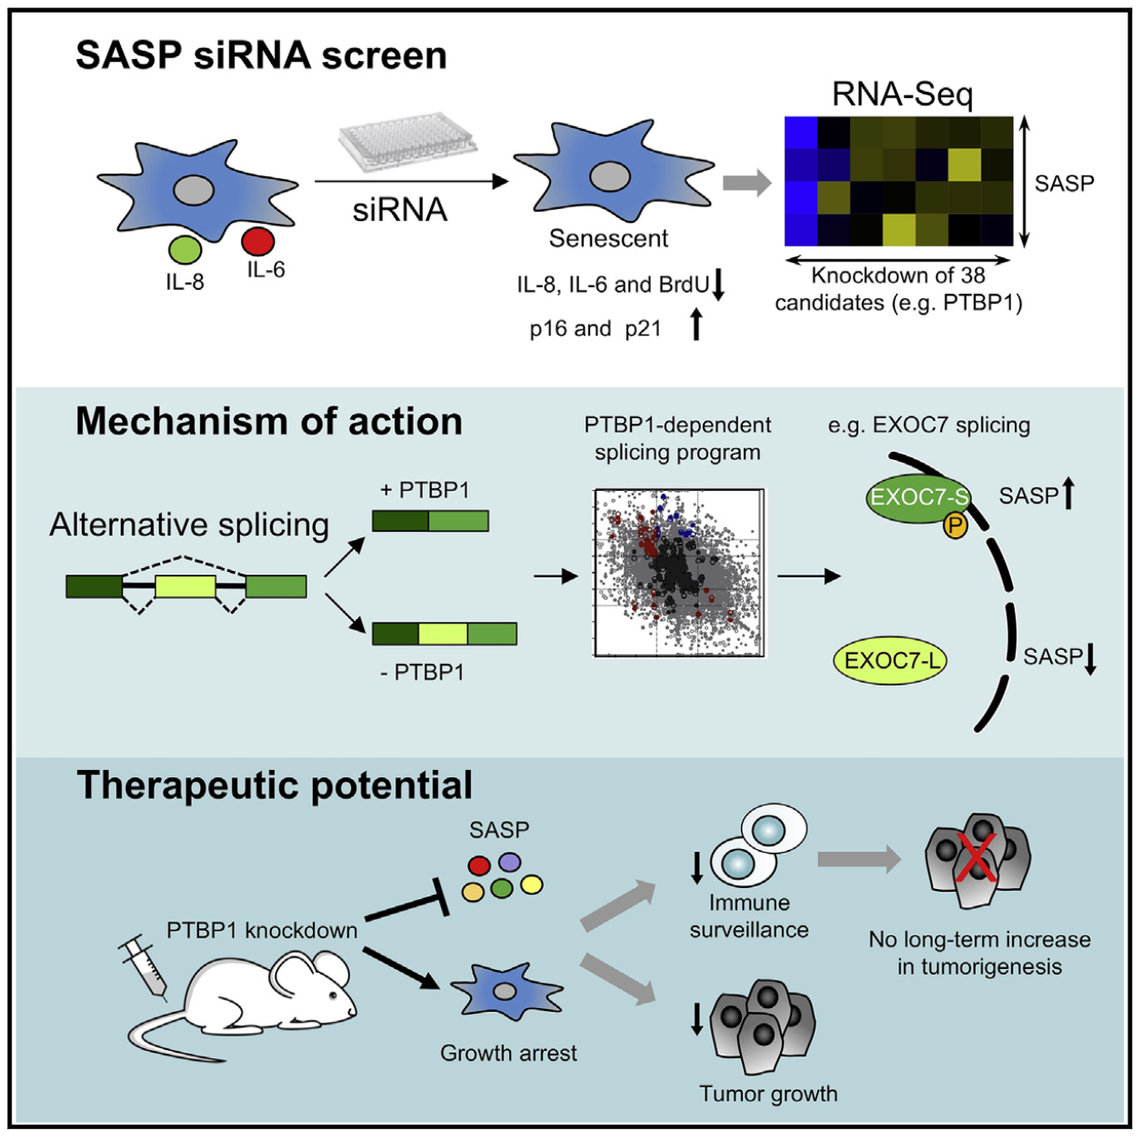

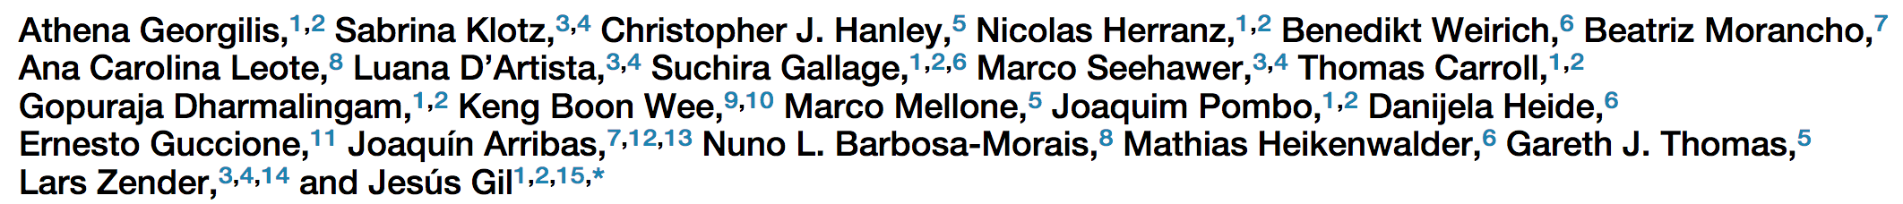
AS signatures of senescence
Jesus Gil
(Imperial)
Mariana
Hypothesis:
Stimulus-specific alternative splicing contributes to the
establishment and maintenance of the senescent phenotype

Slide 35
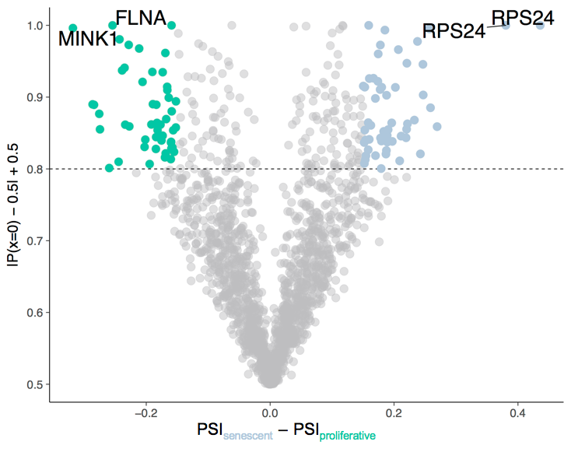
AS signatures of senescence
Jesus Gil
(Imperial)
Mariana
Proliferating
Senescent
(radiation-induced)

Slide 36
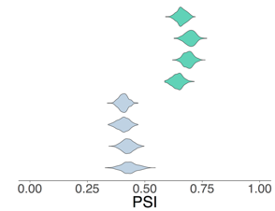




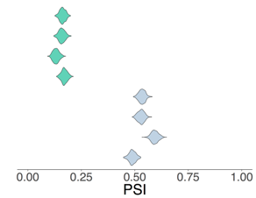


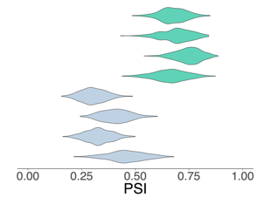
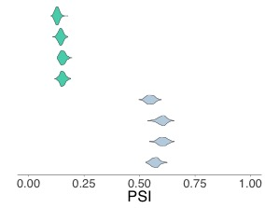
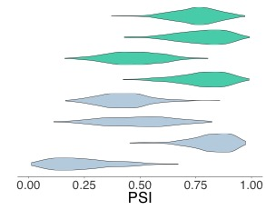
AS signatures of senescence
Jesus Gil
(Imperial)
Mariana
CDK10
Notes:
FLNA (Filamin A) is involved in remodelling the actin cytoskeleton upon changes in cell shape and migration.
RPS24 (Ribosomal Protein S24) encodes a ribosomal protein that is part of the 40S subunit. It is also an RNA-binding protein required for pre-mRNA processing.

Slide 37
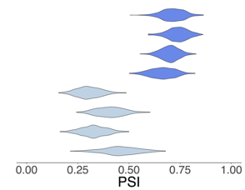
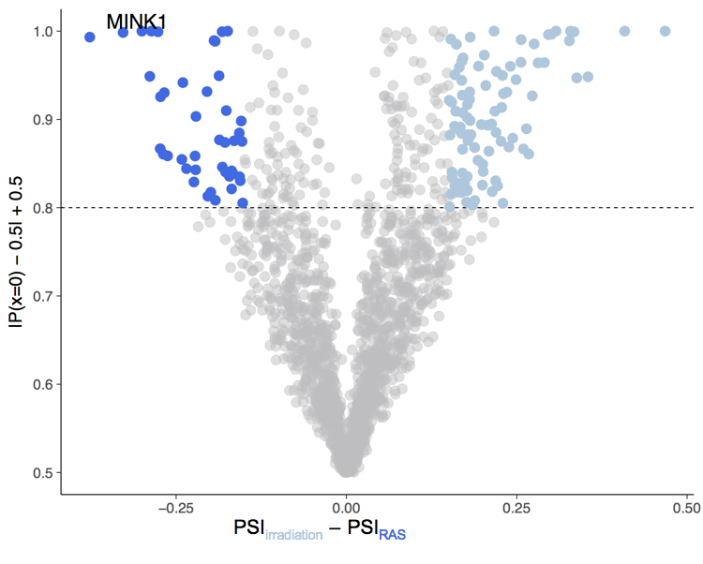

AS signatures of senescence
RAS-induced
Radiation-induced
Jesus Gil
(Imperial)
Mariana
Proliferating
Radiation-induced
User-friendly
package ➔
Notes:
MINK1 (Misshapen Like Kinase 1) is a negative regulator of RAS-related signal transduction, activated after RAS induction and controlling growth arrest through activation of p38 MAPK.

Slide 38
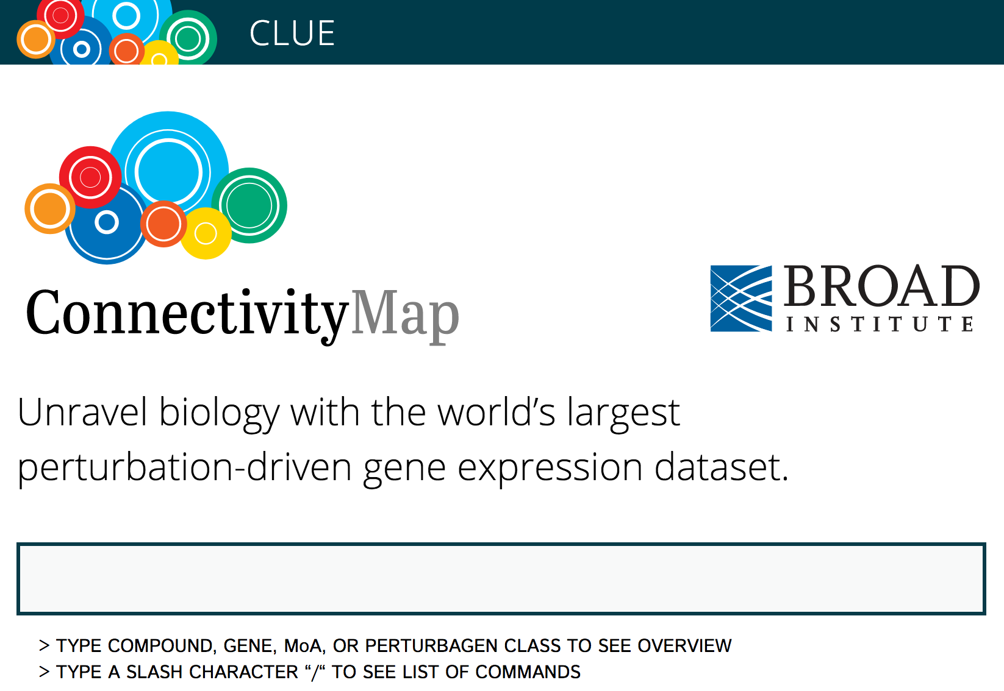
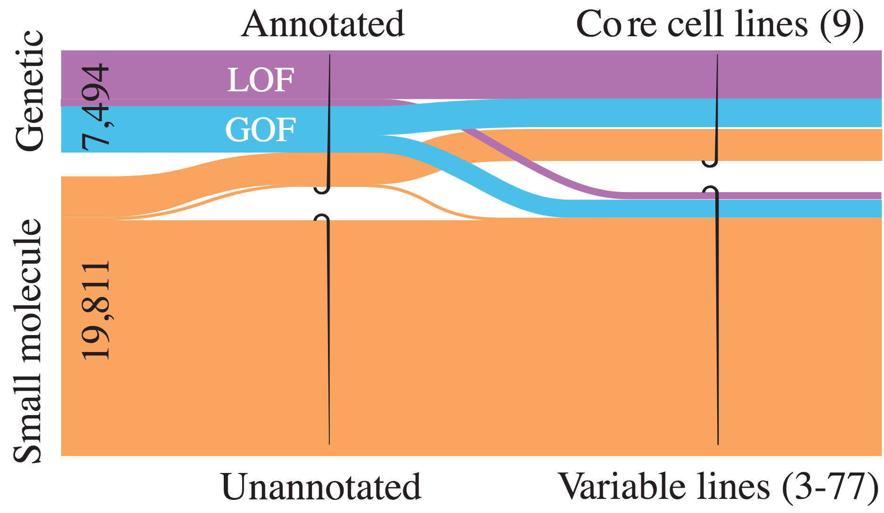
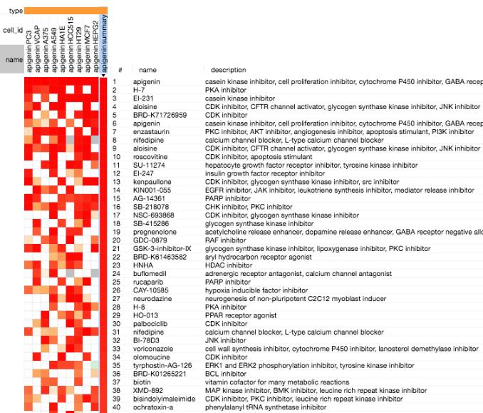
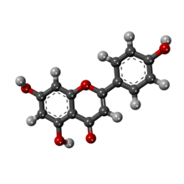
CMap: transcriptional signatures of responses of human cells to chemical and genetic perturbation
Subramanian et al (2017) Cell 171:1437
https://clue.io/
plant flavonoid apigenin
anti-inflammatory
anti-proliferative

Slide 39
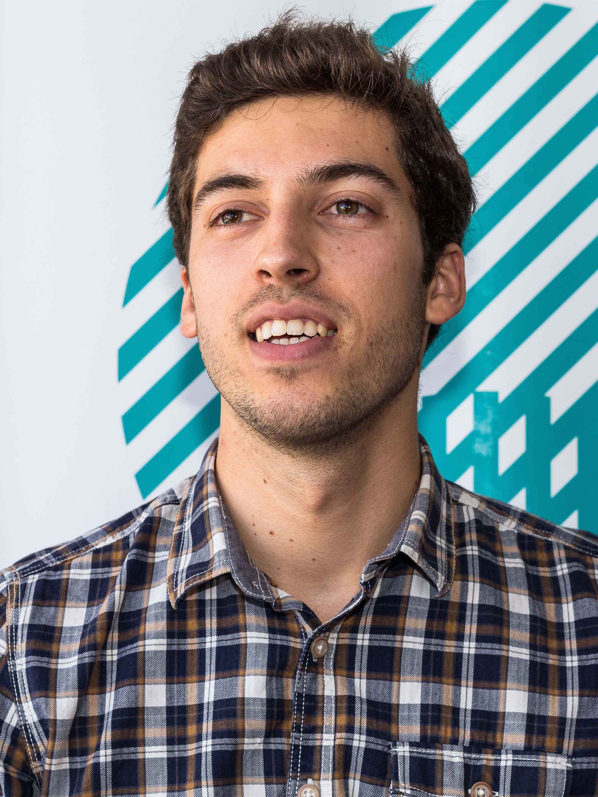
Causality of molecular alterations
Nuno
Bernardo
control
condition
?
Compare with perturbations from CMap
Differentially expressed genes
Gene A KD
Gene B KD
Ranked list of perturbations
Gene C KD
1
Gene C KD
2
3
3
2
1
1
2
3
4

Slide 40
Drug targeting of molecular alterations
Nuno
Bernardo
control
condition
?
Compare with perturbations from CMap
Differentially expressed genes
Drug A
Drug B
Ranked list of perturbations
Drug C
1
Drug C
2
3
3
2
1
1
2
3
4
User-friendly
package ➔

Slide 41
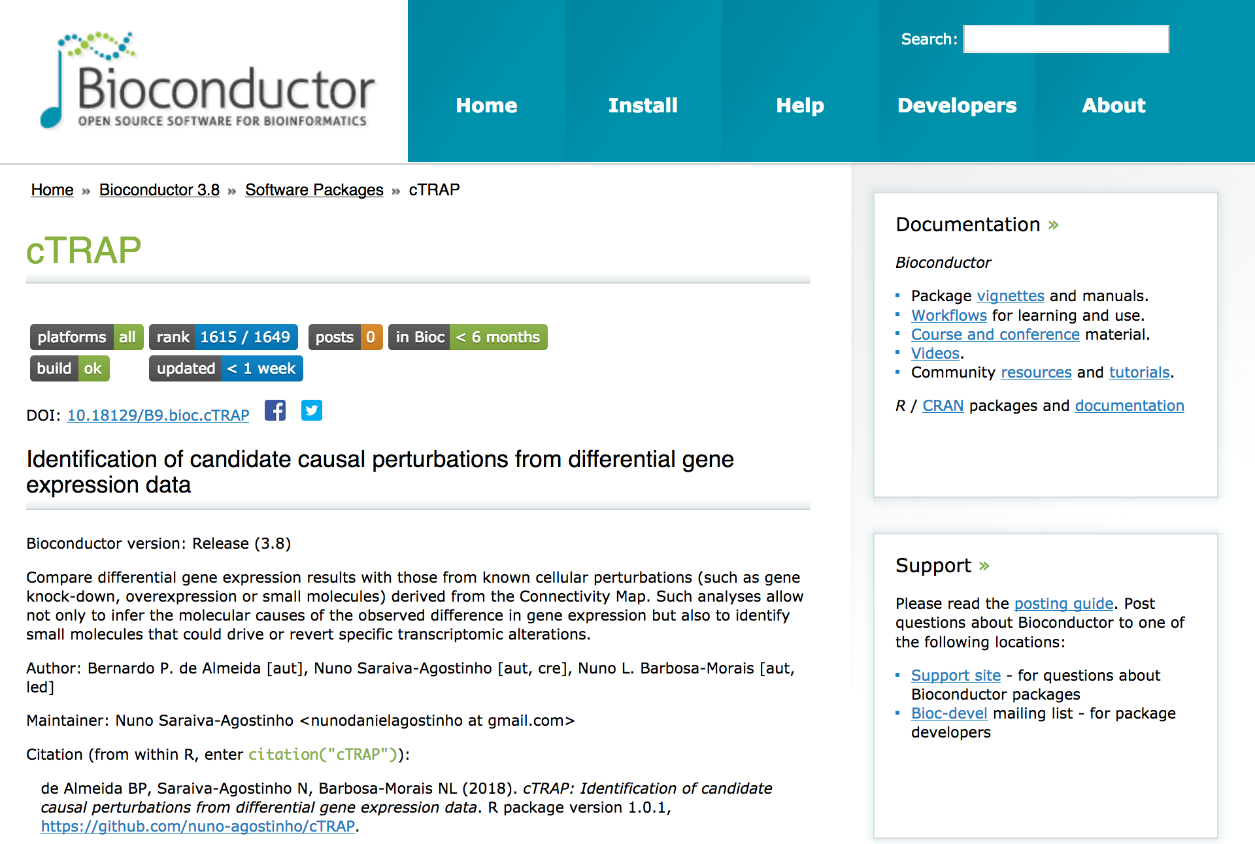
Nuno
Bernardo

Slide 42

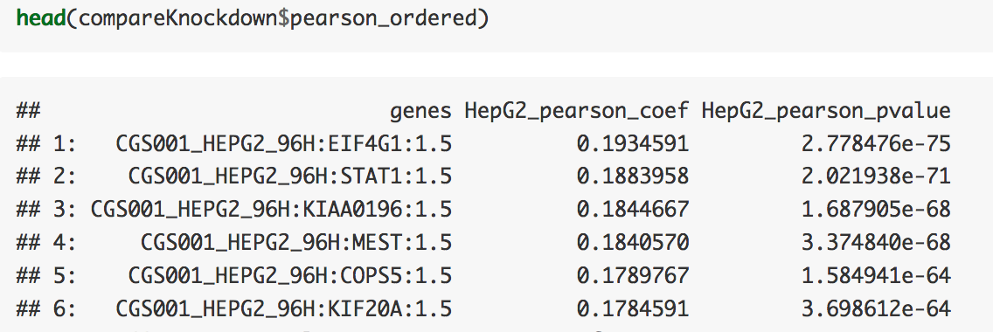
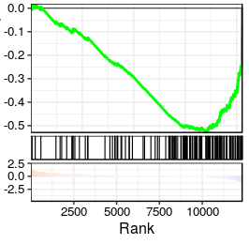


How cTRAP works
Compare statistic for differential expression
(e.g. moderated t-statistic) with z-scores
for each CMap perturbation:
Spearman’s correlation
Pearson’s correlation
Gene Set Enrichment Analysis (N most up- and down-regulated genes)
Nuno
Bernardo
Vignette case study: EIF4G1 shRNA knockdown in HepG2 (RNA-seq)
[voom+limma]
Down-regulated
Up-regulated

Slide 43




Centrosomes and cancer
The major microtubule organising centre in animal cells
Centrosome amplification is a common feature in cancer
Screen for centrosome number and structure
in the NCI-60 panel of human cancer cell lines
Bernardo
Mónica B Dias
(IGC Lisbon)

Slide 44

Centrosome amplification (CA) and cancer
The major microtubule organising centre in animal cells
Centrosome amplification is a common feature in cancer
Pan-cancer prevalence?
Molecular role of CA in tumourigenesis?
CA’s therapeutic value?

Slide 45
Pan-cancer landscape of CA
9,721 tumour and 725 matched-normal samples (32 cancer types)
Bernardo
FDR < 0.05 across all cohorts

Slide 46
CA in breast cancer
Bernardo
*** p-value < 0.001
**** p-value < 0.0001

Slide 47





CA and genomic instability
Bernardo
Genome doublings
Aneuploidy
Taylor et al. (2018), Cancer Cell 33:676

Slide 48
CA and genomic instability
Bernardo
Mutations
CNAs
Clones
Linear regression analyses

Slide 49

CA and prognosis
Bernardo

Slide 50




CA and hypoxia/stromal infiltration
Bernardo
Winter et al. (2007), Cancer Res 67:3441
Yoshihara et al. (2013), Nat Commun 4:2612

Slide 51

CA and proliferation
Bernardo
Diener and Resendis-Antonio (2016),
Front Physiol 7
All associations remain significant when proliferation rate is used as an additional covariate in the regressions

Slide 52

Selectively targeting CA
Cancer Therapeutics Response Portal
CA20 vs drug sensitivity
Bernardo
823 cell lines
354 compounds

Slide 53





cTRAP 2.0
Compare statistic for differential expression with drug sensitivity (e.g. gene expression – IC50 correlation)
Nuno
Bernardo
Cancer Therapeutics Response Portal
860 cell lines
481 compounds
Genomics of Drug Sensitivity in Cancer
1074 cell lines
265 compounds
NCI-60
60 cell lines
21.739 compounds

