Slide 1
Combining genomic data to understand complex human traits
Discovering xQTLs in the brain to understand complex human traits
Sara Mostafavi
Assistant Professor
Depts. Statistics + Medical Genetics
University of British Columbia
Vancouver, Canada
BIRS CMO, Nov 8 2018

Slide 3
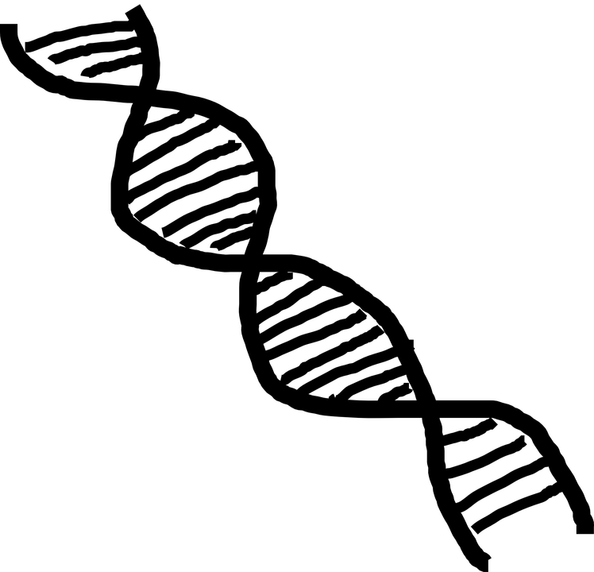
Motivation: genome-wide association studies (GWAS)
Genetotpye
Millions of SNPs ….
Phenotype
(e.g., Schizophrenia)
1 | 1 | 2 | 0 | 0 | 2 | …
1 | 1 | 2 | 0 | 0 | 2 | …
1 | 1 | 2 | 0 | 0 | 1 | …
1 | 1 | 0 | 0 | 0 | 1 | …
1 | 1 | 0 | 0 | 0 | 0 | …
1 | 1 | 0 | 0 | 0 | 2 | …
phenotype
genotype
Confounding covariates

Slide 4
Motivation: genome-wide association studies (GWAS)
Genetotpye
Phenotype
(e.g., Schizophrenia)
Millions of SNPs ….
1 | 1 | 2 | 0 | 0 | 2 | …
1 | 1 | 2 | 0 | 0 | 2 | …
1 | 1 | 2 | 0 | 0 | 1 | …
1 | 1 | 0 | 0 | 0 | 1 | …
1 | 1 | 0 | 0 | 0 | 0 | …
1 | 1 | 0 | 0 | 0 | 2 | …
Require > 100K samples (e.g., psychiatric disorders)
Very polygenic and small effect size at each loci
Majority of associated loci are in non-coding areas of the genome

Slide 5
Expression Quantitative Trait Loci (eQTL) Studies
eQTL study: identification of associations between genetic variants (single nucleotide polymorphisms; SNPs) and gene expression levels.
eQTL
Genotype data
Samples
SNP
Expression data
A
SNP
Transcriptome
Samples
C
mRNA levels

Slide 6
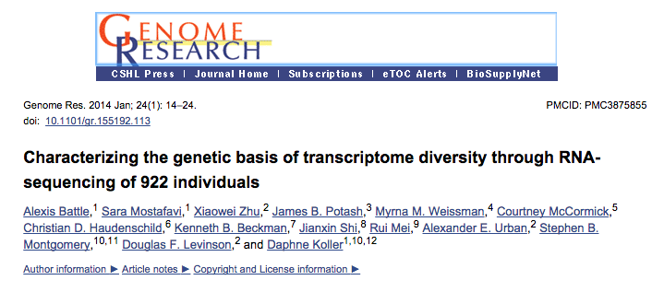

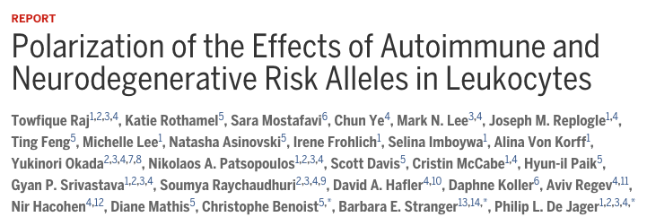
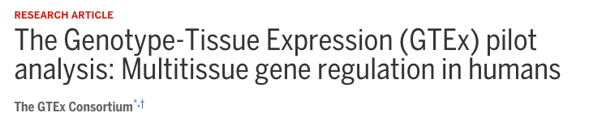
Many large scale eQTL studies have been conducted
The DGN study: genotype and gene expression from blood
  ~1000 individuals
ImmVar project: genotype and gene expression from specific blood cell types
  ~500 individuals
GTEx project: genotype and gene expression from >50 human tissues
  ~100-500 individuals
…….
Notes:
Other things to know:
Poly-A selected, globin-clear, XXXXXX

Slide 7
Key insights from eQTL studies
Cis (local) eQTLs are very well replicated and explain substantial amount of variation in gene expression.
GWAS loci are enriched in eQTLs.
Tissue-specificity and temporal dynamics are important.
    Small in proportion: ~10-20% tissue specific
    Genetics factors that are important to complex human traits can be context-specific
Many GWAS-associated loci are not eQTLs.
  50% of GWAS-SNPs significantly co-localize with any eQTL [GTEx 2017]
  Need to investigate impact on additional molecular traits AND context-specific effects.

Slide 8
Key insights from eQTL studies
Cis (local) eQTLs are very well replicated and explain substantial amount of variation in gene expression.
GWAS loci are enriched in eQTLs.
Tissue-specificity and temporal dynamics are important.
    Small in proportion: ~10-20% tissue specific
    Genetics factors that are important to complex human traits can be context-specific
Many GWAS-associated loci are not eQTLs.
  50% of GWAS-SNPs significantly co-localize with any eQTL [GTEx 2017]
  Need to investigate impact on additional molecular traits AND context-specific effects.
Need to map brain QTLs
Can we look beyond expression as the ‘read out’?

Slide 9




ROSMAP: Religions Order Study (ROS) and Memory and Aging Project (MAP)
Longitudinal study of aging:
  Started in 1994
  N=3000 healthy at enrollment, in 40s or 50s
  30% diagnosed with Alzheimer’s disease (AD) at time of death
RNA-Seq expression data (N=700):
  RNA from DLPFC; average 70M reads
Epigenomic (N=700):
  DNA methylation + Histone acetylation
Genotype (N=2000)
Brain
Phil De Jager
David Bennett

Slide 10
X Quantitative trait loci studies
identification of associations between genetic variants (SNPs) and cellular traits.
DNA methylation data
Genotype data
DNAm
Samples
SNP
Gene expression data
A
SNP
Transcriptome
Samples
C
mRNA levels
Histone mark
Histone modification data

Slide 11
X Quantitative trait loci studies
(all are cis associations)
identification of associations between genetic variants (SNPs) and cellular traits.
DNA methylation data
mQTLs
Genotype data
eQTLs
Samples
SNP
Gene expression data
A
SNP
Transcriptome
Samples
C
haQTLs
Histone modification data

Slide 12
xQTL study in ROSMAP from brain (DLPFC) using ~500 samples with multiple molecular trait measurements
1) Overlap of QTL types?
2) Can we improve statistical power in ‘brain relevant’ GWAS?
Bernard Ng
http://mostafavilab.stat.ubc.ca/xqtl/
Bernard Ng, et al., Nat Neurosci 2017

Slide 13
Statistical view
Gene expression
Histone acetylation
DNA methylation
Genotype
hidden confounds: PCs from corresponding dataset
Adjusting for hidden confounds leads to drastic increase in statistical power in QTL analysis
eQTLs
mQTLs
haQTLs
Number of QTLs (chr 22)
Number of regressed out PCs

Slide 14
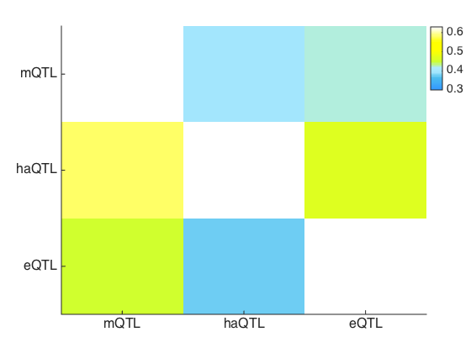
Results: overlap between mQTLs, eQTLs, and haQTLs
Many SNPs effect only one type of molecular traits (e.g., mQTLs)
Best estimate: 40-60% overlap
Pi1-based replication rates for quantifying overlap
Simple overlap analysis
haQTLs
mQTLs
haQTLs
eQTLs
mQTLs
mQTLs
60%
50%
40%
haQTLs
eQTLs
eQTLs
Bernard Ng, et al., Nat Neurosci 2017

Slide 15
Using xQTL associations to improve detection power in GWAS
Hypothesis free vs (genome-wide) hypothesis “weighted” GWAS
  Multiple testing correction: penalize all tested hypothesis equally vs test-specific penalization.
Standard Boneferroni correction
(i.e., hypothesis free):
Weighted Boneferroni correction
(i.e., hypothesis weighted):
Weight of hypothesis i
Weighted Bonferroni correction based on Wasserman and Roeder. arXiv. 2006
Notes:
Hypothesis guided

Slide 16
Thanks!
Hypothesis free vs (genome-wide) hypothesis “weighted” GWAS
  Multiple testing correction: penalize all tested hypothesis equally vs test-specific penalization.
Standard Boneferroni correction
(i.e., hypothesis free):
Weighted Boneferroni correction
(i.e., hypothesis weighted):
Weight of hypothesis i
Weighted Bonferroni correction based on Wasserman and Roeder. arXiv. 2006
Notes:
Hypothesis guided

Slide 17
xQTL guided GWAS results in additional independent significant loci
Standard GWAS identified 240 significant loci in the latest SCZ GWAS
QTL guided GWAS identified an additional 9 independent loci
Bernard Ng, et al., Nat Neurosci 2017

Slide 18
xQTL guided GWAS results in additional independent significant loci
Standard GWAS identified 240 significant loci in the latest SCZ GWAS
QTL guided GWAS identified an additional 9 independent loci
Modest improvement in detection power implies that there are still many “functional SNPs” that we are not modeling….
Bernard Ng, et al., Nat Neurosci 2017

Slide 19
Can we identify additional context specific QTLs from the same dataset?

Slide 20
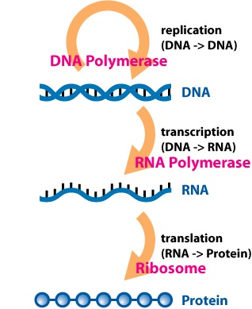

Motivation: Identifying context-specific effects of genetic variation
GxE eQTLs: eQTLs that are only active in certain environments
  Knowles et al., Nat Methods 2017
  Yao et al., HMG 2014
  Kim Kukurba et al., Genome Research 2016
  David Knowles et al., Nat Meth 2017
DNA
Environment
Transcriptome
Notes:
From a statistical point of view, this is simple. If we have measured environmental factors, we can just use them as interaction terms in our linear models.

Slide 21
Motivation: Identifying context-specific effects of genetic variation
Statistical Modeling of GxE eQTLs
DNA
Environment
Transcriptome
Gene expression levels
“environment”
GxE effect
x
Coefficient: detection of significant GxE effects
Notes:
But the challenge is that

Slide 22
Motivation: Identifying context-specific effects of genetic variation
Finding GxE eQTLs : sex, age, medication, smoking, child abuse,…
  Yao et al., HMG 2014
  Kim Kukurba et al., Genome Research 2016
  David Knowles et al., Nat Meth 2017
Statistical Modeling of GxE
DNA
Environment
Transcriptome
Major Challenge: Relevant environment factors can’t be
comprehensively measured
Notes:
But the challenge is that

Slide 23
Can we infer exposure to environmental factor using ‘omics data?
Measured demographical/environmental covariates (rows) are correlated with the latent variables from “omics” data (columns)
Cellular heterogeneity
-log P-values
Top 100 principal components of RNA-seq data
[DGN Study: Battlet et al., Genome Research 2014; Mostafavi et al., Mol Psych 2014]

Slide 24
Can we infer exposure to environmental factor using ‘omics data?
Measured demographical/environmental covariates (rows) are correlated with the latent variables from “omics” data (columns)
-log P-values
Cellular heterogeneity
Smoking
BP meds
Ate before blood draw
Top 100 principal components of RNA-seq data
Notes:
So to understand factors that contribute to these broad patterns, we collected several covariates that relate to technical preparation and sequencing of RNA.
One fix → remove PCs, but unclear if which ones and/or if we would also be losing signal bc Pcs → multiple phenomena
----- Meeting Notes (1/6/14 13:50) -----
put gender and age and stuff makes sense, row labels should align with text, pcs

Slide 25
Can we infer exposure to environmental factor using ‘omics data?
Measured demographical/environmental covariates (rows) are correlated with the latent variables from “omics” data (columns)
“hidden” variables
Technical factors
+ Cellular heterogeneity
-log P-values
Top 100 principal components of RNA-seq data
Notes:
So to understand factors that contribute to these broad patterns, we collected several covariates that relate to technical preparation and sequencing of RNA.
One fix → remove PCs, but unclear if which ones and/or if we would also be losing signal bc Pcs → multiple phenomena
----- Meeting Notes (1/6/14 13:50) -----
put gender and age and stuff makes sense, row labels should align with text, pcs

Slide 26
Methods: Statistical Modeling of GxE
Gene expression levels
“environment”
GxE effect
x
Coefficient: detection of significant GxE effects
Two step approach:
Infer hidden factors from gene expression data
Solve above equation with the inferred factors
Motivated by “proxy” gene GxE studies [Zhernakova et al., Nature Genetics 2016]

Slide 27
We need to use DCARS instead !!!
Gene expression levels
“environment”
GxE effect
x
Coefficient: detection of significant GxE effects
Two step approach:
Infer hidden factors from gene expression data
Solve above equation with the inferred factors
Motivated by “proxy” gene GxE studies [Zhernakova et al., Nature Genetics 2016]

Slide 28
Three approaches to extracting hidden environment factors (i.e., LVs) from gene expression data
Clustering: needs to be “conditional” (e.g., some version of hierarchical clustering)
PCA or variants (sparse PCA)
PLIER – factor analysis with prior knowledge

Slide 29
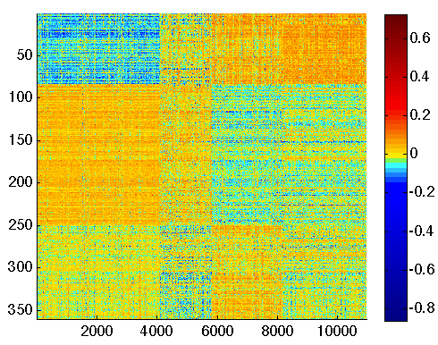
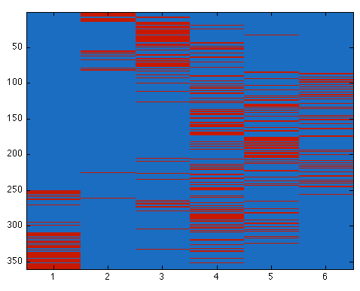
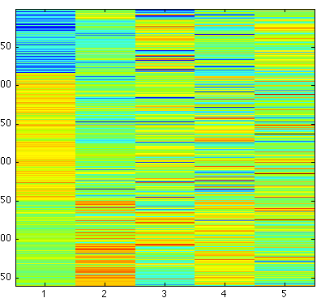
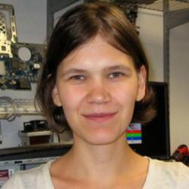
PLIER: Gene pathway-informed latent variables (LVs)
We derive broad patterns (LVs) in gene expression that are supported by prior pathway and functional annotations.
=
X B
+
X V
Known factors
Latent factors
“gene” loading
Observed Expression Data
Regularization term provide prior information
Maria Chikina’s lab, U Pitt
(Mao and Chikina, bioRxiv 2017)

Slide 30
Do the PLIER LVs replicate in different brain studies?
Assess the correlation between LVs inferred from ROSMAP to those inferred jointly (concatenation) of CMC and ROSMAP
Number of LVs
Correlation Coefficient between matched LVs
Bernard Ng et al., In preparation

Slide 31
Methods: Statistical Modeling of GxE
Gene expression levels
“environment”
GxE effect
x
Coefficient: detection of significant GxE effects
Two step approach:
Infer hidden factors from gene expression data
Solve above equation with the inferred factors
Motivated by “proxy” gene GxE studies [Zhernakova et al., Nature Genetics 2016]

Slide 32
Detection of GxE eQTLs using LVs as proxies for hidden environmental variables
Permutation test for detecting significant hits at FDR 0.1
Identified ~2000 GxE eQTLs
GxE eQTLs explain an additional 3-10% of variance in expression
Number of significant GxE eQTLs
LVs
Bernard Ng et al., In preparation

Slide 33
GxE eQTLs replicate well in independent data from cortex
  Replication: CommonMind data, N=500 (Gene expression + genotype)
  Replication pi1 = 0.7
Pi1 statistic = 0.7
Number of associations
CommonMind pvalues
Bernard Ng et al., In preparation

Slide 34
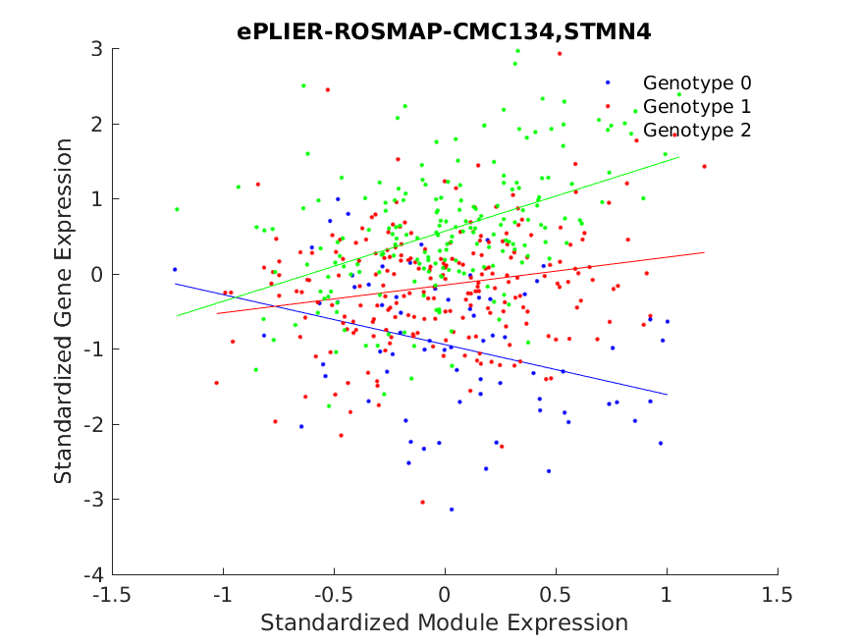
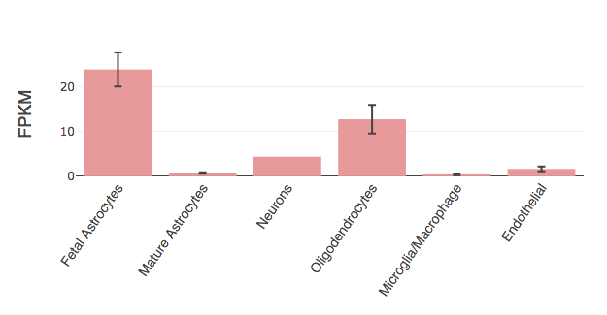
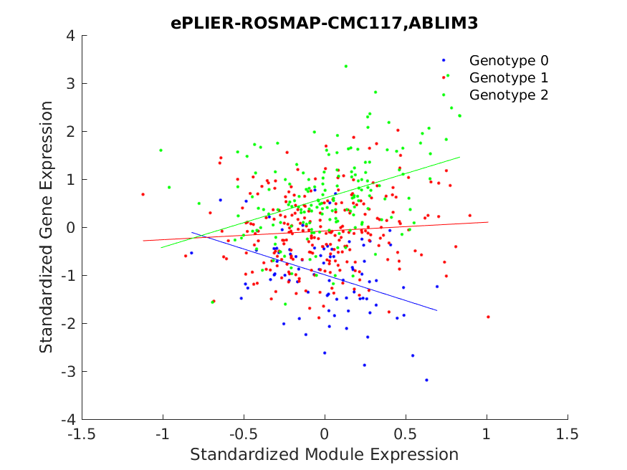
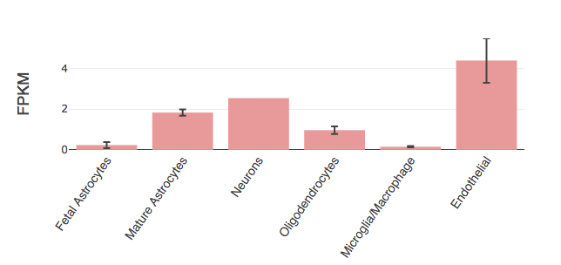
Inference of cell-specific eQTLs through GxLV models
STMN4 gene expression
Ben Barres RNA-Seq Database
STMN4 expression
LV: Oligodendrocyte prop
ALBIM3 gene expression
Ben Barres RNA-Seq Database
ABLIM3 expression
LV: Endothelial prop
Bernard Ng et al., In preparation

Slide 35
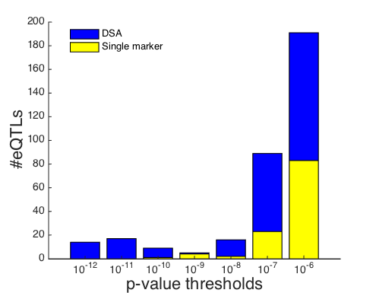
Cell-specific eQTLs: More detection power for LVs compared to ‘single gene markers’
Identify cell-type specific eQTLs using LVs as proxies for cell type proportions
Cell-type LVs
Single gene marker
Bernard Ng et al., In preparation

Slide 36
Summary
Genomic data is more complex and multifactorial than appreciated before.
New opportunities to decompose various factors that impact intermediate molecular traits.
Possibility of inference of larger set of environmental exposures by building models on well phenotyped datasets.

Slide 37
Acknowledgements
UBC
  Bernard Ng
  William Casazza
Funding & Support
  NIH/NIA U01 (De Jager et al)
  BioGen Inc
  NSERC
  CIFAR
ROSMAP Study Collaborators
  Philip L. De Jager (Columbia)
  David A. Bennett (RUSH U)
Collaborators (inspiration and discussions)
Ellis Patrick (U Sydney)
Maria Chikina (U Pitt)
Alexis Battle (JHU)
  Chris Gaiteri (RUSH U)

Slide 38
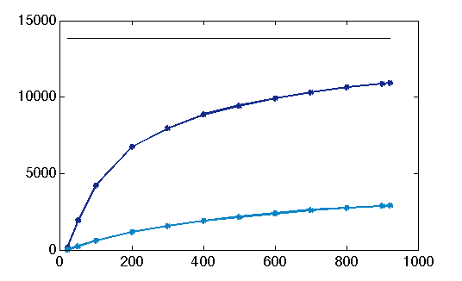
Sample size vs discovery rate
Sample sizes of ~400-500 + normalization are sufficient to find majority of eQTLs
cis eQTLs
Number eQTLs found
6738
Non-normalized data
Cohort size
Battle, Mostafavi et al., Genome Research, 2014
Notes:
Learning curves for cis, trans, iso, gwas
Show number of gwas hits that are best, # that are within 1 order of magnitude?
Majority of genes have detectable regulatory variant
Multiple variants per gene with different effect sizes/frequencies
Regulatory consequences of large fraction of disease risk-variants
Gwas – at 500, 669, 922, 790
Trans at 500, 57, 922, 125

Slide 39
Do the PLIER LVs replicate?
Assess the correlation between LVs inferred from ROSMAP to those inferred jointly (concatenation) of CMC and ROSMAP
Number of LVs
Correlation Coefficient between matched LVs
Bernard Ng et al., In preparation

Slide 40
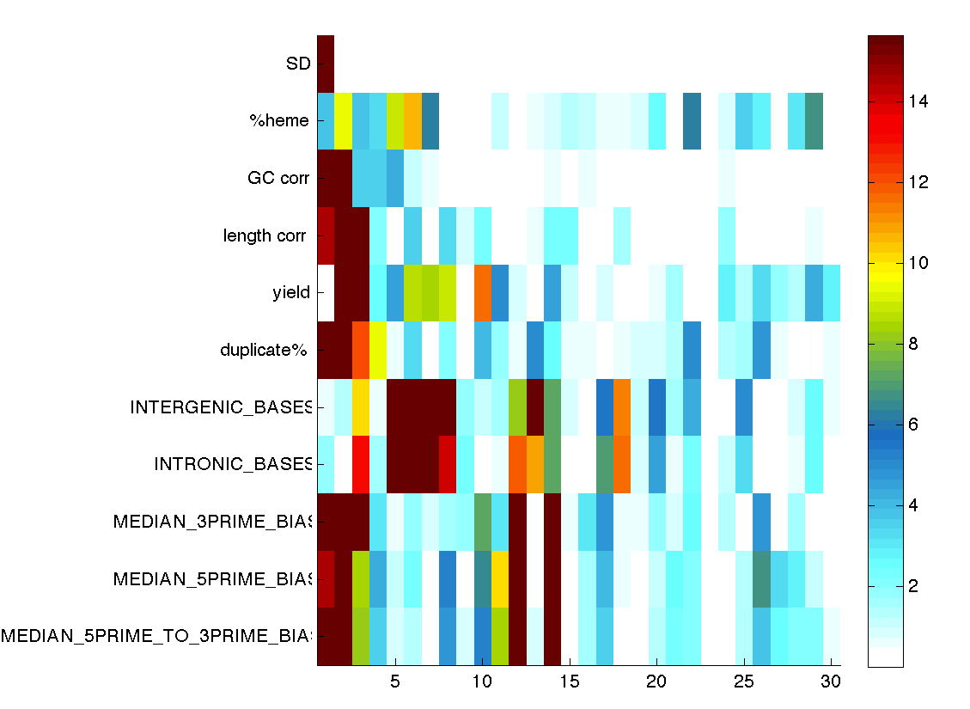
Top expression “patterns” are typically correlated with technical and biological “confounding factors”
Measured technical/biological covariates (rows) are correlated with the top principal components of the RNA-seq data (columns)
Unknown confounder?
e.g., processing technician?
Sequencing depth
…..
……
……
GC bias
…..
…..
…..
…..
RNA yield
% Duplicates
…..
…..
Age
Sex
Time of day
Technical factors
-log P-values
14
12
10
8
6
4
2
Top 30 principal components of RNA-seq data
Battle, Mostafavi et al., Genome Research 2014
Notes:
So to understand factors that contribute to these broad patterns, we collected several covariates that relate to technical preparation and sequencing of RNA.
One fix → remove PCs, but unclear if which ones and/or if we would also be losing signal bc Pcs → multiple phenomena
----- Meeting Notes (1/6/14 13:50) -----
put gender and age and stuff makes sense, row labels should align with text, pcs

Slide 41
Do the latent variables replicate across datasets?
Brain gene expression and genotype data from ~1000 individuals
  CommonMind consortium data (n=500)
  ROSMAP consortium data (n=500)
~50 gene expression “factors” in ROSMAP, ~65-75% are preserved in CommonMind data.

