Slide 1




Differential correlation across ranked samples
Ellis Patrick
School of Mathematics and Statistics,
The University of Sydney
Westmead Institute for Medical Research,
The University of Sydney
ellis.patrick@sydney.edu.au
@TheEllisPatrick
www.ellispatrick.com

Slide 2


Slide 3
Cancer Research UK Cambridge Institute
Cambridge, UK

Slide 4




Sydney Bioinformatics and Biometrics Group,
School of Mathematics and Statistics
Centre for Cancer Research

Slide 5

The Blue Mountains, Australia

Slide 6
Where are we going with this?

Slide 7
Prediction
Patrick et al (2017) Oncotarget

Slide 8

Outline
Notes:
So we know that genes do not work in isolation, but instead coordinate in a system. This naturally lends itself to thinking about gene coexpression and in particular concordance between expression of genes. We can imagine that in certain disease states, that this neatly functioning system can break down, especially in certain parts. Changes in coexpression patterns may be able to point to when and in what way these disturbances take place.

Slide 9
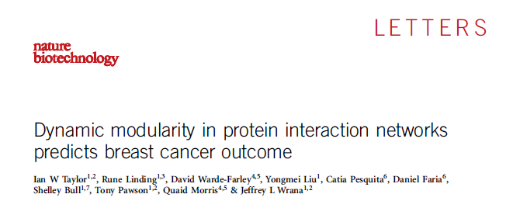
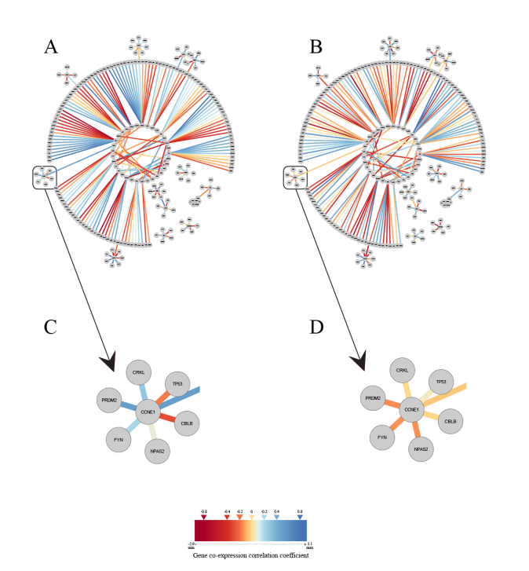
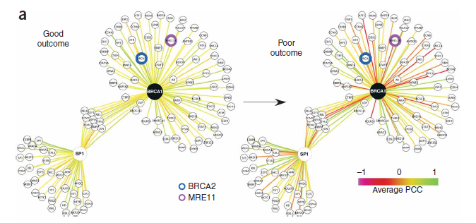
Differential correlation

Slide 10
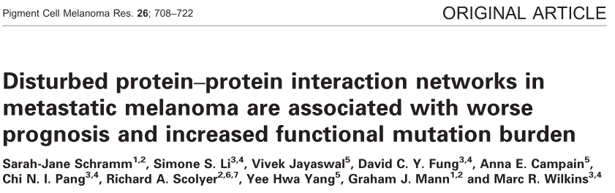
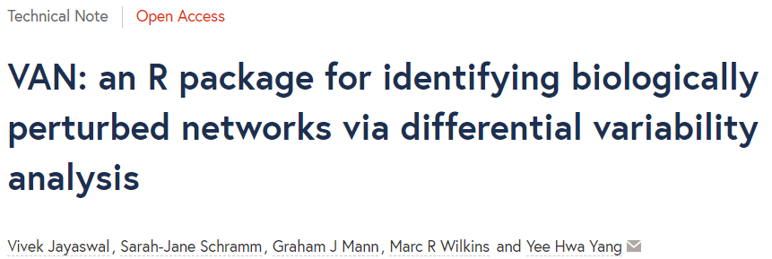
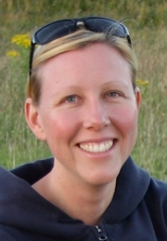
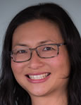

Slide 11
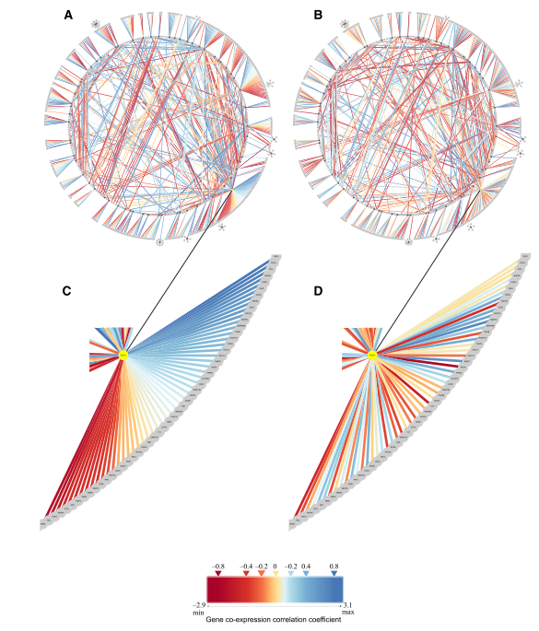
Good outcome
Bad outcome

Slide 12
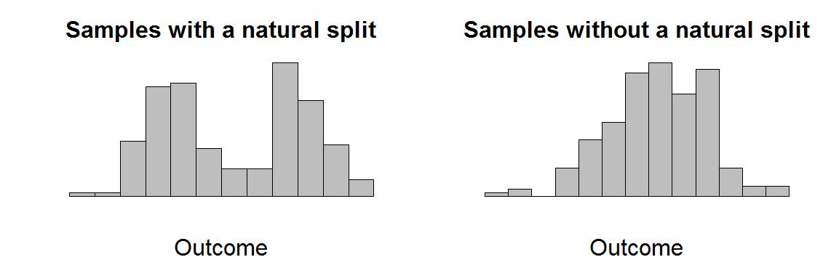
Motivation

Slide 13
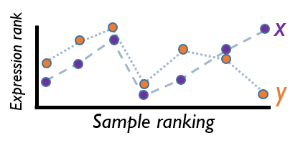
Aim: to identify changes in correlation across a continuous range of samples
y
x
y
x

Slide 14
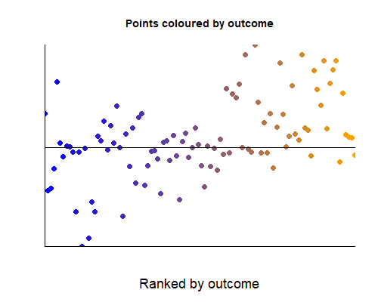
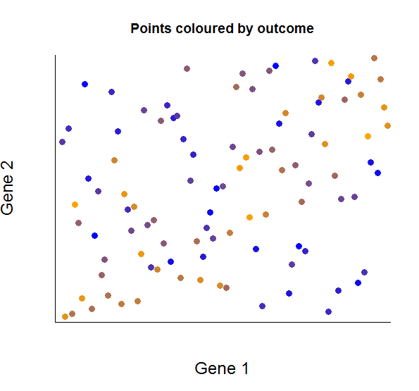
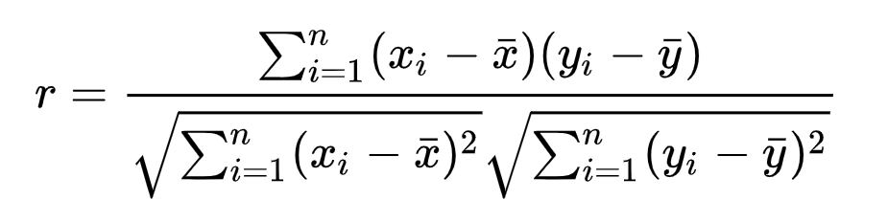

Local weighted correlations
Coloured by outcome
Gene 2 (y)
$$\left(x_{i}−\overline{x}\right)\left(y_{i}−\overline{y}\right)$$
Gene 1 (x)
Ranked by outcome

Slide 15
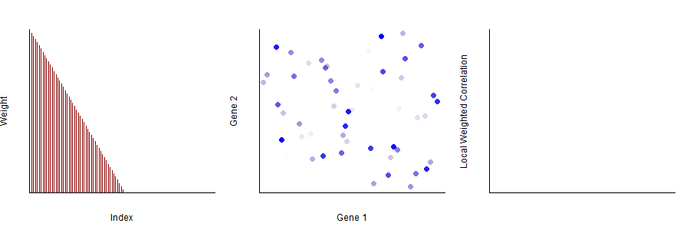
Local weighted correlations

Slide 16
Local weighted correlations

Slide 17
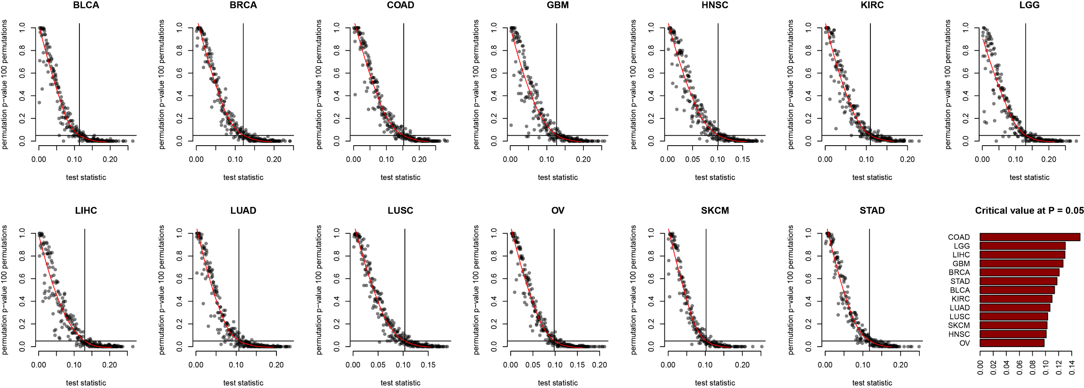
Speeding up permutation tests:
Determining critical values

Slide 18
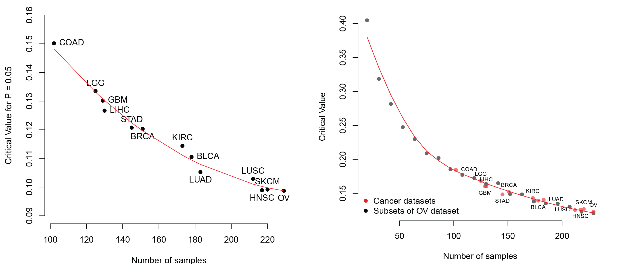

Slide 19
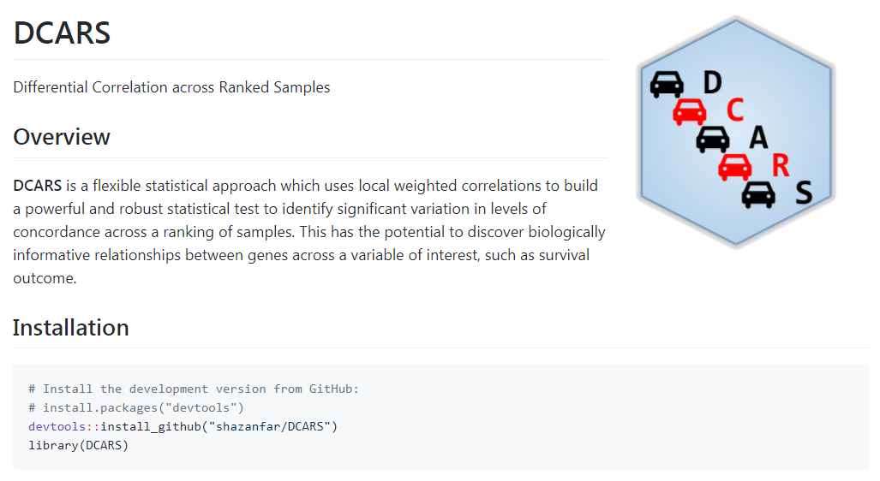
Ghazanfar et al. (2018) Bioinformatics

Slide 21

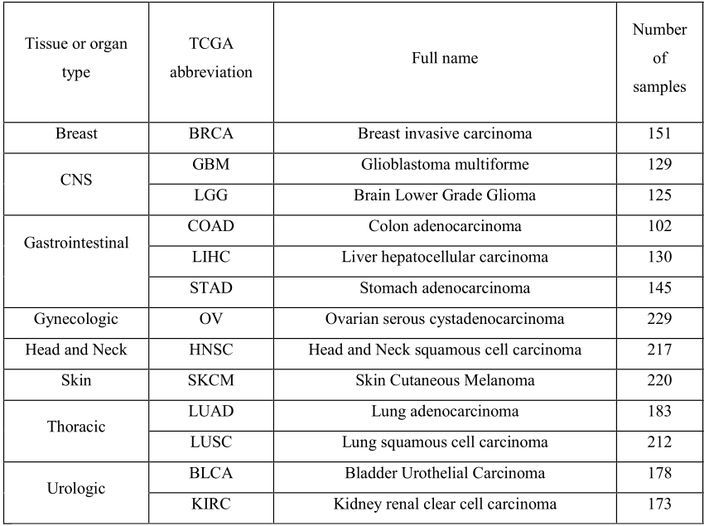

Slide 22
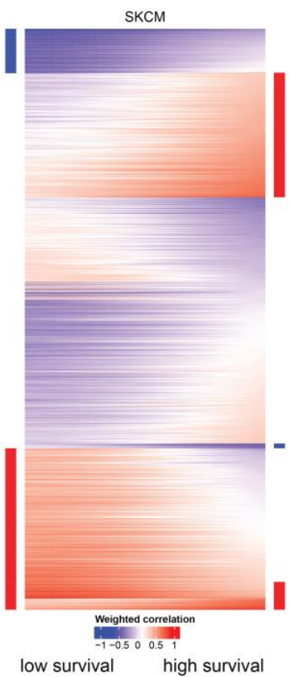
DCARS with TCGA data
Identify significant gene pairs across the STRING network
Characterise these pairs into positive/negative/zero correlation
Further characterise gene pairs with a network approach
gene pairs

Slide 23
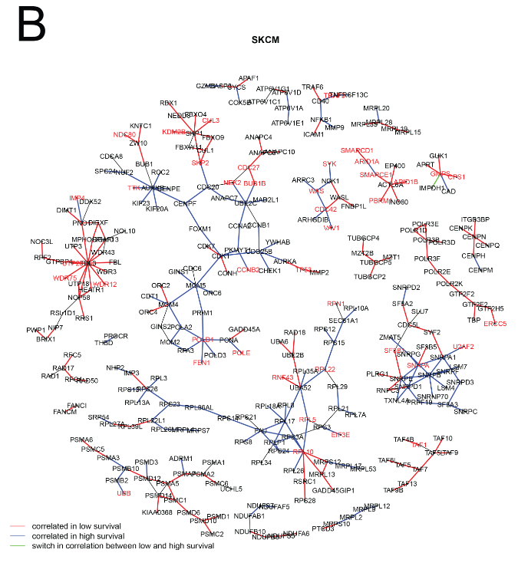
gene pairs
walktrap algorithm implemented in the igraph R package (Csárdi and Nepusz, 2006)

Slide 24
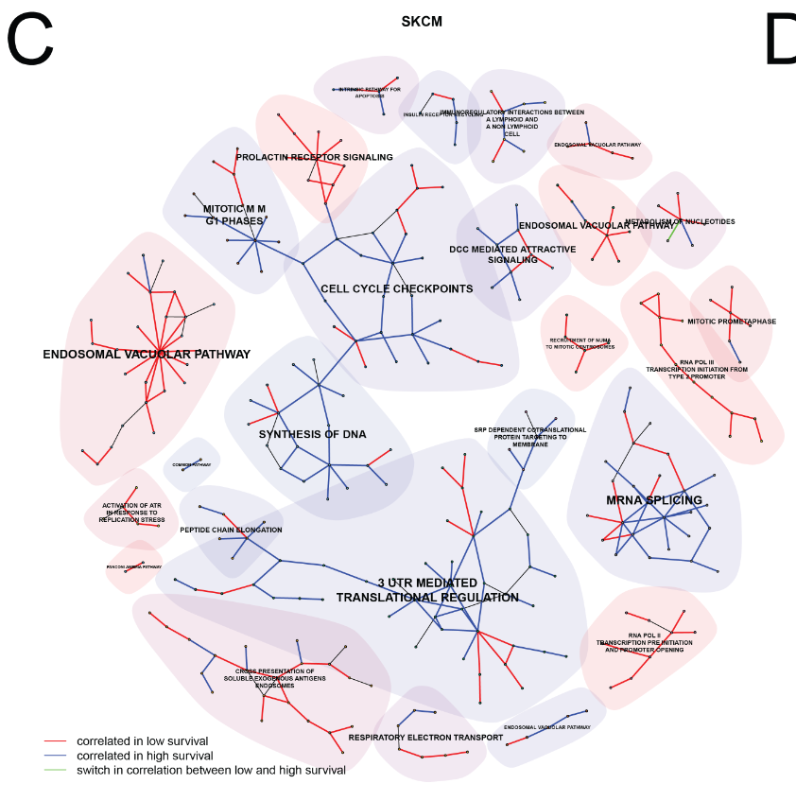
gene pairs

Slide 25



Evaluation: Comparison with other approaches
Differential correlation (Fisher’s Z-transform)
Linear model with interaction effect.
Assess using known cancer genes list

Slide 26
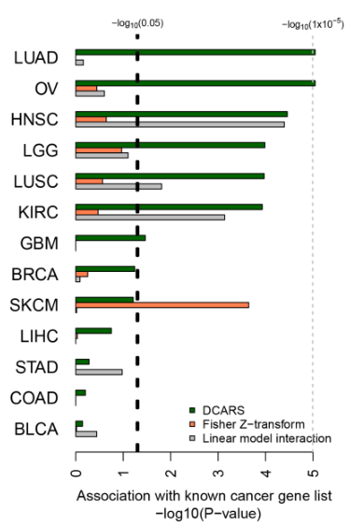
Enrichment of “known” cancer genes

Slide 27
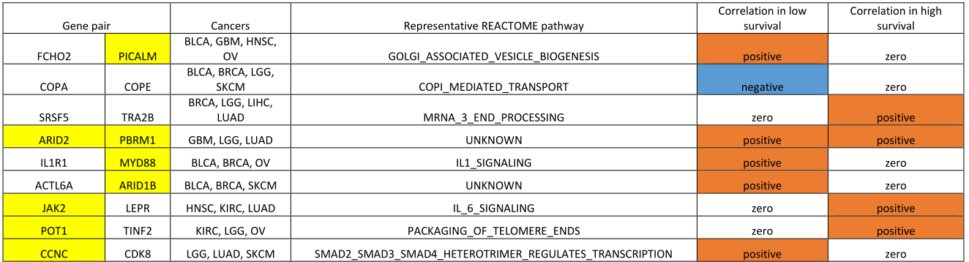
Comparisons across multiple cancers

Slide 28
Further application: Single-cell RNA-Seq

Slide 29
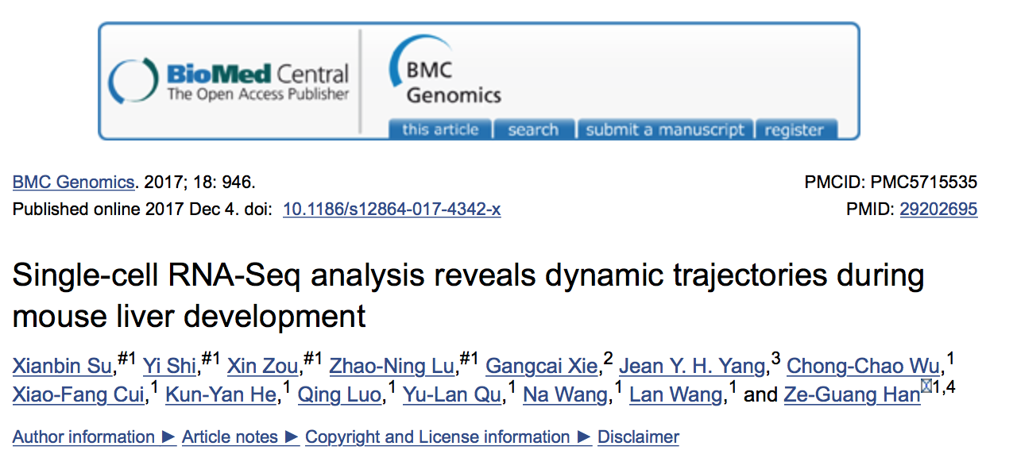
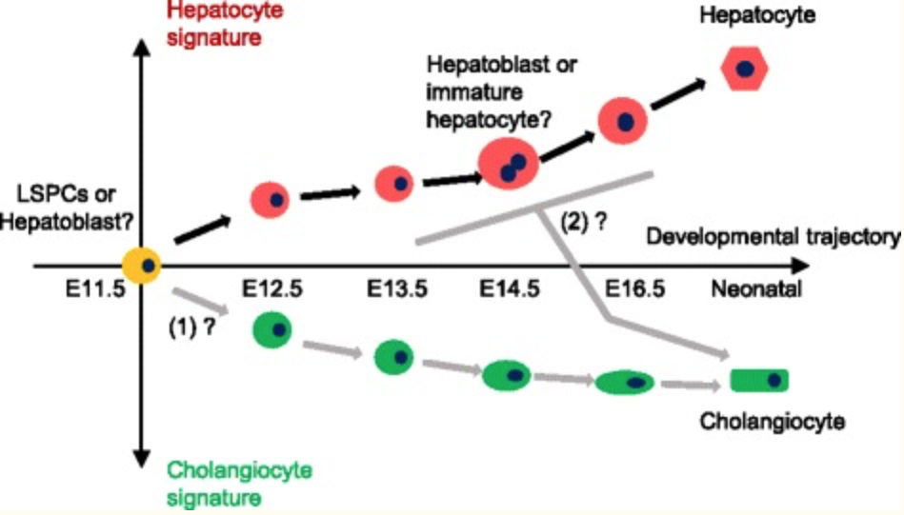
Motivation: Fetal liver development

Slide 30
Motivation: Fetal liver development
Developmental time
E9.5
E10.5
E11.5
E12.5
E13.5
E14.5
E15.5
E16.5
E17.5
GSE87795
Su et al.
N = 389
GSE90047
Li et al.
N = 448
GSE87038 Dong et al.
N = 320
GSE96981 Camp et al.
N = 79

Slide 31

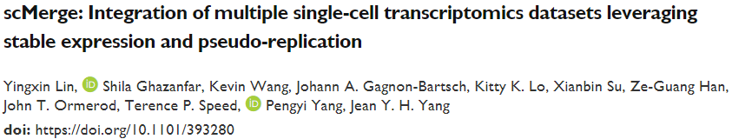

Slide 32
Results: liver datasets – tSNE
LSPCs/Hepatoblast
E10.5
Cholangiocyte
E17.5
Hepatocyte
E17.5

Slide 33
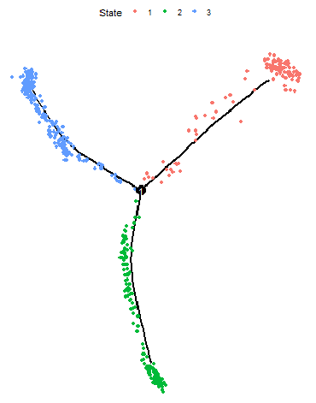
Differential correlation across pseudotime
Hepatocyte
Cholangiocyte
Cell trajectory as estimated
using Monocle 2
Hepatoblast

Slide 34

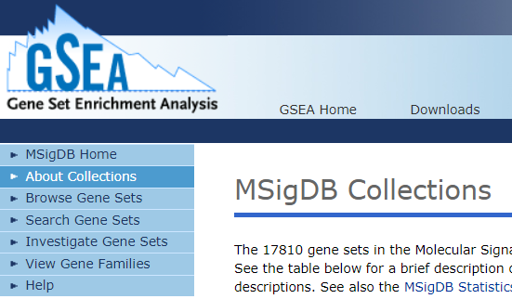
Scaffolding network for DCARS testing
11748 gene pairs tested
1994 genes
FDR < 0.1 | Cholangiocyte | Hepatocyte
Number of gene pairs | 434 | 98
Number of genes | 448 | 147

Slide 35
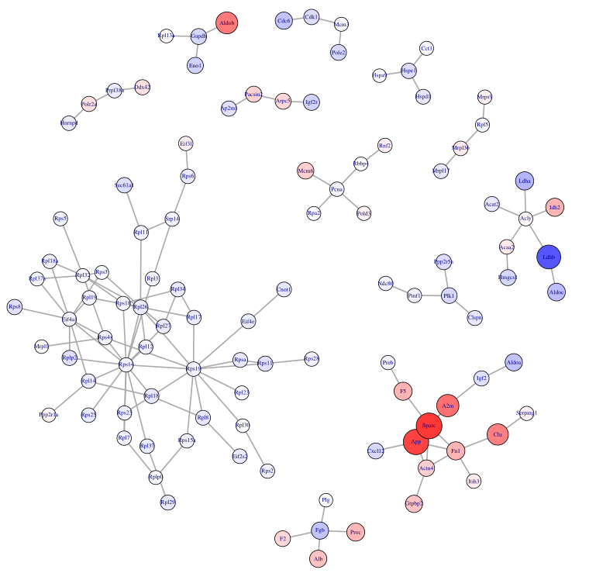
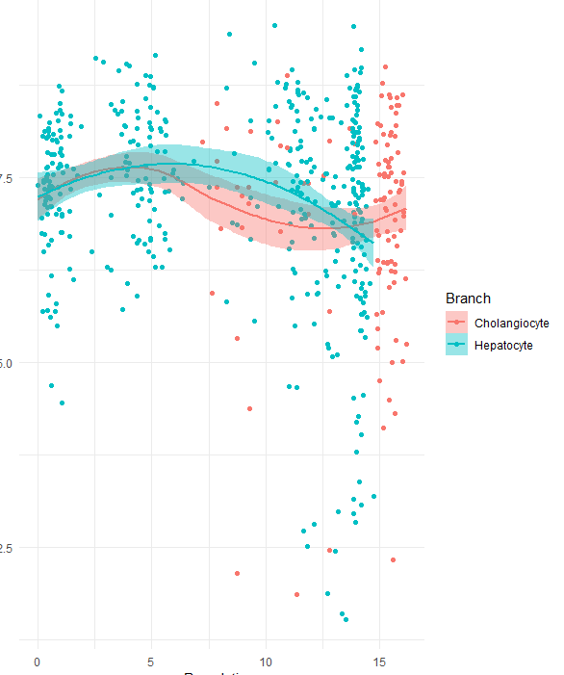
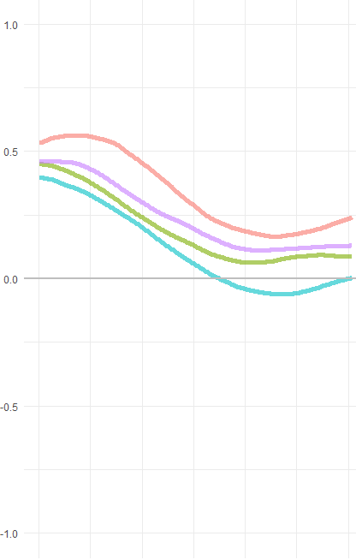
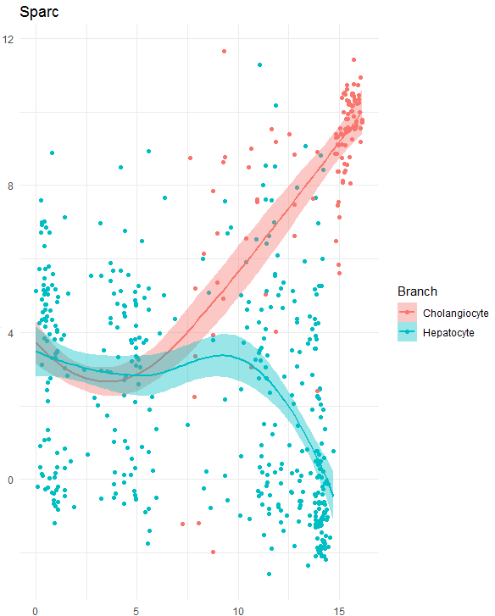
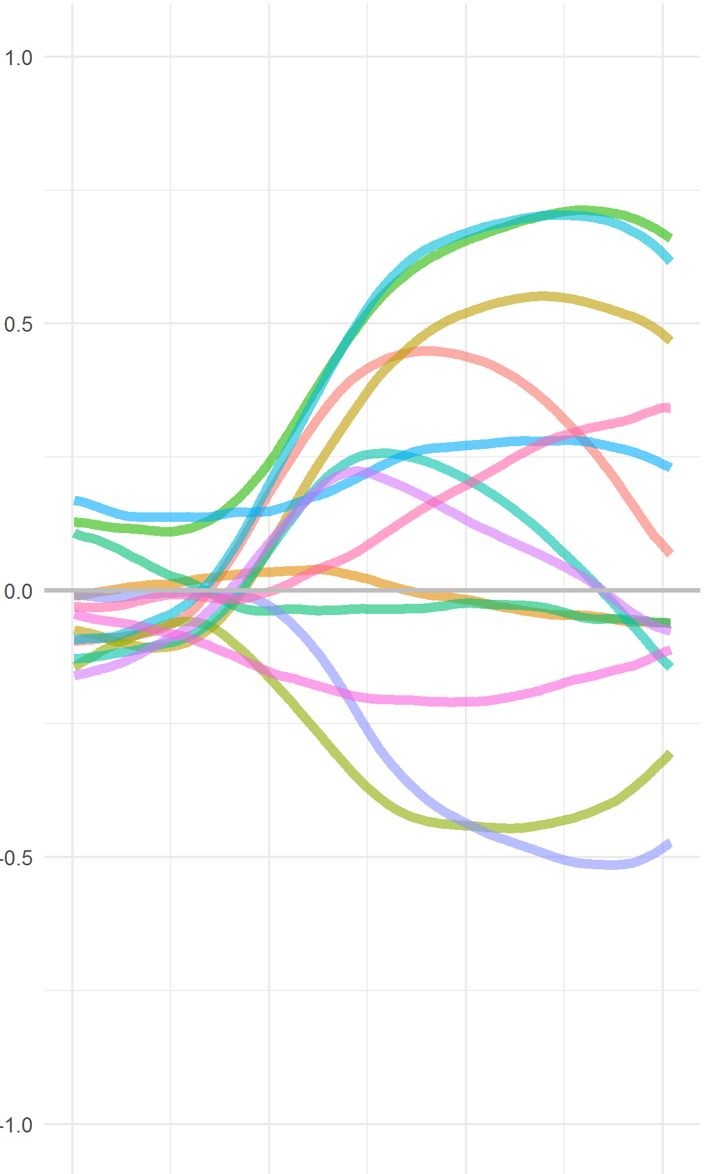
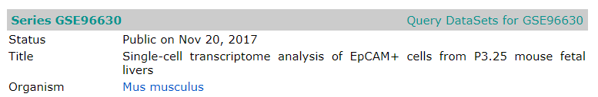
Cholangiocyte gene pairs
Pcna
Subnetworks with 4 or more nodes
Sparc
Expression
weighted correlation
Differential expression in gene
Pseudotime
Pseudotime

Slide 36
Summary
Developed approach for identifying differential correlation across ranked samples.
Applied to cancer survival and lineage trajectories.
Extended by
  Using non-linear censored regression.
  2D smoothing.

Slide 37



Acknowledgements
School of Mathematics and Statistics
Statistical Bioinformatics Group
Shila Ghazanfar
Dario Strbenac
John Ormerod
Jean Yang
Shanghai Jiaotong University
Zeguang Han
Xianbin Su
Xin Zou
Yi Shi

Slide 39
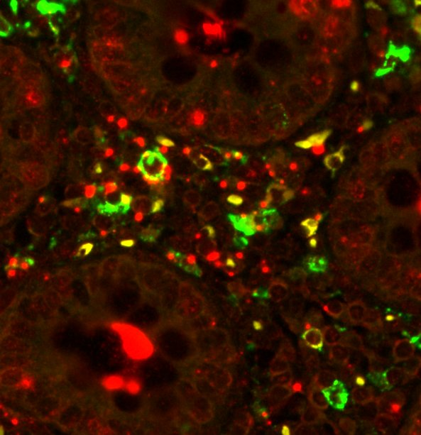
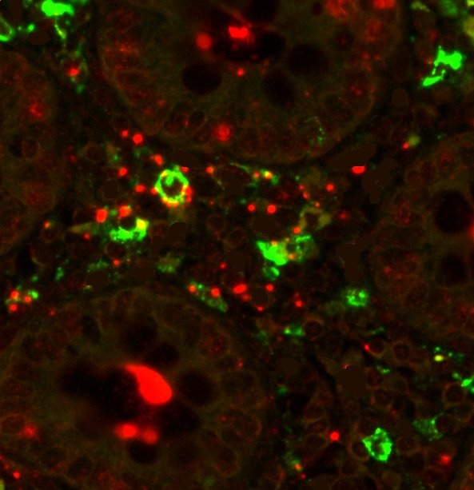
Autofluorescence Removal
CD11c HIV RNA
CD11c HIV RNA

Slide 41
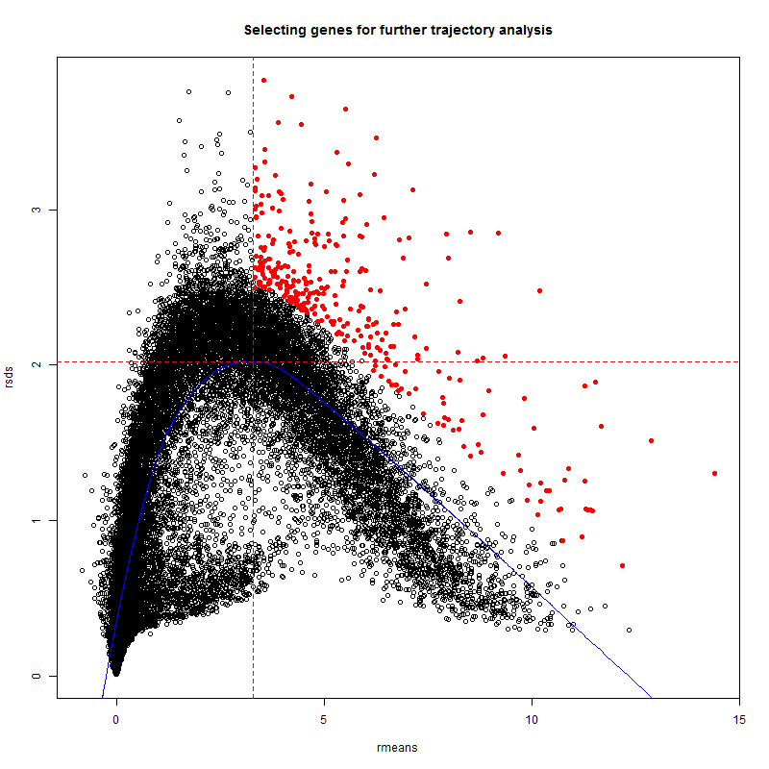

Slide 42
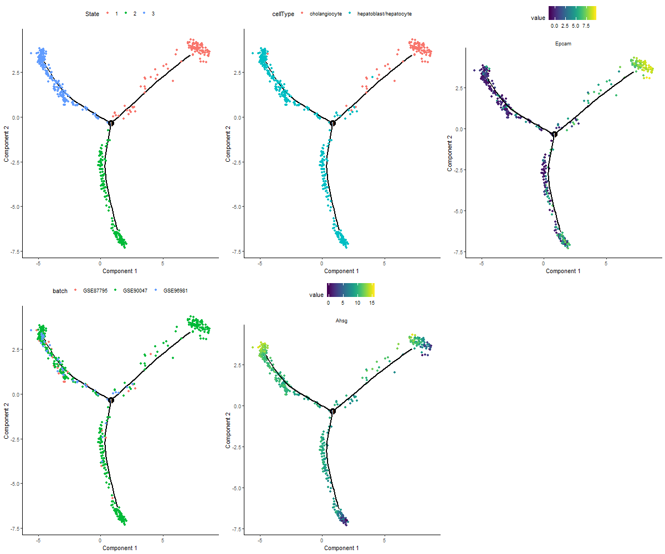

Slide 43
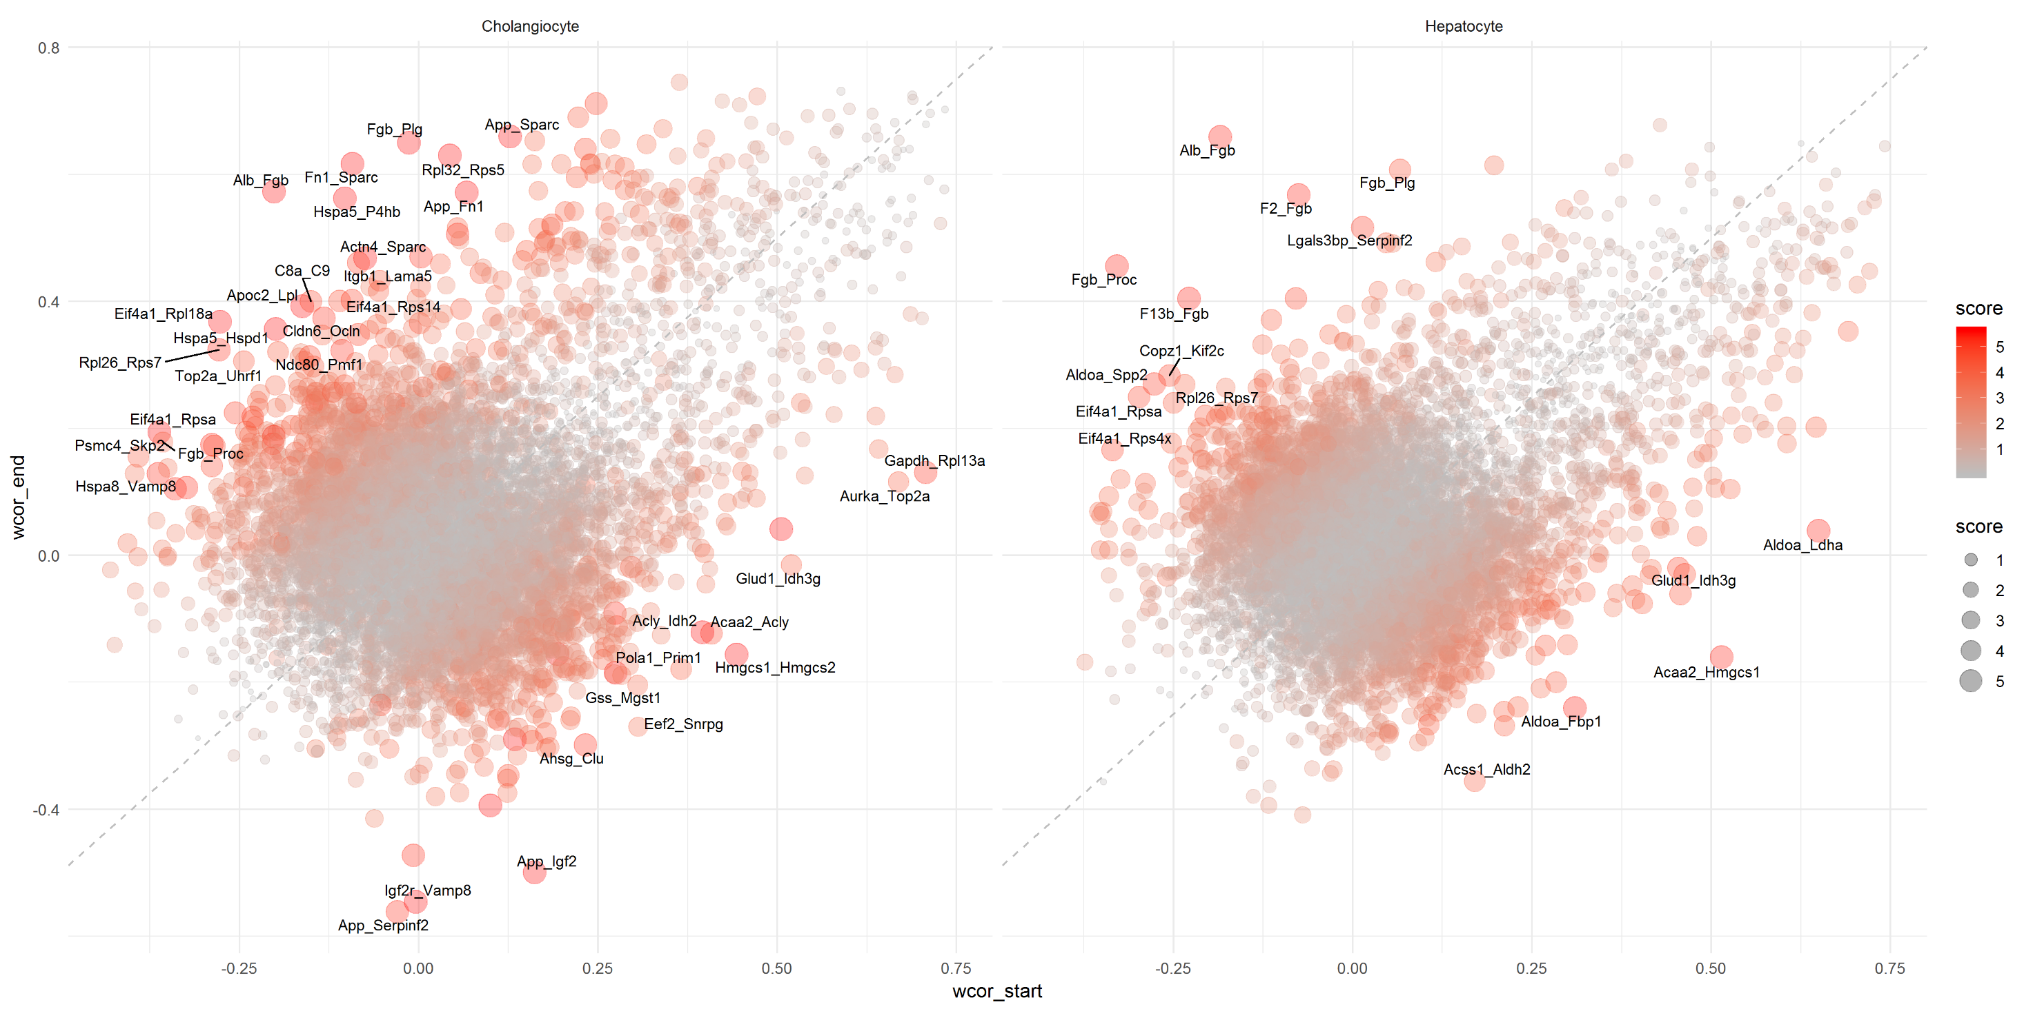

Slide 44
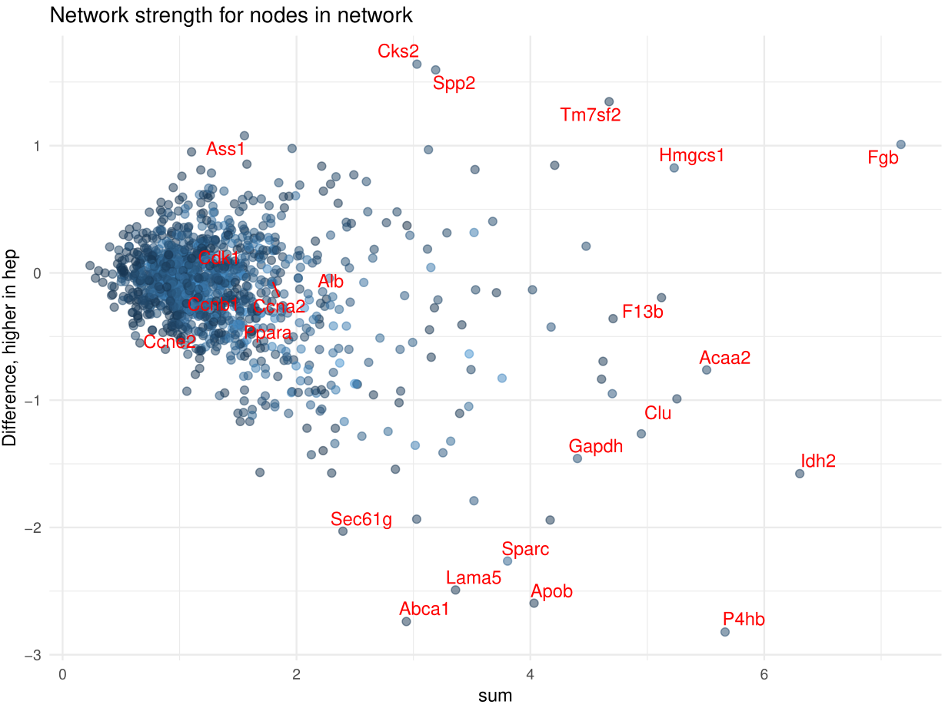

Slide 45
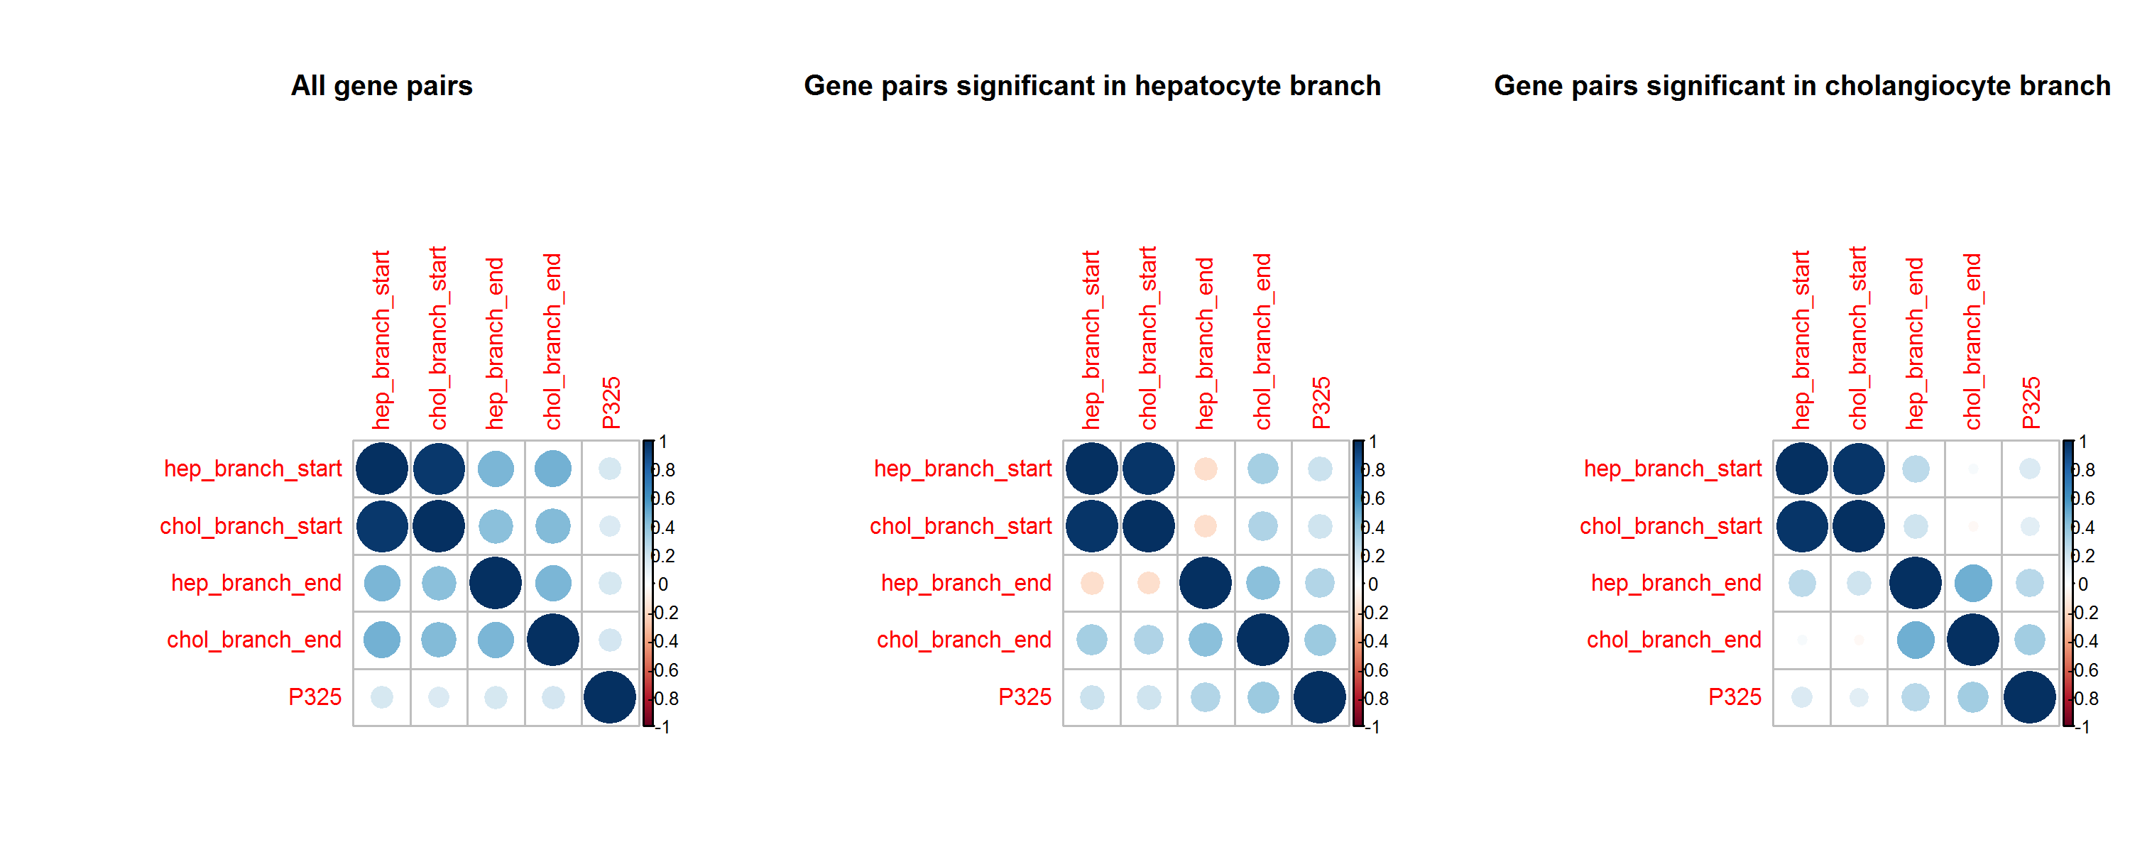

Slide 46
Speeding up permutation tests:
Determining critical values

Slide 47
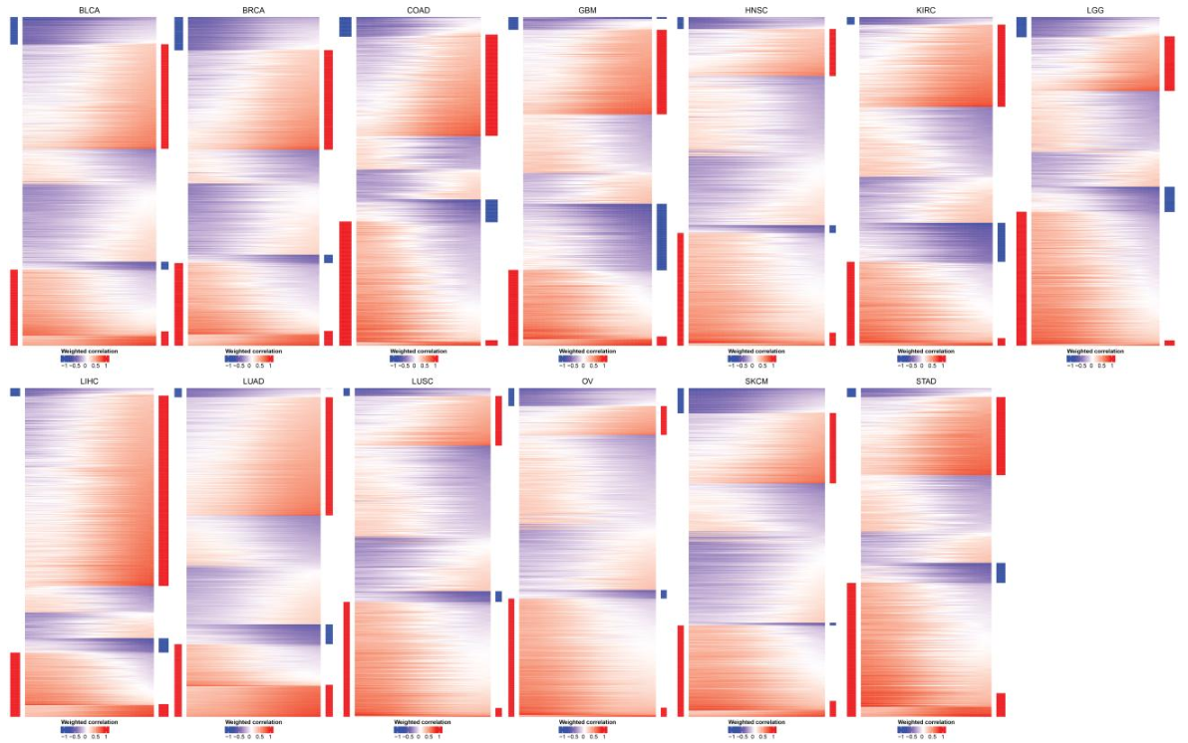
Weighted correlation vectors for 13 cancers

Slide 48
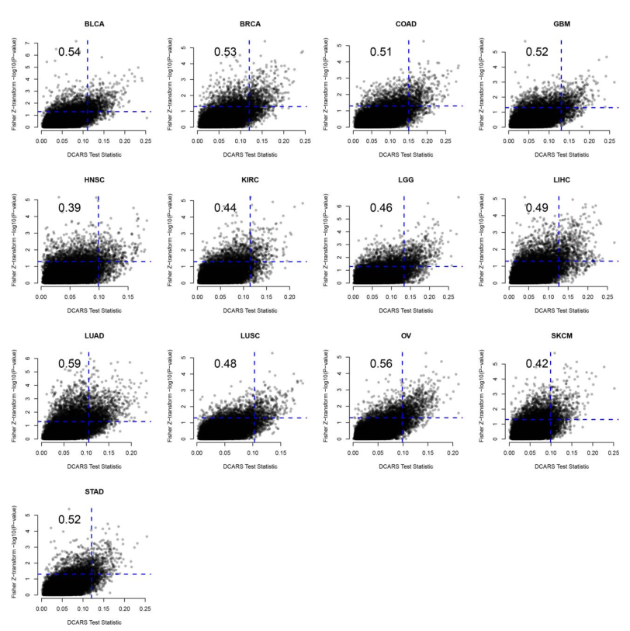
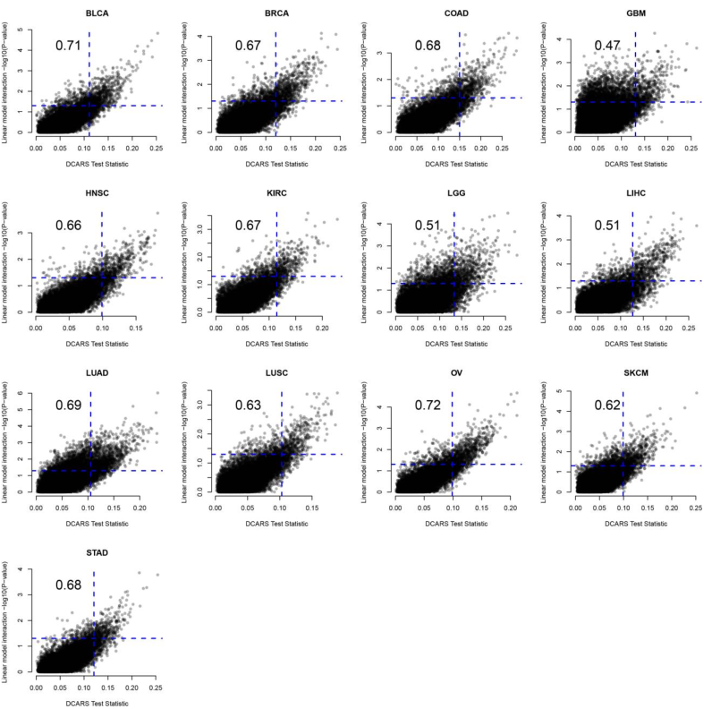
Concordance of DCARS among other methods
Fisher Z-transformation test
Linear model interaction term

Slide 49
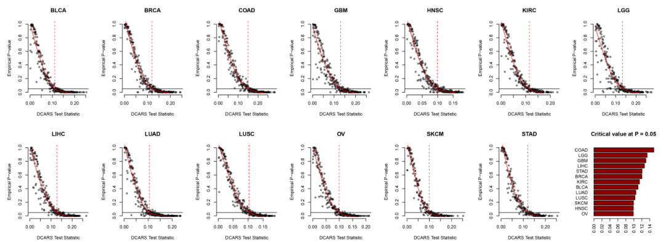
Calculating critical values using permutation on stratified sampled gene pairs

Slide 50
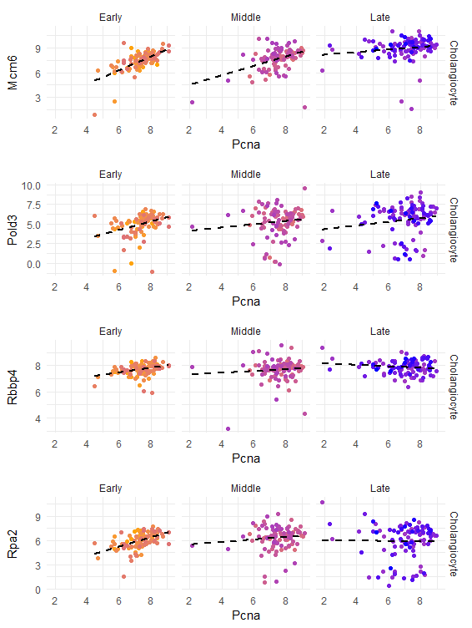
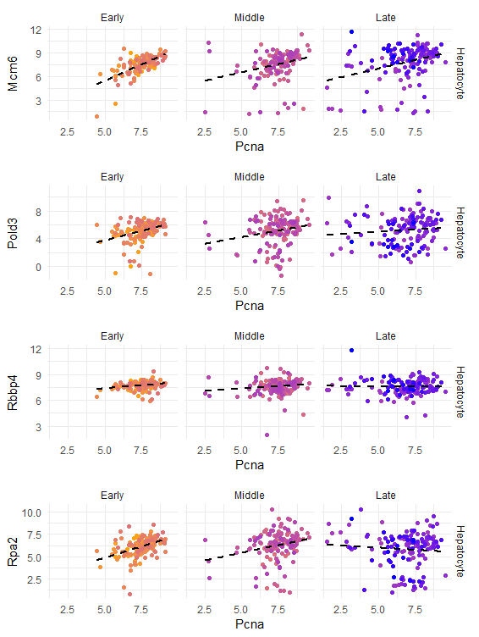
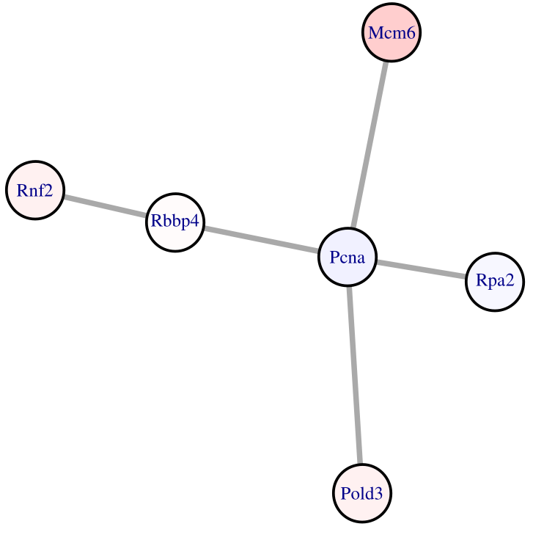
Pcna: DNA replication, mismatch repair

