Slide 1
Detection of de novo copy number deletions
from targeted sequencing of trios
Ingo Ruczinski
Johns Hopkins Bloomberg School of Public Health
Joint work with Jack Fu and Rob Scharpf

Slide 2
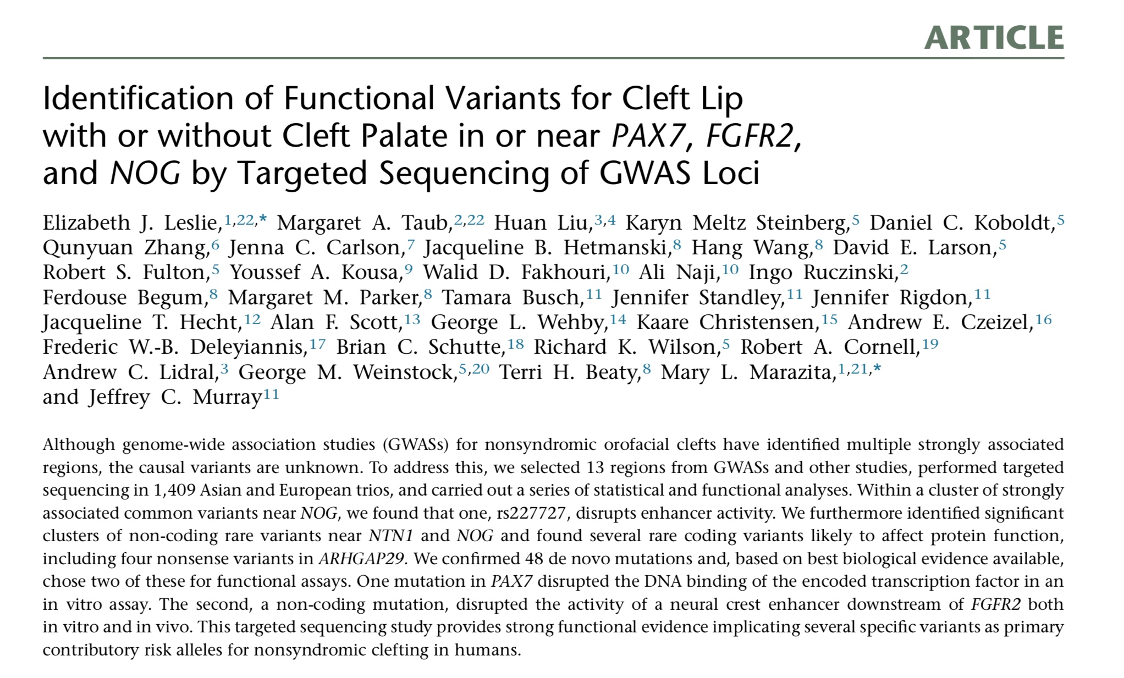
PMID 25704602

Slide 3
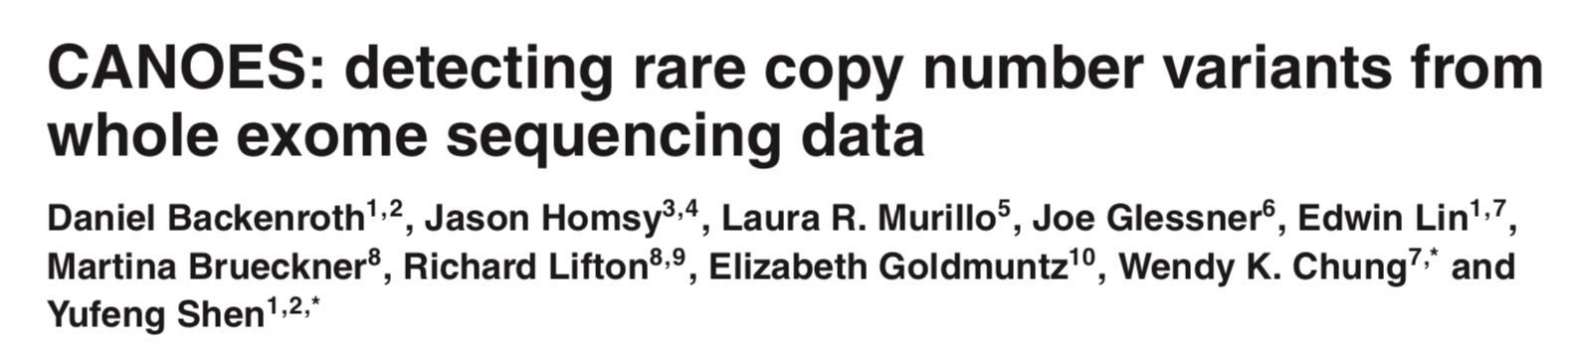
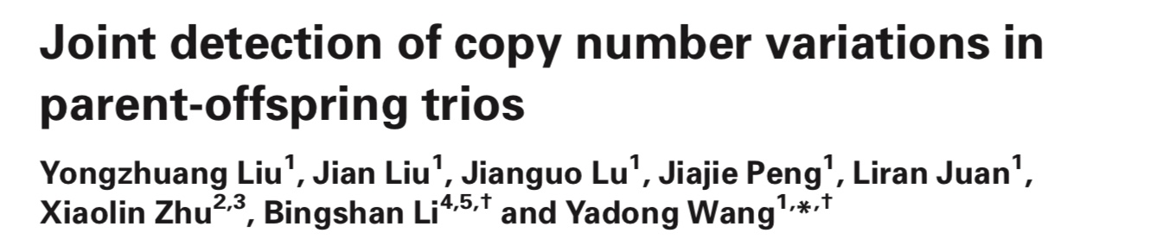

Slide 4
PMID 30084993

Slide 5
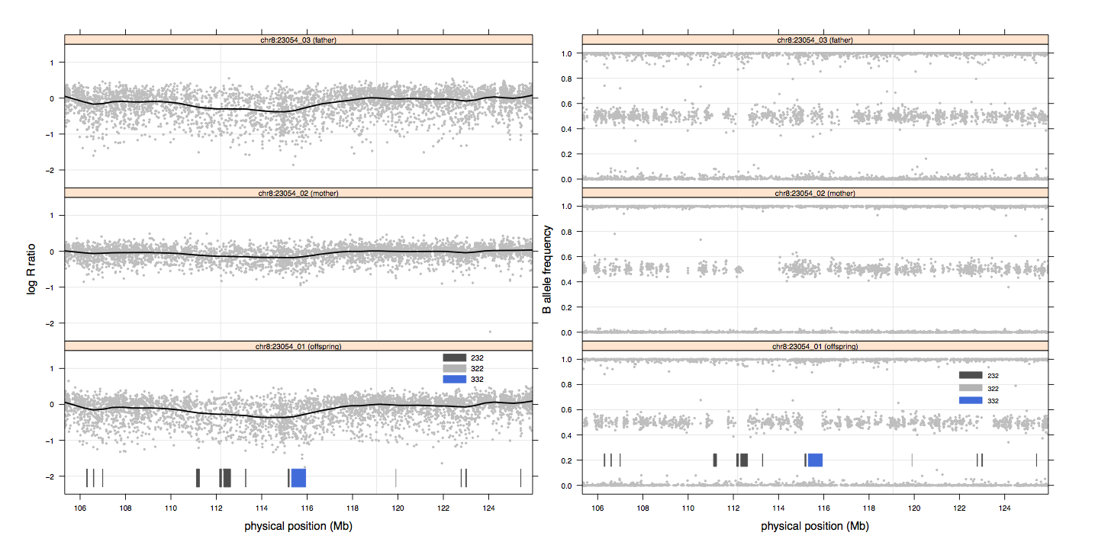
PMID 23234608

Slide 6
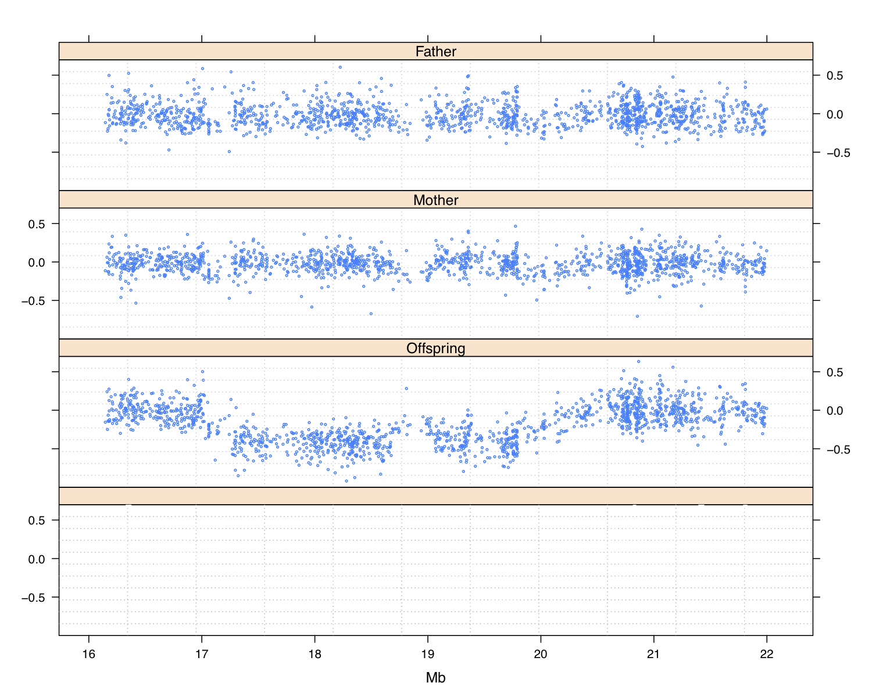

Slide 7
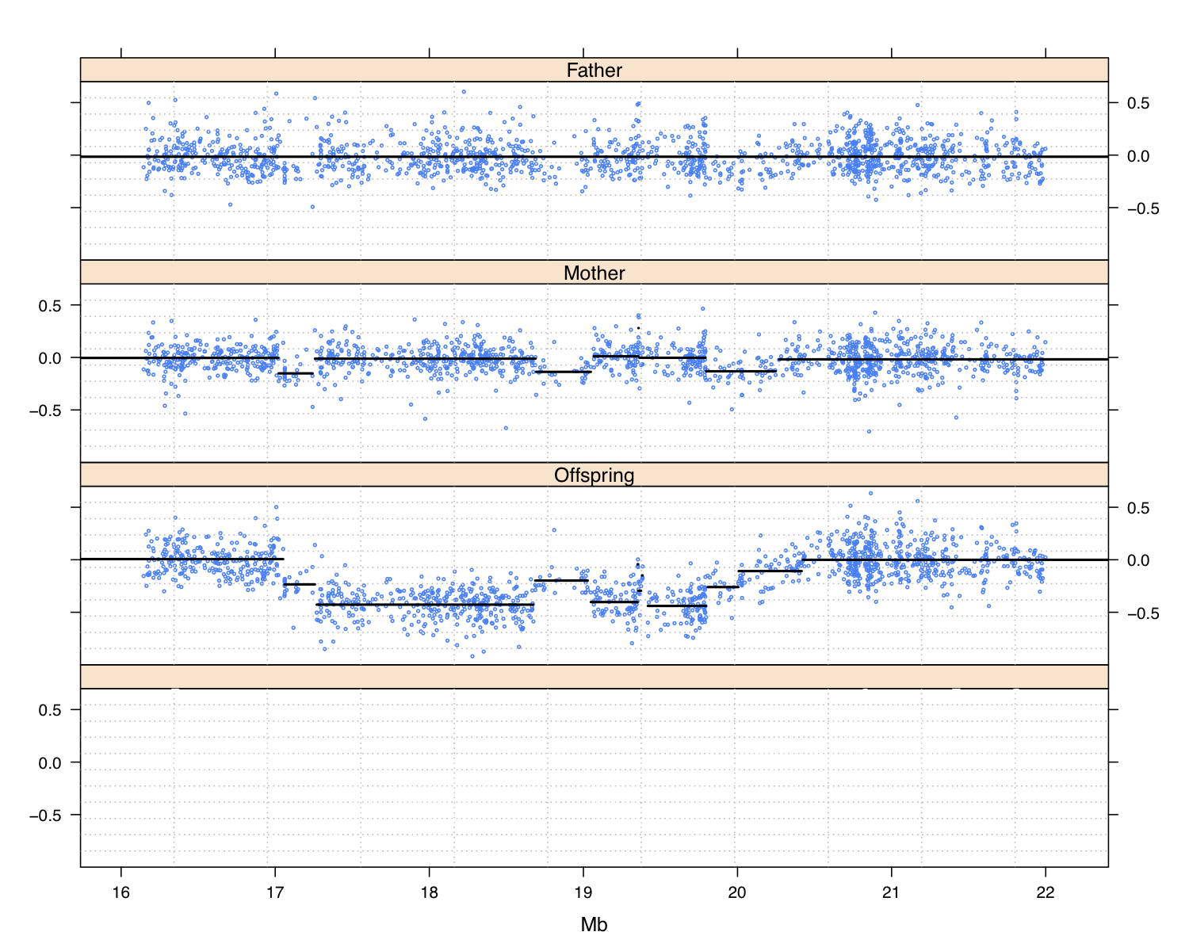

Slide 8
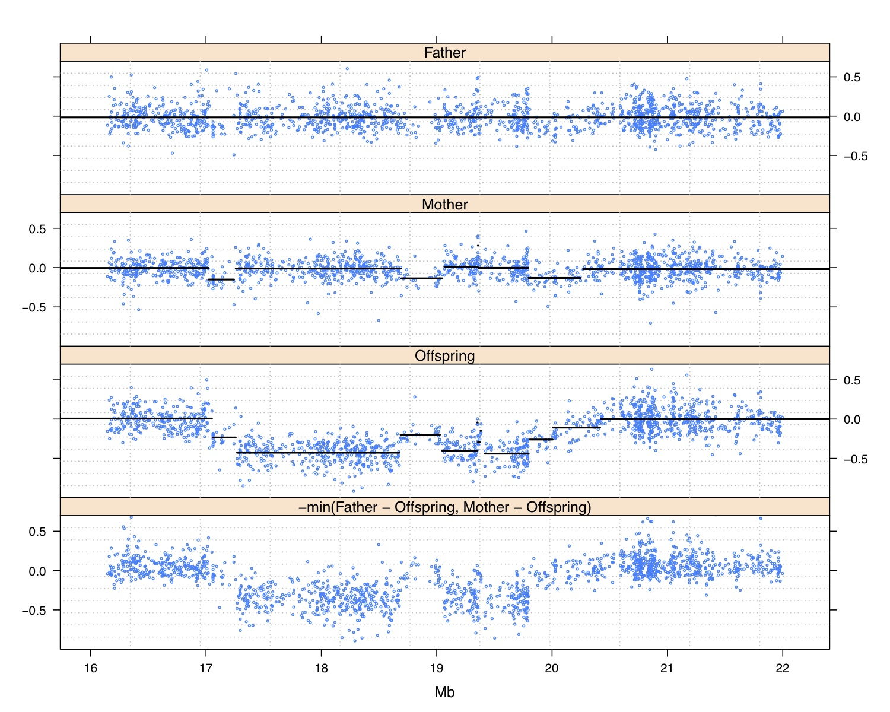

Slide 9
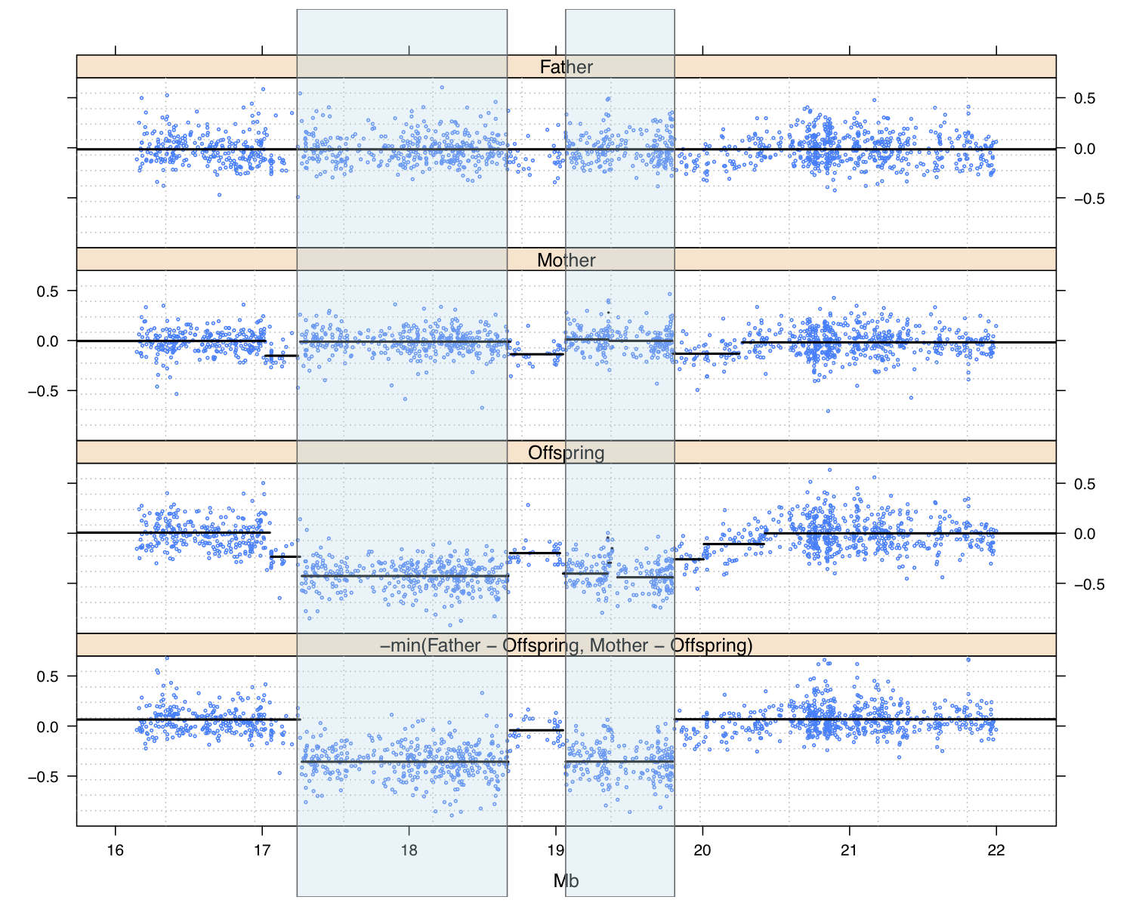

Slide 10
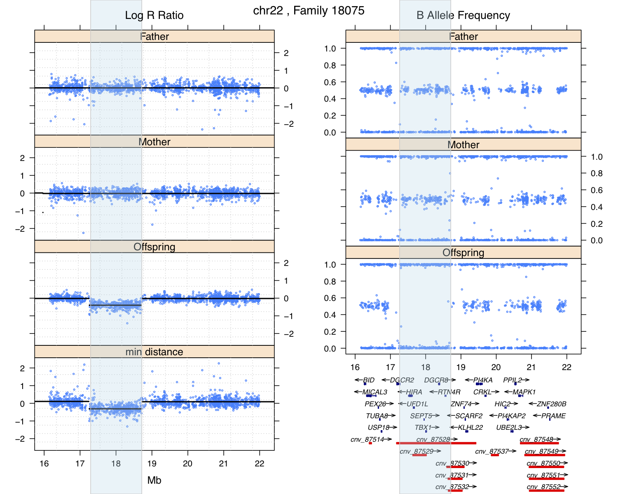

Slide 11
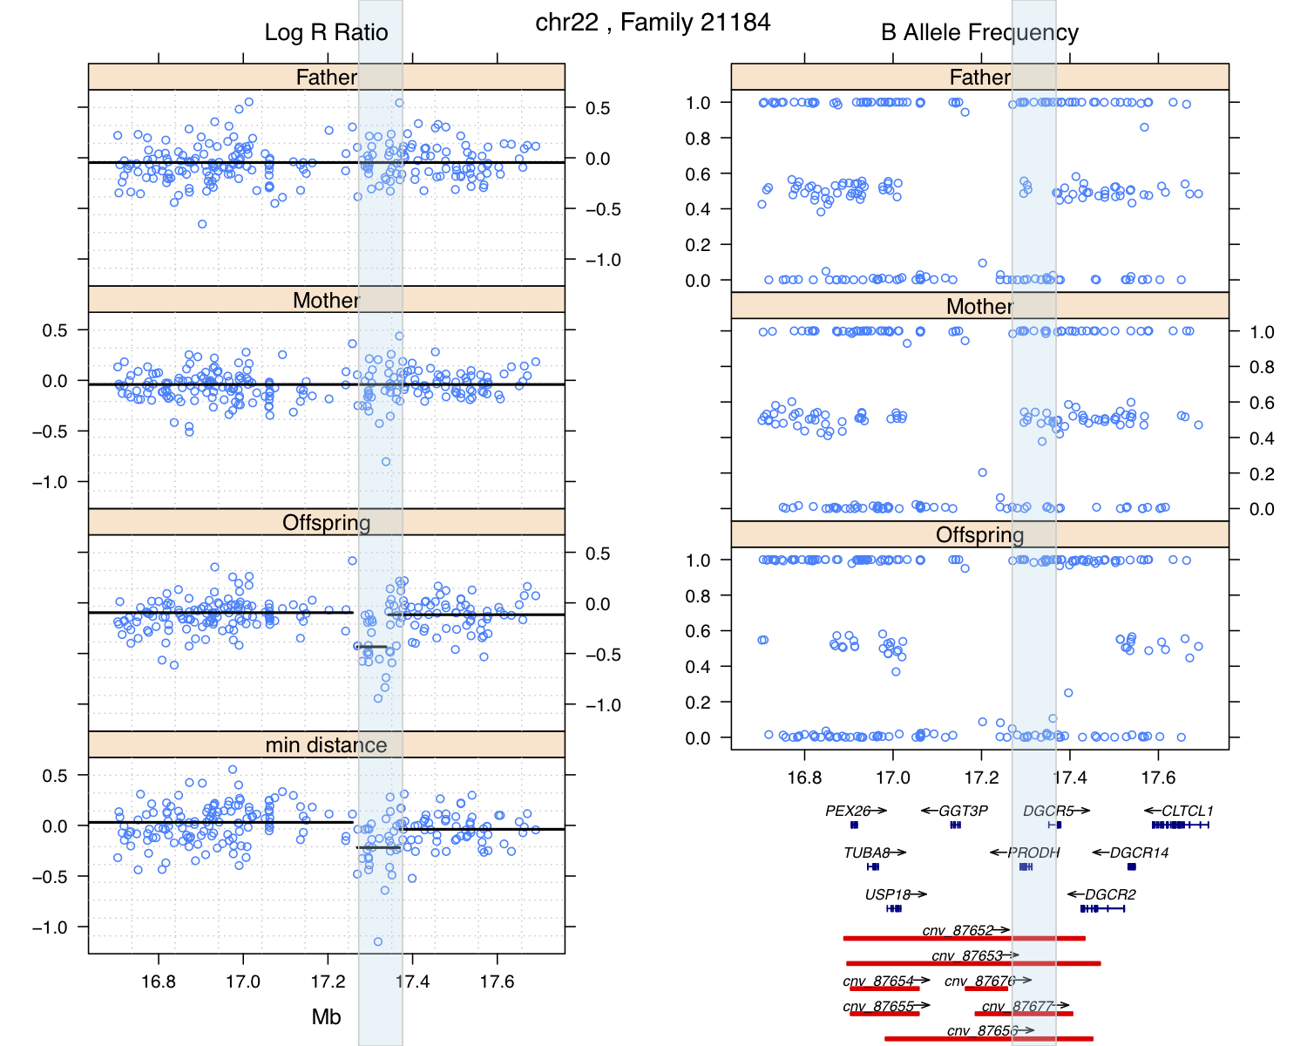

Slide 12
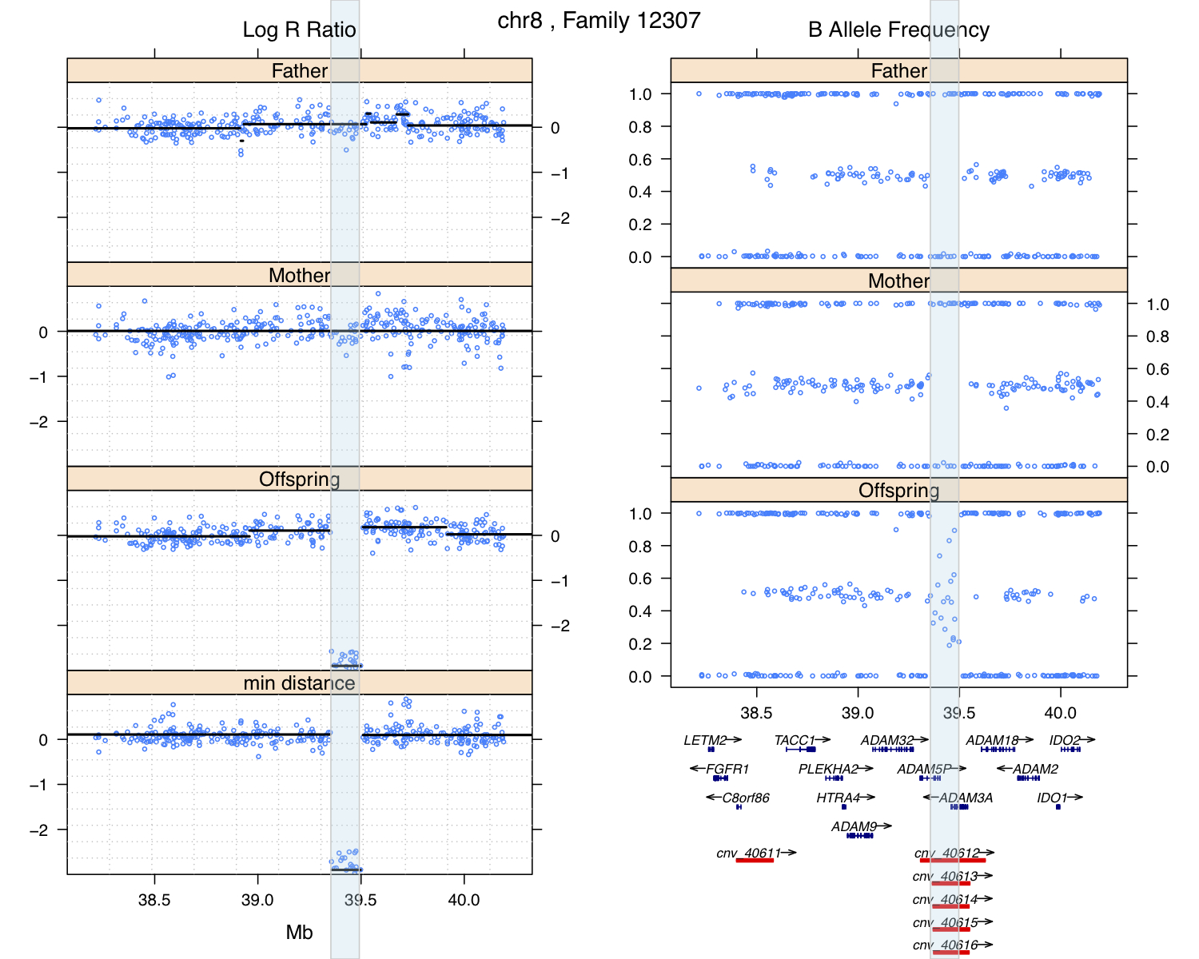

Slide 13
PMID 23234608

Slide 14
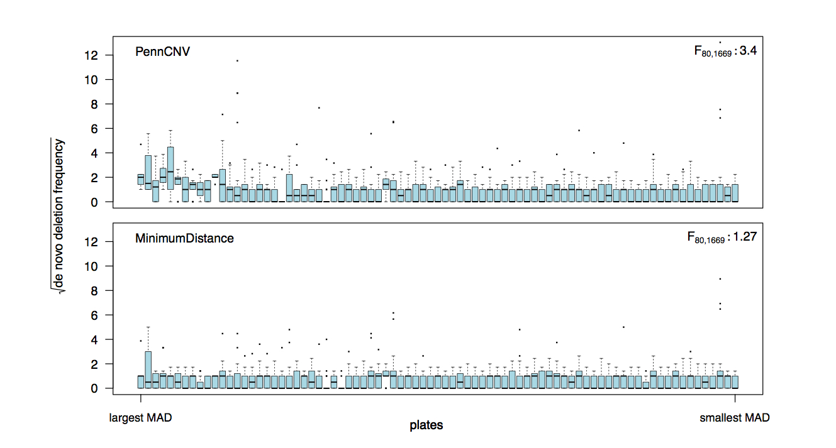
PMID 23234608

Slide 15
PMID 30084993

Slide 16
PMID 30084993

Slide 17
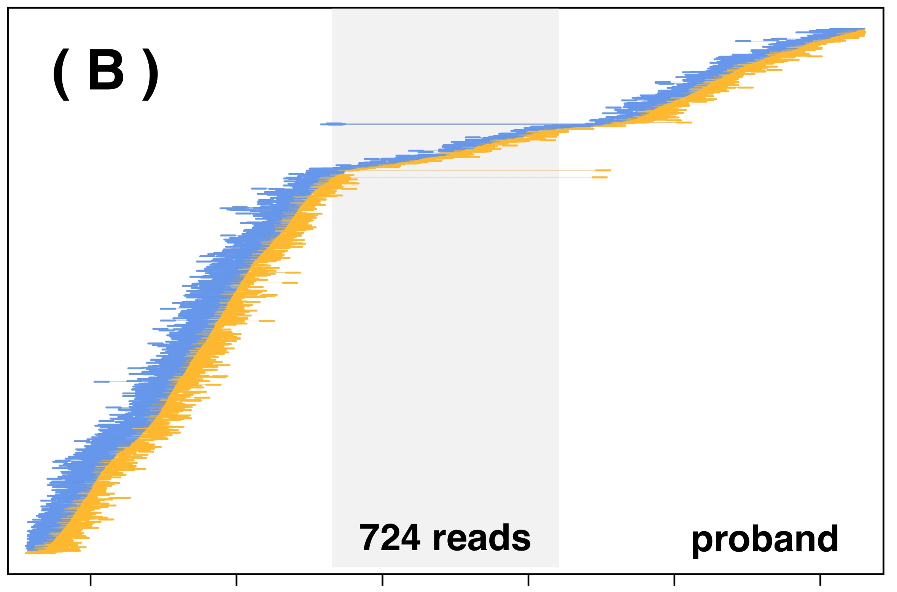
PMID 30084993

Slide 18
PMID 30084993

Slide 19
PMID 30084993

Slide 20
PMID 30084993

Slide 21
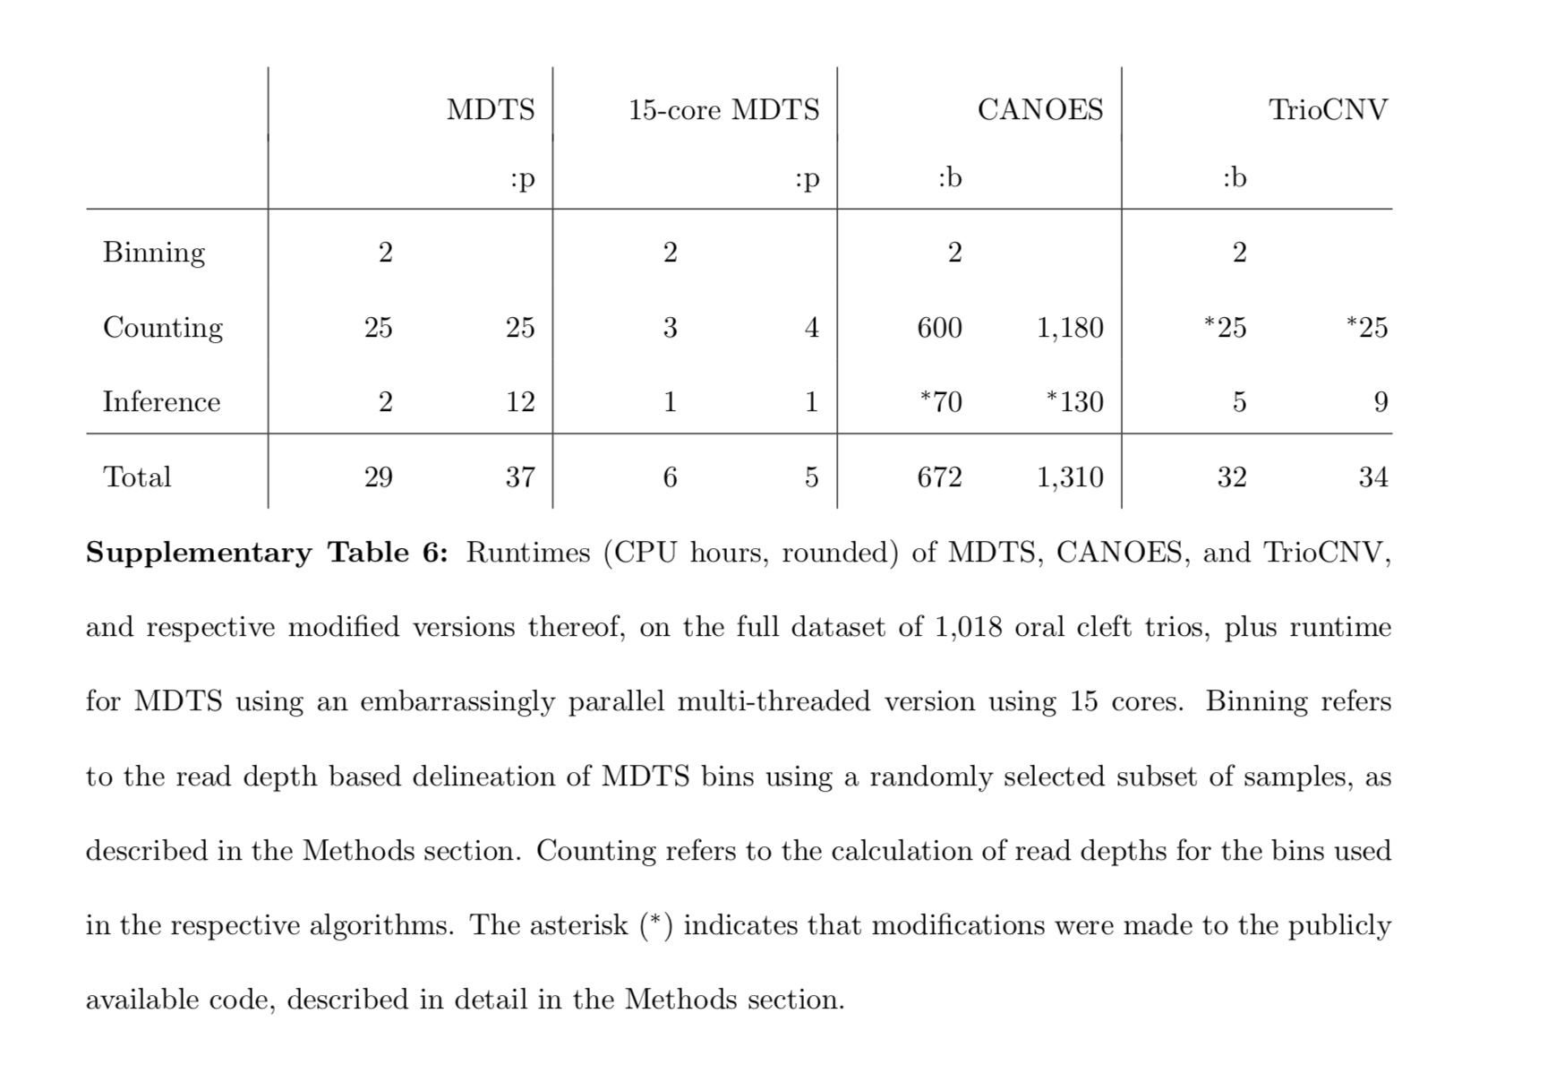

Slide 22
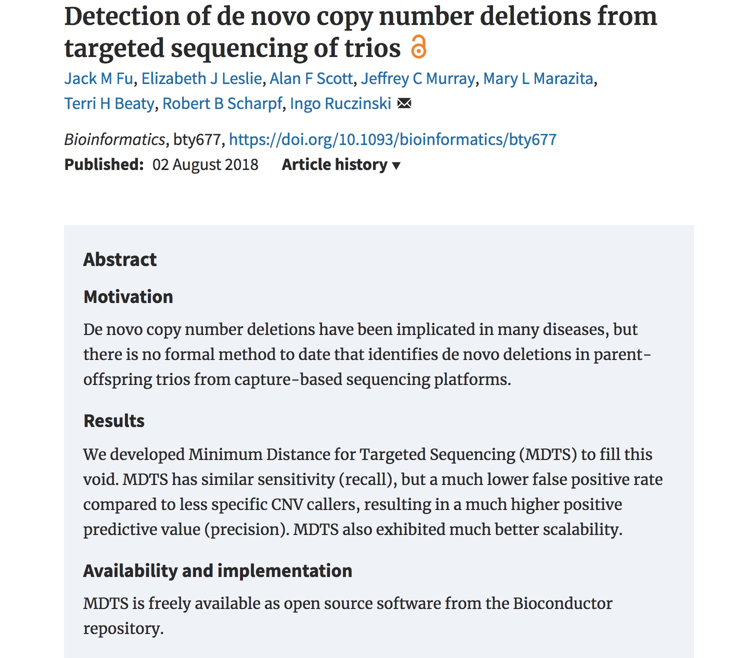
PMID 30084993

Slide 23
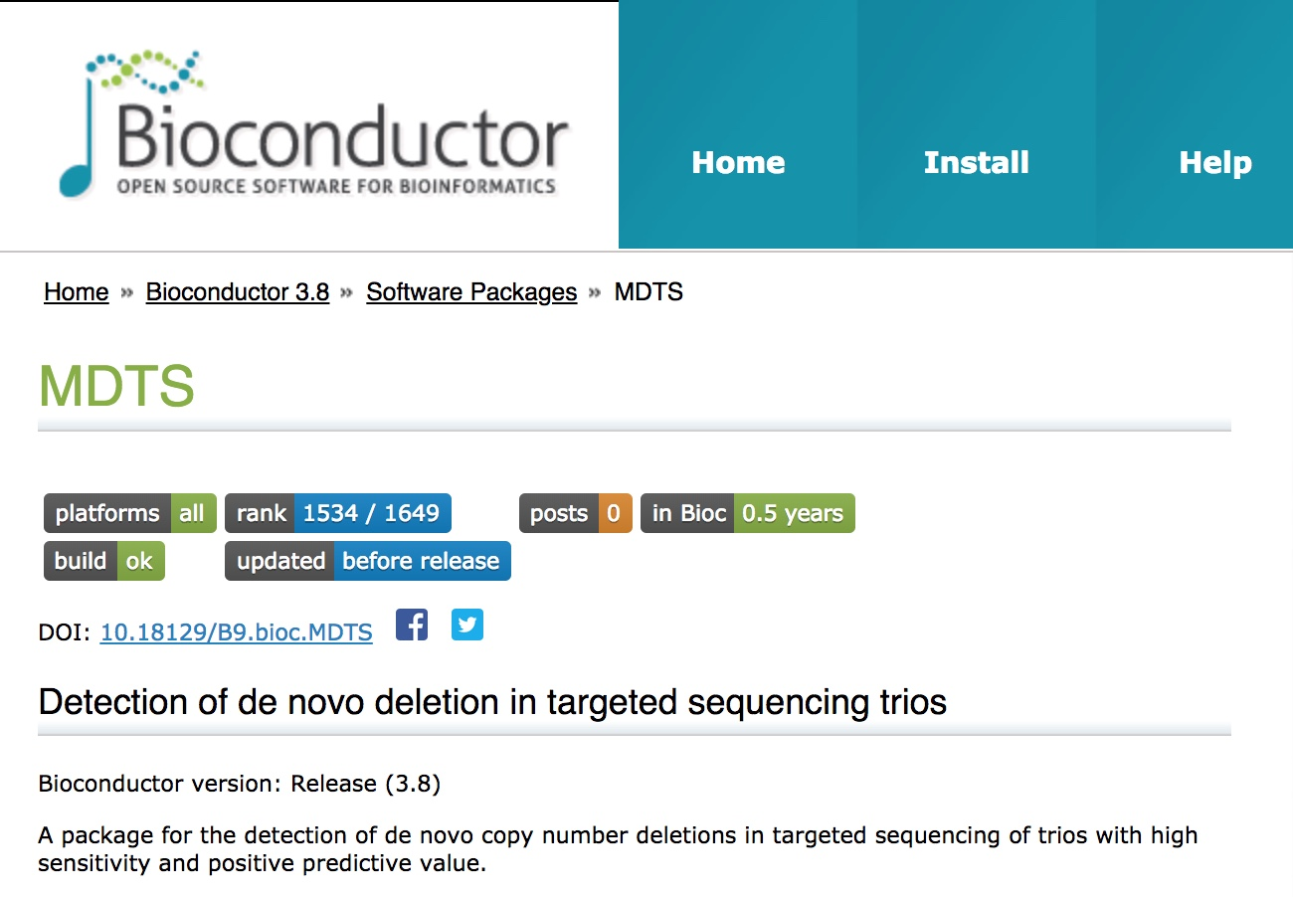
https://bioconductor.org/packages/release/bioc/html/MDTS.html

