Slide 1
Statistical approach for investigating change in mutational process during cancer growth and development
Kim Siegmund
kims@usc.edu
November 8, 2018
BIRS-CMO 2018

Slide 2
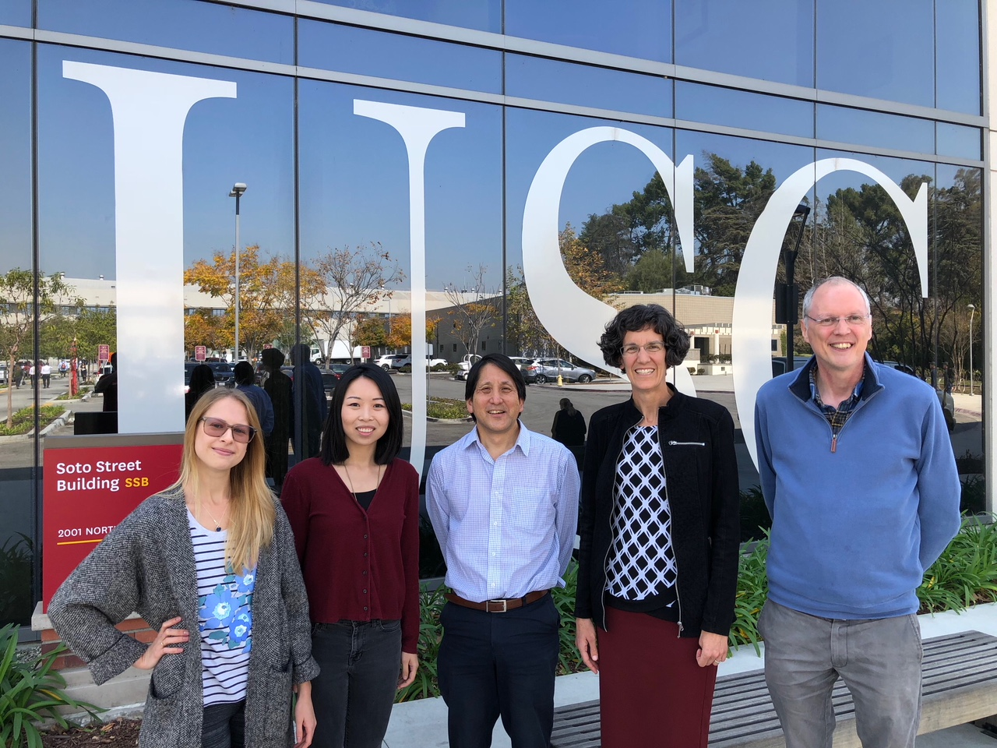

Acknowledgements
Priyatama Pandey
David Conti
(not pictured)
Natalia Zhi Darryl Kim Paul
Zemlanskaia Yang* Shibata Siegmund Marjoram

Slide 3
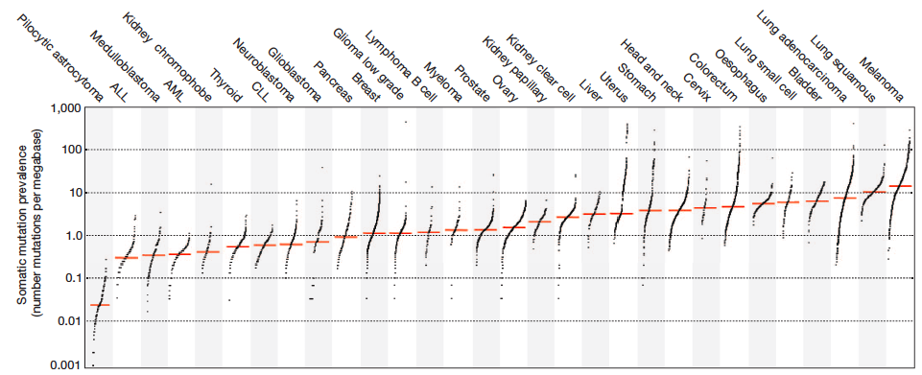
Somatic Mutation Frequencies by Cancer Type
Alexandrov et al.

Slide 4
Mutational Process
100%
0%
Time
Mutation
Catalog
Adapted from:
Alexandrov and Stratton
Curr Opin Genet Dev 2014, 24:52-60.
Key Question:: :Do new mutational processes arise at tumorigenesis?

Slide 5
Tumor Ancestry
Inferring clonal expansion …in CRC
-PNAS 2009
‘Big Bang’ growth model
-Nat Gen 2015
Spatial mutation patterns as markers of early cancer cell mobility
-PNAS 2018
Epigenetic heterogeneity reveals evidence of
Immune surveillance
- Sci Rep, accepted
Time (cell division)
Tumor
initiation
Tumor
Removal

Slide 6

Multi-Region Sequencing
Sample 1 Sample 2
Question:
Are the mutational signatures different in trunk and branch mutations?
Approach:
Hierarchical Latent Dirichlet Allocation model (HiLDA)
Distinguish
Trunk & Branch
mutations

Slide 7
Inferring Signatures from Catalogs
Signatures
# mutations
/signature
error
Fig 1B. Alexandrov et al. (2013) Cell Reports 3, 246-259

Slide 8
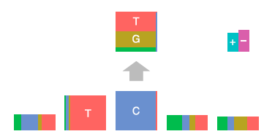
Mutation Signature Model
Shiraishi et al.
PLoS Genetics (2015)
Data (x)
D
signature
Features

Slide 9
Mutation Signature Model (cont.)
Latent Dirichlet Allocation
Shiraishi et al.
PLoS Genetics (2015)
Multinomial
probability
Missing
Data
Tumor
Signature
Mutation
Fit using
EM algorithm

Slide 10


Hierarchical LDA (HiLDA)
q₁ ~ Dir(p₁₁,…,p_{1K}, Φ₁)
q₂ ~ Dir(p₂₁,…,p_{2K}, Φ₂)

Slide 11




Bayes Model Selection
A model indicator variable $M$
Prior
Model odds
Model 1
$$H_{0}:p_{1s}=p_{2s}$$
$$q_{1}\sim Dir(p_{11},..,p_{1K})$$
$$q_{2}\sim Dir(p_{11},..,p_{1K})$$
$$\text{Model} 2$$
$$H_{A}:p_{1s}≠p_{2s}$$
$$q_{1}\sim Dir(p_{11},..,p_{1K})$$
$$q_{2}\sim Dir(p_{21},..,p_{2K})$$
Model 1
q₁ ~ Dir(p₁₁,…,p_{1K})
q₂ ~ Dir(p₂₁,…,p_{2K})
p_{1k} = p_{2k}, for all k
Model 2
q₁ ~ Dir(p₁₁,…,p_{1K})
q₂ ~ Dir(p₂₁,…,p_{2K})
p_{1k} ≠ p_{2k} for any k
Bayes
Factor
Posterior
Model odds
$$Obversed Data$$
Observed Data
Fit using MCMC (JAGS/R)

Slide 12
16 Colon Tumors
Side A Side B
Average 3.1 sSNVs/Mb
3 Whole Exomes/Patient:
2 tumor
1 adjacent normal

Slide 13
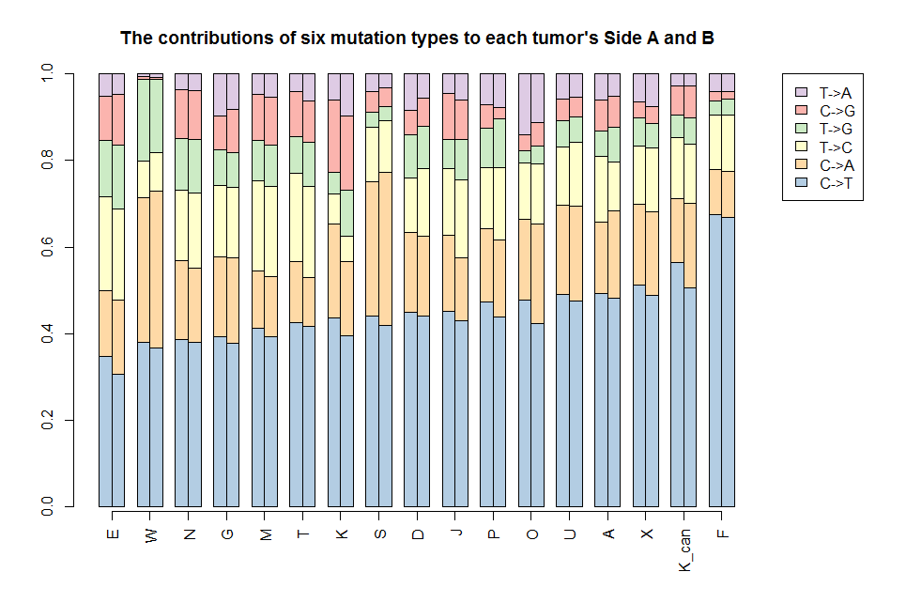
Somatic Mutations

Slide 14
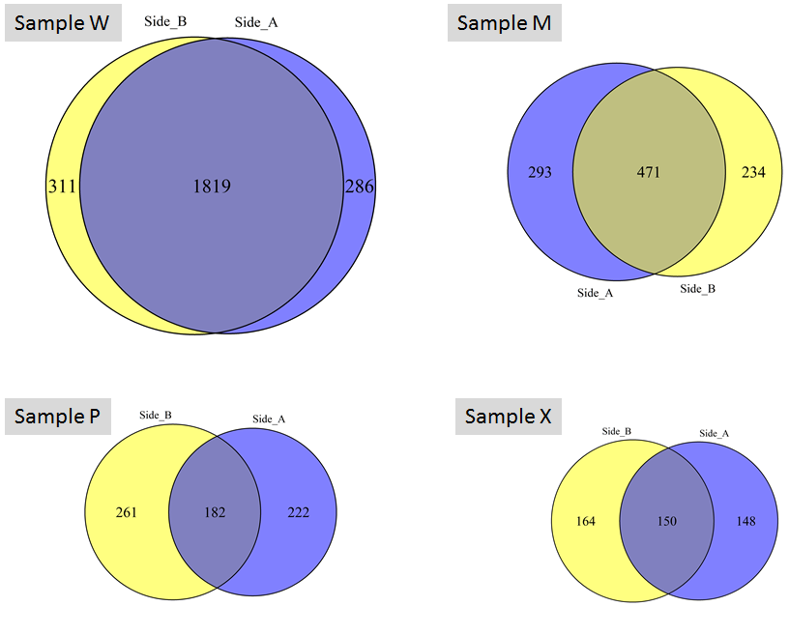
Classify Trunk & Branch Mutations
Sample W
Sample M
Public A
Public B
Private A
Private B
Trunk Branch
Sample P
Sample X

Slide 15
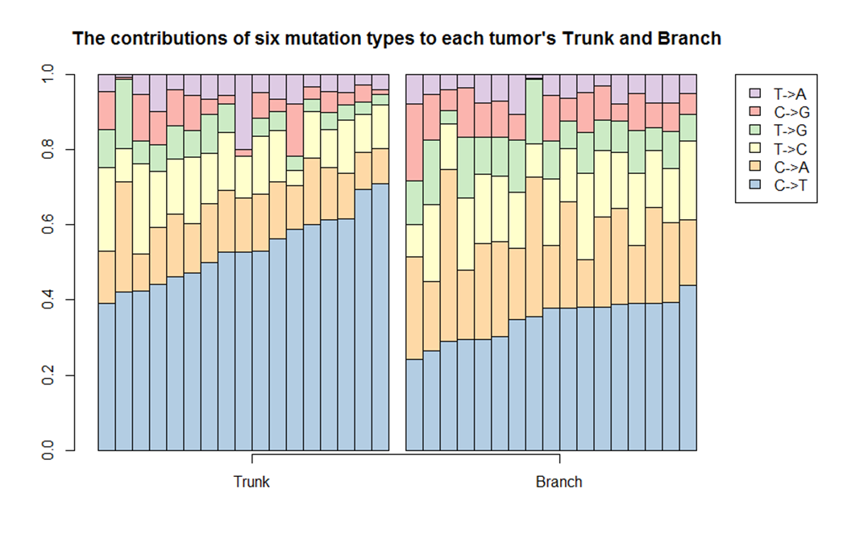
Do Mutational Signatures Differ Before and After Transformation?
Trunk Branch

Slide 16
Estimate Number of Signatures (5-mers)
Analyze 500 bootstrap samples
Cluster k signatures
Compute
  within cluster similarity
  KL divergence
Want high similarity
low divergence
KL Divergence Cosine Similarity
Pick K=2
2 3 4 5 6 7 8 9 10 11

Slide 17

2 Signatures: Side A & Side B
Aging
T
C G
Comment: Fractions from two tumor sides should be equal (Model 1)

Slide 18
2 Signatures: Side A & Side B
Fractional Multinomial
Logit Regression:
Signature | P_{A}-P_{B} | P-value
Aging | 0.006 | 0.85

Slide 19
2 Signatures: Side A & Side B
HiLDA:
95% CI = [0.07,0.11]
Strong evidence for Model 1
Mean Signature Fractions
are the same

Slide 20

2 Signatures: Trunk & Branch
T
Aging
C G
Question: Do fractions vary between Trunk & Branch? (Model 2)

Slide 21
2 Signatures: Trunk & Branch
Fractional Multinomial
Logit Regression:
Signature | P_{Br}-P_{Tr} | P-value
Aging | -0.25 | <0.001

Slide 22
2 Signatures: Trunk & Branch
HiLDA:
95% CI = [10,16]
Strong evidence for Model 2
Mean Signature Fractions
are different

Slide 23
Summary
We propose a 2-Group Latent Dirichlet Allocation model
Group-level estimates of signature ‘exposure’
Test for differences between mean signature exposures

Slide 24
Conclusions
Did not find new signatures during tumor growth
Did find the ‘aging’ signature was more frequent in trunk mutations (BF>14)

Slide 25

@USCBiostat is now hiring faculty and post-docs
LOS ANGELES, CA
kims@usc.edu

