Slide 1
Single cell whole genome sequencing for population genetic inference of cancer dynamics
Sohrab P. Shah
Chief, Computational Oncology
Memorial Sloan Kettering Cancer Center
New York, NY
Scientist
BC Cancer
Vancouver, BC

Slide 2
Disclosure
Shareholder and consultant for Contextual Genomics Inc

Slide 3
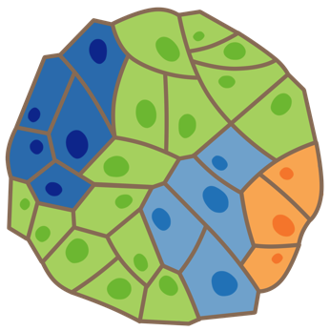
Cancer as a dynamic disease
Diagnosis
Post-treatment
Metastasis
What cell populations constitute a tumour?
Can we predict the trajectories of cell populations?
What is the behaviour of cell populations?
Phylogenetics
Fitness
Phenotype
The unit of selection is the cell.
What can we learn from single cell investigations?

Slide 4
Single cell tagmentation based WGS: Direct library prep
Heterogeneous cell populations
Single cell isolation and lysis
Direct library preparation
Minimal PCR and indexing
Indexed libraries pooled for sequencing
Copy number inference on low-coverage single cell genomes
Cluster analysis and genome pooling
SNV/breakpoint inference on high-coverage pools
Clonal lineage reconstruction
Hans Zahn, Adi Steif, Emma Laks, Shah, Aparicio, Hansen. Nature Methods 2017
Adi Steif
Emma Laks

Slide 5
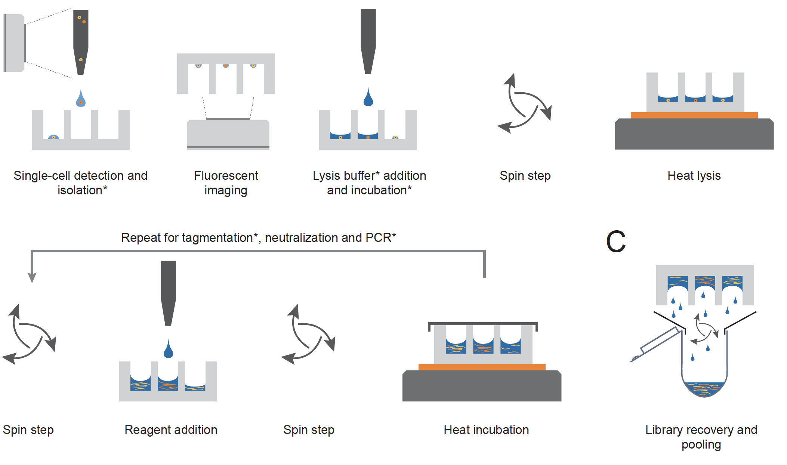
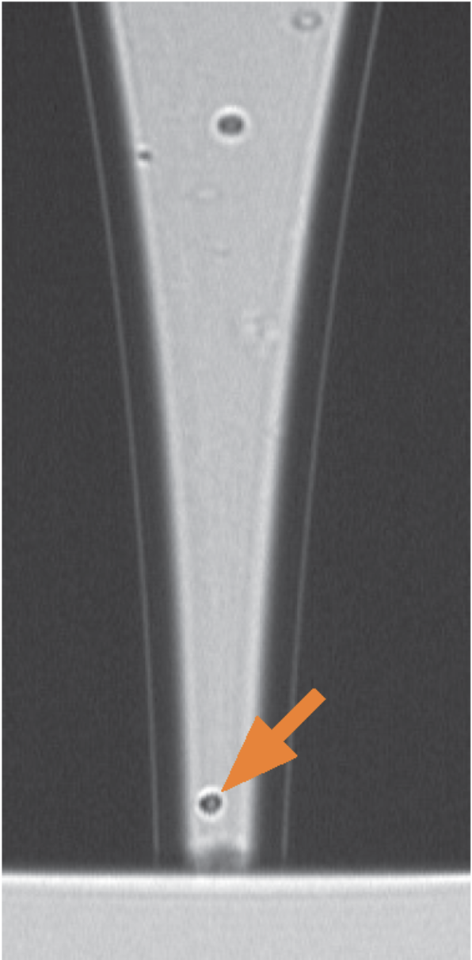
Open well platform scales to 1000s of cells per run
Laks, McPherson, Lai, Zahn, Steif, Shah, Aparicio
https://www.biorxiv.org/content/early/2018/09/06/411058

Slide 6
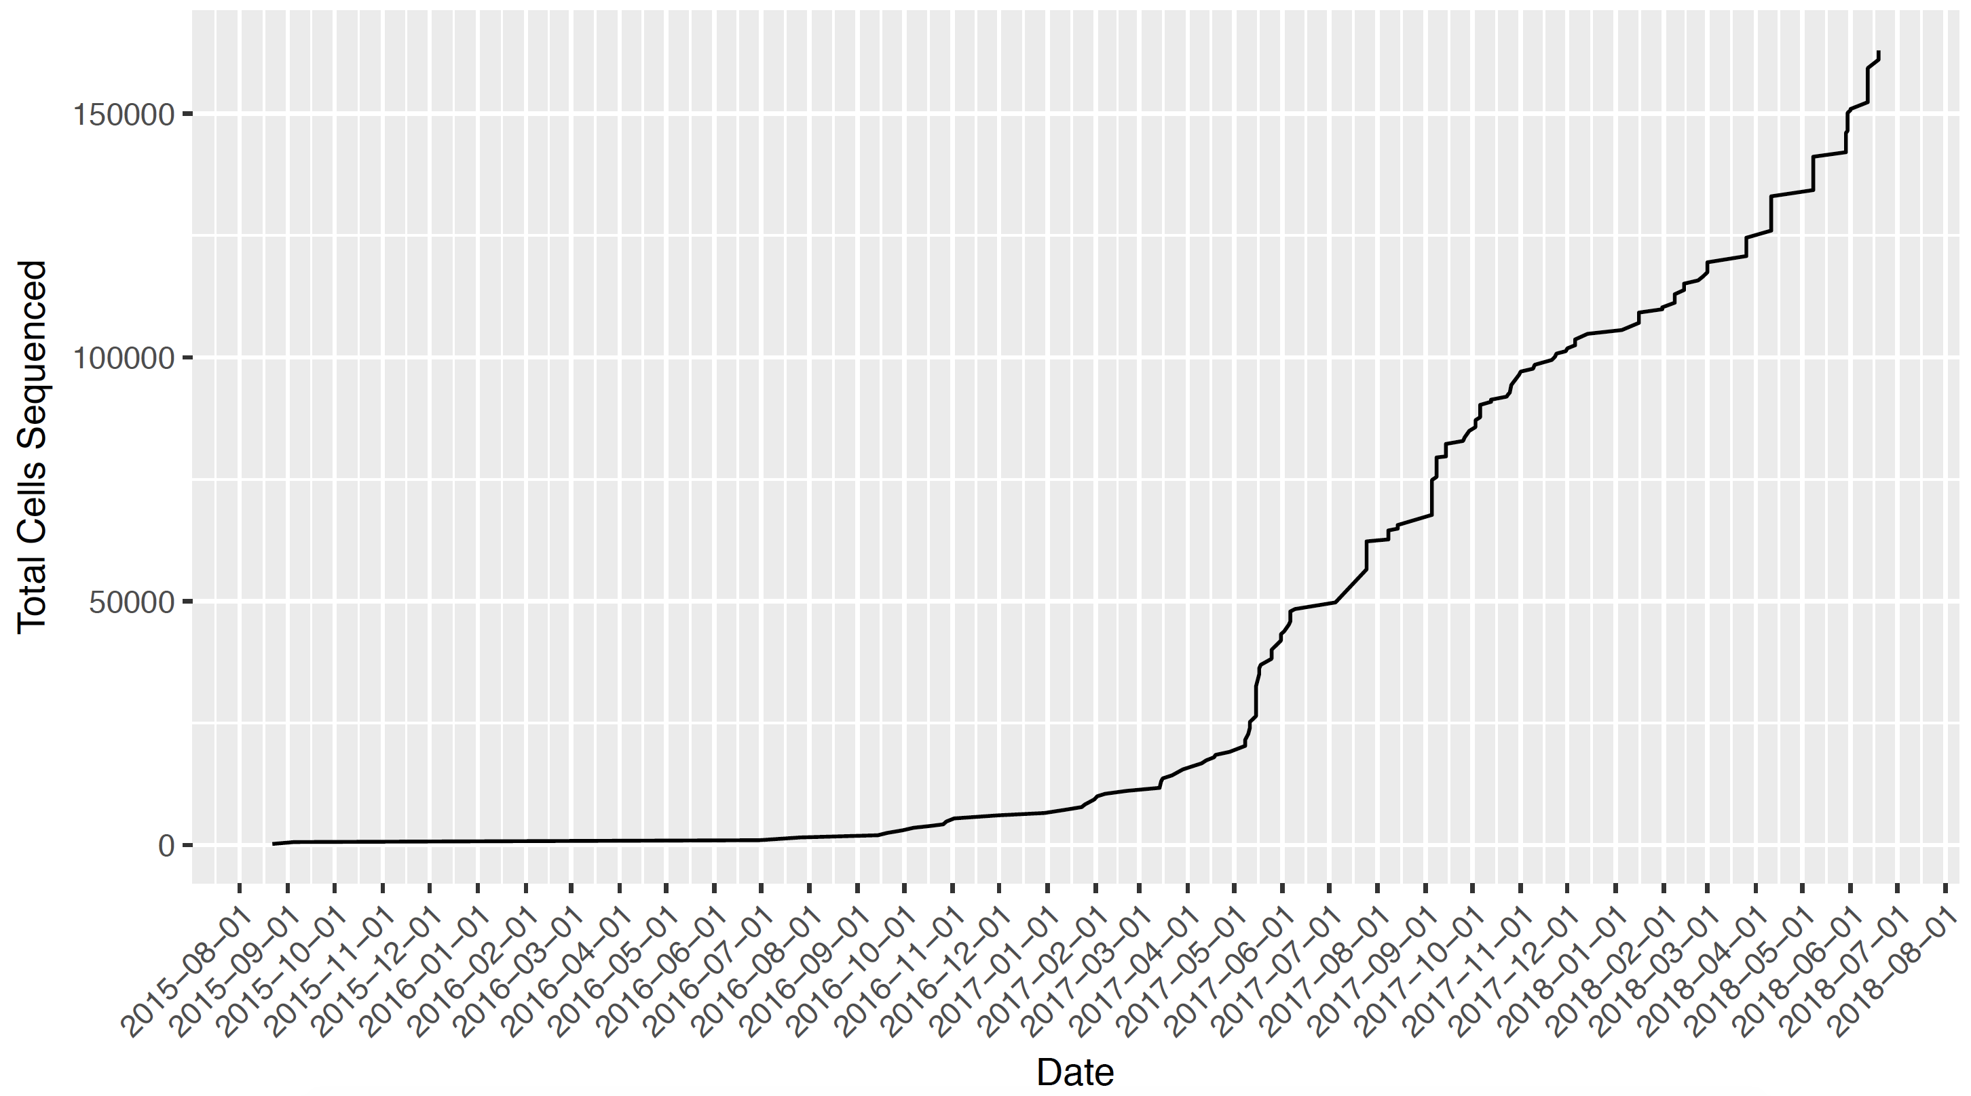
Infrastructure investment facilitates scalable library construction, throughput, and cloud computing
209k cells from 265 libraries
165k live cells
Andrew McPherson
Daniel Lai

Slide 7
Whole genome copy number profiles from DLP
Hans Zahn, Adi Steif, Emma Laks, Shah, Aparicio, Hansen. Nature Methods 2017

Slide 8
Whole genome copy number profiles from DLP
Hans Zahn, Adi Steif, Emma Laks, Shah, Aparicio, Hansen. Nature Methods 2017

Slide 9
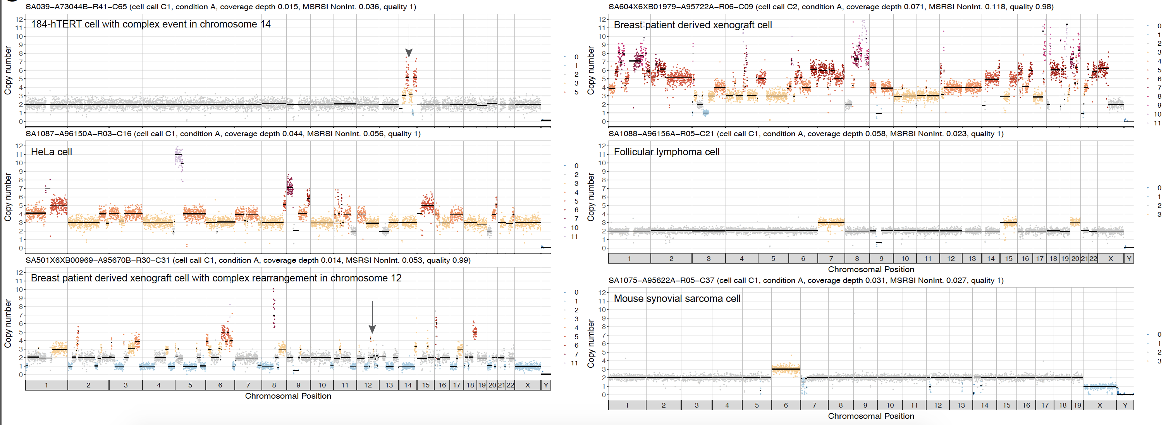
Versatility and robustness over cell types and tissues
Laks, McPherson, Lai, Zahn, Steif, Shah, Aparicio
https://www.biorxiv.org/content/early/2018/09/06/411058

Slide 10
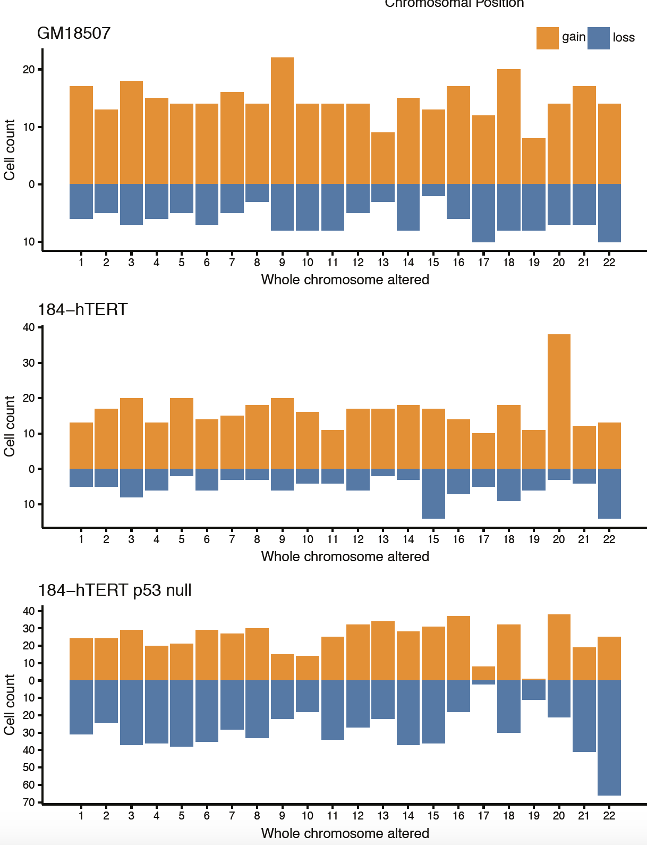
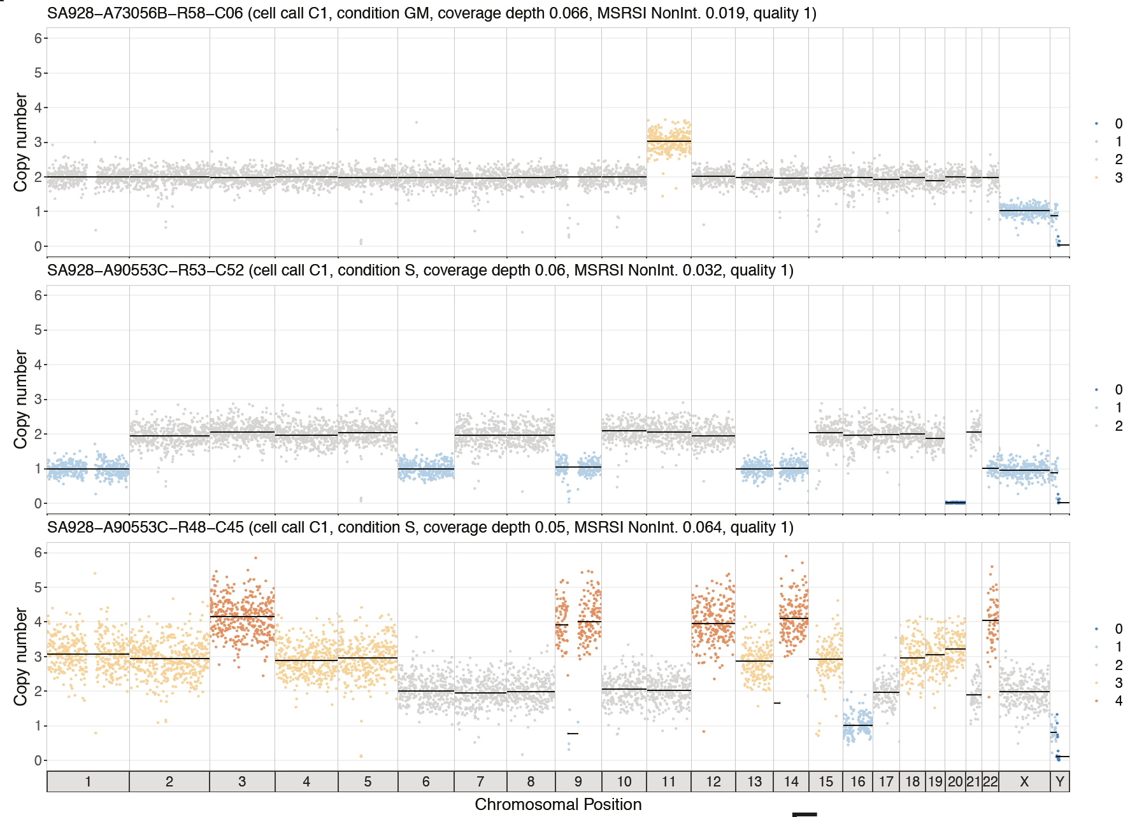
Evidence of negative selection and rates of mitotic errors

Slide 11
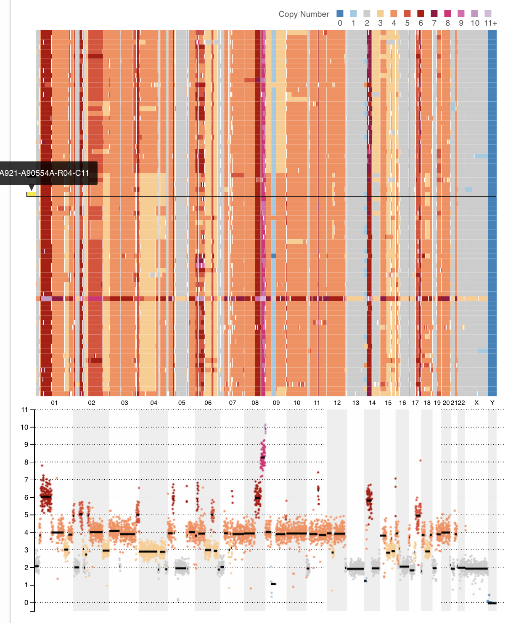
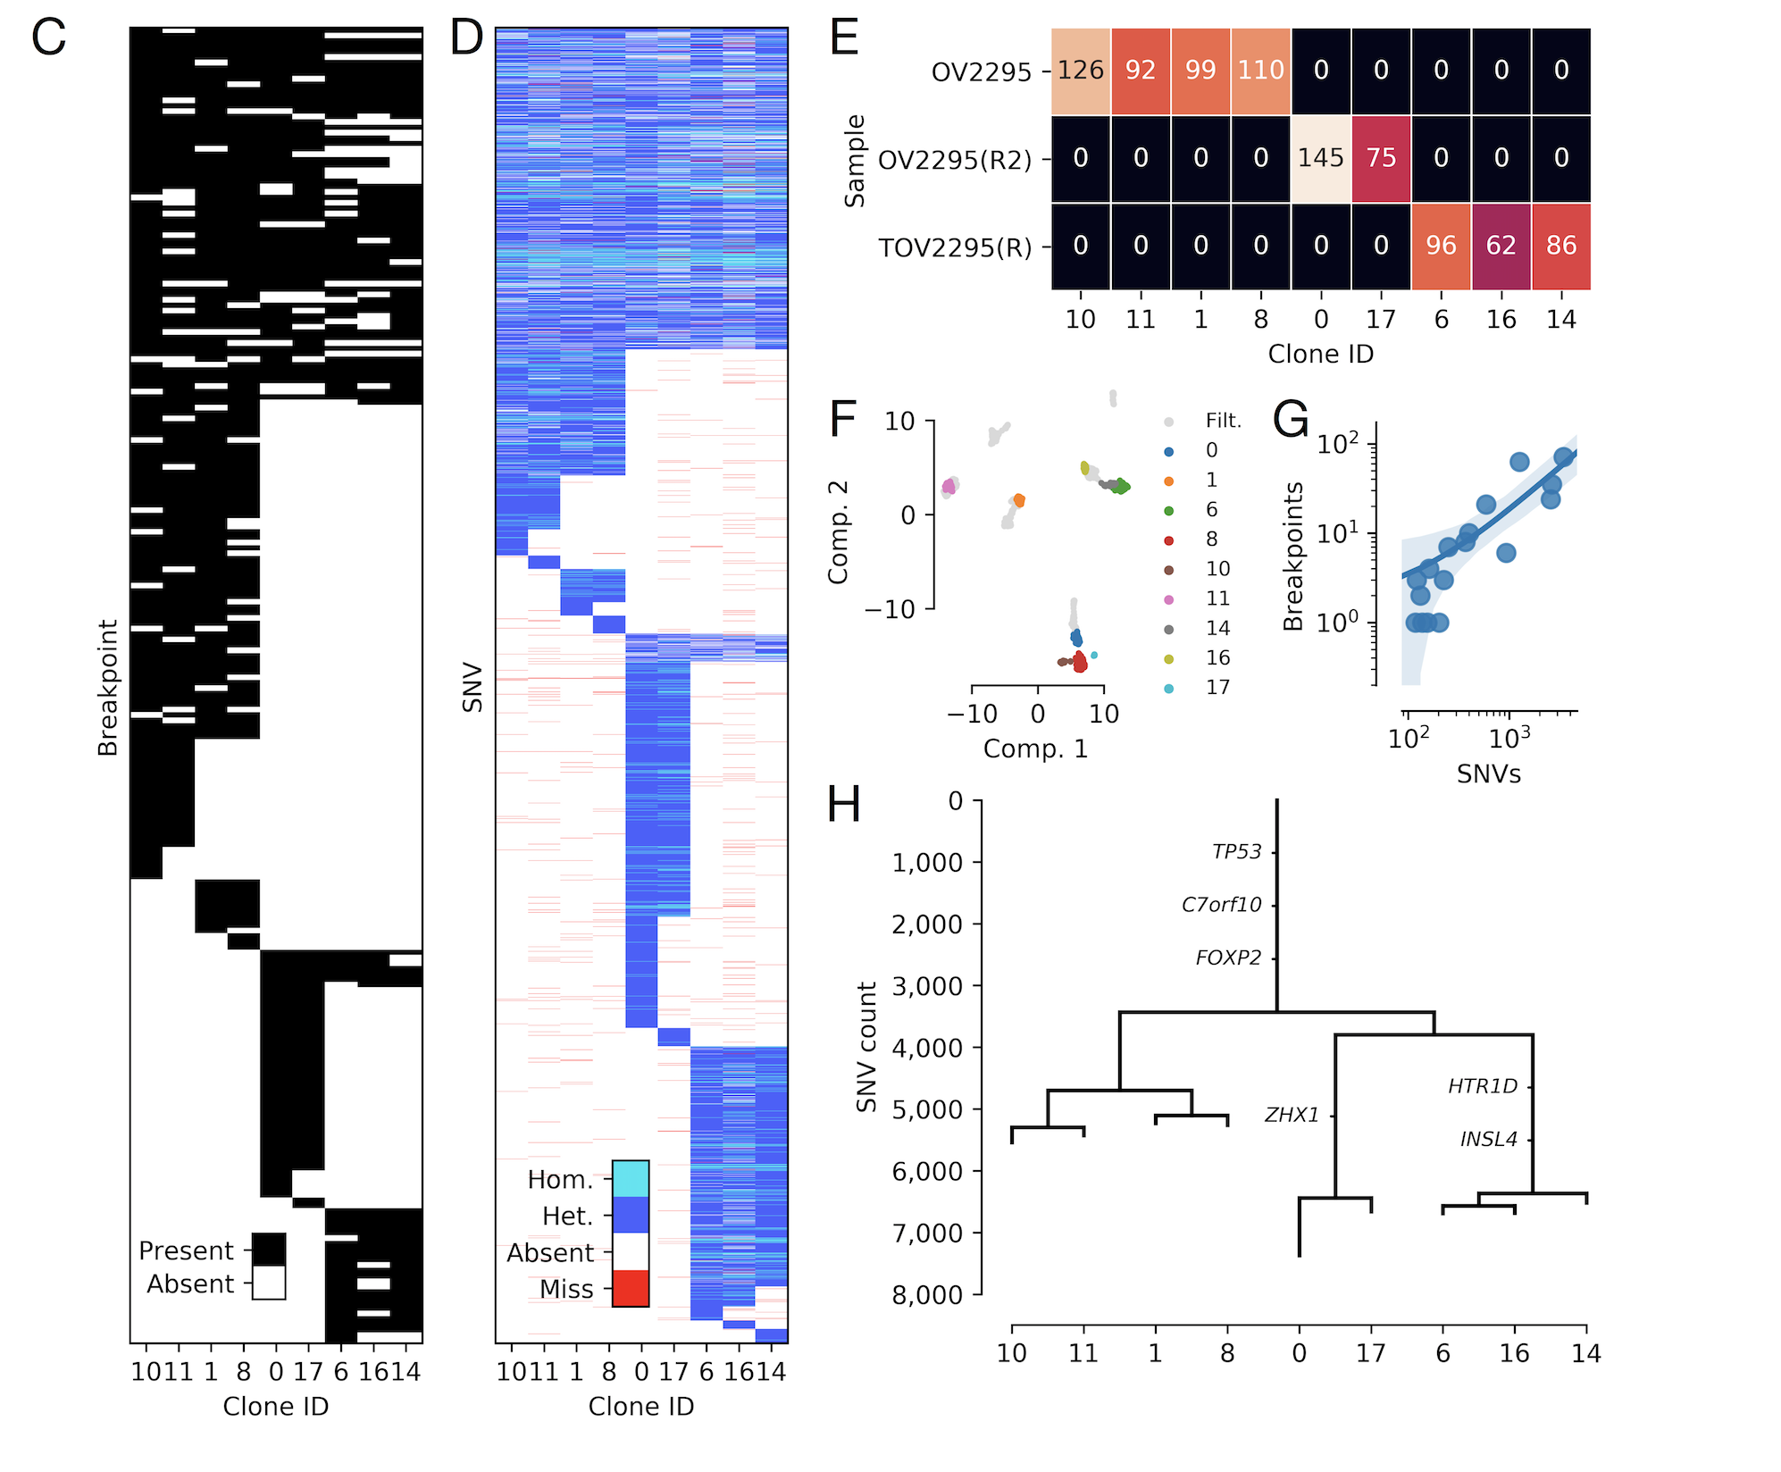
Merging cell subsets for clone-specific inference

Slide 12
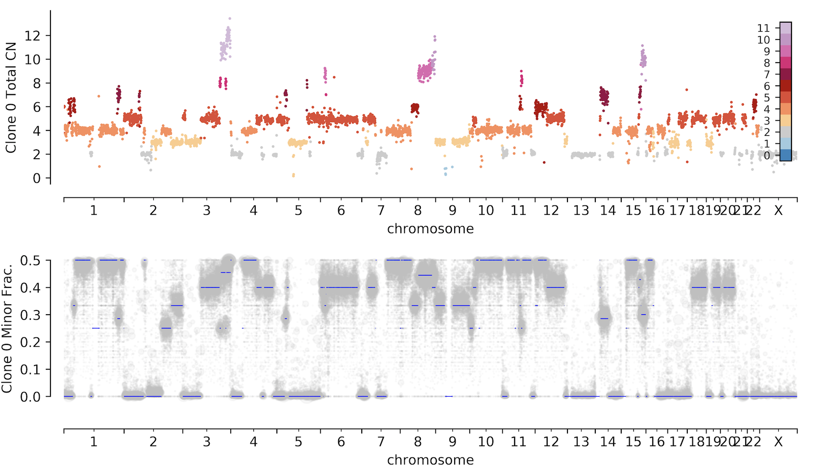
Unambiguous LOH and clone-specific copy number genotypes

Slide 13
Detecting DNA replication timing from dividing cells

Slide 14
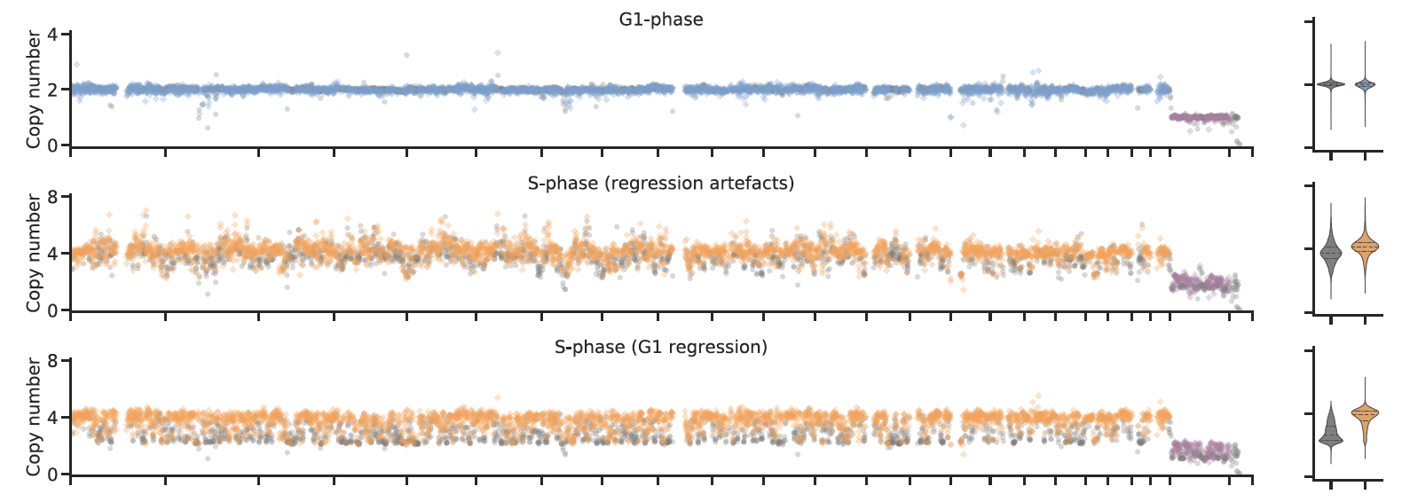
Detecting DNA replication timing from dividing cells

Slide 15
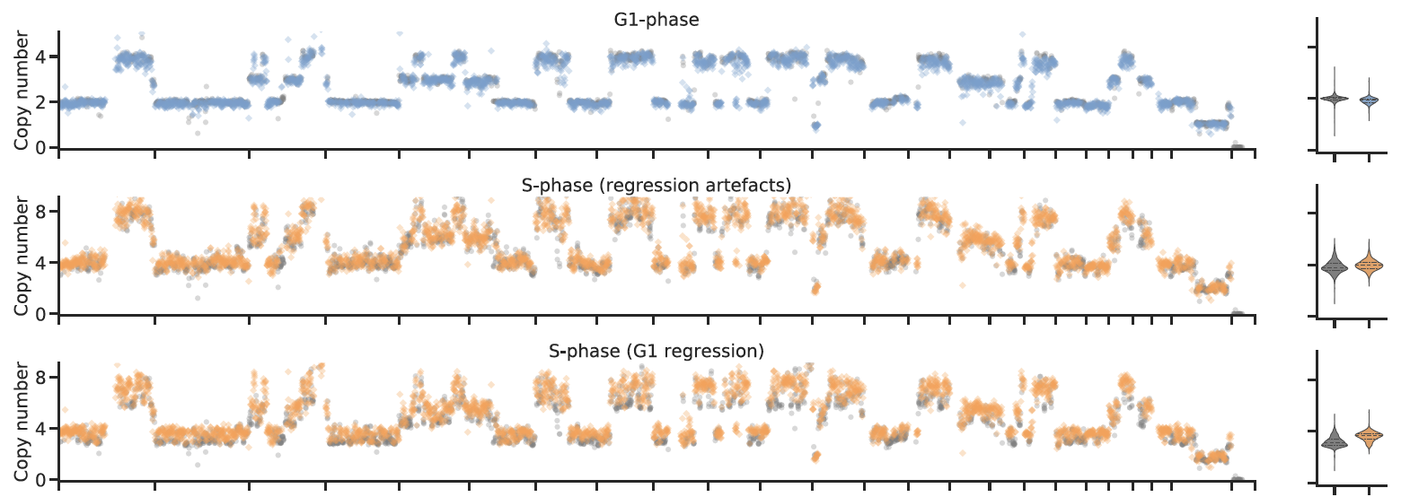
Detecting DNA replication timing from dividing cells:
Aneuploid cells

Slide 16
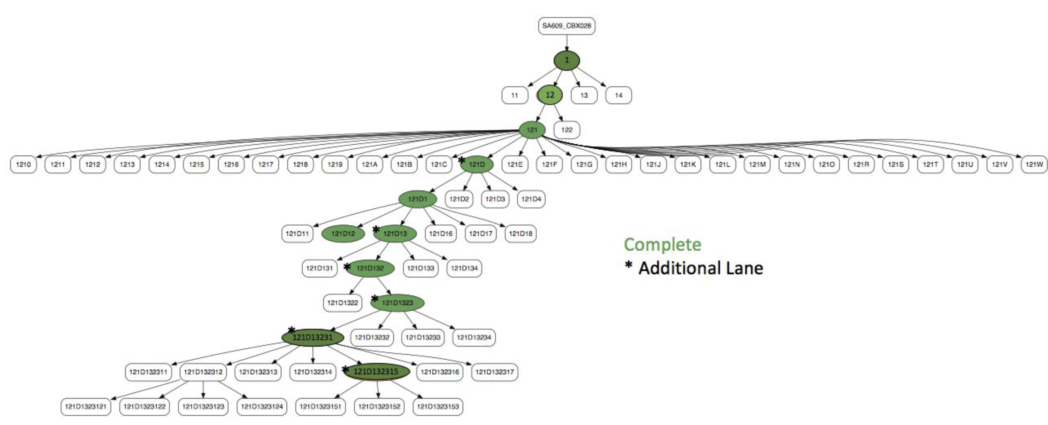
Inferring real time clonal trajectories and quantitative fitness attributes: serial PDX passaging

Slide 17
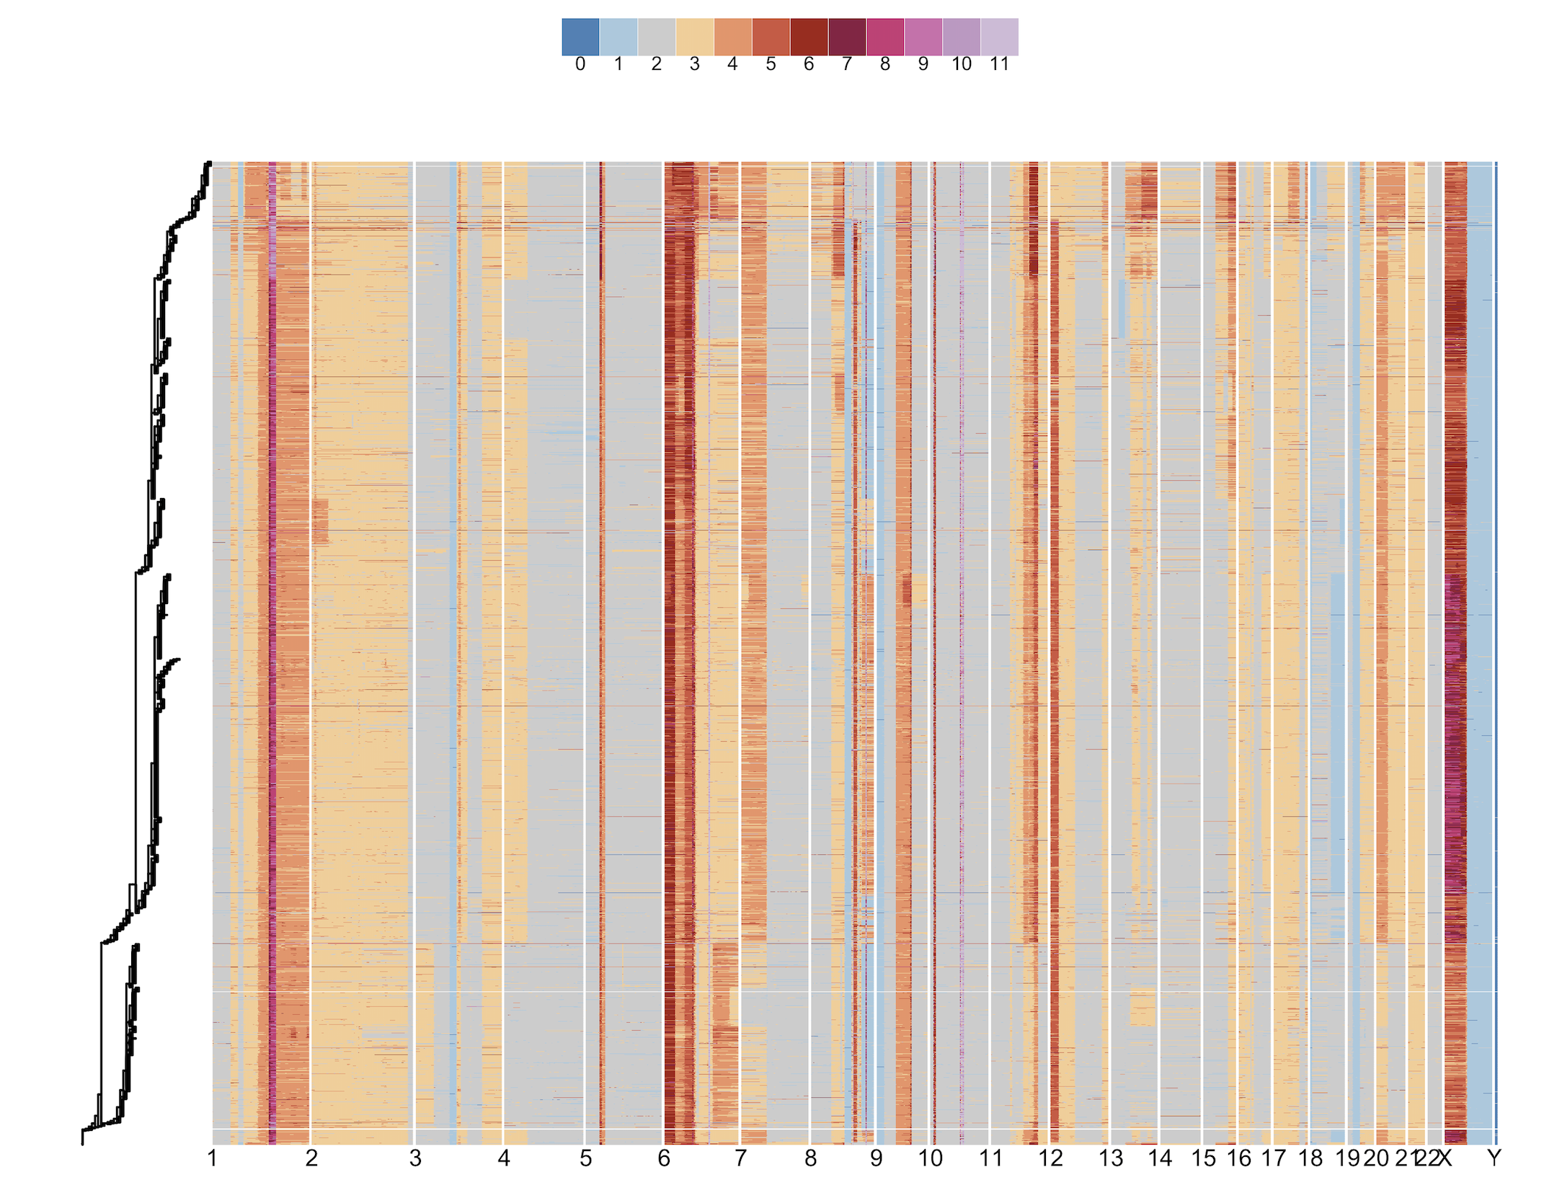
Inferring real time clonal trajectories and quantitative fitness attributes
Copy Number
n=2386 cells
6 timepoints
Ciara O’Flanagan
Emma Laks

Slide 18
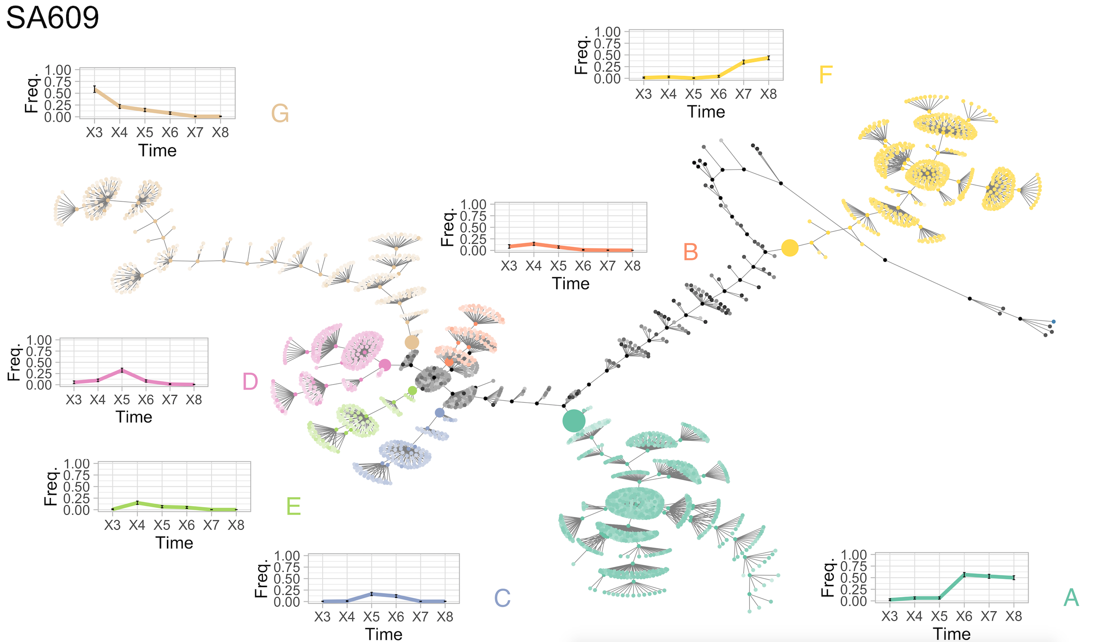
Inferring real time clonal trajectories and quantitative fitness attributes
Alexandre Bouchard-Cote
Sohrab Salehi

Slide 19
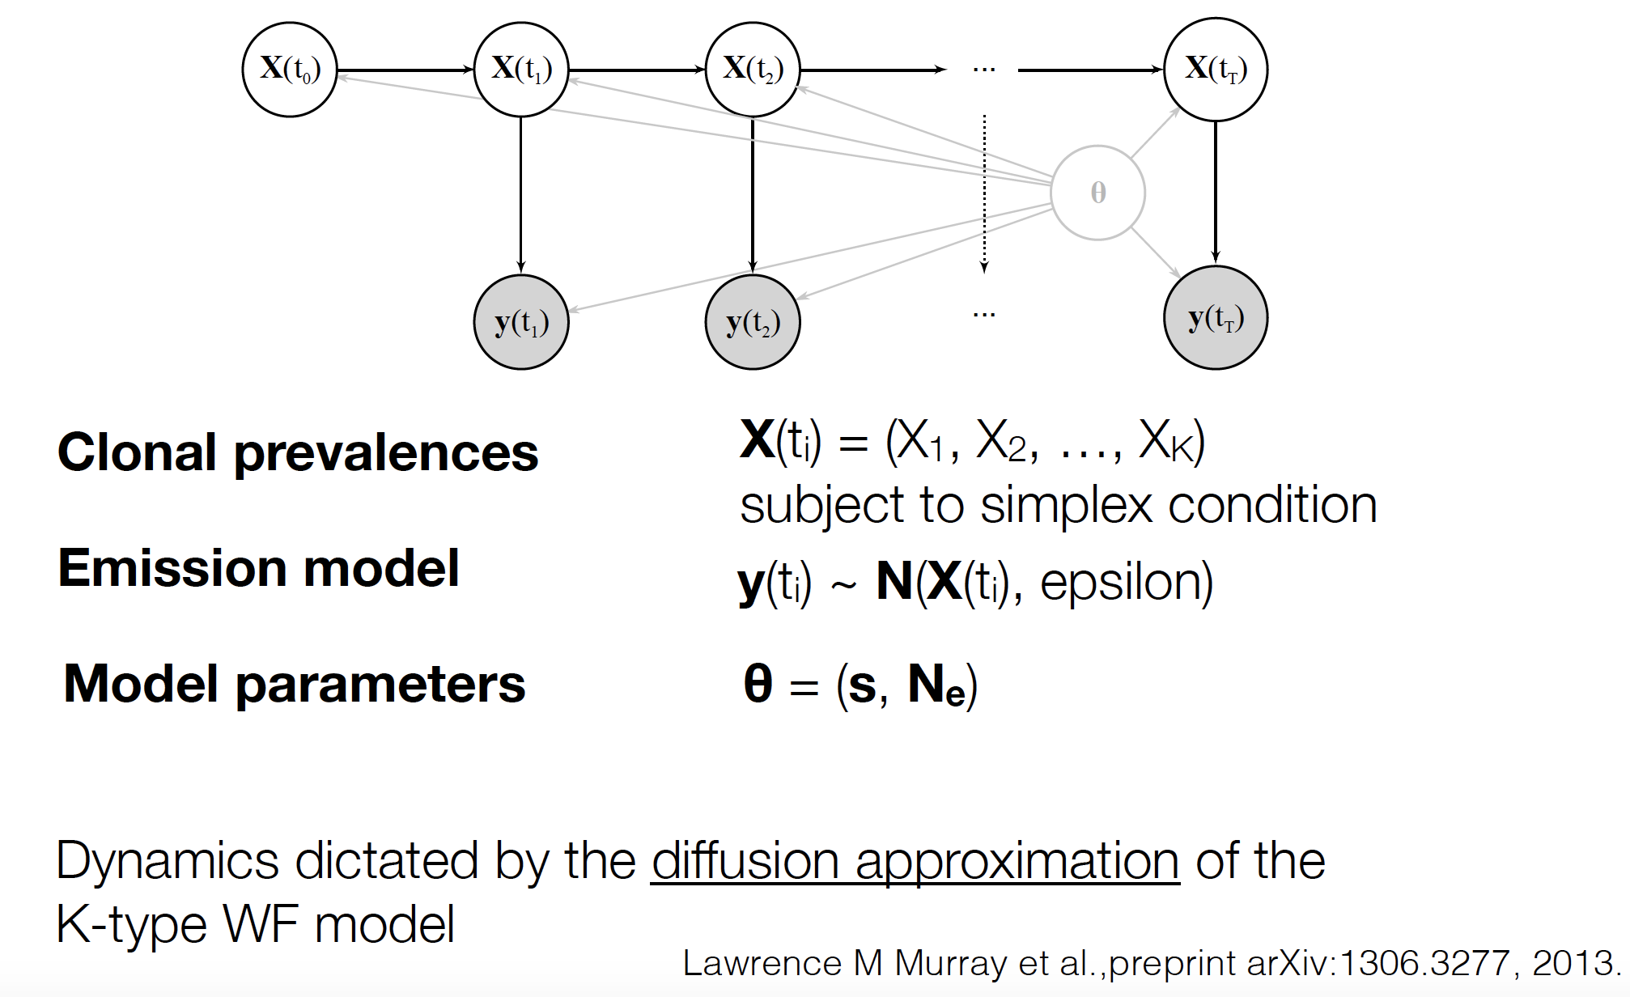
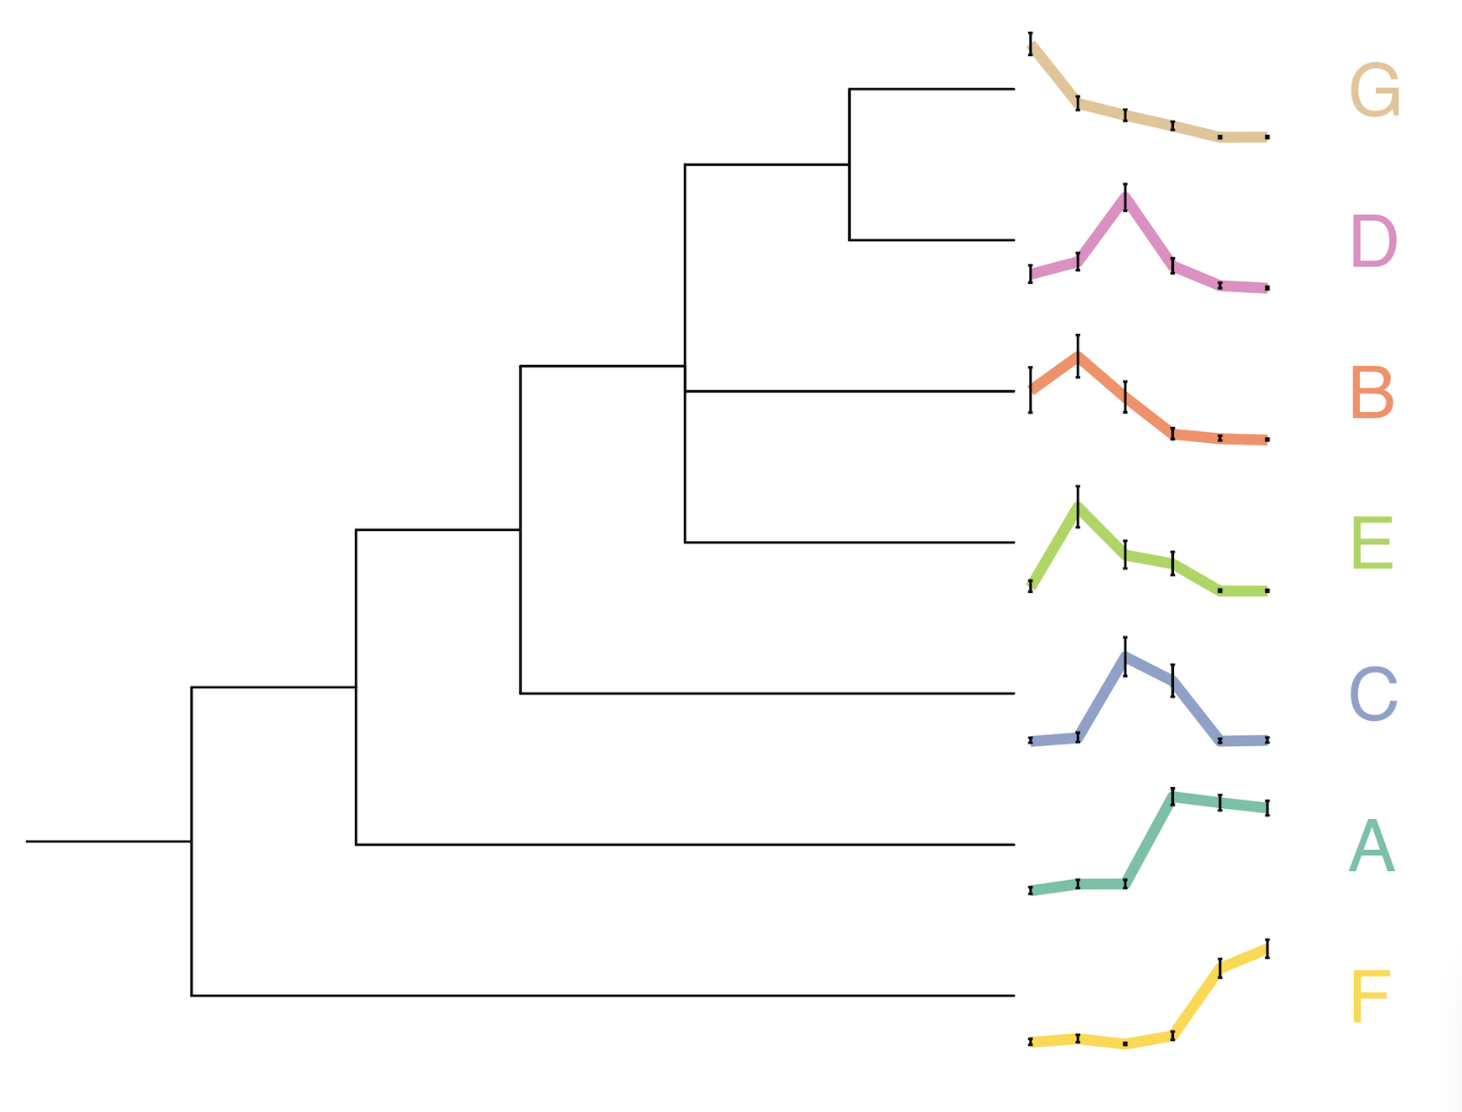
Inferring real time clonal trajectories and quantitative fitness attributes
Alexandre Bouchard-Cote
Sohrab Salehi

Slide 20
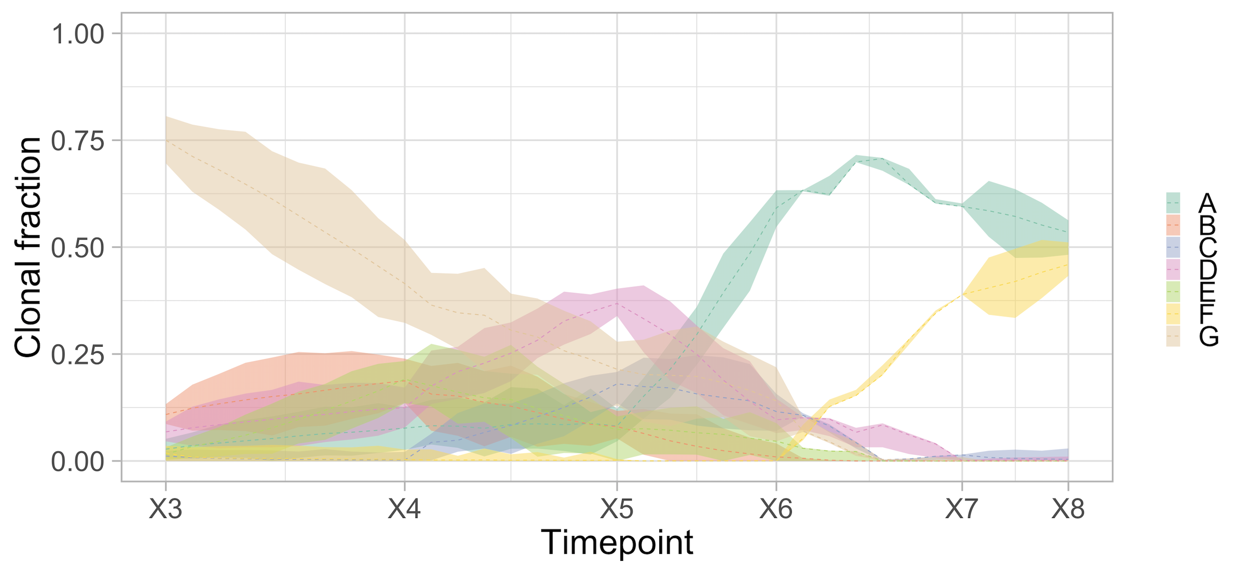
Inferring real time clonal trajectories and quantitative fitness attributes
Alexandre Bouchard-Cote
Sohrab Salehi

Slide 21
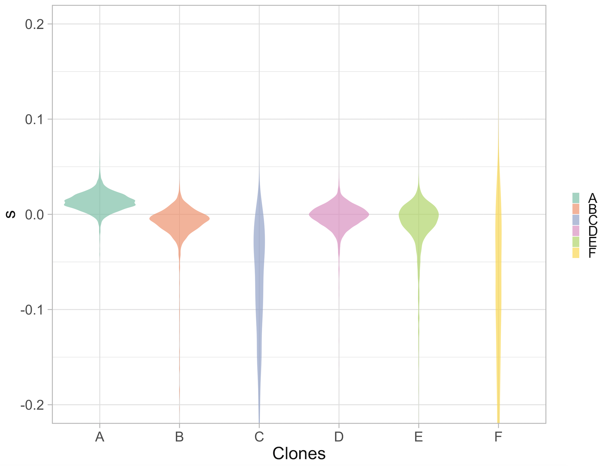
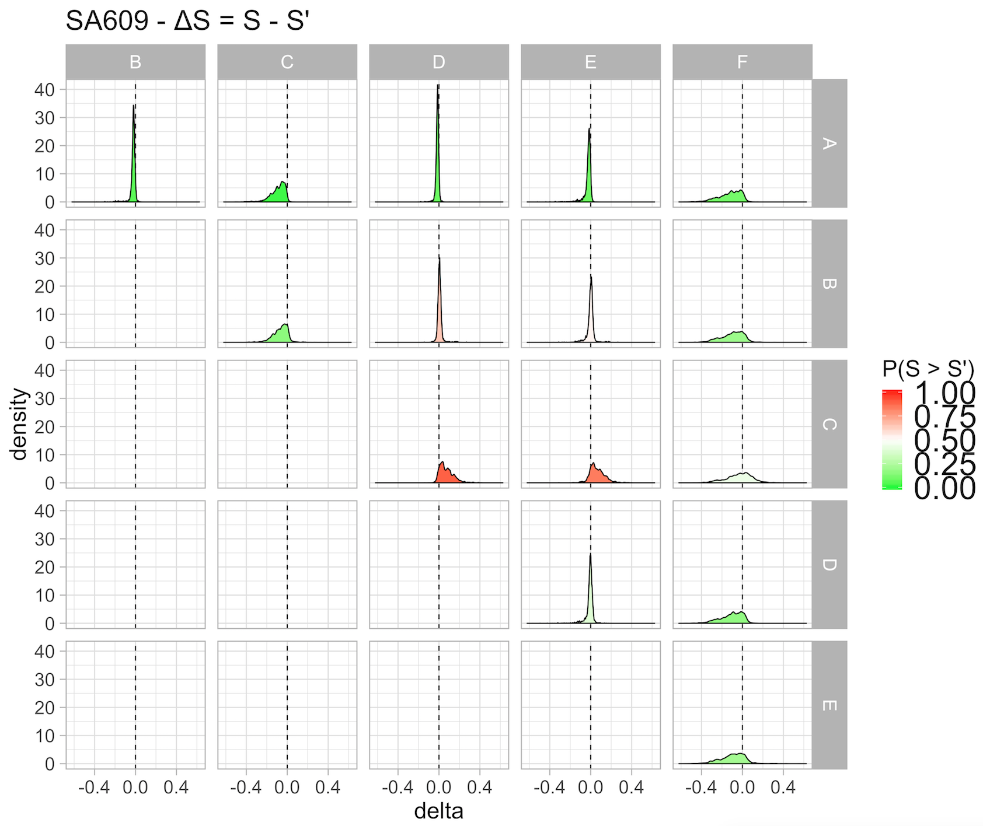
Inferring real time clonal trajectories and quantitative fitness attributes
Alexandre Bouchard-Cote
Sohrab Salehi

Slide 22
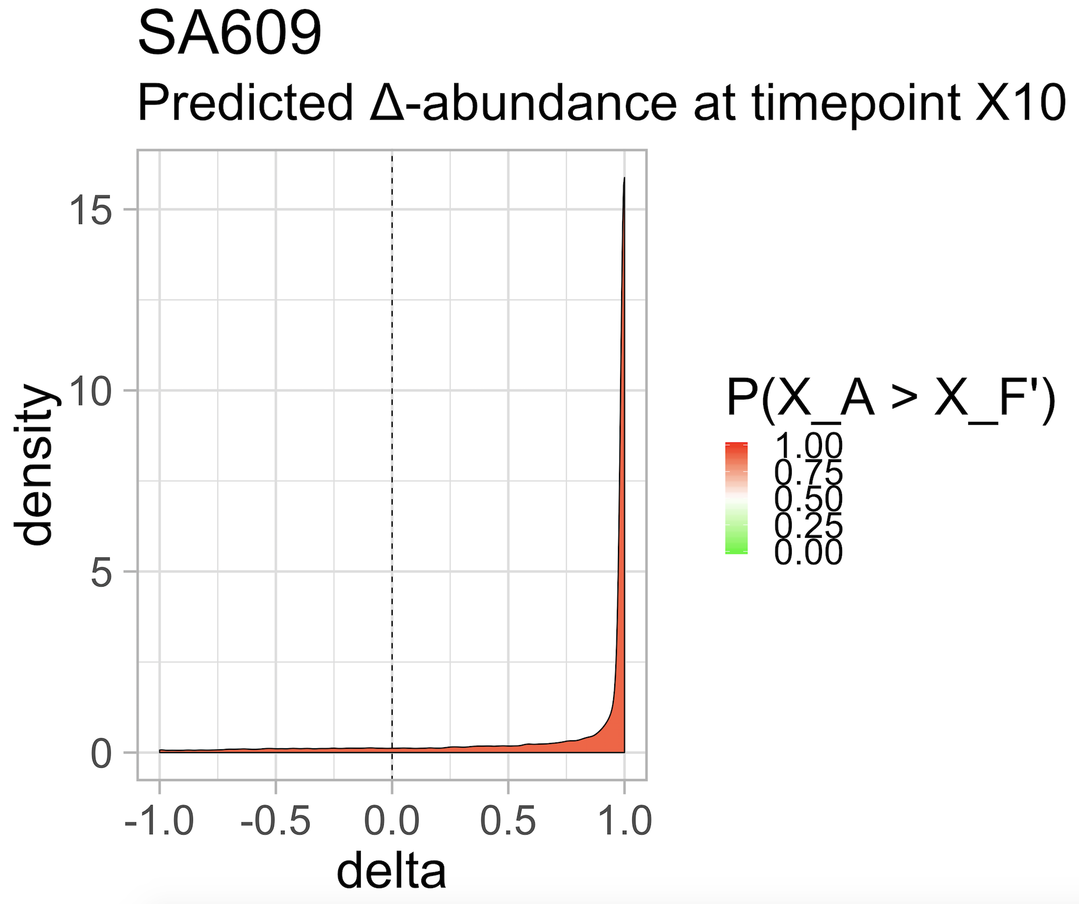
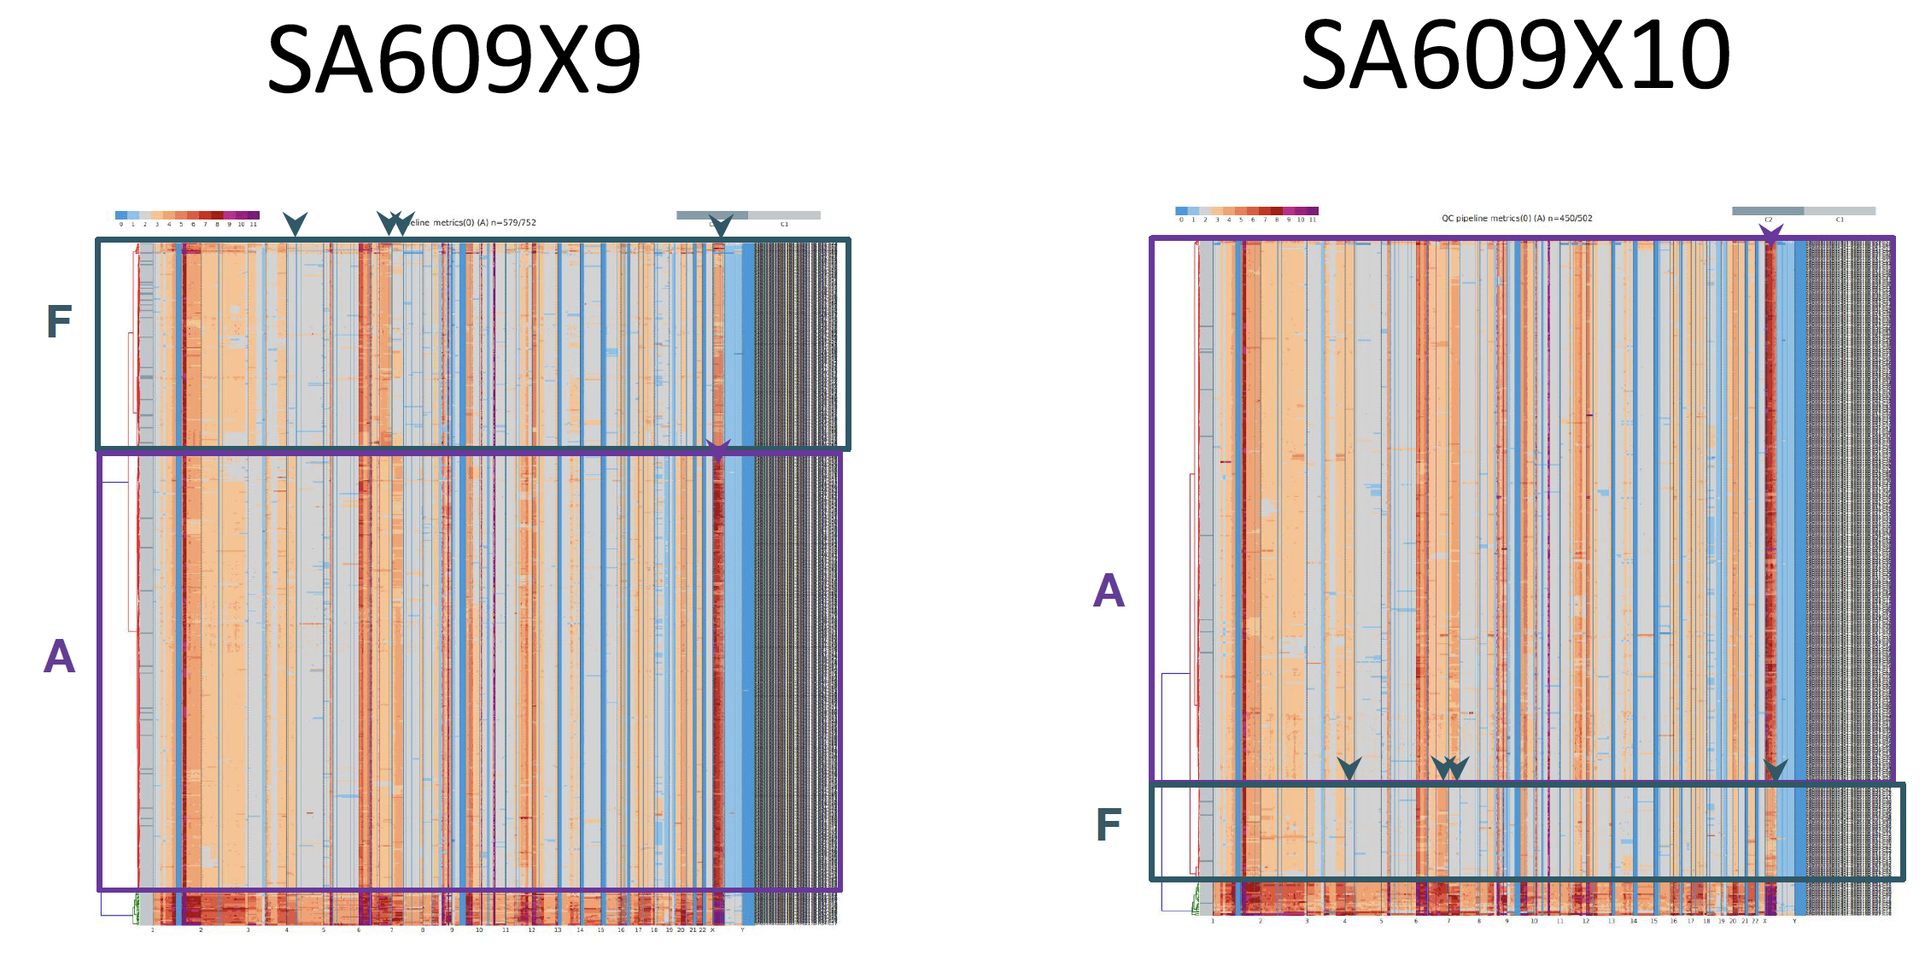
Inferring real time clonal trajectories and quantitative fitness attributes: making predictions
How likely is it for clone A to dominate clone F?
delta = X(A, X10) - X(F,X10)
X(i, t): abundance of clone i at time t

Slide 23
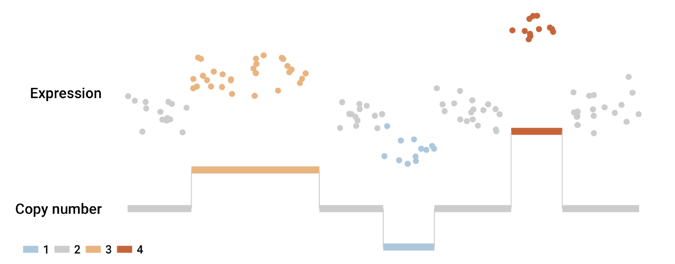
Establishing clonal gene expression profiling through single cell RNA – DNA mapping
https://doi.org/10.1101/344309
Kieran Campbell

Slide 24
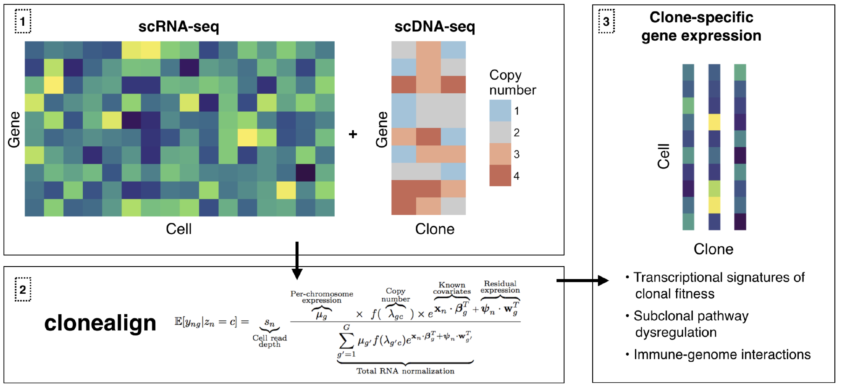
Establishing clonal gene expression profiling through single cell RNA – DNA mapping
https://doi.org/10.1101/344309
Kieran Campbell

Slide 25
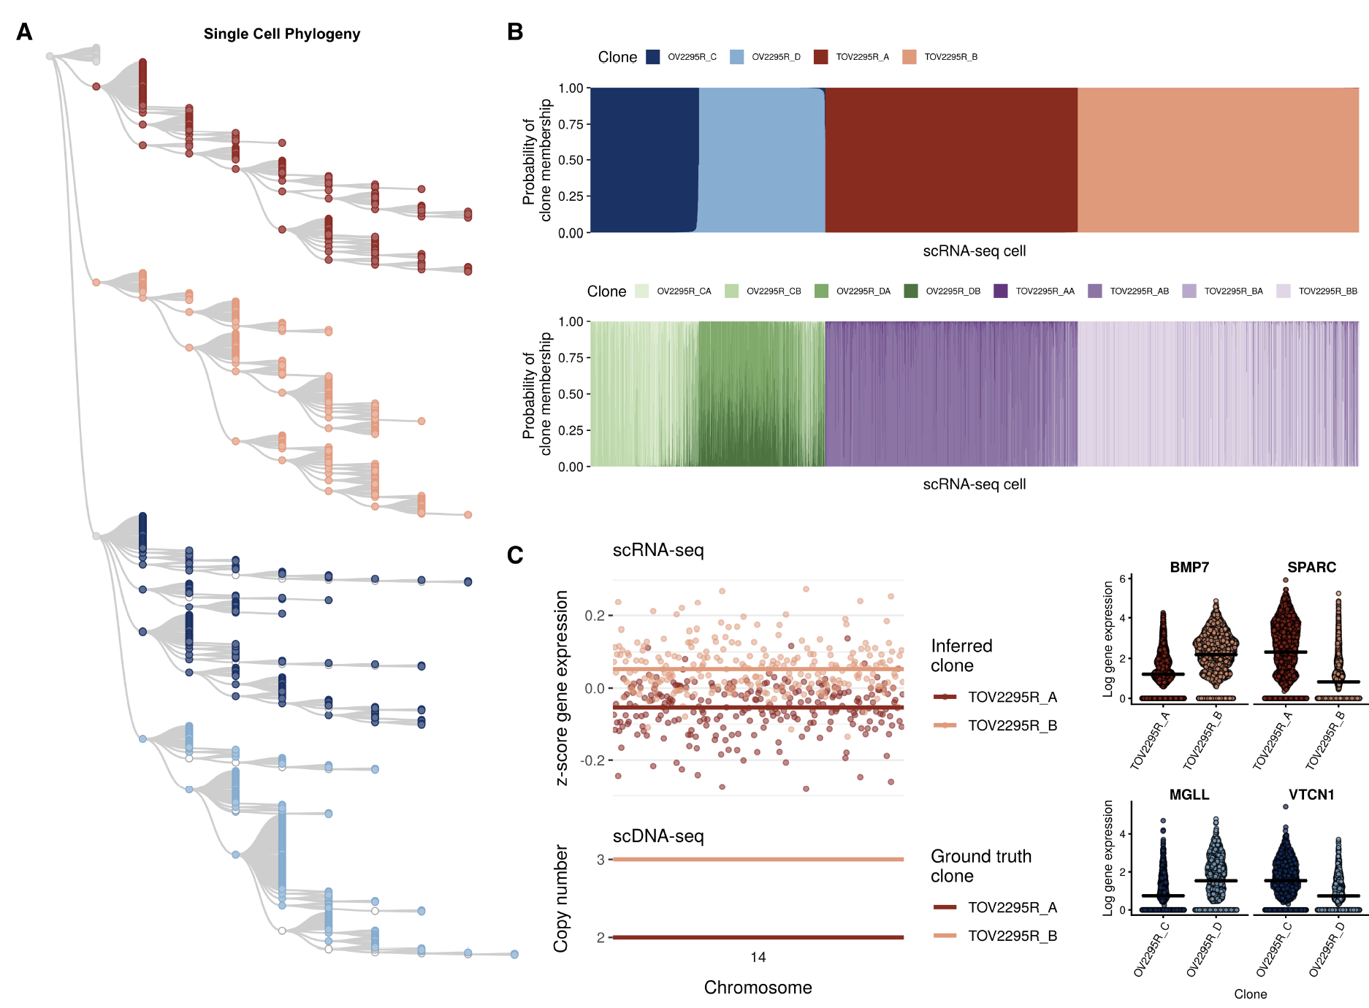
Establishing clonal gene expression profiling through single cell RNA – DNA mapping

Slide 26
Lessons learned from single cell whole genome sequencing at scale
New single cell technologies enable a fundamentally novel approach for studying disease dynamics
Questions about background mutation rates and negative selection become accessible with sc at scale
Sharper views of clonal repertoires are enabled for phylogenetic analysis
Quantitative fitness properties can be calculated in scaled time-series analysis

Slide 27
Acknowledgments
Sam Aparicio
David Huntsman
Jessica McAlpine
Blake Gilks
Alex Bouchard-Cote
Carl Hansen
Brad Nelson
Andrew McPherson
Andrew Roth
Adi Steif
Allen Zhang
Yikan Wang
Ali Bashashati
Hossein Farahani
Tyler Funnell
Kieran Campbell
Sohrab Salehi
Emma Laks
Hans Zahn
Rebecca Asiimwe
Viktoria Bojilova
Samantha Leung
Diljot Grewal
Daniel Lai
Pascale Walters
Nafis Abrar
Spencer Vartr-Watts
Oleg Golovko
Jamie Lim
Ciara O’Flanagan
More info: http://shahlab.ca

Slide 28
Preprints on Biorxiv
https://doi.org/10.1101/411058 Single cell WGS
https://doi.org/10.1101/344309 Integrated scRNAseq + scDNASeq
https://doi.org/10.1101/414482 sc CpG methylation
https://doi.org/10.1101/267500 Integrated SNV + SV signatures

Slide 29
We are building a new research program in Computational Oncology @MSK Open faculty, PDF and staff positions: Statistics, computer science, computational biology Faculty: https://tinyurl.com/yc94q7b6 PDF: https://tinyurl.com/y8o2tr6b shahs3@mskcc.org

