Slide 1
Statistical Methods and Software for the Study of Stem Cell Differentiation Using Single-Cell Transcriptome Sequencing
Kelly Street
PhD Candidate in Biostatistics
University of California, Berkeley
Advisor: Sandrine Dudoit
BIRS-CMO Workshop
November 6th, 2018
Notes:
Brain initiative

Slide 2

The BRAIN Initiative
The Berkeley Team
John Ngai (PI)
Neuroscience
Hillel Adesnik (MCB Neuro)
Helen Bateup (MCB Neuro)
Dan Feldman (MCB Neuro)
Statistics/Informatics
Sandrine Dudoit (Biostatistics/Statistics)
Elizabeth Purdom (Statistics)
Nir Yosef (Computer Science)
Genome Engineering
Jennifer Doudna (MCB/Chemistry/LBNL/HHMI)
Dirk Hockemeyer (MCB CDB)
Russell Vance (MCB Immunology/HHMI)
Core Facilities
QB3 Functional Genomics Laboratory
QB3 Genomics Sequencing Laboratory
Cancer Research Laboratory

Slide 3
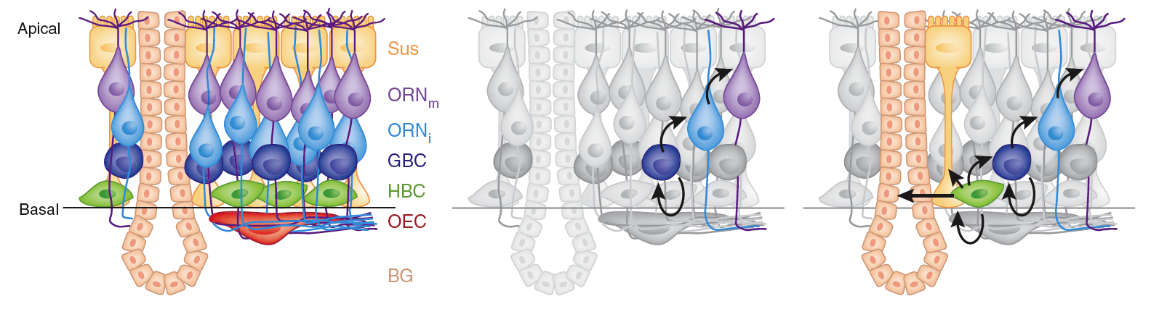
Olfactory Epithelium (OE)
Sustentacular cell (Sus)
Olfactory receptor neuron (ORN)
Immature olfactory neuron
Globose basal cell (GBC)
Horizontal basal cell (HBC)
Olfactory ensheathing glia
Bowman’s gland

Slide 4
Olfactory Epithelium (OE)
Fletcher RB, Das D, Gadye L, Street K, Baudhuin A, Risso D, Wagner A, Cole MB, Flores Q, Choi YG, Yosef N, Purdom E, Dudoit S, Ngai J. Deconstructing Olfactory Stem Cell Trajectories at Single-Cell Resolution. Cell Stem Cell. 2017.

Slide 5
SCONE
Single Cell Overview of Normalized Expression data
Cole MB, Risso D, Wagner A, DeTomaso D, Ngai J, Purdom E, Dudoit S, Yosef N. Performance Assessment and Selection of Normalization Procedures for Single-Cell RNA-Seq. bioRxiv. 2017

Slide 6
SCONE
Single Cell Overview of Normalized Expression data
Cole MB, Risso D, Wagner A, DeTomaso D, Ngai J, Purdom E, Dudoit S, Yosef N. Performance Assessment and Selection of Normalization Procedures for Single-Cell RNA-Seq. bioRxiv. 2017

Slide 7
RSEC
Resampling-based Sequential Ensemble Clustering
Risso D, Purvis L, Fletcher RB, Das D, Ngai J, Dudoit S, Purdom E. clusterExperiment and RSEC: a Bioconductor package and framework for clustering of single-cell and other large gene expression datasets. PLOS Computational Biology. 2018.

Slide 8
RSEC
Resampling-based Sequential Ensemble Clustering

Slide 9
RSEC
Resampling-based Sequential Ensemble Clustering

Slide 10
RSEC
Resampling-based Sequential Ensemble Clustering

Slide 11
Olfactory Epithelium (OE)
Fletcher RB, Das D, Gadye L, Street K, Baudhuin A, Risso D, Wagner A, Cole MB, Flores Q, Choi YG, Yosef N, Purdom E, Dudoit S, Ngai J. Deconstructing Olfactory Stem Cell Trajectories at Single-Cell Resolution. Cell Stem Cell. 2017.

Slide 12
Monocle
Original Data
Jittered Data 1
Jittered Data 2
IC-2
IC-1
IC-1
Notes:
What other methods are there?

Slide 13
Input Data
Low dimensional
PCA, ICA, tSNE, UMAP, …
Clustered
SC3, Seurat, RSEC, …

Slide 14
Minimum Spanning Tree
Identify global structure
Cluster shape sensitive

Slide 15
Constrained MST
Identify global structure
Cluster shape sensitive
Incorporate prior knowledge

Slide 16
Principal Curves
Highly stable
Uses cells, not clusters
Incongruent across branches

Slide 17
Stability
MST on cells (backbone)
MST on clusters
Principal curve
Full data
50 subsets

Slide 18
Principal Curves
Highly stable
Uses cells, not clusters
Incongruent across branches

Slide 19
Olfactory Epithelium
Fletcher RB, Das D, Gadye L, Street K, Baudhuin A, Risso D, Wagner A, Cole MB, Flores Q, Choi YG, Yosef N, Purdom E, Dudoit S, Ngai J. Deconstructing Olfactory Stem Cell Trajectories at Single-Cell Resolution. Cell Stem Cell. 2017.

Slide 20
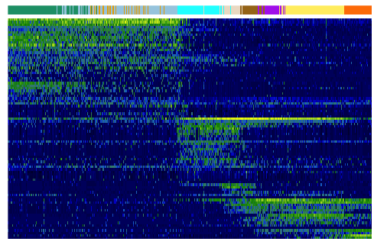
Olfactory Neurogenesis
HBC
mORN
Krt14
Normalized Log Read Counts
Genes
Hes6
Omp
Neuronal Lineage Samples

Slide 21
Principal Curves
Highly stable
Uses cells, not clusters
Incongruent across branches

Slide 22
Simultaneous Principal Curves
Highly stable
Uses cells, not clusters
Mostly congruent
across branches

Slide 23
Simultaneous Principal Curves
Highly stable
Uses cells, not clusters
Mostly congruent
across branches

Slide 24
Stability
k = 5
MST
SPCs

Slide 25
Stability
k = 4
MST
SPCs

Slide 26
Stability
k = 3
MST
SPCs

Slide 27
Stability
k = 2
MST
SPCs

Slide 28
Stability
k = 5
MST
SPCs

Slide 29
Stability
k = 10
MST
SPCs

Slide 30
Stability
k = 15
MST
SPCs

Slide 31
Stability
k = 18
MST
SPCs

Slide 32
Stability
k = 3, …, 17
MST
SPCs

Slide 33
OE Injury Response
Gadye, L., Das, D., Sanchez, M.A., Street, K., Baudhuin, A., Wagner, A., Cole, M.B., Choi, Y.G., Yosef, N., Purdom, E., et al. (2017). Injury Activates Transient Olfactory Stem Cell States with Diverse Lineage Capacities. Cell Stem Cell. 2017.

Slide 34
OE Injury Response
Gadye, L., Das, D., Sanchez, M.A., Street, K., Baudhuin, A., Wagner, A., Cole, M.B., Choi, Y.G., Yosef, N., Purdom, E., et al. (2017). Injury Activates Transient Olfactory Stem Cell States with Diverse Lineage Capacities. Cell Stem Cell. 2017.
Notes:
Blue – activated HBC

Slide 35
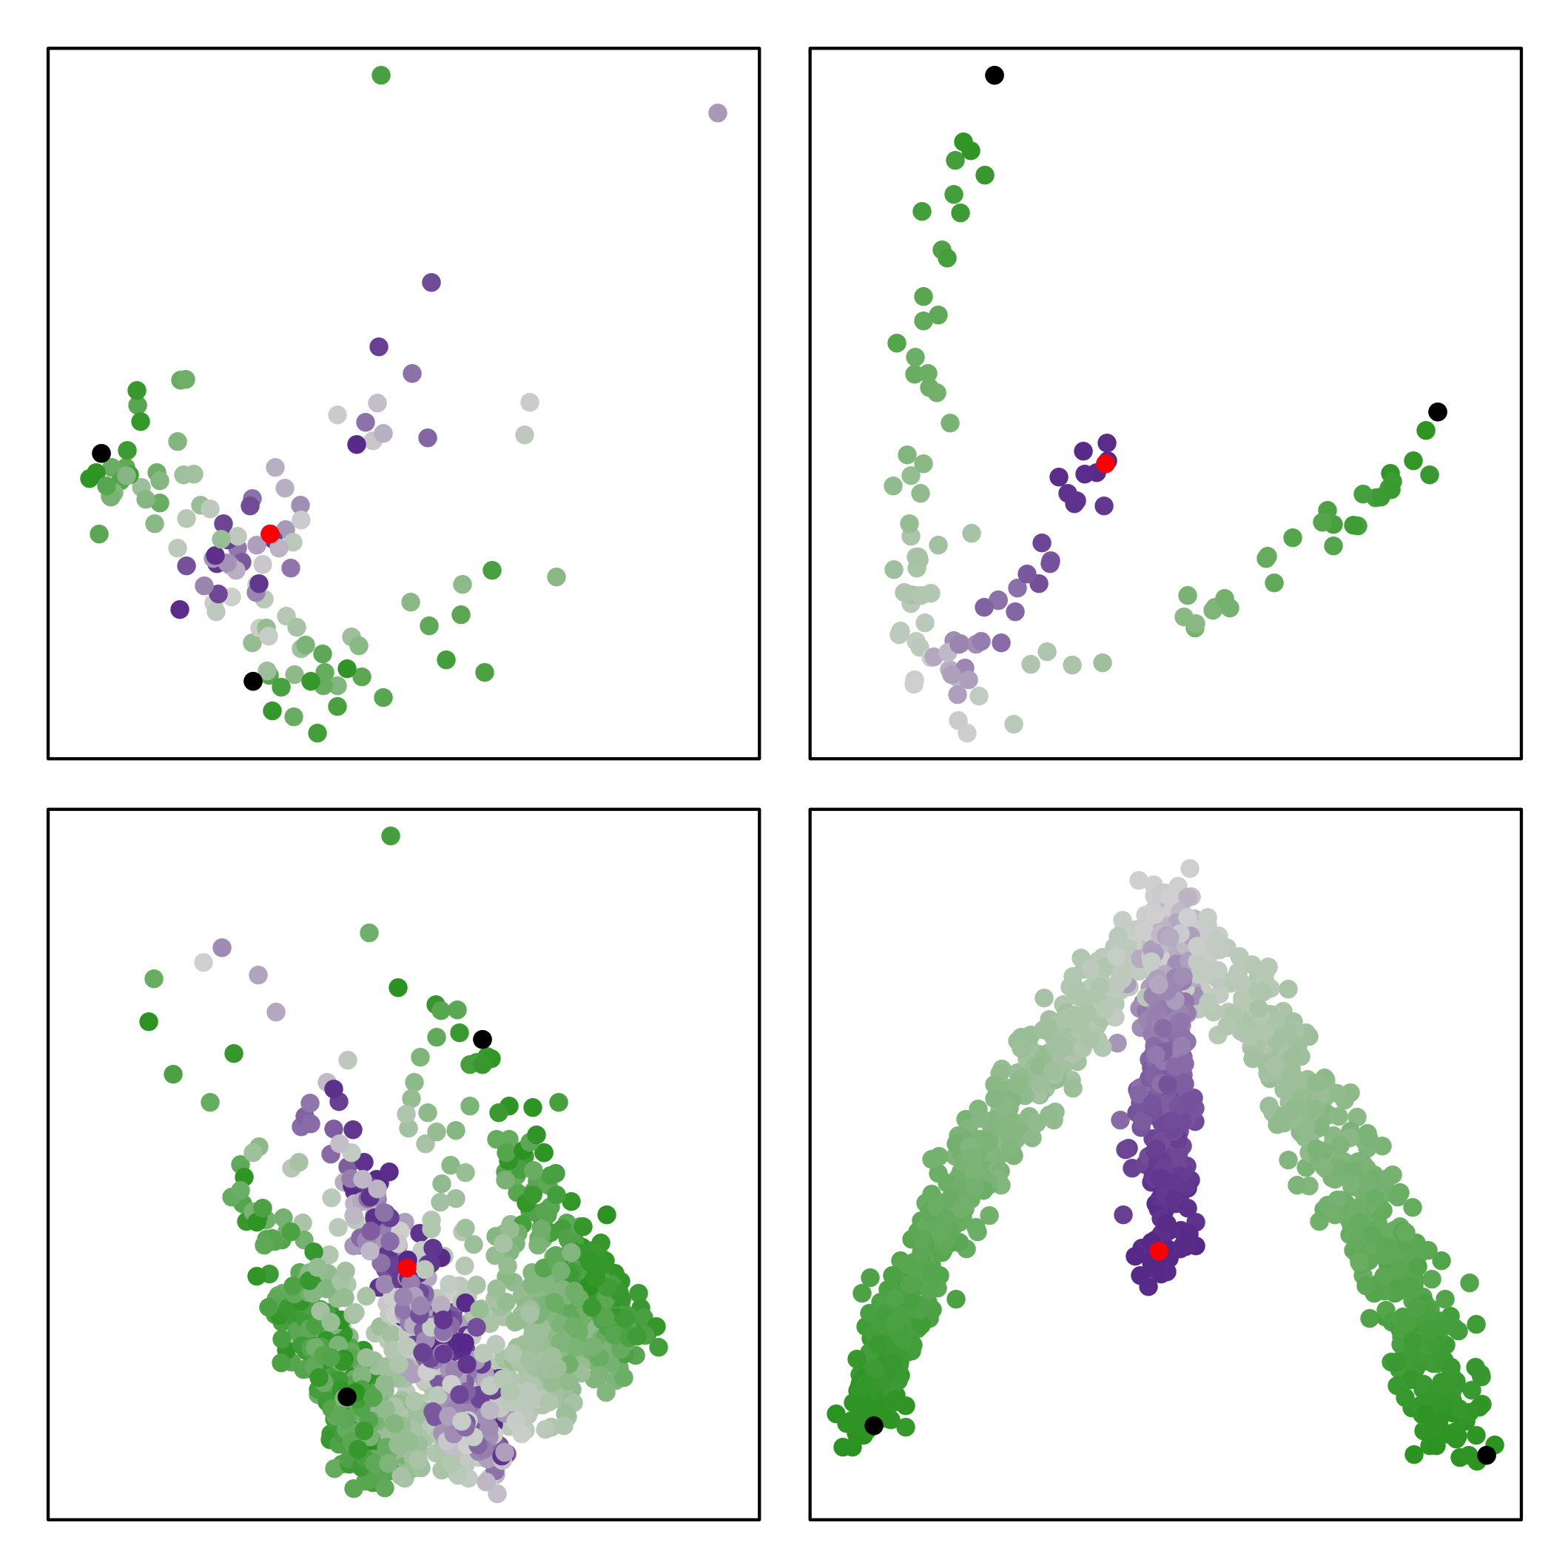

Simulation Studies
More noise
Less noise
Scores
Fewer cells
More cells

Slide 36
Simulation Studies
Saelens W, Cannoodt R, Todorov H, Saeys Y. A comparison of single-cell trajectory inference methods: towards more accurate and robust tools. bioRxiv. 2018. https://www.biorxiv.org/content/early/2018/03/05/276907.
Notes:
Using PCA(3) and k-means(5)

Slide 37
Additional Methods
scone
Single Cell Overview of Normalized Expression data
zinbwave
Zero-Inflated Negative Binomial Model for RNA-Seq Data
clusterExperiment
Compare Clusterings for Single-Cell Sequencing
slingshot
Trajectory inference for Single-Cell Sequencing Data

Slide 38
ZINB-WaVE
Zero Inflated Negative Binomial Wanted Variance Extraction
Risso D, Perraudeau F, Gribkova S, Dudoit S, Vert J-P. A general and flexible method for signal extraction from single-cell RNA-seq data. Nature Communications. 2018.

Slide 39
Recommended Workflow

Slide 40
Recommended Workflow

Slide 41
Thank You!
Special thanks to:
  Sandrine Dudoit
  Elizabeth Purdom
  John Ngai
  Davide Risso
  Russell Fletcher
  Diya Das

Slide 42
Constrained MST
Identify global structure
Cluster shape sensitive
Incorporate prior knowledge

Slide 43
Constrained SPCs
Identify global structure
Cluster shape sensitive
Incorporate prior knowledge

Slide 44
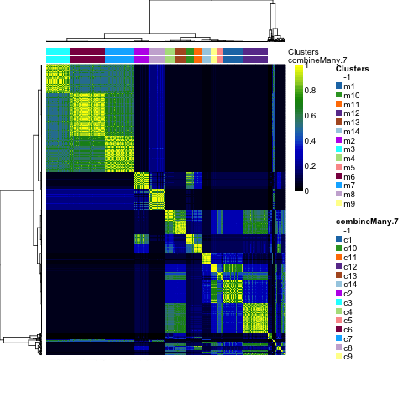
Expression Pattern Clustering
Graphic by Hector Roux de Bezieux.

Slide 46
Simultaneous Principal Curves
Initialization
(2)
(1)

Slide 47
Simultaneous Principal Curves
Update
Lineage 1
Lineage 2
X
Y
Pseudotime
Pseudotime

Slide 48
Simultaneous Principal Curves
Update
(2)
(1)

Slide 49
Simultaneous Principal Curves
Shrink
(2)
(Avg)
(1)

Slide 50
Simultaneous Principal Curves
Shrink
Lineage 1
Lineage 2
Shrinkage
Cells
Pseudotime
Pseudotime

Slide 51
Simultaneous Principal Curves
Shrink

Slide 52
Simultaneous Principal Curves
Shrink

Slide 53
Simultaneous Principal Curves
Result

Slide 54
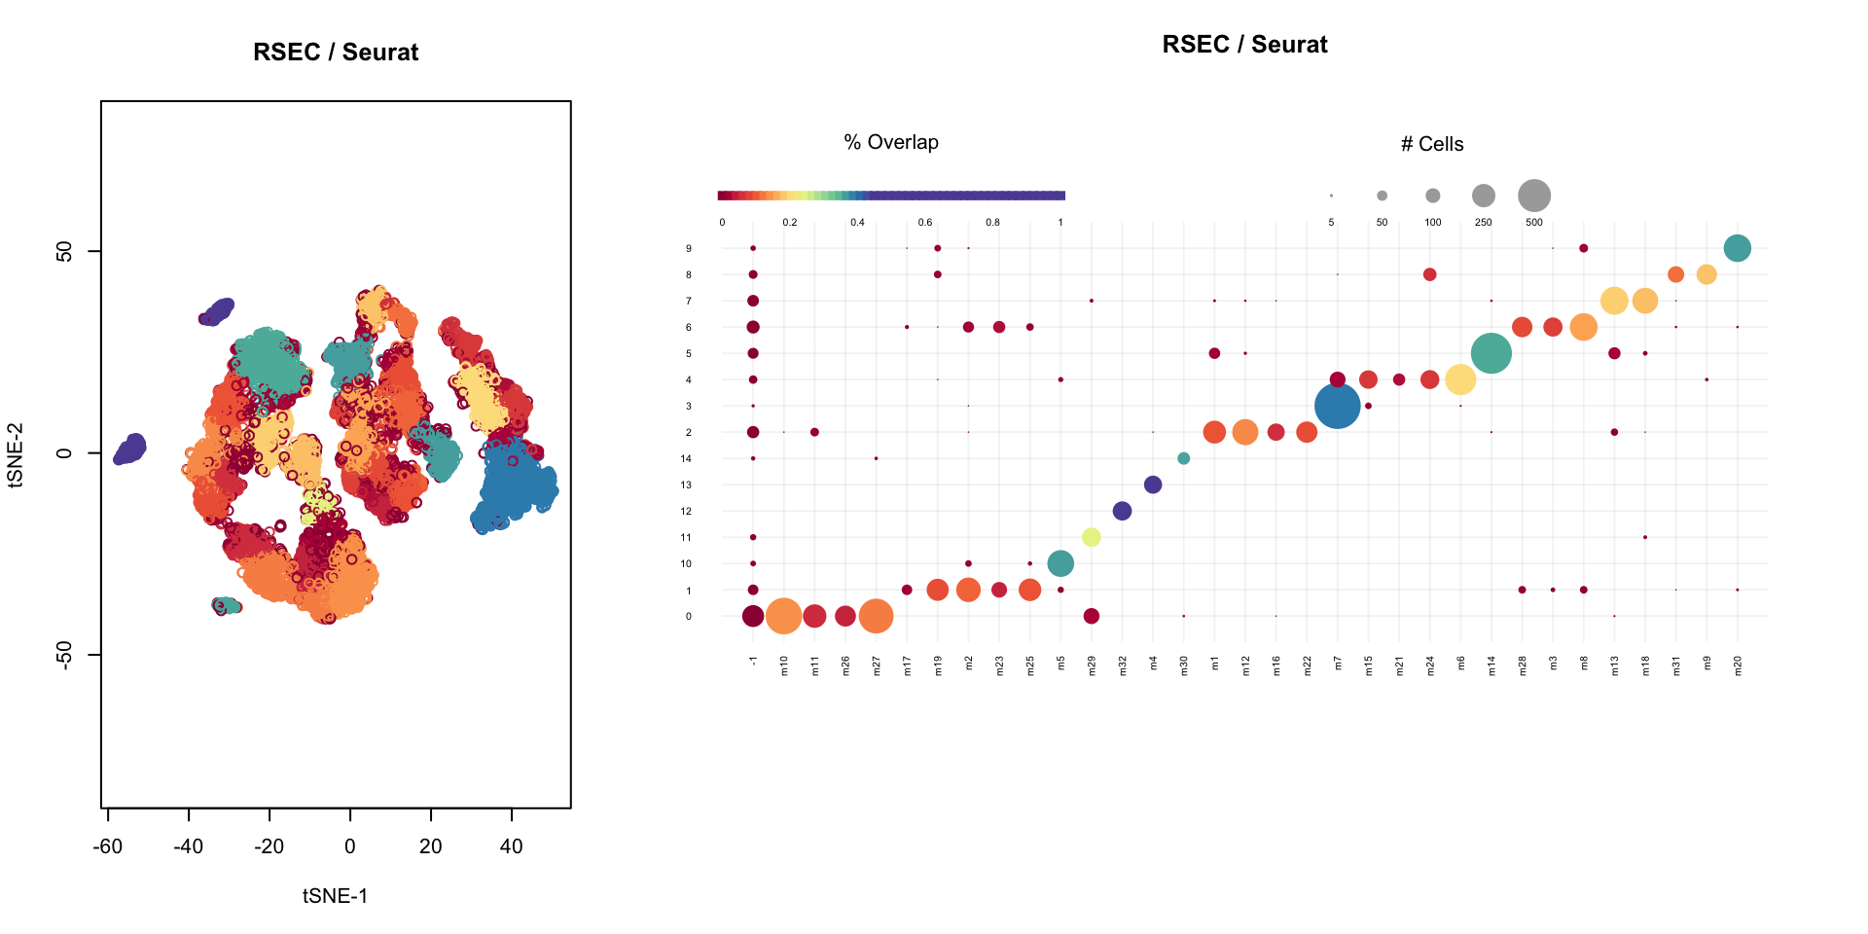
Cluster Analysis
Inhibitory Neurons
Joint work with John Ngai, Elizabeth Purdom, Koen Van den Berge, Diya Das, Rebecca Chance, Shinya Iguchi.

Slide 55
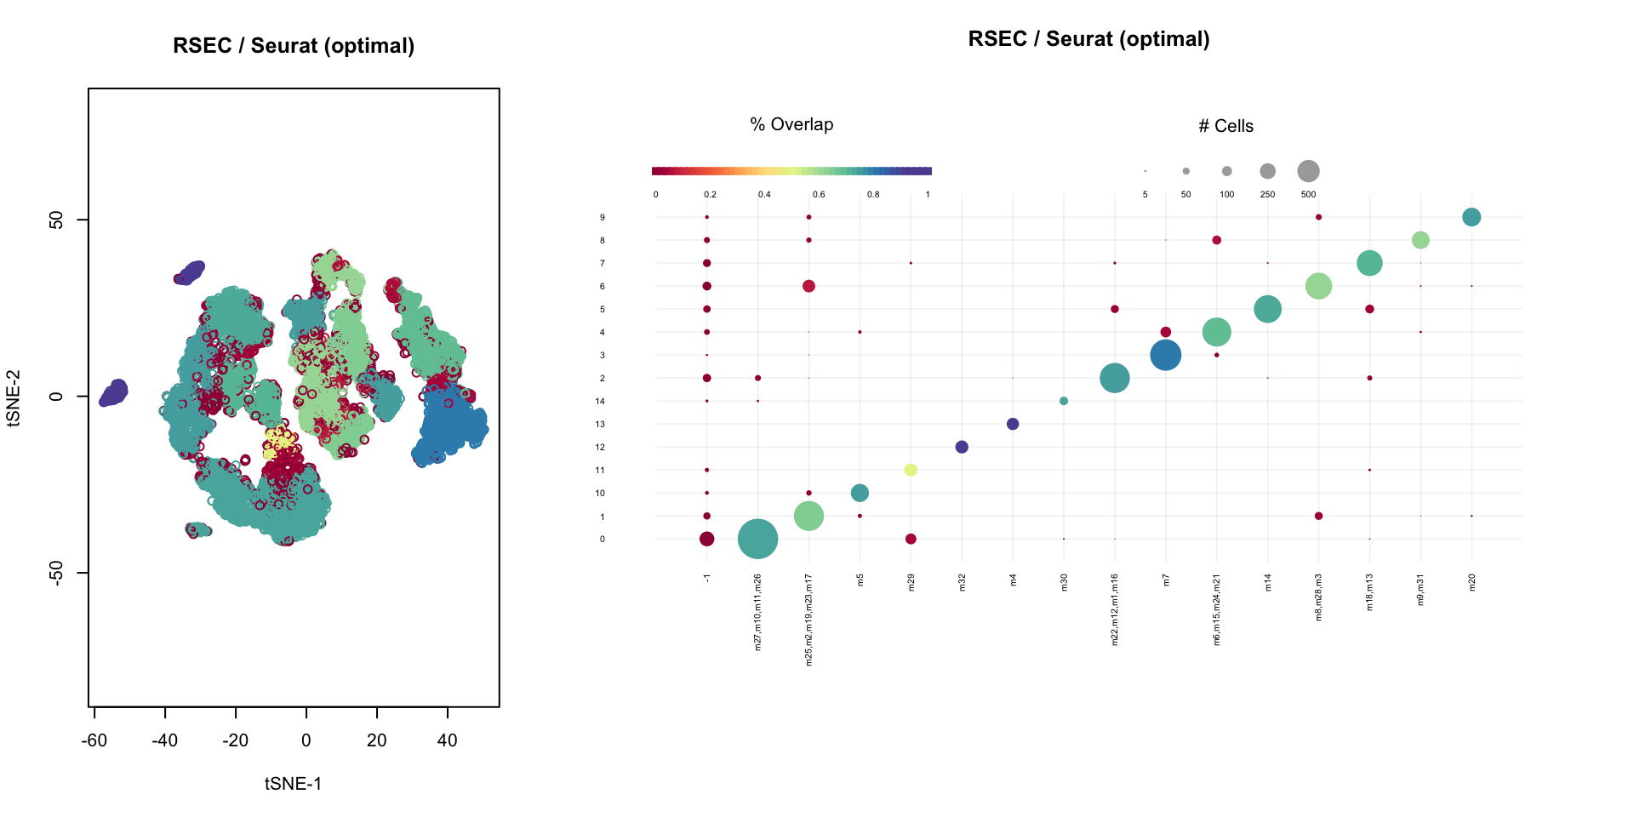
Cluster Analysis
Inhibitory Neurons
Joint work with John Ngai, Elizabeth Purdom, Koen Van den Berge, Diya Das, Rebecca Chance, Shinya Iguchi.

Slide 56
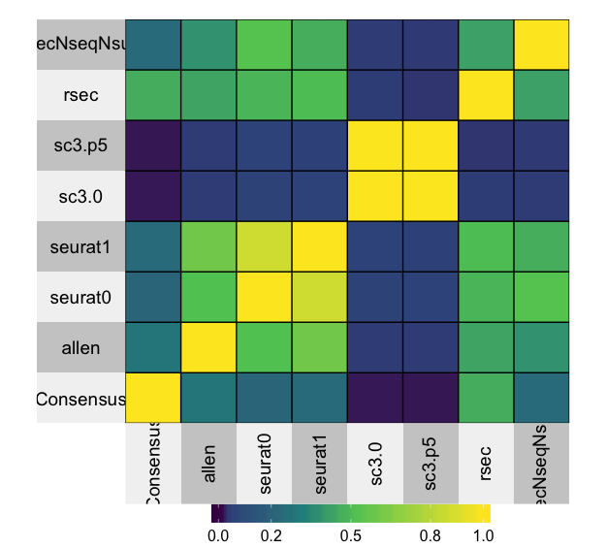
Cluster Analysis
Consensus Clustering
Adjusted Rand Index
Joint work with John Ngai, Elizabeth Purdom, Koen Van den Berge, Diya Das, Rebecca Chance, Shinya Iguchi.

Slide 57
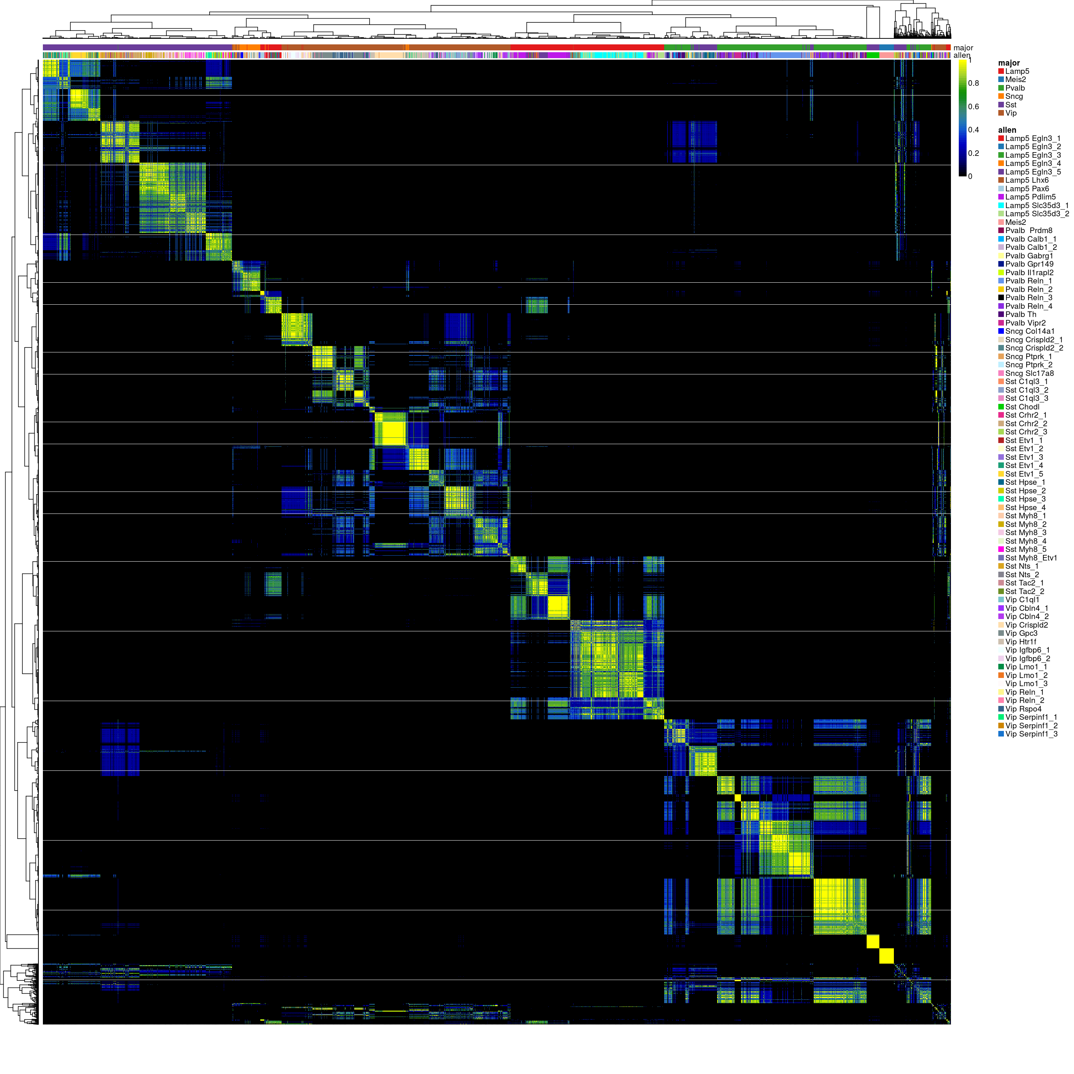
Notes:
BEFORE

Slide 58
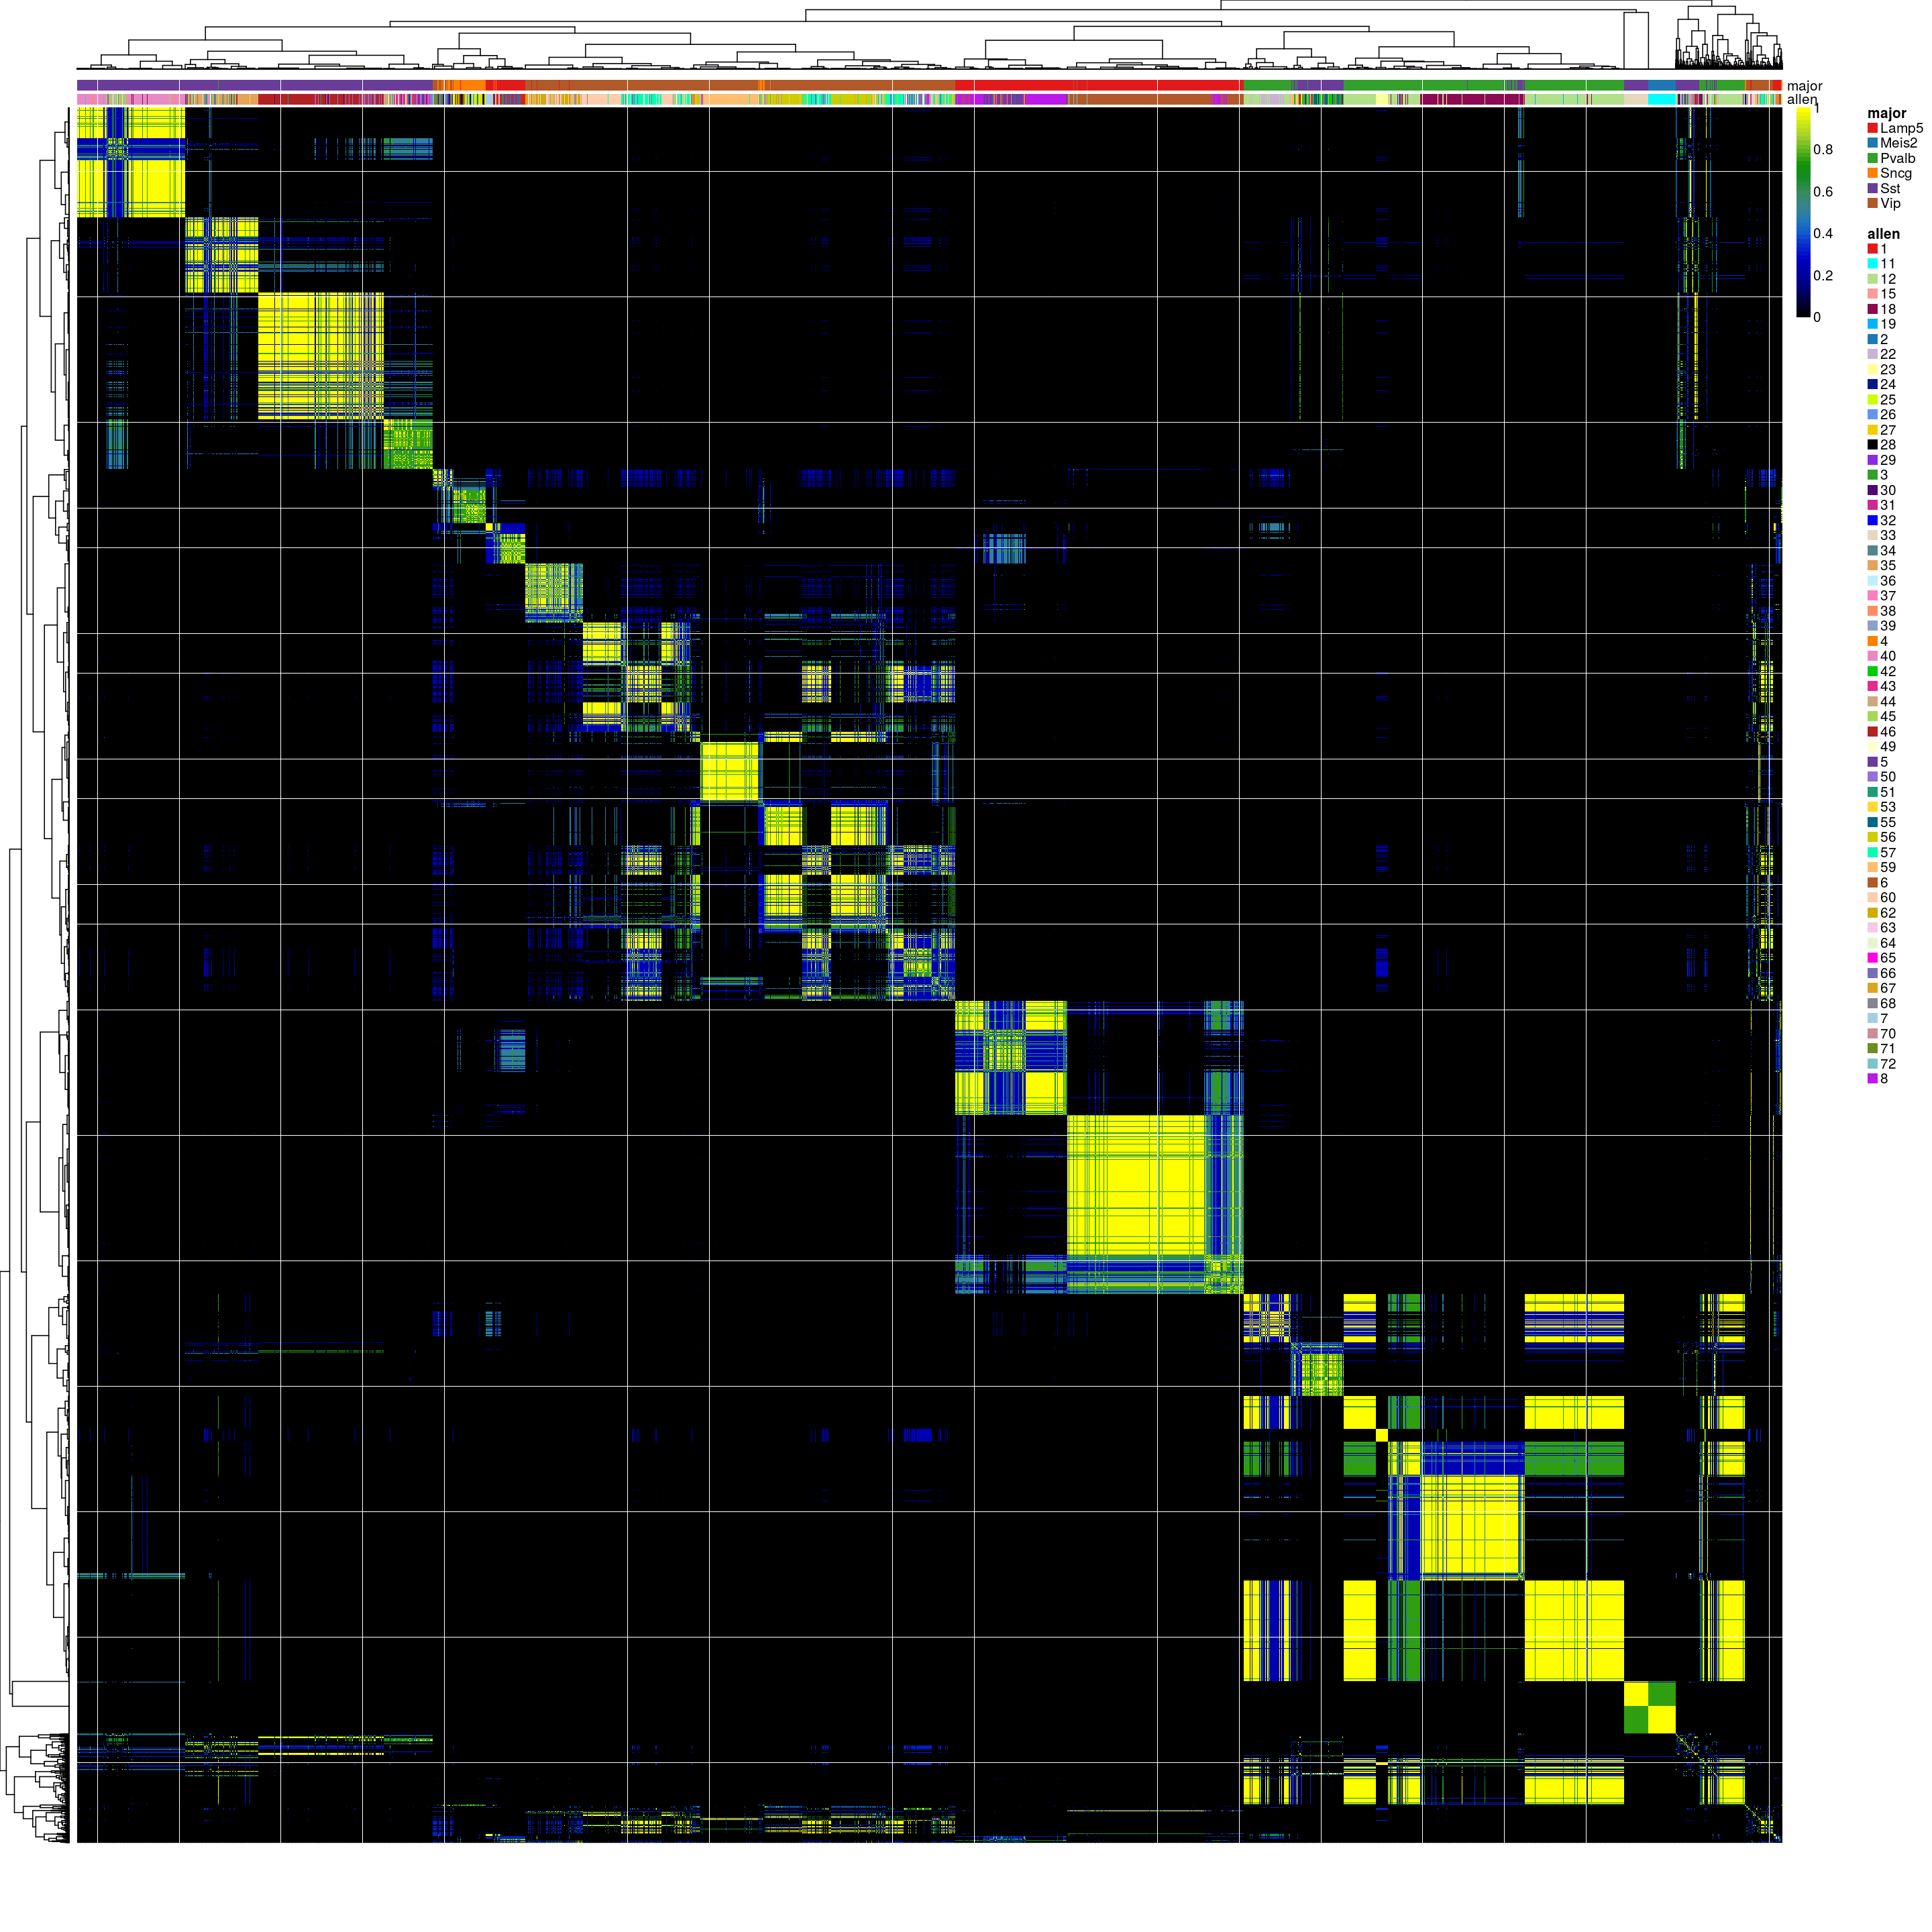
Notes:
AFTER

Slide 59
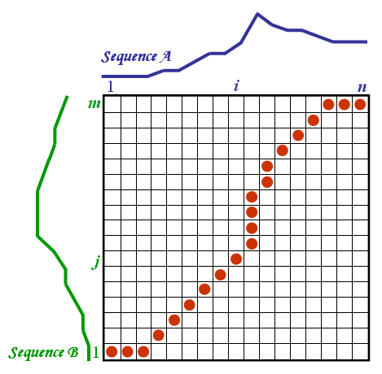
Dynamic Time Warping DE
Joint work with Lieven Clement, Koen Van den Berge, Matthieu Doutreligne, and Hector Roux de Bezieux.
Graphic: https://www.psb.ugent.be/cbd/papers/gentxwarper/DTWalgorithm.htm

Slide 60
Dynamic Time Merging
Mouse Embryogenesis Datasets
Joint work with Lin He and Martin Kinisu. Graphic by Hector Roux de Bezieux.
Notes:
cellAlign

Slide 61
Expression Pattern Clustering
log expression
Cluster 6
log expression
Cluster 8
log expression
Cluster 1
Joint work with Lin He and Martin Kinisu. Graphic by Hector Roux de Bezieux.

Slide 62
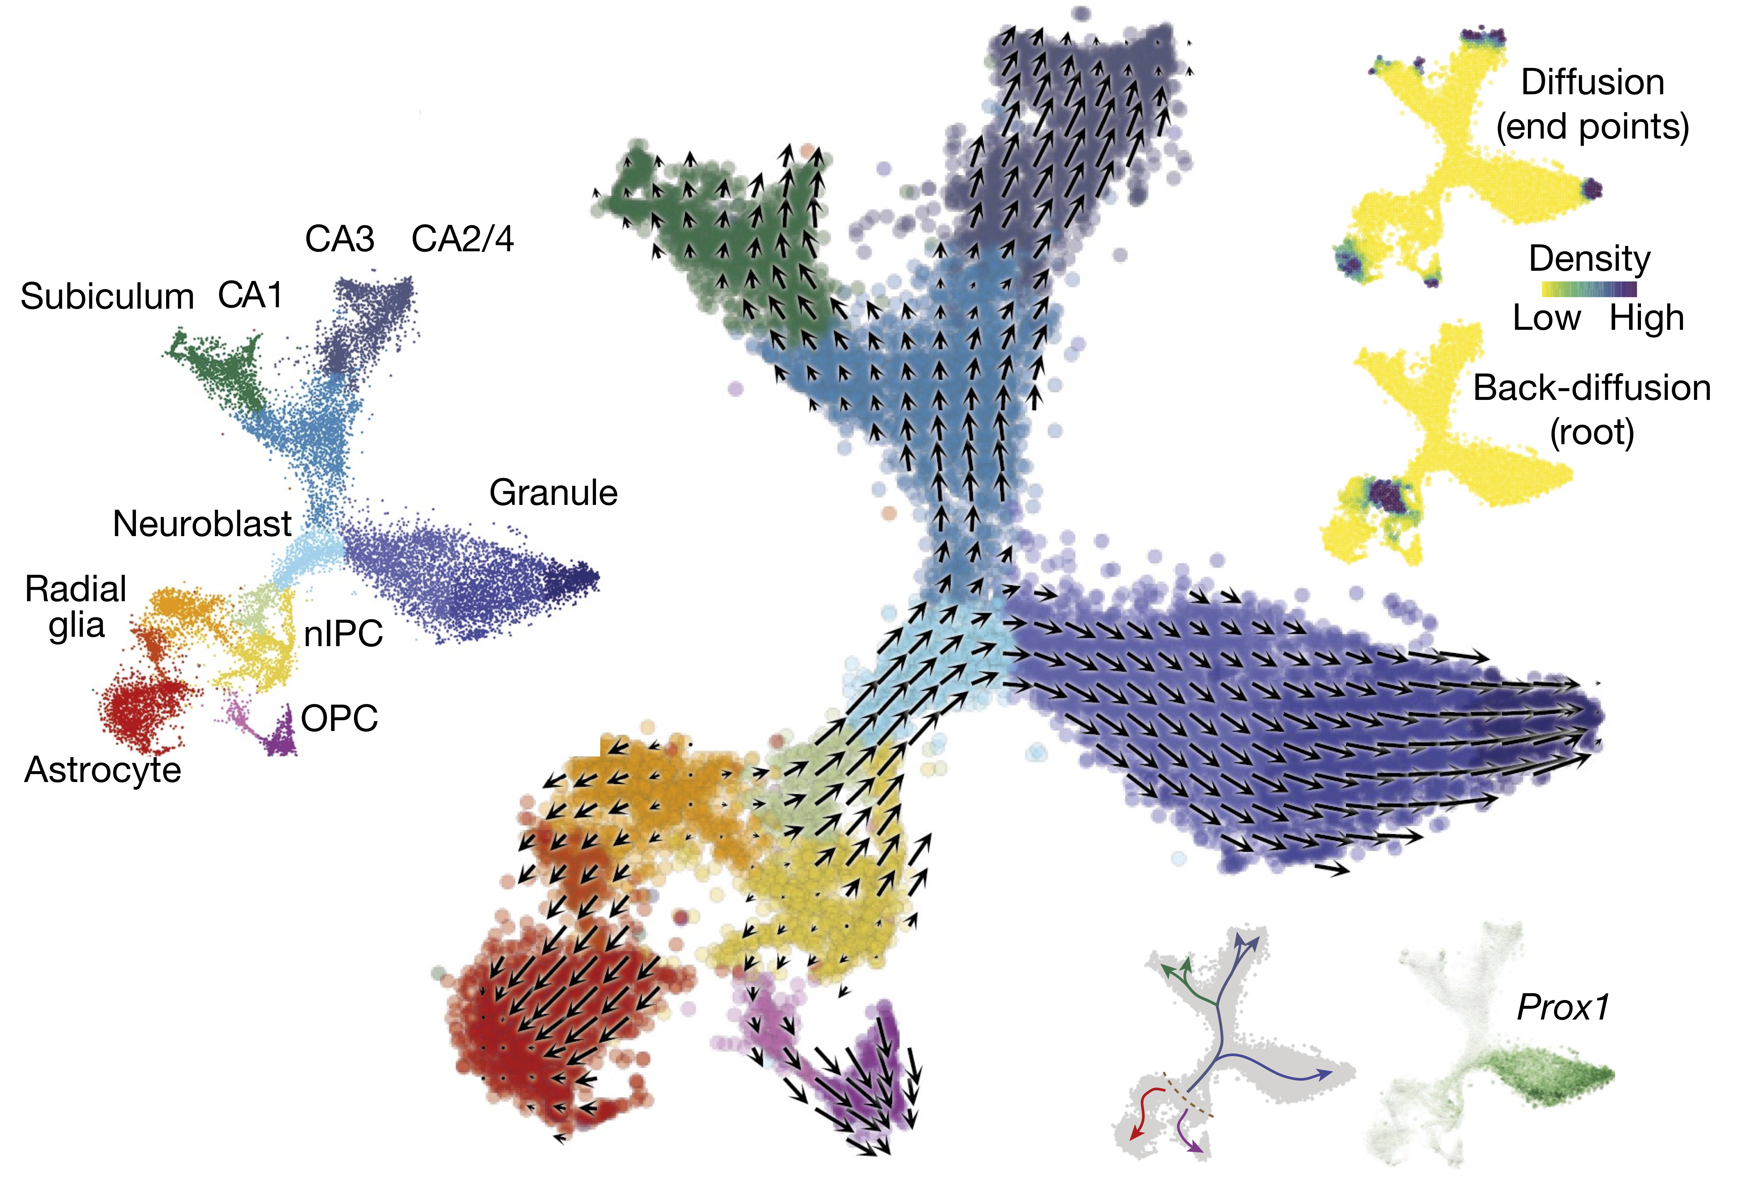
Incorporating RNA Velocity
La Manno, G., Soldatov, R., Zeisel, A., Braun, E., Hochgerner, H., Petukhov, V., Lidschreiber, K., Kastriti, M.E., Lönnerberg, P., Furlan, A., Fan, J., Borm, L.E., Liu, Z., van Bruggen, D., Guo, J., He, X., Barker, R., Sundström, E., Castelo-Branco, G., Cramer, P., Adameyko, I., Linnarsson, S., & Kharchenko, P.V. (2018). RNA velocity of single cells. Nature. 2018; Aug 23;560:494-498.

