Slide 1
Constructing tumor-specific gene regulatory networks based on samples with tumor purity heterogeneity
Pei Wang
Dept. of Genetics and Genomics Sciences
11/5/2018
BIRS

Slide 2
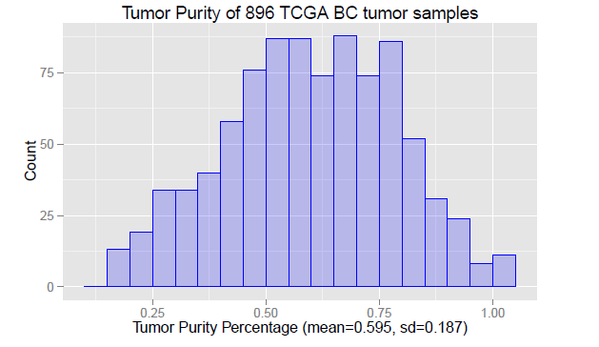
Tumor purity heterogeneity (TPH) is a common issue in many cancer studies
In clinical tumor tissue samples, tumor cells are almost always intermixed with an unknown fraction of normal cells.
Tumor purity percentage, i.e. the fraction of tumor cells, usually varies a lot across tumor samples in most existing bulk tumor profiling based cancer -omic studies.
  Tumor purity percentages among 896 TCGA (The Cancer Genome Atlas) breast cancer samples were estimated to range between 17% to 100%, with a mean at 59:6%.
  Tumor purity percentages is estimated by ABSOLUTE (Carter et. al. 2012 ) based on DNA copy number profiles.

Slide 3
TPH and omics data analysis
Since normal and tumor cells usually have substantially different genomic/proteomic characteristics, TPH, if substantial, could have profound impact on genomic/proteomic profiling.
Data analysis and results interpretation in omics studies require considerable attention to TPH.
Several methods have been proposed to estimate the fraction of tumor cells in clinical tumor samples by using
  next-generation sequencing data
    Su et. al. 2012
  gene expression
    Erkkila et. al. 2010; Shen-Orr et. al. 2010; Bolen et. al. 2011; Shoemaker et. al. 2012;
    ESTIMATE (Yoshihara et. al. 2013)
    CIBERSORT (Newman et. al. 2015)
    XCell (Aran et. al. 2018)
  DNA copy number array data
    ABSOLUTE (Carter et. al. 2012)
  Methylation array data
    Zhang et. al. 2015;
  A comprehensive review and comparison: Aaran et al (2015)

Slide 4
TPH needs to be handled in GRN analysis
Despite aforementioned encouraging progresses, to our knowledge, TPH hasn't been considered in current literatures for gene regulatory network (GRN) or co-expression network analysis.
Why one is interested in co-expression network analysis?
  System level learning is essential for understanding the molecular underpinnings of cancer
  Molecular networks are central to extracting all relevant information from the rapidly increasing volumes of omics data.

Slide 5
TPH needs to be handled in GRN analysis
When constructing GRN based on samples with diverse tumor purities, edges are likely to be estimated among genes with mean shifts between normal and tumor cells instead of gene pairs regulating each other in tumor cells.
Thus, analysis ignoring large variation of tumor purity could lead to artifacts without meaningful biological interpretation.
In this talk, we introduce a new statistical method --- TSNet --- to build tumor-cell specific networks by incorporating TPH.
Notes:
system level learning is essential for understanding the molecular underpinnings of cancer
Molecular networks are central to extracting all relevant information from the rapidly increasing volumes of omics data.

Slide 6
TSNet Model

Slide 7
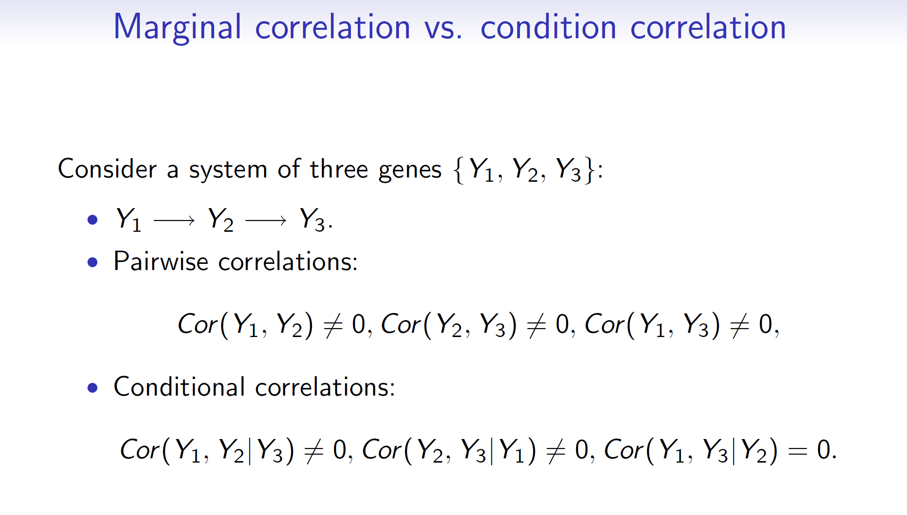
Gaussian graphical model (GGM)
GGM examines interaction among random variables through pairwise conditional correlations, i.e. two variables (nodes) are connected if and only if they are conditionally dependent given the rest of the variables.
Notes:
6,8,3,4,7,9,15

Slide 8
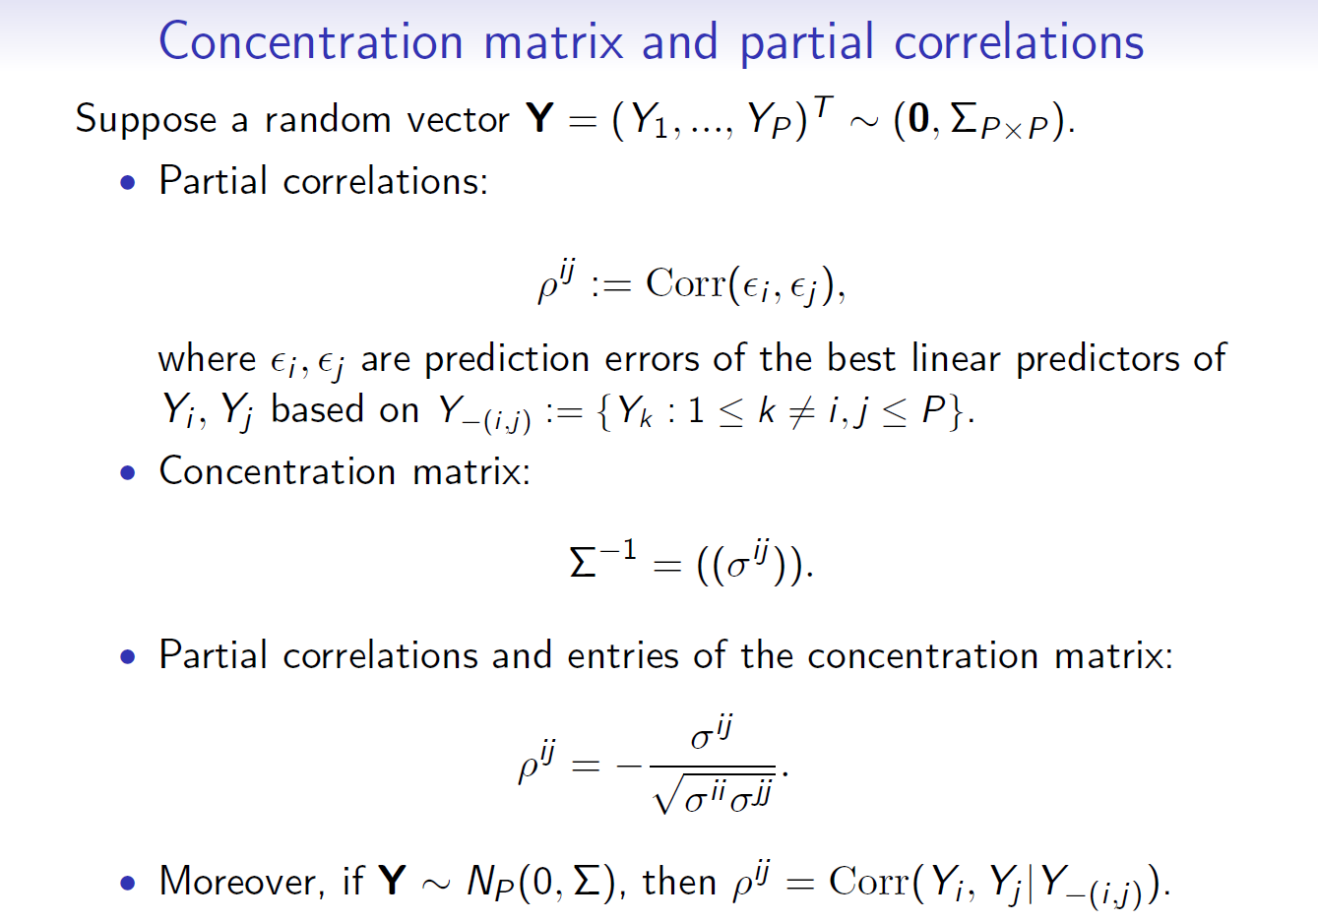
Gaussian graphical model (GGM)
In Gaussian case, conditional correlations are the same as partial correlations and non-zero partial correlations correspond to non-zero elements in the concentration matrix (inverse covariance matrix).
There are many recent works on applying high dimensional GGMs under sparsity and/or structural assumptions to infer GRNs
  Yuan et. al. 2007; Friedman et. al. 2008 (glasso);
  Meinshausen et. al. 2006 (neighborhood selection);
  Peng et. al. 2009 (space);
  Danaher et. al. 2014 (Joint Graphic Lasso);
  Peng et. al. 2010; Wang et. al. 2011; Cheng et. al. 2014;
Notes:
6,8,3,4,7,9,15

Slide 9


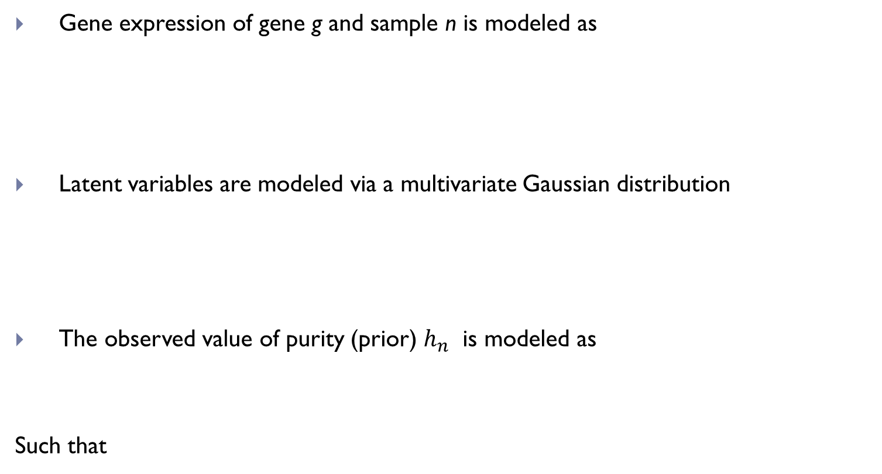
TSNet Model
Gene expression of gene g and sample n is modeled as
Latent variables are modeled via a multivariate Gaussian distribution
The observed value of purity (prior) $h_{n}$ is modeled as
Such that
tumor
normal
tumor
normal

Slide 10



TSNet Model
GOAL: estimate
by maximizing the joint likelihood
with the penalty function being the L1 norm:
which induce sparsity for the overall network.

Slide 11

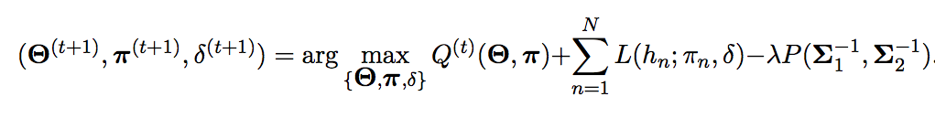
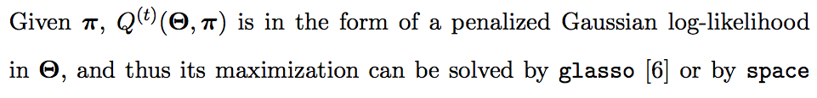
EM Algorithm
Expectation STEP
Given current estimate of parameters, derive
M STEP
Solve the optimization problem

Slide 12
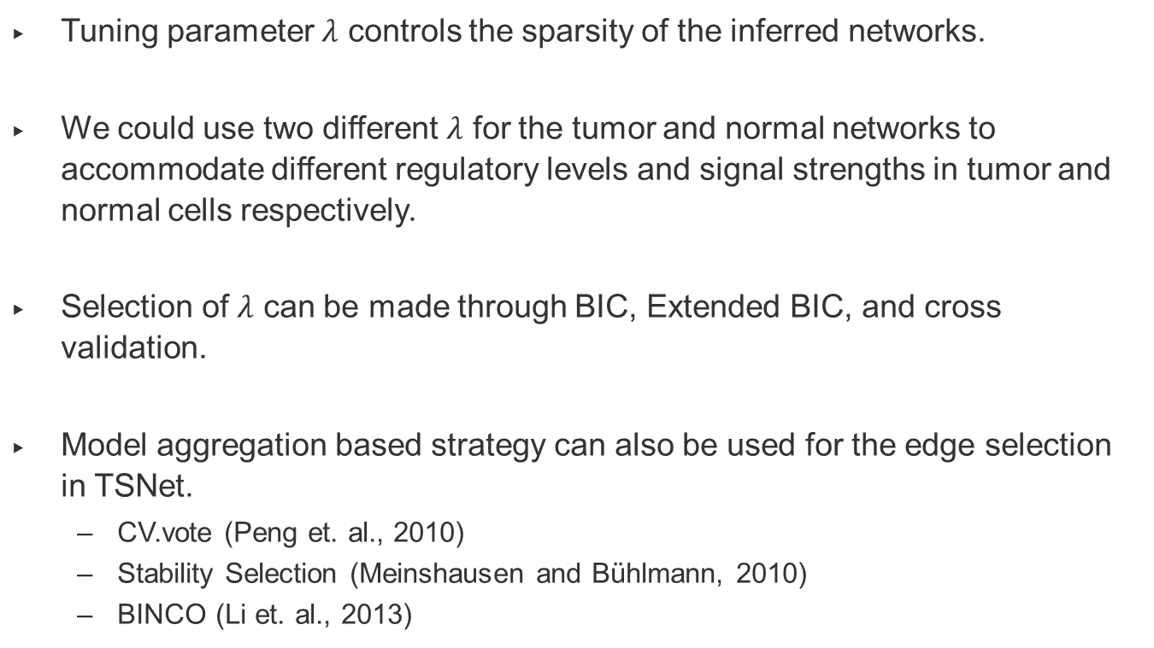
Tuning
Tuning parameter $λ$ controls the sparsity of the inferred networks.
We could use two different $λ$ for the tumor and normal networks to accommodate different regulatory levels and signal strengths in tumor and normal cells respectively.
Selection of $λ$ can be made through BIC, Extended BIC, and cross validation.
Model aggregation based strategy can also be used for the edge selection in TSNet.
  CV.vote (Peng et. al., 2010)
  Stability Selection (Meinshausen and Bühlmann, 2010)
  BINCO (Li et. al., 2013)

Slide 13



Two Steps towards a more efficient model
STEP1. Estimate Tumor Purity based on “aggregated marginal distributions” of genes:
STEP2. Considering Tumor Purity as fixed we estimate covariance structure:

Slide 14

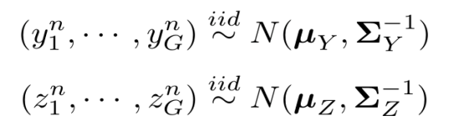
Overview of TSNet
Normal Cell
Infiltration
Other Methods for Tumor Purity Estimation
Estimate
Tumor Purity
Tumor Purity
Prior
Tumor Cells
Step 1
RNASeq Data (Model)
Final
Tumor Purity
Step 2
Estimate
Networks
purity
latent
Observed
gene expression for
sample n and gene g
Estimate precision matrices for latent variables
using Graphical Lasso
Notes:
14

Slide 15
Application on TCGA ovarian cancer data

Slide 16
Application on TCGA Ovarian Cancer Data
RNAseq profiles (firehose, level 3) for 281 ovarian cancer tumor samples.
Purity Inference
Estimate tumor purity for 281 samples using a subset of ~ 200 genes (stromal and immune genes, Yoshihara et al. 2013)
Network Inference
Select 1,000 genes with highest inter-quantile-range across all samples.
Apply TSNet to derive the Tumor/Normal Specific Network.
Apply Graphical Lasso (Yuan et. al. 2007; Friedman et. al. 2008) to estimate one network --- MixNet.

Slide 17
Network estimation --- model selection
Since applying BIC to TSNet and mixNet on this data leads to networks with dramatic different sizes, to facilitate the comparison between these two methods, we chose to adopt a different strategy.
For each network type (i.e., TSNet-tumor, TSNet-normal and mixNet)
  Consider networks of different dimension ranging from 500 to 3,500 edges through varying the tuning parameters in each method.
  Selected edges which were contained in at least 80% of the above networks.
Estimated network via TSNet: Tumor (707 edges) and Normal (793)
Estimated network via MixNet: 993 edges

Slide 18
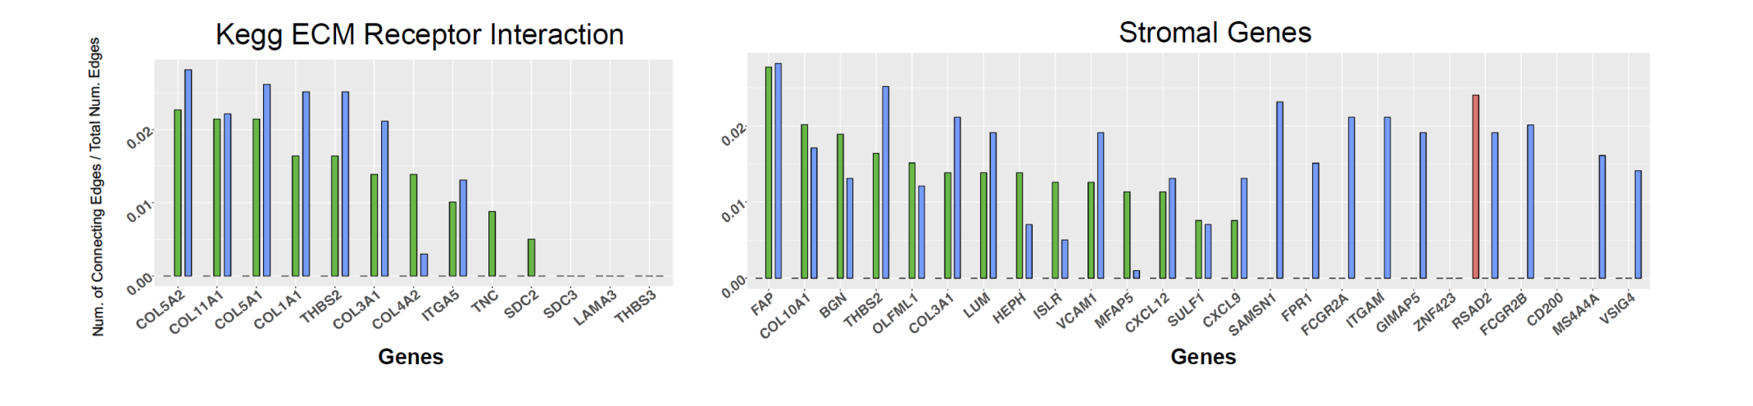
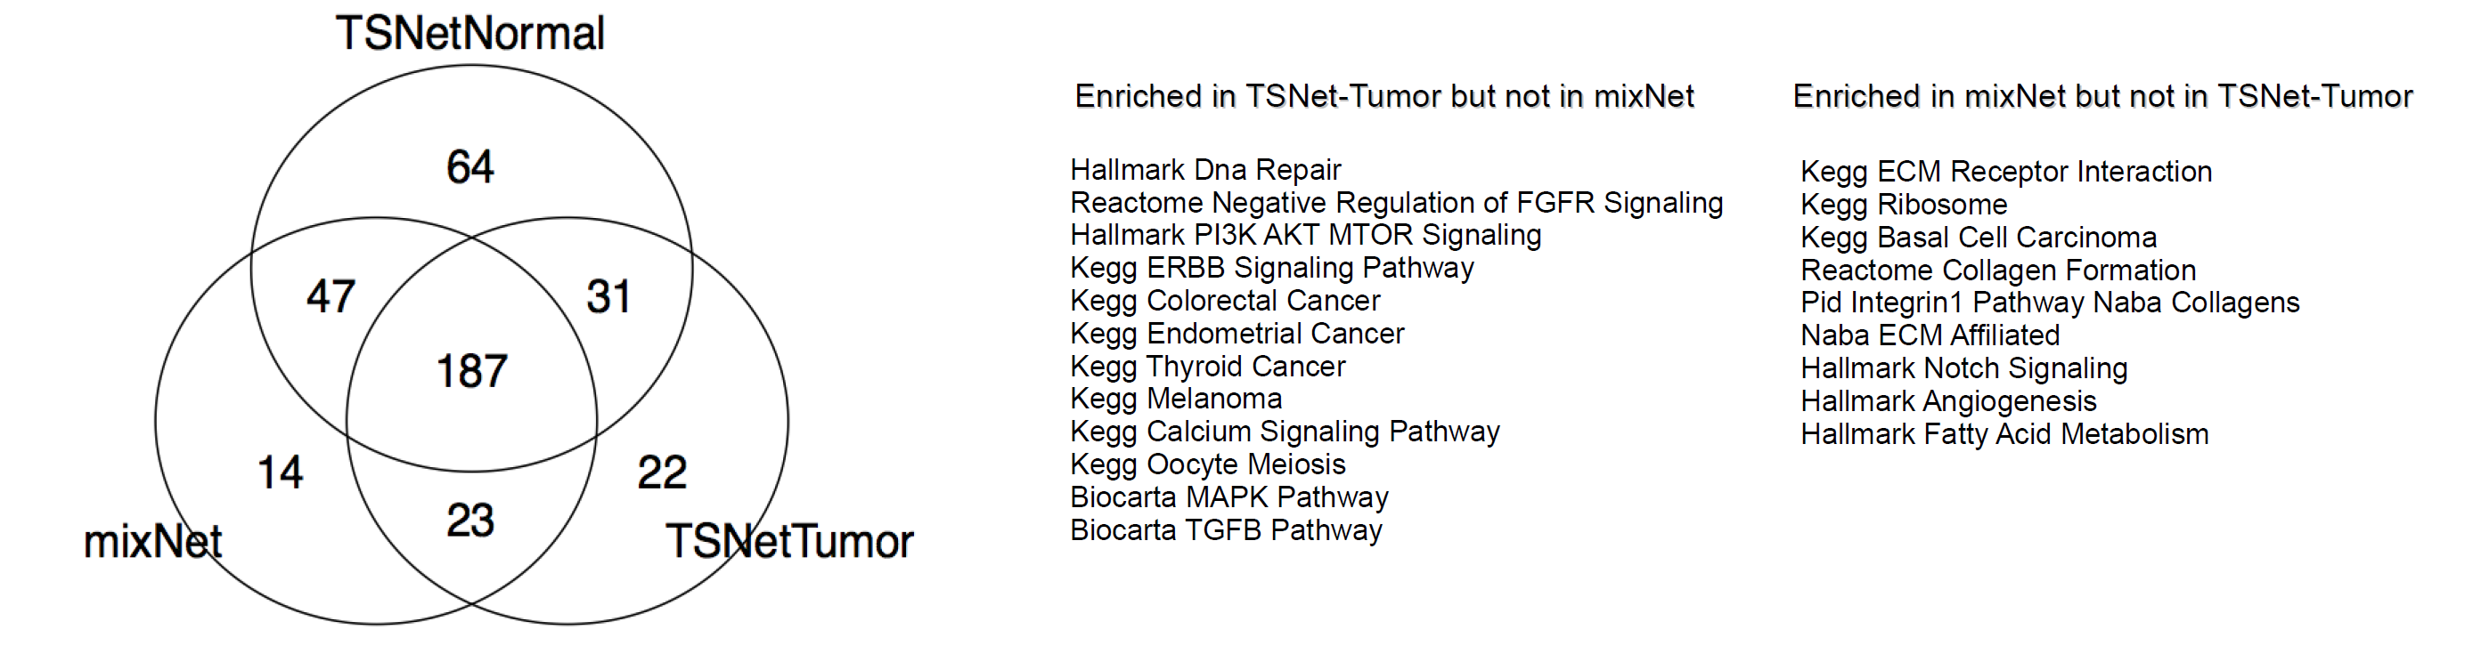
Pathway enrichment of highly connected genes
Red: TSNet-Tumor; Green: TSNet-Normal; Blue: MixNet
442 MSigDB pathways (Canonical & Hallmark, overlap>5)
Notes:
MSigDB Canonical
[27] and Hallmark [26] pathways. In particular, we focused on 442
MSigDB pathways containing at least 5 of the 1; 004 genes utilized in

Slide 19
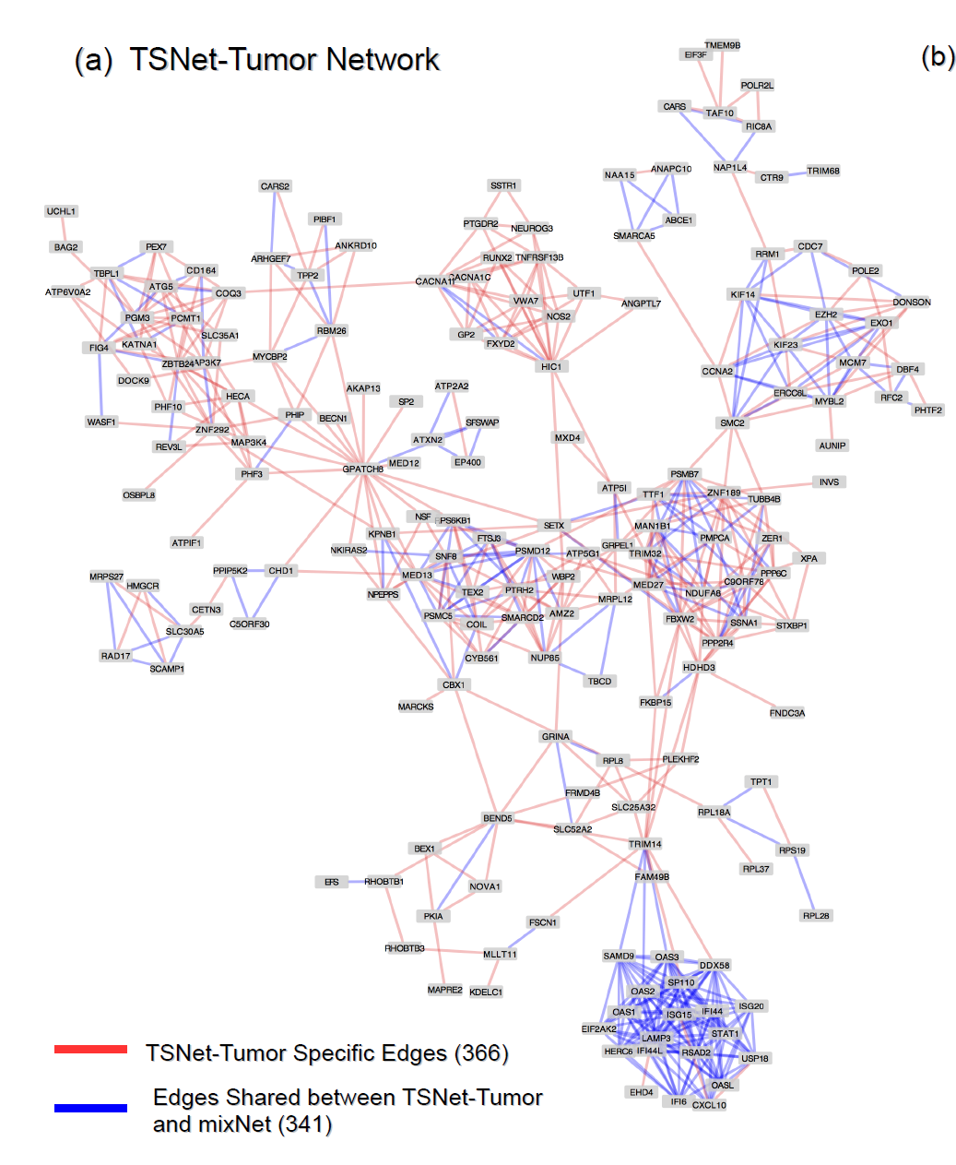
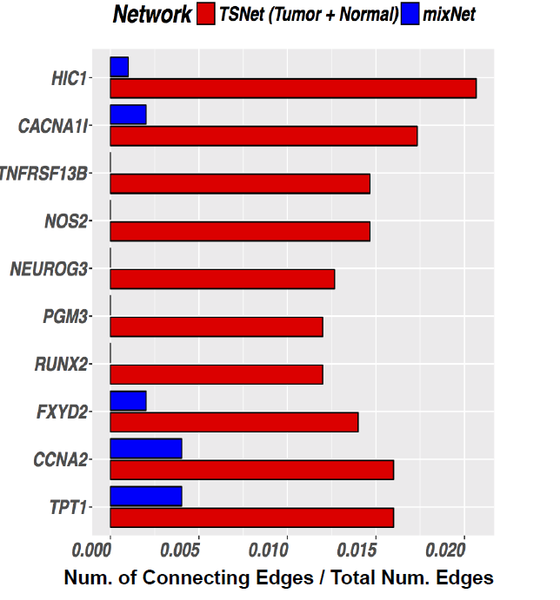
TSNet help to recover tumor specific biological activities that cannot be detected by mixNet
Top 10 hub genes in TSNet networks which were poorly connected in mixNet.

Slide 20
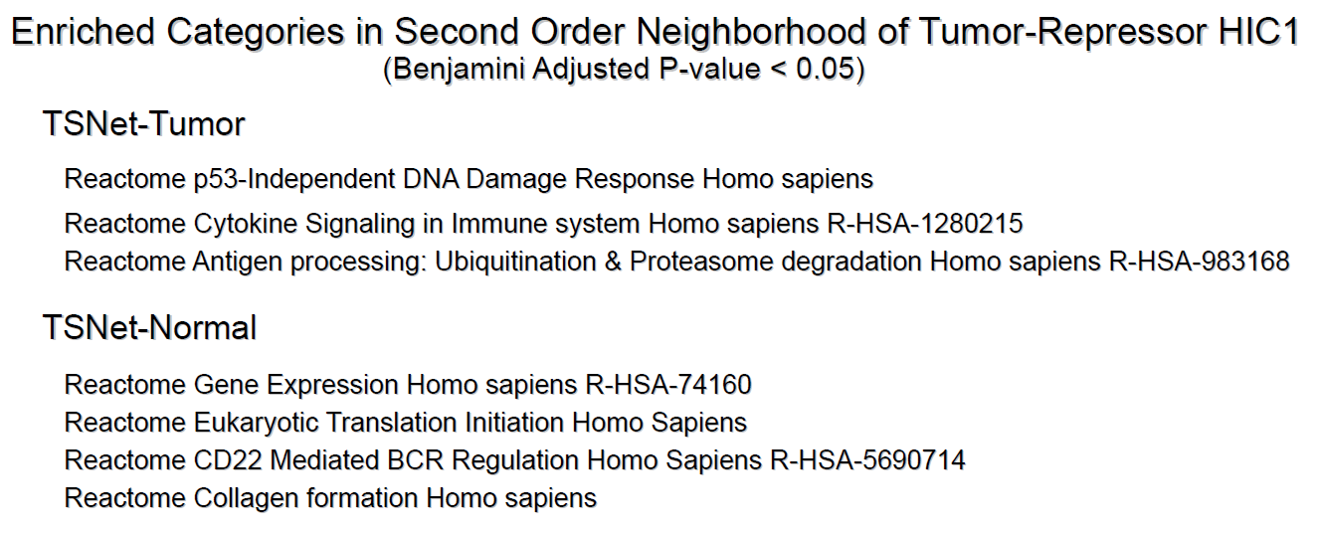
TSNet results reveal different roles of HIC1 in tumor and normal cells
DNAdouble-strand breaks activates the tumor-repressor HIC1 to regulate DNA repair (Dehennaut et. al. 2013)
HIC2 is not only a hub-gene in TSNet-tumor but also a hub-gene in TSNet-normal.
Notes:
Vanessa Dehennaut, Ingrid Loison, Marion Dubuissez, Joe Nassour, Corinne
Abbadie, and Dominique Leprince. Dna double-strand breaks lead to activation
of hypermethylated in cancer 1 (hic1) by sumoylation to regulate dna repair.
Journal of Biological Chemistry, 288(15):10254–10264, 2013.
KumKum Khanna and Stephen P Jackson. Dna double-strand breaks: signaling,
repair and the cancer connection. Nature genetics, 27(3):247, 2001.
HIC2 involves the interaction with tumor micro-enviorment, and was recently shown as a novel regulator of intestinal immune homeostasis.[ref: The transcriptional repressor HIC1 regulates intestinal immune homeostasis]. And it has been suggested that the microenvironment also influenced HIC1 expression in tumor cells.[ ref: Signification of Hypermethylated in Cancer 1 (HIC1) as Tumor Suppressor Gene in Tumor Progression]”

Slide 21
Summary
We proposed a new method – TSNet – which takes into account tumor purity heterogeneity when estimating gene-gene interaction networks.
  Through synthetic experiments, we demonstrated that TSNet can outperform the GLasso which does not take into account TPH for inference
We applied TSNet to TCGA ovarian cancer data and showed that:
1) We can derive a tumor purity estimate that better correlates with Leukocytes signature than other algorithms
2) TSNet-tumor and TSNet-normal helps to reveal gene activities specific to tumor cells and normal cells
Paper: F. Petralia et. al. Bioinformatics, 2018
R-package: TSNet is available through CRAN.

Slide 22
Summary
As future work we would like to account for other cell types when inferring gene-gene networks. It is well known that tumor cells are not homogeneous – yet are the mixture of multiple cell types

Slide 23

Acknowledgement
CPTAC-PGDAC at Mount Sinai
Statistical Modeling of Proteomics Data Pei Wang Lin S. Chen Weiping Ma Jiebiao Wangc
Network Based System-biology learning Eric Schadt Pei Wang F. Petralia Boris Reva Zhidong Tu Dmitry Rykunov Rileen Sinha Umut Ozbek Rui Chang Jun Zhu
Cancer Biology/oncology Amanda Paulovich Peter Dottino John A. Martignetti Raja M Flores Suresh Ramanathan
Software Engineering Y. Antipin Hui Li
TSNet
Francesca Petralia, Mount Sinai
Li Wang, Mount Sinai
Jun Zhu, Mount Sinai
Jie Peng, UC Davis
NIH Grants

Slide 24
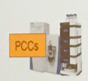
Role of Mount Sinai Team in the CPTAC-PGDAC network
Protein/PTM Identification and Quantification
Pathways/Network
Phenotype Data
(disease status, Subtype, patient survival, mutation status, treatment responses …)
III.1 Phenotype
Association tests
Signatures,
Pathways associated
With phenotypes
Proteomics
Intensity Tables with
NAs imputed
Analysis
III.2 Network
Analysis
Cancer Subtypes
II. Data
Imputation
Modules,
Hub structures
I. Protein
Identification
and Quantification
Raw Proteomics
Data
Proteomics
Intensity Tables
III.3 Multilevel
Analysis
DNA → RNA
→ Protein
microRNA/Protein
Association;
...
Raw Genomics
Data
Processed
Genomics Data
CNV/Protein
Association
…….
The other four PGDACs
Raw (Input) data/results shared across all the PGDACs.
Intermedia data/results shared across all the PGDACs.
Output for further biological interpretation; Shared across all PGDACs.

Slide 25
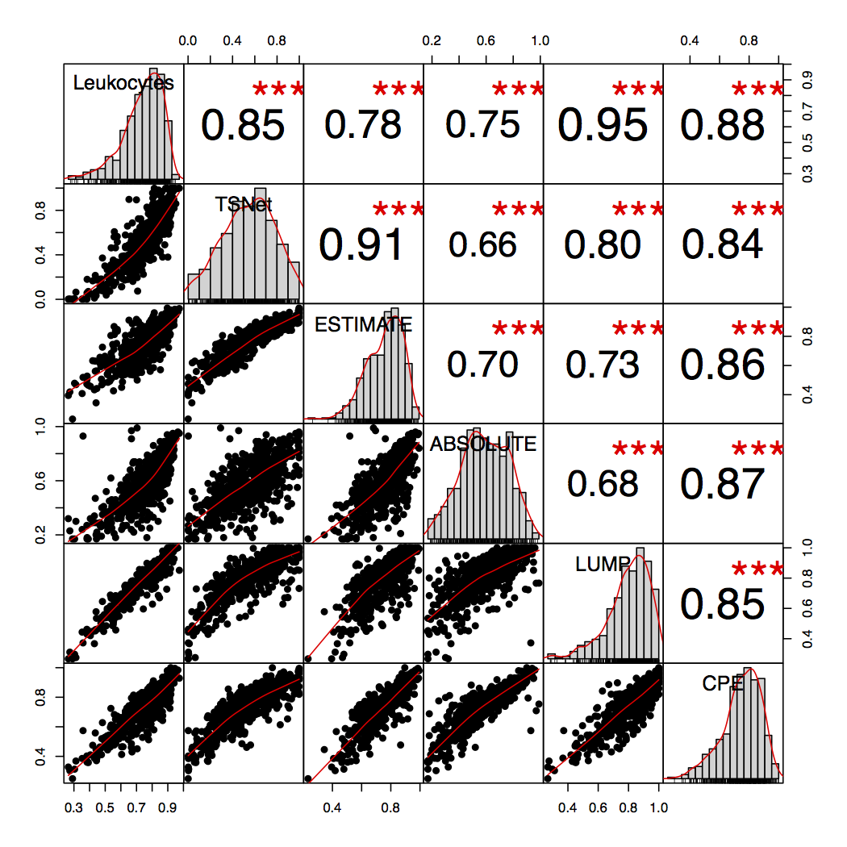
TSNet purity better correlate with Leukocyte signature compared to Absolute and Estimate
Leukocyte signature based on DNA methylation data
Validation
TSNET
- RNAseq data
ESTIMATE
- RNAseq data
ABSOLUTE
- CNV DATA
LUMP
- DNA Methylation
CONSENSUS
- ESTIMATE's purity
- ABSOLUTE's purity
- LUMP's purity
Models and Input for Purity Estimation
Aaran et al (2015)

Slide 26
Brief History of CPTAC
2006-2011 CPTAC 1 (Technology validation)
  Established the standards for proteomics profiling
  Evaluated the feasibility of large scale proteomics projects
2011-2016 CPTAC 2 (Pilot)
  Breast, Ovarian, Colon (Leverage existing specimen/results from TCGA)
  Flagship papers
    Breast, Nature(2016)
    Colon, Nature (2015)
    Ovarian, Cell (2016)
  Data resources have been downloaded word widely.
2016-2022 CPTAC 3 (Large-scale proteomic/genomic profiling)
  5-6 tumors
  200 sample for each tumor
  Sample specimen are collected using protocols optimized for protein profiling.

Slide 27


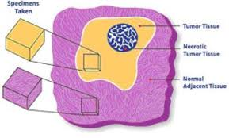
CPTAC3 Data Resources
6 tumors
  Kidney, Endometrial, Lung, Pancreatic, GBM, Liver (China)
200 sample for each tumor
Clinical
Phenotype
and
Outcomes
WGS/WES
WGS/WES
Methylation
RNAseq
MicroRNA
Global-proteomics
Phospho-proteomics
WGS/WES
RNAseq
MicroRNA
Global-proteomics
Phospho-proteomics

Slide 28
CPTAC3 Structure (2016-2021)
3 Proteome Characterization Center
  Broad Institute
  PNNL
  John Hopkins
1 Genomic Characterization Center
  Broad Institute
Bio Specimen
Collection networks
Bio Specimen
Center
5 Proteogenomic Data Analysis Center (PGDACs)
  Broad Institute
  NYU+ Washington U+PNNL
  BCM + U of Miami + UCSF
  Michigan University
  Mount Sinai (Pei Wang, Eric Schadt)
Data Coordinate Center

Slide 29
PGDAC at Mount Sinai --- Rational
We strongly believe that deep system level learning is essential for understanding the molecular underpinnings of cancer
Molecular networks are central to extracting all relevant information from the rapidly increasing volumes of omics data.
Notes:
A key focus of our PGDAC is system level learning, as system level learning is essential to understand the molecular mechanism underlying tumor initiation and development. We will employ network approaches, which are powerful tools to characterize the relationships among genes and proteins in a global manner.
Many recent works have convincingly demonstrated the power of network based system learning to guide mechanistic and translational investigation¹⁵⁻¹⁷

Slide 30
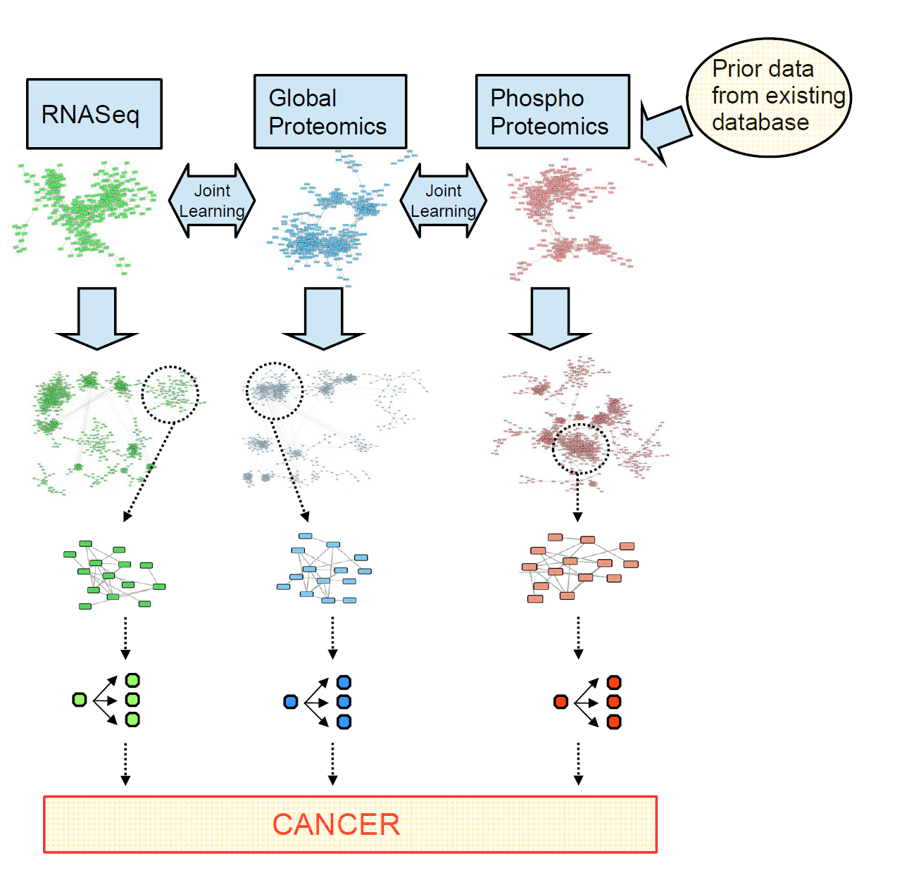
Network based system learning
Joint learning of
multiple networks
Can handle large number
of genes/proteins
Identify
Network Modules
Reduce dimensionality
Refine network by
Taking into account
tumor heterogeneity
Driver Analysis
Find modules linked to disease phenotype and survival

Slide 31
Network based system learning
Joint learning of
multiple networks
Can handle large number
of genes/proteins
Danaher, et. al, 2014 JRSSB
Petralia et al, 2015, Bioinformatics
Petralia et. al. 2016, J. of Proteomics Research
Petralia et. al. 2017, Bioinformatics
TSNet, Petralia et. al. 2018, Bioinformatics
Danaher, et. al, 2014, Biometrika
Lin et. al., 2017, Annals of Applied Statistics
Identify
Network Modules
Reduce dimensionality
Refine network by
Taking into account
tumor heterogeneity
Driver Analysis
Find modules linked to disease phenotype and survival

Slide 32
Outline
Overview
  Clinical Proteomic Tumor Analysis Consortium (CPTAC)
  CPTAC ProteoGenomic Data Analysis Center (PGDAC) at Mount Sinai
    Network based system learning of proteogenomic integration.
TSNet (Tumor Specific Network)--- A new method for constructing tumor specific gene co-expression networks

Slide 33
CPTAC, the Complementary Sibling of TCGA
Clinical Proteomic Tumor Analysis Consortium (CPTAC) is a comprehensive and coordinated effort to accelerate the understanding of the molecular basis of cancer through the application of robust, quantitative, proteomic technologies and workflows.
National Cancer Institute (NCI) launched CPTAC to
  1: Identify and characterize the protein inventory from tumor and normal tissue biospecimens
  2: Integrate genomic and proteomic data from analysis of common cancer biospecimens
  3: Develop assays against proteins prioritized in the discovery stage as potential biomarker candidates
  4: Perform testing of verification assays in relevant cohorts of biospecimens

Slide 34
Simulation Experiments

Slide 35
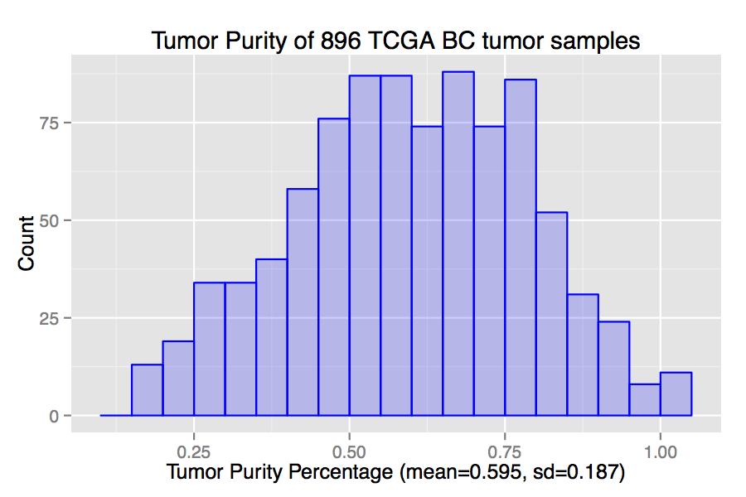

Data Generation
Sample purity from a Beta distribution with mean 0.5 and
variance 0.04 to mimic TCGA breast cancer purity
Randomly draw two networks (Tumor and Normal) of dimension 1,000 from a power law distribution
Sample latent variables
Derive observed protein expression
Observed purity
Generate 10 data sets containing 200 observations each
Observed data
Notes:
35

Slide 36
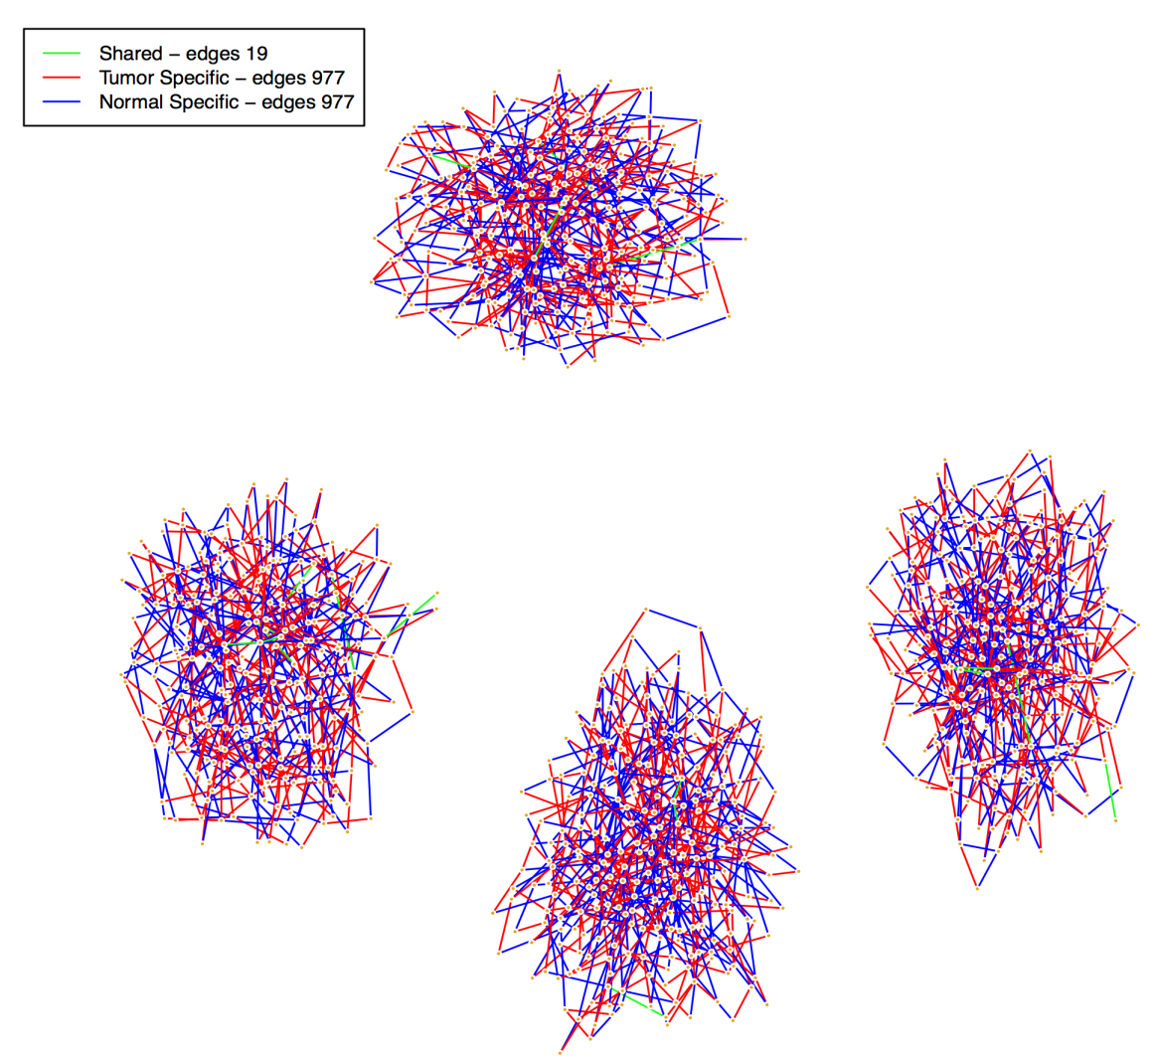
Topology of Normal and Tumor Networks
We followed Danaher et al (2014) to sample networks from the power law distribution
Basically, we divided nodes into 4 groups and randomly sampled each sub-network from power law
The resulting tumor and normal network consisted of 996 edges each with 19 edges shared across the two networks
Based on this network topology we simulated 10 replicates with 200 observations each

Slide 37
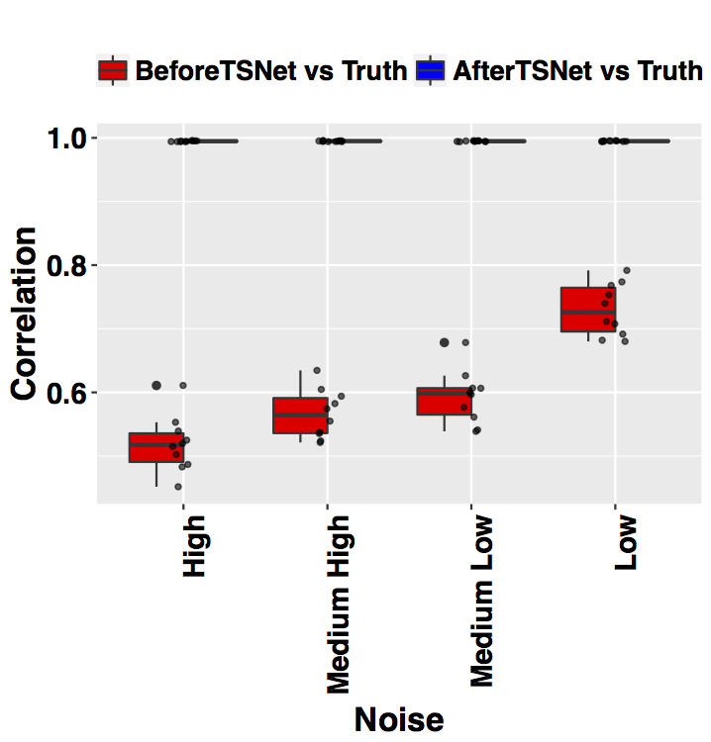
(1) Tumor Purity Estimation
Correlation between TSNet purity and truth for 10 replicates and different noise levels
For sake of efficiency, we estimate the tumor purity and the networks in two different steps.
First, tumor purity is estimated by considering genes with a diagonal covariance matrix.
For any noise level in prior estimate, TSNet is able to provide tumor purity close to the truth
Notes:
37

Slide 38
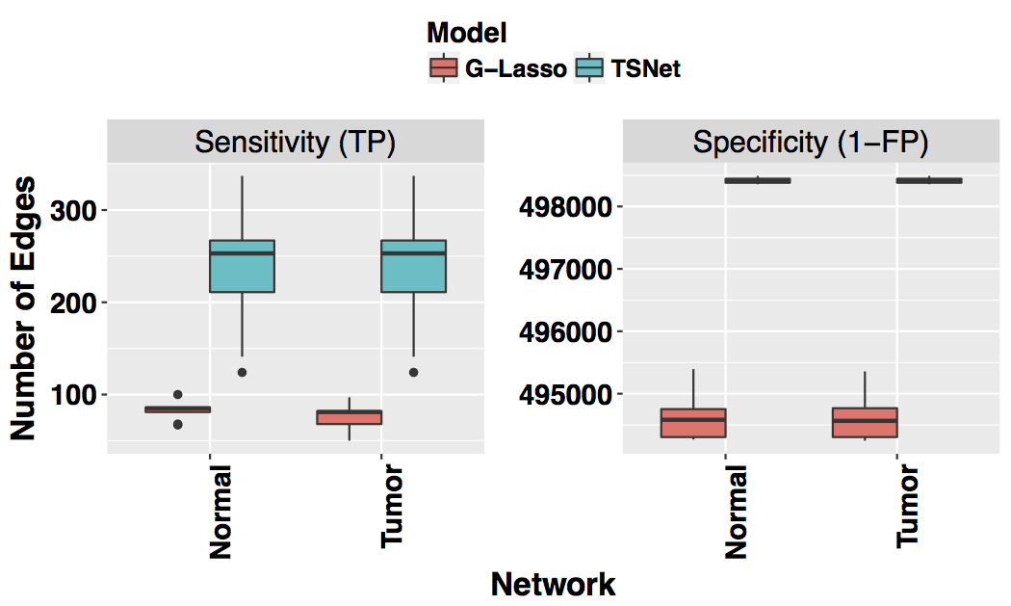
(2) Network Estimation
Estimate tumor and normal network with TSNet.
Estimate one network with Glasso.
Penalization parameters of both models were selected via BIC
Sensitivity and Specificity over 10 replicates:

Slide 39
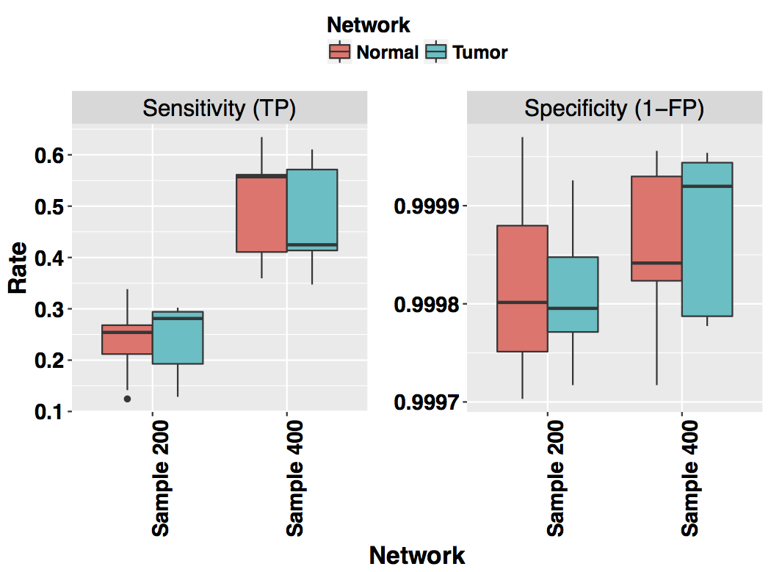
Impact of sample sizes
Increase sample size from 200 to 400.
For each sample size, generate 10 replicates.
Sensitivity doubles, Specificity remains stable

Slide 40
Application on TCGA Ovarian Cancer Data
RNAseq profiles (firehose, level 3) for 281 ovarian cancer tumor samples.
Purity Inference
Estimate tumor purity for 281 samples using a subset of ~ 200 genes (stromal and immune genes)
Network Inference
Select 1,000 genes with highest inter-quantile-range across all samples.
Apply TSNet to derive the Tumor/Normal Specific Network.
Apply Graphical Lasso to estimate one network --- MixNet.

Slide 41
Estimate tumor purity percentages of TCGA ovarian tumor samples
Yoshihara et al (2013) proposed ESTIMATE
- Derive tumor purity from gene expression data
- Focus on a subset of ~200 genes (immune and stroma) based on DNA methylation data
Following ESTIMATE, we also focus on these ~200 genes to estimate Tumor Purity.

Slide 42
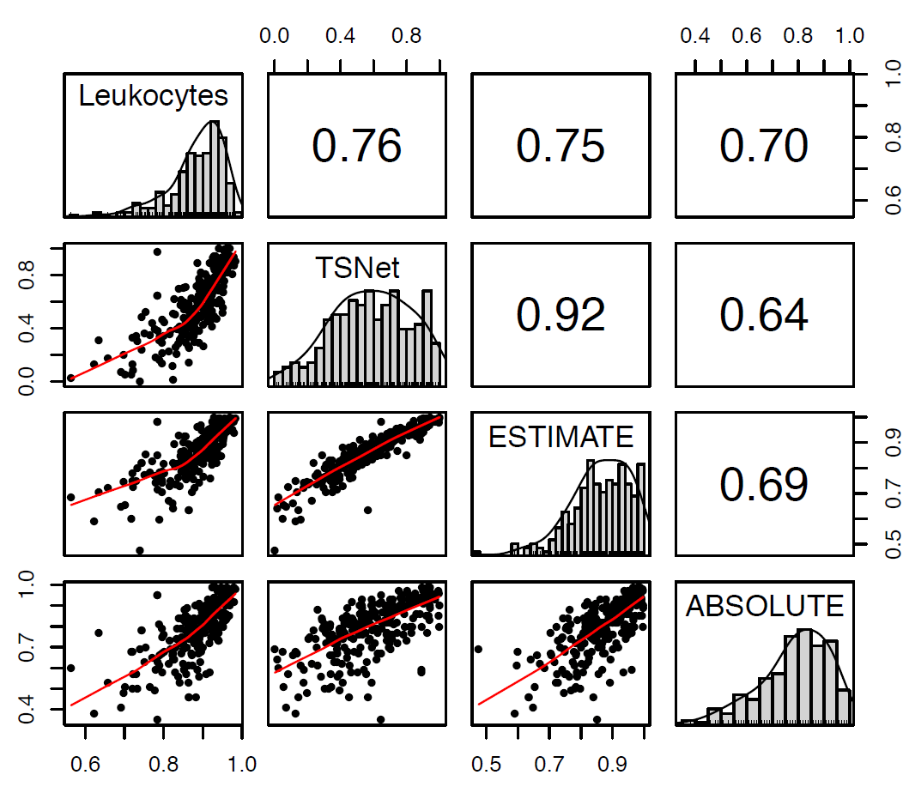
TSNet tumor purity estimation performs well
Leukocyte signature from DNA methylation data
Validation
TSNET
- RNAseq data
ESTIMATE
- RNAseq data
ABSOLUTE
- CNV DATA
Models and Input for Purity Estimation

Slide 43
Network estimation --- model selection
Since applying BIC to TSNet and mixNet on this data leads to networks with dramatic different sizes, to facilitate the comparison between these two methods, we chose to adopt a different strategy.
For each network type (i.e., TSNet-tumor, TSNet-normal and mixNet)
  Consider networks of different dimension ranging from 500 to 3,500 edges through varying the tuning parameters in each method.
  Selected edges which were contained in at least 80% of the above networks.
Estimated network via TSNet: Tumor (707 edges) and Normal (793)
Estimated network via MixNet: 993 edges

