Slide 1
Hierarchical Regularized Regression for Incorporating External Data in High-Dimensional Prediction Models Garrett M. Weaver University of Southern California Los Angeles, CA, United States

Slide 2
Motivation: Use of ‘omics’ in Prediction
Predictors:
Gene expression ($\sim$29,000)
Clinical variables
Sample size: 187
Method: Elastic net regression
Final model: 28 probes + clinical variables

Slide 3
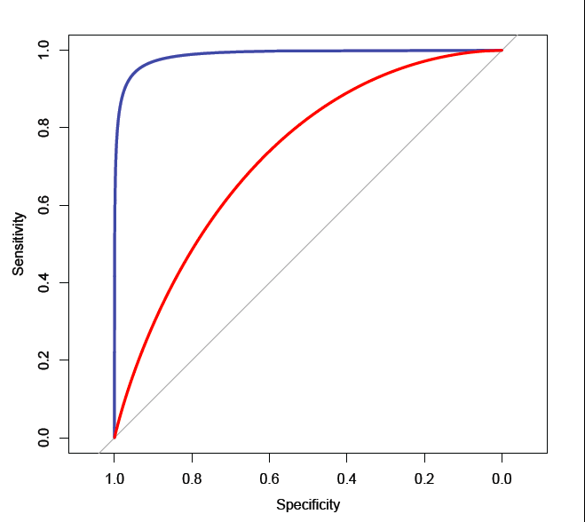
Motivation: Use of ‘omics’ in Prediction
Most Common Genomic Annotations
Signal transduction (9)
Migration/motility/matrix degradation (7)
Tumor suppressor genes/oncogenes (5)
Oxidative stress/oxygen transport (5)
Protein transport (4)
Red: Clinical only: CV AUC = 0.75
Blue: Clinical + 28 probes: CV AUC = 0.97

Slide 4
Motivation: Data Structure
Can we improve prediction by incorporating external information for the predictors? How?
Cellular Components
{
nucleus | cytoplasm | cell surface | cytosol | membrane | …
cell migration | hemopoiesis | acrosome reaction | cell adhesion | glucose transport | …
DNA binding | calcium ion activity | CD4 receptor binding | mRNA binding | GTPase activity | …
Gene 1 | Gene 2 | Gene 3 | Gene 4 | Gene 5 | Gene 6
{
Biological Functions
Gene Annotations
{
Molecular Functions
ID | Probe 1 | Probe 2 | Probe 3 | Probe 4 | Probe 5 | Probe 6 | …
1 | 8.3179 | 4.9389 | 4.8127 | 4.4523 | 6.8563 | 9.1467 | …
2 | 8.0051 | 7.2069 | 8.8757 | 8.5990 | 6.9521 | 8.8852 | …
$$Y$$
(Outcome)
Gene Expression Microarray Data (X)

Slide 5
Motivation: Data Structure
Can we improve prediction by incorporating external information for the predictors? How?
Annotations / External Data
Probe ID | Gene ID | FuncA | FuncB | VarC | …
1 | Gene1 | 0 | 1 | 2.3
2 | Gene2 | 1 | 0 | 0.2
3 | Gene2 | 1 | 0 | 1.5
4 | Gene3 | 0 | 0 | 0.7
$$α$$
Probe
Z
$$β$$
$$Z_{p×q}$$
Probes
Probe1 | Probe2 | Probe3 | Probe4 | …
8.3179 | 4.9389 | 4.8127 | 4.4523
6.8563 | 9.1467 | 4.8033 | 4.6462
8.0051 | 7.2069 | 8.8757 | 8.5990
X
Y
Subject
$$X_{n×p}$$

Slide 6
Integrating External Data: Current Methods
Extend regularized regression to integrate external information
$$y=Xβ+ε, ε\sim MVN\left(0_{n}, σ^{2}I_{n}\right)$$
Penalized Likelihood / Optimization
Bayesian
$$\min_{β}{\frac{1}{2}{\left\|y−Xβ\right\|}_{2}^{2}+λP\left(β\right)}$$
$$\max_{β}{\log{p\left(y | β,X\right)+\log{p\left(β\right)}}}$$
$$P\left(β\right)=\frac{1}{2}{\left\|β\right\|}_{2}^{2}=\sum_{k=1}^{p}{β_{j}^{2}}$$
Ridge Regression:
$$β_{j}\sim N\left(0, σ^{2}/λ\right)$$
$${P\left(β\right)=\left\|β\right\|}_{1}=\sum_{k=1}^{p}{\left|β_{j}\right|}$$
Lasso Regression:
$$β_{j}\sim DE\left(0, λ/2σ^{2}\right)$$

Slide 7
Integrating External Data: Current Methods
Incorporate external data by parameterizing $λ$ in terms of external data
Weighted Lasso with Data Integration (Bergersen 2011)
Adaptive Group-Regularized Ridge Regression (van de Wiel 2016)
$$\min_{β}{\frac{1}{2}{\left\|y−Xβ\right\|}_{2}^{2}+\sum_{j=1}^{p}{λ_{j}}P\left(β_{j}\right)}$$
$$λ_{j}=λw_{j}\left(y,X,Z\right)$$
$$\sum_{j=1}^{p}{λw_{j}\left(y, X, Z\right)\left|β_{j}\right|}$$
$$β_{j}\sim DE\left(λw_{j}\right)$$
$$λ_{j}=λλ_{g}^{′}$$
$$λ\sum_{k=1}^{G}{λ_{k}}\sum_{j∈g_{k}}{β_{j}^{2}}$$
$$β_{j}\sim N\left(0,τ_{g\left(j\right)}\right)$$

Slide 8
Hierarchical Regularized Regression: Data Structure
Structure suggests two-level hierarchy
Association between outcome ($y$) and genomic features $\left(X\right)$
$y=Xβ+ε,$
Association between predictor effects ($β$) and q ‘prior’ variables ($Z$)
$β=Zα+γ,$
Question: Can we extend this hierarchy in regularization framework?
$$α$$
$$y_{i} \sim MVN\left(X_{i}^{T}β, σ^{2}I_{n}\right)$$
Z
$$β$$
$$β_{j} \sim MVN\left(Z_{j}^{T}α, τ^{2}I_{p}\right)$$
X
Y

Slide 9
Hierarchical Regularized Regression: Ridge-Lasso
$$\frac{1}{2}{\left\|y −Xβ\right\|}_{2}^{2}$$
$$\frac{λ_{1}}{2}{\left\|β−Zα\right\|}_{2}^{2}$$
$$\min_{β, α}$$
$$+$$
$$+$$
$$λ_{2}{\left\|α\right\|}_{1}$$
View as 3-level hierarchical model
Probe1 | Probe2 | Probe3 | Probe4 | …
8.3179 | 4.9389 | 4.8127 | 4.4523
6.8563 | 9.1467 | 4.8033 | 4.6462
8.0051 | 7.2069 | 8.8757 | 8.5990
(1) $Y=Xβ+ε, ε \sim MVN\left(0, {I_{n}σ}^{2}\right)$
(2) $β=Zα+γ, γ \sim MVN\left(0, I_{p}τ^{2}\right)$
(3) $α_{k} \sim DE\left(λ_{2}\right), k=1,…,q$
$$X_{n×p} (Genomic Data)$$
Probe ID | Gene ID | FuncA | FuncB | VarC | …
1 | Gene1 | 0 | 1 | 2.3
2 | Gene2 | 1 | 0 | 0.2
3 | Gene2 | 1 | 0 | 1.5
4 | Gene3 | 0 | 0 | 0.7
Unlike standard regularized regression, shrink $β$ towards potentially informative values ($Zα$).
K-fold cross-validation used to tune $λ_{1}$ and $λ_{2}$ (i.e. amount of shrinkage).
If external data noninformative $(α=0)$, solution simplifies to standard ridge regression.
$$Z_{p×q} (External Data)$$

Slide 10
Fitting the Ridge-Lasso
$$\min_{β,α}{\frac{1}{2}{\left\|y−Xβ\right\|}_{2}^{2}+\frac{λ_{1}}{2}{\left\|β−Zα\right\|}_{2}^{2}+{λ_{2}\left\|α\right\|}_{1}}$$
Prototyping
General Convex Optimization Software (CVX)
Use Existing Software
R Package glmnet to implement two-step fitting method
Custom Solution
Develop R package that utilizes coordinate descent to fit model

Slide 11
Fitting the Ridge-Lasso: Custom Solution
Rewrite two-level model as single-level regression
$Y=Xβ+ε$
$β=Zα+γ$
$$Y=XZα+Xγ+ε$$
Analogously, rewrite objective in terms of variable substitution $γ=β−Zα$
$$\min_{β,α}{\frac{1}{2}{\left\|y−Xβ\right\|}_{2}^{2}+\frac{λ_{1}}{2}{\left\|β−Zα\right\|}_{2}^{2}+{λ_{2}\left\|α\right\|}_{1}}$$
$$\min_{γ,α}{\frac{1}{2}{\left\|y−XZα−Xγ\right\|}_{2}^{2}+\frac{λ_{1}}{2}{\left\|γ\right\|}_{2}^{2}+{λ_{2}\left\|α\right\|}_{1}}$$

Slide 12
Fitting the Ridge-Lasso: Custom Solution
$$\min_{γ,α}{\frac{1}{2}{\left\|y−XZα−Xγ\right\|}_{2}^{2}+\frac{λ_{1}}{2}{\left\|γ\right\|}_{2}^{2}+{λ_{2}\left\|α\right\|}_{1}}$$
Convex problems of the form above can be solved by coordinate descent (Tseng 2001)
$$\min_{x}{f\left(x\right)+λ_{i}\sum_{i=1}^{p}{g_{i}\left(x\right)}}$$
$f(x)$ is smooth (continuously differentiable)
$g(x)$ is convex and separable, $g\left(x\right)=\sum_{j}{g\left(x_{j}\right)}$
Comparing to R package glmnet, penalty-type needs to be variable-specific
$${\tilde{β}}_{j}←\frac{S\left(\frac{1}{n}\sum_{i=1 }^{n}{x_{ij}\left(y_{i}−X_{i}^{T}\tilde{β}\right) , λ_{j}δ_{j}}\right)}{x_{j}^{T}x_{j}+λ_{j}\left(1−δ_{j}\right)}$$
$$Lasso→δ=1$$
$$Ridge→δ=0$$
$$Elastic Net→δ∈(0, 1)$$

Slide 13
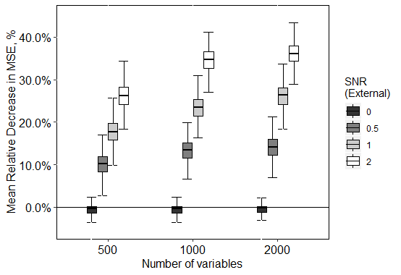
Simulations: Comparing Ridge-Lasso to Ridge
Data
$α$: 100 external variables, 4 true nonzero effects
X and Z simulated $MVN\left(0, AR\left(1 \right)\right)$
$β_{j}|Z \sim N\left(Z_{j}^{T}α, σ_{2}^{2}\right), j=1,…,p$
$Y_{i}|X \sim N\left(X_{i}^{T}β, σ_{1}^{2}\right), i=1,…,n$
1000 replicates at each combination:
# of Predictors: 500, 1000, 2000
External signal-to-noise ratio: 0, 0.5, 1, 2
Training data set (n = 300) to build models
k-fold CV to tune hyperparameters in both models
Evaluate prediction MSE on test data set (n = 1000)

Slide 14
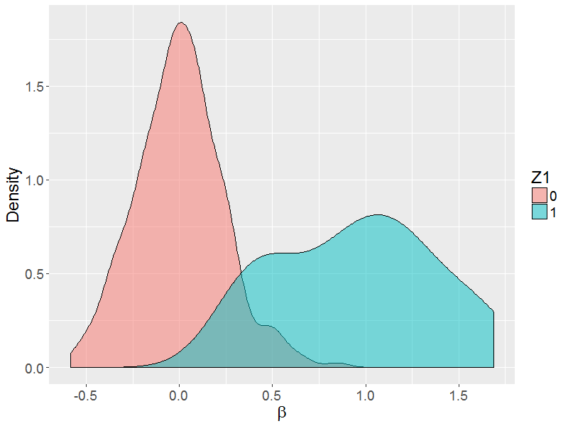
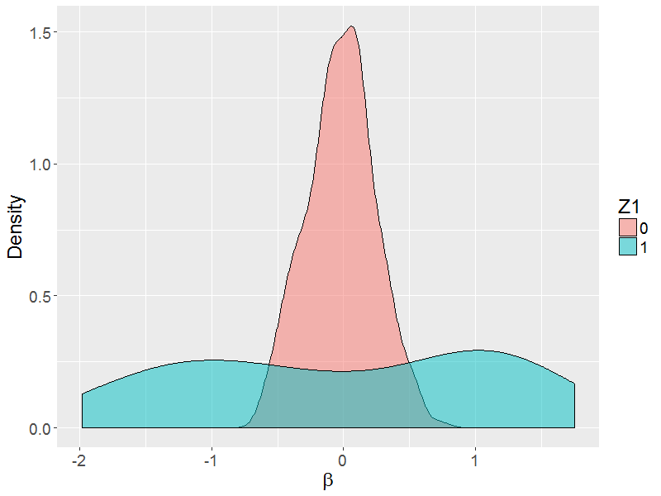
Simulations: Direction of Effect
Scenario 1: Effects in Same Direction
Scenario 2: Effects in Opposite Direction
30 predictors: $β_{j} \sim N\left(1, 0.25\right), { Z}_{1}=1$
270 predictors: $β_{j} \sim N\left(0, 0.125\right), { Z}_{1}=0$
15 predictors: ${ β}_{j} \sim N\left(1, 0.25\right), Z_{1}=1$
15 predictors: $β_{j} \sim N\left(−1, 0.25\right), Z_{1}=1$
270 predictors: $β_{j} \sim N\left(0, 0.125\right), { Z}_{1}=0$

Slide 15
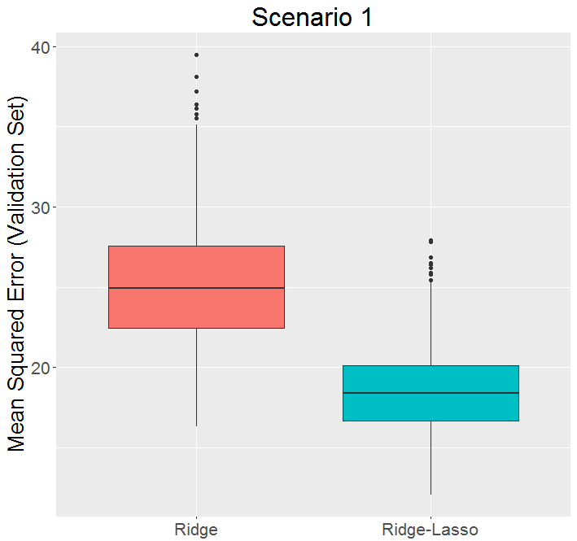
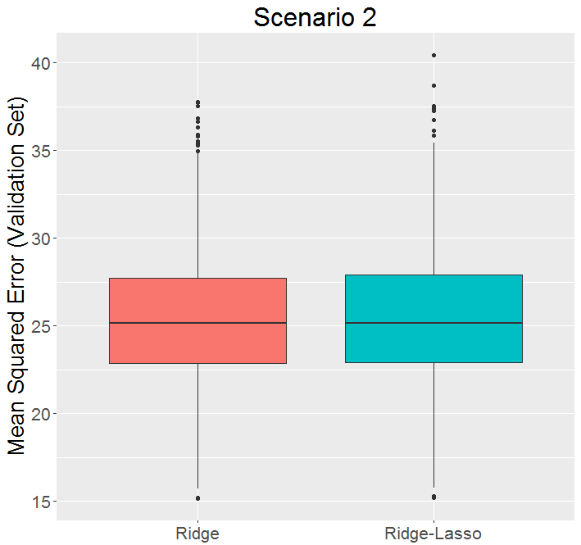
Simulations: Direction of Effect
External Data Informative for both Magnitude and Direction
External Data Informative for Magnitude Only

Slide 16
Application: Predicting Age with Methylation Data
Horvath et al. (2013) developed elastic net regression model that demonstrated strong correlation between methylation levels and chronological age ($r>0.9$)

Slide 17
Application: Predicting Age with Methylation Data
Probe-Gene Mapping ($Z_{p×q}$)
Gene 1 | Gene 2 | Gene 3 | Gene 4 | …
1 | 0 | 0 | 0
0 | 1 | 0 | 0
1 | 0 | 0 | 0
0 | 0 | 1 | 0
0 | 0 | 0 | 0
q $=6,766$ (genes with at least 10 mapped probes)
Columns standardized by sum of mapped probes
$XZ_{j}=$ average methylation level of probes mapped to gene $j$
Probe
Sparse matrix ($≈33 probes/gene$ on average)
Methylation Data $\left(X_{n×p}\right)$
Probe1 | Probe2 | Probe3 | Probe4 | …
8.31 | 4.93 | 4.81 | 4.45
6.85 | 9.14 | 4.80 | 4.64
8.00 | 7.20 | 8.87 | 8.59
$n=656$
$p=250,000$ (top probes by empirical variance)
Subject
Compared models with and without standardization by standard deviation

Slide 18
Application: Predicting Age with Methylation Data
Generated 50 train and test data sets by randomly splitting data (80% / 20%)
k-fold CV to train models / tune hyperparameters
Evaluate prediction MSE in test data set
Method | Ridge | Ridge-Ridge | Lasso | Lasso-Ridge | Elastic Net | Elastic Net-Ridge
Mean Test MSE | 51.8 | 44.1 | 33.0 | 32.4 | 29.1 | 28.7
Median Test MSE | 51.6 | 43.1 | 32.5 | 31.3 | 28.5 | 28.0

Slide 19
Application: Recovering Breast Cancer Gene Signatures
METABRIC: international consortium with aims to further classify tumors based on molecular signatures by using cohort of 2,000 breast cancer patients
DREAM Breast Cancer Prognosis Challenge: open source challenge to further improve prediction using METABRIC cohort
Top model (Cheng et al. 2013) used four gene signatures: ‘attractor metagenes’
Probe-Metagene Mapping ($Z_{p×q}$)
Gene Expression Data $\left(X_{n×p}\right)$
CIN | MES | LYMPH | FGD3-SUSD3
1 | 0 | 0 | 0
0 | 1 | 0 | 0
1 | 0 | 0 | 0
0 | 0 | 1 | 0
0 | 0 | 0 | 1
Probe1 | Probe2 | Probe3 | Probe4 | …
8.31 | 4.93 | 4.81 | 4.45
6.85 | 9.14 | 4.80 | 4.64
8.00 | 7.20 | 8.87 | 8.59
Subject
Probe

Slide 20
Application: Recovering Breast Cancer Gene Signatures
Predict breast cancer mortality within 5 / 7.5 / 10 years of diagnosis
Subset to ER+ / HER2- patients who were not censored within 5 / 7.5 / 10 years
Build models in training data set
Stratified repeated k-fold cross-validation to tune hyperparameters
Compare AUC in test data set
Additional analysis with clinical variables (age and whether lymph node positive)
Method | Test AUC
 | Gene Expression Only | Gene Expression + Clinical
Linear Ridge | 0.695 | 0.741
Logistic Ridge | 0.685 | 0.731
Ridge-Lasso | 0.712 | 0.755

Slide 21
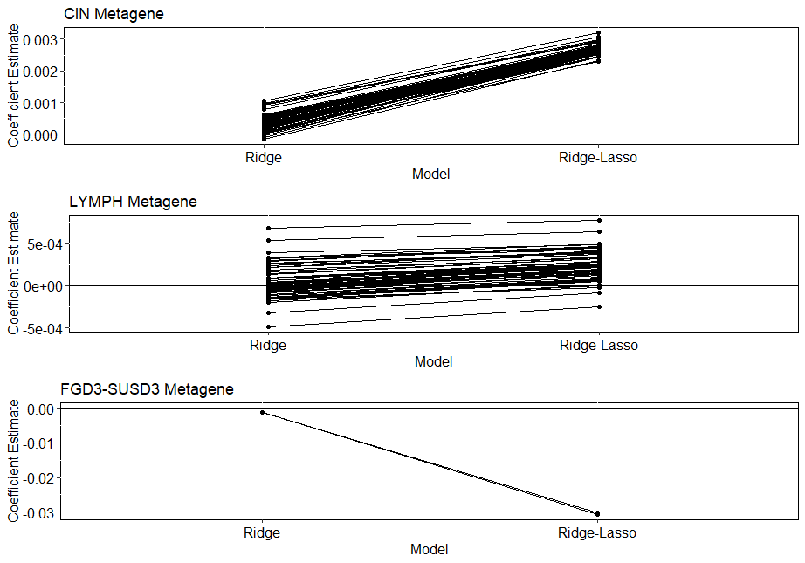
Application: Recovering Breast Cancer Gene Signatures
Metagene | Coefficient Estimate $(α_{k})$
 | Gene Expression Only | Gene Expression + Clinical
CIN | 0.16 | 0.16
MES | 0.0 | 0.0
LYM | 0.014 | 0.0
FGD3-SUSD3 | -0.06 | -0.05

Slide 22
Discussion: What we have learned so far
Novel model to incorporate external data for genomic data in prediction models
Efficient algorithm to fit model for large number of predictors and external variables
Simulations and real data show improved performance when external data is informative for magnitude and direction
Little to no decrease in predictive ability when data is not informative

Slide 23
Discussion: Future Directions
Extension to other outcomes (i.e. survival data)
Modify model to enable use of external data that is only informative for magnitude (absolute value of effect)
Improve hyperparameter tuning
Further analysis to determine other potential sources of external information and how to model such data in our framework

Slide 24
R Package: hierr
hierr() / cvhierr()
Continuous
Binary
Survival
Ridge
Lasso
EN
Ridge
Lasso
Elastic Net
Quantile
Quantile
…
…
…
Outcome:
1st Level Penalty:
2nd Level Penalty:
https://github.com/USCbiostats/hierr

Slide 25
Questions?
Acknowledgements
Dr. Juan Pablo Lewinger
Dr. David Conti
Dr. Duncan Thomas
USC IMAGE P01 Group
NCI Grant #1P01CA196569 and NIEHS Center Grant #5P30ES07048

Slide 26
Fitting the Ridge-Lasso: Method 1
Compute singular value decomposition (SVD) of $X$
$$X=U_{n×n}D_{n×n}V_{n×p}^{T} \left({V_{⊥}^{T}}_{\left(p−n\right)×p}\right)→ Q_{p×p}=\left[V | V_{⊥}\right]$$
Change of variables
$$Q^{T}β=\left[\begin{matrix}V^{T}β \\ V_{⊥}^{T}β\end{matrix}\right]=\left[\begin{matrix}θ \\ η\end{matrix}\right], θ∈ℝ^{n}, η∈ℝ^{p−n}$$
Rewrite objective function
$$\min_{θ,η,α}\left\{\frac{1}{2}{\left\|y−UDθ\right\|}_{2}^{2}+\frac{λ_{1}}{2}{\left\|\left[\begin{matrix}θ \\ η\end{matrix}\right]−\left[\begin{matrix}V^{T}Zα \\ V_{⊥}^{T}Zα\end{matrix}\right]\right\|}_{2}^{2}+λ_{2}{\left\|α\right\|}_{1}\right\}$$
Transform $y$ and $Z$ in terms of SVD components
$y^{∗}=diag{\left(\sqrt{d_{i}^{2}+λ_{1}} \right)}^{−1}U^{T}y$ $Z^{∗}=diag{\left(d_{i}/\sqrt{d_{i}^{2}+λ_{1}}\right)}^{−1}V^{T}Z$

