Slide 1
Exploring single cell data
Presented by
Jean Yang
School of Mathematics and Statistics

Slide 2
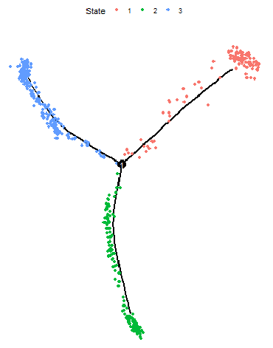
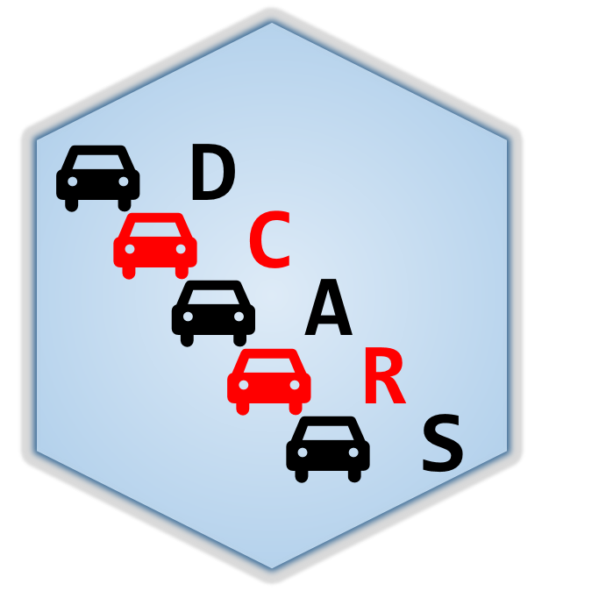
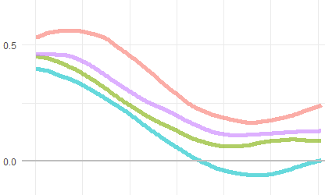
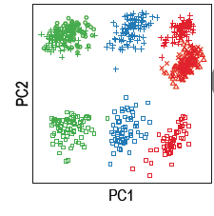
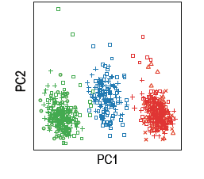
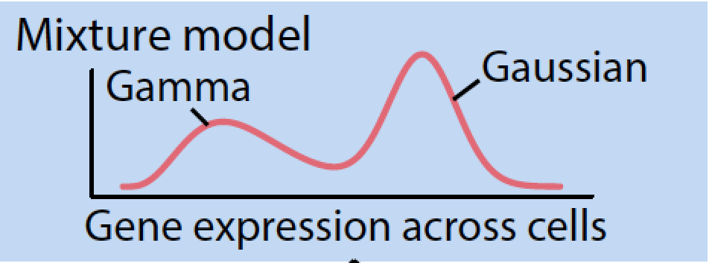
Single cell @ Sydney
Clustering metrics
scMerge
Finding stability expressed genes

Slide 3

Pengyi Yang
Single cell @ Sydney
Clustering metrics
scMerge
Finding stability expressed genes

Slide 4
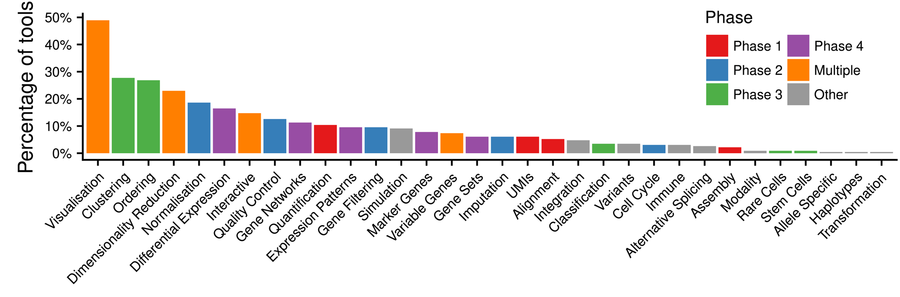
Clustering algorithms
Clustering algorithms
k-means
Hierarchical
25%+
RaceID
SC3
CIDR
Clustering
countClust
Luke Zappia, et al. PLoS Comp. Bio. 2018
RCA
SIMLR
Notes:
Firstly, as many speakers have already shown, after we generated single-cell RNA-seq data, we typically group the cells into different clusters for cell type discovery and visualisation using certain clustering algorithm.
There have been a large number of clustering algorithms developed for single cell RNA-seq data analysis, and for all clustering algorithms, similarity metric is the core. We can roughly categorise similarity metrics into two types,…

Slide 5
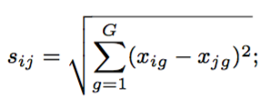
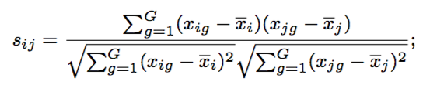

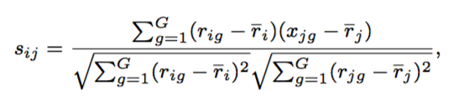

Similarity metric is the core of clustering algorithm
Key question: is there a similarity metric that performs (on average) better for clustering single cells based on their transcriptome?
k-means
Hierarchical
Euclidean
RaceID
Pearson
SC3
Manhattan
CIDR
Spearman
countClust
Maximum
RCA
Correlation-based
SIMLR
Distance-based
Notes:
There have been a large number of clustering algorithms developed for single cell RNA-seq data analysis, and for all clustering algorithms, similarity metric is the core. We can roughly categorise similarity metrics into two types,…

Slide 6
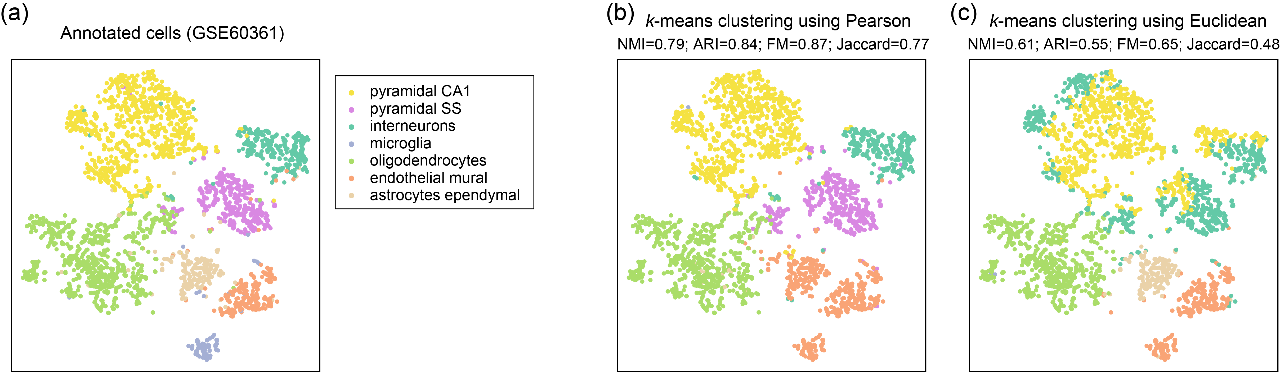
k-means Clustering on GSE60361
k-means Clustering on GSE60361
k-means
pre-defined cell types
Zeisel A, et al. Science 2015

Slide 7
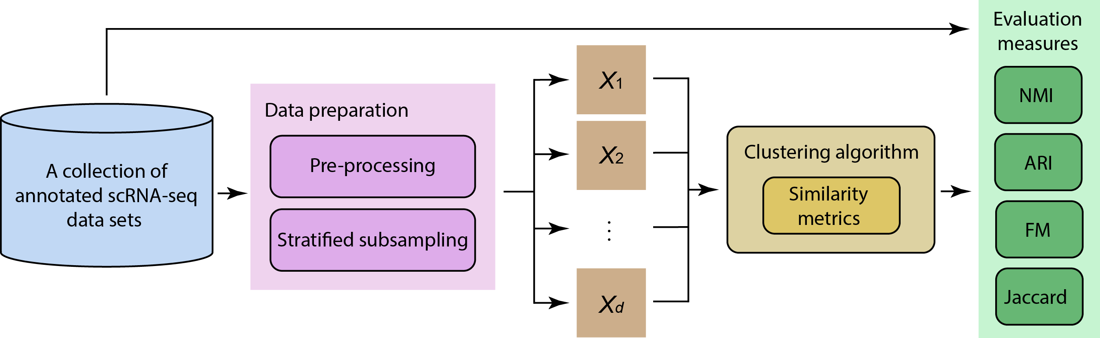
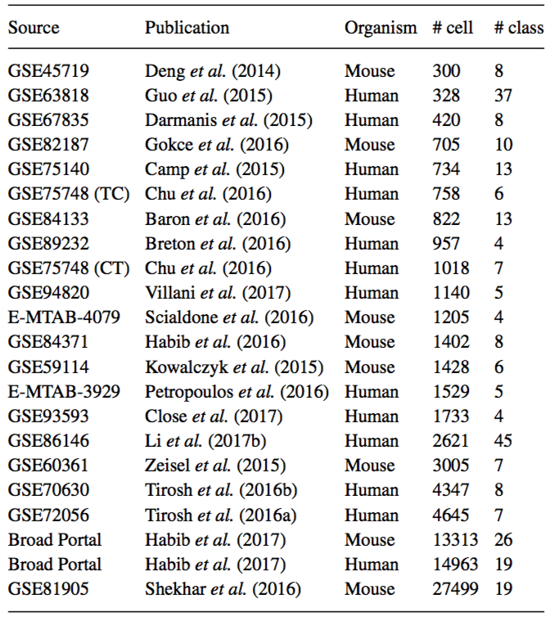
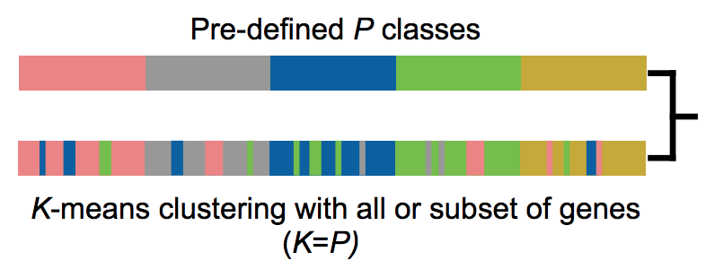
Evaluation framework
Agreement to pre-defined classes:
Normalized Mutual Information (NMI)
Adjusted Rand Index (ARI)
Fowlkes-Mallows Index (FM)
Jaccard Index (Jaccard)
Taiyun Kim
Notes:
To answer this question, we set up this evaluation framework in which…

Slide 8
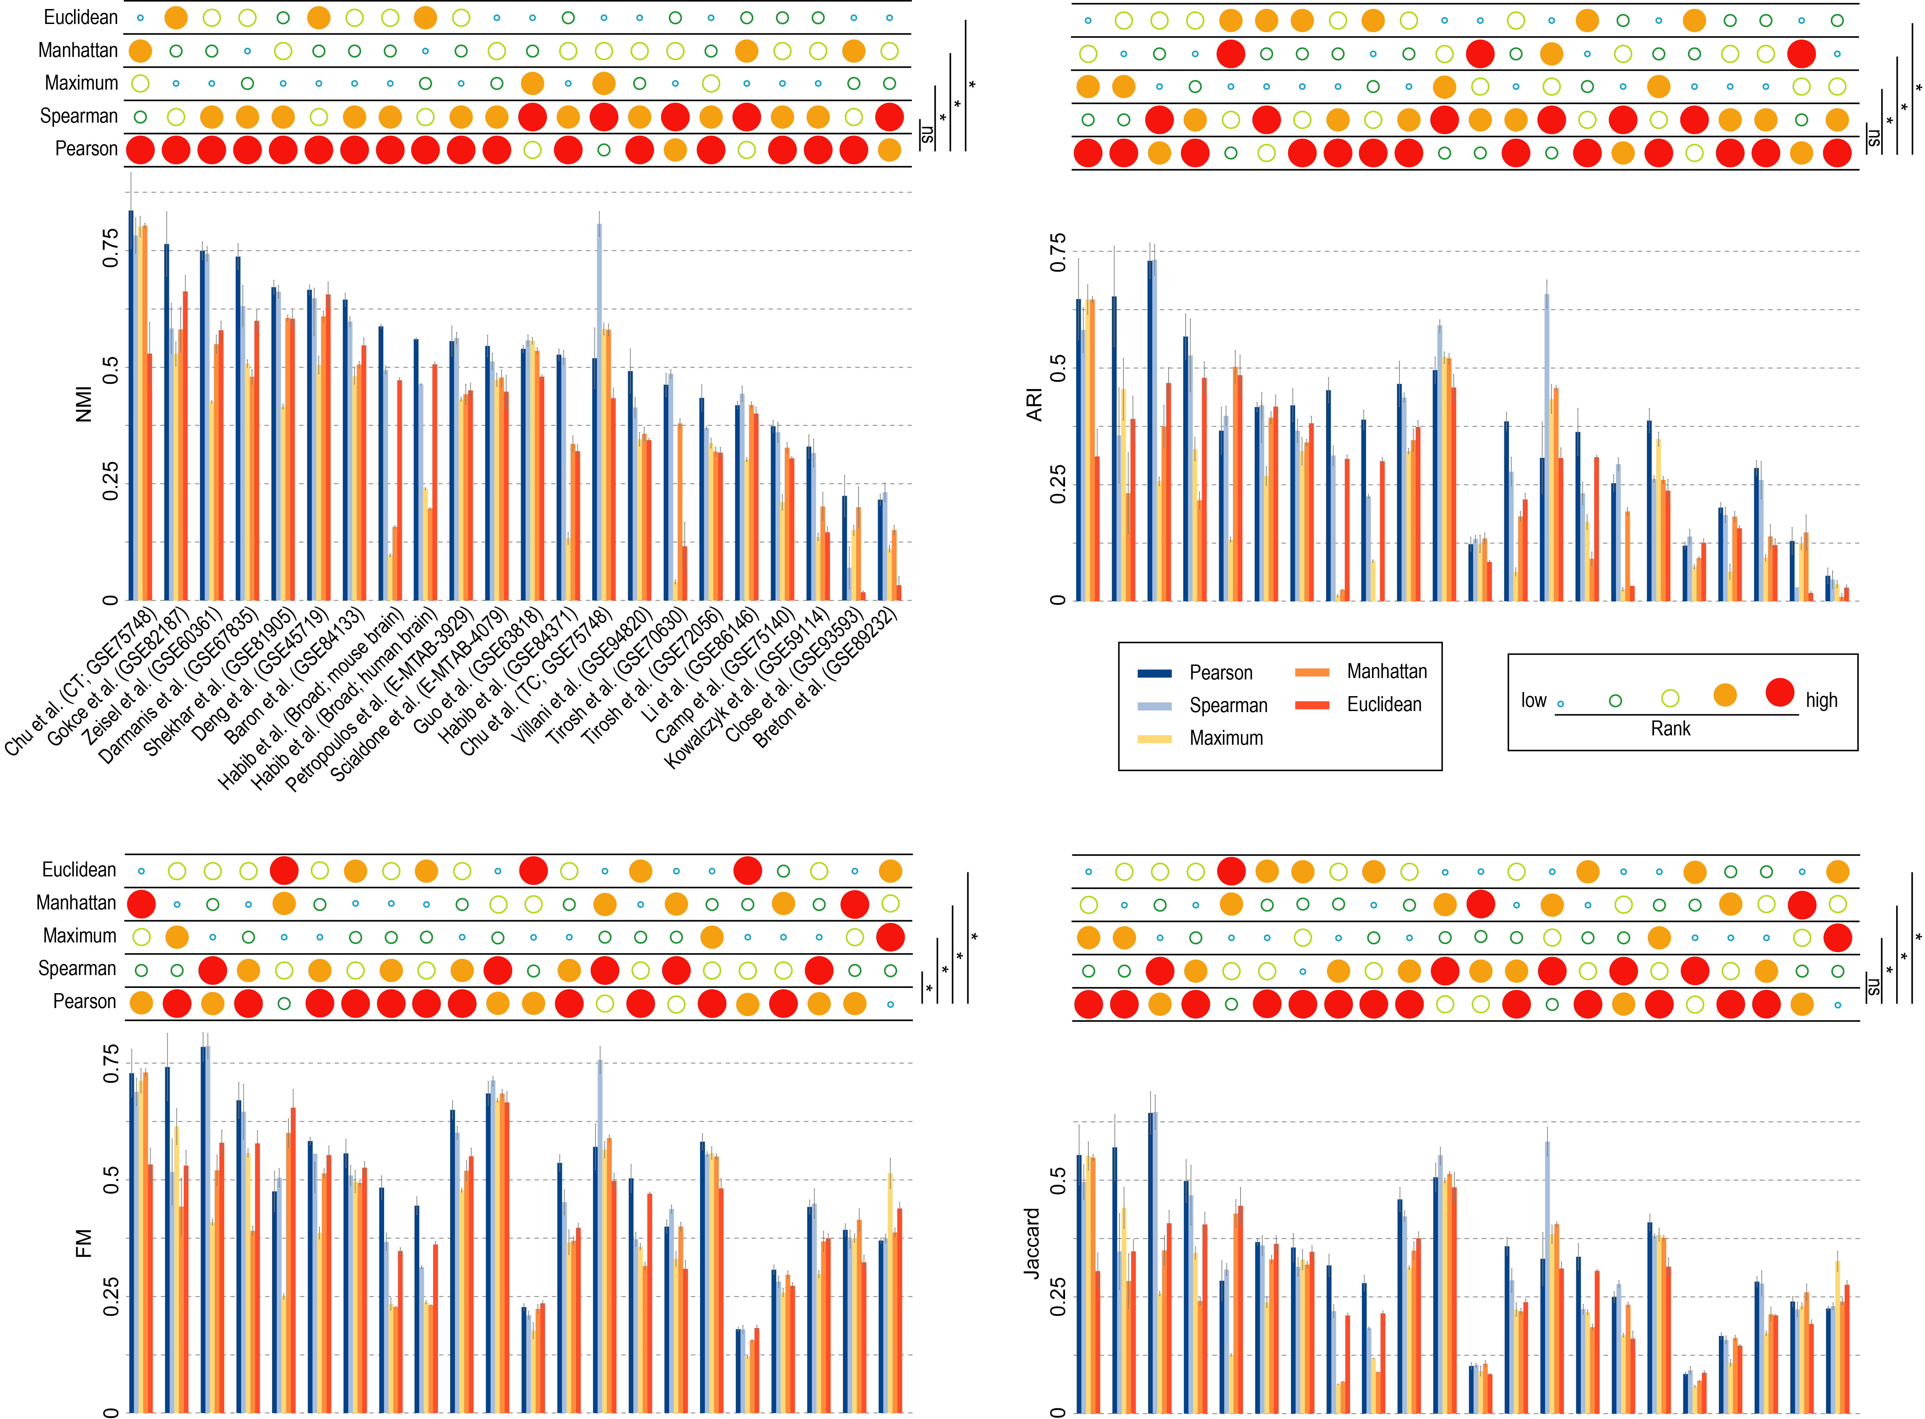
Evaluation results (against the pre-defined cell types)

Slide 9
Evaluation results (against the pre-defined cell types)
On average, correlation-based metrics improved on distance-based metrics by 31.5% (NMI), 39.6% (ARI), 16% (FM), 23% (Jaccard)

Slide 10
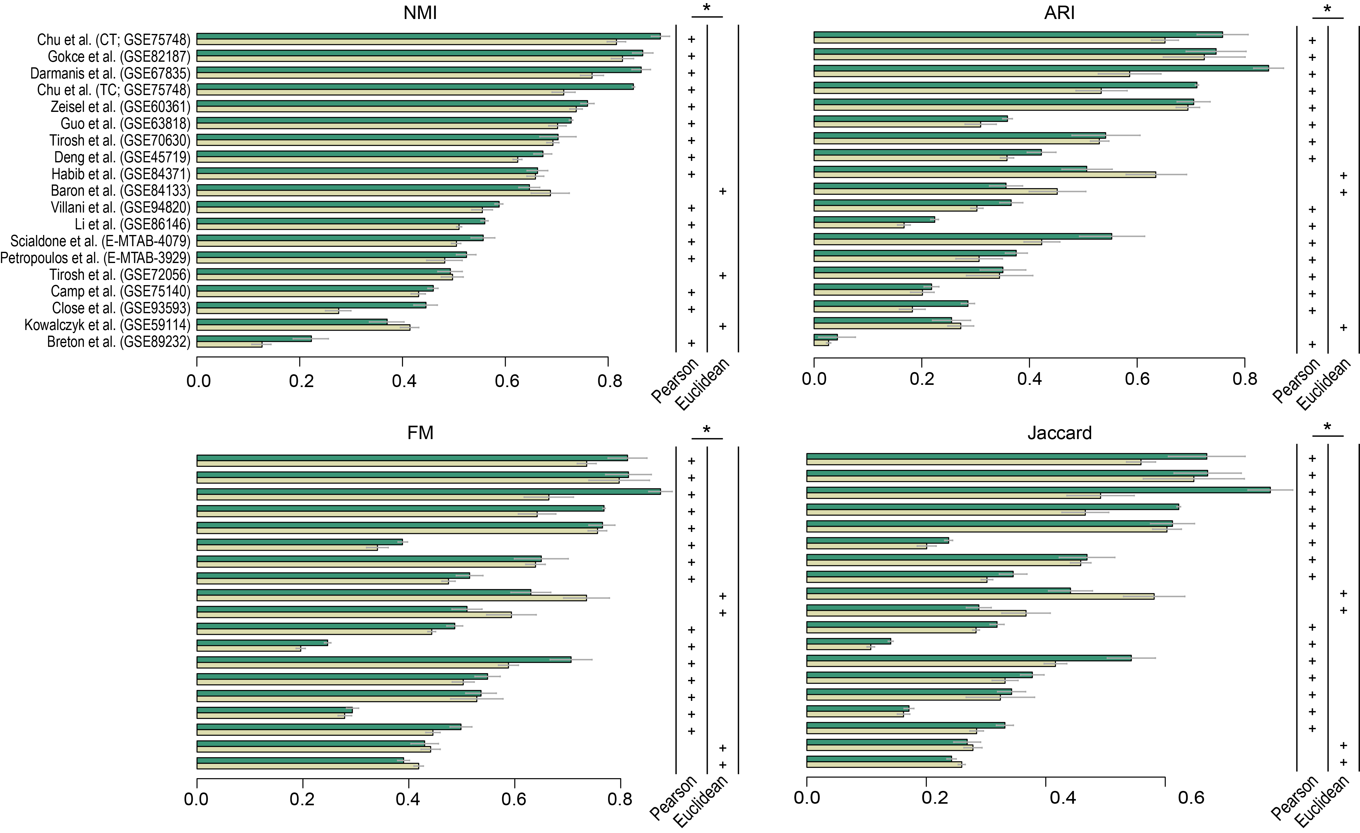


Clustering using a kernel-based approach
SIMLR

Slide 11
Evaluation results of SIMLR with Pearson or Euclidean metric
Evaluation results of SIMLR with Pearson or Euclidean metric

Slide 12

Summary
Discussion
Similarity metrics are key to clustering algorithms.
The choice of similarity metric has a significant impact on scRNA-seq data clustering.
The modification of a kernel-based clustering algorithm, SIMLR, by using Pearson’s correlation gives significant improvement on its original implementation.
Our findings demonstrate the utility of correlation-based metric and may provide a guide to future developments of clustering algorithms for scRNA-seq data analysis.

Slide 13
Single cell @ Sydney
Clustering metrics
scMerge
Finding stability expressed genes

Slide 14
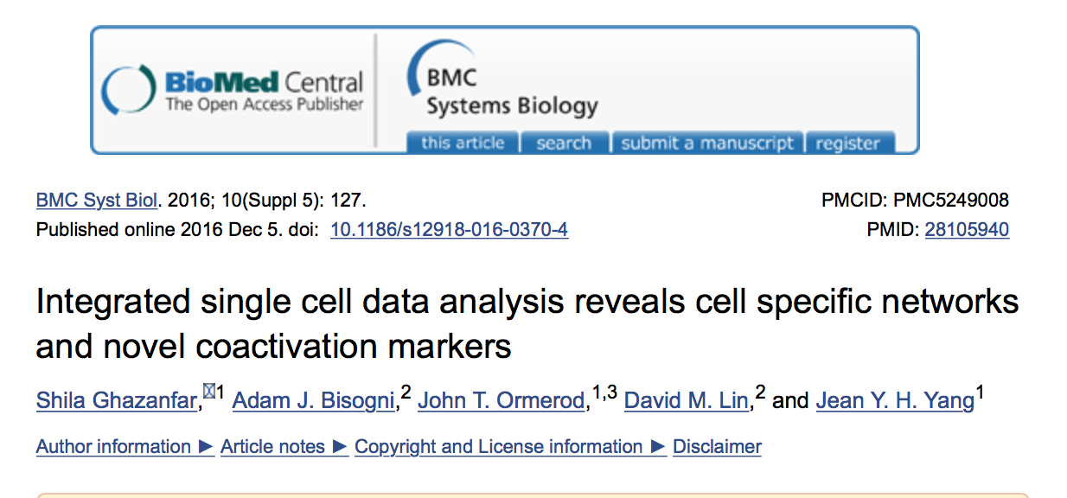

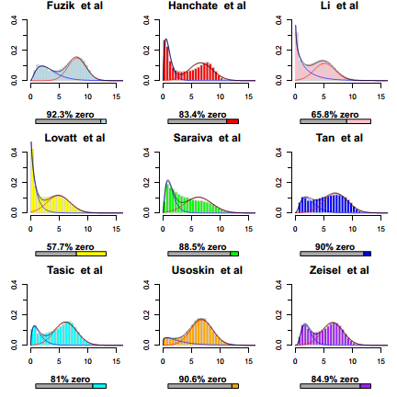
Previous work on mixture modelling
Ghazanfar et al BMC System Biology 2016

Slide 15
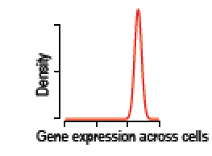
Previous work on mixture modelling
Ghazanfar et al BMC System Biology 2016

Slide 16
Establishing a good set of stably expressed genes
Datasets with wide ranges of cell types
Datasets with wide ranges of cell types

Slide 17
Datasets with wide ranges of cell types
Establishing a good set of stably expressed genes
Datasets with wide ranges of cell types
Stably expressed genes
Human early developmental dataset (Petropoulos et al.):
1529 cells from five time points: E3, E4, E5, E6, E7
Mouse early developmental dataset (Scialdone et al.):
1205 cells from four time points: E6.5, E7.0, E7.5, E7.75

Slide 18
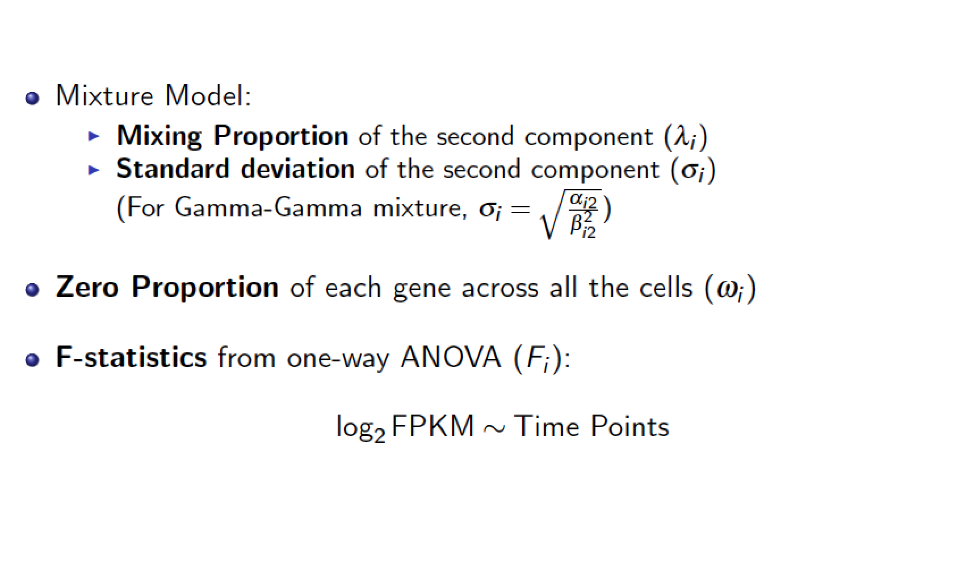
Features
Any conditions or known cell types?

Slide 19
Establishing a good set of stably expressed genes
Datasets with wide ranges of cell types
Stably expressed genes
Gamma-normal mixture model
Mixing proportion
Standard deviation
Zero proportion
F-statistics
λ
μ
σ
ω
F
Stably expressed index
Stably expressed genes (SEG)

Slide 20
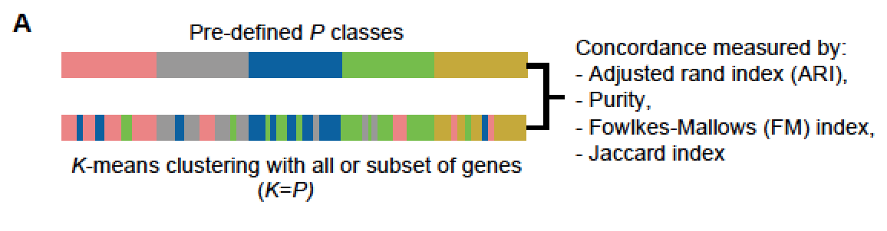
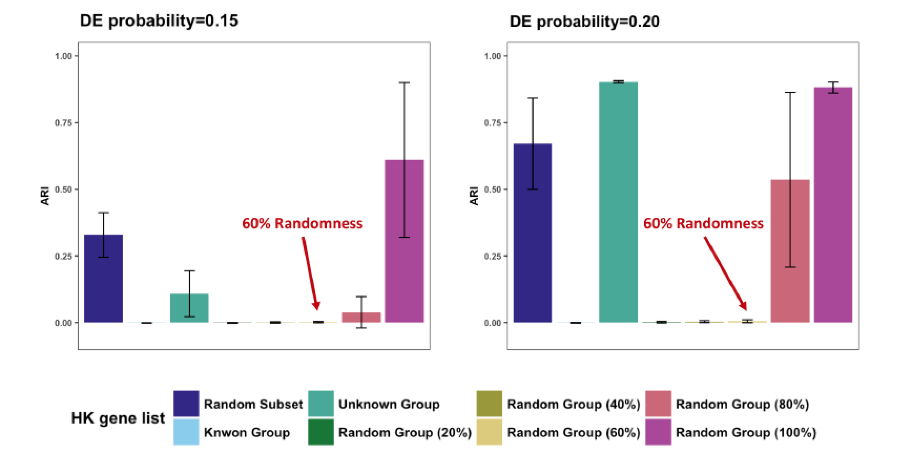
Effect of F-statistics: What if the pre-define group information is not 100% correct.

Slide 21
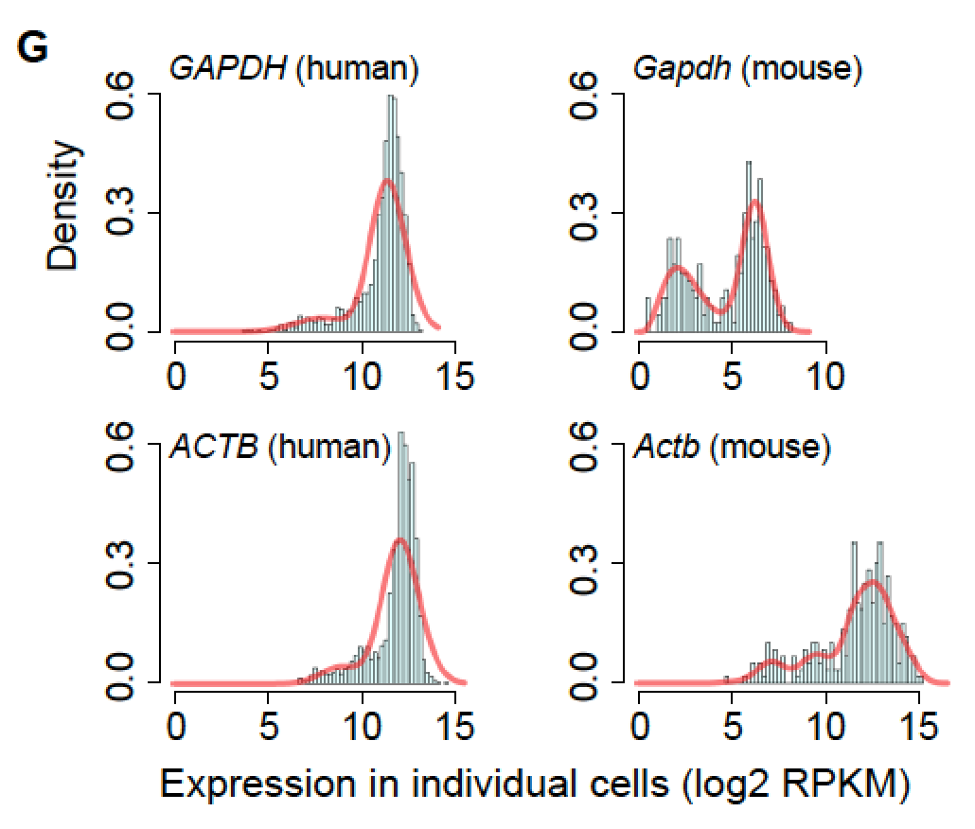
What about GAPDH?

Slide 22
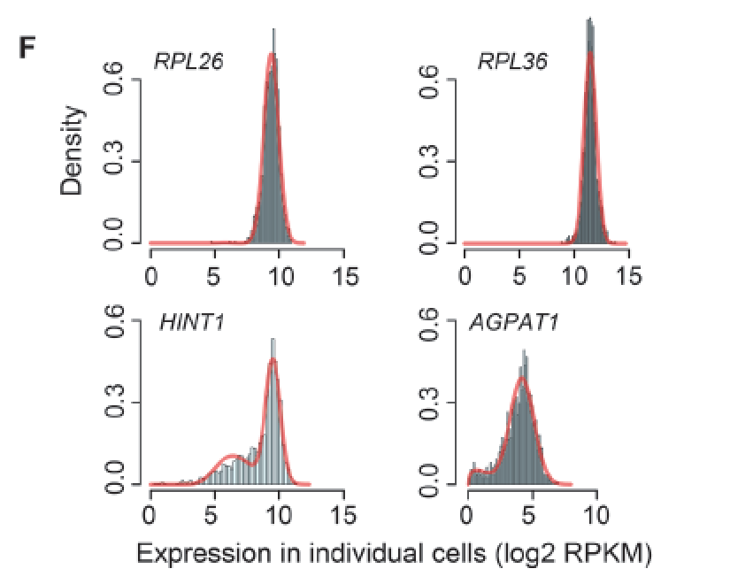
Characteristic of some genes
Example of genes found in scRNA-seq
Example of genes NOT in scRNA-seq but was
Consider “House keeping” in a
Eisenburg and Levanon , 2003
Eisenberg and Levanon. 2003.
Human housekeeping genes are
compact. Trends Genet 19
Notes:
Histograms of expression patterns of example genes that are defined as h-scHK genes using
scRNA-seq data but not bulk microarray or RNA-seq data (RPL26 and RPL36 ) and vice versa
(HINT and AGPAT1 ) across individual cells.
Histograms of expression patterns for GAPDH and ACTB in human and mouse (Gapdh and Actb )
across individual cells.

Slide 23
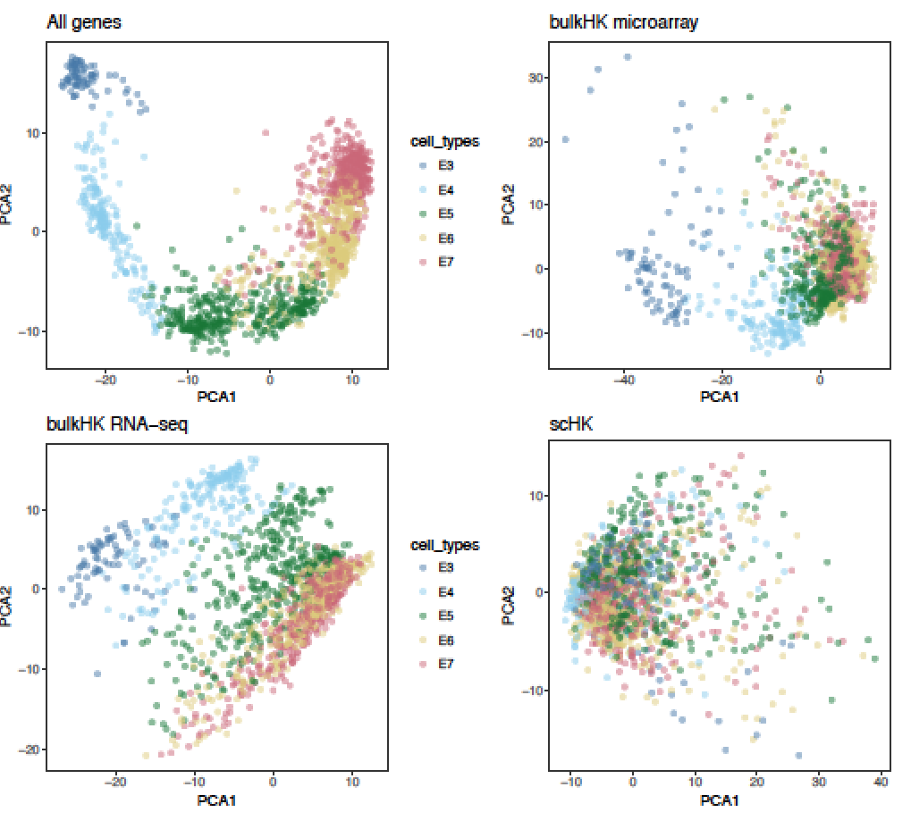
Evaluation of scSEG (PCA plot) -
Human early developmental dataset (Petropoulos et al)
ALL genes
House-keeping
genes based on
microarray data
Observation:
scSEG genes are stably expressed as they show no signal between different cell types.
House keeping
genes based on
bulk RNA-seq
Proposed
scSEG
Eisenberg and Levanon 2013.
Human housekeeping genes, revisited.
Trends Genet 29 :
Eisenberg and Levanon. 2003.
Human housekeeping genes are
compact. Trends Genet 19

Slide 24
Comparison with other data
Peripheral blood mononuclear cells
Villani et al. (2017)
Multicellular metastatic melanoma
Tirosh et al. (2016)
* | All genes | bHK microarray | bHK RNA-seq | scSEG
ARI | 55±8 | 42±3 | 38±4 | 29±6
Purity | 69±7 | 62±2 | 59±1 | 52±5
FM | 67±5 | 56±1 | 52±3 | 45±4
Jaccard | 49±6 | 39±1 | 35±2 | 29±4
* | All genes | bHK microarray | bHK RNA-seq | scSEG
ARI | 31±5 | 18±2 | 18±1 | 15±1
Purity | 80±5 | 73±1 | 74±1 | 71±1
FM | 51±3 | 39±2 | 40±1 | 37±1
Jaccard | 32±2 | 22±2 | 24±1 | 21±1
N = 1150; Number of cell types = 5
N = 4645; Number of cell types = 7
*All indices between the range of [0, 1] and are multiplied by 100. The lowest results from each metric in each dataset is in red
Notes:
The phrase “housekeeping genes” could be a long dinner conversation but what we believe is framework to create “stably expressed genes” that behaves differently to cell type markers

Slide 25
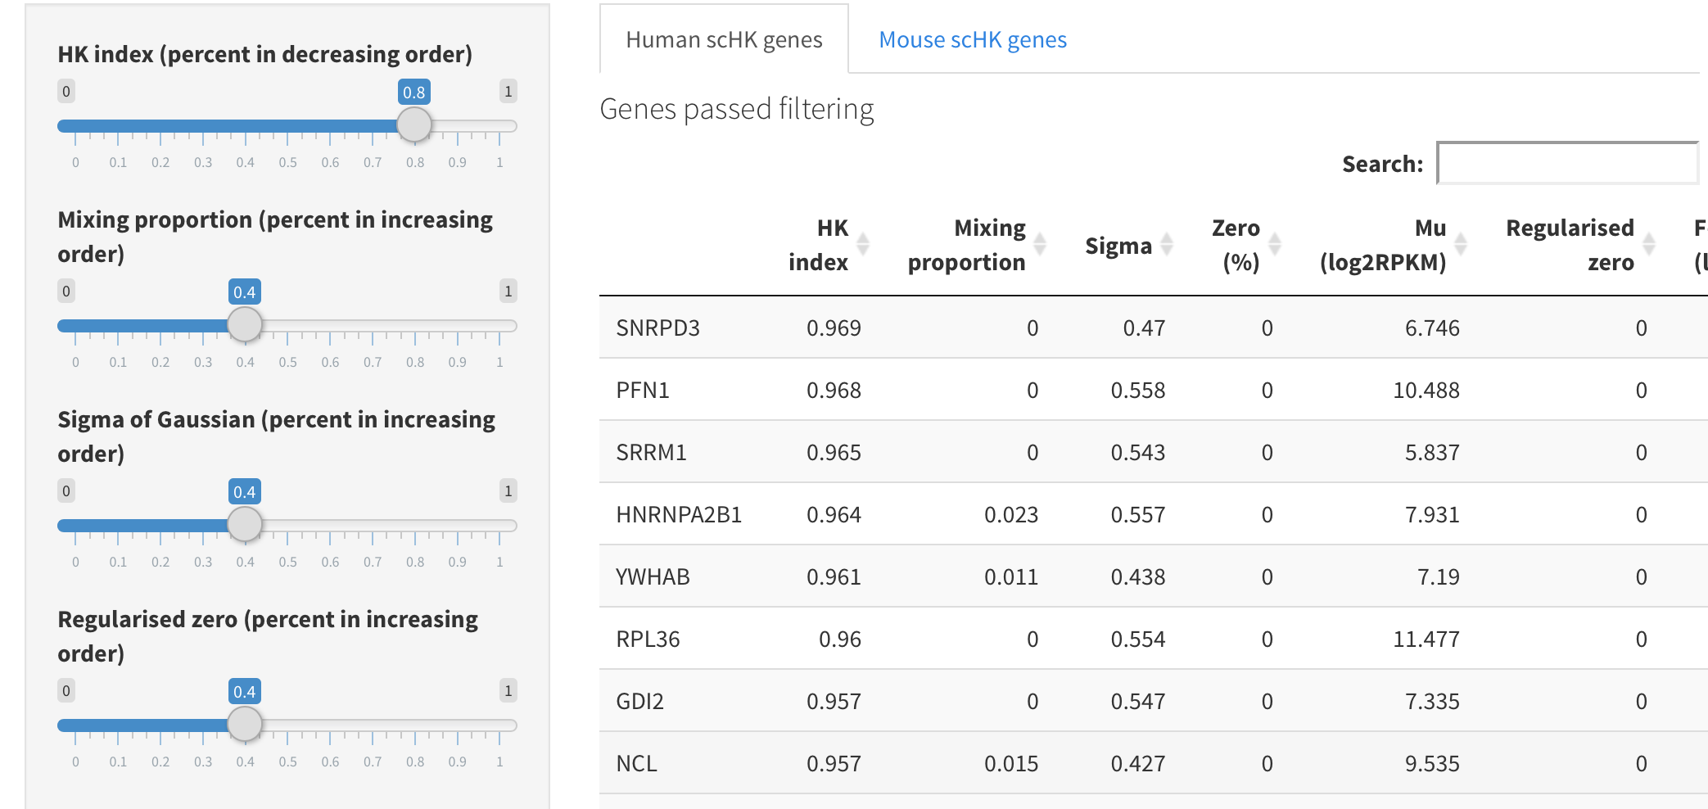
Summary
A framework to identify stably expressed genes.
If anyone is interested in such list of genes based on embryonic stem cell data see http://shiny.maths.usyd.edu.au/scHK/ (not working)

Slide 26
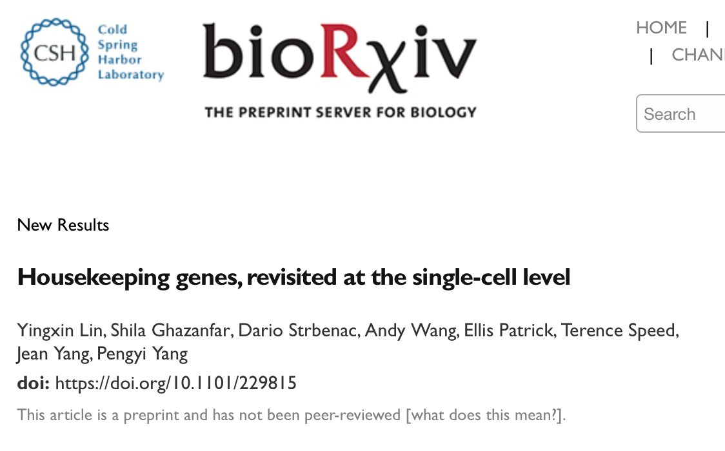
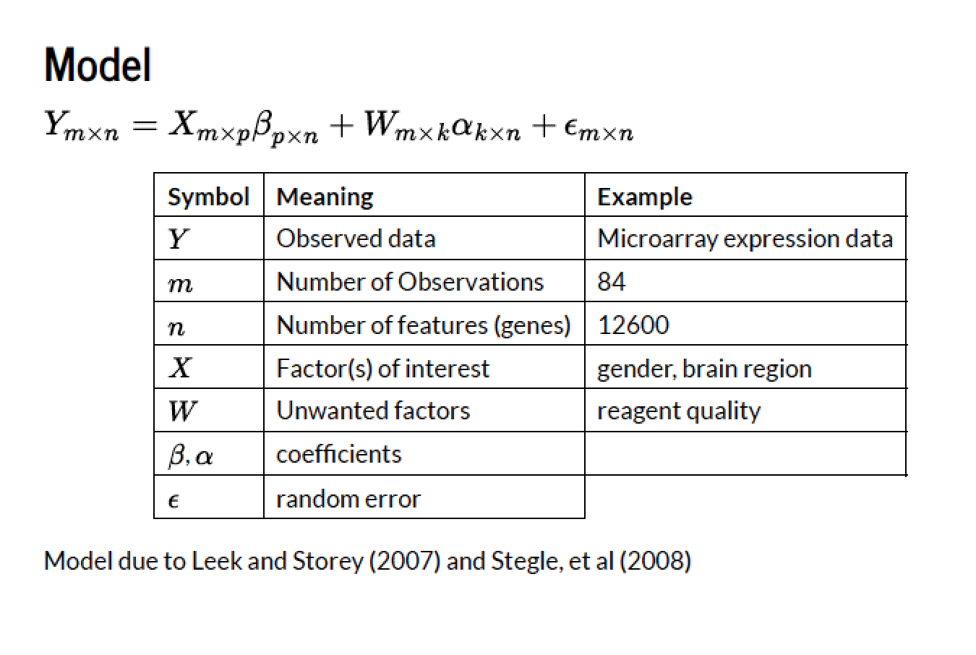
Leading to scMerge
RUVIII
Pseudo Replicates
Stably Expressed Genes
(SEG)

Slide 27


Acknowledgements
School of Mathematics and Statistics (collaborators)
Samuel Mueller
John Ormerod
Pengyi Yang
Ellis Patrick
Postdocs and students
Shila Ghazanfar
Yingxin Lin
Kevin Wang
Sarah Romanes
Andy Wang
Taiyun Kim
Irene Chen
Dario Strbenac
Usyd Faculty of Sciences
- Kitty Lo
Shanghai Jiaotong University
Zeguang Han
Xianbin Su
Xin Zou
Yi Shi
WEHI
Terry Speed
University of Michigan
Johann Gagnon-Bartsch
Notes:
This work wouldn’t be possible without a large team of interdisciplinary researchers working in a team.
This highlights the power of interdisciplinary collaboration how statistics and statistical bioinformatics contributes to biomedical research.

Slide 28
Account for data scaling and zero-counts
Additional processing
Linnorm normalisation
SAVER imputation
Agreement to pre-defined classes:
Normalized Mutual Information (NMI)
Adjusted Rand Index (ARI)
Fowlkes-Mallows Index (FM)
Jaccard Index (Jaccard)
Notes:
To answer this question, we set up this evaluation framework in which…

Slide 29
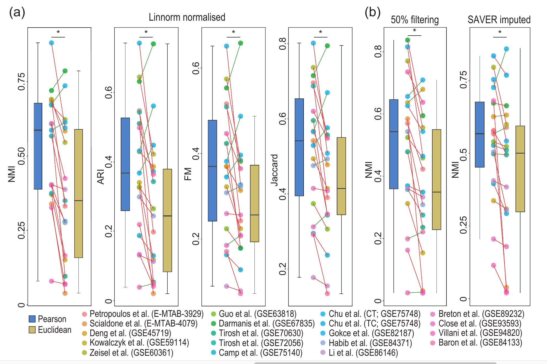
Linnorm normalization and SAVER imputation
Notes:
Next, we wondered if the better performance of Pearson’s correlation on scRNA-seq data clustering may be caused by data-scaling or zero-counts in these scRNA-seq datasets.

