Slide 1
The Computational Curse of Big Data for Bayesian Additive Regression Trees: A Hitting Time Analysis
Yan Shuo Tan
NUS Department of Statistics and Data Science
BIRS-IASM Workshop 2023

Slide 2
The Computational Curse of Big Data for Bayesian Additive Regression Trees: A Hitting Time Analysis
Omer Ronen
Theo Saarinen
James Duncan
Bin Yu

Slide 3
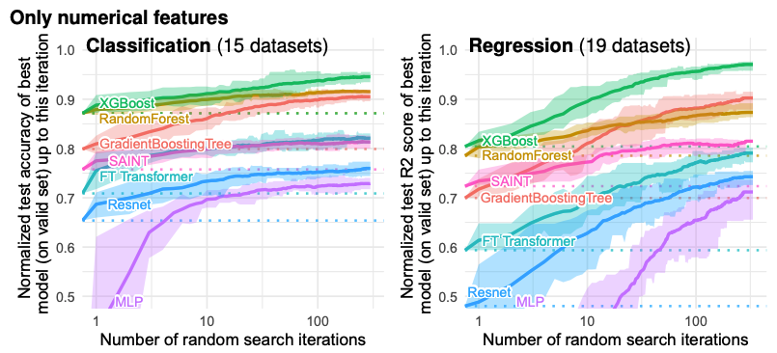
NeurIPS 2022

Slide 4
“
”
… the method that performs consistently well across all dimensions is random forests, followed by neural nets, boosted trees, and SVMs. [11 datasets]
- Caruana, Karampatziakis, Yessenalina (2008)
“
”
The classifiers most likely to be the best are the random forest versions. [121 data sets, 179 models]
- Fernandez-Delgado, Cernadas, Barro, Amorim (2014)
“
”
The post-hoc test underlines the impressive performance of Gradient Tree Boosting, which significantly outperforms every algorithm except Random Forest at the p < 0.01 level. [165 data sets, 13 models]
- Olson, Randal S., et al. (2018)

Slide 5
A decision tree is a piecewise constant model obtained from recursive partitioning of the covariate space
1
X₂
0
1
X₁

Slide 6
A decision tree is a piecewise constant model obtained from recursive partitioning of the covariate space
1
X₂> a
a
X₂
0
1
X₁

Slide 7
A decision tree is a piecewise constant model obtained from recursive partitioning of the covariate space
1
X₂> a
a
X₂
X₁> b
0
b
1
X₁

Slide 8
Random forests (RFs) and Gradient Boosted Trees combine decision trees in an ensemble
X₂> a
+
+
…
X₁> b

Slide 9
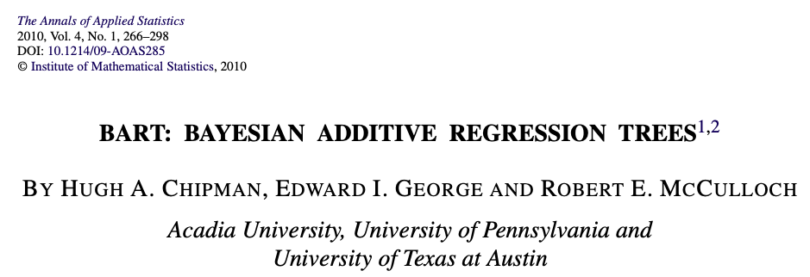
Drawbacks of RFs / gradient boosting
Unclear how to perform uncertainty quantification
Greedy splitting criterion may lead to ensemble models being stuck in local optima
Inefficiency with additive structure [Tan, Agarwal, Yu (2021)]
Overcome these drawbacks using a Bayesian formulation of tree ensembles

Slide 10
How does BART work?
Bayesian nonparametric regression
Step 1: Define prior on space of regression functions
Step 2: Combine prior and data likelihood to get posterior
Step 3: “Sample” from posterior using MCMC
Randomized tree ensemble method
Trees in ensemble are grown using probabilistic moves

Slide 11
BART has become widely used in the applied statistics community
Social sciences [Green and Kern (2010), Yeager et al. (2018), Dorie et al. (2019), …]
Biostatistics [Wendling et al. (2018), Starling et al. (2020), …]
Several popular software implementations: dbarts, BART, bartCause, bartMachine (15K combined monthly downloads)

Slide 12
Theoretical analysis of BART
BART posterior has good predictive and inferential properties
Posterior concentration around true regression function at minimax rate
Sobolev/Holder smoothness [Rockova and Saha, 2019], [Linero and Yang, 2018 ], [Rockova and van der Pas, 2020], …
Anisotropic and heterogeneous smoothness [Jeong and Rockova, 2020], [Rockova and Rousseau, 2023], …
Variable selection consistency [Linero, 2018], [Liu et al., 2021]
However: Can only access the posterior approximately via MCMC.

Slide 13
Theoretical analysis of BART
BART posterior has good predictive and inferential properties
However: Can only access the posterior approximately via MCMC.
We would like to know:
How close is the approximate posterior to the true posterior?
How long must we run the chain to achieve convergence?
Or in technical terms, what is the mixing time of the BART MCMC?

Slide 14
Problem: MCMC chain does not mix well
“... while this algorithm is often effective, it does not always mix well, and recent work suggests that it can be important to run many chains (as many as 10 or 12) to encourage proper mixing (Carnegie 2019)...”
“... warm-start initialization yields considerable improvement in the estimation, which may indicate inadequate chain length of BART (that is, poor mixing)...”
Seems to be “folklore” in the literature, but no rigorous study

Slide 15
Rest of this talk:
How does BART work?
How to frame computational lower bounds for BART?
Hitting time lower bounds for BART and practical takeaways

Slide 16
Part 1: How does BART work? (more details)
Parameterization of space of regression trees
Priors and likelihoods
MCMC algorithm

Slide 17
Parameterization of space of regression trees

Slide 18
Parameterization of space of regression trees
Binary tree structure
Tree topology
?
?

Slide 19
Parameterization of space of regression trees
Binary tree structure
Tree topology
Splitting rule for each internal node
X₂> a
X₁> b

Slide 20
Parameterization of space of regression trees
Binary tree structure
Tree topology
Splitting rule for each internal node
Values on each leaf in partition
X₂> a
X₁> b

Slide 21
Parameterization of space of regression trees
Binary tree structure
Tree topology
Splitting rule for each internal node
Values on each leaf in partition
X₂> a
X₁> b
Assume covariate space is
*
*In practice, BART “discretizes” features

Slide 22
Prior for tree structure
Defined in terms of stochastic process
Start with trivial tree

Slide 23
Prior for tree structure
X_{i}> a
Defined in terms of stochastic process
Start with trivial tree
With probability p, split root node (else stop)
If node is split, draw split feature and threshold uniformly at random, i.e.
Features: {1, 2, …. d}
i
Thresholds: {1, 2, …. m-1}
a

Slide 24
Prior for tree structure
X_{i}> a
Defined in terms of stochastic process
Start with trivial tree
X_{j}> b
With probability p, split root node (else stop)
If node is split, draw split feature and threshold uniformly at random, i.e.
Features: {1, 2, …. d}
i
Thresholds: {1, 2, …. m-1}
a
Repeat with each newly created node

Slide 25
Prior for leaf values
Data likelihood
Independent Gaussian priors for the leaf values
…
Independent Gaussian likelihood for errors in responses
…

Slide 26
MCMC algorithm
Decompose posterior
Have closed form expression
Hence just need to perform MCMC for space of trees to sample from
Will use Metropolis-Hastings. 4 proposal moves:
Grow
X_{i}> a
X_{i}> a
X_{j}> b
X_{j}> b
Grow
X_{k}> c

Slide 27
MCMC algorithm
Decompose posterior
Have closed form expression
Hence just need to perform MCMC for space of trees to sample from
Will use Metropolis-Hastings. 4 proposal moves:
Grow
Prune
X_{i}> a
X_{i}> a
X_{j}> b
Prune

Slide 28
MCMC algorithm
Decompose posterior
Have closed form expression
Hence just need to perform MCMC for space of trees to sample from
Will use Metropolis-Hastings. 4 proposal moves:
Grow
Prune
Change
X_{i}> a
X_{i}> a
X_{j}> b
X_{k}> c
Change

Slide 29
MCMC algorithm
Decompose posterior
Have closed form expression
Hence just need to perform MCMC for space of trees to sample from
Will use Metropolis-Hastings. 4 proposal moves:
Grow
Prune
Change
Swap
X_{i}> a
X_{j}> b
X_{j}> b
X_{i}> a
Swap

Slide 30
MCMC algorithm
Decompose posterior
Have closed form expression
Hence just need to perform MCMC for space of trees to sample from
Will use Metropolis-Hastings. 4 proposal moves:
Grow
Prune
Change
Swap
Pick a move at random
Apply accept-reject filter

Slide 31
BART with multiple trees
Convention: Use m trees
Parameterization and priors:
Each tree is parameterized in the same way as before
Regression function f is defined as the sum of the functions for each tree
MCMC
Combine Gibbs sampling with Metropolis-Hastings

Slide 32
BART with multiple trees
…
Iteration 0:
…
…
Iteration 1:
…
Iteration 2:
Convention: Use 100 burn-in iterations, then 1000 iterations for computing “posterior”

Slide 33
Part 2: How to frame computational lower bounds?
Prior work on mixing time lower bounds for BART
What is wrong with this definition?
How to fix it?

Slide 34
A frequentist analysis of computational lower bounds
Assume we observe training dataset comprising n i.i.d. samples
Warning: Generative distribution can and will be different from Bayesian parameterization!

Slide 35
Defining the mixing time
t - time step of the Markov chain
π - Stationary distribution
Q - Transition kernel
T - initialization

Slide 36
Defining the mixing time
t - time step of the Markov chain
π - Stationary distribution
Q - Transition kernel
T - initialization

Slide 37
Defining the mixing time
t - time step of the Markov chain
π - Stationary distribution
Q - Transition kernel
T - initialization

Slide 38
Previous result with
Theorem (informal): Mixing time for BART with one tree grows exponentially in the sample size.
[Ronen, Saarinen, Tan, Duncan, Yu (2022)]
“
”
This paper has the potential to be a significant contribution to the BART literature. However, I believe that the paper is missing a crucial discussion about whether mixing in tree space is practically relevant or even necessary.
- Reviewer #3

Slide 39
What is wrong with
?
1. Worst case over all initializations
2. MCMC is over space of tree parameters
Whereas BART MCMC initializes from empty tree ensemble
Whereas what we care about is the realized regression function

Slide 40
BART tree parameters are not identifiable

Slide 41
BART tree parameters are not identifiable

Slide 42
Fix this using hitting times for highest posterior density regions (HPDR)
Proposition: OPT is a HPDR and BART posterior concentrates on OPT as n → ∞.
Tan, Ronen, Saarinen, Duncan, Yu (2023, in preparation)

Slide 43
Part 3: Hitting time lower bounds and takeaways
Proof recipe
3 hitting time lower bounds
Practical takeaways

Slide 44
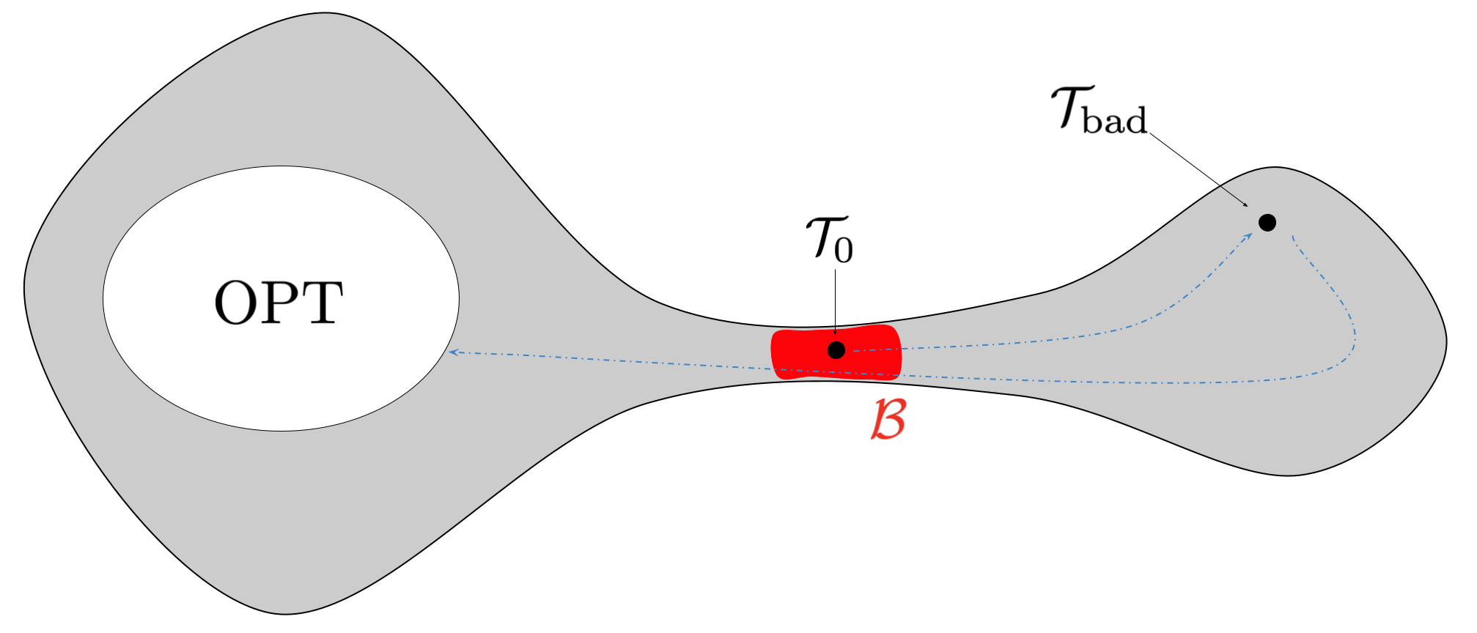
Proof recipe

Slide 45
Result 1: Lower bounds for additive models
Def: (Additive model)
Recall: BART model is
Theorem 1 (informal): If f* is additive, m ≤ m’, then
If furthermore, m < m’, and we allow only grow and prune moves, then

Slide 46
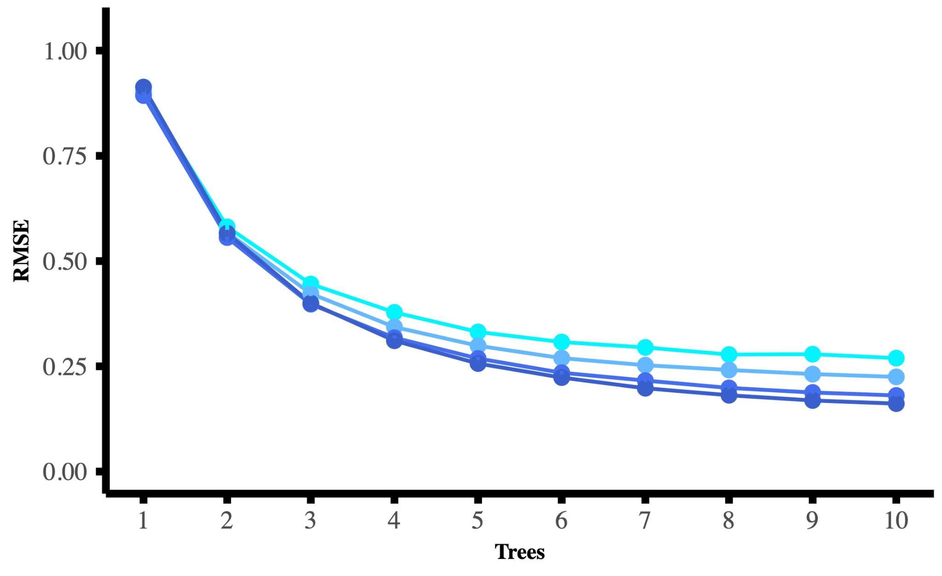
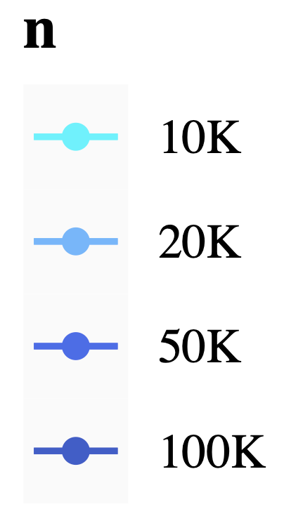
Simulate f* linear, with m’ = 5.

Slide 47
Simulate f* linear, with m’ = 5.
m’ = 5
(m < m’) Inefficient representation [Tan et al. (2021)]
(m ≤ ?) Simulation shows computational bottleneck persists
(m ≤ m’) Theorem 1 shows computational bottleneck

Slide 48
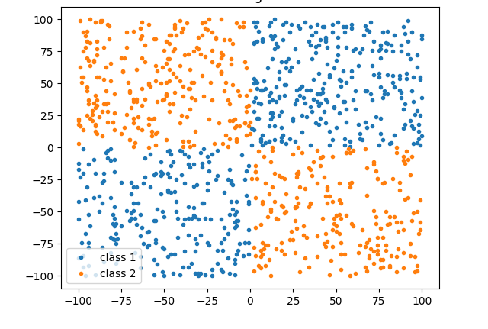
Other results
Assume only grow and prune moves are allowed.
Theorem 2 (informal): If f* contains a pure interaction, then
E.g. XOR function
OPT*: All trees with zero bias

Slide 49
Other results
Assume only grow and prune moves are allowed.
Theorem 2 (informal): If f* contains a pure interaction, then
Theorem 3 (informal): If we fit BART with only one tree (i.e. m=1), then

Slide 50
What do our results mean for practice?
Short-term
Should run multiple MCMC chains and average the results
Should not take BART credible intervals at face value
Long-term
BART sampler has large room for improvement
Temperature control
Using “informed” proposals instead of uniform proposals
More global proposal moves

Slide 51
Key Contributions
Created framework for meaningful computational lower bounds for BART
First analysis of BART with multiple trees
Provide HPDR hitting time lower bounds for BART under three different settings, show that they grow with sample size
Extensive simulation study (in the paper)
Obtain insights on why BART sampler may experience computational issues and suggests how to overcome them.
Paper to appear on arxiv soon (a few weeks)!

