Slide 1
2023 IASM-BIRS WORKSHOPS
How insects fly:
the attached leading-edge vortex and
its vorticity dynamics
Dr. Long Chen
Assistant Professor
Beihang University, China
Notes:
各位专家好。首先向大家表示歉意，因为周末需要到上海出差，所以无法线下参加答辩。我是来自北航交通学院的陈隆，现工作岗位为助理教授。

Slide 2
List of contents
1
Aerodynamics of Flying Insects
2
Leading-edge Vortex Stability
3
Vorticity Dynamics of LEV
Notes:
我将从以下三个方面向各位汇报工作

Slide 3
List of contents
1
Aerodynamics of Flying Insects
2
Leading-edge Vortex Stability
3
Vorticity Dynamics of LEV
Notes:
我将从以下三个方面向各位汇报工作

Slide 4
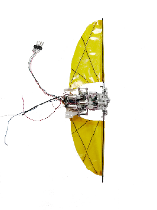
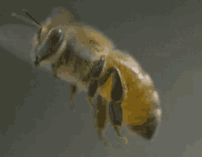
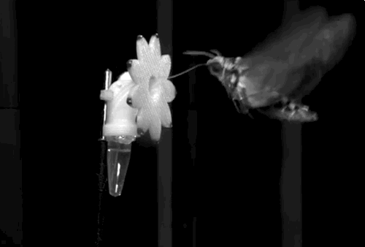
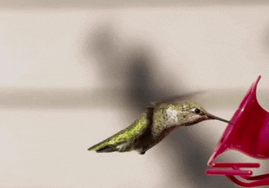
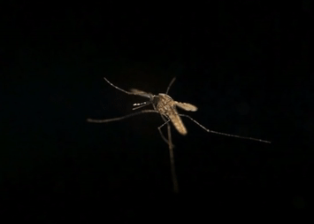
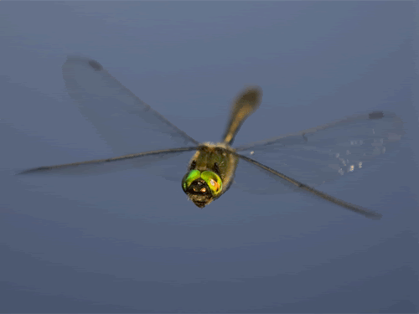
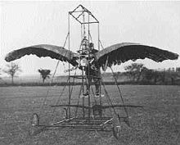
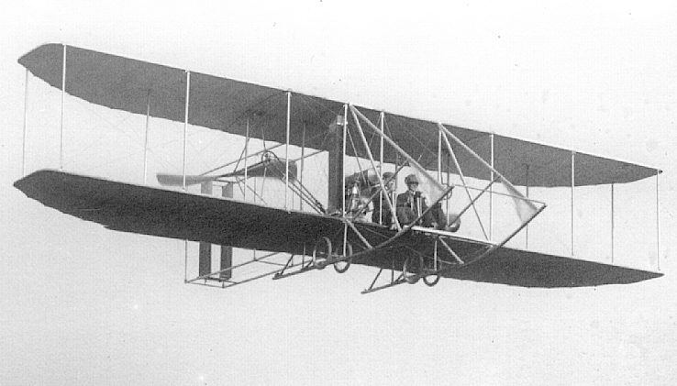
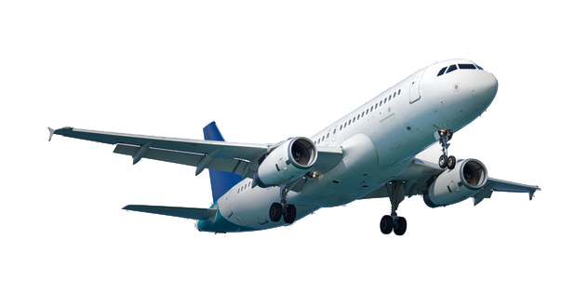
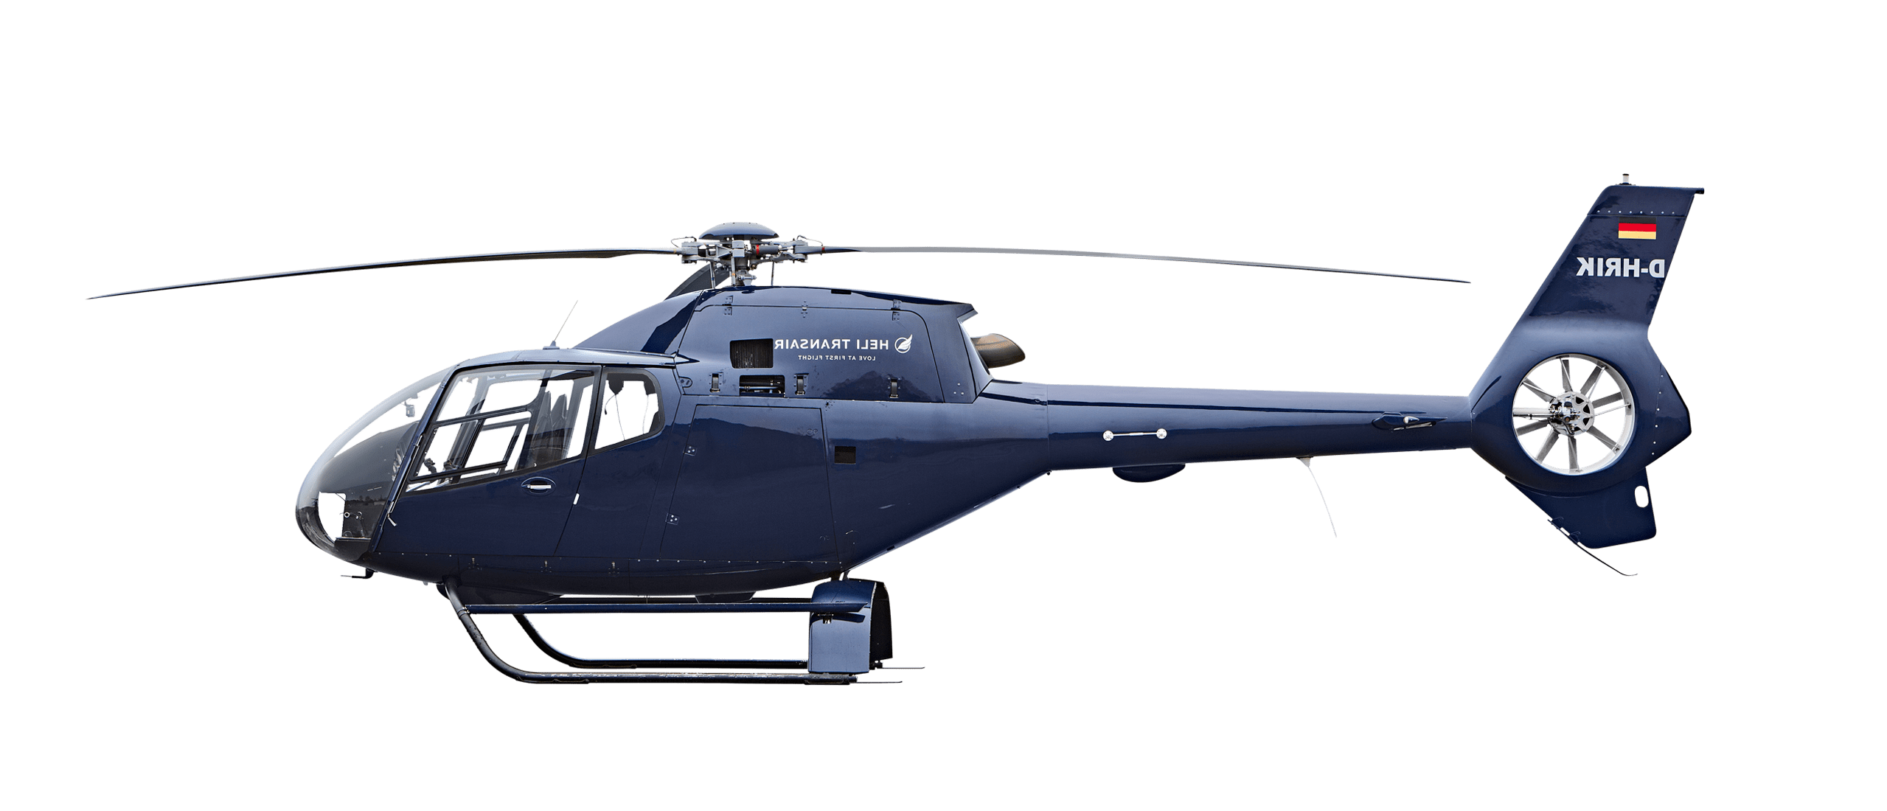
Aerodynamics of Flying Insects
Insects and birds are excellent flyers in nature!
Bee
Moth
Hummingbird
Mosquito
Dragonfly
Horizontal flapping
Vertical flapping
Micro air vehicles
Inspiration
Scale down
×
√
E.P. Frost's 1902
Wright Brothers 1910s
Airplanes & Helicopters in 2020s

Slide 5
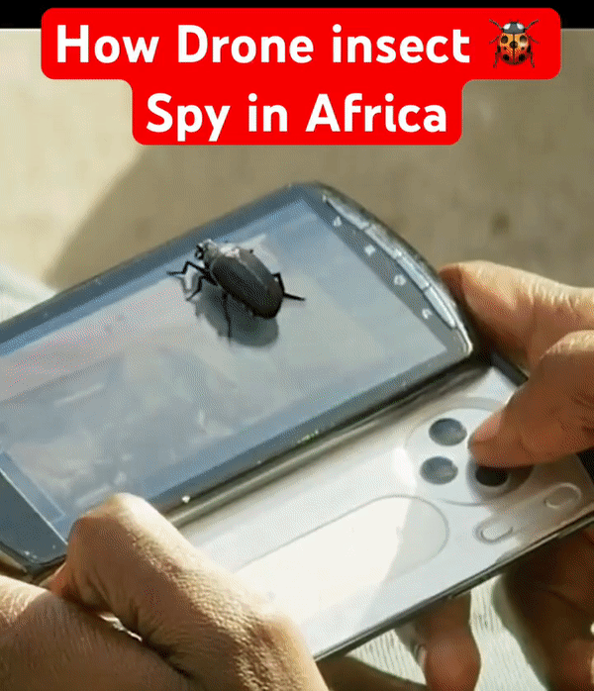
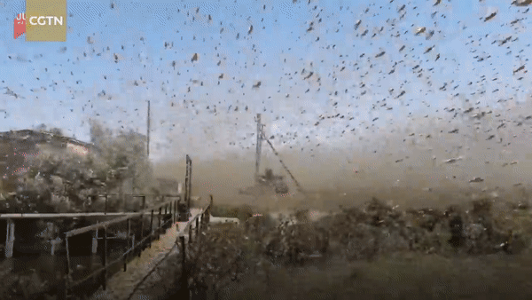
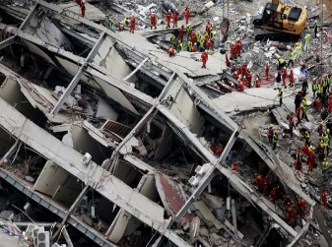
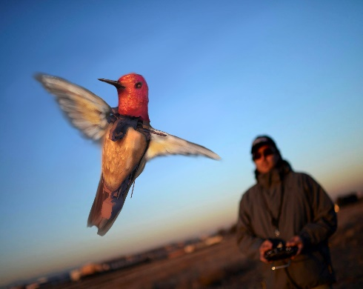
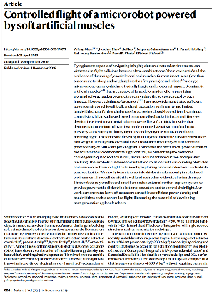
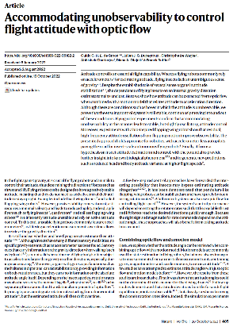
Aerodynamics of Flying Insects
Bio-inspired micro air vehicles become popular and focus
Soldier weapon
Swarm
Reconnaissance
Rescue
Toy
2015
2018
2019
2019
2020
2022
Dragonfly
Butterfly
Robobee I
Robobee II
Delfly I
Delfly II

Slide 6
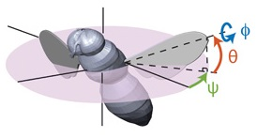
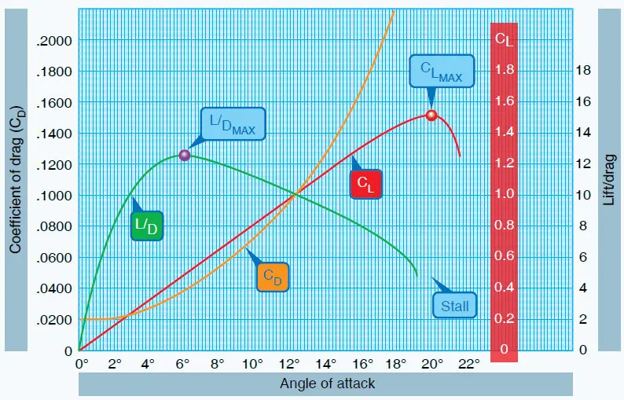
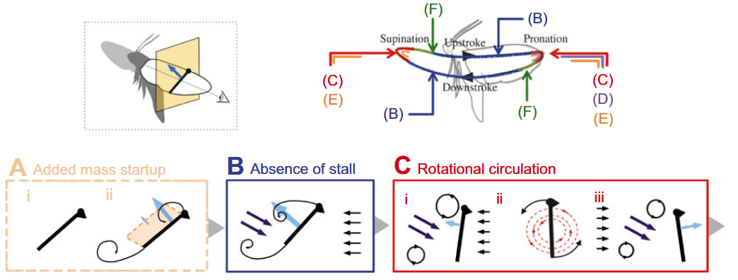
Aerodynamics of Flying Insects
Steady aerodynamics fails to explain an insect flight
Absence of Stall & Dynamic Stall
An insect-like flapping wing at a high angle of attack can not generate sufficient lift for flight!
Leading-edge
vortex
Obviously not true!
Absence of stall as a critical mechanism!

Slide 7
Aerodynamics of Flying Insects
The formation of stable LEV is a common feature of insects
Liu, H. & Aono, H. (2009). Size effects on insect hovering aerodynamics: an integrated computational study.
How does the flapping/revolving motion stabilize the LEV?

Slide 8
List of contents
1
Aerodynamics of Flying Insects
2
Leading-edge Vortex Stability
3
Vorticity Dynamics of LEV
Notes:
我将从以下三个方面向各位汇报工作

Slide 9
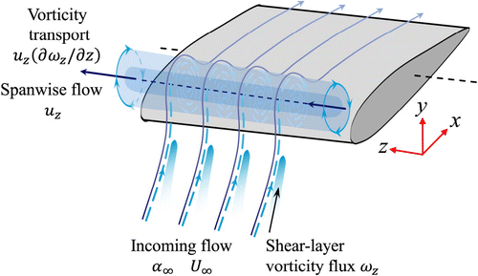
Leading-edge Vortex Stability
Hypotheses to explain a stable LEV on flapping wings
Spanwise convection:
driven by spanwise (tipward) flow
Rotational accelerations:
centrifugal and Coriolis accelerations
D. Lentink & M. H. Dickinson. (2009). Rotational accelerations stabilize leading edge vortices on revolving fly wings.
Pressure gradient motivates the tipward flow
Re-dependent (strong at Re>1000)
Not well defined (velocity, helicity, etc.)
(maybe) Related to spanwise convection
AR-dependent (strong at AR<3)
Not well explained (dynamic forces vs. vorticity)

Slide 10
Leading-edge Vortex Stability
Hypotheses to explain a stable LEV on flapping wings
Downwash:
reduction of effective angle of attack
Vorticity annihilation:
interaction between the LEV and the opposite-sign layer
J. M. Birch & M. H. Dickinson. (2001). Spanwise flow and the attachment of the leading-edge vortex on insect wings.
C. J. Wojcik & J. H. L. Buchholz. (2014). Vorticity transport in the leading-edge vortex on a rotating blade.
Re=110
Limited parameter space
Re=4000
A minor contribution

Slide 11
Leading-edge Vortex Stability
Hypotheses to explain a stable LEV on flapping wings
The LEV stability is relevant to Reynolds number, aspect ratio (span over chord) and Rossby number (or root cutoff).
The local LEV stability at a specific spanwise position may be relevant to revolving radius.
The LEV dynamics is time-variant and dependent on revolving radius during the LEV formation.
The LEV dynamics is still underexplored and requires a temporo-spatial analysis under a universal approach.

Slide 12
List of contents
1
Aerodynamics of Flying Insects
2
Leading-edge Vortex Stability
3
Vorticity Dynamics of LEV
Notes:
我将从以下三个方面向各位汇报工作

Slide 13
Vorticity Dynamics of Leading-edge Vortex
Problem setup and frames
Inertial Cartesian frame → rotating Cartesian frames
Due to the revolving nature
Related to azimuth angle ($θ$) and fixed during the motion
For a specific point A:
Positive radial direction
(from point A to the center of rotation)
Positive tangential direction
(tangential and backward to the wing motion)
Vertical direction is preserved
Gradient tensors are calculated using chain rules

Slide 14
Vorticity Dynamics of Leading-edge Vortex
Vorticity equation in the co-rotating frame
Navier-Stokes equations
Normalized vorticity transport equation (co-rotating frame)
Radial components (r-direction)
Tilting
Stretching

Slide 15
Vorticity Dynamics of Leading-edge Vortex
Simulations and PTV experiments
Numerical simulations
Robotic wing experiments
An in-house solver
Artificial compressibility method
Body-fitted O-H block
Well validated
Oil tank with ‘Shake-the-box’ PTV setups
Dynamically-scaled
Time-resolved 3D flow measurement
Force measurement (Nano17)
L. Chen, J. H. Wu and B. Cheng. (2020). Leading-edge vortex formation and transient lift generation on a revolving wing at low Reynolds number.

Slide 16
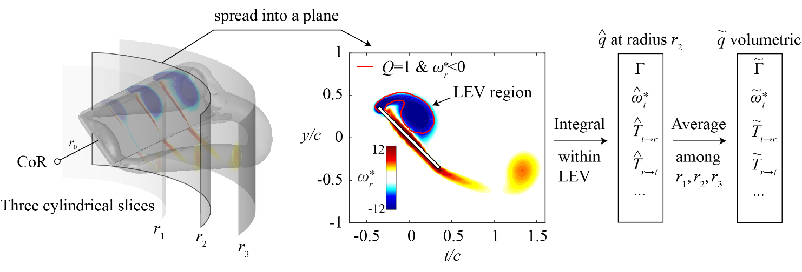
Vorticity Dynamics of Leading-edge Vortex
Benchmark（ Re=1500 AR=3 Ro=2.56）
CFD
A conical LEV
Stable LEV region
Unstable LEV region
Intensity saturation
PTV
^

Slide 17
Vorticity Dynamics of Leading-edge Vortex
Benchmark（ Re=1500 AR=3 Ro=2.56）
^
Tangential convection of radial vorticity represents the spreading of LEV into the downstream
Vertical convection of radial vorticity represents the downwash effect in LEV stability

Slide 18
Vorticity Dynamics of Leading-edge Vortex
Benchmark（ Re=1500 AR=3 Ro=2.56）
^
Radial convection of radial vorticity represents spanwise convection effect in LEV stability
Spanwise convection is limited within the stable LEV region

Slide 19
Vorticity Dynamics of Leading-edge Vortex
Benchmark（ Re=1500 AR=3 Ro=2.56）
^

Slide 20
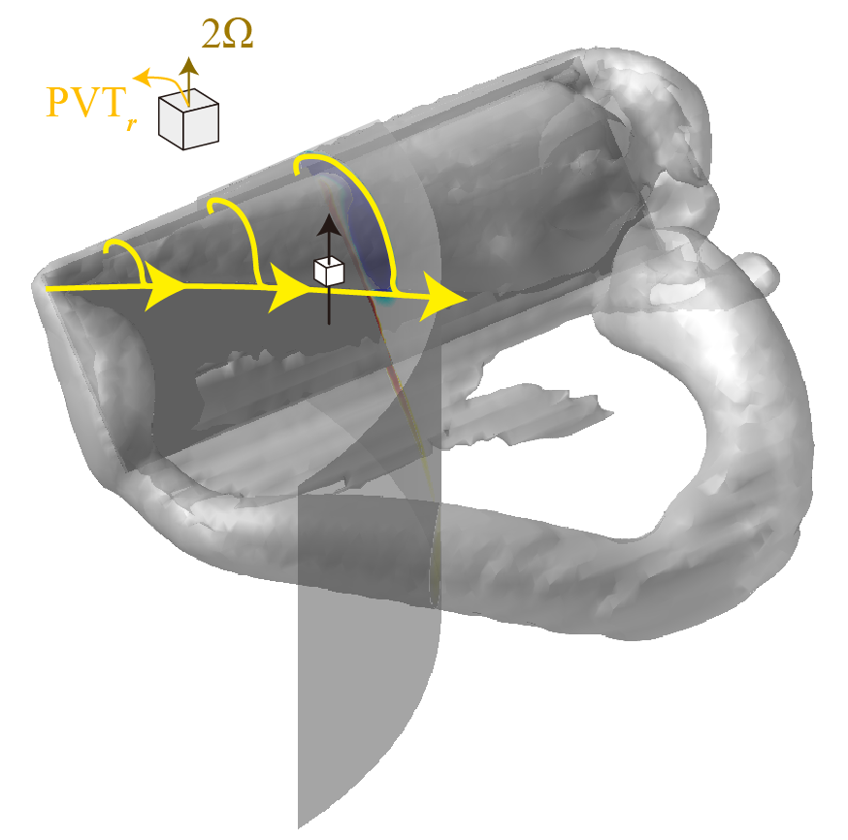
Vorticity Dynamics of Leading-edge Vortex
Benchmark（ Re=1500 AR=3 Ro=2.56）
Planetary vorticity tilting (PVT)
PVT_{r} is the vertical gradient of tangential Coriolis acceleration
PVT_{t} is the vertical gradient of radial Coriolis acceleration
^
Coriolis acceleration

Slide 21
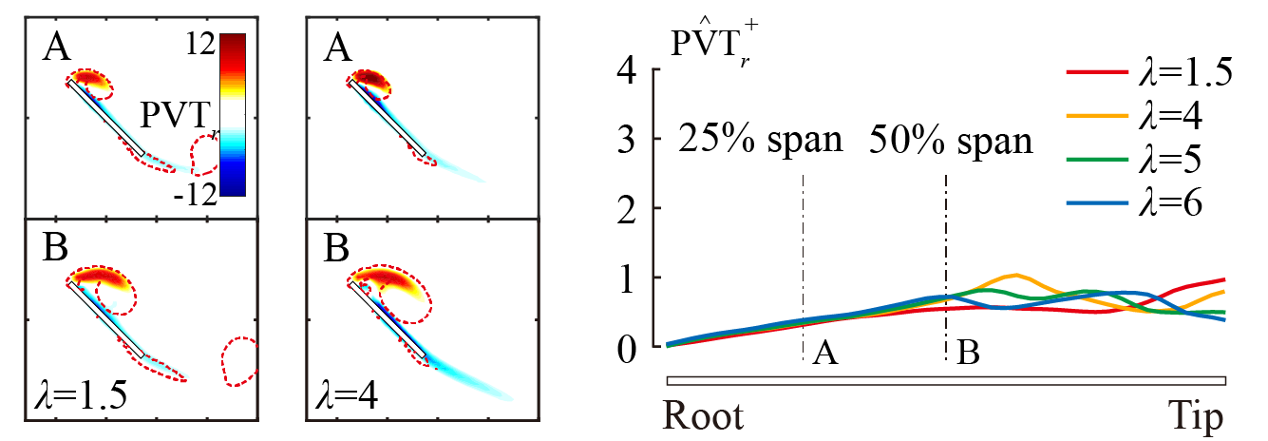
Vorticity Dynamics of Leading-edge Vortex
Benchmark（ Re=1500 AR=3 Ro=2.56）
Planetary vorticity tilting (PVT)
^
PVT_{r} contributes to LEV stability by removing radial vorticity (Re>100)
Once established, the contribution of PVT_{r} is almost Re-independent and time-invariant

Slide 22
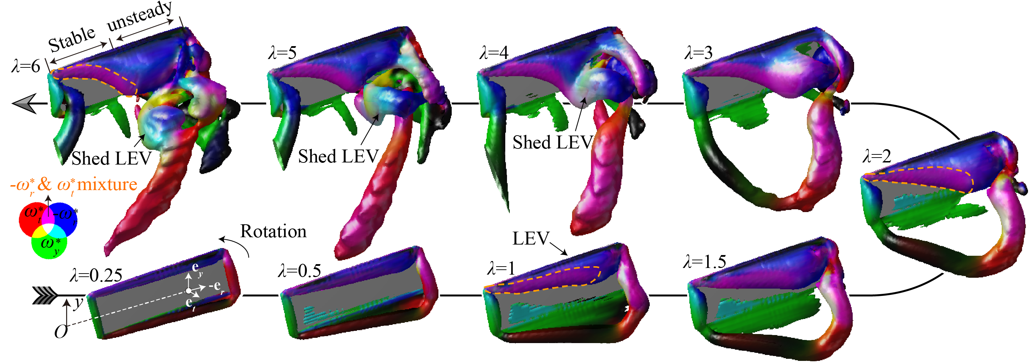
Vorticity Dynamics of Leading-edge Vortex
Benchmark（ Re=1500 AR=3 Ro=2.56）
Dual-stage radial-tangential vortex tilting
The mixing of radial and tangential vorticity within the stable LEV region
^

Slide 23
Vorticity Dynamics of Leading-edge Vortex
Benchmark（ Re=1500 AR=3 Ro=2.56）
Dual-stage radial-tangential vortex tilting
^
The ratio of radial and tangential vorticity within the stable LEV results in a constant.
Any transform between radial vorticity and tangential vorticity?

Slide 24
Vorticity Dynamics of Leading-edge Vortex
Benchmark（ Re=1500 AR=3 Ro=2.56）
Dual-stage radial-tangential vortex tilting
The mutual conversion between radial vorticity and tangential vorticity
^
Tilting of tangential vorticity component into radial direction
Tilting of radial vorticity component into tangential direction

Slide 25
Vorticity Dynamics of Leading-edge Vortex
Benchmark（ Re=1500 AR=3 Ro=2.56）
Dual-stage radial-tangential vortex tilting
The T_{r→t} can enhance the (positive) tangential vorticity
Tangential velocity increases towards the wing tip
Located at the rear boundary of the LEV
^

Slide 26
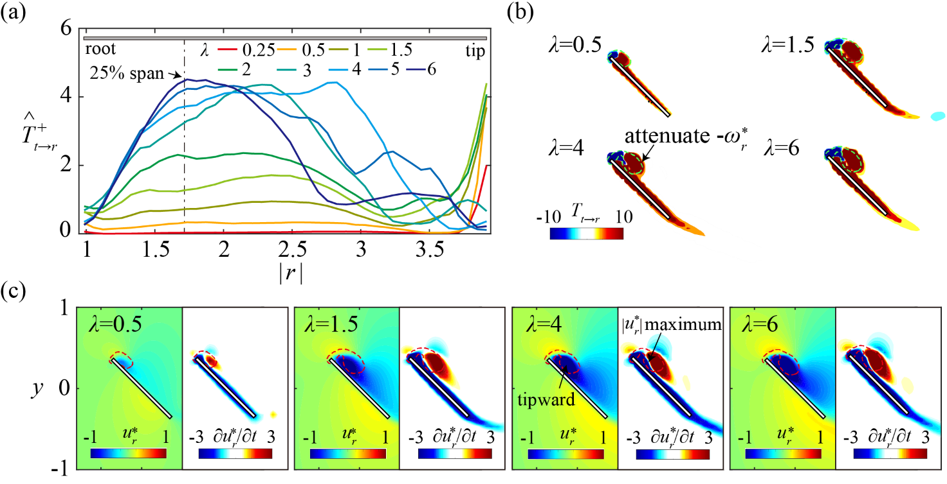
Vorticity Dynamics of Leading-edge Vortex
Benchmark（ Re=1500 AR=3 Ro=2.56）
Dual-stage radial-tangential vortex tilting
The T_{t→r} can cancel out negative radial vorticity in LEV
A reduction of tipward flow along the tangential direction is necessary
The T_{t→r} and T_{r→t} can build up a bidirectional transform of radial and tangential vorticity
^

Slide 27
Vorticity Dynamics of Leading-edge Vortex
Benchmark（ Re=1500 AR=3 Ro=2.56）
Dual-stage radial-tangential vortex tilting
Tilting of tangential vorticity component into radial direction
Tilting of radial vorticity component into tangential direction
^
A negative feedback loop

Slide 28
Vorticity Dynamics of Leading-edge Vortex
Conclusions and other works
The 3D vorticity transports during LEV formation until the steady state has been addressed
Two novel mechanisms for LEV stability has been presented.
Planetary vorticity tilting (PVT) and Dual-stage radial-tangential vortex tilting
The role of Coriolis acceleration in LEV stability has been explained from a vorticity transport perspective.
Effects of Re, AR, Ro and α…
More complicated wing motions, e.g., flapping, pitch-up, forward flight.
^

Slide 29
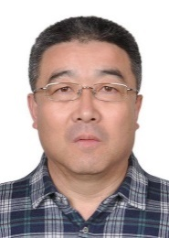
Acknowledgment
Collaboration with Penn State
BEIHANG Group
BioRob-InFL Lab
Prof. B. Cheng
^
Prof. J.J.
Wang
Prof. J.H.
Wu
Prof. C.
Zhou
Prof. L.
Chen
Prof. N.H. Werner
Publications:
Chen, L. et al. (2023). Vorticity dynamics and stability of the leading-edge vortex on revolving wings. Physics of Fluids, 35(9), 091301.
Chen, L. et al. (2023). Dual-stage radial-tangential vortex tilting reverses radial vorticity and contributes to leading-edge vortex stability on revolving wings. Journal of Fluid Mechanics, A29, 963.
Chen, L. et al. (2022). Effects of Reynolds number on leading-edge vortex formation dynamics and stability in revolving wings. Journal of Fluid Mechanics, A31, 931.
Chen, L. et al. (2020). Leading-edge vortex formation and transient lift generation on a revolving wing at low Reynolds number. Aerospace Science and Technology, 97, 105589.
Chen, L. et al. (2019). Volumetric measurement and vorticity dynamics of leading-edge vortex formation on a revolving wing. Experiments in Fluids, 60, 1-15.

