Slide 1
Where does pandemic forecasting go from here?
Michael A. Johansson
Senior Advisor for Infectious Disease Modeling and Analytics, Office of the Deputy Director of Infectious Diseases
Biologist, Division of Vector-Borne Diseases

Slide 2
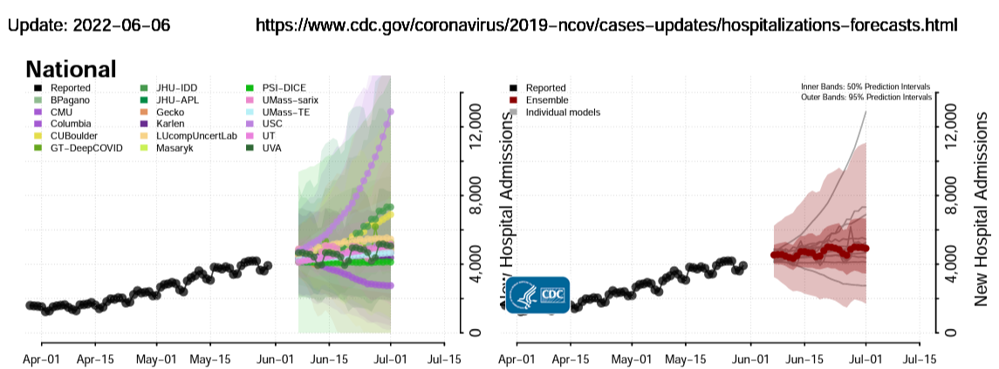
Notes:
Forecasts that matter
National & state
Many models
Real time
Probabilistic - uncertainty
Ensemble
Continuous evaluation

Slide 3
Can we improve forecasts?
Improve reliability
Decrease uncertainty
Extend horizons
Increase spatial resolution

Slide 4
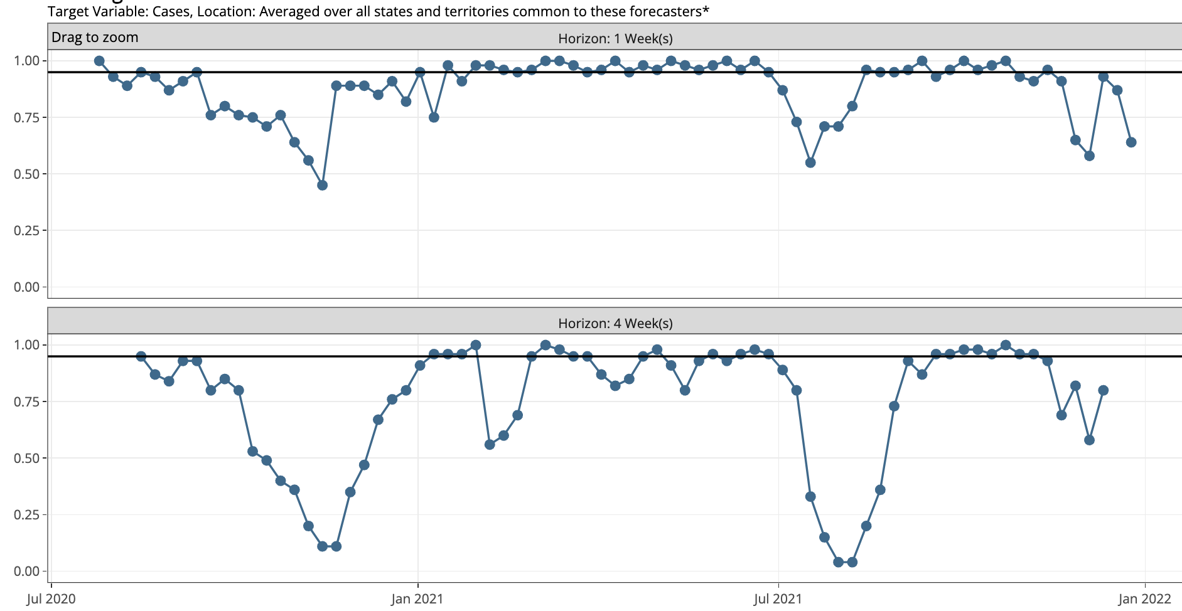
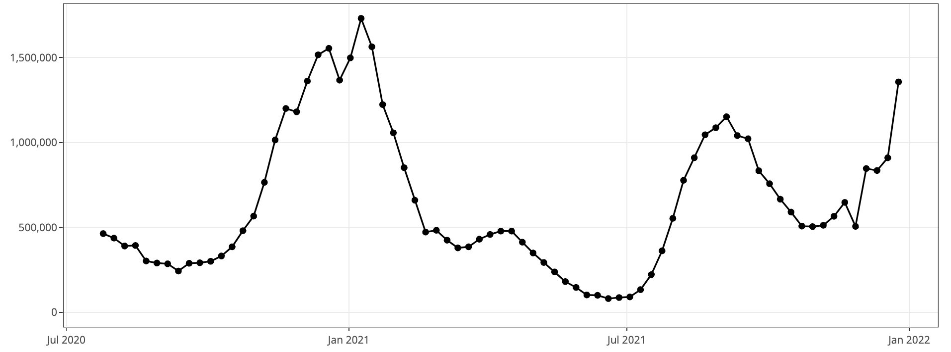
1-wk ahead
Ensemble 95% PI Coverage
4-wk ahead
Reported cases
https://delphi.cmu.edu/forecast-eval/
Notes:
Reliability

Slide 5
https://www.cdc.gov/coronavirus/2019-ncov/science/forecasting/hospitalizations-forecasts.html
Notes:
Uncertainty

Slide 6
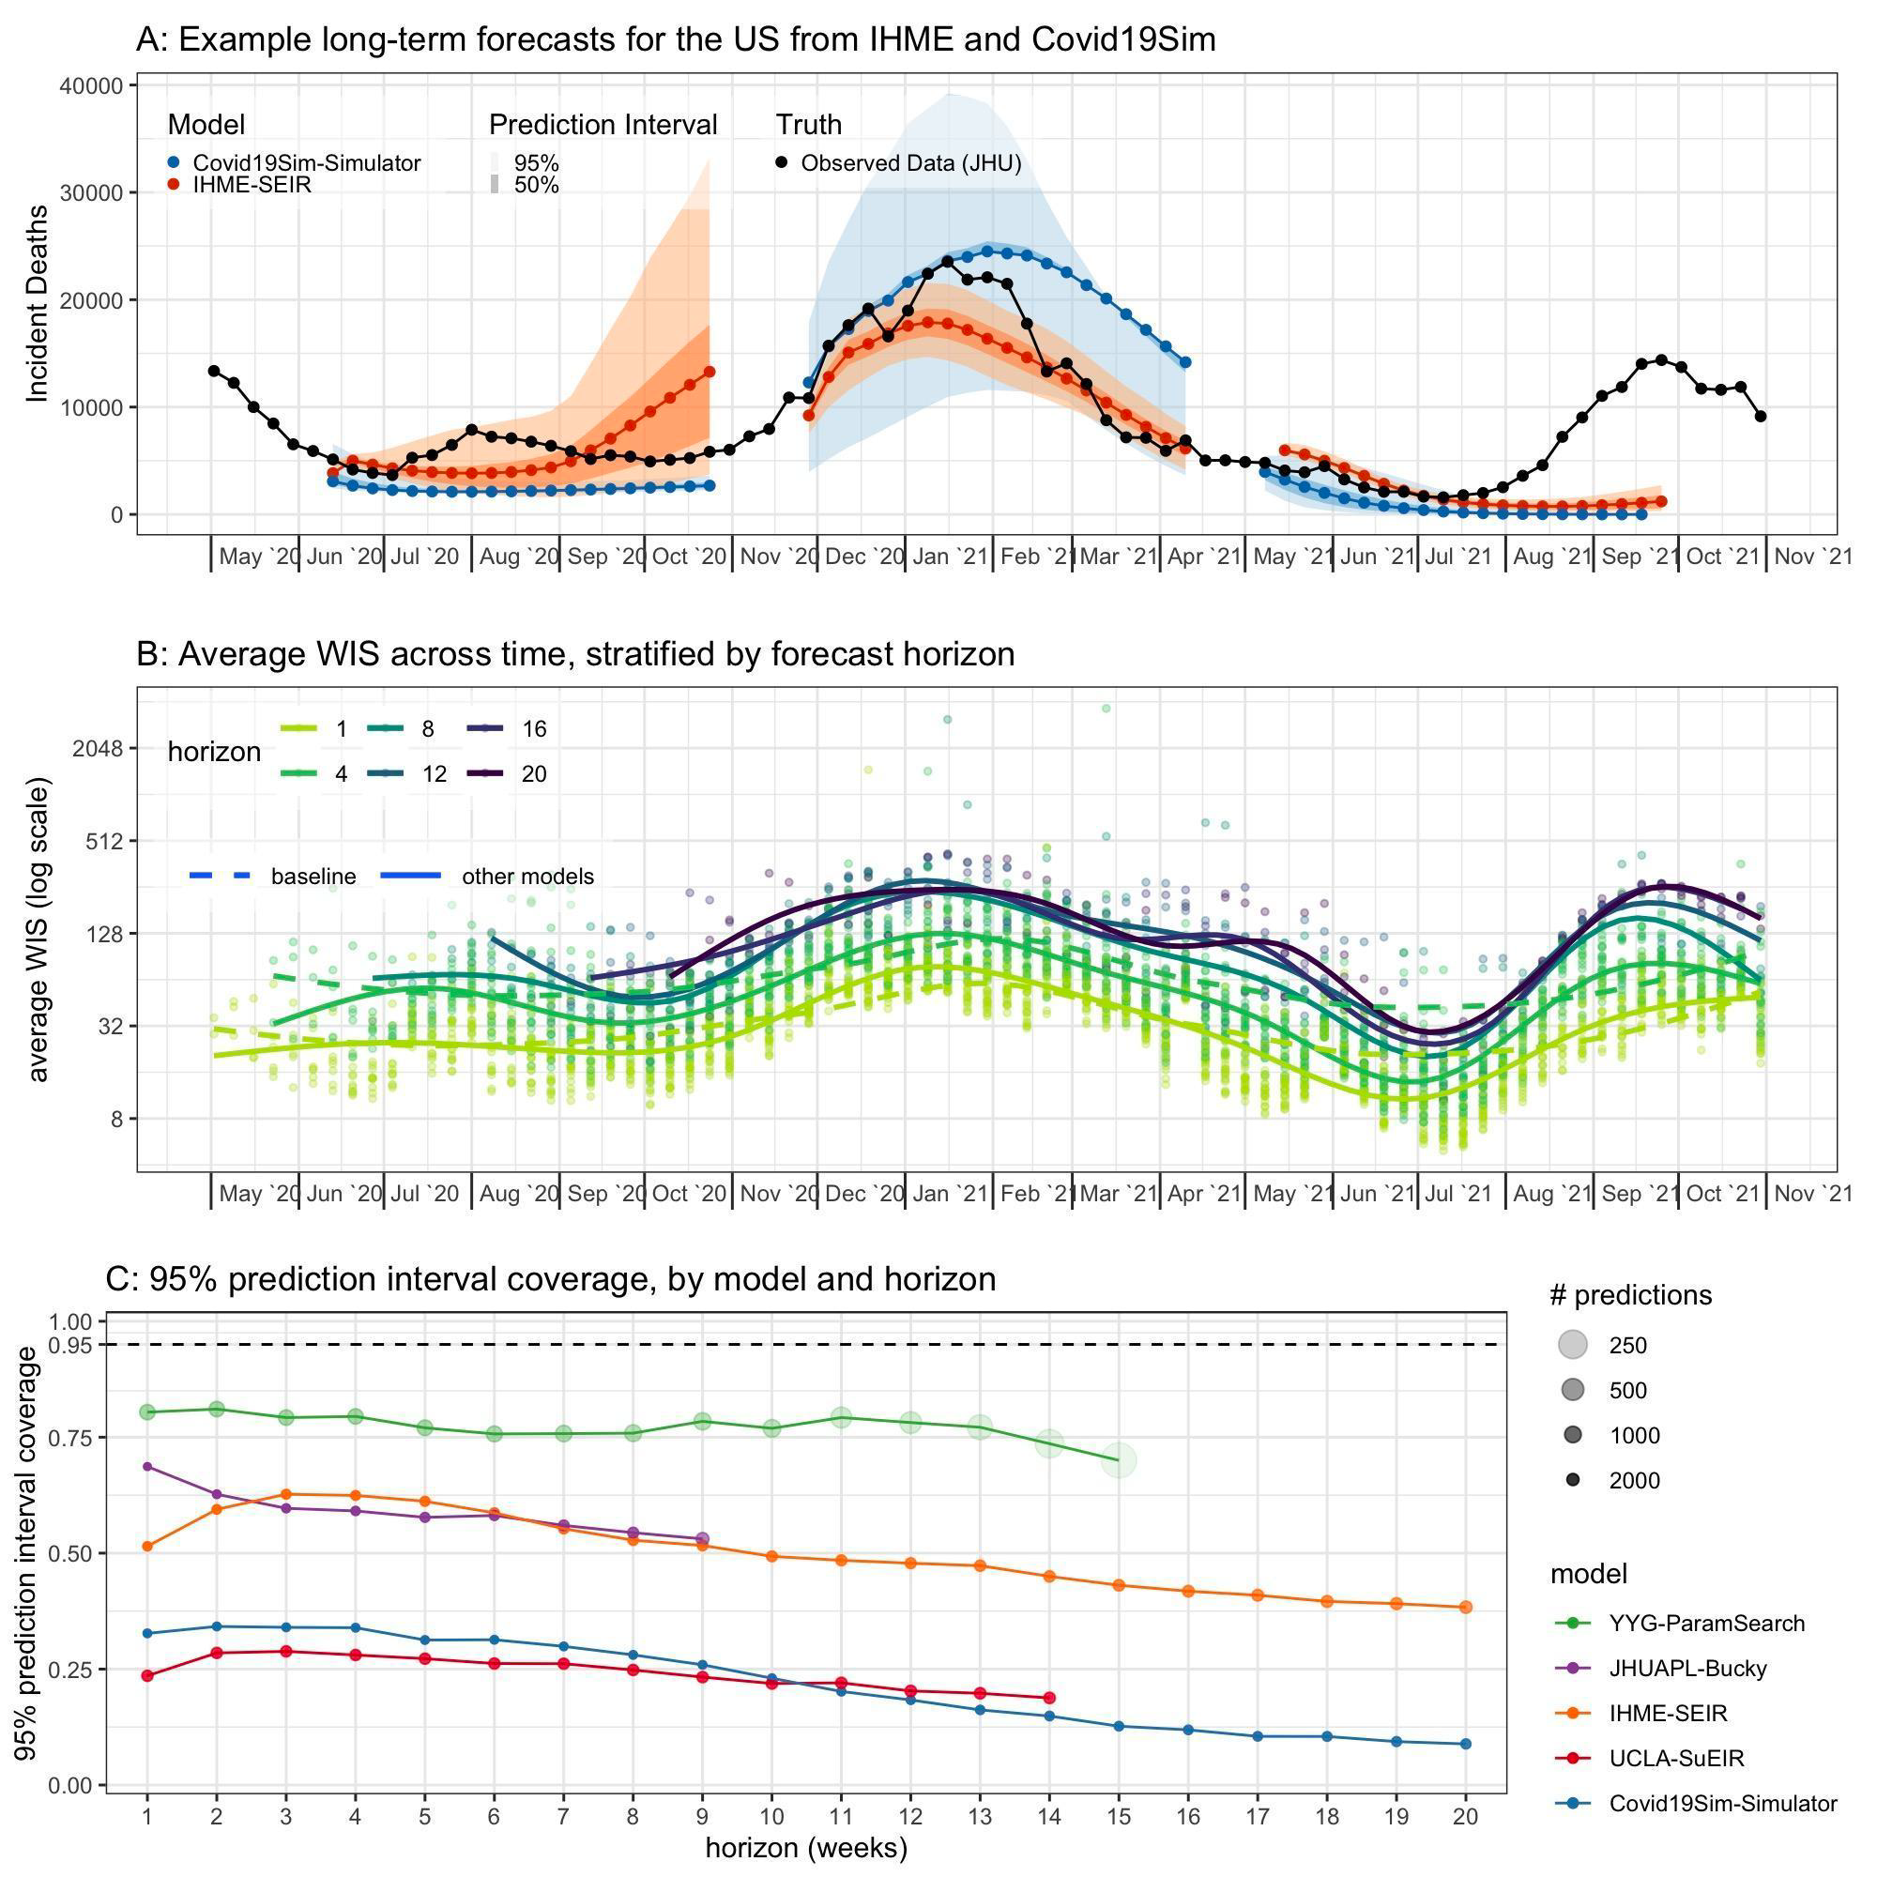
Cramer et al. PNAS 2022
Notes:
Horizons

Slide 7
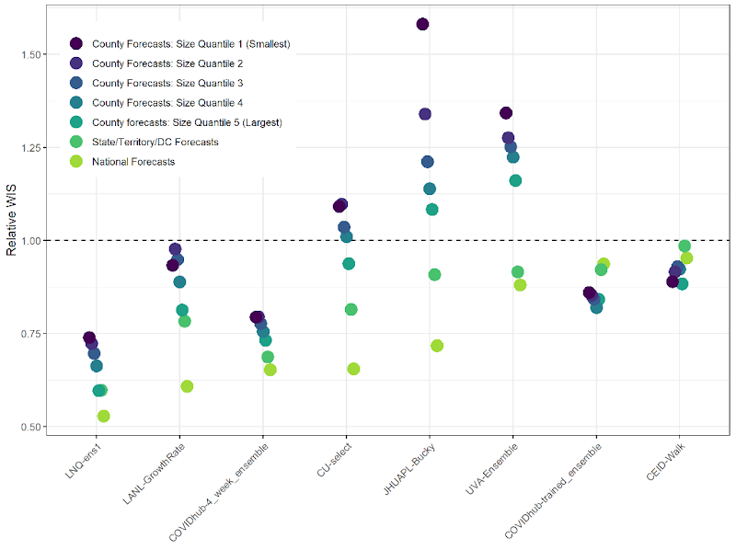
COVID-19 case forecasts
Notes:
Geographical scale

Slide 8
Collaborative forecasting efforts
US Aedes Forecasting Challenge
20 participating teams
US WNV Challenge
15 teams
US WNV Challenge
8 teams
Reich et al. AJPH 2022

Slide 9
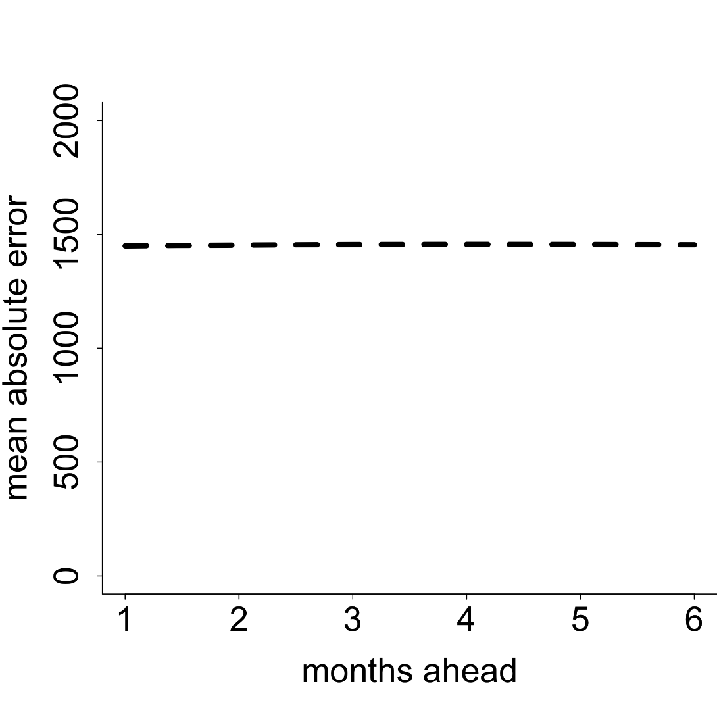
Dengue forecast error - Mexico
Mean
Johansson et al. Scientific Reports 2016
Notes:
39 time series models
National + 17 states

Slide 10
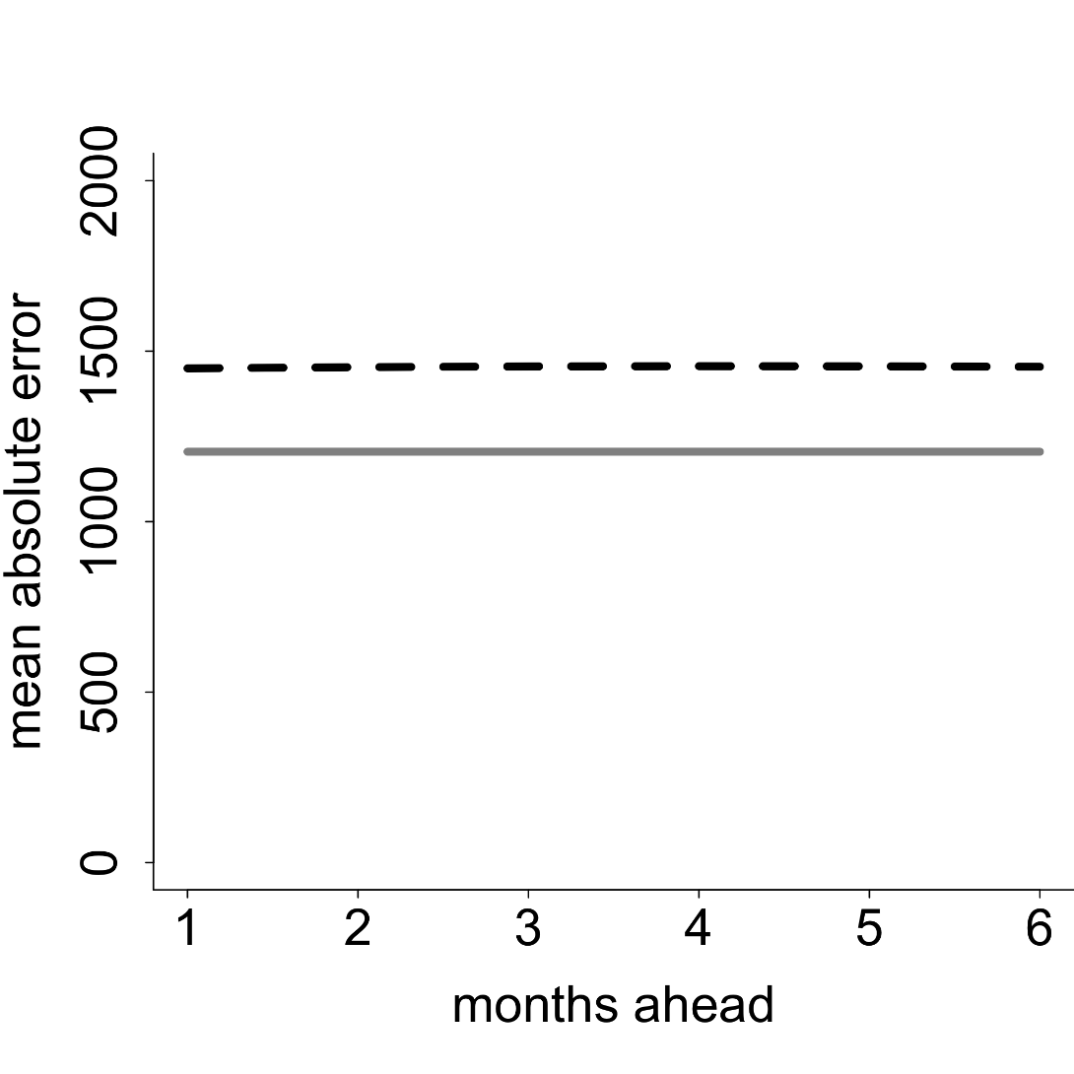
Dengue forecast error - Mexico
Mean
Monthly mean
Johansson et al. Scientific Reports 2016

Slide 11
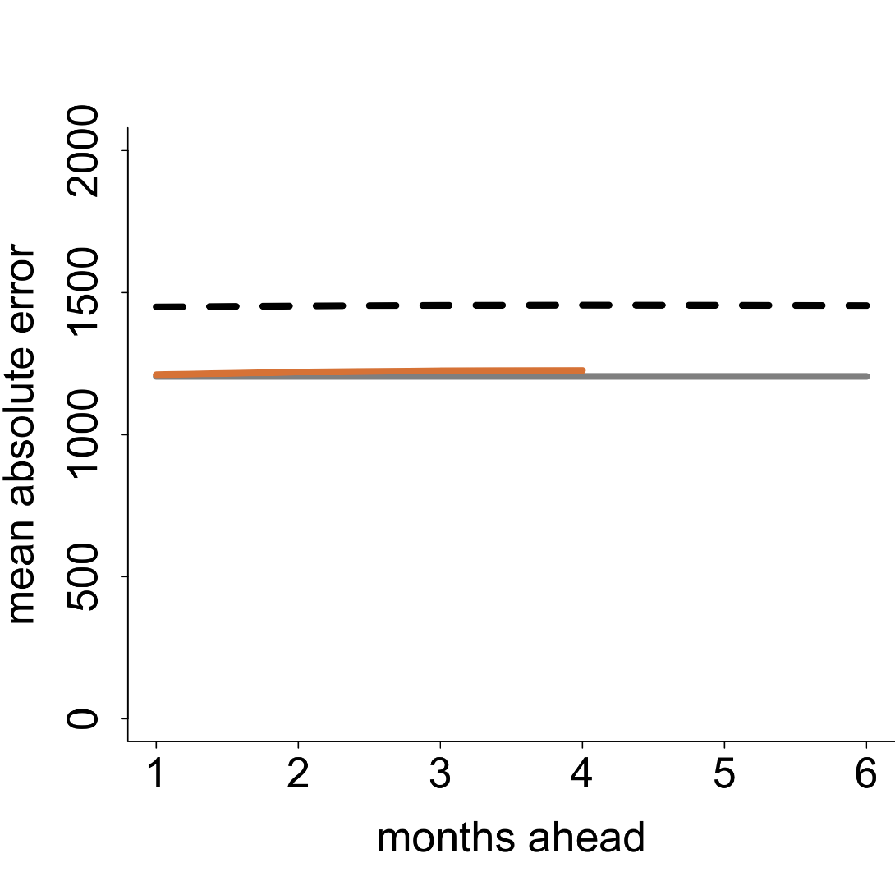
Dengue forecast error - Mexico
Mean
Temperature
Monthly mean
Johansson et al. Scientific Reports 2016

Slide 12
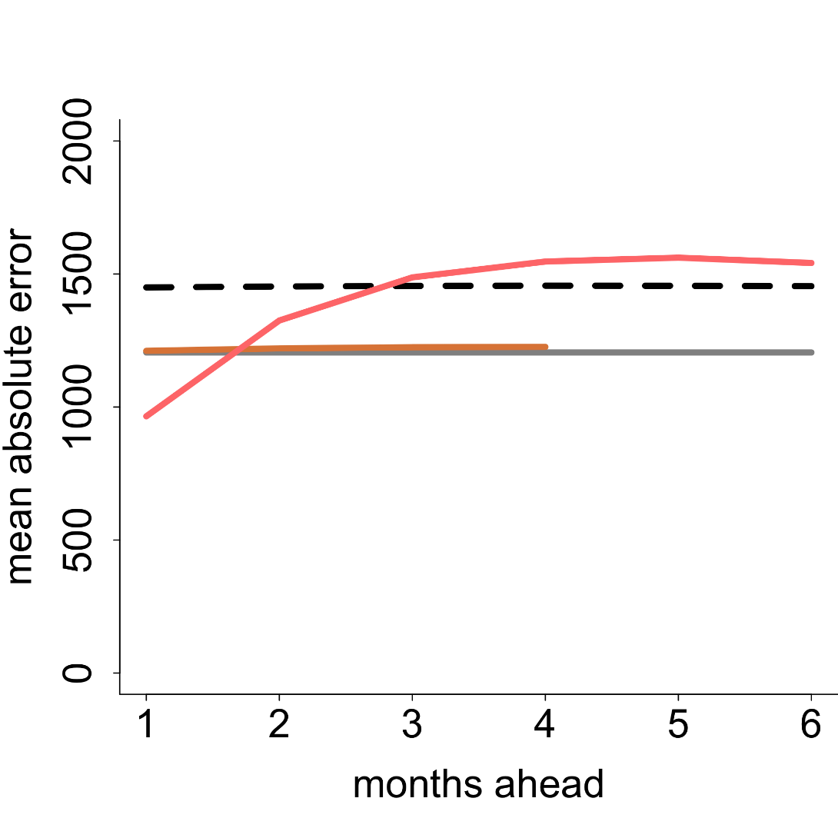
Dengue forecast error - Mexico
Autocorrelation
Mean
Temperature
Monthly mean
Johansson et al. Scientific Reports 2016

Slide 13
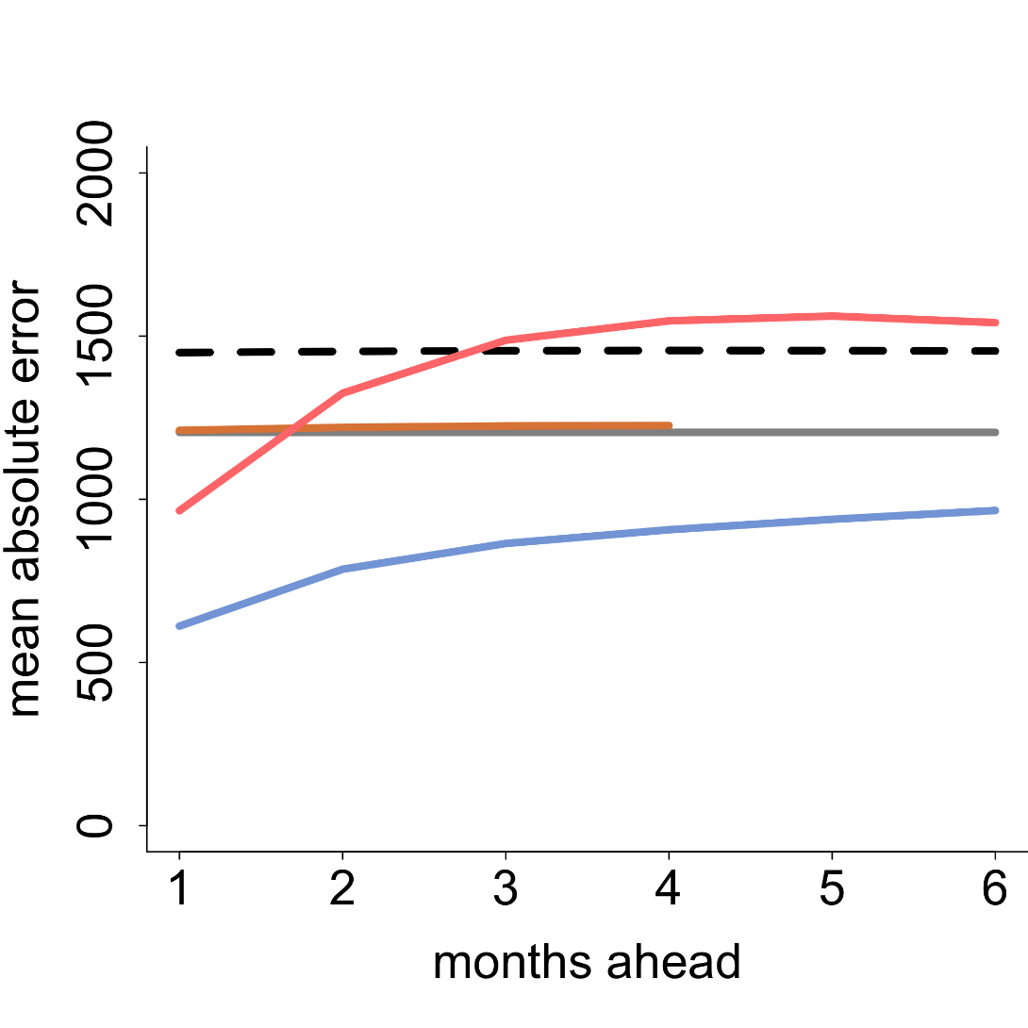
Dengue forecast error - Mexico
Autocorrelation
Mean
Temperature
Monthly mean
Autocorrelation + seasonality
Johansson et al. Scientific Reports 2016
Notes:
Mean cases per month: 1,513
Range: 11 – 16,413
Median: 442
75% percentile: 1619

Slide 14
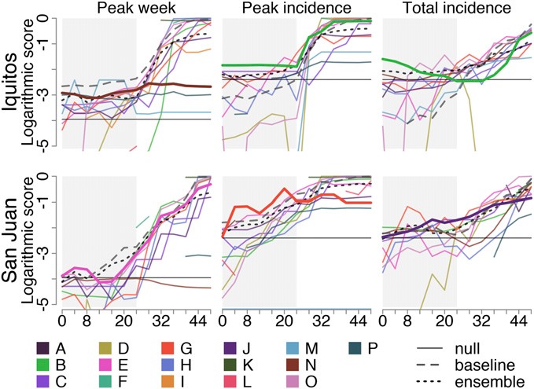
Dengue forecasts
Johansson et al. PNAS 2019
Notes:
SARIMA vs. more complex models
Vect

Slide 15
WNV forecasts

Slide 16
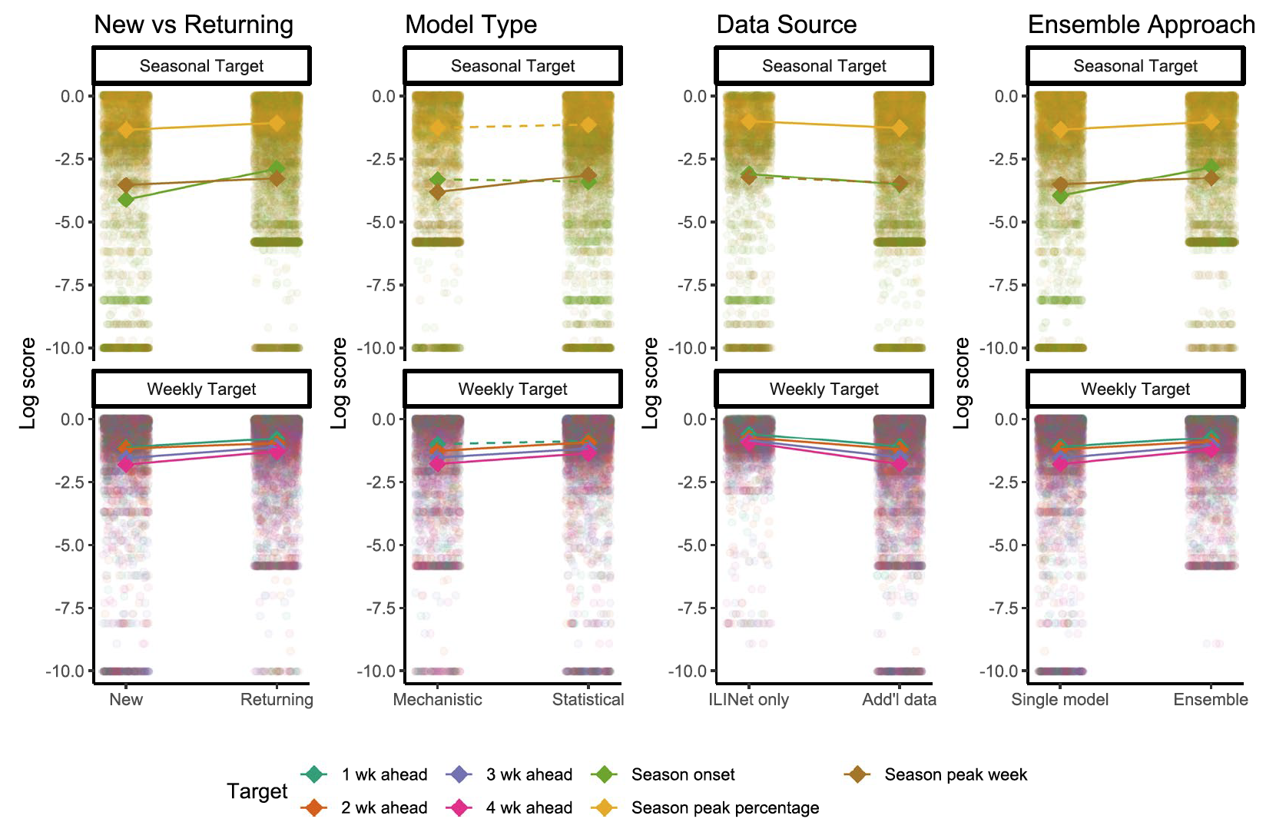
Influenza forecasts
McGowan et al. Sci Rep 2019

Slide 17
COVID-19 death forecasts
Cramer et al. PNAS 2022
Notes:
Ensemble
Baseline-AR
Every model that outperforms the baseline uses case data

Slide 18
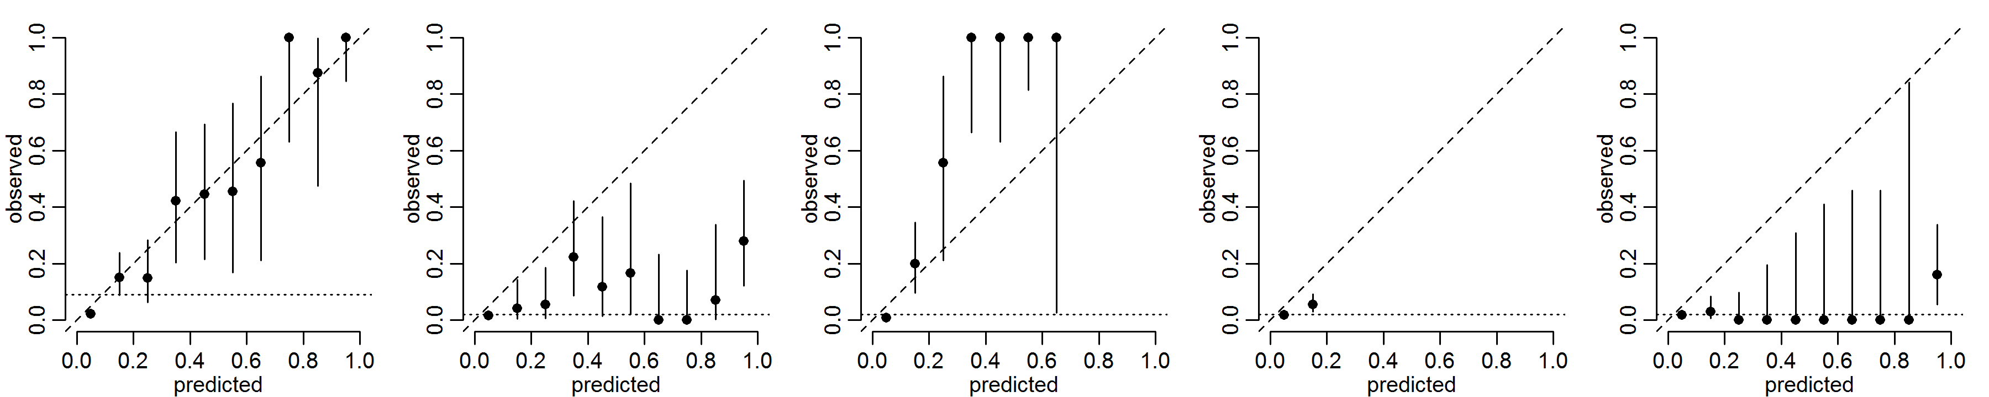
Model calibration
Well-calibrated
Over-confident
Under-confident
No confidence
No resolution

Slide 19
What makes a good forecast?
Data inputs
Model structure
Parameter selection/calibration/fitting
Forecast generation
Notes:
FG – ensemble, uncertainty specification

Slide 20
Better forecasts
Worse forecasts
Multiple models
Statistical*
Autoregression
Historical data*
Calibrated
Single model
Mechanistic*
More data sources*
Climate data*
Vector components*
Notes:
COVID is different

Slide 21
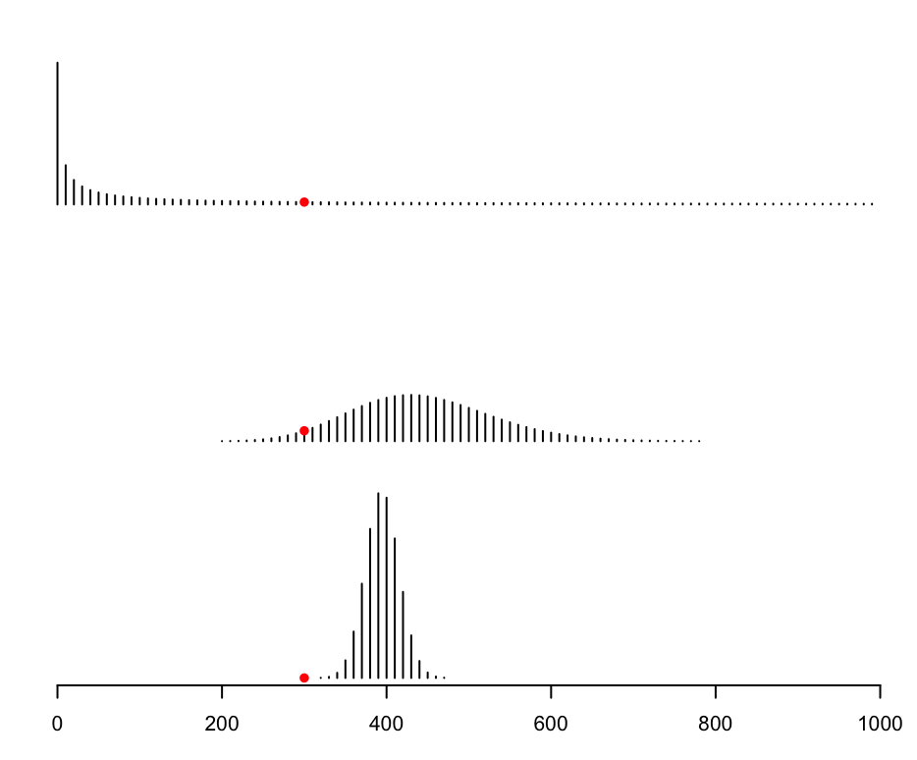
How should we assess forecasts?
Gneiting & Raftery J Am Stat Assoc 2007, Bracher et al. arXiv 2021, Bosse et al. arXiv 2022
Notes:
4 weeks out w a decision about setting up a temporary medical facility in a big city

Slide 22
How should we assess forecasts?
AE | Log Score | WIS
50 | -6 | 174
150 | -4.5 | 91
100 | -Inf | 85
Gneiting & Raftery J Am Stat Assoc 2007, Bracher et al. arXiv 2021, Bosse et al. arXiv 2022
Notes:
A forecast with good WIS could be consistently, objectively wrong but still be useful

Slide 23
What’s the value of …?
Autocorrelation
Mean
Temperature
Monthly mean
Autocorrelation + seasonality
Notes:
Degrees of freedom
Especial data, always: needed better/more data
Ablation studies

Slide 24
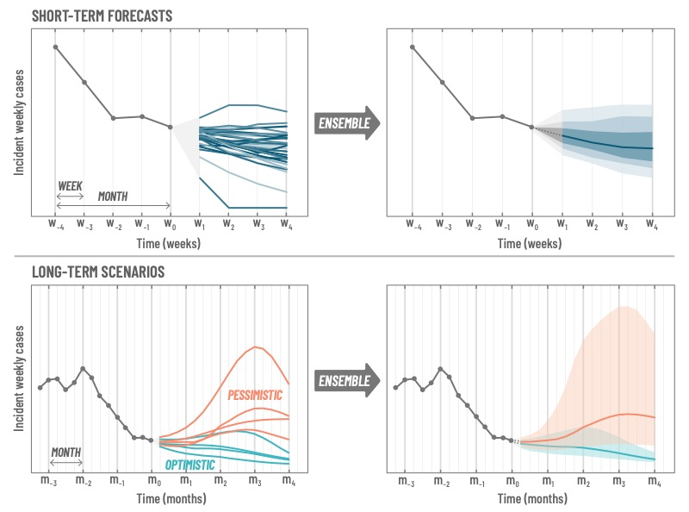
Can we extend horizons?
Reich et al. AJPH 2022

Slide 25
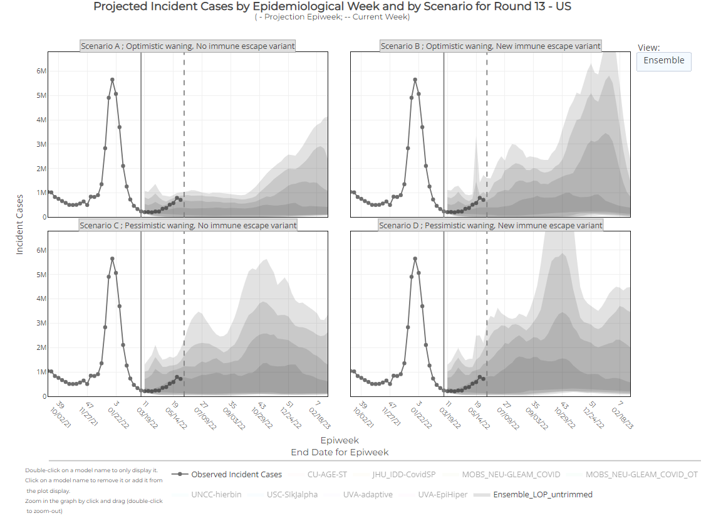
Scenario Modeling Hub
Round 13 – March 15, 2022
  Rows: Levels of waning
  Columns: Impacts of a possible immune escape variant
  8 models
https://covid19scenariomodelinghub.org
Notes:
Better forecasting -> better scenario models
Better starting place & better understanding of mechanistic drivers

Slide 26
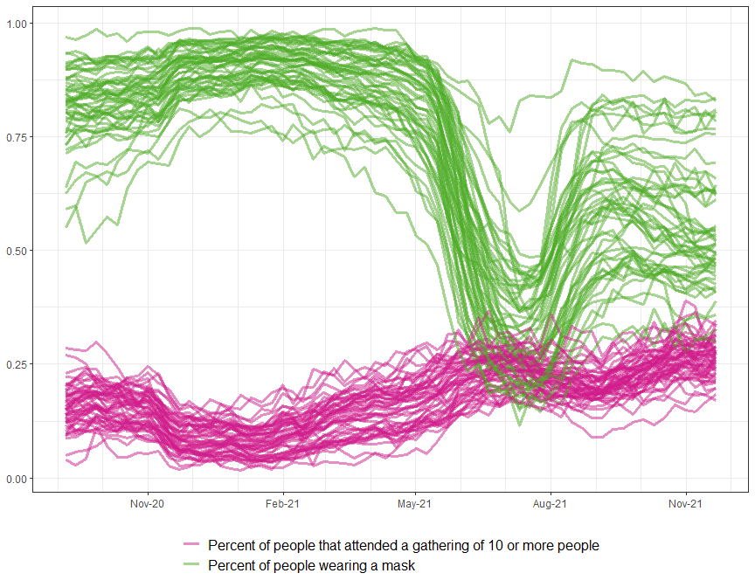
Can we incorporate behavior?
Dynamics change -> behavior changes -> dynamics change
Difficult to parameterize
Challenge for forecasts and scenarios
https://delphi.cmu.edu/covidcast/

Slide 27
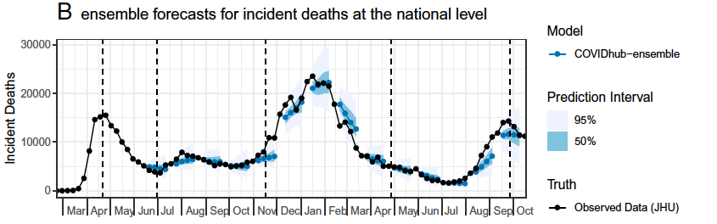
Where do forecasts go wrong?
Cramer et al. PNAS 2022
Notes:
Slow to capture speed of growth and declines
High uncertainty at peaks (and nadirs)

Slide 28
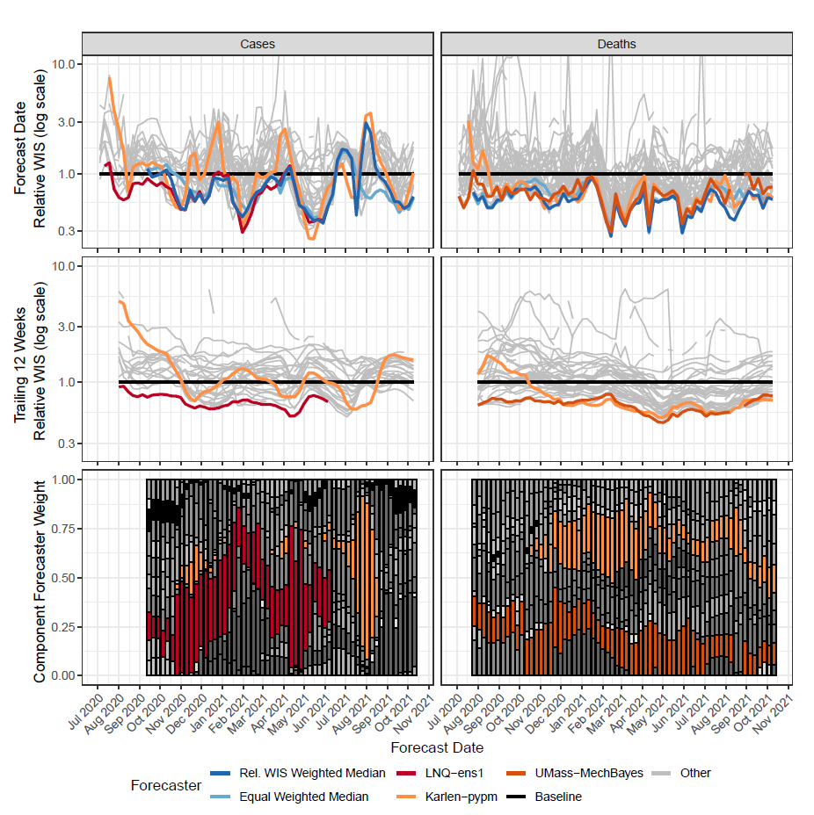
Can we build a better ensemble?
Ray et al. arXiv 2022
Notes:
Training period
Missing data
Ensemble inclusion
Weighting approaches
– target national v state v county, hosp v death
- Shape – weighting recent forecasts, limiting max weight

Slide 29
 | Past | Present | Future
Data | Single-source, delayed, paper reports, spreadsheets | Close to real-time digital data, multiple sources and formats | Diverse real-time data available via Application Programming Interfaces
Analytic tools | Ad hoc statistical and mechanistic | Ad hoc and dynamic statistical, mechanistic, machine learning, hybrid, and ensemble approaches | Benchmarked hybrid and ensemble approaches
Computational power | Personal computers | Personal computers >> high performance computing | High performance computing
Evaluation | Bespoke outcomes and error metrics | Standardized probabilistic outcomes and proper scores becoming more common | Standardized probabilistic outcomes and proper scores with benchmarks
Interoperability | Very little | Output standardization common; Input standardization increasing; Code standardization uncommon | Standardized inputs, code bases, and outputs

Slide 30
Conclusions
Standards for data, code, and code sharing can facilitate model evaluation, production, reproducibility, and research.
Translating model complexity to forecasting skill is challenging.
Forecasting can be a test of causality.
Recent and long-term historical outcome data are consistently important ingredients.
The forecasting value of data, parameters, and models is often not clear.
Emerging pathogens require adaptable approaches for new and changing data, limited historical data, and mitigation responses.
Notes:
Why is a SARIMA model better than a mechanistic model for a 4 week ahead forecast? Historical data? Stochasticity that matters?

Slide 31
Acknowledgments
Participating teams
ECDC & European Hubs
CDC
  Matt Biggerstaff
  Velma Lopez
  Karen Holcomb
  Craig McGowan
U. Massachusetts, Amherst
  Nick Reich
  Evan Ray
  Estee Cramer
Carnegie Mellon University
  Roni Rosenfeld
  Ryan Tibshirani
  Logan Brooks

