Slide 1
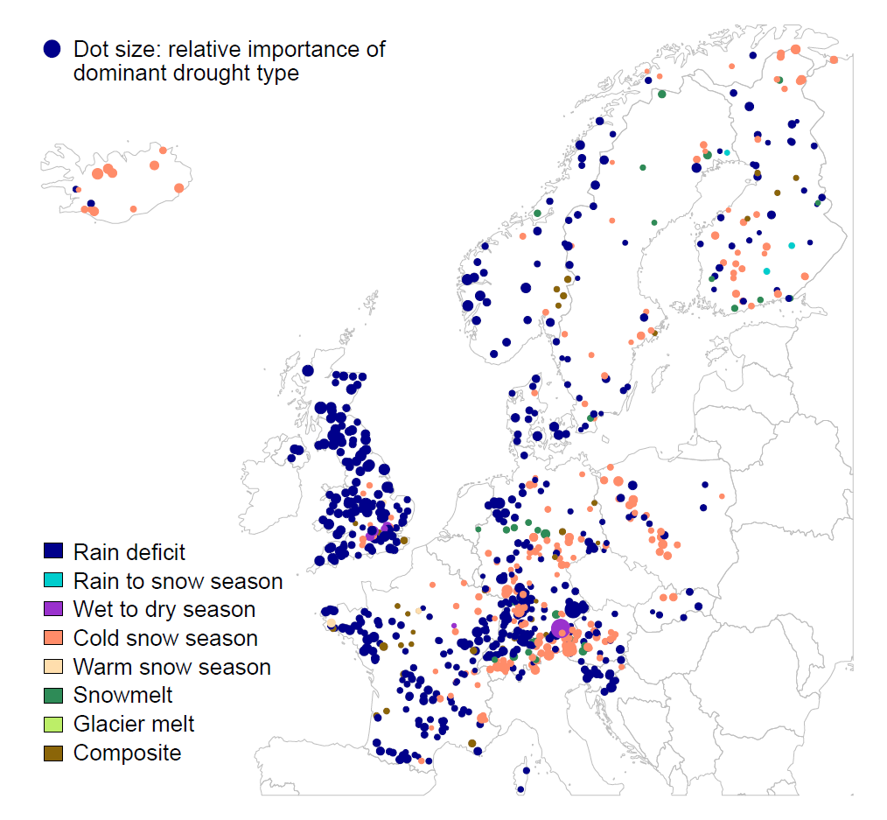
Causes of moderate and extreme hydrological droughts differ
Manuela Brunner, Anne Van Loon, and Kerstin Stahl
BIRS Workshop, 28.06.2022
manuela.brunner@hydrology.uni-freiburg.de
@ManuelaIBrunner
Notes:
5 minutes

Slide 2
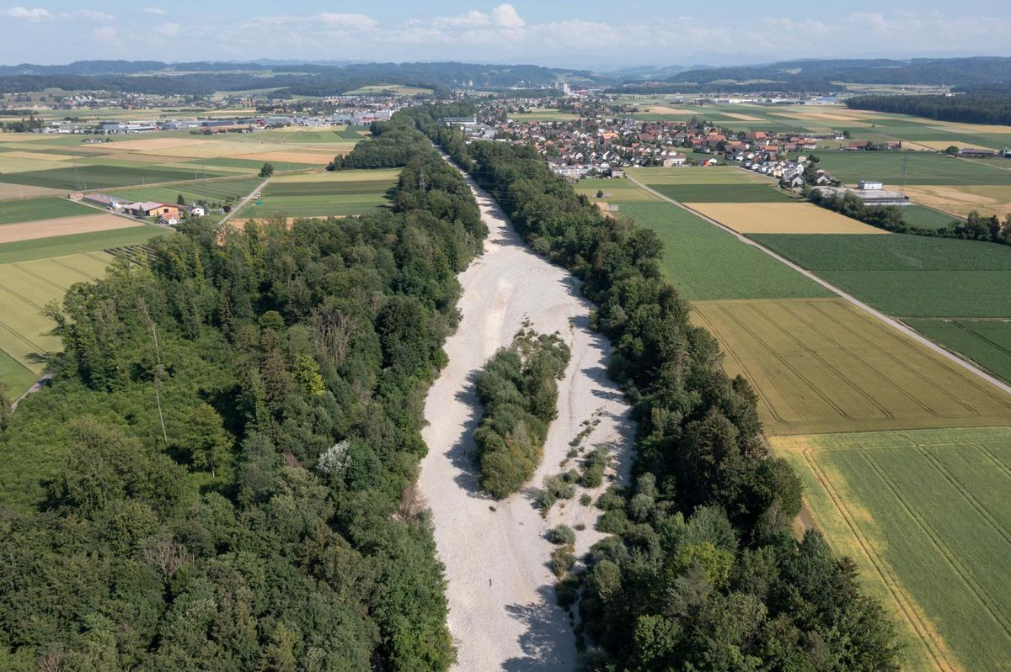
What drives moderate and severe droughts?
Emme, 21.06.2022 Beat Mathys
Notes:
Emme ist bereits im Juni wegen Mangel and Schneeschmelze und Regendefiziten trocken gefallen.
Other events are driven by other processes.
Question

Slide 3
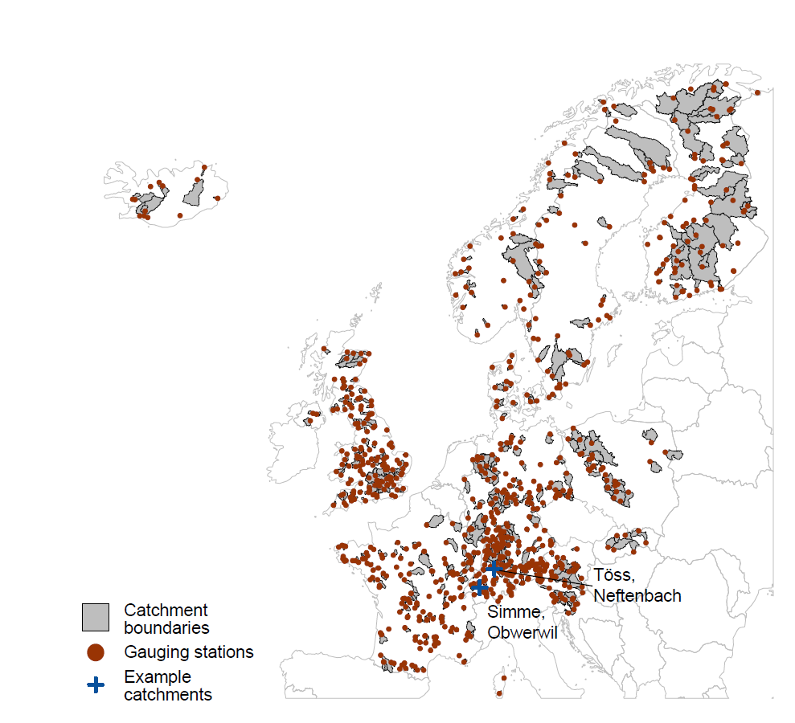
Dataset
Notes:
Map of 817 nearly natural catchments contained in the GRDC runoff database used to analyse hydrological drought types in Europe and locations of two example catchments in different regions and hydroclimates.

Slide 4
Drought definition
Droughts characteristics
Discharge (mm/d)
Time (days)
Time (days)

Slide 5
Hydrological drought classification
Rainfall driven
Proximally rainfall deficit
Snow driven
No
Yes
Rainfall deficit in summer
Streamflow deficit in snow-season
Yes
No
Yes
No
Transition to snow accumulation
Transition to dry period
Snow accumulation possible
No SWE available for melt
No
No
Yes
No
No
Yes
SWE availability but melted
Glacier cover
Yes
Yes
Yes
Yes
No
No
Rain-to-snow season drought
Wet-to-dry season drought
Warm snow season drought
Glaciermelt drought
Rainfall deficit drought
Cold snow season drought
Composite
Snowmelt drought
Notes:
We group drought events into eight drought types using a standardized classification scheme applicable to large samples of catchments.

Slide 6
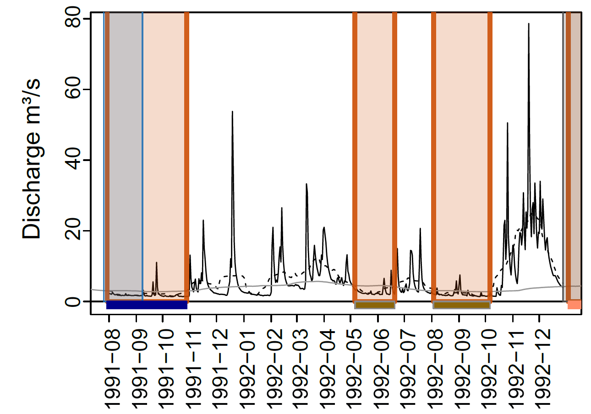
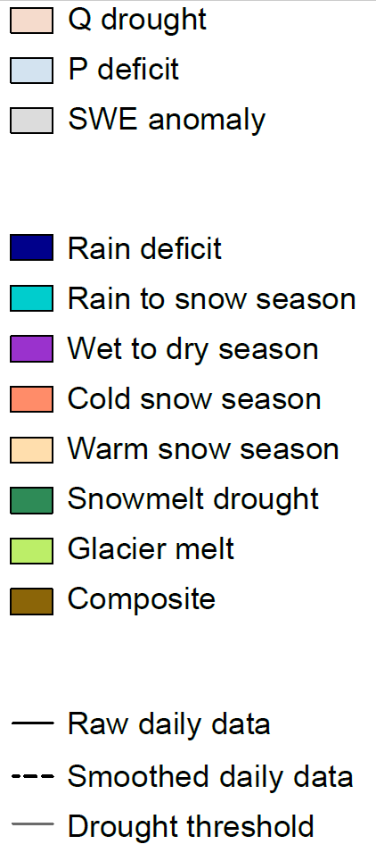
Drought types
Töss catchment

Slide 7
Drought types vary in severity
Duration
Deficit
Minimum flow

Slide 8
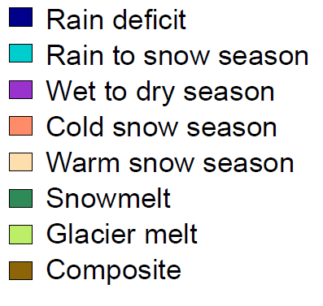
Dominant drought type
Notes:
Droughts in Western Europe are mainly driven by rainfall deficits and those in the Alps and Scandinavia by cold snow seasons (i.e. snow accumulation).

Slide 9
Seasonally dominant drought types
Winter
Summer
Notes:
The dominant drought type varies seasonally. In summer, snowmelt droughts are important in the Alps and Scandinavia.

Slide 10
Drought type frequency
Relative importance
Warm
Cold
Notes:
Warm and cold regions show a different drought type mix with snow-driven droughts becoming more important in colder catchments.

Slide 11
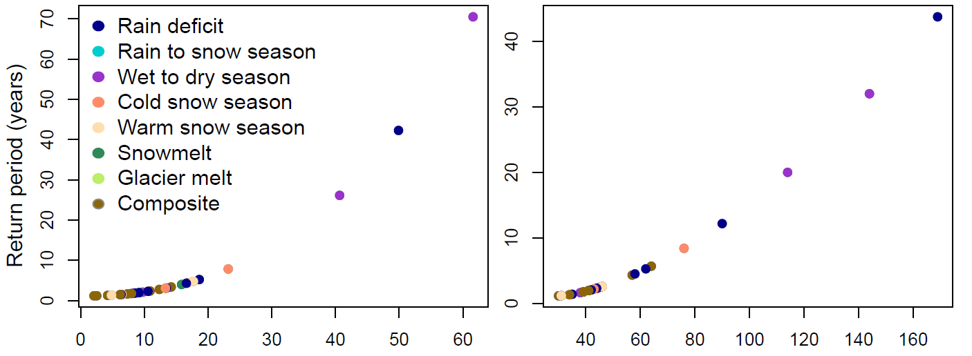
Process variation with event severity
Deficit
Duration
Severe
Moderate
Töss catchment

Slide 12
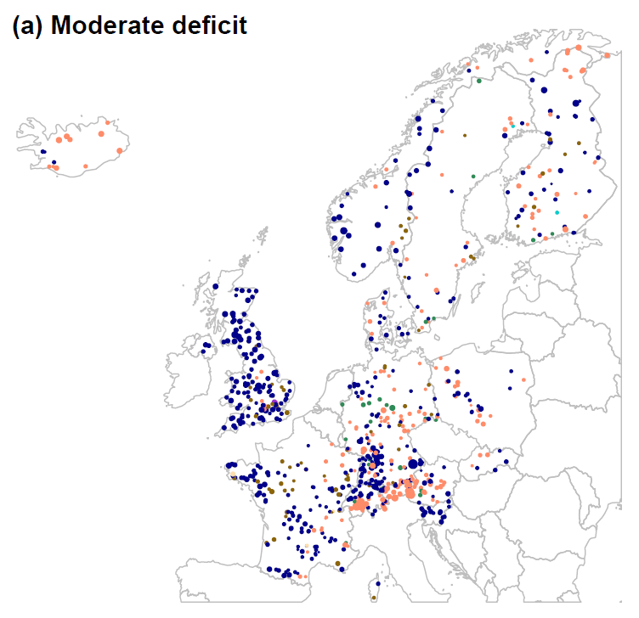
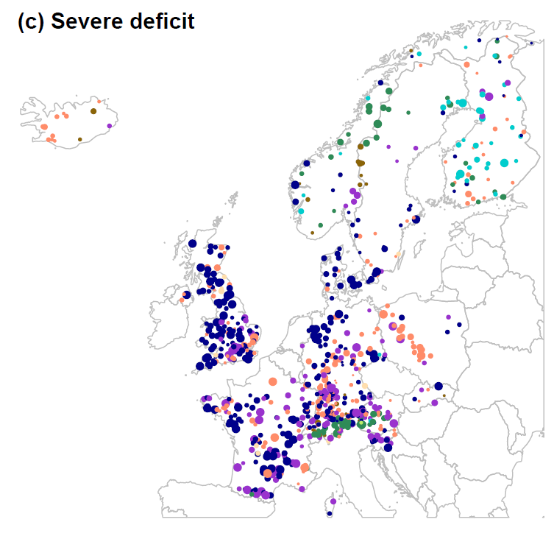
Dominant drought type variation with event severity
Moderate deficit
Severe deficit

Slide 13
Moderate vs. severe droughts
Moderate deficits
Relative importance
Severe deficits
Warm
Cold
Notes:
Moderate and severe droughts are driven by different processes. In warm regions, severe droughts are predominantly caused by rainfall deficits prolonging into the dry season and in cold regions by snowmelt deficits.

Slide 14
Moderate vs. severe droughts
Moderate durations
Relative importance
Severe durations
Warm
Cold
Notes:
Moderate and severe droughts are driven by different processes. In warm regions, severe droughts are predominantly caused by rainfall deficits prolonging into the dry season and in cold regions by snowmelt deficits.

Slide 15
How do drought generation processes and severity change with climate?
Emme, 21.06.2022 Beat Mathys
Notes:
Emme ist bereits im Juni wegen Mangel and Schneeschmelze und Regendefiziten trocken gefallen.

Slide 16
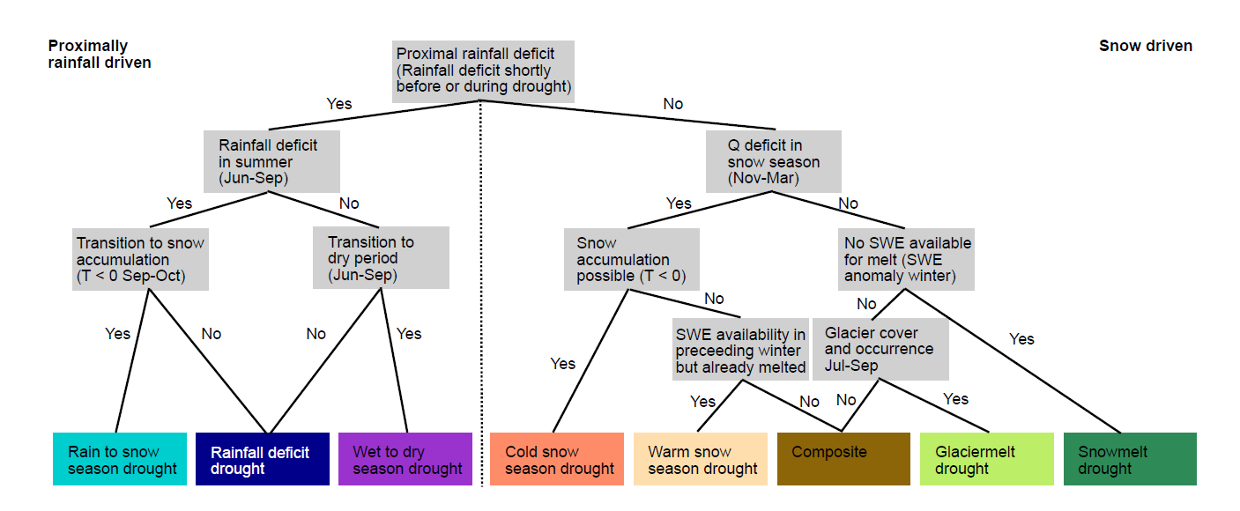
Conclusions
Spring
Standardized classification scheme for streamflow droughts
Dominant drought types in Europe vary regionally and seasonally
Moderate and severe droughts are moderated by different processes
Brunner et al. under review
manuela.brunner@hydrology.uni-freiburg.de
@ManuelaIBrunner
16

