Slide 1

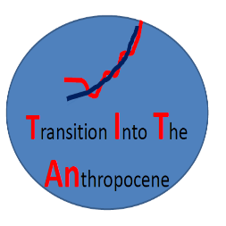
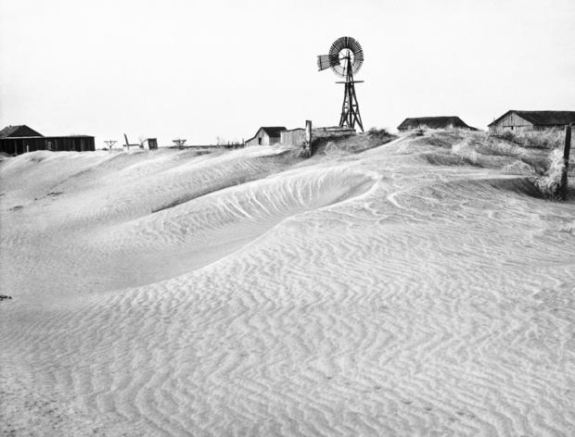
Past and future changes in the probability of extreme temperature events
Gabriele Hegerl¹,
With thanks to Nicolas Freychet, Tim Cowan, Andrew Schurer, Ross Slater, Friederike Otto, Graeme Auld, Arno von Kietzell, Vikki Thompson
AP Photo
Notes:
As climate changes, the frequency and intensity of weather extremes is changing as well. Recent damaging extreme weather and climate events raise questions about the link between climate change and extreme events. Studies of past and recent extreme events highlight the unique factors that contribute to each event as well as common contributing factors, and how a changing climate changes their intensity and frequency. This talk gives examples of interpretation of observed extreme events and model projections, using methods from comparison of tendencies between physically based climate models and observations, use of very large, targeted ensembles of simulations, to analysis of analogue observed situations. It will be discussed how these methods can be combined to shed light despite data uncertainty and sparse

Slide 2
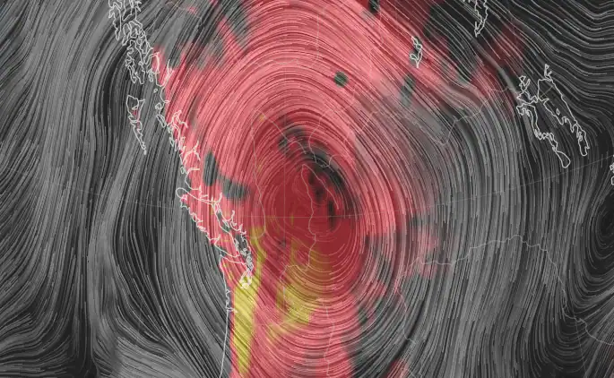
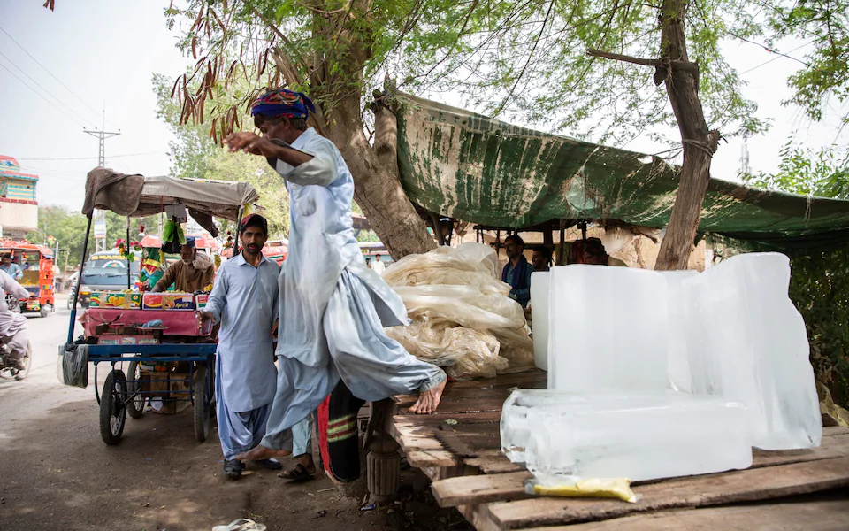
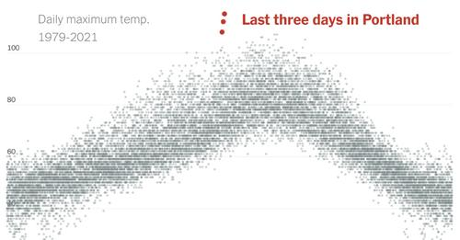
Heat waves
Heat wave examples
Future predictions
Some questions
Jakobabad 2021 above 50 degrees too hot for humans (Telegraph)
Nullschool earth/Washington times HW in Pacific NW USA (record heat) at present; GJ van Oldenborgh

Slide 3
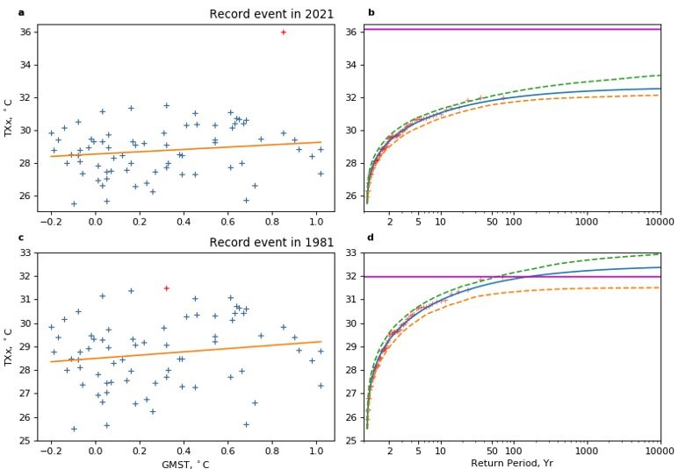
GEV use: US Northwest Heat wave: Alberta
GEV fit of annual maximum of observed daily maximum temperature (Tx)
Tx (ERA5, 1950-2021) against global mean surface temperature all data vs 2021 and GEV fit (without 2021)
Data without 2021 focusing on previous record
Thompson et al., in prep (emergence project)
Possible reasons for fail:
Issues with selection of analysis (triggered by HW) see also Anthony’s talk; input Ioanis Papastatopoulos
Not all feedback sampled (extreme drying pushes more energy to sensible heat)
Others? How do we test this?

Slide 4
GEV fit to European data: spatial fit
GEV generally fitted to independent points.
Ault, Papastatopoulos et al., thesis, paper in prep:
Estimated change in risk ratio change for 1/100 year event between 1950s and 2018 (and its uncertainty) using EOBs data
GEV fit that accounts for CO₂ influence on location and scale parameter
Spatial coherence estimated by Gaussian Markov Random Field; penalizes high spatial variability in estimate

Slide 5
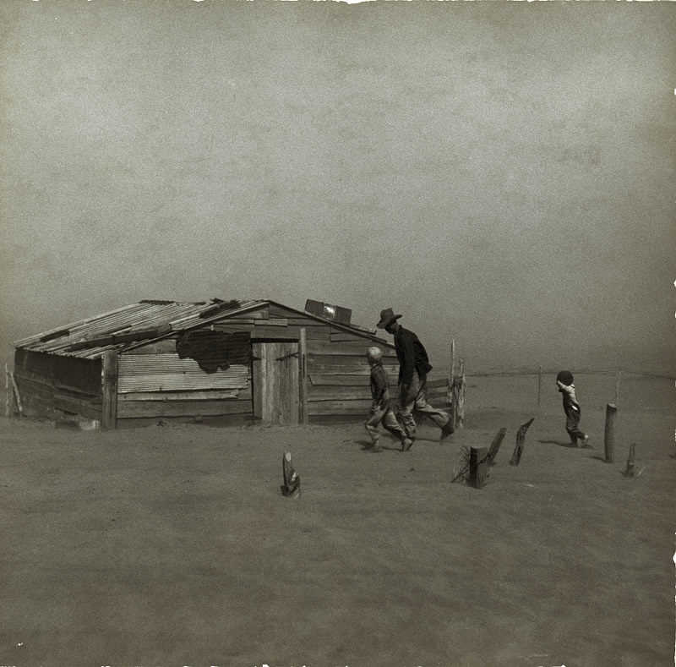
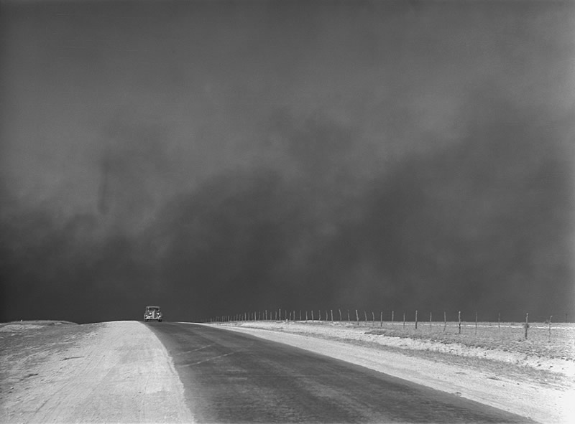
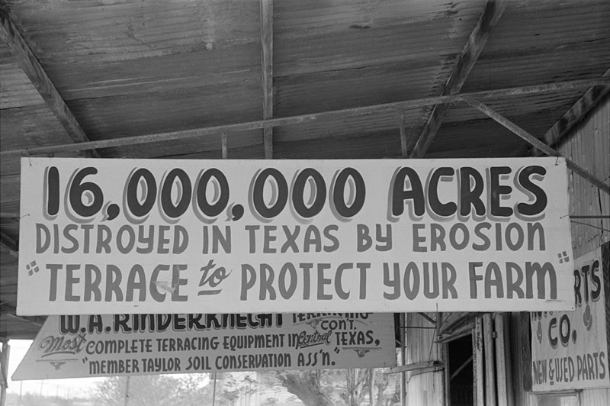
Explaining record events: 1930s dustbowl heatwaves
Sioux County, Nebraska, Spring 1936
Oklahoma, 1936
Texas Panhandle, March 1936
Dust Bowl: named after dust storms, mostly from 1933 through to 1935. Around 65% of Great Plains damaged by erosion in 1934 (Cook et al. 2014 GRL). Right after rapid expansion of cropland replacing prairie
Oklahoma Panhandle, 1936
Williams County, Nth Dakota, 1937
Coincided with The Great Depression (~1929 – late 1930s);
  Wheat price dropped by two-thirds in 2 years (1929-1931) with oversupply (production up 300% in the 1920s).
  Drought Impacts: millions of residents displaced (~10% out-migration), dust pneumonia, crop failures, starvation, rioting.
  Record-breaking heat
Taylor, Texas. April 1939
Photo credits: Russell Lee, Arthur Rothstein, Dorothea Lange (The Library of Congress, Prints & Photographs Division), Matt Loughre (The Sun UK)

Slide 6
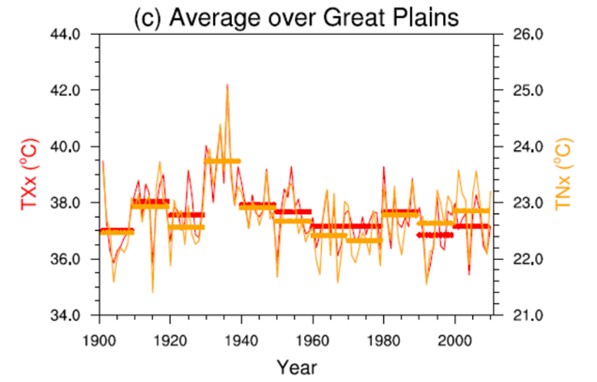
1930s heat waves
Record annual daily daytime and nighttime temperature
During Dust Bowl drought
  Droughts influenced by Sea Surface Temperatures (e.g. Schubert et al., 2004) and dust (Cook et al. 2009)
  Land surface feedbacks, such as dry soil and vegetation, are generally important (e.g. Mueller and Seneviratne 2012)
Heat wave metrics
Heat wave: Tmax > 90th percentile for at least 3 consecutive days, and Tmin > 90th percentile for the 2nd and 3rd days (i.e. persistence of heat).
Heat wave duration (HWD) – longest summer heat wave
Heat wave frequency (HWF) – total number of summer heat wave days
Heat wave amplitude (HWA) – hottest day (Tmax anom) of hottest summer event

Slide 7
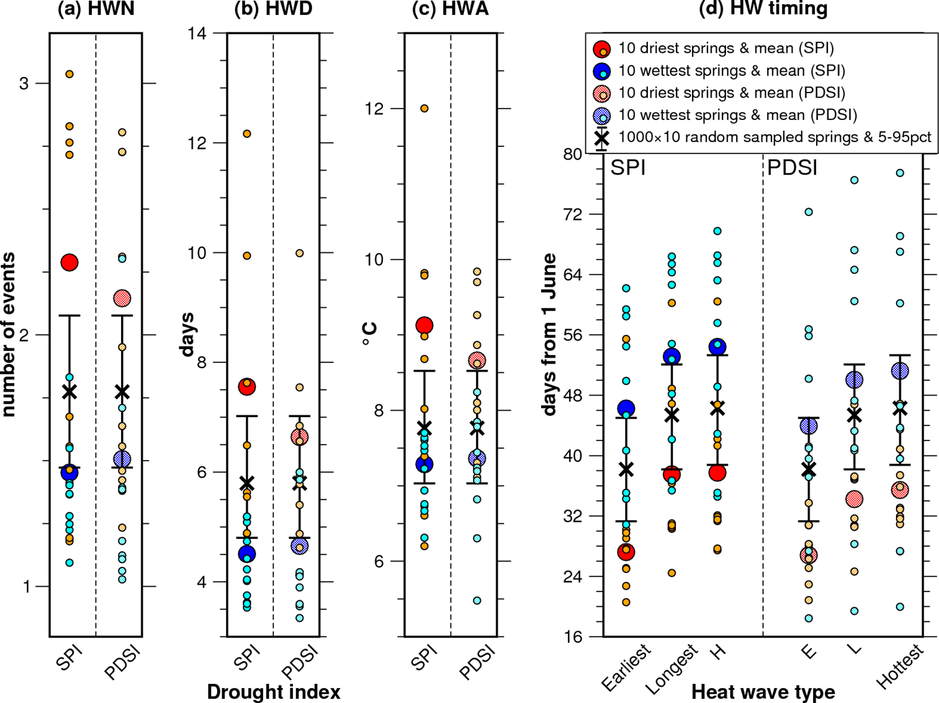
20th century historical data lessons
Vegetation and soil conditions matter: precipitation deficit (based on Standardised Precipitation Index (SPI) and Palmer Drought Severity Index (PDSI)
heat wave metrics following wet spring and dry springs
Heat waves more frequent, longer, stronger earlier after precipitation deficit
=> here looking for analogue conditions should involve spring precipitation
(Cowan et al., J Climate, 2017)
=> different statistical distribution for years with wet and dry springs?
(Cowan et al. J. Climate, 2017)

Slide 8
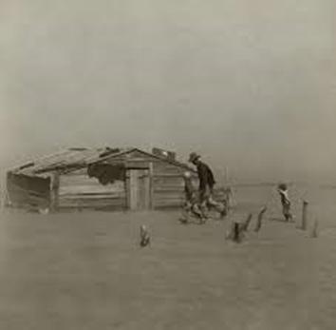
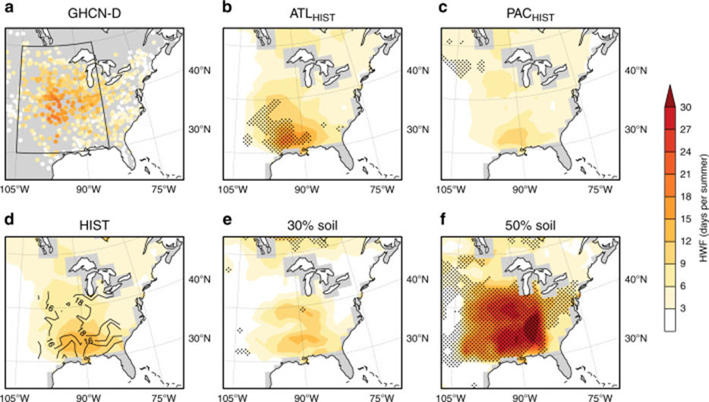
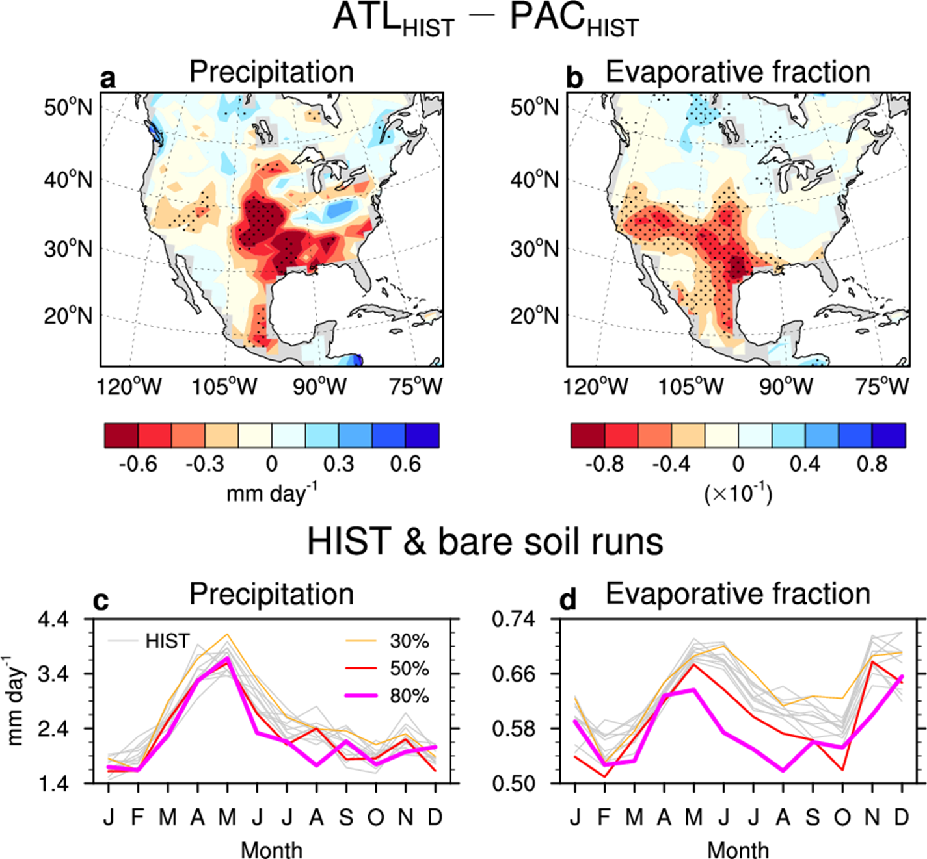
Mechanism: stronger evaporation with more exposed soil
10 climate simulations with observed sea surface temperatures in Atlantic, Pacific, and both => anomalously warm Atlantic and cold Pacific matter
3 bare soil experiments 30, 50, 80% bare soil (up to 100% grass removal)
=> Vegetation change can really ramp up heat in models!!
(Cowan et al., Nature comms. 11(1):2870, 2020)
Notes:
Evaporative fraction: latent heat flux to sum of latent+sensible heat flux

Slide 9
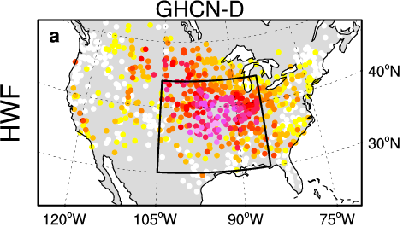
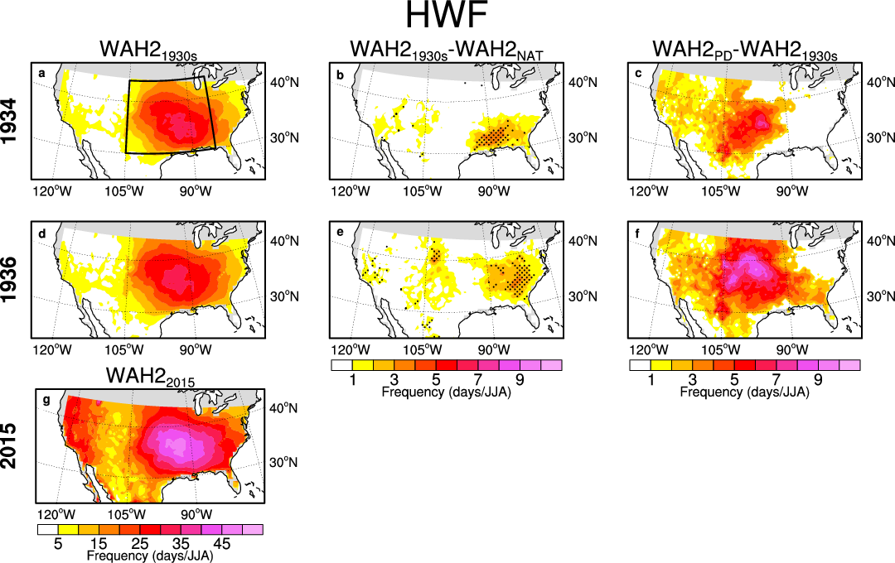
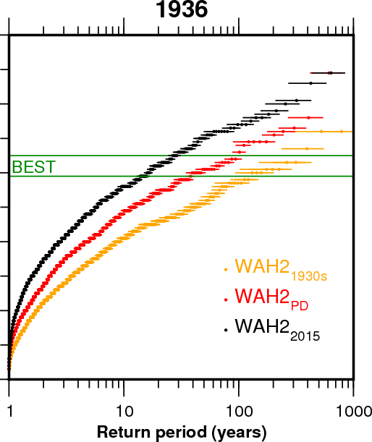
Impact of greenhouse gases on 1936 heat waves (weather@home2 experiments, Oxford)
Model ensemble (top 10% largest)
1-in-15 yr
Summer HW frequency (days)
1-in-100 yr
1-in-40 yr
1930s GHG contribution
GHG contribution since the 1930s
Greenhouse gases (Cowan et al., nature climate change 10, 505–510, 2020)

Slide 10
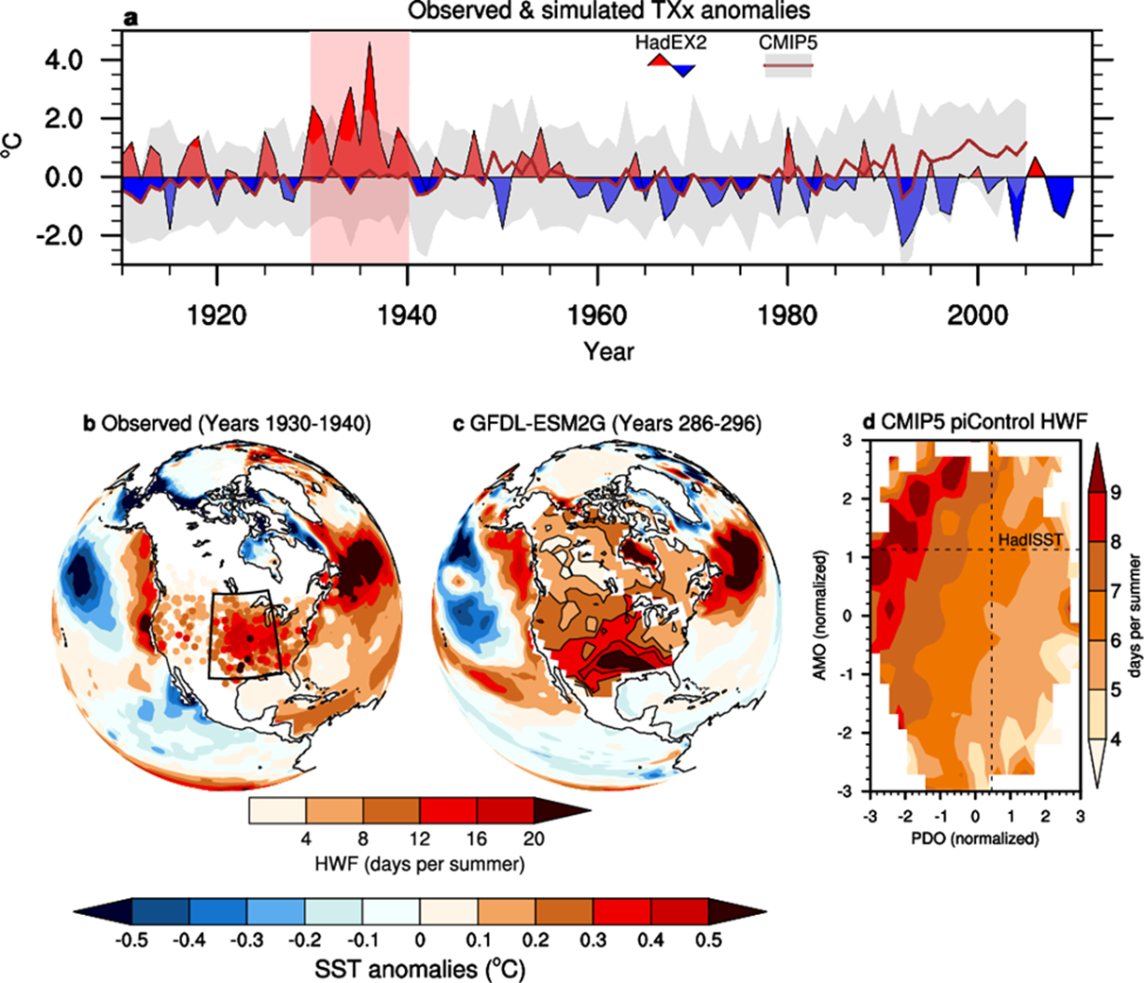
Lessons from case study
Potential for strong enhancement by vegetation feedbacks => this could also happen in future and produce an important strengthening mechanism that widens out the tail of the distribution; and sudden changes in land conditions can really mess with the distribution
Climate models don’t reproduce this in that region (they seem ok in most other regions): role of irrigation?

Slide 11
Marine heat waves: a data issue
Marine heat waves from longterm SST data (months >90th perc 51-2020)
Strong recent increase, but bias towards high HW tendency for old data
(von Kietzell, submitted; GloSAT project)

Slide 12
How do we expect heat waves to change in a warmer climate?
Identified for 1.5, 2 and 3 degrees warmer than preindustrial – this puts models on same basis despite different warming rate, and lots of changes scale with global mean temperature (approximately) – using large ensembles of climate model simulations
Annual maximum of single day, 3-day mean, 5 day mean temperature in exceedance decades relative to present day in 1 decade per period and 10 or more realizations of different climate model simulations (minimum hundred samples)
Fit GEV distribution
Risk ratio: probability future/present day of a 1/10yr event present day
Slater et al., Atm Sci letters, 2021

Slide 13
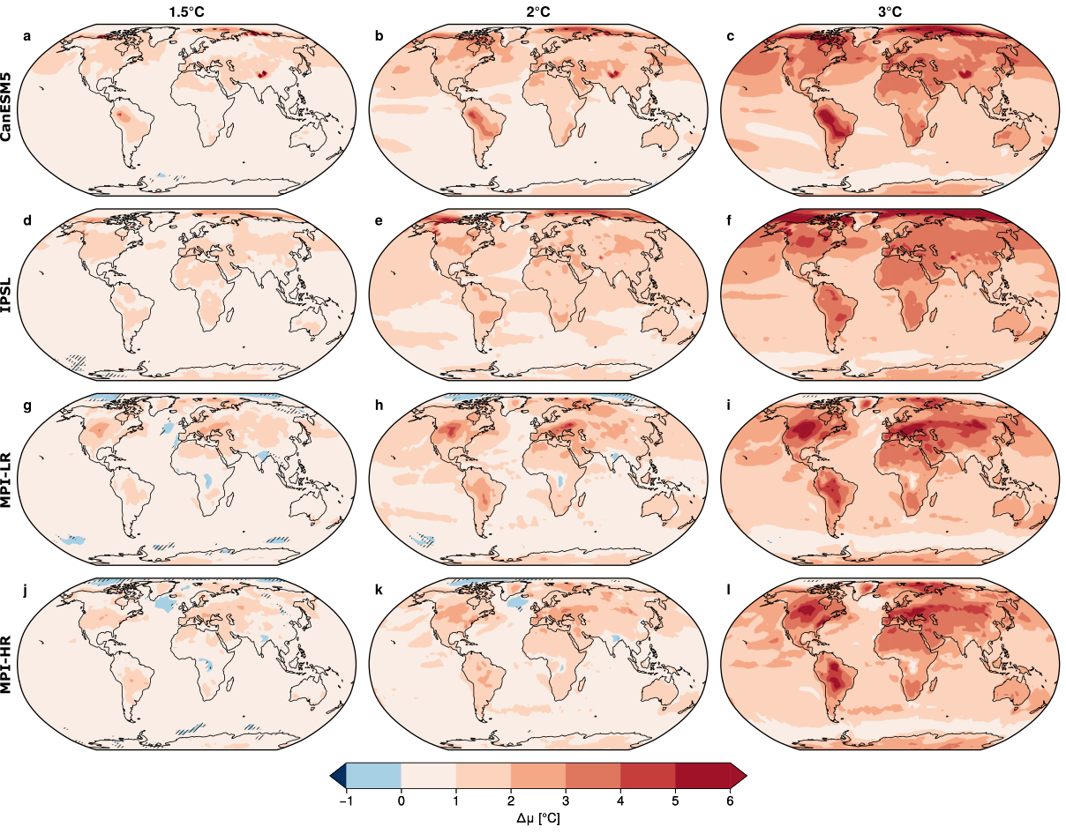
Change in location parameter
1.5ºC
2ºC
3ºC
Robust to using different models
(relative to bootstrapped sample with 1 ensemble member each removed)

Slide 14
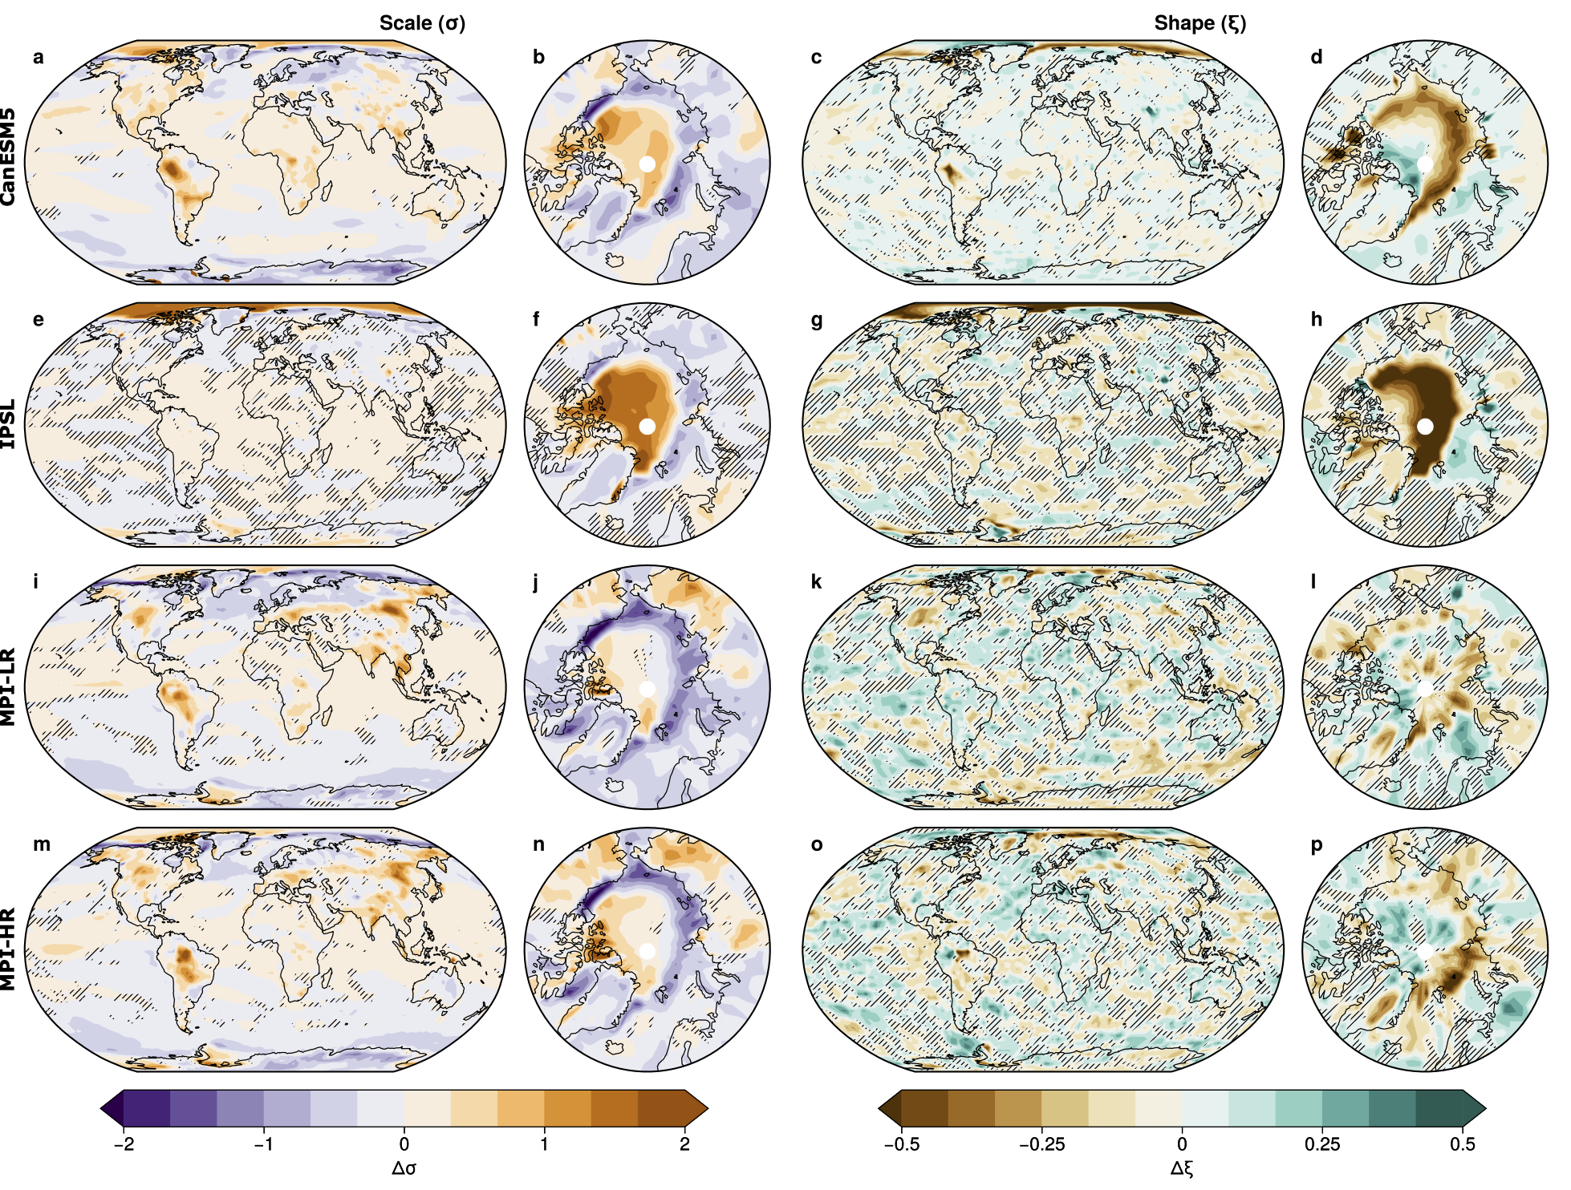
Change in scale and shape parameter
At 3ºC
Distribution widens and tail lengthens in areas that used to be permanently ice covered and narrows where summer sea ice is now gone; otherwise noisy and insignificant
Some widening in continental interiors

Slide 15
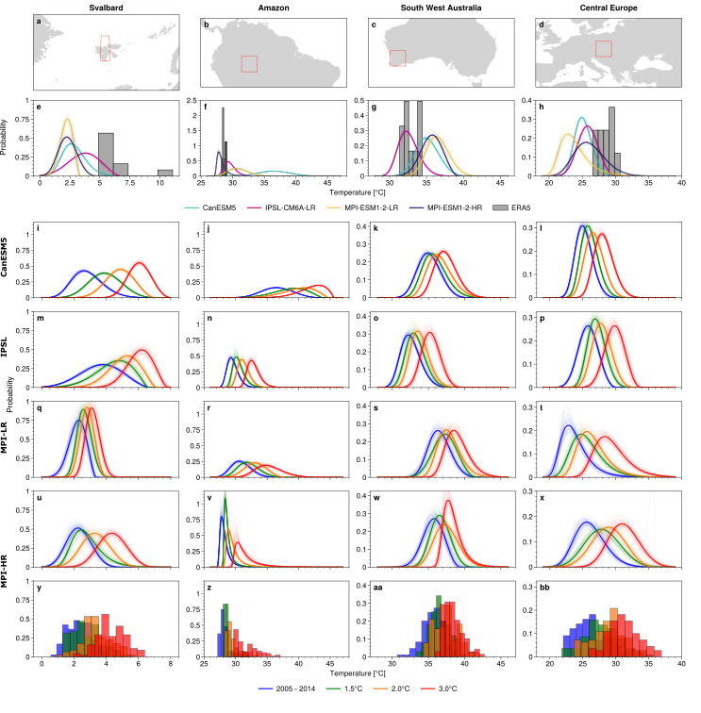
What does the change look like
Some models do not well fit today’s observed/analysed temperature distribution => constraint on models?
Change for 1.5, 2 and 3 degrees relative to present time indicates some change in distribution

Slide 16
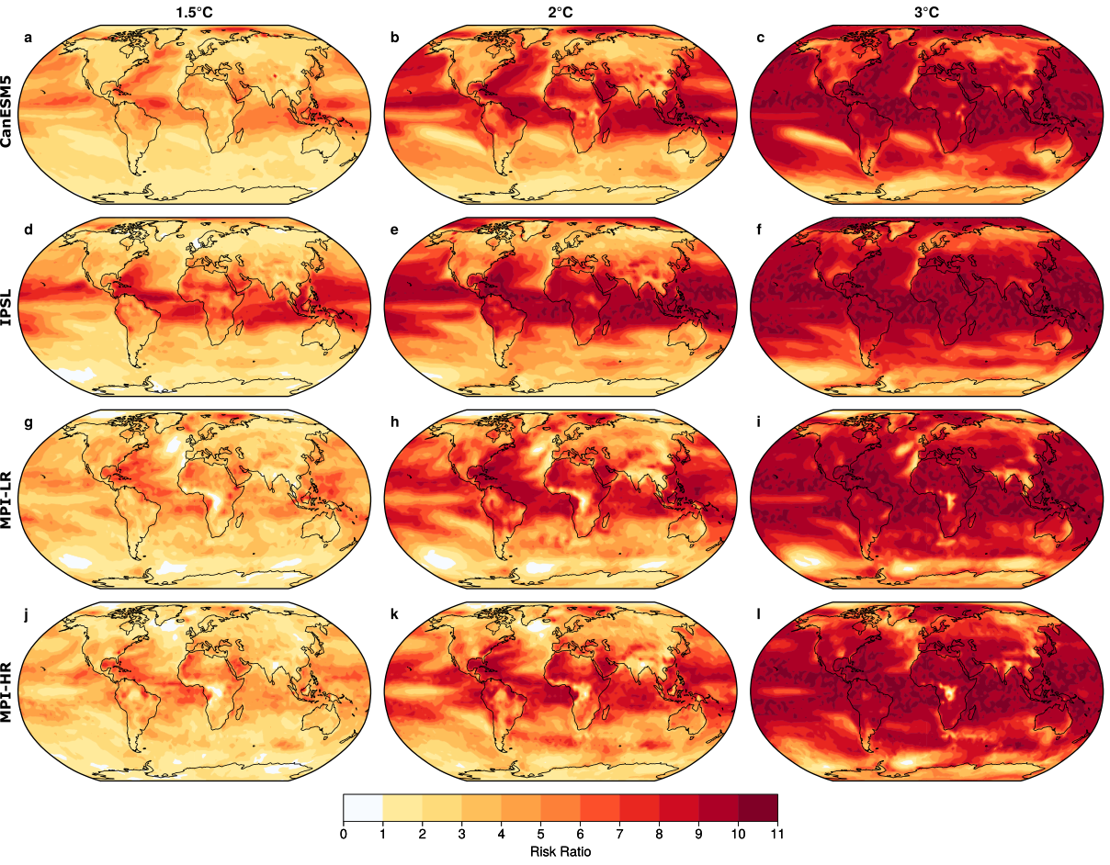
Risk ratios for a 1/decade heat event will increase strongly in future
Risk Radio: Probability(future)/probability(present)
Change up to return periods of 1/yr rather than 1/decade
Strong change in the tropics
Changes slightly larger in longer heat waves
Two issues:

Slide 17
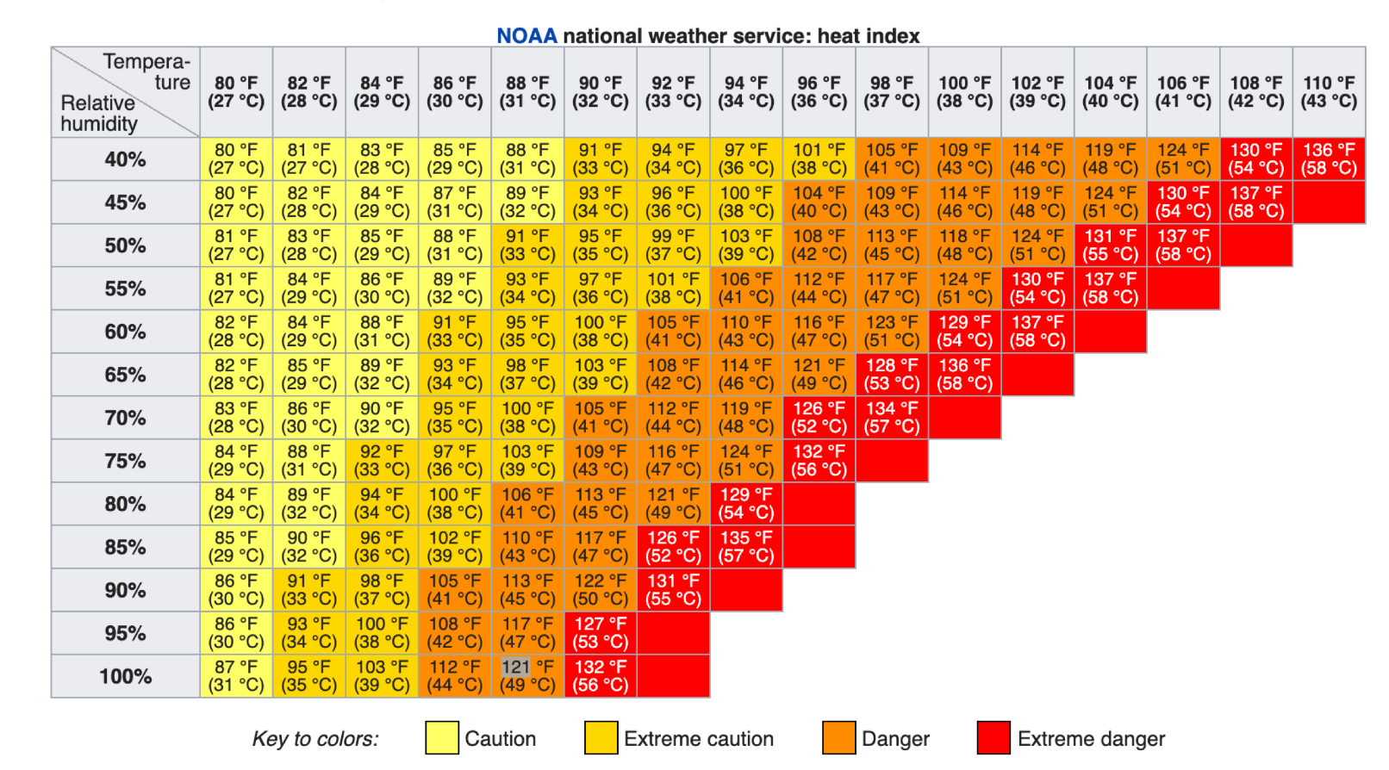
Heat stress
→ Temperature & Humidity
→ More fair to compare different regions/climates
→ Indices (HI, TW, WBGT*)
→ Exposure… to what?
→ Severe events:
-HI=40°C, (corresponds to TW = 27-28°C)
-based on warning systems
→ Deadly events:
-TW=35°C, from heat transfer model (Sherwood and Hubert 2010), but gray area…
→ “Unprecedented” events:
-TW>31°C / HI>55°C
-limit of current observations
-impact?
Same
heat stress
Lytton (B.C. Canada) – 29th June 2021
T=49.4°C / RH=8% → HI=46 °C
T=35°C / RH=30% → HI=36 °C
Paris (France) – 12th Aug. 2003
T=40°C / RH=19% → HI=39 °C
T=31°C / RH=41.5% → HI=31 °C

Slide 18
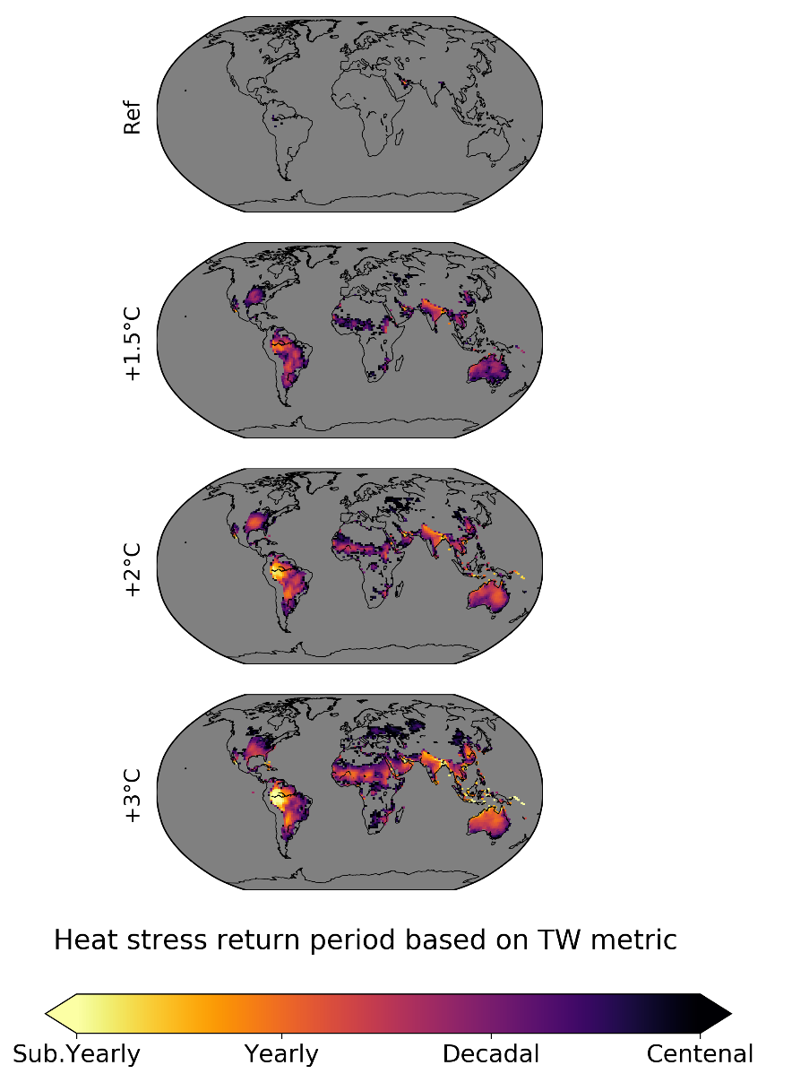
Unprecedented events Tw>31ºC; significant population exposure predicted
CMIP6 (historical & SSP370) - daily

Slide 19
Extremes research challenges
compound hazards – how do we characterize them and what are important ones? (storm with rain; co-incident drought in breadbaskets of the world; preceding drought to heat; heavy rainfall on saturated ground, spatially correlated extremes – see Zscheischler et al 2020 nature climate change) – for impacts, not all aspects need to be extreme
How do we determine which climate models are fit for purpose for projecting future extremes
Characterizing observed changes, making the best use of data while recognizing location specific features
Learning from historical extremes
Projection of extremes that realistically characterizes danger to humans, crops etc: needs model data that are realistic or bias corrected
Causality methods are promising, we are exploring them for aerosol impacts

Slide 20
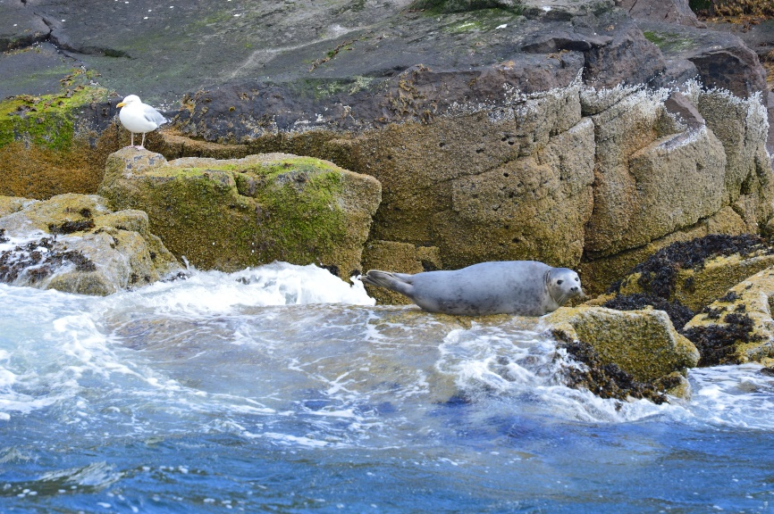
Thank you!

Slide 21

Not reproduced in CMIP5 where land surface change doesn’t reflect short transitions
A single GFDL simulation accidentally quite similar
Weak link between warm Atlantic and cool Pacific to extreme heat conditions in Great Plains and this links to drought:

