Slide 1
Deep neural networks with controlled variable selection for genetic studies
Zihuai He
Department of Neurology & Neurological Sciences
Department of Medicine (Biomedical Informatics Research)
Stanford University

Slide 2
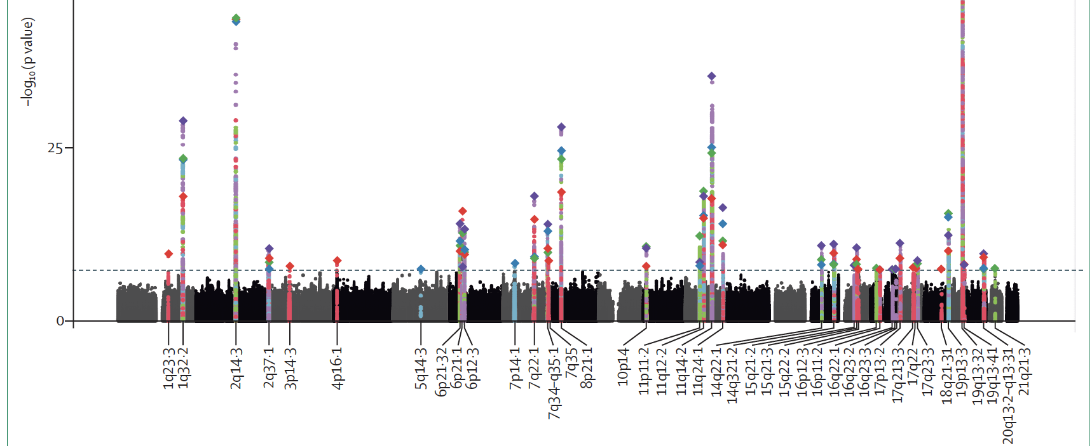
Genome-wide association studies (GWAS) of Alzheimer’s disease
Test association between a trait of interest (Y) and each genetic variant (G), adjusting for covariates (X), Y~X+G; quantified by a p-value.
Select genetic variants with p-value<5*10^-8.
Andrews et al. (2020), The Lancet Neurology

Slide 3
Potential complex genetic interactions

Slide 4
Challenges for applying neural networks (NN) to genetic studies
Poor interpretability
Difficult to identify how changes of the genetic variants influence the disease outcome
Most feature attribution methods lack a rigorous control on the false discovery rate (FDR)
Susceptible to noise and a lack of robustness
NN training is stochastic
Feature attributions can be relatively random
Sheer number of genetic variants, low signal-to-noise ratio, and strong correlations among genetic variants

Slide 5
Feature attribution methods for NN
Existing methods can quantify relative importance of each input feature
Gradient backpropagation method (e.g. gradients, integrated gradients, expected gradients, DeepLIFT)
Explaining by removing” methods (e.g. SAGE, SHAP, LIME)
In genetic studies, we look for a threshold to rigorously define selected variants
Figure from Ghorbani and Abid et al. (2018)

Slide 6
The model-X knockoff framework (Candes et al. 2018, JRSS)
For $i$–th individual, augment the original data $G_{i}$ with synthetic data ${\tilde{G}}_{i}$, such that
Exchangeability -- ${\left(G_{i},{\tilde{G}}_{i}\right)}_{swap\left(S\right)}\sim \left(G_{i},{\tilde{G}}_{i}\right)$
Conditional independence -- ${\tilde{G}}_{i}⊥Y_{i}|G_{i}$
For $j$–th variant, calculate importance score for original data and synthetic data, and their contrast
$W_{j}=T_{j}−{\tilde{T}}_{j}$
Knockoff filter to define $W_{j}>τ$ as significance. Control for false discovery rate (FDR)
$τ=\min\left\{t>0: \frac{1+\#\left\{j:W_{j}≤−t\right\}}{\#\{j:W_{j}≥t\}}≤q\right\}$
Sesia et al. (2019), (2020), (2021), He et al. (2021) extended it to genetic studies

Slide 7
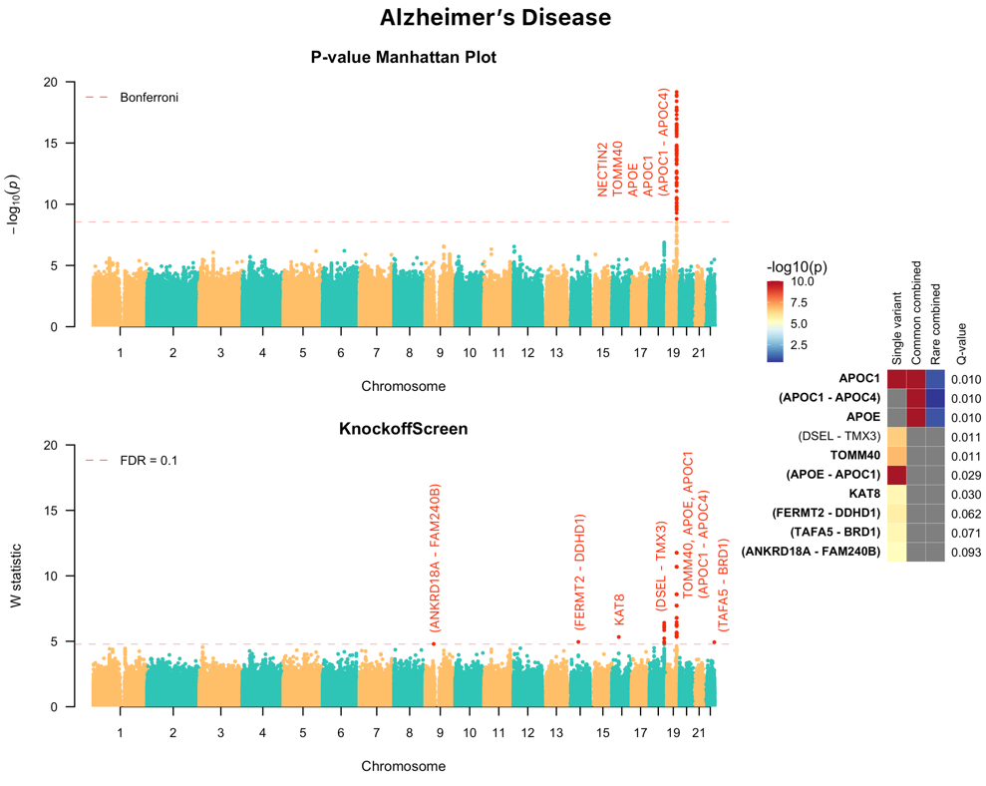
Benefits of model-X Knockoff inference
Prioritize causal variants over associations
Enhanced power for locus discovery
Model-free
(Analysis of ADSP; ~4000 WGS)

Slide 8
Proposed feature selection in NN
Given Y, G, X, we test hypothesis $Y⊥G_{j}|G_{−j}, X$
Step 1: Generate multiple simultaneous knockoffs per variant and per sample $\tilde{G}$. (Gimenez and Zou, 2018; He et al., 2021)
Step 2: Jointly modeling all genetic variants, knockoffs, and potential confounders in the AL/ML model
$$ℱ=\left\{f≡f_{β,W}:X,G,\tilde{G}→β^{T}X+g_{W}\left(G,\tilde{G}\right)\right\}$$
Step 3: Calculate the feature importance score for both original and knockoff variants
Step 4: Select putative causal variants via knockoff filter

Slide 9
Proposed NN architecture

Slide 10
The hierarchical layers improves computational efficiency

Slide 11
Pronounced randomness in feature selection in DNN due to its stochastic nature
We calculate the stabilized FIs as
$FI=\sum_{jk}{ψ_{jk}FI_{jk}}$.
For j-th set of hyper-parameter and k-th epoch number,
$$ψ_{jk}=\frac{\max\left(val_loss\right)−{val_loss}_{jk}}{\max\left(val_loss\right)−min(val_loss)}$$

Slide 12
Aggregation improves the robustness

Slide 13
Power and FDR
10,000 individuals
2,000 genetic variants
Minor allele counts > 10
Four causal variants with non-linear effects

Slide 14
Real data application
Functionally informed analysis of 8,461 protein quantitative trait loci (pQTLs)
To identify pQTLs that are also putative causal variants of AD

Slide 16
Discussion
The method is not restricted to genetic studies
Still computationally intensive – future application to whole genome
Better method to de-randomize feature selection

Slide 17
Acknowledgments
Postdocs and students
Peyman H. Kassani
Fred Lu
Yann Le Guen
Prashnna K Gyawali
Xiaoxia Liu
Xinran Qi
Aaron Sossin
Collaborators
Iuliana Ionita-Laza (Columbia)
Linxi Liu (Pittsburgh)
Michael D Greicius
Emmanuel Candes
Chiara Sabatti
Our new group for interpretable AI/ML for AD is hiring!

Slide 18
The knockoff filter
Knockoff filter with multiple knockoffs:
$κ_{Φ_{kl}}=\underset{0≤m≤M}{arg max}{T_{Φ_{kl}}^{m}}$, $τ_{Φ_{kl}}=T_{Φ_{kl}}^{\left(0\right)}−\underset{1≤m≤M}{median}{T_{Φ_{kl}}^{(m)}}$
$$τ=\min\left\{t>0: \frac{\frac{1}{M}+\frac{1}{M}\#\left\{Φ_{kl}:κ_{Φ_{kl}}≥1,τ_{Φ_{kl}}≥t\right\}}{\#\{Φ_{kl}:κ_{Φ_{kl}}=0,τ_{Φ_{kl}}≥t\}}≤q\right\}$$
“Detection threshold”=(1/ Target FDR)/number of knockoffs, e.g.
Target FDR=0.10, five knockoffs; requires ~10/5=2 independent signals.
In addition, $τ_{Φ_{kl}}$ has reduced variation given the same data.

Slide 19
Activation function

Slide 20
Knockoff generator
For each variant, generate multiple knockoffs ${\tilde{G}}_{j}^{(1)}, ⋯,{\tilde{G}}_{j}^{\left(M\right)}$ such that they are jointly exchangeable
For each target window $Φ_{kl}=\left\{j:k≤j≤l\right\}$, calculate p-value $p_{Φ_{kl}}^{(0)},p_{Φ_{kl}}^{\left(1\right)},⋯,p_{Φ_{kl}}^{\left(M\right)}$
Define $T_{Φ_{kl}}=−\log_{10}{p_{Φ_{kl}}}$, ${\tilde{T}}_{Φ_{kl}}^{\left(m\right)} =−\log_{10}{p_{Φ_{kl}}^{\left(m\right)}}$
Select $Φ_{kl}$ when $W_{Φ_{kl}}=\left(T_{Φ_{kl}}−\underset{1≤m≤M}{median}{T_{Φ_{kl}}^{m}}\right)I_{T_{Φ_{kl}}≥\max_{1≤m≤M}{T_{Φ_{kl}}^{m}}}>τ$
We model it with a conditional
auto-regressive type model
with low-rank approximation
and develop a resampling-based
generator that is more robust to the
distribution of G.

Slide 21
The knockoff generator with practical assumptions
Assume Markov property (local linkage disequilibrium)
$$ℒ\left(G_{j}|G_{−j},{\tilde{G}}_{1:j−1}^{1}, {⋯, \tilde{G}}_{1:j−1}^{M} \right)=ℒ\left(G_{j}|G_{k∈B_{j}},{\tilde{G}}_{1≤k≤j−1,k∈B_{j}}^{1},⋯,{\tilde{G}}_{1≤k≤j−1,k∈B_{j}}^{M}\right)$$
Assume a linear model (genotype dosage)
$${\hat{G}}_{j}=\hat{α}+\sum_{k≠j,k∈B_{j}}{{\hat{β}}_{k}G_{k}}+\sum_{1≤m≤M}{\sum_{k≤j−1,k∈B_{j}}{{\hat{γ}}_{k}^{m}{\tilde{G}}_{k}^{m}}}$$
We calculate the residual ${\hat{ε}}_{j}=G_{j}−{\hat{G}}_{j}$ and its $M$ permutations ${\hat{ε}}_{j}^{∗1},…,{\hat{ε}}_{j}^{∗M}$, and then define the knockoff feature for $G_{j}$ to be ${\tilde{G}}_{j}^{m}={\hat{G}}_{j}+{\hat{ε}}_{j}^{∗m}$.
Note: the covariance matrices largely overlap; the original variants knockoffs are highly correlated. A low-rank approximation is possible.

