Slide 1
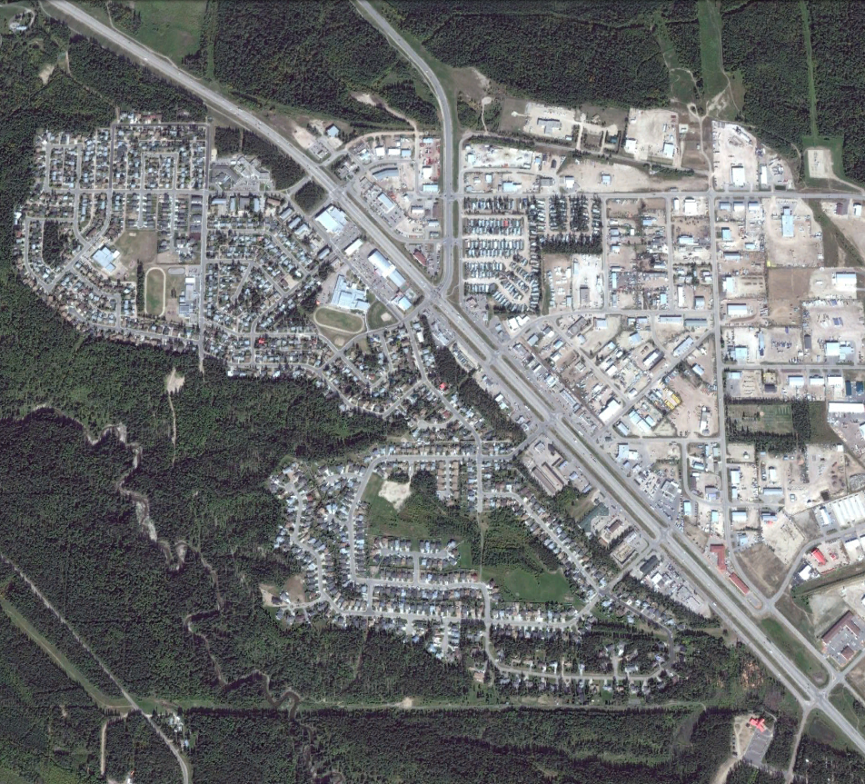





Characterizing biophysical wildfire processes for strategic risk assessment – Selected methods and considerations
Jen Beverly
Presented at BIRS Workshop Climate Change Scenarios and Financial Risk
July 5th, 2022
Connect
jen.beverly@ualberta.ca
wildfireanalytics.org
@fireanalytics

Slide 2
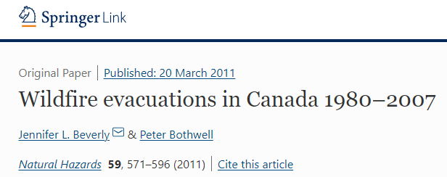
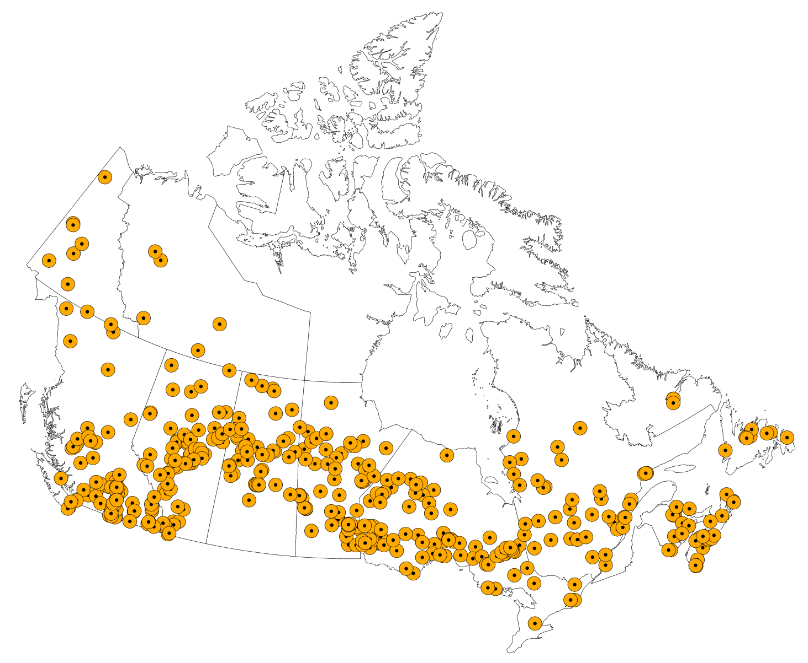
Wildfires can impact communities
  547 evacuation events
  497 homes destroyed
  209,121 evacuees
  Median number evacuated per year: 3,590
  Median number of homes lost 2
  Median distance from fire: 3 km
  Prompted by smoke: 19%
  Civilian fatalities 1
More people evacuated 2011-2018 than in the previous 31 years
2

Slide 3
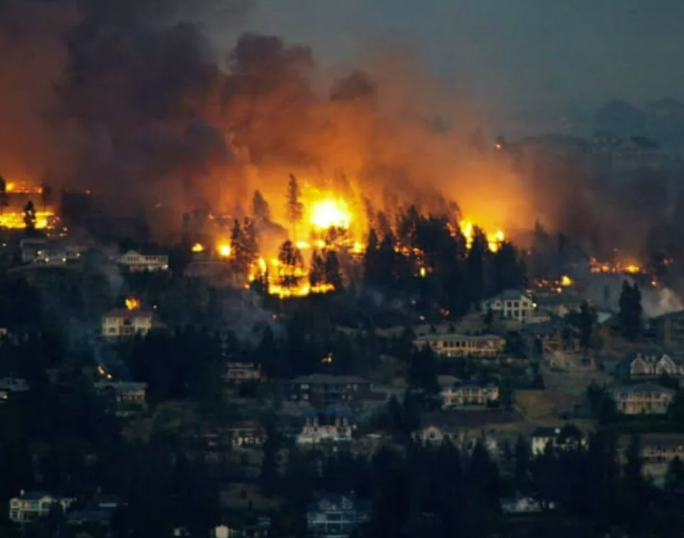
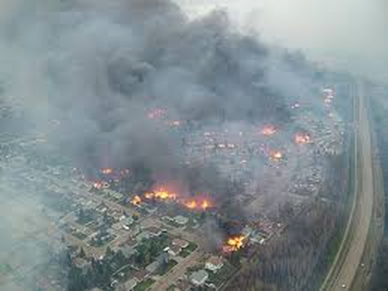
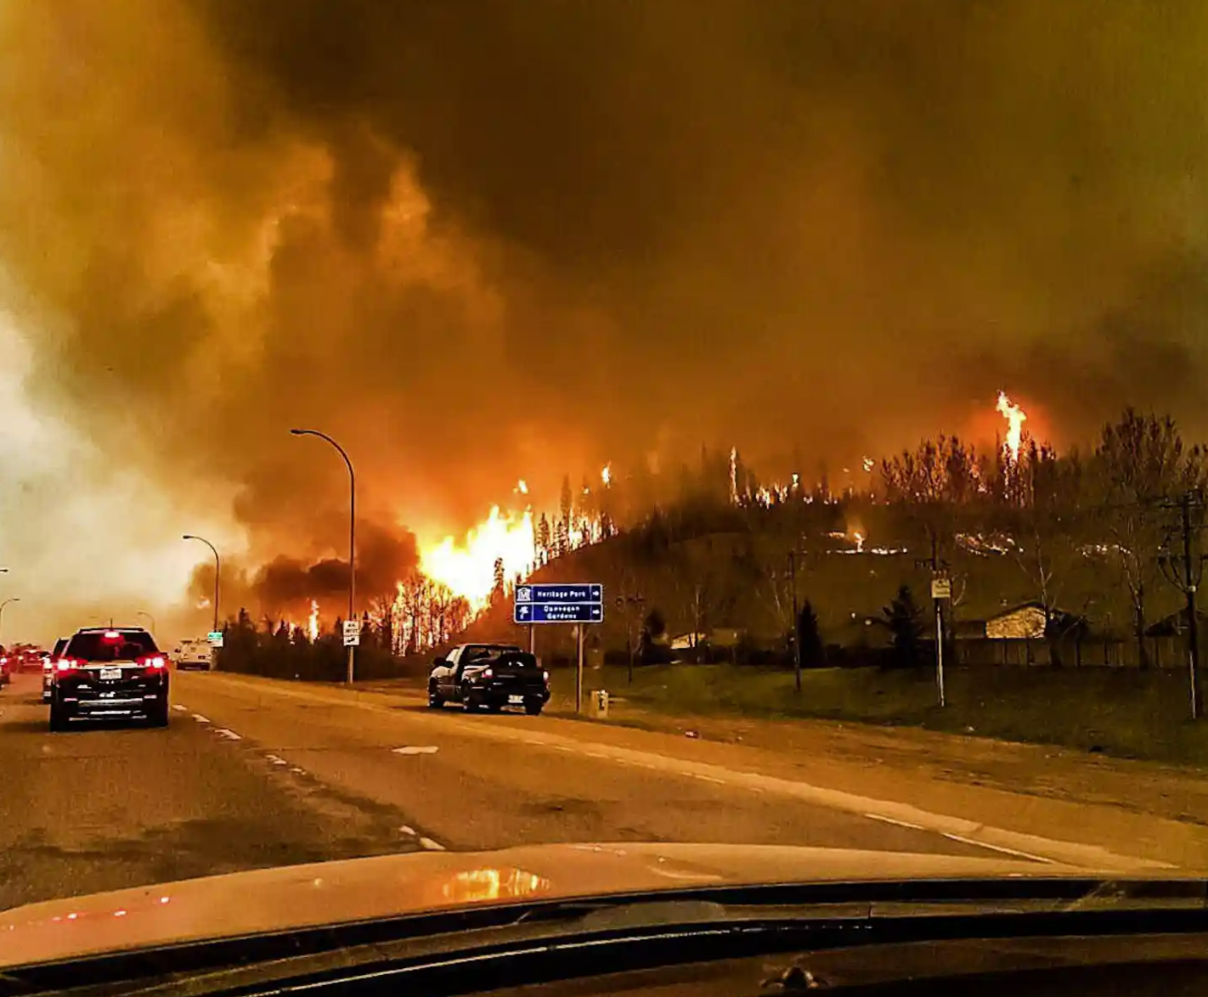
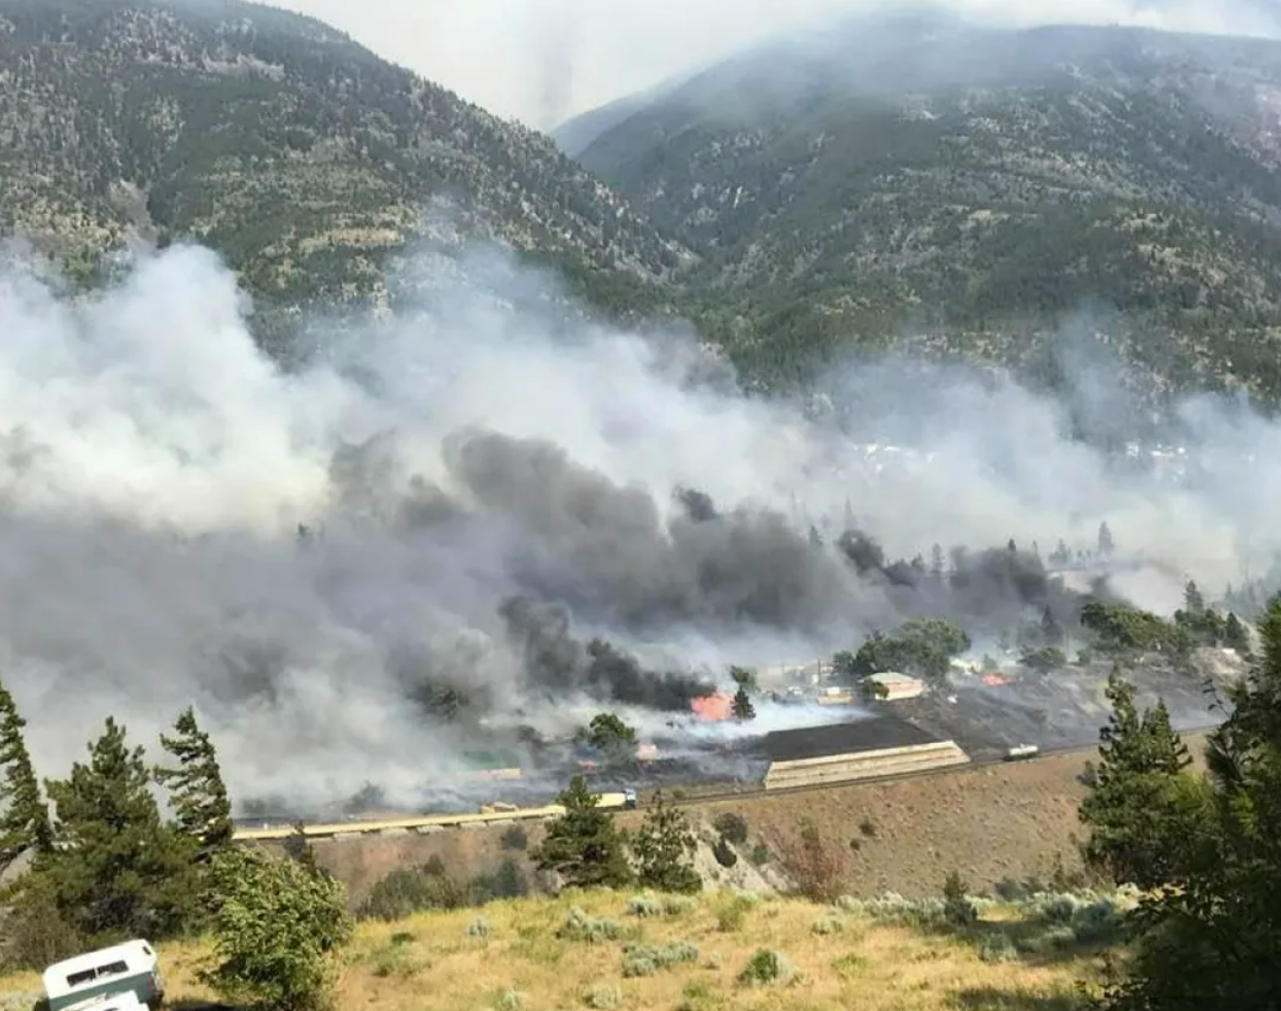
Trend or outliers?
Kelowna 2003
Slave Lake 2011
Fort McMurray 2016
Lytton 2021
August 2003
May 2011
May 2016
June 2021
100 km/h winds
27,000 evacuated
239 homes destroyed
$200M in damages
100 km/h winds
7,000 evacuated
433 homes destroyed
$700M insured damages
72 km/h winds
90,000 evacuated
2,400 homes destroyed
$3.6B insured damages
70 km/h winds
1,000 evacuated
Village 90% destroyed
$78M insured damages
3
(Photo sources: Andy Clark/Reuters; Town of Slave Lake; Twitter.com/Jerome Garot/EPA; Edith Loring-Kuhanga/Facebook)
Notes:
63 to 74 km/h - strong enough to send large, loose objects (garbage cans, patio furniture) flying. Tree limbs can break, cars can veer off the road.
By 75 km/h, the wind is strong enough to damage structures.
By 90 km/h it can uproot entire trees.

Slide 4
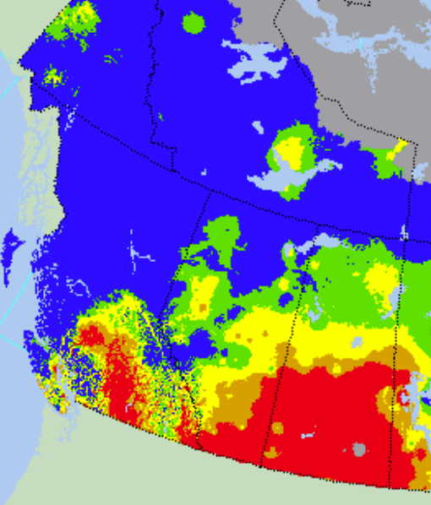
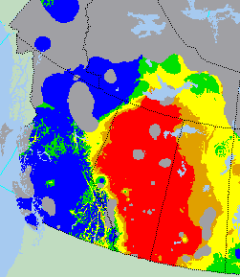
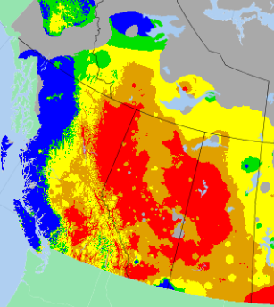
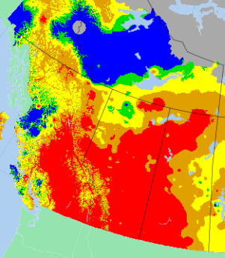
Kelowna
Slave Lake
Fort McMurray
Lytton
August 22, 2003
May 15, 2011
May 3, 2016
June 30, 2021
Map source: CWFIS, NRCan
>30
Fire Weather Index (FWI)
A numeric rating of fire intensity.
Used as general index of fire danger throughout the forested areas of Canada.
20-30
10-20
5-10
0-5
4
Nil

Slide 5
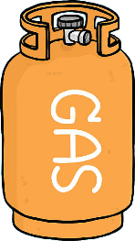


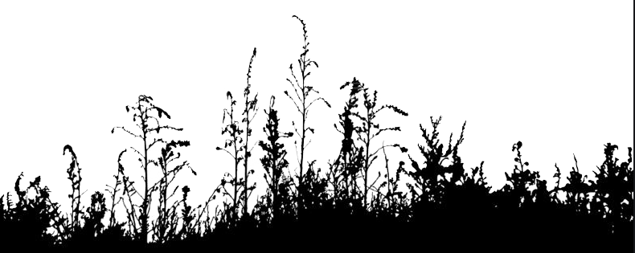
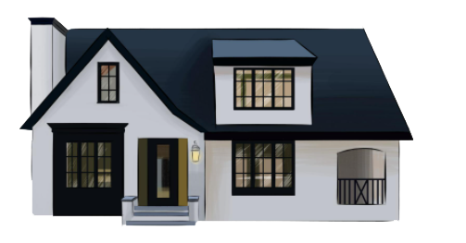

Perfect storm
fuels are available
AND
there’s an ignition
“the perfect storm” – when a confluence of many factors or events – no one of which alone is particularly devastating – creates a catastrophic force. Such confluence is rare and devastating (Emanuel and Fuchs 2008).
AND
the wind blows towards me
4
Illustration sources: Tank - O.Tasai; house – vecteezy.com
5

Slide 6
Grey swan
fuels are available
AND
there’s an ignition
“grey swan” – known events with unknown likelihood (Nafday 2011); we can specify outcomes but not probabilities (Gholami et al. 2018); we are in a state of “incomplete” knowledge in which attempts to assign probabilities are neither rational nor science-based (Sterling 2007).
AND
the wind blows towards me
4
5
Illustration sources: Tank - O.Tasai; house – vecteezy.com
6

Slide 7
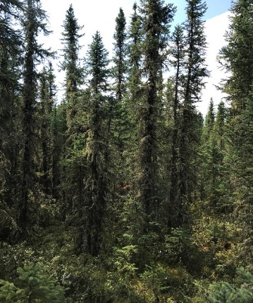
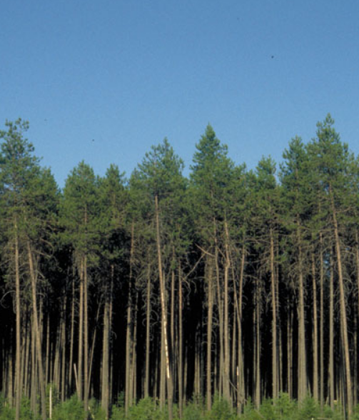
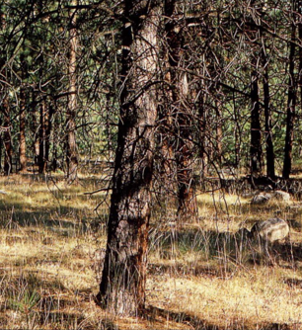
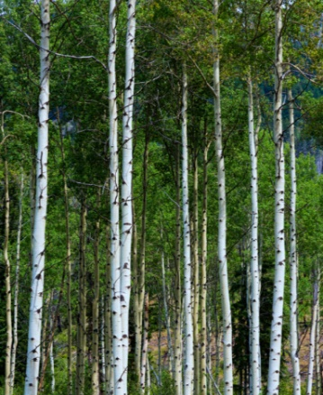
Fuel characteristics (structure) matters
Amount and compactness of crown fuel
Crown base height
Amount of surface fuel
Fuels are the hazard (potential source of harm)
7

Slide 8
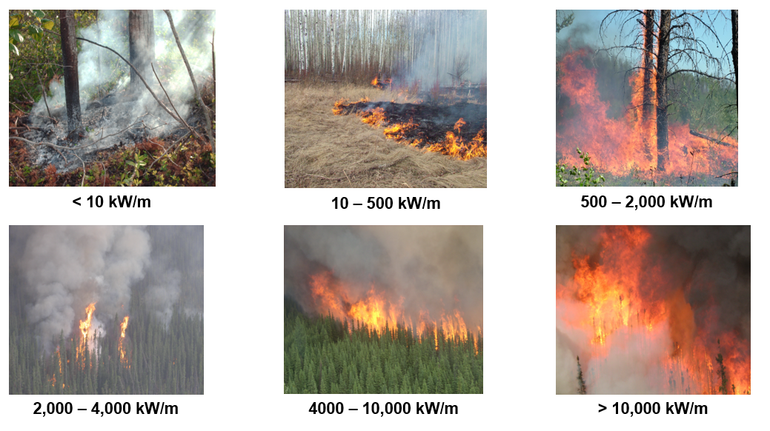
Fire intensity dictates suppression effectiveness
I = h w r
  Ground
  Surface
  Crown
Threshold for ground crew effectiveness
  Suppression success
  Suppression failures
Threshold for airtanker effectiveness
8

Slide 9
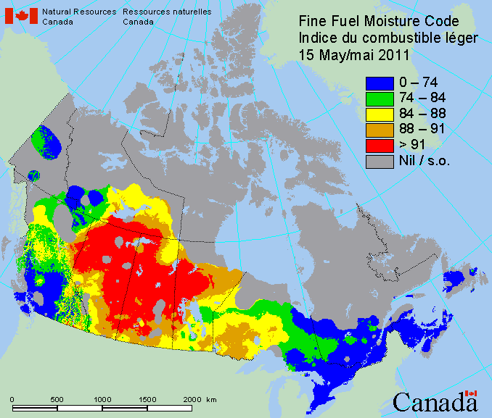
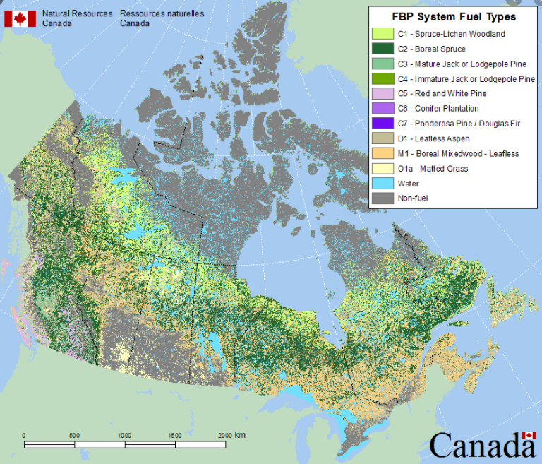
Where can we expect fires? Fixed versus variable factors
There are things we can know for today, the next several days
There are things we can know for this season, the next several seasons
Fuel moisture (availability)
Wind speed, direction
Ignition agents
What burns, where it is (fuel)
Operational capabilities
Location of values (receptors)
Highly variable within a fire season
(lots of predictive uncertainty)
Mostly fixed within a fire season
(lots of certainty)
9

Slide 10
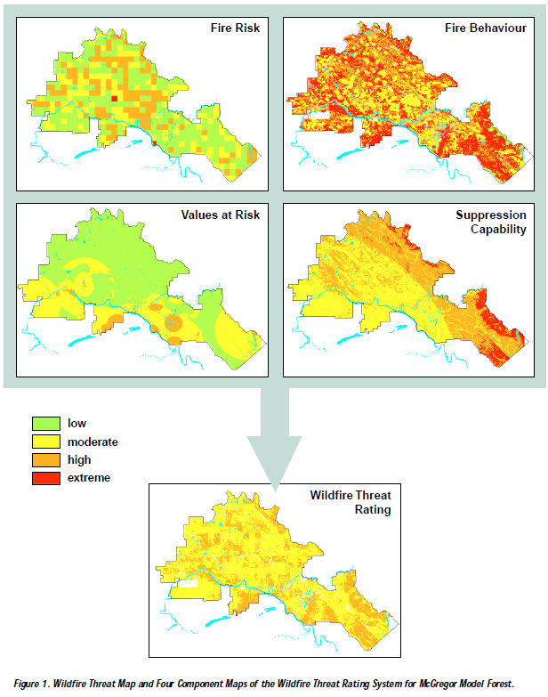
Ignition patterns
Threat rating
[ignition patterns]
Number of fires per 4 km² 1950-1991
Rate of spread; intensity; crown fraction burned
Initial attack time; terrain; water proximity
Development; timber values; visual quality
Wildfire Threat
Wildfire threat map and four component maps of the Wildfire Threat Rating System for McGregor Model Forest
Source: Hawkes, B., Beck, J., 1997. A wildfire threat rating system. Forestry Canada, Pacific Forestry Centre, Technology Transfer Notes 1, Victoria, BC, Canada.
3

Slide 11
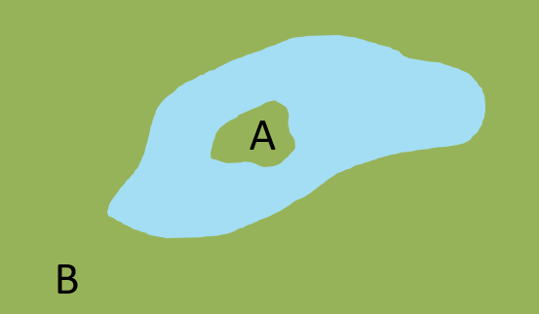
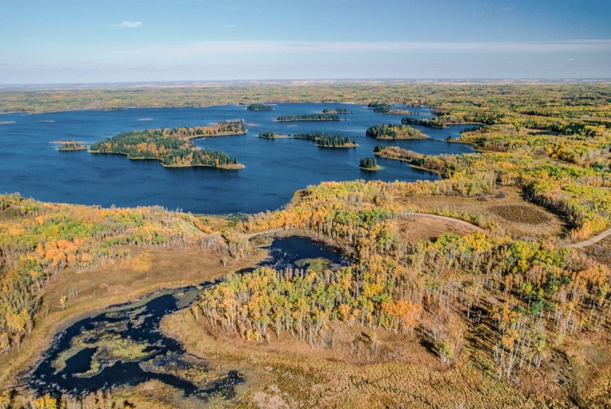
Spatial context – fires are contagious
Point estimate of a threat is detached from the spatial context of its surrounding fuel neighbourhood
Ignores the contagious nature of fires
Photo source: https://peakvisor.com/park/elk-island-national-park.html
11

Slide 12
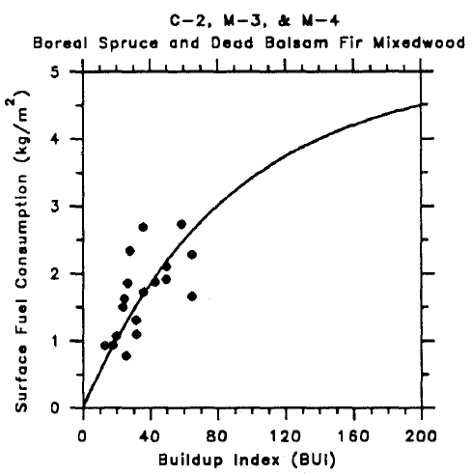

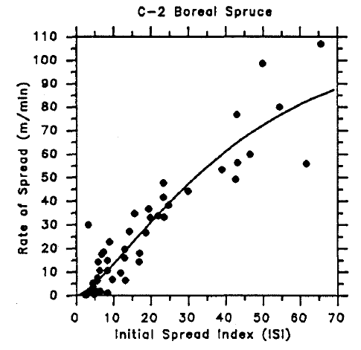
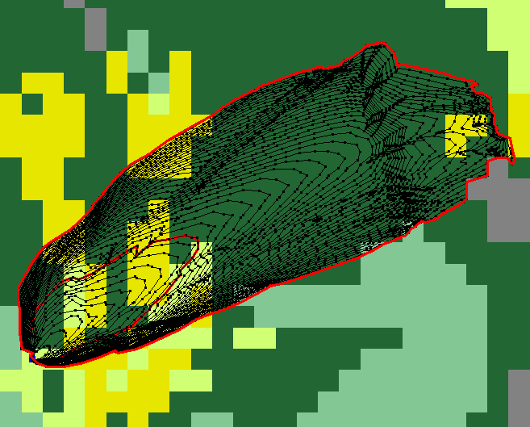
Solution? Simulate the spread of fires
C-2 Boreal Spruce
I = h w r
Rate of spread (n = 48)
Weight of fuel consumed (n = 13)
Constant – heat of combustion
12
Image source: N. McLoughlin

Slide 13
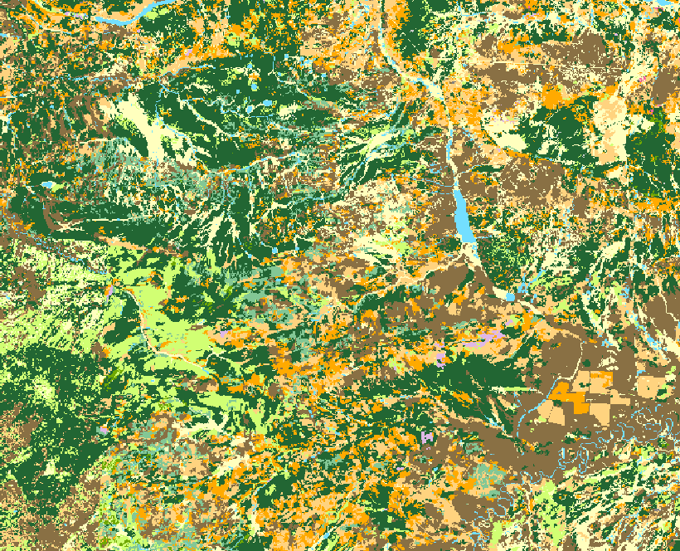
Many simulations - express fixed and variable factors
Monte Carlo simulation process
Iteration 1
13

Slide 14
Many simulations - express fixed and variable factors
Monte Carlo simulation process
Iteration 2
14

Slide 15
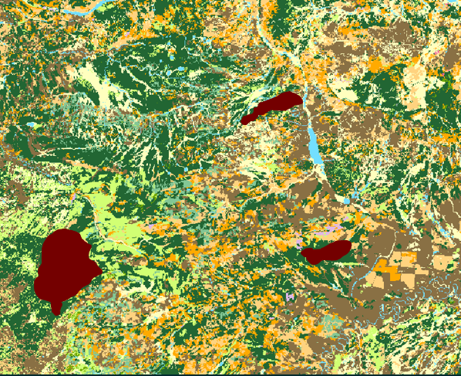
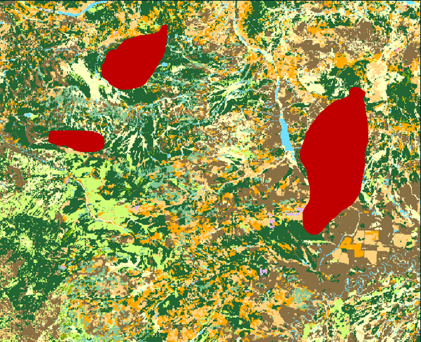
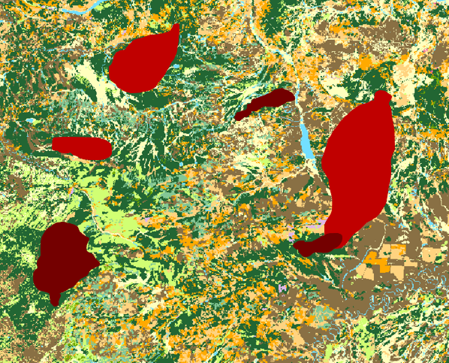
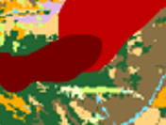
Simulated burn probability
Iteration 1
Iteration 2
Burn probability (BP) at a given pixel in the landscape grid is calculated as:
# times the pixel burned
# chances to burn (iterations)
BP = 1/2 or 0.5
BP = 2/2 or 1.0
15

Slide 16
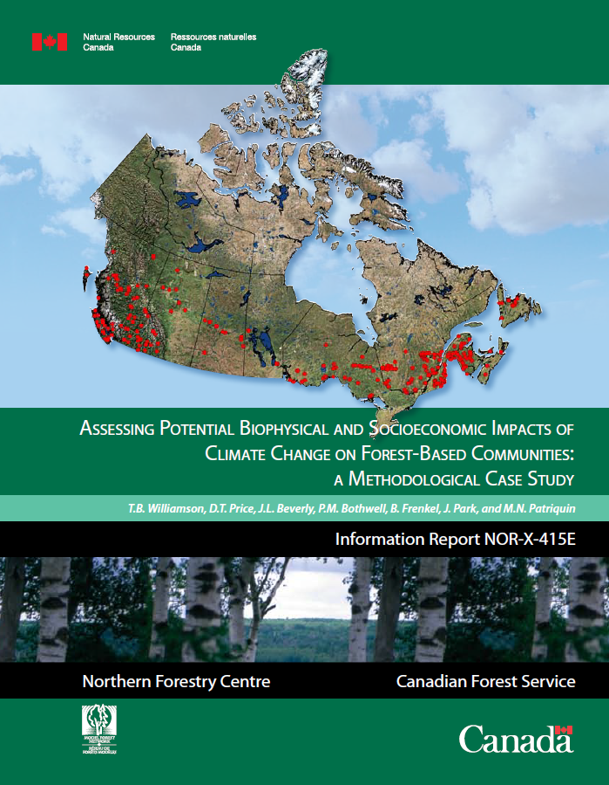
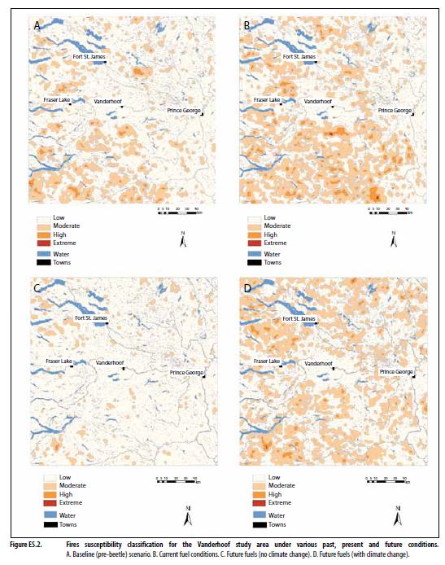
Model climate change scenarios
Model inputs adjusted to reflect climate change scenarios (weather pools, escaped fire numbers)
Historical data used to calibrate model (duration of burning, spread event days)
Relies on historical ignition patterns
Relevance of historical data to current and future conditions questionable (occurred under different conditions)
17

Slide 17
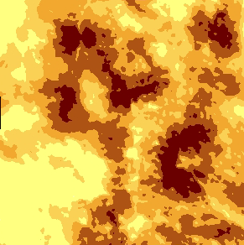
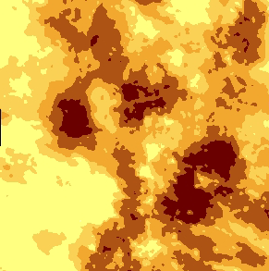
Stochasticity means thousands of iterations required
Replicate maps can differ from each other
To explore impacts of scenarios, modelers therefore fixed the fire sets by holding ignition points constant and then varying other inputs like the fuels or the weather
Base Case Replicate 1
Base Case Replicate 2
30% different
17

Slide 18
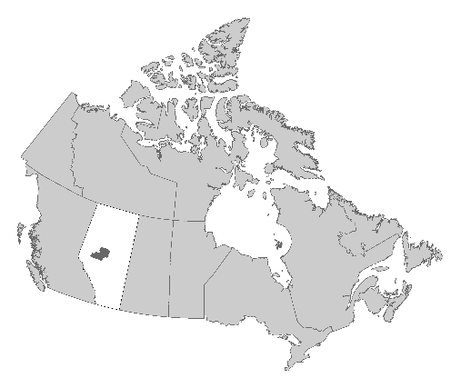
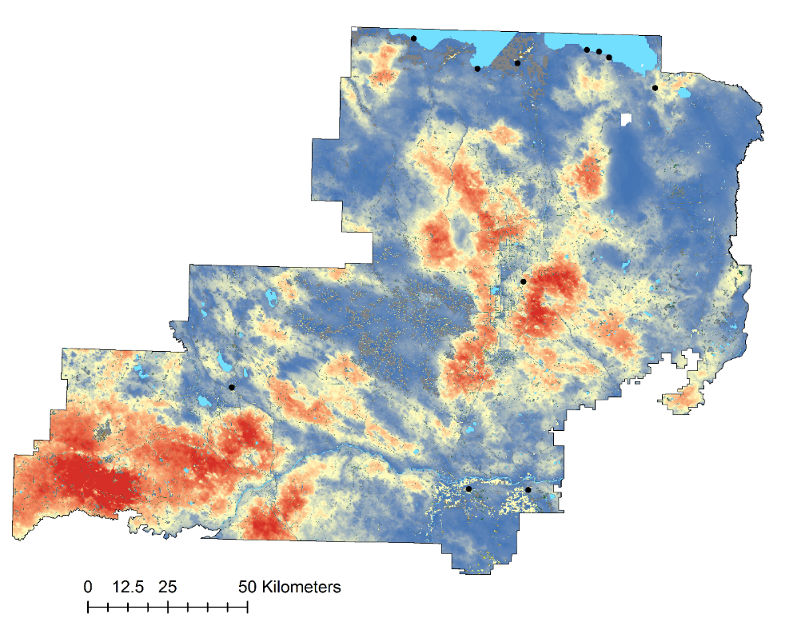
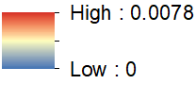
Does it work?
Beverly et al. (2009)
2.4 million ha study are
25,000 iterations
125,000 simulated fires
Estimated with 2005 data
Published 2009
Slave lake burned 2011
Slave Lake
Swan Hills
Fox Creek
2005 Burn Probability
Whitecourt
18

Slide 19
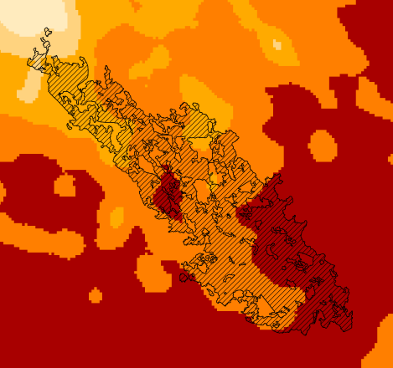
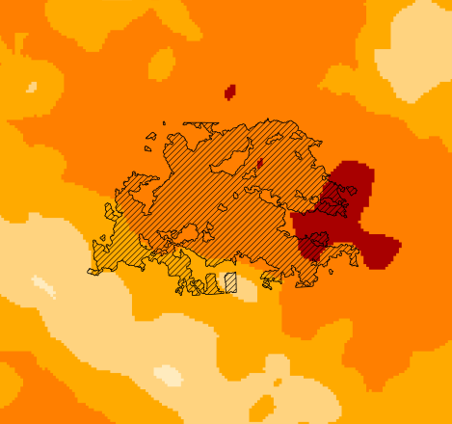
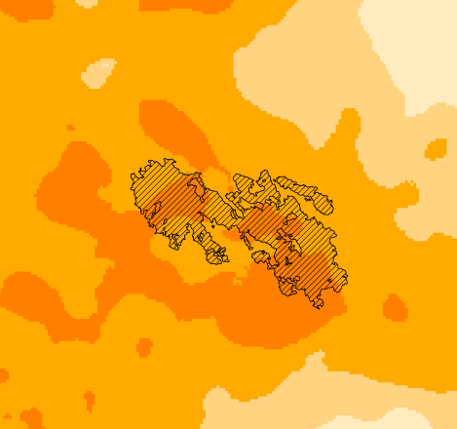
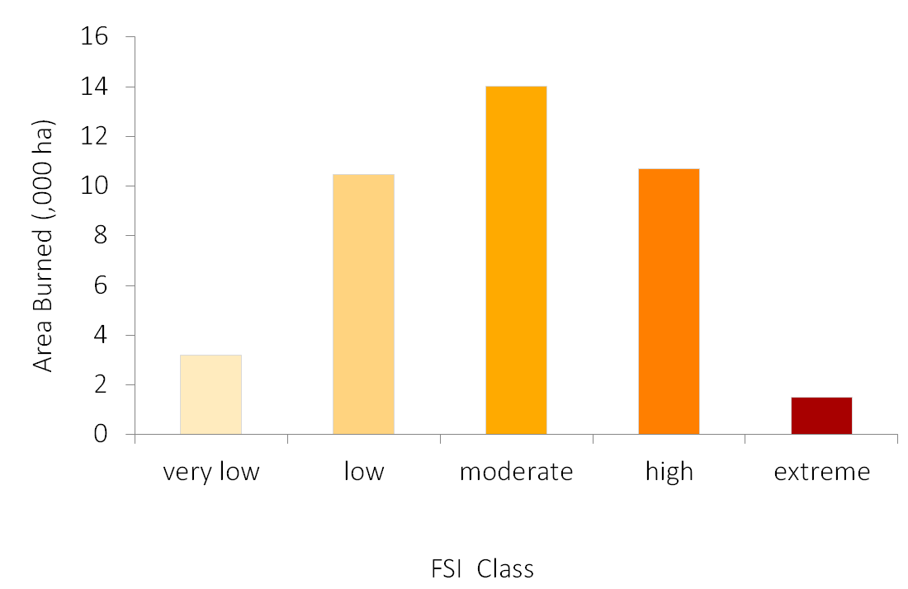
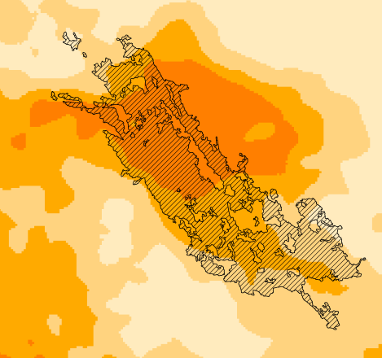
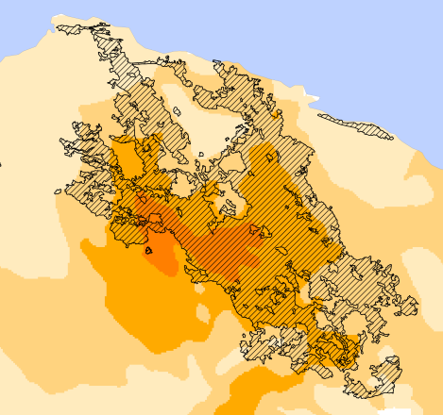
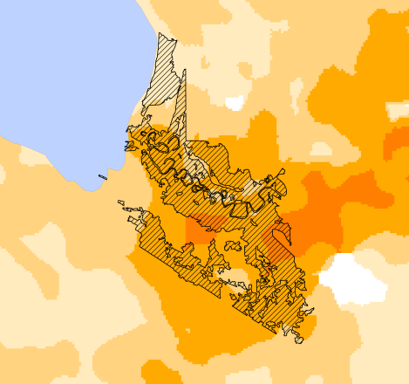
Where did real fires burn?
2011
2009
2006
2011
2011
2011
Burn Probability Class
19

Slide 20
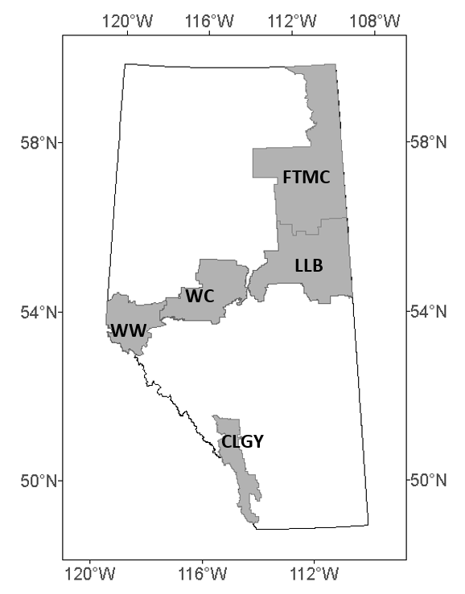
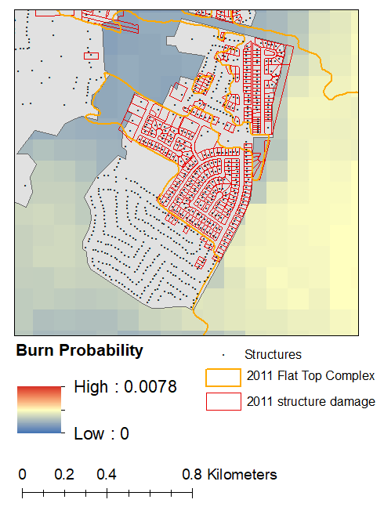
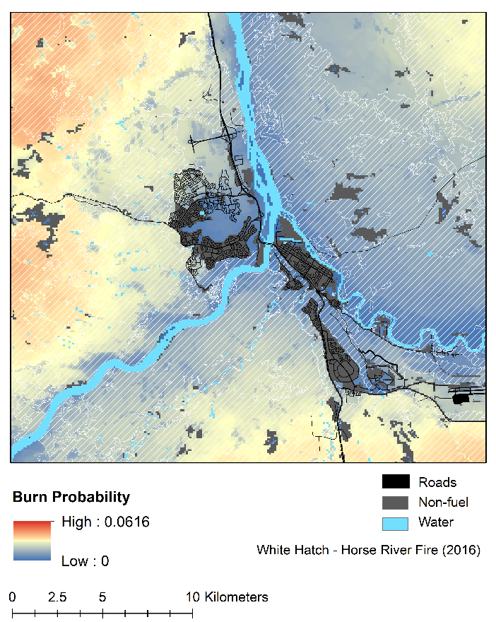
Do fires burn preferentially in BP hotspots? No.
Beverly and McLoughlin (2019)
Slave Lake
Fort McMurray
5 study areas
138 fires
543,049 ha burned
70% of burned areas occurred in areas where burn probability was in the lower half of the range (i.e., in the BP cold spots)
20

Slide 21
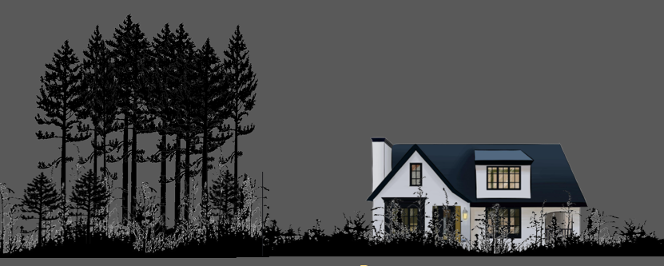



Exposure based on transmission distances
Beverly et al. (2009)
500 m
100 m
Longer range embers
Shorter range embers
30 m
Radiant Heat
21

Slide 22




Highway 88
22
7

Slide 23


Simple metric of exposure (Beverly, McLoughlin, Chapman 2021)
Hazard Fuel (1)
Forest Protection Area land cover
100 m
Other land cover types (0)
100 m
500 m
There are 80 pixels within 500 m – how many can transmit fire to me?
  Σ hazard fuel pixels 75
  total pixels 80
94% exposure
=
= 0.94
23

Slide 24


Same validation test as BP simulation
burned area
protection area
study area
Exposure based on 2007 fuel map
Overlaid fires in the years that followed (2007-2019)
2,331 fires, burned 2,606,387 ha
Landscape fire exposure –
a numeric rating of the potential for fire transmission to a location given surrounding fuel composition and configuration, irrespective of weather or other fire controls.
24

Slide 25


What about weighting for distance, CFL, HFI, ROS?
Forest Protection Area land cover
100 m
100 m
Tried weighting pixels by:
  Nearness
  Crown fuel load (CFL)
  Head fire intensity (HFI)
  Rate of spread (ROS)
Tried increasing window to 1000 m
Increased complexity did not improve correspondence with real fires
Hazard Fuel (1)
Other land cover types (0)
25

Slide 26

Can be combined with variable fire controls
Landscape fire exposure –
a numeric rating of the potential for fire transmission to a location given surrounding fuel composition and configuration, irrespective of weather or other fire controls.
Exposure (%)
Receptive and exposed
26

Slide 27



Next steps
PhD student Air Forbes
Metrics for characterizing wildfire exposure around communities
Identify community exposure types/groups
Whitecourt
PD – Number of Patches
CV – Patch Size Coefficient of Variation
CA – Class Area
27
Lake Louise

Slide 28

Jen Beverly
Acknowledgements
Alberta Wildfire
  Neal McLoughlin
  Liz Chapman
  Laura Stewart
Forest Resource Improvement Association of Alberta (FRIAA)
Institute for Catastrophic Loss Reduction (ICLR)
Thank you, looking forward to questions and discussion
Connect
jen.beverly@ualberta.ca
wildfireanalytics.org
@fireanalytics
28

